Slide 1
Watershed Academy Watershed Coordinator Training Series
The Clean Water Act
1: Overview and Water Quality Standards

Slide 2
Kentucky is a water-rich state!
Approximately 92,000 miles of streams
1,000 square miles of wetlands
350 square miles of lakes or reservoirs

Slide 3
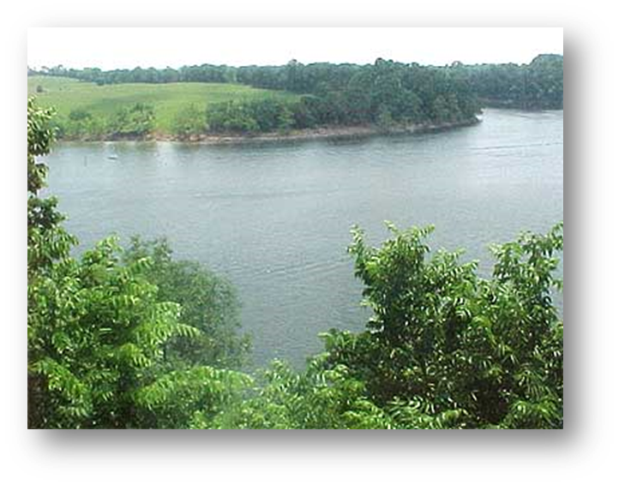
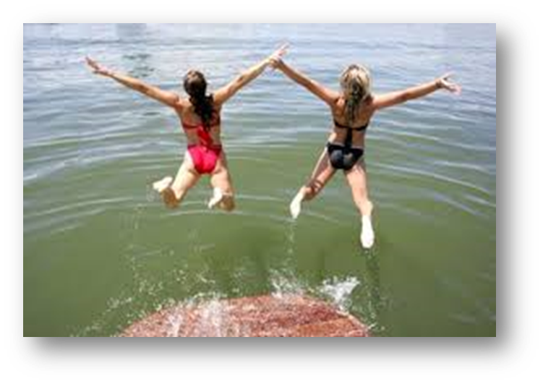
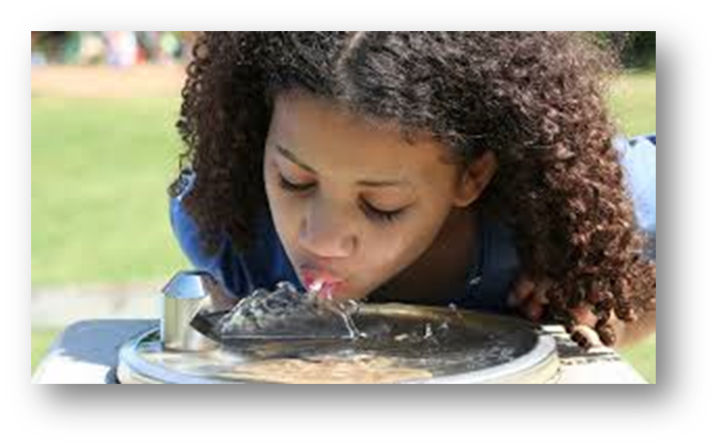
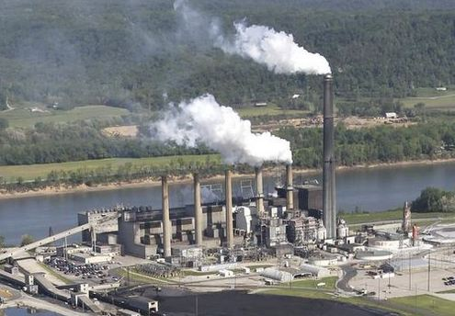
Water is central to Kentuckians’ survival and enjoyment.
Notes:
Water is central to Kentuckians’ survival and enjoyment. Need to protect it for the variety of uses:
Drinking water
Industrial uses and thermoelectric power plant cooling
Fishing
Swimming
Boating
Support of ecological functions and aquatic life
Water laws enable public agencies to provide protection of our water resources.
But, it also critical that citizens and water professionals like you are familiar with these laws, so that you can provide assistance to the responsible government agencies and help them do their jobs.

Slide 4
Laws are needed to protect this resource for our uses.
Clean Water Act
National Environmental Policy Act (1969)
Endangered Species Act (1973)
Safe Drinking Water Act (1974, 1996)
Toxic Substances Control Act (1976)
Resource Conservation and Recovery Act (1984, ‘86)
Surface Mining and Reclamation Act (1977)
Comprehensive Environmental Response, Compensation and Liability Act (CERCLA) or Superfund (1980)
Kentucky Agriculture Water Quality Act (1994)
Notes:
This is a listing of the water laws that we will cover during this workshop. We will focus mainly on the Clean Water Act, but I would like to give you a preview of other water-related laws that we will touch on.
Optional to provide these additional details:
1969 - National Environmental Policy Act (NEPA)
Assure all branches of government consider environmental impacts prior to taking any major federal action that effects the environment
1973 - Endangered Species Act (ESA)
Provides protection of endangered species
1974 - Safe Drinking Water Act (SDWA) -amended in 1996
Protect quality of drinking water focusing on all waters with actual or potential designated drinking water use, surface or groundwater
Established minimum standards for tap water
1976 – Toxic Substances Control Act
EPA authority to require testing and restriction of chemical substances including PCBs
1976 - Resource Conservation and Recovery Act (RCRA) – amended in 1984, ‘86
Authority to control hazardous substances “cradle-to-grave.” Address underground storage tanks
1977 - Surface Mining Control and Reclamation Act (SMCRA)
Regulates the environmental effects of coal mining. Created program to regulate active mines and reclaim abandoned ones
1980 - Comprehensive Environmental Response, Compensation, and Liability Act (CERCLA) or Superfund
Clean up uncontrolled or abandoned hazardous waste sites, spills, and contamination
1986 - Superfund Amendments and Reauthorization Act (SARA) - Amended CERCLA to continue cleanups.
1994 - The Kentucky General Assembly passed the Kentucky Agriculture Water Quality Act in 1994. The goal of the act is to protect surface and groundwater resources from pollution as a result of agriculture and silviculture (forestry) activities.

Slide 5
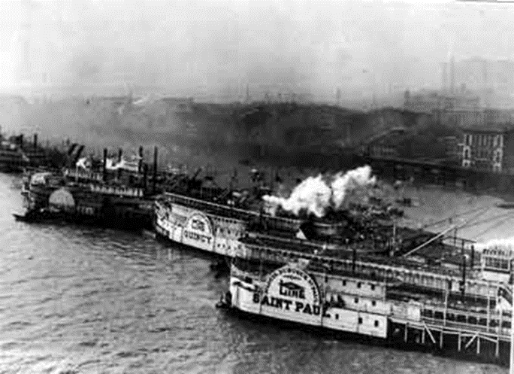
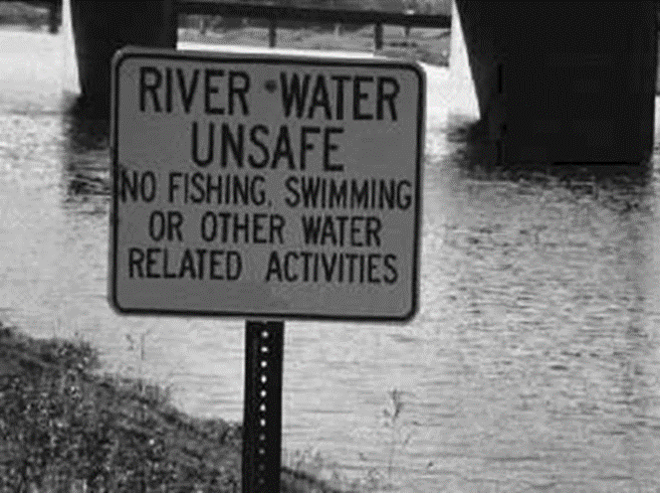
History of the Clean Water Act
Rivers and Harbors Act (1899)
Federal Water Pollution Control Act (1948)
Notes:
Rivers and Harbors Act of 1899
Prohibited discharge of any refuse matter of any kind or description whatsoever, other than that flowing from streets and sewers, and passing therefrom in a liquid state. (Prohibited discharge of refuse into a navigable water, other that what was flowing from the streets or sewers.)
It was reported in 1945 that over 3,500 communities pumped 2.5 billion tons of raw sewage into streams, lakes, and coastal waters every day
Federal Water Pollution Control Act (Clean Water Act) of 1948 - Developed plans for reducing pollution and improving sanitary conditions.
Authorized the Surgeon General of the Public Health Service to prepare comprehensive programs for eliminating or reducing the pollution of interstate waters and tributaries and improving the sanitary condition of surface and underground waters.
Authorized the Federal Works Administrator to assist states, municipalities, and interstate agencies in constructing treatment plants to prevent discharges of inadequately treated sewage and other wastes into interstate waters or tributaries.

Slide 6
Cuyahoga River in Ohio catches fire in 1969.
“The river that "oozes rather than flows" and in which a person "does not drown but decays.” Time Magazine, 1969
Notes:
June 1969 – An oil slick on the Cuyahoga River in Cleveland, Ohio caused the river to catch on fire. The river had been polluted from decades of industrial waste from along its shores as it flowed into Lake Erie. This event became symbolic of the need to address out-of-control pollution and helped motivate the passage of the Clean Water Act.
1968 -1970 – pollution surveys showed losses in fishing industry, high levels of DDT in fish, high levels of bacteria
July 1970 Department of Health, Education and Welfare reported that 30% of drinking water samples had chemicals exceeding the recommended Public Health Service limits

Slide 7
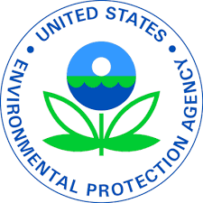
1972 Federal Water Pollution Control Act Amendments AKA the “Clean Water Act”
Created the Environmental Protection Agency
Authorized the EPA to control discharges of pollution through the “National Pollutant Discharge Elimination System” (NPDES)
Provided federal grants for treatment facilities
Notes:
In 1972, a bill providing amendments to the Water Pollution Control Act was passed by overriding President Nixon’s veto. It established ways to create water quality standards and a permitting authority, which became the U.S. Environmental Protection Agency.
The Clean Water Act provided the basic structure for regulating discharges of pollutants into waters of the United States.
Through the NPDES program, the EPA had authority to implement pollution controls.
It became unlawful for any person to discharge pollutants from a point source into navigable waters, unless a permit was obtained.
The CWA also required water quality standards to be established for all contaminants to surface waters.

Slide 8
CWA: Goal is to restore and maintain the chemical, physical and biological integrity of the nation’s waters.
Eliminate discharge of pollutants into navigable waters by 1985.
Achieve water quality which provides for…
Protection and propagation of fish and wildlife
Recreation in and on the water by 1983
Prohibit discharge of toxic pollutants in toxic amounts.

Slide 9
Amendments to the CWA
1977 Clean Water Act Amendments
Gave EPA authority to set “technology-based” effluent standards
Added stormwater discharges to permitting program
1987 Clean Water Act Amendments
Authorized measures to address “nonpoint source pollution” coming from runoff from a variety of land uses (agricultural lands, construction sites, urban areas, forests, etc)
Federal 319 program created to cover 60% of nonpoint source projects
Added stormwater permit requirements for industry and municipalities (newly defined as point sources)
Notes:
The CWA has been amended three times—in 1977, 1981 and 1987.
The intent to assure improved water quality remained, but the ambitious goals of the 1972 act proved difficult to achieve.
These amendments adjusted some timelines, and the rigid command-and-control approach was modified to a more flexible approach that emphasized partnerships among all levels of government.
An example of this increased flexibility is the 1977 amendment, which allowed permittees to achieve wastewater effluent standards according to available technology. Previously, the permittee would have been required to meet a certain discharge standard, regardless of technical feasibility or cost.
Prior to 1987, the emphasis had been focused on addressing point source pollution. But, by 1987, it had become apparent that significant amounts of pollution were coming from diffuse sources that were more difficult to identify.
Thus, the 1987 CWA amendments attempted to address these additional sources through Section 319 authorizations. The 319 grant program provides 60% of the costs of nonpoint source management projects through federal funding. The recipient must provide the remaining 40% of the cost.

Slide 10
Federalism – Federal vs State Law
Notes:
\

Slide 11
Federalism and Water Laws
Federal Law
Clean Water Act, CFR
“Waters of the United States”
National Pollutant Discharge Elimination System (NPDES)
Interstate commerce and navigable waters
Requires designated uses
Requires Technology-based limits
Funds Revolving Fund
State Law
KAR/KRS
“Waters of the Commonwealth”
Kentucky Pollutant Discharge Elimination System (KPDES)
Intrastate commerce and all waters
Sets designated uses
Sets technology-based limits
Allocates State Revolving Fund
Delegated Authority
Enforcement
Construction Permits
Water Quality Standards
“Jurisdictional Determination”
Notes:
\

Slide 12
USEPA Delegation of CWA to States
It is the policy of the Congress to recognize, preserve, and protect the primary responsibilities and rights of States to prevent, reduce, and eliminate pollution, to plan the development and use (including restoration, preservation, and enhancement) of land and water resources, and to consult with the Administrator in the exercise of his authority under this chapter.
33 U.S.C. §1251(b).
Notes:
\

Slide 13
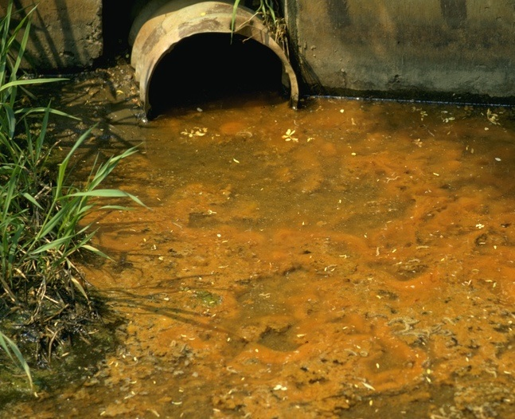
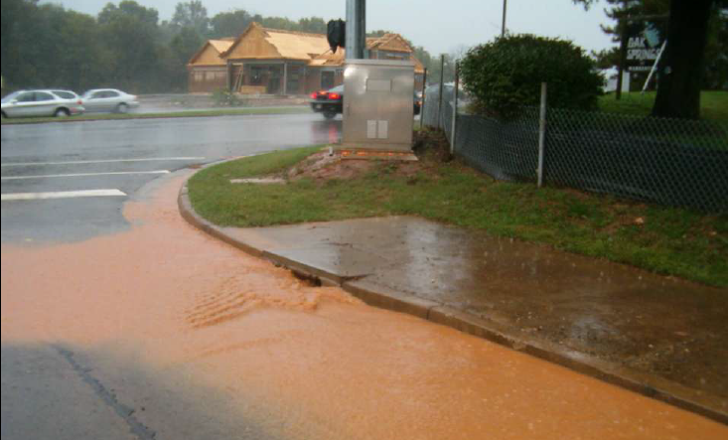
Types of Water Pollution
Point Source
Single, identifiable source
Nonpoint Source
Runoff from many places
Notes:
Poor water quality may have a specific and observable source, such as a sewage treatment plant outfall or an industrial discharge. These are referred to as point sources of pollution.
However, not all sources of pollution will be easily identifiable. Most pollution is carried into streams by rain and snowmelt running off the ground surface. This is referred to as nonpoint source pollution.
Most nonpoint source pollution is from land that is:
built on or paved
farmed
bare soil

Slide 14
Clean Water Act: Successes and Challenges
Successes:
Point Sources
Challenges:
Nonpoint Sources
Large initial reductions through control of point sources, but nonpoint management is more difficult because it comes from many locations.
Notes:
The CWA has been very successful at addressing the point sources of pollution, but reduction of nonpoint pollution has proven much more difficult.
Why do you think nonpoint sources pose a greater challenge?
Some of the reasons include:
The widespread and diffuse nature of these sources make it difficult to target control measures.
The nonpoint management practices (often referred to as “best management practices” or BMPs) are mainly voluntary, so that adds to the difficulty.
And, there is a lot of collaboration and coordination required to make a significant improvement in water quality.

Slide 15
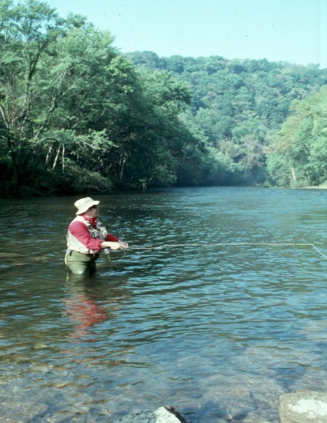
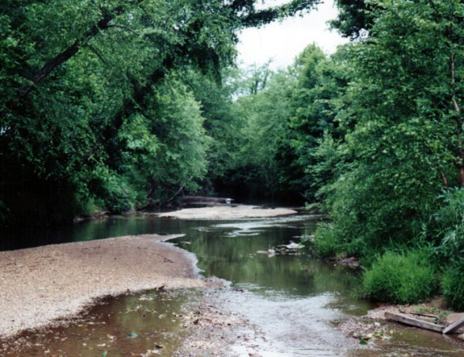
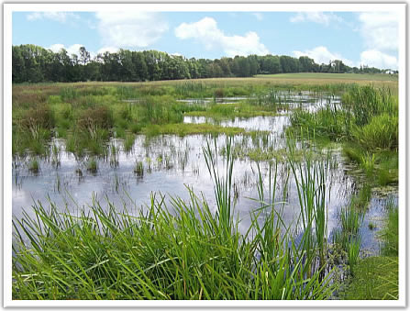
Kentucky’s Water Resources
Of the water bodies assessed:
Over half threatened or impaired
Two-thirds polluted by nonpoint sources

Slide 16
Clean Water Act: Titles
I: Research and Related Programs
II: Grants for Construction of Treatment Works
III: Standards and Enforcement
Effluent Limits
Water Quality Standards & Implementation Plans (303)
Water Quality Inventory (305)
Toxic and Pretreatment Effluent Standards
Inspections, Monitoring, and Entry
Nonpoint Source Management Program
Notes:
The Clean Water Act has 7 “Titles” or major sections. Some of these Titles are referenced frequently as a watershed coordinator and others rarely. We will highlight some of the pertinent programs and elements here as an overview and go into more detail later in the training.
I: Research and Related Programs
Research (Section 104)
Pollution control programs (106)
II: Grants for Construction of Treatment Works
Develop Waste Treatment Management Plans and Facilities (201) for Areas (208) and Basins (209)
III: Standards and Enforcement
Effluent Limits (301)
Water Quality Related Effluent Limits (302)
Water Quality Standards and Implementation Plans (303)
Designated Uses, Water Quality Criteria, Anti-degradation, Annual List of Impaired Waters – 303(d) List, Total Maximum Daily Load (TMDL)
Water Quality Inventory (305)
Bi-annual state reports to congress – 305(b) Report
Toxic and Pretreatment Effluent Standards (307)
Inspections, Monitoring, and Entry (308)
Nonpoint Source Management Program (319)

Slide 17
Clean Water Act: Titles
IV: Permits and Licenses
Certification Program for WWTP Operators
National Pollutant Discharge Elimination System (NPDES)
Permits for Dredged or Fill Materials (404)
Disposal of Sewage Sludge
V: General Provisions
Clean Watersheds Needs Survey
VI: State Water Pollution Control Revolving Funds
Notes:
IV: Permits and Licenses
Certification Program for WWTP Operators (401)
National Pollutant Discharge Elimination System (NPDES) (402)
Permits for Dredged or Fill Materials (404)
Disposal of Sewage Sludge (405)
V: General Provisions
Clean Watersheds Needs Survey (516)
VI: State Water Pollution Control Revolving Funds

Slide 18
CWA Title I: Research & Related Programs
Section 104: Research
Section 106: Water Pollution Control Programs
EPA States
$$$$$$$
Notes:
Will walk through Titles and important Sections of the Clean Water Act, beginning with Title I that relates to research and related programs.
Section 104 of Title I provided grant money to the states to conduct water quality improvement research.
Section 106 of Title I passed federal money to the states for water pollution controls.

Slide 19
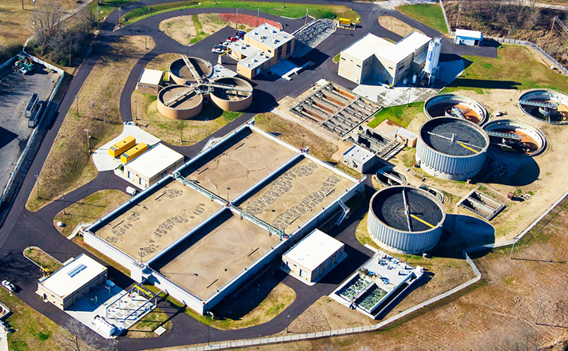
CWA Title II: Grants for Construction of Treatment Works
Sections 201, 208 and 209
Basin or Areawide Waste Treatment Planning
Notes:
This title authorized federal funding GRANTS to assist cities with meeting the CWA’s pollution control requirements. This funding mainly focuses on the design and construction of municipal sewage treatment facilities.
Funding is allocated to the states based on state population numbers and a national survey of estimated sewage treatment funding needs.
In the late 80s and early 90s, there was a shift to allocating more of responsibility to state and local governments for wastewater treatment expenditures.
As a result, more federal funding has been transferred to states via the State Water Pollution Control Revolving Fund program, which is a loan program rather than a grant program, and thus needs to be repaid.
This shift to loans has proven to be especially difficult for smaller municipalities that have more difficulty repaying project loans.
For example, there have been several recent instances in Kentucky of overflows of inadequately treated sewage flowing into streams from municipal plants, for which there is no easy solution to pay for repairs or upgrades.

Slide 20
CWA Title III: Standards and Enforcement

Slide 21
Kentucky Division of Water Responsibilities
1) Monitoring and Assessment
2) Permitting
3) Compliance and Enforcement
4) Planning
Notes:
The Division of Water is responsible for all of these important functions toward implementing the Clean Water Act.
In this training, we will mainly focus on those aspects that most directly relate to watershed planning and management and your roles in those efforts—monitoring and assessment and planning.
Permitting and compliance will mainly be covered in Section 3 today.

Slide 22
Water Quality Standards Development: KPDES Permitting Technology-Based Effluent Standards
Administered by Kentucky Division of Water’s KPDES Branch
Based on current reasonable technology
Self-monitored through Discharge Monitoring Reports (DMRs)
With spot-checking by DOW staff
Enforced through Notice of Violations or Agreed Orders
Implemented through Facility Upgrades
With support from DOW Facilities Branch, State Revolving Loan Fund, Kentucky Infrastructure Authority, and Kentucky Area Development Districts
Notes:
In order to achieve its goals, the CWA requires that all discharges into the nation’s waters are unlawful, unless that are authorized by an associated permit.
The Division of Water’s Kentucky Pollutant Discharge Elimination System (KPDES) Branch oversees this permitting requirement for the state.
In order to regulate the pollutant concentrations contained in effluent (discharge) from point source permittees, the following approach is used:
A permit is issued, specifying the allowable pollutant levels that can be discharged. These levels are based on available technology.
The permittee self-monitors to ensure that effluents are meeting permit requirements and submits regular “discharge monitoring reports.”
DOW field staff can show up to sample effluent and ensure that reporting is accurate.
Permits are issued for 5 years, at which time they must be renewed for the discharge to continue.

Slide 23
Water Quality Standards Development: KPDES Permitting Water Quality-Based Effluent Standards
Administered through Watershed Framework Process (DOW Watershed and Water Quality Branches)
Based on waterbody’s designated use (swimming, fishing, aquatic life support, drinking water, etc)
Monitored through DOW’s statewide sampling network
With some supplemental monitoring from other agencies and orgs
Findings reported in 305(b) and 303(d) Reports (biannually)
Notes:
As permitting shifted to better address nonpoint sources, “Water Quality-based effluent standards” were developed.
These standards were tied to water quality criteria that would enable waters to be used for specific uses.
For example, bacteria levels had to be within certain measurable levels to ensure safe recreational uses. Permits were structured to help meet hose levels.
This next level of permitting required additional work in order to:
assess existing (or ambient) water quality status through monitoring efforts
establish appropriate criteria to meet “designated uses” and
to develop ways to look holistically at watersheds that included all point and nonpoint sources of pollution.
The “watershed approach” to managing water quality evolved as way to encompass these needs.

Slide 24
CWA Title III
Water Quality Standards Program
National Water Quality Inventory
Total Maximum Daily Loads (TMDLs)
Nonpoint Source Management Program
Notes:
We will cover each of the these aspects of CWA Title III, which all attempt to measure and improve water quality in a more holistic, comprehensive way.

Slide 25
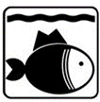
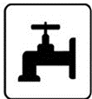
Water Quality Standards Program
Kentucky’s Designated Water Uses:
Primary Contact Recreation
Secondary Contact Recreation
Aquatic Life (Warm-water and Cold-water)
Domestic Water Supply
Fish Consumption *
Outstanding State Resource Water
Notes:
These uses describe all of the expected water uses and enable water quality criteria to be established so that they can safely occur.
Primary contact recreation – refers to swimming or any activity in which the person is submerged in the water
Secondary contact recreation – refers to recreational activities in or around the water, during which the person’s face is not underwater, such as wading, boating and fishing
Aquatic life – describes conditions necessary for the survival of aquatic organisms. Different criteria are needed for animals that thrive in cooler water, such as trout. Most of Kentucky’s waterbodies are characterized as warm-water.
Domestic Water Supply – refers to waterbodies that are used as a municipal water source. The water (“raw water”) is pumped pumped to drinking water treatment plants, but it is critical that the source water meets certain criteria to enable acceptable drinking water.
Fish Consumption – Not listed in 401 KAR 10:026 Section 5, Table A as a designated use. However, the 2016 IR has a footnote stating that it is being assessed as a use.
This use is based on levels of certain contaminants, such as mercury and PCBs, found in fish tissue, rather than in the waterbody itself. Advisories are issued when contaminant levels have the potential to harm people eating them. For example, there is a statewide advisory for Kentuckians who are under 6 years old or women of childbearing age to minimize consumption of certain fish to six meals per year or less.
Outstanding State Resource Water – waters that meet certain requirements and are of national ecological or recreational significance, including those that support federally threatened or endangered species

Slide 26
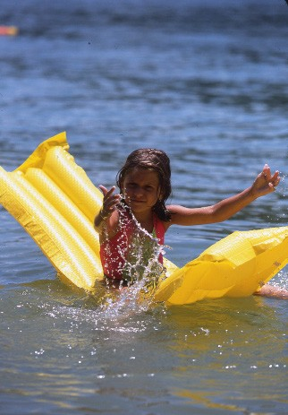
Water Quality Standards:
Kentucky Designated Uses
Primary Contact Recreation (PCR)
Includes swimming or other activities where your head goes under water and you are likely to swallow water
Bacteria (E. coli) are indicator organisms
Also considers pH level
Notes:
Indicator is Escherichia coli
Samples for support determination are collected 6 times/year during May – October (recreation season) or 5 samples in 30 days
The instantaneous criterion of 240 colonies/100 mL is used for the monthly samples
The geometric mean criterion of 130 colonies/100 mL is applied when 5 samples in 30 days are collected.
pH values must be within the range from 6.0 SU - 9.0 SU to demonstrate support of the use

Slide 27
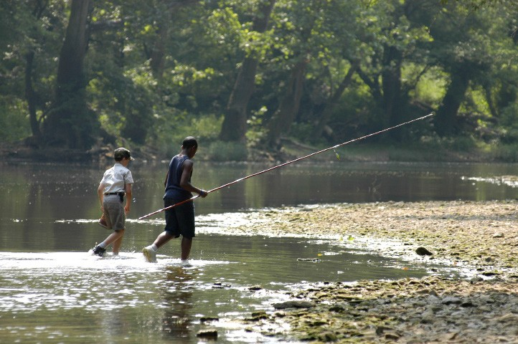
Water Quality Standards:
Kentucky Designated Uses
Secondary Contact Recreation (SCR)
Involves fishing, boating, wading, or activities where skin is in contact with the water, but the head does not go under water
Bacteria (Fecal coliform)
are indicator organisms
www.fw.ky.gov
Notes:
Fecal coliform is the indicator
Criteria for this use applies year-round
Excess macrophyte, algae growth, nuisance algal blooms, or high suspended sediments are considered in lakes and reservoirs when assessing waters for this use.

Slide 28
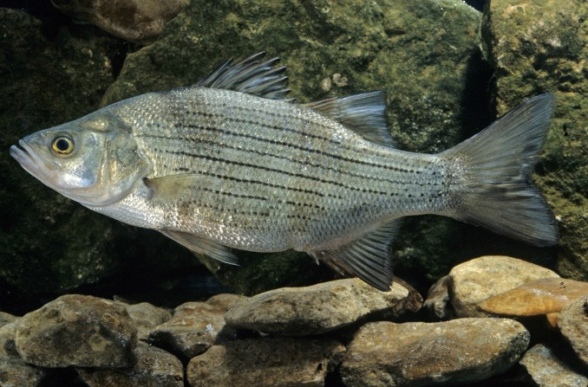
Water Quality Standards:
Kentucky Designated Uses
Aquatic Life
Assesses the healthy variety of animals that live in water
Adequate mix of habitat conditions and healthy water supports a balanced community of aquatic life
Cold vs Warm Water Habitat Conditions
www.fw.ky.gov
Notes:
KY Aquatic Life Use
Streams
Assessed primarily on biological community results in headwater and wadeable streams
One or two biological communities (macroinvertebrates or fishes) are used as indicators of this use
Grab samples of chemical constituents are collected at time of biosurvey
Different criteria are used for streams that are classified as “cold water” or “warm water.” Warm water is the default aquatic life assessment classification, and cold water streams are considered “special use waters.” Cold water aquatic habitats (CAH) are those surface waters and associated substrate that will support indigenous aquatic life or self-sustaining or reproducing trout populations on a year-round basis (401 KAR 10:031, Section 4).
Lakes
Large (boatable) water bodies and reservoirs are monitored and assessed primarily on multiple chemical data samples
Conventional and non-toxic chemicals are screened for the percentage of exceedences of criteria for use support determination
Reservoirs are monitored during the growing season as this is the time trophic condition is expressed

Slide 29
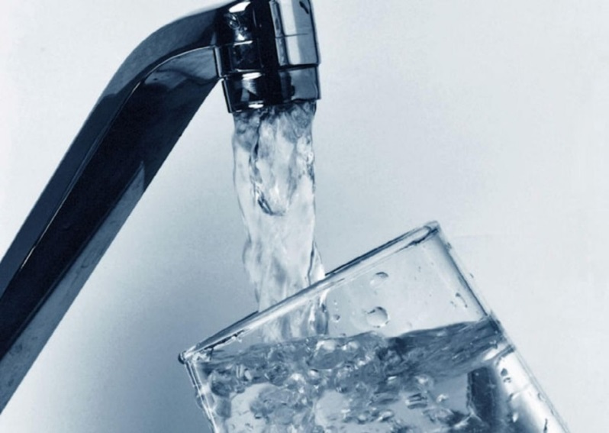
Water Quality Standards:
Kentucky Designated Uses
Domestic Water Supply
Involves human drinking water and is tested from source of water
Water must not have more pollution than can be cleaned to a level safe for humans to drink
Notes:
Applies to source water at point of intake
Use support is determined by the treatment plant’s compliance with MCLs in finished water.
An annual average of quarterly samples is evaluated for use support. If an average exceeds the associated MCL, the water does not support the domestic water supply use.
Maximum Contaminant Level (MCL) = legal threshold limit on the amount of a substance that is allowed in public water systems under the Safe Drinking Water Act
MCL results are reported to consumers in an annual report from their drinking water provider and are called “Consumer Confidence Report”

Slide 30
Water Quality Standards:
Kentucky Designated Uses
Fish Consumption
Assesses the safety of eating fish
Based on the amount of chemicals found in the flesh of the fish (most common are mercury and PCBs)
Notes:
Fish tissue also tested for other metals and pesticides
Statewide advisory for children <6 and women of childbearing age set at 1-meal/week
Methylmercury concentrations in fish tissue is a human health criterion to protect consumers
0.3 mg/Kg methylmercury is the criterion that should not be exceeded

Slide 31
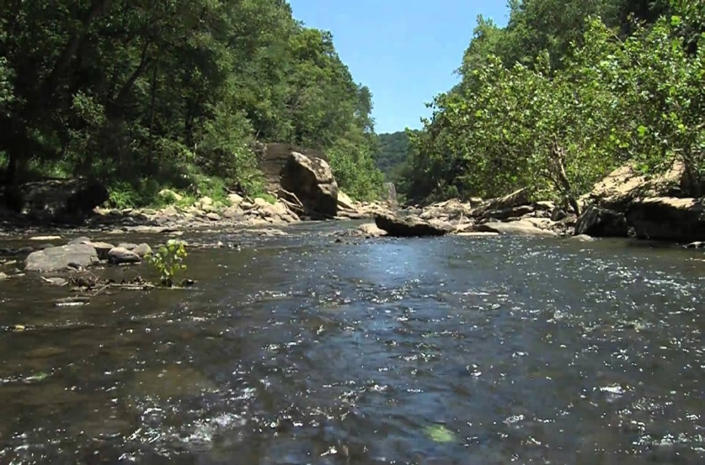
Water Quality Standards:
Kentucky Designated Uses
Outstanding State Resource Water
Describes streams or lakes that have unique features worthy of legal protection
Threatened or endangered species, Kentucky Wild Rivers, Exceptional Waters or Wild and Scenic Rivers are considered
Reference reaches included
Kentucky Wild Rivers Program
Rockcastle River
Notes:
Reference reaches are the least impacted streams. They are not necessarily pristine, but represent streams that have been least impacted by human activities in the region. Thus, they represent best available conditions and can be used as benchmarks for comparisons with other streams within the area.
Can find OSRWs and other special uses waters online at http://eppcapp.ky.gov/spwaters.
Special Use Waters also include Outstanding National Resource Waters, cold-water aquatic habitat, exceptional waters, reference reach waters, state wild rivers, and federal wild and scenic rivers.

Slide 32
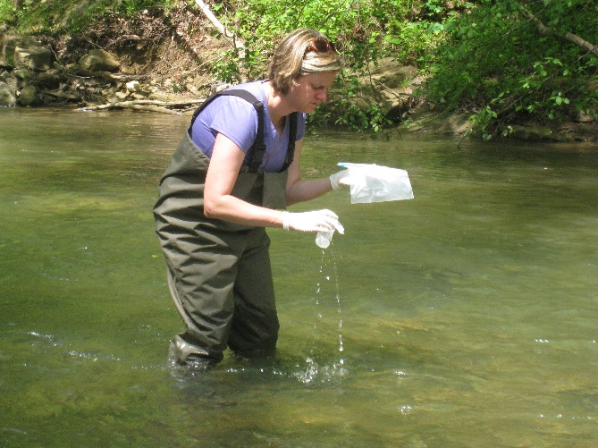
Water Quality Standards Program: Using Water Quality Criteria in Kentucky
Scientific information is used to develop appropriate thresholds of water quality that support the designated uses.
Chemical concentrations in water, or other observations, are used by DOW to make these assessments.
Notes:
Another part of the WQ Standards program are criteria, which can be:
Nutrients, metals, bacteria concentrations in the water
Biological and habitat assessment scores
The CWA requires that assessment Standards are reviewed every three years in a Triennial Review process
This allows for stakeholder input and potential revisions.

Slide 33
Water Quality Standards: Kentucky Criteria – 401 KAR 10:031
Section 1: Nutrient Criterion (Narrative)
Section 2: Minimum Criteria for All Surface Waters
Section 3: Use designations and flows for criteria
Section 4: Aquatic Habitat
Section 5: Domestic Water Supply
Section 6: Pollutant Limits (Table)
Section 7: Recreational Limits (E. coli, fecal coliform, pH)
Section 8: Outstanding Resource Waters
Section 9: Ohio River
Section 10: Exemptions
Notes:
Overview slide, do not go into detailed descriptions at this point. Explanatory slides to follow.
Kentucky’s water quality criteria are described in Kentucky Administrative Regulation 401 10:031, which is accessibly online. It includes these sections that pertain to a variety of uses and criterion.

Slide 34
Water Quality Standards: Example of Narrative Criteria (10:031 Section 2)
Surface waters shall not be aesthetically or otherwise degraded by substances that:
(a) Form objectionable deposits;
(b) Float as debris, scum, oil, etc to form a nuisance;
(c) Produce objectionable color, odor, taste, or turbidity;
(d) Injure, are chronically or acutely toxic or produce adverse responses in humans, animals, fish and other aquatic life;
(e) Produce undesirable aquatic life or result in the dominance of nuisance species
(f) Cause fish flesh tainting.

Slide 35
Water Quality Standards: Numeric Criteria vs. Indicators
Chemical/Bacteriological Numeric Criteria
Magnitude or concentration
Duration or averaging period
Frequency or return interval
Habitat/Biological Indicators
Require field sampling and studies
Fish, macroinvertebrates, plants, etc.
Compare conditions at “study site” with relatively un-impacted “reference site”
Whole Toxicity
Notes:
There are different types of numeric criteria which will be covered subsequently:
Chemical and Bacteriological criteria will typically have a concentration for a specific period of time that occurs on a set frequency
Habitat and Biological Indicators require field surveys of species of visual features, calculation of an index score, and then comparison against reference reaches in the same biotic region. Habitat/Biological are indicators and these standards have not been promulgated through the regulatory process as criteria. Thus, associated “numbers” for these assessments are not in Chapter 10.
Whole toxicity testing which exposes aquatic organisms in a laboratory setting to different dilutions of the pollutant discharge water to evaluate the toxicity to aquatic species.

Slide 36
Water Quality Standards Program
Water Quality Criteria in Kentucky
Toxicity of pollutants – levels harmful to humans or
aquatic life
Acute
higher levels over short time period
more immediate impacts
Chronic
lower levels over longer time period
may accumulate/concentrate over time in organisms
Notes:
Acute – hours
Chronic – days
Chemical:
Acute toxicity: <lethal conc. or < 1/3 of acute : chronic ratio
Acute: Min - 1 hr exposure = harmful effect
Chronic: Max - 96 hr exposure = no harmful effect
Acute and chronic criteria are applied to the drinking water and aquatic life use assessments.

Slide 37
Water Quality Standards: Bacteriological Examples (10:031, Section 7)
Bacteria Criteria:
Primary Contact Recreation (May 1 – Oct 31)
Geometric mean of 5 samples within 30 days E. coli < 130 cfu / 100 mL
<20% of samples over 30 days E. coli < 240 cfu / 100 mL
Secondary Contact Recreation (all year)
Geometric mean of 5 samples within 30 days Fecal coliform < 1000 cfu / 100 mL
<20% over 30 days Fecal coliform < 2000 cfu / 100 mL
Notes:
CFU = colony forming units, the way that E. coli are counted in the lab
Bacteria criteria are used to assess both primary and secondary contact recreation uses.

Slide 38
Water Quality Standards: Chemical Examples
Pollutant | Human Health Criteria in μg/L¹ | Warm Water Aquatic Habitat Criteria in μg/L²
 |  | Acute | Chronic
Arsenic | 10.0 | 340 | 150
Barium | 1000 | - | -
Cadmium | 5 | e^{(1.0166 (ln Hard*)-3.924)} | e^{(0.7409 (ln Hard*)-4.719)}
Chloride | 250,000 | 1,200,000 | 600,000
Chromium, hexavalent | - | 16 | 11
Copper | 1300 | e^{(0.9422 (ln Hard*)-1.700)} | e^{(0.8545 (ln Hard*)-1.702)}
Cyanide, Free | 140 | 22 | 5.2
Fluoride | Na | - | -
Lead | 15 | e^{(1.273 (ln Hard*)-1.460)} | e^{(1.273 (ln Hard*)-4.705)}
Mercury | 2 | 1.4 | 0.77
Nickel | 610 | e^{(0.8460 (ln Hard*)+2.255)} | e^{(0.8460 (ln Hard*)+0.0584)}
Phenol | 21,000 | - | -
Silver | - | e^{(1.72 (ln Hard*)-6.59)} | -
Sulfate | 250,000 | - | -
Zinc | 7,400 | e^{(0.8473 (ln Hard*)+0.884)} | e^{(0.8473 (ln Hard*)+0.884)}
Notes:
Examples from Kentucky’s published water quality standards.

Slide 39
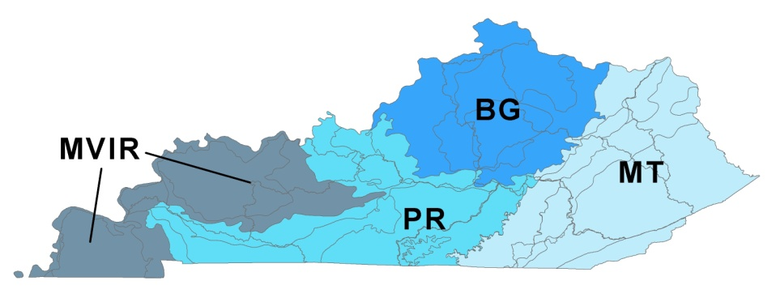
Water Quality Standards: Biological Indicator Bioregions
Kentucky’s geology creates distinct areas, referred to as bioregions. Each bioregion naturally supports different types of plants and animals. Biological assessments are based on these known differences.
Bluegrass
Pennyroyal
Mississippi Valley/ Interior River Lowland
Mountains
Notes:
Kentucky is divided into different geologic regions, which have different influences on the types of plants and animals present in and around streams that exist in those regions. The different areas resulting from these influences are called bioregions.
The four bioregions of Kentucky are the Mountains (MT), the Bluegrass (BG), the Pennyroyal (PR) and the Mississippi Valley/Interior River Lowland (MVIR).
These bioregions support different types and numbers of macroinvertebrates in the streams located there.

Slide 40
Water Quality Standards: Anti-degradation Policy (What to do when water quality is better than required?)
Three Levels of Protection:
Protect Baseline
Use of Assimilative Capacity not a Right (Can’t degrade unless…)
No degradation of Outstanding Waters
Applies to permitted activities, nonpoint sources, and water quality standards review. Included in 401 KAR 10:031.
Notes:
For protection of existing good water quality:
Anti-degradation applies parameter by parameter and use by use. If 6 designated uses are assigned to a waterbody, and 5 of those uses are impaired, anti-degradation policies still apply to the protection of the 1 remaining use. Likewise, if pollution levels are greater (worse) than the criteria for 28 of 30 parameters, anti-degradation would still apply to the 2 remaining parameters.
Three are three levels of protection under anti-degradation:
The “Floor” baseline – the state water agency should not allow a new source that would result in the loss of an existing use if it can be prevented.
No “free fall” to just barely meeting criteria. Not an automatic right to be able to discharge just because the stream can handle a little more load. If a discharge will cause substantial degradation, even if it does not result in the loss of a use, they MUST JUSTIFY that the discharge a) cannot be avoided and b) that it is necessary for economic or social development.
No decline in outstanding waters

Slide 41
Water Quality Standards Criteria into Practice
If standards are exceeded, Kentucky is obligated to:
Put on list of impaired waterbodies (303(d) list).
Develop a Total Maximum Daily Load (TMDL).
If present, write WQ-based KPDES limit.
Preventing cause of, or contribution to, violations of water quality standards
Consistent with allocations of load in applicable TMDLs, if developed
Notes:
The practical application of water quality standards is that…
If water quality standards are exceeded, this does not directly produce a related enforcement action.
Instead, exceedances result in the stream, river or reservoir being listed on the 303d list of impaired waterbodies.
Then, a TMDL report will need to be developed to further assess the degree of impairment, pollutant contributors, and outline the management activities needed to correct the problem.
Also, any KPDES permits for discharges into the impaired waterbody will need to be adjusted so that those discharges do not contribute to the water quality violation.
The KPDES permit may also need to be amended so that pollutant releases are minimized in accordance with the TMDL management recommendations.

Slide 42
If Water Quality Monitoring suggests the need for improvement:
TMDL or source assessment defines level of improvement needed (pollutant reductions)
Watershed plans provide recommended solutions
Solutions implemented through federal, state, local programs, as well as private initiatives.
Permit modifications (KPDES, etc.)
Best Management Practices
Citizen or business-led initiatives
Notes:
In summary, if water quality monitoring shows that pollutant levels need to be reduced to meet standards, the avenues of action include:
TMDLs
Watershed Plans
Combined implementation of various federal, state and local programs, as well as private initiatives to correct the problem.

Slide 43
State Jurisdiction: “Waters of the Commonwealth”
“Waters of the Commonwealth"
“any and all rivers, streams, creeks, lakes, ponds, impounding reservoirs, springs, wells, marshes, and all other bodies of surface or underground water, natural or artificial, situated wholly or partly within or bordering upon the Commonwealth or within its jurisdiction”
-KRS 224.1-010
Notes:
This and the next three slides are optional and provide an explanation of the ongoing debate over CWA jurisdiction over “Waters of the United States.
The classification of “waters of the United States” has been hotly debated, with some wanting more comprehensive protections on water quality and others resisting the regulatory implications.
Discussion point: Resistance from private property rights and corporate interests. Viewed by some as government over-reach.

Slide 44
CWA Jurisdiction: Waters of the U.S.
CWA applies to:
“Waters of the United States” (WOTUS)
What are these?
WOTUS Rule – Current and ongoing debate
Are ephemeral streams, agricultural ditches, urban swales, wetlands, or ponds under CWA jurisdiction?
If so, you need a permit and may have to pay or mitigate if you impact it.
Notes:
This and the next two slides are optional and provide an explanation of the ongoing debate over CWA jurisdiction over “Waters of the United States.
The classification of “waters of the United States” has been hotly debated, with some wanting more comprehensive protections on water quality and others resisting the regulatory implications.
Discussion point: Resistance from private property rights and corporate interests. Viewed by some as government over-reach.

Slide 45
Waters of the U.S.
1986 / 1988: Definition Includes:
May be used for interstate commerce
All interstate waters, including wetlands, whose impact could affect interstate commerce
Impoundments of these waters
Tributaries of these waters
Wetlands adjacent to these waters
2007: Rapanos Supreme Court case
Challenged federal CWA jurisdiction over isolated wetlands
“Significant nexus” with traditionally navigable waters
Notes:
Rulings in 1986 and 1988 specified that the CWA applied to navigable waters that could be used for commerce, as well as impoundments, adjacent wetlands, and non-navigable tributaries.
The Rapanos Supreme Court case in 2007 clarified specific waters that would need to be assessed by the EPA and U.S. Army Corps of Engineers for jurisdiction. These agencies would be responsible for determining whether or not the waterbody has a significant nexus (or connection) with a traditional navigable water. This largely related to the permanency of the tributary or wetland.
This ruling further stated that the agencies would generally not assert authority over swales, erosional features or man-made ditches.

Slide 46
Waters of the U.S. continued…
2015: Clean Water Rule
Issued to clarify Waters of the United States following the Rapanos case
2018: 2015 Rule Delayed - Current rulemaking ongoing
Notes:
In 2015, in order to clarify confusion over the Rapanos Supreme Court ruling the Corps and EPA promulgated a new regulation.
This Clean Water Rule attempted to define the scope of federal water protection with a more consistent approach.
Following an Executive Order by President Trump in February 2017, the EPA and Corps of Engineers were required to review and rescind (get rid of) or revise the rule.
In February 2018, a new rule was published that delayed the applicability of the 2015 ruling until February 2020 in order to give the agencies time to reconsider their definition of “waters of the United States.”

