Slide 1
Watershed Academy
Watershed Coordinator Training Series
Dealing with Data
4. Basic Mapping Tools

Slide 2
Basic Mapping Tools
Free Options
  ArcGIS Online – commercial software with free online version
  QGIS (www.qgis.org) – similar to ArcGIS but full version is free
  Google Earth – free and has Street View
  GRASS GIS (grass.osgeo.org/) – developed by USACE for environmental planning
  Map Window (www.mapwindow.org/) – used with EPA’s BASINS and made open source
Notes:
There are a number of resources that are available for mapping including some great open source options.
It is beyond the scope of this module to offer a complete GIS training. We want to provide you with some options for further work.
Perhaps the most used GIS platform is ArcGIS with its various suite of applications. Most of these are commercially available. We will work through a simple example using ArcGIS Online.
If you are familiar with ArcGIS but are a small nonprofit without the money for licenses, you might consider QGIS which is very similar and is even superior in some ways. The time required to review this platform is beyond the scope of this training.
Google Earth is also a free GIS software that has an option that no other application has – its StreetView which allows you to do roadway surveys of nearby streams. This program also allows for points to quickly be created and shared with others.
There are other free open-source software that is available including GRASS GIS, developed by the USACE, and Map Window, developed for the EPA BASINS program. You might explore using these platforms.

Slide 3


Slide 4
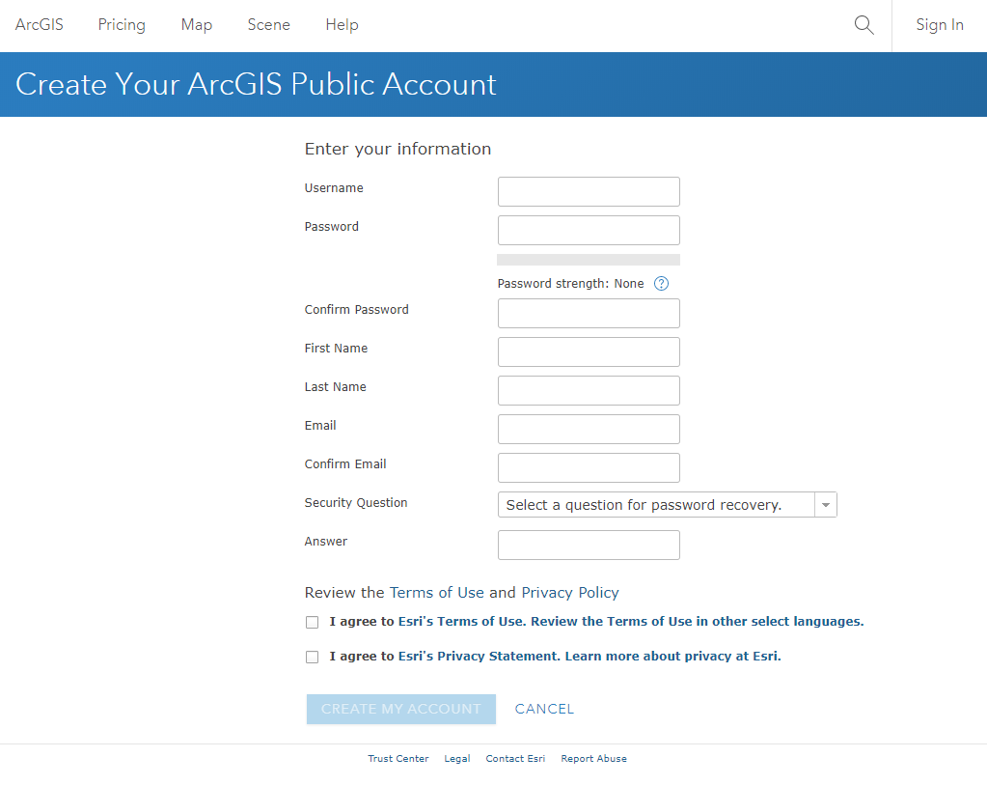
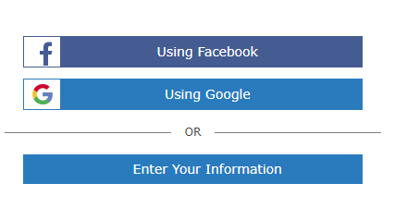
ArcGIS Online
Sign In or Create Free Public Account:
  https://www.arcgis.com/home/createaccount.html#
Notes:
Fo ArcGIS Online, you can create a free public account via its login screen.

Slide 5

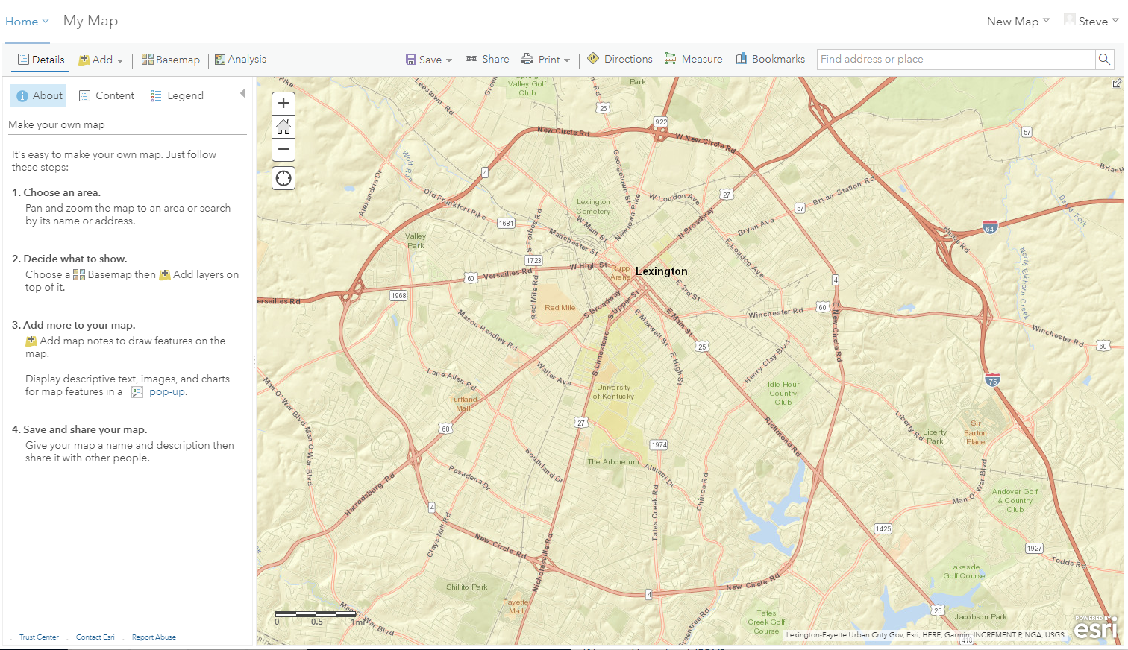
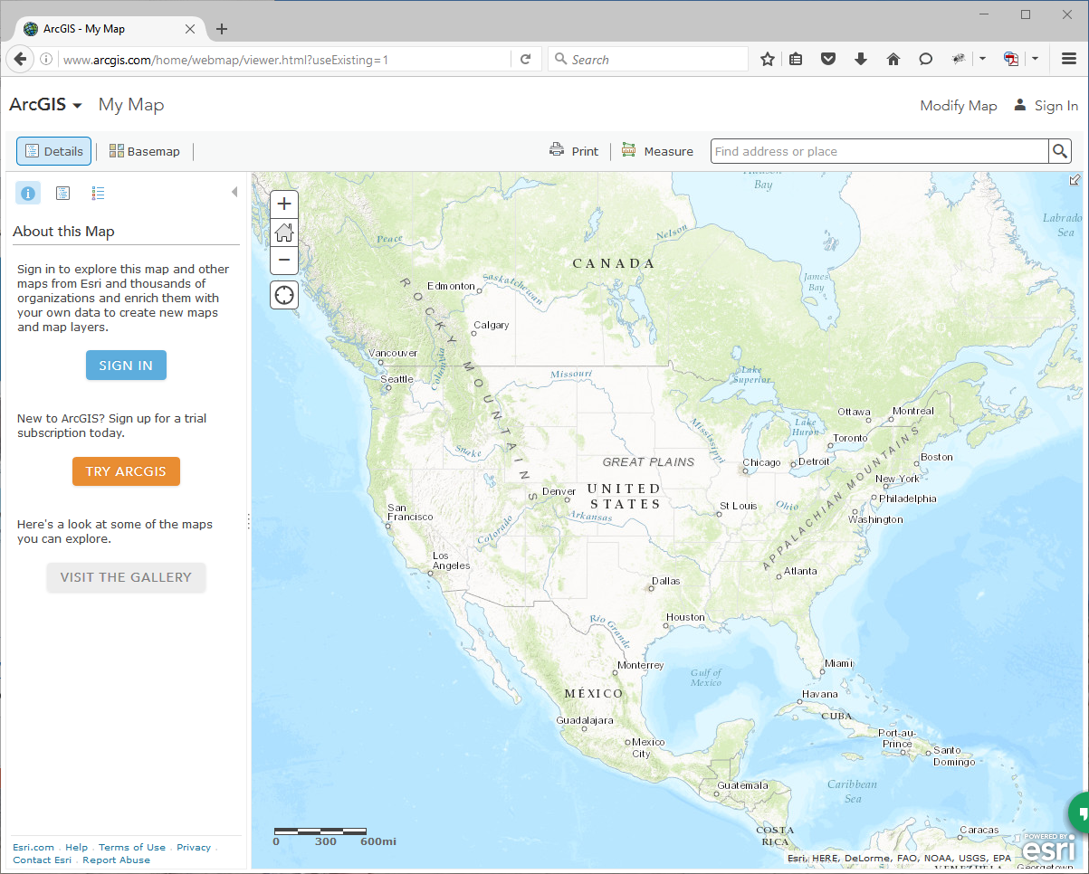
New Map
Notes:
Once you login, you will have a number of options and formatting that varies based on your account or organizational settings and your browser window size.
Click on the Map button at the top of the screen and you should have a blank map pop up.

Slide 6

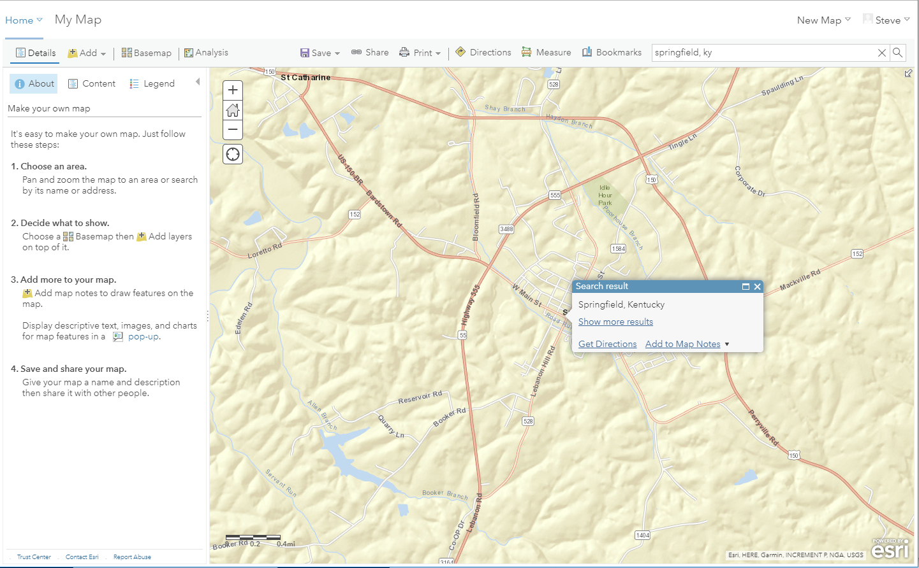
Springfield, KY
Notes:
For this example, we are going to enter “Springfield, KY” in the top right corner of the screen and hit enter.
The map will center on this location.

Slide 7
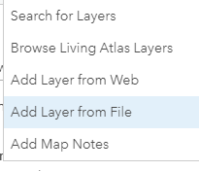
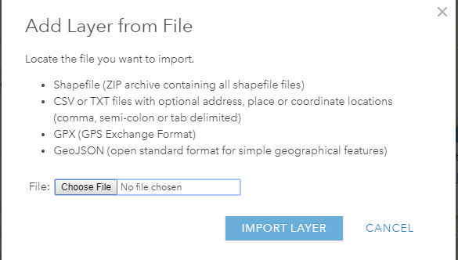
Add StreamStats Delineation
Notes:
Now we want to add the watershed delineation that we obtained from USGS StreamStats.
Go to add > choose a layer from file > then choose the file.

Slide 8
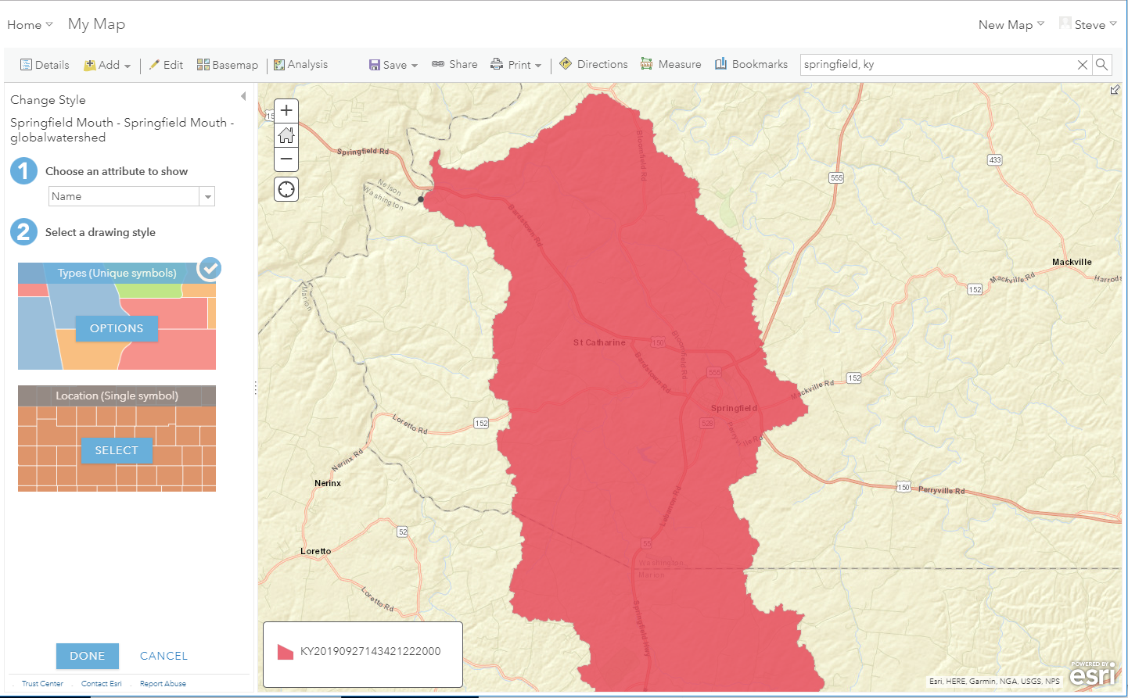
Watershed Area
Notes:
This is what it looks like when the watershed is brought in.

Slide 9
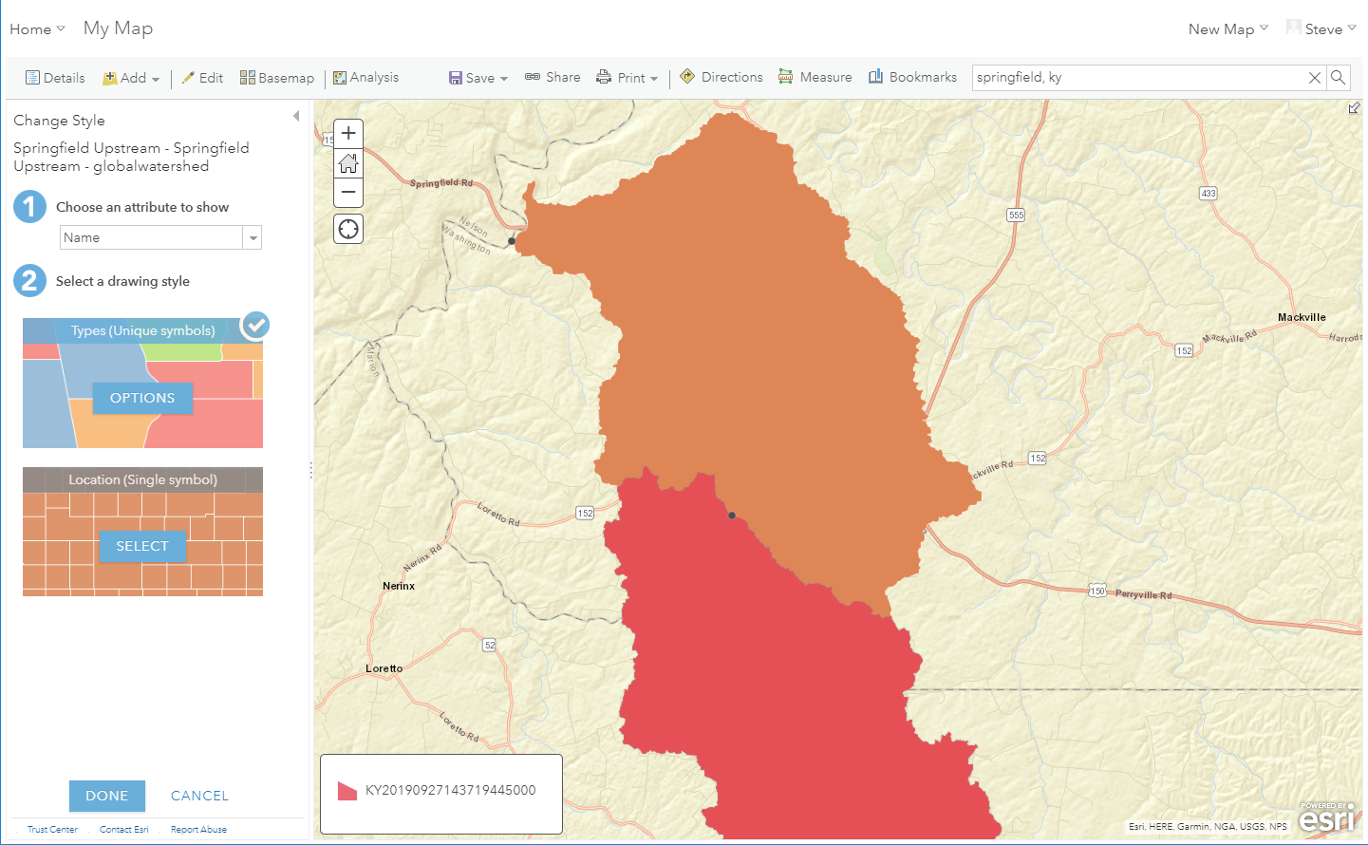
Add Upstream Area
Notes:
When we add the delineated watershed upstream of our focus watershed, this is the result.
Now we will click in the Types (Unique Symbols) and adjust the settings

Slide 10
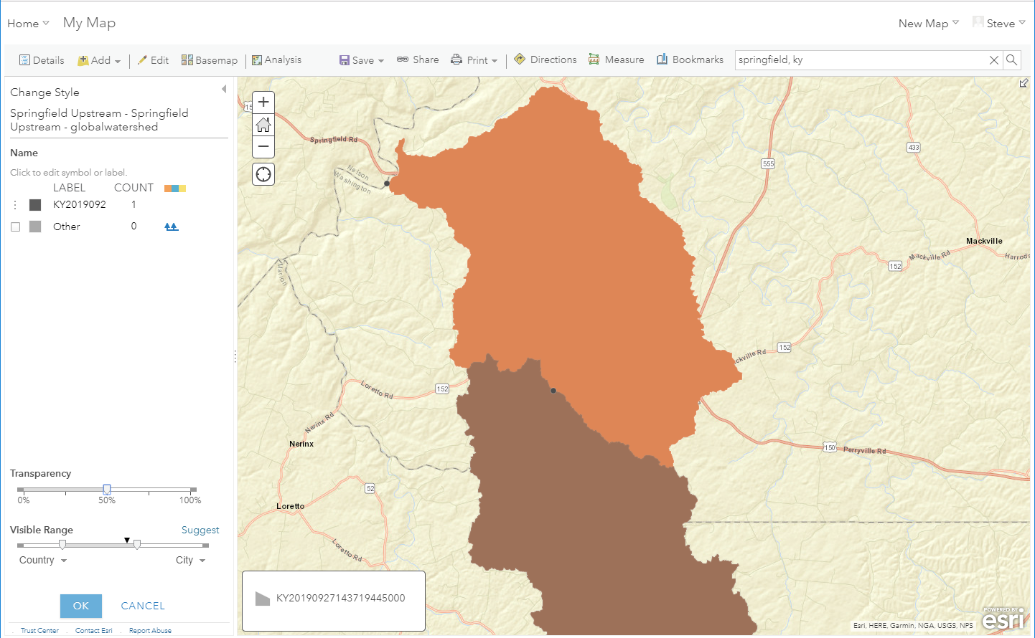
Adjust Colors / Transparency
Notes:
Here is the menu that comes up.
By clicking on the label you can adjust the text in the label. By clicking on the color, you can adjust the color. Notice there is a slide at the bottom for transparency.
In this case, we will change the color to black and adjust the transparency to 50%.

Slide 11
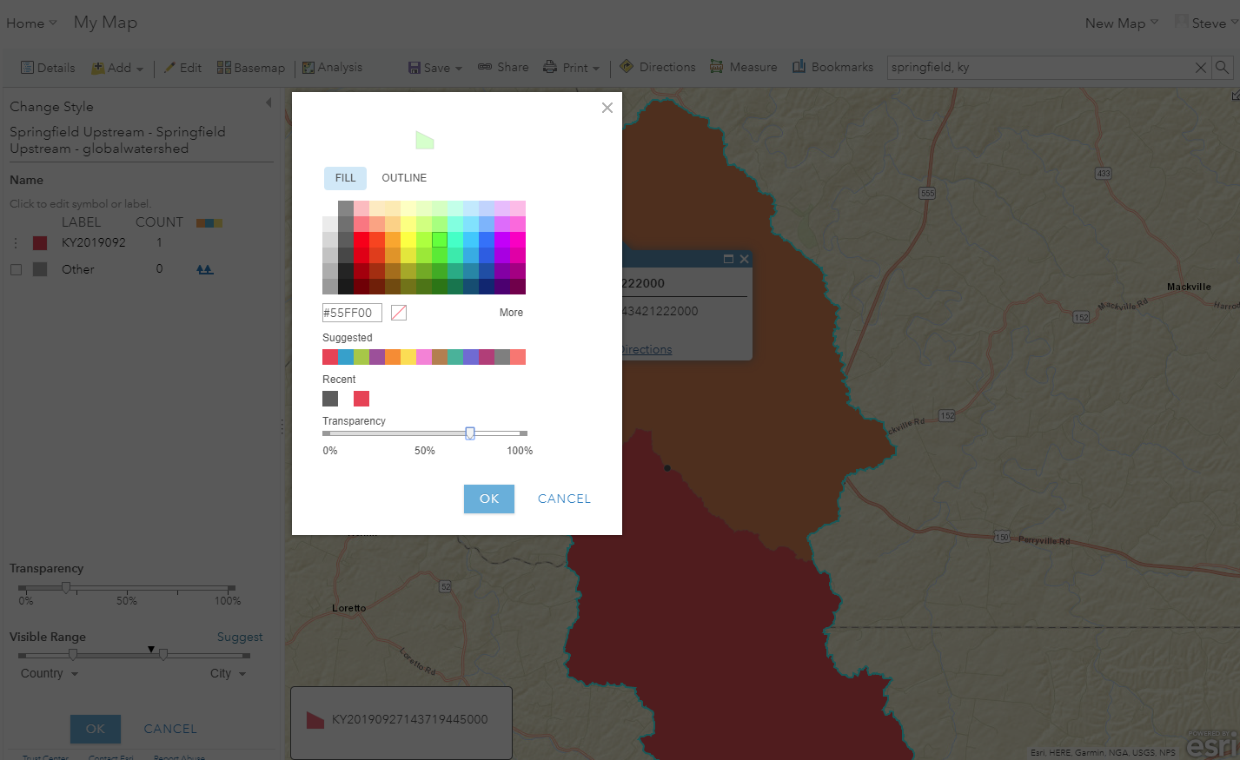
Adjust Colors / Transparency
Notes:
Here you can see the ability to adjust the color and the transparency when you click the color.
Notice at the top you can also adjust the fill or the outline.
Click Ok.

Slide 12
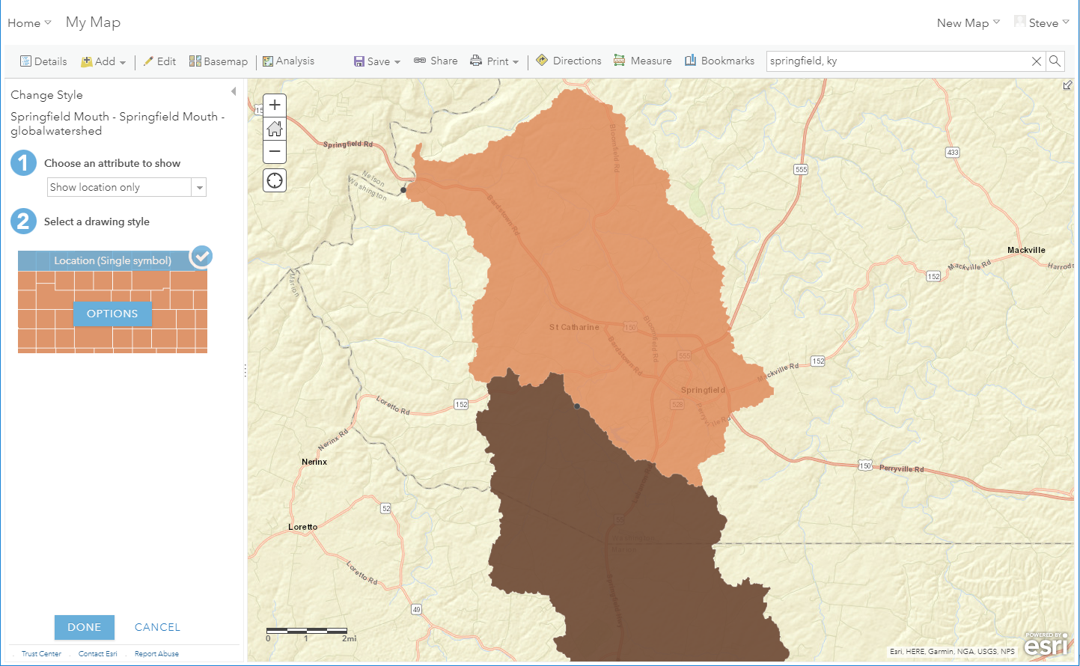
Adjust Colors / Transparency
Notes:
So here is the revised figure make sure you click DONE at the bottom to save the changes.

Slide 13
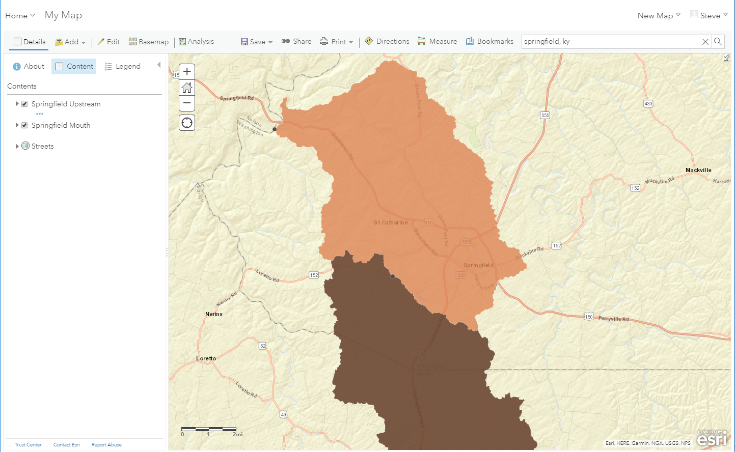
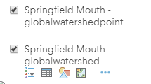
Select Other Layer
Notes:
By clicking the “Content” header, it will show all of the different features. In this case we want to adjust the color of the Mouth layer,
So we click that layer title and we got a drop down menu.
By clicking on the feature options we can change the color on that feature as well.

Slide 14
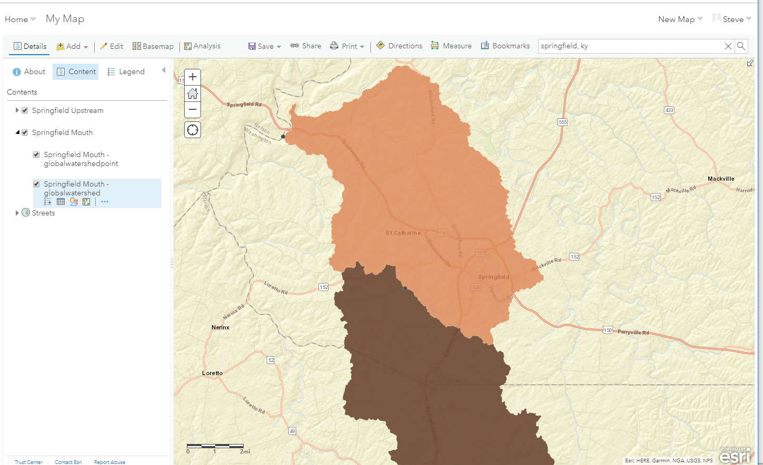
Adjust

Slide 15
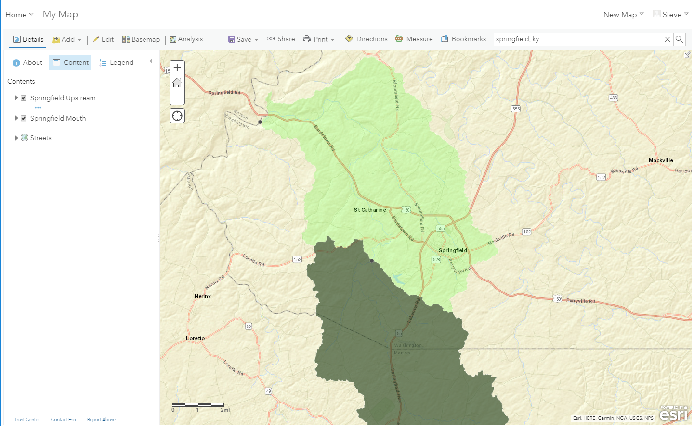
Example Watershed Map
Notes:
Here we have an example watershed map.

Slide 16
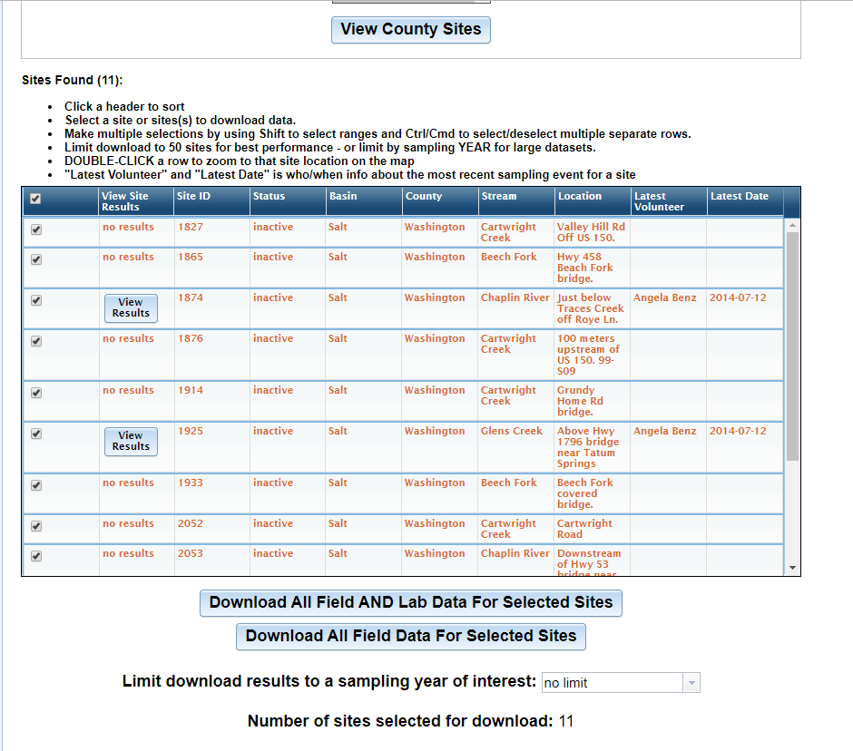
Watershed Watch
http://kgs.uky.edu/wwky/main.htm
Notes:
Download some data for multiple sites
In this case I downloaded all sites in Franklin County.

Slide 17
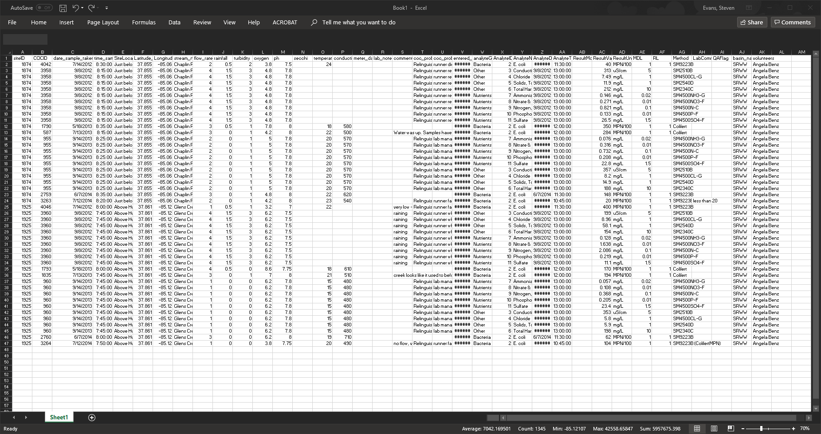
Open (or cut and paste) in Excel
Notes:
2. Open tab-delimited data in Excel to manipulate

Slide 18
Rename Columns
Column F: “Latitude_NAD83” to “Latitude”
Column G: “Longitude_NAD83” to “Longitude”
Notes:
2. Open tab-delimited data in Excel to manipulate

Slide 19
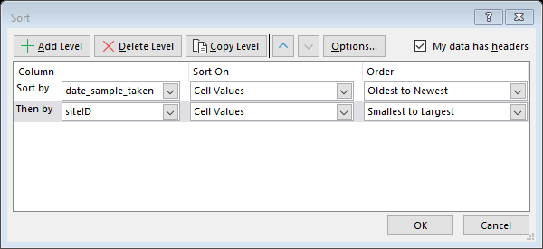
Extract One Sampling Event
Sort by Date then SiteID
Notes:
3. Sort data by Date AND THEN SiteID – want to analyze data for one date (multiple sites)

Slide 20
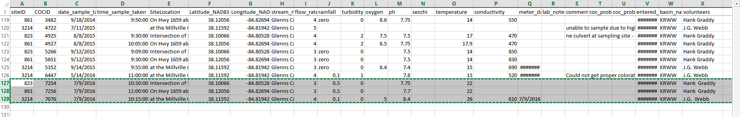
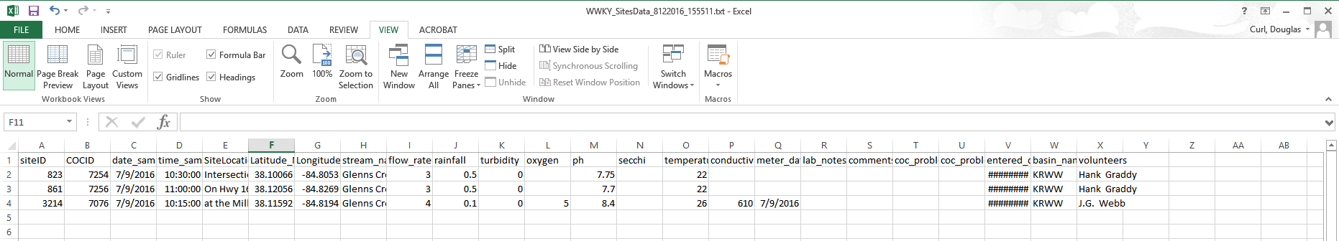
Extract One Sampling Event
Copy and paste into a new sheet.
Save as “CSV (Comma delimited) (*.csv)”
Notes:
4. Isolate data of interest: select and copy an “event” (one date) and paste into a new sheet with headers. Save the new sheet as a delimited text file.

Slide 21

Create Map and Add Data
Notes:
6. Drag-drop the created delimited text file into the opened map in browser or click “Modify Map” at top right and “Add Layer From File”

Slide 22
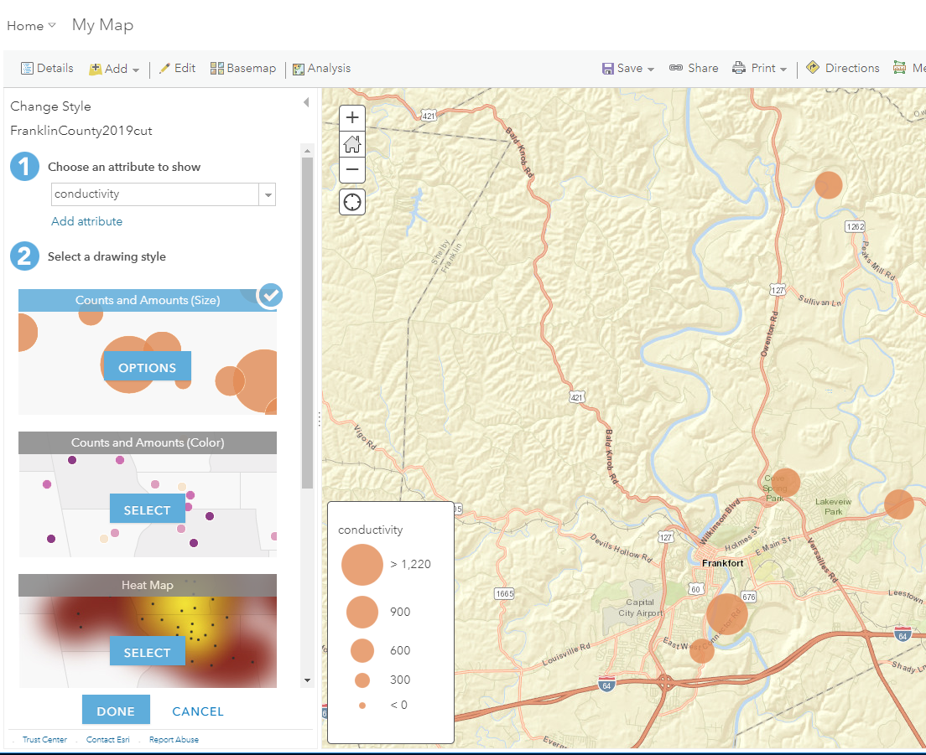
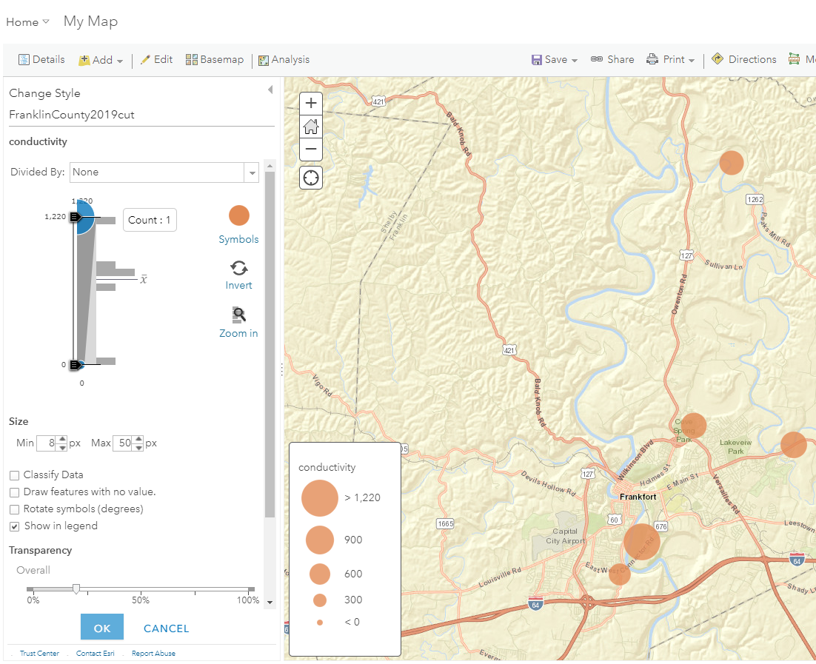
Adjust display and attributes
Notes:
8. Points should plot onto the map, and map will zoom to that area. Now you can symbolize the points to show relative values. One left select “Choose an attribute to show”. The drawing style “Counts and Amounts (Size)” will display automatically – click options to alter the display or use Color or Heat Map. Play around with it to get a desired map.

Slide 23
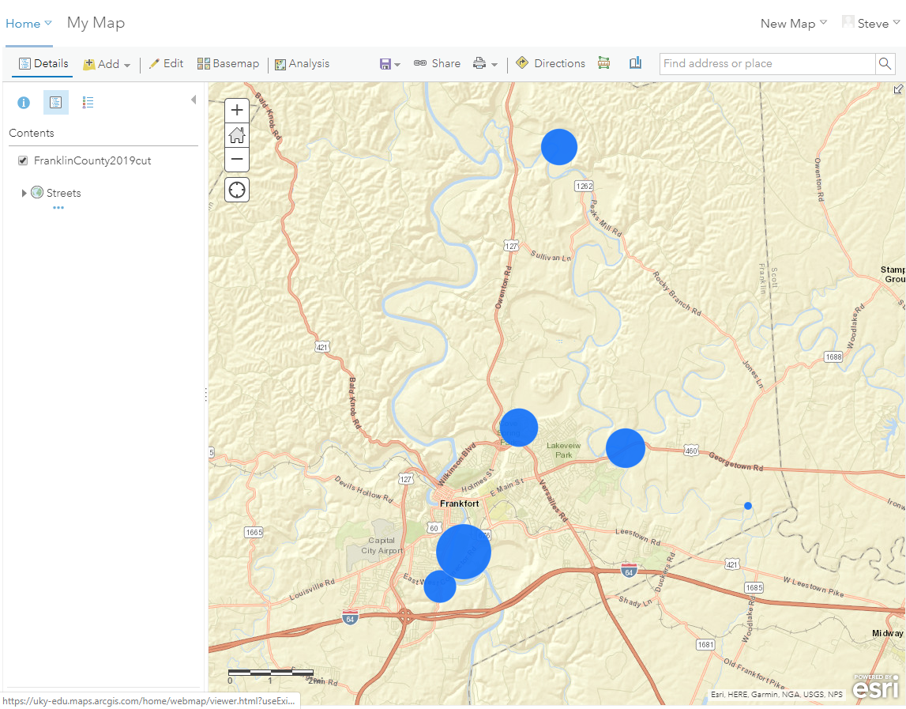
Print or Share
Notes:
9. You can print the map, or login to ArcGIS Online and you can save and easily share the map as an interactive map with other people.

Slide 24
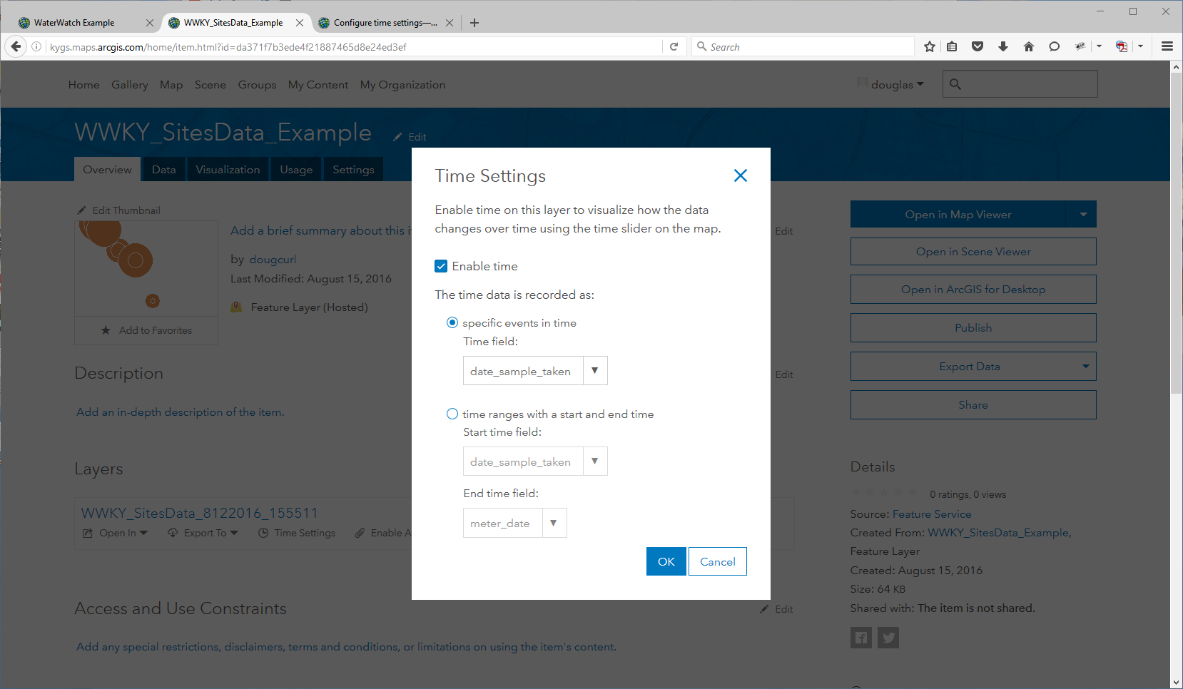
Advanced Options
Notes:
10. If you login and save the map – you can do other things, such as show all the data with a time-slider:
Create an account (if needed) and login
Add entire dataset CSV into map
Save Layer to your account
On Layer details – “Publish Layer” as a hosted layer (right side menu)
Open hosted layer details
Under layers: click “time settings” – click “enable time” in the popup
Open layer in map viewer…

Slide 25
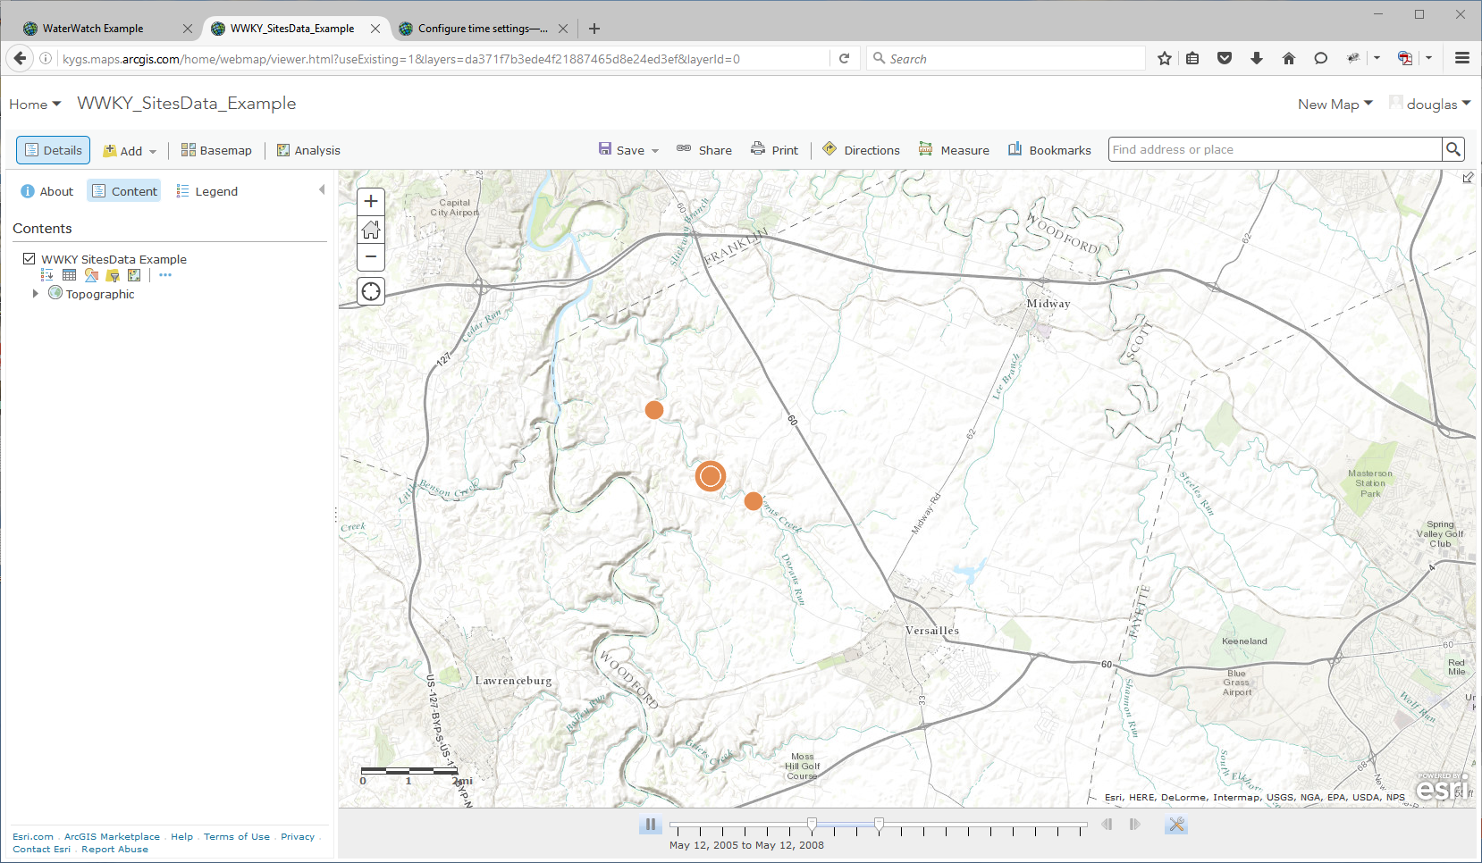
Advanced Options
Notes:
10. If you login and save the map – you can do other things, such as show all the data with a time-slider:
Create an account (if needed) and login
Add entire dataset CSV into map
Save Layer to your account
On Layer details – “Publish Layer” as a hosted layer (right side menu)
Open hosted layer details
Under layers: click “time settings” – click “enable time” in the popup
Open layer in map viewer…
And you should see a time slider at the bottom – will need to play with the settings to get desired map.

Slide 26
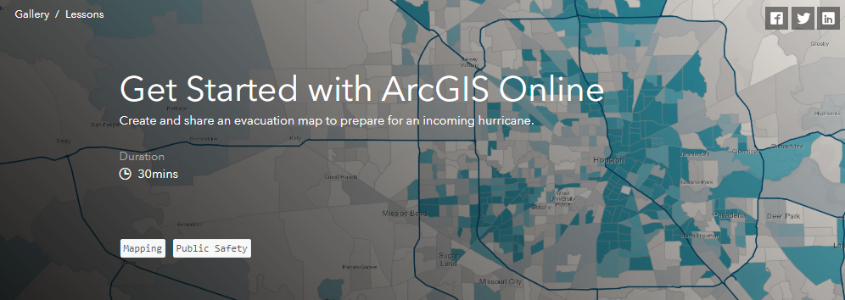
For Further Learning:
https://learn.arcgis.com/en/projects/get-started-with-arcgis-online/

Slide 27

Google Earth

Slide 28
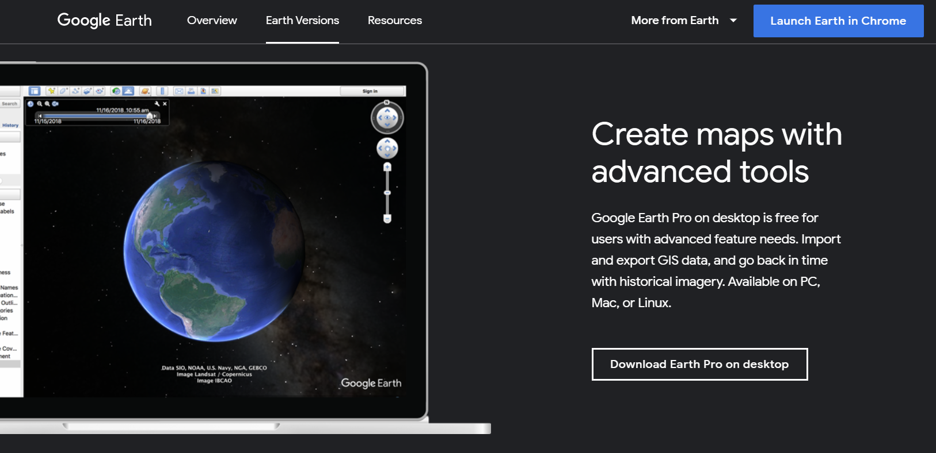
Google Earth
Free Download:
  https://www.google.com/earth/versions/#earth-pro

Slide 29
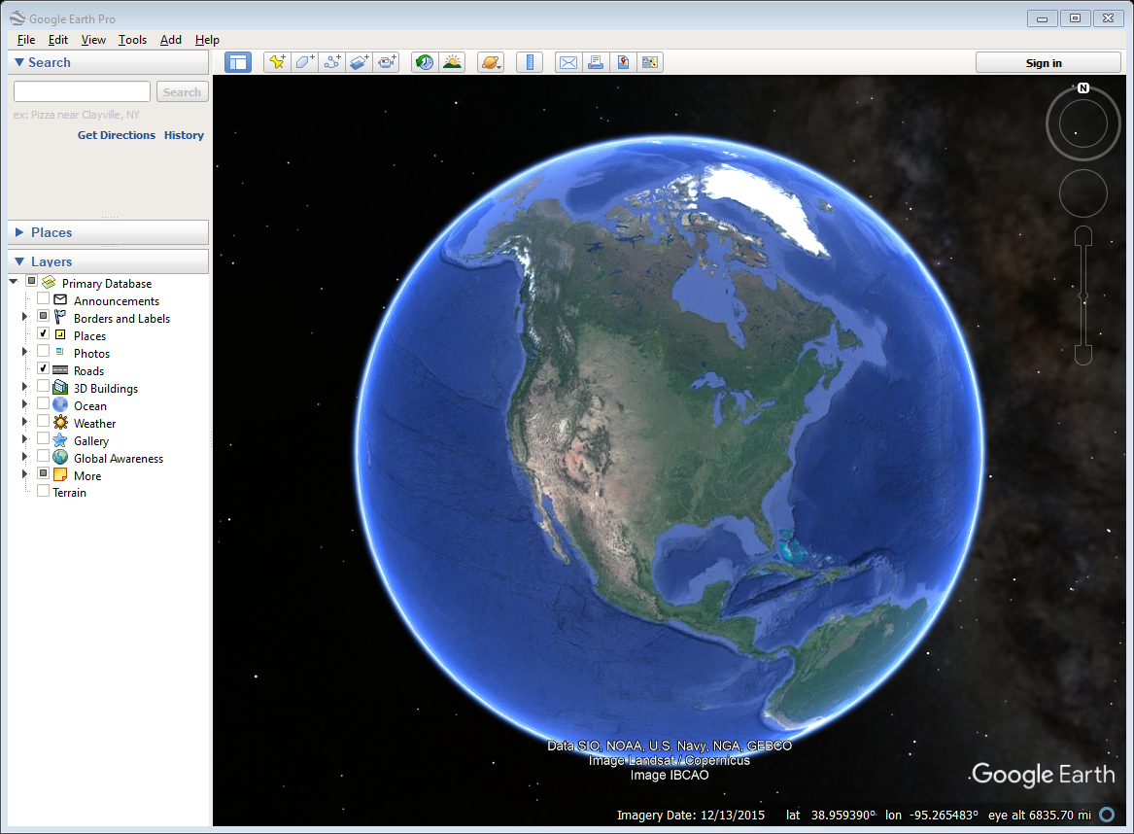
Google Earth

Slide 30
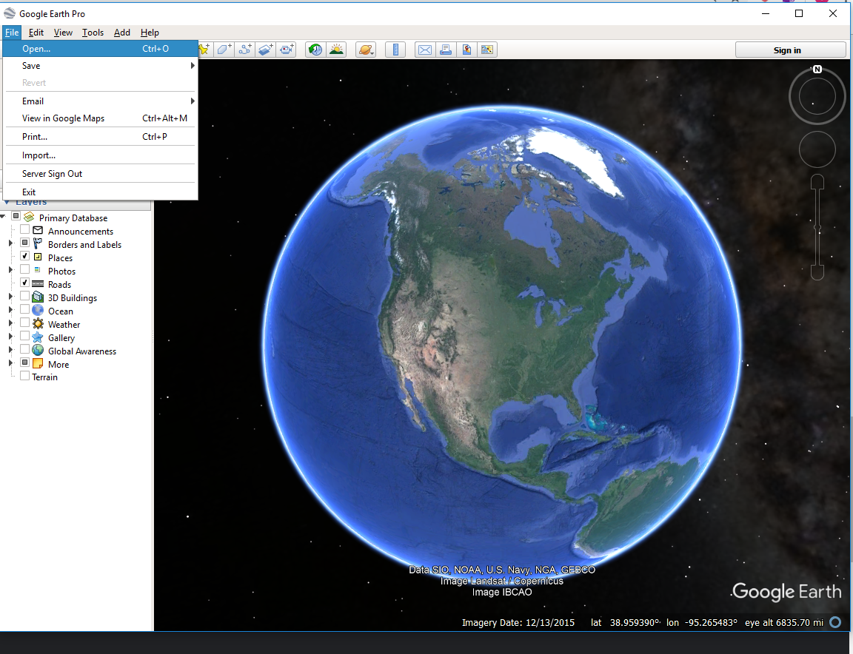
Import Shapefile
Notes:
Have to extract zip files. Click on shapefile.

Slide 31
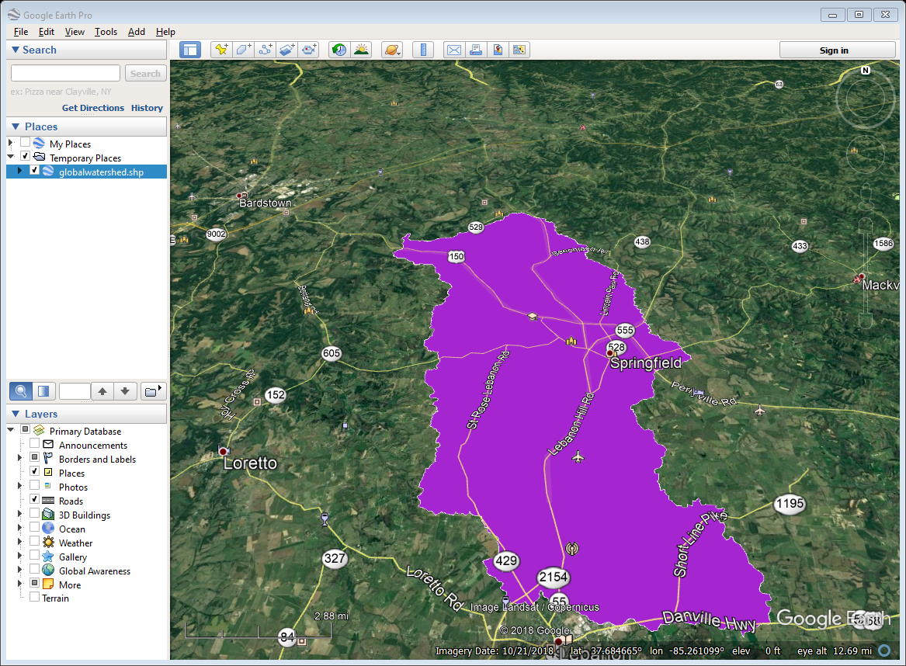
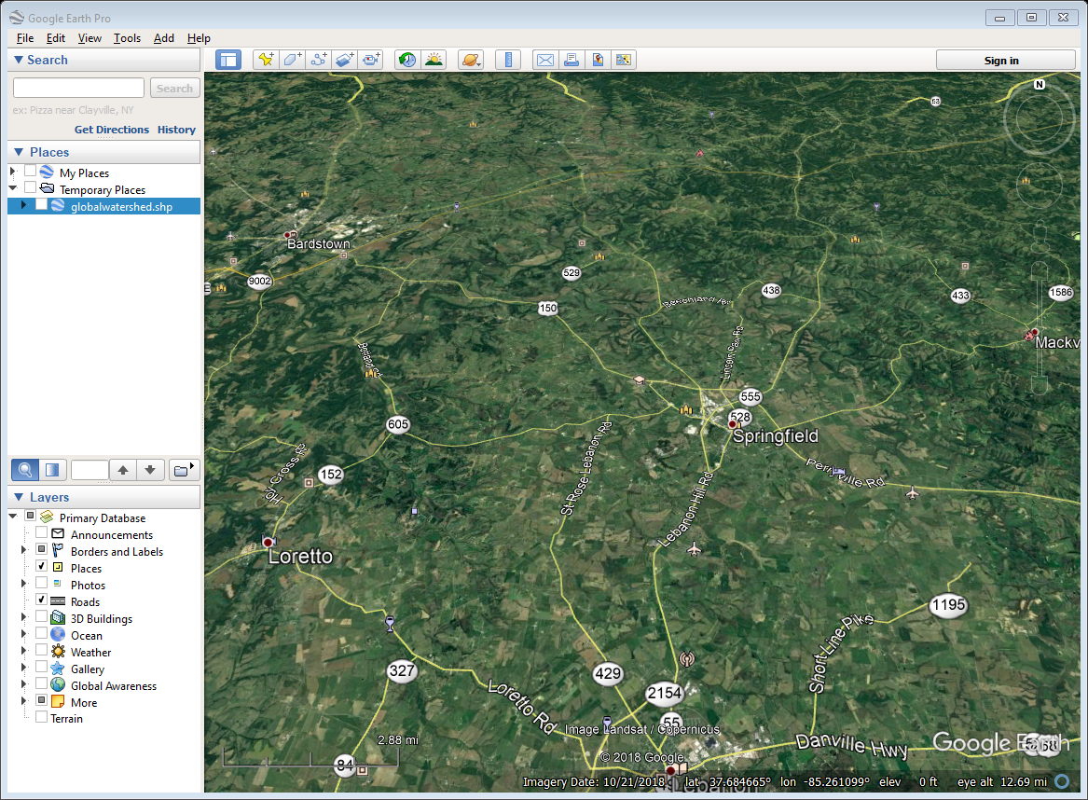
Import Shapefile

Slide 32
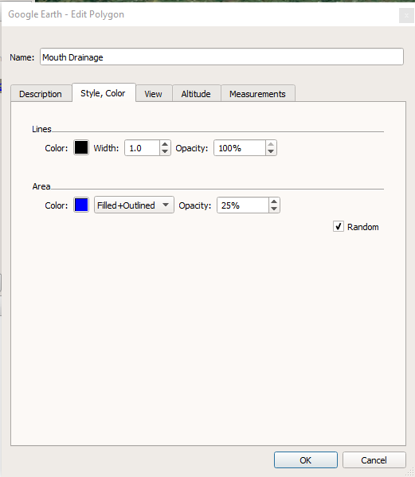
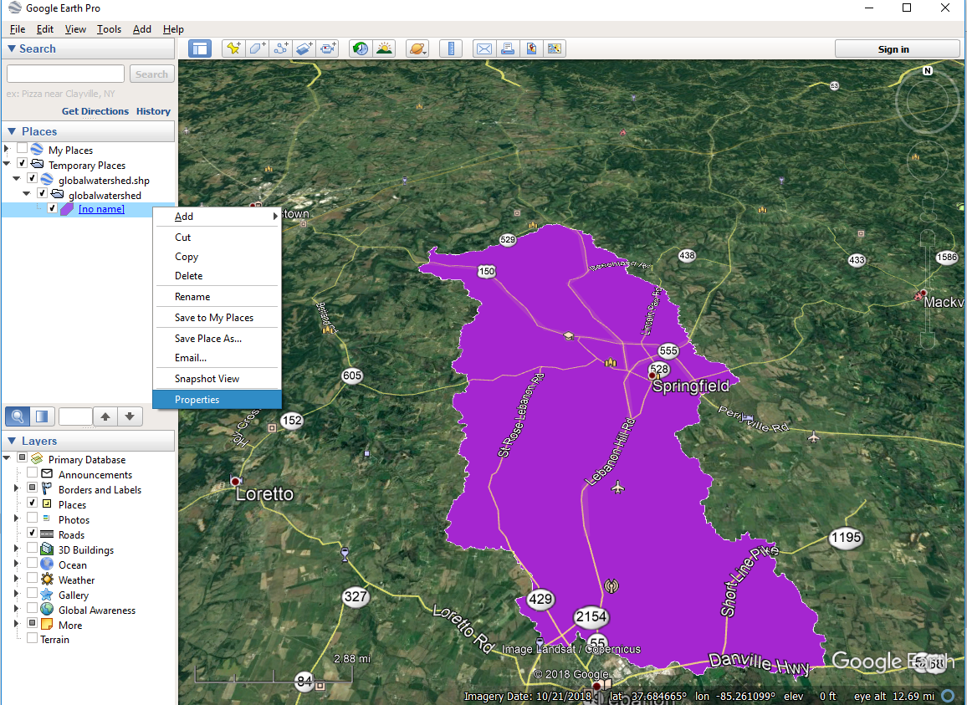
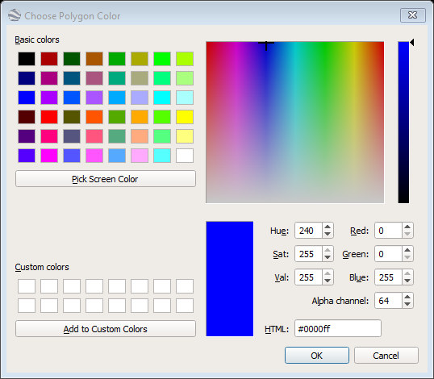
Import Shapefile

Slide 33
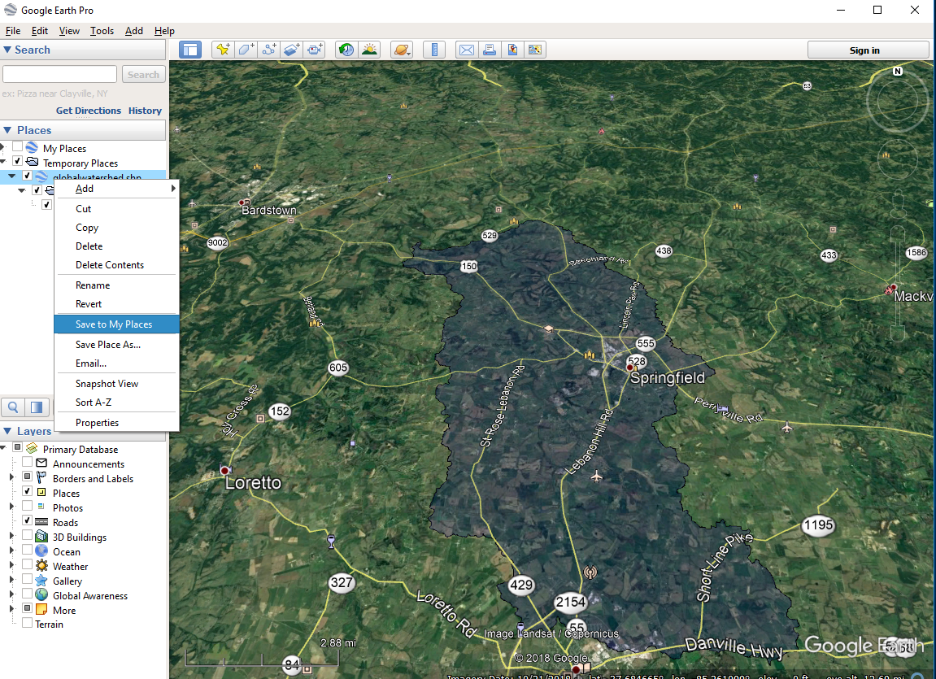
Save and Share

Slide 34
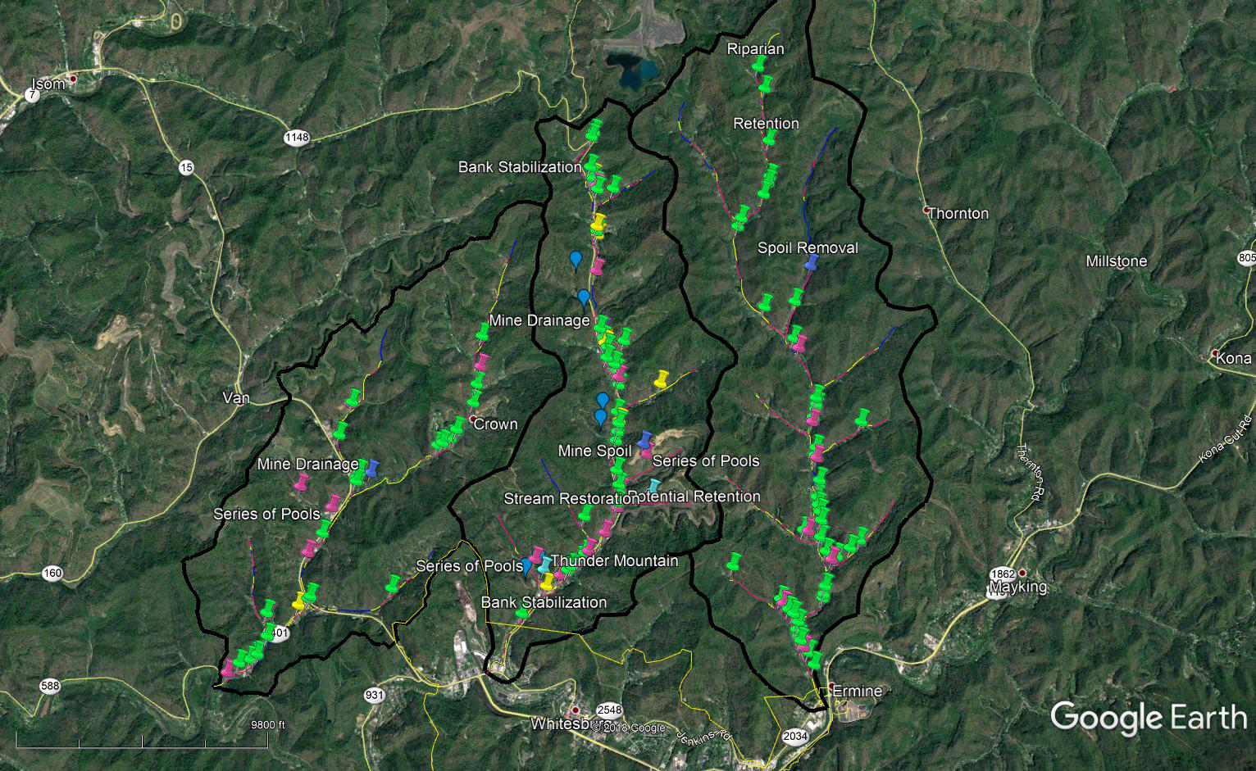
Exploring BMP Solutions

Slide 35
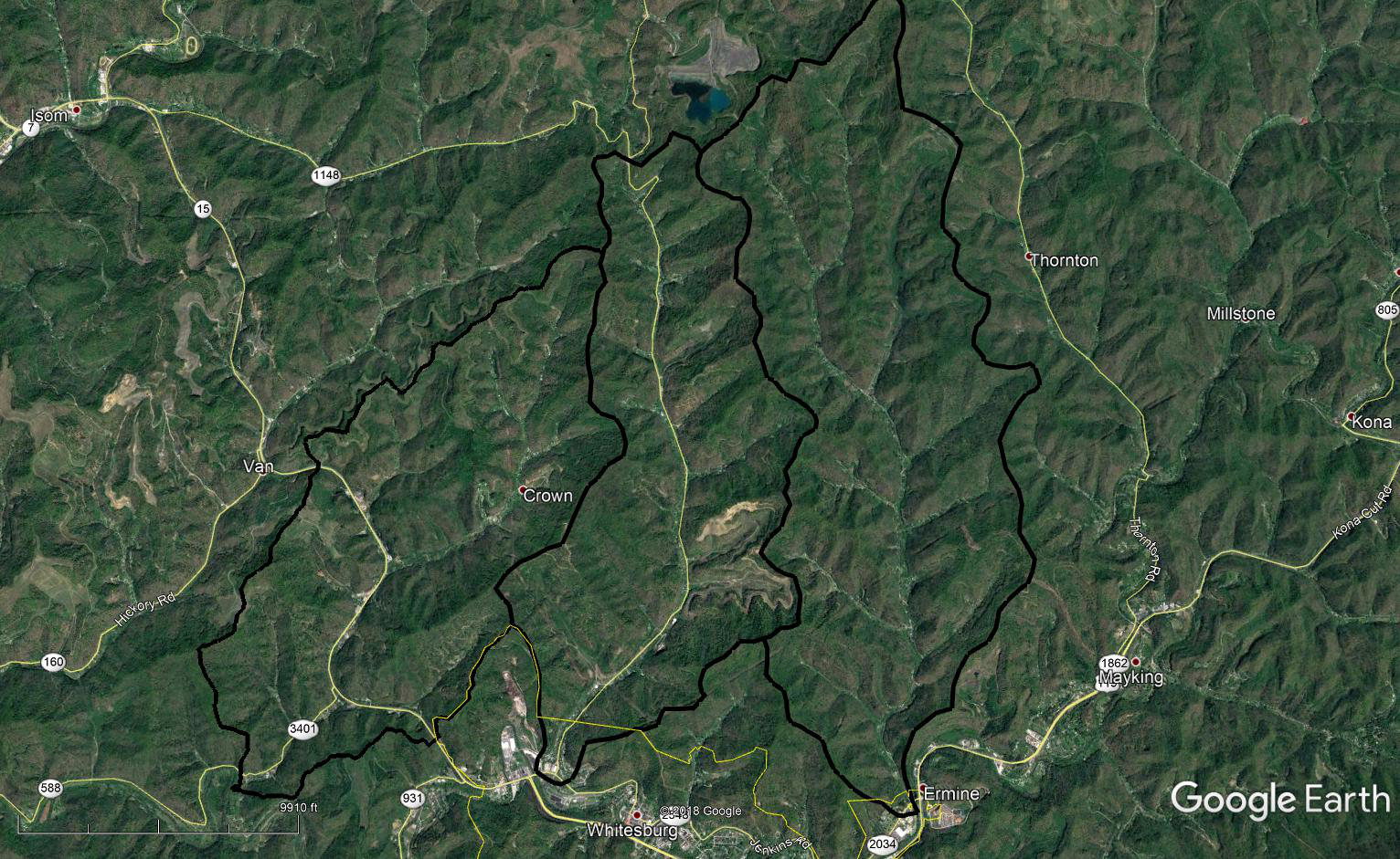
Imported Drainage Area Layer

Slide 36
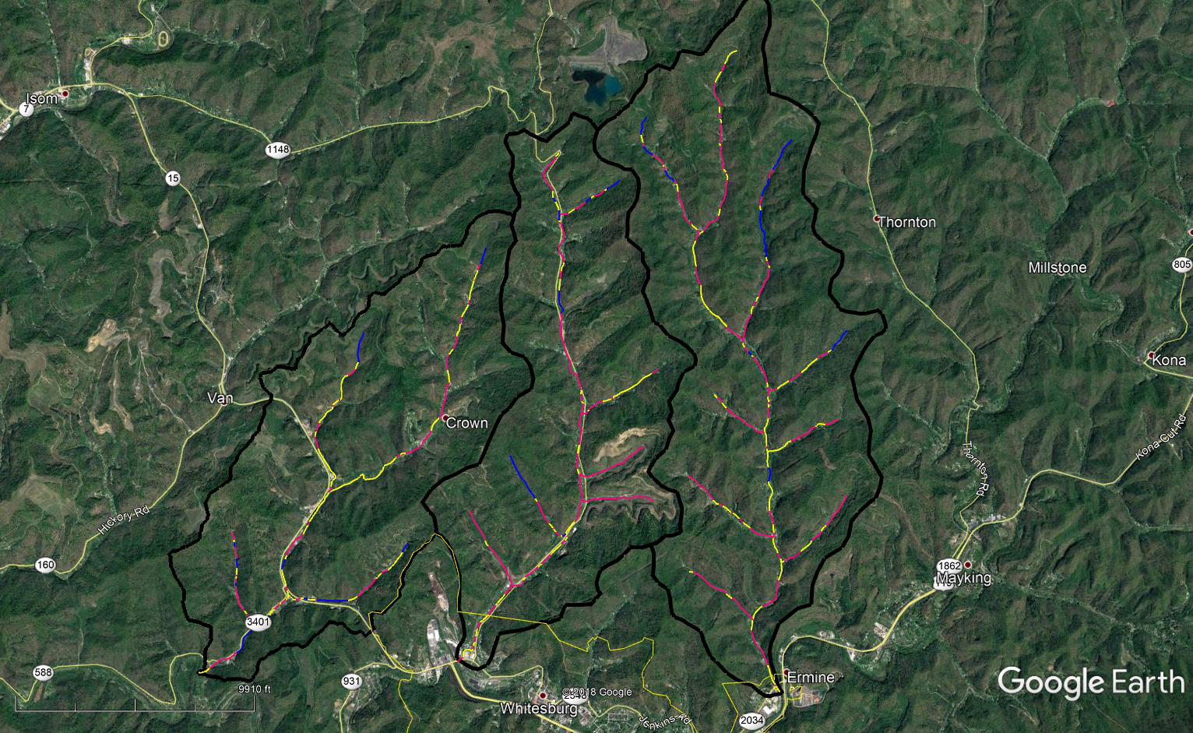
Imported Stream Layer

Slide 37
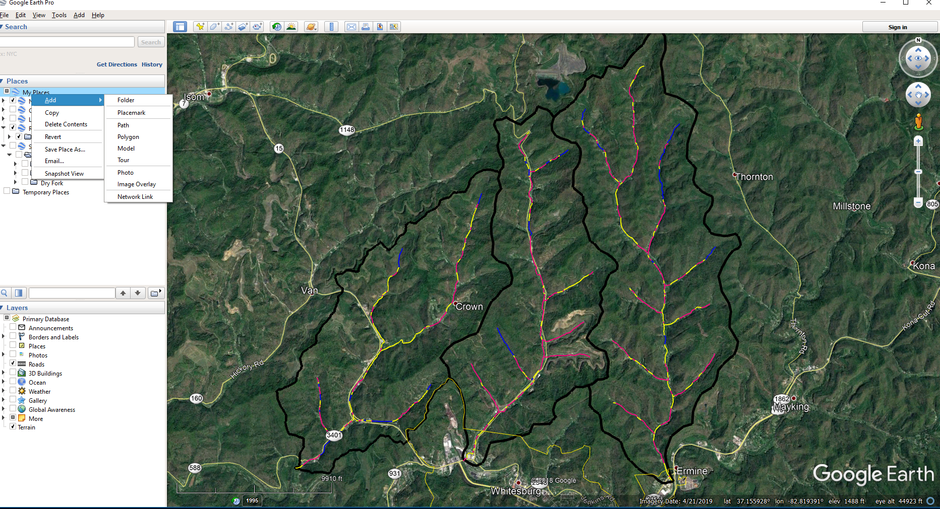
Create a Folder “Stream BMPs”

Slide 38
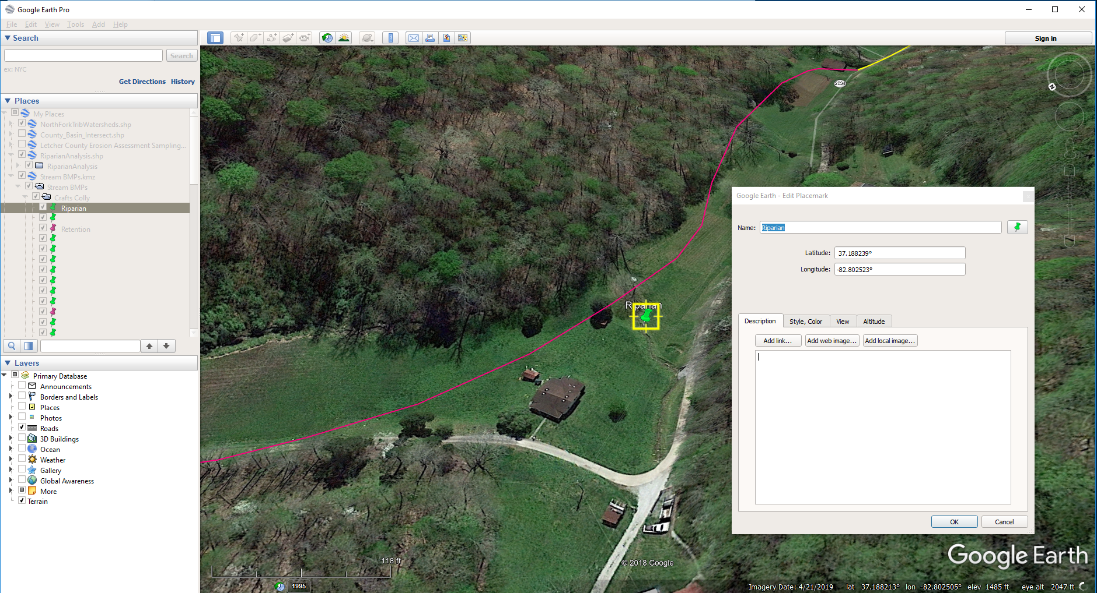
Use Street View / Aerials to Review

Slide 39

Use Aerials / StreetView to Review
Turning on “Terrain” can be very helpful in visualizing elevations

Slide 40
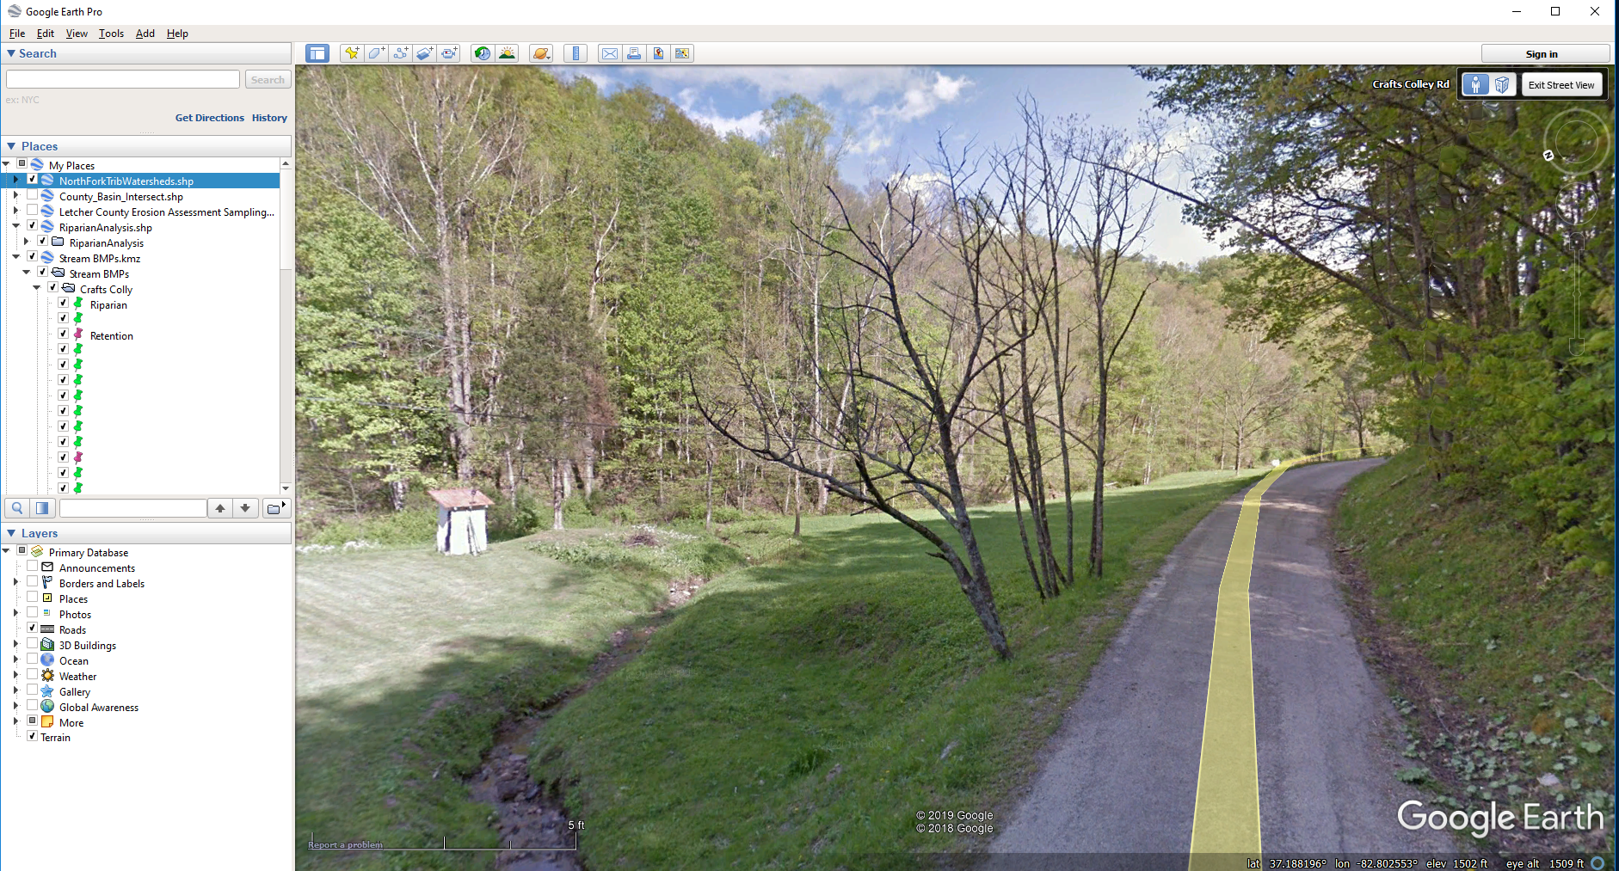
Use Aerials / StreetView to Review

Slide 41
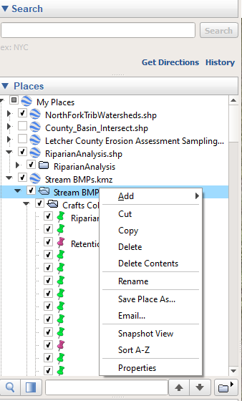
Save or Email
Save Place As…..
  Saves as a *.kmz file
  Can be imported into ArcGIS
Email
  Will directly email out the features

Slide 42

Edit > Copy Image
Use Edit > Copy Image to capture an image of your map for a report.

Slide 43
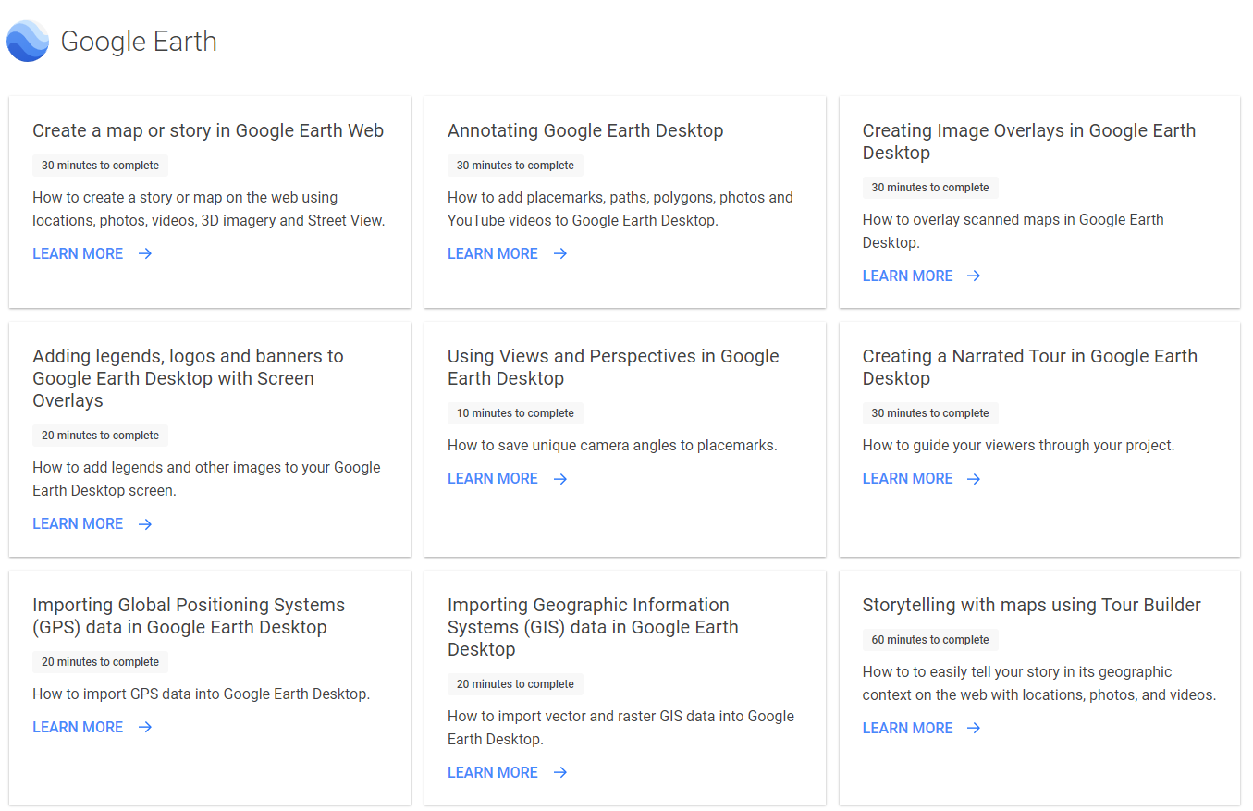
For Additional Learning
https://www.google.com/earth/outreach/learn/
  Annotating Google Earth
  Importing GIS data into Google Earth

