Slide 1
Watershed Academy Watershed Coordinator Training Series
Land Use Impacts &
Related Best Management Practices
2. Selecting BMPs
Notes:
Now, we are going to talk through some of the ways to consider BMP options and select those that best fulfill your water quality management goals.

Slide 2
Watershed Planning Process
Identify causes and sources of pollution ✓
Estimate load reductions expected ✓
Describe management measures and target critical areas
Estimate technical and financial assistance needed
Develop education component
Develop project schedule
Describe interim, measurable milestones
Identify indicators to measure progress
Develop a monitoring component
Notes:
Based on the Kentucky Watershed Planning Guidebook, these are the steps of the planning process.
At this point, we have evaluated land use and evaluated causes and sources of pollution.
We have also analyzed water quality data to develop needed pollutant loading reductions and prioritized areas for improvement or protection activities.
It’s time to put all of this information together to develop management practices that enable water quality improvements.
This is the information that is included in Chapters 5 and 6 of watershed planning documents, which are dedicated to exploring management options and developing a plan of action.
Once BMP selections are finalized, you can include the relevant partners for technical and financial assistance, accompanying education needs, a project schedule with milestones, progress indicators and follow-up monitoring plans.

Slide 3
What is a BMP?
A Best Management Practice or BMP is a…
“technique, measure or structural control that is used for a given set of conditions to manage the quantity and improve the quality of stormwater runoff in the most cost-effective manner.”
- USEPA
Remember, “best” is subjective and highly site-specific. Appropriateness of a practice is dependent on the site characteristics and situation.
Notes:
First, let’s make sure that we are clear on what we mean by BMP or “best management practice.”

Slide 4
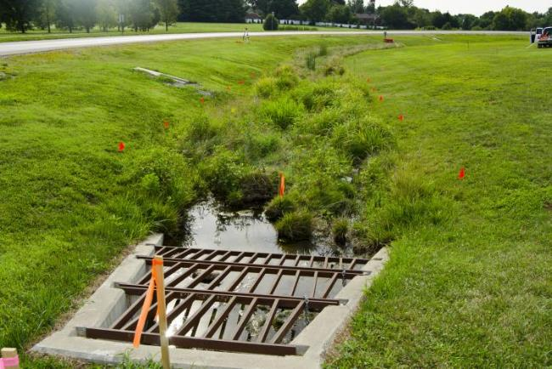
Management Practices help control pollutant loads
Reduce availability of pollutants
Example: reducing fertilizer or manure applications to crops
Reduce pollutants generated
Example: erosion control seeding
Slow transport or delivery of pollutants
Example: routing runoff through grass swales
Deposit pollutant off-site
Example: Manure storage facilities
Remediate or intercept pollutant
Example: stormwater wetland cell
Bioswale on UK Campus Lexington, KY
Notes:
Management measures help control the pollutant loads to receiving water resources in multiple ways.
Reduce the availability of pollutants by limiting their application or use (Example: reduced fertilizer or manure application to crops)
Reduce the pollutants generated by the activity (Example: erosion control seeding to hold soil in place)
Slow transport or delivery of pollutants by reducing the amount of water transported, or by causing the pollutant to be deposited near the point of origin ( Example: routing runoff through grass swales to encourage infiltration)
Deposit the pollutant off-site before it reaches the waterbody (Example: manure storage facilities contain manure for later use during appropriate application times)
Remediate or intercept the pollutant before or after it is delivered to the water resource through chemical or biological transformation (Example: a stormwater wetland cell traps and utilizes nutrients through natural processes)
Source: Handbook for Developing Watershed Plans to Restore and Protect Our Waters, USEPA

Slide 5
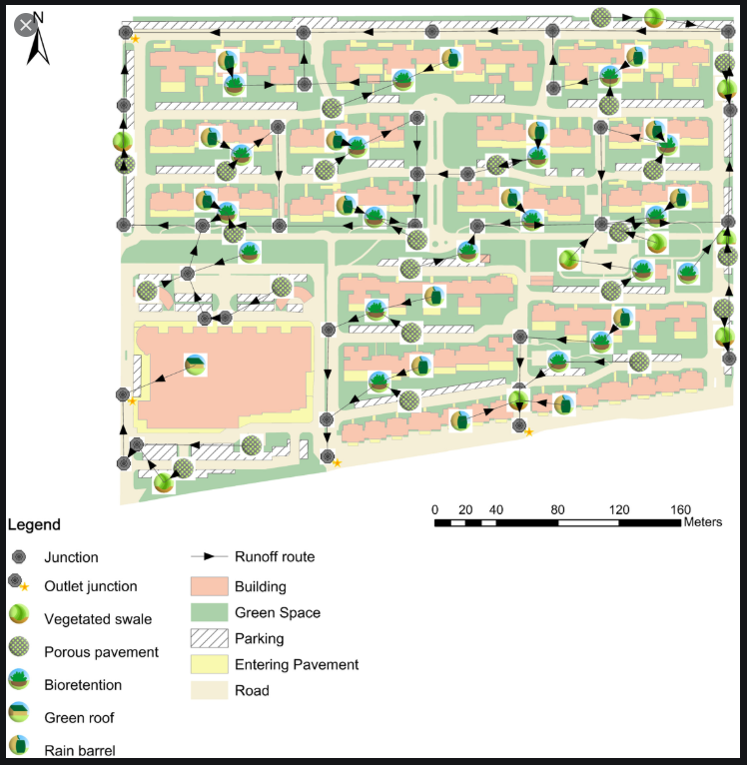
Types of BMPs
By Scale:
Lot
Regional/Community
Watershed
By Structural Type:
Localized BMPs
Linear BMPs
Area BMPs
Notes:
BMPs can be classified so many different ways. Two of these are according to scale and type.
Scale-based classification is dependent on whether they are used on an individual lot or land parcel, installed community-wide, or applied at a watershed scale.
BMPs can also be categorized by whether their structural form relates to a point (localized BMPs), a linear configuration, or over an area.
In this graphic, you can see various stormwater BMPs located throughout an area (community), as well as by individual lots The colors depict impervious surfaces (pink, beige and white with hash marks) and green spaces. Runoff flow paths are indicated by arrows. Urban BMPs are sited throughout the area, including vegetated swales, porous pavement, bioretention, green roofs and rain barrels.
Graphic Source: Site-Scale LID-BMPs Planning and Optimization in Residential Areas, Luodan You; Te Xu; Xuhui Mao; and Haifeng Jia, Ph.D., D.WRE
Journal of Sustainable Water in the Built Environment, Volume 5, Issue 1, February 2019

Slide 6
Watershed Scale BMPs
Tested BMPs
Notes:
At the watershed scale, you assess the cumulative ability of BMPs to reduce the overall loading of a pollutant or multiple pollutants.
One online modeling tool available for this type of assessment is the Soil and Water Assessment Tool (or SWAT), which was developed by the USDA. It uses GIS capabilities to simulate land-based changes and their effects on water quantity and quality. SWAT is widely used in assessing soil erosion prevention and control, non-point source pollution control, and regional management in watersheds.
In this example, 5 types of BMPs were tested throughout a subwatershed of the Minnesota River Basin to see how they reduced sediment loading. Since the majority of the land use was either used for row crop or livestock production, the BMPs related to agricultural land coverage. Water quality sampling data from 2001 through 2008 was used to calibrate a model predicting conditions in 2030, using BMP coverages, added urban land predictions and 2030 point source discharge estimates.
Sources: Evaluation of a Watershed-Scale Model for BMP Implementation within a Lower Minnesota River Tributary, Adam Freihoefer, Metropolitan Council, 2010 Minnesota Water Resources Conference
https://www.slideshare.net/adamfreihoefer/evaluation-of-a-watershedscale-model-for-bmp-implementation-within-a-lower-minnesota-river-tributary-17264244
Soil and Water Assessment Tool, https://swat.tamu.edu/

Slide 7
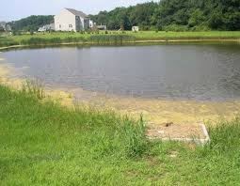
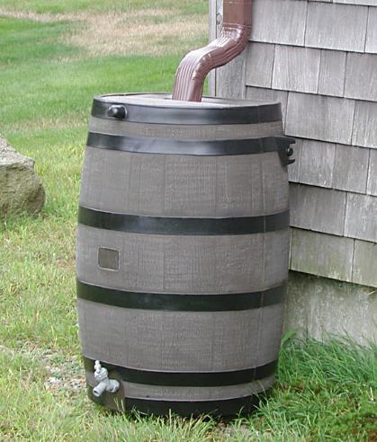
Localized Structural BMPs
Practices that capture upstream drainage at a specific location
May use a combination of detention, infiltration, evaporation, settling and transformation to manage flow and remove pollutants
Notes:
Examples of localized or point BMPs include constructed wetlands, infiltration basins, bioretention structures, rain gardens and rain barrels, and wet and dry ponds.
These methods all capture and treat runoff at specific points in the watershed.

Slide 8
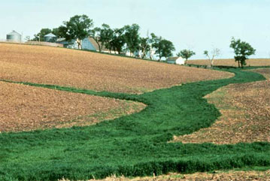
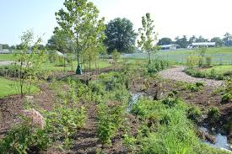
Linear Structural BMPs
Grassed Waterway, NRCS Wisconsin
Riparian Buffer, Univ. of Kentucky
Practices that have a narrow linear shape adjacent to stream channels
Provide filtration of runoff, nutrient uptake, and added benefits such as stream shading, wildlife habitat and aesthetic value
Notes:
A linear BMP is located adjacent to stream channels and therefore has a narrow, linear shape.
These BMPs can provide runoff filtration, nutrient uptake and added benefits, such as stream shading, wildlife habitat and aesthetic values.
Examples of linear BMPs include grassed swales, infiltration trenches, vegetated filter strips and enhanced riparian buffer zones.

Slide 9
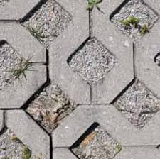
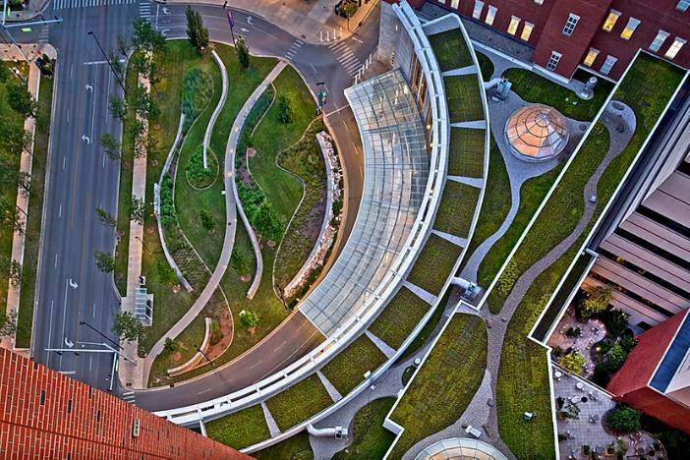
Area Structural BMPs
Permeable Pavers
Green Roof at UK Chandler Medical Center, Scott Pease Photography
Land-based management strategies that affect impervious area, land cover and pollutant input
Notes:
Broader, land-based strategies manage runoff from larger, less-defined areas.
Examples of area BMPs include green roofs, porous pavement and preserved natural areas.

Slide 10
Different ways to present the BMPs….
Pollutant Type
Point Source vs Nonpoint Sources
Structural vs Non-Structural Approaches
General Land Use Types
Agricultural
Wastewater Treatment
Urban/Stormwater
Mining
Forestry
Stream and Floodplain Restoration
Subsequent Sections of Module 4: Land Use and Related BMPs
Notes:
As I’ve noted, there are a multitude of ways to categorize water quality best management practices.
Practices could be grouped in the following ways:
1) Type of pollutant that is targeted and addressed, such as Sediment, Organic enrichment, Nutrients, Pathogens, or Habitat Impairment
2) Source of pollution – practices that focus on addressing either Nonpoint sources or Point sources
3) Type of Strategy – Structural or Non-structural approaches
Structural controls are built facilities that capture runoff, treat it through chemical, physical or biological means and discharge the treated effluent to receiving waters, groundwater or conveyance systems. Examples – stormwater detention basin or a covered livestock manure storage area
Nonstructural controls typically involve changes in activities or behaviors and focus on controlling pollutants at their source. Example – erosion control plans, septic system maintenance education
4) Land Use Type – practices that are used to address activities involved in a specific land use (i.e., urban/stormwater, agricultural, forestry, wastewater treatment, resource extraction, etc.)
The subsequent sections of this module will outline the practices primarily by land use type, with some differentiation between structural and nonstructural practices.

Slide 11
Steps to Select Management Practices
Inventory existing management efforts ✓
Quantify the effectiveness of current measures ✓
Identify critical areas in the watershed where additional management efforts are needed ✓
Identify new management opportunities
Identify possible practices
Determine relative pollutant reduction efficiencies
Develop screening criteria to determine opportunities/constraints
Rank alternatives and develop candidate management practices
Notes:
Within the watershed planning process, there are also recommended procedural steps in selecting BMPs. Here is an overview of these steps.
1) - The first step in the process is to inventory what has been or is being accomplished in the watershed. Future projects and management practices should augment efforts already under way. This analysis will allow you to determine where modifications are needed to existing programs, practices, or ordinances and where new practices are needed.
2) The next step involves quantifying the effectiveness of existing management efforts. This step will allow you to establish a baseline level of pollutant load reductions that are already occurring and will help guide the selection of additional management practices in targeted areas.
3) (#3 and #4) Based on the pollutant sources, you can locate critical areas where management measures will likely achieve the greatest pollutant load reductions.
Then, you can identify new opportunities for implementing management measures.
4) (#5) Once opportunities for pollutant load reductions are identified, you can match them with candidate management practices, to be used alone or in combination.
5) (#6) This step will involve research into management practice specifications to help you determine which practices have the greatest pollutant removal effectiveness under existing conditions, which may be most feasible, and which practices may be most acceptable to landowners.
6) (#7) After researching candidate management measures and practices, you should have enough information to analyze each management opportunity using screening criteria that you develop. The screening criteria are based on various factors, such as your critical areas, site conditions, and constraints. These criteria will help you sort through the different attributes of each practice so you can select the practices worthy of more detailed analysis.
7) (#8) Then, you can quantify their effectiveness and conduct the associated cost versus benefit analysis and suggest candidate practices for use.
Once you have completed Chapter 4 of the Watershed Plan, you will have already done steps 1, 2 and 3. The other steps in the process still need completion.
This presentation will focus on walking through these steps
Source: USEPA Handbook for Developing Watershed Plans to Restore and Protect our Waters

Slide 12
Notes:
# 7 – Develop screening criteria to determine opportunities and constraints is an important part of the process that is often given inadequate attention
Once you have a list of potential management practices for addressing identified water quality concerns, you need to put them through a review process that includes various screening criteria.
First, looking broadly at critical areas, goals and objectives.
Then, looking more closely at details, such as load reduction estimates, legal requirements, physical constraints, costs and added benefits.
As we will discuss more later and in Module 5 on Likely Partners for watershed planning, the local insights in this phase are crucial. You will need to know where opportunities for BMP installations may be possible on public lands or private property with landowner permission. You also will glean info about feasibility and who is likely to be more willing to collaborate.
After this review and local discussion, you should be able to propose a more refined list of management practices that can be included in your watershed action plan.

Slide 13
BMP Selection Considerations Overview:
Effectiveness at removing target pollutants (load reductions)
Technical Feasibility
Land area and site constraints
Maintenance
Financial Constraints
Cost/cost effectiveness
Legal Hurdles
Community acceptance and support
Impact on Other Resources
Added benefits
Important to consider synergistic effects too!
Notes:
We are going to talk through some of the many factors to consider when deciding which management measures (or BMPs) are realistic for your watershed. This slide provides an overview of these considerations.
Many require localized knowledge of watershed concerns and interests, which is why it is so important to work with the local community to make these determinations.
In addition to their effectiveness at removing targeted pollutants, BMP selection is also based on:
Technical Feasibility
Land area and site constraints – Is there enough space to construct the potential BMP?
Examples: Is the stream too close to the adjacent roadway to allow for a wider vegetated buffer area? Is there sufficient acreage to install a detention basin? Is there enough area with adequate soil to install a septic system drainage field?
Maintenance burden – What is the long-term maintenance requirement of the BMP? Is there a responsible party that is willing to undertake that maintenance? Is that maintenance likely to wear down that partner, causing loss of continuing support?
Financial constraints – Funding resources are critical to successful watershed planning and implementation. When considering and comparing BMPs, find information about the expense of the practice. Are there likely funding sources that could help cover the costs? Or, there may be a way to combine funding sources to achieve BMP implementation.
Legal Hurdles – Some watershed issues may be beyond the scope of what a watershed group can address and may instead require an agency to conduct regulatory enforcement.
Community acceptance and support – Local support and cooperation is crucial to success. Get local input on water quality goals for protection and restoration activities. Are there areas in the subwatershed that are more likely to receive acceptance for potential BMPs? Are there local spokespeople that are willing to communicate the water quality issues and needs to a variety of stakeholder groups in the community?
Impact on other resources – Will the selected BMPs negatively impact other natural resource areas in some way?
Added benefits – Are there any resultant benefits from the BMP that would make it an easier sell for gaining community acceptance? Maybe, the enhanced stream buffer would provide shade along a recreational trail that follows the creek. Or, the stormwater retention pond could serve as a water feature in the local park? Or, the sewer line extension would enable new businesses and restaurants to locate in an area lacking those amenities.
The synergy of multiple agencies, organizations, and individuals working toward a water quality goal cannot be underestimated. It can produce a stronger voice with more justification for getting things done.
Consider a watershed that is being polluted by high bacteria, sediment and nutrient loading from a failing wastewater treatment plant. The state environmental agency may be pushing for upgrades to the treatment plant, but it could be helpful for the local utility to hear that it is also important to its local residents and customers. And, valid data justifying the water quality impacts strengthens this argument.

Slide 14
BMP effectiveness is variable.
Source: www.bmpdatabase.org
Notes:
BMP effectiveness is variable.
Different BMPs perform different functions and have different efficiencies for addressing water quantity and quality concerns.
This graph shows the variability of stormwater BMPs in removing total suspended solids.
The blue plots show the TSS concentrations of the influent entering the BMP, and the green plots show the concentrations in the effluent leaving the BMP.
You can see that there is a lot of variation in results among the same type of BMP with the whisker plots, as well as among the different BMPs.
In general, it seems that bioretention and media filters show bigger reductions in TSS than grass strips or swales.
The flow input rate can cause variance in effectiveness, as BMPs have differences in retention and treatment capabilities depending on flow.
In practice, actual load reductions can also vary depending on such factors as the extent of the practice, existing load level and local features such as soils and hydrology.
Although data on management practice effectiveness can be very limited or unclear, the resources often provide insight on relative performance.
Focus on identifying the practices that will have the greatest likelihood of achieving the watershed goals.

Slide 15
1) Evaluating BMP Effectiveness
Ensure that candidate BMPs will help achieve load reductions in critical area of watershed
How to quantify effectiveness?
Estimates of relative load reductions (useful for screening options)
(low, medium, high)
Published literature values + Spreadsheet calculations
Detailed watershed models
Water quality monitoring (before/after)
Notes:
You can use various approaches to evaluating the performance of BMPs and their ability to achieve needed load reductions.
There are many resources available for preliminary screening of management practices.
(CLICK) Most at least provide estimates of the relative effectiveness of options. These types of simplified resources can help you develop an initial summary of some of the most promising options. You can then add information as you develop a more robust evaluation.
(CLICK) The next simplest approach is to reference published literature values in combination with a simple spreadsheet tool that helps account for estimated pollutant loads, areas treated and percent reductions (or a range of % reductions) expected. The spreadsheet tool can be modified to evaluate multiple scenarios or combinations of BMPs.
Literature values usually provide an average pollutant removal percentage for the BMP type. This is usually based on one or more monitoring studies in which performance was measured using a combination of flow and chemical monitoring.
These values can be difficult to find and may provide a wide range of expected removal rates. This is because the effectiveness of practices in removing pollutants is dependent on many factors, including local climate, design specifications and type of pollutant. The study may not span long enough to capture seasonal variations in precipitation and temperature.
So, when considering literature values, look at the location and climate of the study area, as well as the amount of data collected.
So, these first two simplified options can be appropriate for comparative analysis, but may lack sensitivity to precipitation, seasonal patterns and storm events.
(CLICK) If that level of analysis is needed and adequate data is available, you can also use a detailed watershed model. Models require significant input for the management techniques being considered, but can produce a much more accurate estimate of effectiveness. The field of watershed modeling is developing as new tools are being created to assess the selection, placement and cost of management practices. The selection of a specific model to use is based on the questions you need to answer and the strategies under consideration. In addition to providing a way to assess pollutant loads and evaluating practices, it should ultimately test the recommended approach for the watershed plan.
(CLICK) Water Quality Monitoring is the best way to understand a particular BMP. Usually a BMP is monitored for a limited number of rain events with multiple samples taken for each event. This information can then be used to help refine a watershed model.

Slide 16
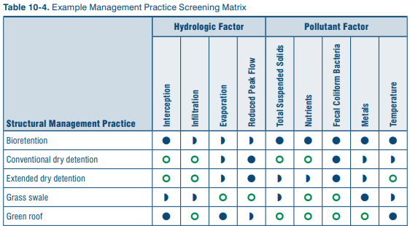
Relative BMP Effectiveness Example
Notes:
As an example of considering qualitative or relative BMP effectiveness, this excerpt from a table in the EPA’s Handbook for Developing Watershed Plans shows how a community can compare urban stormwater BMPs.
Both hydrologic and pollutant removal effectiveness are rated from poor to moderate to high. This allows users to also consider the multiple and complementary benefits of a practice.
For example, the first row provides ratings for bioretention. It rates very well for intercepting flow, and moderate for the other hydrologic functions of infiltration, evaporation and reduced peak flow. But, it’s pollutant removal potential is very good for all categories – nutrients, fecal coliform, metals and temperature.

Slide 17
Literature Value/Spreadsheet Example: Using No-Till Practice to reduce sediment loads
USEPA
Notes:
Or, as in this example, you can use percent load reduction estimates to make rough estimates of total load reductions over an entire watershed.
Suppose your watershed has 10 potential sites where conventional till could be converted to no-till, enabling a 75% reduction in sediment load.
Each site has unique conditions, but you can calculate loading rates for each site, based on variations in slope and soil composition and the area (tons/acre/year in this example).
From this analysis, you can estimate that converting to no-till on these 10 sites will remove approximately 2,672 tons of sediment from the receiving waterbody, reducing the net load to 892 tons/year.

Slide 18
Examples of Watershed Models
For Agricultural Practices: SWAT, AGNPS, GWLF, STEPL
For Urban Practices: SWMM, P8-UCM, STEPL
Mixed Land Use: STEPL, HSPF
Find more info at:
https://www.epa.gov/nps/handbook-developing-watershed-plans-restore-and-protect-our-waters
Notes:
Models tend to specialize in agricultural, urban or mixed land use scenarios, and each has its own strengths and weaknesses.
We will not go into any detail on theses models, but you are encouraged to refer to the EPA’s Handbook for Developing Watershed Plans for more information. They are all described in detail, including the types of practices they consider and their strengths and limitations.

Slide 19
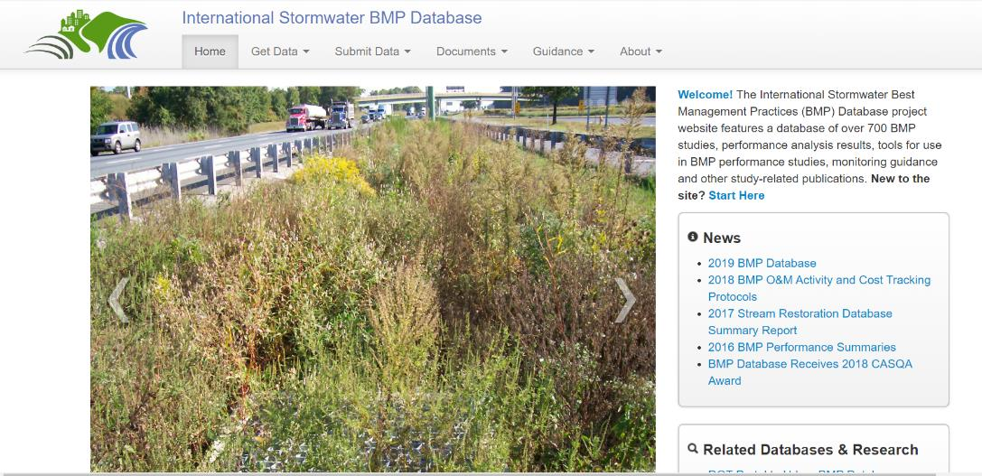
International Stormwater BMP Database www.bmpdatabase.org
Publicly accessible repository for BMP performance, design and cost information.
Provides scientifically sound information to improve the design, selection and performance of BMPs
Notes:
When searching for BMP performance details to use in one of these assessment approaches, one of the more useful resources is the International Stormwater BMP database.
It serves as a clearinghouse of available BMPs and their related performance, design and cost info.
You can also find and submit related scientific research into BMP effectiveness.
It currently includes over 700 BMP studies, performance analysis results, tools for use in BMP performance studies, monitoring guidance and other study-related publications.
On the homepage, you can click on the Start Here link to see the various levels of information provided.

Slide 20
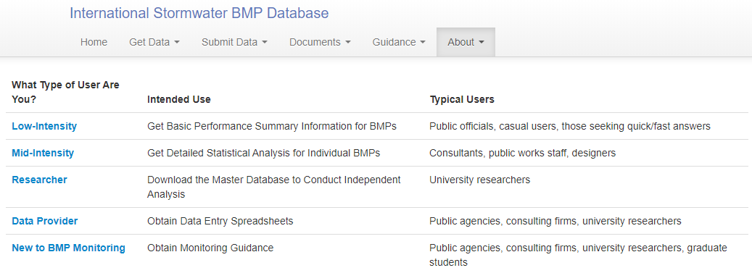
Notes:
(CLICK) Low Intensity users, such as public officials or those needing quick, simple answers, are directed to more basic information, such as the 2016 BMP summary report.
(CLICK) Mid-intensity users, such as consultants, public works staff, or possibly watershed coordinators, are directed to more detailed guidance and research results.
(CLICK) There is also a selection for those who are new to BMP monitoring and possibly want to develop their own study of a practice’s effectiveness.

Slide 21
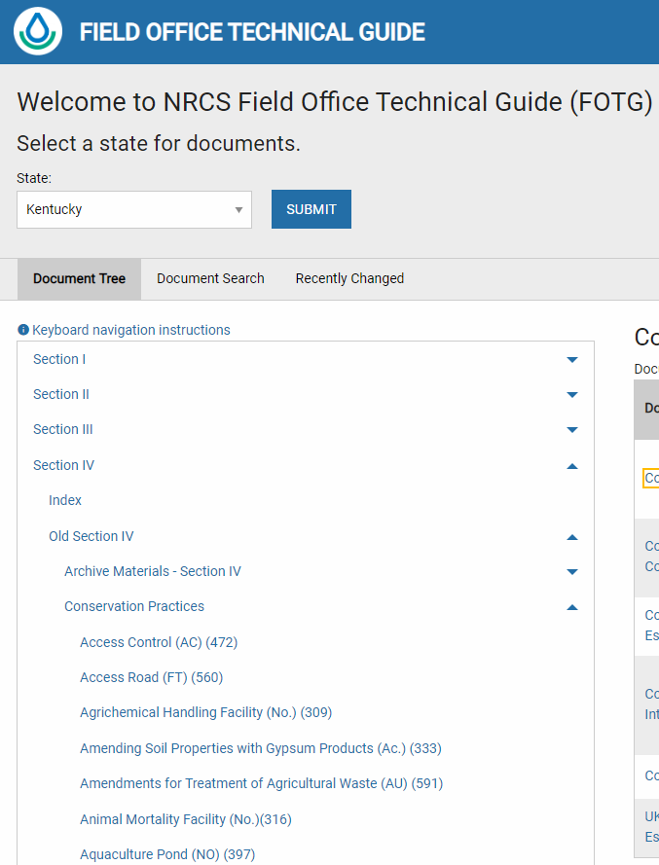
Kentucky NRCS Field Office Technical Guide (FOTG) https://efotg.sc.egov.usda.gov/#/details
Provides summaries of management practices
National Conservation Practice standards should not be used to plan, design or install a conservation practice.
Use standards for your state to insure that you meet all state and local criteria, which may be more restrictive than national criteria.
Notes:
The NRCS also maintains a database of agricultural BMPs, the National Conservation Practice Standards.
Since the national database was developed in the western United States with its unique conditions, Kentucky has its own technical guidance on how practices should most be most effectively installed in the state.
The access to Kentucky’s Field Office Technical Guide is somewhat tricky, since it does not link directly from the national database website (https://www.nrcs.usda.gov/wps/portal/nrcs/detailfull/national/technical/cp/ncps/?cid=nrcs143_026849).
After entering the web address https://efotg.sc.egov.usda.gov/#/details, select:
Kentucky
Section IV
Old Section IV
Conservation Practices
Then, you will see the listing of practices with their associated specifications.

Slide 22
BMP Evaluation
Performance should be evaluated over a wide range of real-world conditions…including varying rainfall events, soil types, and land uses.
Should also consider the volume reduction potential of any BMP both for its own sake and for its impact on total load reduction of pollutants.
Notes:
As we have already mentioned, there are many factors to consider when evaluating and selecting BMPs and they need to be considered over a wide range of real-world conditions.
Evaluating the volume reduction potential of a BMP is critical in assessing its overall performance. One of the primary impacts of stormwater is related to the increased volumes of surface runoff that are a direct result of increased impervious surfaces in urbanized watersheds.
As we previously discussed, increasing impervious surface in a watershed changes the natural hydrology and increases the amount of water transported in surface flow. These changes can have significant impacts on smaller and medium-sized streams and rivers and the riparian areas that protect them. Streambank erosion, channel deformation and down cutting, and loss of natural habitat are among the more common impacts of increased runoff from impervious surfaces. Choosing BMPs that reduce volumes through infiltration and evapotranspiration can be essential to protecting or restoring watersheds.
Volume reduction also can play a significant role in overall pollutant load reduction, which may not be immediately apparent if concentration numbers are compared. When a BMP, such as a rain garden or bioretention practice, captures a portion of incoming runoff and infiltrates it into the soil, the pollutants in that portion are prevented from entering a nearby river, lake, or coastal water. Simply comparing the concentration in and the concentration out does not account for this reduction in the total load of the pollutant that has been reduced.
Source: USEPA

Slide 23
BMP without Volume Reduction
Source: USEPA
Notes:
The graphic illustrates a BMP that removes pollutants but does not reduce the total volume of stormwater treated and discharged.
(CLICK) In this hypothetical example, 1 million liters of stormwater from several storm events are treated by the BMP. The average concentration of the pollutant coming into the BMP is 100 mg/l.
Multiplying volume by concentration provides the total load, 100 kg, of the pollutant coming into the BMP during the storm events.
(CLICK) This BMP does manage to reduce pollutant loading by 50%, but does not reduce the volume of the discharge.
So, the concentration of the effluent is reduced to 50 mg/L, but the overall volume is the same (1 million liters).

Slide 24
BMP with Volume Reduction
Source: USEPA
Notes:
With the addition of volume reduction, you can see a greater reduction in loading.
(CLICK) Here, as with the previous example, 1 million liters comes into the BMP at an average concentration of 100 mg/l, resulting in a total incoming load of 100 kg.
This BMP infiltrates 50 percent of the stormwater, so only 500,000 liters is discharged into the environment.
(CLICK) This BMP also reduces the concentration of the pollutant by 50% to 50 mg/l.
However, the combined effects of volume reduction and pollutant removal result in a greater reduction in load to 25 kg.
Thus, the true performance of this BMP is 75% total load reduction, which is only apparent after considering both of these factors.
Note that if the effluent concentration values (50 mg/l) were compared or if a "percent removal" were calculated using the incoming and outgoing concentrations, the performance of the BMPs would have appeared equal.

Slide 25
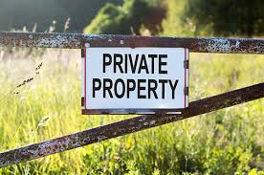
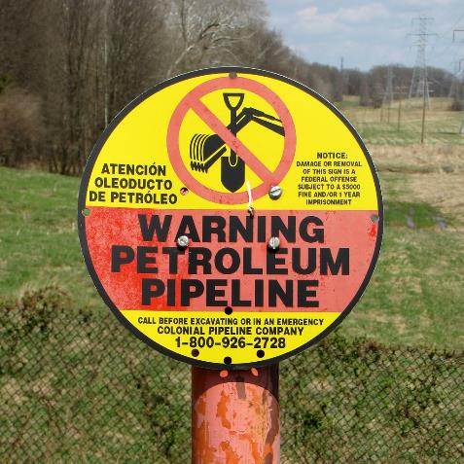
2) Technical feasibility – land area/site constraints
Property ownership – public or private, how many owners?
Property access – for BMP construction and maintenance
Land characteristics – steep slopes, wetlands, high water tables, soil types, open space
Infrastructure – utilities, road crossings, buried cables or pipelines, stormwater outfalls
Site visit recommended with related permitting agencies
Notes:
In addition to reviewing pollutant removal effectiveness, there are many other criteria to consider in reviewing your list of potential BMPs.
One of these is technical feasibility.
A primary consideration is property ownership. If it’s public, that could potentially make the project easier to carry out and fund. If it’s private, you will need to convince the owner or owners.
Site access is another major consideration. Will you be able to freely and safely access the site for BMP construction and maintenance? If you are dealing with a private owner, you may need to obtain written consent in a legal document.
Land characteristics relate to site access feasibility, in that they may make it difficult or dangerous to access the chosen site. If dealing with very wet areas, you may end up creating more harm than good at the site. In contrast, large open areas may be more amenable to BMP installation.
And, it is always important to review on-site infrastructure, such as road crossings, water and sewer lines, natural gas pipelines and buried electrical lines. The presence of these features can make installation unfeasible. Or, there may be infrastructure on site that lends itself to upgrades, such a stormwater outfall that could be retrofitted with enhanced settling features.
It is very helpful to arrange a site visit with relevant permitting agency staff who can point out some of these issues for you.

Slide 26
3) Financial constraints
Consider feasibility of both short and long-term costs
Short term Installation
Long-term Continued operation and maintenance
BMP cost estimates available in guidance manuals
Cost efficiencies between comparable BMPs
Can develop comparison metrics
Pounds/Acre/Year of X removed
$/Acre Cost of BMP
$/Pounds of X removed
Notes:
You will also need to consider both the short-term installation costs and longer-term operation and maintenance costs of the BMPs under consideration.
These estimates may be available in guidance manuals, such as those mentioned earlier for stormwater and agricultural practices, or from other clearinghouse sources, such as the Center for Watershed Protection or USEPA.
You should use local or regional cost estimates when possible. Otherwise, use most recent national estimates.
You can also use cost estimates to further develop BMP comparison metrics by calculating the per unit cost of pollutant removal.
Using the area cost of the BMP (e.g. $/acre), you can deduce the unit cost of removing the pollutant (e.g., $/pound of X removed).

Slide 27
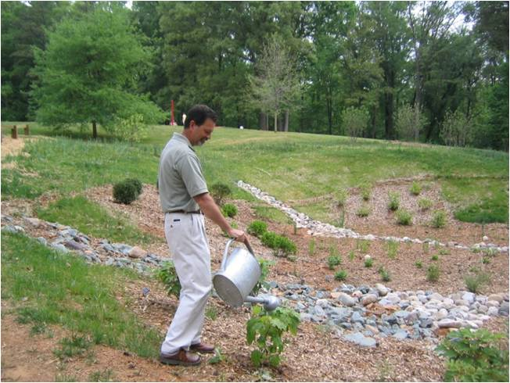
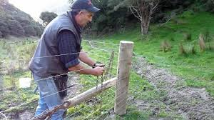
Maintenance requirements
In order to ensure effectiveness, proper BMP maintenance is critical.
Includes both routine, scheduled maintenance, and emergency repairs that may be needed after storm events.
Maintenance is usually the responsibility of the BMP property owner (unless the MS4 agrees to it).
Chesapeake Stormwater Network
Notes:
Most BMPs will require ongoing maintenance to ensure their continued effectiveness. Consider who will be responsible and how to ensure that it takes place.
Maintenance of BMPs on private property is usually the responsibility of the property owner, but MS4-permitted communities assume responsibility for structures on private properties.

Slide 28
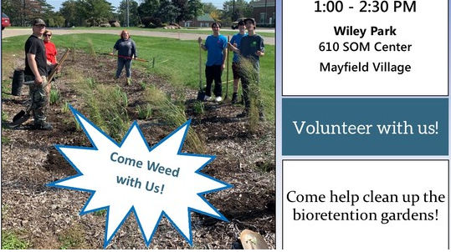
Common Maintenance Concerns
Inflow/Outflow issues
Dewatering/Clogging
Undesirable vegetation
Sediment erosion/deposition
Trash
Flow path problems
Structural failure
Cuyahoga Soil and Water District
Notes:
Sometimes green infrastructure gets a bad rap because the practices are not maintained and therefore do not function properly. For this reason, some communities limit their use.
To avoid problems and encourage use of green infrastructure, maintenance requirements and agreements are essential and should be agreed upon at installation. This photo shows an example of a bioretention area or rain garden that needs weeding to keep it attractive and maintain public support for this practice.
Other examples of maintenance concerns that need to be addressed are:
Inflows and outflows to slow or too fast
Drainage or clogging issues
Undesirable vegetation, such as weeds or invasive species
Too much sediment eroding into or out of the BMP
Trash that is carried in and trapped, becoming unsightly or interfering with practice effectiveness
Diverted or improper flow path into or out of practice can also diminish effectiveness
Structural failure of the practice
Ultimately, if maintenance issues continue, you may decide that the practice is inappropriate for the site.

Slide 29
4) Legal/Regulatory Requirements
Identify legal or regulatory requirements
Are permits required?
(i.e., USACOE 401/404 stream disturbance or dredge and fill)
Do floodplain regulations affect the project?
Is the project impacting a wetland and thus may be prohibited?
Does a local stream buffer ordinance prohibit the near-stream activity?
Is a conservation easement needed from private property owners?
Or, if publicly owned, who needs to approve it?
* Site visits by regulatory staff can be very helpful!
Notes:
You will also need to identify any legal or regulatory requirements and whether or not these pose significant constraints for the BMP under consideration.
For example, if the BMP involves work in the stream channel, you will be required to obtain a section 404 permit from the U.S. Army Corps of Engineers and a 401 permit from the state for “dredge and fill” activities.
Again, it is helpful to invite potential regulatory agency staff to a site visit to help with identifying legal hurdles to BMP implementation. Module 5 of the Kentucky Watershed Academy will provide more insights from partnering agencies and organizations on this topic, as we will be hearing from representatives about their programs and the technical and financial assistance that they may be able to provide.

Slide 30
5) Community Support
How is practice perceived by nearby landowners?
Will it cause nuisances, such as ponding of water, weed growth or mosquito populations?
Can issues be addressed though strategic placement, design and education and outreach?
Can you involve residents in the BMP selection and design process?
Compatibility with other local planning objectives?
Notes:
Ultimately, community support and social acceptance can really help drive which BMPs are utilized.
How is the practice perceived by nearby landowners? Is there support or resistance?
If it’s resisted, why? Are there potential nuisances associated with it that need to be explained or addressed such as ponded water, weed growth or mosquito outbreaks?
Is it possible to address some of these issues through more strategic practice placement (i.e., away from busy neighborhoods) or adding recreational features to draw people in and help them better understand and feel comfortable with the practice?
Can you involve residents in open discussion activities that help tailor project selection and design to local sensibilities?
And, is the BMP project compatible with current planning objectives?

Slide 31
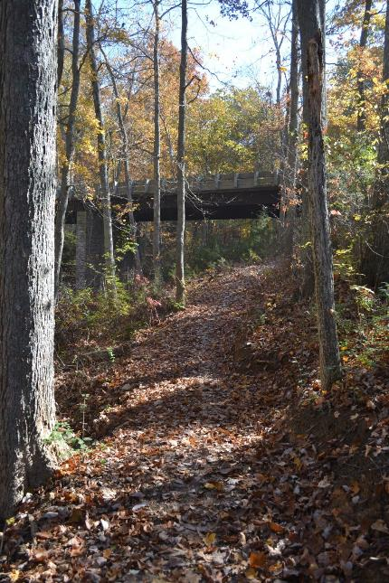
6) Added benefits or synergistic effects…
May be effective at controlling multiple pollutants
May add habitat benefits
May enhance outdoor recreation features
…Or, 7) unintended impacts
May inadvertently increase generation, transport or delivery of another pollutant
The Parklands Trail, Louisville, KY
Notes:
Some practices may help reduce pollutants in addition to those targeted. These secondary or added benefits can help make a BMP more favorable in the selection process.
For example, erosion control measures for reduced sediment loading can also reduce phosphorus that is adsorbed to silt and clay particles. Therefore, an erosion control practice such as grassed buffer strips may help reduce sediment loads, as well as the transport of particulate phosphorus.
Habitat enhancement is another potential secondary benefit of some BMPs.
For example, a riparian buffer to reduce sediment and nutrient loading can also create a habitat corridor for birds and other wildlife, as well as providing shading for the stream and possible recreational features.
OR, while reducing the targeted pollutant, a practice may inadvertently increase the contributions of a different pollutant.
An example would be the use of conservation tillage to reduce soil erosion. This practice can create larger soil pore spaces, or porosity, which enables increased nitrate leaching through the soil. In these situations, it is especially important to be mindful of the amount and timing of fertilizer additions to crops.
Or, a stormwater BMP could exacerbate peak flows if the timing of its stormwater release coincides with delayed upstream flows.

Slide 32
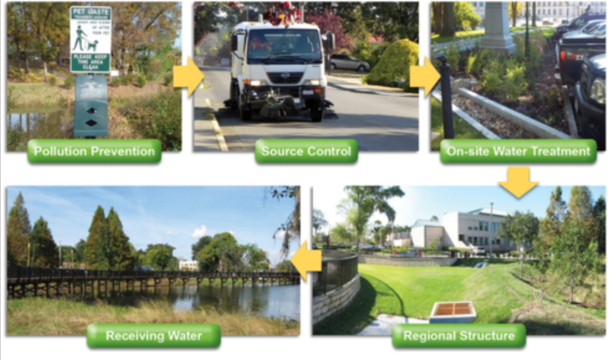
BMP Effectiveness: Treatment Trains or Management Systems
The use of two or more practices to more effectively achieve load reductions.
Source: Minnesota PCA
Notes:
Multiple BMPs can be combined to achieve greater load reductions. When the same runoff is treated by more than one practice, the configuration is referred to as a treatment train.
This approach may apply to on-site and regional BMPs that work together to remove pollutants using combinations of hydraulic, physical, biological and chemical methods.
In this example, several approaches are used to reduce pollutants before the water enters the receiving waterbody.
Pollution Prevention is encouraged by pet waste collection stations.
Source Control is achieved through street sweeping.
On-Site Treatment is accomplished through parking lot bioinfiltration areas.
A Regional Structure allows additional infiltration and settling before the water flows into the Receiving Water.
It is important to realize that the effectiveness of treatment train practices is not necessarily cumulative. A second practice may treat an already reduced load after the runoff has been pre-treated, so it is inaccurate to simply add associated load reductions to predict an overall reduction.

Slide 33
Ranking Candidate BMPs
Assumptions:
Practices will be installed and maintained properly
Public outreach and education can encourage adoption of practices
Notes:
Once you have collected all of this information, it may be helpful for you to create a ranking table with the criteria you’ve considered.
This example provides subjective rankings of 1 to 4, with 1 being the lowest rating and 4 the highest. It assumed the proper installation and maintenance of BMPs and accompanying education and outreach to encourage adoption.
Averages of BMP scores can help with selecting practices to implement.
You can present these summary scores to your stakeholder groups to assist them with the final selection process.
If they disagree with some of the ratings, be sure to make changes to reflect the local input.

Slide 34
Who should be at the table?
Community residents and interest groups
City/county leaders
Relevant agency staff depends on the land uses in the watershed
Water/wastewater utilities - State Environmental Agency
Agricultural agencies - State/District Transportation
Health department
Parks and Recreation department
Stormwater manager
School leaders and teachers
Notes:
We will delve further into the stakeholder partnership discussion in the next module on Chapter 5, but it is important to include these groups and individuals in the BMP selection process.
First and foremost are local leaders and community residents. Watershed projects should be community-driven to better ensure their long-term acceptance and success.
When making BMP decisions, it is also important to have representatives present who can answer questions that may arise about construction, maintenance, cost or other issues.
For example, if some in the farming community are not familiar with a proposed practice, it would be helpful to have a Soil Conservation District representative or NRCS agent present to explain how it works and help increase familiarity and confidence in using it. The better that you ensure initial questions and concerns are adequately addressed, the more likely the practice will be implemented.

Slide 35
Evaluate Candidate BMPs to Select Final Strategies
Models and spreadsheets can help refine load reduction and cost estimates for final evaluation.
Notes:
In the final selection process, you will evaluate the candidate practices using either a spreadsheet or modeling tools to evaluate relative load reductions, costs and benefits, social acceptance and other criteria to come up with your listing of final management strategies.

Slide 36
Other considerations…
When developing BMPs for watersheds with multiple sources,
be sure that BMPs address each source and are complementary.
Work from upstream to downstream for greater impacts. Headwater practices are more likely to show benefits without added interference from upstream sources. Progress builds on success!
BMPs can be adapted and installed as needed in a downstream progression.
Notes:
When developing BMPs for watersheds with multiple sources, make sure that your final selections address all major sources and are complementary.
By working from upstream, headwater areas to downstream areas, you may be able to demonstrate earlier successes than can help build support for continued efforts.
Downstream projects can be adjusted and developed based on previous, headwater results.

Slide 37
In summary…
Limited resources
available for watershed protection and restoration.
Important to identify and select the Best Management Practices that most effectively and efficiently achieve water quality goals.
Notes:
In summary, a watershed planning mindset recognizes the limited resources of time, people and money, with the aim being to select the most effective and efficient solutions to achieve water quality goals.
Being mindful of these general, overarching considerations will help in making realistic recommendations for your watershed area.

