Slide 1
Watershed Academy
Watershed Coordinator Training Series
Land Use Impacts &
Related Best Management Practices
7. Mining BMPs

Slide 2
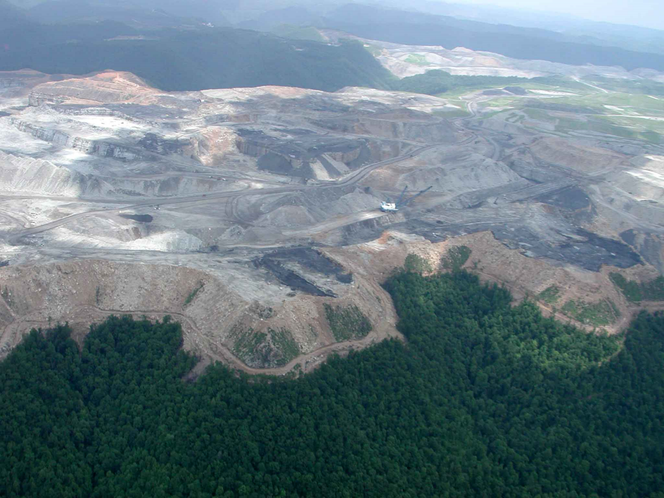
Mining has expansive impacts…
Notes:
The expanse of coal mining operations in the landscape can have a profound impact on water resources, both within the area of activity and well downstream of it.

Slide 3
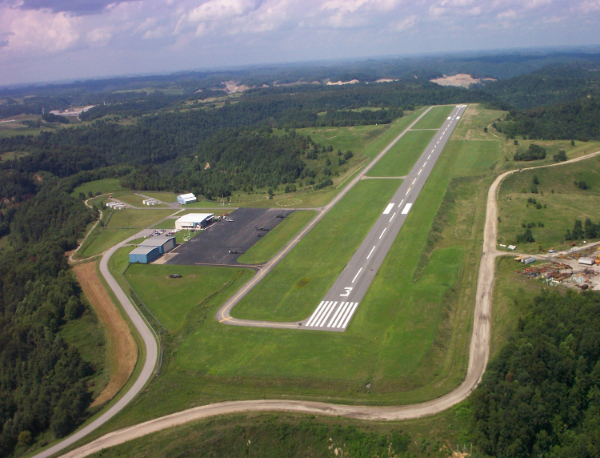
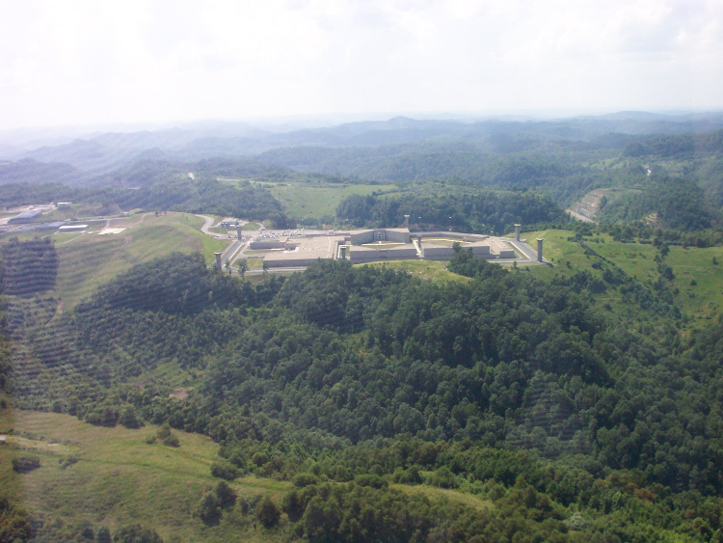
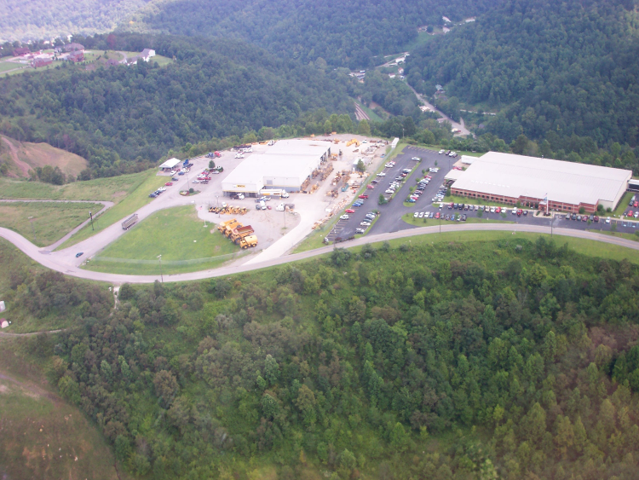
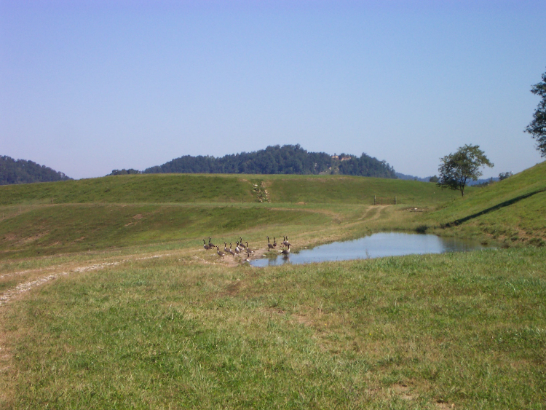
… and restored land can have great benefits
Notes:
It has also created large areas of flat land for development and wildlife habitat in the mountainous region of Eastern Kentucky.
Schools, industry and airports are some of the uses that have been made on abandoned mine lands in Kentucky.
Post-mining lands have also become wetland areas for waterfowl and habitat for reintroduced native elk populations.

Slide 4





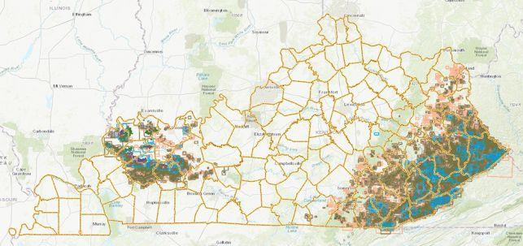
Mining in Kentucky
Source: Kentucky Geological Survey
Notes:
Resource extraction, primarily coal mining, is conducted in the far western and eastern regions of the state, so these BMPs will be most relevant to watershed professionals in these areas.

Slide 5
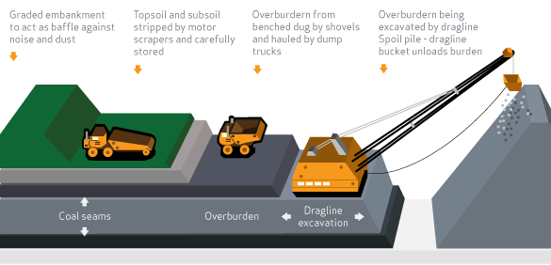
General Surface Coal Mining Process
Topsoil and subsoil stripped, removed and stored. Overburden of rock and soil broken up using explosives, then dug and hauled away, or excavated by dragline to spoil pile.
www.worldcoal.org
Notes:
There are many types of mining, but the main two categories employed in Kentucky are surface mining and underground mining. The mining method is largely dependent on the geology of the coal deposit.
Surface mining is employed when the coal deposit is (obviously!) near the surface of the land. This type of mining can recover larger percentages of coal seams and can cover broad expanses of land using a variety of large-scale equipment. (see graphic)
The general surface mining process includes the following steps:
The overburden of rock and soil is broken up using explosives, then removed using draglines or by shovel and truck.
Once the coal seam is exposed, it is drilled, fractured and mined in strips.
The coal is then loaded on to large trucks or conveyors to be carried away to a coal preparation plant or for direct use.
Sources:
worldcoal.org/coal/coal-mining
https://www.epa.gov/sc-mining/basic-information-about-surface-coal-mining-appalachia

Slide 6
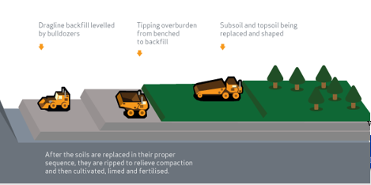
Surface Coal Mining Process (continued)
During or after coal is removed, stored overburden and soils are replaced to approximate original land contours. Soils may need to be “ripped” to relieve compaction before being seeded for revegetation.
www.worldcoal.org
Notes:
4) As part of the rehabilitation and reclamation process, stored overburden and soils are replaced to approximate original land contours while mining is ongoing or soon afterward.
The soils may then need to be “ripped” to reduce compaction before planting with grasses, trees or other vegetation.
The two main types of underground mining are room-and-pillar and longwall mining. In room-and-pillar, a network of “rooms” are cut into the coal seams, leaving behind “pillars” of coal to support the roof. Longwall mining removes the entire face of a coal seam section using mechanical shearers. The face can range from about 100 to 350 meters. Temporary, hydraulic supports hold up the roof of the seam while coal is being extracted. Once mining is complete, the roof is allowed to collapse.

Slide 7
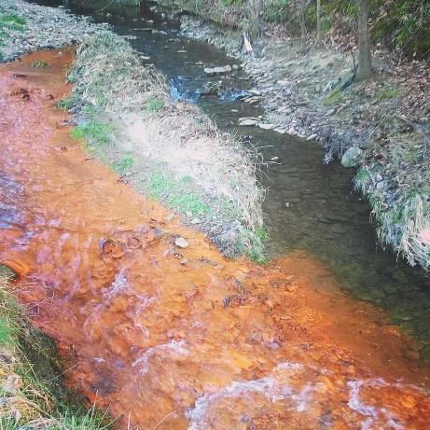
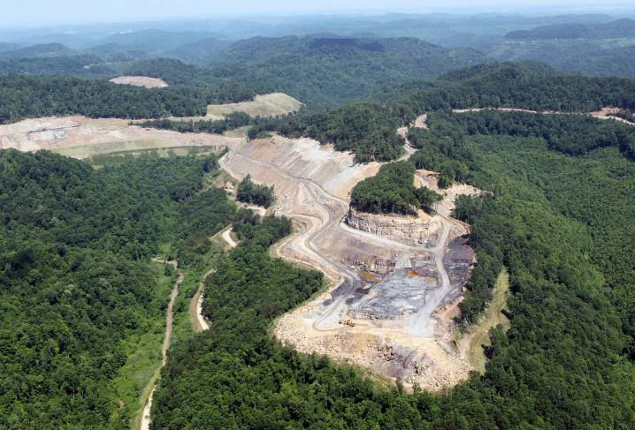
Water Quality Pollutants of Concern
Metals
Conductivity
pH
Sulfate
Sediment
Notes:
Mining activities can have varied and long-lasting impacts on water quality.
Drainage from mined lands can contribute high levels of metals, such as iron, manganese, aluminum, arsenic, copper and lead to receiving waterbodies.
These metals and other contaminants can raise the conductivity of the water, harming aquatic life.
The oxidation of ferric sulfide (FeS2) and other substances can result in acid mine drainage with very low pH levels. A low pH is harmful to aquatic life, as well as other life forms that come in contact with it.
Sulfate is also typically associated with coal resources in Kentucky and runoff from mined sites can carry high concentrations into waterways.
Sulfate can bond with water to form sulfuric acid, which can further lower the water’s pH.
High sulfate concentrations can also cause drinking water to have a bitter taste and may have a slight laxative effect. Other animals, such as cattle, are also sensitive to high levels of sulfate in water. Sulfate levels about 250 mg/L can corrode metal plumbing, especially copper pipes. So, less corrosive options, such as plastic piping, are often used in these areas.
And, like construction and forestry operations, mining disturbs large areas of soil and sediment that can be carried to nearby waters.

Slide 8
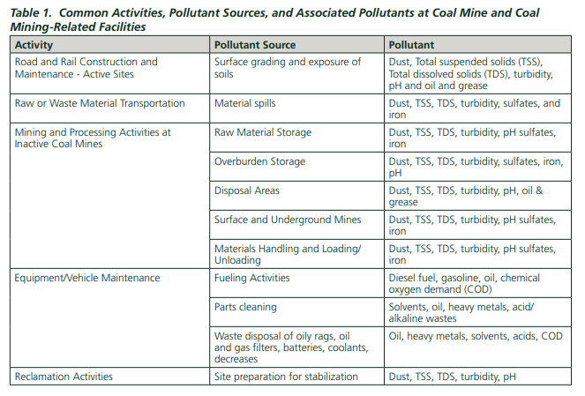
Source: USEPA
Notes:
This table, taken from a USEPA document, lists categories of mining activities with some of the expected pollutants and their sources.
Dust, total suspended solids, turbidity and pH are common to most of the activities. Oil, fuels and other chemicals are contributed by equipment use and maintenance activities.
Source:
https://www.epa.gov/sites/production/files/2015-10/documents/sector_h_coalmines.pdf

Slide 9
Surface Mining Control & Reclamation Act (SMCRA), 1977
Most coal mining areas are subject to erosion and control measures under SMCRA as it relates to the following:
Hydrologic Balance – addresses discharges, including NPDES requirements
Sediment Control Measures – must be designed, constructed and maintained using best available technology to prevent contributions of sediment to streamflow or runoff outside permit area
Discharge Structures – discharges from sediment ponds, impoundments and diversions must be controlled by energy dissipaters, riprap channels, etc. to minimize disturbance to hydrologic balance
Notes:
There are many laws that apply to coal mining activities, but we will just cover a few of the more important ones that relate to water quality protection.
The Surface Mining Control and Reclamation Act (SMCRA) was passed in 1977 with dual goals of promoting coal mining to provide the country with this fuel source, while also minimizing the environmental impacts of the mining process.
SMCRA addresses erosion and control measures as they relate to hydrologic balance, sediment control and water discharges.
In Kentucky, the Division of Mine Reclamation and Enforcement (DMRE) is responsible for inspecting all surface and underground coal mining permits in the state to assure compliance with SMCRA.
The DMRE is also responsible for regulating and enforcing the surface mining reclamation laws for non-coal mining sites in the state, including limestone, sand, gravel, shale and the surface effects of dredging river sand and gravel.
DMRE works closely with two other agencies within Kentucky’s Department for Natural Resources (DNR), the Division of Mine Permits and the Division of Abandoned Mine Lands to ensure that all established standards of operation are addressed and that the public and the environment are protected.

Slide 10
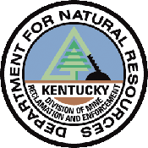
Mining Requirements for Water Quality Protection
General Mining Permit/Mining & Reclamation Plan
(KY Division of Mining and Reclamation Enforcement)
CWA 404 Permit (U.S. Army Corps of Engineers)
401 Water Quality Certification (KY Division of Mining Permits)
Stream Restoration or Mitigation Plan (KY Division of Water)
Kentucky Pollutant Discharge Elimination System (KPDES) Permits (KY Division of Water, Surface Water Permits Branch)
DMRE checks for compliance, notifies KDOW if investigation and enforcement are needed
Notes:
Coal mining permits applications to Kentucky’s Dept. for Mining Reclamation and Enforcement must include a Mining and Reclamation Plan.
A Clean Water Act Section 404 permit is frequently required from the U.S. Army Corps of Engineers, since it is needed for most proposed discharges of dredged or fill materials into waters of the U.S.
When 404 permits are required, a state-issued 401 permit is also needed. The Clean Water Act Section 401 Water Quality Certification program in Kentucky ensures that activities which may result in a discharge into waters of the Commonwealth which require a federal permit or license are consistent with Kentucky’s water quality standards (401 KRA Chapter 5). The Energy and Environment Cabinet has authorized the Department of Natural Resources to issue individual water quality certifications related to surface coal mining operations.
And, when mining operations result in permanent stream loss, a stream restoration or mitigation plan must be submitted to the Division of Water. When proposed disturbances include one acre or more of jurisdictional wetlands, a wetlands mitigation plan is also required.
The Kentucky Division of Water is responsible for reviewing and issuing KPDES permits. The KPDES requires a BMP plan and its components are described in the permit.
DMRE conducts the associated monitoring for KPDES permit compliance and notifies KDOW if there are any discharge violations. KDOW is then responsible for investigating and enforcing the permit.

Slide 11
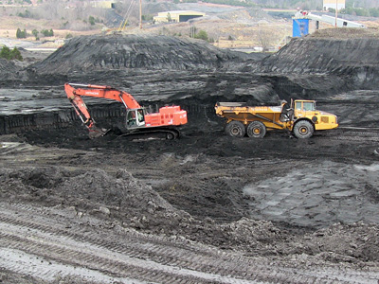
Mining and Reclamation Plan
BMPS are required by KY Law and Regulations:
  1990 Kentucky Surface Mining Law
  Permanent Program Regulations for Surface Coal Mining and Reclamation Operations and Coal Exploration Operations
Includes sections that address:
Topsoil handling
Backfilling and grading
Spoil disposal
Acid and toxic material handling
Surface water control and monitoring
Ground water control and monitoring
Revegetation
Each of these sections specifies the BMPs the operator intends to use to meet regulatory performance standards.
Notes:
As required by 1990 Kentucky Surface Mining Law and related regulations, mining permit applications must contain a Mining and Reclamation Plan.
This plan includes sections covering topsoil handling, backfilling and grading, spoil disposal, acid and toxic material handling, surface and ground water control and monitoring and revegetation.
Each section contains associated BMPs that the operator intends to use.
The terms of the mining permit must be met throughout the mining process, including site preparation, mining and reclamation and the 5-year period of extended responsibility.
Photo: Kentucky AML website, https://eec.ky.gov/Natural-Resources/Mining/Abandoned-Mine-Lands/Pages/AML_Pilot_Program.aspx

Slide 12
Kentucky Coal Mining Practice Guidelines for Water Quality Management (March 1996)
Document includes guidance for practices to be used before, during and after mining
Recommends structural and nonstructural methods that minimize the movement of debris, sediment and acid drainage from the land to surface and ground water.
“The best way to prevent pollution of streams with debris, sediment and acid drainage is to keep rainfall runoff and ground water away from debris, bare soil, and acid spoil.”
https://eec.ky.gov/Environmental-Protection/Water/Reports/Reports/NPS9215-CoalBMPs.pdf
Notes:
In 1996, Kentucky developed a guidance document for BMPs to protect water quality from mining land uses. This document is still in use today and recommends a variety of structural and nonstructural practices to control pollution from debris, sediment and acid drainage.
A central tenet of this document states that “The best way to prevent pollution of streams with debris, sediment and acid drainage is to keep rainfall runoff and groundwater away” from these materials.
The BMPs that follow relate to this overriding concept.

Slide 13
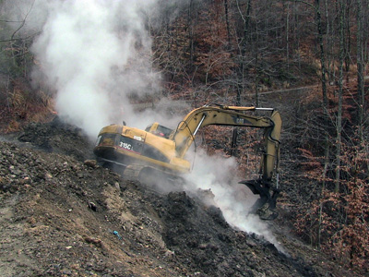
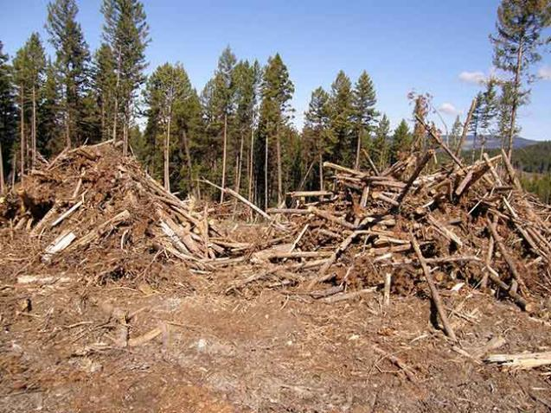
Pollutant: Woody Debris
Clearing and Grubbing – site preparation during which trees and brush are removed
May be chipped for mulch, burned or incinerated or allowed to decompose through windrowing
Should not be placed where it can clog streams
Notes:
Woody debris results from site preparation before mining occurs. Clearing and grubbing refers to the removal of trees and brush from the land surface to allow equipment to access coal layers beneath the ground.
The resulting debris is typically chipped for mulch, burned or incinerated or may be stacked in windrows to be composted.
It should not be placed in streambeds, where it alters water flow and quality.

Slide 14
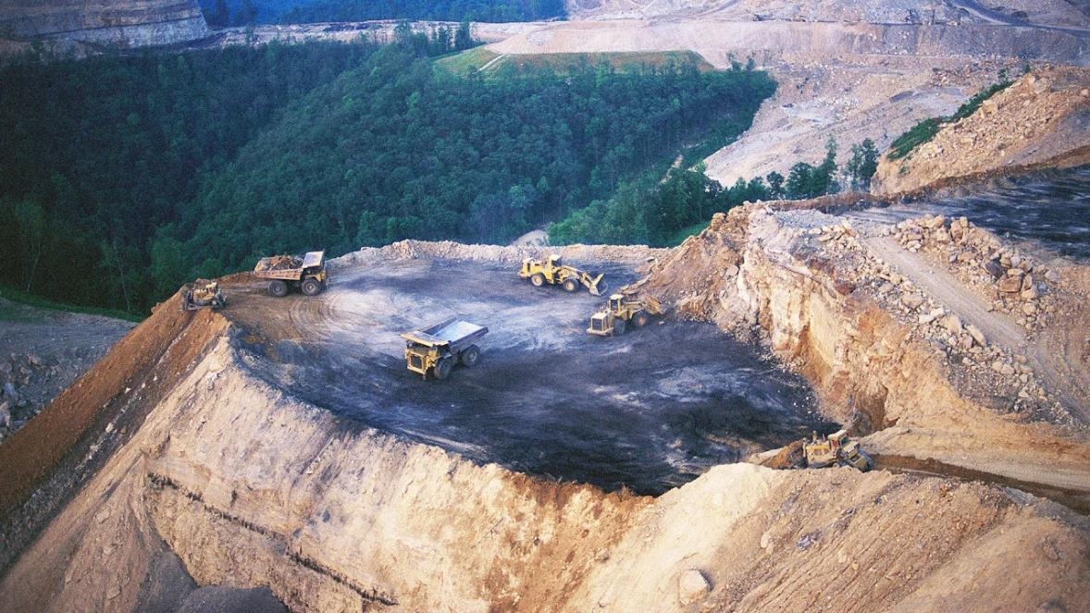
Pollutant: Sediment
Disturbances that include the removal of vegetation and earth moving can accelerate erosion.
Notes:
The main sources of sediment and soil erosion associated with surface mining include:
haul and access roads
areas of active mining
areas being cleared for mining activities, and
areas in the process of reclamation.
As with any activity involving soil disturbance, it is best to think of prevention through the use of erosion control measures.
This reduces threats to water quality, reduces the need for more costly reclamation or restoration, and prevents a valuable natural resource (soil) from becoming a pollutant.

Slide 15
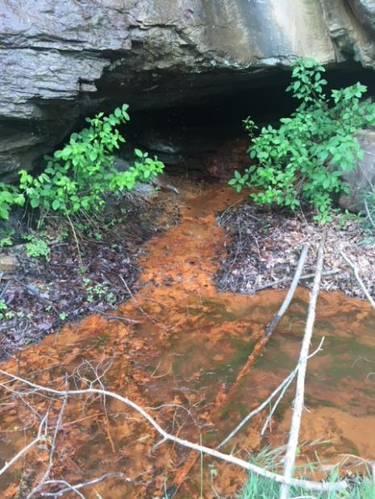
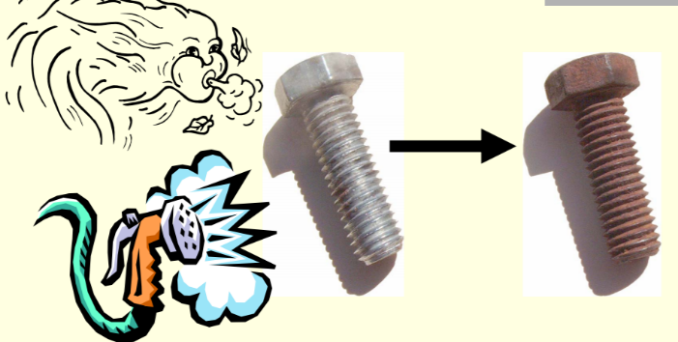
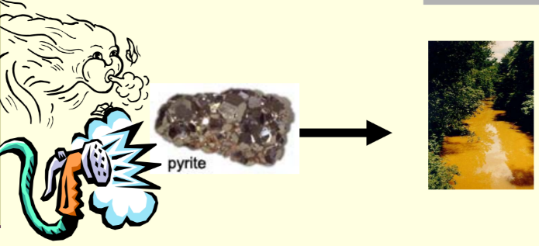
Pollutant: Acid Mine Drainage (AMD)
Similar to rust forming…
Pyrite + Water + Oxygen Iron Hydroxide + Acidity + Sulfate
FeS₂ + H₂0 + O₂ Fe(OH)₃ + H⁺ + SO₄
Notes:
Acid mine drainage results from a process similar to that of rust forming on an iron screw. When the iron is exposed to water and air, it rusts.
Pyrite (or “fool’s gold) is a mineral commonly found in mines that contains iron and sulfur as ferric sulfide. When it is exposed to water and air, it forms the orange-colored iron hydroxide, acidity (H+ ions) and sulfate.
Sulfate can bond with water molecules to form sulfuric acid or can attach to calcium atoms to form a gypsum sludge. Elevated sulfate levels are often found in AMD discharges.

Slide 16
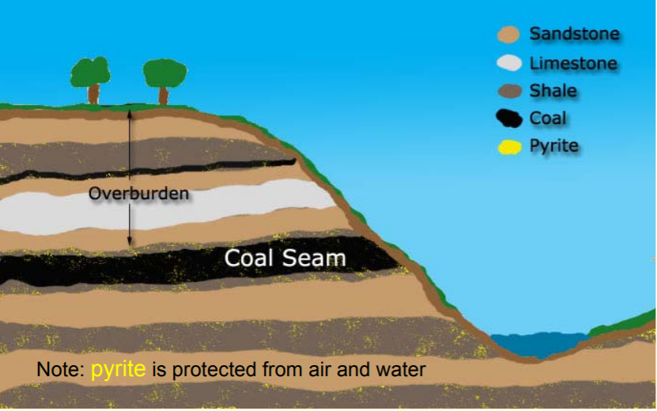
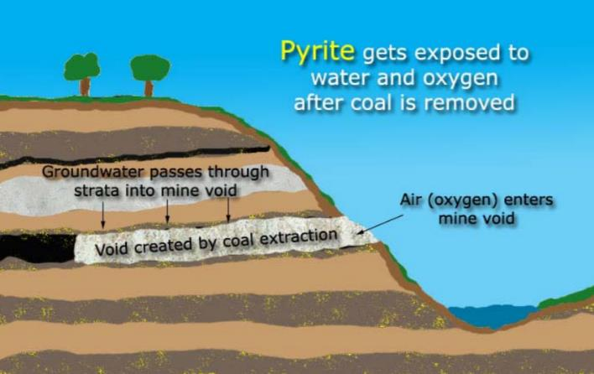
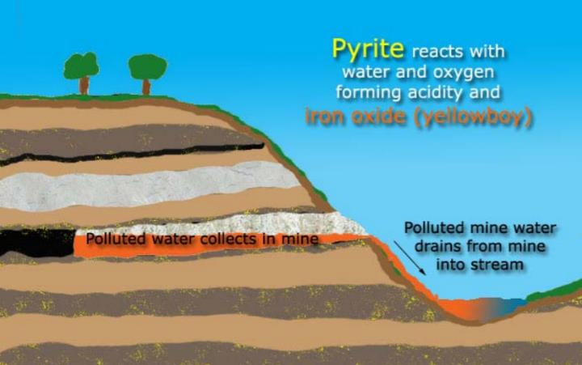
Pollutant: Acid Mine Drainage (AMD)
Before Mining
After Mining
Groundwater Discharge
Source: Western Pennsylvania Coalition for Abandoned Mine Reclamation
Notes:
These graphics depicting the AMD formation process were developed by Western Pennsylvania’s Coalition for Abandoned Mine Reclamation.
You can see that pyrite is buried beneath layers of stone, dirt and coal until mining exposes it to air and groundwater.
Iron hydroxide shows up as an orange sediment that coats the bottom of streams and limits light penetration into water. It can smother aquatic life and destroy stream habitat.
Acidity, or a lowered pH, can be toxic to aquatic organisms and may cause other metals to dissolve more readily and become available.
For instance, clays are typically high in aluminum. When clay is dissolved by acidity, it can release aluminum into runoff water. It appears as a white solid and may be visible as a coating on rocks or cloudiness in the water. Aluminum can also be toxic to aquatic life.
Source: Ask Me About Pyrite! The formation of polluted mine water, Western Pennsylvania Coalition for Abandoned Mine Reclamation
http://www.amrclearinghouse.org/Sub/education/AskMeAboutPyrite/AskMeAboutPyrite.pdf

Slide 17
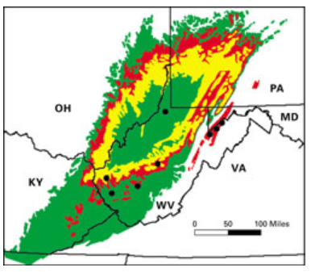
Not all mine drainage is acidic!
May be called…
Neutral mine drainage
Mining-influenced water
Contaminated mine drainage
Metalliferous drainage
But, frequently still referred to as AMD.
Low AMD potential
Intermediate potential
High potential
Source: USGS
Notes:
AMD may be used generally to refer to mine drainage, but it is important to note that it is not always acidic. It may be neutral or even basic, depending on the characteristics of the surrounding bedrock and coal seams.
Drainage from mines is particularly acidic in Pennsylvania, Ohio, northern West Virginia and Maryland. In Kentucky, West Virginia and Virginia, mine drainage is far less likely to be acidic. However, other contaminants, such as manganese and selenium, may be problematic.
In cases where drainage from mined land is not acidic, it is referred to as neutral mine drainage or mining-influenced water.
In situations where it still contains high metal concentrations, it may be referred to as metalliferous drainage. And, this type of water may still have an alarming orange precipitate of iron, but not have the assumed low pH.
Source: Coal Extraction – Environmental Prediction, Fact Sheet 073-02, Cecil, C. Blaine and Susan J. Tewalt

Slide 18
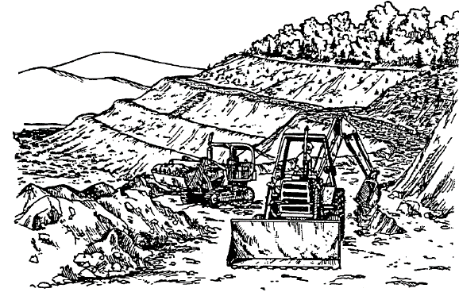
Mining Activities Addressed by KY Mining BMPs
Mine Drainage Treatment
Topsoil and Overburden Handling
Roads
Revegetation
Notes:
Kentucky’s guidance document provide recommendations for managing four types of coal-mining related activities—mine drainage treatment, roads, topsoil and overburden handling and revegetation.
We will review some of the Mine Drainage Treatment and Topsoil and Overburden Handling BMPs.
Procedures for road construction and maintenance and post-mining revegetation are very similar to those used at other types of construction sites and lands used for timber harvesting.

Slide 19
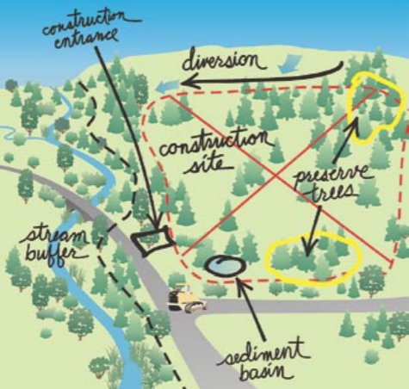
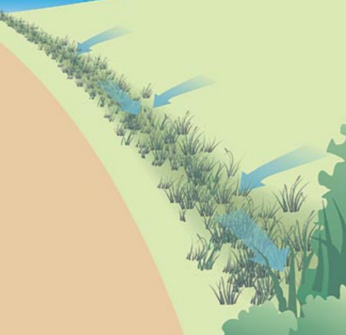
Mine Drainage BMPs
General Erosion Control:
Sedimentation Ponds
Channel Protection
Silt Fences
Vegetative Filters
Diversion Ditches
Unique to Mining
Mine drainage treatment
Diversion
Ditch
Notes:
Drainage issues can be stemming from current mining activity or historic or abandoned mining sites. Abandoned mine lands result from mining that occurred before modern environmental laws and therefore were not managed or reclaimed to protect natural resources. This includes old underground mines, un-reclaimed strip mines, and coal refuse piles.
Other than the process of mine drainage treatment, most of the drainage practices used for managing runoff from mining sites are similar to those used on other construction sites. Thus, the Kentucky Erosion Prevention and Sediment Control Field Guide is a good resource for mining BMPs, as well as for general construction.
For example, the practices of using silt fencing to prevent off-site runoff of soil and sediment and diversion ditches to help sediment settle out before flows reach receiving waters are already familiar. Note practices in the upper graphic that include diverting flow around the construction site, which could be a mining site.

Slide 20
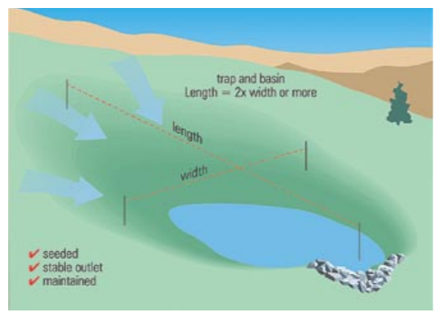
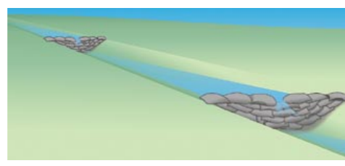
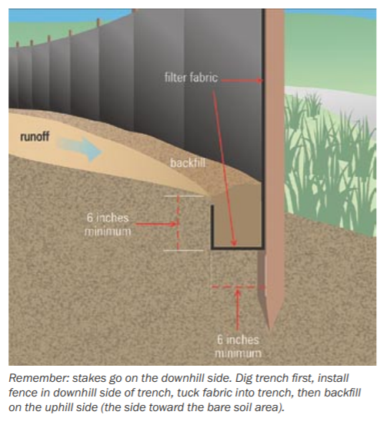
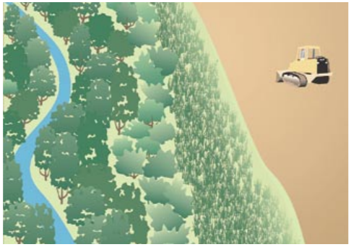
Drainage BMPs - Erosion Control
Sedimentation Pond
Check Dams
Silt Fences
Vegetative Filters
Notes:
Other erosion control measures used on mining sites and common to general construction activities are:
Sedimentation Ponds – water detention storage structures designed to detain storm flow.
They enable the removal of settleable solids from runoff and collect runoff flows for point source discharge.
They should be located immediately below the disturbance and out of perennial streams unless approved in a permit application.
Channel Protection – measures used to stabilize channels against erosive forces.
Channels can be lined with grass, rock, riprap or concrete. They can also be protected with check dams to reduce the velocity of stormwater flow. Dams can be constructed of straw bales, lumber or rock. However, straw bales are not generally recommended due to their tendency to decompose and fail.
Silt Fences – temporary sediment barriers constructed of a semi-permeable fabric stretched between and attached to supporting posts. They trap sediment while allowing runoff to pass through the fence.
Silt fences can be effective in short-term erosion and sediment control, especially during the construction phase of other control structures, haul roads and in small drainage basins.
Fences need to be properly installed to prevent failure. This includes placing them along the land’s contours to capture flows and installing the stakes on the downhill side of the fence. The fabric and stakes should be buried in about 8-10 inches of dirt.
Vegetative Filters – temporary or permanent sediment traps of cultivated or naturally occurring vegetation. Also referred to as riparian zones, grass filter strips and stream buffer zones.
They provide areas for the deposition of runoff pollutants before they reach drainage ways.
In mining areas, these are best employed in areas of moderate slope that receive sheet flow from storm events.

Slide 21
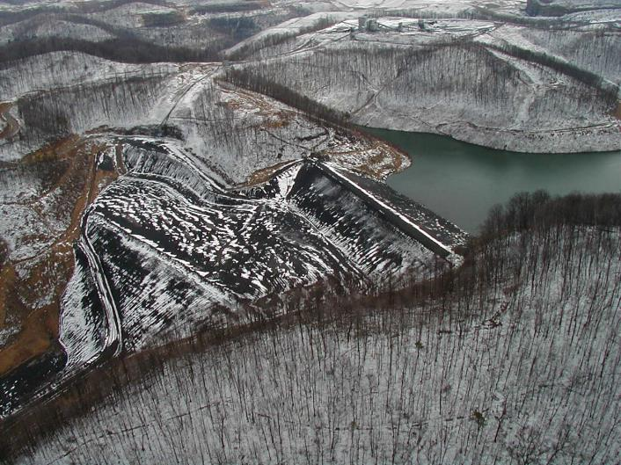
Drainage BMPs - Mine Drainage Treatment
All surface drainage from disturbed areas must pass through a sedimentation pond (or series of ponds). Adequate measures, along with ponds, must be installed to meet KPDES effluent limitations.
Treatment Strategies:
pH adjustment / metals removal
Aeration
Settling
Notes:
Moving on to drainage controls…
Kentucky’s guidance states “all surface drainage from disturbed areas must pass through a sedimentation pond (or series of ponds). Adequate measures, along with ponds, must be installed to meet KPDES effluent limitations.”
Specific to mine drainage treatment, all strategies have two common goals – neutralizing acidity and capturing and retaining metals.
These goals can be accomplished through chemical treatment, aeration, and settling procedures. Treatments for mine drainage must be designed to meet the specific chemical and physical characteristics of the drainage being treated, which can vary depending on the site’s geology, hydrology and other factors.
Graphic: Coal waste impoundment, https://www.arcc.osmre.gov/resources/impoundmentLinks.shtm

Slide 22
Mine Drainage Treatment – pH Adjustment/Reducing Acidity
An alkaline reagent is added to increase the pH of the water.
As the pH rises, metals become more insoluble and precipitate out of solution.
Treatment reagents are mainly calcium or sodium-based.
Hydrated Lime H₂SO₄ +Ca(OH)₂ CaSO₄ + 2H₂O
Crushed Lime H₂SO₄ + CaCO₃ CaSO₄ + 2H₂O + CO₂
Quick Lime H₂SO₄ + CaO CaSO₄ + H₂O
Caustic Soda H₂SO₄ + 2NaOH Na₂SO₄ + 2H₂O
Soda Ash H₂SO₄ + Na₂CO₃ Na₂SO₄ + H₂O + CO₂
Notes:
For the first step in treating discharges with a low pH, the alkaline reagent used to neutralize acidity is selected based on several factors, including its solubility, chemical costs, application requirements, and maintenance needs. Remember that this step also enables dissolved metals to precipitate and settle out. Treatment may be active (addition of chemicals) or passive (treatment while flowing through structure. Most treatments are calcium or sodium based.
Hydrated lime (calcium hydroxide) is the most commonly used reagent. It can be applied in a dry or liquid form and is relatively inexpensive. It is often used in situations where large volumes of acid mine drainage must be treated over a long time period (greater than 3 years).
Crushed limestone (calcium carbonate) is the cheapest reagent by weight, but it has limited solubility and lower reactivity at higher pHs. Since it is unable to help raise the pH much about 7.5, it is inadequate to assist with the precipitation of most heavy metals. However, passive treatment systems have successfully used covered limestone-lined drainage trenches to treat AMD in an anoxic state.
Quick lime (calcium oxide) is seldomly used because it forms gypsum (CaSO4) in the neutralization process, which can clog discharge pipes.
Caustic soda offers the benefit of raising drainage pH above 10, thus fostering the precipitation of manganese. A downside is that it also produces a gel-like ferric hydroxide sludge.
Soda ash is most commonly used to treat AMD that has a low flow rate and low acidity. It can be used in a solid, briquette form or as a slurry.
Some AMD discharges are not acidic, so this step can be skipped to move on to deciding how to precipitate and capture heavy metals.

Slide 23
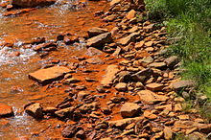
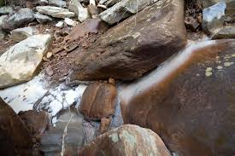
Mine Drainage Treatment – Metals Removal
Raising the pH helps enable metals to precipitate out or chemical additives may be needed.
Iron Fe(OH)₃ or “yellowboy”
  Slimy orange compound at pH >3.5
Aluminum Al(OH)₃ or Gibbsite
  Gelatinous white compound
Manganese precipitates at pH > 8 if
iron has already precipitated
  Black compound
Notes:
Layers of rock and earth above the coal removed during mining commonly contain traces of iron, manganese, and aluminum and can also contain other heavy metals that can be toxic to fish and other life if the concentration is high enough.
Iron, for example, can destroy the aquatic food chain that fish feed on and can clog the gill structures of fish.
Iron, manganese and aluminum are the most common metals that need to be removed from mine drainage. Each forms a solid precipitate with of an identifying color.
Metals may be removed by raising the pH of the water and allowing them to precipitate out as sediments or by adding chemicals to encourage precipitation. Like with pH neutralization, the method should be selected carefully, based on the metals to be removed and their concentrations, its effectiveness, availability and cost, and byproducts of the reaction.
Iron and manganese are common in groundwater and may need to be removed from solution with the addition of potassium permanganate. Potassium permanganate oxidizes iron and manganese into their insoluble states. Once these metals form solid precipitates, they can be removed in settling ponds or basins.

Slide 24
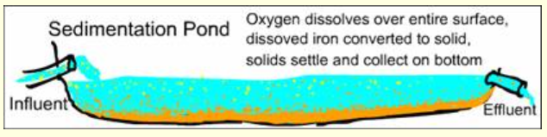
Mine Drainage Treatment
– Aeration/ Settling
Aeration – any activity that increases the oxygen transfer rate
  Aeration of mine drainage water encourages oxidation of soluble metals to produce insoluble metal precipitates.
Settling – required process for removal of metal precipitates and sludges
  Settling can be achieved in a sedimentation pond, a series of ponds, a clarifier, or a treatment wetland.
Notes:
Sedimentation ponds accomplish the dual goals of aeration and settling of mine drainage. The addition of oxygen at the pond’s surface and the detention time work together in a single pond or multiple ponds in succession. Settling is also possible in a fabricated clarifier structure or in treatment wetland.

Slide 25
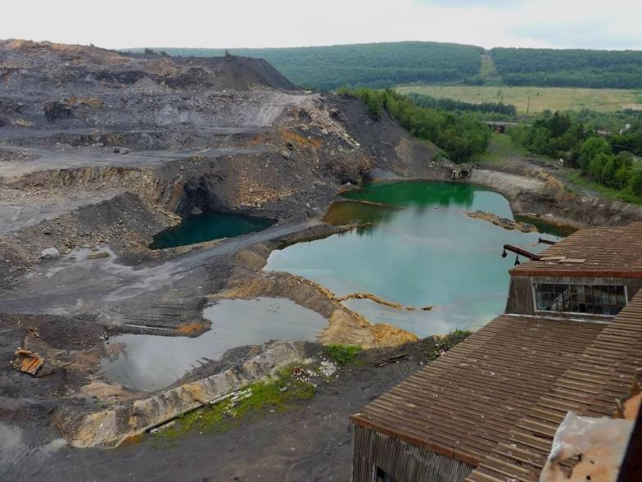
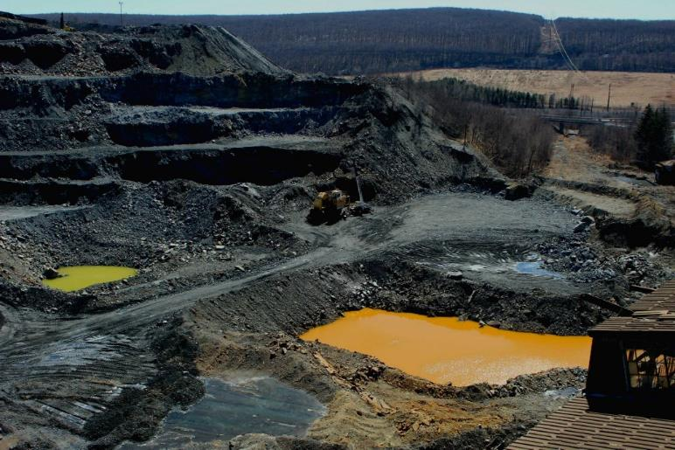
Bluish water prior to oxidation of mine runoff water
Orange water following oxidation of iron hydroxide
Source: unevenearth.org
Notes:
These photos show settling ponds with bluish water entering the pond and the orange colored water following oxidation of ferric hydroxide.
Photo source: Uneven Earth, “Legacy: abandoned mine impacts in Pennsylvania’s Appalachia,” April 7, 2016

Slide 26
Mine Drainage Treatment Methods
Active Treatment
  Chemical Water Treatment System
Passive Treatment
  Constructed Wetland
  Limestone Channels
  Limestone Beds
  Vertical Flow Reactor
Notes:
Methods for treatment of mine drainage include active chemical treatment or passive treatment

Slide 27
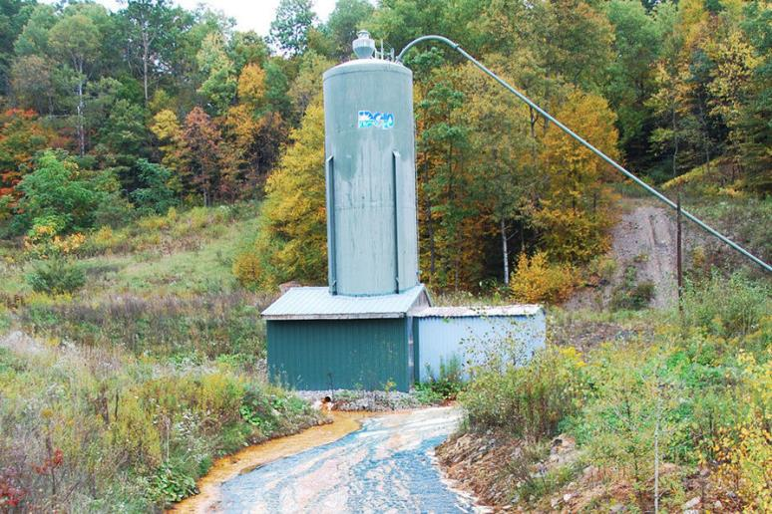
Chemical Water Treatment System
Chemicals
  Limestone
  Lime
  Quicklime
  Soda Ash
  Caustic Soda
  Ammonia
Treatment System
  Inflow pipe or ditch
  Storage tank
  Valve to control discharge
  Settling pond
Source: extension.wvu.edu
Chemicals and dosage rate specific to geology.
Expensive because of electricity and chemicals long term

Slide 28
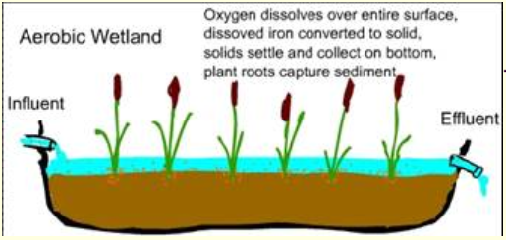
Constructed Aerobic Wetland
Adds oxygen
Allows settling of particles
May capture and treat flow from a sedimentation pond
Source:
Hedin et al,
2012
Notes:
Artificial wetlands are also utilized to aerate and settle metals in mine drainage.
The microbes in a wetland system can help further remove heavy metals fixing them in the underlying soils in an insoluble state.
They are typically recommended in conjunction with other AMD treatment practices. For example, they can become long-term, passive treatment installations that receive pre-treated water from settling ponds.
Sludge may need to be periodically dredged and removed from these wetlands.

Slide 29
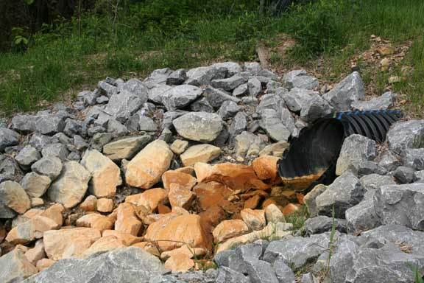
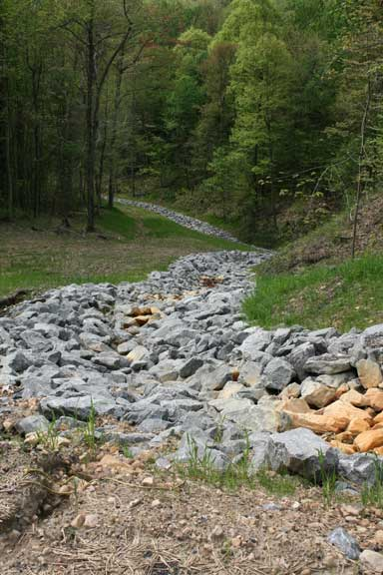
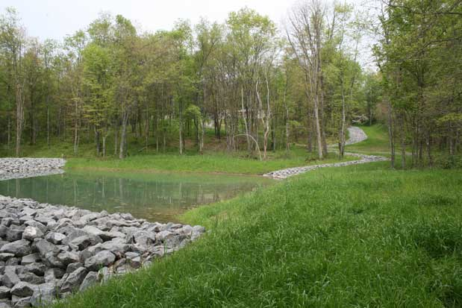
Limestone Channels
Notes:
The simplest method of passively treating AMD is to use limestone rock to line the drainage or stream channel. The limestone dissolves as water flows over it, adding alkalinity and increasing pH.
If the drainage contains dissolved metals, they may drop out of solution with the increased pH and aeration as the water moves over the rocks. The solid precipitate can “armor” the channels, reducing effectiveness. When this happens, the rocks can be mixed around or more can be added.
If the channel is on a steep slope, armoring may be less likely, but the treatment may be less likely as the water moves over the limestone more quickly.
Photo Source: Reducing Acid Mine Drainage in Deckers Creek, West Virginia Success Story, NRCS
https://www.nrcs.usda.gov/wps/portal/nrcs/detail/wv/newsroom/stories/?cid=nrcs144p2_074474

Slide 30
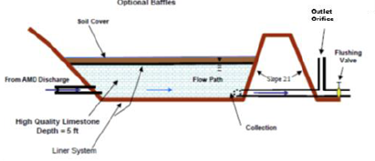
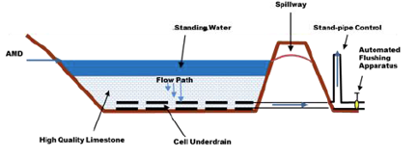
Limestone Beds
Anoxic
Limestone Bed
Drainable
Limestone Bed
Notes:
In anoxic limestone beds, high quality limestone is buried under a liner and soil covering to avoid the interaction of mine drainage with oxygen from the atmosphere.
This treatment is not used with ferric iron or aluminum because it will clog. However, for ferrous iron and manganese, this treatment is effective for increasing alkalinity of the AMD before a settling pond.
Drawbacks are that they are difficult to repair and they have a limited lifespan of about 20 years.
A drainable limestone bed is simply a pond filled with limestone that includes an underdrain. The limestone treats the acidic water, allowing the metals to precipitate out. Draining the bed on a weekly basis can help prolong the life of this treatment system by decreasing the amount of iron precipitate crust on the rocks.

Slide 31
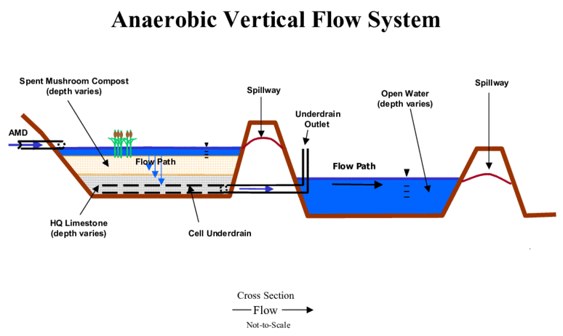
Vertical Flow Reactor
Incorporate benefits of anoxic limestone drains and anaerobic wetlands
Notes:
An anaerobic vertical flow system allows the drainage to pass through a series of treatment steps before water is discharged. (These are also sometimes called Successive Alkalinity Producing Systems or SAPS.)
First, water flows into an artificial wetland, then filters vertically down through a compost layer to remove dissolved oxygen. The removal of oxygen helps prevent iron precipitate (or yellowboy) from forming and coating the limestone in the next step, reducing its effectiveness.
Then, the AMD passes through an anoxic limestone layer to add alkalinity.
The water leaves through an underdrain which typically flows into a settling pond in which iron and other contaminants can be removed.
Most of these treatment options have the drawback of requiring large amounts of space, which can exceed the land available. They also may not be desirable for private property locations.

Slide 32
Mining Activities Addressed by KY Mining BMPs
Mine Drainage Treatment
Topsoil and Overburden Handling
Roads
Revegetation
Notes:
Now we will transition over to the second major category: Topsoil and Overburden Handling

Slide 33
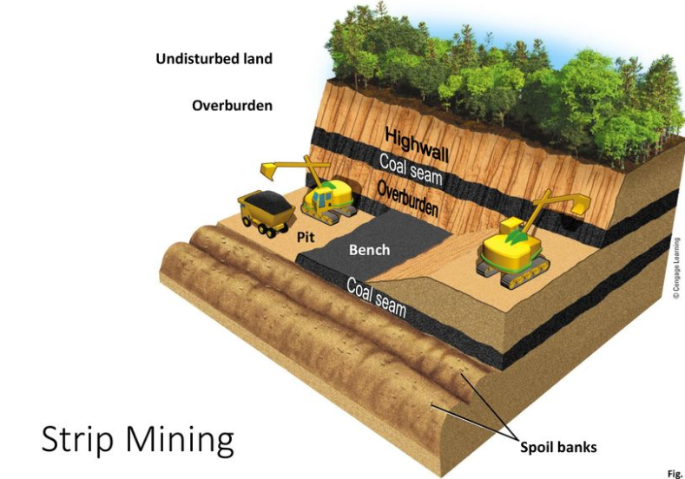
Topsoil and Overburden Handling
Addresses the rock and soil that lies above a coal seam, also called waste or spoil.
Topsoil Removal and Storage
Temporary Spoil Storage
Backfilling and Grading
Scarification
Topsoil Redistribution
Acid/Toxic Spoil
Noncoal Mine Waste
Excess Spoil Disposal
Notes:
Overburden refers to material of any nature, excluding topsoil and subsoil, which lies above a natural deposit of coal.
The guidance manual provides recommendations for multiple types of topsoil and overburden categories.
Handling of these materials goes through many steps, from the initial removal of topsoil to backfilling and grading and the disposal of excess or acid spoil.
In general, overburden and topsoil be should stabilized and recontoured if needed to conform to the site’s topography, then vegetated. And, surface waters and stormwater runoff should be diverted around piles of these materials.

Slide 34
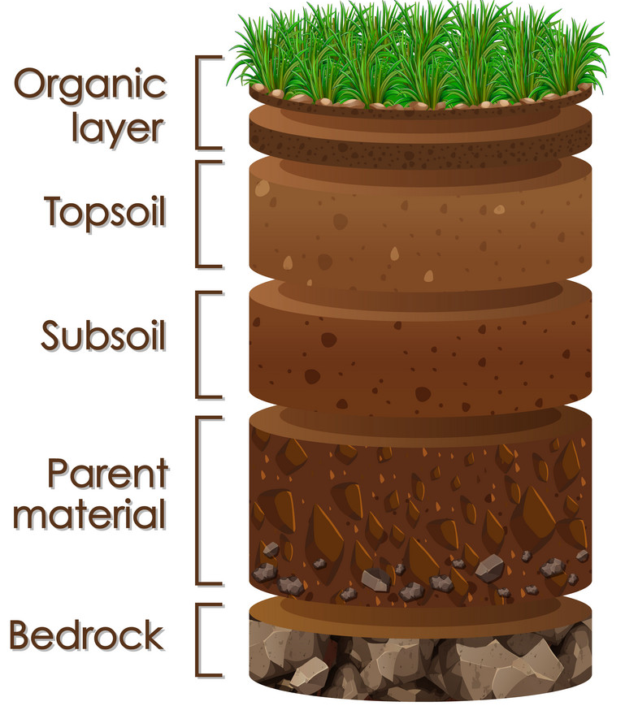
Topsoil Removal and Storage
Should be removed as separate layers from areas to be disturbed, segregated from other materials and redistributed or stockpiled for later redistribution.
Topsoil is richest soil layer, critical for successfully establishing post-mining land use
Ideally, is immediately distributed on land that has just been mined
Notes:
Topsoil is the richest uppermost layer of soil and is critical for successful revegetation efforts post-mining.
In some areas, such as the mountainous Appalachian region, topsoil may be less than 6 inches thick. In these cases, topsoil may include the unconsolidated material beneath it to a depth of six inches.
Ideally, topsoil that is removed from an area of an advance cut should be immediately distributed on land already mined.
If it must be stockpiled, measures should be taken to stabilize piles and minimize erosion. For stockpiles left in place more than 30 days, the establishment of quick growing annual or perennial vegetation is required.

Slide 35
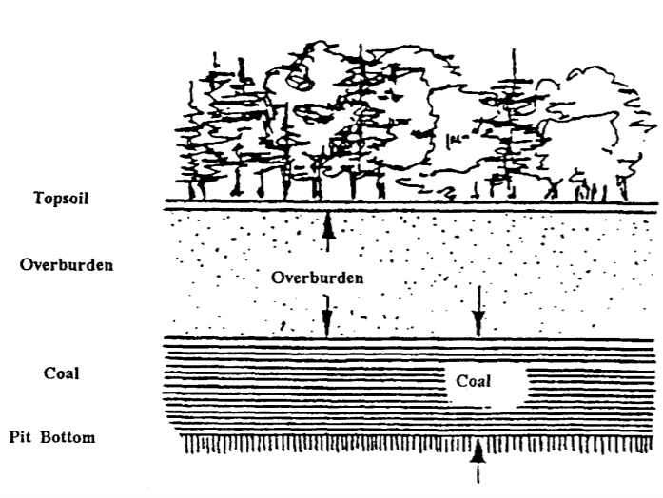
Temporary Spoil Storage
Spoil refers to all overburden material that is excavated during mining operations, excluding topsoil, subsoil, coal mine waste and mined coal.
Temporary storage is needed when it cannot be immediately backfilled and regraded.
Piles should be located on stable sites, with little or no slope
Avoid areas with seeps or springs or poor drainage
Locate to minimize handling distances/costs
Notes:
In addition to the guidance listed on the slide, diversions should be created around the spoil storage site, and all storage areas much drain to a sediment pond.

Slide 36
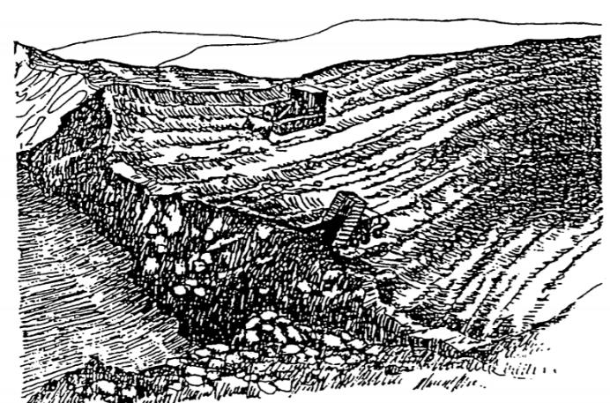
Backfilling and Grading
Procedures used in replacing spoil into the pit or onto the bench and grading to approximate original contour (AOC).
Conducted as mining is occurring.
Ensures stability and safety of regraded areas
Minimizes soil erosion and water pollution
Promotes revegetation
Restores hydrology
Notes:
Backfilling and grading procedures include eliminating highwalls and spoil piles and dewatering of mining pits.
By conducting these activities as mining is occurring…you can better (read bulleted items)
Within 30 days of backfilling and rough grading, the area must be final graded, scarified, topsoil redistributed, and seeding completed.

Slide 37
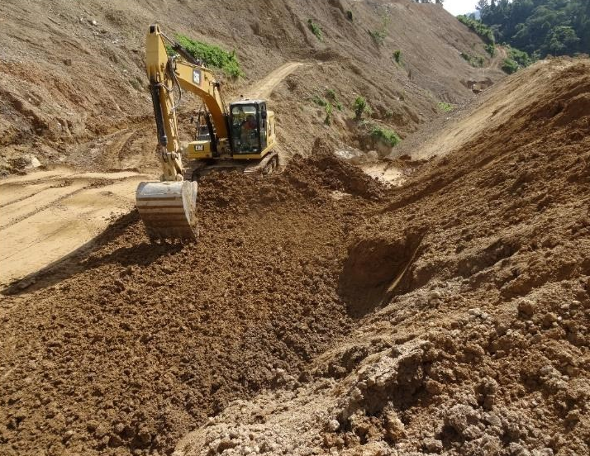
Scarification
Procedures or techniques used to prepare the regraded soil surface for eventual topsoil redistribution and revegetation—i.e., gouging, ripping, disking or other surface roughening.
Improves bonding between subsoil and topsoil layers
Reduces compaction and enhances plant root penetration of soil
Increases water infiltration and groundwater recharge
CNW Group/TVI Pacific Inc.
Notes:
Extremely compacted soils often result from the sue of heavy earth-moving equipment. Surface roughening, or scarification, is critical to ensuring water infiltration and vegetation root penetration on reclaimed land.
If possible, roughening should be done on the contour to minimize erosion. On steep slopes, a dozer can be driven up and down the slope to create cleat or track marks that can aid in reducing runoff, soil erosion and seed loss.
Prior to scarification, lime may be applied to soils to raise the pH to a level that is needed for establishing vegetation.

Slide 38
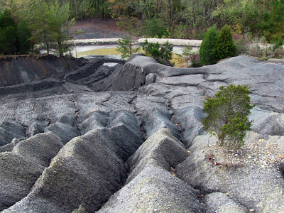

Acid/Toxic Spoil Handling
Coal refuse pile (Source: amrclearinghouse.org)
To avoid future toxic or acid mine drainage, spoil can be:
Mixed with other overburden materials
Buried with other overburden materials
Treated with limestone
Compacted
Placed to minimize contact with surface or groundwater
Encased in low-permeability materials
Notes:
The identification, selective handling and/or burial of potentially acid or toxic-forming spoil is a crucial measure to protecting surface and groundwater quality. This helps prevent the formation of acid mine drainage.
This type of spoil can be mixed with other overburden materials to help neutralize these effects or it can be buried with a minimum of 4-feet of non-acid, non-toxic forming material.

Slide 39

Excess Spoil Disposal
Excess spoil refers to the mined overburden left over after the mine site is otherwise graded and restored. It must be stabilized with drainage and construction practices.
Notes:
Spoil refers to overburden, the rock above the coal seam, and underburden, the rock between coal seams.
The usual method of disposing of this excess soil and rock is to place it in engineered earthen and rock structures, knows as head-of-hollow fills, hollow fills or valley fills.
A sediment pond is installed downslope of these “valley fills” to collect runoff and allows settling of particulates.

Slide 40


Abandoned Mine Lands Reclamation
AML are areas affected by coal mining that ceased operation prior to May 18, 1982, on which no person or entity has any continuing reclamation responsibility under federal or state law.
Reclamation needs may include:
  Highwall failure
  Landslides
  Drainage problems
  Mine openings
  Dangerous water impoundments
  Mine spoil areas
  Subsidence
  Hazardous gas emissions
  Dangerous equipment/structures
Notes:
Kentucky’s Division of Abandoned Mine Lands is charged with protecting the public from health and safety problems caused by mining that occurred before 1982. These dangers may include landslides, water-filled pits, open mine portals and dilapidated equipment and buildings. AML restores these sites to a safe and environmentally stable condition through reclamation activities.
AML division also administers a bond forfeiture program. Before a company begins mining, they are required to post a reclamation bond. If the company fails to mine and reclaim the site to the standards specified in their permit, the bond money may be forfeited to the state. These forfeited funds are used to reclaim the site.
AML has also overseen a recent Pilot Program to distribute federal funding for reclamation of AML sites in conjunction with economic and community development and reuse goals. You will learn more about this program in Module 5, when we hear from “Likely Partners,” but you should be aware that it is a potential source of funding for watershed improvement projects that assist with the goals of the pilot program.
Kentucky Abandoned Mine Land (AML) Projects
Under the authority of Title IV of the Surface Mining Control and Reclamation Act of 1977 (SMCRA), the Office of Surface Mining, Reclamation and Enforcement (OSMRE) provides Kentucky with federal financial assistance through annual construction grants for Abandoned Mine Land (AML) projects to reclaim and restore land and water resources adversely affected by eligible coal mining operations. Kentucky submits project proposals to OSMRE throughout the year for OSMRE "authorization to proceed with construction activity" (ATP), after which Kentucky may begin construction contracting and accomplish actual reclamation work to remedy an AML problem.
Resource: Kentucky Energy and Environment Cabinet Abandoned Mine Lane Homeowner and Development Guide, 2016
https://eec.ky.gov/Natural-Resources/Mining/Abandoned-Mine-Lands/Documents/AML_Development_Guide.pdf

Slide 41


Case Study: Octavia Church, Pike County
Notes:
The Octavia Church AML Project reclaimed a sidehill refuse area of approximately 6 acres, which was situated near Octavia Church and threatened motorists on the adjacent road in eastern Pike County.
During heavy rains, coal refuse washed into and blocked the roadside stream, causing sediment and water to flow onto the road surface. This increased the risk of accidents, as well as increased needed maintenance by road crews.
The sediment also increased maintenance costs at downstream culverts and bridges, and was an environmental problem.
An existing sediment pond was cleaned out and the the dam spillway was repaired.
A berm along the edge of the creek and diversion ditches lined with rock or erosion control blankets were constructed to route runoff to the sediment pond.
Coal refuse was removed from the creek banks.
After all marketable coal refuse was removed, the remaining refuse was covered with topsoil at least 2-feet deep.
Drainage was further controlled with hay bales, berms and diversion ditches, and the areas was revegetated.
https://eec.ky.gov/Natural-Resources/Mining/Abandoned-Mine-Lands/projects/Pages/Octavia_Church.aspx

Slide 42


Rock Creek AMD Project: A 319 Success Story
Notes:
Acid mine drainage from coal mines had decimated aquatic life in a 4-mile stretch of Rock Creek in McCreary County. The upper portion of the creek was considered a wild and outstanding natural resource water. But, the lower portion was suffering from acid mine drainage from over 40 coal mine portals and coal refuse dumps, which severely impacted aquatic life. This lower segment was listed on the 1990 303d list for nonsupport of aquatic life and swimming.
Best management practices (BMPs) installed in the Rock Creek watershed included removal of coal refuse from streambank areas, open limestone channels and a vertical flow wetland system. Water in the creek was further treated with limestone sand.
A 319h grant provided funding for the construction of the open limestone beds and the removal of coal refuse from the streambanks. Other funding was obtained from the Appalachian Clean Streams Initiative, Eastern Kentucky PRIDE/NOAA, Kentucky AML and USGS.
These practices decreased acid and sediment loading to the creek and enabled areas that previously could not support fish to host diverse fish populations.
In 2002, the lower 4-mile segment of Rock Creek was reclassified from nonsupport to partial support for both aquatic life and swimming on Kentucky’s 303(d) list of impaired waters. Acid loading to the receiving waterbody of Big South Fork of the Cumberland River was also dramatically reduced.
https://www.epa.gov/sites/production/files/2015-11/documents/ky_rock.pdf

Slide 43


AMD & Art Park
Creative, visually interesting AMD Treatment Project in PA
Includes:
Wetlands
AMD Treatment System
Litmus Garden
Recreation Area
LOTS of partners enabled by
art and environmental interests
~$800,000 in funding, plus in-kind contributions
Notes:
The final project we will mention is especially creative and serves as a great teaching tool for the public. The 35-acre AMD and Art Park is located in a mined area of southwestern Pennsylvania. The AMD flows into the park with a pH of 2.8 and exits at about with a pH of about 6.5.
One section of the park is devoted to the wetland treatment cells and ponds of the AMD treatment system.
An accompanying Litmus Garden functions as a visual representation of the changing acidity of the water.
As the water moves through the treatment system, it undergoes a visual transition from the red-orange AMD to the blue-green color of clean water.
Small groves or bands of thirteen native tree species were chosen for their autumn foliage colors that turn deep red around Pond 1 and grade through orange and yellow to blue-green at the end of the treatment system in Pond 6, creating a visual reflection of improved water quality.
Another area, called the History Wetland educates about the site’s previous use as a coal mine.
And, another section is being developed as a recreation area with sports fields and a pavilion.
More info at https://www.amdandart.info/

Slide 44

Want to learn more?
http://dep.wv.gov/WWE/Programs/nonptsource/Documents/Projects/OM_Manual.pdf
Notes:
This supplemental resource for Watershed Groups from West Virginia DEP has valuable additional guidance for those who are looking for ways to proactively address mine runoff problems.

