Slide 1
Watershed Academy Watershed Coordinator Training Series
Land Use Impacts &
Related Best Management Practices
1. Land Use and Water Quality

Slide 2
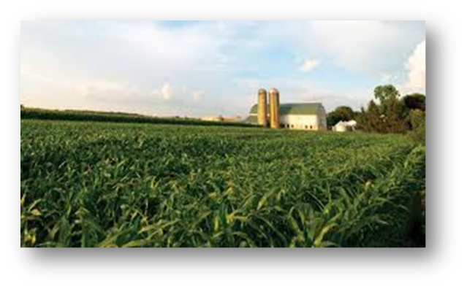
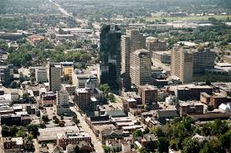
Module 4 Outline Land Use Impacts and Related BMPs
Total Pollutant Loads/Yields (from Module 3)
Watershed Characterization
BMP Selection and Evaluation
Examples of Land Use BMPs
Urban Development/Stormwater
Agricultural/Forestry
Wastewater Treatment
Mining
Habitat/Stream Channel Restoration
Education applies to all!
Notes:
We will begin this module with a reminder of where we left off in module 3, during which we discussed pollutant loads and yields and ways to reduce those values to meet water quality goals.
In order to do this, you need to understand the contributing watershed, the prevailing land uses, and potential pollutant sources.
Once you have this information, you can begin to identify and select associated best management practice options that will help lower the pollutant loading to receiving waterways.
After today’s presentations discussing the factors to consider in selecting appropriate BMPs, we will go through examples of BMPs that are used in different land use scenarios during our upcoming weekly webinars.
These will include presentations on BMPs related to urban development and stormwater, agriculture and forestry, wastewater treatment, mining, and habitat improvement.
Of course, education is a common theme that applies as a BMP for all of the above.

Slide 3
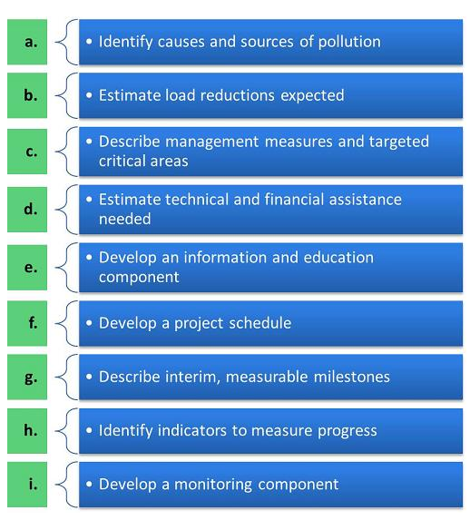
Watershed Planning Process
Notes:
In the watershed planning process, we are focusing on step c of the “a through i” watershed planning criteria outlined by the USEPA.
Describe management measures and targeted critical areas
Once BMPs are identified for the critical areas, you can begin to develop the following planning details—estimates of technical and financial assistance needed, information and education components, a project schedule and interim milestones.

Slide 4
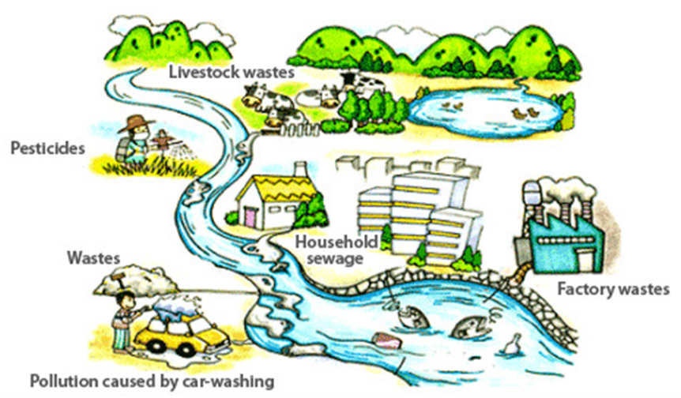
Watersheds and Water Quality
Water:
Hydrology
Hydraulics
Environmental:
Geomorphology
Land Use / Discharges
Biology / Ecology
Notes:
As we have learned, many factors influence water quality as it moves through a watershed.
It is affected by two basic categories of factors:
The water itself—which is influenced by the climate and weather, as well as the hydrology (properties, distribution, and circulation of water on and below the earth's surface and in the atmosphere) and hydraulics (how the water flows within the stream channel).
Environmental influences – Relate to the physical setting which the water flows over and under and through and is being discharged into. This is affected by the geomorphology of the area (physical features of the earth’s geology), the land use of the area, as well as the vegetation and organisms that are in a watershed and its waterbodies.
These topics were covered in more depth in Module 2.
In this module, we will be focusing on the environmental contributions of land use.
The graphic provides a simplified illustration of some of the pollutants that could be located in your watershed based on the types of land uses.
Factory wastes are likely to be piped point sources with associated permits, but the others are mainly nonpoint sources with only voluntary means of controlling them.

Slide 5
Load Calculation Goal
How much do we need to reduce to be healthy?
Where to focus?
Healthy Stream
Notes:
In Module 3, we discussed how you calculate an existing pollutant load and compare it to a water quality standard or benchmark—shown by the red line for healthy stream conditions.
If the pollutant load is greater than this standard, you can determine how much the level needs to be reduced to achieve the criteria of a healthy stream or other waterbody type.

Slide 6
Loads and Yields
Load = mass / time (e.g. lbs/year)
Amount at a point
Yield = mass / time / area (e.g. lbs/year/sq mi)
Amount from an area
Accounts for land runoff sources
Notes:
To assist with this process, we talked about calculating pollutant loads and yields using these equations.
Loads refer to pollutant measurements at a specific point and yields refer to pollutant amounts contributed by a land area.
Loads = mass/time and Yields = mass/time/area
Since the yield is determined by dividing the total load by area, it accounts for that area’s land runoff sources.

Slide 7
Pollutant Loads
Subwatershed Load
12,000 lbs/ Total Nitrogen
22,000 lbs/
Total Nitrogen
Total Load
Notes:
We also talked about assessing incremental and total loads. Here is a visual of a watershed that illustrates these concepts.
What is the incremental load of Total Nitrogen of the subwatershed? 12,000 lbs for the subwatershed in green
And, the total load for the entire watershed? 22,000 lbs of the entire watershed, including the subwatershed colored in green

Slide 8
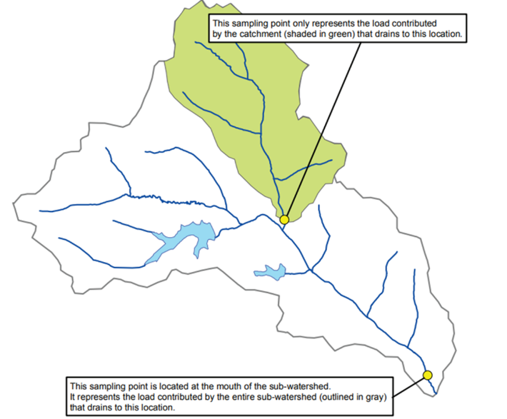
Pollutant Yields
In order to compare and prioritize subwatershed areas, annual loads must be normalized to account for geographic size differences.
Pollutant Yield = Load
Area
2 square miles
Annual Subwatershed (Incremental) Yield =
12,000 lbs TN/year/2 square miles =
6,000 lbs/square mile
Total Yield =
22,000 lbs/TN/year/8 square miles =
2,750 lbs/square mile
8 square miles
Notes:
Since subwatershed areas can contribute varying levels of the overall pollutant load, it is helpful to know their incremental yields for prioritizing management practices where pollutant reductions can be greatest.
Using our previous example, you can calculate yields for the subwatershed in green and for the total watershed area.
The subwatershed contributes 6,000 lbs of Total Nitrogen per square mile, whereas the overall watershed contribution is only 2,750 lbs per square mile.
It appears that the subwatershed is contributing a higher yield than the overall watershed, so this may be a good area to address first. It is also a headwater subwatershed, so improvements may translate to downstream water quality improvement.

Slide 9
Example: Pollutant Load Reduction Map
28.8 trillion
45.5 trillion CFU/year
3.3 trillion
0.2 trillion
10.9 trillion
2.6 trillion
27.8 trillion
Notes:
If you are selecting BMPs, then you should ideally have a map of your watershed with load reductions that are necessary from each subwatershed area, as this example from the Clarks Run Watershed in Boyle County shows.
The map provides needed pollutant reductions of Nitrogen, Human E. coli and Cattle E coli for each of the contributing subwatersheds. This information has been very helpful in developing and prioritizing BMPs for implementation.
For instance, the implementation activities have included septic system repairs and replacements. Coordinators of this program can refer to the Human E. coli reductions needed in each of the subwatersheds to prioritize homeowner applications. Where do you think they should focus?
Stanford Road – 45.5 trillion CFU/year
South 2nd Street – 28.8 trillion CFU/year
US127 Bypass – 0.2 trillion
Corporate Drive – 2.6 trillion
Balls Branch West – 27.8 trillion
Balls Branch Mouth – 10.9 trillion
KY52 – 3.3 trillion

Slide 10
Other Prioritization Considerations
Priority #1
High Pollutant Yields
Motivated stakeholders
Mainly agricultural
Priority #3
Lower Pollutant Yields Most of area already protected
Land Use/Cover
Geology/Soils
KDOW Assessments
Geography (Headwaters/Confluence)
Stakeholder Support
Local concerns
Available funding
Priority #2
Highest Pollutant Yields Greater Imperviousness
Notes:
Of course, there are many other factors to consider when making final prioritization decisions, such as:
Land use and land cover characterization - What types of BMPs will be needed to address the prevailing land uses? Are these likely to be effective? Is much of the watershed area already protected as public or forested lands? Does a high percentage of impervious land cover prevent significant improvement?
Geological characteristics – Is the geology favorable for karst formations that would allow for underground pollutant flows into or out of the watershed area and therefore make pollutant reductions difficult to predict?
Soil characteristics – Is the soil type easily erodible and likely to contribute to loading? Does it allow for slow or fast infiltration rates? Are the soils already high in certain nutrients?
Kentucky Division of Water 305b assessments – Does the watershed contain streams that are already known to be impacted or are noted for high quality needing protection?
Geography – Headwater streams are often better to prioritize because you are not dealing with upstream contributions and can see impacts more quickly. Then, you can work your way downstream for ongoing improvements.
Stakeholder support – Is there local interest in protecting or restoring water quality? What are the local goals or special water interests? Do these align with the watershed planning goals? Or local concerns that may strengthen support – Is there an issue, such as a pending development permit or a threatened water supply, that may add support to related watershed management initiatives?
Available funds that may make some subwatershed efforts easier – Are there related funding sources that can help pay for proposed BMPs, such as Farm Bill cost-share programs that help pay for agricultural practices? Could a proposed development project incorporate BMPs, such as stormwater retention basins? Could you work with a recreational trail planning effort to add educational components?
In this example, priority is given to the subwatershed that displays high pollutant yields, but also includes motivated stakeholders and a majority agricultural land use—which could reduce the types of BMPs needing to be implemented.
The Priority #2 subwatershed has the highest pollutant yields, but it has greater imperviousness and may be more difficult to address.
Priority #3 has lower yields and is also already largely protected as a nature preserve.

Slide 11
Annual Load Reduction Goal
Water Quality Criteria
MOS
Notes:
By evaluating the land use characteristics at a watershed or subwatershed level, we can begin to target some “best practices” that will help us reach our water quality goals.
This graph shows how various land use sources contribute to the overall annual phosphorus load, with WWTP standing for Wastewater Treatment Plant. A Margin of Safety (MOS) is typically added to load reduction goals in the TMDL report, providing a buffer for unknown sources or other goal satisfaction obstacles.
In order to meet the water quality criteria, loads will need to be reduced and/or reallocated among the various land uses.
We will be discussing the relative effectiveness of land-use focused BMPs, which will be important to consider in estimating expected load reductions.
While effectiveness at pollutant reduction can vary greatly, depending on a variety of localized factors, there are ways to estimate reductions for the evaluation process.

Slide 12
Selection of Best Management Practices
Identification of Priority Subwatershed Areas
Subwatershed Characterization
Likely Sources
Selection of Appropriate Best Management Practices
Notes:
In summary, once you have used the load and yield calculations to prioritize subwatershed areas for improvement, you can begin evaluating these areas for land use and likely pollutant sources.
Then, you can develop a list of associated best management practices that can be further evaluated and vetted for effectiveness and feasibility.

Slide 13
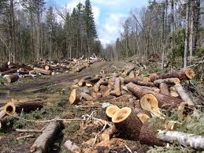
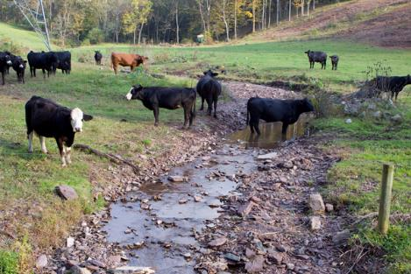
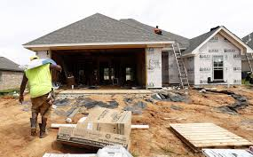
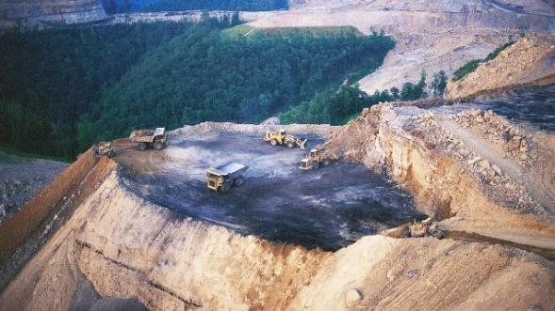
Land Use Connections to Water Quality
Notes:
Let’s begin to look at some of the land use types and considerations, all of which can have differing impacts.
In Kentucky, some of these land coverages include Urbanization, Crop and Livestock Farming, Forestry, and Mining.
As we review management practices that can be adopted to address pollutant contributions from each of these land uses, we will go into greater detail about the most common pollutants of concern stemming from these activities.

Slide 14
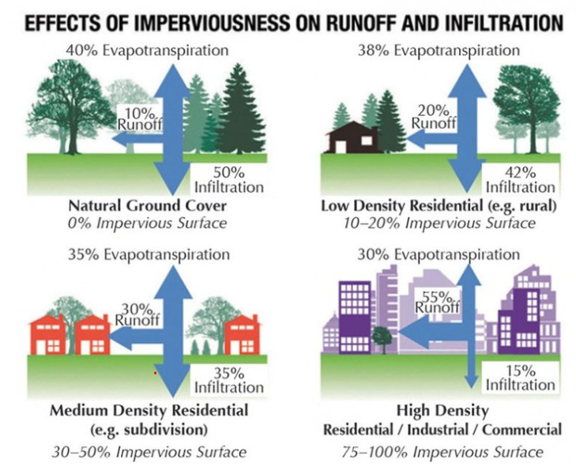
Imperviousness
Impervious surfaces are areas covered with roads, parking lots, roofs and other surfaces that do not allow water to soak into the ground.
Imperviousness refers to the amount or percentage of land area covered with these surfaces.
Source: City of Griffin, GA Municipal Government
Notes:
One major land cover or land use factor to consider when evaluating watersheds is imperviousness.
The fate of rain that falls on the land is strongly affected by the percentage of land cover that is impervious to water infiltration.
Imperviousness - the sum total of all hard surfaces within a watershed including rooftops, parking lots, streets, sidewalks, driveways, and surfaces that are impermeable to infiltration of rainfall into underlying soils/groundwater (USEPA Watershed Academy)
This graphic shows how less rainfall infiltrates the ground and more rainfall runs off as the percent imperviousness increases. Evapotranspiration also decreases with increased imperviousness and fewer trees.
In a forested or grassy area (top left), most rain soaks into the soil (infiltrates), where it eventually is used by growing plants or percolates downward into the groundwater table or re-enters the atmosphere through evapotranspiration through trees and other vegetation.
With increasing density moving clockwise around the graphic, less water infiltrates and more water runs off to nearby storm sewers or natural streams, carrying pollutants picked up along the way.

Slide 15
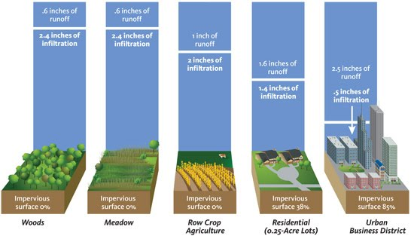
Effects of Impervious Surfaces
3” of rain
Increasing runoff, decreasing infiltration
Image Credit:
Landscape for Life
Notes:
This is another graphic that illustrates how changes in land cover and increasing impervious cover affect infiltration and runoff.
Forests and other areas with good vegetation cover (see woods and meadow above) and little disturbance from humans enables most rainfall to soak into the soil, rather than running off the ground. Of the 3” rainfall, only 0.6 inches runs off.
Runoff increases and infiltration decreases with the reduction in tree and other vegetative land cover (row crop and residential).
In built-up areas with a lot of pavement and buildings, very little rainfall soaks into the soil and we see much more water runoff.
So, in the urban district, 2.5” of the 3” rainfall runs off and only 0.5” filters into the ground.
This generally results in stream flows that have high peak levels and low flows in between, as well as poorer water quality.
Pasture or crop land falls between these two extremes. On agricultural land, some rainfall runs off, while some infiltrates into the ground where it can be used by plants or provide base flow for streams. Heavier-use pastures with highly concentrated animals have more compacted soils, resulting in greater runoff rates.
Graphic Source: Landscape for Life – Water Workbook (https://creativecommons.org/licenses/by-sa/4.0/)

Slide 16
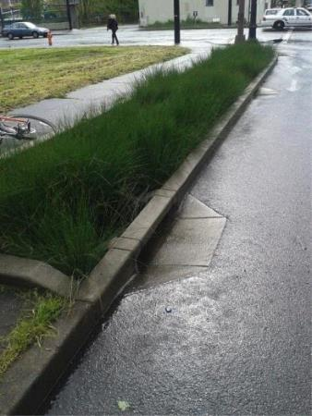
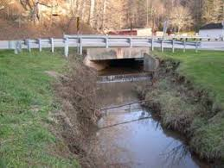
Imperviousness Increases Volume and Speed of Runoff
Conventional urban infrastructure enables faster stormwater collection and movement to the nearest waterway,
which often results in…
increased flooding
streambank erosion
streambed scouring
Notes:
In addition to increases in runoff amounts or volume, imperviousness increases the speed of runoff and subsequent instream flows.
Thus, with increased imperviousness, we often see more flooding, bank erosion and streambed scouring problems.
These effects are of concern for both human infrastructure and aquatic habitat.
Flooding and high flows can damage roads, bridges, buildings and other infrastructure.
Aquatic habitat is scoured away decreasing the presence and numbers of organisms that can survive.

Slide 17
Increased “flashiness” of stormwater
Source: Lehman College, CUNY
Notes:
Another aspect of increasing urbanization is stream flashiness. As you can see in this diagram, increased urbanization and impervious surfaces lead to a faster, greater stream discharge response. In contrast, the forested watershed shows a more gradual, moderated rise in stream discharge.
Unless countermeasures (stormwater BMPs) are designed and installed, an urbanized area will flood more frequently and severely than previously.
Graphic source: https://courses.lumenlearning.com/cuny-lehman-geo/chapter/human-impact-floods/, Figure 9

Slide 18
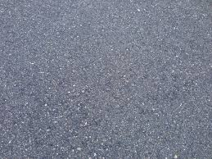
Imperviousness Impacts
Less groundwater recharge
Lower stream base flows
More runoff and related erosion
Aquatic life impacts
Prone to larger and more frequent floods
Increased stream temperature (lower dissolved oxygen, increased algal growth)
Notes:
In summary, imperviousness is a big deal because it causes all of these negative effects on water quantity and quality.
Less groundwater recharge not only impacts underground aquifer replenishment, but also limits baseflows for surface streams during dry conditions.
More runoff and erosion adds pollutants to receiving waterbodies.
Aquatic life habitat is often scoured away by high stormwater flows and associated flooding.
Flooding becomes more of a problem when waterbodies cannot accommodate increased flows.
Stream temperatures increase when runoff water passes over warmed surfaces on its way to the stream. Higher water temperatures result in lower dissolved oxygen concentrations and the potential for increased algal growth.

Slide 19
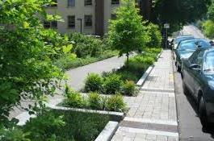
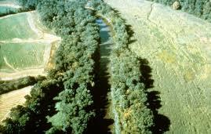
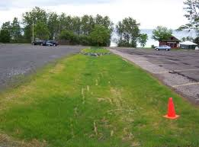
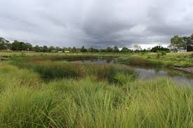
Solutions to absorbing and treating runoff contributions using vegetation
Green Infrastructure
Notes:
You may have heard of the Grey to Green movement. This refers to the effort to move away from traditional concrete (grey) solutions for water management toward solutions that include the use of vegetation to absorb and treat water runoff (green solutions). These solutions are also referred to as Low Impact Development.
The images on this slide show:
Green Infrastructure to treat runoff from parking lots, roads and sidewalks (2 photos on left)
Riparian Buffers to treat runoff from adjacent pasture and crop land (top right)
A Treatment Wetland to manage runoff from residential development (bottom right)
As we talk through the various land use best practices today, you will note that many incorporate green infrastructure solutions.

Slide 20
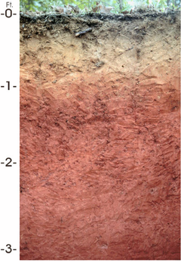
Soil type also affects water quality
Erosion potential
Drainage potential
Nutrient content
Favorability for crops, pasture, development and other land uses
Finer grained soils tend to generate more runoff (clays)
Notes:
In addition to imperviousness, another watershed characteristic to consider when evaluating and recommending management activities is soil type.
Soil types affect water quality by how easily they erode, what they contribute when they do erode, and what types of land use they best support.
Additionally, fine-grained soils (silts and clays) become more compacted, reducing the ease of water infiltration and generating greater runoff rates.

Slide 21
USDA-SCS Soil Classification
Hydrological Soil | Type of Soil | Runoff Potential | Infiltration Rate (mm/hr)
Group A | Deep, well-drained sands and gravels | Low | > 7.5
Group B | Moderately deep, well-drained with moderately fine to coarse textures | Moderate | 3.8 – 7.5
Group C | Soils with moderately fine to fine textures | Moderately High | 1.3 – 3.8
Group D | Clay soils that swell significantly | High | < 1.3
Source: Schwab et al, 2002 (researchgate.net)
Notes:
This chart shows how the USDA (United States Department of Agriculture) and SCS (Soil Conservation Service) rates four different soil classifications in relation to runoff and infiltration.
The faster the infiltration rate, the lower the runoff potential, and vice-versa.
Group A - Deep, well-drained sand and gravel soils obviously have higher infiltration rates and lower runoff rates.
Groups B and C, with fine to coarse and moderately fine to fine soil textures, produce more moderate runoff potentials.
As you can see, the clay soils in Group D have much lower infiltration rates and thus have greater runoff potential.
Another important factor to note is that when development occurs and soils are disturbed, compacted with bulldozers, and topsoil removed, infiltration is likely to be much slower and runoff much greater.
We will be discussing ways to determine watershed soil types for your area of interest.

Slide 22
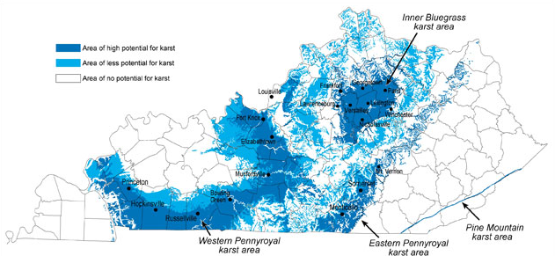
Geology affects land use and flows
Karst Geology – topography formed from the dissolution of rocks, creating underground drainage systems
Source: Kentucky Geological Survey
Source: Kentucky Geological Survey
Notes:
The geology of the state has a profound effect on water quality and water movement over, under, and through the land surface.
The subsurface will affect the chemical characteristics of the water, drainage patterns, and the groundwater-surface water interactions.
Karst bedrock features can greatly influence groundwater flow paths and the associated travel of pollutants to surface waters.
This map shows the karst regions of Kentucky. The darker blue areas are highly karstic, and the lighter blue areas are less karstic. The karst topography of Kentucky is mostly on limestone, but some is also on dolostone.
Geological features also influence the land’s topography and types of land uses in the area.
In Kentucky, cropland farming tends to occur mainly in the flatter bottomland areas of western Kentucky.
Farmland in the central Bluegrass region is utilized more for livestock production and urbanized areas.
And, the mountainous terrain of eastern Kentucky has historically been used for logging and mining.
Additional info:
About 55 percent of Kentucky is underlain by rocks that could develop karst terrain, given enough time. About 38 percent of the state has at least some karst development recognizable on topographic maps, and 25 percent of the state is known to have well-developed karst features.

Slide 23
Resources for finding Land Use Features:
Google Maps / Google Earth
National Land Cover Database
WikiWatershed
Local Zoning Maps
Kentucky Infrastructure Authority (KIA) Portal
ECHO Database
USDA National Agricultural Statistics Service
U.S. Census Data
Notes:
In order to assess these features and further evaluate and prioritize water quality efforts, there are many online and other resources. We have touched on some of these in previous modules.
Google Maps or Google Earth is a useful, free tool to scope out satellite imagery of your watershed area and begin to identify prevailing land uses and possible pollutant sources.
The National Land Cover Database is developed by the USGS and other partners. It provides updated land cover information on a national scale, including imperviousness.
WikiWatershed is a watershed modeling web app that provides an easy to use interface for finding a variety of helpful information. (We will be delving into this tool and practicing with it in our first activity of the day.)
Local zoning maps can help watershed planners evaluate potential or likely changes in land use by showing where development is likely to occur (i.e., residential, commercial, industrial zones).
The Kentucky Infrastructure Authority portal is a useful tool for learning about local drinking water and wastewater systems and where cities and towns may be planning for infrastructure improvements or expansion. Map coverages from the KIA and regional Area Development Districts can help determine sewered vs non-sewered residences.
The USEPA’s ECHO database (Enforcement and Compliance History Online) helps you find permitted point source discharges and track their compliance history.
The USDA’s National Agricultural Statistics Service provides a variety of data related to crop production and livestock types and numbers by county.
U.S. Census Data can be helpful in discerning population concentrations and the income and education levels of residents.
All of this information can be helpful in prioritizing subwatersheds and selecting appropriate best management recommendations, as well as outreach and education approaches.

Slide 24
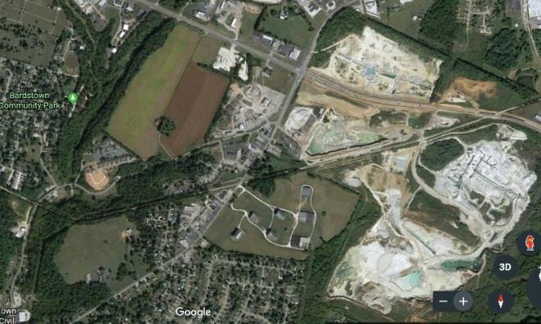
Google Maps Searching satellite imagery in your watershed is helpful for general observations. Zoom to sites of interest.
Notes:
You can search for a location on GoogleMaps, then zoom in to areas of interest to better understand the “lay of the land” and the various land uses in the watershed area.
In this example, you can zoom into the area northeast of Bardstown, within the Beech Fork watershed. A large stone quarry there could be contributing to sediment loads, metals, or high conductivity levels in nearby tributaries. It is also likely to generate a lot of runoff from exposed bedrock areas.

Slide 25
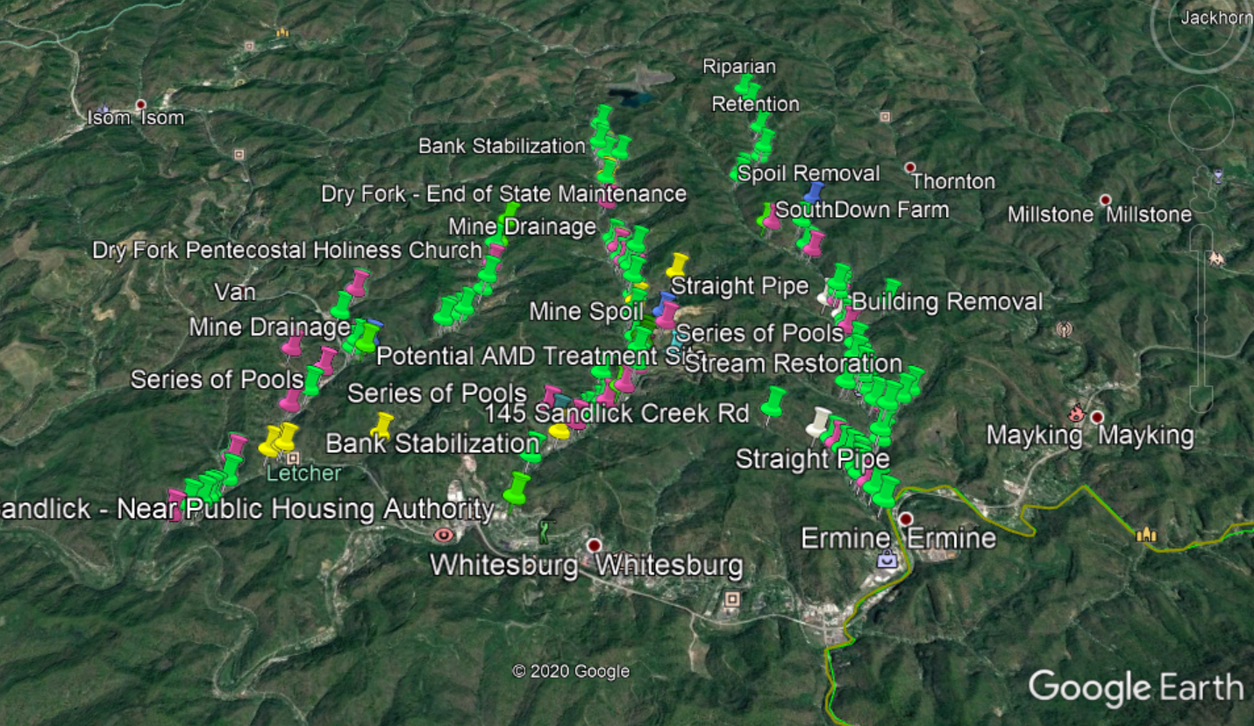
Google Earth Marking locations for potential BMP sites
Notes:
You can also use Google Earth to search around your watershed and become more familiar with its distinguishing features.
And, later you can mark sites for potential BMP locations that can be reviewed by local residents for feasibility and other considerations.
This example uses different colored pins to mark possible locations for riparian plantings, streambank stabilization, stream restoration, mine remediation and other BMPs.
Green = Riparian planting
Pink = Potential Retention / Step Pools
Teal = Stream Restoration
Blue = Mine Drainage / Spoil Removal
White = Straight Pipe / Building Removal
Yellow = Bank Stabilization

Slide 26
National Land Cover Database – Interactive Viewer (www.mrlc.gov)
Pasture/ Hay
Forest
Crops
Notes:
A National Land Cover Database is hosted online at www.mrlc.gov. (You can also download NLCD maps at http://kygeoportal.ky.gov/geoportal/catalog/main/home.page. See 2011 NLCD Land Cover Image Service.)
The Interactive Viewer provides broad coverages of land types for the state.
The legend of this graphic of Kentucky lists all of the possible land cover types:
Wetlands
Crops – more in Western Kentucky
Pasture/Hay – more in Central Kentucky
Grasslands
Forests – more in Eastern Kentucky
Barren Land
Developed Land (low, medium, high intensity in red)
This viewer is helpful, but the data is also incorporated in the WikiWatershed tool, which we will discuss next.

Slide 27
Wiki Watershed (Modelmywatershed.org)
Analyzes lots of land characteristics for you!
Streams – stream orders, length in agricultural/non-ag
Land – landcover distribution
Soil – Infiltration rates
Terrain – elevations (min/max/average)
Climate – mean precipitation/temperature
Point Sources – discharge permittees, discharge details, pollutant loads
Animals – estimated numbers of farm animals
Water Quality – estimates Total Suspended Solids (TSS), Total Nitrogen (TN) and Total Phosphorus (TP) loading
Notes:
WikiWatershed or Model My Watershed is a watershed-modeling web app that enables citizens, conservation practitioners, municipal decision-makers, educators, and students to analyze land use and soil data in their watersheds.
During the following activity, we will walk through the tool visualizations for each of the characteristics listed here.
WikiWatershed also allows users to:
Model stormwater runoff and water-quality impacts using professional-grade models
Compare how different conservation or development scenarios could modify runoff and water quality

