Slide 1
Watershed Academy
Watershed Coordinator Training Series
Effective Communications
3. Developing an Outreach Campaign

Slide 2
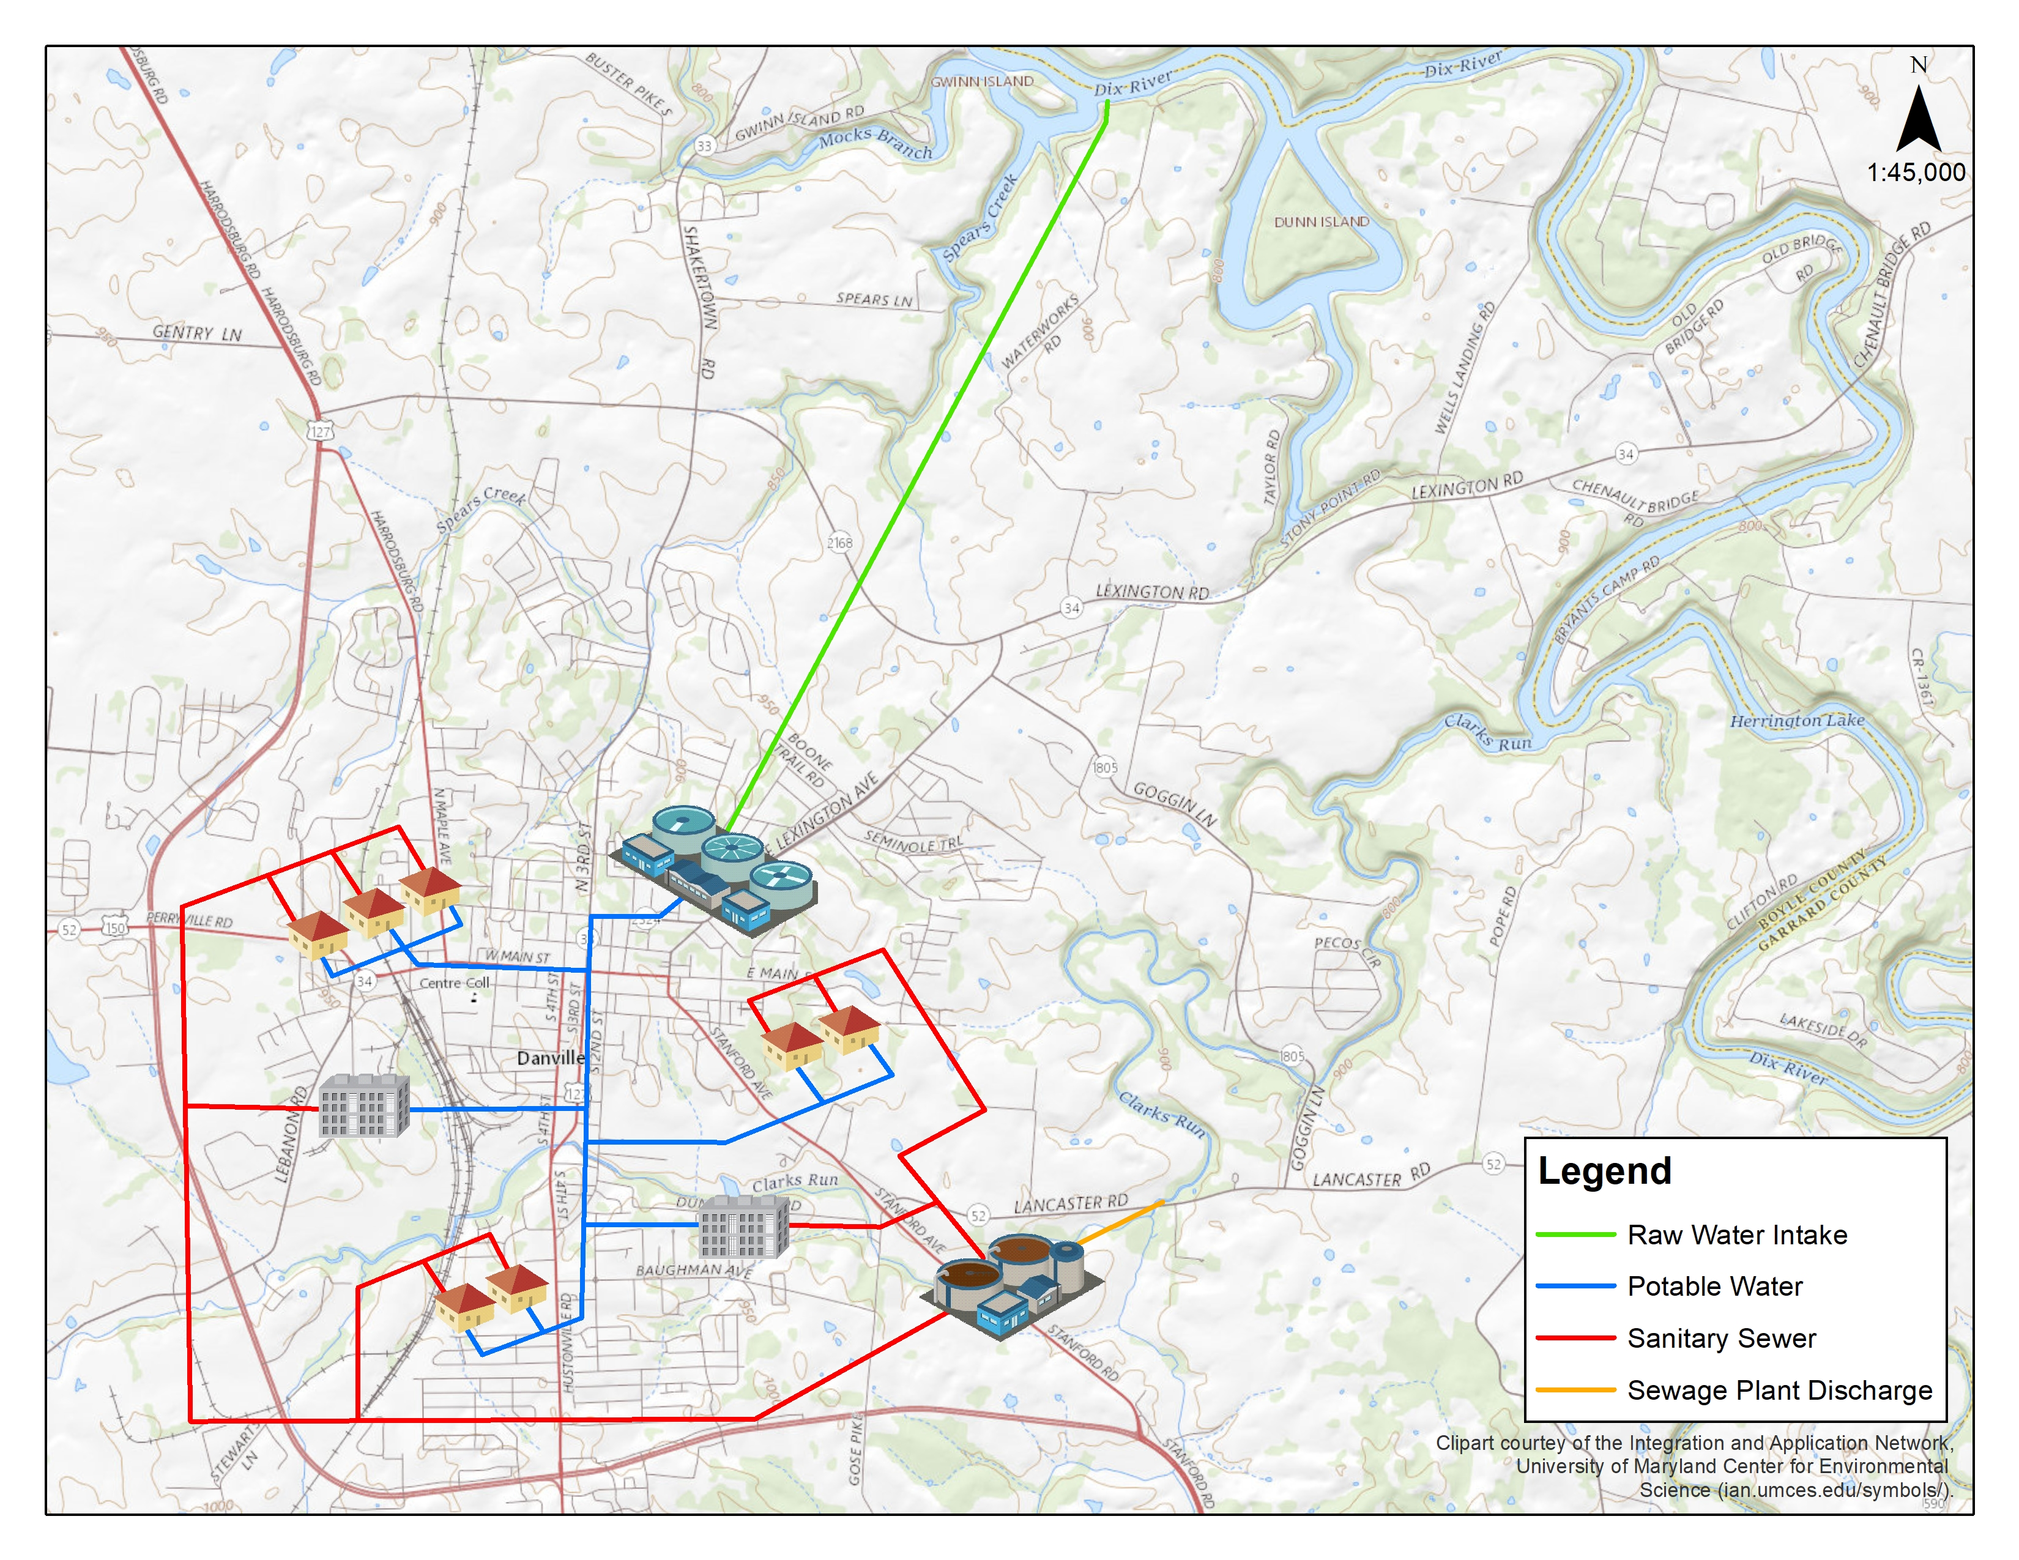
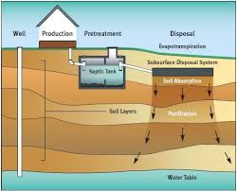
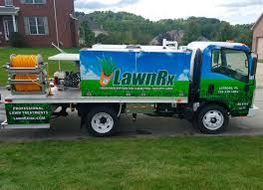
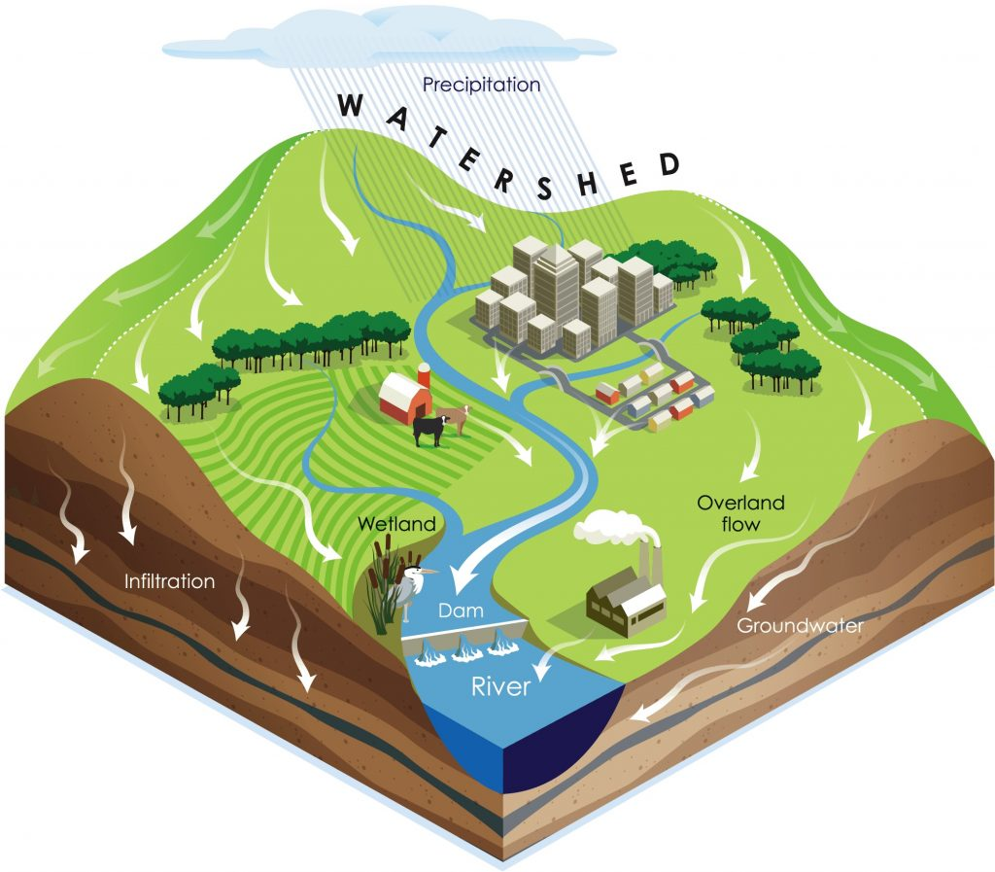
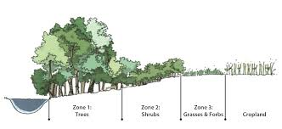
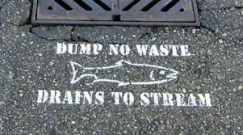
Source: bewaterfriendly.com
Notes:
Why is watershed outreach so important?
CLICK - Well, first how many people (outside of work) do you know that can tell you what a watershed is?!?
CLICK – How many people realize that city storm sewers drain straight to waterbodies?
CLICK – How about lawn fertilizer runoff and its impacts to receiving waters?
CLICK - How many people know that septic systems can pollute our creeks and streams if they aren’t maintained?
CLICK – How about the importance of vegetated buffer zones along creeks?
CLICK – And, what about just the basics of where their household water comes from and where it goes after they use it?
So, there’s plenty of outreach work for us to do!

Slide 3
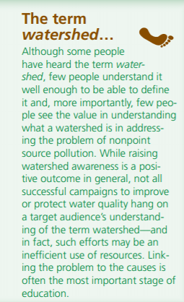

Linking Cause
Effect
Notes:
In our communications, it’s important to link a cause to an effect that people care about.
A Kentucky water education campaign from the 90’s attempted to teach people about the impacts of runoff pollution through the slogan, “If it’s on the ground, it’s in your water.”
It was hoped that this catchphrase would help people make the direct connection between pollution, rainfall, and their water quality (and it didn’t necessitate full comprehension of the watershed concept).

Slide 4
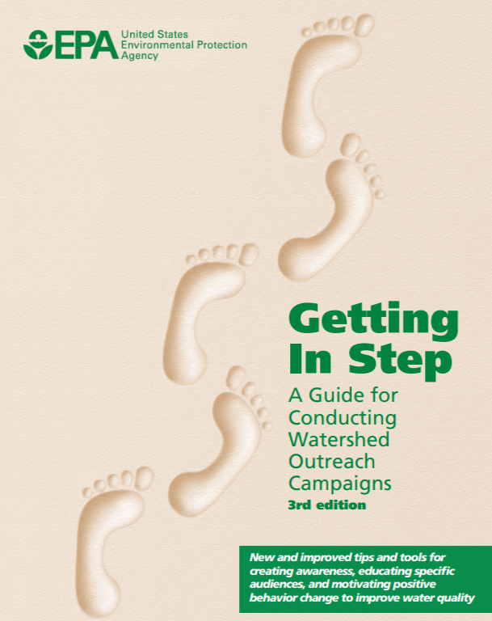
How do we best reach out to people and motivate them to act?
Target our message to a specific audience in a way that prompts them to respond to that message!
Notes:
Once we help people understand the cause and effect, how do we motivate people to act?
CLICK - To do this, we need to create a targeted message to a specific audience in a way that prompts them to respond. This takes some careful research and thought.
In this module, we will be discussing HOW to effectively reach out to people and motivate them, including:
ways to understand who your audience is
how to create messages that are meaningful to them, and
ways to communicate that message which, hopefully, prompt behaviors that help reduce water pollution.
The USEPA’s Getting in Step guide on conducting watershed outreach campaigns is an invaluable reference for these efforts and we will be walking through its main points in this presentation. As you work through these concepts in your own work, you are encouraged to refer to this document for more thorough guidance.
There are also a slew of other resources on this topic, some of which we will also be touching on today and some of which will be listed in the supplemental resources for Module 6.

Slide 5
Developing a Watershed Outreach Campaign
STEP 1: Define the driving forces, goals, and objectives
STEP 2: Identify and analyze the target audience
STEP 3: Create the message
STEP 4: Package the message
STEP 5: Distribute the message
STEP 6: Evaluate the outreach campaign
Notes:
The EPA guide divides the outreach campaign process into 6 main steps, each of which builds on the previous step.
Define the driving forces, goals, and objectives
Identify and analyze the target audience
Social Marketing and behavior change tools
Create the message
Behavior Change Matrix
Package the message(evaluating when and how to use different media)
Distribute the message
Evaluate the outreach campaign for its effectiveness at achieving your goals
We are going to go through each of these steps briefly during this overview presentation and then individually in subsequent sessions.

Slide 6

Let’s start planning…
…because you need a plan!
Notes:
To conduct your outreach campaign, a plan is needed—just as a map or driving directions are needed when you set out on a road trip.

Slide 7
STEP 1: Define the forces, goals & objectives
Driving Force:
Why are we thinking about doing this?
  e.g. concerns of health risks, flooding, land use change, regulations?
Goal(s):
General statements that express the broad focus.
  e.g. To increase recreational use? To decrease flooding? To limit property loss due to erosion?
Objectives:
Specific actions aimed to achieve the goal(s).
SMART - Specific, Measurable, Achievable, Relevant, Time-focused
Notes:
First, let’s decide where we are going! This includes our driving forces, goals and objectives.
Driving Force: Why are we thinking about doing this?
By identifying the forces that are driving the need for the campaign, you can better determine an overall scope for the campaign and focus it on what needs to be done. The driving force often centers around a specific issue.
Examples of driving forces for watershed campaigns may include public concerns such as health risks or flooding, land use change concerns, and regulations.
Goal: General statements that express the broad focus of your effort. Make sure that your goal links back to the driving force behind it.
Examples of goals could be: Recreational use attainment, Fish population increases, Decreased flooding, Reduced property loss due to erosion
Objectives: These are specific actions that are aimed to help achieve the stated goal or goals. You’ll probably develop several objectives for each goal you’re trying to achieve.
The objectives you develop should be Specific, Measurable, Achievable, Relevant, Time-focused (SMART).
Consider if your objectives are meant to create awareness, provide information or encourage action among your targeted audience.
How many people do you want to reach? Over what time frame?
Think about how you will measure success.
The more specific you can be, the easier it will be to develop related tasks or action items.

Slide 8
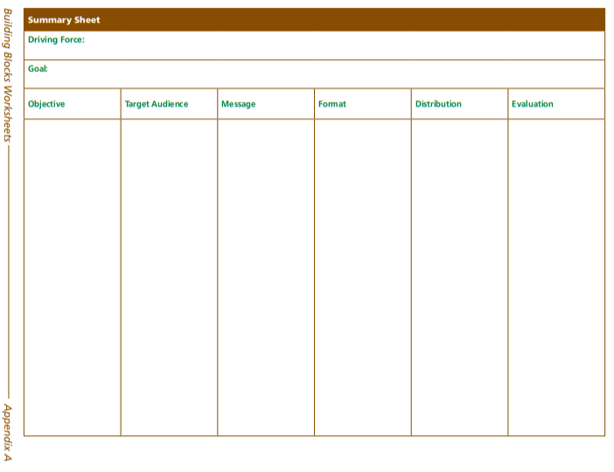
Building Blocks Worksheet
Notes:
As we work through the Module 6 presentation, you will be working through a series of worksheets to help you develop an outreach strategy.
We will talk more about forces, goals, and objectives in the next presentation today.

Slide 9
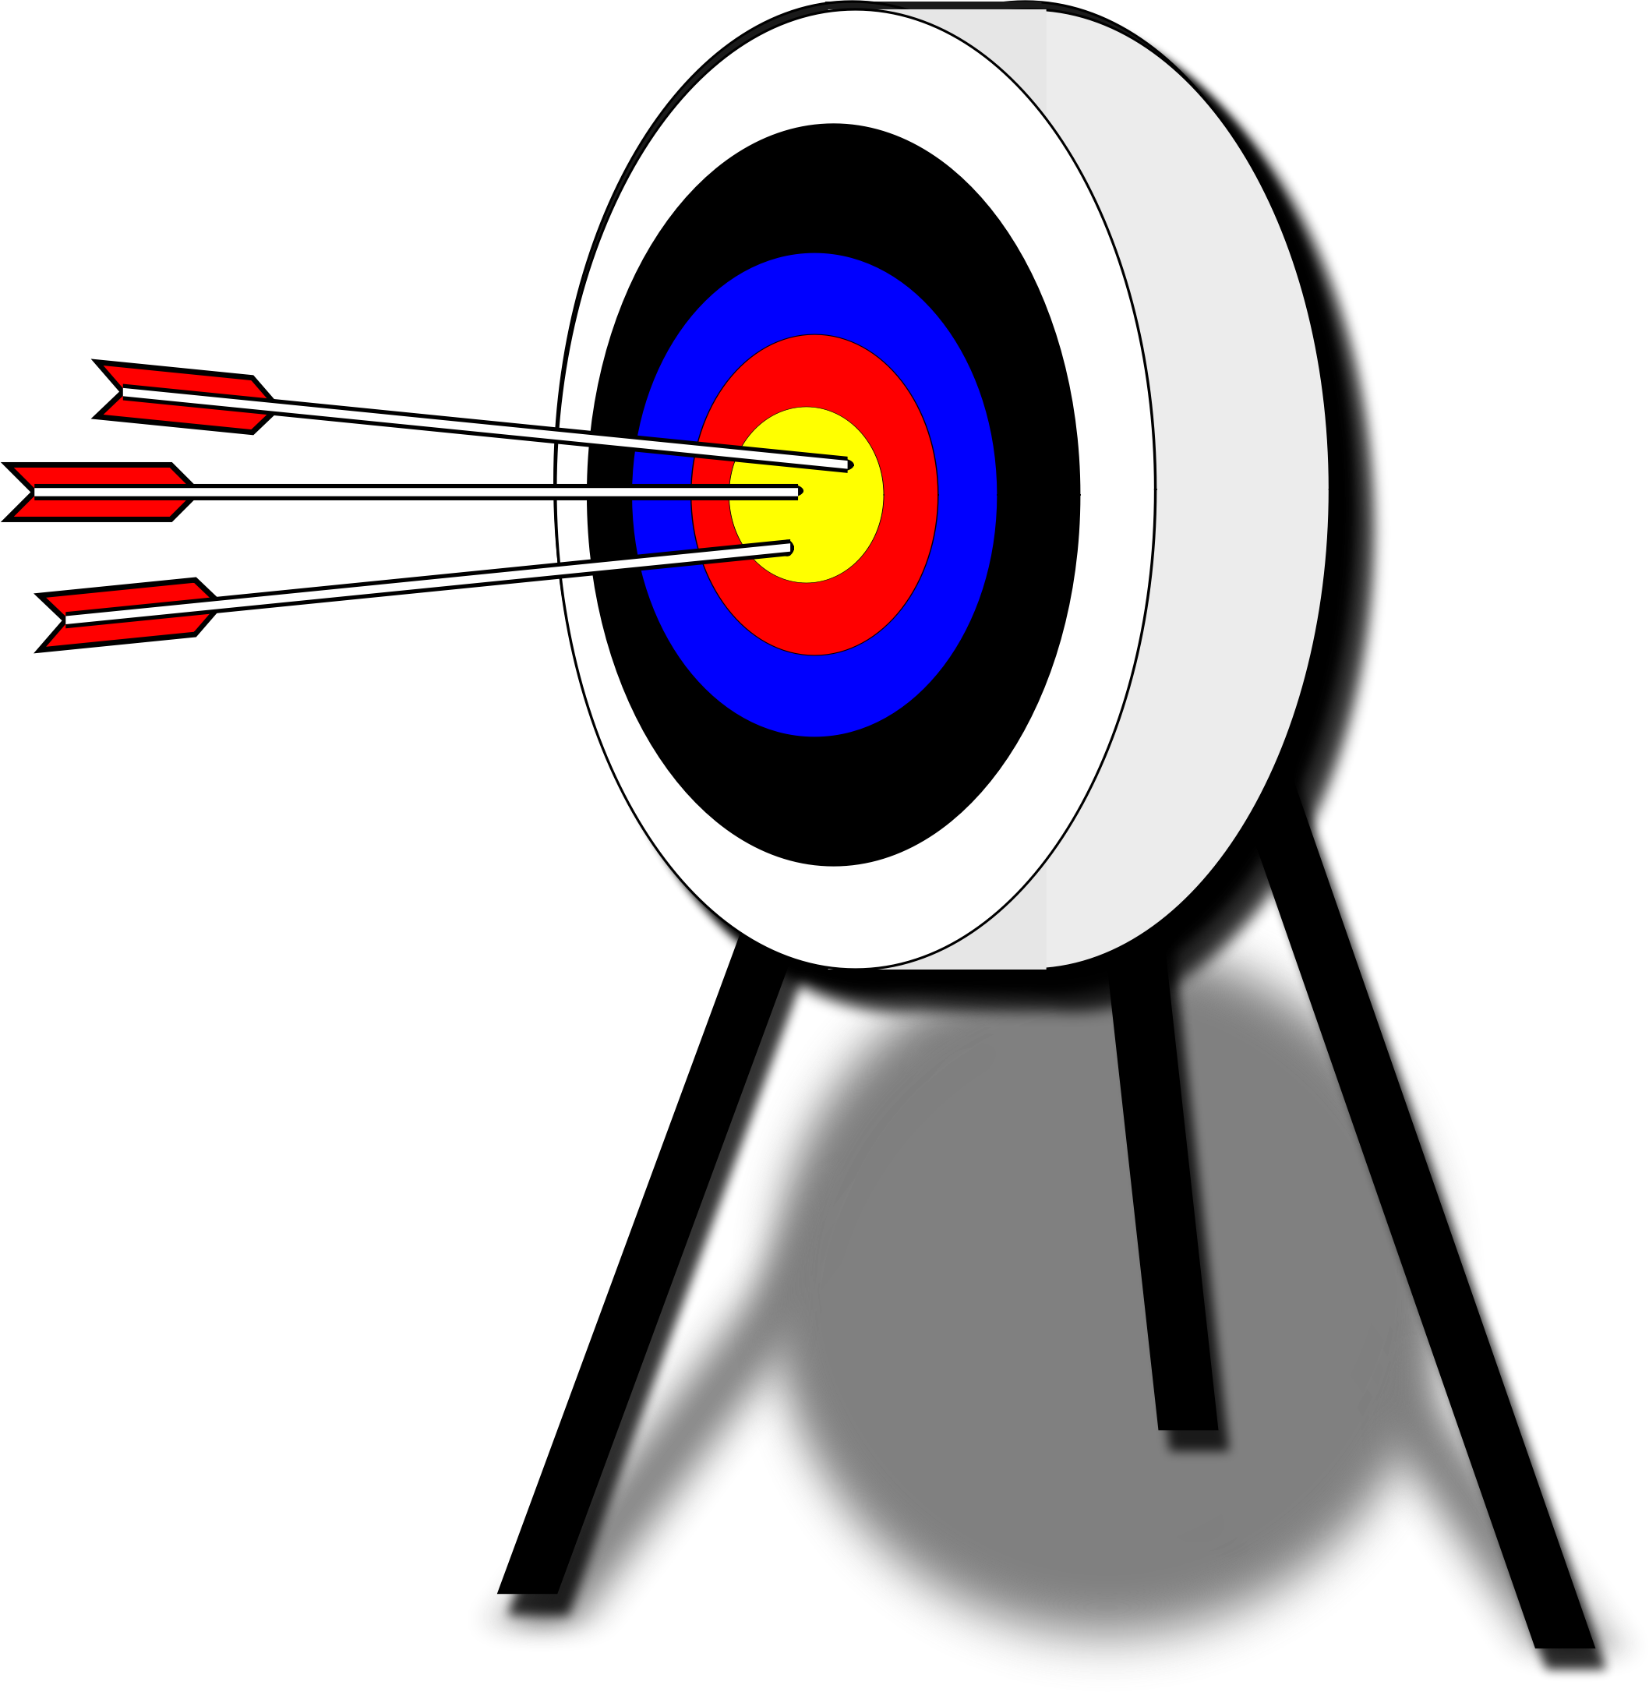
Who do we want to reach?
STEP 2: Identify and Analyze the Target Audience.
Might be obvious, might require research.
General awareness among general audience has limited effectiveness, only first step.
Will want to tailor message to fit segment of community that you wish to reach.
Think of audience as a customer, and you as salesperson.
  Want them to “buy” a behavior or attitude to help achieve your goals.
Notes:
Now, we need to figure out who we want to reach with our campaign to help achieve our goals. Let’s talk about developing a targeted audience.
Generalized outreach and education among a broad audience can help raise awareness about a water resource, but it is unlikely to result in real changes. It should only serve as a first step in the process.
You will always want to break down the target audience into the smallest, most specific segments possible and tailor your message in a way that resonates with each segment.
In this way, you are similar to a salesperson who is trying to convince your specific audience to buy into attitudes or behaviors that will help satisfy their needs as well as yours. Think about what’s in it for them? By figuring out what is important to the targeted audience, you can craft a message that is most effective.
For example, a target audience for increasing streamside vegetation buffers may require identifying property owners along the stream corridor. Neighborhood associations can help promote the need if they are bought into the benefits that it can provide. And, another audience may be local officials who can develop and implement buffer ordinances to help satisfy water quality regulations or community livability goals.

Slide 10
STEP 2: Identify and Analyze the Target Audience.
Segment the audience
Decide which segment to target
Determine what information you need
Obtaining the information
Analyzing and understanding the audience
Audience
Farmers
Homeowners
Elected Officials
Notes:
So, for this 2nd step in the process—identifying and analyzing your target audience, you will first want to SEGMENT YOUR AUDIENCE.
2) Then, you’ll decide which segment you want to start focusing on first.
3) Determine what information you need to better understand this group and its understanding and attitudes about your issue.
4) Once you know what information you need, you can go about tracking it down.
5) And, then you can analyze it to help you better understand this sector of people.

Slide 11

STEP 3: Create the Message(s)
STEP 3: Create the Message(s)
Your Message
Be clear and specific
Engage your audience
Consider Water Quality Objectives
Connect to audience values
Bring about awareness
Articulate needed actions
Notes:
Now, you get to be creative and use the information you have gathered to create your message or, likely, messages!
It’s time to prompt the knowledge, attitudes and actions that will help you achieve your water quality objectives.
CLICK - Begin by reflecting on your water quality objectives.
Then, when developing your related message:
(CLICK) Be clear and specific
(CLICK) Engage your audience
(CLICK) Make sure you do this by connecting with their values and appealing to them on their own terms.
(CLICK) In many cases, you will need to begin by building awareness of the issue before you can advocate for action.
(CLICK) And, prompt a response by providing clear, specific actions the audience members can take.

Slide 12
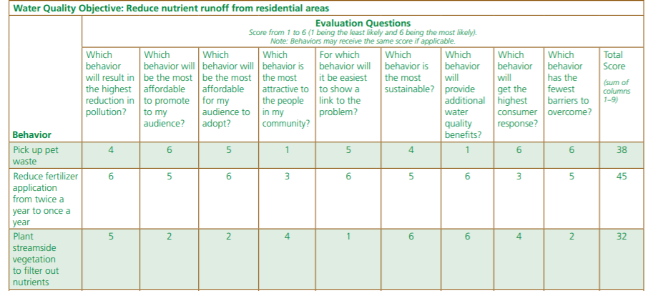
STEP 3: Create the Message(s)
Behavior Selection Matrix
Notes:
We will help walk you through a behavior selection matrix. First, we’ll list potential behaviors to address the objectives outlined in Step 1. Then, we’ll refine which behaviors are most feasible and should be pursued through messages developed in Step 3.

Slide 13

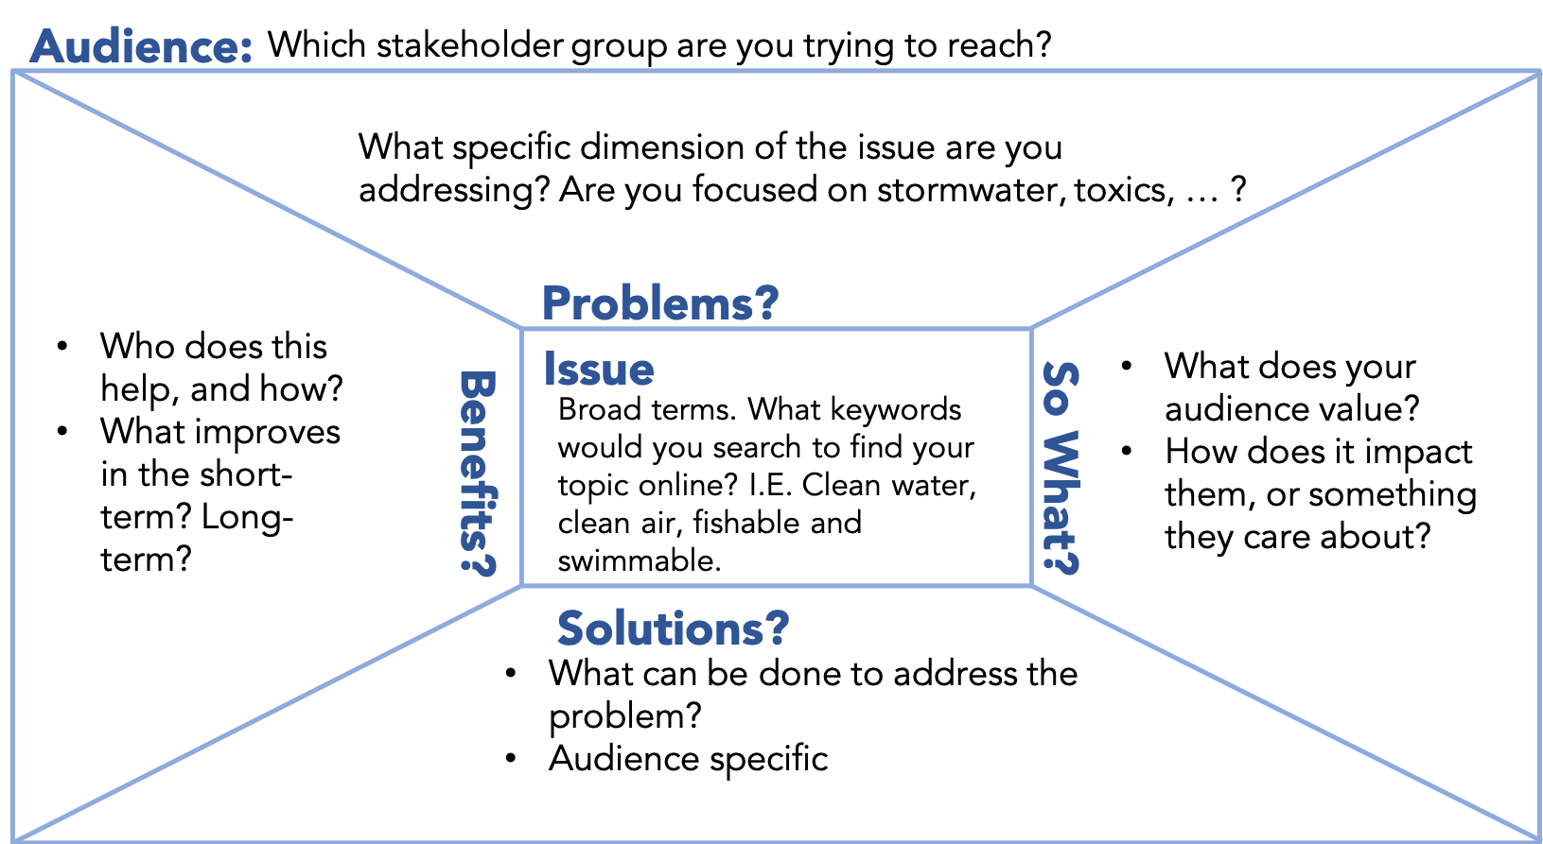
STEP 3: Create the Message(s)
Message Box
Notes:
And, we will introduce you to the COMPASS Message Box as a tool to help you create your message and tell your story.
This can be used for developing websites, writing press releases, or preparing for a meeting with a key representative.
The goal is to help you think through the key pieces of information to provide to your audience.

Slide 14


STEP 4: Package the Message
Audience Format
Size of audience
Geographic distribution
Level of awareness/education
Preferred formats
Notes:
Now that you’ve defined the objectives, assessed the target audience and crafted the message, it’s time to figure out the best format for delivering the message to your audience.
You need to think about where the target audience gets its information. For example, the farming community is likely to frequent farm supply or feed stores, the cooperative extension office, read articles in farming publications, and may be willing to attend a field day event.
To link the audience to the appropriate format, consider:
Its size – a door-to-door campaign is not practical for a large audience, and a big event is not practical for a small audience
Its geographic distribution – if the audience is spread out over a large area, a single workshop is not likely to draw in a significant number of participants
The level of awareness and education – is this issue new and unfamiliar, or have their been past efforts to raise its visibility; also, consider language barriers if English is not the first language for many residents
Preferred formats – consider availability of internet access before settling on a campaign-specific website; what format will have a lasting impact?

Slide 15

STEP 5: Distribute the Message
HOW?
Direct mail, email, door-to-door, phone calls, etc.
WHO?
Most trusted members of the community.
WHEN?
Timing is important!
Notes:
How? Even in today’s online world, face-to-face communications are important ways to build understanding and buy-in. A two-way conversation is more meaningful and includes facial expressions, body language and other intangibles in human connection and communication. It is also easier to ignore other messaging approaches that don’t involve in-person communication, such as emails, texts or phone calls.
Who? A member of the target audience is often the most effective message delivery vehicle. Recruiting audience members—or joining in their events or on their publications—should be a primary consideration during any message distribution effort.
Your organization - Staff member
Government agency – Someone from target audience?
Community Spokesperson – celebrity, reporter, or other respected community members
Peers of target audience - Snowball approach from word-of-mouth communications
WHEN? The timing of your message should also be considered and scheduled to generate the greatest impact.

Slide 16
STEP 6: Evaluate the Outreach Campaign
Evaluate what is working every step of the way.
  PROCESS:
  Is the effort being carried out effectively?
  IMPACT:
  Was change affected?
  Consider social and environmental indicators.
  CONTEXT:
  Community perceptions and ramifications of the message(s)
Notes:
Evaluation of your outreach program provides a way of collecting feedback so that you can continuously improve it and ensure that it’s effective at achieving your goals. This is commonly referred to as adaptive management. It enables you to adapt your approach along the way if things aren’t working. Evidence of effectiveness is also often a requirement for grant-funded projects.
By considering this step from the outset of your campaign, you can better ensure that you are evaluating it with some accuracy along the way.
You will want to consider three types of evaluation:
Process evaluation looks at how effectively you executed the planned activities, such as meetings or media pushes.
Impact evaluation includes ways of measuring achievement of the actual goals or objectives of the outreach effort. These can be social indicators (behavior-based) or environmental indicators. A social indicator may be how many people actually adopted the behavior being promoted. An environmental indicator may be how much the water quality parameter has decreased over the course of the campaign.
Context evaluation helps you understand how the program played out in the community as a whole, how it was perceived, and any economic or political ramifications it may have had. This type of evaluation may help you figure out what approaches work better than others. For example, was the watershed festival well-attended and did you receive positive feedback about it in the community?

Slide 17
STEP 6: Evaluate the Outreach Campaign
Evaluation Indicator Selection
Notes:
We will use another worksheet to help us think through evaluation approaches throughout the campaign process.

Slide 18
Implementation
Operating Plan Matrix
Notes:
Finally, once a complete campaign strategy has been developed, we need a way to track our implementation status. We’ve devised a worksheet to help get you started on that too.

Slide 19
Worksheet Overview
Overview
1
Force, Goal, Objective
2
Target Audience
3
Message
4-5
Format / Distribution
6
Evaluation
1.1
Force, Goal, Objective
2.1
Select Target
3.1
Message Box
4-5
Checklist
6.1
Evaluation
2.2
Describe Target
2.3
Barriers
Operating Plan
1.2
Behavior Selection
Notes:
This overview is intended to help you see the bigger picture of the Outreach Campaign process. We’ve mentioned a lot of worksheets, so this slide will hopefully help you make sense of them.
An Overview Worksheet summarizes the entire process from Step 1 through 6.
In Step 1, we focus on the overarching forces, goals, and objectives, and begin to list potential behaviors that could be used to accomplish the objectives.
For Step 2, there are 3 spreadsheets to help you walk through 1) selecting and 2) describing the target audience, and 3) identifying barriers to communicating the message. Once we are more familiar with the target audience, we will select which behaviors can best accomplish our objectives.
In Step 3, we will work through the Message Box worksheet.
For Steps 4-5, we have a checklist to think through Format and Distribution considerations and select the best approach.
For Step 6, we have created a form to list out your evaluation strategies.
And finally, once the full plan is completed, you can develop an operating plan to keep track of the everything.

Slide 20
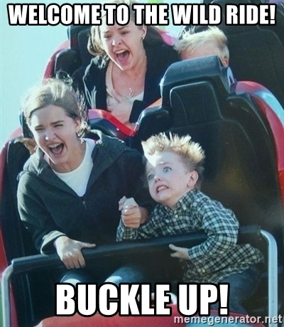
Questions

