Slide 1
Watershed Academy Watershed Coordinator Training Series
Land Use Impacts &
Related Best Management Practices
Activity 1. Using WikiWatershed
Notes:
This activity is intended to increase your familiarity with WikiWatershed, a user-friendly watershed assessment tool to help familiarize you with the generalized landscape of your watershed.

Slide 2
hosted by Stroud Water Resource Center
Model My Watershed is a watershed-modeling web app that enables you to:
Analyze real land use and soil data in watersheds
Model stormwater runoff and water-quality impacts using professional-grade models
Compare how different conservation or development scenarios could modify runoff and water quality
Notes:
WikiWatershed is an initiative of the Stroud™ Water Research Center in Pennsylvania.
The Stroud Water Research Center “seeks to advance knowledge and stewardship of freshwater systems through global research, education and watershed restoration. They provide a wide selection of educational resources on their website, including excellent tools for macroinvertebrate identification.
(SLIDE CONTENT)

Slide 3
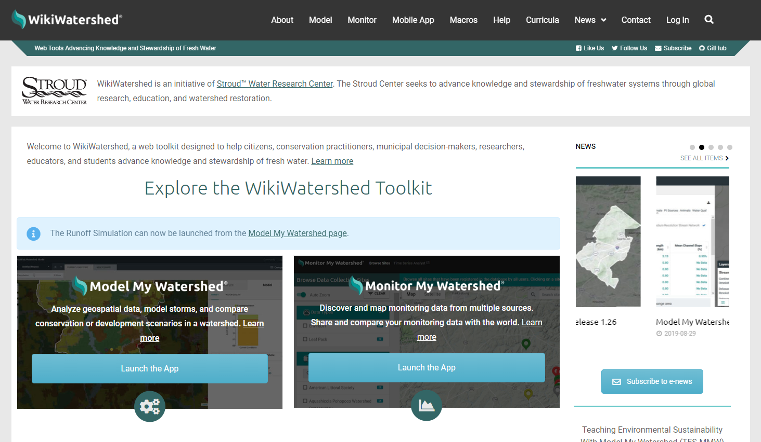
wikiwatershed.org
Notes:
First, go to the WikiWatershed website and click on the “Model My Watershed” Launch the App button to begin.

Slide 4
Step 1: Enter location info into search box.
Enter example info here.
Notes:
This will open the initial page that lists 3 options.
1) “Select Area and Analyze.” this is where we will be spending the most time and will be starting off. This provides quick summaries of data layers for an areas
2) Monitor My Watershed allows you to search for water quality data from various national databases or share your own data.
3) And, Model My Watershed utilizes models to compare impacts of different conservation and development scenarios on water quality. We will take a brief look at this option later.
To get started with selecting our area, enter your location of interest in the search box at the top right corner and click the magnifying lens to zoom to your location.

Slide 5
Notes:
In this example, we selected Paint Lick, Kentucky.
After confirming that it has zoomed to the correct location, click on the Get Started button.

Slide 6
Delineate Watershed
Click here to highlight streams.
Notes:
We are going to delineate a watershed of interest in your chosen location, in this case, Paint Lick.
In the layers box (in lower left hand corner of map), click on the layer, Continental US Medium Resolution Stream Network, to see streams show up in blue. Then click the delineate watershed header on the left.

Slide 7
Click the most downstream point to delineate.
Notes:
Click on the most downstream point of the stream, or its confluence with the receiving waterbody, to see its contributing watershed area.
This particular tributary of Paint Lick Creek is called Lowell Branch.

Slide 8
Stream Network Statistics for selected watershed
Notes:
Here, you can see the contributing watershed for Lowell Branch.
We want to draw your attention to the three tabs (Analyze, Monitor, and Model) at the top of the left hand side. These correspond to the three functions of the program we already mentioned. We will focus on the Analyze function.
The first tab lists stream network statistics, including stream order lengths and mean channel slopes.
It also includes stream lengths in agricultural and non-agricultural areas.
Also, note that the overall watershed area is shown at the top of the display. This particular watershed is 16 square kilometers.

Slide 9
Land Cover Distribution (NLCD) for watershed
Sort
Notes:
In the layers box, select the NLCD coverage to change the map display to land cover.
You can visualize the land cover in one of two ways. You can turn the layer on or off in the top left of the data summary box or from the Layers coverage grid box. Also note that next to each of the layers in the Layers menu is a gray letter “I” inside a circle. This will display the legend for that layer.
Click on the Land tab under Analyze to see the land cover distribution statistics for your selected watershed.
You can sort coverage % from highest to lowest to see which land cover types are dominant in your watershed and the area that they encompass.
This watershed is overwhelmingly used for pasture and hay.

Slide 10
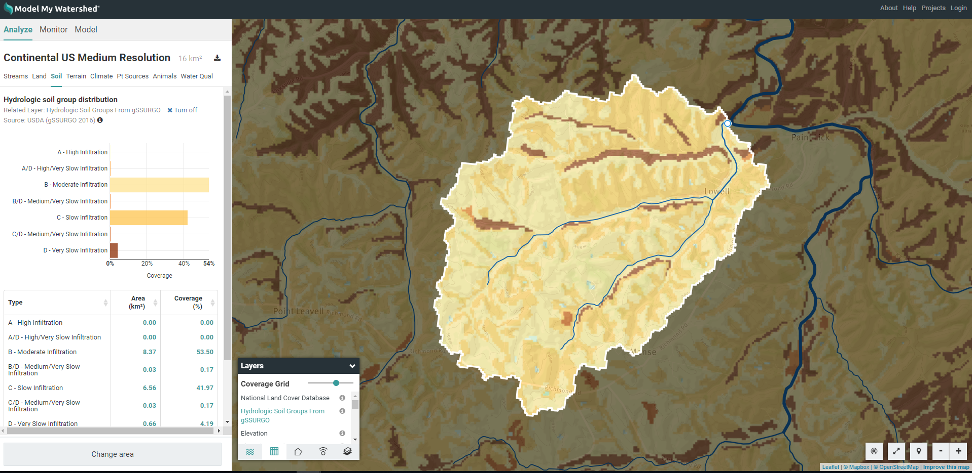
Hydrologic Soil Group Distribution for watershed
Notes:
Next, select the Soil tab and change the layer coverage to Hydrologic Soil Groups.
In this example, the soils have mainly moderate or slow infiltration rates, with a few areas of very slow infiltration (dark brown) in the bottomland valleys.

Slide 11
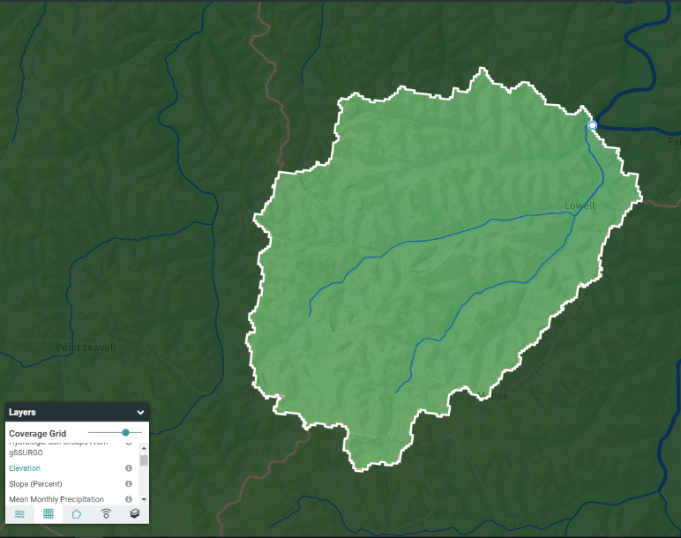
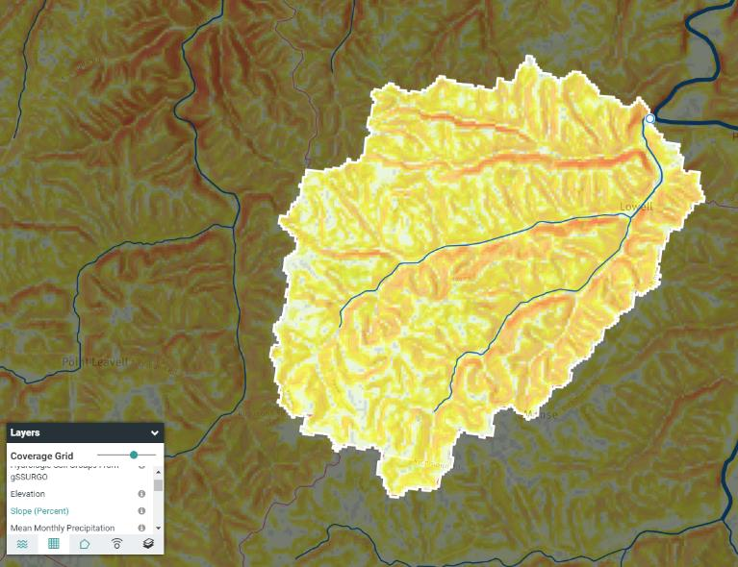
Terrain Statistics for Watershed
Elevation Coverage
Slope Coverage
Notes:
By clicking on the Terrain tab, you can see elevation levels and slope percentages in the watershed.
You can also view separate Layer coverages for Elevation and Slope. The slope coverage uses different colors and is more informative than the elevation coverage, with the steeper areas shown in orange and the flatter areas in white.

Slide 12
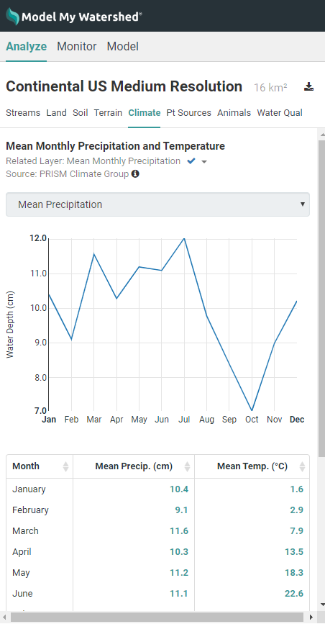
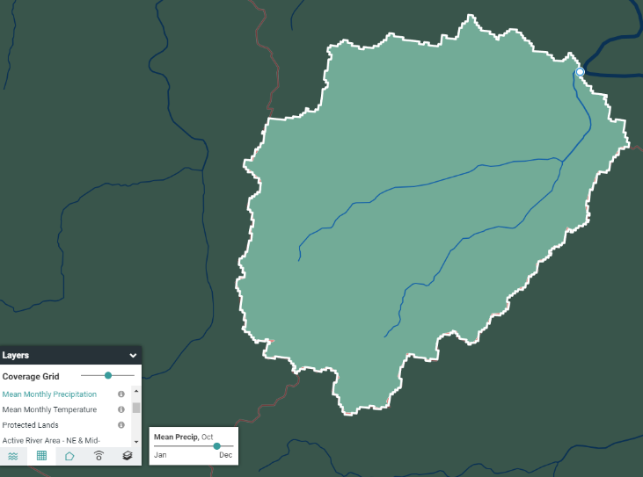
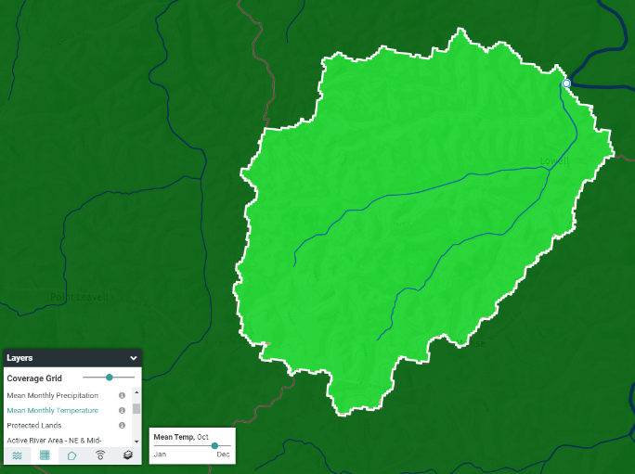
Climate in Watershed
Precipitation Coverage
Temperature Coverage
Select Month
Select Month
Notes:
Click on the Climate tab to see mean monthly precipitation and temperature values for your watershed.
You can select precipitation and temperature coverages, then select individual months. However, this seems to have limited value. Values are depicted as different colors, but the monthly differences are not obvious in the map format since you can only view one month at a time.

Slide 13
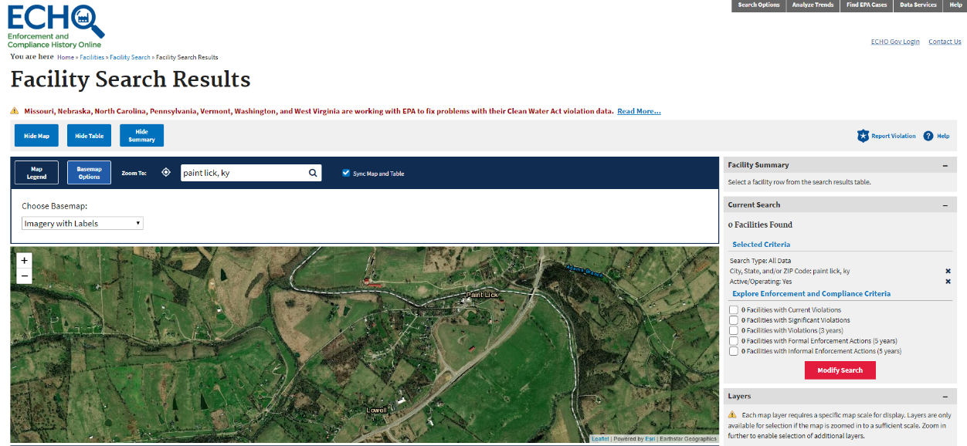
Point Sources in the watershed
WikiWatershed coverage of point sources is spotty but remember USEPA’s ECHO Database for NPDES permit mapping has lots of pertinent info!
Notes:
The next tab for Point Sources is not functional for Kentucky, but remember that you can find that information along with A LOT of relevant details on the USEPA’s ECHO Database (which was covered in Module 1).

Slide 14
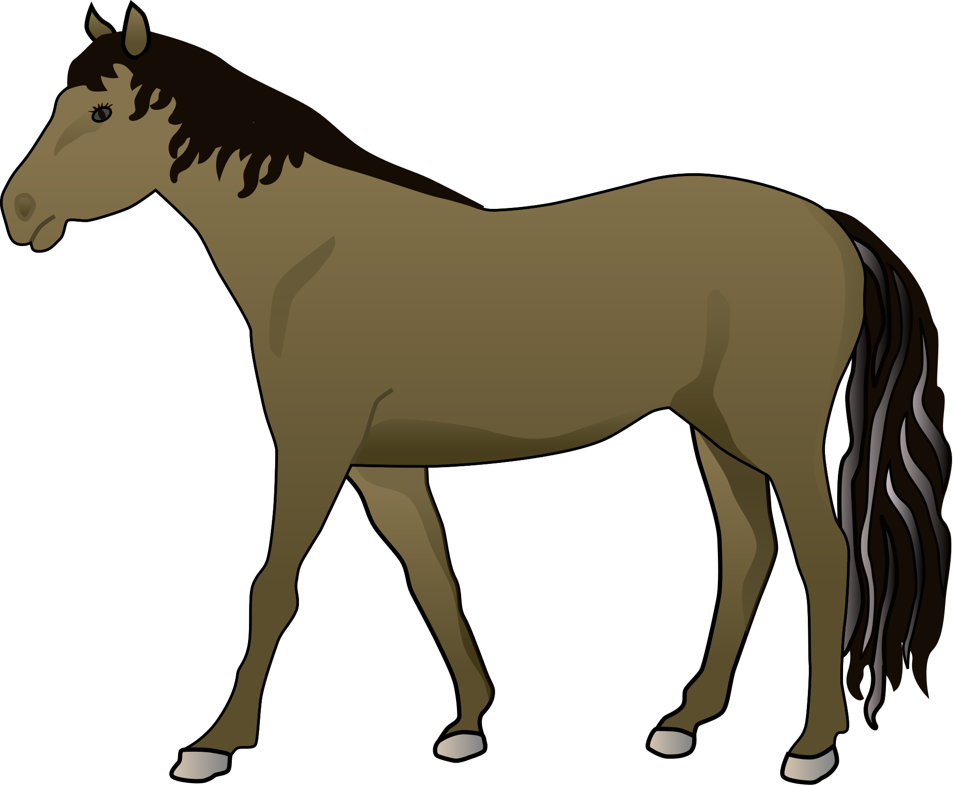
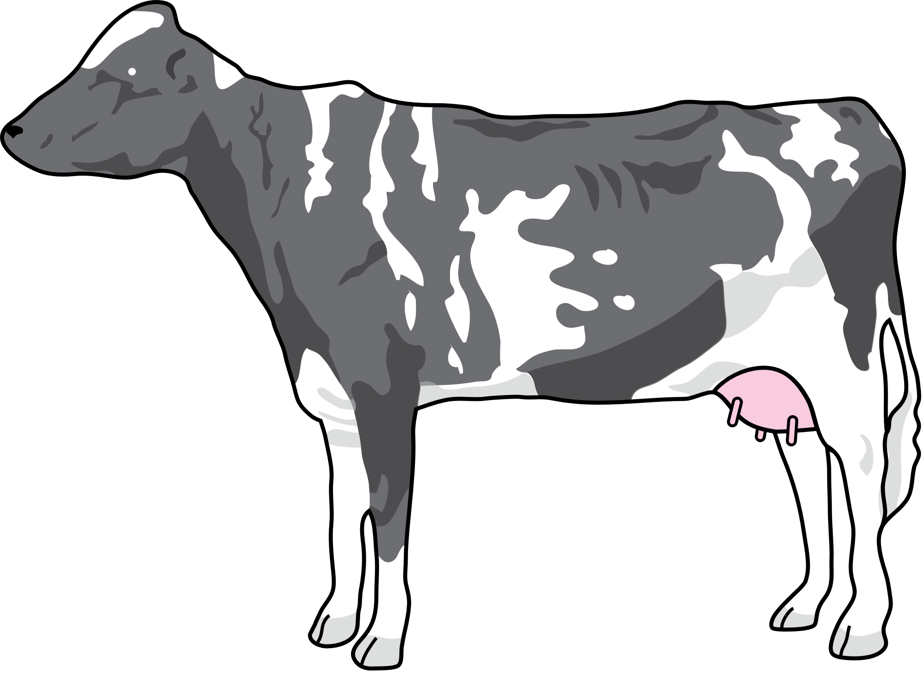
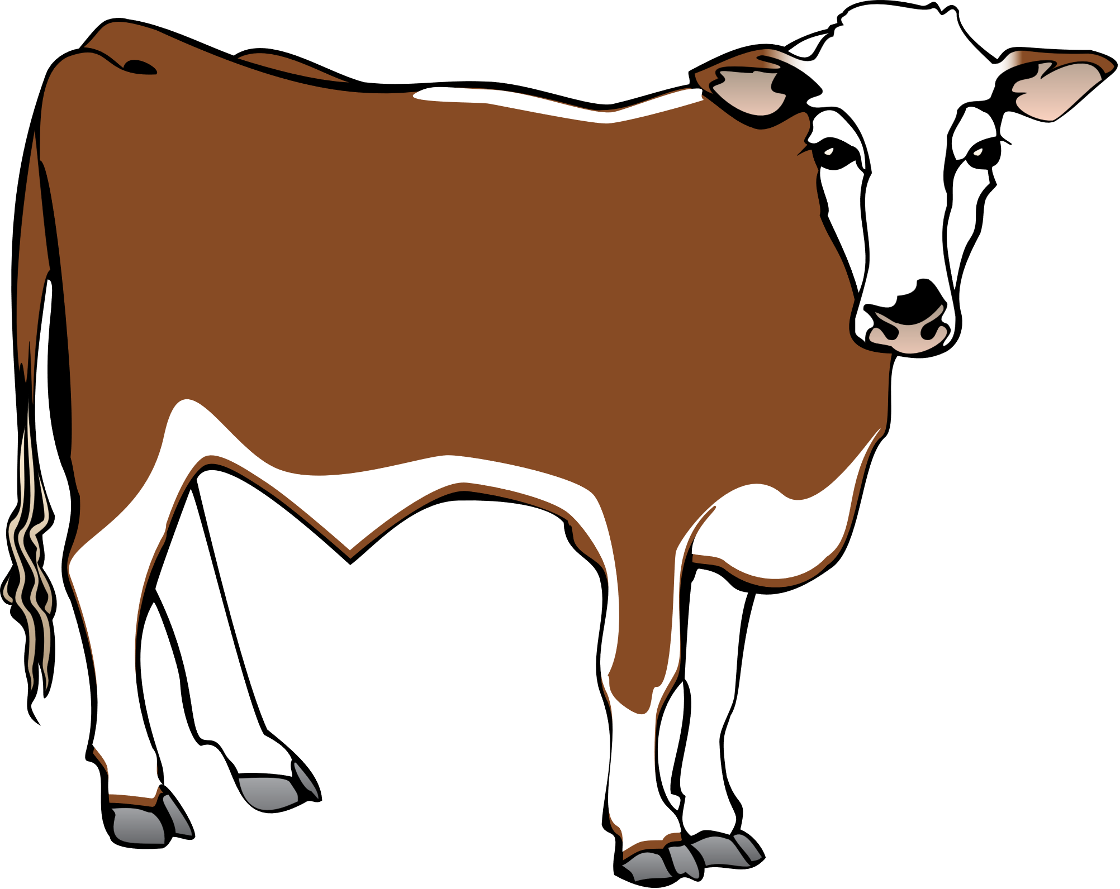
Farm Animals in the Watershed
From NLCD Coverage Results:
Pasture Area = 12.09 km²
Average # of Beef Cows per km² =
439 cows / 12.09 km² =
36 cows / km²
Mainly beef cattle
Graphics: ian.umces.edu
Notes:
The next function for Animals (or Livestock) does not come with an associated map coverage, but it is a helpful reference for USDA data on the numbers of various livestock types in the watershed.
You can also refer back to the pasture area coverage from the NLCD data and estimate #s of livestock per area. (TEXT BOX IN TOP RIGHT)
In this case, the dominant livestock type of beef cattle has an estimated number of 439. If you divide the # of cows by the pasture area of 12.09 square kilometers, you can see that there are approximately 36 cows per square kilometer in this watershed.

Slide 15
Protected Lands in the Watershed
Notes:
The Protected Lands layer coverage shows natural and recreational areas, as well as conservation and agricultural easements.
There are none in our chosen watershed, but you can see several in the surrounding area. The Pinnacles hiking area is in green to the east of Berea.

Slide 16
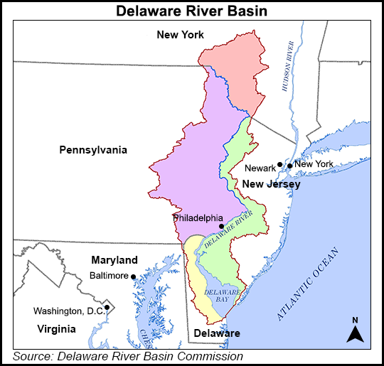
Water Quality currently for Delaware River Basin only.
Extra map coverages for Northeast/ Mid-Atlantic and Delaware River Basin
Notes:
The final tab for water quality is not yet linked to available data for Kentucky. It currently only has data for the Delaware River Basin. And, you will also see that there are extra map coverages specific to the Delaware Basin and other eastern regions. Lucky them!
In case you are wondering…the Delaware River Basin covers parts of four states: Delaware, New Jersey, New York, and Pennsylvania (shown in different colors in the map). The river flows 330 miles from upstate New York to the Delaware Bay, where it meets the Atlantic Ocean.
NOTE that at the bottom of the left column there is a gray button that says “change area” you can use this to go backward to the main menu and select a new area.

Slide 17
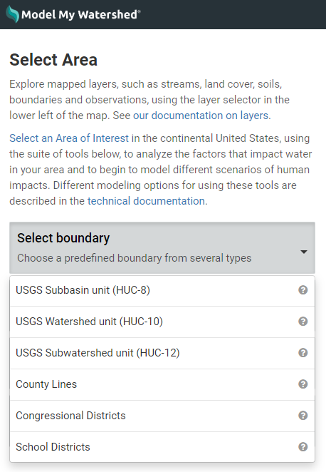
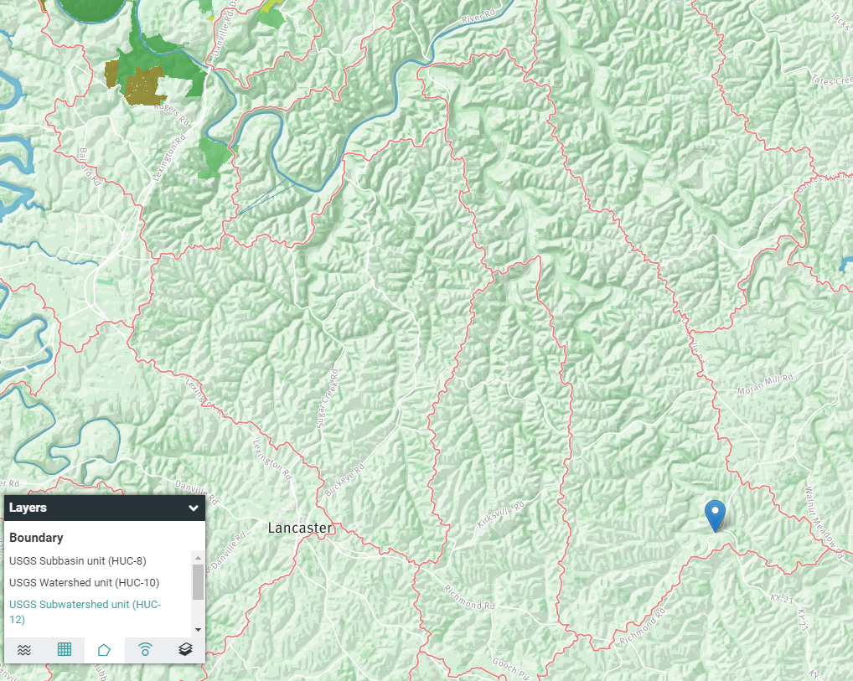
Other Available Area Boundaries
Paint Lick
HUC-12
Notes:
Remember that on the initial page of Model My Watershed, we were offered the option to select a boundary, as opposed to delineating a watershed from a selected point on the stream.
These include USGS Hydrologic Unit Code 8, 10 and 12 areas, county lines, congressional districts and even school districts.
In this example, the Paint Lick HUC-12 Watershed area is shown in a red outline. Paint Lick Creek flows northward to the Kentucky River.

Slide 18
Select Boundary – HUC Watersheds
Notes:
If you click on the HUC12 selection, these delineations show up in pink and you can scroll over them to see the HUC names.
Then, click on the HUC that contains your area of interest, and the same details will be calculated for that HUC area.
So, if we want to see the HUC12 that includes our example area of interest, we look for the pink line that surrounds it and click inside that area, then go through the same process to find watershed characteristics.

Slide 19
HUC 12 Example
Notes:
Here, the HUC12 for the Lower Paint Lick Watershed is shown along with some of its statistics.

Slide 20
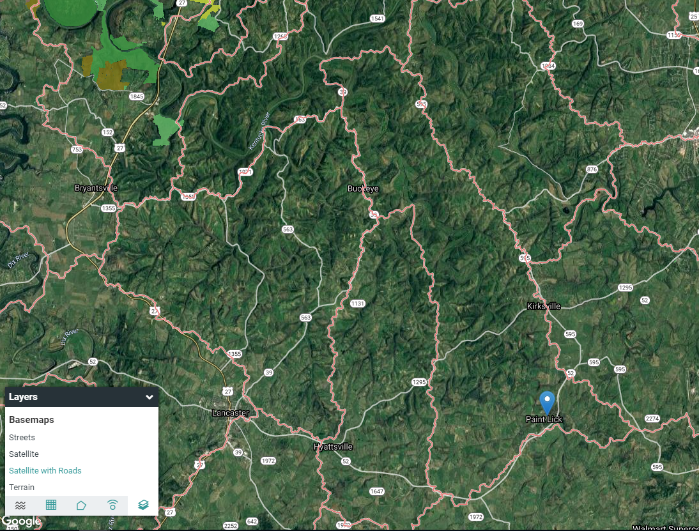
Basemap Options
Streets
Satellite
Satellite with Roads
Terrain
Notes:
There are also several basemap options to use, including satellite with or without labeled roads.

Slide 21
Runoff Simulation
Specify precipitation amount
Notes:
If you click on Model at the top of the page and select the Site Storm Model option, you can see how a specified precipitation amount (adjustable on slider at top right) affects runoff, infiltration and evapotranspiration.
This model simulates a hypothetical 24-hour storm using a hybrid of three model algorithms. It’s designed primarily for use with smaller, more developed areas.
Note the small link to the “Runoff Simulation” under the table. We will come back to this tool in just a moment.

Slide 22
Runoff Loads of TSS, TN and TP
Estimated Loads
Notes:
You can also see estimated loads of total suspended solids, total nitrogen and total phosphorus from the contributing watershed area.

Slide 23
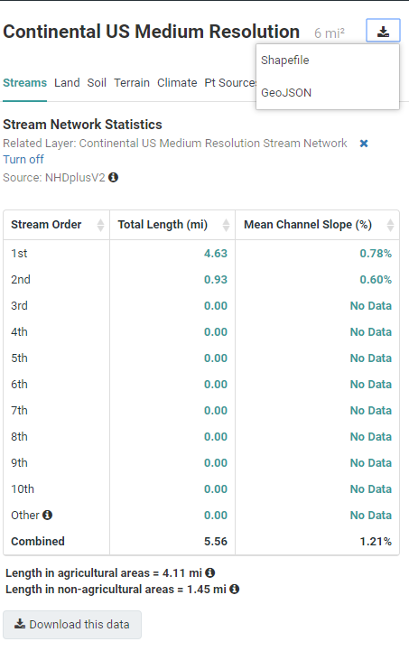
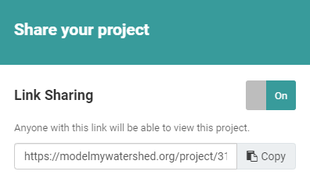
WikiWatershed – Download, Save, and Share
Notes:
You can download all of this data, which can be saved or printed in spreadsheet format.
You can also download the watershed or other boundary delineations and save them as Shapefiles for use in ArcGIS.
And, the maps can clipped and saved in various formats.
The Share your project function allows you to save and share a project with others through a direct link.
So, there is a lot of functionality on WikiWatershed, and we haven’t even covered all of it!

Slide 24
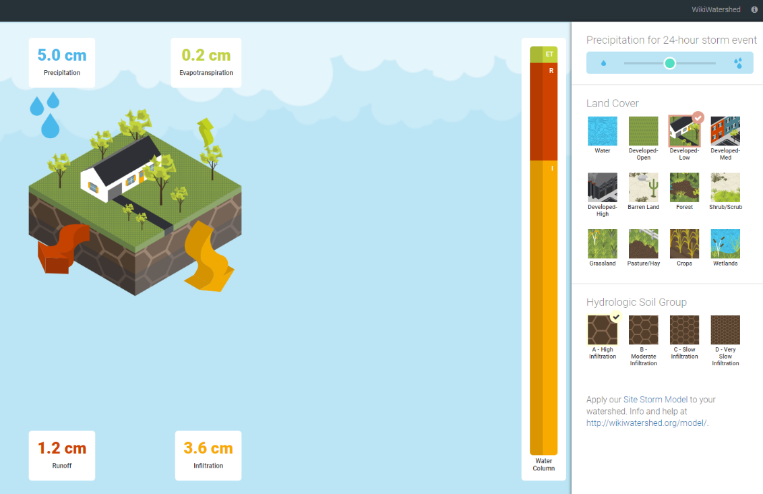
Model My Watershed – Runoff Simulation
The Runoff Simulation is an animated version of the Site Storm Model.
It allows users to see how land use and soil determine the amount of rainfall that:
infiltrates into the soil
runs off into streams, or
is evaporated and transpired by plants
Notes:
One final fun tool on the modeling page worth mentioning for its educational value is the Runoff Simulation animated tool.
This tool is not watershed-specific, but is a good visual for comparing various land cover and soil types with regard to infiltration, runoff and evapotranspiration rates.
You can adjust the 24-hour storm amount in the top right corner and change the land cover and soil types. The proportion of infiltration, runoff and evapotranspiration adjust according to these selections.
Here we have selected low development and high infiltration soils. You can see that infiltration is 3 times the runoff rate.

