Slide 1
Watershed Academy
Watershed Coordinator Training Series
Dealing with Data
5. Quality Assurance / Quality Control Overview

Slide 2
Quality Assurance / Quality Control
Overview of QA / QC
Quality Assurance Project Plan Elements
Quality Measurements
Data Screening Considerations
Notes:
Overview of topics to be addressed in this presentation

Slide 3
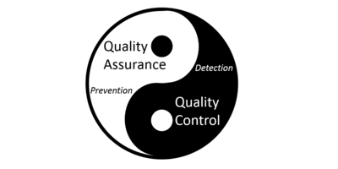
Quality Assurance / Quality Control
Quality
Assurance
Preventing data issues
Before and during collection
Quality
Control
Detecting and repairing data issues
After collection
www.usgs.gov
Notes:
We should begin by stating that the reason we are discussing quality assurance and quality control that these are an EPA requirement for any data collected for 319(h) and any data used for Kentucky Division of Water Use Assessment
Quality Assurance and Quality Control are separate processes but they are intertwined with one another.
Quality Assurance (QA) focuses on Prevention of data problems through good policies.
Quality Control (QC) focuses on Detection of data problems that occur during the monitoring process itself and minimizing their impact.

Slide 4
Quality Assurance / Quality Control
Quality
Assurance
Procedures
Audits
Data Verification
Data sheets or eForms
Quality
Control
Duplicates, checks, blanks
Root cause assessment
Reject flagged data
www.usgs.gov
Notes:
Examples of these two related concepts help demonstrate these separate but related foci:
Quality Assurance (QA) includes procedures, audits, data verification, good data sheets, and similar items. These forms, procedures, and policies help ensure good, consistent practices.
Quality Control (QC) includes duplicate samples, quality check samples, root cause assessments, or rejecting data that does not meet a certain standard. These detect whether the data meet the standards.

Slide 5
Quality System
(Policy / Regulations)
48 CFR 46, 40 CFR 31, 35
EPA QA/R-5, EPA QA/G-5
Quality Management Plan
(Organization / Program)
KY DEP Quality Management Plan,2016
Your organization’s plan
Quality Assurance Project Plan
QAPP for Clean Creek Watershed Plan”
QAPP Template (KDOW Website)
Guidebooks:
Examples:
Methods for Assessing Habitat in Wadeable Waters, KDOW
EPA 350.1 Ammonia, Nitrogen
Hach Multimeter User Manual
Standard Operating Procedures
Analytical Methods
Equipment Manuals
Documentation:
Examples:
Chain of Custody, Lab sheet, Calibration Logbook
Lab Data Review Checklist
Datasheets / Forms / Logbooks
Review Checklists
Notes:
Quality Assurance and Quality Control is assured through a series of documents that move from very general to very project specific.
A Quality System is a policy or regulation that sets overarching requirements for quality.
For example, 40 CFR 46 covers quality assurance on all federal projects. 40 CFR 31 and 35 covers uniform administrative requirements for environmental grants
EPA QA/R-5 and G-5 have to do with what is required in developing quality assurance management plans
A Quality Management Plan documents the general practices that and organization used to ensure quality.
For example, the Kentucky Department for Environmental Protection has an overarching document. Other organizations may have one as well.
The Quality system and Quality Management Plan documents will inform plans for a specific monitoring project. Each project will have specific management, data collection, and data assessment methods customized for that project. These documents are called QAPPs (Quality Assurance Project Plan).
The QAPPs will reference a lot of other documents that indicate how to perform a specific procedure (standard operating procedure), testing method, or operate and maintenance a piece of equipment. These guidebooks ensure that the data collection and testing methods are repeatable and standardized.
Finally, there are standardized forms used to document the data. This includes datasheets, custody logs, maintenance and calibration logs, review checklist. These forms and documents are used to track all information associated with the collection and testing in a standardized manner.

Slide 6
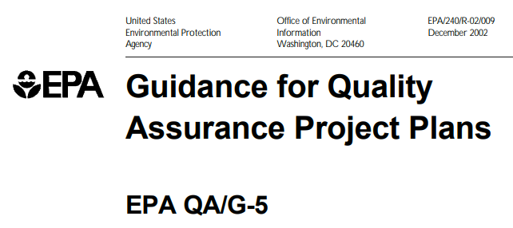
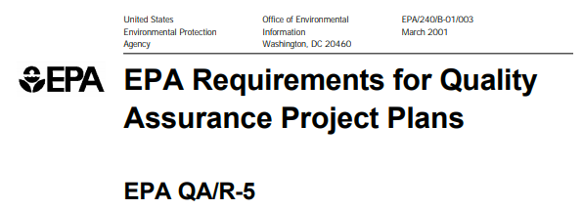

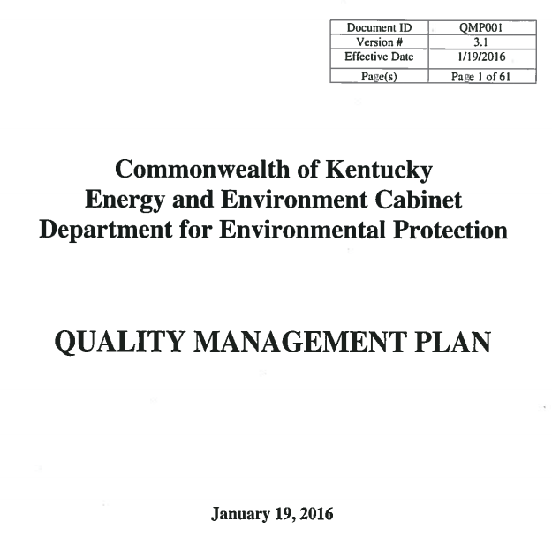
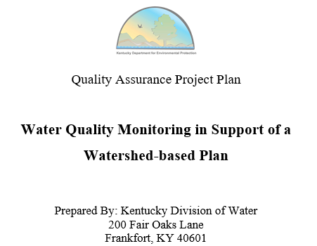
Quality System
(Policy / Regulations)
Quality Management Plan
(Organization / Program)
Notes:
For watershed planning, two EPA guide form the “Quality System.” These specify what is required for a quality assurance project plan (QAPP).
The Commonwealth of Kentucky also has a Quality Management Plan document.
All of these inform a template, developed by the Kentucky Division of Water, that covers what is required in a QAPP for water quality monitoring to support a watershed plan.
A QAPP is necessary for all EPA/KDOW approved watershed planning documents.

Slide 7
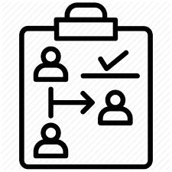
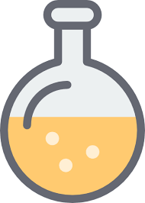



Quality System
(Policy / Regulations)
Quality Management Plan
(Organization / Program)
Quality Assurance Project Plan
Planning / Management
Data Collection
Data Assessment
Notes:
So what goes into a Quality Assurance Project Plan?
You probably will not be developing one as a watershed coordinator, but you might be involved in selecting the technical group who will prepare one. Therefore, it is helpful to have a brief overview of the contents of this document.
Essentially, the document covers three basic areas:
Detailed description of the project management and plan for successful completion
Detailed description of how the data will be collected and analyzed
How will the data be assessed for fitness for use and processed for decision making
We will examine each of these areas a little more in depth.

Slide 8
Quality System
(Policy / Regulations)
Quality Management Plan
(Organization / Program)
Quality Assurance Project Plan
Planning / Management
Data Collection
Data Assessment
Category | Description
Project Goal | Why? Goal of the project, objectives, study questions and issues.
Project Team | Who? Org chart with project manager, responsible personnel, quality assurance officer, field manager, laboratory manager, etc.
Schedule | When? Milestones, Sampling Dates, Report Dates
Data Objectives | What? Type of data. How addresses objective When response is necessary.
Criteria | How good? How much data is necessary and what is minimum quality? When do you exclude data and when do you act upon it?
Training | Key Expertise
Notes:
The Planning and Management section of the QAPP covers an overall description of the who, what, when, where, why, and how of the study. It sketches out the study goals, purpose of each step, objectives of the data, and criteria for acceptance and action.
We will elaborate a little more on the data objectives and indicators

Slide 9
Data Objectives and Action Limits
Data Quality Objectives
What question are you trying to answer? How good does the data need to be in order to answer that question?
  Present / absence or quantitation?
  Statistical difference?
  Allocate between sources?
  General idea for improvements?
Action Limits
What are concentrations or levels at which a response is necessary?
  Regulatory limits, laboratory test maximums, investigation triggers
Notes:
Data quality objectives indicate how good the data needs to be in order to answer the questions you are trying to ask. This is specified by data quality indicators (addressed in next slide).
Action limits are a list of critical levels such as regulatory limits, maximums of a laboratory test, or levels that trigger additional investigation.
All this needs to be known and specified before beginning a study.

Slide 10
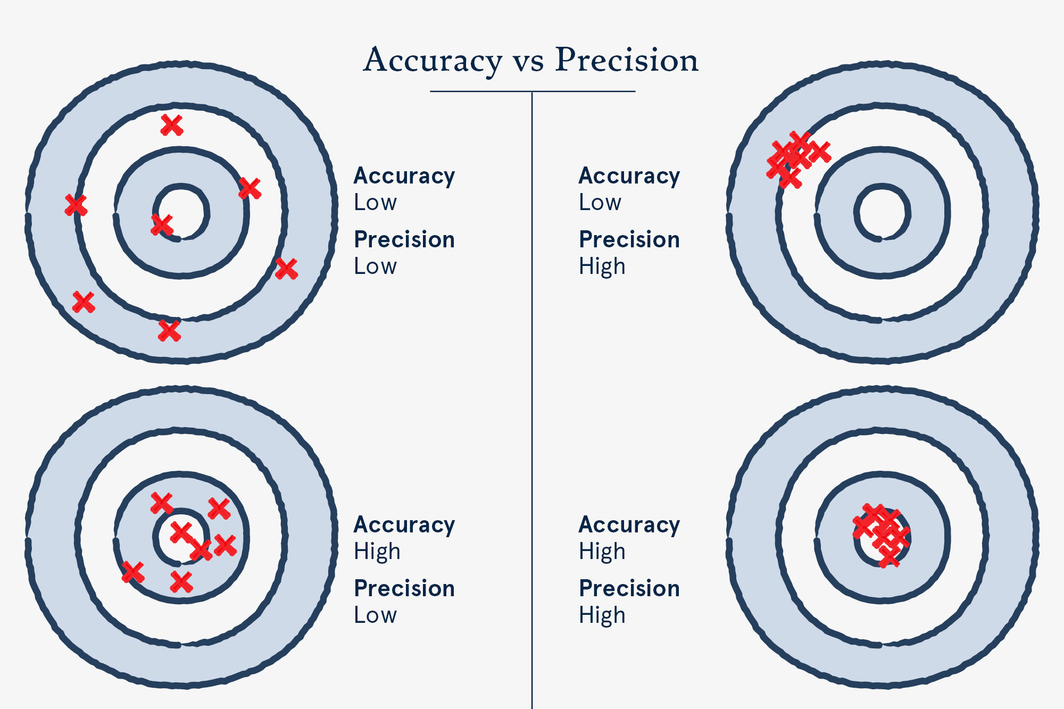
Data Quality Indicators
Precision
  (reproducibility)
Accuracy/Bias
  (trueness)
Representativeness
(sample reflects field)
Comparability
  (similar to other studies
  or locations)
Completeness
(% collection needed, criticality)
Sensitivity
  (minimums)
www.fivesenses.com.au/
Notes:
Here are the six major indicators of data quality.
The graphic illustrates the different between accuracy (trueness) and precision (tightness of grouping).
These data quality indicators will frequently be summarized in a series of tables.

Slide 11
Sample Number
Sample size equations are used to determine how many samples are necessary to produce statistically significant result.
  Example: About 250 samples required to detect a 100 MPN drop in E.coli over 10 years with starting mean of 300 MPN.
Watershed projects are not generally collecting enough data to make statistical statements about reductions.
Generally sufficient for targeting BMPs.
Notes:
When we talk about water quality monitoring projects in general, there needs to be some awareness that often insufficient data is collected to make statistically significant statements about reductions.
There are sample size equations which can be used to calculate the number of samples needed to make a given decision. The equations account for the following factors
Statistical power and confidence
Minimum detectable change
Mean and standard deviation
Water quality target
Therefore there is not a one size fits all projects.
An example is given regarding determining trends for E.coli.
So for watershed planning, the data being collected is generally insufficient for statistically significant statements about reductions.
However, they are generally sufficient to give some general targets to focus best management practices on
Make sure to keep a 40,000 foot perspective.

Slide 12
Quality System
(Policy / Regulations)
Quality Management Plan
(Organization / Program)
Quality Assurance Project Plan
Planning / Management
Data Collection
Data Assessment
Study Design
Problem / Goal
Site Locations
Project Team
Standard Operating Procedures
Schedule
Data Quality Objectives
Analytical Methods
Equipment / Supplies
Acceptance / Performance Criteria
Quality Controls
Datasheets / Forms
Training Required
Notes:
The second section of the QAPP covers data collection. That includes the design of the study, specific locations (or at least the method or choosing the locations), procedures, lab tests, equipment used, forms, etc.
I want to zoom in a little bit on the study design, quality controls, some of the data sheets.

Slide 13
Study Design (see handouts)
Source: National Water Quality Monitoring Council, 2017
Notes:
Study designs for watershed planning will typically be “targeted” monitoring, but they may pull data collected for other purposes. The National Water Quality Monitoring Council (NWQMC) has developed fact sheets on each of these study designs. These have been included in your training packet as references (Briefly hold up each).
Each monitoring design has specific strengths, weaknesses, and products that result.

Slide 14





Quality Controls: Precision
Field Field
% Difference
=
Difference Between Results
Average of Results
Lab Lab
i.e.
(20%)
Lab Duplicate Field Duplicate
Notes:
Ok. When it comes to quality controls, there are some quality controls that will be in almost every quality assurance plan.
This includes controls for precision, accuracy, and sensitivity.
To measure precision, duplicates or split samples are used. The duplicates can be taken in the field (two bottles collected) or one sample can be run twice in the laboratory.
A lab duplicate measures just the laboratory error while the field duplicate includes variability in the field conditions.
Here you expect the results to be the same, so comparing the two results gives a % difference for those measurements.
So a result is never just a result, but a result +/- some percentage.
Measurements in the field (pH, dissolved oxygen, etc.) can also be replicated to provide similar data.

Slide 15

Quality Controls: Accuracy
Known volume of chemical added
% Recovery
=
Amount Substance Measured
Amount Supposed to Measure
Deionized Water Sample
i.e.
(90 – 110%)
Spike/Control Matrix Spike
Notes:
To measure accuracy, there are two types of controls.
On the left is a laboratory control sample or a laboratory spike. On the right a matrix spike sample.
In both cases, a known amount of a pollutant is injected into either a blank (water free from the pollutant) or a duplicate of a sample collected in the field.
In both cases, the test is run to see how the amount measured (or recovered) during the testing procedure compares with what was injected into the sample.
The difference between the laboratory control and the matrix spike is the effect of the sample upon the measurement (too dark color, some sort of chemical interference, etc.)
The % Recovery is usually given a range of acceptance (i.e. 90-110% or 80-120%) depending on the method. If these samples are not in the correct range, the laboratory should be re-testing to get acceptable results.

Slide 16
Quality Controls: Sensitivity
Field Field
Above
Sensitivity
Limit
Method Detection Limit (MDL)
Reporting Limit (RL)
Lab Lab
i.e.
(< 0.25 mg/L)
Lab Blank Field Blank
Notes:
In order to measure how sensitive a measurement is or whether there has been contamination in the process, blank samples may be analyzed.
Blank samples indicate contamination that may occur in the lab or field as well as the ability of the laboratory to distinguish noise from a quantifiable result.

Slide 17
MDL vs RL
MDL = Method Detection Limit
RL = Reporting Limit
Level at which a signal is distinguishable from noise.
Lowest quantifiable level
Detected but not quantified
Generally RL = MDL x 3 or lowest point on calibration curve
If the sample is diluted, the reporting limit will be higher
Between MDL and RL are estimates and must be flagged.
Zero
True zero is unmeasureable for most methods. Best you can say is value is less than your lowest measurable number.
QUANTIFIABLE
CONCENTRATION
DETECTABLE BUT NOT QUANTIFIABLE
All lab results should have an MDL and an RL
UNDETECTABLE
NOTE: “Reporting Limit” is a broad term. Some labs use:
LOQ (Limit of Quantitation).
PQL (Practical Quantitation Limit) includes analyst variability.
Notes:
For most methods, you cannot measure true zero as a result. You can only say it is less than your testing ability.
There are different ways to express how sensitive a test is.
A method detection limit is the level at which a signal can be distinguished from noise. Something is present, but at this level you cannot quantify the results – only estimate them.
A reporting limit or limit of quantitation is the level at which you can state an actual number with a level of statistical certainty.
It is important that the laboratory indicates both of these levels for each test.

Slide 18
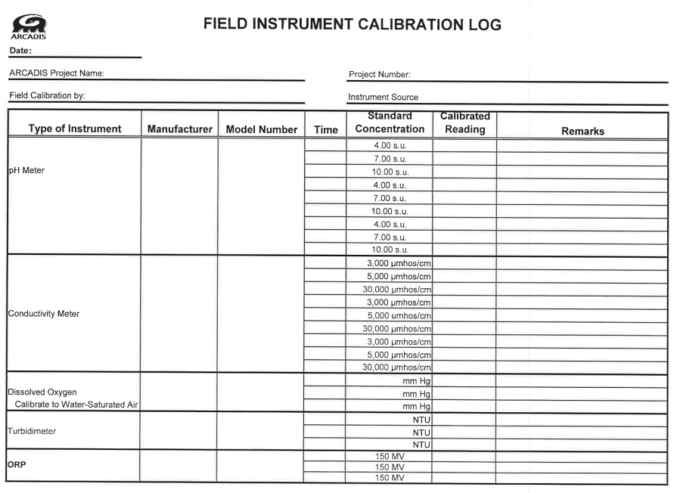
Datasheets / Equipment
Notes:
All equipment (field as well as laboratory) must have a log of calibration and maintenance. This allows for tracing any problems that occur over time and can identify suspect measurements. This is an example of a field instrument calibration log. Where possible to standardize the information recorded, datasheets should be developed.

Slide 19
Quality System
(Policy / Regulations)
Quality Management Plan
(Organization / Program)
Quality Assurance Project Plan
Planning / Management
Data Collection
Data Assessment
Study Design
Assess / Oversight
Problem / Goal
Field / Lab Audits
Site Locations
Project Team
Standard Operating Procedures
Reviews / Response
Schedule
Reports to Managers
Data Quality Objectives
Analytical Methods
Review and Usability
Equipment / Supplies
Verification and Validation
Acceptance / Performance Criteria
Quality Controls
Datasheets / Forms
Review Checklists
Training Required
Qualifiers / Limits
Notes:
The third major section of a QAPP focuses on data assessment.
It includes what sort of actions are taken along the way to oversee the data collection process including audits and notifying folks of problems
It also includes reviewing the data and making sure it is valid for the purpose intended.

Slide 20
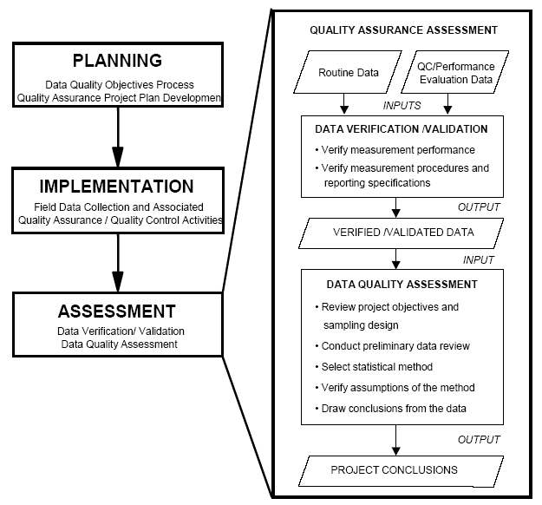
Notes:
Here you can see a summary of the data assessment process.
You look at your data as well as quality controls , inspections, and audits and decide what needs to be thrown out based on pre-determined protocols.
You will want to indicate the type of statistical analyses used, how outliers will be identified, what models the data will be plugged into, etc. It describes how you will process the data to arrive at the end goal and what deliverable formats that end goal will take.
So this summarizes what generally goes into a QAPP document.

Slide 21
General Data Considerations
Collection Considerations:
  Seasonality
  Flow and Timing
  Rainfall and Sources
Review Considerations:
  Data qualifiers
  Non-detections
  Units
Notes:
Having given an overview of the QAPP document contents, I want to give a brief overview of some data considerations when developing a plan.

Slide 22
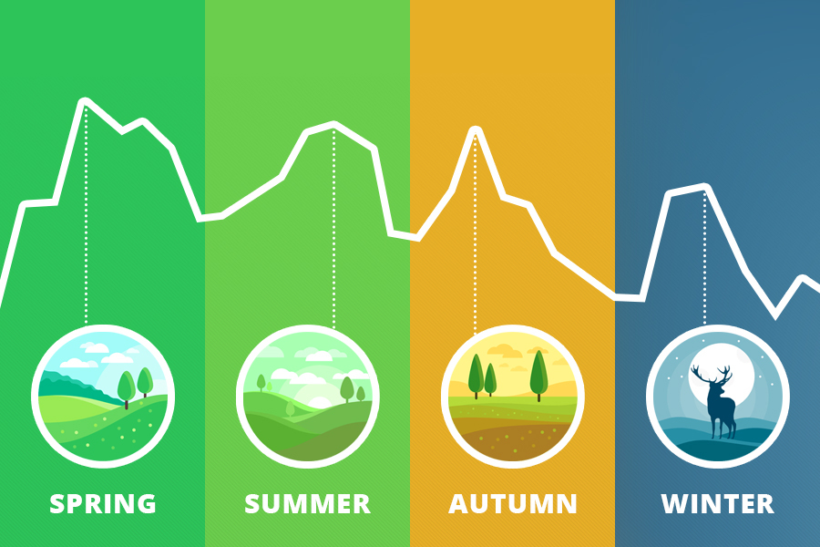
Data Considerations: Seasonality
Rainfall and Groundwater
Landuse
Road salting
Ag Tilling
Fertilization
Health Risks
Life Cycles
Notes:
The first is seasonality.
The KDOW has requirements of month sampling for 1 year at a minimum for basic plan development. This is because waterbodies can act very differently throughout the year.
Think about the type of pollutants that may be coming from landuses in your area.
Is the rainfall different in certain times of the year?
Do people fertilize at certain times?
How about applying salt to roads?
When are people playing in the streams?
When do critical periods for different organisms occur?
Certain periods may require more attention. Think about this during your study planning.

Slide 23
Data Considerations: Rainfall and Source
Weather Related Sources of Phosphorus
Wet Weather | Dry Weather
Lawn Runoff Pasture Runoff Cropland Runoff Sanitary Overflows Livestock/Animal Waste Runoff Bank Erosion | WWTP Effluent Groundwater / Geology Septic Systems
Antecedent dry period?
Point vs non-point source?
Notes:
KDOW requires collection of at least 2 wet events and 2 dry events for successful monitoring. This recognizes that pollutant concentrations are very different in wet weather vs dry weather.
What is dry weather? How long does in need to be dry before a rainstorm comes through in order for it to qualify as a “wet-weather” event. This is described as an “antecedent dry period.”
Thinking about potentially nonpoint sources vs point sources and how they relate to the weather conditions is important.

Slide 24
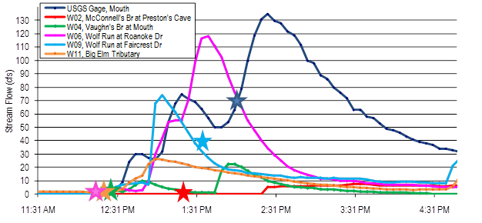
Data Considerations: Flow and Timing
Non-synoptic?
Inter-site Flow Ratio Variation?
Notes:
Consider the effect that flow might have on your sample collection.
Here is an example of storm event monitoring in Wolf Run in Lexington, KY. Each of these colors represents the hydrograph for a different site in the waterhed. From the time the stream started rising to the peak of the storm took two hours at the most. The flow that is measured at the site is largely a product of when the sampler arrived at the location.
If I am trying to compare pollutant loads between sites, then I will have to have a more standardized way to adjust the flow.
Especially if you are comparing samples collected on different days at different sites (non-synoptic), understanding the flow is very important. Otherwise you might be comparing apples to oranges.

Slide 25
Data Considerations
Data qualifiers
Lab specific codes (many be different from lab to lab and can change over time)
Some trigger discarding results or reanalysis.
Notes:
All laboratories will have some sort of code system for qualifying data that is outside of the quality control limits.
You will need to decide what to do about different types of results. For instance, some results may need to be thrown out and re-collected. For others the lab may need to reanalyze. These decisions need to be thought through before sampling begins so that a proper response can be made during the course of the data collection period in the event of a problem.

Slide 26
Data Considerations: Handling Non-detects
What do you do with less than results (or greater than)?
All as “0”?
All is “reporting limit”?
½ of reporting limit?
Other?
Even for simple statistics you will need a policy for how to address non-detections.
Notes:
Even if you are only doing simply data summaries, you need to think through how to handle samples that are below the detection limits.
There statistical guides (such as from the USGS and EPA) that help inform decisions about how to handle non-detections based on the percentage of the data that are below the detection limits. However, assuming everything is 0 vs assuming it is equal to the reporting limit can really bias the results particularly if the reporting limit is close to the water quality standard.

Slide 27
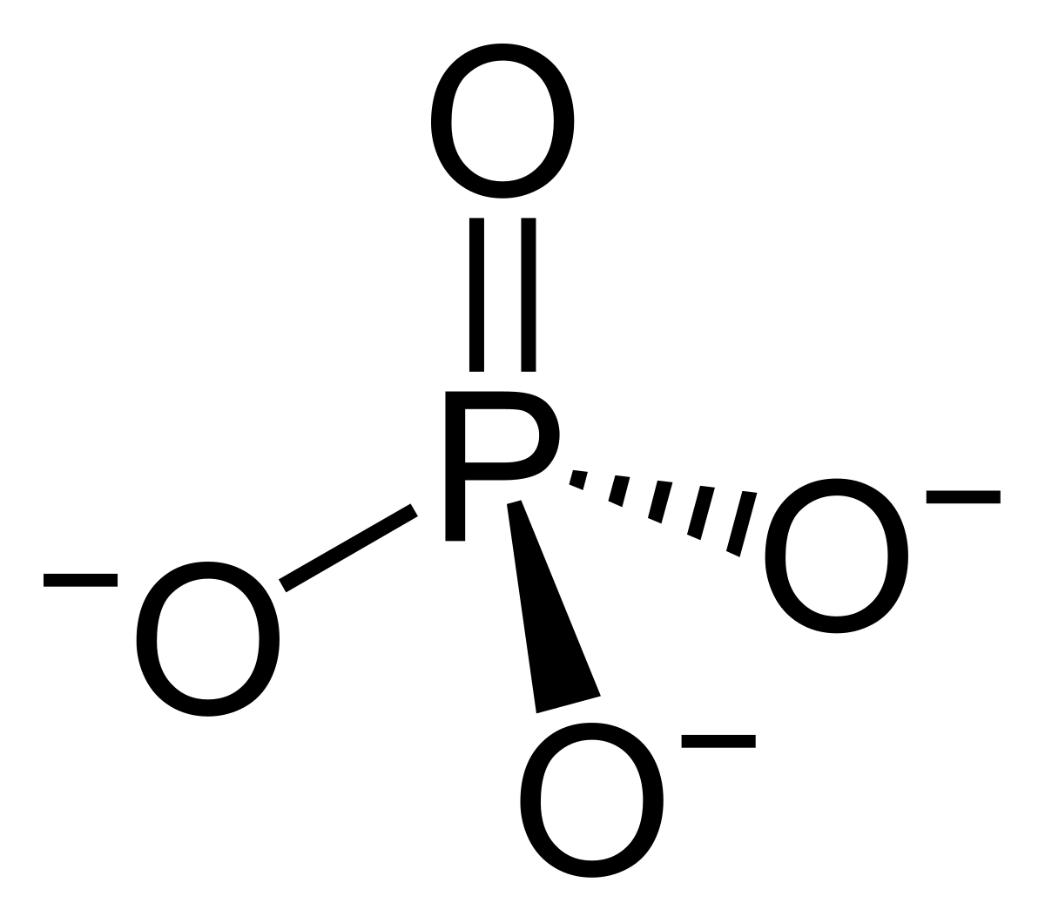
Data Considerations: Units
Nutrients:
P
mg/L as P
Wt: 30.97
mg/L as PO4
Wt: 94.93
Total PO4 x 0.3262 = Total P (as mg/L P)
Notes:
You will want to pay close attention to units.
Sometimes data errors occur because the wrong unit is recorded (for instance a conductivity meter may switch to mS/cm rather than µS/cm)
Another common error occurs with nutrients. Sometimes phosphorus is reported in terms of the element phosphorus (P) while other times it is reported as phosphate (PO4). Phosphate weighs a little over 3 times as much as phosphorus. Be sure to record the proper units using the “as P” or “as PO4” ending.
Similar issues can occur with nitrate, ammonia, and other nutrients. If the full unit is not recorded, the data is unusable.

Slide 28
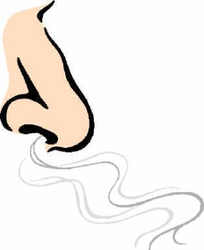
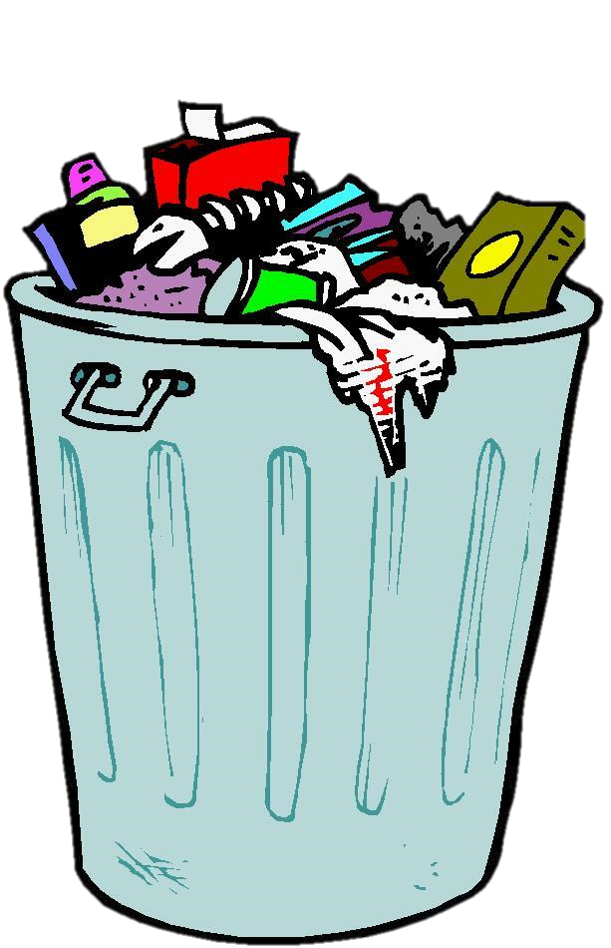
Passing The Smell Test
Is this data garbage?
Check:
Visual Scan
Scientific Scan
Odd Phenomena
P.U!
Data
Notes:
We began with the analogy of garbage in, garbage out. So how can determine if your data is garbage?
I like to refer to this as the “smell test.” It is a very basic screening to see whether the data is garbage or not.
The “smell test” has three elements to determine if your data stinks: 1) a visual scan, 2) a scientific scan, and 3) a review for odd phenomena.

Slide 29
Passing The Smell Test
Visual Scan
pH > 14 or negative?
µS/cm or mS/cm for Conductivity?
Decimal Errors
Missing Data
Sloppy Handwriting
P.U!
Data
Notes:
The visual scan means looking over the data as it is received to look for obvious errors.
Sometime the data may be entered in the wrong column of a spreadsheet producing the impossibility of a negative pH result or > than 14.
Sometimes you might pick up on a unit error in conductivity if the other measurements are around 900 and then one site is 1.2. It is likely that the meter switched units.
Sometimes a decimal can be left out or the sampler forgot to fill in a field or the handwriting is sloppy. If you follow-up quickly after the sampling, you can often have the sampler or lab analysts make corrections.
If you start to notice a lot of these errors, you will want to be extra thorough with the data.

Slide 30
Passing The Smell Test
Scientific Scan
TKN (as N) ≥ Ammonia (as N)
Orthophosphorus (as P)
≤ Total Phosphorus (as P)
E.coli NOT > 2420 without dilution
TDS ≈ 0.5 - 0.7 x Conductivity
P.U!
Data
Notes:
Another scan to use is the scientific scan. This scan relies on cross-parameter checks on numbers.
While allowing for some accuracy or precision errors within the testing methods themselves, certain principles should always hold true:
TKN testing includes ammonia as well as other forms of organic nitrogen. Therefore if ammonia is a greater than TKN, you should follow up with the lab.
Similarly total phosphorus should be greater than orthophosphorus, so you can use this as a general check.
If you have an E.coli result of >2420 and the lab did not perform a dilution, then you know there is an error because that is the maximum of the IDEXX method.
Also you can typically use your TDS as a check on your conductivity…. If you have a full dissolved ion profile, you can even do an ion bass balance.

Slide 31

Ion Mass Balance Check
Milliequivalent (meq/L) = mass (mg/L) x Charge
molecular weight
Anions (-)
Chloride, Nitrate, Nitrite, Fluoride, Bicarbonate, Carbonate (-2), Sulfate (-2), Phosphate
Cations (+)
Calcium (+2), Magnesium (+2), Sodium, Potassium, Ammonium, Iron (+2), Manganese (+2), Aluminum (+3)
Sum of anions (-) OR cations (+) in (meq/L) x 100
≈ Conductivity (µS/cm) ± 10%
Calculation Tool: https://www.lenntech.com/calculators/tds/tds-ec_engels.htm
Notes:
This is an example of an ion mass balance:
There are some online calculators for the process, but if you have a breakdown of the cations or anions, you can convert them to milliequivalents by multiplying by the charge and dividing by the molecular weight. The sum of the anions should be equivalent to the sum of the cations. Also either one x 100 should be equivalent to the conductivity +/- 10%.
This can be a helpful check on your laboratory data…. to see whether your data stinks or not.

Slide 32
Passing The Smell Test
Odd Phenomena
Low Flow and Low Dissolved Oxygen
  If pooled a sample should not be taken.
  Beaver pond?
High Sediment with High Nutrients, E.coli, or Metals during Dry Weather
  If dry weather, was the bottom accidently disturbed during sampling or turbid upon arrival?
P.U!
Data
Notes:
Lastly, we have the odd phenomena check.
For instance, you might have a low flow and low dissolved oxygen. Follow up with discussion may indicate that the sample was collected from a pool. I had an instance where beaver had constructed a dam 50 feet upstream and the dissolved oxygen was low because of the dam.
You might also have conditions in which there are really high sediment numbers during low flow conditions but the stream is not turbid. This might indicate that someone disturbed the bottom when collecting a sample.
Low dissolved oxygen measurements on continuous monitoring sensors can occur because a snail attaches to the sensor or the sensor gets covered with sediment or it just needs cleaning. Be suspicious of the data and investigate.
Develop a “nose” for the data… if it smells fishy look into it more. Exclude if necessary.

Slide 33

Quality Assurance / Quality Control
Notes:
In summary, the basic quality assurance and quality control mean that you are planning ahead to address errors that may occur during your project from start to finish so that you have a plan to respond when problems happen.
As the old saying goes, “If you are failing to plan, you are planning to fail.”

