Slide 1
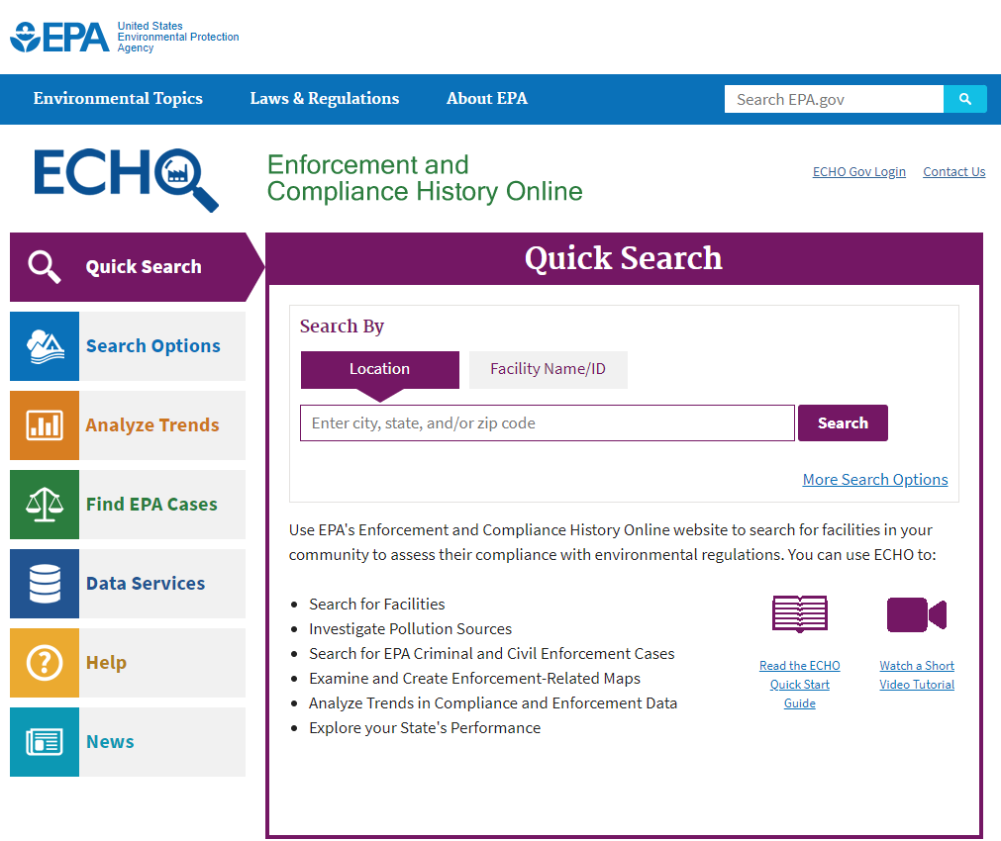
ECHO Tutorial
https://echo.epa.gov/

Slide 2
Accessing Quick Start Guide
https://echo.epa.gov/

Slide 3
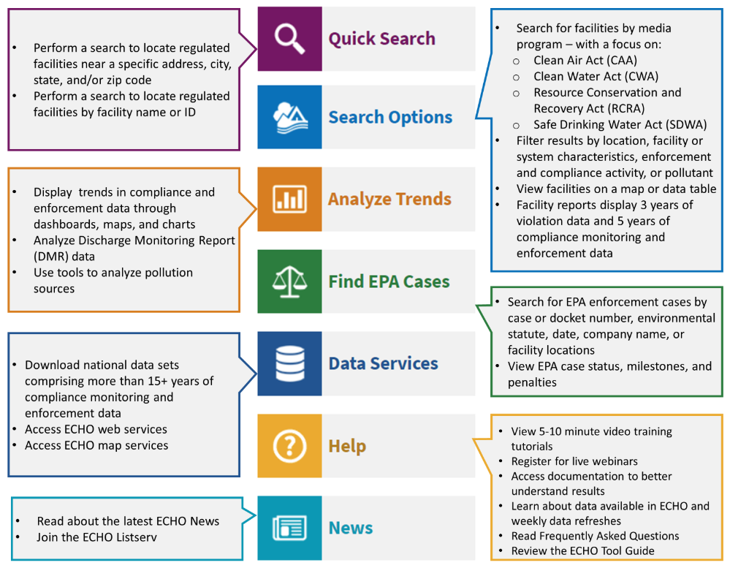
Quick Start Guide

Slide 4
Community Search
https://echo.epa.gov/
INSERT YOUR COMMUNITY OF INTEREST

Slide 5
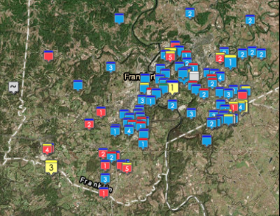
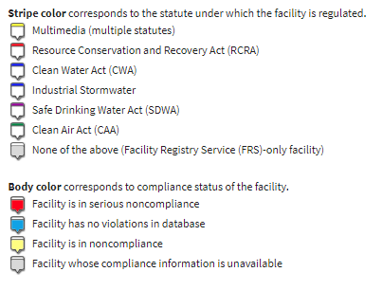
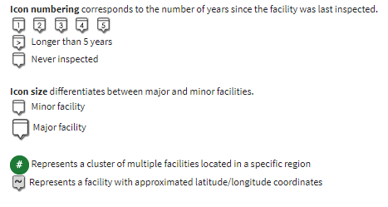
Community Search
1. Click One Facility
2. Click on facility name on the Pop-up to see the detailed report.
3. We will overview how to use the detailed facility reports.

Slide 6
ECHO Video Tutorials
https://echo.epa.gov/

Slide 7
ECHO Video Tutorials
Video Tutorials
Facility Search Tutorial……………………………………………
Detailed Facility Report – Overview Tutorial …………..
Detailed Facility Report – Facility-Level Data and Error Reporting………………………………………………………
Water Effluent Charts…………………………………………….
Comparative Maps and Dashboard ……………………….
TOTAL
NEW (May 2018)
TRI and DMR Comparative Dashboard (4 videos)…...
5:19 minutes
6:21 minutes
6:49 minutes
7:10 minutes
7:37 minutes
33:14 minutes
19:00 minutes

Slide 8
ECHO Video Tutorials
Video Tutorials
Facility Search Tutorial……………………………………………
Detailed Facility Report – Overview Tutorial …………..
Detailed Facility Report – Facility-Level Data and Error Reporting………………………………………………………
Water Effluent Charts…………………………………………….
Comparative Maps and Dashboard ……………………….
5:19 minutes
6:21 minutes
6:49 minutes
7:10 minutes
7:37 minutes
WATCH
Quick Overview

Slide 9
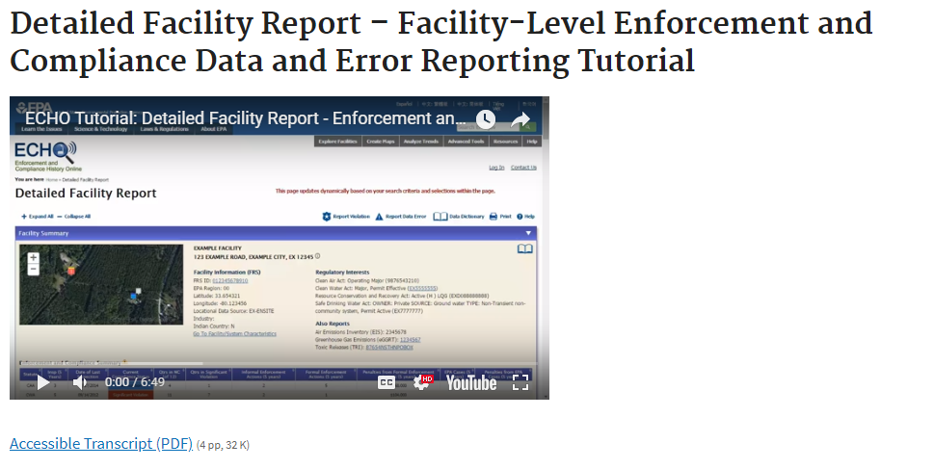
Detailed Facility Report Tutorial
Watch video tutorial to overview reports:
https://youtu.be/c5vSASFOyoQ

Slide 10
Effluent Charts

Slide 11
Effluent Charts

Slide 12
Effluent Charts

Slide 13
Effluent Charts

Slide 14
Pollutant Loading Report

Slide 15
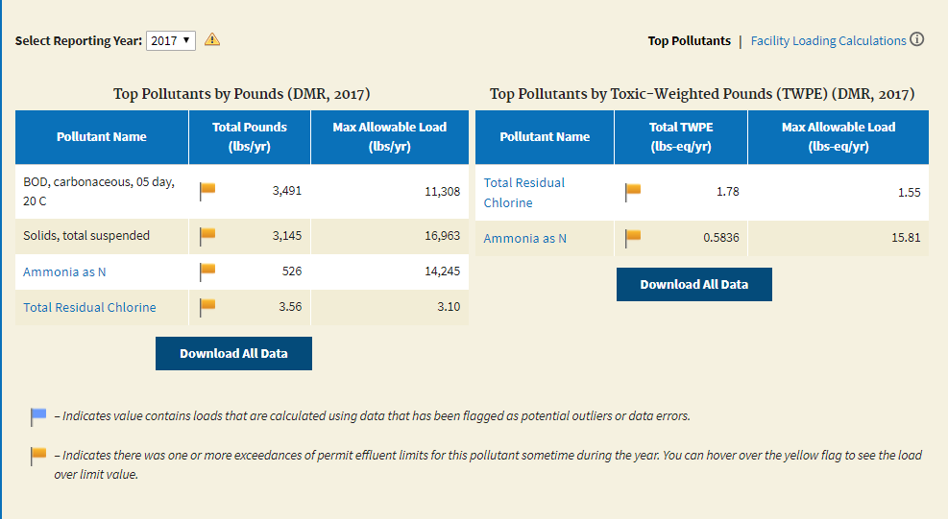
Pollutant Loading Report

Slide 16
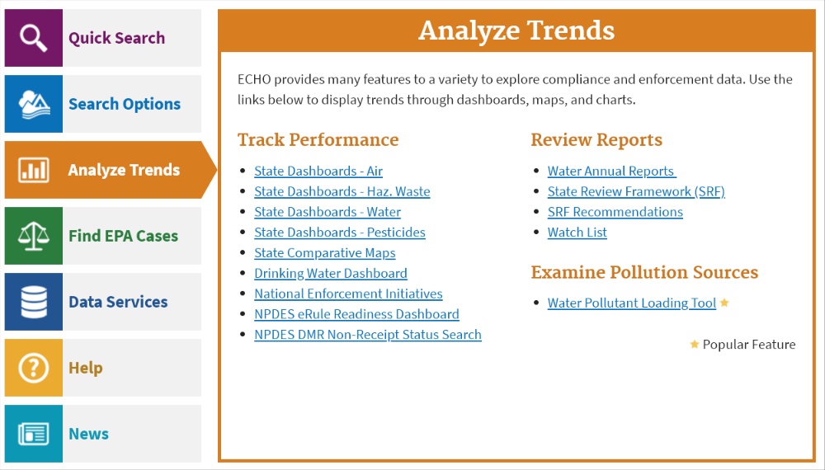
State Water Dashboard

Slide 17
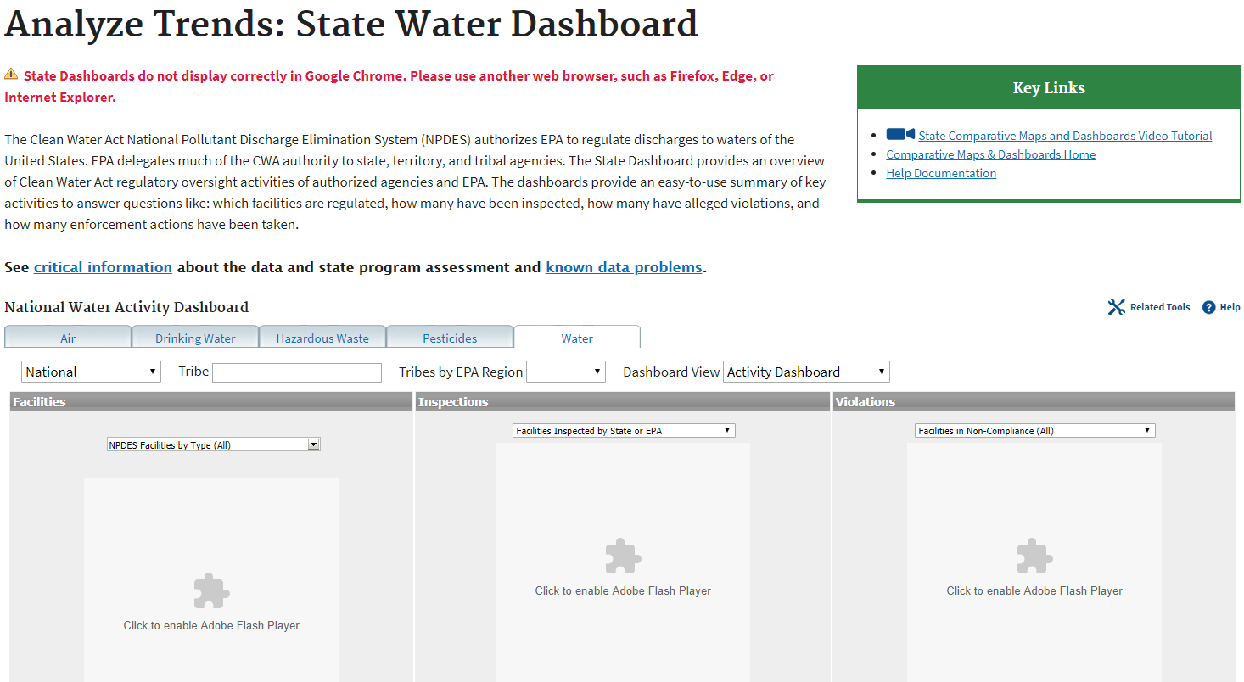
State Water Dashboard
Select KENTUCKY
Two Modes
Activity or Performance

Slide 18
State Activity Dashboard
May have to enable flask or click the individual charts, but these statewide summaries should show up.
Information is clickable for drill down
Can change options on pull downs

Slide 19
State Performance Dashboard

Slide 20
Water Pollutant Loading Tool

Slide 21
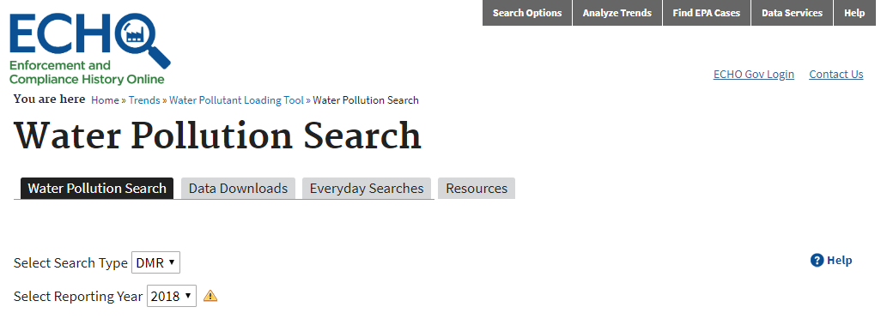
Water Pollutant Loading Tool

Slide 22
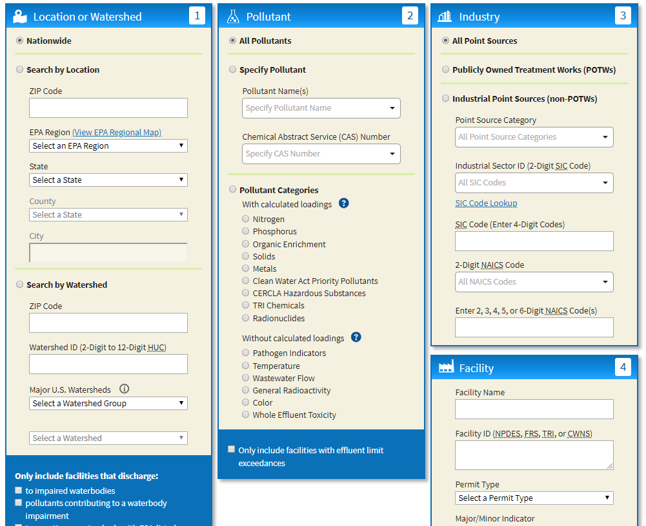
Water Pollutant Loading Tool
Pollutants:
All Pollutants search defaults to “Pollutants with Calculated Loadings.” To select parameters without loadings (i.e. Pathogen Indicators) select individually.

Slide 23
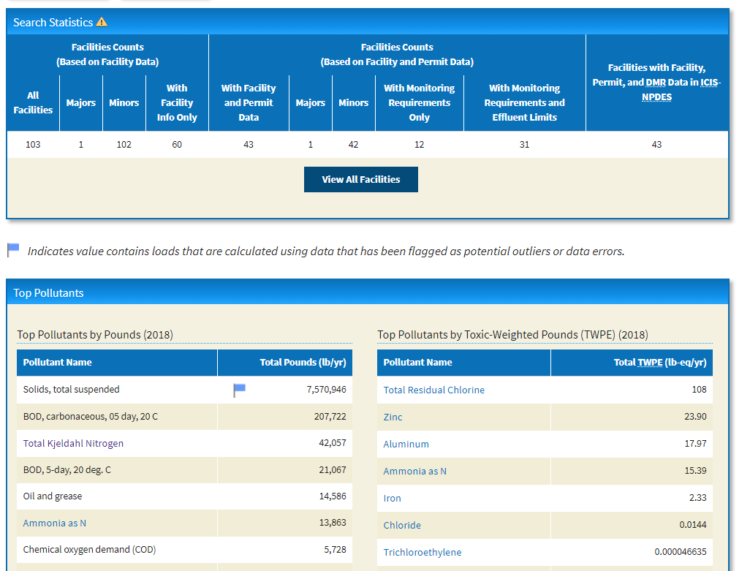
Water Pollutant Loading Tool

Slide 24
ECHO Tool
Explore other features, such as:
Everyday Searches for
Nutrient modeling
Annual Loadings
State Comparative Maps
Drinking Water Dashboard
Water Annual Reports

