Slide 1
Watershed Academy
Watershed Coordinator Training Series
Dealing with Data
4. Understanding Basic Statistics, Graphs and Charts

Slide 2

Telling an Accurate Story
“Facts are stubborn things, but statistics are pliable.”
― Mark Twain
The goal of the watershed coordinator is to faithfully communicate the story told by the data.
This means avoiding data communication traps.
Notes:
We’ve all heard the funny quotes about statistics. We laugh because there is truth behind them.
As a watershed coordinator, your goal is to faithfully communicate the data to others. You serve as a trust agent working between the technical consultants and the decision makers and stakeholders. Your job is to faithfully explain with the data indicates. That means you will have to do your best to avoid misrepresenting or misinterpreting the data.
A full analysis of water statistics and visualization would likely be a week long course. Our goal in this section is to hit the high points.

Slide 3
Stats, Graphs, and Charts
Basic Descriptive Statistics
Visualizations and Pitfalls
Data and Benchmarks
Report Card or Multi-metric Summaries
Notes:
Overview of presentation

Slide 4
Basic Stats: Central Tendency
“Average”
Arithmetic Mean [Excel Function =AVERAGE()]
  Sum of numbers / count of numbers
  Tends to be biased toward higher numbers
Geometric mean [=GEOMEAN()]
  Multiply numbers then take the Nth root of their count (i.e. 2 numbers = square root, 3 numbers cubed root, etc.)
  Typically better for environmental data which can vary over large ranges (not as skewed by high values)
  Cannot be calculated with zero values
Median [=MEDIAN()]
  Middle number on sorted sequence of data from least to greatest
  50% break point
  Can handle zeroes
Notes:
When we use the term ”average” in our regular conversation, we are talking about the central tendency of the data.
“Average” in our regular conversation refers to the arithmetic mean. You sum all the numbers and divide by the count of the numbers. The only problem with this measurement is that it tends to be biased towards higher numbers. Therefore, it often is not the best way to measure the central tendency in environmental datasets.
There are other ways to measure the central tendency that may better represent the data. The geometrics mean and the median are two of those.
Geometric means are typically better for representing environmental data because they are not as skewed towards high values. However, they cannot be calculated with zero values (i.e. non-detects must be substituted with a low value).
Medians are another common method for calculating the central tendency. All the values are sorted from least to greatest and the middle number is the median. 50% of results are above and below this point.
Excel functions for these different ways of calculating the central tendency. You would put the range of cells to be “averaged” within the parentheses.

Slide 5
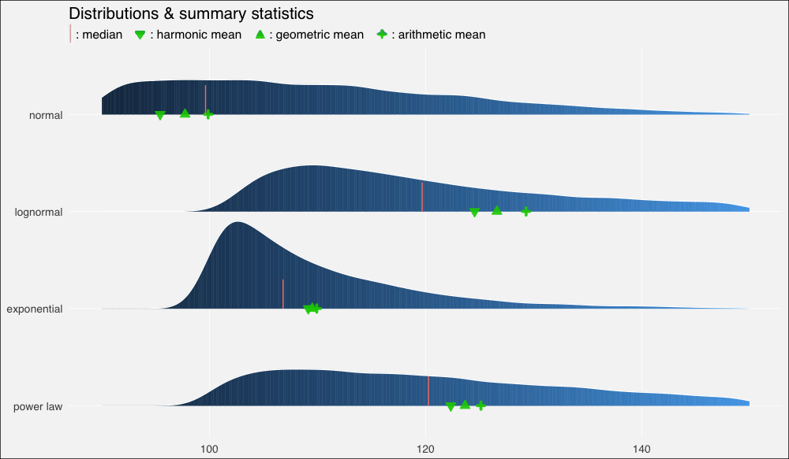
Basic Stats: Central Tendency
“Average”
On Average You’re Using the Wrong Average, https://towardsdatascience.com/
Notes:
This is a visual representation of how several measures of central tendency compare using a few different datasets.
Note the black boxes for average and highest in each instance.
The median is the blue line. The geometric mean is the red circle.
Which one is “correct?” You’d have to ask a statistician for that, but the geometric mean or median tends to be a better indicator with environmental data

Slide 6
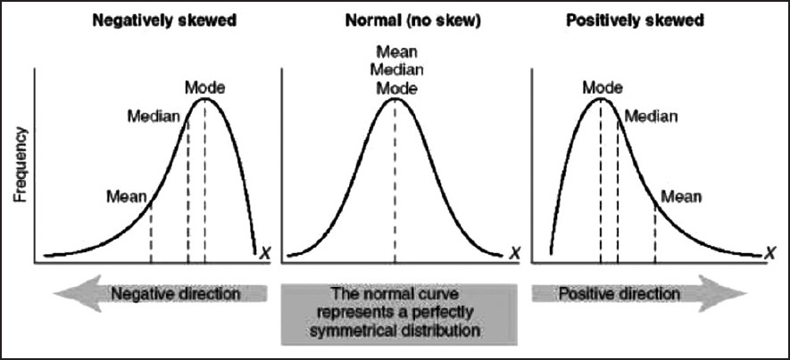
Basic Stats: Skewness
Skew [=SKEW()]
  Measure of symmetry (length of tails)
  Positive – tail longer to right
  Negative – tail longer to left
Notes:
Skewness is the measure of the symmetry of a probability distribution around its mean.
In a normal (bell shaped) probability, both sides are equal so there is no skew. The mean, median, and mode are all the same.
A general rule of thumb is that the skewness indicates the direction of the longer tail (left = negative, right = positive)
Another way to view this is that the direction of the mean as compared to the median. (However these rules can fail in multimodal distributions – i.e. more than one peak)
This can be used along with a histogram to show (for instance) whether a confidence interval can correctly be applied to the dataset or not.

Slide 7
Basic Stats: Spread
Range [=MAX()-MIN()]
  Difference between smallest and largest numbers
Sample Variance [=VAR.S()]
  Sum of squared differences from mean divided by (count - 1).
Standard Deviation [=STDEV()]
  Square root of sample variance
Notes:
Another basic statistic is a measure of the spread.
There are a lot of different measures – we will cover three.
One is range. This is simple the difference between the maximum and minimum values.
Variance and Standard Deviation are two related measures of the spread. The standard deviation is simple the square root of the variance,
For example, for the numbers 1, 2, 3, and 4 the mean is 2.5 and the sample variance is 1.67.
[(1 – 2.5)² + (2 – 2.5)² + (3 – 2.5)² + (4 – 2.5)²] ÷ (4-1) = 1.67
The standard deviation will be 1.29
Now the standard deviation is helpful because it provides us some information if a normal (bell-curved) distribution is present.

Slide 8
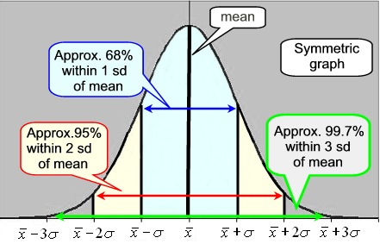
Basic Stats: Spread
https://mathbitsnotebook.com/
Notes:
See this illustrates what a standard deviation shows. You can see that 68% of results are within 1 standard deviation of the mean and 95% of results are within two standard deviations of the mean. Etc.
Now there are statistical tests that can be used to calculate 95% confidence intervals and such, but that is a deeper dive than today.
We will look at one other way to summarize the spread of the results: quartiles

Slide 9
Basic Stats: Spread
Quartiles [=QUARTILE(,#)]
  0 = Minimum
  1st = 25% of results below
  2nd = Median, 50% below
  3rd = 75% results below
  4th = Maximum
Interquartile Range (IQR)
  Difference between 3rd and 1st Quartile
Outlier Screening
  Consider excluding if:
  Upper = 3rd Quartile + 1.5*IQR
  Lower = 1st Quartile – 1.5*IQR
Notes:
Quartiles are a way to measure the spread and combine some elements we have already.
How many quarts are in a gallon? FOUR. Likewise, quartiles are a way to divide the data up into 4 equal groups.
Starting at the minimum (0 quartile),
the first quartile is from 0 to 25% of the results,
then 25% to 50% (median),
then median to 75% of the results, and
then 75% to the maximum (4th quartile).
This provides a very nice summary of the range of the data and the central tendency.
It can also be very helpful in performing outlier screening. Potential outliers include values that are 1.5 times the interquartile range (middle 50% of values).
This may be better illustrated in the following graphic

Slide 10
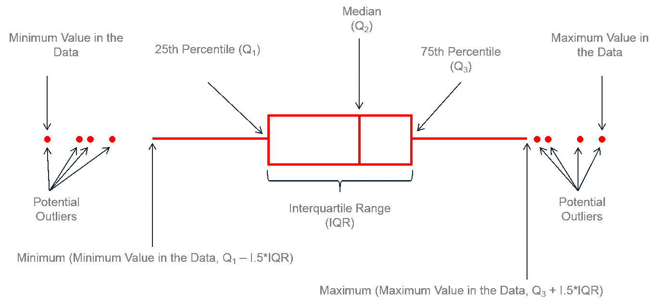
Basic Stats: Spread via Boxplot
https://www.leansigmacorporation.com/box-plot-with-minitab/
Notes:
This graphic is called a boxplot or a box and whiskers plot.
Point out the median first – 50% of the values are above and 50% below.
Point out the maximum and minimum. Some boxplots do not have the outliers as dots but go all the way to the max and minimum. The whiskers extend to the maximum and the minimum.
The interquartile range is the “box” portion of the graph. The middle 50% of the results are within that box (the interquartile range).
In this graph, the potential outliers were identified by multiplying the interquartile range by 1.5 and adding or subtracting to the bounds of in the interquartile.

Slide 11
Basic Stats: Potential Outliers
Investigate further:
Data Entry Error?
  Investigate and fix.
Experimental / Sampling Error?
  Investigate and fix.
Extreme or Rare Event?
  Do not exclude. May be most important data!
Do not exclude just because unusual, but because is expected as error. Let data guide.
Notes:
There potential outliers should not be excluded from the data immediately. In fact them may be the most significant finding in the dataset! Rather, they should be investigated to see if there is a typo, some sort of lab error, or if something out of the ordinary occurred during the collection (storm event or very turbid for instance).
Outliers should only be excluded if they are suspected to be in error.

Slide 12
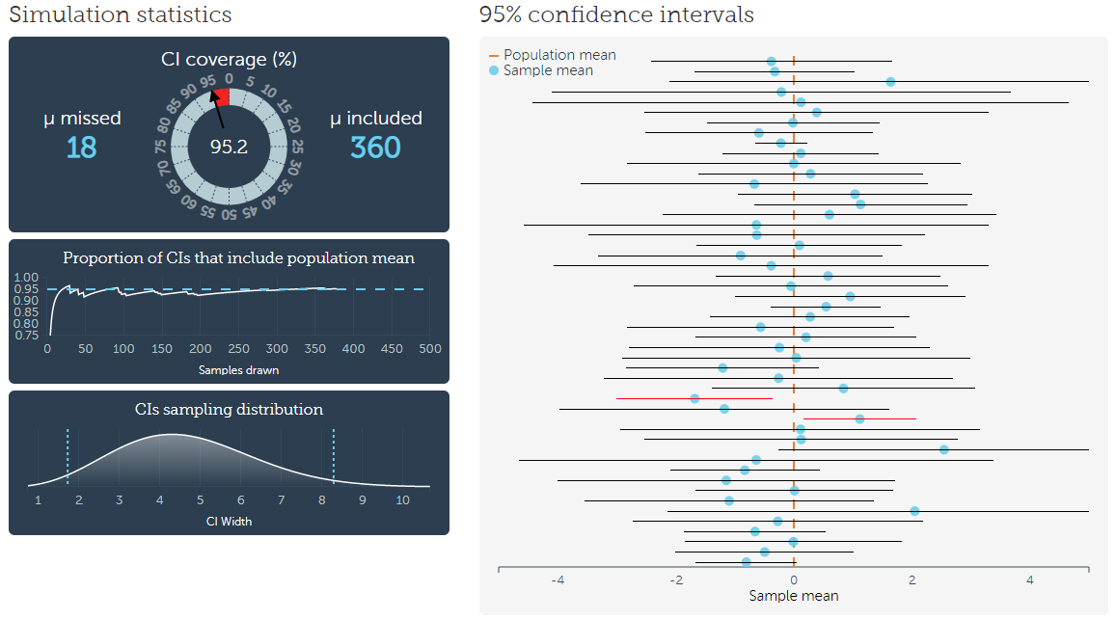
Statistically Significant
https://rpsychologist.com/d3/CI/
Large difference ≠ statistical difference.
Confidence intervals (CI) = proportion of CIs of random samples that contain mean. (i.e. 95% confidence interval =5% random samples have no overlap)
Notes:
One last stats related comment and then we will be done (shew!)
Unless someone did a calculation of statistical significance, you need to be careful about drawing too many conclusions because one number is bigger than another.
A large difference does not equal a statistical difference. The chart indicates random sampling of a known dataset at 95% confidence intervals. All of these results were obtained by sampling the same dataset. The red dotted line is the true mean of the entire population. The blue dots are the means based on the sampling with the lines representing the 95% confidence interval. As you can see two of the sampled sets actually do not contain the true mean at all. In fact, it would be expected that 5 out of every 100 samplings of the true dataset would not contain the true mean.
It is important to understand (and many people do not) that confidence intervals are not error rates, just the portion of random samples that contain the mean.

Slide 13
For Further Reading on Water Stats
U.S. Geological Survey, Techniques of Water-Resources Investigations Book 4, Chapter A3
by D.R. Helsel and R.M. Hirsch
pubs.usgs.gov/twri/twri4a3/
Data Quality Assessment: Statistical Methods for Practitioners, 2006 (EPA QA/G-9S)
Notes:
If you want to dig deeper, here are some guidance documents that you can explore more fully.

Slide 14
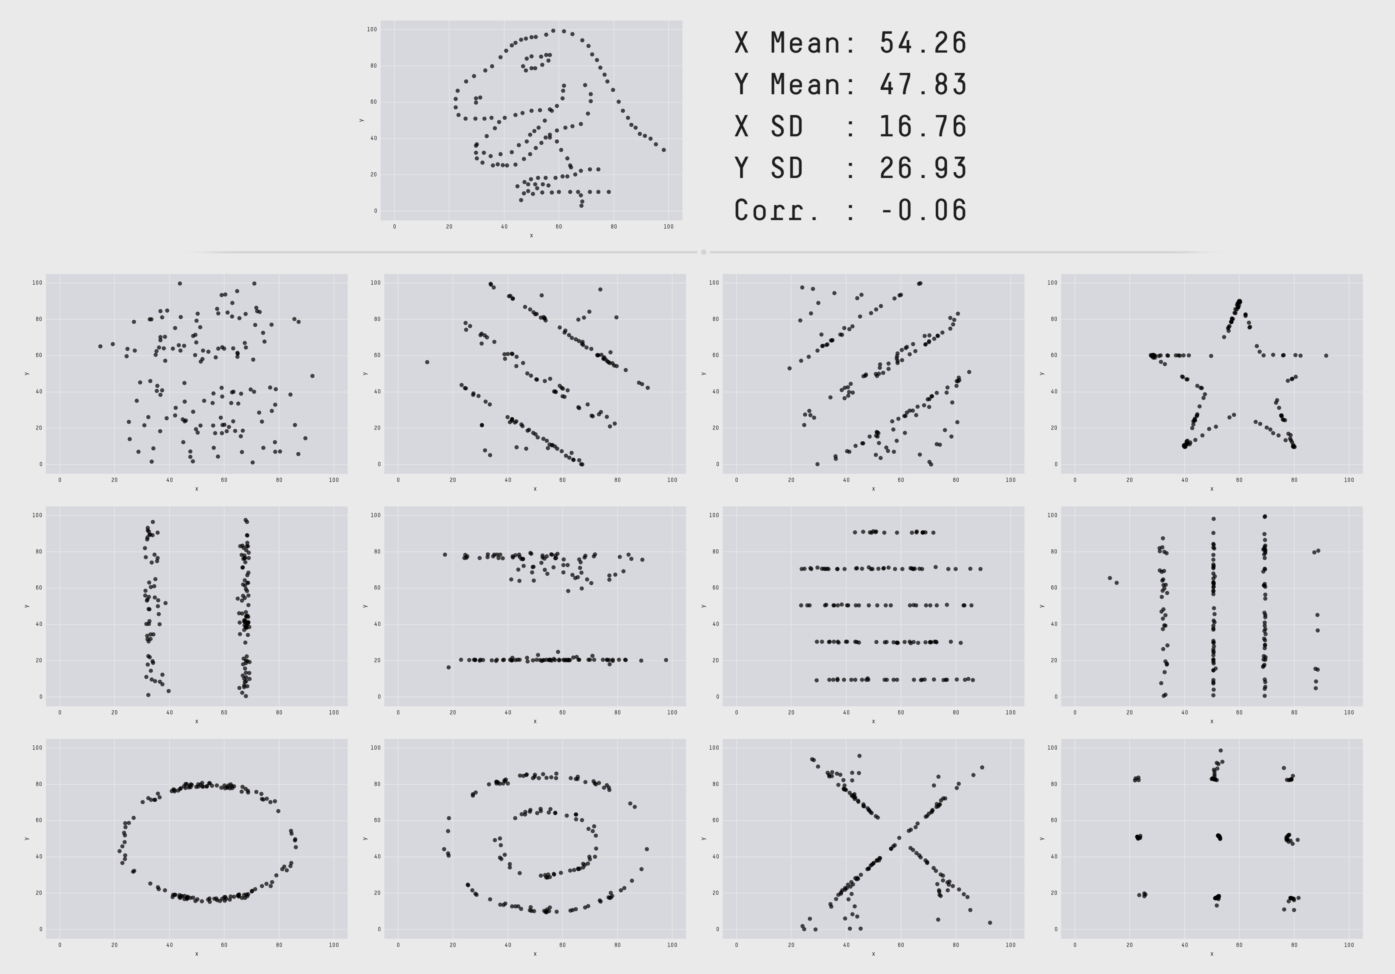
Matejka J, Fitzmaurice G. Same stats, different graphs: generating datasets with varied appearance and identical statistics through simulated annealing. In Proceedings of the 2017 CHI Conference on Human Factors in Computing Systems 2017 May 2 (pp. 1290-1294). ACM.
More than Just Stats Needed
X Mean: 54.26
Y Mean: 47.83
X SD: 16.76
Y SD: 26.93
Corr. : -0.06
Notes:
OK.
Now to illustrate that you need more than just statistics to tell your story, here is some rather dry statistical data for X and Y coordinates with a mean and standard deviation as well as a correlation coefficient.
Based on this information what does this plot look like?
Well it turns out that it can look like a lot of things. All of these images have exactly the same summary statistics.
So telling the story of the data requires more than just statistics. You will need some sort of data visualization.
What sort of visualization should you use?

Slide 15
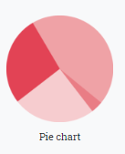
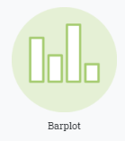
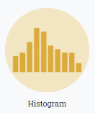

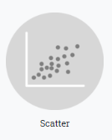
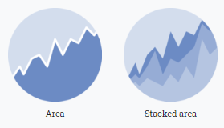
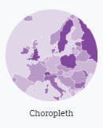
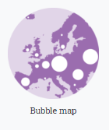
Common Visualizations and Pitfalls
https://www.data-to-viz.com/
Notes:
The website data-to-viz.com has some excellent details on how to select the right data visualizations for your particular project. We are going to explore some of the more common visualizations and some of their pitfalls.

Slide 16
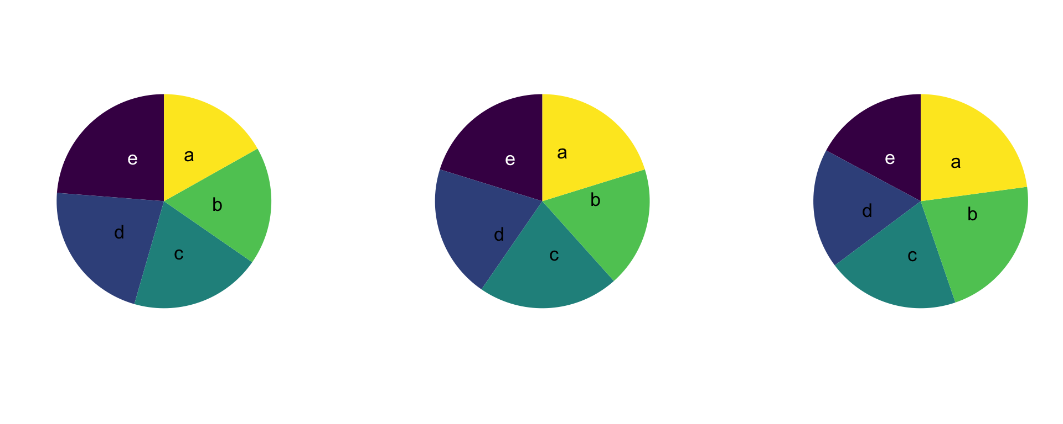
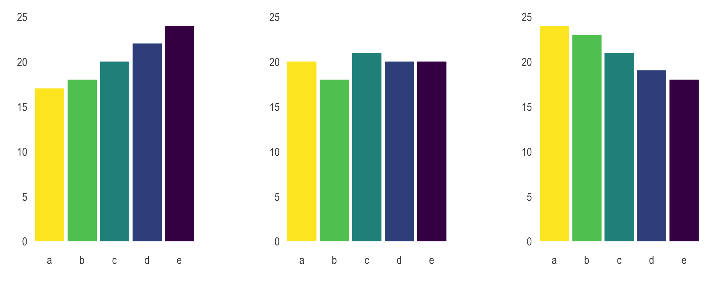
Pie Chart
What trends do you see as different between charts?
How about now?
Generally avoid using pie charts.
Use barplots or some other alternative instead.
Don’t do 3D or exploded.
https://www.data-to-viz.com/

Slide 17
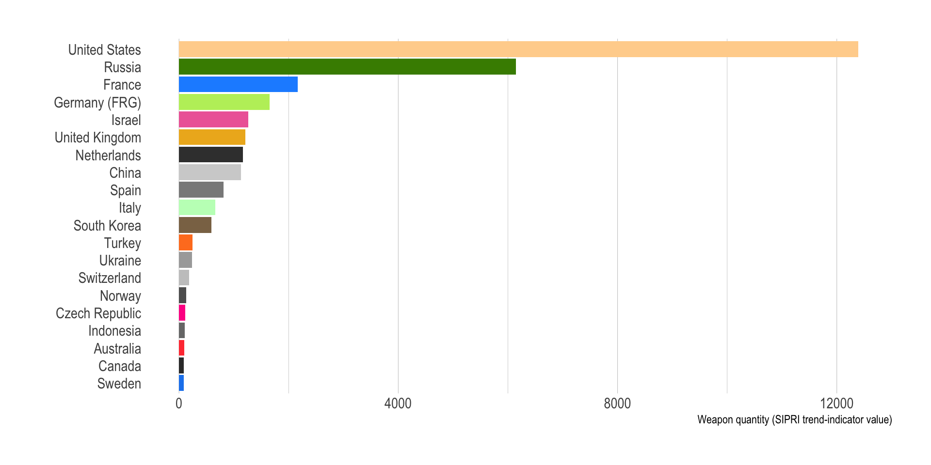
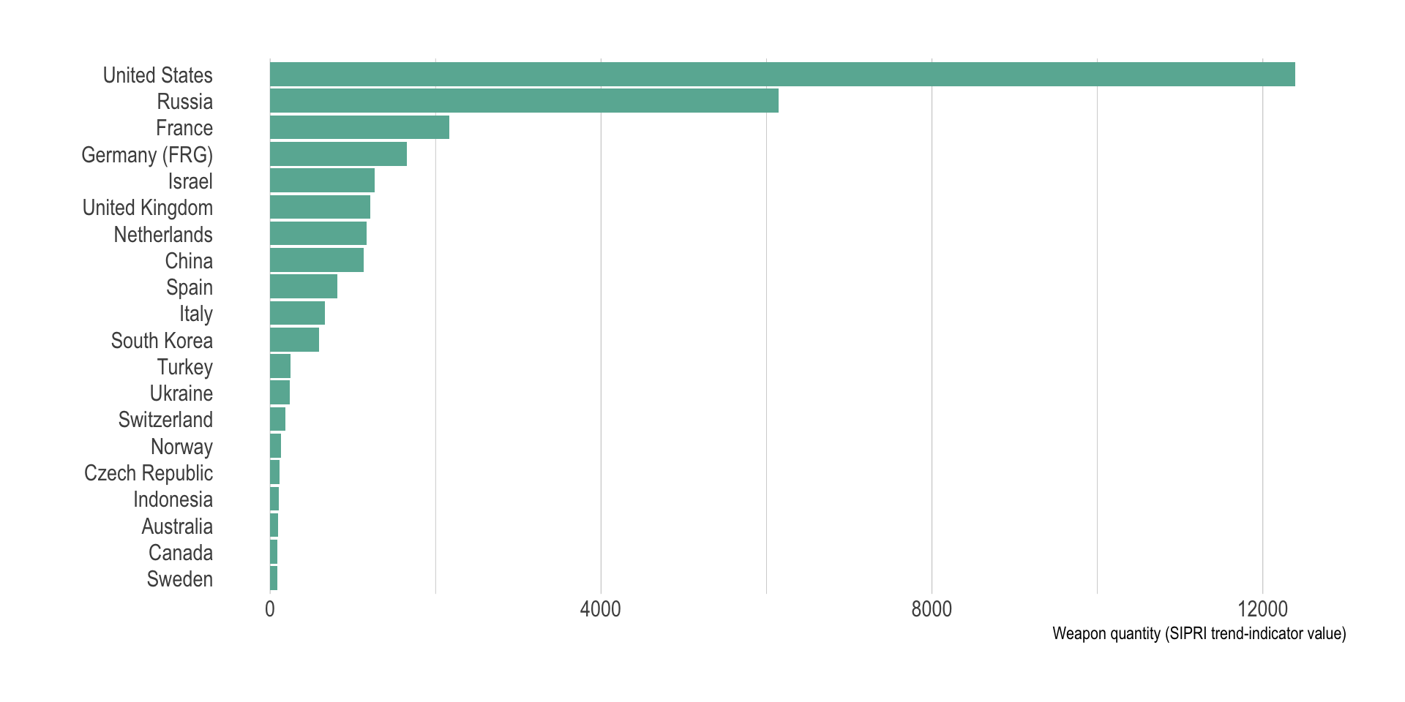
Bar Plot
Values of independent categories
Order your bars by value if possible
Don’t add color if no meaning
For long labels use horizontal
https://www.data-to-viz.com/

Slide 18
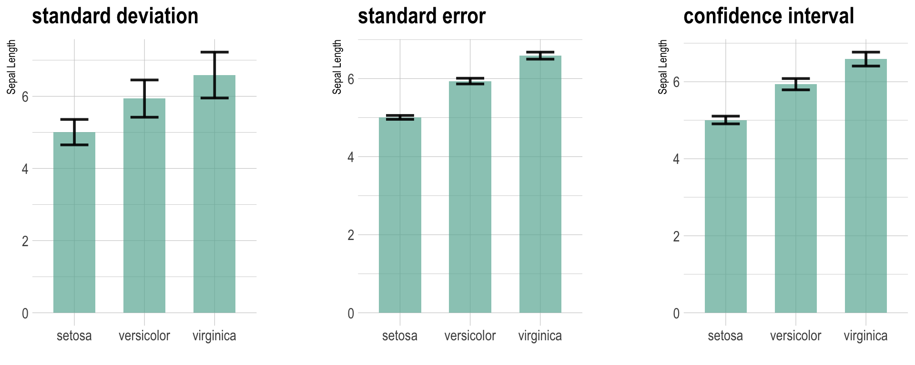
Bar Plot
Be careful with error bars
Avoid error bars if possible.
If needed, consider a boxplot or label clearly.
https://www.data-to-viz.com/

Slide 19


Histogram
Use for summary of distribution, not precise values
Adjust bin sizes to tell story
Make sure bins are constant size
USGS, Statistical Methods in Water Resources

Slide 20
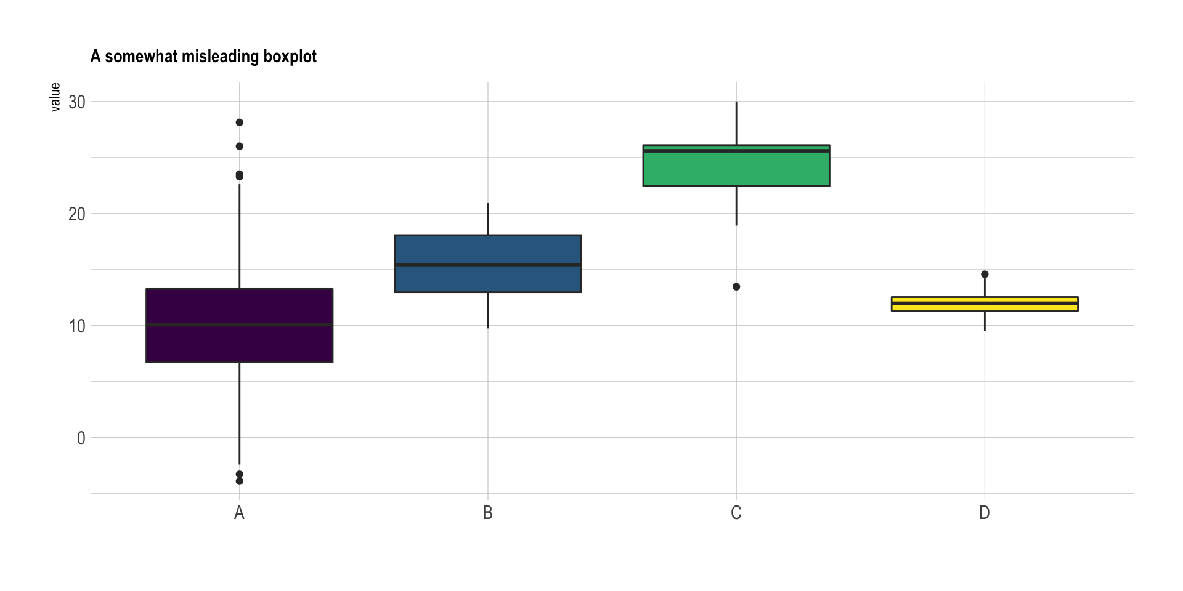
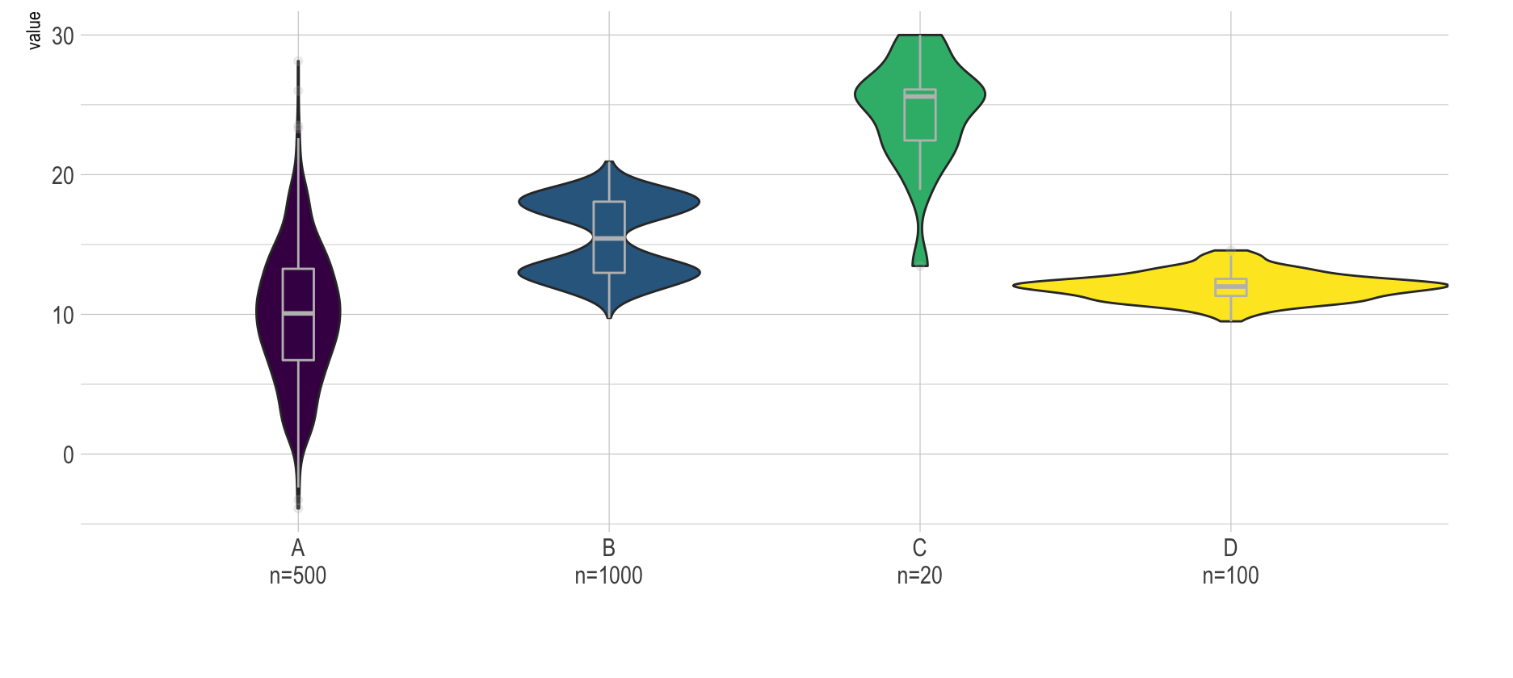
Boxplot
Useful summary of distribution of data
Can hide differences in sample size and different distribution shapes
https://www.data-to-viz.com/

Slide 21
Boxplot
Useful summary of distribution of data
Can hide differences in sample size and different distribution shapes
Normalizing chemical data by dividing by benchmarks (red line) can help illustrate problems but benchmark level is critical.
LFUCG, Annual Monitoring Program Evaluation Report

Slide 22
Scatterplot
Example of Logarithmic Scale:
10, 20, 30 …
100, 200, 300 …
1000, 2000, 3000 …
Relationship between two variables
Identify groups or trends
Beware of overplotting
For time series consider line plot or connecting
USGS, Statistical Methods in Water Resources

Slide 23
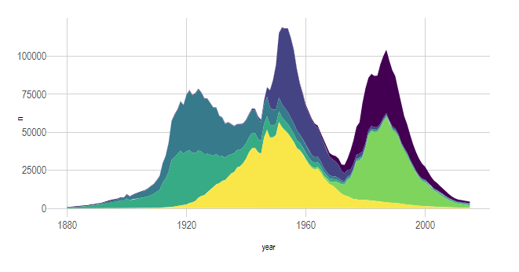
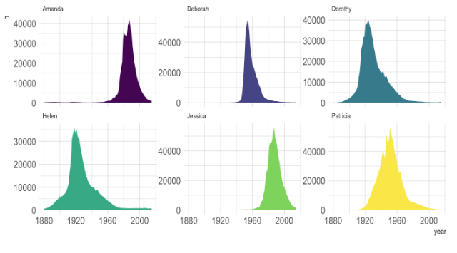
Area Plot
Stacked Area
Grid of Area Plots
Change in variables, typically over time.
Stacked area charts can be difficult to estimate areas
Be careful of too many lines (Try a grid of small charts)
https://www.data-to-viz.com/

Slide 24
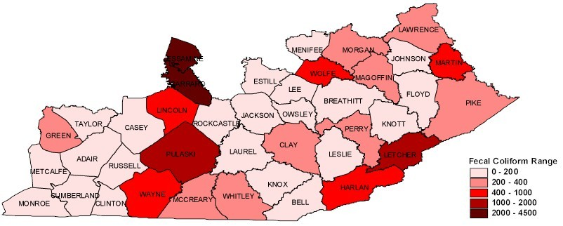
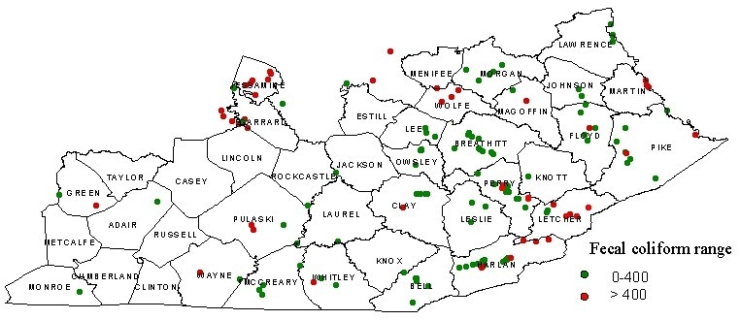
Choropleth Map
Display values for regions of maps
The size of your regions may bias
Beware of continuous colors

Slide 25
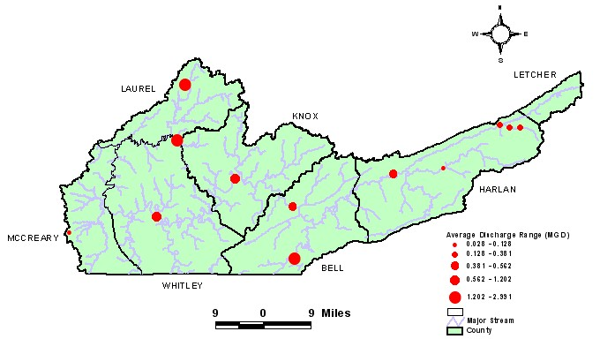
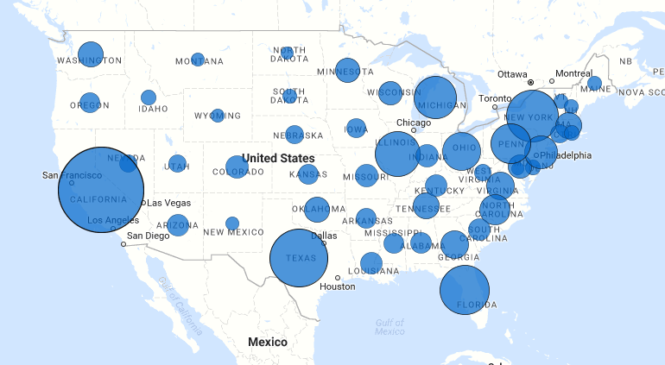
Bubble Map
WWTP Discharge Magnitudes
Data at points or regions via bubble size or color.
Can help address area bias of choropleth map
Be careful of too much data

Slide 26
Other Visualization Recommendations
Avoid Dual Axes
  Can be misleading, hard to read
  Use side by side charts or other alternative
Highlight Important Parts
  Don’t make people figure out the main point. Label it or otherwise highlight.
Stand-Alone
  Visualizations should be stand-alone and need no interpretation. Include notes if need be.

Slide 27
Data and Benchmarks
Tricky Comparisons
  Bacteria
  Metals
  Un-ionized Ammonia
Comparison Methods
  Frequency of Exceedance
  Magnitude of Exceedance

Slide 28
Bacteria Criteria
Primary Contact Recreation: E.coli
Period: May 1 to October 31
Criteria:
  Not >130 MPN/100 mL as geometric mean on not < 5 samples in 30 days
  Not >240 MPN/100 mL in 20% of samples in 30-day period
Secondary Contact Recreation: Fecal coliform
Period: All year
Criteria:
  Not >1,000 MPN/100 mL as geometric mean on not < 5 samples in 30 days
  Not >2,000 MPN/100 mL in 20% of samples in 30-day period

Slide 29
Bacteria Criteria
E.coli: Results of 5 Samples in May at three sites:
Which is Worse?
Impaired?
 | % Exceeding
 | 130 | 240
Site A | 80% | 0%
Site B | 20% | 20%
Site C | 60% | 60%

Slide 30
Bacteria Criteria
E.coli: Results of 5 Samples in May at three sites:
Which is Worse?
Impaired?
 | % Exceeding
 | 130 | 240
Site A | 80% | 0%
Site B | 20% | 20%
Site C | 60% | 60%

Slide 31
Bacteria Criteria
E.coli: Results of 5 Samples in May at three sites:
Which is Worse?
Impaired?
 | Geometric Mean | % Exceeding
 |  | 130 | 240
Site A | 131 | 80% | 0%
Site B | 133 | 20% | 20%
Site C | 552 | 60% | 60%

Slide 32
Bacteria Criteria
E.coli: Results of 5 samples in May at three sites:
All impaired but for different reasons.
Need to be careful about showing ONLY frequency of exceedance or magnitude. These can be misleading.
 | 30-Days, 5 samples |  |  |  |  | Geometric Mean | % Exceeding |  | Reduction to Meet
 | 1 | 2 | 3 | 4 | 5 |  | 130 | 240 | 130 | 240
Site A | 129 | 131 | 131 | 131 | 131 | 131 | 80% | 0% | 0.5% | -
Site B | 1000 | 80 | 80 | 80 | 80 | 133 | 20% | 20% | 2% | -
Site C | 2420 | 2420 | 2420 | 60 | 60 | 552 | 60% | 60% | 76% | 56%

Slide 33


Metals Criteria
Applying the WQ Criteria
Acute:
=e(1.0166 (ln Hard*)-3.924)
Chronic:
=e(0.7409 (ln Hard*)-4.719)

Slide 34

Metals Criteria
Cadmium Acute: =e(1.0166 (ln Hard*)-3.924)
 | A | B | C | D
1 | Cadmium (µg/L) | Hardness (mg/L) | Acute Criteria (µg/L) | Exceedance?
2 | 73.1 | 408 | 8.91 | Y
3 | 20.5 | 431 | 9.42 | N
=EXP(1.0166*(LN(B2))-3.924)
=IF(A2>C2,”Y”,”N”)

Slide 35
Un-ionized Ammonia Criteria
Applying the WQ Criteria
Y = 1.2 (Total ammonia-N)/(1 + 10^{pKa-pH})
pka = 0.0902 + (2730/(273.2 + T_{c}))
Where: T_{c} = temperature, degrees Celsius.
Y = un-ionized ammonia (mg/L)
Not > 0.05 mg/L

Slide 36
Un-ionized Ammonia Criteria
Y = 1.2 (Total ammonia-N)/(1 + 10^{pKa-pH})
pka = 0.0902 + (2730/(273.2 + T_{c}))
 | A | B | C | D
1 | Ammonia-N (mg/L as N) | pH (SU) | Temp (C) | Un-ionized Ammonia (mg/L as N)
2 | 1.50 | 8.06 | 16.30 | 0.06
3 | 1.50 | 7.87 | 12.22 | 0.03
=1.2*(A2/(1+(10^((0.0902+(2730/(273.2+C2)))-B2))))

Slide 37
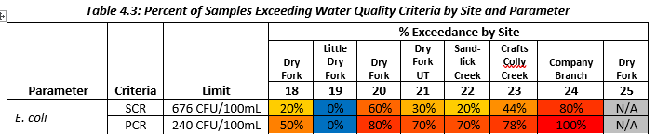
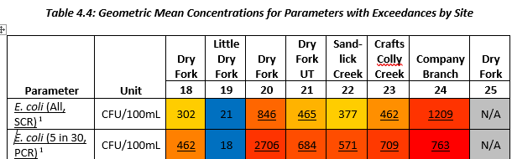
Magnitude and Exceedance Table
E. coli

Slide 38
Magnitude and Exceedance Table
Iron

Slide 39
Report Card or Multi-metric Summaries
Water Quality Indices
Report Cards
Multi-Metric Web Portals

Slide 40
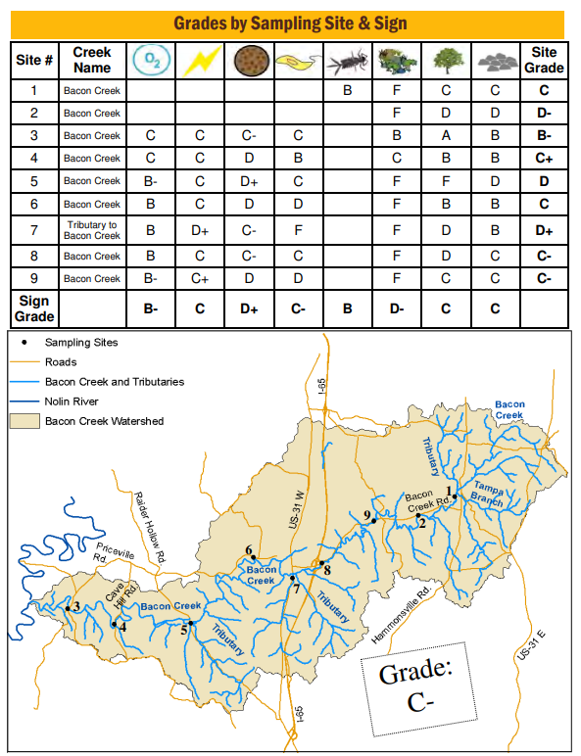
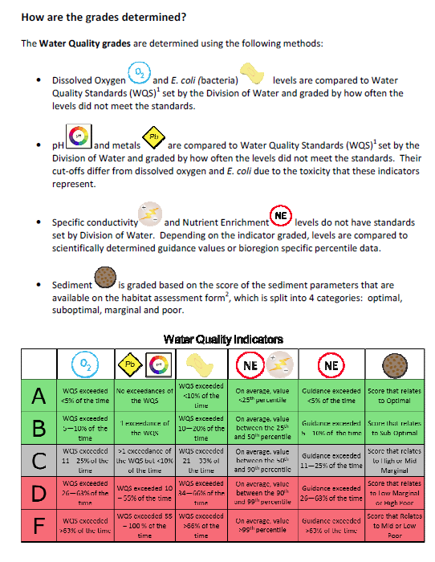
Report Card or Multi-metric Summaries
TMDL Health Reports

Slide 41
Report Card or Multi-metric Summaries
General Process:
  Select Key Health Variables
  Establish Break Points
    Regulatory Criteria or Scientific Benchmark
    Assign to three (Good, Fair, Poor) or five (A, B, C, D, F) categories (some do scale from 1-100)
      Frequency of Exceedance
      Magnitude of Concentration or Load
      What best conveys focus areas
  Allocate to an Area, Stream, or Point

Slide 42
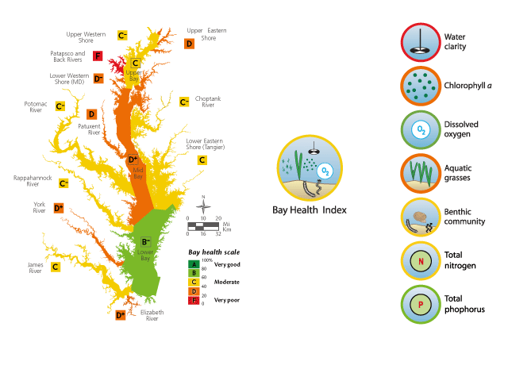
Report Card or Multi-metric Summaries
Chesapeake Bay Report Card
http://ian.umces.edu/ecocheck/

Slide 43
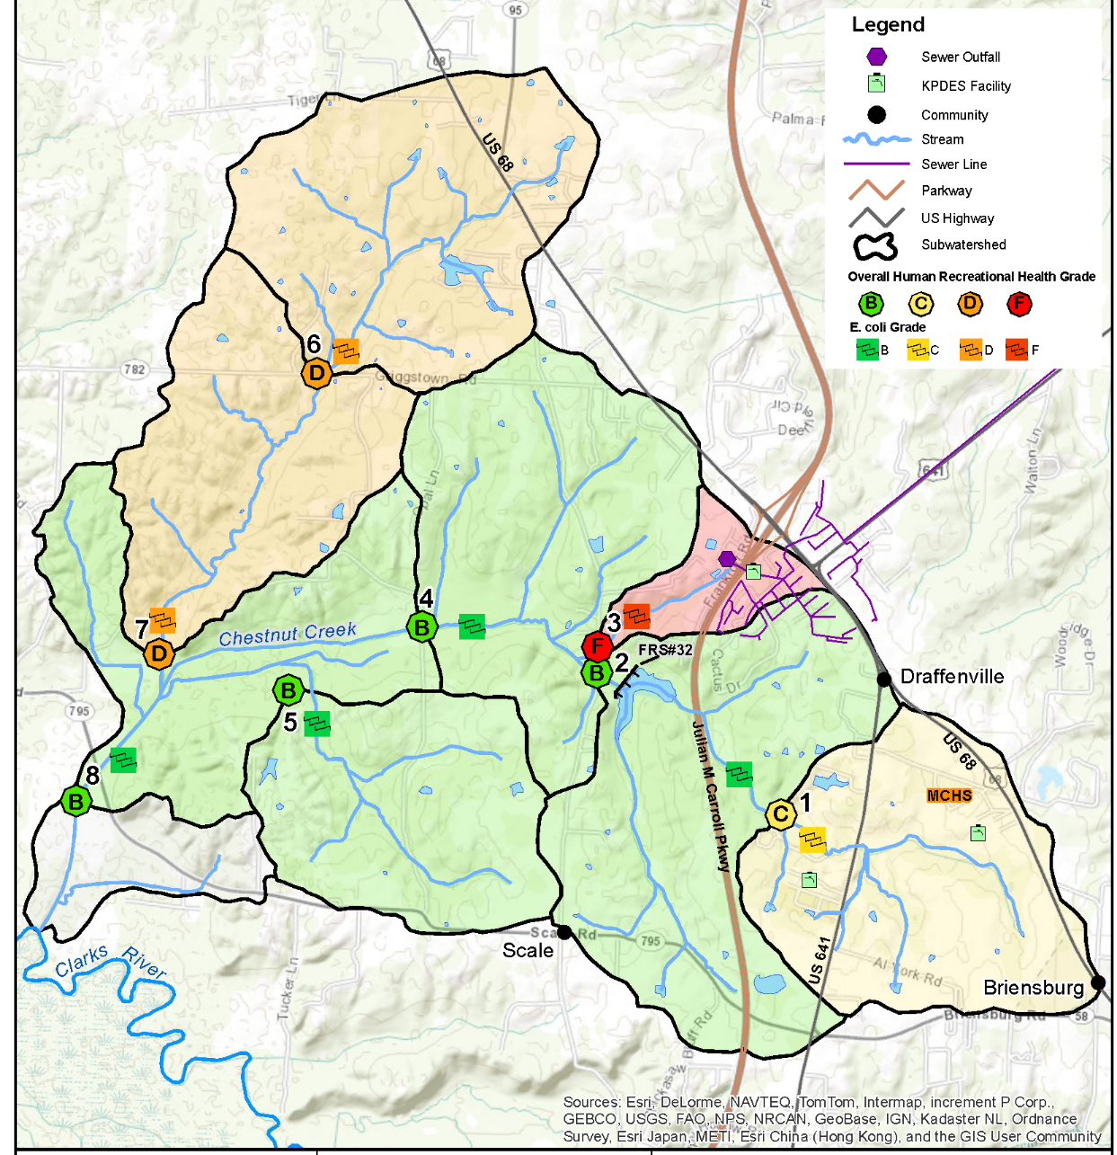
Report Card or Multi-metric Summaries
Chestnut Creek Watershed Plan
Human Health Grade
Site | E. coli % Exceeding 240 CFU/100mLs | Overall Human Health Grade | Load Reduction Required
1 | 22% | C | 57%
2 | 17% | B | 60%
3 | 54% | F | 87%
4 | 20% | B | 45%
5 | 11% | B | 0%
6 | 30% | D | 64%
7 | 32% | D | 42%
8 | 18% | B | 0%
Sites 2,4,5,8 meet criteria
Site 1, 3, 6, 7 are Problem Areas

Slide 44
Basic Statistics, Graphs, and Charts
Goal is to distill large datasets into easily understandable visuals that are actionable by decision makers.
Know your data’s limitations.
Seek not to be possible to understand, but to be impossible to misunderstand.

