Slide 1
Watershed Academy
Watershed Coordinator Training Series
Land Use Impacts &
Related Best Management Practices
8. Stream and Floodplain Restoration BMPs

Slide 2
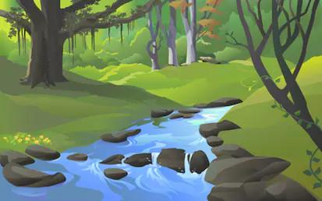
Why Stream or Floodplain Restoration?
To Improve:
Stream Hydraulics and Hydrology
  Extremes of flooding / dry channels
  Floodplain storage
  Channel shape / profile
Erosion or Sedimentation
  Bank stabilization
  Bank protection
  Degradation / aggregation
Habitat
  Riffles, pools, runs, glides
  Vegetation
  Tree falls/ rootwads / leaf packs
  Wetlands / floodplains
Notes:
Floodplain and Stream Restoration is the reestablishment of the structure and function of ecosystems and floodplains to return the ecosystem as closely as possible to its natural conditions and functions prior to being developed. Ecosystems are naturally dynamic and it would not be possible to replicate the system to the exact pre-development conditions. Rather, the restoration process reestablishes the general structure, function, and dynamic, self‐sustaining behavior of the ecosystem. (FEMA Floodplain and Stream Restoration Fact Sheet 2017)
However, In this presentation, we are using stream or floodplain restoration in its broadest sense to include less comprehensive action, such as bank stabilization or habitat enhancement, that help move the stream towards these natural conditions and functions or stabilize current conditions.
In general, stream restoration activities are undertaken to address stream hydraulic or hydrologic issues such as too much peak flow (flooding) or dry channels during drought; erosion or sedimentation issues that endanger infrastructure, contribute sediment, or smother habitat; or a lack of habitat impacting the aquatic creatures that are able to inhabit the stream.

Slide 3
Restoring Aquatic Habitat
Flow Types
Habitat Types
Source: Cluer and Thorne, 2013
Notes:
Recall from Module 2 the varying depth and velocity regimes that we are ideally seeking to protect or create to enhance aquatic habitat diversity.
These include the riffles, runs and pools that are colonized by varying aquatic species, forming a healthy aquatic ecosystem.
When selecting and designing habitat enhancement structures, it is important to be mindful of these in-stream components, as well as the presence of a healthy, well-vegetated riparian zone.
Also, having a variety of different types of places where aquatic creatures can live such as emergent vegetation, under rocks of different sizes, in root wads or leaves packs hanging on branches, woody debris, and other locations. Different creatures use different habitats so a variety is good.

Slide 4
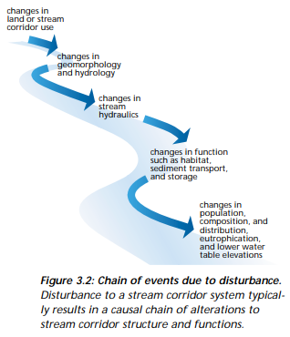
Disturbances to Streams and Floodplains
Natural and human-induced disturbances to stream corridors create causal effects that have the potential to impact key ecological functions.
Stream restoration is VERY complex
Need to treat source and symptoms
Need a comprehensive restoration plan
A licensed engineer is typically required to stamp designs for restored streams.
Source: NRCS
Notes:
When selecting habitat restoration BMPs, it is best to identify and address the underlying cause of the problems, rather than simply applying BMPs that treat the symptoms. A land use change or direct disturbance to the stream channel can set off a chain of impacts to the stream’s geomorphology and hydrology, its hydraulics, its functions and biological composition.
For example, if a recent road project has channelized an upstream stream segment, then you may need to find ways to manage flows and associated sediment runoff between the construction site and your habitat improvement site. Otherwise, efforts to restore habitat function will be futile.
In addition to considering upstream activities, a combination of restoration techniques are typically needed to address prevailing conditions and desired goals. A single technique may become a short-lived ineffective fix on a larger system-wide program. Thus, individual restoration techniques should be integrated in a broader restoration plan.
For most habitat restoration efforts, a licensed engineer is necessary to approve the plans. This overview of BMPs is so you have an underdtanding of some of the techniques they use.
Reference: FISRWG (10/1998). Stream Corridor Restoration: Principles, Processes, and Practices. By the Federal Interagency Stream Restoration Working Group (FISRWG)(15 Federal agencies of the US gov't). GPO Item No. 0120-A; SuDocs No. A 57.6/2:EN 3/PT.653. ISBN-0-934213-59-3.

Slide 5
Restoration Design Process
Select Structures & Plan Layout
Avoid placing near manmade structures or existing habitat
Space structures to enhance habitat diversity
Size the Structures Appropriately
Should produce desired habitat function at normal range of flows from baseflow to bankfull
Investigate hydraulic and sediment transport effects
Avoid barriers to flow conveyance
Avoid deposition or erosion (assess velocity and sediment discharge relationships)
Design and Install Structures
Priority should be given to on-site materials (logs, stone, trees)

Slide 6
General Design Considerations
Potential impacts of failure should be assessed.
  Techniques that change channel slope or cross section can cause channel instability upstream and downstream. Seek professional design assistance!
  Assess potential impacts on flood elevations.
  Some BMPs are not feasible when headcuts or streambed degradation is occurring.
  Streambank toe protection may be a necessary addition to restoration activities that include bank treatments.
Check for permitting requirements! Most require them.
Notes:
The following are general considerations that apply to many or all habitat restoration approaches.
• The potential adverse impacts from failure of these and other techniques should be assessed before they are used.
• Techniques that change the channel slope or cross section have a high potential for causing channel instability upstream and downstream. They should therefore be analyzed and designed by an interdisciplinary team of professionals. These techniques include: weirs, sills, grade control measures, channel realignment, and meander reconstruction.
• The potential impact on flood elevations should be analyzed before these and other techniques are used.
• Many techniques will not endure on streams subject to headcuts or general bed degradation.
• Some form of toe protection will be required for many bank treatment techniques to endure where scour of the streambank toe is anticipated.
• Any restoration technique installed in or in contact with streams, wetlands, floodplains, or other water bodies are subject to various federal, state, and local regulatory programs and requirements. Most techniques presented in this appendix would require the issuance of permits by federal, state, and local agencies prior to installation.
Source: Stream Corridor Restoration: Principles, Processes and Practices, NRCS, 1998.

Slide 7
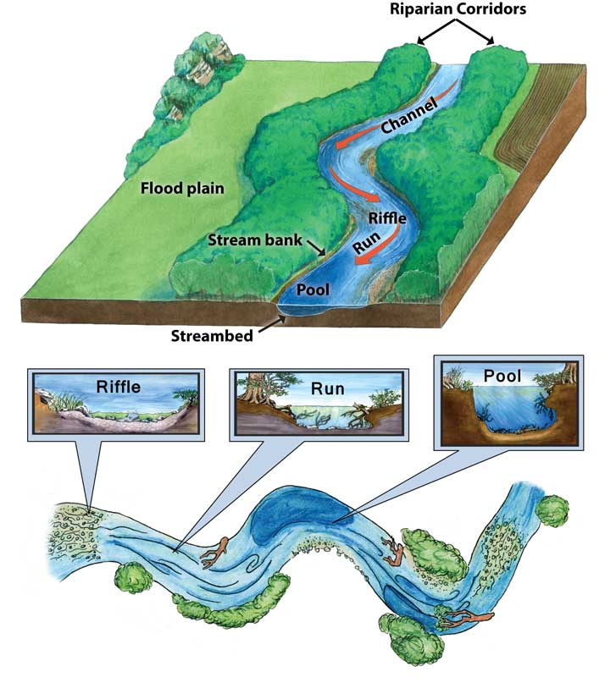
Habitat and Stream Restoration Practices
Floodplain Restoration
Riparian Restoration
Bank Restoration
In-Stream Structures
1
2
3
4
Source: Texas Aquatic Science
Notes:
Habitat enhancements frequently accompany stream restoration practices. Although individual habitat enhancements, such as boulder placement or felled trees, can be placed in the stream, the best approach to improved habitat is to restore a fully functional, well-vegetated stream corridor within a well-managed watershed. Long-term habitat improvement should rely on natural fluvial processes interacting with a well-vegetated stream corridor and associated woody debris.
For this reason, practices are installed in coordination with upstream watershed management efforts.
Habitat and stream restoration objectives can be grouped in a variety of ways. For this presentation, we are going to move from the outside of the stream system towards the channel. This will not be a comprehensive guide to all floodplain and stream restoration BMPs but should orient to general practices and concepts.

Slide 8
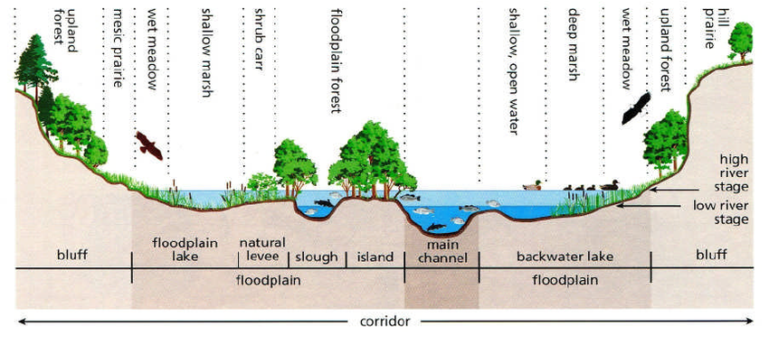
1. Floodplain
Floodplains provide opportunities for a wide variety of stream restoration activities including:
Flood Storage
Two-Stage Channel
Braided Channels
Floodplain Wetlands
Groundwater Dams
Microtopography
Source: FISRWG 1998
Notes:
Streams floodplains provide storage of floodwaters, but with development in the floodplain or increased imperviousness causing a higher peak flow, more area may be impacted by floods.

Slide 9
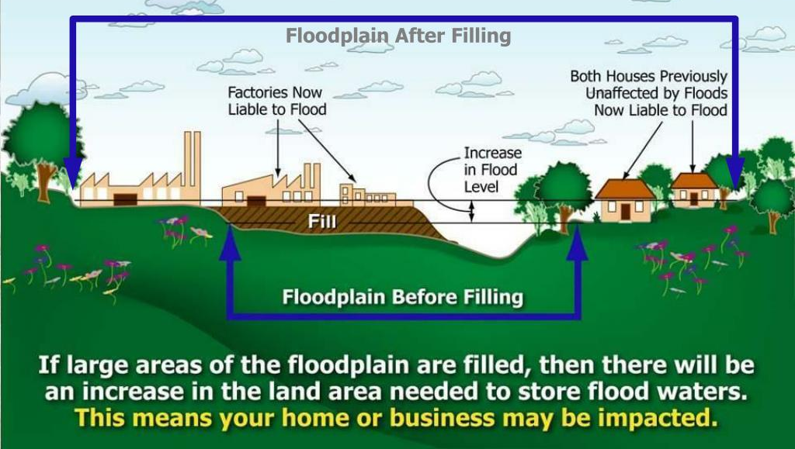
Floodplain – Storage
If filled by new development or flood levels rise due to increased imperviousness, additional infrastructure can be impacted
Source: Lincoln.ne.gov
Notes:
Streams floodplains provide storage of floodwaters, but with development in the floodplain or increased imperviousness causing a higher peak flow, more area may be impacted by floods. This can increase the impacts to structures not previously located in the floodplain.
Flood Insurance Programs and Floodplain permitting helps to guard against these impacts in various ways.

Slide 10
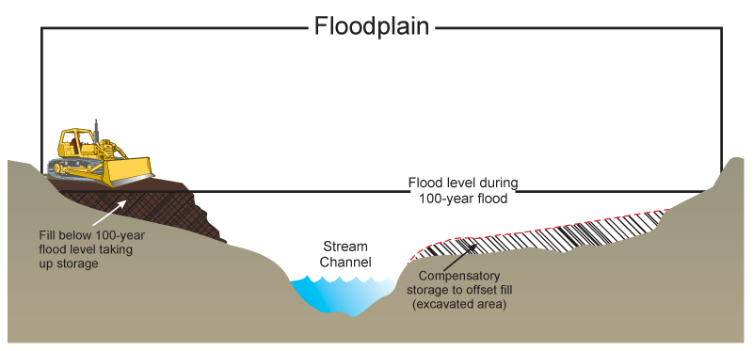
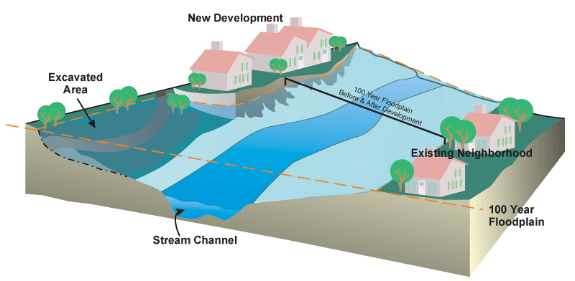
Floodplain – Compensatory Storage
Create flood storage in proportion with the volume filled
Excavate additional floodplain or adding detention basins to reduce flooding
Some communities require no net rise
Source: Lincoln.ne.gov
Source: Lincoln.ne.gov
Notes:
In many cases, neighborhoods will install detention basins to reduce the peak flows in the streams. However, another alternative is to require that
Equivalent storage capacity is retained with the flood plain. Some communities require no net rise of the flood levels by requiring compensatory storage excavation offsets.

Slide 11
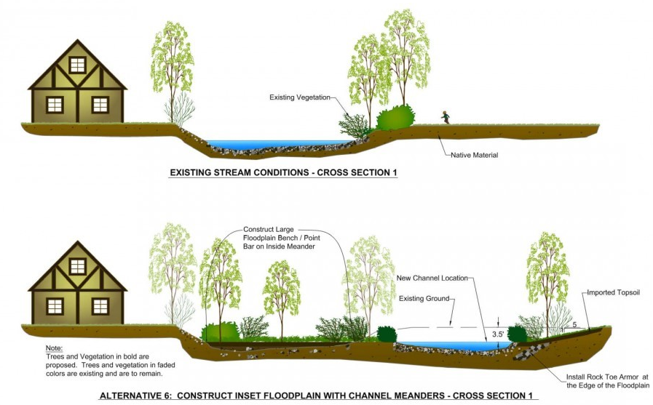
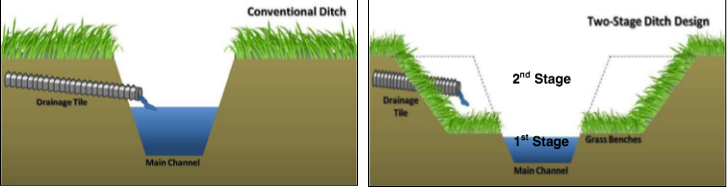
Floodplain – Two-Stage Channel
Two-Stage
Lower channel for base flow
Upper channel for flood conveyance
Works in agricultural as well as urban areas
Source: Confluence, Inc
Source: Ohio State Ag BMPs
Notes:
In areas in which development has already occurred and the stream has become channelized, additional flood capacity can be created by rolling back the banks of the stream and providing access to a floodplain. This is also called a two-stage channel design because it has a small channel for lower base flows and then a wider upper channel with a floodplain bench. This improves the habitat as well as the sediment transport capacity.
This concept works in ag areas as well as urban. The expansion of the floodplains allows for the creation of more diverse habitat.
It should be noted that in many cities, structures that have been historical built within the floodplain may be purchased and the structures demolished in order to improve the floodplains and limit the impacts to residents with repeat flooding.

Slide 12
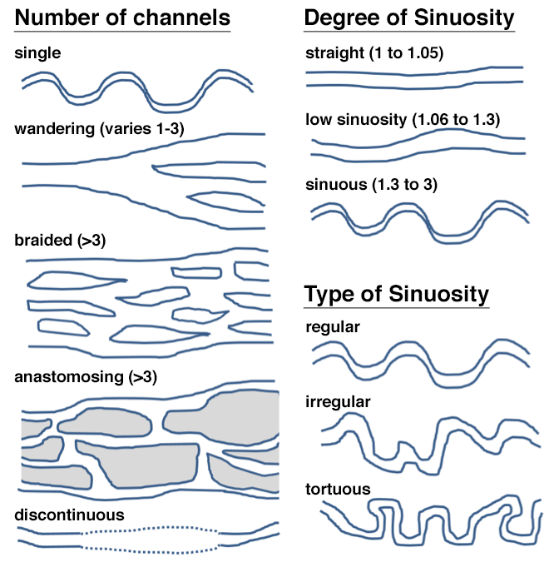
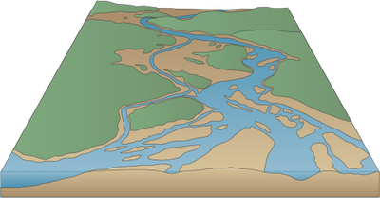
Floodplain – Multi-Channel Streams
Spread flow across floodplain in braided or anastomosing streams
Provides variety of habitats and minimal erosive force
Allows channel formation and movement freely in floodplain
Restoration Direction
Source: serc.carleton.edu/
Notes:
To take this concept to a higher level, some philosophies of stream restoration seek to wide floodplains with little variation in elevation in order to create braided or even anastomosing streams. Most natural channel restorations will seek to increase the sinuosity of the stream in order to slow down the flows, but under this model the key design is the floodplain and the expectation is that the stream will migrate on its own over the area.

Slide 13
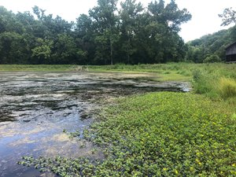
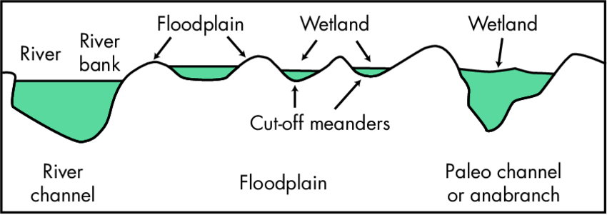
Floodplain – Floodplain Wetland
Route overbank stream flows through large off-line wetland areas. Provide stormwater storage, pollutant removal and habitat.
Source: Sustainable Streams, LLC
Pollutants Addressed:
Total suspended solids, nutrients, bacteria
Source: Roberts, Young and Marston, 2000
Notes:
Floodplain, streamside, bankfull or benchfull wetlands all refer to the same thing. They operate on a similar concept to multiple channels in that they can provide habitat, storage, and a place to slow water down. This practice has a high potential to treat large volumes of polluted water by routing overbank stream flows through large off-line wetland areas.
Ideal candidates for the creation of bankfull or benchfull wetlands include large, low-lying swaths of land adjacent to the channel and publicly-owned lands improve feasibility.
Reference: Gunpowder Creek Watershed-Based Plan
Gunpowder Creek Example: YMCA BANKFULL WETLAND
BOONE COUNTY CONSERVATION DISTRICT - BURLINGTON, KY
~7-acre-ft floodplain wetland provides hydrologic restoration to Gunpowder Creek while also improving habitat conditions, water quality benefits, and serving as an educational feature for YMCA programming.

Slide 14
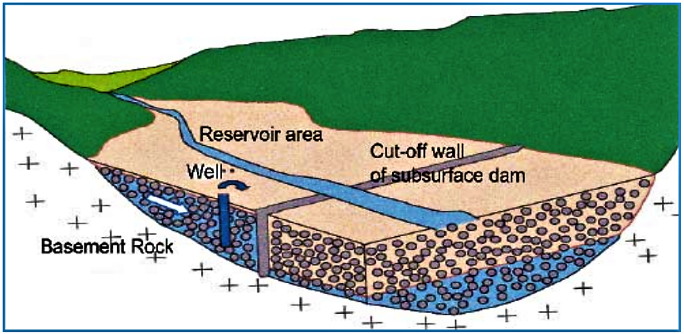
Floodplain – Groundwater Dams
Excavation to bedrock to install cross- floodplain, clay, groundwater dams to raise the groundwater elevation to sustain stream flow
Source: sswm.info/
Source: Sustain Issue 2011, Kentucky Institute for the Environment and Sustainable Development
Notes:
For multiple channeled streams and floodplain wetlands, groundwater dams are sometimes used to increase the groundwater level. This can also be used in single channel streams. Groundwater dams – work sort of like ribs across the floodplain.
The floodplain is excavated down to bedrock and then a clay layer is compacted acting as a dam to groundwater. This causes the stream level to rise as the water must go over the berm. This causes the low flows to be sustained for a longer period of time during droughts. A riffle will form along this rib on the surface.
Mill Branch in Knox County – restored by Art Parola’s team at the University of Louisville is shown as an example of this process.

Slide 15
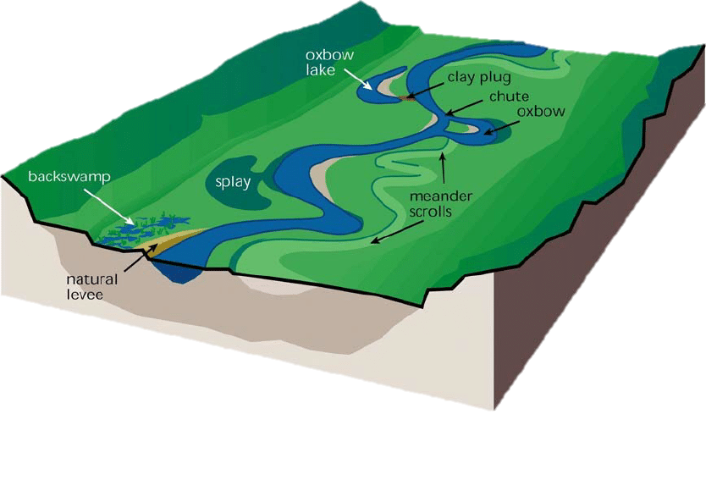
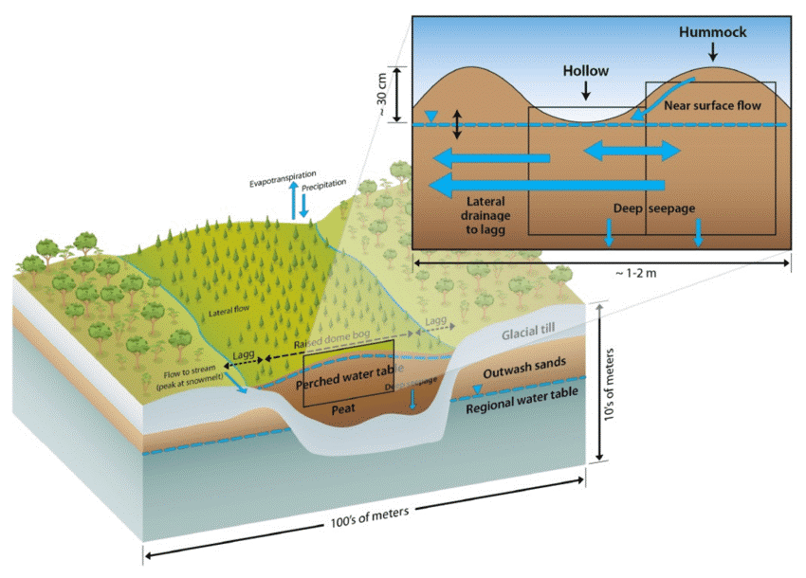
Floodplain – Microtopography
Source: FISRWG 1998
Source: Shi etal., 2015
Notes:
It is important to remember that changes in elevation across a floodplain, even small ones, can create a variety of habitats.
Cut off meanders can form small lakes and levees can create small wetlands. Across floodplain wetlands hummock and hollow patterns can create a “bumpy” surface which can create a lot of different habitats across the surface. As water fluctuates upward and downward over these areas, they may be able to support a variety of differing vegetation.
Some restorations include simulated tree falls where wood is left in place with scoops removed in areas by a backhoe.

Slide 16
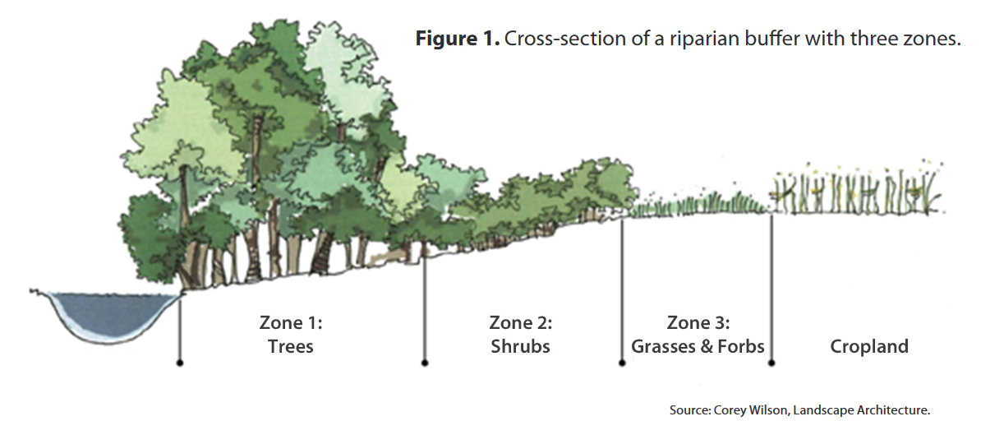
2. Riparian Restoration
Conservation easements
Floodplain or stream buffer setbacks
Greenway
Native planting and invasive removal
UK Cooperative Extension
Notes:
The riparian zone has been mentioned in really every presentation on best management practices because of its importance. It is also an area where volunteers can make a difference and engineering plans are not required.
Here we just want to point out that as part of maintaining a riparian zone, conservation easements, required stream buffers or setback zones, or greenway ordinances may be helpful in protecting these areas and restricting the type of activities that area allowed in these areas.
As always, planting native species and removing of invasive species are an important part of increasing habitat.

Slide 17
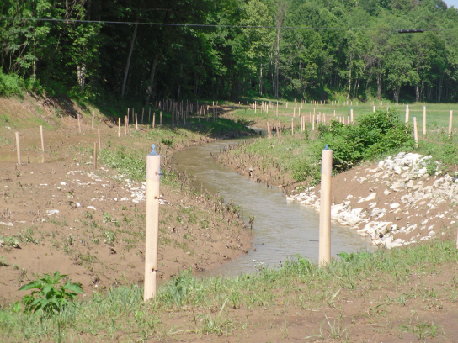
3. Bank Restoration
Various practices used to prevent or slow soil erosion from edges of stream channel.
Armoring (using rock or concrete)
Vegetative methods (using trees and other vegetation)
Indirect methods (using flow diversion)
Source: NRCS - Kentucky
Bank stabilization technique must be matched to the physical characteristics of the site.
Strength of protection = Strength of attack
Notes:
One of the most common general issues needing to be addressed in watershed improvement efforts is streambank stabilization.
Generally, the three forms of streambank stabilization are armored protection from erosion (generally using either rock or concrete), diversion of erosive flows (often with strategically placed rock or wood), and vegetative stabilization with plantings.
Armor – protective material in direct contact with the streambank
Vegetative methods – function as either armor or indirect protection or sometimes both
Indirect methods – extend into the stream channel and redirect the flow so that hydraulic forces at the channel boundary are reduced to a nonerosive level. Examples are dikes and other flow deflectors—weirs and crossvanes
The effectiveness of a specific streambank stabilization technique will be dependent on the physical characteristics of the restoration site, including land uses, soil types, geology, flow velocities and durations.
The BMPs used should be appropriately matched to the volume and flow characteristics at the site.
When selecting BMPs, it is also important to consider site access, maintenance, urgency and availability of materials.
Source: Stream Corridor Restoration: Principles, Process and Practices, USDA NRCS, October 1998
Bank stabilization practices, often referred to as bioengineering, are a nonstructural means of stabilizing streambanks from further accelerated erosion. Bank stabilization practices that rely on vegetation to protect streambanks are much more sensitive to the effects of urbanization than more structural practices. While the effects of increasing imperviousness are less noticeable with structural practices, bank stabilization practices in highly impervious watersheds tended to be less successful. This is the primary reason bank stabilization (e.g., nonstructural) practices are utilized less frequently or used in combination with bank protection practices. While these practices have been found to be very effective on rural and agricultural stream channels (i.e., low impervious cover), they are less able to withstand the elevated storm flows, high stream velocities, and rapid water level fluctuations that occur in urban streams.

Slide 18
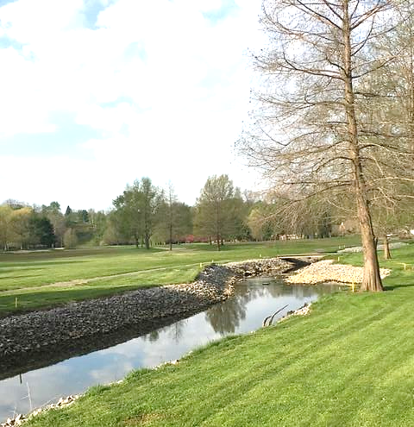
Bank Armoring – Riprap
A blanket of appropriately sized stones extending from the toe of slope to a height needed for long-term durability.
Used when:
long-term durability is needed
discharge is high
there is a threat to property
no practical way to incorporate vegetation
Should be used with vegetative plantings to stabilize upper bank
Stable, but no habitat or water quality benefit!
Notes:
Applications and Effectiveness • Can be vegetated (see joint plantings). • Appropriate where long term durability is needed, design discharge are high, there is a significant threat to life or high value property, or there is no practical way to otherwise incorporate vegetation into the design. • Should, where appropriate, be used with soil bioengineering systems and vegetative plantings to stabilize the upper bank and ensure a regenerative source of streambank vegetation. • Flexible and not impaired by slight movement from settlement or other adjustments. • Should not be placed to an elevation above which vegetative or soil bioengineering systems are an appropriate alternative. • Commonly used form of bank protection. • Can be expensive if materials are not locally available

Slide 19
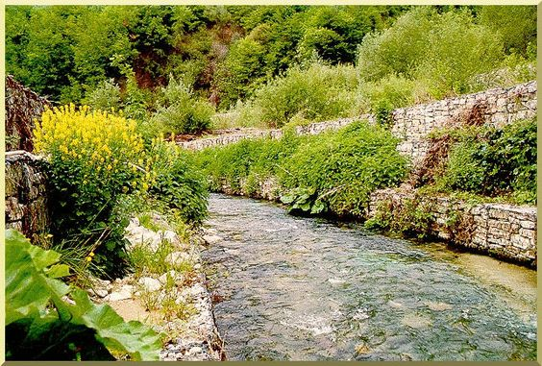
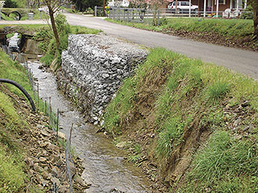
Bank Armoring – Gabion Baskets
Wire-mesh, rectangular baskets filled with small to medium size rock and soil and placed to form a structural toe or sidewall.
Live branch cuttings can be placed in baskets to take root, binding the structures together and into the slope.
Stable, but no habitat or water quality benefit!
Source: Federal Highway Administration
Notes:
Applications and Effectiveness • Useful for protecting steep slopes where scouring or undercutting is occurring or there are heavy loading conditions. • Can be a cost effective solution where some form of structural solution is needed and other materials are not readily available or must be brought in from distant sources. • Useful when design requires rock size greater than what is locally available. • Effective where bank slope is steep and requires moderate structural support. • Appropriate at the base of a slope where a low toe wall is needed to stabilize the slope and reduce slope steepness. • Will not resist large, lateral earth stresses. • Should, where appropriate, be used with soil bioengineering systems and vegetative plantings to stabilize the upper bank and ensure a regenerative source of streambank vegetation. • Require a stable foundation. • Are expensive to install and replace. • Appropriate where channel side slopes must be steeper than appropriate for riprap or other material, or where channel toe protection is needed, but rock riprap of the desired size is not readily available. • Are available in vinyl coated wire as well as galvanized steel to improve durability. • Not appropriate in heavy bedload streams

Slide 20
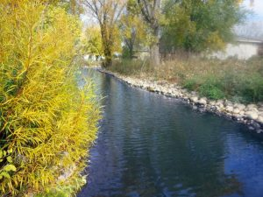
Bank Restoration – Streambank Toe Support
A ridge of quarried rock or stream cobble placed at the toe of the streambank as an armor to deflect flow from the bank, stabilize the slope, and promote sediment deposition.
Use where banks are being undermined by toe scour and vegetation cannot be used
Failed streambank soils & sediments collect at toe and allow revegetation
Should be used with upper bank revegetation
Source: Strand Associates
Notes:
Applications and Effectiveness:
• Should be used on streams where banks are being undermined by toe scour, and where vegetation cannot be used.
• Stone prevents removal of the failed streambank material that collects at the toe, allows revegetation and stabilizes the streambank.
• Should, where appropriate, be used with soil bioengineering systems and vegetative plantings to stabilize the upper bank and ensure a regenerated source of streamside vegetation.
• Can be placed with minimal disturbance to existing slope, habitat, and vegetation.
Source: Stream Corridor Restoration, NRCS

Slide 21
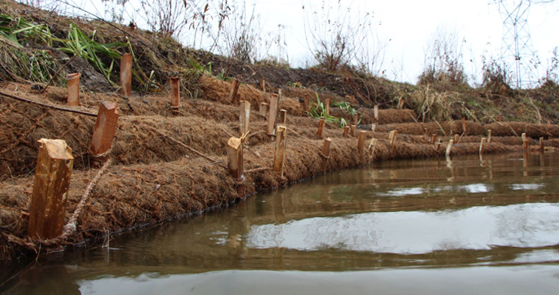
Bank Restoration – Coir Logs
Tube shaped erosion control devices filled with fiber material
Provide stabilization on a variety of slopes
Allows for rooting of plants
Can be used in combination with live staking
Source: Geosynthetic Systems
Notes:
Moving away from rock-based stabilization, we come to coir logs or fiber rolls.
These are tube-shaped erosion-control devices filled with a variety of materials such as straw, coconut fiber, or composted material. Each roll is then wrapped with netting like burlap, or coir to provide longevity. These rolls or logs are staked into the bank and allow for the rooting of plants or live staked trees to grow over the surface. When installed in combination with straw mulch, or erosion control blankets, these devices can be used to armor steep slopes while providing habitat.
Fiber rolls also help to slow, filter, and spread overland flows. This helps to prevent erosion and minimizes rill and gully development. Fiber rolls also help reduce sediment loads to receiving waters by filtering runoff and capturing sediments.

Slide 22
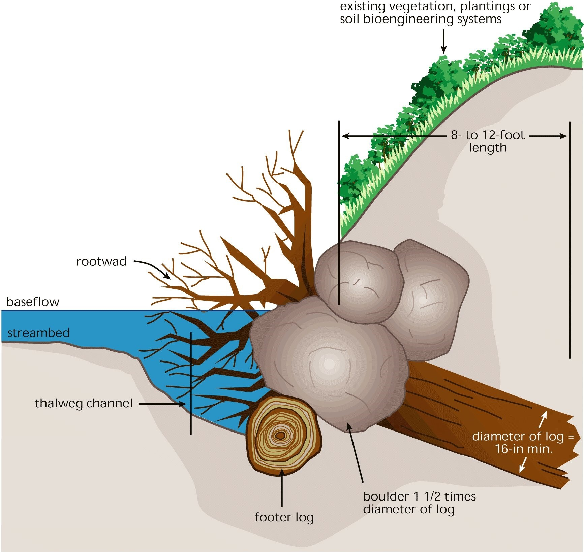
Bank Restoration – Root Wads
Logs with root wads are placed in and on streambanks to prevent erosion, trap sediment, and improve habitat diversity.
Tend to create undercut banks with deeper water, shade and cover
Organic debris collects on roots, providing macroinvertebrate food source
Provide great fish habitat
Source: Massachusetts Clean Water Toolkit
Notes:
Rootwads can tolerate high shear stress if they are well-anchored and provide effective bank protection.
They should be placed in outer meander bends and other areas of concentrated shear stresses and flow velocities along the banks.
Banks underneath root wads tend to become slightly undercut, forming an area of deep water, shade and cover for a variety of fish species. Organic debris tends to collect on the root stems that reach out into the channel, providing a food source for numerous macroinvertebrate species.
Where possible, they should be used in combination with plantings to stabilize the upper bank and provide a regenerative source of vegetation.
Some species, such as willow or cottonwood, may sprout on their own and help colonize the bank with new vegetation.
Will decompose over time and may need replacement.
Materials may not be readily available and therefore expensive, or require heavy equipment use to install.

Slide 23
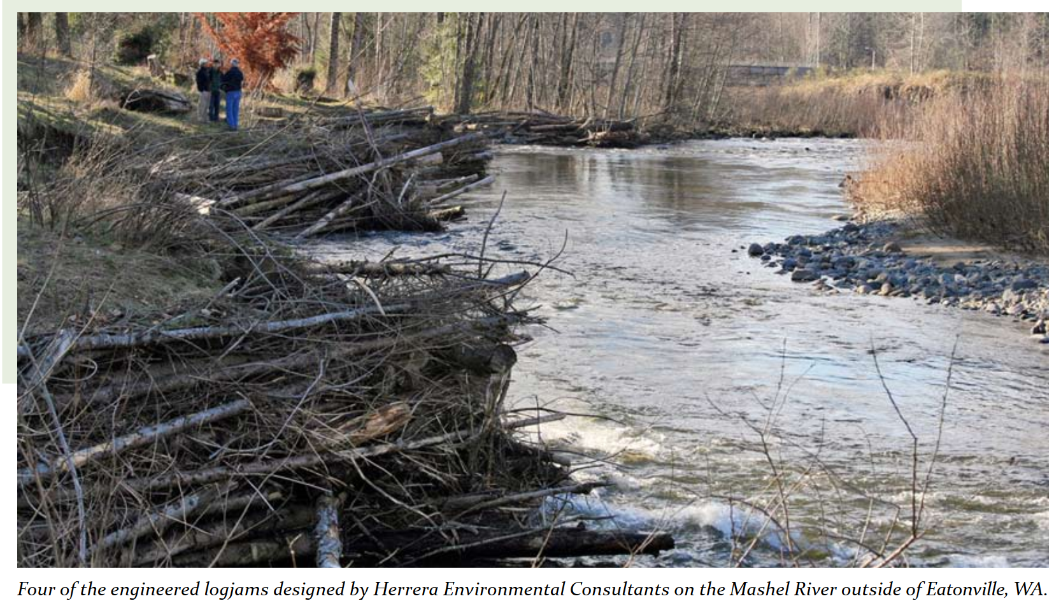
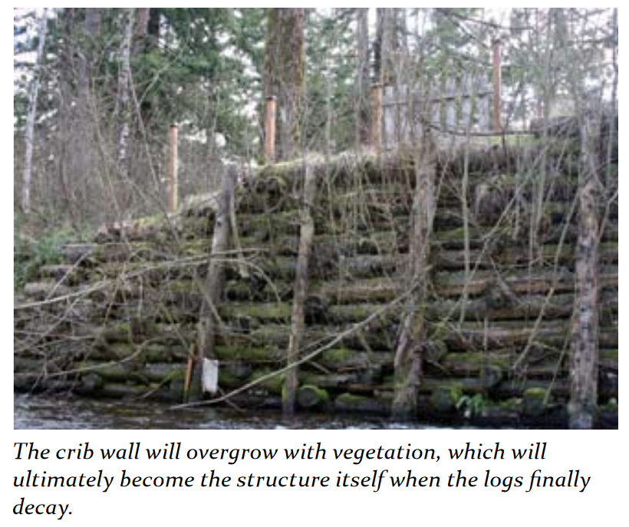
Bank Restoration –
Engineered Logjams and Cribwalls
Logs jams are criss-crossed patterns of logs driven into the streambank and anchored in an interlocking pattern.
Cribwalls are retaining walls composed of logs which will cover over with vegetation after they decay providing long term stabilization
Source: FEMA, Engineering with Nature
Notes:
Engineered Log jams and Cribwalls provide erosion control while also provide fish habitat and natural armoring of banks. This can provide a greener, more sustainable solution than concrete armoring.
Engineered log jams have the additional advantage of providing fish habitat underneath the logs.

Slide 24
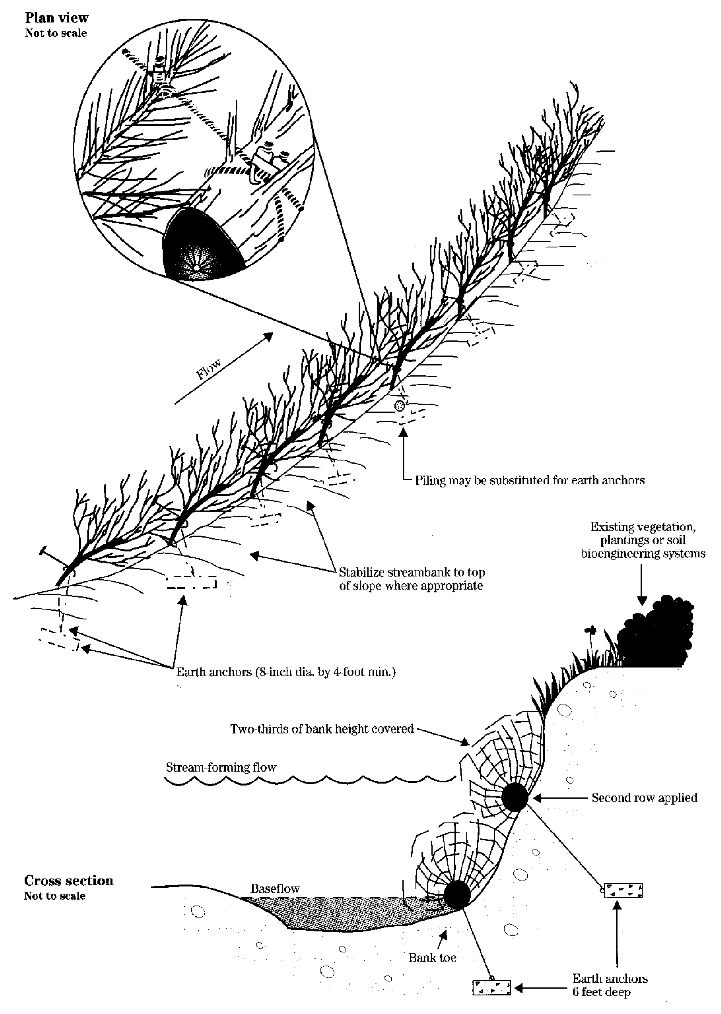
Bank Restoration – Tree Revetments or Snags
Whole tree logs are laid parallel to the bank and cabled to piles or anchors.
Trees slow current along the eroding bank
Allows silt and sediment to be deposited along the bank and within the tree branches
Plants and trees can establish in this area and further stabilize bank
Source: Massachusetts Clean Water Toolkit
Notes:
Another restoration technique that can be used is a tree revetment or snags. The idea here is to provide armoring while the bank is healing from the restoration and growing over with more permanent vegetation.
A tree revetment is an inexpensive way of stopping erosion by anchoring trees together along a stream bank. The trees greatly slow the current along the eroding bank; which decreases erosion and allows silt to be deposited along the bank and within the tree branches. The deposited material forms a good seed bed in which the seeds of river trees such as cottonwood and sycamore can sprout and grow. The resulting trees spread roots throughout the revetment and stream bank. By the time the revetment trees have decayed, the bank should be stabilized by the roots of the living trees. As an added benefit, tree revetments provide excellent fish and wildlife cover.
(source – Missouri Dept of Conservation, https://mdc.mo.gov/property/improve-my-property/habitat-management/pond-stream-care/streams-tree-revetments-stabilize)

Slide 25
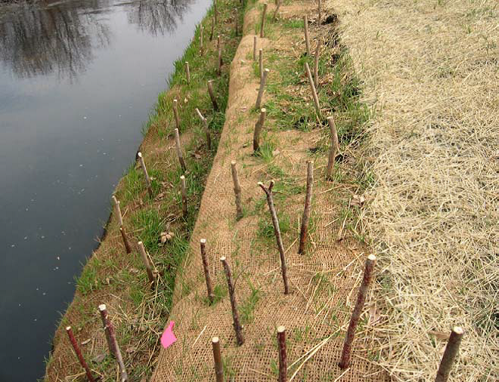
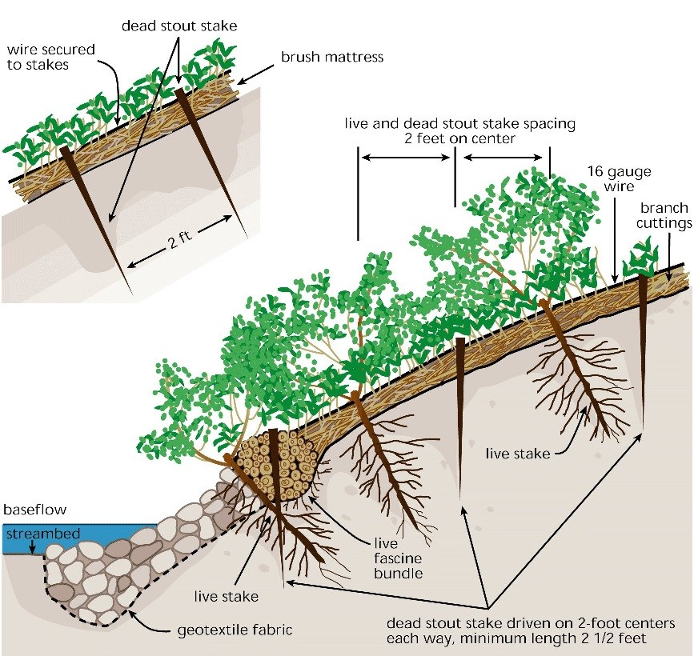
Bank Protection –
Live Staking / Brush Mattress
Plant materials, in the form of live woody cuttings, are inserted deep into the bank or anchored in other ways.
Source: Tennessee Wholesale Nursery
Staking resists plant washout during establishment period
Provides some immediate erosive protection
Can be combined with rocks, logs or brush or natural fabrics to further combat erosion
Source: FISRWG
Notes:
Another bank protection technique that may be utilized in conjunction with other techniques is live staking or brush mattresses.
These work best in areas with light erosion or in areas of more severe erosion when used in conjunction with other practices.
To install live stakes, straight branches of living woody plans like willow or dogwood are driven into the dirt – either by hand (if loose enough) or with a dibble bar. The cuttings are made from plants that will sprout roots and grow from these branches. The stakes should be snugly planted, with about 70% buried and 30% exposed. Place the stakes in a triangular pattern at about 2 to 3 feet apart, with a maximum of 4 stakes per yard. Typically this is best to do in early spring or late winter. Can be planted deep enough to access soil moisture and eliminate need for irrigation.
Geotextile fabric is often laid down first to hold off further erosion until the live stakes begin to grow, Anchor the fabric by burying the end in the substrate, behind the live stakes. Rip Rap at the toe is optional.
Brush Mattresses are installed perpendicular to the stream flow in a shallow trench and staked down. They are a combination of live stakes, branch cuttings, and live bundles of woody plants (fascines)
Cost: Low.
Difficulty: Easy, can be done by landowner
Effectiveness: Medium

Slide 26
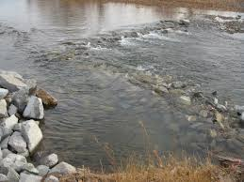
4. Instream Structures
A variety of rock, wood and earth structures placed across the stream channel and anchored in the streambanks to provide a hardened area of the bed that resists erosive forces.
Combat stream degradation and maintain bed elevation.
Examples:
Step pools
Rock weirs
Cross vanes
J-hook vanes
Wing deflectors
Log drops
Lunkers
Hyporheic zone enhancement
Dam removal
Source: MA Clean Water Toolkit
Notes:
Having addressed some of the techniques for bank stabilization we come to instream structures to address the profile and cross-section of the stream channel.
Land uses involving the installation of culverts, straightening of channels and removal of riparian vegetation can all cause damaging changes in channel slope. Usually, we see incised channels from bed erosion (degradation), but a raised bed level (aggradation) can also result, with no pool or riffle sequences, a shallow/wide channel, and a silty bed.
If a stable channel is required for the habitat improvement design, then grade control structures should be considered as the first step in design process.
We will look at a number of examples of these controls. In general, they are often designed as upstream U’s or V’s to create downstream scour pools for fish habitat or resting.
If properly applied, these structures can be effective. Sometimes, however, their effectiveness can be lessened by unforeseen changes in the channel, as the stream might meander around the structures. Or, they can be destroyed by excessive flows or catch too much gravel. Log structures will also eventually decompose. Therefore some designers try to stabilize the floodplain and allow for some flexibility in the formation of the channel over time.
The Stormwater Manager’s Resource Center (http://www.stormwatercenter.net) provides information on each of these practices in their Fact Sheets.
Sources:
The Cross-Vane, W-Weir and J-Hook Vane Structures…Their Description, Design and Application for Stream Stabilization and River Restoration, D.H. Rosgen
Massachusetts Clean Water Toolkit, http://prj.geosyntec.com/npsmanual/gradecontrolmeasures.aspx

Slide 27
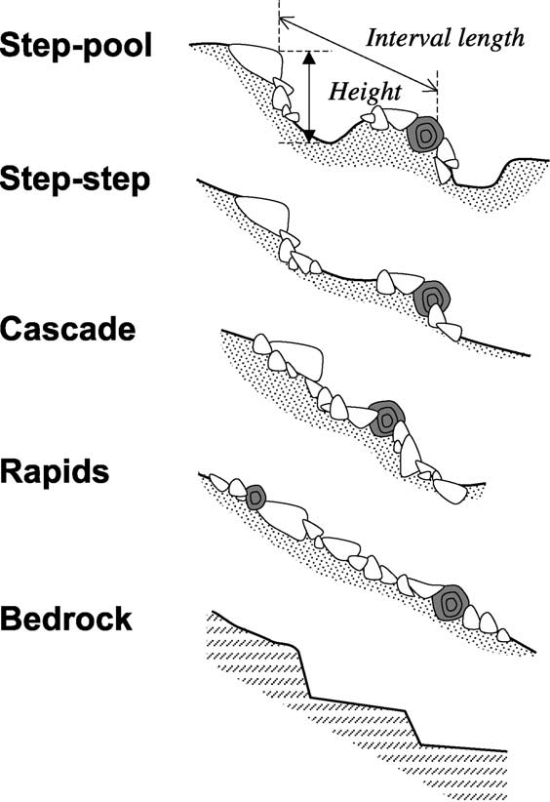
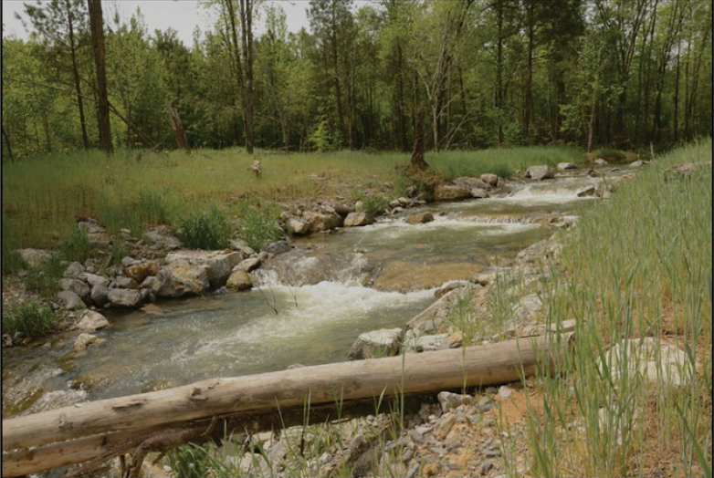
Instream Structures – Step Pools
A series of structures designed to dissipate energy in steep gradient stream sections.
Source: Gomi et al, 2003
Often used to address downcutting of streambed
Made of large rock in short, steep drops
Must be stable at all flows
Drops should be low enough to allow upstream fish migration
Source: Hatchery Creek Step-Pool, Stantec
Notes:
The first of the structures that we want to consider is the step pool sequence.
Step pools get their name because from their profile they look sort of like stairs. They consist of a series of structures designed to dissipate energy in steep gradient sections of a stream. They are often used in areas where headcuts are migrating upstream or where a channel has degraded below a culvert or outfall.
So with a step pool – rather than wiggling the stream back and forth to slow it down, you move it up and down in a cascading fashion.
Step-pools are made of large rock in alternating short steep drops (pools) and then longer areas where the flow will be directed slightly uphill. The number of steps is determined by the extent of the drop in invert of the stream. The requirement is that the structure must be stable at all flows such that the rock must be large enough to be essentially immobile. The drops should also be low enough to allow aquatic life to migrate upstream.
https://www.epa.gov/sites/production/files/2015-07/documents/ncd_review_checklist.pdf
http://prj.geosyntec.com/npsmanual/gradecontrolmeasures.aspx

Slide 28
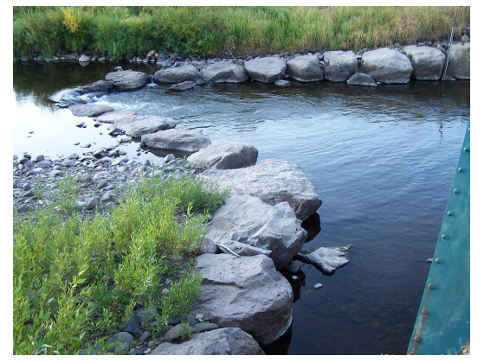
Instream Structures – Rock Weirs
Log, boulder or stone structures placed across the channel and anchored to the streambank and/or bed to create pool habitat, control bed erosion, or collect and retain gravel.
Source: Dept of the Interior
Notes:
Rock weirs serve enable grade control and create a variety of flow velocities, while maintaining the bed load transport of the stream.
Weirs point upstream with the sides angled at 15 to 30 degrees. The “legs” of the weir continue up to the streambank to just above bankfull elevation.
The stones that make up the weir do not touch each other. During baseflow conditions, water is forced to flow around and between the stones.
During high flows, the water rises over the stones, creating a scour pool below the structure, but allowing sediments to move through.
Weirs can also be constructed from logs. Like rock weirs, log weirs provide bedform diversity, maintain channel profile, and provide pool and cover habitat.
Source: Reclamation: Managing Water in the West, Qualitative Evaluation of Rock Weir Field Performance and Failure Mechanisms, U.S. Department of the Interior, Bureau of Reclamation, Technical Service Center, September 2007.

Slide 29
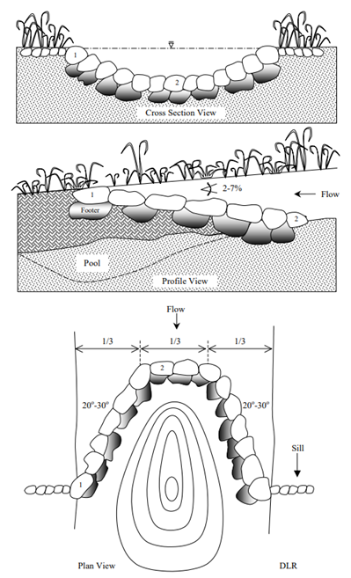
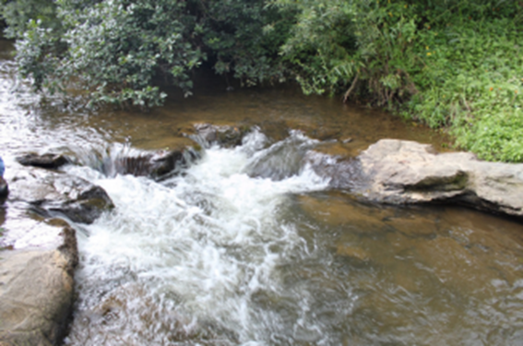
Instream Structures - Cross-Vanes
Flow
Photo: Carmen Agouridis, Univ of KY
Source: Dave Rosgen
Notes:
The cross vane structure is similar to a weir, but differs in that stones do not extend much above the stream base flow level. The Cross-Vane decreases near-bank shear stress, velocity and stream power, while increasing the energy in the center of the channel.
Often, a cross vane will be placed above and below a meander to establish elevations for pool and riffle formation.
For many fish species, these pools form areas of refuge due to increased water depth and prime feeding areas as food items are washed into the pool from the riffle.

Slide 30
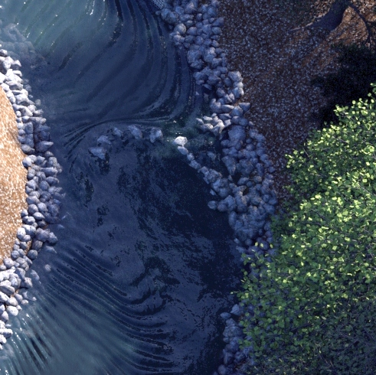
Instream Structures – J-Hook Vanes
J-shaped structures that extend upstream from streambank into stream channel.
Mimics effect of tree falling partially into stream.
Usually placed along bank at point where erosion is occurring at toe of slope.
Reduce erosion along bank by redirecting flow to center of stream.
Also, create scour pools on downstream side.
Source: MA Clean Water Toolkit
Notes:
J-hook vanes can be constructed of logs or rock, or both.
They should be carefully placed to avoid scour erosion on the upstream side from eddying effects of the water.
The curved end is placed to encourage downstream scour pool formation.
These structures enhance habitat by:
Creating downstream scour pools
Narrowing and deepening the baseflow channel
Enhancing riffle habitat on the upstream side
The boulders also tend to trap leaf packs and small woody debris that are used as a food source for macroinvertebrate species.

Slide 31
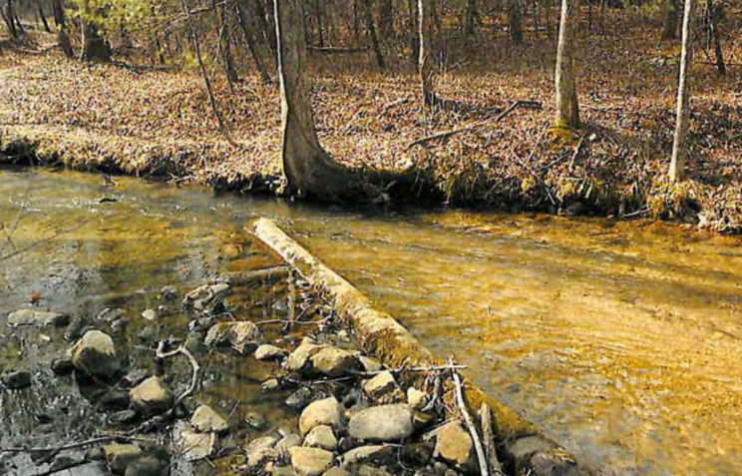
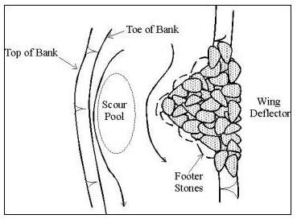
Instream Structures– Wing Deflectors
Structures that protrude from either streambank but do not extend entirely across the channel.
Deflect flows away from bank and toward channel thalweg.
Scours pools by constricting channel and accelerating flow.
Stormwatercenter.net
Source: USDA
Notes:
Flow deflection can be achieved through the placement of either log or stone or combination of both as “wing deflectors.” The slide photo shows a log deflector.
Wing Deflectors protrude from the streambank and extend partially across the channel width. They are usually simple to construct and a cost-effective way to restore a meandering thalweg to altered channels that are wide, shallow and sluggish. These structures are meant to behave as an artificial bar, reducing stress on the banks by directing bankfull flows toward the thalweg (the area of lowest bed elevation in the stream’s path). They enhance habitat by creating scour pools.
They can be installed as single structures, in an alternating series, or opposite each other (a double-wing deflector).
Deflectors placed in sand bed streams may settle or fail due to erosion.
Source: Stream Habitat Improvement Handbook, USDA Southern Region, June 1992
https://efotg.sc.egov.usda.gov/references/public/NE/Streamandhabitatimprovement.pdf
Massachusetts Clean Water Toolkit
http://prj.geosyntec.com/npsmanual/wingdeflectors.aspx

Slide 32
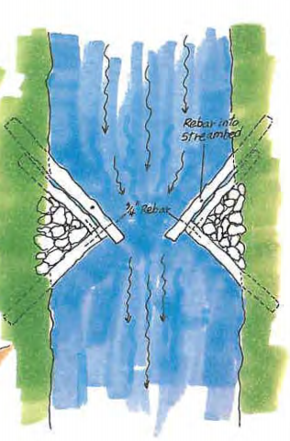
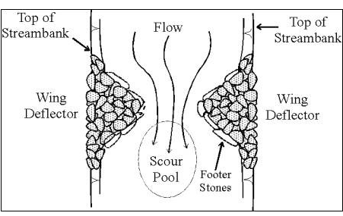
Instream Structures – Double-Wing Deflector
Two wing deflectors placed on opposite banks to create a midchannel pool through scouring action in shallow stream segments.
The scour pool creates habitat for aquatic insects and fish.
Stormwatercenter.net
Source: USDA
Notes:
In opposing pairs, deflectors further increase mid-channel velocity and cause the formation of a scour pool.
These structures enhance habitat through pool formation, the narrowing and deepening of the baseflow channel, and the enhancement of riffle habitat.
Wing deflectors should only be expected to alter low flow and bankfull stream conditions. Installations to modify higher flows can aggravate erosion and cause channel instability.

Slide 33
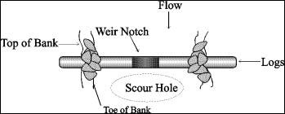
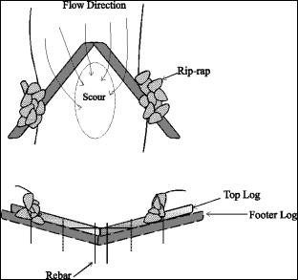
Instream Structures – Log Drops and V-Log
Log-Drop is using a large, tree log for grade control by burying across the channel. V-Logs are placed in a V shape to channel flow.
Must be careful of elevation lest they form a fish barrier
Can direct flow to scour below the log
Some macroinvertebrate inhabit submerged wood
Provide grade control
Source: Log Drop, stormwatercenter.net
Source: V-Log Drop, stormwatercenter.net
Notes:
Logs can be utilized in a number of ways for grade control.
For a log drop, a log is places perpendicularly across the stream and buried under several feet of the stream bank on each side. In some cases a second log may be placed on top of this first log depending on the base flow level. In some cases, notches can be made in the logs to concentrate the base flow. Care must be taken as to the elevation for the logs as they may form a barrier for fish passage if too high.
A variation of the standard log drop structure is the V-log structure where two logs form a V pointing upstream. The logs are lowest (at or below the stream invert) at the apex and rise into the stream banks. This structure has the advantage of not potentially creating a fish barrier and is more effective at concentrating flows and creating scour pools below the structure.
https://www.stormwatercenter.net/

Slide 34
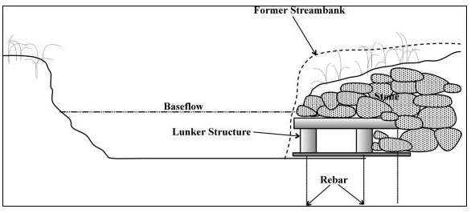
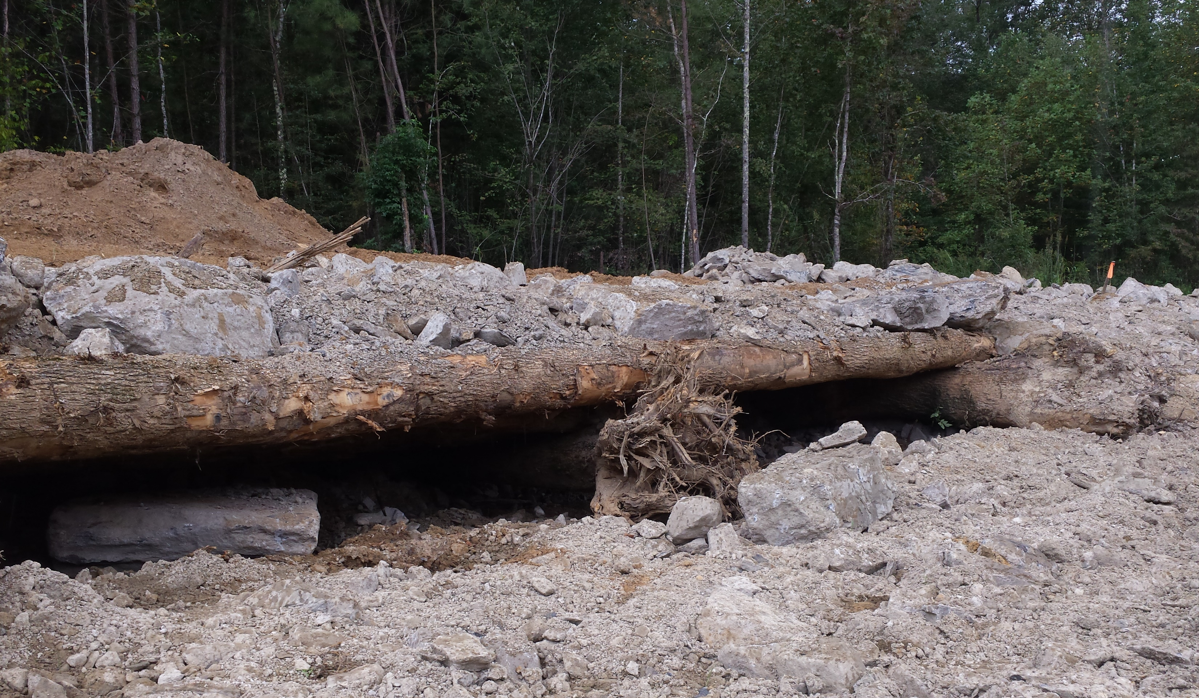
Instream Structures – Lunker Structures
Crib-like, wooden or stone structures installed along the toe of a stream bank to create overhead bank cover and resting areas for fish.
Developed to mimic fish habitat from undercut banks
Provide structural protection for the stream bank
Source: stormwatercenter.net
“Lunker bunker” created for fish habitat
Source: KDFWR Hatchery Creek Photos
Notes:
Lunkers are crib-like, wooden structures installed along the toe of a stream bank to create overhead bank cover and resting areas for fish.�
A lunker consists of two logs with wooden spacers nailed between them.�
Additional logs are nailed across the spacers perpendicular and a crib like structure is formed.�
The structure is installed by first grading the streambank back and creating a trench along the new bank line.�
This trench must be wide and deep enough so that the lunkers lay flat and are completely covered by water.�
The lunkers are secured to the stream bottom with rebar. Once in place, rock is placed on top of and behind the lunkers and the streambank is graded down to meet the front edge of the lunker.
https://www.stormwatercenter.net/

Slide 35
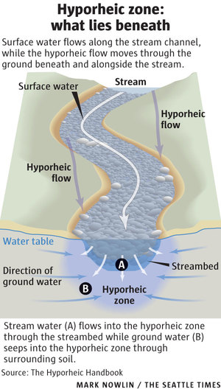
Instream Structures – Hyporheic zone
Hyporheic zone is the saturated area underneath and adjacent to a stream where ground water connects with the surface water
Addition of wood chips to gravels in this zone can help nutrient processing, particularly denitrification.
Can provide unique habitat to some microbes and aquatic organisms

Slide 36
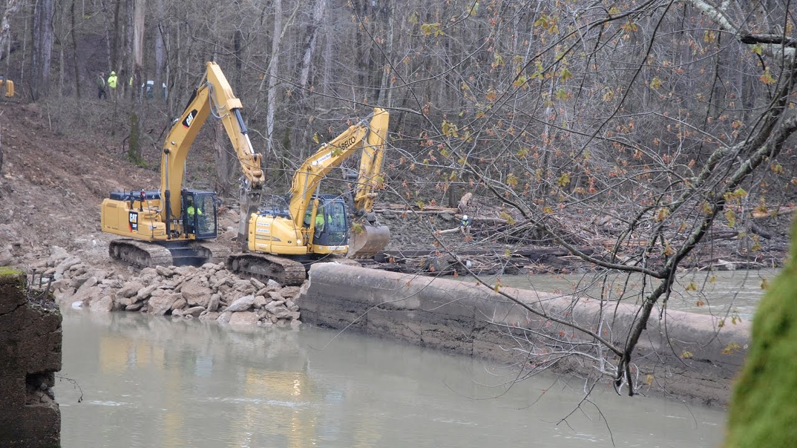
Instream Structures – Dam Removal
Removal of check dams or lock and dams
Dams can provide for power, flood control, irrigation, navigation, or recreation
Removal restores flows for fish and wildlife
Alter the flow regime
Provide for improved transport of sediment and nutrients
Can also remove a potential public safety hazard
Removal of Green River Lock and Dam 6
Source: USACE
Notes:
Another stream restoration technique that is commonly utilized it the removal of check dams or lock and dam structures.
Dams were once frequently installed to provide power, flood control, irrigation, or recreation. However these dam structures altered the hydrology of the stream creating often a sort of slow-moving impoundment. These dams cause sediments to slow down and accumulate burying stream bottom habitat. They also can affect riffle habitats in the surrounding areas.
Removing these dams can restore ecological flows which can support a variety of fish and wildlife, including mussels. This also allows for the improved natural transport of sediment and nutrients. Finally, it can eliminate a potential safety hazard as these structures approach failure.

Slide 37
Habitat and Stream Restoration Practices
Floodplain Restoration
Riparian Restoration
Bank Restoration
In-Stream Structures
1
2
3
4
Source: Texas Aquatic Science
Notes:
These are some of the many stream restoration practices that may be utilized by water resource engineers.
It is important to have a general idea of the types of practices that can be implemented for planning purposes and to think of requests, but in most cases the designs will need to be conducted by registered engineers and hired contractors.
We hope this overview provides some understanding of how streams may be improved in your watershed.

