Slide 1
Watershed Academy Watershed Coordinator Training Series
Dealing with Data
8. Spreadsheet Tools

Slide 2
Spreadsheet Tools
Filtering Results
Conditional Formatting
Pivot Tables

Slide 3
Filtering Results
https://support.office.com/en-us/article/video-sort-data-in-a-range-or-table-ffb9fcb0-b9cb-48bf-a15c-8bec9fd3a472
Sort Data (1:54)
Sort Details (3:55)
Autofilter Details (3:55)

Slide 4
Conditional Formatting
https://support.office.com/en-us/article/video-use-conditional-formatting-03ab07da-1564-4913-b69f-2b1a370c8910
Use Conditional Formatting (2:03)
Autofilter Details (3:55)

Slide 5
Pivot Table
https://support.office.com/en-us/article/video-create-a-pivottable-and-analyze-your-data-7810597d-0837-41f7-9699-5911aa282760
Create a Pivot Table (1:35)
Create a Pivot Table Manually (5:36)
Sort, Filter, and Calculate (4:07)
Use Slicers, Timelines, and Pivot Charts (3:52)

Slide 6
Pivot Table
https://support.office.com/en-us/article/video-create-a-pivottable-and-analyze-your-data-7810597d-0837-41f7-9699-5911aa282760
Create a Pivot Table (1:35)
Create a Pivot Table Manually (5:36)
Sort, Filter, and Calculate (4:07)
Use Slicers, Timelines, and Pivot Charts (3:52)

Slide 7
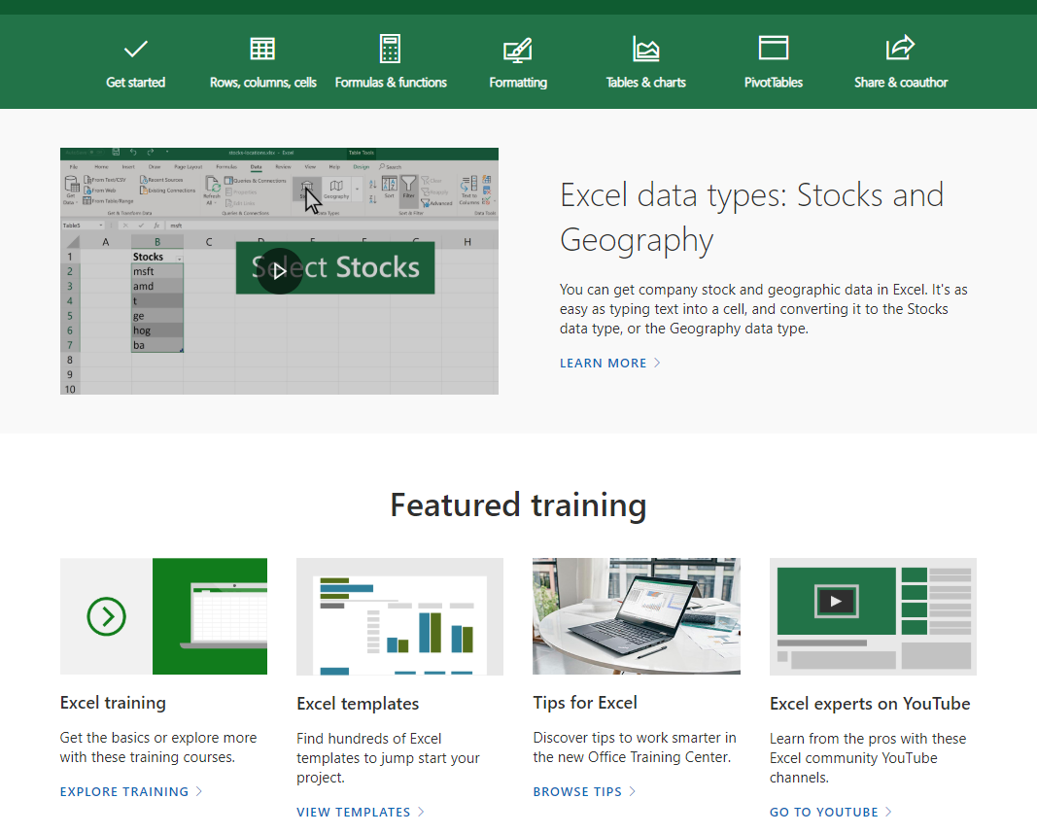
Other Training and Templates
https://support.office.com/en-us/excel

