Slide 1
Watershed Academy Watershed Coordinator Training Series
Dealing with Data
2. Collecting Data: Requirements for Watershed Planning

Slide 2
Collecting Monitoring Data
Basic Monitoring Equipment
Watershed Plan Monitoring Requirements and Logistics
Site Selection and Scale Considerations
Data Quality Levels
Notes:
In this section, we will be talking through the basics of water quality monitoring—the equipment used…the parameters that need to be assessed…site selection and sampling logistics…and data quality levels.

Slide 3
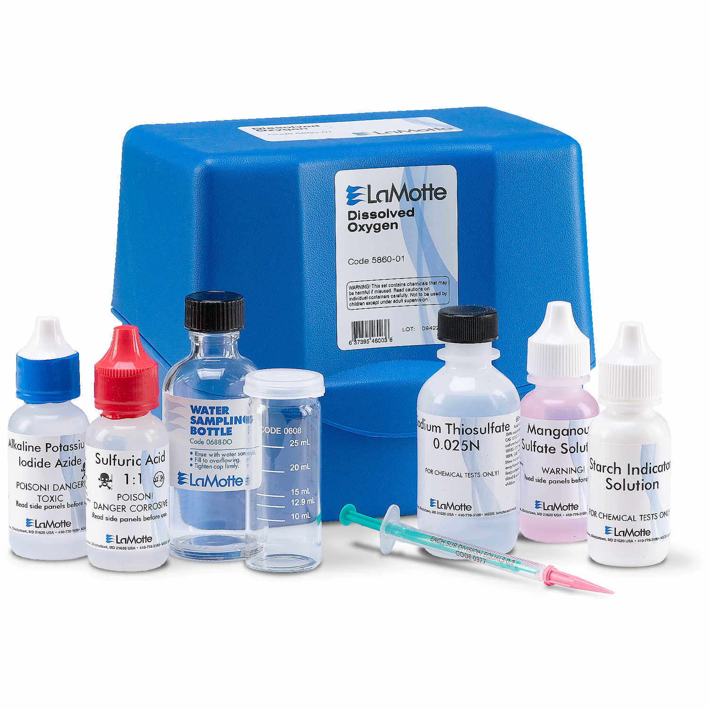
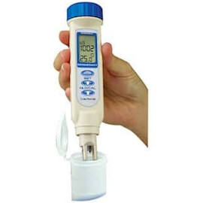
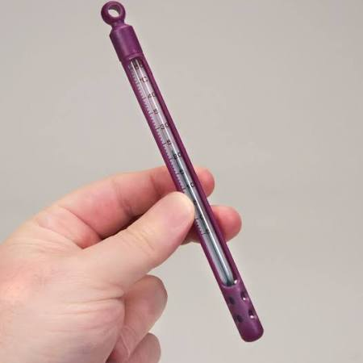
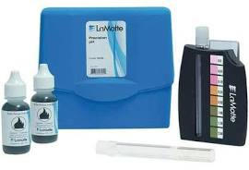
Monitoring Equipment: In-situ
Dissolved Oxygen
Conductivity
Basic Volunteer Monitoring Kit
$200-$250 Total
pH
Temperature
Notes:
First, we want to briefly cover some of the more common equipment you will encounter in water quality monitoring for technical reports.
For measuring basic physicochemical parameters in the field, there are a range of options depending on price and required accuracy / sensitivity.
Basic field parameters include dissolved oxygen, pH, conductivity, and temperature.
Separate kits are available from different manufacturers. Total cost is around $200-$250 dollars for an initial set of equipment.
This is the type of equipment that is provided to citizen samplers in Kentucky’s Watershed Watch program.

Slide 4
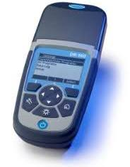
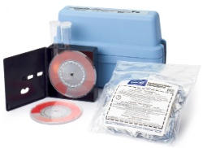
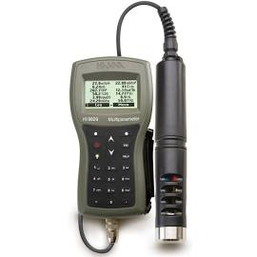
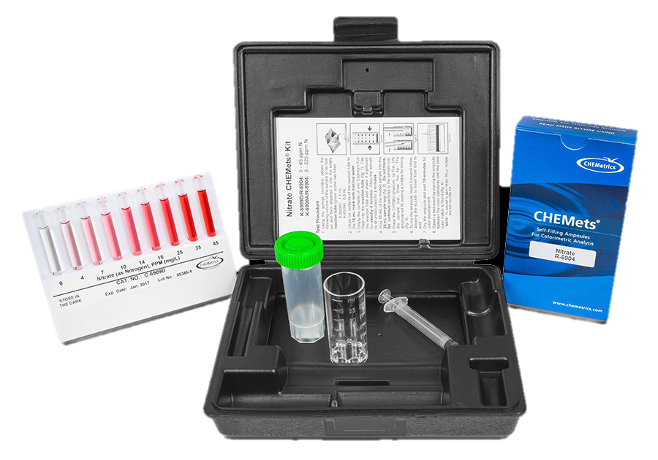
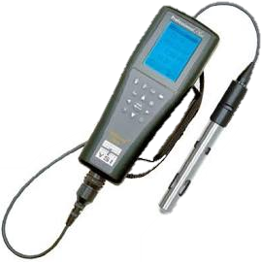
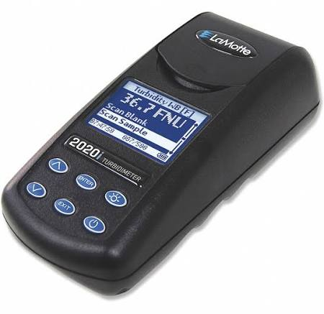
Monitoring Equipment: Insitu
Dissolved Oxygen, pH, Temperature, and Conductivity All in One:
$1,000+
Handheld Colorimeter $1,500+
Single parameter Colorimeter
$50-100
Turbidimeter
$500+
Notes:
If you want to pay a little more initially to get results faster and more accurately, the same information can be collected with multi-parameter water quality meters (also called sondes). These start at around $1,000 and can cost over $5,000 depending on the quality of the instrument and the capacity of the datalogger.
There are also field instruments called colorimeters that can measure many commonly collected laboratory parameters. These provide immediate field results based on the color of the vial after a chemical reaction. A colorimeter than can run a spectrum of tests costs over $1,500, while individual single parameter colorimetric kits can be obtained for $50 to $100.
A turbidimeter, which measures water turbidity, can also be added to some multiparameter sondes or purchased separately for about $500.

Slide 5
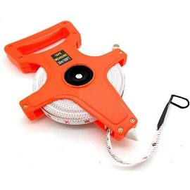
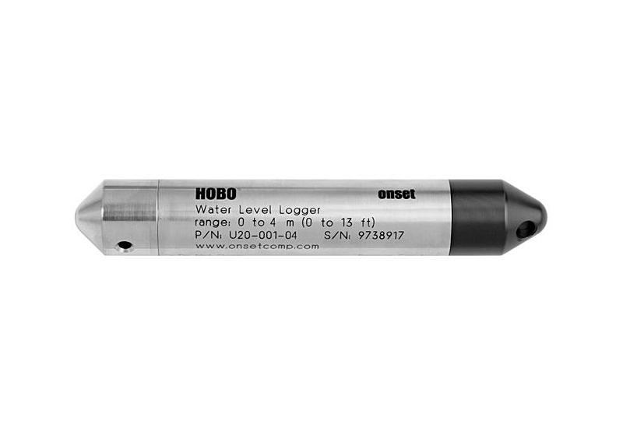
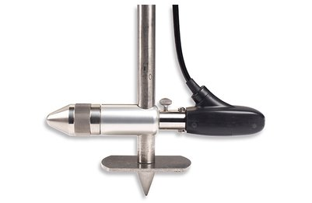
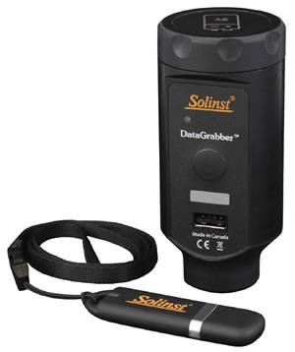
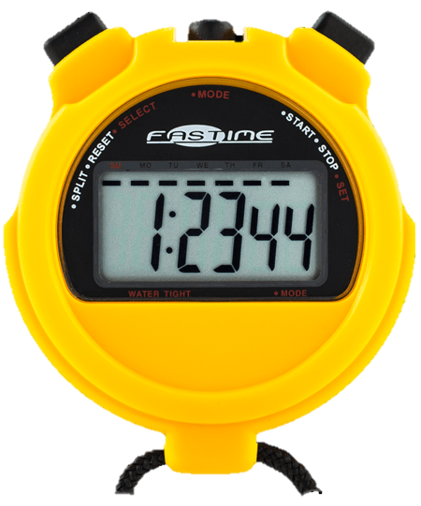
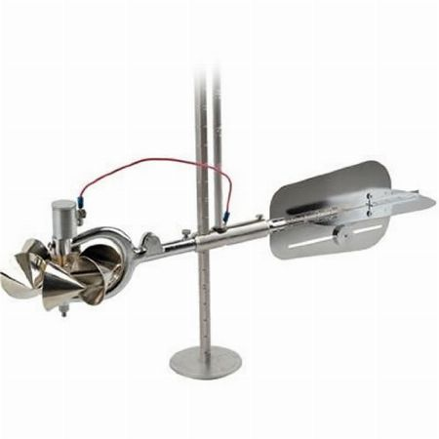
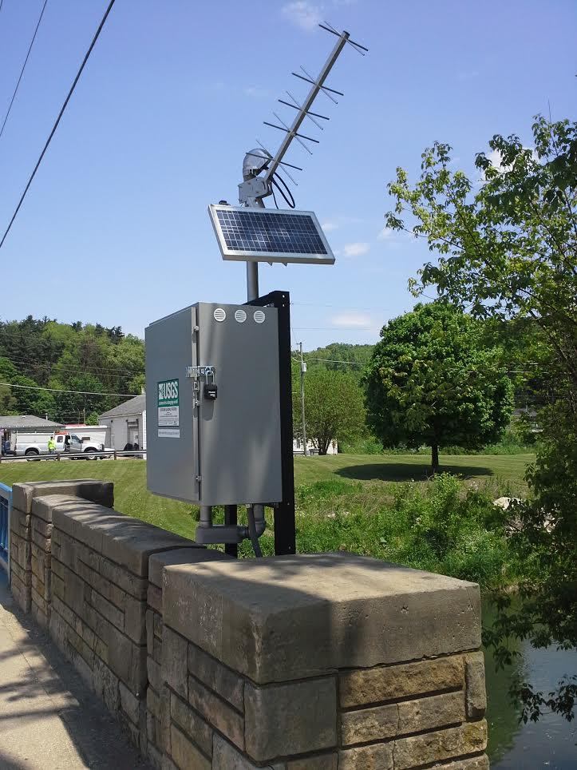
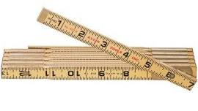
Monitoring Equipment: Stream Flow
Simple float method
~$20-40
Topset wading rod
and flow meter
$5,000+
Continuous monitoring station
$10,000+
Notes:
Stream flow can be measured in a variety of methods, again with the cost increasing with accuracy.
To get a very simple estimate of stream flow, a measuring tape of around 100 feet, a wooden ruler or yard stick, a stopwatch, and a “weighty” object such as an orange can be used. While a great method for volunteers, this method is less accurate than other methods.
For more precise measurements, a topset wading rod combined with an electromagnetic, doppler, or a Price-type meter can be used in conjunction with a tape measure to determine the flow. These meters begin at $5,000. This will allow for accurate time of visit measurements.
For long term measurements, continuous monitoring stations can be constructed, and pressure transducers installed. The stream will have to be surveyed and flows routinely measured in order to develop stage discharge curves that correlate the depth of the water to the stream flow. A power source and telemetry may also need to be installed to transmit results. These costs can exceed $10,000. This is necessary if you need a more comprehensive assessment of the flow regime.

Slide 6
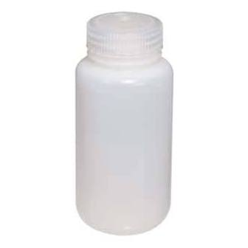
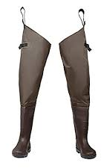
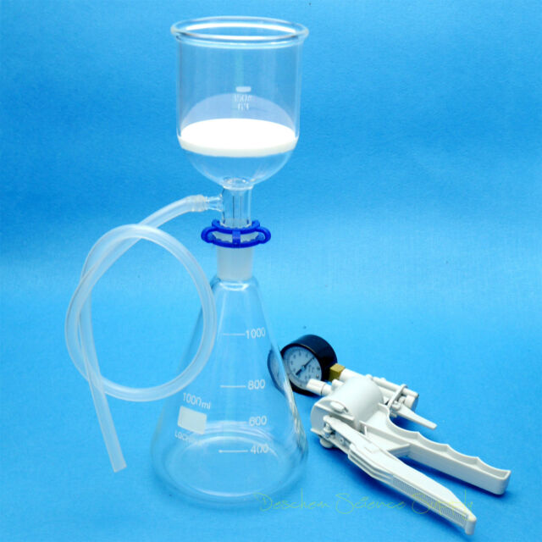
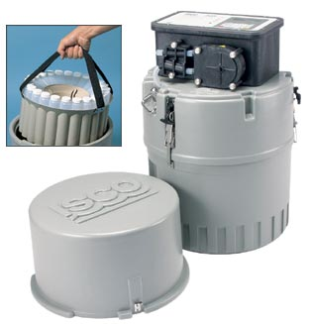
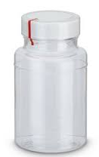
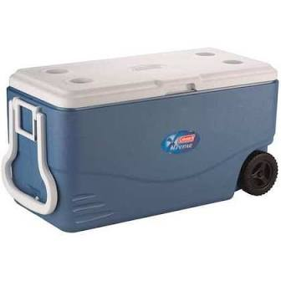
Monitoring Equipment: Lab Samples
Grab Sampling
Field Filtering
$50-100
Composite Sampler
$1000+
Notes:
For collecting samples in the field, you will need some clean bottles, a pen and paper to record the custody, and a cooler to keep samples on ice. Deionized water is also needed for cleaning equipment. Depending on the depth of water, hip waders or chest waders may also be necessary.
If field filtering is required, for instance for orthophosphorus collection or chlorophyll a, then a field filtration system with a hand vacuum pump will be necessary. These typically cost less than $100. It should be noted that if such equipment is used for orthophosphorus, clean procedures are extensive and utilize hazardous chemicals.
If you want sample collection to occur automatically or to composite samples (collect numerous samples over timespan and combines them into one representative sample) over the course of a storm, an automatic sampler can be installed. This can be helpful if a sampling site is in a remote location, stormwater runoff sampling, pretreatment sampling, or other automated needs.

Slide 7
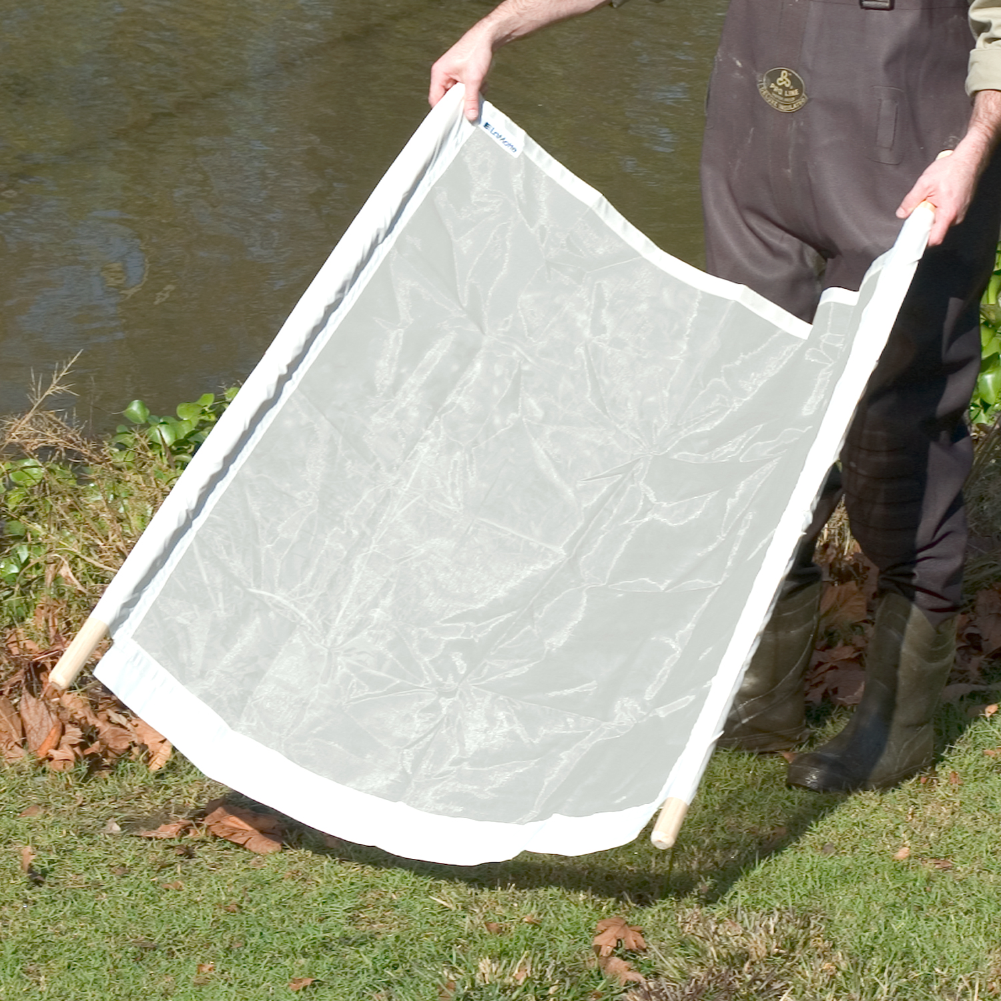
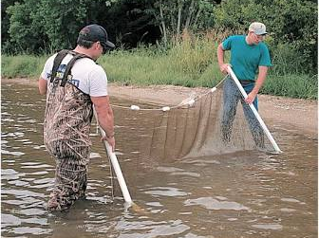
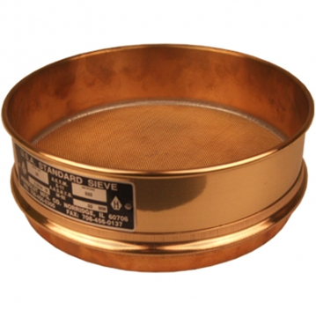
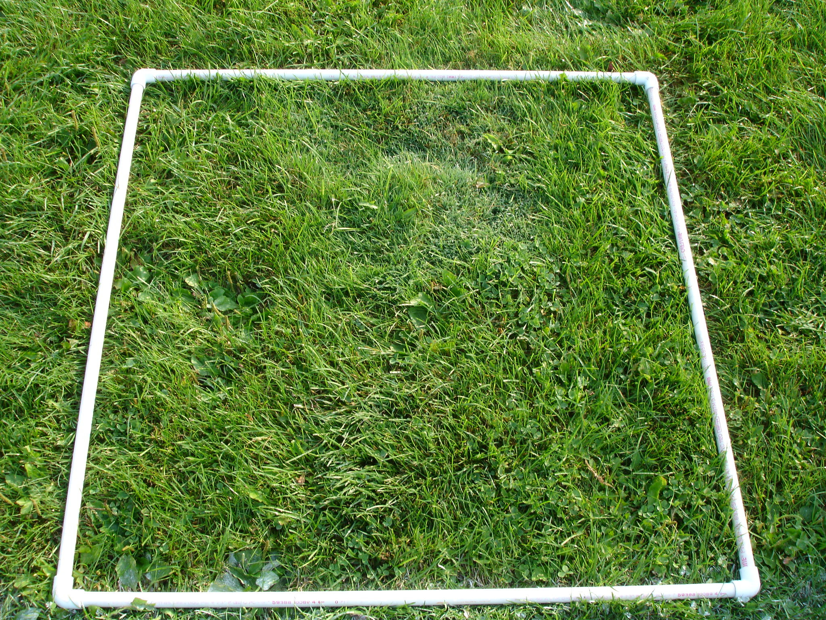
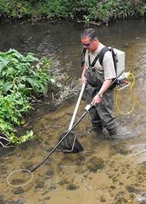
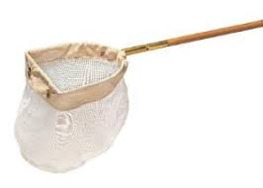
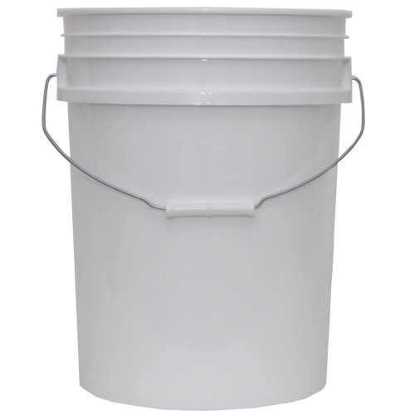
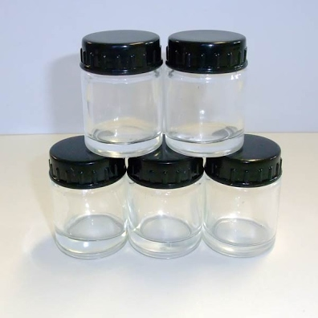
Monitoring Equipment: Biological
Habitat
Macroinvertebrates
Fish
Notes:
For biological surveys including habitat, aquatic macroinvertebrates, and fish, a range of equipment is required.
For habitat, just a camera and a datasheet is required. A tape measure to record the length of the reach and the depth of the water or height of the banks may be helpful.
For macroinvertebrates, a quarter meter square quadrat is used in conjunction with a kick-net to sample riffles. D-frame nets, a sediment sieve, sorting trays, tweezers, buckets, and sampling jars and vials are also necessary. For volunteer sampling, you might want an identification key, but for bioassessments, this identification will occur in a laboratory.
For fish surveys, seines are used as well as backpack or boat electroshockers, nets, and buckets. You’ll probably want a key for this in the field, and a few jars in case you need to hold on to a specimen.

Slide 8
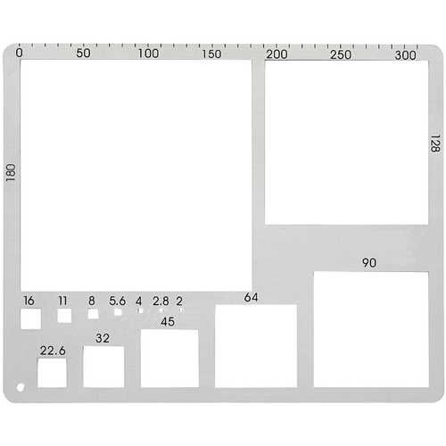
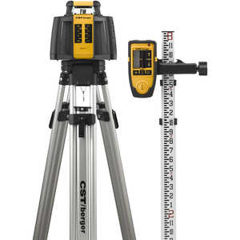
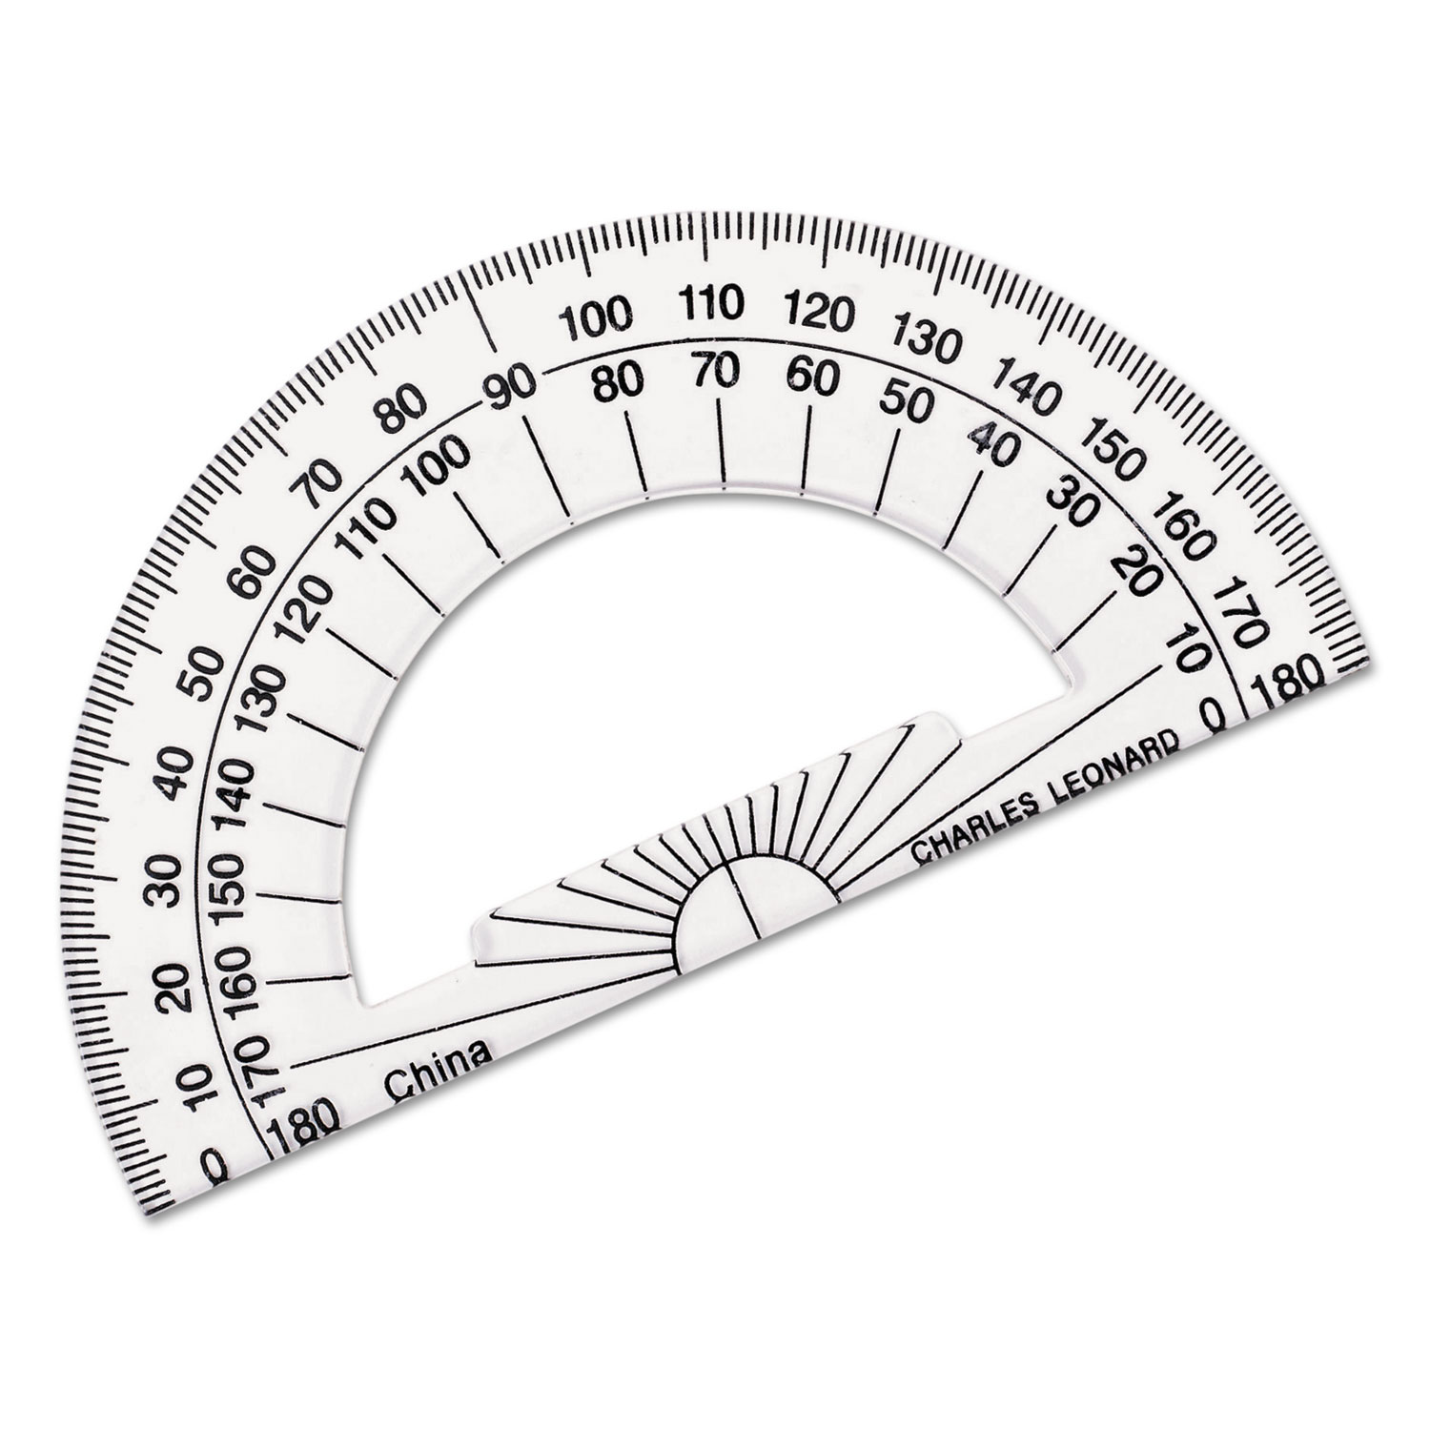
Monitoring Equipment: Erosion and Geomorphology
Gravelometer
Surveying Equipment
Protractor
Notes:
For watershed planning, some sort of survey for erosion will need to be accomplished. This may be as simple as taking some pictures along with GPS locations and measuring the height and length of streambank eroding.
A protractor may be helpful to estimate the bank angle or a clinometer may be used if more exact measurements are necessary. A gravelometer may be used to determine the pebble size when doing a pebble count to characterize the stream bed.
For more extensive characterizations, stream surveying equipment may be necessary. Bank pins or sediment traps may also be installed in streams for intensive projects.

Slide 9
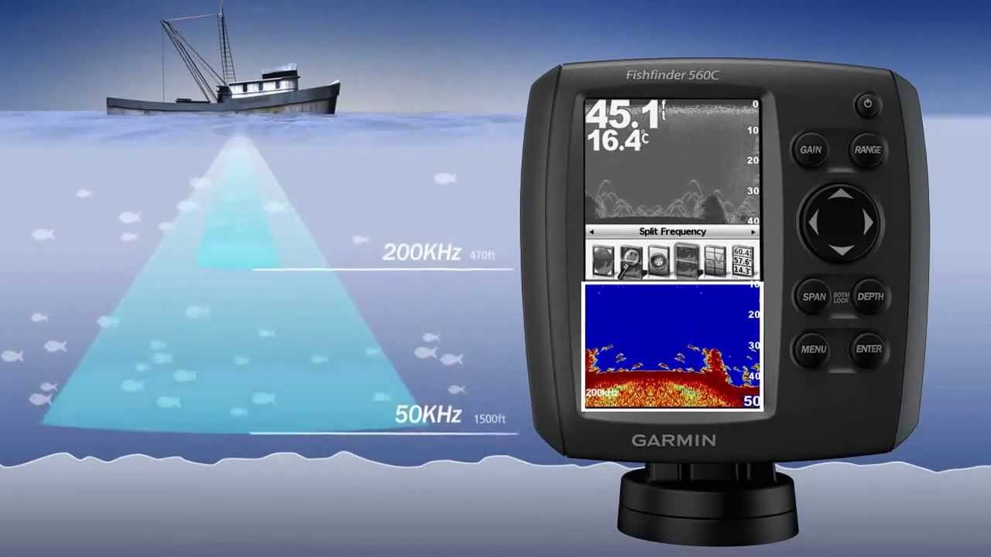
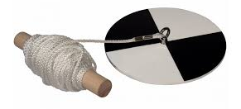
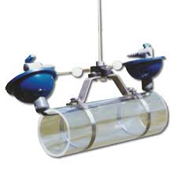
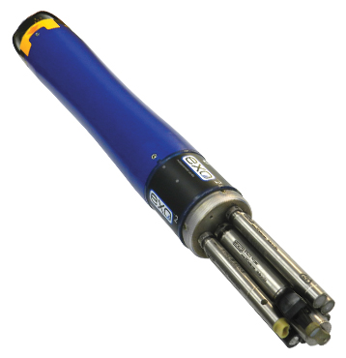
Monitoring Equipment: Lakes
Secchi disk
Fishfinder for depth
Multiparameter sonde with measured depth cable
Van Dorn sampler
Notes:
In addition to the equipment previously noted, lake monitoring can utilize some specialized equipment.
A secchi disk can provide a low cost measurement of water transparency.
A Van Dorn Sampler allows samples to be collected from a specific depth by lowering via a measured rope and releasing a weight that closes the ends of the container.
A fish finder can be used to determine lake depth.
A multi-parameter sonde is also used in lakes with a long, pre-measured cable to reach the desired depth of measurement.

Slide 10
Watershed Monitoring Requirements
Quality Assurance Project Plan (QAPP)
Sampling Procedures
Required Water Quality Parameters
Cost Considerations
Notes:
Having looked at some of the equipment that is used in monitoring, we now want to take a brief look at the requirements for watershed plan monitoring.

Slide 11
Quality Assurance Project Plan (QAPP)
Must be approved before watershed planning monitoring can occur – 319(h) requirement.
Plan includes information about:
project management,
data quality objectives,
sampling and laboratory methods,
quality controls,
data assessment and response, and
data review and use
Template available online.
https://eec.ky.gov/Environmental-Protection/Water/QA/Pages/default.aspx
Typically prepared by technical consultant.
Notes:
QAPPs are a must for watershed planning. These take time to compile (they are often over 50 pages), are project specific, and are typically prepared by a consultant.
You will need to factor in time and labor for someone to develop this document.

Slide 12
Standard Operating Procedures (SOPs)
Standardized approach to data collection and sample processing. SOPs are available for the following:
Algae
Bacteria
Fish
Groundwater
Habitat
Index Calculation
Macroinvertebrates
Sampling and Field Measurements
Approved SOPs are available online for all Division of Water Methods
https://eec.ky.gov/Environmental-Protection/Water/QA/Pages/default.aspx

Slide 13
Required Field Parameters for Watershed Planning
Group | Field Parameters | Frequency | Time / Site
Flow | Stream Discharge | Every Time | 30 - 60 min
Field Data | pH | Every Time | 15 - 60 min Depending on equipment
 | Dissolved Oxygen | Every Time
 | % Saturation | Every Time
 | Conductivity | Every Time
 | Temperature | Every Time
 | Turbidity (est.) | Every Time
Group | Survey | Frequency | Time Requirement
Biology | Habitat Assessment | Once, Mar-May (<5sqmi) May-Sept (>5sqmi) | 4 hours + Lab Identification
 | Macroinvertebrates
Erosion | Visual Erosion Assessment | Review of reaches | Varies by access
Notes:
This table lists the parameters required in the preparation of watershed plans, including the collection frequency and the estimated time required to take the measurement.
These parameters as well as the lab parameters should be discussed with KDOW early in the project planning

Slide 14
Water Quality Laboratory Parameters for Watershed Planning
Group | Lab Parameter | Frequency
Bacteria | E. coli | 5x/ 30 days in May/ June & Monthly
Nutrients | Nitrate/Nitrite | Monthly
 | Ammonia | Monthly
 | TKN | Monthly
 | Total Phosphorus | Monthly
 | Orthophosphate | Monthly
 | Biochemical Oxygen Demand | Monthly
Solids | Total Suspended | Monthly
 | Total Dissolved | Monthly
Must use EPA approved laboratory methods
Notes:
For parameters requiring lab analysis, EPA-approved methods must be used by the lab. These will be outlined in the QAPP.

Slide 15
Lab Cost Considerations
Group | Lab Parameter | Typical Cost*
Bacteria | E. coli | $20 - $40
Nutrients | Nitrate/Nitrite | $16 - $35
 | Ammonia | $12 - $20
 | TKN | $20 - $35
 | Total Phosphorus | $13 - $20
 | Orthophosphate | $13 - $25
 | Biochemical Oxygen Demand | $19 - $30
Solids | Total Suspended | $10 - $20
 | Total Dissolved | $10 - $20
Average Cost/Site:
1 Event: ~$230
1 Year: ~$2,900
Assumes:
Most parameters: 12 events
E. coli: Add 4 events
Add 20% for field duplicates
Does not include labor or field supplies
Note: high and low flow collection events are required
*Based on DOW, university, and commercial lab feedback. Individual labs may vary. Costs only for purpose of generalized estimate.
Notes:
These cost estimates can assist with both watershed plan proposal development and review.

Slide 16
Site Selection, Scale, and Logistics
Sampling Logistics
Preliminary Site Selection
Drainage Area Analysis
Final Site Selection Factors
Notes:
Having looked at some of the equipment that is used in monitoring, we want to take a brief look at the process for selecting sampling sites and determining the logistics of a monitoring plan.

Slide 17
Sampling Logistics
How many sites can feasibly be sampled per event?
Where is laboratory?
What is travel time for samplers to watershed and to laboratory?
Hold Time
E.coli to lab within 6 hours of collection, lab run within 2 hours
What is expected time to sample per site? Travel time between sites?
Notes:
One very practical consideration for planning water quality sampling efforts is timing. Here are some factors to consider when scheduling your sampling runs.

Slide 18
Preliminary Site Selection
How many sites?
Time Constraints
Budget
Entire HUC
~10-50 sqmi in size, typically HUC-12 or smaller
Entire Drainage?
If possible, headwater drainage
Pre-planning Review Prioritization
Point sources
Landuses Changes
Prior Sampled Sites
Mouth
Major Tributaries
BMP Placement Needs
Notes:
During Preliminary Selection, you are trying to determine your budget, time constraints, focus area, and other factors.
When considering a watershed to monitor, it should be a HUC-12 or smaller. If possible, it is best to choose headwater watersheds because you do not have to consider upstream inputs.
In your review, you will want to review available data sources to identify challenges, potential pollution sources, and form some general idea of the types of solutions that would be necessary in an area. We will work through an example.

Slide 19
Example: Lower Cartwright Creek, Washington County
Land use
Mouth
Mostly Cattle Pasture
Row Crops along Floodplain
Springfield, KY
Upstream Input
Notes:
As an example for watershed planning, Lower Cartwright Creek in Washington County near Springfield Kentucky was chosen at random (area with no prior planning).
Lower Cartwright Creek is a HUC-12 watershed, so it is the right size. It is not a headwater watershed, so we will have to be sure and monitor at the upstream input. This is not optimal, but it is workable.
By pulling up the landuse in WikiWatershed, we can see that it includes the city of Springfield in the headwaters, mostly cattle pastures throughout the area, and some row crop use concentrated near the floodplain of the streams.

Slide 20
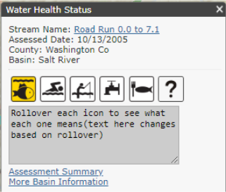
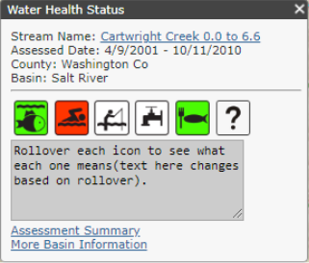
Drainage Area Analysis Lower Cartwright Creek
Current Impairments
Notes:
Searching for the watershed in the Kentucky Health Portal, we see that at least two reaches have been assessed by KDOW.
Cartwright Creek, from 0.0 to 6.6 miles, is impaired for primary contact recreation, but supports uses for aquatic life and fish consumption.
Road Run is impaired (partial support) for aquatic life use.
So, this tells us there is a difference between these two reaches.

Slide 21
Drainage Area Analysis Lower Cartwright Creek
Permitted Discharges
WWTP, Automotive, Construction, Feed Facility, Dairy Products, Topsoil
Public Water Supply, Concrete, Quarry
Notes:
Pulling in the data from the Kentucky Watershed Viewer, we can see locations of the permitted dischargers. What sort of problems might these dischargers cause? Where might you place sites?
You should note that most of the permitted dischargers are clustered in Springfield, KY. WWTP, feed, and dairy may cause high nutrient levels. Sediment sources might include construction, the feed facility and the topsoil retailer.
However, the public water supply protection area is located on a tributary to the south of Springfield, so this would be a good location for a sampling site. There are also quarry and concrete dischargers in the area which may be contributing sediment or high pH.

Slide 22
Drainage Area Analysis Lower Cartwright Creek
WWKY
4 Sites,
All Inactive
Notes:
A review of the watershed watch – KGS portal shows 4 sites in the area, all inactive. These may be good locations to put sites for the future since they have some history.

Slide 23
Site Selection Lower Cartwright Creek
Desk Review
1) Identify potential sampling locations
Notes:
So, having conducted this brief background assessment, you will need to choose potential sampling locations on the map and mark where potential locations might be.
Note that this discussion should begin early with the KDOW. But we want to give you a conceptual idea of how to approach the issue.
A good way to accomplish this is just to print out a basic map, and then add locations as you go through the review process.
Take a moment and identify all potential sites (just general now, not necessarily thinking of the best ones).

Slide 24
Site Selection Lower Cartwright Creek
Desk Review
2) Prioritize sites: Why priority?
Critical
High Priority
Medium Priority
Low Priority
Notes:
Here is a general idea of where sampling could be conducted.
The next step is to prioritize these sites. What locations are absolutely essential? High, Medium, Low priority?
What do you think?

Slide 25
Site Selection Lower Cartwright Creek
Desk Review
Critical
High Priority
Medium Priority
Low Priority
Notes:
Here is the prioritization. Yours may look a little different.
Red sites include the mouth of the watershed, the input upstream and downstream of Springfield, a major land use change.
Orange sites include the tributary to the south with the source water protection area and permitted dischargers, the mouth of Road Run (a KDOW site), and at the Bardstown Road crossing of Cartwright Creek, and downstream of some of the major tributaries along Cartwright Creek and Bloomfield Road.
Green Sites include some major tributaries that it would be good to catch.
Blue sites include some historic WWKY sites and some tributaries of lesser importance.
Based on this exercise, I really want to sample 7 (critical / high priority) sites. So that would be around $20,300 in just lab costs for a year. But how many teams will I need to cover the area (labor cost).

Slide 26
Field Sampling Logistics Example Case
Travel to sites: Assume about 30 minutes
Arrive at site 9:00 (~30 min. to gather equipment)
Lab: ~ 45 minutes away
Arrive by 4:00 PM for analysis before closing.
Must leave from last site by 3:00.
5 hours to sample (30 min for lunch)
Assume 1-hour sampling per site / team of 2
One team = 5 sites maximum
Notes:
So, using this watershed, we need to get an idea of some logistical constraints for field collection.
First, we have to identify our time to travel to the watershed, the time to travel to the lab, and the minimum time per site per team.
In this case, it is assumed that it will take 30 minutes to pull equipment together and 30 minutes to travel to the watershed.
By searching for “environmental labs” the closest one is 45 minutes away and we know that they stop accepting samples for E.coli at 4:00 PM (pretty standard).
With lunch, that leaves 5 hours to sample.
Assuming our team can sample one site per hour, then we can do 5 sites maximum per team. A more experienced team may be able to move faster, however flow measurements can take more time.
This gives us some basic logistics for what is possible in order to estimate time / field cost for a project. If I want to sample 7 sites, I will need at least two teams to cover all sites in the same day. Now I can project my labor costs (2 teams of 2 for 16 events at 8 hours per day) based on a labor rate.

Slide 27
Final Site Selection Factors
Authorization?
Access Restrictions (i.e. gates)?
Safety (parking, slopes, high flow, ice)?
Well-mixed zone?
Previous monitoring?
Backwater effects?
Low flow conditions?
Construction planned?
Uniform conditions?
Notes:
Authorization. The location of the data acquisition sites will in part be guided by the permission granted by the landowners and the appropriate authorities.
Accessibility. The data acquisition site should be located such that field personnel can safely perform the required duties during both high and low flow conditions. In some instances, data acquisition sites must be located in remote areas to achieve the project objectives.
Safety. The data acquisition site should be located such that following the designated safety protocols will ensure the safety of field personnel. Special consideration should be given to high flow events, traffic, debris, and steep slopes.
Well-mixed zone. The data acquisition site should exhibit characteristics of a well-mixed zone with regards to suspended sediments and water quality parameters. The water should be sufficiently mixed such that a single sample will closely reflect the average parameter value for the reach.
Low flow conditions. The data acquisition site should allow for data collection during low flow conditions, especially with regards to water level. As such, the low flow channel or thalweg should be located and utilized to every extent possible.
Previous Monitoring. Is there another site previously sampled that is nearby. You may benefit from historic data there.
Backwater. The data acquisition site should be located such that backwater effects are not encountered. Backwater effects may be attributed to the changing stream depths to in-stream structures, low flow bridges, and debris jams.
Low flow conditions. The data acquisition site should allow for data collection during low flow conditions, especially with regards to water level. As such, the low flow channel or thalweg should be located and utilized to every extent possible.
Construction planned. If construction is planned in the area it may alter your access or site conditions during the monitoring. Check with property owners where possible.
Uniformity. With regards to streamflow measurements, the data acquisition site should be located along a uniform reach such as a riffle or run. A constant depth characterizes uniform flow conditions, across the reach, coupled with parallelism amongst streamlines, bed, water surface, and energy grade.

Slide 28
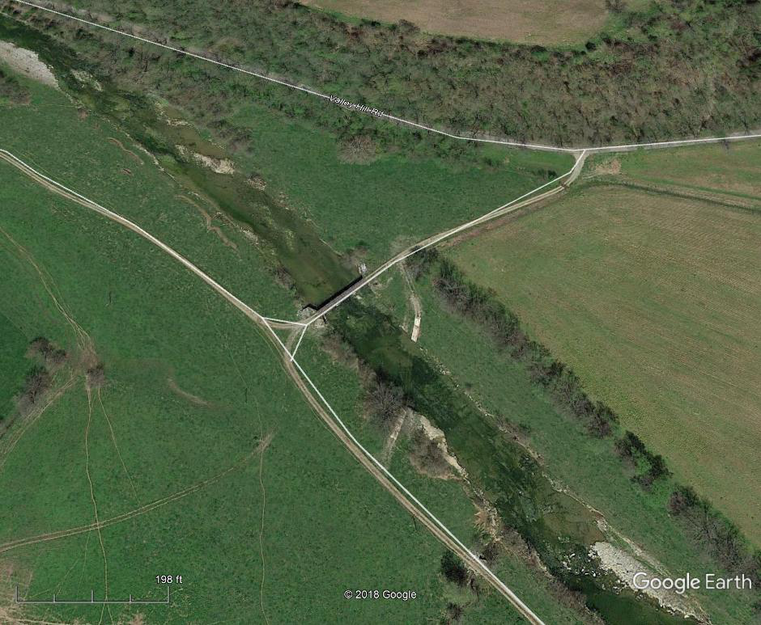
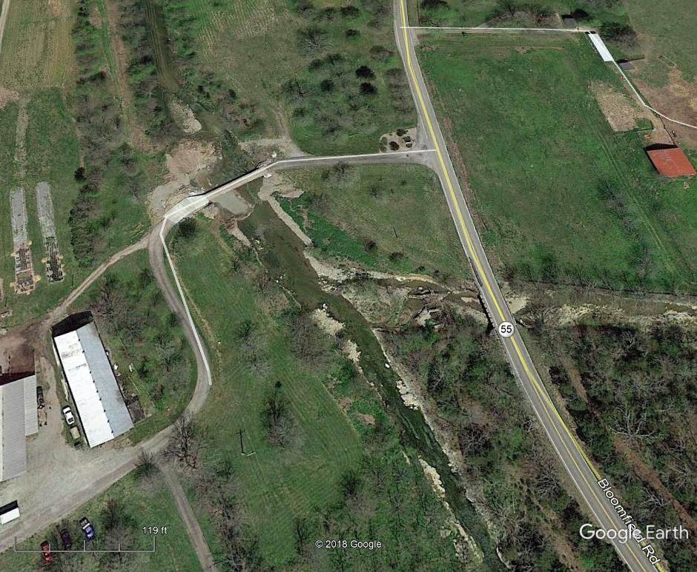
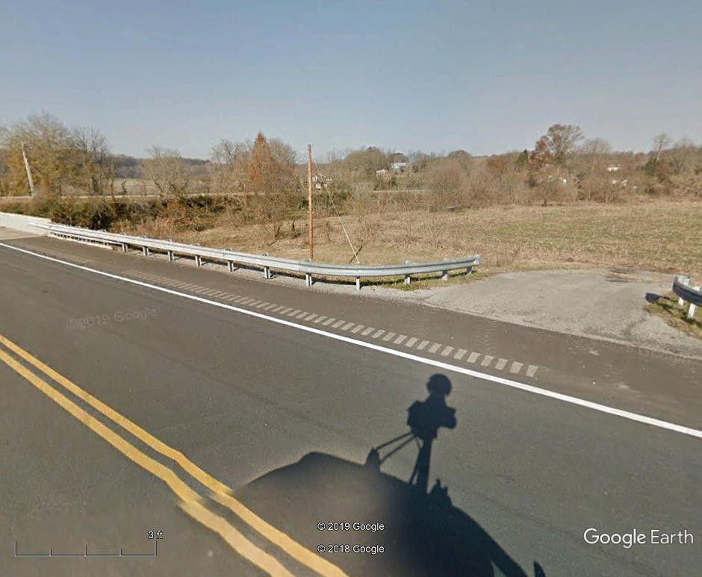
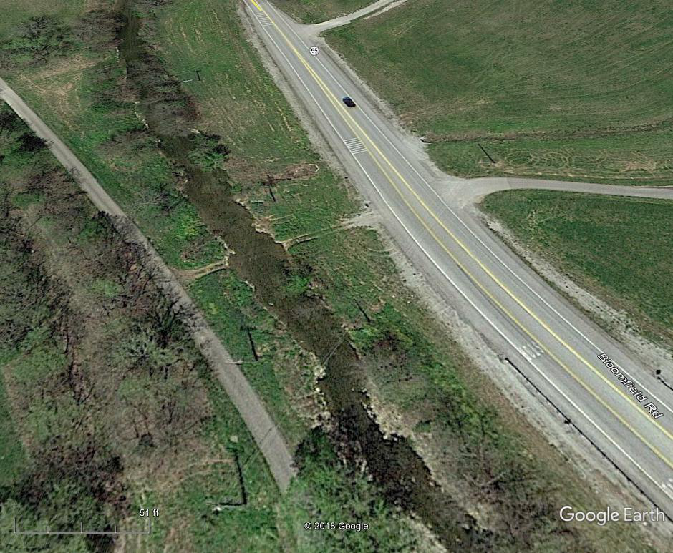
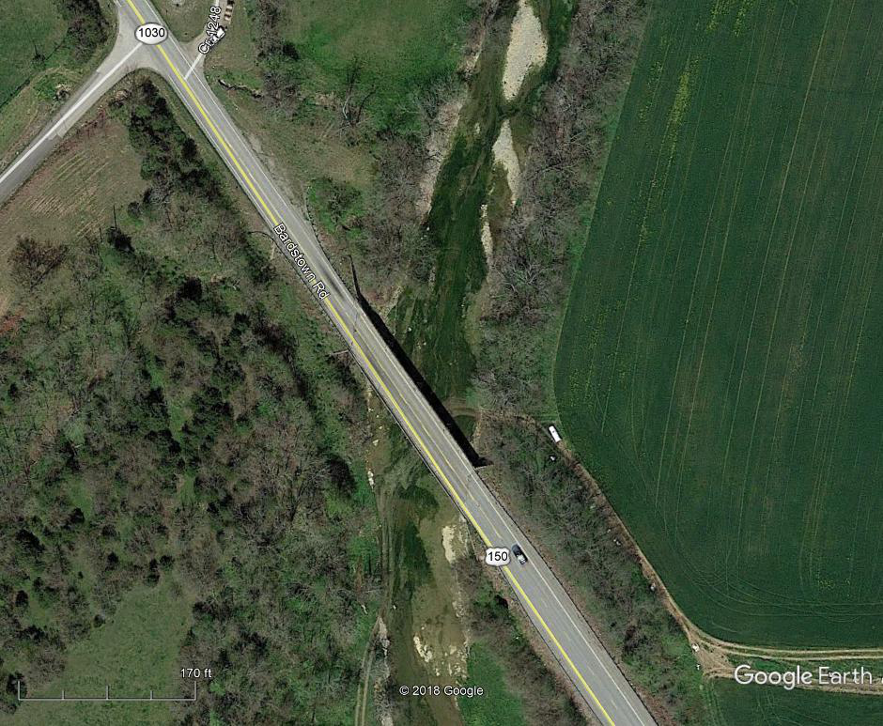
Final Site Selection Lower Cartwright Creek
Notes:
Let’s say we have budget for 7 sites to be sampled by two teams. Prior to doing a final field visit to verify, you want to do a Google Earth “Street view” and aerial review of the locations.
For each location, the first thing you need to consider is where to park. Look for roadway pulloffs, parking lots, or other accessibility. If you cannot park safely, then find another site.
Then consider how far you would have to park. If parking is far away, you have to transport equipment to the sites.
If you have to walk upstream or cross over a tributary, remember that some sampling events may be during storm flows, so that may not be safe.
Most of the critical and high priority sites look great.

Slide 29
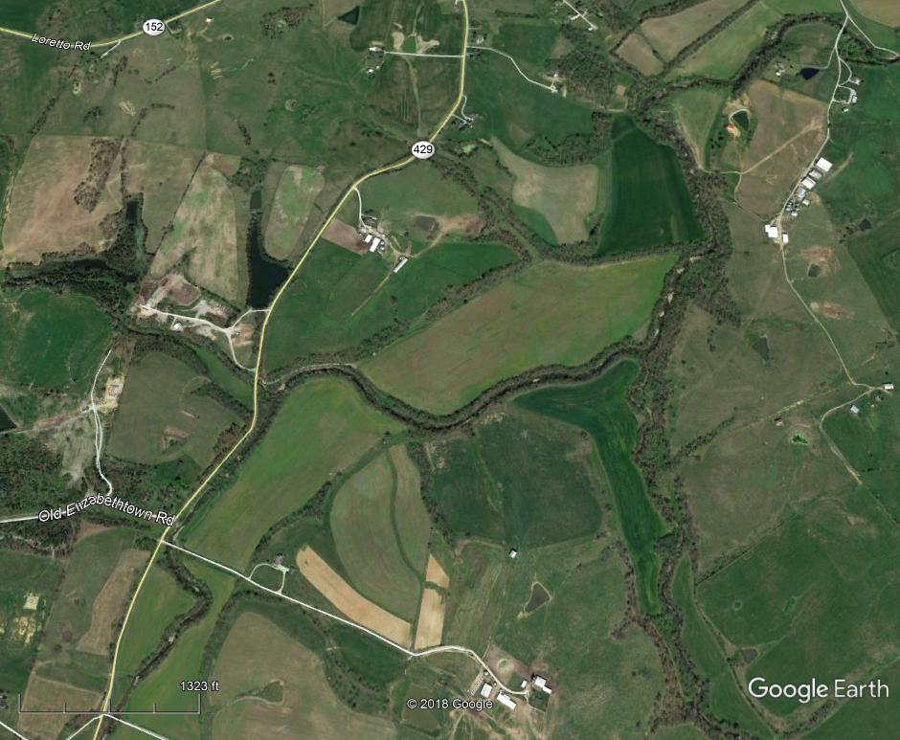
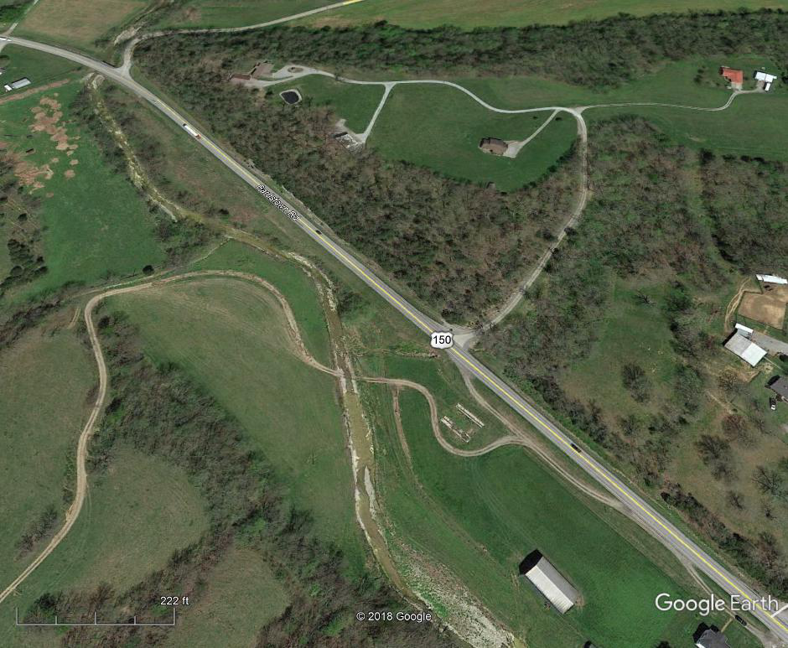
Final Site Selection Lower Cartwright Creek
Notes:
However, look at this tributary near the furthest upstream point in the watershed.
The only way to access that tributary would be to walk quite a distance over farmland. This makes this site a poor choice.
If we decide we have budget for 7, we can move the site to one of out “good” sites which has a nice roadway pull off and trail.

Slide 30
Final Site Selection Lower Cartwright Creek
Use StreamStats to Delineate after Field Verification
Notes:
This picture is just a hand drawn delineation of watershed drainage areas to get an idea of what each site is capturing. This will give you an idea of what sort of resolution you will have on the data for BMP placement when the project is completed.
If you are developing a monitoring plan and have finalized your sites via a field collected GPS location, it is now time to work with a GIS specialist to develop a sampling map, or develop one of your own using publicly accessible tools that we will cover later today.
One of the easiest way to delineate a drainage area is to use StreamStates by USGS.

Slide 31
Site Selection Lower Cartwright Creek
Erosion Survey
Notes:
But first, remember you will want to do some sort of erosion survey as well. Take a look a the location of the tributaries and see how much is accessible by road.
In this case, you can do a visual survey of erosion of most of the streams pretty quickly.
For other areas you would need to get permission to access properties. That will take time. You will also be limited by the rate of walking per day and travel time back and forth to the vehicle to move to a new location.
Use these accessibility estimates to determine the amount of time the effort should take in order to develop labor estimates.
(i.e. 3 miles of walking stream per day x number of miles need, etc.…)

Slide 32
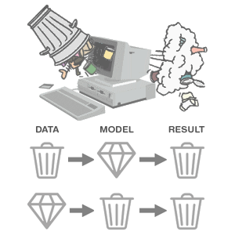
Data Quality Levels
Notes:
Okay, in talking about monitoring planning, one last item we want to mention is data quality.
There is an idiom that originated with computer scientists regarding data quality: “garbage in, garbage out.”
If you have poor quality inputs, the result will be poor no matter how good or fancy your analysis is.
Likewise, if your analysis is poor, it result will be poor no matter how good the data.
So how good does our water data have to be for the result not to be garbage?

Slide 33
Data Sufficiency, Credibility, and Quantity
Without proper quality assurance, data can only be used for screening use.
Kentucky uses EPA has level of information ratings from 1 (low) – 4 (high).
For assessment or TMDL purposes, must meet certain thresholds of data quality.
Generally, must use approved standard operating procedures (SOPs) and a Quality Assurance Project Plan (QAPP).
Notes:
EPA has defined level of information ratings to evaluate the quality depending on the data type.

Slide 34
Indicators to Assess Designated Use
Use | Human Recreation | Aquatic Life
 |  | Stream | Lake / Reservoir
Core Indicators | E. coli, fecal coliform, pH | Macroinvertebrates, Fish, Sedimentation, in-situ measurements Priority and non-priority chemical parameters | Fish kills, in-situ measurements, Non-priority chemical parameters
Supplemental Indicators | Nuisance plants, Nuisance algal growth or blooms, Suspended sediment, Odor, Human toxic or behavior response, Debris, Unnatural oil slick | Algae/Diatom, Flow | Trophic State Index, Secchi depth, Nuisance plants, Nuisance algal growth or blooms
Source: KDOW CALM
Notes:
This chart, taken from Table 3-1 in the KDOW CALM (Consolidated Assessment and Listing Methodology), indicates the aquatic life use and the human recreational use (primary and secondary) core indicators and supplemental indicators. Supplemental indicators cannot be used alone to make a final use assessment, but only as support for an assessment. Core indicators are measurements that can indicate that an impairment is present if enough samples of sufficient quality are collected.
The human recreational use indicators are pretty straight-forward. E.coli is typically used to assess human recreational use.
For the aquatic life use, macroinvertebrates and fish are primarily used to assess headwater and wadeable streams.
Two other distinctions should be noted – Priority and non-priority pollutants.
Priority Chemical Parameters include a specific list of 126 chemicals that includes volatile and semi-volatile organic compounds, PCBs, pesticides, heavy metals, and the like. 65 of these are called “toxic pollutants.” This is the long-list of chemicals in 401 KAR 10:031
Nonpriority chemicals include in situ parameters as well as nutrients, alkalinity, chlorine, and the like.

Slide 35
Aquatic Life Use Assessment Data Needs Summary
Category | Chemical | Biology | Habitat
Minimum Data Level? | 3 | 3 | 2
Expertise Needed? | Trained volunteer acceptable | Need professional biologist to perform | Trained volunteer acceptable
QAPP Needed? | Yes | Yes | No
What Collected? | Quality controlled data for physicochemical, bulk parameters, nutrients, and metals (as needed) | At least, macro survey and ID to lowest taxa. Prefer fish survey also. Compare via MBI and KIBI Indices | EPA Rapid Bioassessment Protocol (RBP) compared to Indices
How Much Data? | Monthly or more frequent with seasons covered (~1 year) with high and low flows represented | At least one site major stream / river segment | In conjunction with biology or more frequently
Notes:
As an overview – in order to meet the KDOW requirements for a watershed plan, you must produce chemical, biological, and habitat data at the following quality levels.
The KDOW CALM (Consolidated Assessment and Listing Methodology) indicates the levels necessary for use for assessment purposes. DOW is collecting data for watershed plans such that it can also be used for assessments and TMDLs.
Some key takeaways include the need for a professional biologist for collection of Biology.
Although a QAPP is not necessary to use habitat data in aquatic life use assessments, it should be developed for collection for watershed planning.

Slide 36
What is a professional biologist?
Graduation with a BA or BS in a biological, environmental, or natural science, which includes at least 30 credit hours in the biological sciences.
3 years of professional experience in research, environmental impact assessment, or related environmental program areas. Graduate work can substitute on a year-for-year basis.
For macro identification, also need proficiency in the identification of macroinvertebrates to the genus level.
Notes:
So what is a professional biologist? These are the minimum requirements that you would need for a contractor if you do not have one on staff.

Slide 37
Collecting Monitoring Data Summary
Basic Monitoring Equipment
Do you want to purchase or contract out?
Watershed Plan Monitoring Requirements and Logistics
Overview of what to look for in screening a watershed
Site Selection and Scale Considerations
Able to select sites and develop a budget / logistics for sampling
Data Quality Levels
Know how good the data must be to get approval for watershed planning use

Slide 38
Monitoring Data Collection Logistics
To develop a watershed plan, you must have some idea of the logistics before you start.
Hopefully this presentation provides enough information to determine budget / cost / logistics for collecting good quality information that is sufficient for planning purposes.

