Slide 1
Watershed Academy Watershed Coordinator Training Series
The Clean Water Act
3: Kentucky Pollutant Discharge Elimination System

Slide 2
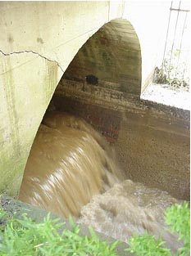
Kentucky Pollutant Discharge Elimination System (KPDES) Overview
Illegal to discharge pollutants from a point source to waters of the United States except by a permit.
Kentucky Issues permits
Permit Duration: 5 years
Public review and comment
General vs Individual
~9,000 Permits (2018)
60% General
40% Individual
Notes:
Watershed Coordinators are primarily focused on management of nonpoint sources. However, permitted and unpermitted point sources are present in most watersheds. Therefore, it is helpful to have some basic background on how these sources are managed, so that you can determine what is acceptable, who to contact, how much pollution may be due to these sources, and other information.
It is illegal to discharge pollutants from a point source to waters of the United States except by a permit
Kentucky Division of Water, not the EPA, issues permits in the Commonwealth, through its KPDES system
Each permit has a duration of 5 years before it must be renewed
All permits are subject to public review and comment
Permits can be either general or individual:
General Permit - 1 permit is issued for a large area (often the state), with many notices submitted as applications are made. These permits are available when there are many similar operations, types of waste, same limits or standards.
Individual Permit: For an individual permit, 1 permit is issued for each application submitted. It is customized to each applicant.

Slide 3
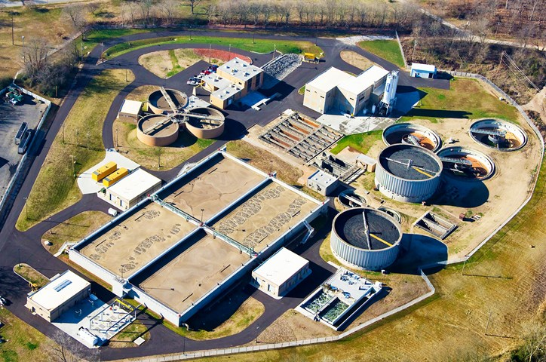
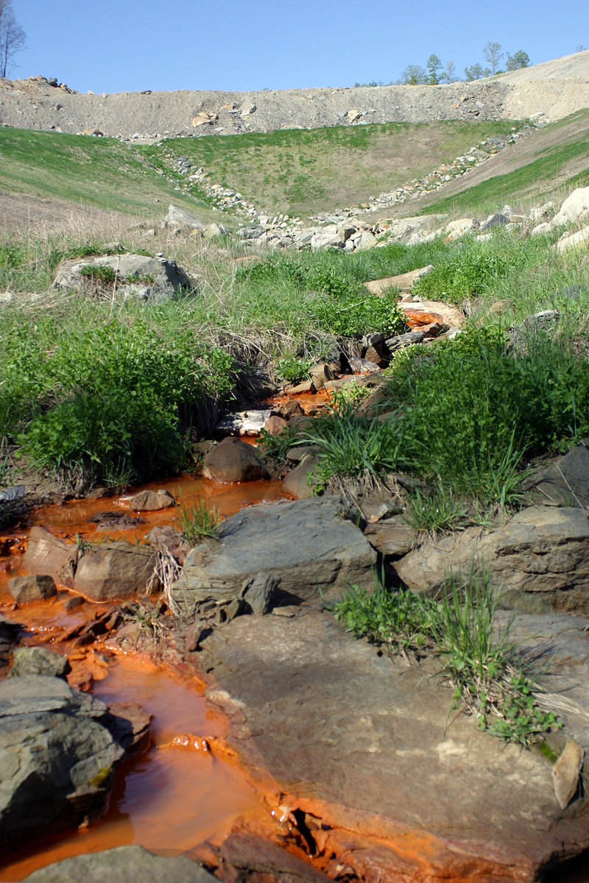
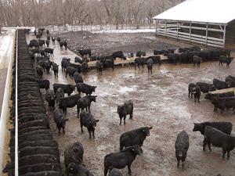
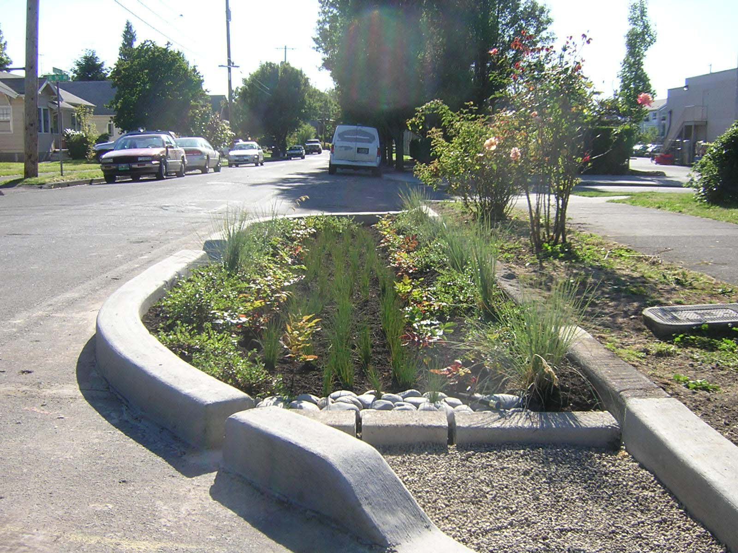
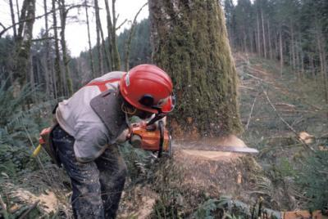
Types of KPDES Activities
KPDES Permitted Activities:
Municipal Wastewater Discharges
Non-Process Wastewater Discharges
Sanitary Wastewater Discharges
Storm Water Discharges
Manufacturing and Mining
Commercial
Concentrated Animal Feeding Operations (CAFO)
Aquaculture Projects
Silvicultural Activities

Slide 4
Types of Discharges
Pretreatment
KPDES
Illegal: Straight pipes or Sanitary Sewer Overflows (SSOs)
Regulated: Combined Sewer Overflows (CSOs)
Notes:
Permits are also either Direct or Indirect
Indirect = Discharge to Publicly Owned Treatment Works (POTW) or “sanitary sewer,” which then discharges to the waterbody. These are managed through the National Pretreatment Program.
Direct = Discharge to directly to surface waters. The KPDES manages only direct discharges. However, wastewater facilities are required to have a Pretreatment Program and a Sludge Management program
It should also be noted that straight pipes or sanitary sewer overflows are concerned “illegal” and cannot be permitted.
However combined sewer overflows (sanitary and storm sewers), which are part of the design of some sanitary systems are regulated under the wastewater permit.

Slide 5
Non-KPDES Permits
Construction of:
Dams
Water/Wastewater Treatment Plants
Stream or floodplain disturbance
Water Withdrawal
Notes:
KPDES system does not cover all permits that might result in releases of pollutants to waterways.
Construction of dams, water and wastewater treatment plants, and general disturbance of the streams or construction in the floodplain are all handled outside of the NPDES program.
Water withdrawals are also handled outside of the NPDES system.

Slide 6
KPDES Permit Elements
Effluent Limits
Best management practices
Compliance Schedule
Monitoring Requirements
Reporting Requirements
Standard Conditions
Notes:
Permits follow a basic format that is helpful to know in order to orient yourself.
Each has basic elements
Effluent Limits – these tell how much a facility can discharge. These are specific, numeric, measurable limits often expressed as concentrations and volumes for a given time
Best management practices – these practices are required ways in which the permittee must try to reduce or minimize their pollution. They may be either structural (something must be constructed like a sediment pond) or non-structural or behavioral (good housekeeping, education program, etc.)
Compliance Schedule – If a permittee cannot immediately meet the new effluent limits due to a need to modify their facility, the permit may include a series of enforceable sequences of actions with required dates that lead to compliance. This is called a compliance schedule. Not every permit contains a compliance schedule.
Monitoring Requirements – this describes what the permittee must monitor, how frequently, and the techniques that should be used to do so.
Reporting Requirements – If the permit requires monitoring, it will also described how the results are submitted – typically through monthly discharge monitoring reports (DMRs)
Standard Conditions – boiler plate language included in all permits which include provisions and circumstances under which a permit may be reopened or revoked or that the KDOW can enter the facility to perform inspections.

Slide 7
Effluent Limits
Effluent Limits: End-of-pipe performance standards
Technology-Based Effluent Limits: performance standards based on available pollutant removal technology for the facility type
Water Quality-Based Effluent Limits
Additional site-specific water quality-based limits when tech limits are inadequate
Assigned from the Waste Load Allocation of associated TMDL, when available
Notes:
Effluent limits or “discharge limits” are performance standards allowing the discharge, as long as it meets the specific conditions.
Technology-based limits are derived from studies that determine what levels of pollution control can be achieved using the most cost-effective set of pollution prevention and control techniques for a facility type. You may see different acronyms in effluent guidelines that describe these limits:
Existing dischargers:
BAT = best available technology, economically achievable
BCT = best conventional technology
BPT = best practicable technology
New Source Performance Standards – these are for new sources and are often more stringent because they can be built during the construction process.
Water Quality-based limits are additional protections assigned when the waterbody needs additional protections. These limits are more stringent, risk-based, and typically back-calculated from water standards or WET limits for the water body to the specific facility. An example would be if there is a TMDL and the wasteload allocated to the permitted dischargers must be reduced.

Slide 8
Effluent Limits
Example of a Technology-Based Limit for Municipal Discharges
Notes:
This is an example technology-based limit from a municipal discharge permit. You can see on the left column the specific parameters: BOD, TSS, and pH. In this case, there is a limit for a 30-day average concentration and a 7-day average concentration. In addition to the maximum concentrations, there is a % removal requirement for BOD and TSS.
So parameters, concentrations, time-frame, and in this case a specific removal requirement.
You will see some variation form permit to permit, but it will look somewhat like this.

Slide 9
Compliance and Enforcement
Drinking Water, Wastewater, & Complaints
~5,000
inspections
annually (2018)
Notes:
Kentucky Division of Water conducts about 5,000 inspections for permit compliance each year with the breakdown on the inspections shown in the pie chart.
They conduct routine inspections, as well as investigations of complaints from citizens.

Slide 10
Compliance and Enforcement
Type of Violations
Discharge without a permit
Permit effluent exceedances
Non-effluent permit violations
Types of Enforcement Penalties
Monetary fines
Imprisonment
Supplemental environmental projects (SEP)
Agreed Order
Notes:
If a permittee is not in compliance with their permit, they will be given a notice of violation or a NOV. If compliance is not met, the state may pursue an enforcement action.
Violations can occur in multiple ways:
If a facility is discharging without a permit, that is a violation.
If a facility discharges above its effluent limits, it is a violation
If a facility does not meet some other aspect of the permit, such as not submitting monitoring results on time or reporting false results, or not meeting compliance schedules or other deadlines, it is a violation
Rather than go immediately into enforcement actions and penalties, the goal is to bring facilities into compliance. The Department for Environmental Protection has a Division of Compliance Assistance that is tasked with providing education and assistance so that facilities can come into compliance.
When compliance cannot be met through assistance, enforcement penalties may be pursued. This may include:
Fines for typical violations (exceed limits, fail to report)
Imprisonment for criminal violators (repeated, willful violations)
Supplemental environmental projects (SEP) – monetary penalty goes to restoration projects, not to KY Treasury
Agreed Order – a written agreement between the Kentucky Department of Environmental Protection and the violator

Slide 11
Monitoring and Reporting
Based on self-monitoring and reporting
Regulated facilities are required to gather and report on representative samples of data
Federal requirements specify monitoring and reporting requirements
Each permit describes and specifies these conditions

Slide 12
Monitoring and Reporting
Discharge Monitoring Reports (DMRs):
Facilities electronically report to the EPA/DOW
Reports are available online through EPA Enforcement and Compliance History Online (ECHO)
https://echo.epa.gov/
Download 3-5 years of data, tables and charts with results, annual pollutant load estimates, compliance history and more
Notes:
Monitoring and Reporting is:
Based on self-monitoring and reporting. Facilities perform their own monitoring with agency spot-checks during their inspections.
Permittees report through Discharge Monitoring Reports which are available online through the EPA ECHO system.

Slide 13
Monitoring and Reporting
https://echo.epa.gov/
Notes:
This is what the site interface looks like, so in our next activity, we will explore how to use this system to review facilities of interest in your area.

