Slide 1
Watershed Academy
Watershed Coordinator Training Series
The Clean Water Act
4: Specific Permit Types and Other Environmental Laws

Slide 2
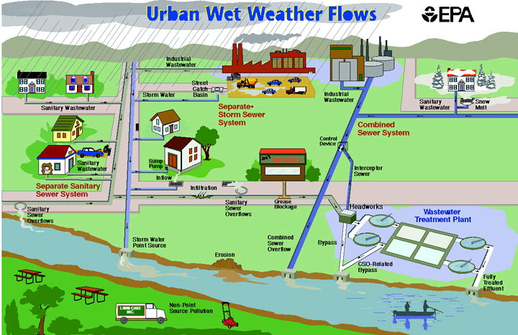
Sewer Systems
Notes:
We want to begin this presentation by focusing on sources of human waste entering into streams, since bacteria is a frequent issue that needs to be addressed in watershed plans.
Often times the public thinks all sewer systems are the same and all the water gets treated. But there are two types of systems: combined sanitary sewer system and a separate storm sewer system.
The combined system allows sanitary and storm water flows to mix, and the combined flow goes to the wastewater treatment plant.
This potentially creates large, unmanageable volumes of water for the plant, so sometimes waste is inadequately treated OR, sometimes excess flows bypass treatment and go untreated to the nearby waterway.
The separate system enables storm water and sanitary discharges to go into different systems of pipes.
This reduces treatment plant overloads, but means that storm water enters waterbodies untreated.

Slide 3
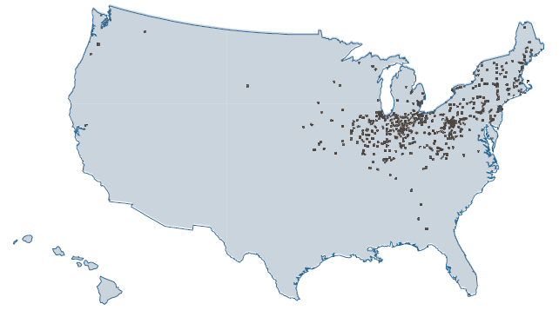
Sewer Systems
Combined Sewer Overflows (CSO)
Sanitary Sewer Overflows (SSO)
EPA 833-R-04-001, 2004
Notes:
Maps and graphics from 2004 NPDES CSO Report to Congress: A comprehensive characterization of combined sewer overflows (CSOs) and sanitary sewer overflows (SSOs).
The graphics indicate where these different types of overflows occur within the U.S.
CSOs are designed so that storm water flows into the same set of pipes as sanitary discharges. During heavy rains, excess flows go into streams at designated locations.
In separate systems, the rainwater is supposed to flow into storm pipes that are separate from the sewage.
Unfortunately, water infiltration into leaky or cracked sanitary sewer pipes can cause sewage overflows, as well as blockages.
The maps show where these overflows occur – SSOs are much more numerous that CSOs, however CSOs contribute much larger volumes of flow and associated pollutants.

Slide 4
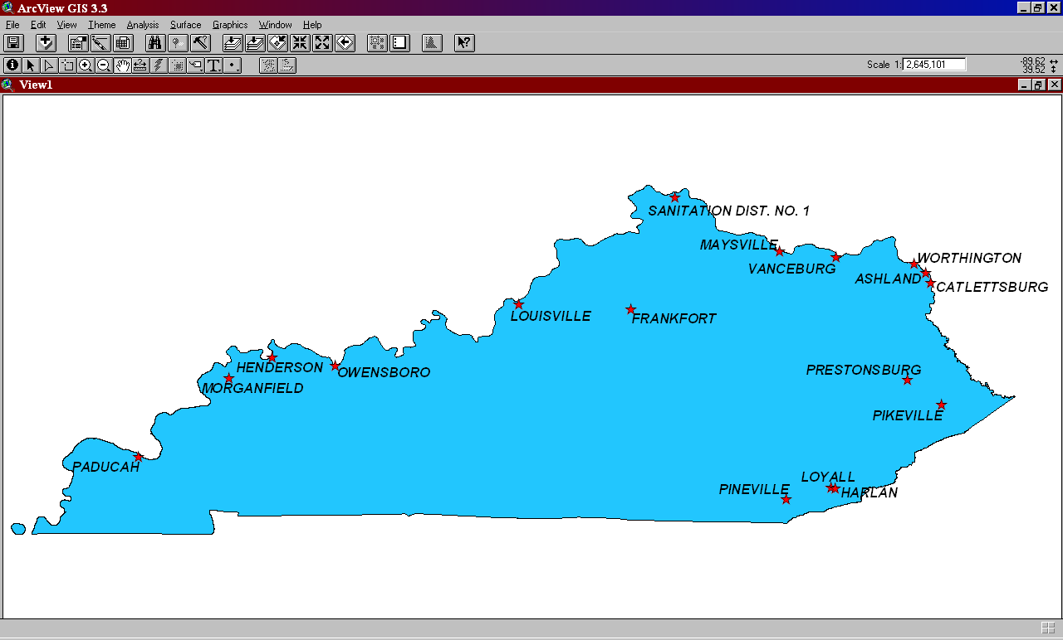
Sewer Systems
Combined Sewer Overflows (CSO)
74
9,348 CSOs/ year
Discharge 850 billion gallons/year
17 CSO communities with 288 outfalls in KY
11
5
3
115
15
8
17
14
8
Red numbers indicate CSO outfalls in 2004
2
1
3
11
6
3
1
Sanitary Sewer Overflows (SSO)
23,000 to 75,000 SSO overflows/year
Discharge 3 to 10 billion gallons/year
EPA 833-R-04-001, 2004
Notes:
Statistics on CSOs and SSOs from 2004 NPDES CSO Report to Congress.
A number of these CSOs have been corrected since that time, but this provides a state-level comparison.
Again, while SSOs are more common throughout the state, CSOs contribute much greater volumes of discharge.
It is important to understand the type of sanitary system that is located in the watershed area in which you are working. This information will be helpful with developing appropriate management recommendations for water quality improvement.

Slide 5
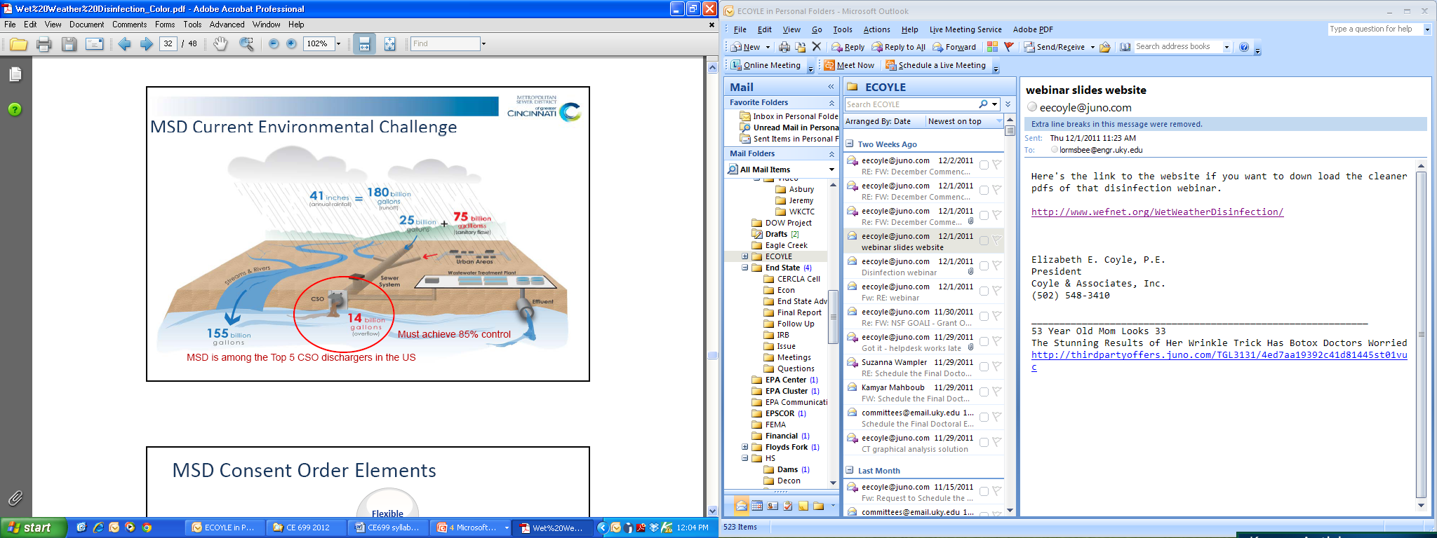
Notes:
Here you can see some of the challenges in CSO communities, this one in MSD of Cincinnati, one of the top 5 CSO dischargers in the United States.
41 inches of rainfall produce some 180 billion gallons of runoff.
Of this, 155 billion gallons (86%) flows into the streams and rivers, but 25 billion gallons enter the combined system.
This accounts for 25% of the total volume that these sewers carry.
14 billion gallons of this sewage / stormwater mixture overflow into streams, while 86 billion gallons are treated at the wastewater treatment plant.
The challenge is how to reduce the volume of stormwater entering the treatment system.
The use of green infrastructure is one approach to reducing the amount of stormwater entering the system. Measures such as grassed swales or channels, rain gardens, and vegetated parking lot islands, help excess water slow down and sink into the ground.
It is also helpful to begin to separate the sanitary and storm systems where possible.

Slide 6
Clean Watersheds Needs Survey
Required under Section 205 / 516 of CWA
Estimates Capital Costs needed to meet CWA goals
Conducted every 4 years – 2012 estimate $6.245 billion
https://www.epa.gov/sites/production/files/2015-10/documents/cwns_fs-ky.pdf
Notes:
The Clean Water Act requires that each state estimate the capital costs required to meet the Clean Water Act goals for wastewater planning.
The 2016 survey is not yet available, but the total cost was $6.245 billion dollars in 2012 with most expenses needed to address wastewater system repair, new systems, and correction of CSOs

Slide 7
Wastewater Planning for Regional Areas
Wastewater Municipal Planning Section
of KDOW
  Reviews 20-year facility plans prepared by municipalities or sewer districts
  Prepares priority list, ranking wastewater improvement projects for loans from State Revolving Fund (SRF) and estimates funds needed for CWA requirements
Notes:
When working with wastewater utilities in the area, it is important to know what projects are currently proposed in your area and their ranking for potential funding.
The Wastewater Municipal Planning Section at KDOW reviews these plans with a 20-year projection in order to inform the Clean Watersheds Needs Survey.
Extra info:
Governed by Sections 201, 208, 209 of CWA, Regional Facility Planning - 401 KAR 5:006

Slide 8
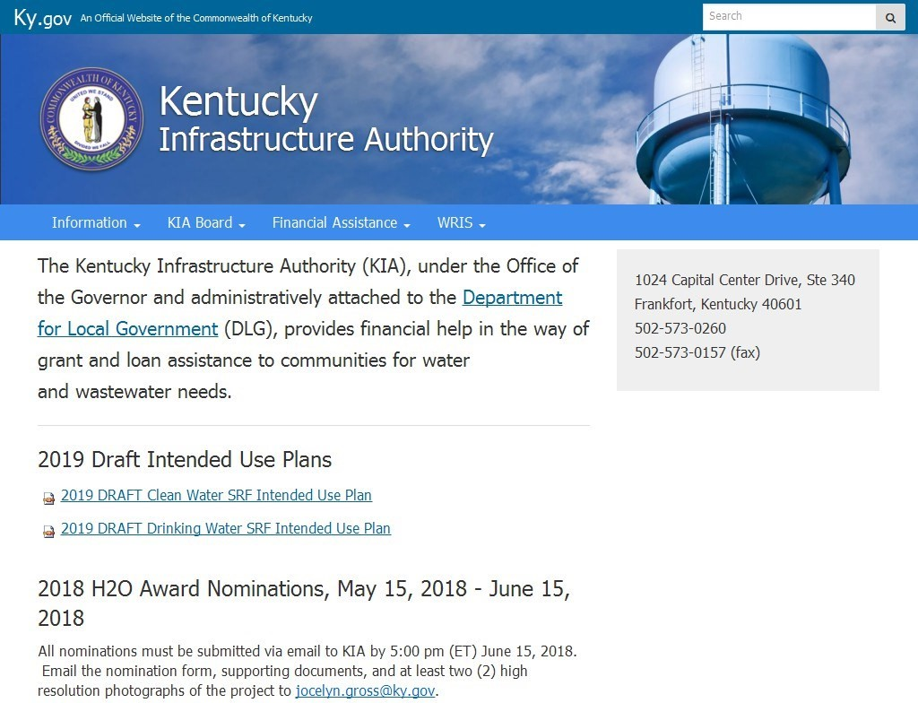
http://kia.ky.gov
Notes:
If you would like to review this information, you can access it through the Kentucky Infrastructure Authority website.
Under the WRIS tab, click the “Management Plans” option on the dropdown list and look for the “Kentucky Wastewater Management Plan.”
You can also review a lot of information about the municipalities and the state of the systems from the WRIS Portal.

Slide 9

Kentucky Wastewater Management Plan
https://kia.ky.gov/WRIS/Management%20Plans1/ 2015%20Wastewater%20Management%20Plan.pdf
Notes:
In the Management plan, you will find the percentage of homes that are serviceable for public wastewater systems.
This will give you an idea of the number of septic systems or straight pipes you might find in your area.

Slide 10
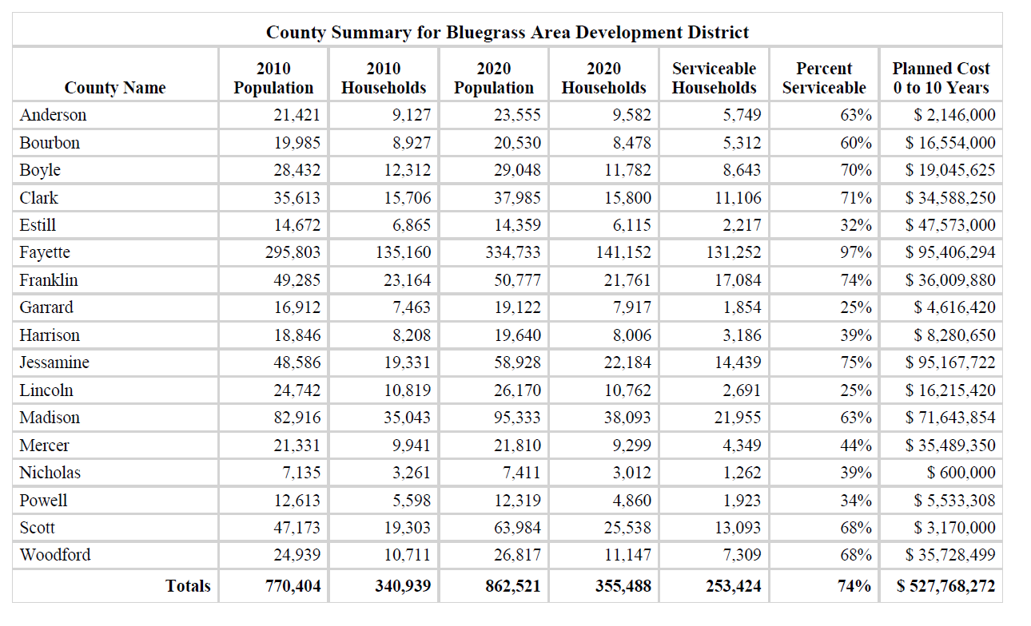
Bluegrass Area Development District
Notes:
Here is another county analysis within the Bluegrass ADD from the wastewater management plan.
Particularly interesting is the percent of serviceable households, meaning that these households could connect to a municipal sanitary sewer line.
This will begin to help you to understand at a county level what the prevalence of sanitary sewer connections might be in the county as opposed to septic systems or straight pipes.
The plan also lists all of the proposed wastewater projects throughout the state.

Slide 11
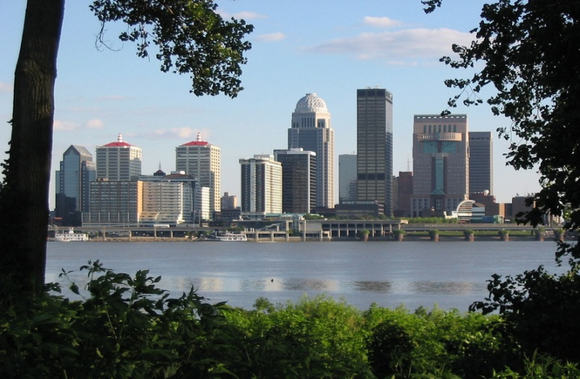
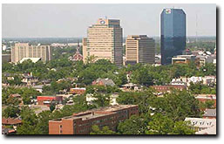
Consent Decrees ($) - A legal settlement outlining the resolution of an environmental law violation.
Municipal Sewer Systems
Louisville Kentucky (2006)
  $500,000,000
    CSOs
    SSOs
Lexington, Kentucky (2008)
  $300,000,000
    SSOs
    Stormwater
Notes:
In order to stop violations of the Clean Water Act, the EPA has negotiated “Consent Decrees” for two municipalities in Kentucky. These actions included a large fine, required actions for the municipality, and even outlined projects that must be completed.

Slide 12
Municipal Separate Storm Sewer Systems (MS4s)
What is an MS4?
An MS4 is a conveyance or system of conveyances that is:
  Owned by a state, city, town, village, or other public entity that discharges to waters of the U.S.
  Designed or used to collect or convey stormwater (including storm drains, pipes, ditches, etc.)
  Not a combined sewer
  Not part of a Publicly Owned Treatment Works (sewage treatment plant)
Notes:
Moving from sewage, let’s look more in depth at stormwater permits.
We talked about separated systems and the MS4 is the name of the system that collects the stormwater separate from the sanitary sewer.

Slide 13
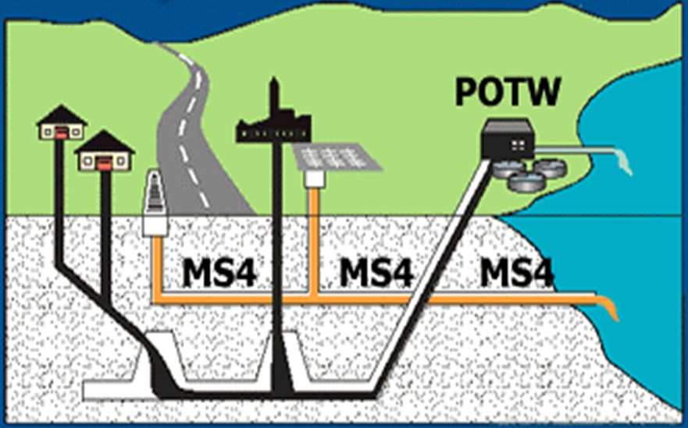
Municipal Separate Storm Sewer Systems (MS4s)
Notes:
So, just a reminder, the MS4 system flows untreated to the streams, while the sanitary system flows to the wastewater treatment plant, or the Publicly Owned Treatment Works (POTW).

Slide 14
MS4 Permits
Clean Water Act Amended (1987):
  Required development of a permit program for discharge of storm water
Phase I MS4 Permits (1990):
  Required medium and large cities or certain counties with populations of ≥100,000 to obtain a NPDES permit
Phase II MS4 Permits (1999):
  Required small MS4s in urbanized areas (≥50,000, population, 1000 / sq mi.), as well as small MS4s outside the urbanized areas that are designated by the permitting authority, to obtain NPDES permit.
Notes:
The history of the stormwater permit is relatively short.
The Clean Water Act was amended in 1987 to require the development of a stormwater permitting program.
Phase I permits for communities with populations >100,000 were required as of 1990, and
smaller Phase II communities were required to have permits in 1999.

Slide 15
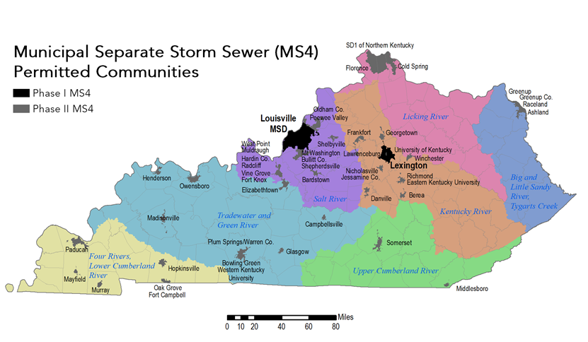
Notes:
This map shows the locations of Kentucky’s Phase I (Lexington and Louisville) and Phase II stormwater-permitted communities.

Slide 16
MS4 Permit Requirements
Minimum Control Measures (MCMs) for Phase I and II:
Public Education/Outreach
Public Involvement/ Participation
Illicit discharge detection and elimination
Construction site runoff controls
Post construction controls
Good housekeeping/ pollution prevention
Requirements for Phase I Only:
Monitoring outfalls
Inspection of industrial facilities
Potential to partner on TMDL implementation!
Notes:
Phase I and Phase II permits are similar in that they both have 6 minimum control measures to be addressed.
The Phase I permits are more specific and also require monitoring of outfalls and inspection of industrial facilities.
If you have an MS4 in your watershed, they can often serve as a great partner, particularly if you can align some of your activities with their permit requirements.
All MS4’s have public education and public involvement requirements. Therefore, they can be excellent partners when it comes to educating and engaging the public with regard to pollution problems in the watershed.
MS4s also have post-construction control requirements for stormwater retention and detention that are specific for each area. It is important to be familiar with these requirements.
The pollution prevention measure refers to specific controls for their municipal operations and facilities, which will also be helpful to understand.
If a TMDL has been established in your watershed, there may be opportunities to collaborate with the MS4 regarding its implementation.
We will discuss some of these elements in more detail.

Slide 17
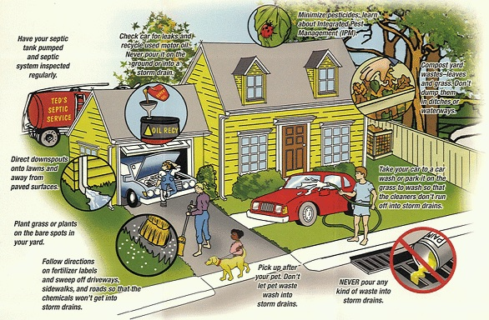
MS4 Permits: MCM #3
Illicit Discharge Program
Map of outfalls
Legal prohibition and enforcement
A plan to detect and address illicit discharges
Public education and outreach
Best management practices
Notes:
MS4s are required to have a program to identify and eliminate illicit discharges. Illicit discharges are generally anything other than stormwater that is entering the stormwater collection system.
Municipalities are required to map their outfalls so they know how to trace illicit discharges through the system.
They must have a plan to detect them, make them illegal through ordinance, and have practices to address them.
So, MS4s can be partners in trying to track down these sources of pollution if it occurs in their jurisdiction.

Slide 18
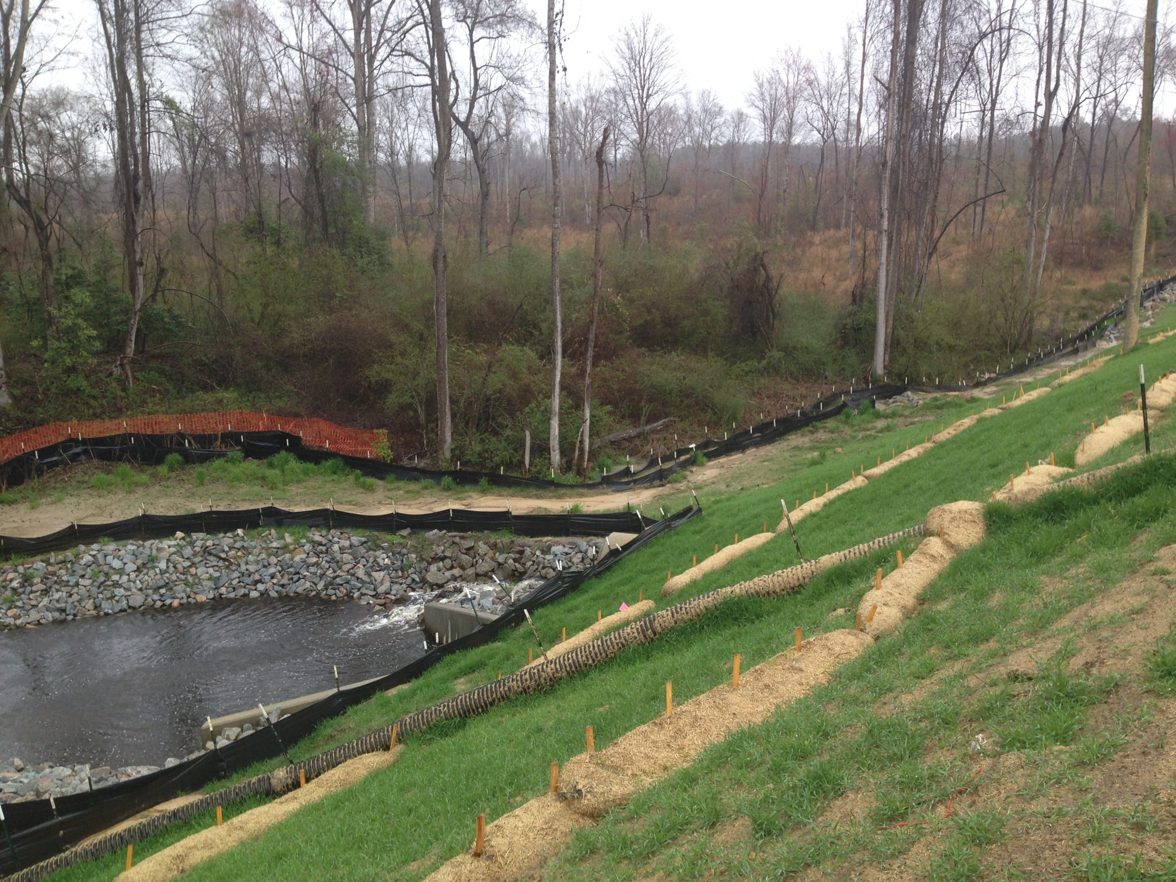
MS4 Permits: MCM #4
Construction Site Runoff Controls
Reduce pollutants in runoff from land disturbance ≥1 acre.
Regulatory mechanism
Site Plan Review
Inspections and penalties
Ensure compliance
Consider and follow up on public concerns
Determine BMPs
Storm Water Pollution Prevention Plan (SWPPP)
Notes:
MS4s also must inspect construction sites with more than 1 acre of land disturbance. This includes having a program to review site plans, inspect facilities, and ensure compliance.
If you are working in an MS4 area and notice construction erosion problems, you may be able to work with the MS4 to resolve these issues. Each construction site is required to have a storm water pollution prevention plan to address stormwater pollution. So if you notice sedimentation around a construction site, you should be able to work with the MS4 to ensure that the site comes into compliance.

Slide 19
MS4 Phase I Permits:
Inspection of Industrial Facilities
Types of facilities inspected:
Facilities with effluent limits (KPDES permitted facilities)
Manufacturing
Mineral, metal, oil, gas
Hazardous waste facilities
Automotive Garages
Landscaping / Nurseries
Recycling facilities
Transportation
Treatment works
Landfills
Light industry
Construction
Notes:
Phase I Permits also require the inspection of industrial facilities to determine if they are contributing to water quality problems. This slide lists some of the different types of facilities that might be inspected.

Slide 20

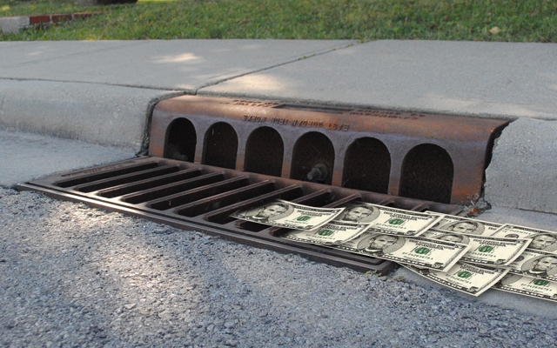
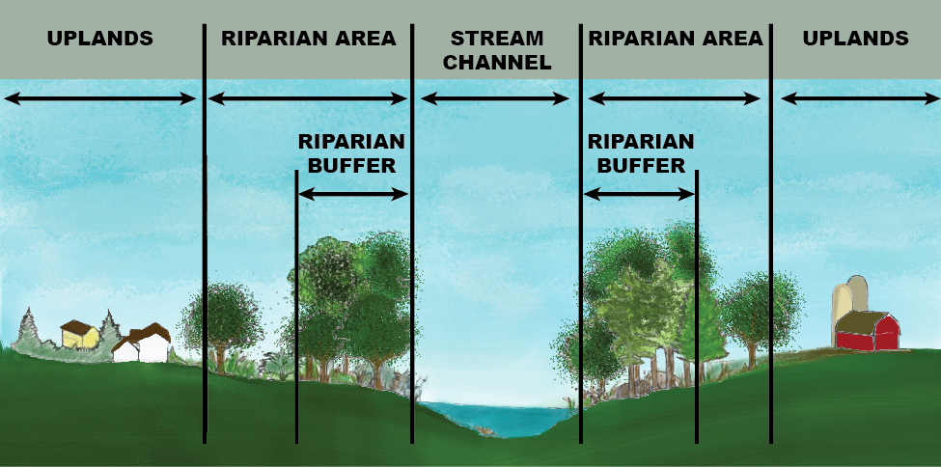
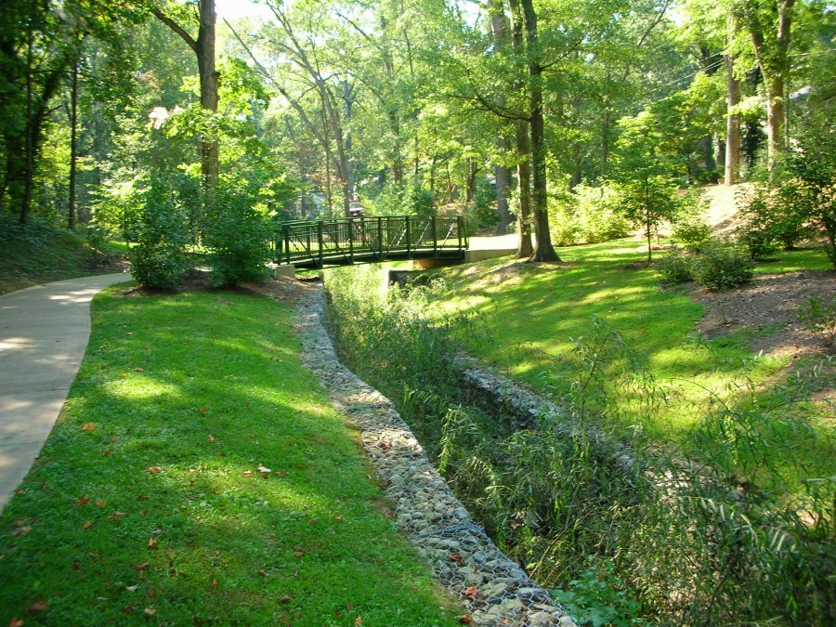
MS4 Permits:
Common Local Ordinances
Stormwater
Management Fee
Riparian Buffers Greenways
Notes:
Water Quality Management Fee
Communities may charge a stormwater fee, which is usually based on the amount of impervious surface on the owner’s property.
These fees create a fund that assists with the costs of implementing the stormwater program and the installation of stormwater management practices.
These fees may also be available for citizen-led BMP implementation projects or other uses depending on the community. Check to see what the policy is in your area.
Riparian Buffers
Communities may have ordinances or zoning requirements that protect riparian buffers by establishing a construction setback zone. Ordinances may range in what is allowable in these buffer areas. For example, some required the protection of a 25-foot setback from the streambank.
Greenways
Corridors of open or natural spaces along streams may be managed for conservation, recreation, or wildlife protection. Management can vary from community to community. These greenway programs can have opportunities for water improvement in conjunction with recreational opportunities.

Slide 21
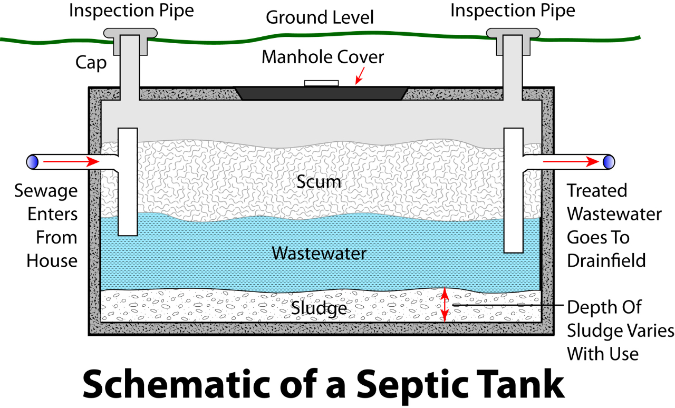
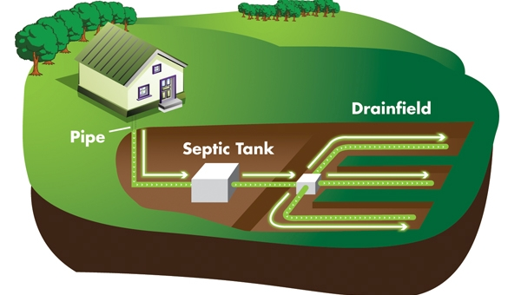
Septic Systems are regulated by County Health Departments, not KY DOW
Health department records on locations and performance of septic systems are variable. There is no statewide database. Many septic systems are installed prior to street addresses being assigned to residences, and the records pre-date GIS.
Notes:
In many areas, sanitary sewer systems have not been constructed.
Therefore, onsite wastewater treatment systems (mainly traditional septic systems) and straight pipes will be utilized to handle household sewage.
Septic systems work by allowing solid materials to settle out in the tank and effluent water to flow into the drainfield, where it is then absorbed by the soil and treated through microbial interactions.
However, if septic systems are not pumped out regularly, the drainfields can become clogged with sludge (or lint from washing machines) and cause backups.
These failing systems can contribute to instream bacteria concentrations, particularly if these systems are in close proximity to the stream.
Soils throughout Kentucky are generally poor or inadequate for septic tank installation and sewage treatment.
Karst features also enable sewage to flow more freely into groundwater without adequate treatment.
Kentucky Division of Water does not regulated septic systems – these are covered by the County Health Departments.
However, when wastewater is at the surface and running into a waterbody, it is a violation of 401 KAR 10:031.
Watershed Coordinators should know that there is not a statewide database for septic tank owners, nor is there even a county specific one.
Records vary form county to county.
So, you will need to work with the local health department to understand where problem areas might be.

Slide 22
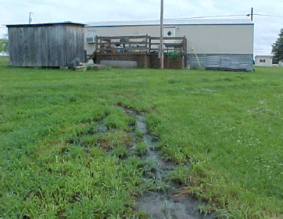
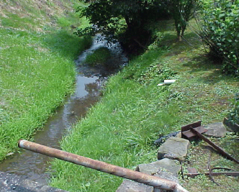
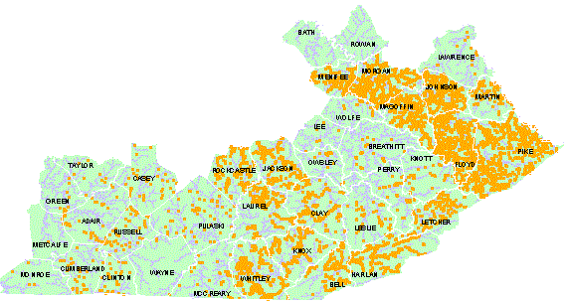
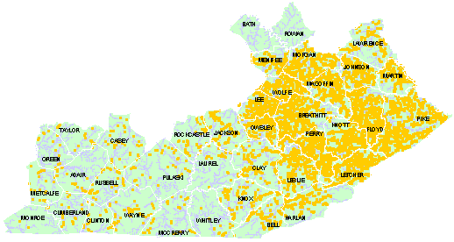
Failing Septic Systems
Straight Pipes
In 2001, it was estimated that 17,000 failing septic systems and 16,000 straight pipes were located in eastern Kentucky
http://www.uky.edu/WaterResources/PRIDE%20-%20Copy/problemmaps1.htm
Notes:
Failing septic systems and even straight pipes are a huge problem in certain areas of the state where wastewater infrastructure has not been constructed.
A 2001 study by Eastern Kentucky PRIDE and KWRRI estimated 17,000 failing septic systems and 16,000 straight pipes were located in the area.
Although these figures have likely decreased, this is still a huge issue for this area of the state.

Slide 23
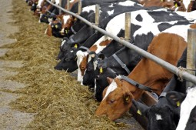
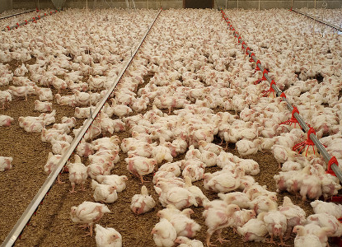
AFO/CAFO Permit
Animal Feeding Operation (AFO)
Stabled, confined and fed for 45 days or more in any 12-month period (confined)
Crops or vegetation not sustained in normal growing season (bare)
Concentrated Animal Feeding Operations (CAFO)
AFO’s are defined as “Large”, “Medium”, or “Small” and no longer use Animal Units to define size.
Any AFO that discharges manure or wastewater into a stream or ditch is a CAFO regardless of size.
Notes:
Not all animal feeding operations, operations with confined animals and bare areas, require permits.
An animal feeding operation (AFO) requires a permit if it is concentrated – a CAFO.
If it discharges manure or wastewater into a stream, then it automatically qualifies as a CAFO not matter how big or small.
The regs defining CAFOs and AFOs are located here: http://www.lrc.state.ky.us/kar/401/005/002.pdf
"Large animal feeding operation" means an AFO that stables or confines as many as or more than the numbers of animals specified in any of the following categories: (a) 700 mature dairy cows, whether milked or dry; (b) 1,000 veal calves; (c) 1,000 cattle other than mature dairy cows or veal calves. Cattle includes heifers, steers, bulls, or cow or calf pairs; (d) 2,500 swine each weighing fifty-five (55) pounds or more; (e) 10,000 swine each weighing less than fifty-five (55) pounds; (f) 500 horses; (g) 10,000 sheep or lambs; (h) 55,000 turkeys; (i) 30,000 laying hens or broilers, if the AFO uses a liquid manure handling system; (j) 125,000 chickens other than laying hens, if the AFO uses other than a liquid manure handling system; (k) 30,000 ducks, if the AFO uses other than a liquid manure handling system; or (l) 5,000 ducks, if the AFO uses a liquid manure handling system.
"Medium animal feeding operation means an AFO that stables or confines the type and number of animals within any of the following ranges: (a) 200 to 699 mature dairy cows, whether milked or dry; (b) 300 to 999 veal calves; (c) 300 to 999 cattle other than mature dairy cows or veal calves. Cattle includes heifers, steers, bulls, or cow or calf pairs; (d) 750 to 2,499 swine each weighing fifty-five (55) pounds or more; (e) 3,000 to 9,999 swine each weighing less than fifty-five (55) pounds; (f) 150 to 499 horses; (g) 3,000 to 9,999 sheep or lambs; (h) 16,500 to 54,999 turkeys; (i) 9,000 to 29,999 laying hens or broilers, if the AFO uses a liquid manure handling system; (j) 37,500 to 124,999 chickens, other than laying hens, if the AFO uses other than a liquid manure handling system; (k) 25,000 to 81,999 laying hens, if the AFO uses other than a liquid manure handling system; (l) 10,000 to 29,999 ducks, if the AFO uses other than a liquid manure handling system; or (m) 1,500 to 4,999 ducks if the AFO uses a liquid manure handling system.
Small concentrated animal feeding operation (“Small CAFO”). An AFO that is designated as a CAFO and is not a Medium CAFO.

Slide 24
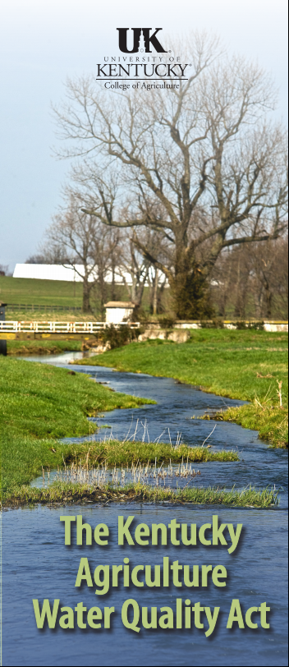
Kentucky Agriculture Water Quality Act
Kentucky law since 1994 to protect surface and groundwater from pollution from ag and forestry practices.
Not a permit but a requirement
All landowners >10 acres of ag or forestry must develop and implement a water quality plan
Notes:
The Kentucky Agriculture Water Quality Act is not a permit system, but it requires all landowners with more than 10 acres of agricultural or forestry land to develop a water quality plan.
The Water Quality Plan specifies best management practices related to forestry, pesticides and fertilizers, farmstead, crops, livestock, and the protection of streams and other waters.
It is a way to help farmer’s ensure that they are protecting the waterways as they conduct their farming operations.
Farmers must provide their plan in order to qualify for cost-sharing assistance through federal Farm Bill programs.

Slide 25
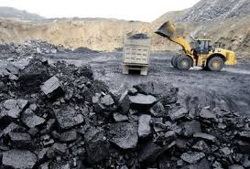
Resource Extraction Permitting
SMCRA 1977: Two Programs Created
  Regulate current coal mines – permitting process
  Clean up abandoned mines (from mining prior to 1977) Abandoned Mine Land (AML)
Mining-Related Agencies in Kentucky:
  Division of Abandoned Mine Lands (AML) – 100% Federal funding from collected mining fees
  Division of Mine Permits (DMP)
  Division of Mine Reclamation and Enforcement (DMRE)
Notes:
SMCRA – Surface Mining Control and Reclamation Act
(In Kentucky, mining regulations are in Title 405 KAR, KRS Chapter 350-352.)
The Division of Abandoned Mine Lands (AML) works throughout Kentucky’s coal fields to protect the public from health and safety problems caused by mining that occurred prior to 1982.
AML administers a water supply replacement program through which they will extend waterlines into areas where drinking water has been contaminated by past mining activity.
Division of Mine Permits ensures that permitted activity meets human health and environment standards of SMCRA.
Division of Mine Reclamation and Enforcement is responsible for inspecting all surface and underground coal mining permits in the state to assure compliance SMCRA.
Also responsible for regulating and enforcing laws for non-coal mining sites, including extraction of limestone, sand, gravel, shale and river sand and gravel.

Slide 26
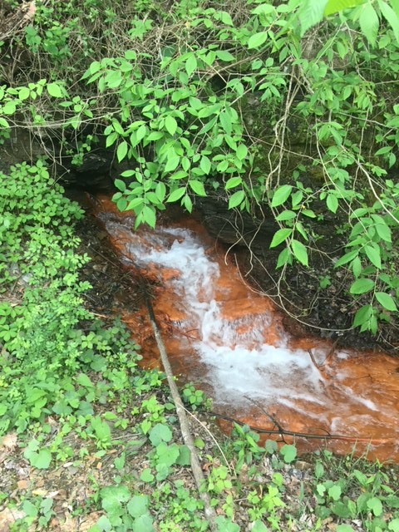
Additional Regulations for Mining
401 Water Quality Certification
Addresses water quality impacts from activities that cause discharge or fill into regulated surface waters such as vegetative debris, sediment, gravel, animal waste, acid mine drainage (ferric hydroxide and sulfuric acid)
Biological Intensive Survey
Evaluates chemistry, habitat, macroinvertebrate, fish populations, depending on location
Notes:
Section 401 and 404 of the Clean Water Act regulate projects that involve the discharge of dredged or fill materials into waters of the U.S.
Mining activity creates dredged or fill materials and therefore is covered by the 404 permitting and 401 certification requirement.
This certification includes management requirements for handling vegetative debris, sediment and acid mine drainage created through the mining process.
The next slide will provide additional information about 401 and 404 requirements.
A biological intensive survey is also need for coal mining permitting….the Kentucky Division of Water has specific guidelines for sampling and site identification that are published on its website in order to guide what mining operations are required to sample. The guidelines require chemical samples as well as different types of biological samples depending on the size of the waterways.

Slide 27
Clean Water Act Permits
Section 401: Water Quality Certification
Section 404: Discharge of Dredge or Fill Materials
Section 401 (KDOW):
  Certification of Water Quality of Discharge
  Goal of 401: “the Commonwealth of Kentucky certifies it has reasonable assurances that applicable water quality standards…, will not be violated by the above referenced project”
Section 404 (Army Corps of Engineers):
  Pertains to discharge of dredge or fill material into a water of the United States.
Notes:
For construction permits that will potentially impact a water of the United States, two different permits are needed.
The Army Corp of Engineers administers the 404 permit process. The applicant must perform a jurisdictional delineation of all water resources in the construction area. This means determining whether there are any streams or wetlands in the area, and if so determining their size or length and how much would be impacted. They are also to assess whether the water resources have “significant nexus” with a water of the United States.
Kentucky Division of Water’s 401 certification validates the US Corps of Engineers 404 permit.
This dual-agency approach ensures that the federal and state regulatory agencies approve of the project and have outlined their expectations for measures that will protect water quality.

Slide 28
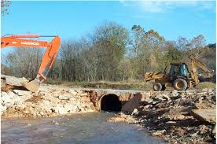
Construction Permits
404 Permits
US Army Corps of Engineers issues:
  Nationwide Permits (NWP) – general permits for common activities with minimal impact (<300ft stream, <1/10 acre wetland)
  Individual Permits (IP) – larger impacts with public comment period
  Both permits may involve mitigation to compensate for impacts to streams or wetlands
Notes:
Examples of Common Permit types:
NW #3 - Maintenance Activities
NW #12 - Utility Line Crossing of Streams
NW #13 - Bank Stabilization
NW #14 - Road Crossing of Streams
NW #21 - Surface Mining Activities
NW #27 - Stream/Wetland Restoration
NW #39 – Development

Slide 29
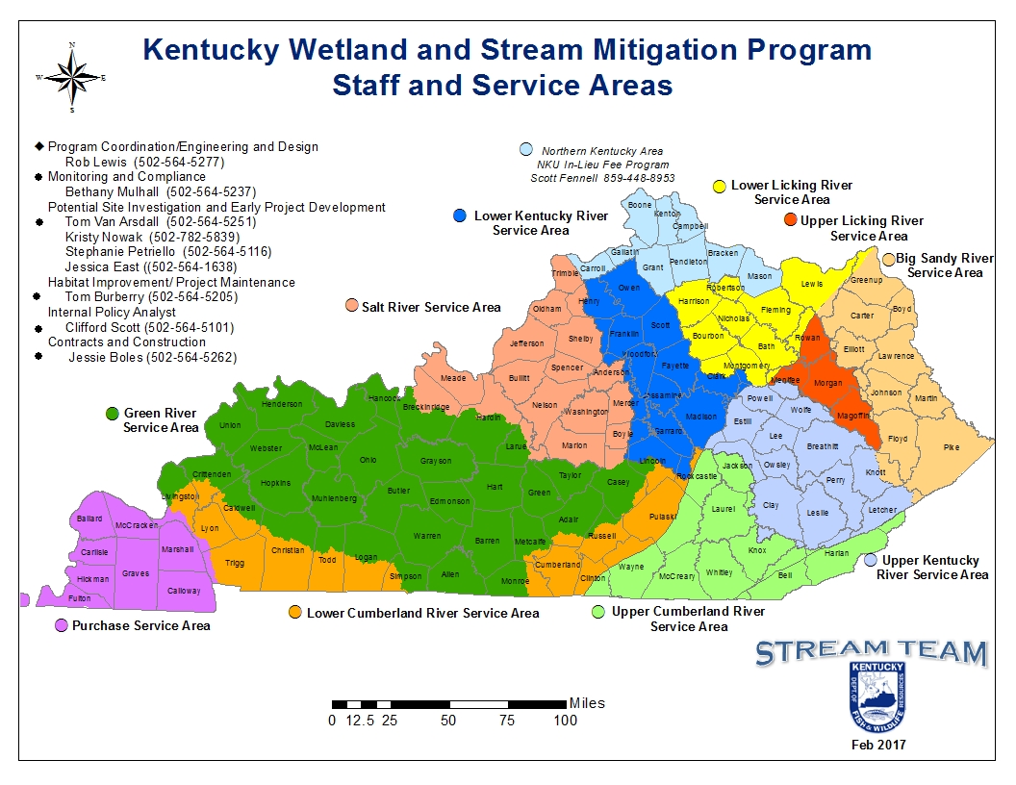
404 Construction Permits
FILO Program
With impacts, can pay a “fee in lieu of” on-site permittee-based restoration.
Purchase credits based on amount of impact.
KDFWR and their restoration specialists perform stream and wetland restoration projects.
https://fw.ky.gov/Fish/Pages/Stream-Team-Program.aspx
Notes:
When significant impacts will occur, the permittee can mitigate them by restoring a stream or wetland in another area.
Or, they can pay a “fee in lieu of” restoration.
These fees are then used to professionally restore a stream segment or wetland area within the same river basin as the construction project.
This FILO program is managed by multiple agencies, but is directly overseen by Kentucky’s Department of Fish and Wildlife Resources.
FILO program provided for in KRS 150:255.

Slide 30
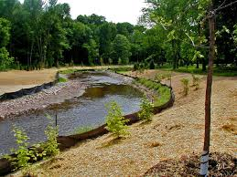
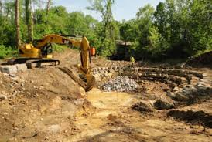
Construction Certification and Permits
401 certification to construct a stream
  KDOW (in or along stream)
Floodplain permit to construct
  KDOW - Within 100-year floodplain
  Dams, bridges, culverts, buildings, fill, stream alterations, impoundments
  Use existing or perform flood studies (National Flood Insurance Program map)
Notes:
Permits are also required from DOW for stream construction (or stream restoration work) and construction activity within the 100-year floodplain.
The 100-year floodplain is the land that is predicted to flood during a 100-year storm. It has a 1% chance of occurring in any given year.

Slide 31
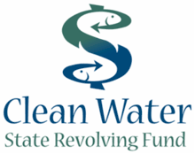
State Revolving Loan Funds
Clean Water Act Section VI
EPA Annual Capitalization Grant to States
  20% match by states
Low (sometimes no) interest rate loans with up to 20-year payback period
Mostly to construct or repair wastewater facilities, but can go to nonpoint source as well.
  Septic repair
  Easement purchase
  Wetland purchase and restoration
  Brownfields conversion
  Minimize runoff from farmlands

Slide 32
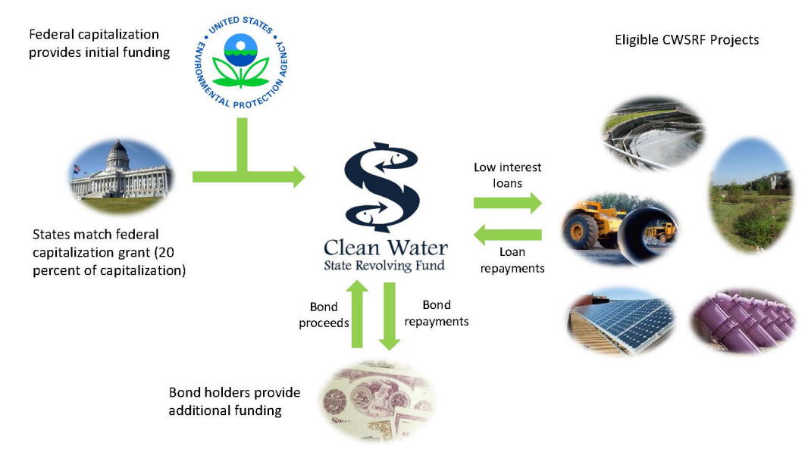
State Revolving Fund $ Flow
https://www.epa.gov/sites/production/files/2015-06/documents/cwsrf_101-033115.pdf
Notes:
This diagram shows how funds flow in the SRF program.
Federal money from EPA flows to the states, and the states provide their 20% match.
Bond holders, such as banks, provide additional funding.
And, the SRF recipients receive and pay back low-interest loan amounts to complete their projects.

Slide 33
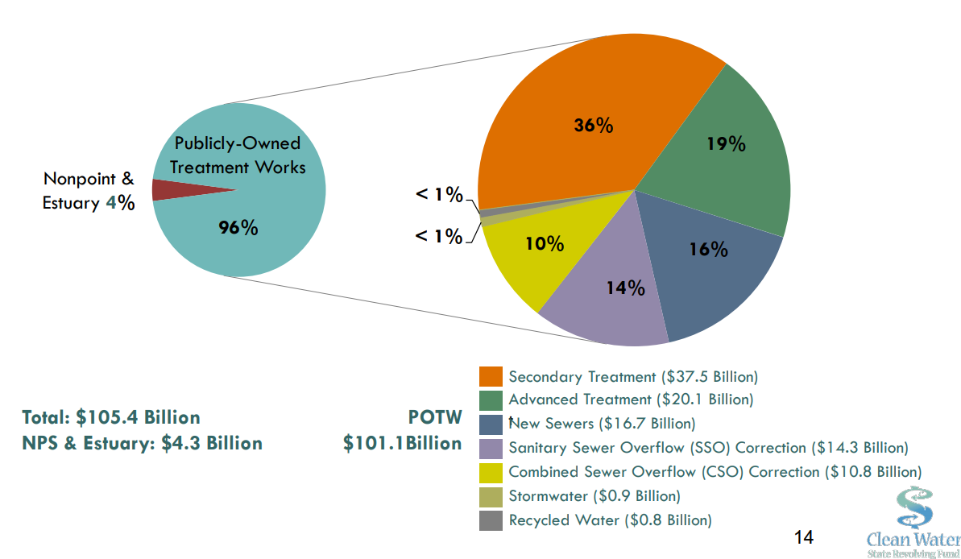
State Revolving Loan Funds
National Summary 2014
https://www.epa.gov/sites/production/files/2015-06/documents/cwsrf_101-033115.pdf
Notes:
These pie charts show how SRF funds were used nationwide in 2014.
By far, the majority of funding was used for wastewater treatment plants and related infrastructure.

Slide 34

Other Environmental Laws:
Safe Drinking Water Act (SDWA) and Groundwater Rule (GWR)
SDWA regulates water supplies
  for >25 people
  Consumer Confidence Reports
  Microbial Byproducts and Disinfection
  Operator Certification
  Source Water Assessment Programs
GWR to reduce risk of microbial contamination to drinking water from groundwater systems
  Requires sanitary surveys (i.e. well near leaking septic)
  Must remove 99.99% of viruses or total coliform, if not monitoring and corrective action
Notes:
Often when the public thinks about water quality protection, they immediately think of drinking water.
It is important to know that the SDWA and the GWR are legislative mandates that protect drinking water supplies and source waters.
These laws help ensure that the public understands the quality of their drinking water and any contamination concerns.
A waterbody could be failing standards required for recreational use, but may still provide quality drinking water after treatment and disinfection.
The SDWA requires the Consumer Confidence Reports you receive in the mail, have rules about disinfection byproducts, potential contamination threats to the water supply, and operator certification.
The Groundwater Rule includes additional requirements for the protection of drinking water systems that use groundwater sources. It also requires surveys of potential contamination sources, and calls for corrective action if viruses or bacteria are present.

Slide 35
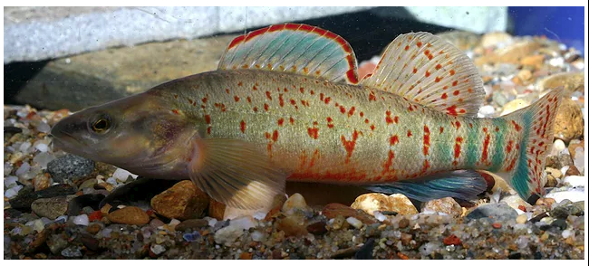
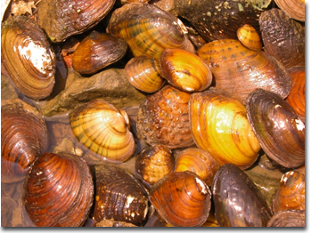
Other Environmental Laws:
Endangered Species Act (ESA)
49 federally threatened or endangered species in Kentucky (June 2018)
37 species (75%) are aquatic including:
  9 fish
  2 crustaceans
  26 mussels
What may potentially be in your area? https://ecos.fws.gov/ipac/
Kentucky Arrow Darter
https://www.conservationfisheries.org/kentucky-arrow-darter
Freshwater mussel assemblage from the Licking River,
Photo by Monte McGregor
(https://fw.ky.gov/Wildlife/Pages/Freshwater-Mussels-and-Aquatic-Snails.aspx)
Notes:
Federal agencies must ensure that their activities are not likely to jeopardize the existence of these species.
If these species are present in your watershed, they may restrict some of your planned projects, but also provide opportunities to create protective habitat for these species.

Slide 36
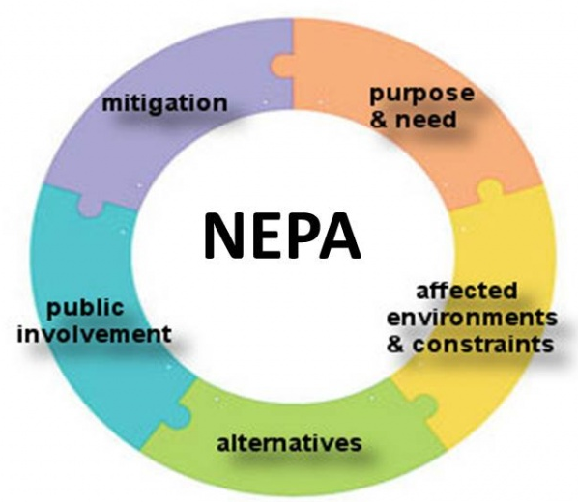
Other Environmental Laws:
National Environmental Policy Act (NEPA)
NEPA (1970) requires federally funded projects to consider environmental effects and multiple alternatives through one of three levels of analysis:
Categorical Exclusion (CatEx)
Environmental Assessments (EA)
Environmental Impact Statements (EIS) OR Finding of No Significant Impact (FONSI)
Good source of data if available
Notes:
Levels of NEPA Analysis
Categorical Exclusion (CatEx) – doesn’t individually or cumulatively have a significant effect
Environmental Assessments (EA) – whether or not potential to cause significant environmental impacts. Addresses need, alternatives, impacts, and consultation
Environmental Impact Statements (EIS) OR Finding of No Significant Impact (FONSI) – more rigorous and detailed document with public comment explaining decisions
The more rigorous the document, the more detail that may be available.
As a watershed coordinator, these documents may have done a lot of work for you. They typically consider the following impacts and provide related discussion:
Affected environment
Threatened and endangered species
Air quality
Water impacts
Historic and cultural preservation
Socio-economic impacts
Soils and geology
Noise and aesthetics
Energy
Hazardous wastes
Direct, indirect, and cumulative impacts
Cost analysis
So, if there is a federally funded project in the watershed area, such as a road, these can be valuable references.

