Slide 1
Watershed Academy
Watershed Coordinator Training Series
Likely Partners
1. Developing Partnerships
Notes:
This presentation is part one of the Kentucky Watershed Academy Module 5: Likely Partners. It will focus on some fundamentals of developing partnerships.

Slide 2
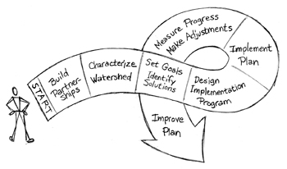
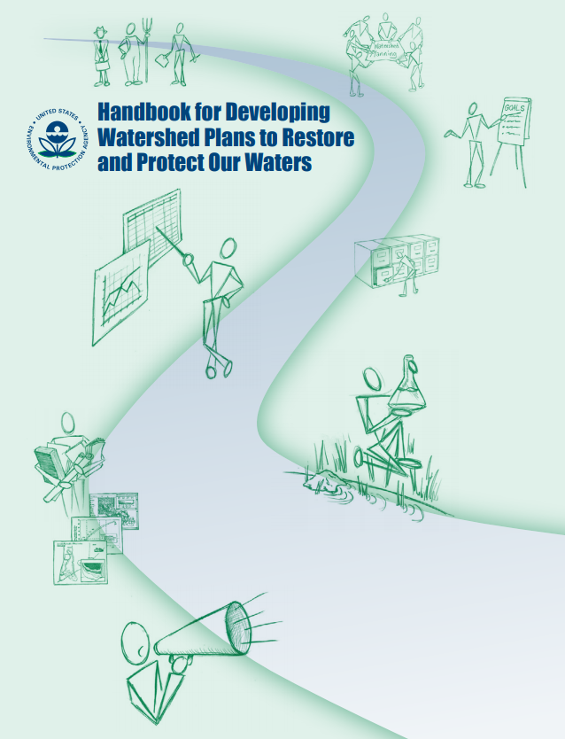
Developing Partnerships
Why make partnerships?
How do you get stakeholders involved?
How do you recruit and maintain volunteers?
Notes:
The presentation will cover three major questions:
Why should you make partnerships?
How do you get stakeholders involved?
How do you recruit and maintain volunteers?
All of these questions are intended to address STEP 1: Build Partnerships, shown in this graphic from the EPA’s steps to effective watershed management.
Much of the content for this presentation has been pulled from the EPA’s Handbook for Developing Watershed Plans to Restore and Protect Our Waters.

Slide 3






Who are these partners?
Stakeholders affect or are affected by implementation:
“We make decisions”
“Your decisions affect us”
“We can make it easy or difficult”
“We have knowledge”
Partners:
“Let’s work together”
Notes:
First, what do we mean when we talk about stakeholders and partners? What is the difference?
A stakeholder is anyone who may help with implementation of watershed improvement or protection actions or is affected by them.
This can include decision-makers, residents or businesses in the area, individuals or organizations that can create roadblocks or smooth the road to success, or local historians or others who have information to contribute.
(CLICK) A partner is one of these stakeholders who is willing to participate in the watershed planning process or its implementation.
There may be some cases in which partnerships may not be appropriate for watershed planning, such as if just a few landowners are located in the area or if the land use is dominated by one type and planning is led by a group or agency affiliated with that land use. However, in most circumstances, commitment from a diverse group of stakeholders to partner together on implementation planning will be beneficial.

Slide 4

Benefits of Stakeholder Input and Partnerships
TEAM: Together Each Achieves More
Two heads are better than one
Shared responsibility in collective decisions
Pooled resources increase success
Many hands make light work
Develop trust, support, and relationships
Larger megaphone and platform
Notes:
Our society is filled with slogans that praise the benefits of partnerships. But partnerships are a lot of work – they require time and resources. So why should you pursue them?
TEAM: Together Each Achieves More – this slogan is applicable in implementation planning when people have water-related needs or problems that they cannot solve alone. The partnership is greater than the sum of its parts because it provides a holistic solution.
Two heads are better than one – This slogan acknowledges that watersheds are complex and various areas of experience are necessary to develop solutions. Some might be skilled in the technologies of Best Management Practices, but lack the networking contacts to place these practices on the ground. Others may have local knowledge of perspectives on issues, but not know how to work around them. Some bring marketing, graphic design, or education and outreach skills. Many different professions and backgrounds are needed to contribute to successful planning.
Shared responsibility in collective decisions – relates to how partnerships provide shielding for individuals or organizations on decisions because the actions were not taken in isolation. There is blame to share if things go wrong and praise to share when things go right.
Pooled resources increase success – Whether it be financial resources, technical assistance, or outreach, collaboration between multiple organizations and agencies can increase the reach of resources
Many hands make light work – With more participation, one organization or individual does not have to shoulder all the burden. Group collaboration on events can make for a much larger event. For example, volunteers can help with information gathering, outreach activities or riparian plantings in order to lessen the overall burden.
Develop trust, support, and relationships – many organizations and individuals participate in the planning process because it helps them to build relationships with potential clients or they just enjoy the time and friendships with like-minded people. When you’ve worked together successfully on one project, it can make working together on future projects easier.
Larger megaphone and platform – each group or organization has its own network. By working together, you can deliver your message to people you would not otherwise be able to.
In general, working with diversified interests increases the chances of broader, more sustained success.

Slide 5

Why Partnerships Succeed
Right representation
Clear, common purpose
Collaborative decisions
Effective, flexible coordination and organization
Two-way open communication
Opportunities to demonstrate skills and leadership
Participants enjoy relationships and network
Challenge and sense of accomplishment
Notes:
Partnerships can succeed for several reasons:
Right representation – It is best to have all interests represented in the watershed. Exclusion or lack of participation of some group can cause roadblocks later.
Clear, common purpose – People want to know why they are involved. When the overall purpose is not clear or shared, then others may direct the planning toward their own agendas.
Collaborative decisions – People are less likely to participate if their needs or views are not heard. Reaching decisions by consensus is key for wide acceptance and success.
Effective, flexible coordination and organization – If meetings are too frequent, people will drop out. If they are too few, scattered, or do not have a clear purpose – then people will lose interest. Good communication, organization, and flexibility to local desires are essential for success.
Two-way open communication – All groups can be subject to power plays. Ensuring that all voices are heard and not just instructed is important. Perceived or real inequities can kill partnerships.
Opportunities to demonstrate skills and leadership – Providing space for leaders to emerge within the planning group is key. Many participate in order to grow in their skills or add to their resume. Providing opportunities to take ownership will aid in success.
Participants enjoy relationships and network – This may be one of the most important factors. Everyone can think of some group they groan about when they get a meeting reminder. There are others that are so fun that you cannot wait until the next one. Make sure your meetings are enjoyable and provide plenty of opportunities for networking.
Challenge and sense of accomplishment – It’s great to work together and succeed. Make sure you share the successes and provide plenty of stimulating challenges to keep people coming back for more.

Slide 6

Why Partnerships Fail
Personality conflict
Differing values
Attendance without commitment
Lack of acknowledgement or credit
Unclear roles or expectations
Fear of association or lack of independence
Power struggles, inequities, or biases
Low community interest or controversial
Notes:
Partnerships can also fail.
The worst-case scenario is to spend years in developing a watershed plan that then turns into a large paperweight because no one is implementing it. Why do planning partnerships and implementation efforts fail?
Personality conflict – Unfortunately, some people just do not get along. Relationships can fail. Organizations or individuals can let each other down and refuse to work together. If these individuals remain in the same positions for years, a lack of participation can become institutionalized.
Differing values – Perhaps one group is pro-development and another is anti-development. If people with opposing views cannot find a middle ground of mutual respect with shared values, then partnerships will not work out.
Attendance without commitment – Often partnerships break down at the transition from planning to implementation. People may be willing to come to a meeting because it gets them out of the office but be unwilling to act within the meetings or subsequently. Providing direction on how you expect each partner to contribute from the onset is important.
Lack of acknowledgement or credit – Be generous with your praise, as recognition is often a major reason why groups participate. Don’t forget to acknowledge contributions or you may not receive them again.
Unclear roles or expectations – If individuals or organizations don’t know why their participation is vital or feel like they are being asked to do too much, they may drop out. Clear roles and expectations allow for people to know what they are signing up for.
Fear of association or lack of independence – If your group becomes biased in one direction or if participants feel as if they are being tied too closely to positions they cannot advocate, they may distance themselves. Show respect to all views on issues.
Power struggles, inequities, or biases – If one individual or organization dominates the conversation and others are not afforded time to share their perspective, they may decide their time is better spent elsewhere.
Low community interest or controversial - Be aware of controversies and avoid them where you can, but make sure your planning touches on issues that are of interest to the community, or you may quickly find yourself working alone.

Slide 7

Overcoming Obstacles
Start well
Keep assessing new invites
Build momentum
Get to know each other
Stay positive
Regularly reward, recognize and respect
Encourage input from quieter voices
Notes:
So, how do we overcome these obstacles to successful partnerships?
Start well – you never know quite what to expect from a community when you start a watershed planning effort, but you should put a lot of work in before calling your first meeting. We will talk about some of ways to do this in the following slides. As the saying goes – you don’t get a second chance to make a first impression. Some may come to an initial meeting looking for threats against their interests and viewing your angle suspiciously. Providing a safe, open environment with opportunities for people to speak their mind is important.
Keep assessing new invites – Your team should regularly be reaching out. As information emerges and planning progresses, you should be exploring new avenues, angles, opportunities, and insights. New participants can keep the process from stagnating.
Build momentum – Don’t tell everything you know all at once, but continually reveal facts about the area and highlight projects to sustain interest. Offer small bites of information and topics to allow the group to build confidence, interest, and relationships.
Get to know each other – Spend time not only during the meetings, but socialize outside of them too. Ask ice breaker questions. Allow time for personal relationships to develop.
Stay positive – Change takes time. so stay positive. Highlight the small incremental wins you’ve achieved. Give periodic reviews of what has been accomplished. Try to find the silver linings.
Regularly reward, recognize and respect – Showing appreciation of the contributions of others goes a long way. Have a long memory of this appreciation for favors and contributions.
Encourage input from quieter voices – Make sure meetings are not dominated by the more powerful or informed partners by deliberately asking questions of and requesting comments from those who are less talkative. This conveys their importance to the partnership.

Slide 8
Stakeholder Involvement Overview
Identify stakeholders
Determine roles and responsibility
Define organizational structure
Conduct ongoing outreach
Identify skills and resources
Encourage participation and involvement
1
2
3
4
5
6
Source: USEPA
Notes:
Having overviewed some basics about why to pursue partnerships, lets look at how to go about recruiting and utilizing partnerships using the USEPA’s 6 steps of stakeholder involvement.
We will address each of these steps individually.

Slide 9
1. Identify Stakeholders
TECHNICAL
FINANCIAL
REGULATORY
LOCAL
OUTREACH
Landowners
County or city elected officials
Business and industry
Neighborhood Assoc
Citizen / volunteer groups
Community service orgs
Religious orgs
Environmental or conservation groups
Recreational groups
Educators
Federal, state, regional and local agencies
Special districts
Parks and public lands
Utility managers
Scientists, engineers, consultants
Planners
Notes:
The first step is to develop a list of stakeholders, including those who can provide technical, financial, regulatory, local and outreach assistance.
You might consider categorizing these in terms of influence and interest. There will likely be a regular crowd of interested people and professionals who attend, but you will want to diligently pursue those who may be the most influential, but minimally interested. You will have to think through why their influence matters and how to appeal for their participation.
You will want to pull in a diverse group of stakeholders. At first, you may not have contacts, but you should first reach out to a trusted group of the closest partners and work outward to receive input on who to involve and when.
Think of different talents, interests, concerns, and perspectives as you build your group.

Slide 10
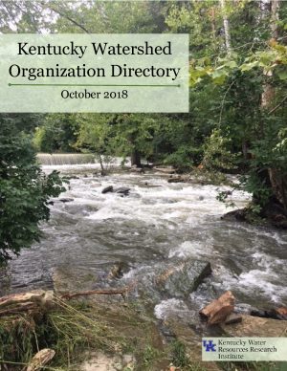
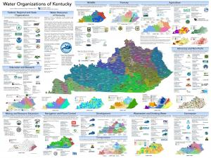
1. Identify Stakeholders
www.research.uky.edu/kentucky-water-resources-research-institute/ watersheds-general-information
www.research.uky.edu/kentucky-water-resources-research-institute/kwrri-publications
Notes:
KWRRI has developed several guides to try to assist you in this process.
The Kentucky Watershed Organization Directory was developed in 2018 to provide a short two-page overview of various organizations and agencies throughout the state, what they do well, and where they seek partnerships for assistance. It is a helpful starting place for understanding your partners. KWRRI is accepting new submissions and revisions to this directory, so feel free to contact us if you would like to be added or see your organization’s information updated.
Secondly, the “Water Organizations of Kentucky” map was developed as an overview of organizations that work within various domains related to water. The poster has numerous small maps that help you understand some of the resource issues and contact areas at a glance.
Both of these documents are available on KWRRI’s website at the links provided.
We also hope the presentations as part of this Module 5: “Likely Partners” series will provide a better understanding of who to work with and why.

Slide 11

1. Identify Stakeholders
Local Champion
May be single most important factor in success
More than just a stakeholder
Personal investment in the change and keeping progress moving forward
Understands the local needs, drivers, and connections
Notes:
One of the most critical factors for a successful project is to find a local champion.
The local champion is more than just a stakeholder, but is also an individual or organization that has a personal investment in keeping the progress moving forward.
This may be an institution with long-standing commitments toward water quality improvements or an individual with a passion for water quality and the perseverance to make change.
Some of the many local champions we have witnessed in Kentucky include:
Retired volunteers
Farmers
Water or wastewater utilities
Local municipalities or stormwater utilities (MS4s)
University professors or staff in water sciences or cooperative extension
Nonprofits
These local champions have the drive that will keep momentum going over many years. Champions can emerge out of the planning process, but an eye needs to be kept on who is going to take personal responsibility for making progress with implementation activities.

Slide 12
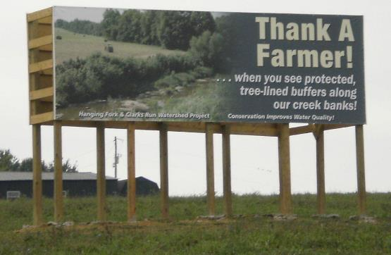
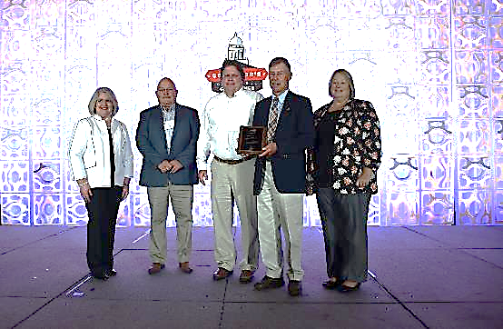
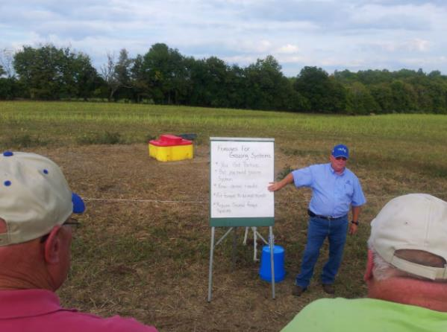
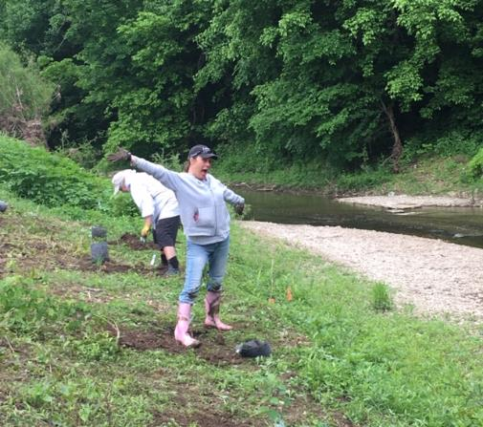
Local Champions of Hanging Fork Watershed
Notes:
The Hanging Fork Watershed planning and implementation effort in Lincoln and Boyle Counties has definitely benefitted from local champions that have been instrumental in achieving progress.
A local farmer worked as an agricultural watershed coordinator to promote ag BMPs and convince farmers of their benefits. He helped “sell” these practices to farmers and enabled them to use a combination of 319 funds and state cost-share money to install them throughout the watershed. A roadside sign was placed on one of the farms to help recognize the farmers who create riparian buffers and use other practices that protect water quality.
A local citizen worked with Lincoln County government and the Bluegrass ADD to form a sanitation district and obtain loan and grant funding for a major sewer line extension that addressed over 500 homes on problematic septic systems. The sanitation district has received multiple awards for their significant efforts to expand infrastructure and improve water quality.
A Hustonville city council member helped organize and promote a riparian buffer enhancement at a local park that is located on Hanging Fork and serves an outdoor recreation focal point in the community.

Slide 13
2. Determining Roles and Responsibilities
Before contacting, have some idea of answers to these questions:
What is role? (input, decider, author, etc.)
How will decisions be made?
Are they expected to develop a work product?
How much time will this require?
Start with more interested partners and work toward less.
Notes:
After listing out the stakeholders that you believe are needed, you need to have some idea of what role you would like the partner to play and of responsibilities that they will have.
First, decide what are you asking the partner to do: provide input? Make decisions? Author a grant or report? Provide labor? Use their facilities? Help provide outreach? The more clarity you can provide the better. The better you know the partner, the better you will be able to direct your ask.
Second, provide some idea of how decisions will be made. Are decisions limited to a smaller group, but input is requested from a larger group or is consensus required? Do you need a formal board with quorum? If so, when and how do votes occur?
Third, are you asking them to develop a deliverable or implement a practice? If so, be upfront about it.
Fourth, provide an estimate of the amount of time that will be required of them. How long will meetings be and how frequently? Are you paying for their services? What is the duration of the project? Do they need to participate in every meeting?
In this overall approach to directly communicating with potential partners, start with your most interested and essential partners and then work towards the less engaged and essential. It is helpful to keep notes on commitments and willingness for future reference.
Surveys, online, via phone or in-person, may be a way to obtain information about stakeholders before requesting a partnership. You can use these to determine a potential stakeholder’s:
knowledge of issues and concerns
Attitudes and opinions about the community
Their use of the resource
Their motivations
Whom they trust
What they value
And what are key local activities

Slide 14
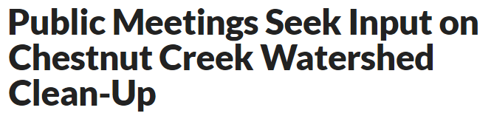
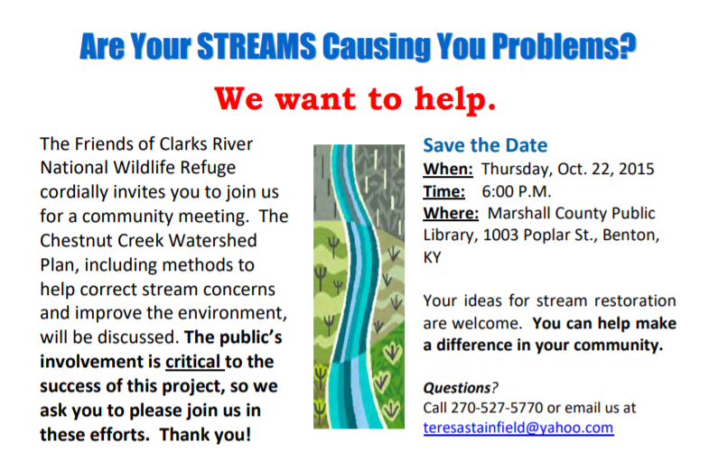
Notes:
During the Chestnut Creek watershed planning effort, this postcard was mailed to 1,000 residents to invite them to a public meeting in an effort to expand participation and feedback.
Usually, these invitations bring in about 20 to 30 people who want to hear more about what is going on.
This one attracted closer to 100 people, many of whom had concerns and biases about the purpose and intent of the meeting. For instance, there were strong opinions that cleaning out the creek would be best and a lot of talk about flooding that the leaders were not prepared to address at that point.
Because the attendees didn’t have a clearer expectation of what was needed or wanted from them, their confusion led to unnecessary frustration and emotion.
Instead of it being an informational meeting about the planning process and the known basics about Chestnut Creek, the organizers had to diffuse tensions by opening it up to general discussion about the resident’s concerns.
In retrospect, the organizers realized that they should have done a little more prep work and developed a more specific mailer. Also, there needs to be some thought put into how to listen to and respond to potential concerns with correct information.
As an interesting side note: That particular meeting was very awkward because the sanitation district operator was present and got called on the carpet for being out of compliance but stated that they were in compliance. He did not come to meetings after that. In the end, the entire sanitation district board got fired and replaced as a result of this planning effort, but the operator remained and he has been able to do his job more effectively.

Slide 15
3. Organizational Structure
Guiding Questions
How funded?
  Community funded
  Grant funded
How formal or informal?
To what degree does community desire participation?
Structure Options
Core Development Team
Steering Board
Advisory Committees or Workgroups
  (i.e. technical, outreach, etc)
One-on-One Stakeholder Meetings
Focus Group Meetings
Open Public Meetings
Volunteer Data Collection
Public Workshops
Online Surveys
NOT ONE SIZE FITS ALL
Notes:
You will also need to consider the organizational structure. This is often determined by how the funding is administered and the drivers behind the planning effort.
For instance, if a plan is funded by a grant (such as one of KDOW’s 319 grants), then there will be specific partners who are under contractual obligations. In this instance, you may have a nonprofit or local government as the lead with technical consultants hired to help manage the process or conduct outreach. In this scenario, you may have a core team with informal committees or workgroups.
However, if the planning is driven by community interests and funding, then a more formal voting process may be necessary before the group decides to mutually commit resources toward an objective.
The degree of formality required will also depend on the type of feedback you need—decisions, advice or support.
And lastly, structure depends on whether the community desires to participate. If this is a contentious issue, then more formal efforts will likely be needed with lots of space for feedback. If there is not a lot of community interest, then there may be more latitude in how informally the process moves forward.
Not every watershed is the same, so one structure will not work for all situations.
A variety of different engagement formats are listed to help you determine the best framework for your community.

Slide 16
Watershed Management Framework Process - 1998
DOW
Watershed Steering Committee
KRA
Basin Coordinator
WWKY
USGS
River
Basin Team
Goal 3: $olve problems at
the local level.
Other
Federal
and
State
Agencies
Universities
NGOs
1. Scoping and Data
Gathering
Local
Stakeholder
Groups
2. Assessment
3. Prioritization
and Targeting
4. Plan
Development
Local Watershed
Task Forces
Goal 1: Increase cooperation
and efficiency.
5. Implementation
Goal 2: Set priorities.
Notes:
As an historical example of engagement fine-tuning,…when Kentucky originally adopted the Watershed Framework Process to better manage water quality in the state, it was envisioned as an effort led by state and federal agencies, who brought in other partners to form a Watershed Steering Committee. This Committee would help select and oversee statewide watershed management efforts. (These groups are noted on the left.)
Priorities were to be established by the 7 major river basin coordinators and basin teams throughout the state, who would help guide local partners to take improvement or protective actions. (shown in the middle)
Watershed Watch in Kentucky was seen as a important resource for local stakeholders. It was also believed that local watershed groups would be formed out of the state’s recommendations and guidance.
For the most part, this approach proved to be problematic.

Slide 17
Watershed Management Framework Process - Now
Local Stakeholder Groups
Basin Teams/
Basin Coordinators
Universities
State and Federal Agencies
NGOs and Others
Notes:
It was realized that the reverse approach is often better, where the local, grass-roots level stakeholders express concerns and interest in water quality and the basin teams and coordinators work with other partners to provide the support needed to understand and address the issues of concern.

Slide 18
Stakeholder Participation
Lessons Learned from Floyd’s Fork Watershed Stakeholder Engagement Project
Where citizens desire to be engaged.
Where citizens believe most engagement in public participation takes place.
Used real-time feedback and focus groups interviews to navigate solutions.
Notes:
Local involvement is critical, but the ways to gain it vary and need to be tailored to the situation.
This realization played out in the Floyd’s Fork Watershed of northern Kentucky when a TMDL aroused concerns about regulation of land uses, including agriculture and development. The federal EPA and the Kentucky Division of Water understood that they needed an intermediary to help guide the public engagement process to build trust and understanding of the water issues and potential ways to address them fairly.
Public meetings and real-time feedback tools during those meetings helped with understanding that the stakeholders wanted a higher level of engagement in the decision-making process than just being informed and possibly consulted. They were more interested in a higher partnering level of participation.
This graphic of the Amstein Ladder of Participation illustrates citizen perceptions of the quality of their public involvement on an eight-point scale (Arnstein, 1969). The ladder shows the degree that citizens feel they have been involved in matters from Non-Participatory manipulation and therapy…to Tokenism through informing, placation and consultation…to where the Floyd’s Fork stakeholders wanted to demonstrate some level of Citizen Power through partnership or delegated power. Most citizens respond that their experience falls somewhere between informing and placation in the Tokenism level of participation.
You should consider where on this ladder you see the current process and where you think it should be.
If people don’t trust the process, they may drop out quickly and avoid or undermine it because they don’t think their voices are being heard and their concerns aren’t being addressed.
In Floyd’s Fork, KWRRI led a stakeholder inclusion effort that asked stakeholders and focus groups who they trust and who they use as information sources. This information was used to develop management recommendations.
On the flip side, once you are trusted, people may not show up because they may not feel like they need to participate.

Slide 19
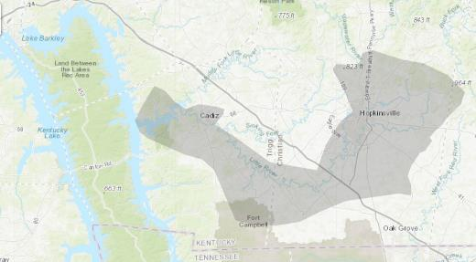
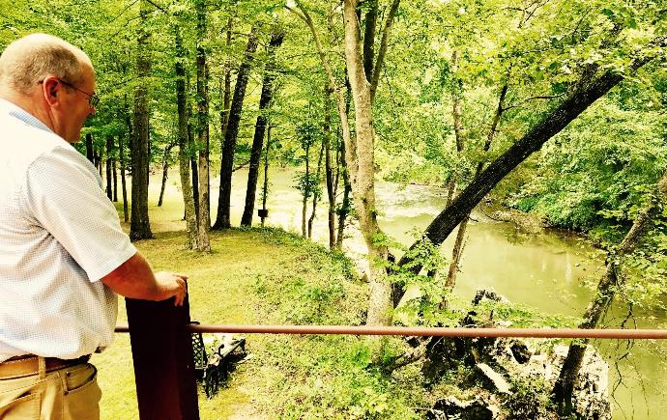
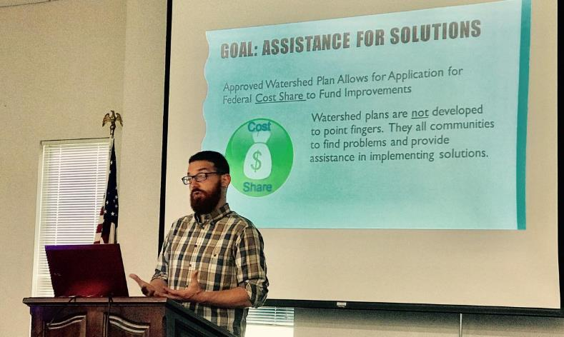
Organizational Dynamics in Little River, Four Rivers
Photos: Nicole Erwin, Ohio Valley ReSource
Notes:
The organizational structure of the Little River Watershed Consortium in near Land Between the Lakes in Christian County was also unique because it was and is led by community leaders, including elected officials, wastewater utility directors and large-scale farmers.
These participants are higher level decision-makers and wanted a leading role in the water quality analysis and resultant decision-making, as it could have direct effects on their business interests.
This led to meetings with more rigid, formalized procedures, including establishing a required quorum of attendees and voting procedures.
As a strong organization, they were able to raise about $800,000 to pay the USGS to conduct extensive water sampling, including fecal source tracking, to help identify the bacteria sources and solutions.
The analysis was compiled as a watershed planning document by Third Rock Consultants, and Hopkinsville subsequently decided to complete two major water and sewer infrastructure projects.

Slide 20
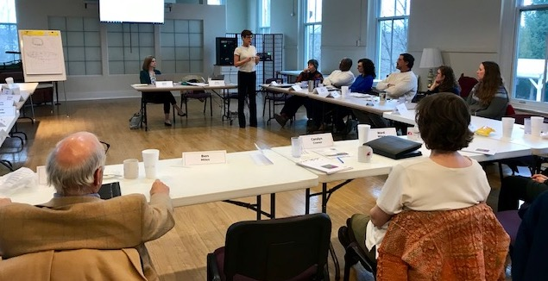
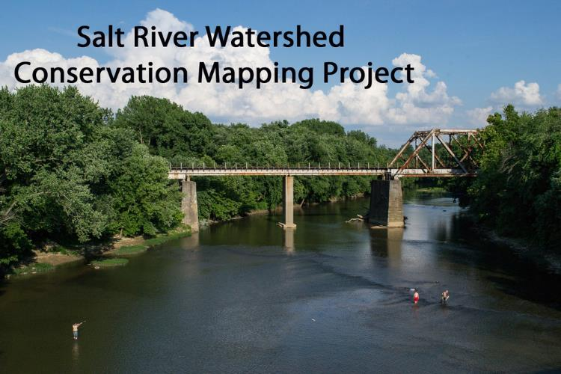
Organizational Strength: Salt River Conservation Collaborative
Notes:
Another example of a more formalized organization structure is the Salt River Conservation Collaborative.
This diverse group of Kentucky conservation organizations is jointly working to protect water quality, wildlife habitat, natural areas and farmland in the Salt River watershed, while increasing awareness and support for conservation.
Its structure represents a Core Development Team or a Steering Board.
Although these organizations have shared goals, the large group of diversified interests approaching them from different angles could make progress a little slower. The strength and broad inclusiveness of the group is also more likely to be more successful and resilient over the long term.

Slide 21


4. Identify Skills and Resources
Skills
Accounting
Graphic Design
Fund Raising
Writing
Public Relations
GIS / Mapping
Technical expertise
Facilitation
Education / Training
Resources
Audience communication
Volunteer access
Database access
Meeting facilities
Food / sponsorship
Equipment
Demonstration projects
Networking connections
Notes:
As we’ve mentioned, within your partner group, you will want to think about the skills and resources that partners may be able to contribute.
The ability to have access to a diverse skill set will improve your efforts.
Here you can see a list of some of the skills or resources that should be evaluated for need and who can fulfill them.
By identifying these key resource people, you can make more direct and specific requests for assistance that may be more likely to be accepted and help these individuals feel more engaged.

Slide 22
5. Encourage Participation and Involvement
Pay attention to type and degree of effort desired. (e.g. preference for planning vs doing)
Focus on issues of importance to stakeholders
Recognize and respect different views
Communicate appropriately
Notes:
The fifth step in stakeholder involvement is encouraging participation and involvement.
This does not necessarily mean attendance at every meeting. Some may be interested in the DOING, but not the PLANNING, or vice versa. Understanding how people are interested in helping and the degree of effort they desire is important. Some may just want periodic updates.
Make sure that you are addressing issues of importance to stakeholders. In some cases, this may mean piggy-backing your outreach efforts onto tangentially related efforts in the community. Find out what is important to stakeholders and make sure you are addressing that in some way.
Be sure to capture and affirm different views and perspectives on issues, even when you disagree with them. It is only through respect that you will be able to find adaptable solutions.
Lastly, you will want to have regular communication, but not too frequent or too infrequent.

Slide 23
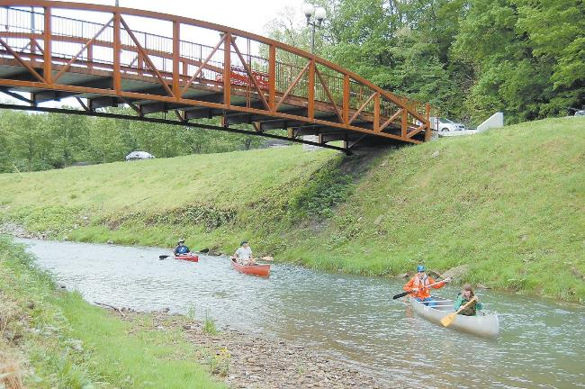
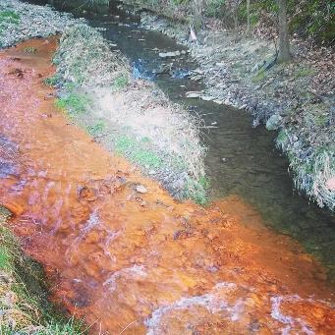
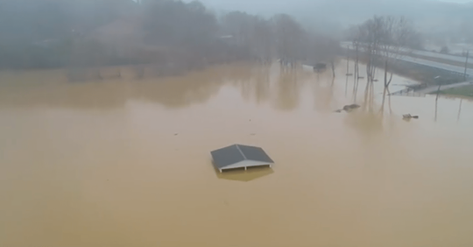

Combining Water Concerns & Interests in Upper North Fork of Kentucky River
Notes:
In order to encourage partner interest and better ensure an inclusive watershed improvement effort Whitesburg, the need to expand to issues of greatest concern in the community was quickly realized.
The local watershed coordinators wisely suggested that outreach include water quality information and assistance related to drinking water and flooding concerns in the community.
By working to address these concerns in conjunction with general water quality improvement of the streams, the overall effort will be more likely to attract and retain local interest and involvement.

Slide 24
6. Conduct Outreach
KENTUCKY WATERSHED ACADEMY
MODULE 6: EFFECTIVE COMMUNICATIONS
Notes:
The last step in this process is conducting the outreach to inform the community about water quality status and issues and gain buy-in with the desired changes or improvements to the watershed. This will be the focus of Module 6: Effective Communications.

Slide 25
Collaborating with Local, State, and Federal Programs
Effective watershed plans will work with other agencies, programs, and initiatives to accomplish goals.
Focus of Module 5: “Likely Partners” is to introduce you to some of these partners and programs.
Notes:
In summary, effective watershed plans involve working with other agencies, programs and initiatives to accomplish water quality goals.
The remainder of the Module 5 presentations will introduce you to many of the Kentucky partners that you may want to engage with.

Slide 26

How do you recruit and maintain volunteers?
Build Relationships
Recruitment Plan
Training
Database and Tracking
Notes:
Since successful watershed projects also include some element of local volunteers for input and putting water quality improvement practices on the ground, we want to quickly discuss volunteer recruitment and maintenance.
The River Network has some fantastic resources on this topic, which we’ve used for this presentation.
In general, the concepts are similar to building partnerships. They involve:
Building Relationships in the community
Recruitment Plans for gaining new volunteers
Training of new volunteers
Database and Tracking of volunteer interests and participation, as well as their contact information and other details

Slide 27
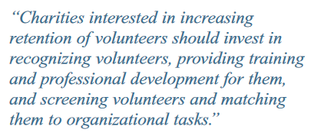




Volunteer Retention Factors
- 2004, The Urban Institute, Volunteer Management Practices and Retention of Volunteers
https://www.nationalservice.gov/pdf/Management_Brief.pdf
Notes:
We want to begin with this statement from a 2004 study by the Urban Institute entitled, “Volunteer Management Practices and Retention of Volunteers.”
After reviewing the practices of several different non-profit organizations that used volunteers, they came to this conclusion:
“Charities interested in increasing retention of volunteers should invest in (1) recognizing volunteers,(2) providing training and professional development for them, and (3) screening volunteers and matching them to organizational tasks. These practices all center on enriching the volunteer experience. Management practices that focus more on the needs of the organization, such as documentation of volunteer numbers and hours, are unrelated to retention of volunteers, even though they help the program to realize other benefits.”
So above all, if you want to attract and maintain volunteers – make sure you recognize them, grow them, and direct them towards suitable tasks.
The report also noted:
“In addition to adopting certain management practices, charities can provide a culture that is welcoming to volunteers, allocate sufficient resources to support them, and enlist volunteers in recruiting other volunteers. All of these practices help charities to achieve higher rates of retention.”
Put simply – if you want volunteers, make sure you provide a fun, rewarding environment for them.

Slide 28
Volunteers in the U.S.
Who volunteers?
By Gender
  26.5% of Men
  33.8% of Women
By Generation
  Generation Z – 26.1%
  Millennials – 28.2%
  Generation X – 36.4%
  Baby Boomers – 30.7%
  Silent/Greatest Generation – 24.8%
Volunteers:
Give at 2x the rate
5x as likely to belong to group
3x as likely to help neighborhood
Source: www.nationalservice.gov, 2020
Notes:
Before we get into recruiting volunteers, let’s learn a little more about this group of people.
The following statistics show the volunteer rates in America for 2019 broken down by gender according to the National Service organization.
About a third of women volunteer, while only about a quarter of men do.
Generation X currently has the highest rates of volunteering, but a pretty wide spectrum is represented.
Those who do volunteer are more likely to be givers (double the rate of non-volunteers). They are 5 times as likely to belong to a group or organization, and 3 times as likely to help someone in the neighborhood as opposed to a non-volunteer.
So, people who volunteer are great resources to have on your team, and sometimes the best way to find them may be to look in related organizations

Slide 29
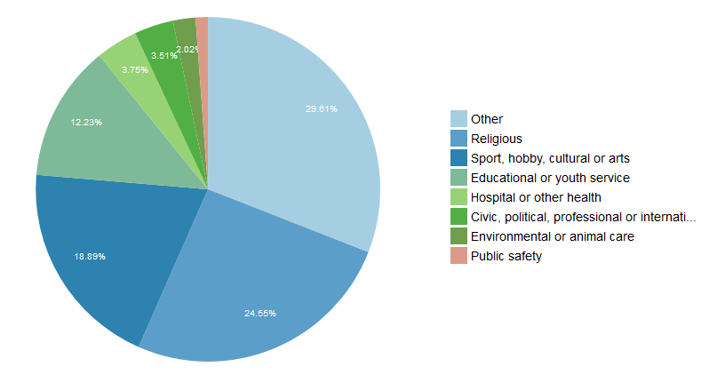
Kentucky Volunteers by Type
Source: www.nationalservice.gov, 2020
Notes:
What sort of volunteers are we talking about?
People in Kentucky volunteer heavily for church activities, sports leagues, and youth education.
Environmental volunteers only account for about 2% of this documented volunteerism category, but there is probably some crossover to the “other” category as well.

Slide 30
Building Relationships
How do you invite people to volunteer?
What are the responsibility levels of your pyramid?
How do you level up or train?
How do you recognize gifts?
Notes:
When you think about volunteering, you are really talking about people giving their time to something they care about. But rather than give their time, some may choose to give financially.
Time and Financial Givers are on a spectrum of support levels. You will probably have a larger number of people who may be willing to give a little time or money based on their awareness or interests, but as volunteers take personal ownership and responsibility, they will likely want to give more.
Thinking through this spectrum is important for your organization. How do you move people along this spectrum from just being aware to feeling personally responsible?
In building relationships with volunteers, you need to think through your initial contact. What is the initial ask? Is a clear vision articulated? Are the tasks clearly outlined? Have you made the project accessible and easy to share? How is your branding? How do most people come in contact with your organization?
Then, how are you incentivizing greater desire to give or advance? Do you offer levels of recognition or greater input into the process with greater giving? Do you provide levels of training to advance? How do you find leadership and provide them with opportunities to grow? What requirements are made of various levels of involvement?
How do you go about recognizing your donors or most involved volunteers?
All of these questions are focused on building relationships over time as interest and commitment grows.

Slide 31

Recruitment Plan
Research / survey motivations
Define target groups and audience
Determine strategies and media for each target group
Detail who, what, when, where, why, how for each strategy
Create a calendar and budget
Create a tracking system
Notes:
In order to recruit additional volunteers, it is important to have a good sense of the drivers behind their interest in contributing – of either time or money.
(CLICK) You need to start by understanding your audience. There may be some market-based research in the literature, or you made need to develop surveys of your current volunteers or likely audience. Either way the goal is to understand the motivations for participation.
(CLICK) Based on this research, you can then devise the best strategies to reach each target group or audience. For instance, certain social media platforms may work best for a younger audience, or recreational groups may have a common meeting place where outreach could be conducted. Think marinas for boaters and anglers, or feed stores for farmers, or the library for school-age children.
(CLICK) For each strategy, a comprehensive detail of who, what, when, where, and why should be worked out as an annual plan complete with a calendar and accompanying budget.
(CLICK) And, a system, such as a simple spreadsheet or database, should be used to track when activities are completed and help understand what approaches are working or not.
These plans can then be evaluated on an annual basis to see what improvements need to be made.

Slide 32
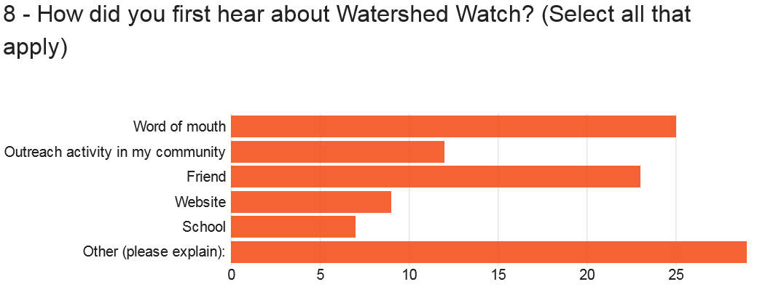
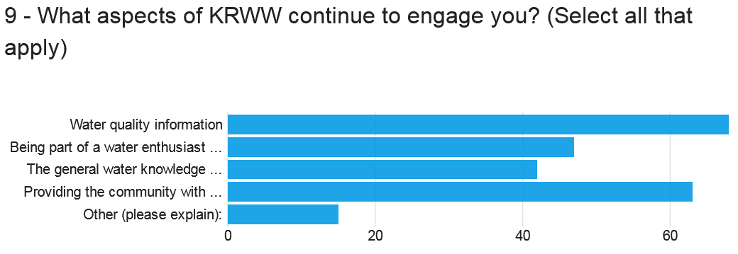
Example: Kentucky River Watershed Watch
Notes:
As an example, we can look at the results of this survey used in 2018 to gage motivations and outreach strategies for participation in the citizen sampling organization, Kentucky River Watershed Watch.
You can see that word-of-mouth and friends were cited as common ways to find out about Watershed Watch, but there were many who selected the Other category. Some of these related to articles in newspapers, work-related sources, or through participation in similar non-profit organizations.
The water quality information gained through sampling participation and the ability to provide it to their communities were the major drivers behind their continuing engagement.

Slide 33

Training
Reinforce the mission
Make it fun – FOOD HELPS!
Communicate professionalism
Have a clear description of tasks and materials
Include interaction and group activities
Ask for feedback
Encourage networking
Tell stories and share successes
Notes:
For volunteer training, remember that these training sessions will form a strong impression as to the type of effort you are managing.
Make sure you use these sessions to concisely reinforce the mission of your organization in a FUN, PROFESSIONAL environment. Having food and refreshments always help make the atmosphere a little more casual and festive.
Make sure that all tasks are very clearly described and that all materials necessary are available.
Be sure to include time for interaction and group activities. Volunteering with others is what makes it worthwhile, so training should be interactive and social.
Be sure to get feedback before and after the workshop in order to know what you did well and what could be changed.
Also, some people will volunteer solely for the professional networking opportunities, so be sure to provide plenty of time for such activities (don’t over script).
Finally, don’t forget to inject energy and hope by relaying successes and personal stories. This builds enthusiasm and relationships.

Slide 34
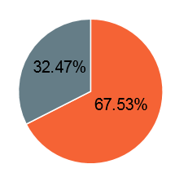

Example: Kentucky River Watershed Watch
Kentucky River Watershed Watch is interested in gauging our samplers' interest in new opportunities and new formats for collecting data.
Would you be interested in conducting more frequent community-focused monitoring in order to characterize a specific watershed?
Notes:
Additional questions on the Watershed Watch survey inquired about participant interest in further levels of participation. This question asks if samplers would be interested in conducting more intensive sampling to better characterize their watersheds. The majority were interested in stepping up to this level of engagement.

Slide 35
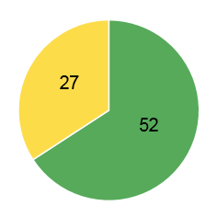

Example: Kentucky River Watershed Watch
A Master Sampler Program offers additional training to enable sampling results to be adequate for consideration and use by scientific researchers and regulatory agencies.
If a Master Sampler Program was available would you be interested in pursuing it?
Notes:
Another question asked about willingness to participate in a Master Sampler program, requiring additional training, but enabling sampling results to be considered by regulatory agencies and scientific researchers. Again, the majority of respondents expressed interest in this option.

Slide 36

Database
Simple tracking forms
  Sign-in sheet with contact info
  Time in / time out
  Monthly log
  Waivers
Estimates of hours and individuals
Central database can save time
Useful for grant match
Notes:
Finally, it is important to have some sort of system to track engagement, contact info, and time.
Often, sign-in sheets with hours of participation are necessary for tracking “in-kind” match for grants, but these forms can also help you keep up with contacts and reward strong volunteers.
Simple forms in conjunction with spreadsheets will go a long way, but in some cases, more formalized central databases may be necessary.
If you use a combination of paper and electronic forms – make sure the information matches and goes to the same place.

Slide 37
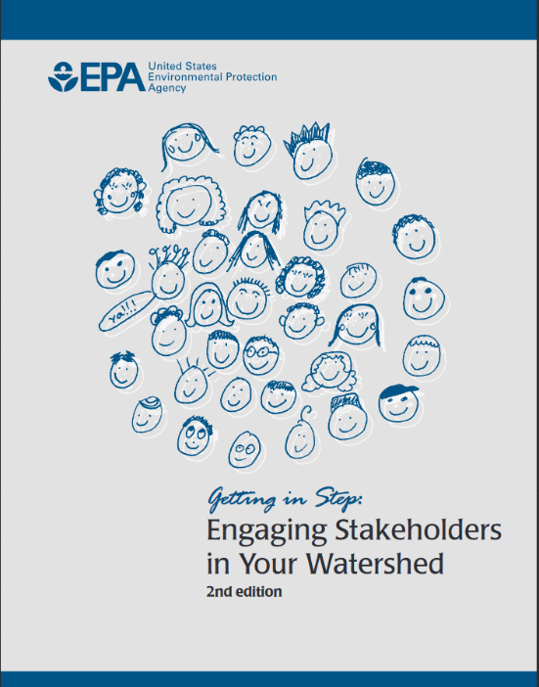
References
EPA: Engaging Stakeholders in Your Watershed (2013)
  cfpub.epa.gov/npstbx/files/stakeholderguide.pdf
River Network
  www.rivernetwork.org/connect-learn/resources/
EPA Handbook for Developing Watershed Plans to Restore and Protect Our Waters (2008)
Notes:
Here are some of the resources that were used in developing this presentation and which may be helpful for additional information.
Next, we will move on to explanations of local and regional partners that will be helpful in your watershed management pursuits.

