Slide 1
Watershed Academy
Watershed Coordinator Training Series
Module 6: Effective Communications
4. Step 2 – Target Audience
Notes:
Welcome

Slide 2
Developing a Watershed Outreach Campaign
STEP 1: Define the driving forces, goals, and objectives
STEP 2: Identify and analyze the target audience
STEP 3: Create the message
STEP 4: Package the message
STEP 5: Distribute the message
STEP 6: Evaluate the outreach campaign
Notes:
During Module 6 of the Watershed Academy “Effective Communications,” we have been progressing through the EPA’s six steps of a watershed outreach campaign.
During this presentation we are going to cover Step 2: Identifying and analyzing the target audience. Of all the steps in the process, this might be the most critical and the most unfamiliar to many of you.

Slide 3
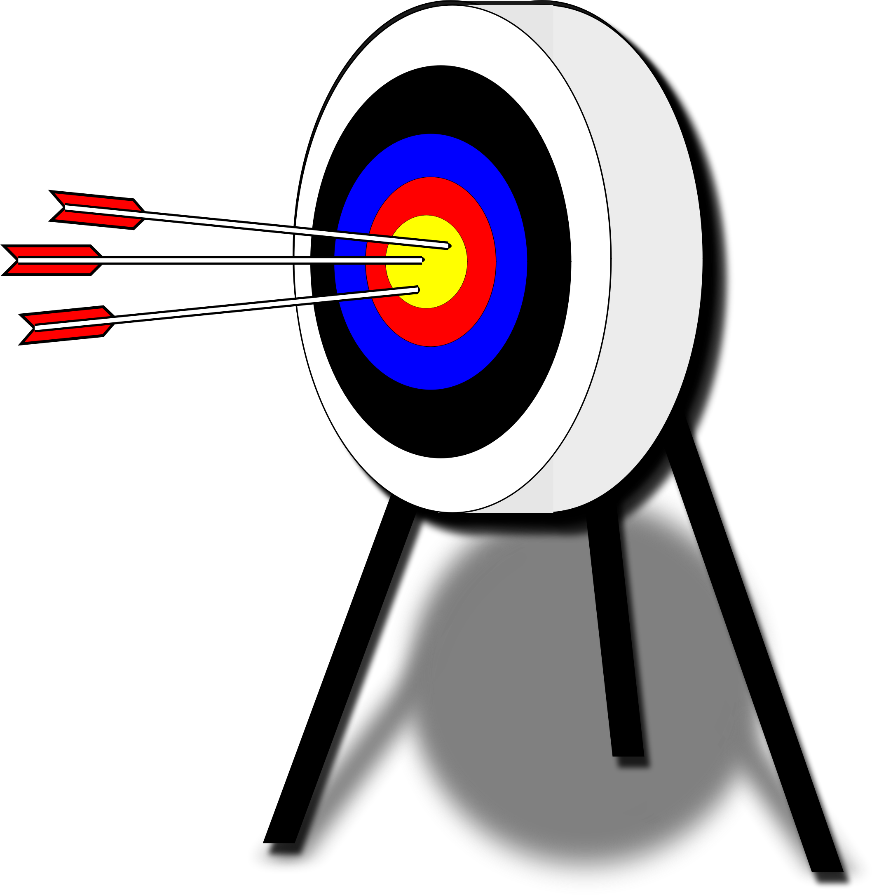
Who do we want to reach?
STEP 2: Identify and Analyze the Target Audience.
Might be obvious, might require research.
General awareness among general audience has limited effectiveness, only first step.
Will want to tailor message to fit segment of community that you wish to reach.
Think of audience as a customer, and you as salesperson.
  Want them to “buy” a behavior or attitude to help achieve your goals.
Notes:
As an overview, we need to figure out who we want to reach to achieve our goals. This is our target audience.
For example, a target audience for increasing streamside vegetation buffers may require identifying property owners along the stream corridor. Neighborhood associations can help promote the need. And, another audience may be local officials who can develop and implement buffer ordinances.
Very generalized outreach and education can help raise general awareness about a water resource, but it is unlikely to result in real changes. It should only serve as a first step in the process. If you are not narrowing your audience, your awareness message could be ineffective or even counter-productive.
You want to break down the target audience(s) into the most specific segments possible to receive a unified message and tailor your message in a way that resonates with those segments.
In this way, you are similar to a salesperson who is trying to convince your specific audience to buy into attitudes or behaviors that will help satisfy their needs as well as yours. Think about what’s in it for them? By figuring out what is important to the targeted audience, you can craft a message that is most effective.

Slide 4
Identifying & Analyzing the Target Audience
Consider potential audience
Select the target audience
Describe the target audience characteristics
Determine additional information needed
Describe current behaviors, knowledge, attitudes, and perceptions
Identify barriers and facilitators
Consider further segmentation of the audience.
Develop an audience profile
Complete behavior selection matrix
Audience
Farmers
Homeowners
Elected Officials
Notes:
The process of identifying and analyzing the target audience has 9 steps, listed here (Read them).
Step 4: Determining additional information, could be placed after steps 5 or 6, but the idea is to make sure you are keeping an running list.
(Click) It is important to keep in mind from the beginning that as you are learning more about your audience, you might find that only a specific segment of your original target audience is where you need to focus. Therefore, in Step 7 (or prior), you might need to refocus the process on this audience and clarify your previous work.

Slide 5
Identifying & Analyzing the Target Audience
Consider potential audience
Select the target audience
Describe the target audience characteristics
Determine additional information needed
Describe current behaviors, knowledge, attitudes, and perceptions
Identify barriers and facilitators
Consider further segmentation of the audience.
Develop an audience profile
Complete behavior selection matrix
Selecting Target Audience Form
Describe Target Audience Form
Identifying and Removing Barrier Form
Behavior Selection Matrix Form
Notes:
We also want to note that we have tried to facilitate this process by providing worksheets to help guide you through the process. There are 4 worksheets provided in the Excel workbook, that help cover these steps.

Slide 6

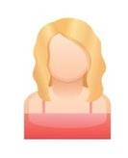

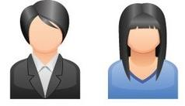

1. Consider Potential Audience
Stakeholders affect or are affected by implementation:
“We make decisions”
“Your decisions affect us”
“We can make it easy or difficult”
Notes:
In Module 5, we discussed the difference between stakeholders and partners.
A stakeholder is anyone who may help with implementation of watershed improvement or protection actions or is affected by them.
This can include decision-makers, residents or businesses in the area, individuals or organizations that can create roadblocks or smooth the road to success, or local historians or others who have information to contribute.

Slide 7
1. Consider Potential Audience
Potential Wider Audience
Key-Decision Maker Audiences
Affected Audiences
Roadblockers and Facilitators
Be thorough and document on
Selecting Target Audience Form
Notes:
For the sake of finding our target audience, it helps to clarify who the audience is as a whole. Before we narrow in one one group, we want to begin by taking the wide-angle view and listing out the potential audiences.
(Click) It is important to be thorough when considering potential audiences. Selecting a target audience is not intended to be exclusionary or divisive. Rather, it is intended to help focus on how to obtain the greatest change for a specific issue.

Slide 8
Target Audience Form
Affected Audiences
Roadblockers and Facilitators
Key-Decision Maker Audiences
Target Audience
Why?
Notes:
Here is an overview of the form in your spreadsheet workbook.

Slide 9
Target Audience Groupings
Geographic area
  School districts, neighborhoods, land use, ZIP Code, stream landowners, etc.
Demographics
  Gender, age, ethnicity, income, recreational activity, organizational affiliations, landowner-type, etc.
Occupation
  County magistrates, developers, cattle farmers, landscapers, golf course managers, etc.
Attitude and Behaviors
  Dog owners who don’t pick up, litterbugs, over-fertilizers, farmers who plant or graze in riparian zones, etc.
Notes:
Targeted audiences can be grouped in several different ways depending on your objectives.
As a starting point, consider grouping by:
Geographic Area
Demographics
Occupation
Behavior Patterns
We will cover this more in depth later when we characterize the audience, but right now you are just trying to describe the full extent of the world of the issue of concern.

Slide 10
2. Select the Target Audience
Screening Questions
IMPACTED: Who is most affected?
SIZE: How many people are in the audience?
CRITICALITY: How critical is the audience's change in behavior?
SUCCESS: How likely is the change?
POWER: Who controls the behavior or resources required for change?
Select target and explain why.
Notes:
Once you have thoroughly documented the potential audiences, you want to think through some screening questions to help you identify were to focus. Different audiences might be highlighted in each of these questions, but taking the answers of the screening questions as a whole, this can help you to identify where to focus your time.

Slide 11
EXAMPLE
Objective: Prevent the reoccurring flooding in the Shady Acres neighborhood
Key-Decision Maker Audiences
Affected Audiences
Roadblockers and Facilitators
Mayor, City Council Member, City Engineer / Stormwater Dept, Planning and Zoning, Impervious surface owners, Flooded homeowners
Homeowners, city maintenance crews, drivers on local roads, real estate agents, insurance agencies, road crews, upstream businesses/ landowners (runoff), downstream streamside owners (erosion), HOAs / neighborhood associations, emergency services …
Stormwater engineers, developers, neighborhood associations, FEMA / NFI coordinator, grants to purchase homes or property for BMPs, businesses willing to reduce imperviousness
Notes:
Here is an example for an objective for preventing the neighborhood flooding.
In the chat, take a few moments to record some ideas about answers for each of these categories.
Here are our ideas….

Slide 12
EXAMPLE
Objective: Prevent the reoccurring flooding in the Shady Acres neighborhood
IMPACTED:
SIZE:
CRITICALITY:
SUCCESS:
POWER:
Target:
60 households being flooded
Everyone upstream is larger audience. As would be the owners. City officials much smaller.
Critical to either reduce runoff (upstream), increase detention (upstream), or purchase and remove impacted homes (in area). City officials critical to all. Upstream landowners or flooded homes next most critical
Depends on amount of water to reduce, but engineering model to estimate. City funded project more likely than individual owner actions.
Mayor, city engineer, or magistrate
City Officials (1st), Flooded Homeowners (2nd), Upstream Large Impervious Area Owners (3rd)
Notes:
Now think through how you would answer these questions:
(Go through each one by one with chat interaction).
In the end, you would probably want to target the City officials first. However, if they are already aware of the issues but not willing to take action, you might want to bring together the homeowners to advocate for the problem. Lastly, if they are not able to gain traction and develop a grant or project to fix the flooding issues, then perhaps the next step would be to approach the upstream owners of large impervious surface areas and see if they might be willing to implement projects to reduce their stormwater runoff quantities or install detention basins.

Slide 13
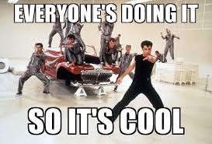
Social Norms
Everyone’s Doing It (or not)!
Social Norms – the standards of attitude and behavior that are perceived as normal, accepted, and expected among members of a community
  Establishing new norms
  via critical mass
Notes:
When thinking about targeting audiences, one consideration should be the social norms of the audience.
Social norms are the standards of behavior and attitudes that are considered normal, accepted, and expected in a community.
When trying to change social norms, it is important to know where to start and how to gain a critical mass.

Slide 14
So, who to target?
Concept of Social Diffusion – when a new idea of behavior is adopted by 15 to 20% of an audience, it has the critical mass to spread on its own.
Innovators (risk takers)
  Adventuresome, educated, high social status, upwardly mobile.
Early Adopters (decisive)
  Right behind the innovators.
Early Majority (cautious)
  Deliberate, information seekers. Want to see results first.
Late Majority (skeptical)
  Largest segment, resist change, conservative
Laggards (good luck!)
  Most resistant to change. Very set in their ways.
FOCUS HERE
NOT HERE
Notes:
In deciding which segment of your audience to target, you should think about the concept of Social Diffusion, which states that once a new behavior or idea is adopted by 15 to 20% of an audience, it then has the critical acceptance to spreading through the remainder of the audience.
This theory was developed by Dr. Everett Rogers following 30 years of research assesses 5 categories of people within an audience that generally adopt new behaviors in sequential stages and at fairly predictable rates: 1) Innovators; 2) Early Adopters; 3) Early Majority; 4) Late Majority; and 5) Laggards. This theory was also popularized by Malcom Gladwell’s “Tipping Points” which shows how it can apply to pandemics, crime, fashion trends, and other widely differing issues.
By identifying which categories the members of your audience might fall into, you can better understand when and how to motivate them.
Many outreach campaigns fail because organizers believe they need to focus heavily on targeting the late majority and laggard segments of the audience since those segments encompass the greatest number of people. However, those segments are the hardest people to reach and hardest to convince that they should change their behavior. People in these categories will not even consider changing until the idea has become well accepted by a solid majority of the target audience.
Focus instead on “preaching to the choir” with the innovators and early adopters. Once you’ve successfully reached these people, they can help spread the word through their own circles and reach people in the other categories. (EPA Watershed Academy)
You also want to be aware of Connectors (people who are strong, diverse, social networkers) and Mavens (Information accumulators for the purpose of distribution – who spread information for the joy of it). These individuals can help connect you to the right people and provide you with the right type of information for your projects.

Slide 15
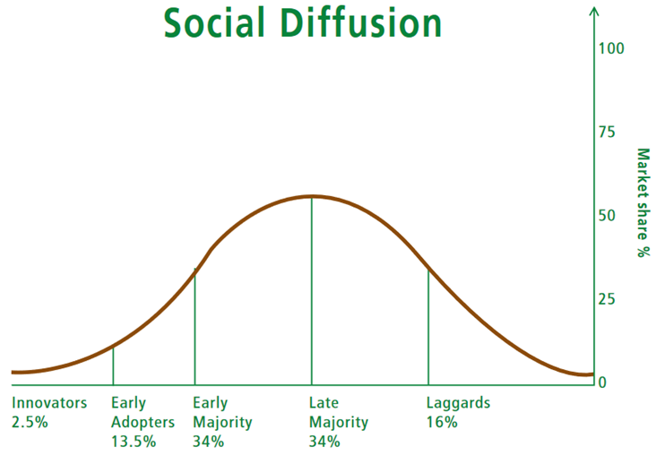
Audience Composition by Social Diffusion Category
50%
Notes:
Innovators and Early Adopters typically make up about 16% of an audience, so you are almost to the tipping point for message spread if you can convince those two categories of people.
If you can continue the message spread to the early majority, you are potentially able to reach and sway 50% of your audience with your messaging! According to the theory of social diffusion, the rest will come slowly with time.

Slide 16

Case Study: The Lush Lawn
Notes:
Often, especially in the eastern U.S., a lush lawn is seen as desirable and there is some social pressure to maintain a well-kept, green expanse of grass on your property.
If you see others in your neighborhood using a lawn care company to fertilize their or grass or personally fertilizing their lawn, there may be social pressure to do the same.
It may be that the homeowners are not aware of the potential impacts to water quality from heavy nutrient runoff when fertilizers or overapplied or applied just before a rain event.
Find out where the audience gets their info about lawn care? It’s likely to be the local lawn and garden stores, or neighbors, friends or family.
So, what potential audiences may you need to reach?
Homeowners
Neighborhood associations
Local lawn and garden stores
Lawncare companies
Municipal planners or state legislators (for potential fertilizer ban)
Local garden clubs
Other idea?

Slide 17
3. Describe the target audience characteristics
Socio-Demographic | Geographic | Psychographic | Communication Channels | Other Opportunities
Gender, age, education, occupation, income, education, family size, language, ethnicity, religion | Region, district, city, urban, rural, subdivision, land use, zoning | Personality, attitudes, concerns, beliefs, interests, values, emotions, opinions, lifestyle | Preferred media, Frequency of use, Use for general, environmental, or intra-audience communication | Where do they spend time, what activities are they already engaged in, what events
Adapted from:
Breakthrough-ACTION at John Hopkins University. “How-to-Guide: How to Do an Audience Analysis.” www.thecompassforsbc.org
Notes:
In order to develop an effective messages that connects with an audience, you need to do some sleuthing to figure out what they think about the issue and what messages might engage and motivate them. Remember, we are selling our watershed customers a product! This product could be environmental awareness to start with, then organization membership, help with a stream restoration project, a voluntary behavior change, or something else.
One category to evaluate is Socio-demographics, which helps you define the socioeconomic makeup of the target audience. This information will allow you to think about appropriate messaging and how individuals may be able to engage and participate. If the area includes mainly retired persons, they may be more available for daytime activities and have the freedom to volunteer.
Another category to consider is the Geographic distribution of audience members with regard to watershed issues. Is the population all within one or more specific neighborhoods? Is it only a specific zoning type? These details can help identify methods to connect them that might not otherwise be apparent.
Investigations to understand the Attitudes, Beliefs and Perceptions (or Psychographic factors) will help you link the watershed issues with the audience’s concerns. If they don’t see the issue as a concern or don’t understand how it affects an environmental value, you may need to step in and help make those connections. And, if your organization is not perceived favorably by the target audience, you may need an intermediary to help convey your message. You need to understand some of their key values and interests. You’d probably approach a hobby farmer different from a full-time professional farmer. Think of unique behaviors or interests that help focus the audience.
By figuring out ways that your audience gets their information, you can develop, format, and distribute your message. Are there local newsletters or newspapers that people pay attention to? Is there an electronic message board service that people pass or see in businesses? Do people tune into a local radio station? Should you use airplane banners?? Ok, that’s probably not realistic… Its as important to know who they don’t trust as it is to known who they do.
Then there’s the piggy backing opportunities based on other known factors. You want to the nitty-gritty of social dynamics and relationships to help you figure out how best to communicate. Who talks to whom? Who are the influential decision-makers and leaders? Understanding community culture will help you avoid blunders and connect with the “cool kids” (leaders).
Now, at this point, we might be going into shock or feeling overwhelm because you don’t know a lot of this information. That’s ok. Many outreach campaigns are structured on an ad hoc basis, seizing upon low hanging fruit. What is important is that you begin to make a list of what you need to know and explore ways to collect it.

Slide 18
3. Describe the target audience characteristics
Socio-Demographic | Geographic | Psychographic | Communication Channels | Other Opportunities
Gender, age, education, occupation, income, education, family size, language, ethnicity, religion | Region, district, city, urban, rural, subdivision, land use, zoning | Personality, attitudes, concerns, beliefs, interests, values, emotions, opinions, lifestyle | Preferred media, Frequency of use, Use for general, environmental, or intra-audience communication | Where do they spend time, what activities are they already engaged in, what events
Census data (EJ Screen Mapper) | GIS analysis, PVA data, planning and zoning, member orgs | Social surveys, media reports, literature, local health depts, member orgs | Media reports, social surveys | Direct observation, surveys, member orgs.
Notes:
Here are some places where you can begin to find this information. These tools will depend on your audience composition and your available time and money. First, you can try checking with similar organizations and see what they might be able to share about their information sources.
This slide provides a listing of possible info sources. Don’t worry about the need to use all of them—any info on the audience is helpful to strengthening the success of your campaign.
Demographic databases, such as the U.S. Census Bureau’s, contain all kinds of info on the makeup of potential audiences. If you want help, consider asking a college marketing or other related class for help as a real-world project for them to pursue. We’ll show a tool to help access that data quickly in a few slides. The census data has its limits (particularly due to how some tracts are drawn) so it should be ground-truthed, but it is nonetheless an essential source.
Local public agencies, such as the Property Valuation Agencies (PVA) and planning departments, can also be valuable sources of information. Health departments may be able to offer insights and details about onsite wastewater (septic) system use and problem areas. Be sure to give plenty of lead time for these efforts and keep information confidential to preserve your reputation and credibility.
Trade associations may be able to provide info on your target audience and also serve as a conduit for delivering your message. For example, if you want to find out which dry cleaners use eco-friendly processes, you may want to reach out to an associated trade group to see if they can help. Your local Chamber of Commerce may also be a helpful resource to find info about local businesses and the demographics of the community.

Slide 19
3. Describe the target audience characteristics
Notes:
Here is the section of the worksheet where you can summarize this information. Note that you just need to have some bullet point. Make sure to keep track of the source for your information for later reference.

Slide 20
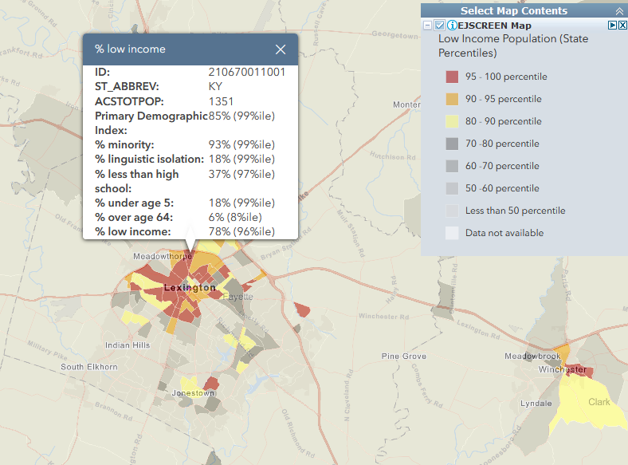
Census Data (via EJSCREEN Mapper)
EPA’s Environmental Justice Screening and Mapping Tool
https://ejscreen.epa.gov/mapper/
Can “Add maps” with different census layers, as well as environmental layers.
Click the tracts to get quick insights.
Notes:
We noted briefly that Census data is a great source of information about your audience. One of the easiest ways to quickly extract this information at a tract level is through the EPA’s Environmental Justice Screening and Mapping Tool.
You can add maps with all sorts of census data overlays as well as different environmental layers. By click on an individual tract you can get a quick picture of what is going on in that area.
In this instance, we have color coded low income populations around Lexington, and you can see some of the summary statistics to identify vulnerable populations that are shown by clicking on a tract.
If you are looking for county level data, the CEDIK Community Assessments may also be helpful to you.

Slide 21

Kentucky Environmental Knowledge and Attitudes
Kentucky Environmental Education Commission
Survey of environmental knowledge, attitudes, and behaviors
https://keec.ky.gov/Publications/Pages/MasterPlan.aspx
Notes:
For some general ideas about the perceptions of Kentuckians towards the environment, the KEEC conducted a 2014 of Kentuckian’s Knowledge, Attitudes, and Behaviors. You can access this information through their website under the 2015 Land, Legacy, and Learning IV report.
This might give you a starting place for conducting studies of your audience or a comparison point for your group as opposed to the state as a whole.

Slide 22


4. Determine Additional Information Needed
List data needs
How to collect (future presentation)
  Surveys (Mail, Phone, Email/Internet, Personal)
  Interviews / Focus Groups
  Community/Neighborhood Forum
  Direct Observation
  Community cultural assessment and characterization
How to track success over time (Step 6)
Notes:
As we mentioned – don’t panic about what you do not know. Start making a list and a plan to collect that information. Now this step should be conducted after Steps 5 and 6 as well, but it makes sense to pause here.
There is a lot of potential with surveys and lots of options for ways to conduct them—by mail, phone, e-mail/internet forms and in person. Surveys can also be used as a way to measure success after a project by measuring changes in attitudes or behaviors. In a future presentation, we are going to cover some basics of performing surveys to delve more deeply into how to develop different social research tools.
This includes focus groups. Focus groups provide an opportunity to meet directly with members of the target audience and get more in-depth insights and feedback. Be sure to accommodate focus group participants with the timing and location that is most convenient for them. An outside moderator is helpful to ensure that you don’t introduce bias and influence the discussion.
Similar to focus groups, you can arrange informal discussions with neighborhood or community groups to gather information. These are more open-ended, can involve more people and are a little more casual. Many homeowner associations have regular meetings and may be willing to give you some time to speak during their meetings. These may also be a good time to pass out surveys that attendees can fill out and return, or you can provide the internet link to an online survey you have developed.
Observing what people actually do, as opposed to what they say they do is a good way to discover true behaviors. However, it needs to be done in a public way that is not perceived as an invasion of privacy. Peeking in windows and hiding out in stream buffers are not advised!
A more thorough approach to understanding the target audience is a Cultural Assessment and Community Characterization. This approach is useful if you are new to an area, there is no baseline information to work with, or previous efforts to reach and motivate an audience have failed. The EPA’s “Community Culture and the Environment: A guide to Understanding a Sense of Place” provides more detailed information on conducting these assessments that go a step further to analyze the cultural and ethnic preferences, beliefs and attitudes in a community.
You probably also want to begin thinking about how to track changes in the audience over time due to outreach efforts. We will touch on that more in Step 6: Evaluations.

Slide 23
Wisconsin, 15-Target Audience Study
Outreach Themes:
The Audience
Message Content
Message Vehicle Delivery
Outreach Strategy
Public Participation
Supporting and motivating professionals
Evaluation
Education for:
Individuals, Groups, Web, Community, and Beyond the Community
Extracts: Recreational Water Users
Don’t use representative stakeholders – do direct surveys and interviews.
Attend to age, education, gender, income as it relates to participation in outdoor activities
Attend to engagement in environmental behavior rather than attitudes about environment
Much more…
University of Wisconsin, Environmental Resources Center. 2006. Outreach That Makes a Difference: Target Audiences for Water Education –A Research Meta-Analysis.
https://fyi.extension.wisc.edu/wateroutreach/
Notes:
There are also a number of resources out there that have done some of the legwork for a given audience. For instance, the University of Wisconsin Extension Service has a lot of great content on how to change behavior and conduct outreach and education campaigns. Their publication “Outreach that Makes a Difference” describes 15 different audiences and gives research support ways to engage and educate in different scenarios.
For example, in dealing with the target audience of “recreational water users,” they recommend not using representative stakeholders because the interests can vary so much depending on the age, education, gender, and income level of the users. They recommend doing direct surveys and interviews and engaging them while they are participating in the activities. These are just a few of the audience related insights compiled there.

Slide 24
Some factors positively influencing BMP adoption by farmers
Information:
  Timely access to technical information
  In-person information dissemination
Financial:
  Incentives, Subsidies, or Loans
Norms:
  Social conformity and neighbors
  Encouragement of friends / family / ag agencies
Demographics:
  Family member planning to take over
  Higher caste or income
Risk and Time
  Conservation risk tolerance
  Positive time preference
Environmental Consciousness
  Awareness of impacts
  Environmental stewardship intentions
Characteristics of Farms
  Communication between renter and owner
  Access to labor
Liu, T., Bruins, R., & Heberling, M. T. (2018). Factors Influencing Farmers' Adoption of Best Management Practices: A Review and Synthesis. Sustainability, 10(2), 432. https://doi.org/10.3390/su10020432/
Notes:
Here is an example of a literature survey of some general factors that positively influence BMP adoption by farmers. This study provides a literature review of studies associated with farmers and this is just a subset of the data they compiled. It is intended to give you an idea of some of kinds of bullet items you might gather for your specific audience. You could build upon this data for specific farmers in your area.

Slide 25

YOU TRY!
For your target audience:
Fill out the information you know about key sociographic, geographic, and psychographic variables as well as communication channels and other opportunities.
Don’t be concerned if you don’t know much. Begin to think of how you might collect this data
Notes:
Now it is your turn to get started.
Let’s take a 5 minutes for each of you to work through your target audience form individually and then you can discuss in small groups what you know and what sort of information you might need. Begin to make a list of some additional information you need and share common issues.
Then we can group back together and discuss some of your findings and answer some questions.

Slide 26

5. Describe current behaviors, knowledge, attitudes, and perceptions
What water quality-related activities do they currently engage in and why?
What is the knowledge base of the audience on watershed issues?
At what stage of change is the audience in?
Do they think there is a problem and if so, who is responsible?
What is their view of your organization?
Notes:
For the next step, we wanted to break out some of the specific questions related to the water quality. These are going to be more locally specific, so you might need to do surveys to determine these answers or interview local organizations or community members.
These questions will help you to determine where the audience is on the spectrum of awareness and implementation and whether or not you are the organization that needs to be taking the lead in communicating.

Slide 27
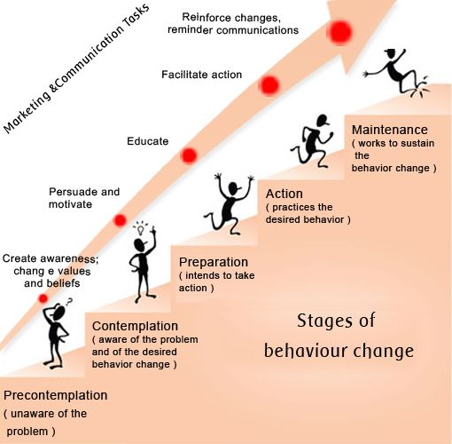
Stages of Change
Precontemplation
  Awareness
Contemplation
  Motivation
Preparation
  Education
Action
  Facilitation
Maintenance
  Reminders
Notes:
You may have been wondering what the “Stage of Change” meant. This refers back to the Theory of Stages of Behavior Change. Depending upon what stage of behavior change the audience is in, you will engage in different strategies. For each “step” in the behavior change, the corresponding strategy indicates how to move them to the next step.
So if folks are unaware of a problem, then an awareness campaign is called for. However, if they are already aware, then you may need to focus on motivating. For those that are prepared to take action, then they will need education of the specifics. Those that are acting may need help to make progress, and finally those that have adopted the behavior may need reminders to keep on doing so.

Slide 28
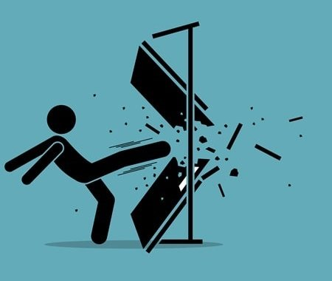

6. Identify barriers and facilitators
What are the Barriers to Action?
  Knowledge: Unaware?
  Physical: Too inconvenient?
  Economic: Too expensive?
  Social: Social unacceptable?
  Psychological: What’s the point? Not going to matter.
(Use form to help think through these.)
Who can make the change easier
(facilitator)?
Notes:
The next step in the process is to consider the barriers to change that might be in place as well as facilitators who might make change easier.
There are many reasons that Barriers to Action for more sustainable behaviors may exist:
They may unaware of the impacts of current behaviors on water quality.
They might think that the more sustainable behavior is too inconvenient, costs too much, takes too long, or is socially unacceptable.
They might think that their personal change in behavior can’t have an impact.
It is important to figure out how to minimize or remove these barriers so that the perceived benefit outweighs the cost or extra effort involved.
We provided you with a more detailed form to think through the barriers in a series of questions, with the goal of adding to your target audience characterization form.

Slide 29
Barriers Form
Checklist of questions to think through various types of barriers
Notes:
This shows the workbook you can use to think through barriers.

Slide 30
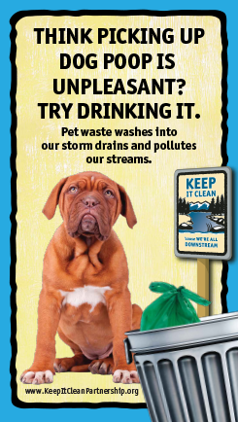
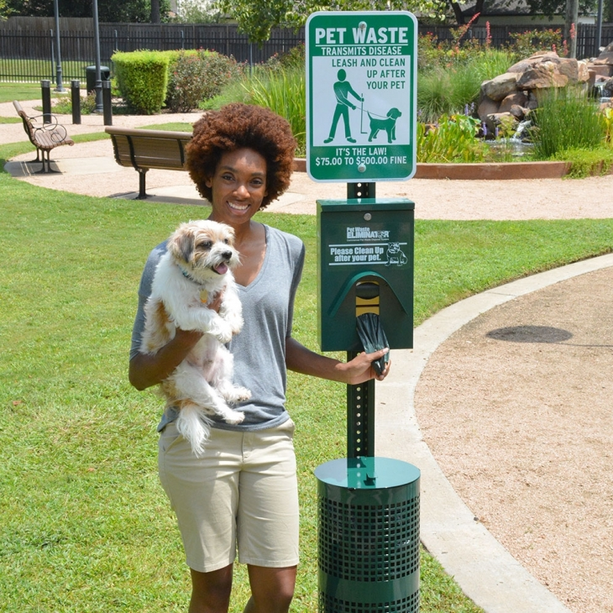
Barrier Case Study: Pet Waste Pickup
Petwasteeliminator.com
Notes:
Pet waste is a great case study of barriers to action and efforts to overcome them.
Many people do not pick up their pets. What do you think are the barriers to action?
It’s gross! Don’t have time to deal with it!
It’s part of nature and will biodegrade quickly.
It’s fertilizer for the grass.
Nobody will notice if you don’t pick it up.
They are unaware that it’s a major pollutant contributor to streams—each gram of dog poop contains over 20 million E. coli bacteria colonies, plus nitrogen and phosphorus.
Educational campaigns have attempted to help overcome the awareness barrier and handy pet waste stations make it easier and less unappealing.

Slide 31
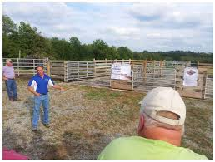
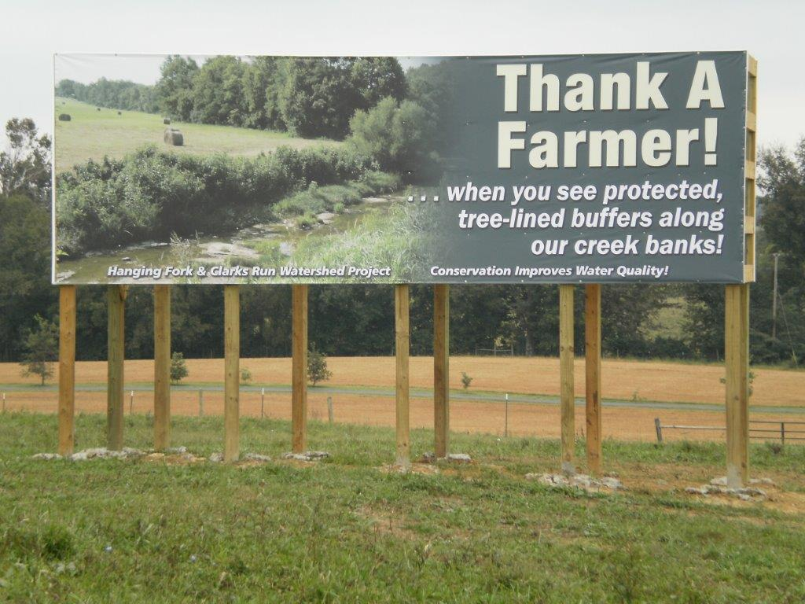
Case Study: Farm Demonstration Days
Notes:
In the case of farming, what are the barriers to implementing BMPs?
Cost
Time
Labor
Social norms
How to dispel those barriers?
Farm demonstration days to better acquaint farmers with conservation practices and the potential cost, labor and time benefits are a great option.
And, appreciative signage (as in this example from Hanging Fork Watershed) is a good way to start adjusting the social norm toward acceptance.

Slide 32
8. Develop an audience profile
Profile
  Quantitative
  Data collected on audiences
  What and why and demographics
Persona
  Qualitative but accurate representations
  Fictional characters based on data, structured role-play
  Vivid detail to help understand needs, motivations, behaviors, and context
  Validated be based on interviews and correspondence
Notes:
As we approach the end of our target audience characterization process, it is good to develop an audience profile.
There are two different types of summaries, and we will provide examples of each.
For a profile, you will want quantitative data collected on audience and information that answers questions about what (responding to a variable), why (do they act that way), and who (demographics).
The second audience summary is called a persona. This is a qualitative summary based on interviews and correspondence with the audience or organizations that commonly work with them. This is not about statistics but developing an informed composite characterization in vivid detail in order to picture who you are trying to communicate with. Obviously you want to be careful of bias here, so developing this persona based on community interactions is important.

Slide 33
Floridians Who Use Irrigation Online Survey
Online survey:
1,063 respondents who use irrigation and can control landscaping decisions.
Evaluated:
Florida environmental issues
Irrigation water source
HOA Status
Current conservation behaviors
Likelihood of engaging in future practices
Familiarity with water-related programs
Importance of plentiful clean water
Confidence in water safety and availability
Interactions with Extension
Political beliefs
Demographics
Warner etal. 2015. University of Florida IFAS Extension https://edis.ifas.ufl.edu/wc199
Notes:
For an example of a quantitative PROFILE, the University of Florida Extension service used an online survey of over 1000 respondents to understand how people are irrigating their landscaping to direct conservation efforts.
You can see a list here of the topics that they covered in their survey.

Slide 34
Floridians Who Use Irrigation in Home Landscaping
Descriptors | Water Considerate Majority (45%) | Water Savvy Conservationists (36%) | Unconcerned Water Users (19%)
Normative beliefs, behavior control, and irrigation attitudes. | Moderate | High | Low
Engaged in water conservation practices | Somewhat | Very | Not
Likely to engage in future water conservation | Somewhat | Highly | Unlikely
Perceived importance of clean water | Moderate | High | Low
Perceived importance of plentiful water | Moderate | High | Low
Warner etal. 2016. University of Florida IFAS Extension https://edis.ifas.ufl.edu/wc200
Notes:
Based on the results of the survey, they identified three major audiences: the water considerate majority (45%), the water savvy conservationists (36%), and the unconcerned water users.
They summarized the different variables that caused them to be lumped into these groups. Based on the responses, they decided to target the water considerate majority with the outreach.
So this one used a survey with statistics to develop a profile.

Slide 35
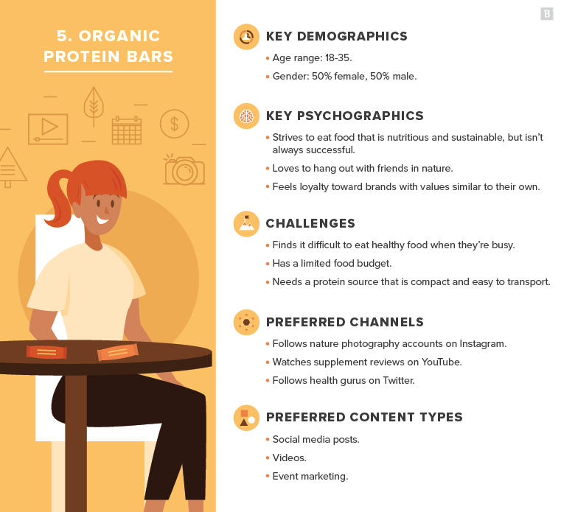
Business audience profile example
Bullet point summary
Example for selling organic protein bars
Source:
www.brafton.com/
Notes:
Here is another example of a profile using bullet points. This example is from marketing organic protein bars, but it gives an idea of how the information is summarized. You’ve got a quick idea what this audience looks like and some ideas on how to communicate with them.

Slide 36

Audience Persona Example
Resource Conservers
They hate waste. Spot them wearing classically styled clothing, toting cloth shopping bags and sipping from reusable water bottles. Avid recyclers of milk jugs and Tide bottles, they drop off old electronics at Best Buy. They read news on-line to save trees, and are quick to re-use their Reynolds wrap. Ever watchful of saving their “drops” and “watts,” they install low-flow showerheads and compact fluorescent bulbs branded with EPA’s Energy Star and WaterSense labels. Shunning over-packaged products, they only turn on the lights when they have to, and they plug their appliances into power strips for easy shut-off when they leave for work.
Jacquelyn Ottman. 2010. A Smart Way to Segment Green Consumers. Harvard Business Review. https://hbr.org/2010/02/a-smart-way-to-segment-green-c
Notes:
This is an example of an audience persona from the Harvard Business Review with the goal of describing the different types of “green consumers” with a goal for selling them products. Notice the vivid descriptions in the persona.
You can really picture this person and have some great ideas about how to relate to them. That’s the goal. Know your audience well enough to be able to give a balanced, accurate description of them for the purposes of aiming your message to the right mark.
If you are going to spend significant money and resources in an outreach campaign, this type of analysis of the audience will make it worthwhile.

Slide 37
9. Complete the behavior selection matrix
Now you should be ready to go back to the Behavior Selection Matrix and score your behaviors (Least Likely 1 to 6 Most Likely)
Highest reduction in pollution?
Most affordable to promote?
Most affordable to adopt?
Most attractive to community?
Easiest to link to problem?
Most sustainable?
Additional water-quality benefits?
Highest consumer response?
Fewest barriers to overcome?
Notes:
At this point in time, you should be able to return to your behavior selection matrix with a fresh set of eyes. You might want to add some additional behaviors because you know the audience better. You are also now ready to make an informed assessment of the audience views on various aspects of the project and so can score the proposed behaviors less subjectively.

Slide 38
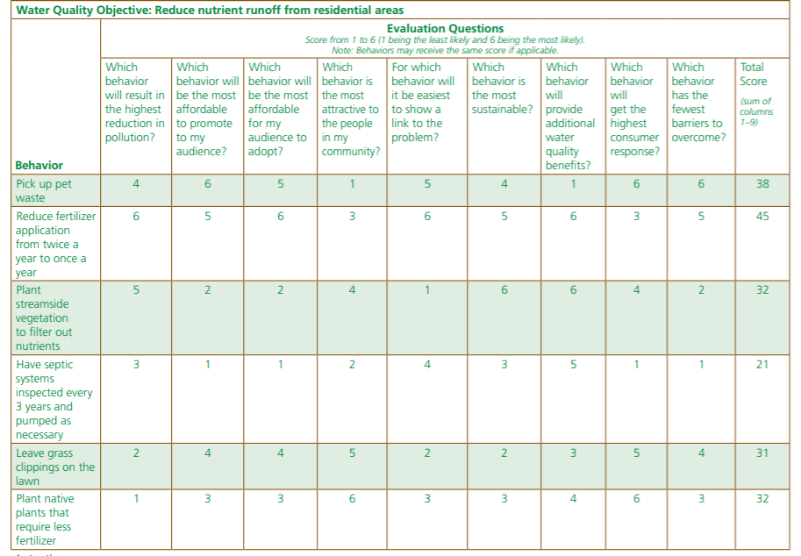
Notes:
Here is an example of a matrix that was created by a group to determine the most effective ways to help reduce nutrient runoff from residential areas. For now we just want to identify some potential behaviors to address an objective. We will not be ready to score these behaviors until we have done the target audience assessment. But this will give you the overall process.
The committee used its research to rate different behaviors based on various considerations, with 1 being least likely and 6 being most likely.
At the top are the questions addressed
Behaviors included: picking up pet waste, reducing fertilizer applications form once to twice/year, planting streamside vegetation, septic system pumpouts, leaving grass clippings on lawn, planting native plants that require less fertilizer.
It was determined that reducing fertilizer applications to one a year would be the more likely and effective measure to encourage.
Guidebook, page 52
We have provided a worksheet that will calculate the total scores automatically to help you perform the behavior selection.

Slide 39
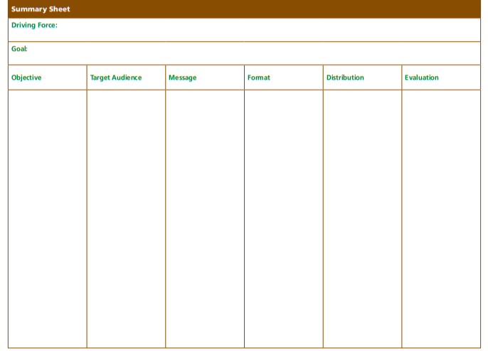
ACTIVITY: Building Blocks Worksheet
Have I defined the audience in a way that separates it from the general public?
How many target audiences or segments do I need?
Have I segmented the audience so that I can develop targeted messages for each subgroup?
Do I understand the target audience? If not, how should I go about that?
Can I identify the opinion leaders or info disseminators in the target audiences?
Notes:
Now, you can fill in the target audience or audiences on the summary form. You will need to do this for each objective, and you might have several different target audiences for a given objective. You can include the descriptions of the target audiences in your report. If an audience is extremely small, you will want to keep the audience descriptions internal for privacy purposes.
Please note, that it will not always take this level of detail and analysis to generate the target audience. Sometimes the audience is apparent and such analysis is overkill. Also, it is often the case that several objectives will utilize the same target audience. Therefore, you might end up with just a few key target audiences for your watershed plan.
At this time, we will take questions or comments.

