Slide 1
Watershed Academy Watershed Coordinator Training Series
Land Use Impacts &
Related Best Management Practices
6. Forestry BMPs

Slide 2
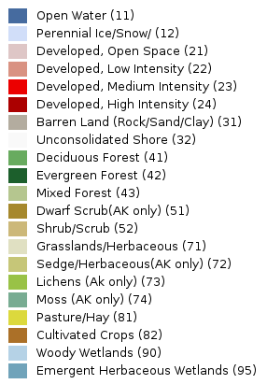
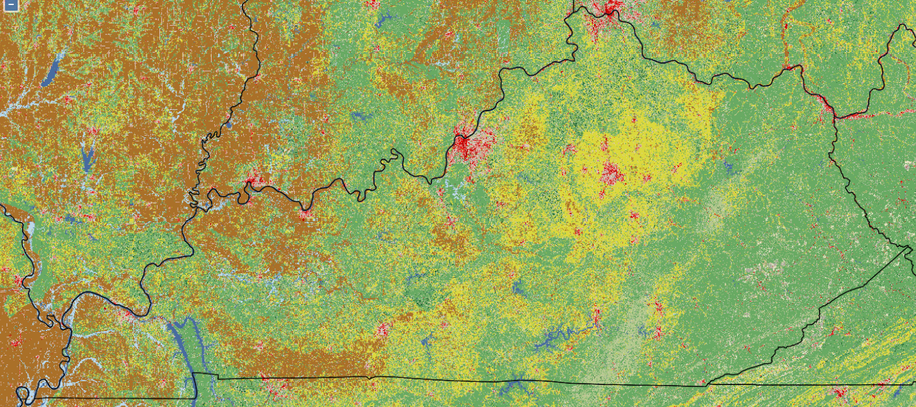
Forestry Best Management Practices
Notes:
Forestry practices (silviculture and logging) occur throughout the state, mainly by private landowners. This map shows broad-scale land coverage in the state, with plenty of forested areas shown in the darker green colors.
Water quality issues related to forestry are sometimes brought to the attention of watershed practitioners and it is helpful to know the relevant laws and industry guidance.
Frequently, we may just facilitate transfer of the information to the Kentucky Division of Forestry or KDOW field staff personnel for a field investigation.

Slide 3
Tree Canopy Shading
Overhanging roots and fallen logs serve as aquatic habitat
Roots stabilize banks and reduce erosion, filter runoff,
absorb floodwater and overland runoff
Addition of organic matter as food source for aquatic organisms
Notes:
It’s first important to remember that forests in and of themselves are water quality BMPs! They provide a multitude of benefits to waterways, including:
Providing tree canopy shading, which helps keep water temperatures cool and reduces algal blooms
Stabilizing banks with tree roots
Filtering runoff pollutants through trees’ root systems
Absorbing excess runoff and floodwaters through root systems
Providing a food source to aquatic organisms through fallen leaves, twigs and other associated organic matter
Providing direct habitat through roots hanging over the banks and fallen wood
With this in mind, we will consider practices that enable the growing and harvesting of trees in sustainable ways that do not cause unnecessary harm to stream systems.

Slide 4
Healthy Forests = Healthy Waters
KY Division of Water created an interactive mapping tool to help those in the forestry industry see proximity to special use waters. Visit https://watermaps.ky.gov/forestry.html.
Notes:
As shown in this map, the watersheds surrounding Kentucky’s Outstanding National Resource Waters and high quality Cold Water Aquatic Habitat waters have a mean percent forested area of 65%, with some areas having as much as 97.7% forested areas. (blue and purple areas)
Much of the watersheds with less than 25% forested area are located in the Lower Cumberland Basin, which was historically prairie. (yellow/gold areas)
Although each of these waterbodies is protected for different reasons, the high quality waters of Kentucky consistently feature watersheds with large areas of forestland.
Source: Kentucky Statewide Assessment of Forest Resources and Strategy, June 2010

Slide 5
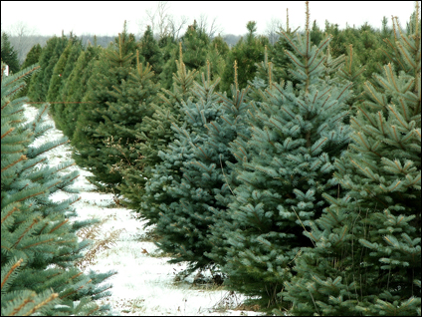
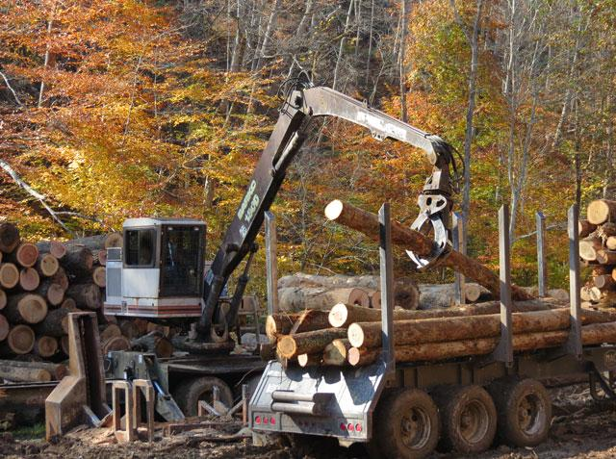
Kentucky Agricultural Water Quality Act includes Forestry Activities
Silviculture – activities used to grow and care for forests and trees—including tree planting, thinning, and timber stand improvement
Timber Harvesting – activities used to cut and harvest trees
Notes:
Forestry operations include both silvicultural and timber harvesting. All parties involved in these activities are responsible for water quality protections, including land owners logger and silvicultural operators.
The Kentucky Agriculture Water Quality Act includes the requirement for forest landowners to develop a Water Quality Plan for their property and to ensure that it is adhered to during operations.
Thus, the development of this plan is one of the first things that should be done when planning a forestry operation.

Slide 6
Notes:
Forests cover nearly half the state of Kentucky and are the foundation of a forest sector that is a major economic force in the Commonwealth. The demand for oak stave logs used in bourbon and wine barrels has greatly increased in recent years, and is a major focus of the current timber industry.
The 2018 estimates for the economic contribution of Kentucky’s forest sector include:
$8.4 billion in direct economic contribution
$13.3 billion in total economic contributions
26,000 jobs in the forest sector
nearly 60,000 jobs overall
This map shows the distribution of wood industries (dots) throughout the state and the number of Kentucky Master Loggers by county. We’ll be talking more about what it means to be a Master Logger momentarily.

Slide 7
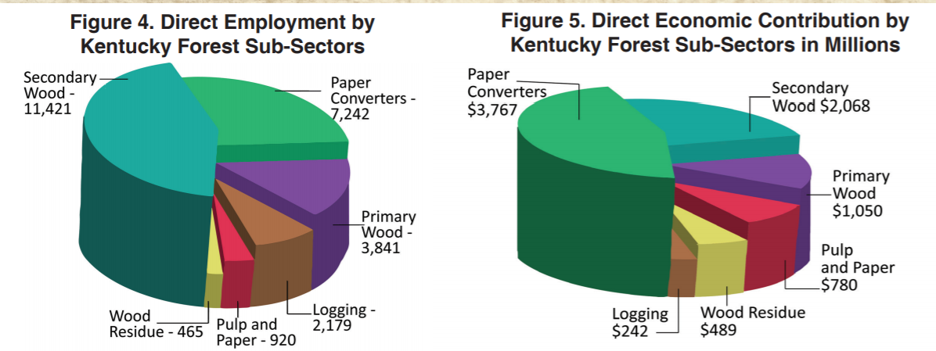
Kentucky Forest Sector: Economic Contribution Report 2016-2017, UK Forestry Extension
Notes:
These pie graphs from UK’s forest sector economic report in 2016 to 2017 show the employment numbers by sector with secondary wood products and paper converters as the highest employers
and direct economic contributions, with the same sectors leading in millions of dollars contributed to the economy during the year.

Slide 8
Flow of Harvested Wood in Kentucky
$4,560
$8,578
$1,033
$1,051
$2,736
$1,978
Total Estimated Value of 1 Acre of Harvested Woodland = $19,935
Source: UK Forestry Extension
Notes:
This graphic shows the flow and economic contribution of one harvested acre of Kentucky woodland.
First, woodland owner receives payment for timber sold (approx. $1,000).
Then, logger sells the wood to a mill for processing into products, such as lumber, cross ties or paper.
These products may move on to secondary industries, such as cabinet makers or industries that convert paper to a final product. This represents the greatest economic value, so it’s important
Mill waste or residue, including sawdust, chips and bark, are then sold for uses such as mulch or charcoal.
It’s important to remember that, although the economic payout is less than that for other sectors, the initial contribution of the woodlands themselves and its logging is critical to sustaining all of the other sectors.
Thus, the need for sustainable forestry practices!

Slide 9
Kentucky Forest Conservation Act & Master Logger Program (July 15, 1992)
Forest Conservation Act – regulates all commercial loggers and requires use of BMPs to help protect water quality
Requires all logging operations to have one Master Logger on site and in charge
Kentucky Division of Forestry oversees inspection/enforcement
Master Logger Program – an education program that teaches logging methods that benefit both industry and the forest
Developed by UK Dept of Forestry Extension, Kentucky Forest Industries Association and Kentucky Division of Forestry
Notes:
More than 95 percent of the 1.1 billion board feet of sawtimber harvested annually in Kentucky comes from nonindustrial private landowners.
To help ensure that all loggers are well-informed on sustainable practices, the Master Logger Program was developed in 1992 by the University of Kentucky Department of Forestry Extension, Kentucky Forest Industries Association (KFIA) and Kentucky Division of Forestry (KDF) as partners.
The program was voluntary from 1992 until July 2000, when the Forest Conservation Act became law. (KRS 149.330 - 149.355)
The Forest Conservation Act requires water protection BMPs and at least one person on site and in charge that has successfully completed the Master Logger program.
Loggers must complete the three-day KML program in order to receive their Master Logger designation. The training includes discussion and demonstration of best management practices (BMPs) for logging, forest ecology, chainsaw safety, personal protective equipment and directional felling techniques.
Master loggers must also complete 6 hours of continuing education courses every 3 years.

Slide 10
Kentucky Logging BMP Field Guide: a field guide to the minimum requirements for logging
forestry.ca.uky.edu/bmp-pubs
Notes:
The Kentucky Logging BMP Field Guide was developed by the UK Dept of Forestry and the Kentucky Division of Forestry as a comprehensive field reference to help loggers meet the mandatory BMP requirements for water quality protection.
It provides details about the BMPs loggers should use before, during and after timber harvesting.
When done well, logging can be conducted in a way that provides valuable natural resources with minimal harm to our water resources.
Research has shown that BMPs minimize the adverse effects that timber harvesting and other silvicultural operations can have on water quality and aquatic organisms by keeping the associated pollutants out of the stream. Reduction of nonpoint source pollution through the use of silvicultural BMPs results in healthier, more diverse aquatic habitats and stream ecosystems.

Slide 11
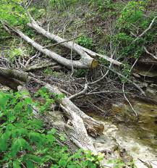
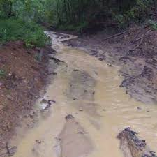
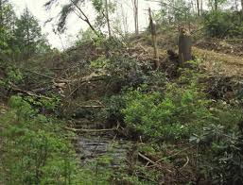
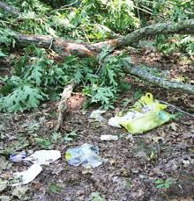
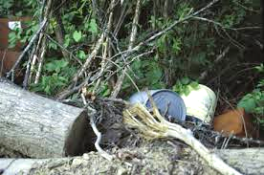
Forestry-Related Water Quality Impacts
DEBRIS
WATER TEMPERATURE
SEDIMENT
FLUIDS
Nutrients
Pesticides
TRASH
Notes:
Forestry operations can bring about a variety of water quality impacts. Timber harvesting is the most common forestry activity in Kentucky and its resultant pollution is most noticeable on small order streams, which often contain shallow, riffle areas that provide abundant oxygenated habitat.
On a statewide basis, however, forestry related nonpoint source pollution is a much smaller contributor than other land use activities, such as agriculture, resource extraction or urban runoff. As a watershed coordinator, you may not encounter forestry-related concerns as often as some of the other land use concerns, but it is helpful to be informed on the potential issues and recommended BMPs.
Sediment is the most common logging pollutant in Kentucky. Haul roads, skid trails, and landings (log decks) are areas of disturbed ground that can erode. Dirt and mud can also be pushed directly into streams.
Logging debris including tops, limbs, cut offs, and other woody debris that are left in streams can pollute waters. This is because they can change how water flows, leading to increased bank erosion that produces sediments. The decomposition of logging debris can also result in lower oxygen levels, harming aquatic life.
Water temperature can increase when increased sunlight results from the removal of too many trees adjacent to a stream. This can also cause lower dissolved oxygen levels and detrimental algae in waters that are high in nutrients. All of these impacts can result in harm to aquatic species.
Fluids like diesel fuel, gasoline, oil, hydraulic fluid and anti-freeze have the ability to harm aquatic life. These fluids come from equipment leaks and improper disposal of fluid containers and filters. Controlling these fluids is important in preventing pollution.
Trash, including discarded oil and fluid cans and personal litter, can contribute to water pollution and should be properly disposed of.
Nutrients can run off from fertilizer applications to revegetated areas or adhered to soil particles.
And, pesticides can run off from improper application on logging and silvicultural sites.
Source: https://forestry.ca.uky.edu/sites/forestry.ca.uky.edu/files/for67_0.pdf

Slide 12
Relative Importance of Silvicultural NPS Pollutants
Source: UK Cooperative Extension
Notes:
This graphic shows the relative impacts of silvicultural/forestry-related nonpoint source pollutants, with sediment having the greatest impacts in the form of added waterbody turbidity, sedimentation and embeddedness.
Thermal pollution from lost tree canopy cover and greater sun exposure to the waterbody is of 2nd greatest impact, causing increased water temperatures and related reductions in dissolved oxygen.
Other impacts are altered streamflows, causing bank cutting and scouring, and added organic matter and nutrients from runoff, further reducing dissolved oxygen.
Source: Kentucky Forest Practice Guidelines for Water Quality Management, Jeffrey Stringer, University of Kentucky Department of Forestry and Cary Perkins, Kentucky Division of Forestry, 2001

Slide 13
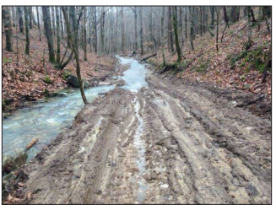
BMPs for Streams and Other Waterbodies
Stream and ephemeral channels must not be used as roads, trails or loading of logs, unless no other alternative exists or more water quality degradation results from road or trail development. In these exceptions, use minimal channel distance possible.

Slide 14
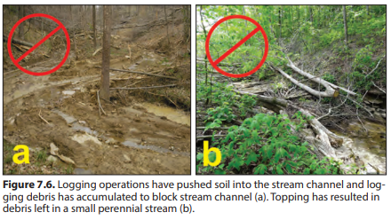
Logging Debris and Disturbed Soil
Disturbed soil or logging slash (tops and cutoffs) should not be left in or have the potential to be washed into streams.
Notes:
Both photos show instances of soil and logging debris that has been left. in stream channels, negatively impacting the streams

Slide 15
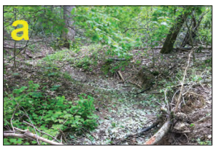
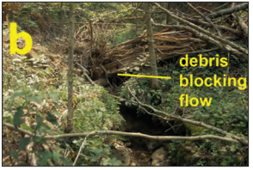
Logging Debris in Ephemeral Channels
Logging slash that blocks the flow of water should not be left in ephemeral channels.
Notes:
There is more leeway with ephemeral channels in the BMP guidance. Some slash may be left in these channels, as long as it does not block or potentially block water flow.
It is still recommended that this type of debris be removed during felling and skidding operations to avoid having to deal with it after equipment has been taken away from the site.
Photo “a” shows a clear ephemeral channel with no debris obstructions. Photo “b” shows a channel blocked by leftover logging debris.

Slide 16
Forestry Water Quality Plan Minimum BMP Requirements
BMP 1: Access Roads, Trails and Landings
(includes stream crossings)
BMP 2: Revegetation of Silvicultural Disturbed Areas
BMP 3: Streamside Management Zones
BMP 4: Sinkholes, Sinking Streams and Caves
BMP 5: Fluids and Trash
BMP 6: Proper Planting of Tree Seedlings by Machine
BMP 7: Fertilization
BMP 8: Application of Pesticides
BMP 9: Site Preparation for Reforestation
BMP 10: Silviculture in Wetland Areas
Greatest Impact on Water Quality
Notes:
The Kentucky Agriculture Water Quality Plan includes BMPs that are recommended for each of these 10 BMP categories.
Research has shown that the timber harvesting activities with the greatest impact on water quality are:
those included in BMP #1 - log landings, access roads and skid trails, including stream crossings
and BMP #3 - streamside management zones.
We will spend most of our time focusing on these 4 practices.
Again, the Kentucky Agriculture Water Quality Act requires all landowners who use their property for forestry operations to develop a water quality plan that incorporates these BMPs.
And, all parties involved in woodland operations, including landowners, loggers, and silvicultural operators, are responsible for carrying out these practices for water quality protection.

Slide 17
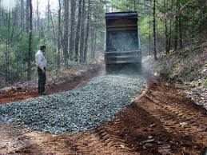
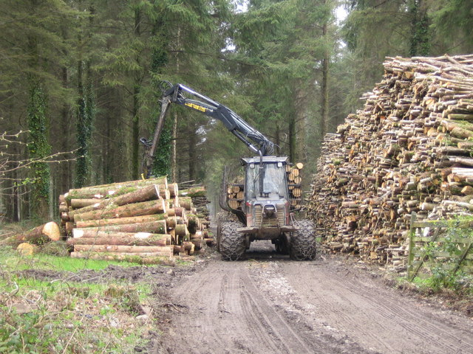
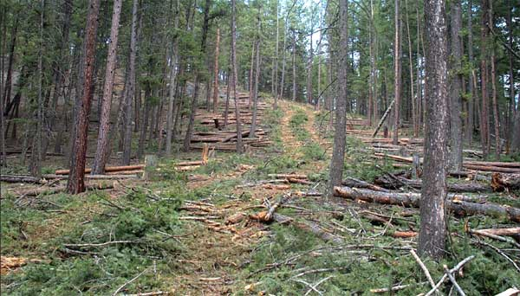
Access Roads, Trails and Landings
Landing or Log Yard
Access Road
Source: NC Forest Service
Secondary or Skid Trail
Source: Massachusetts DEP
Source: fs.fed.us
Notes:
For those unfamiliar with logging terminology, let’s begin with a definition some terms.
An access road is constructed to connect timber harvesting or some other forest activity with the farm or public road system.
Secondary or skid trails are temporary trails used by logging equipment to move logs from a point near where it was harvested to an access road or concentration area.
This concentration area, is called a landing or log yard. It refers to the areas where harvested forest products are temporarily concentrated and stored before being permanently removed from the woods.
It is important to construct and maintain these each of these logging features in a way that minimizes soil erosion and protects nearby water bodies from sedimentation.

Slide 18
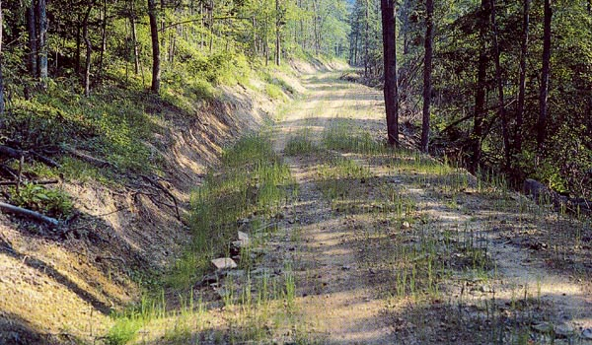
BMP 1 – Access Roads, Trail and Landings
Primary Pollutant: Sediment
Minimize grade of roads and trails
Add water control structures to drain surfaces and reduce erosion
Avoid using logging equipment when ruts may develop
Use elevated stream crossings when possible and stabilize any disturbed ground
Follow recommended practices for stabilizing temporarily inactive or permanently retired logging areas
James Kochenderfer
Notes:
Forest roads are necessary for access, but can cause more erosion than any other aspect of logging. When sediment washes away from timber harvesting sites, it usually starts from the erosion of poorly built forest roads. In contrast to the permeable, absorbent soils of the surrounding forests, roads create hard, compacted surfaces that easily channel runoff.
On the bright side, good logging road and trail construction can reduce erosion significantly.
Some of the most important principles of BMP 1 for roads, trails and landings are listed on this slide.
They should be built with minimal steepness or grade. The idea is to move small amounts of water over short distances, rather than larger amounts of water over longer distances—which is more likely to cause erosion.
To prevent runoff from entering streams or channels, water control structures should be installed at appropriate intervals to adequately drain surfaces and reduce erosion.
Skidders and other logging equipment should not be used when conditions are favorable (wet) for rut development and damage cannot be readily resurfaced with available equipment.
Where economically and/or topographically feasible, elevated crossings (such as bridges, culverts or pole crossings) should be used when crossing perennial and intermittent streams, as well as ephemeral channels.
Follow practices for minimizing erosion and runoff from inactive or permanently retired logging sites.
Resources:
www2.dnr.cornell.edu, Best Management Practices During a Timber Harvest
Kentucky Agriculture Water Quality Plan

Slide 19
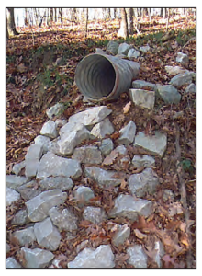
Water Control Structures
Notes:
These graphics from the field guide show a water control structure practice that diverts muddy runoff off of the road so that it doesn’t enter the stream.
Rock may be used at the outlet of the control structure, such as at this culvert, to reduce gully erosion.

Slide 20
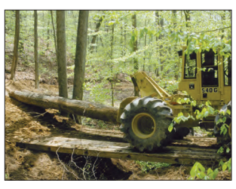
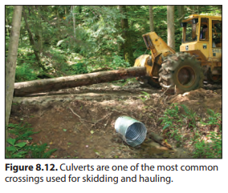
Stream Crossings
Should be kept to a minimum and cross streams at right angles
Culverts
Wooden skidder bridge
UK FOR-130
Notes:
Stream crossings should only be used when necessary and should be constructed at 90-degree angles to the stream to reduce erosion by limiting impacted bank lengths.

Slide 21
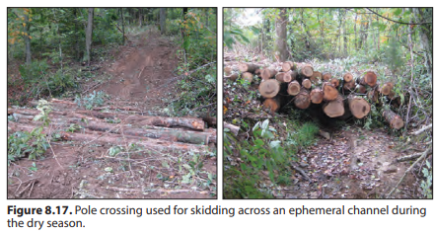
Stream Crossing Minimum Requirements
Should be elevated (with bridges/culverts) where possible
Fords should only be used on streams with firm and/or protected channel beds and stable banks
Avoid depositing soil into stream or channel
Immediately stabilize disturbed ground associated with crossings
Notes:
Crossings can be significant sources of sediment if attention is not paid to proper:
• location
• selection of crossing type
• installation and removal
The four minimum requirements are designed to reduce muddy water runoff and soil deposited in the channel and to minimize disturbance of streams and ephemeral channels while providing operational flexibility.
There are a variety of elevated crossing designs, but topographic difficulties such as bank height or channel width, can make their installation difficult. In those situations, fords can be used that allow equipment to move directly over the stream bed.
The above graphic shows a pole crossing over an ephemeral channel.

Slide 22
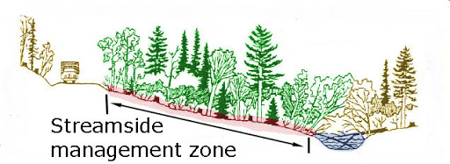
BMP 3 – Streamside Management Zones
Addresses areas adjacent to perennial and intermittent streams, as well as lakes and other waterbodies
Primary Pollutants: Sediment, Water Temperature, Debris, Pesticides, Fertilizers, Animal Waste
Source: Cornell Cooperative Extension
Perennial streams – must maintain specific width and percentage of original overstory trees
Perennial/Intermittent streams – minimum distances for roads/ trails/landings from banks, where feasible
Notes:
A Streamside Management Zone is a strip of woodland located adjacent to a stream or other waterbody where only limited disturbance is desirable. This concept should also be familiar to you as a buffer zone, a riparian zone, a wildlife corridor, or some other name for this protected strip of land.
Streamside management zones (SMZs) must be used directly adjacent to streams or waterbodies and should be marked prior to logging. If they are not correctly implemented or ignored, this protection is very difficult or impossible to correct. SMZs are not required around ephemeral channels.
SMZs help maintain natural temperatures in perennial waterbodies through shading, maintain the integrity of the bank, and reduce the amount of sediment entering the water by minimizing soil disturbance and filtering overland flow. Intermittent streams are generally dry in the summer months and do not require shading.
Both perennial and intermittent SMZs require protection of the banks, channel, and of the adjacent strip of forestland by avoiding unnecessary disturbance and preserving overstory trees. Overstory trees are the taller trees forming the main canopy and shading benefits.
Source: Kentucky Agriculture Water Quality Plan

Slide 23
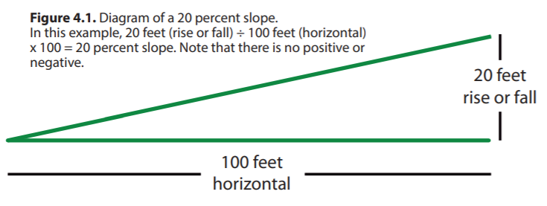
BMP Measurements
Effectiveness and efficiency of BMPs dependent on:
Steepness (slope %)
Distance (slope distance, rather than horizontal distance)
Notes:
For SMZs and other forestry BMPs, the steepness and slope distance of the land directly relate to the BMP’s effectiveness. Thus, these measurements are needed when designing BMPs appropriately for site conditions.
Steepness is measured using SLOPE PERCENT, which is the rise or fall (measured in feet) over 100 feet of horizontal distance.
When distance is used in BMP minimum requirements or recommendations it refers to distance as measured across the ground (referred to as slope distance) and not horizontal distance.
BMPs that require the use of these measures include:
• width of standing trees in streamside management zones
• distance of roads, trails, and landings from water bodies in streamside management zones
• spacing of water control structures on haul roads during use
• spacing of water bars or other water control structures on retired skid trails and roads.

Slide 24
Relationship of SMZ Requirements to Slope and Distance
Example: A perennial stream with a slope of 20% would require preserving at least 50% of overstory trees to a minimum distance of 50 feet from the streambank. Roads and trails should be at least 100 feet from the streambank.
Notes:
The use of these criteria for SMZs is shown in this table.
This table shows guidance for overstory tree retention (width and percentage) and minimum distances for roads, trails and landings. Three stream types are included – regular perennial, intermittent, and CWAH, or Cold Water Aquatic Habitat, which are streams that can support trout populations.
See example on slide.
What would be the requirements for an intermittent stream with 25% slope?
No overstory requirements, but roads would need to be constructed at least 100 feet away from the stream bank.
How about a trout stream with a 10% slope?
Maintain 75% of overstory trees within 100 ft of the bank, and roads must be at least 100 feet away.

Slide 25
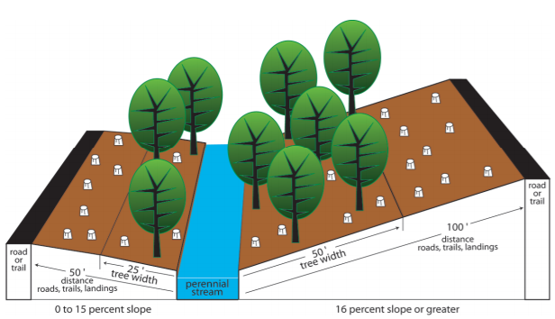
Streamside Management Zone Guidance
Notes:
This diagram from a Kentucky Master Logger publication further illustrates the SMZ guidance with a graphic depiction.
Note that the required overstory trees increases with increased slope, as does the distance of the road from the stream (right side of diagram). These increased restrictions are designed to limit erosion.
Source: Kentucky Master Logger BMP Brochure, 2017

Slide 26
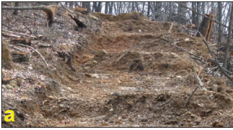
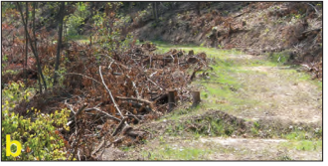
Extra Measures for Road, Trails, Landings
When it is not feasible to locate these features at the minimum distance:
Minimize road and trail grade
Prevent water from collecting at low points
Increase water control structure frequency (photo a)
Use logging debris or other sediment barriers to slow runoff
(photo b)
Notes:
There are situations where it is not feasible to locate roads, trails and landings at the required SMZ distance. When they must be located closer to streams, extra precautions are needed to reduce muddy runoff.
These include the measures listed on this slide.
Photo a shows increased frequency of water bar structures on a road to slow runoff.
Photo b shows properly placed debris to reduce or slow runoff to streams.

Slide 27
Notes:
This map overlay shows the canopy cover distance (dashed yellow line) and the road and trail distance (solid yellow line) from both a perennial (solid blue line) and an intermittent stream (dashed blue line). Note that roads in area “d” outside both of these SMZ areas was logged with 70% of trees removed and skid trails constructed on the contour.
While leaving streambank trees along intermittent streams is not required, it is recommended by the BMP Field Guide.

Slide 28
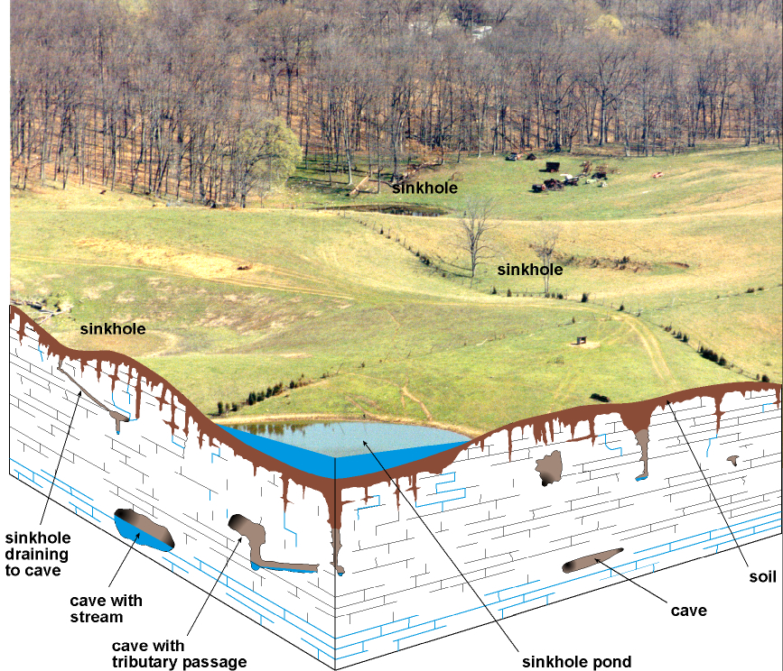
BMP 4 – Activity near Sinkholes, Sinking Streams and Caves
Primary Pollutants: Sediment, Debris, Pesticides, Fertilizers, Animal Waste
Runoff from roads, trails and landings shall not drain into SINKHOLES, SINKING STREAMS, or CAVES.
Soil and logging debris shall not be concentrated or actively accumulated in a sinkhole.
Notes:
This BMP concerns forested areas in karst topography which contain “sinkhole” depressions. Sinkholes (or karst windows) are open or closed circular depressions in karst (limestone) areas where surface waters flow to join an underground drainage system. Sinkholes are caused by dissolution of the underlying limestone bedrock.
A “swallet” is a point where surface water leaves the surface and flows underground.
For the purposes of this BMP, sinkholes include: depressional areas with or without swallet, sinking streams, caves, karst windows, and naturally occurring pits or vertical shafts.
Design information for KAWQP: The distance between any disturbed area (disturbed areas include access/haul roads, trails, log landings, or those disturbances produced from mechanical site preparation treatments) and the open swallet of a sinkhole will be at least 30 feet for areas of 5 percent slope. An additional 10 feet in width will be added to this zone for each 10 percent increase in slope up to a maximum width of 65 feet.

Slide 29
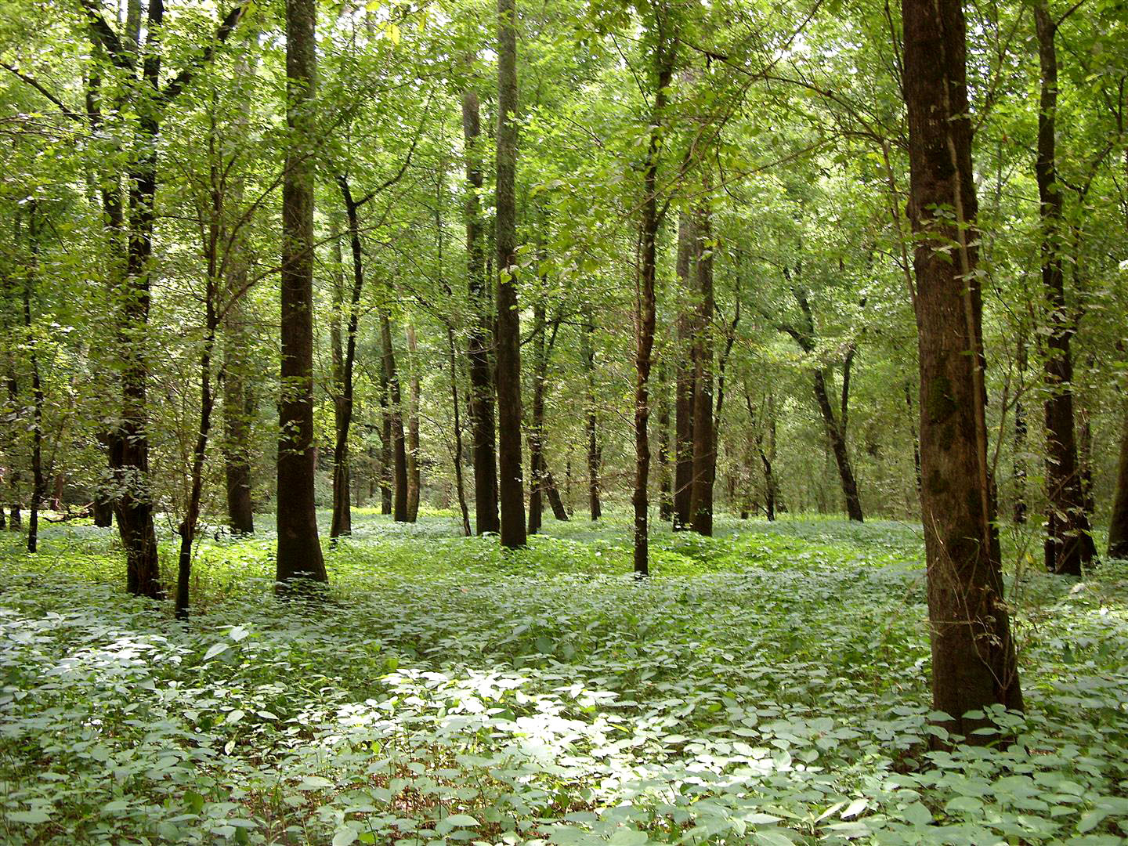
BMP 10 – Silviculture in Wetland Areas
Source: Kentucky EEC
Require additional considerations due to their uniqueness and sensitivity
Minimize road construction, locate landings on higher ground, minimize vehicle traffic
Notes:
Forested wetlands, because of their uniqueness, require additional considerations above those listed in other BMPs dealing with silvicultural activities.
When silvicultural activities including harvesting are implemented in wetlands, additional BMPs shall be used including: minimizing construction of roads, locating landings on higher ground, and minimizing vehicle traffic.
Crossing of streams and sloughs should be avoided. If not possible, follow appropriate stream crossing requirements of BMP 1.

Slide 30
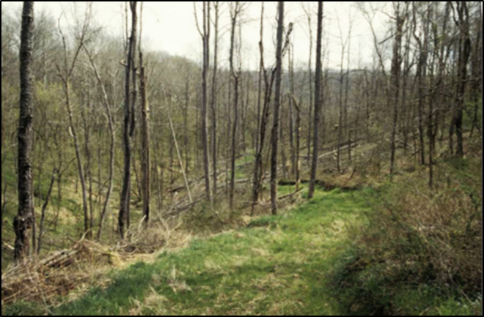
Retirement of Logging Sites
Includes roads, trails, landings, and other areas of bare ground that can result in muddy water runoff
Areas that cannot drain into streams or channels do NOT have to be retired.
Retirement includes:
getting ruts out
removing berms to ensure drainage
removing temporary stream crossings
Seeding for revegetation
Notes:
Once a logging operation is complete, it is important to leave the land in a state that does not cause future degradation of waterways.
This includes attention to any roads, trail, landings or other areas of bare dirt that were used for timber harvesting.
The Forestry BMP Field Guide details multiple retirement measures that need to be satisfied prior to a final inspection.
These include removing ruts and smoothing surfaces and removing constructed berms and temporary stream crossings. Logging debris should not block the flow of water in ephemeral channels.
It also calls for seeding and related practices needed to ensure revegetation of the area. A good covering of grass and legumes on retired roads, trails and landings shows that a logging job was completed conscientiously with attention to final requirements.
An updated rule as of 2017, requires the use of at least one measure to promote vegetative cover, such as loosening compacted soil, fertilization, mulching or liming. This updated rule also removes the requirement to use forestry retirement practices on flat areas that do not drain to streams or channels.

Slide 31
Inspection & Enforcement
KY Division of Forestry has authority to inspect commercial timber harvests for use of BMPs and presence of Master Logger.
Initial/Periodic/Final Inspections – KDF county ranger identifies Master Logger, discusses job with them, inspects for use of BMPs
IF NO MASTER LOGGER PRESENT OR BMP VIOLATIONS:
Written Warning
Compliance Inspection
Informal Conference
Notice of Violation
Special Order
Administrative Hearing, Bad Actor Designation, Fines
Notes:
Loggers are not required to notify the Kentucky Division of Forestry of their operations, but it is recommended that they do so when starting the operation.
Once logging begins, a KDF county ranger can visit the site for an initial inspection, periodic or compliance inspections and a final site retirement inspection.
If the inspector finds that a Master Logger is not on site or the operation is creating an immediate or imminent risk to water quality, several steps can be taken to address the situation.
Written Warning is issued to the owner or operator
2) Compliance Inspection – a reinspection occurs to ensure that the correct BMPs are implemented
3) An owner or operator can request an informal conference with the KDF to discuss the situation. A plan and timeline may be developed to address the issue.
4) If, after these steps, the logging operation is still found to be out of compliance, a Notice of Violation will be issued, stating the required corrective action and timeline for completion.
5) If BMPs are still not addressed, a Special Order is issued that mandates the logger cease all or a portion of the operation and implement the measures in the NOV. Operations can resume once these conditions are satisfied.
6) If violations are still not corrected, the Special Order can initiate an Administrative Hearing that can result in a $1,000 fine per violation and designation as a bad actor. Since these designations can be assigned for each violation, a logger or operator can accrue multiple bad actor designations.

Slide 32
Master Logger and Bad Actor Listings masterlogger.ca.uky.edu
How to get off of the list!
Comply with final orders, fix sites, pay fines
Formally request removal of designation
Sign agreement to notify re: every operation for next 2 years
Be NOV-free for the 2-year period
Notes:
In addition to providing a listing of certified Master Loggers in Kentucky, the Master Logger website provides a database of “bad actors.”
Mills may choose not to purchase logs from bad actors, so there can be direct financial repercussions.
If a logger and/or operator wants to have their name removed from the ‘Bad Actor’ list they must:
Comply with any and all final orders against them, including fixing all sites and paying all fines.
Request to have their designation removed by calling Timber Harvesting Compliance Section at Frankfort at 502-564-4496 or 800-866-0555.
Sign an agreement which states that the logger will notify the local Division of Forestry office of every logging operation for the next two years.
Must be ‘Notice of Violation’ free for that two-year period.
For those with multiple Bad Actor designations, additional provisions apply for removal of this status.

Slide 33
Notes:
Don’t be a bad actor!

