Slide 1
Watershed Academy
Watershed Coordinator Training Series
Water Quality Basics
2. Hydrology / Hydraulics

Slide 2









Stream Functions Pyramid
Notes:
In this session, we are going to look at the first two components of the functional pyramid – hydrology and hydraulics.

Slide 3
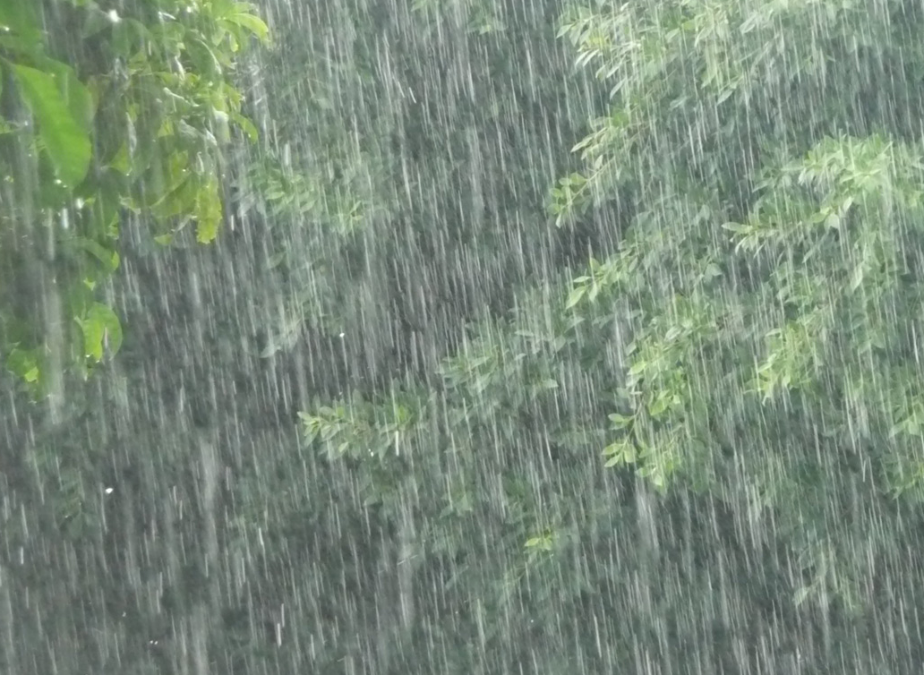
HYDROLOGY
Water transport from watershed to channel
Stream channel
Precipitation / Runoff Relationship
Flood Frequency
Flow Duration
Source: NASA, 2017
Notes:
At the base of our pyramid, is the Hydrology function, which refers to the study of the properties, distribution, and circulation of water on and below the earth's surface and in the atmosphere.
It encompasses precipitation, evaporation, infiltration, groundwater flow, surface runoff, stream flow, and the transport of water and substances within water.
In relation to stream function, it addresses the transport of water from the watershed to the channel.
Without surface water flow, there would not be stream channel formation and the subsequent aquatic ecosystem.
Parameters considered in the “Hydrology” function of a stream include 1) Stream Channel Forming Discharges, 2) Precipitation / Runoff Relationship, 3) Flood Frequency, and 4) Flow Duration
Flow duration characterizes the ability of the watershed to provide flows of various magnitudes.

Slide 4
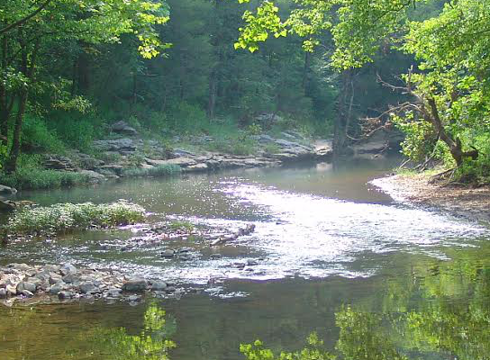
HYDRAULICS
Water transport within the stream channel, floodplain, and sediment
Interaction with bed, banks, floodplain, sediment along and beneath stream, etc.
Floodplain connection
Flow dynamics
Groundwater / Surface Water Exchange
Source: Kentucky Fish & Wildlife, 2015
Notes:
The 2nd level of the pyramid was the function….Hydraulics.
When conducting assessments or implementing a stream restoration project, it is important to distinguish between watershed scale functions of water transport (Hydrology) and reach scale relationships that describe how water interacts with the channel (Hydraulics).
Hydraulic functions transport water in the stream channel, on the floodplain, and through sediments.
It defines how water behaves once it reaches a channel and how it interacts with the bed, banks, floodplain, and hyporheic zone (the porous sediment along and under the stream).
It is closely related to Geomorphology (Level 3) functions and many interrelationships exist between these two categories.
At a basic level, water must be present in the channel before sediment can be moved.
Hydraulic functions also affect many functions in Levels 4 and 5 because they determine the amount of force and power that is exerted by the water on aquatic habitats.

Slide 5
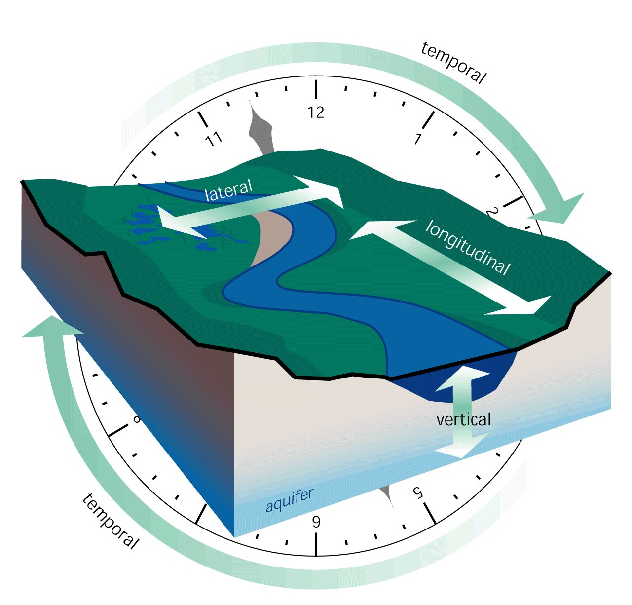
Four Dimensions of Streams
Source: FISRWG, 1998
Notes:
We tend to look at streams as fixed features on a landscape where the water flows. But to assess streams we need to think of the four dimensions in which they change.
Vertical - surface water and groundwater interactions
Waterbodies are not purely surface features, but constantly interact with groundwater aquifers and exchange water, chemicals, and even organisms. Over its entire length, a stream often varies between influent reaches where surface water leaks downward into the aquifer, and effluent reaches where the stream receives additional water from the aquifer.
Longitudinal - slope and drainage patterns
Flowing water systems commonly go through structural changes en route from their source to mouth. The slope and topography of the area will affect how the stream functions.
Lateral – channel and floodplain features
A stream has different parts in the channel but also expands out into the surrounding floodplains and hillslopes during floods. The entire gradient needs to be considered realizing that a stream fluctuates laterally.
Temporal - travel and change
Lastly, it is important to realize that streams are always changing. The vertical, lateral, and longitudinal structure is not permanent. Watershed managers should always think in terms of the structural changes in progress and their rates of occurrence.

Slide 6
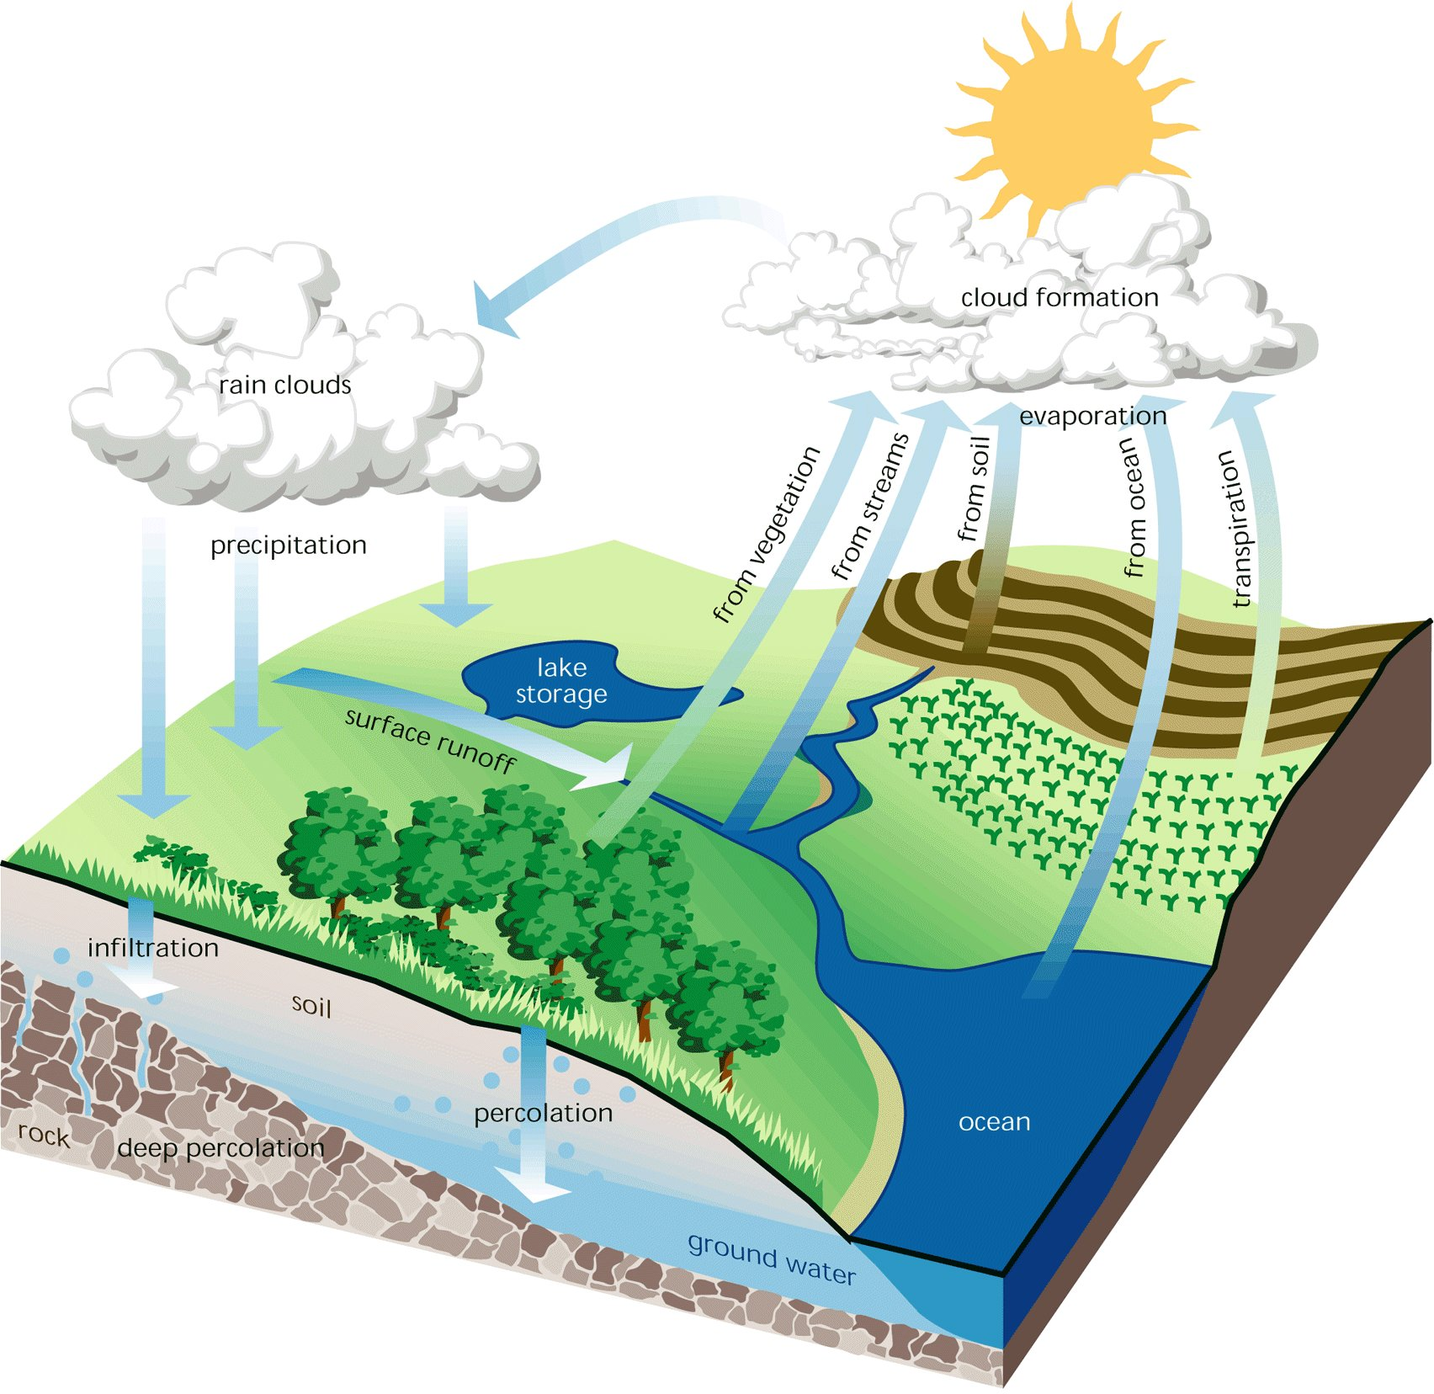
Hydrologic Cycle
Source: FISRWG, 1998
Notes:
We spoke briefly about the hydrologic cycle and its elements in the overview.
What we want to note here is how the PRECIPITATION, EVAPOTRANSPIRATION, and INFILTRATION affect SURFACE RUNOFF.

Slide 7
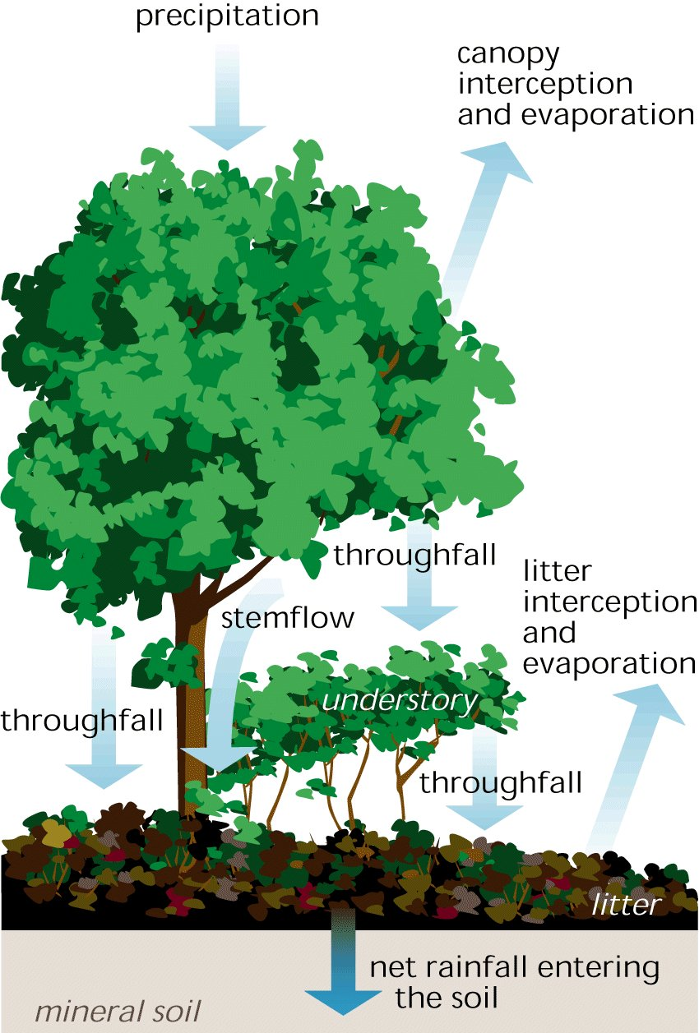
Evapotranspiration
Interception by trees and vegetation (doesn’t reach ground) and evaporates
Transpiration pulled from ground by roots and used by tree, some water returns to atmosphere from pores in leaves
Evaporation from soil and surfaces
Source: FISRWG, 1998
Notes:
Much of the PRECIPITATION that falls from the sky does not reach the ground where it can infiltrate or runoff. Rather it evaporates back into the air due to interception, transpiration, and evaporation.
This the amount of vegetation in the area will affect the amount of groundwater and surface waters.

Slide 8
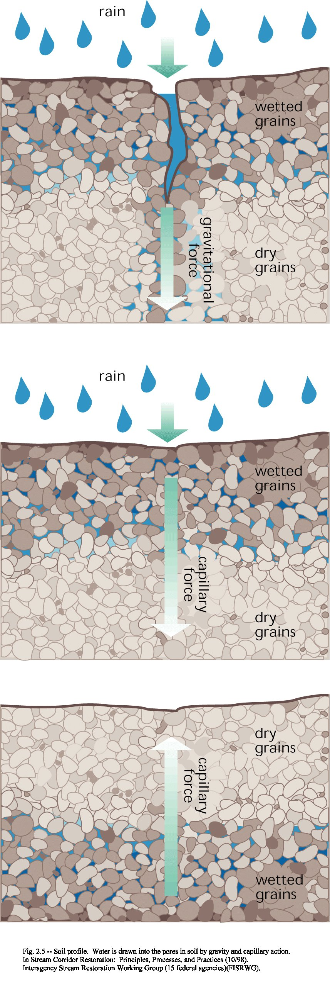
Soil Infiltration and Moisture
Precipitation is drawn into soil through gravity and capillary action through pores in the soil.
Soils with more porosity can infiltrate more water.
After a storm, the water will travel lower with some holding to particles as soil moisture.
Source: FISRWG, 1998
Notes:
What does make it to the ground may infiltrate the soil through small pores. See slide text.
The maximum amount of rainwater that can enter a soil in a given time, called infiltration capacity, is influenced by the soil type, structure, and moisture content at the start of the rain.
Early in a storm, water usually enters a soil readily, as it is literally sucked into the dry ground.
As the soil becomes saturated, it becomes more difficult for water to seep into the ground, so it is more likely to run off.
Note that while moving through the soil, water will carry different chemicals with it into the groundwater supply, or some chemicals will remain attached to soil particles.

Slide 9
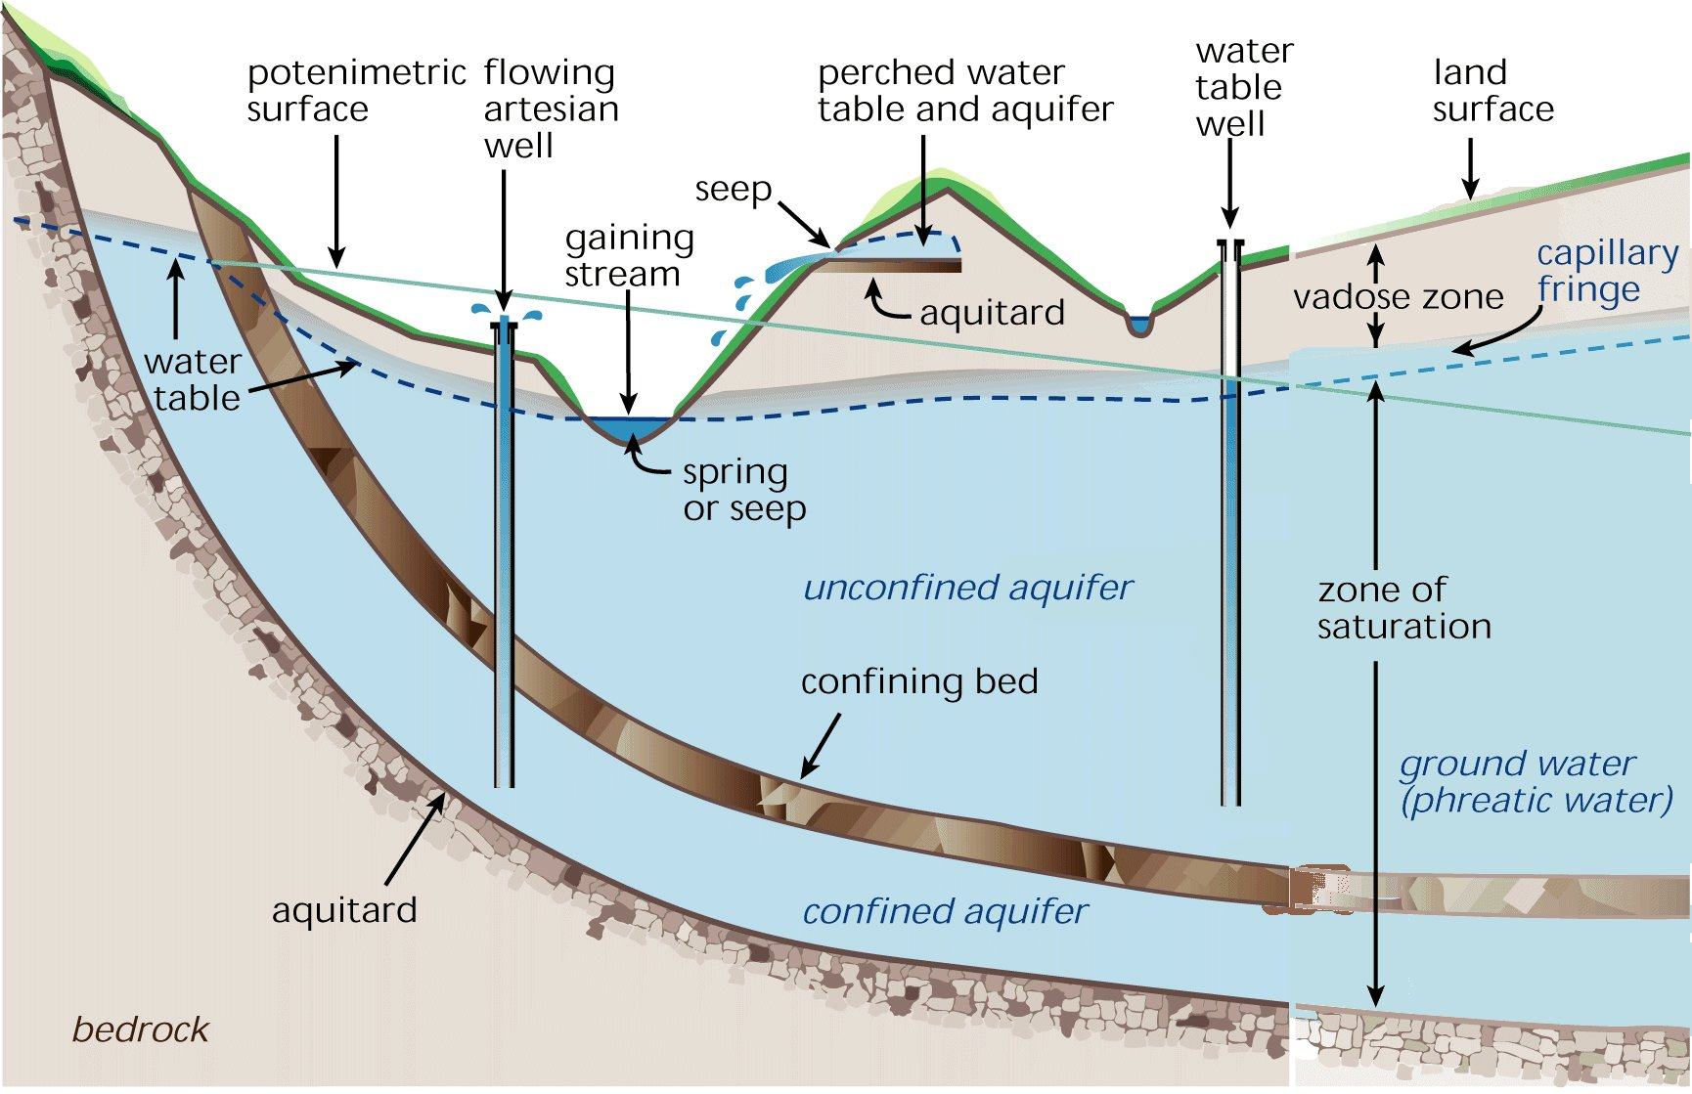
Groundwater
Source: FISRWG, 1998
Notes:
As water moves downward it will come to a place that is saturated with water, called the “zone of saturation.”
If this area produces a regular supply of water, it may be called an “aquifer.”
In some cases, the soil has a layer (such as clay) that the water cannot quickly penetrate called an “aquitard” or “fragipan.”
This may cause the water not to penetrate deeper.
In other cases, there may be a rock layer that does not have much permeability.
This may separate a “confined aquifer” and an “unconfined aquifer.”

Slide 10
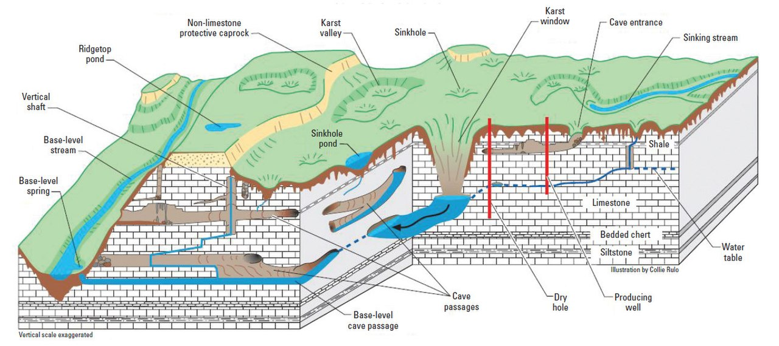
Karst and Groundwater
Source: wikipedia
Notes:
In areas in which there are limestones and dolomite, karst topography may form from the dissolution of the rocks, creating sinkholes, caves, sinking streams, and springs.
In some cases, the karst system will route water in a different direction than the surface drainage pattern. This can make water and associated pollutant tracking very difficult.

Slide 11
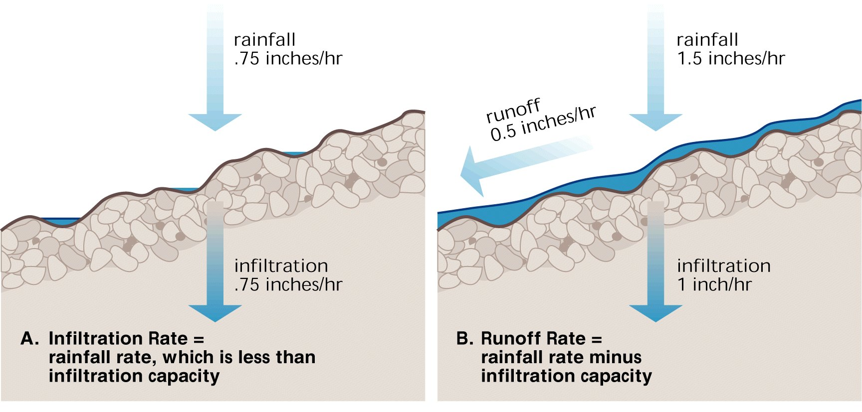
Infiltration vs Runoff
Source: FISRWG, 1998
Notes:
If the rainfall rate is greater than the infiltration capacity of the soil, some water will runoff the ground’s surface.
Runoff will also occur when the soil particles are completely saturated with water and cannot absorb any more water.
Different soils have different runoff rates based on their particle sizes and textures.

Slide 12
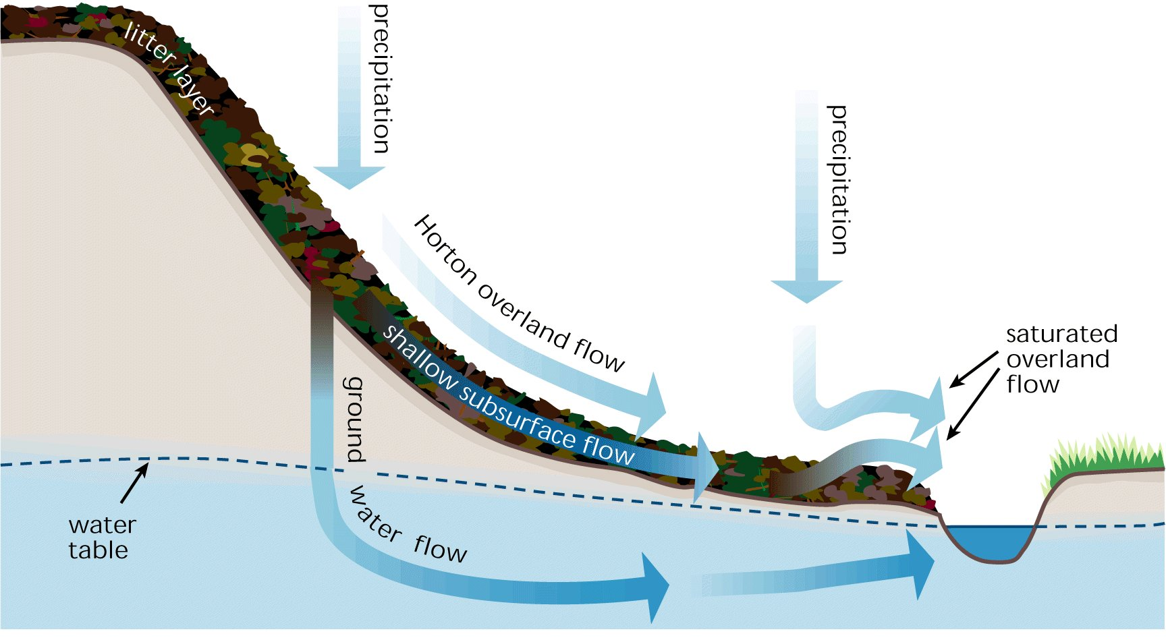
Groundwater and Runoff
“Overland sheet flow”
Source: FISRWG, 1998
Notes:
When groundwater surfaces, it results in “gaining streams,” meaning that that they are receiving supplementary water from underground sources.
This groundwater is also joined by surface flow which includes: 1) overland sheet flow, 2) subsurface flow through the saturated soil, and 3) saturated overland flow or “quick return flow” which emerges when the soil becomes so saturated that it emerges before reaching the stream channel.
As storms continue, the saturated flow level moves further and up the hillside

Slide 13
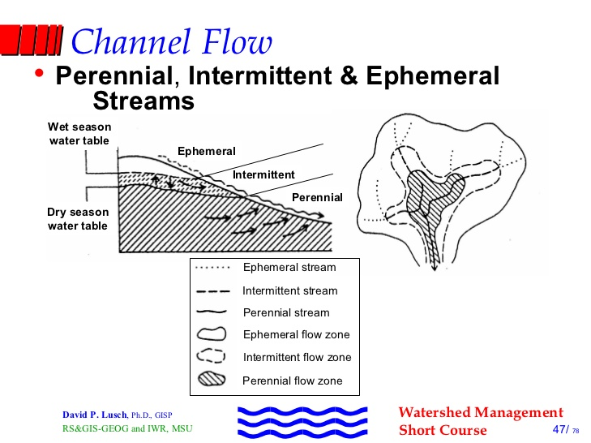
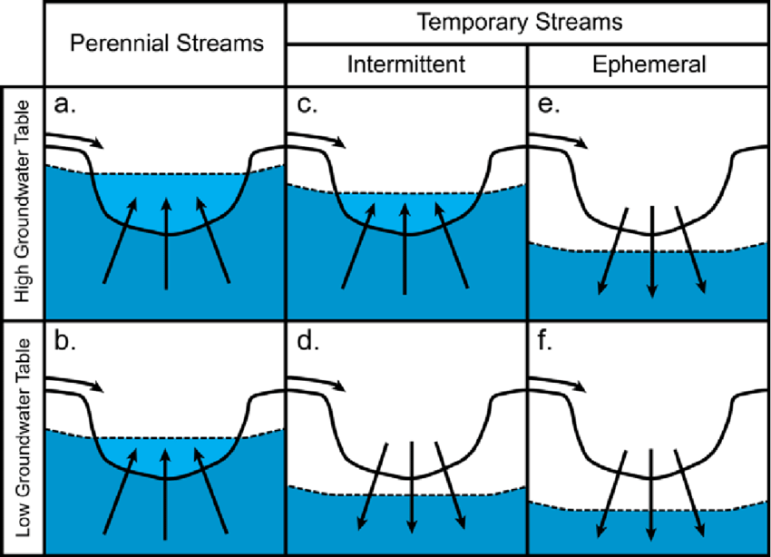
Stream Flow Regime
Source: Hosen, 2011, Temporary streams: the hydrology, geography, and ecology of non-perennially flowing waters.
Source: Lusch, 2011, Watershed Management Short Course
Notes:
Streams may be classified as ephemeral, intermittent, or perennial based on their flow and its relationship to the groundwater table.
Ephemeral streams flow for brief periods in response to rainfall. These streams are influent or “losing” reaches that lose water to the groundwater aquifer.
Intermittent streams flow during wet season (winter-spring) when the groundwater table is higher, but don’t normally flow during the dry season when the groundwater table is lower.
Perennial streams typically flow year-round.
You can see how these streams are typically located within a watershed, with ephemeral streams flowing into intermittent which flow into perennial.
The exception to this rule is in karst areas.

Slide 14
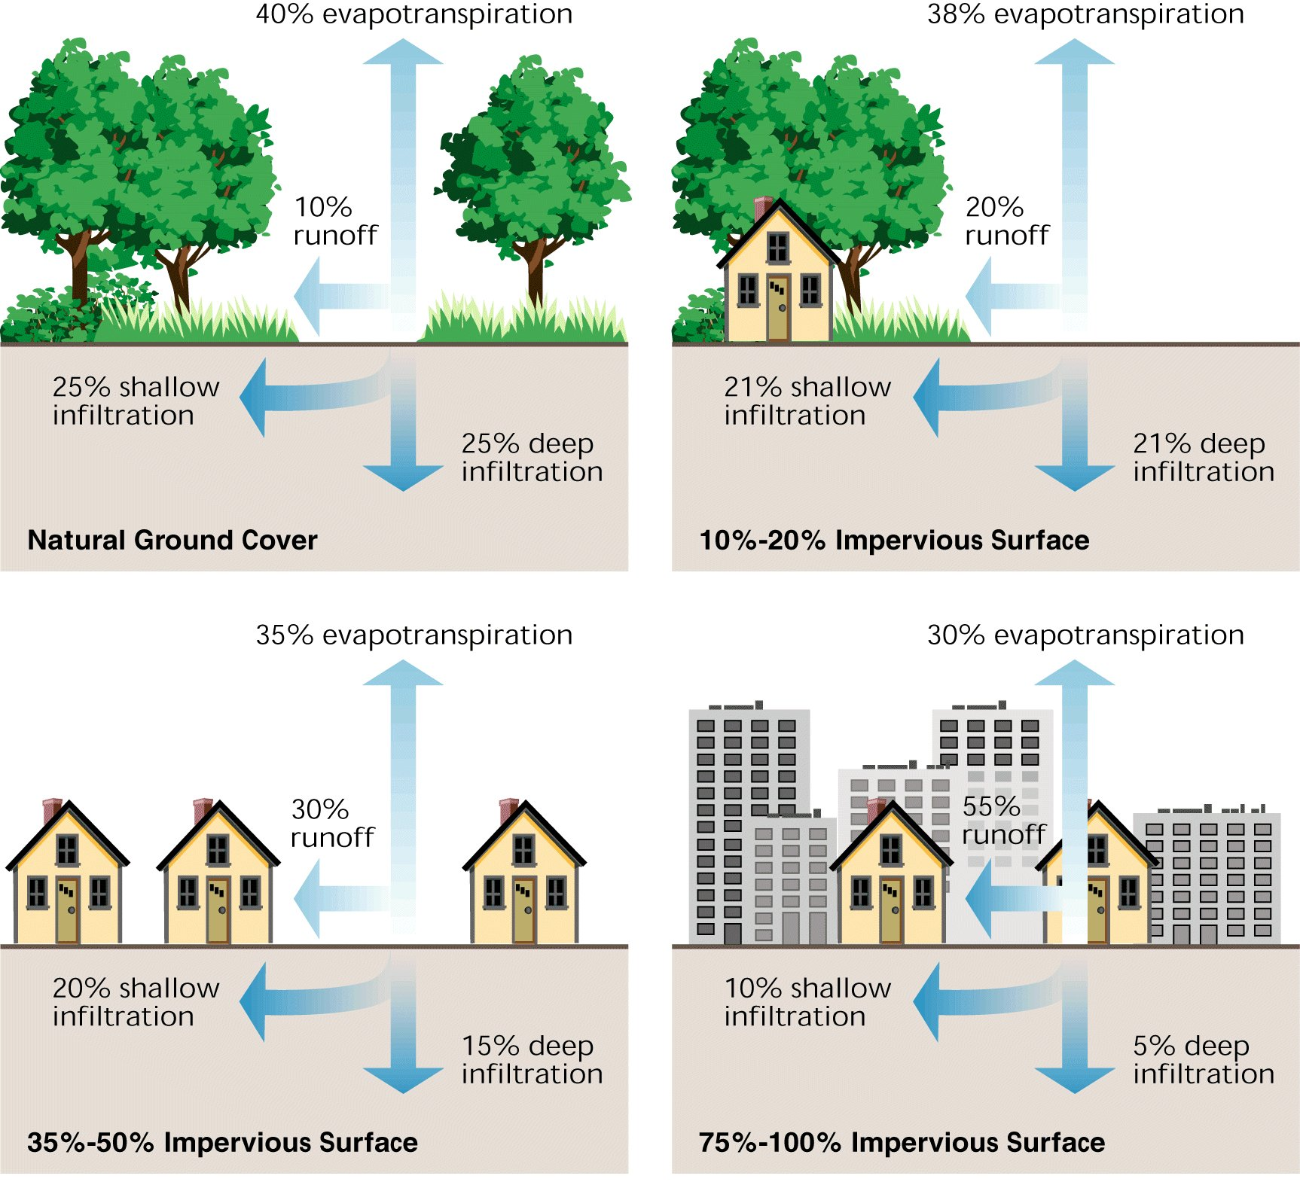
Urbanization and Hydrologic Cycle
Source: FISRWG, 1998
Notes:
Urbanization of an area typically involves increasing the amount of impervious surfaces, or surfaces that don’t allow water to filter into the ground. These include paved surfaces, rooftops, sidewalks and parking lots.
An increase in imperviousness will decrease evapotranspiration and infiltration. But, it will increase the amount of runoff.
Thus, urbanization increases the volume and velocity of water reaching the streams, but groundwater levels will decrease.
The above graphic shows this phenomenon as the percentage of land area covered with impervious surfaces increases.

Slide 15
Longitudinal Zones
Source: FISRWG, 1998
Notes:
Three longitudinal zones are usually recognized -
headwaters, where flow is usually lowest of anywhere along the system, slope is often steepest, and erosion is greater than sediment deposition;
transfer zone, the middle range of the stream where slope usually flattens somewhat, more flow appears, and deposition and erosion are both significant processes;
and the downstream end's depositional zone, where flow is greatest, but slope is minimal and deposition of sediment significantly exceeds erosion most of the time.
Erosion and deposition occurs in all zones, but in each zone the primary processes are shown.
Headwaters need not be in mountains, but will vary in topography by region.

Slide 16
Drainage Patterns by Valley
Notes:
The shape of a stream will be influenced by the slope and geology of the valley in which the stream is located.
Recognizing the valley shape will help to determine how streams in an area look, as the geology and topography will greatly affect the drainage pattern.
So note in the steep mountain valleys, the streams are confined but will have a lot of vertical changes. In wide plains, the stream may be wide and flat. Not all streams are the same shape because they are located in different areas.

Slide 17
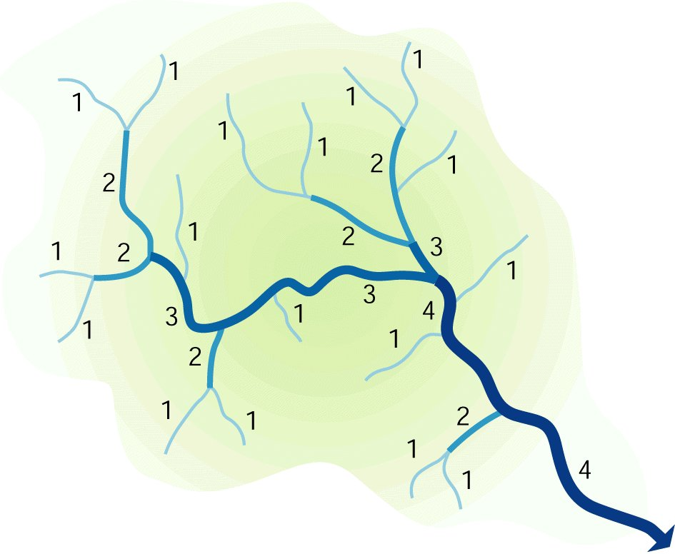
Stream Order by Size
1st Order Stream = Small
Strahler Numbering Rules
  Headwater = 1
  Confluence of two of same order -> next order.
    1 -> 2 = 2 (no change)
    2 -> 2 = 3
    2 -> 3 = 3 (no change)
    3 -> 3 = 4
4th Order Stream = Larger
Source: FISRWG, 1998
Notes:
Stream order classification assigns a number to a stream network based on the number of tributaries contributing to its flow. Thus, it is a measure of the relative size of streams.
The smallest tributaries are referred to as first-order streams.
The largest river in the world, the Amazon River, is a twelfth-order stream.
1st through 3rd order streams are typically headwater streams. It is estimated that 80% of the world’s waterways fall into this category.
4th through 6th order – typically considered medium streams
7th order or larger – constitutes a river

Slide 18
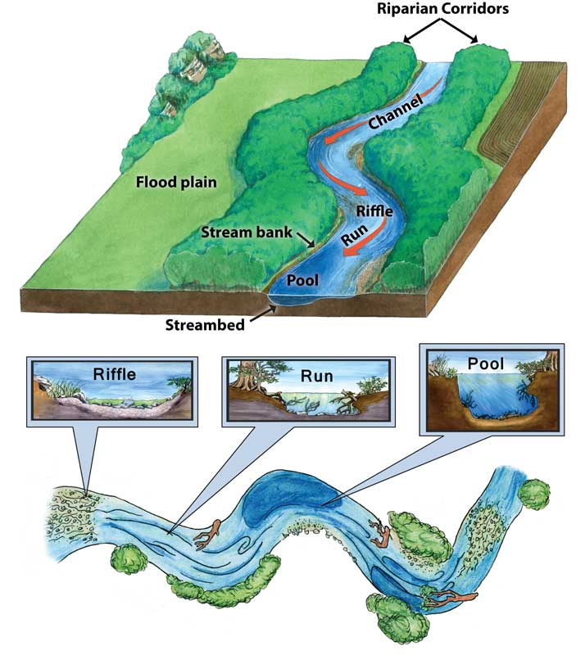
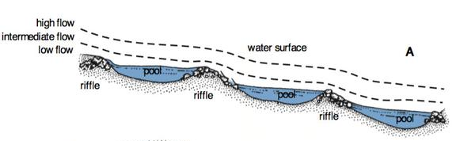
Riffle, Run, Pool
Sources: Missouri Department of Conservation, etal
http://texasaquaticscience.org/streams-rivers-aquatic-science-texas/
NC State Extension Publications https://content.ces.ncsu.edu/natural-stream-processes
Notes:
As water flows downstream, the elevation of the stream will form riffle, run, pool, and glide (not shown) sequences.
A riffle is a shallow faster moving area of the stream
A run is a medium depth area between the riffle and the pool
A pool is a deep area with low flow velocity
A glide is the gradually increasing area between the pool and the riffle
The water energy is low in the pools where sediment will drop out, but will increase and even run slightly uphill over riffles and into the next pool. In this way, the water will “step” down from a higher elevation to a lower one.
These riffle, run, pool, sequences will help slow the water and release the energy along steep slopes.

Slide 19
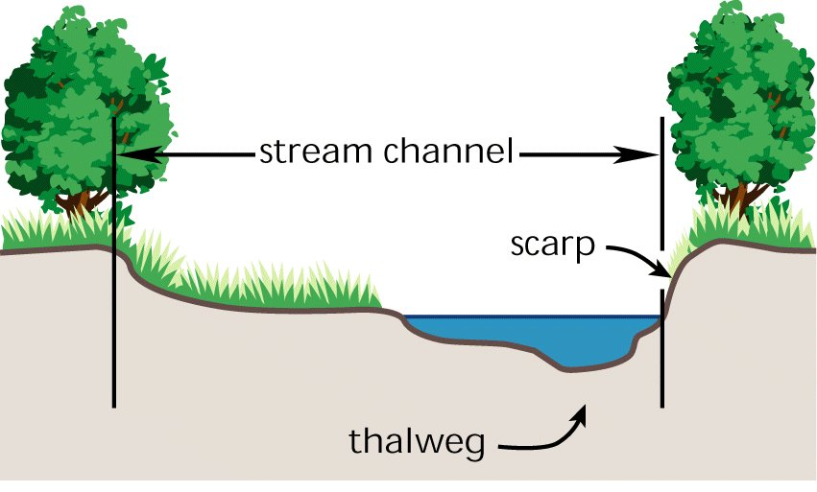
Lateral Stream Channel Cross-Section
Wetted Width
Source: FISRWG, 1998
Notes:
The stream channel has different parts. The thalweg is the deepest part of the channel where the water will be moving the fastest. The scarp is the sloped bank on either side of the channel. The wetted width is the area that has water at a given point. The stream channel extends upward to “bankfull” where it will spill over into the floodplain.
The bankfull width is very important for understanding the stream channel. Relationships between the drainage area and the bankfull cross sectional area can be used to determine what the stream channel should look like in a stable environment. Streams may be incised too deeply to access their floodplain or overwidened.

Slide 20
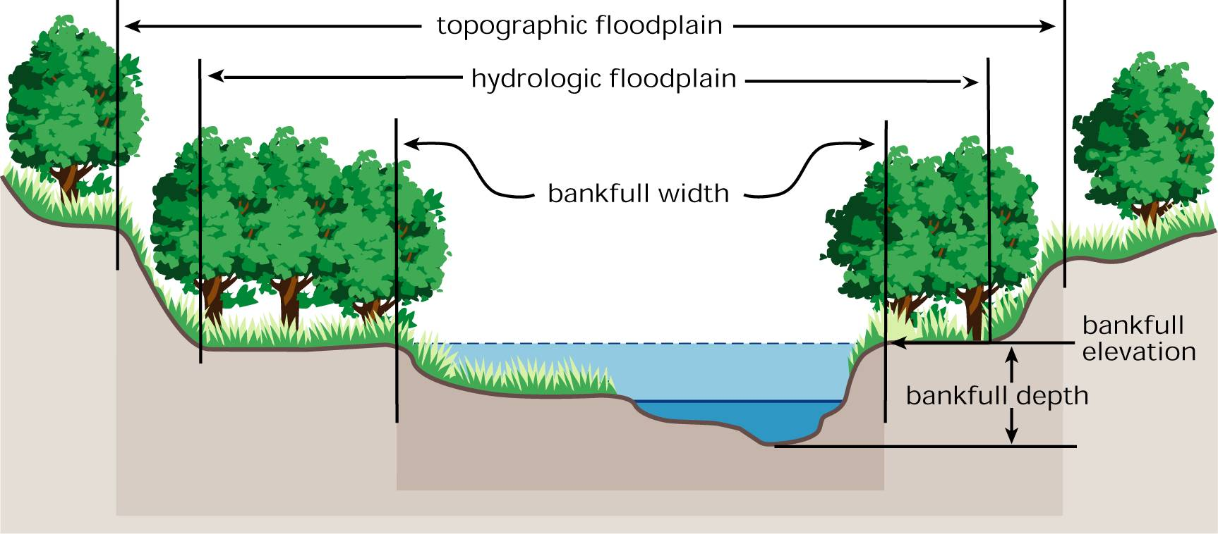
Lateral Floodplain Cross-Section
Source: FISRWG, 1998
Notes:
While water typically flows within the channel during baseflow, it may extend across its floodplain in response to storm events.
Some streams have a “hydrologic floodplain” which is defined as being AT or BELOW bankfull elevation. This area will be inundated in 2/3 of years.
Then there is a larger area adjacent to the channel called the “topographic floodplain.” This area may be defined as the “100-year floodplain” or the “500-year floodplain” based on % chance of reaching that level in any given year.
However, because of probability, a house in the “100-year floodplain” has a 1% chance of occurring in any given year, but a 26% chance of flooding within the term of a 30-year mortgage.
A “500-year flood” has 0.2% in a given year, but a 6% chance of occurring over 30 years.
Because of changes in climate, these percentages may be underestimated.
The point is that water will interact with the area outside of the stream channel and the water quality will be affected. This floodplain is important for allowing the energy of the stream to spread out during flood events and reduce erosion.
Terraces may be present above the floodplain where the floodplain once extended prior to downcutting (eroding and moving downward).
Further uphill will be upland slopes, which produce runoff or soil infiltration and groundwater.

Slide 21
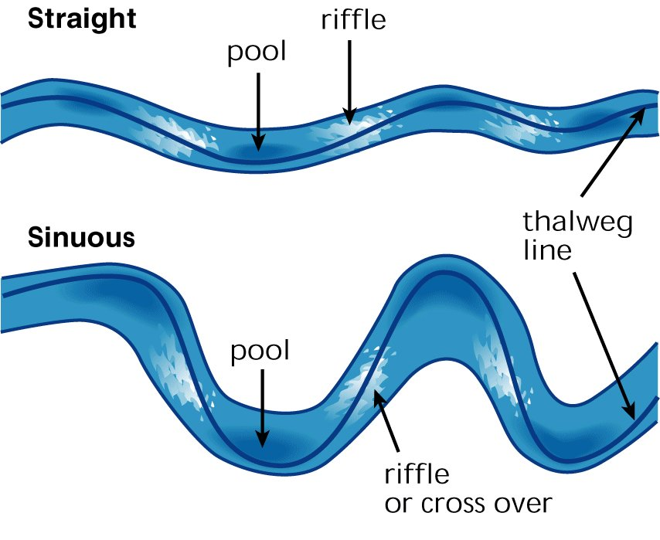
Meanders
Source: FISRWG, 1998
Notes:
Streams located on broader, flatter areas with wider floodplains tend to follow a more sinuous path with lots of curves. The sinuous stream with lots of curves will tend to slow down the waters leading to reduced energy and erosive force.

Slide 22
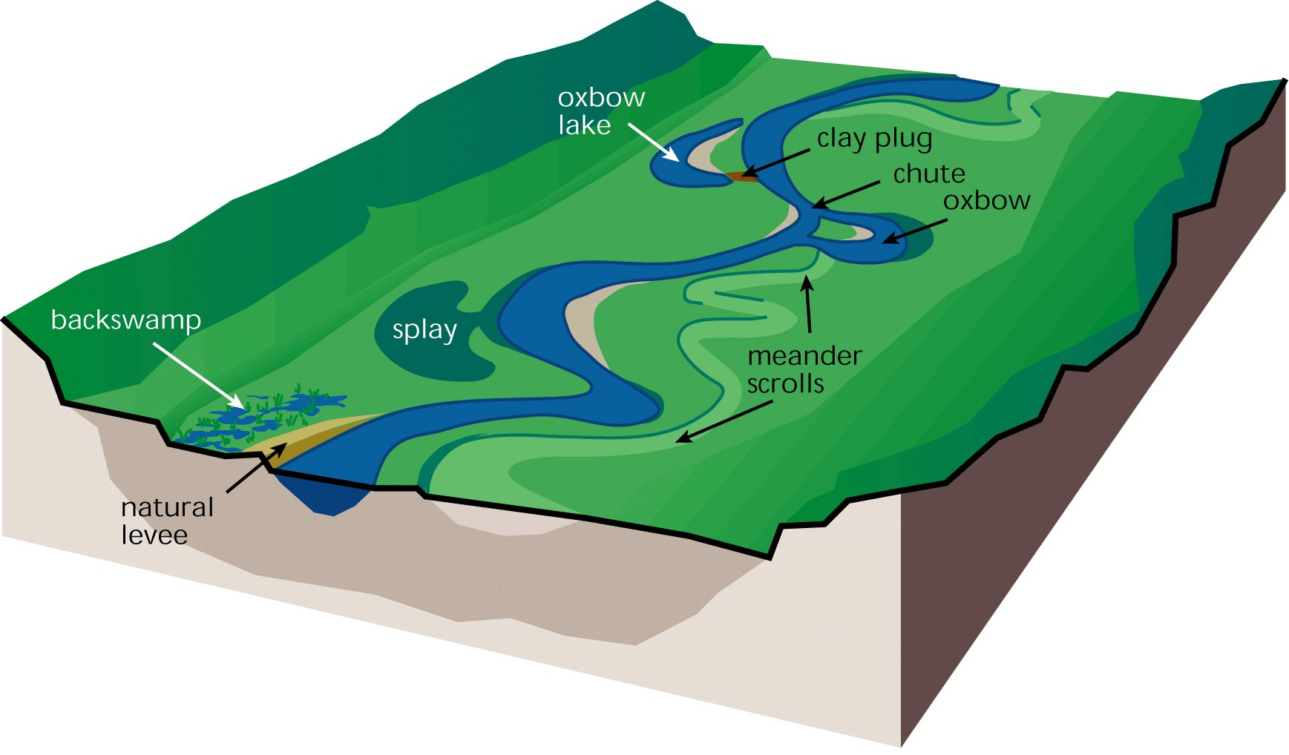
Floodplain Features
Source: FISRWG, 1998
Notes:
Floodplains will often have a variety of features which can help to slow runoff from the surrounding hillsides. They also can filter out pollutants, provide groundwater storage, and habitat.

Slide 23
Source: Rosgen, 1996
Notes:
Classification systems have been developed to help determine types of streams.
Dave Rosgen developed this classification system based on the shape of the channel, the longitudinal slope, the ratio between the width and depth, entrenchment, sinuosity, and other factors.
Identifying stream types help to predict the streams behavior in terms of erosion potential, sensitivity to disturbance, and other factors.
The stream types do not imply that any one is better than another. For instance, an Aa+ stream is not “better” than a D, E or F stream. It is not like an academic grade!

Slide 24
Stream Flow
Q = AV
Where:
Q = Discharge
A = Cross sectional Area
V = Velocity of water
The roughness of the channel and the slope of the water will affect the velocity.
Source: FISRWG, 1998
Notes:
How to calculate stream flow.

Slide 25
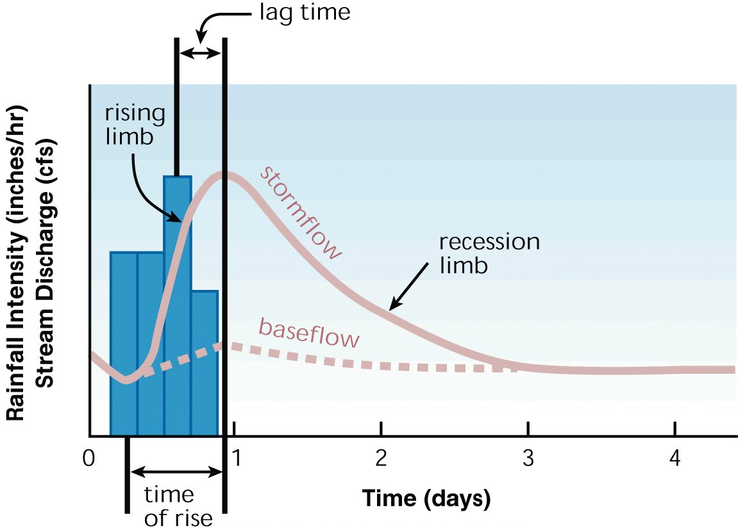
Stream Hydrograph
Source: FISRWG, 1998
Notes:
The response of the stream in response to a rain event can be shown by a hydrograph.
In a hydrograph, the stream discharge is on the Y-axis, and time on the X-axis.
The precipitation can also be shown at the top of the graph or superimposed as in this example, with the blue bars representing rainfall intensity.
In the graph you can see the “hydrographic rise” of the stream. Then there is the peak flow – the maximum flow during a storm event. The time between the peak rainfall and the peak streamflow is called the “lag time.” The receding limb is typically not at steep as the rising limb as the flood waters more gradually decline. Finally, there is the baseflow which can be derived by connecting a dotted line between the baseflow before the storm and the bend in the receding limb. This indicates the groundwater contributions to the streamflow.
Understanding a stream hydrograph is important because the sources of the water are different depending on when you sample, and this affects water quality. During the hydrographic rise most of the contaminants will be from surface runoff and erosion will be present. During baseflow, you will have more groundwater and see effects from point sources of pollution.

Slide 26
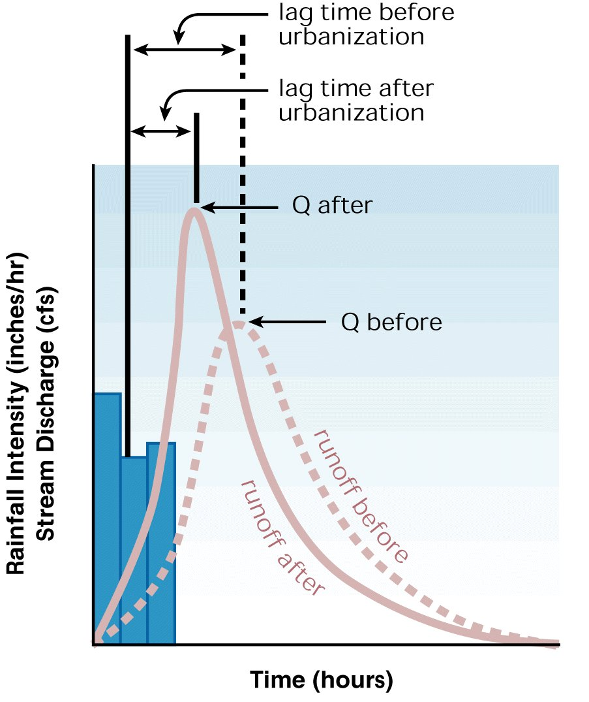
Stream Hydrograph and Urbanization
More Intensity after Urbanization
Higher peak
Shorter lag time
Source: FISRWG, 1998
Notes:
Here in this graph we are noting that the discharge (Q) changes due to urbanization producing higher peaks (see Q after vs Q before) and shorter lags (see lag times at top).
Stormwater infrastructure has been installed to move water off of streets, parking lots and sidewalks as quickly as possible, routing it directly to the nearest waterway. Ditches, culverts and pipes take water straight to the stream.
Thus, we will see quicker, higher peak flows.
The realization of problems caused by this approach has created a new challenge for stormwater managers in urban areas. They now are seeking ways to slow down the water through storage so that flooding and erosion may be minimized. The installation of stream detention features allow these areas to function as a reservoir that holds stormwater and releases it over an extended period of time.
Because aquatic macroinvertebrates can be swept downstream when flows are excessively high, minimizing flows below levels that transport the sediments and aquatic organisms in the stream is also important to maintaining healthy aquatic ecosystems.

Slide 27
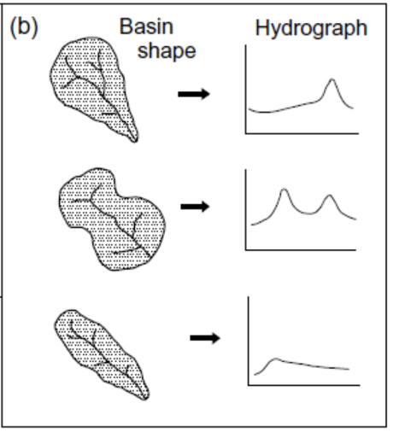
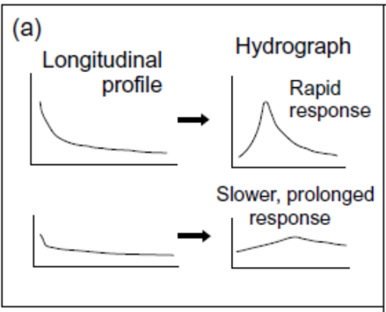
Stream Hydrograph and Topography
Source: Gordon et al. 2004. “Stream Hydrology: An Introduction for Ecologists” Second Edition
Notes:
The shape of the hydrograph is not just affected by the amount of imperviousness, but also by the steepness of the profile and the shape of the basin.
Try to thinking about how long it would take for individual drops of water falling at different points to reach the mouth of the watershed and then put all of those drops together. This will help make sense of what a water sample represents.
As a watershed coordinator, it is helpful to have a general awareness of the basic concept of how water reaches a common point:
A really steep watershed will be expected to shed water quickly causing a quick rise to the peak stream flow.
The shape of the watershed will effect the time that it takes for water to reach a common point.
Graph a - STEEPNESS
(a), 1st example has steeper terrain profile, producing quicker runoff and a more rapid increase in flow or discharge.
(a) 2nd example has flatter, more gradual stream slope, producing a slower, more moderated increase in flow from a rainfall event.
Graph b – SHAPE (click for it to appear)
(b), 1st example – larger area in headwaters results in some lagtime in the arrival of the flow peak
(b), 2nd example - Sometimes “double peaks” can occur because the basin shape staggers when the flow arrives at the measurement point.
(b), 3rd example – narrower, more uniform area draining to the stream at all points produces a relatively small peak will longer recession of waters.

Slide 28
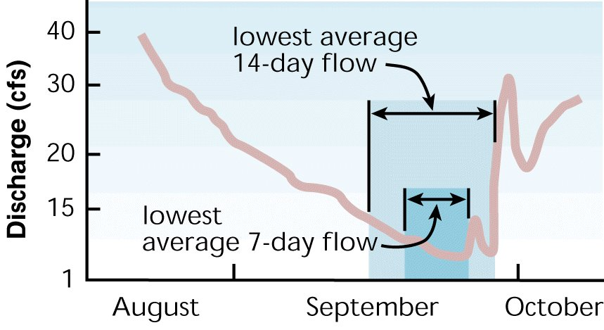
Stream Hydrograph and Droughts
Source: FISRWG, 1998
Notes:
Understanding flow during a flood event is important, but so is determining flow during dry periods.
Many permits will use the 7 day, 10-year low flow to determine concentrations that permittees are allowed to discharge.
Also referred to as the 7Q10—it is the lowest 7-day average flow that occurs (on average) once every 10 years.
During these low flow periods, less water is in the stream, and less dilution of pollution is occurring.
In other words, pollutant levels may be more concentrated and likely to produce negative impacts.

Slide 29
Hydrology and Hydraulics Measurement
Assessed by stream gages, models, and equations to evaluate the relationship between rainfall and water in stream.
Assessed by measures such as bank height ratios, water depth vs discharge curves, shear stress calculations, and groundwater tracers to evaluate the transport in the channel, on floodplain, and through sediment.
Notes:
In order to measure the various hydrologic and hydraulic functions occurring in a watershed, a number of measurements may be utilized by water scientists.
In general, all watershed plans will need to have some understanding of the relationship between precipitation, runoff, and stream flow in order to calculate pollutant loading and interpret chemical sampling results. This is the hydrology component.
(CLICK for info) The hydraulics measurements will help determine whether erosion is occurring and high and whether the high flows may be impacting macroinvertebrate populations. The interactions between the surface water and the groundwater may need to be traced in karst systems and may introduce unique flow paths.
Basic awareness of the concepts of hydrology and hydraulic measurements, presented in this short overview should help watershed coordinators better understand the context for sedimentation, source tracing, and pollutant loading analysis.

