Slide 1
Watershed Academy Watershed Coordinator Training Series
Module 6: Effective Communications
8. Step 6 - Evaluations
Notes:
Now, we’re going to return to our stepwise explanation of how to conduct a watershed outreach campaign and talk about ways to evaluate its effectiveness.

Slide 2
Developing a Watershed Outreach Campaign
STEP 1: Define the driving forces, goals, and objectives ✓
STEP 2: Identify and analyze the target audience ✓
STEP 3: Create the message
STEP 4: Package the message
STEP 5: Distribute the message
STEP 6: Evaluate the outreach campaign
Notes:
We have been gradually working through the steps, starting with Step 1 (define forces, goals, objectives), moving on to Step 2 (identifying and analyzing our target audience. However, instead of moving directly onto Steps 3, 4 and 5, we are going to jump ahead to the 6th step during this presentation.

Slide 3
1, 2 … 6?
Why Now?
Want to evaluate indicators of success after each step – what worked?
Can think about follow-up studies when collecting baseline data.
Adaptive management – how will you adjust your plans?
Notes:
Why did we skip from 1 to 2 to 6?
Because although evaluations should be addressed as the last step, it really needs to be considered from the beginning and all along the way.
This provides a way of collecting feedback so that you can continuously improve your program and ensure that it is effective in achieving your goals. This is commonly referred to as adaptive management because it enables you to adapt your approach if things aren’t working. So, by considering this step from the outset of your campaign, you can better ensure that you are evaluating it more effectively.
For those of you working under a grant agreement, documentation of project effectiveness may also be a requirement.

Slide 4
STEP 6: Evaluate the Outreach Campaign
Consider 3 Types of Evaluation:
PROCESS Evaluation
Is the effort being executed effectively?
IMPACT Evaluation
Was change affected?
Consider Social Indicators and Environmental Indicators.
CONTEXT Evaluation
What are the community perceptions and social, economic or political ramifications of your campaign?
Notes:
You will want to consider three types of evaluation:
Process evaluation looks at how effectively you executed the planned activities, such as meetings, events or media pushes.
Impact evaluation includes ways of measuring achievement of the actual goals or objectives of the outreach effort. These can be social indicators (behavior-based) or environmental indicators. A social indicator may be how many people actually adopted the behavior being promoted. An environmental indicator may be how much the nutrient level has decreased over the course of the campaign.
Context evaluation helps you understand how the program played out in the community as a whole, how it was perceived, and any economic or political ramifications it may have had. This type of evaluation may help you figure out what approaches worked better than others. For example, was the watershed festival well-attended and did you receive positive feedback about it in the community?

Slide 5
Process Evaluation Indicators Is the effort being executed effectively?
# of workshops held / # of attendees
Materials developed (brochures, webpage, etc.)
# of informational materials distributed
Distribution effectiveness
Number of opportunities achieved / Cost per lead
Email open rate
Website clicks / social media views or interactions
# of meetings held
Direct and indirect staff time
Online poll for feedback
Notes:
(Enter some suggestions for possible ways to evaluate your outreach process into the chat box.)
Here are some examples of some ways that you can evaluate your process.
The online poll could be a feedback survey on the outreach campaign or website or information about why they engaged in the BMP… anything to measure whether the planned activities were effective.

Slide 6
Impact Evaluation Indicators Did we achieve our objective?
Social Indicators
Number adopting BMPs
Pre- and Post- tests of knowledge after workshop
Increased awareness
Reduced barriers to desired behavior
Improved resources or support capacity
Changed attitudes
Environmental Indicators
Pounds of pollutant load reduced
Increase in habitat bioassessment score
Feet of riparian zone widened or improved
Notes:
(Enter some suggestions for possible ways to evaluate your outreach impact into the chat box.)
Here are some other examples of ways you can evaluate the social and environmental impacts of your campaign.

Slide 7
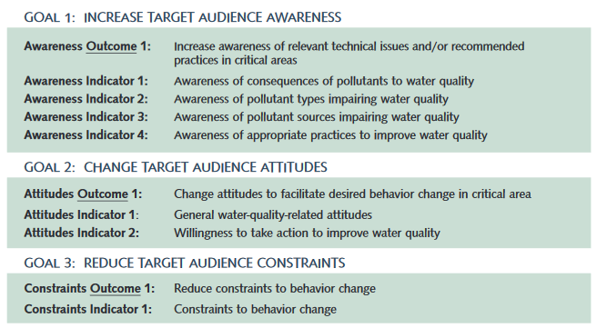
Social Indicators
Genskow, Ken and Linda Prokopy (eds.). 2011. The Social Indicator Planning and Evaluation System (SIPES) for Nonpoint Source Management: A Handbook for Watershed Projects. 3rd Edition. Great Lakes Regional Water Program. (104 pages)
https://iwr.msu.edu/sidma/Info/pdfs/SI_Handbook_v4_02012012.pdf
Notes:
In last week’s presentation on social research, we referenced “The Social Indicator Planning and Evaluation System (SIPES) for Nonpoint Source Management: A Handbook for Watershed Projects” developed by the Great Lakes Regional Water Program. This guidebook includes some great examples of general social indicators that are associated with common outreach goals and objectives.
For example, here are 3 goals to increase target audience awareness, change audience attitudes and reduce constraints to the desired behavior change.
Each of these are linked with a general outcome and measurable indicators.

Slide 8
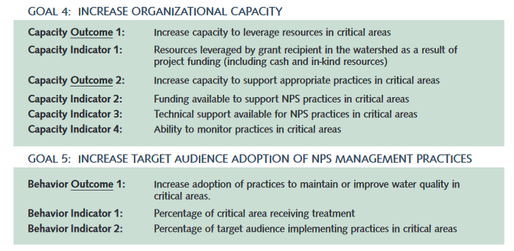
Social Indicators
Genskow, Ken and Linda Prokopy (eds.). 2011. The Social Indicator Planning and Evaluation System (SIPES) for Nonpoint Source Management: A Handbook for Watershed Projects. 3rd Edition. Great Lakes Regional Water Program. (104 pages)
https://iwr.msu.edu/sidma/Info/pdfs/SI_Handbook_v4_02012012.pdf
Notes:
Continued – Here are the outcomes and indicators associated with goals to increase organizational capacity and increase the target audience’s adoption of NPS management practices. You can use these as a reference in developing your evaluation criteria.

Slide 9
Context Evaluation Indicators What are the community perceptions? Political, social or economic ramifications? Perspectives on why approaches are or are not working?
Wrong messenger? (Trust in messenger)
Disproportionate burden on one group
Perceived preferential treatment
Economic downturn affecting adoption
Political issues
Notes:
Lastly, you want to evaluate the context. These are situational indicators that are a little more difficult to standardize.
(Enter some suggestions for possible ways to evaluate your outreach context into the chat box.)
Here are some suggestions.
Preferential treatment could be discovered through a survey question to understand why certain groups quit coming to a meeting, and you might find out that they thought your group was biased towards their opposition. Or it could be that certain groups don’t apply for funding because they “know” others will be chosen due to the way the metrics are set up.

Slide 10
Workbook
How do you know they are any good?
How do you know if you’ve identified the target audience sufficiently?
Is your message well received?
Is your message reaching its intended audience?
Is your distribution method working?
Notes:
The Excel worksheets we provided included a guide to help you think through the evaluation types associated with each step in the outreach campaign development process.
This is not to say that you necessarily NEED evaluations at every level and some indicators are better suited for different steps in the process.
For example, you would probably want to use process indicators for evaluating the distribution step and context indicators for considering your target audience.
I admit that this logic does not come naturally to me, so you may also struggle and want to work with a team to develop your evaluation approaches.

Slide 11
Evaluation at a minimum…
Time and resources may determine degree to which you can evaluate your outreach program.
Review outreach plan with watershed team or staff to determine:
Whether objectives are being achieved
If the target audience is being reached
The response rate to distributed materials
Demonstrate improved understanding of the message (ideally with pre- and post-tests/surveys)
Whether the desired change in behavior was achieved
Notes:
Your group’s technical and financial resources, as well as time availability, will determine the level to which you can conduct evaluation activities.
However, there are some minimal considerations that should be discussed and considered to achieve some basic level of understanding and need for adjustments.
You should:
Review the outreach plan and outcomes to determine if objectives are being achieved.
Determine if the target audience is being reached.
Assess what type of response you are receiving to distributed materials.
Make any needed improvements for message comprehension and the adoption of the desired behaviors.
Ultimately, your project’s success will depend on how well it was conceived, planned, implemented and adapted.
You invested in developing the strategy…you should also invest in ensuring that it is working!

Slide 12
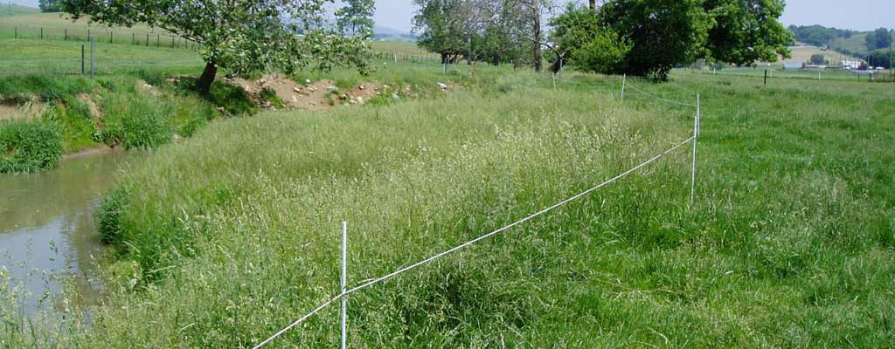
Evaluation Example: Mill Creek
Did stream bank fencing on farms improve water quality?
# of farmers who showed interest by contacting project staff (impact and context)
# of articles published in the local media outlets (process)
# of farm tours given (process)
Miles of stream bank fenced (impact)
Water quality measurements of suspended solids & E coli (impact)
This Photo by Unknown Author is licensed under CC BY-ND
Notes:
Here are some examples of evaluation indicators for an effort to use stream bank fencing on farms along Mill Creek to improve water quality.
These possible indicators could help them address the project’s process, context and impact.

Slide 13
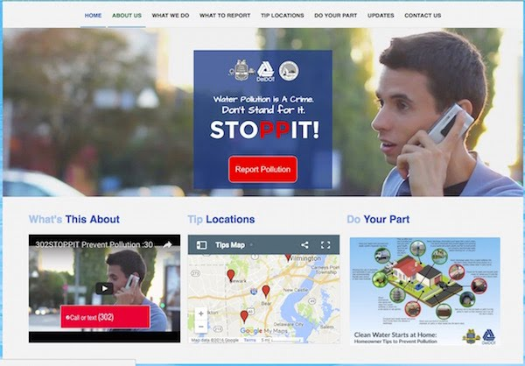
Evaluation Example: Mill Creek
Example: New Castle County, DE STOPPIT! Campaign
MS4 Permit required:
250,000 advertising impressions
Demonstrate statistically valid increase in stormwater awareness
County chose to promote illicit discharge hotline
http://www.waterwordsthatwork.com/environmental-outreach-updates/discharge-webinar
This Photo by Unknown Author is licensed under CC BY-ND
Notes:
A great example of a marketing campaign evaluation can be seen in a webinar example from “Water Words That Work,” an organization that focuses on water outreach and communication.
The example comes from New Castle County in Delaware, where the MS4 permit required the county to generate 250,000 advertising impressions and to generate statistically valid increases in stormwater awareness.
The county chose to promote their illicit discharge hotline: 302STOPPIT and www.302STOPPIT.org, with the slogan “double P stands for prevent pollution”.
They conducted surveys via phone, text, emails, and web forms.
Their promotions ran for 1 month in July 2015 with a $60,000 budget for a population of 550,000 residents. They mentioned 4 behaviors – proper disposal of motor oil, yard waste, pet waste, and household chemicals. They ran commercials on cable, YouTube, Facebook; used online banners and ads, put up billboards, and communicated via official channels, through partners, and via community groups – among other methods.

Slide 14
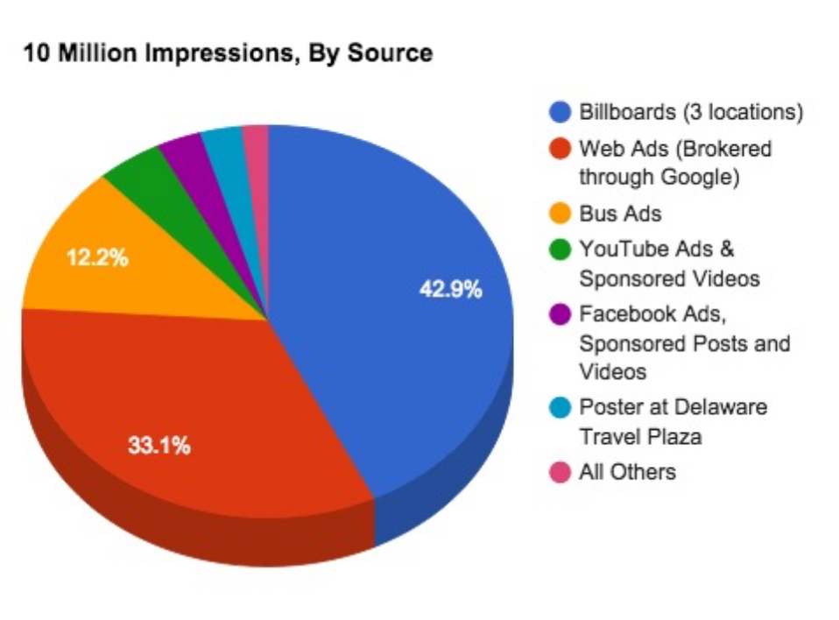
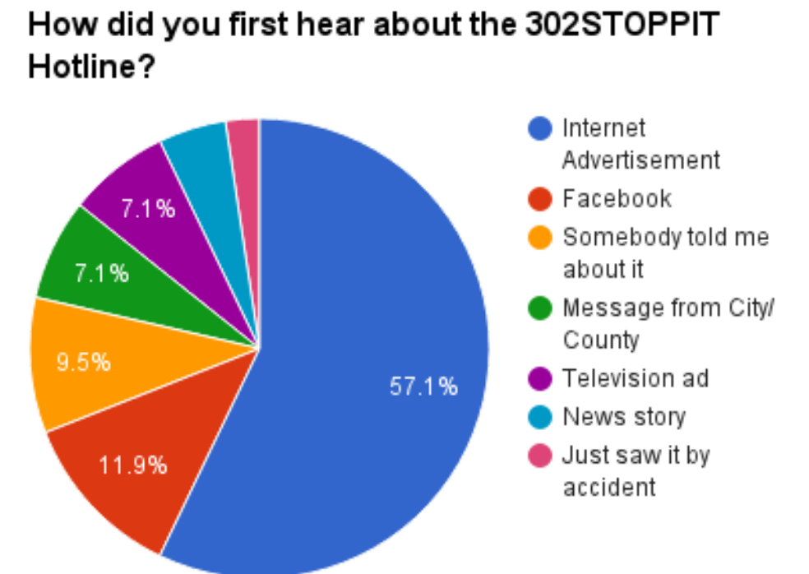
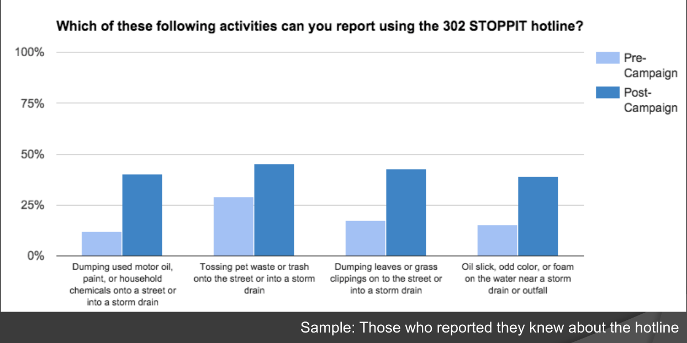
Evaluation Example: Mill Creek
Example: New Castle County, DE STOPPIT! Campaign
http://www.waterwordsthatwork.com/environmental-outreach-updates/discharge-webinar
This Photo by Unknown Author is licensed under CC BY-ND
Notes:
Their end result was over 10 million impressions with the bulk of the impressions coming through billboards, web ads and bus ads.
(Click) They were able to show statistically significant changes in awareness through their surveys – often doubling awareness, and they received increased actionable reports on illicit discharge activities.
(Click) And, because they measured where they were getting reports from, they were able to adjust the campaign in future years so that it cost less and created greater impact.
For instance, they found that online ads cost only 1/3 of the budget, but produced 2/3 of illicit discharge reports. Further, city messaging produced 15% of reports, but cost nothing. They also found that cable TV ads cost 40% of budget, but only produced 7% of tips. And, although billboards, signs and posters were cheap, they produced no results at all.
If you are interested in learning more about this campaign, we recommend that you watch the webinar at the website link.

Slide 15
ACTIVITY: Building Blocks Worksheet
Now, you should be able to fill in the last column of your Building Blocks Worksheet with ways that you can evaluate your campaign so that you will be able to improve it by changing course along the way.
In small groups, discuss the types of evaluations you might need regarding process, impact, and context, as well as any challenges you foresee with the evaluation process.
Notes:
Do I have a baseline on the target audience’s behaviors, beliefs or attitudes?
How will I know if the audience has received the message?
What tools will be used to assess the impact of the campaign?
Who will be responsible for tracking budgets and schedules?
What will be done with the results of the evaluation?

