Slide 1
Watershed Academy Watershed Coordinator Training Series
Dealing with Data
1. The Watershed Coordinator and Data Driven Watershed Planning

Slide 2
Scientific Method and Watershed Planning
Pre-Planning Phase / Watershed Characterization
Develop Water Sampling Plan
Conduct Water Sampling
Analyze Data, Calculate Pollutant Loads, and
Identify Sources
Develop Management Recommendations and Complete Planning Document
Gather Info
Form Hypothesis
Test with Experiment
Analyze Results
State Conclusions
Notes:
In order to effectively communicate watershed issues and goals AND be taken seriously by decision-makers and local citizens, we need to adhere to scientific principles throughout the watershed planning and management process.
Let’s revisit the scientific method and how the 319h required planning process follows it.
It progresses through a series of steps to draw a conclusion
Gather information – Pre-Planning Phase for Developing Watershed Plan
Form a hypothesis – Develop Sampling Plan that helps us understand pollutant levels and possible sources
Test with an experiment – Conduct Water Sampling
Write down results – Data Assessment
Analyze results – Calculate Loads, Identify Sources
State conclusions – Make Management Recommendations
Report results – Complete Report
As watershed coordinator, you must ensure that decisions are founded upon unbiased quality data and that this information is properly communicated to stakeholders.
The scientific method seeks to minimize the biases of the experimenter in seeking solutions.
Therefore, reliance upon good quality data is necessary at each step in the planning process.

Slide 3
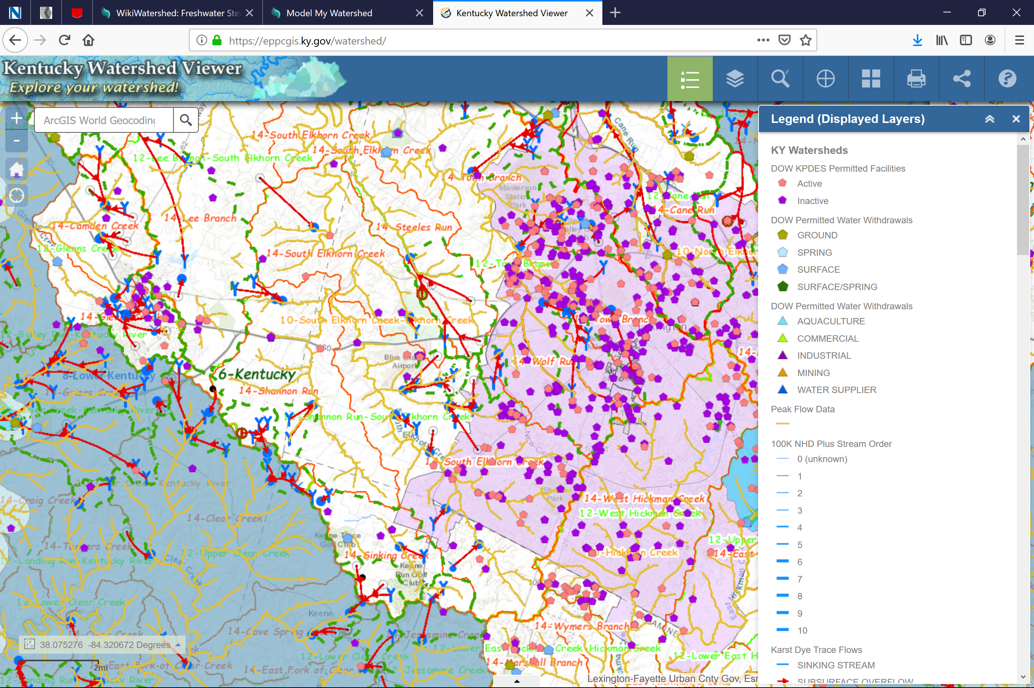
Pre-Planning
Notes:
In the pre-planning phase, you are conducting observations about the area to decide where to best focus watershed planning efforts.
This is often necessary for statewide, regional, municipal organizations.
In this step in the planning process, you are trying to evaluate 1) potential problems, 2) available data, and 3) potential partners and solutions.
The main screening tools in this process include:
Kentucky Water Health Portal – this will indicate if KDOW has enough data to assess the status of the waterbodies and if so what the status currently is.
Kentucky Watershed Viewer – this KDOW product can be used to see the HUC areas, karst zones, water supply protection areas, karst zones, permitted dischargers, and other data. All these are useful in determining potential partners as well as complications and point sources.
WikiWatershed – we will train on this tool in the BMP module, but it provides a quick review of land use as well as agricultural statistics for the area, and soils. This is very helpful in understanding the types of nonpoint sources in the area.
WWKY Data Portal – Reviewing sites in the portal will provide some screening for water quality problems and identify some potential volunteers who may be willing to partner with you.

Slide 4
Watershed Characterization
Notes:
After making preliminary observations and selecting a focus watershed, the next task is to further characterize the watershed area.
A wide variety of data sources are mined for information that may impact water quality, as well as results of any past monitoring that has been conducted. (See slide.)
A handout is provided with websites for data sources. The Kentucky Watershed Guidebook may list other potential sources.
After reviewing the data for validity and accuracy, it must later be summarized and presented in an easily understood manner. This becomes Chapter 2 of a Watershed Plan.
Based on the findings of this characterization, a monitoring plan will need to be developed to address any gaps in the data.
An active hypothesis of what might be impacting the watershed or any risks of impacts will drive the sampling project design.

Slide 5
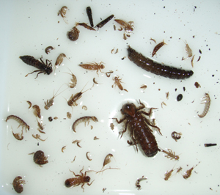
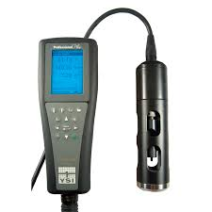
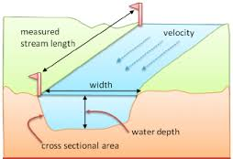
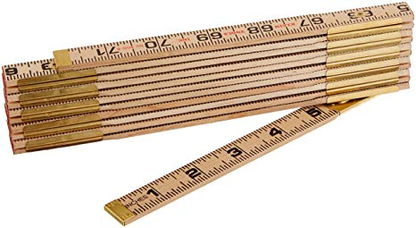
Monitoring
Notes:
Having determined the data gaps, the next step is to develop and implement a plan to collect additional data.
Based on existing information, sampling locations and parameters are selected in order to properly assess potential sources of pollution or impairment.
It is important to be mindful that this data must be of sufficient quality to support later decisions.

Slide 6
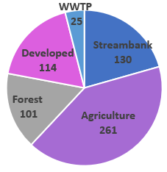
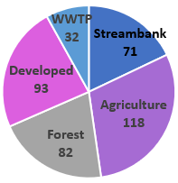
Load Assessment and BMPs
Bank Stabilization
Stream Restoration
Agriculture/Nutrient Mngt BMPs
Stormwater BMPs
Logging BMPs
Current Phosphorus Load
(Tons/Yr)
Stream Capacity Load
(Tons/Yr)
Stream Capacity Load
(Tons/Yr)
Notes:
Once the data is collected, it must be analyzed to determine what, if any pollutants exceed related water quality standards or benchmarks.
For those that do exceed benchmarks, the sources and the steps necessary (or best management practices) to reduce the pollution to healthy levels must be determined.
A proper understanding of the data collected in the previous steps is critical to making the right conclusions at this stage of the process.
As an example, the pie charts show the current phosphorus load allocation (left) and the capacity of the stream with a division of the loading amongst sources (right) for a watershed. The stream capacity refers to the amount of phosphorus that can be contributed to the stream within water quality protection limits.
In both charts, the percentage of the whole amount of phosphorus loading is shown. For example, agriculture is currently contributing 40% of the load, but will need to be reduced to 30% through appropriate management techniques.
BMPs refer to the recommended Best Management Practices for each loading source that will reduce their load contribution, hopefully to achieve healthy water conditions.
Therefore, a number of each type of BMP and the expected reductions must be calculated for the watershed planning report.

Slide 7
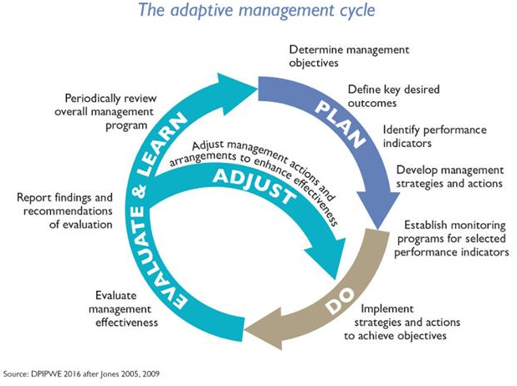
Measuring Success
Notes:
Watershed management must be adaptive.
Once a plan is developed and implementation begins, there must be evaluation of the success of the implementation and adjustment of the plan accordingly.
The plan itself should describe how success will be measured and what the ongoing leadership for evaluation and continued planning will look like.

Slide 8
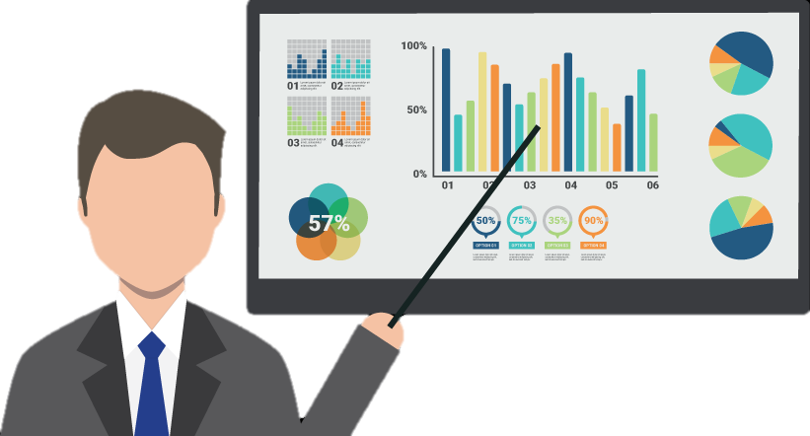
Technical vs Coordinator
Technical Expert(s)
Perform Monitoring Statistical Analysis Quality Assurance Modeling and Load Allocation Develop Maps, Charts, Graphs Evaluate Technical Feasibility Measurement of BMP Pollutant Reductions
Watershed Coordinator
Coordinate Monitoring Initial Screening / Final Review Outreach and Education Communicate Data Partnership Development Community Input / Acceptance BMP Implementation and Documentation
Notes:
It is important to realize that as a watershed coordinator, you are not responsible for all aspects of data.
Fortunately, you are part of a team of professionals with different areas of experience.
This chart helps to clarify the technical experts’ responsibilities on the watershed planning team.
On an effective team, each member has a general understanding of what decisions and actions other team members will be contributing.
You will need to be able to articulate your role as well as the roles of others on the team.

Slide 9
Dealing with Data Module
How to…develop a monitoring plan
How to…perform data screening and know good data
How to…understand and explain graphs, maps, charts
How to…calculate pollutant loads and allocate sources
How to…use some basic mapping and Excel spreadsheet tools
Notes:
Although you may not be performing the data analysis yourself, it is important to have some general familiarity with the types of things the technical experts are considering in order to improve your data communication, education, and outreach skills.
To be effective, watershed coordinators need to have some background in data collection, management and quality assurance.
This module is intended to train watershed coordinators (not data scientists).
In order to help you in your specific role, the following skills and topics will be addressed in this “Dealing with Data” module:
How to assist with the development of a monitoring plan for a watershed planning effort
How to perform screening of data and review of watershed plan documents
How to understand the components of good quality data
How to explain maps, charts, and graphs in the watershed plan and understand some of the limitations of the data, and
An overview some simple mapping and database tools for use in exploratory data analysis and communication.
This module is not intended to train attendees on how to perform all of the required steps in monitoring, calculating loads, and performing data analysis. It is rather to familiarize you with these components of watershed planning.

