Slide 1
Watershed Academy
Watershed Coordinator Training Series
Effective Communications
1. The Art of the Meeting

Slide 2
The Art of the Meeting
Objective: Help participants learn how to prepare an effective meeting and to practice some core facilitation skills.
NOAA. 2010. Introduction to Planning and Facilitating Effective Meetings. https://coast.noaa.gov/data/digitalcoast/pdf/effective-meetings.pdf
EPA. 2013. Getting in Step: Engaging Stakeholders in Your Watershed EPA 841-B-11-001
Notes:
This presentation is a little bit different than others in this module in that it is focused on helping to prepare and facilitate effective meetings,
This presentation has relied upon the NOAA Intro to Planning and Facilitating Effective Meetings and the EPA Getting ins Step Guide for Engaging Stakeholders.

Slide 3
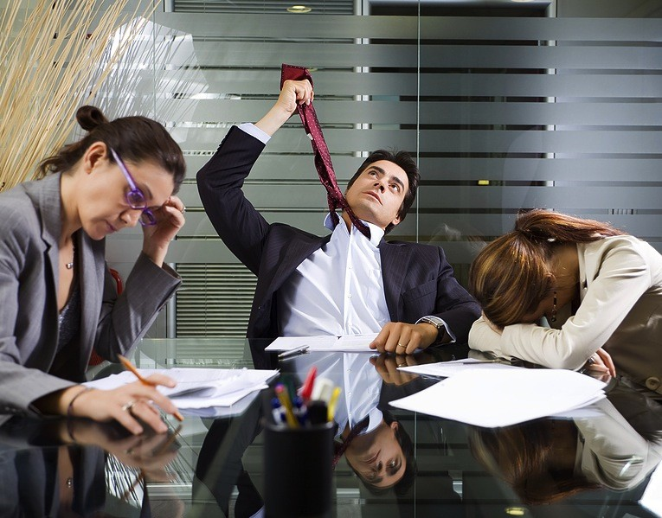
The Art of the Meeting Overview
Preparing for an Effective Meeting
Executing a Meeting with Strong Facilitation Skills and Activities
Dealing with Disruptive Behaviors
Meeting Follow Up
We’ve all been there….
Notes:
Look… we all know what it is like to be in a poorly managed meeting. Hopefully with today’s agenda we will help you to improve your meetings.

Slide 4
Meeting Ground Rules
If your wifi bandwidth allows, keep video ON but mute microphone
Use hand signals
Use chat to indicate questions along the way.
Participate as fully as possible in breakout sessions and interactive activities.
Please do not take phone calls or work on other materials during the session (if you can help it)
NOTE: Setting ground rules is recommended!
Notes:
We want to begin the meeting with some ground rules. (These are specific to virtual meetings!)
Why? Because this is an effective meeting practice that helps everyone be on the same page.

Slide 5

Hand Signals
I want to contribute!
Break or proposed change in format
Slow down
Language
Please translate
Major objection
Speak up
Applause
I agree!
I like that!
I’m confused
(in front of face)
www.seedsforchange.org.uk
Notes:
During this meeting, we want to introduce some hand signals.
Hand signals are good for virtual meetings especially, but also for in person meetings.
Ever had multiple people talking over each other? Use the single finger to indicate you would like to speak and wait for the facilitator to recognize you.
Don’t understand a word or acronym – use the L to quickly communicate that and if you are really confused wiggle your fingers in front of your face.
Agree! Shake your hands back and forth.
Need to interrupt for something procedural or a bathroom break? Use the timeout sign.
Other signs include, speed up or slow down, thumbs up, and you can point at your wrist if we are running out of time….
These are ways to increase participation without increasing interruptions.
If you are excited about hand signals please indicate applause

Slide 6




Icebreaker Activity
Virtual Spectrum Lines
Indicate your level of agreement with the following statements by moving your hand across the spectrum of your screen.
Strongly
Agree
Neutral
Strongly Disagree
Notes:
It is also great to start meetings with ice breaker activities.
In this case, we are going to use a virtual spectrum line.
You can do spectrum lines in person by requesting that people line up according to their level of agreement with various statements. In person, it gets people out of their seats and moving and provides a visual feedback.
Here we are going to indicate the level of agreement by adjusting your finger to the position on the screen showing your level of agreement. We are going to do up and down, but you can also do side to side.
Let’s see how this works by indicating your level of agreement:
I understand how spectrum lines work
I have seen spectrum lines used in a meeting before
I will use this activity in a future meeting
I am having a great day today

Slide 7

Preparation
Notes:
With that introduction, let’s start in on the preparation.

Slide 8


Initially Inviting Stakeholders
Send written invitation (personalized)
Follow up phone call for first meeting
If can’t attend, ask for a delegate
If can’t come, offer sending minutes or reaching out about future decision input.
At meeting, ask for group commitment
Notes:
Particularly when you are putting together your first stakeholder meeting, you want to make a strong first impression.
You can do this by sending a written invitation and following up with a phone call. This shows that you are well-organized and that each stakeholder is important.
If individuals cannot make it, ask for them to send a delegate. This indicates that you really value their organization’s input.
If stakeholders cannot (or will not )come, you can offer to keep them updated by sending them meeting notes and asking if they would be willing for you to reach out about input on relevant future decisions. In this way, you can keep folks involved even if they cannot regularly attend meetings.
At the first meeting, after explaining the purpose you should ask people to sign a group pledge to the process and to make reasonable effort to attend stakeholder meetings. Commitment is important and writing it down seems more binding than just a voice vote.

Slide 9
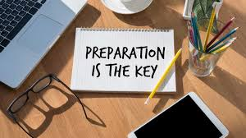
Preparation for Meetings
Provide advanced notice
Define the meeting purpose and objectives
Establish roles
Develop the agenda
Forward agenda and other background materials needed
Plan the meeting space and logistics
EPA. 2013. Getting in Step: Engaging Stakeholders in Your Watershed EPA 841-B-11-001
Notes:
In preparing for regular meetings, there are several items that should be on your checklist.
First, you should try to schedule the meeting a month out if possible, but certainly more than a week. There are multiple coordination apps that can be used to try to assist with meeting scheduling. (such as Doodle Poll)
We will cover the other items in the following slides.

Slide 10
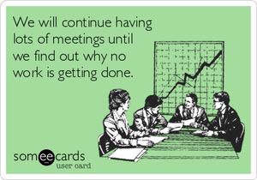
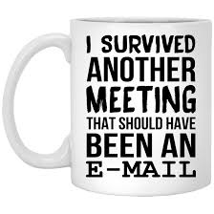
Purpose and Objectives
Why are you calling the meeting?
  Planning or visioning? Decision-making? Team-building? Problem-solving? Evaluating or tracking a project? Information sharing?
What do you hope to accomplish?
  Single sentence summary
  If information sharing, include a “so that” statement.
  Desire concrete outputs of the meeting (takeaways)
  What decisions need to be made?
  Is there sufficient time to accomplish?
What topics need to be discussed to reach the desired outcomes?
Notes:
You want to be sure that you define your purpose and objectives for the meetings prior to scheduling.
We have all been in meetings where there really does not seem to be a purpose and it could have been summarized in an email. You don’t always need to have a meeting. Just look around the room and think about the cost of the salaries and wages of the people attending and ask: “Is this really the most effective use of time?”
If you are calling a meeting, it needs to have a purpose. Some examples of that purpose are provided. If your purpose is “information-sharing” you need to be able to articulate a “so that” statement. Meetings must DO something.
Further, you should be able to provide a quick summary of what the concrete outputs or decisions should be.
And, make sure that you increase the happiness of the attendees by defining a meeting purpose that is clear and achievable.
Finally, list out the topics that will need to be addressed to reach the outcome.

Slide 11

Establishing Roles
Participant list
  Who and what background do they have?
  Any sensitive interpersonal dynamics?
  Have an attendance sheet
Roles
  Facilitator (particularly for large meetings)
  Meeting Leader (Content Expert – may also facilitate)
  Recorder (one or more)
  Participant
  Meeting Planner (larger meeting)
  Others: Timekeeper, Technology-Keeper, Agitator
NOAA. 2010. Introduction to Planning and Facilitating Effective Meetings. https://coast.noaa.gov/data/digitalcoast/pdf/effective-meetings.pdf
Notes:
For most meetings, you will want to have an attendance sheet to pass around, but even before the meeting you want to think about your participants. What unique backgrounds or skills do they have that you want to hear about? Do two people have different views that are likely to cause conflict and slow progress?
Then, be sure that you have assigned roles for the meeting. Listed are some common roles. We will be talking more about the role of the facilitator later, but sometimes, particularly for smaller meeting the facilitator and leader can be combined into a dual role. For large meetings, or meetings where there are a lot of interactions, you need a facilitator.
You will also want someone designated as the recorder to keep minutes and the others may just be general participants.
Some other roles that are often helpful are the meeting planner who manages all the logistics, registration, set-up, and other duties. You might have timekeepers to help move through the agenda, technology keepers to load presentations and troubleshoot slides or microphones, and an agitator to ask the questions others are thinking but afraid to ask or to play devil’s advocate.

Slide 12
Agenda
Two Agendas
  Participant Agenda (Concise summary)
  Process Agenda (Detailed steps for leading)
NOAA. 2010. Introduction to Planning and Facilitating Effective Meetings. https://coast.noaa.gov/data/digitalcoast/pdf/effective-meetings.pdf
Notes:
Meetings should have an agenda.
Actually they should have 2 agendas – one for the participants and one for the leaders, which provides extra details about the process.
The participant agenda should be very concise with discussion items or objectives.
The process agenda should have times, activities and objectives, meeting roles, setup and material items. The layout in this slide shows an effective way to work through the process meeting agenda item by item.

Slide 13






Logistics (Meeting Planner)
Location
Contact
Equipment
Food / Snacks
Breaks
Layout
NOAA. 2010. Introduction to Planning and Facilitating Effective Meetings. https://coast.noaa.gov/data/digitalcoast/pdf/effective-meetings.pdf
Notes:
Large meetings will greatly benefit from an assigned planner who helps manage the logistics. If not, someone (typically the leader or facilitator) will need to think through these considerations.
Location: Where will it be held? Does it best suit the group and its travel requirements?
Contact: Who is the contact person for the facility and logistics?
Equipment: Do you need wall space or a whiteboard? Audiovisual equipment?
Food / Snacks: Do you need to have food or beverages?
Breaks: Are there enough breaks?
Layout: What are the room layout arrangements?

Slide 14
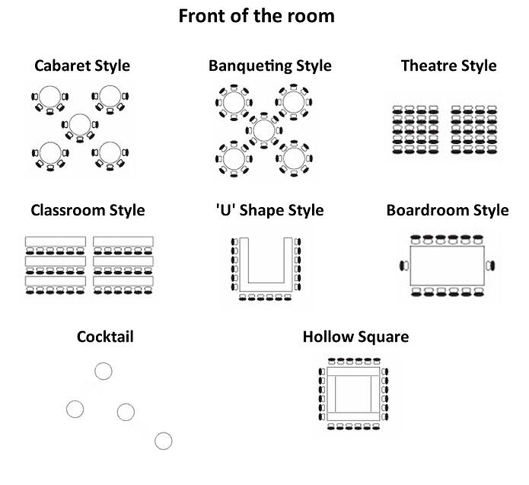
Room Layout
Notes:
The way that people are arranged in a meeting will affect the participation. Here are some common layout styles:
Cabaret Style = notes and group interaction, as well as speaker interaction
Banqueting = small group settings or meals
Theater Style = Maximize seating with minimal note taking and participant interaction
Classroom = Speaker to participant interaction with notes and large seating
U-Shape = large committee with audiovisual presentations
Boardroom = clear leader of meeting and discussion-based
Cocktail = Allow for informal socialization and networking with some seating
Hollow square = Large committee interaction

Slide 15

Execution
Notes:
Once you have worked through your meeting’s purpose and objectives, agenda, roles, and logistics, you are ready to execute the meeting.
Let’s take a look at some skills, activities, and tools that will aid in that process.

Slide 16
Stages of Meeting Discussion
Opening (Brainstorming)
  Idea generation, clarification, information gathering
Prioritizing (Reducing)
  Synthesizing, eliminating ideas, evaluation
Closing (Agreement)
  Decisions, prioritization, or agreements
NOAA. 2010. Introduction to Planning and Facilitating Effective Meetings. https://coast.noaa.gov/data/digitalcoast/pdf/effective-meetings.pdf
Notes:
It is helpful to begin by noting that meetings (or at least meeting segments) tend to have a regular shape to discussion.
There is an opening phase where a question or topic is introduced, brainstorming is conducted, thoughts are clarified, and information is shared. So, the question prompts the discussion scope and content.
The second phase is the prioritization or reduction phase. In this step, information is summarized, similar ideas are combined, and action items are evaluated. The goal here is to narrow the choices or data to make it more manageable.
Lastly, there is a closing section or agreement phase. This is where decisions occur, final prioritization is made, and the group reaches an agreement

Slide 17

Role of Facilitator
Uses knowledge of group process to guide
through the structure of the meeting.
Can be internal or external.
Content-neutral person
Ensures all voices are heard and assumptions are tested
Designs meeting processes to help achieve purpose and objectives
Guides discussions by asking questions and reminding of goals
Takes public notes of key points
Helps carry out decisions
Good at synthesizing and organizing ideas quickly.
NOAA. 2010. Introduction to Planning and Facilitating Effective Meetings. https://coast.noaa.gov/data/digitalcoast/pdf/effective-meetings.pdf
Notes:
The facilitator serves a key role in meetings. If a meeting leader is also serving as the facilitator, then their skills can often make or break the success of the meeting.
Facilitators are meeting process and structure experts. They help move the participants through the stages of the meeting. They are not necessarily content experts. Although knowing something about the subject will help, they need to remain content-neutral. Their goal is not to solve the problems or necessarily to contribute content to the discussion, but to get involvement from the participants so that they can achieve the meeting objectives. This person can be an internal group member or you can hire a professional facilitator.
Facilitators also help design the meeting so that it flows smoothly and is effective. They ask questions, guide discussions, and keep the meeting on track. They will draw out the quieter voices and tone down the outspoken ones. They will summarize points, take visible notes on flipcharts, and help the group to arrive at decisions.

Slide 18
Facilitator Skills
Active Listening
Remaining Neutral
Asking Questions
Paraphrasing
Summarizing
Negative Polling
Restating the Purpose
Label a sidetrack
Using Parking Lot
Mirroring or Naming Reactions
Flip Chart Notes
Interventions for Disruptive Behaviors
NOAA. 2010. Introduction to Planning and Facilitating Effective Meetings. https://coast.noaa.gov/data/digitalcoast/pdf/effective-meetings.pdf
Notes:
Here are some of the skills of a facilitator.
They need to use their body language to show they are actively listening to content and to clarify thoughts.
They don’t need to lead the group in their opinion but try to show respect to all opinions in a neutral stance.
Facilitators ask questions, paraphrase – summarize – or synthesize responses to ensure it is captured
They may use negative polls (does any one not agree with that direction) to keep things moving along
When participants get sidetracked, they will label it as such – capture ideas in the “parking lot” for future discussion, and restate the purpose of the meeting.
Facilitators are accurate readers of the mood of the room, and they may label low energy and call for a break or explain that they see confused faces and work towards resolutions.
They will often use flip charts to capture the group’s thoughts
And inally, they will manage disruptive behaviors and personalities

Slide 19
Facilitation Tools
Introduction Tools
Team Building Tools
Idea Generation Tools
Participation Tools
Decision Making Tools
Prioritization Tools
NOAA. 2010. Introduction to Planning and Facilitating Effective Meetings. https://coast.noaa.gov/data/digitalcoast/pdf/effective-meetings.pdf
Notes:
How does a facilitator do this?
Well, in addition to the basic skillset, they have access to a number of tools that can be utilized to engage the participants. We will explore the tools in these different categories.

Slide 20

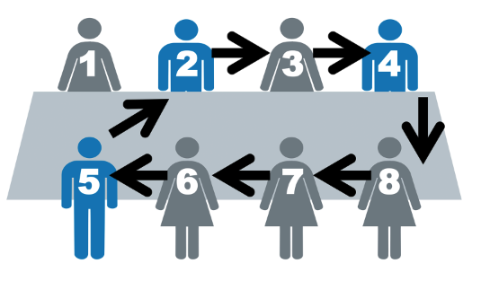
Introduction Tools
Personal Introductions (Unfamiliar Audience)
  Go around room and give name / org and one other fact: expectation for meeting, unique personal habit, etc.
Excitement Sharing (Familiar Audience)
  Share something positive in personal or professional life.
Speed Networking
  Alternative 1: Stand in line and provide 30-60 second elevator pitch to each other. Exchange business cards. Then lines move to left or right.
  Alternative 2: Have organizations man numbered tables and participants visit for short Q&A then switch.
    (Requires advanced planning during registration)
Notes:
It is always good to start the meeting on the right footing!
If you have an unfamiliar audience or someone new has joined, you might want to start with going around the room and giving your name and organization, as well as one other piece of information. This could be a personal fact (to relationships?), meeting expectations, or some other items like a fun question to build energy.
If people know each other, consider having everyone state something positive in personal or professional life to build energy and excitement for the meeting.
Another fun alternative is speed networking. In this case, participants have their business cards and an elevator pitch ready and they each take about 30 seconds to introduce themselves before moving to the next person. If you have time, you can also schedule different organizations to “table” and others can come and participate in a short Q&A session for about 10 minutes before switching.

Slide 21
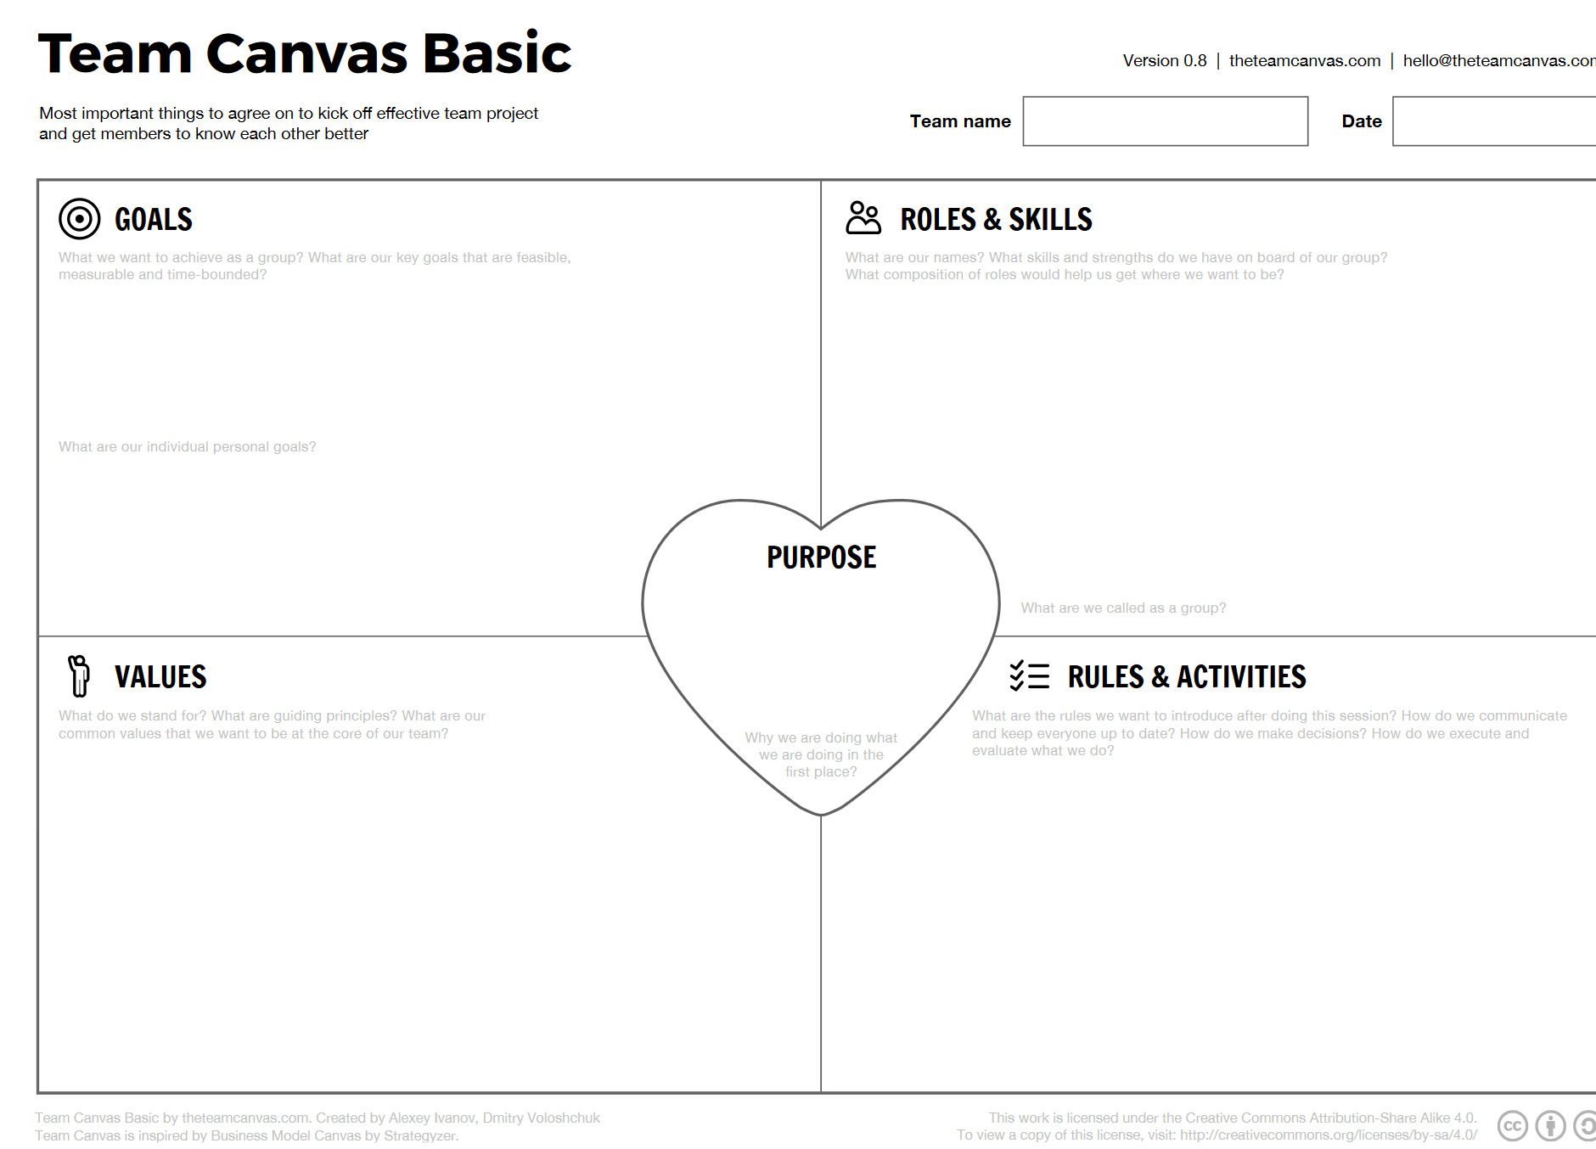
Team Building Tool - Canvas Session
Use whiteboard or flip charts to make squares
Distribute post-it notes and pens to team members
Work through section by section
http://theteamcanvas.com/
Notes:
If you are just starting a team, you might consider using a Team Canvas Session. You can go to the website to download templates or just write them on whiteboards or flipcharts. The facilitator will help the group use define their goals, roles and skills, values, rules and purposes. If you get really motivated, you can add strengths, weaknesses, opportunities and risks (SWOT) – personal goals as well as group goals, and needs and expectations.
By working through this as a group, you can quickly develop a framework for moving forward. Take five minutes on each section to post ideas and then work back over to clarify.

Slide 22
Idea Generation Tools / Exploration
Brainstorm
  Option 1: Ideas stated as fast as possible without censoring. Recorders write
  Option 2: Topic flipchart papers and participants roam and write.
Small Group Breakouts
  Break into 3-15 people to discuss then provide summary report outs. Groups have recorders and spokesmen.
Roleplay Community
  Provide a scenario and have participants play different roles in the community to help gauge reactions and anticipate conversations.
  Practice later today…
Notes:
If you are seeking to generate ideas, there are a number of options.
People talk about brainstorming sessions, but they are often not handled correctly. Brainstorming sessions have no censoring or evaluation. You either need to have a sufficient number of recorders to write down all ideas, or you can place flipcharts around by topic and have people roam around and write feedback on them. You can sort through the ideas later.
Small group breakouts (3-15 people) can help reduce a large group to a number that allows for more open communication. Each group will need its own recorder and spokesperson.
Another alternative is role-playing different scenarios. By speaking from different viewpoints in the community or switching perspectives, it can help you to consider and work through potential objectives.
We are going to practice this later today.

Slide 23
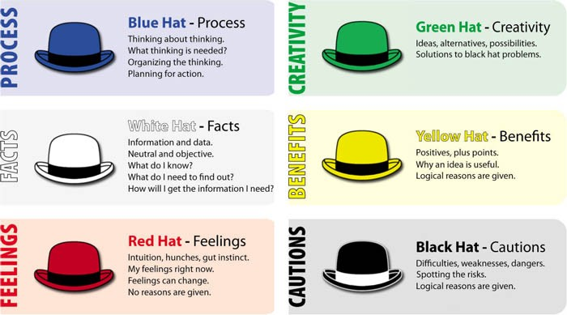
Six Thinking Hats
https://trickle.app/drip/16339-the-six-thinking-hats-encourage-people-to-approach-a-challenge-from-different-perspectives/
Notes:
The Six Thinking Hats activity has been developed by Edward de Bono in a book of the same title.
There are two options:
The whole group wears each hat together at the same time, or
The hats are distributed throughout the group and each individual brings a unique perspective.
You don’t need an actual hat (a colored paper will do).
Read the description of the roles on the slide.

Slide 24
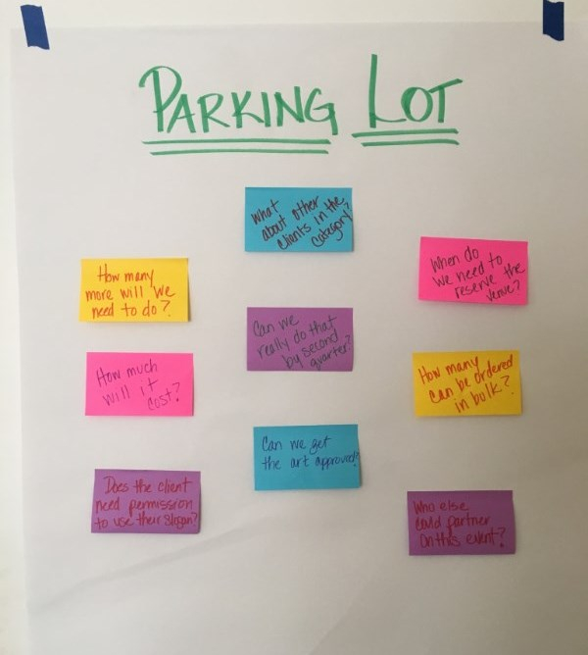

Participation Tools
Parking Lot
  If going off track, briefly stop meeting to record non-agenda item on post-it for returning to at a later time (or meeting).
  Include in meeting minutes
Speakers List
  When people raise a finger, you recognize them and write them down to speak at appropriate time.
Speaker Ball or Pass the Mic
  Object that designates person allowed to talk (if you have dominant talkers or interrupters).
Notes:
There are several tools you can use for increasing participation.
One is the parking lot. This is simply a way to recognize that the meeting has gone off track and to provide the opportunity to document the sidetrack for follow-up at a later time. You can pause the meeting long enough to document the concern and then include it in the meeting minutes for a later meeting or (if time permits) return to the issue later in the meeting.
Maintaining a running speaker’s list (indicated by raising a finger and the facilitator saying – I see you and you…etc) will help maintain order while providing opportunities to speak. You can also provide time limits or limit the number of opportunities to speak if need be.
Finally, you can utilize a speaker ball or passing the microphone to help keep people from talking over each other.

Slide 25
Decision-Making Tools
Consensus Decision-Making
  If objective is to reach consensus, let participants know what level of consensus is needed. Is comfortable consensus enough? How strong do people feel? Might need high degree. Simple majority if need decision but consensus cannot be achieved.
Consultation
  If known diverse views, objective may be to list suggested recommendations. Discussions can help clarify viewpoints and lead toward diverse viewpoints.
Prioritization
  Objective is to prioritize needs, options, or solutions. Get input from group to determine priorities.
NOAA. 2010. Introduction to Planning and Facilitating Effective Meetings. https://coast.noaa.gov/data/digitalcoast/pdf/effective-meetings.pdf
Notes:
When it comes to making decisions, you need to have a clear idea of what level of agreement is necessary and how to achieve it.
This may depend on the nature of the decision and the passion of the participants. If you cannot build a group consensus but you need an immediate decision, a simple majority vote may suffice.
It is important to note that sometimes the goal is not making a decision, but simply receiving input and feedback. You may want this to be the end goal if there are a lot of diverse views and you need the discussion to help better understand viewpoints for a later decision.
Finally, the objective may be to prioritize the actions and determine their relative importance, innovativeness, feasibility, schedule, or other factors.
Understanding what type of decision you need and/or adjusting based on the tone of the audience is important.

Slide 26

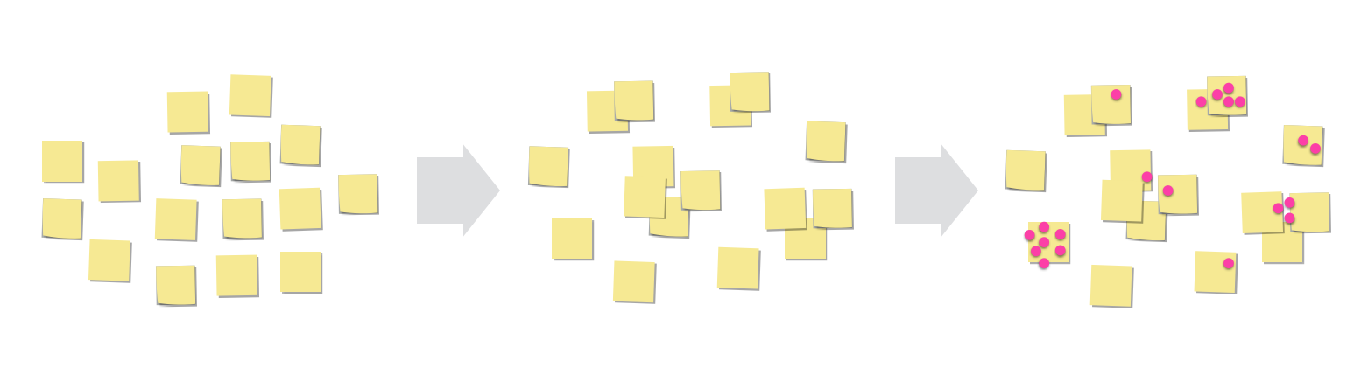
Prioritization Tools
Thumbs Spectrum or Spectrum Lines
  Line up between two spectrums to show agreement. (or vertically with hand high or low)
Dot Voting
  Generate ideas on post-its
  Group clusters or themes
  Give a set number of dots (3-6) distribute votes.
Notes:
If you are looking to prioritize, you can use the thumbs spectrum or the spectrum lines (as covered in the introduction) to help get immediate feedback.
You might also consider the dot voting system. In this system, participants generate ideas, then group them into clusters or themes and finally the use dots to distribute votes for the preferred solutions
When using dot voting, be sure to check that:
It is used as a discussion and exploration tool, rather than a decision-making tool (there may be biases and you may miss valuable feedback.
Ensure votes are not split among too many similar items (count categories together)
Items that are non-negotiable or systems in which all elements are required for them to work cannot use such prioritization schemes
Beware of cause-and-effect relationships between items
Consider using colors to help highlight perspectives (most innovative, most feasible, most important, etc.)
https://medium.com/@stephenanderson/whats-wrong-with-dot-voting-exercises-9f121e20474a
You can also utilize paper ballots to score out in a similar way with additional advanced preparation.

Slide 27
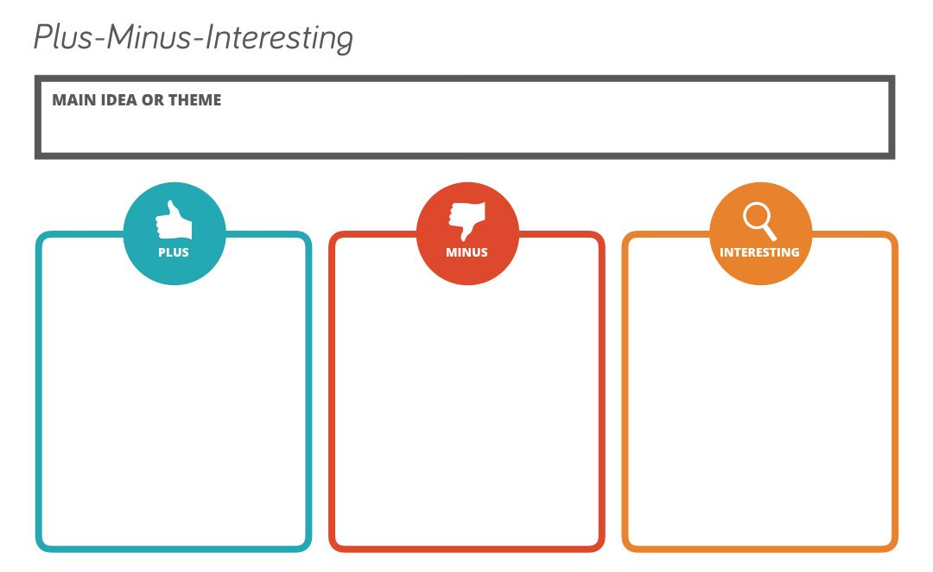
Prioritization Tools - PMI Chart
Notes:
Another idea is a Plus – Minus - Interesting chart or PMI chart.
In this chart, you right down the pros and cons of each alternative as well as important but neutral facts. This can help clarify alternatives

Slide 28

Prioritization Tools
2,4,8 Consensus
  Round 1: Pairs (2) agree on top 3 priorities (3 minutes)
  Round 2: Combine two pairs (4) and agree on joint top 3. (4 minutes)
  Round 3: Combine two 4’s and agree on joint top 3. (5 minutes)
  Repeat until whole group together or sufficiently reduced.
Notes:
Another tool is the 2,4, 8 consensus.
This tool generates ideas and prioritizes them. In this activity, you start in pairs generating ideas and then combine groups and promote only the top ideas.
So, for example, you start in pairs (groups of 2) and the pairs generate their best three ideas for the issue under discussion. You can use 1 minute to think individually and then 2 minutes to discuss.
Then, pairs combine into groups of 4 and take 4 minutes to agree on a joint top 3 solutions. So, they have to eliminate 3 ideas between the groups.
Then, these groups join (group of 8) for another selection of a combined top 3 priorities (5 minutes).
You can adjust the times as needed, but this gives you an idea of the process. You can also report out in groups at this point or have the groups of 8 join and repeat the process. The result is a short list of priorities that can be moved forward in a relatively short amount of time.

Slide 29
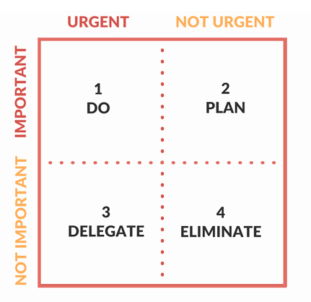
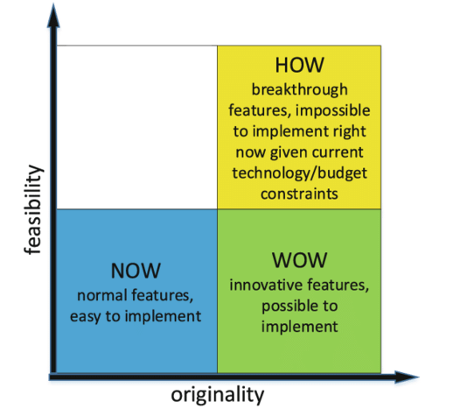
Prioritization Tools
Urgent / Important Grid
  Eisenhower Matrix
  Sort out most critical tasks by urgency and important spectrums
How-Now-Wow
  Idea selection base on originality and feasibility
  Use stickers (yellow, green, blue) to rank options like dot voting
Notes:
Other tools include the urgent / important matrix (also called the Eisenhower matrix) and the How-Now-Wow matrix.
The Eisenhower matrix helps sort tasks by importance and urgency such that you can focus on the most critical issues, schedule long-term planning for others, and either delegate or eliminate those that take up lots of time but accomplish less.
The How-now-wow matrix looks at feasibility versus originality. Often the most creative ideas get bypassed for familiar but boring ones. This matrix helps prioritize the wow factor. These colors can be used with the dot voting systems or brainstorming lists to help prioritize.

Slide 30
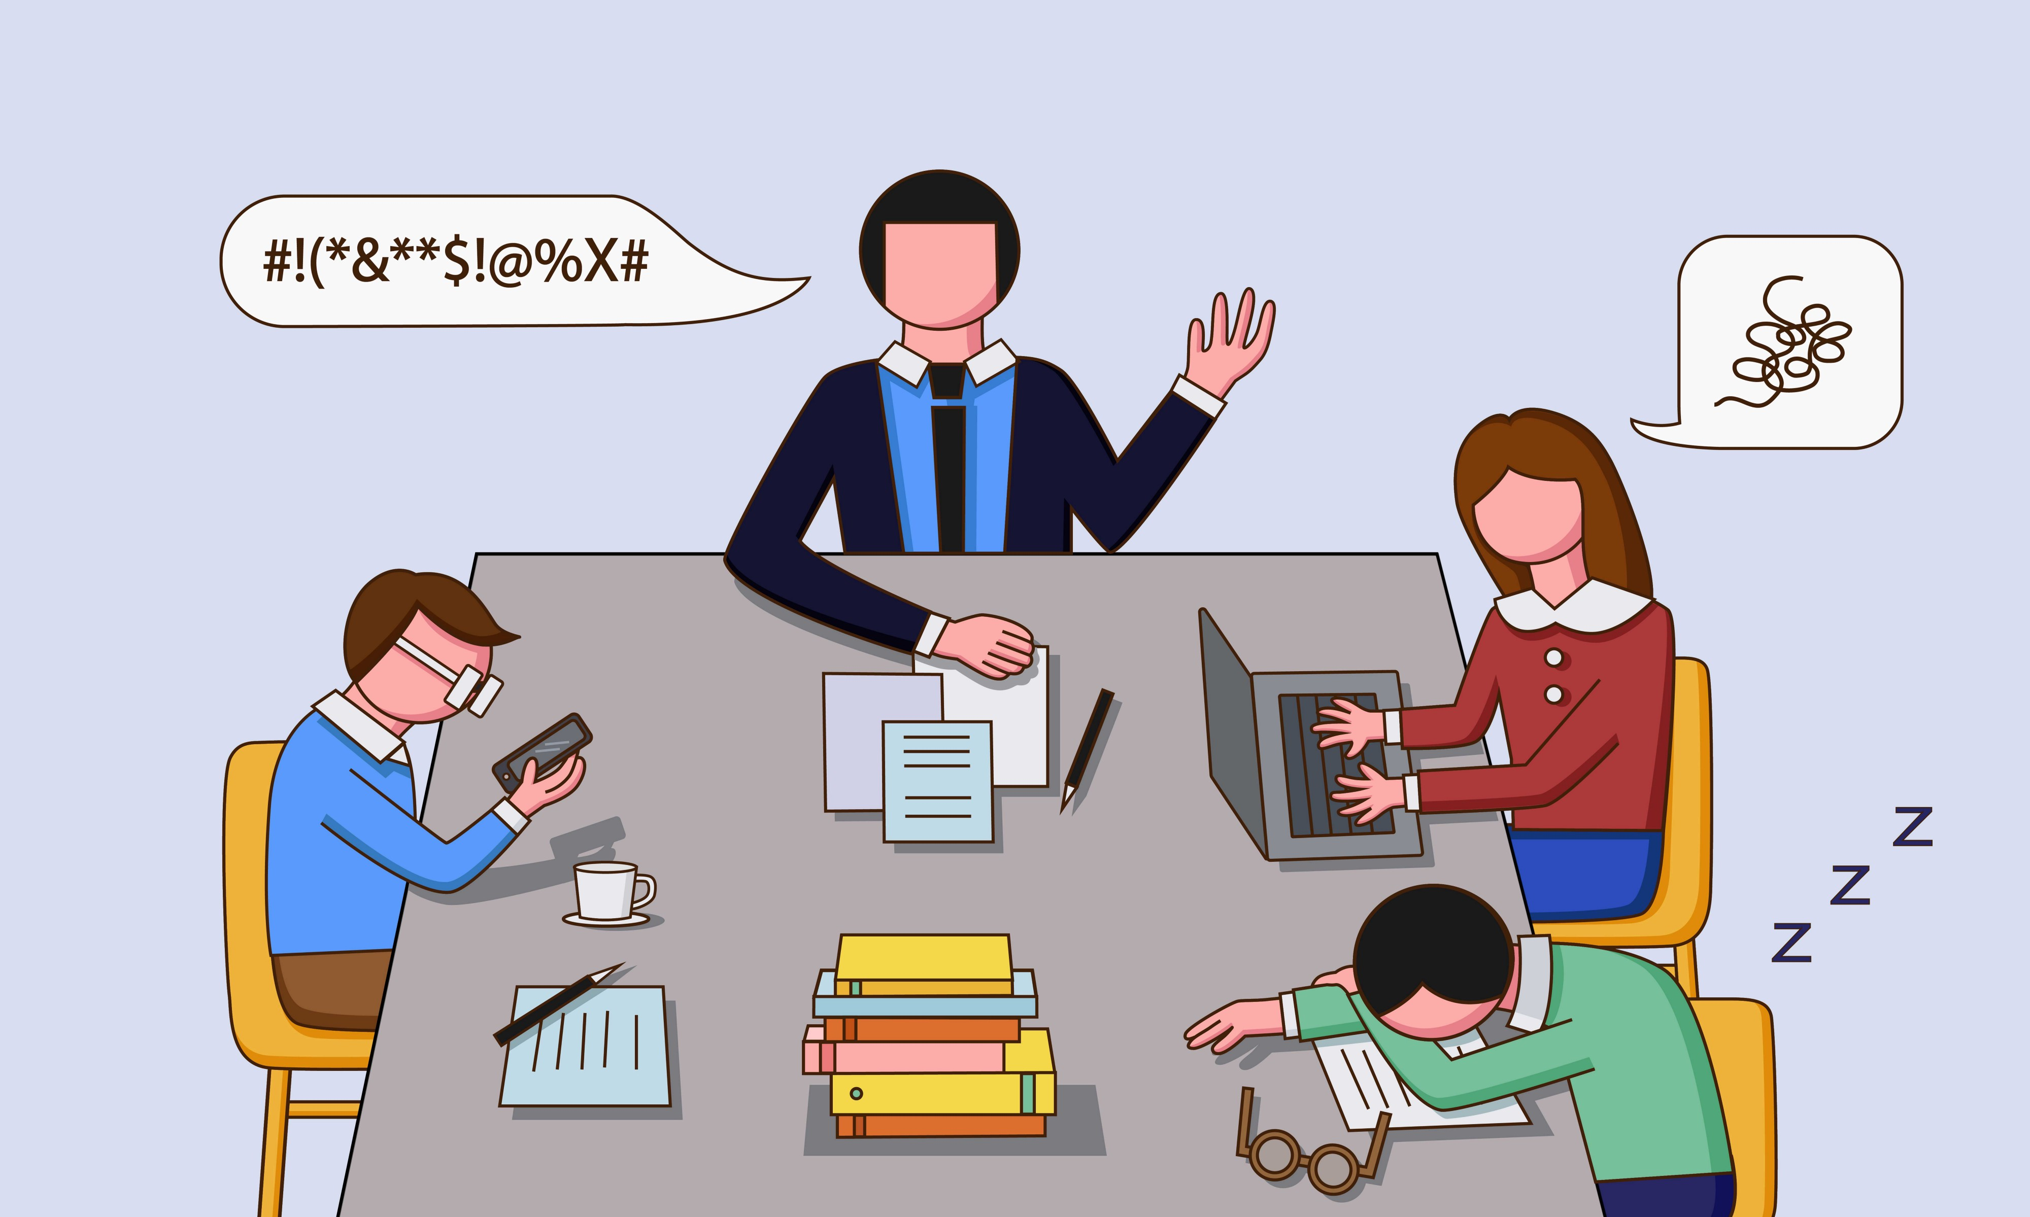
Disruptive Behaviors
Notes:
For feedback - Hold up the number of fingers for the new techniques that you learned from that session?
We will now transition to “Disruptive Behaviors”

Slide 31
Positions vs Concern / Interest
Position
Concern / Interest
Opinion about how to go about accomplishing an objective
“The development should be allowed to move forward.”
Underlying value or area of importance for individual or group
“We value jobs, tax revenue, and quality of life”
If you have trouble agreeing, probe positions to find underlying interests.
  Why do you believe that is best?
  What makes you feel so strongly?
NOAA. 2010. Introduction to Planning and Facilitating Effective Meetings. https://coast.noaa.gov/data/digitalcoast/pdf/effective-meetings.pdf
Notes:
First, it is helpful to be aware of the difference between a position statement and a statement of concern or interest.
When disagreements cause the progress to halt, listen to whether positions or values are being stated. A position will include underlying concerns or interests that need to be probed. For instance, someone may insist that development should move forward in spite of environmental concerns. But probing that position you might be able to identify values such as job creation, increased tax revenue, and enhanced quality of life.
When values / concerns / areas of importance are stated, discussion can turn to methods of compromise or solutions that address all concerns.
Sometimes though, it is not the positions that cause conflicts, but the personalities.

Slide 32
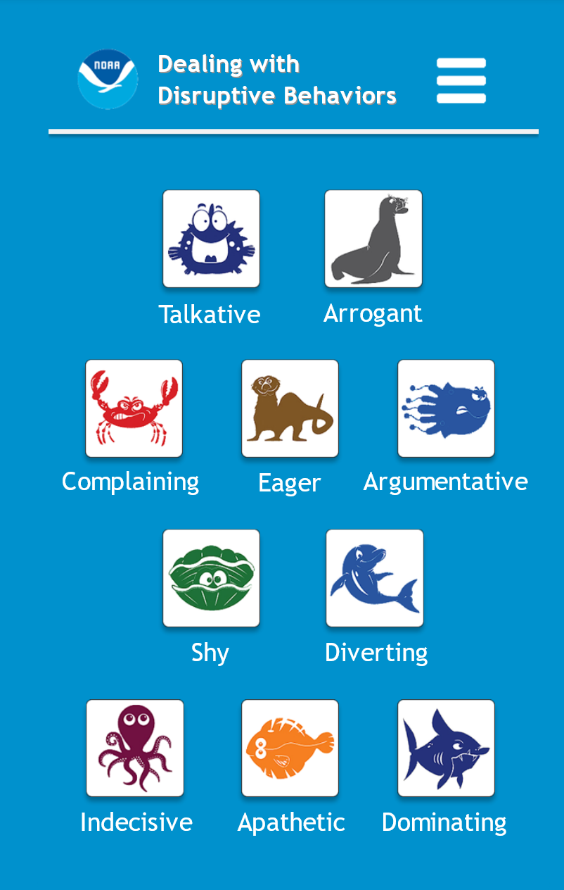
Dealing with Disruptive Behaviors
Talkative Blowfish
Arrogant Sea Lion
Complaining Crab
Eager Sea Otter
Argumentative Jellyfish
Shy Clammy
Diverting Dolphin
Indecisive Octopus
Apathetic Flounder
Dominating Shark
Bookmark
https://coast.noaa.gov/ddb/
Notes:
If you start noticing some disruptive behaviors in your meeting, you might discretely pull up this bookmarked site on your phone and find a quick guide on how to deal with the disruptive behavior.
NOAA (National Oceanic and Atmospheric Administration) has created this helpful and hilarious app that uses sea creatures to categorize different behaviors. Note the web address in the section below. Please type in that address on your phone so you can bring it up and utilize it for the next activity.
As you look at this list, can you think of some people in various meetings that fit these characterizations? READ THE DIFFERENT BEHAVIORS.

Slide 33
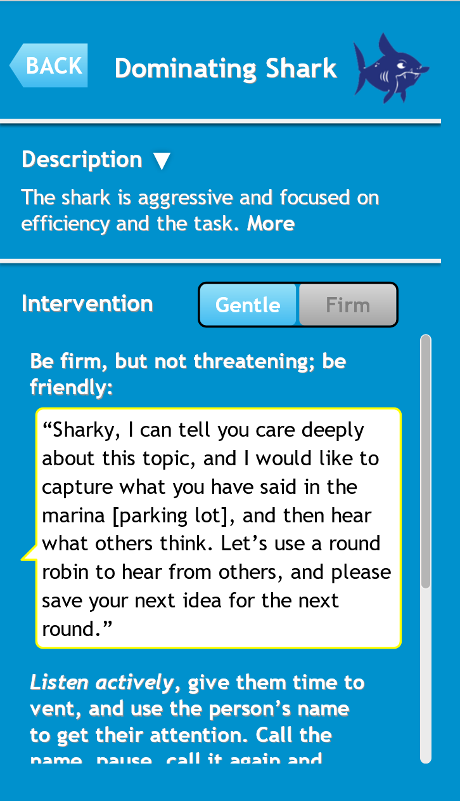
Dealing with Disruptive Behaviors
Discretely pull up site on phone
Read Described Behavior
Suggested Interventions:
  Gentle
  Firm
Bookmark
https://coast.noaa.gov/ddb/
Notes:
Take a moment a pull this up now. You can click on the icons and it will describe the behavior and suggest gentle or firm interventions.
Here is the example of the shark.
Now what you will normally have to watch out for is that you don’t actually say “Sharky Sharky” when addressing the person with aggressive behavior. You will have to watch out for that because it will go through your mind!

Slide 34
Dealing with Disruptive Behaviors
Let’s Try:
Groups of 4.
Designate one facilitator
Other 3 pick a secret persona
Facilitator to introduce the discussion topic and ask questions
Facilitator actively listen and try to name the characters
Suggest an appropriate response to resolve.
Reveal identities and switch.
Facilitator Choose from Potential Topics:
Drinking water
Lake management
Wastewater BMPs
Infrastructure financing
Water Quality Monitoring
Water Research
Citizen Science
Other
Bookmark: https://coast.noaa.gov/ddb/
Notes:
What I’d like to do now is role play with these disruptive behaviors. We will divide up into groups of 4 and one person will be the facilitator and the other three will pick a secret persona. Then the facilitator will ask questions to generate discussion along a topic and the other three individuals will act out their character. The facilitator will continue to ask questions and actively listen, all while trying to determine what the various behavior types are. When the facilitator thinks they have everyone figured out, they will propose a way to overcome the disruptions by calling on the sea creature’s name (something you normally would not do).
Reveal your identities and then switch.

Slide 35


Slide 36
Two Essential Post-Meeting Tasks
“Steve Jobs insisted that every item on a meeting agenda have a designated person responsible for that task and any follow-up work that happened. He called that person the DRI—the Directly Responsible Individual. He knew the public accountability would ensure that a project or task would actually get done, and he wanted to set clear, organized instructions for his team to follow.”
Two essential items after every meeting are:
Meeting notes / Minutes
Follow-up on commitments
Axtell, Paul. November 26, 2015. “Two Things to Do After Every Meeting.” Harvard Business Review. https://hbr.org/2015/11/two-things-to-do-after-every-meeting

Slide 37
Meeting Notes / Minutes
Highlights
  Usually single page
  Bullets not transcription
  Distribute within 24 hours.
Contents
  Attendees
  Key points on each topic
    Decisions, Differing Views,
  List of specific actions to be taken by whom by when
    (This means you must address this in the meeting)
  Next Meeting Date
ESSENTIAL:
Keep following up on action item progress
Axtell, Paul. November 26, 2015. “Two Things to Do After Every Meeting.” Harvard Business Review. https://hbr.org/2015/11/two-things-to-do-after-every-meeting

Slide 38
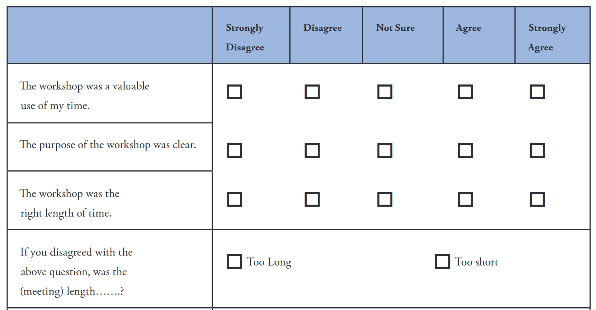
Post Meeting Feedback Evaluation
NOAA. 2010. Introduction to Planning and Facilitating Effective Meetings. https://coast.noaa.gov/data/digitalcoast/pdf/effective-meetings.pdf
Notes:
Particularly when your meeting is a workshop, community forum, focus group, or some other similar type event, you will want to receive feedback on the meeting for future events.
This portion of the evaluation comes from the NOAA guide.

Slide 39
Post Workshop Feedback Evaluation
Other Questions:
  Contributions valued?
  Format Effective?
  Knowledge Before / After the Workshop
  Evaluate Meeting:
    Location
    Facilitation
    Materials
  What did you like best? Least?
NOAA. 2010. Introduction to Planning and Facilitating Effective Meetings. https://coast.noaa.gov/data/digitalcoast/pdf/effective-meetings.pdf
Notes:
Here are some other items to consider including in your meeting feedback evaluation.
You can conduct the evaluation at the end of the meeting or send an email follow up for an online survey within 24 hours (less effective).

Slide 40
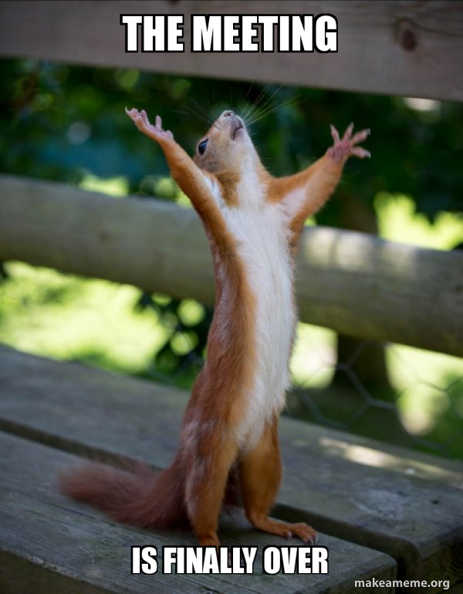
Wrap Up
Write your most valuable takeaway in the chat!
Final questions?

