Slide 1
Watershed Academy
Watershed Coordinator Training Series
Module 6: Effective Communications
2. Science of Science Communication

Slide 2
Opinions on Water
2019 Study by American Public Media
Knowledge: People answered about 50% of questions about water correctly
Connection: everybody (85%) cares about water saying it plays a meaningful role in life and are concerned about the future.
Concerns: Public desires water protection and 22% have contributed $ or time toward a water organization
Action: 7 in 10 conserve water and 16% try to keep water clean.
Notes:
2019 nationally representative phone survey by American Public Media and APM Research Lab
1005 participants.
Looked at water knowledge, connection, concerns, and action. We are going to dig more into the results of this study to get an idea of what people think of water.
Let’s see how you do:
Poll #1: Knowledge of Water – 4 questions of the 10 asked….
In most U.S. towns, when it rains, where does most of the water that goes into storm drains end up?
Which one of the following statements is true about wetlands, such as swamps or marshes?
Do you happen to know the original source of the tap water in your home, such as a river, reservoir, or underground aquifer?
Which of these is the largest source of pollution of rivers, lakes, and oceans:

Slide 3
Opinions on Water: What People Know
52% know where stormwater ends up.
49% understand the role of wetlands in filtering and flooding.
47% know where tap water comes from.
Only 23% correctly identified nonpoint source runoff as largest pollution source, 38% incorrectly believe factories are responsible.
2019, American Public Media
Notes:
Here are the results. How did you compare with most Americans.
Poll#2: Connection with Water
In the warmer months, how often do you spend free time doing activities in or around bodies of water, including lakes, rivers, or the ocean?

Slide 4
Opinions on Water: How People Connect
Half of respondents feel personal connection to a specific water body.
62% recreate in or around water body at least once per month in warmer months.
67% feel it is important for children to learn more about water resources.
65% are at least somewhat interested in learning more.
2019, American Public Media
Notes:
You can see that 85% of respondents said water played an extremely meaningful or very meaningful role in their life. 50% had a personal connection to a waterbody. About 2/3s recreated there (the polling question), found it important to teach children, and wanted to learn more

Slide 5
Opinions on Water: People’s Concerns
84% concerned about the future of water resources like lakes, rivers, & streams
“Despite not having high levels of knowledge about water, people living in the U.S. are very concerned about the future of water resources. While this concern cuts across demographic categories, marginalized communities are acutely aware of issues facing our water resources.”
2019, American Public Media
Notes:
About the same percentage of people who thought water was meaningful were concerned about the future of water (most very concerned). This is especially true of marginalized communities.
So people may not have a high level of knowledge, but nevertheless people know to be concerned.

Slide 6
Opinions on Water: Action
Actions do not match the scale of problems
7 in 10 report taking some action to protect water in daily life (mostly water reduction)
“People want to take action. Our water community needs to work together to support them with tangible and coordinated ideas for action that will drive change.”
2019, American Public Media
Notes:
The problem is that the actions people are taking do not match the scale of the problems.
While most are taking action (typically towards water conservation / reduction of use).
The report notes that people want to take action but need tangible ideas – easy ways to act – to make a difference.

Slide 7
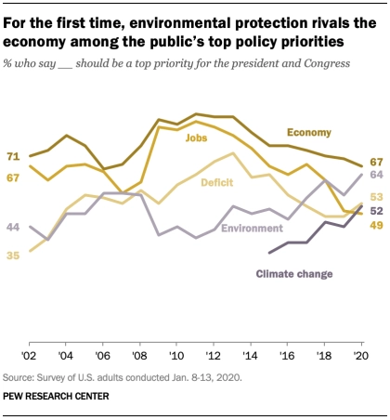
Top National Priorities February 2020
https://www.pewresearch.org/politics/2020/02/13/as-economic-concerns-recede-environmental-protection-rises-on-the-publics-policy-agenda/
Notes:
In a nationally representative Pew Research Study conducted in January 2020, the environment was one of the top priorities for the president and Congress.

Slide 8
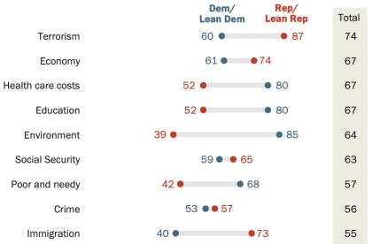
Top National Priorities February 2020
https://www.pewresearch.org/politics/2020/02/13/as-economic-concerns-recede-environmental-protection-rises-on-the-publics-policy-agenda/
Notes:
But as we delved down deeper into the data, we see that there is a large discrepancy in the prioritization of this subject based on political party.

Slide 9
Opinions on Water Resources
Overwhelmingly people care about water resources
Despite lacking knowledge, people value water resources, are concerned about the future of water resources, and are willing to act and see public policy change on water and environmental issues.
While concern over water does not show a difference by political affiliation, environmental concerns show a strong difference.
Notes:
So to summarize these national surveys:
People care about water and are willing to act even though they lack knowledge and aren’t sure what to do. They need US to help give them simple solutions.
Further, while environmental concerns are deemed important they seem to have a strong political divide, but water concerns do not.

Slide 10
Science Communication and Behavior Change
Theories by sociologists, psychologists, economists, communicators, etc.
You have one even if you don’t recognize it.
Some Conceptual Models:
Information Deficit Model
Cultural Cognition Thesis
Moral Foundations Theory
Theory of Planned Behavior
Stages of Change Model
Social Cognitive Theory
Notes:
With a general national water context, we want to begin to ask the question:
“How do we affect change?”
There are numerous theories out there about behavior change and science communication (one literature review documented over 60) that come from sociologists, psychologists, economists, communicators, and others. Everyone has a model for how this is done, but perhaps you (like me) have never given it much thought to this point. We are going to cover some of the conceptual models for behavior change, but first I’d like to know what my audience’s previous interactions with these models looks like.
Poll#3: Check all of the models of science communication and behavior change with which you are familiar

Slide 11
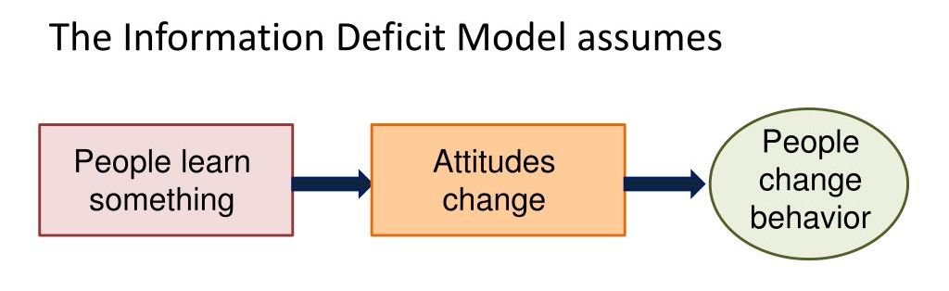
Information Deficit Model
(Public Irrationality Thesis)
“If they knew what I knew,
they would do what I do.”
Solution: We need education and awareness!
Notes:
If you think that awareness and education is the solution, there is a good chance that you hold to the Information Deficit Model – also known as the public irrationality thesis.
These names come from the thought that if people just knew more, they would act differently. Essentially, it assumes that the public’s behavior is not rationale because if people knew what you know their attitude would be changed and they would do what you do.
I have to confess, this was my dominate model until I began researching this topic and is probably the dominant model among most people.
This is not to say that there are not places for awareness and education, but studies have been done to see whether this model is true.

Slide 12
Information Deficit Model
(Public Irrationality Thesis)
Dan Kahan. 2015. What is the “science of science of science communication?” Journal of Science Communication, Vol. 14, No. 3, 2015.
Notes:
Dr. Dan Kahan is a professor of law and psychology at Yale and has a terrific article on the science of science communication. His paper, as with much of this research, addresses climate change because of the contentions related to the subject area, but it applies across scientific communication.
On the left we see a chart of what should happen according to the public irrationality thesis or information deficit model…. As science comprehension increases the perceived risk should increase. However, their results (based on 1540 responses) shows that it actually decreases.

Slide 13
Cultural Cognition Thesis
“Group affinities are integral to the mental processes ordinary member of the public use to assess risk.”
“Motivated reasoning” refers to the tendency of people to conform their assessments of all sorts of evidence to some goal unrelated to accuracy. (i.e. rival sports teams and a penalty call)
When positions on facts become associated with social groups individuals selectively assess evidence in patterns that reflect their group identity.
Dan Kahan. 2015. What is the “science of science of science communication?” Journal of Science Communication, Vol. 14, No. 3, 2015.
Notes:
Therefore, Kahan proposed another model called the cultural cognition thesis.
He reasoned that in the same way as two opposing sports fan bases will “see” a penalty call in different ways based on their support for their team, so also people’s group affinities affect the ways that they few risks.
When positions on facts become associated with group idenities, people will selectively assess the evidence through their group.

Slide 14
Cultural Cognition Thesis
Dan Kahan. 2015. What is the “science of science of science communication?” Journal of Science Communication, Vol. 14, No. 3, 2015.
Notes:
One of the ways in which they found this shows up is in who people deem experts.
There is so much information out there, none of us can be experts in all of it, so we rely on our group networks to determine who is trustworthy. Often this results in confirmation bias.
Here we see the results of a survey which presented an individual’s academic credentials and memberships as well as a book except from the author with 50% receiving a statement of “high risk” and 50% “low risk” – but all from the same person. They then asked the respondent to determine whether or not the individual was an expert.
You can see the results plotted by political spectrum (bottom axis from democrat (left) to republican (right)).
People determined whether these qualified scientists were experts based on their argument with the position of their cultural peers.

Slide 15
Cultural Cognition Thesis
Dan Kahan. 2015. What is the “science of science of science communication?” Journal of Science Communication, Vol. 14, No. 3, 2015.
Notes:
Not all scientific issues show these sorts of political skews – that is skews based on group identity.
In these charts you can see risk on the vertical-axis and political affiliation on the horizontal-axis.
You can see that the risk of global warming, private gun possession, and fracking are all strongly affected by political affiliation, but artificial food coloring, radio waves from cell phones, and genetically modified food are not.

Slide 16
Cultural Cognition Thesis
Dan Kahan. 2015. What is the “science of science of science communication?” Journal of Science Communication, Vol. 14, No. 3, 2015.
Notes:
These charts show the same information, but with the horizontal axis shown ordinary science intelligence. It shows that actually as people are increasingly educated on these science issues that are associated with group identity, their perceived risk becomes increasingly divergent based on political affiliation.
What this means is that it is not just “education and awareness” that is at odds. Increased knowledge leads to increased disagreement.

Slide 17
Cultural Cognition Thesis
“The fundamental source of the paradox, empirical study suggests, is the entanglement of opposing factual beliefs with people’s identities as members of one or another cultural group. It’s logical to surmise, then, that the solution is to disentangle knowledge and identity when communicating scientific information.”
Dan Kahan. 2015. What is the “science of science of science communication?” Journal of Science Communication, Vol. 14, No. 3, 2015.
Notes:
What has happened is that factual belief has become entangled with personal and group identity.
Therefore in communicating the information, the need is to disentangle these factors.

Slide 18
Moral Foundations Theory
Care: cherishing and protecting others; opposite of harm.
Fairness or proportionality: rendering justice according to shared rules; opposite of cheating.
Loyalty or in-group: standing with your group, family, nation; opposite of betrayal.
Authority or respect: obeying tradition and legitimate authority; opposite of subversion.
Sanctity or purity: abhorrence for disgusting things, foods, actions; opposite of degradation.
Liberty: the loathing of tyranny; opposite of oppression.
Individualizing values
Binding values
Liberty
Graham, J.; Haidt, J.; Koleva, S.; Motyl, M.; Iyer, R.; Wojcik, S.; Ditto, P.H. (2013). Moral Foundations Theory: The pragmatic validity of moral pluralism. Advances in Experimental Social Psychology. 47. pp. 55–130.
Notes:
At this point I want to introduce the Moral Foundations Theory, as it helps to shed some light upon what is going on with the “Cultural Cognition Thesis.”
Moral Foundations Theory was created by a group of social and cultural psychologists to understand why morality varies so much across cultures yet still shows so many similarities and recurrent themes. In brief, the theory proposes that several innate and universally available psychological systems are the foundations of “intuitive ethics.” Each culture then constructs virtues, narratives, and institutions on top of these foundations, thereby creating the unique moralities we see around the world, and conflicting within nations too. The five foundations were initially proposed to which a sixth (liberty / oppression was added).

Slide 19
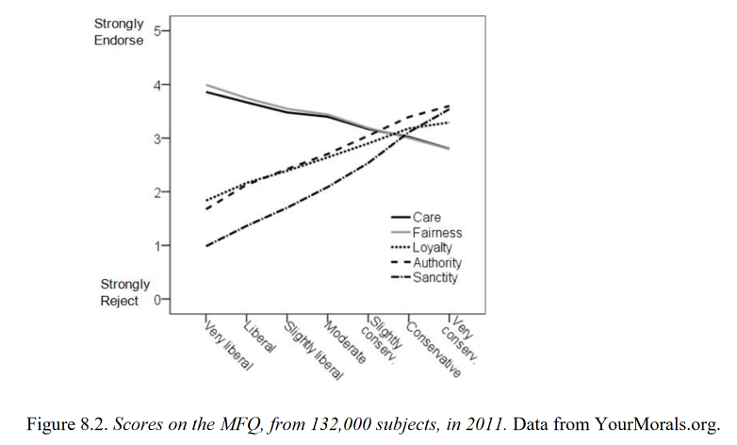
Moral Foundations Theory
Individualizing values (Care/harm and Fairness(proportionality) / cheating) highest among self identified liberals.
Binding Values(loyalty, authority, and sanctity) higher among most conservatives.
Liberty/oppression (not shown) is on own axis – often strongly associated with libertarians

Slide 20
Moral Foundations and Environment
Christopher Wolsko. 2017. Expanding the range of environmental values: Political orientation, moral foundations, and the common ingroup. Journal of Environmental Psychology. Volume 51, 2017. Pages 284-294.
Study to evaluate the connection between moral foundations, messaging, and environmental values:
Political orientation survey
Moral framing environmental PSA from either
  Individualizing values
  Binding and liberty values
  Control (generic)
Surveys on Values, Connectedness to Nature, Conservation Intentions, and Climate Change Attitudes
Repeat experiment using “expanded common in-group” PSA

Slide 21

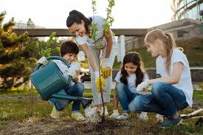
Moral Foundations and Environment
Individualistic Values PSA
Show your love for all of humanity and the world in which we live by helping to care for our vulnerable natural environment. Help to reduce the harm done to the environment by taking action. By caring for the natural world you are helping to ensure that everyone around the world gets to enjoy fair access to a sustainable environment. Do the right thing by preventing the suffering of all life-forms and making sure that no one is denied their right to a healthy planet. SHOW YOUR COMPASSION.
Christopher Wolsko. 2017. Expanding the range of environmental values: Political orientation, moral foundations, and the common ingroup. Journal of Environmental Psychology. Volume 51, 2017. Pages 284-294.

Slide 22
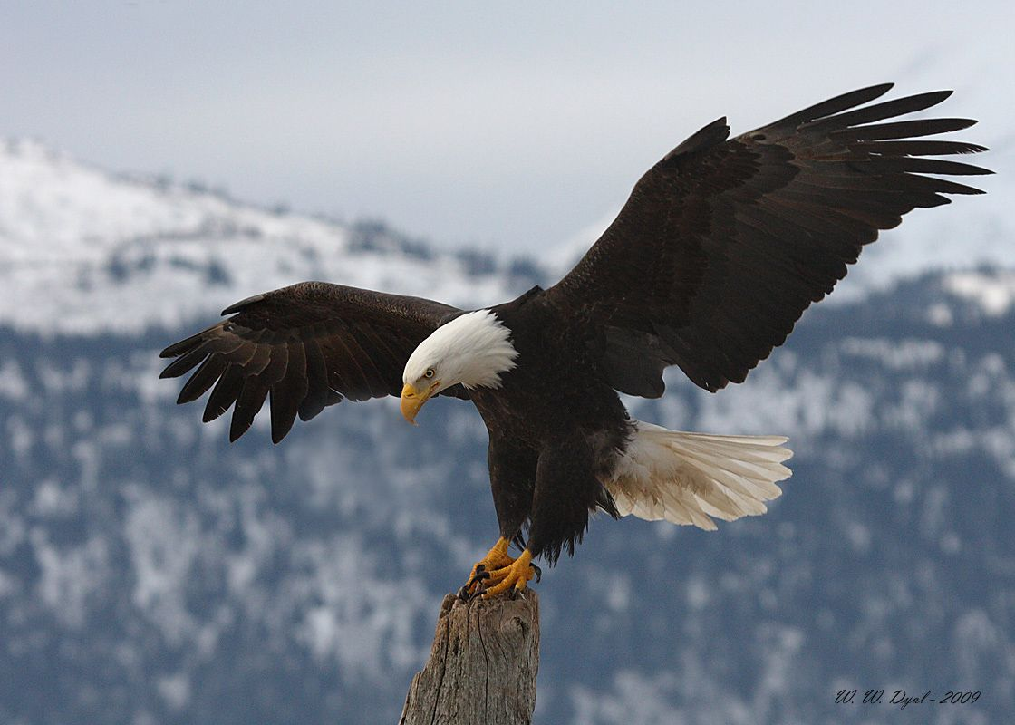

Moral Foundations and Environment
Binding Values PSA
Show you love your country by joining the fight to protect the purity of America's natural environment. Don't trust protection of the environment to the government – people don't need bureaucrats to tell them how to care for their own land. Honor the American tradition of taking personal responsibility for yourself and for the land you call home. By taking a tougher stance on protecting the natural environment, you will be honoring all of God's Creation. Demonstrate your respect by following the examples of your religious and political leaders who defend America's natural environment. SHOW YOUR PATRIOTISM!
Christopher Wolsko. 2017. Expanding the range of environmental values: Political orientation, moral foundations, and the common ingroup. Journal of Environmental Psychology. Volume 51, 2017. Pages 284-294.

Slide 23
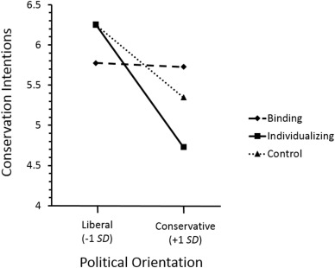
Moral Foundations and Environment
Individualizing message and control are similar (liberal appeal). This is typical environmental messaging.
Binding message lowered liberal but raised conservative.
Christopher Wolsko. 2017. Expanding the range of environmental values: Political orientation, moral foundations, and the common ingroup. Journal of Environmental Psychology. Volume 51, 2017. Pages 284-294.

Slide 24
Moral Foundations and Environment
Expanded Common In-Group Message PSA
Conservative Values, Conserving the Environment: It is no secret that politically liberal agendas have tended to dominate discussions about the natural environment. Recently though, a large number of both liberal and conservative politicians, scientists, executives, and religious leaders have argued that traditionally conservative values are extremely well-suited for protecting the natural environment. Traditional conservative values that have been favored include: 1 Demonstrating your patriotism by protecting our natural environment 2 Taking personal responsibility – for yourself and for the land you call home 3 Making your own decisions on local land and water issues in the best interests of families, rather than leaving it to bureaucrats 4 Defending the purity of God's Creation against pollution 5 Respecting your elders and teaching your children good values
Christopher Wolsko. 2017. Expanding the range of environmental values: Political orientation, moral foundations, and the common ingroup. Journal of Environmental Psychology. Volume 51, 2017. Pages 284-294.
Notes:
Paired with pictures from binding values.

Slide 25
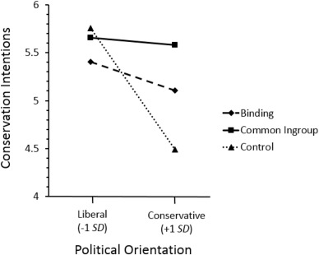
Moral Foundations and Environment
Expanded Common Ingroup message raised conservatives to equal conservation intentions as liberal without lowering the liberal.
Speaking to the target group values without alienating others can help disentangle.
Christopher Wolsko. 2017. Expanding the range of environmental values: Political orientation, moral foundations, and the common ingroup. Journal of Environmental Psychology. Volume 51, 2017. Pages 284-294.

Slide 26
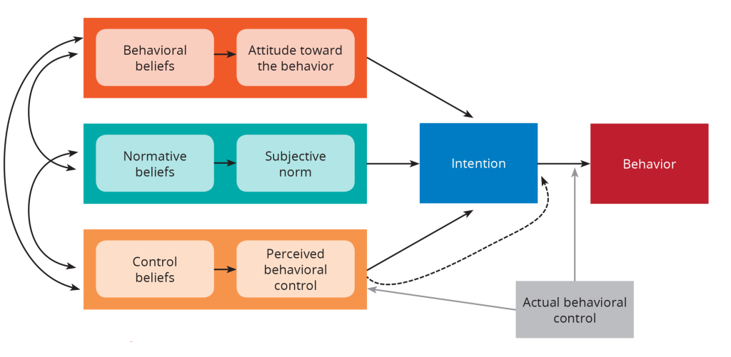
Theory of Planned Behavior
Graphic: https://sbccimplementationkits.org/
Notes:
According to the Theory of Planned Behavior, behavior is influenced by three elements:
Attitude: That the behavior will be beneficial to the individual.
Subjective norms: The belief that other people think that the behavior is acceptable.
Perceived ability: The belief that one has the skills and capability to change behavior.
The Theory of Planned Behavior can be used to change behaviors that are heavily influenced by peers and the close social network. This theory tells us that the close social network needs to be targeted to support the desired behavior change in the individual, as well as that it is important to highlight the short-term benefits of the behavior change to promote action.

Slide 27
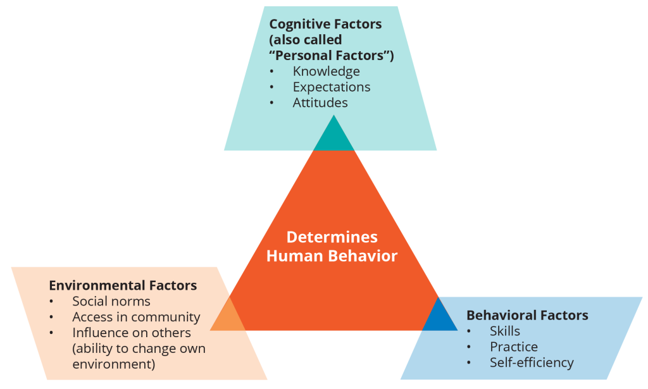
Social Cognitive Theory
https://sbccimplementationkits.org/
Notes:
Social Cognitive Theory (SCT) was develop in 1986 growing out of the Social Learning Theory (SLT) from the 1960s. It states that learning occurs in a social context with a dynamic and reciprocal interaction of the person, environment, and behavior. The unique feature of SCT is the emphasis on social influence and its emphasis on external and internal social reinforcement. SCT considers the unique way in which individuals acquire and maintain behavior, while also considering the social environment in which individuals perform the behavior. The theory takes into account a person's past experiences, which factor into whether behavioral action will occur. These past experiences influences reinforcements, expectations, and expectancies, all of which shape whether a person will engage in a specific behavior and the reasons why a person engages in that behavior.
Reciprocal Determinism refers to the dynamic and reciprocal interaction of person (individual with a set of learned experiences), environment (external social context), and behavior (responses to stimuli to achieve goals).
In the application of the Social Learning Theory, the learner (audience) is encouraged to:
Observe and imitate the behavior of others.
See positive behaviors modeled and practiced.
Increase his/her own capability and confidence to implement new skills.
Gain positive attitudes about implementing those skills. Experience support from his/her environment to use those skills.

Slide 28
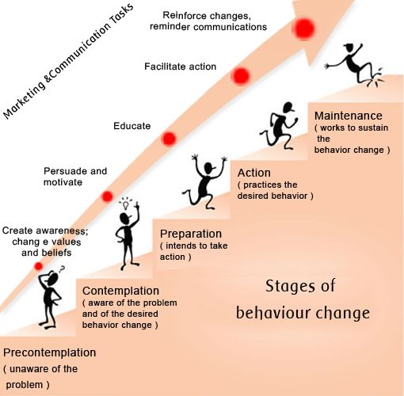
Stages of Change (The Transtheoretical Model)
Notes:
The Transtheoretical Model (also called the Stages of Change Model), developed by Prochaska and DiClemente in the late 1970s, was developed to address how people quit smoking. It focuses on the decision-making of the individual and assumes people do not change behaviors quickly and decisively but continuously through a process.
The TTM posits that individuals move through six stages of change: precontemplation, contemplation, preparation, action, and maintenance. For each stage of change, different intervention strategies are most effective at moving the person to the next stage of change and subsequently through the model to maintenance, the ideal stage of behavior.
Precontemplation - In this stage, people do not intend to take action in the foreseeable future (defined as within the next 6 months).
Contemplation - In this stage, people are intending to start the healthy behavior in the foreseeable future (defined as within the next 6 months).
Preparation (Determination) - In this stage, people are ready to take action within the next 30 days. People start to take small steps toward the behavior change, and they believe changing their behavior can lead to a healthier life.
Action - In this stage, people have recently changed their behavior (defined as within the last 6 months) and intend to keep moving forward with that behavior change. People may exhibit this by modifying their problem behavior or acquiring new healthy behaviors.
Maintenance - In this stage, people have sustained their behavior change for a while (defined as more than 6 months) and intend to maintain the behavior change going forward.

Slide 29
From Awareness to Strategic Outreach
When done wrong, an awareness campaign carries four specific risks:
No action
  Horse farms, riparian zones and EPM in opossum
Wrong audience
  Detroit residents reject tree planting because of distrust of city
Create harm
  “Flushable wipes” have increased the clogging of sanitary sewer systems.
Backlash
  SPARROW model and Kentucky agricultural groups
Christiano, A. and A. Neimand. 2017. Stop Raising Awareness Already. Stanford Social Innovation Review. Spring 2017. P. 34-41

Slide 30
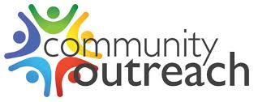
Values of Outreach
Listening and Participation
  We tend to automatically lump things into agree or disagree. Engagement must have two-way communication to be shaped effectively
Trust
  Trust is based on perceived competence and warmth
  People want to know your point of view and humanity
Positive Identity
  People are more likely to accept messages that reinforce or build their social identity and belonging

Slide 31

You need an outreach strategy…
… and we’re going to help you build it.

