Slide 1
Watershed Academy
Watershed Coordinator Training Series
Land Use Impacts &
Related Best Management Practices
3. Agricultural BMPs

Slide 2
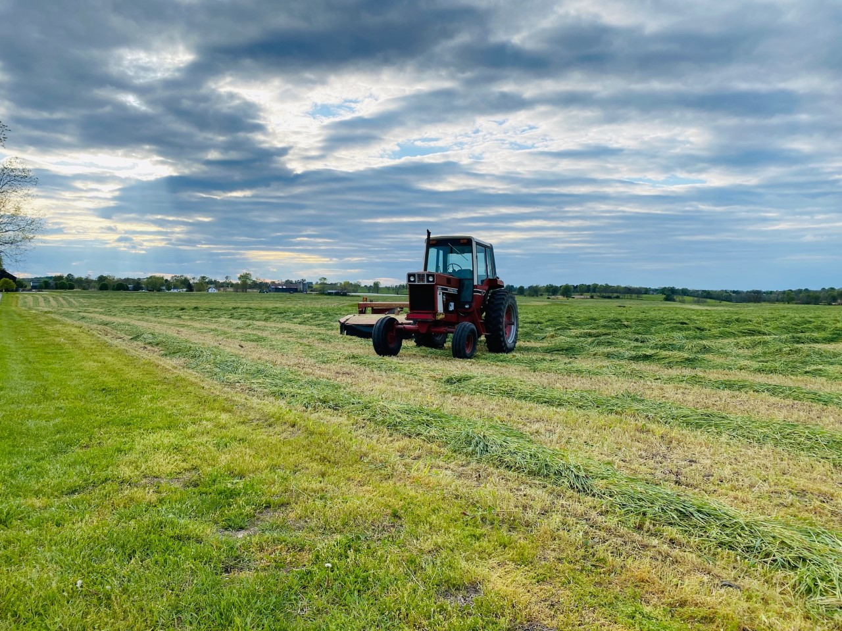

Slide 3
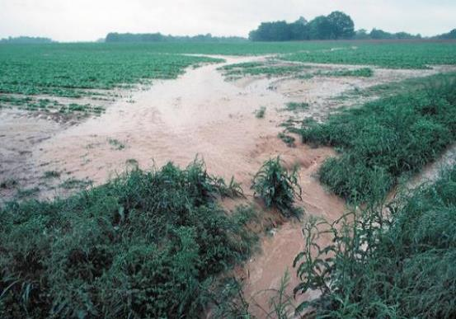
Agricultural BMPs improve water quality by:
Reducing water pollutants:
  Soil/sediment (erosion)
  Nutrients (primarily nitrogen and phosphorus)
  Chemical pesticides
  Chemical herbicides
  Bacteria/pathogens (animal waste)
Improving riparian habitat
Helping regulate stream flows by
slowing & reducing runoff
Notes:
Agricultural best management practices improve water quality by reducing pollutant contributions. These pollutants can include soil or sediment, nutrients (mainly nitrogen and phosphorus), chemical pesticides and herbicides and animal-related bacteria and pathogens.
Recommended practices can also improve riparian habitat along waterways throughout and downstream of the farm AND help regulate stream volumes and velocities by limiting runoff.

Slide 4

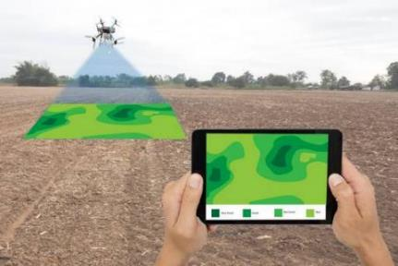
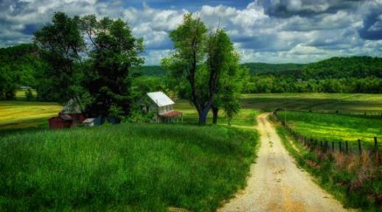
Economics, Efficiency and Environment
Photo by Bob Bell
In order to achieve successful agricultural BMP implementation, farmers must be able to see how the practices will:
Increase farming profitability
Make their day-to-day farming practices easier
Improve the land, soil and water quality on their property
Notes:
In addition to helping care for natural resources, farmers need to see how these BMPs will help them more directly. This includes increasing the farm’s profitability and making day-to-day farm work easier.
Some examples of ways that practices can help farmers achieve greater profits are:
Increased crop health and productivity through preventing soil and nutrient loss from their land
Preserving land acreage by preventing land loss to streambank erosion
Fostering healthier, more valuable livestock through easier feeding and watering access
Easier, more comfortable (drier, safer) working conditions created by better design for livestock care—including feeding, watering, immunizing, and birthing conditions.

Slide 5
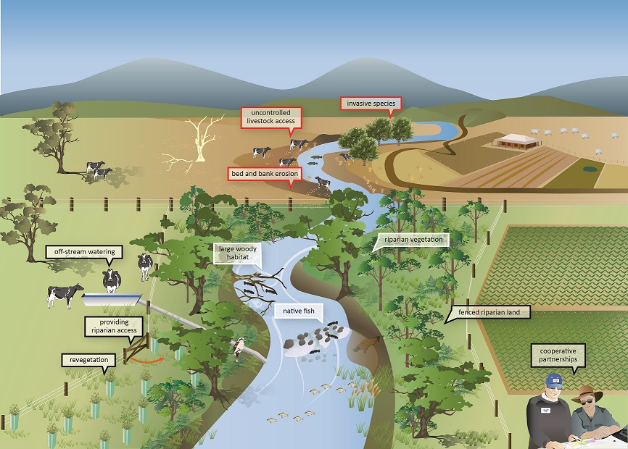
Without Management Practices
With
Management
Practices
Notes:
This graphic provides a comparison of a farm managed with conservation practices in the lower half vs. a farm without practices in place (upper half).
You can see that the limited livestock access to the creek with off-stream watering and the protected riparian vegetation by the crop land have enabled habitat to thrive, supporting bird, fish and other species.
The stream buffers also limit stream bed and bank erosion, reducing pollutants in the stream and preventing loss of property as land is eroded away.
Source: https://www.water.vic.gov.au/waterways-and-catchments/riparian-land (Austrailia)

Slide 6
“The bottom line” support for Ag BMPs
Cost-savings and profit increases are the most powerful selling points for implementing agricultural BMPs.
Soil loss = loss of valuable resource
“My soil is my bank account. And erosion is like going to my savings account, drawing a little money out every day, and then throwing it away.”
Reduced tilling = Lower fuel costs
More precise chemical applications = Lower chemical cost
Improved pasture settings = Healthier, more valuable livestock
Land and water stewardship are motivators, but they are likely to be secondary to financial and efficiency considerations.
Notes:
When encouraging farmer use of BMPs, it’s helpful to emphasize the potential for cost savings and profit increases. Farms often operate with thin profit margins, so any way to increase that margin could be appealing.
For example:
Preserving valuable top soil will help ensure that this valuable resource is there to support healthier crops and pasture land.
By using practices that reduce the need for extra tilling, time and fuel and labor costs can be saved.
With more precise chemical and fertilizer applications in limited areas where it is most needed, these expenditures can be reduced.
Improved pasture land produces healthier, more valuable livestock.
So, for many land and water conservation is important, but financial and operating efficiency advantages may be stronger selling points.

Slide 7
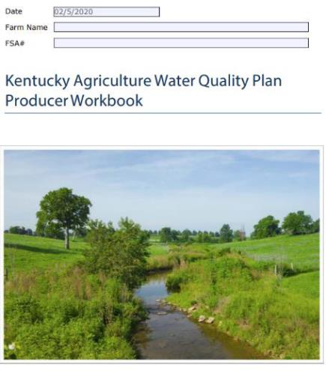
Kentucky Agriculture Water Quality Plan
When?
Kentucky General Assembly passed related act in 1994
Who?
Any landowner who operates 10 or more acres for agriculture or silviculture (forestry) OR who applies for payments from agriculture programs under an agreement with state or federal government
Why?
To protect surface and ground water from being polluted by farming operations
Notes:
In order to protect surface and groundwater resources from pollution related to agricultural and silvicultural activities, the Kentucky General Assembly passed the Kentucky Agriculture Water Quality Act in 1994.
This Act requires Agriculture Water Quality Plans for any landowner who uses 10 or more acres for agricultural or silvicultural activities.
Plans are also required with any applications for cost-share assistance provided by farm management funds, including state-cost share, NRCS’s EQIP (Environmental Quality Incentives Program) and Kentucky’s CAIP (County Agriculture Investment Program) funds.

Slide 8
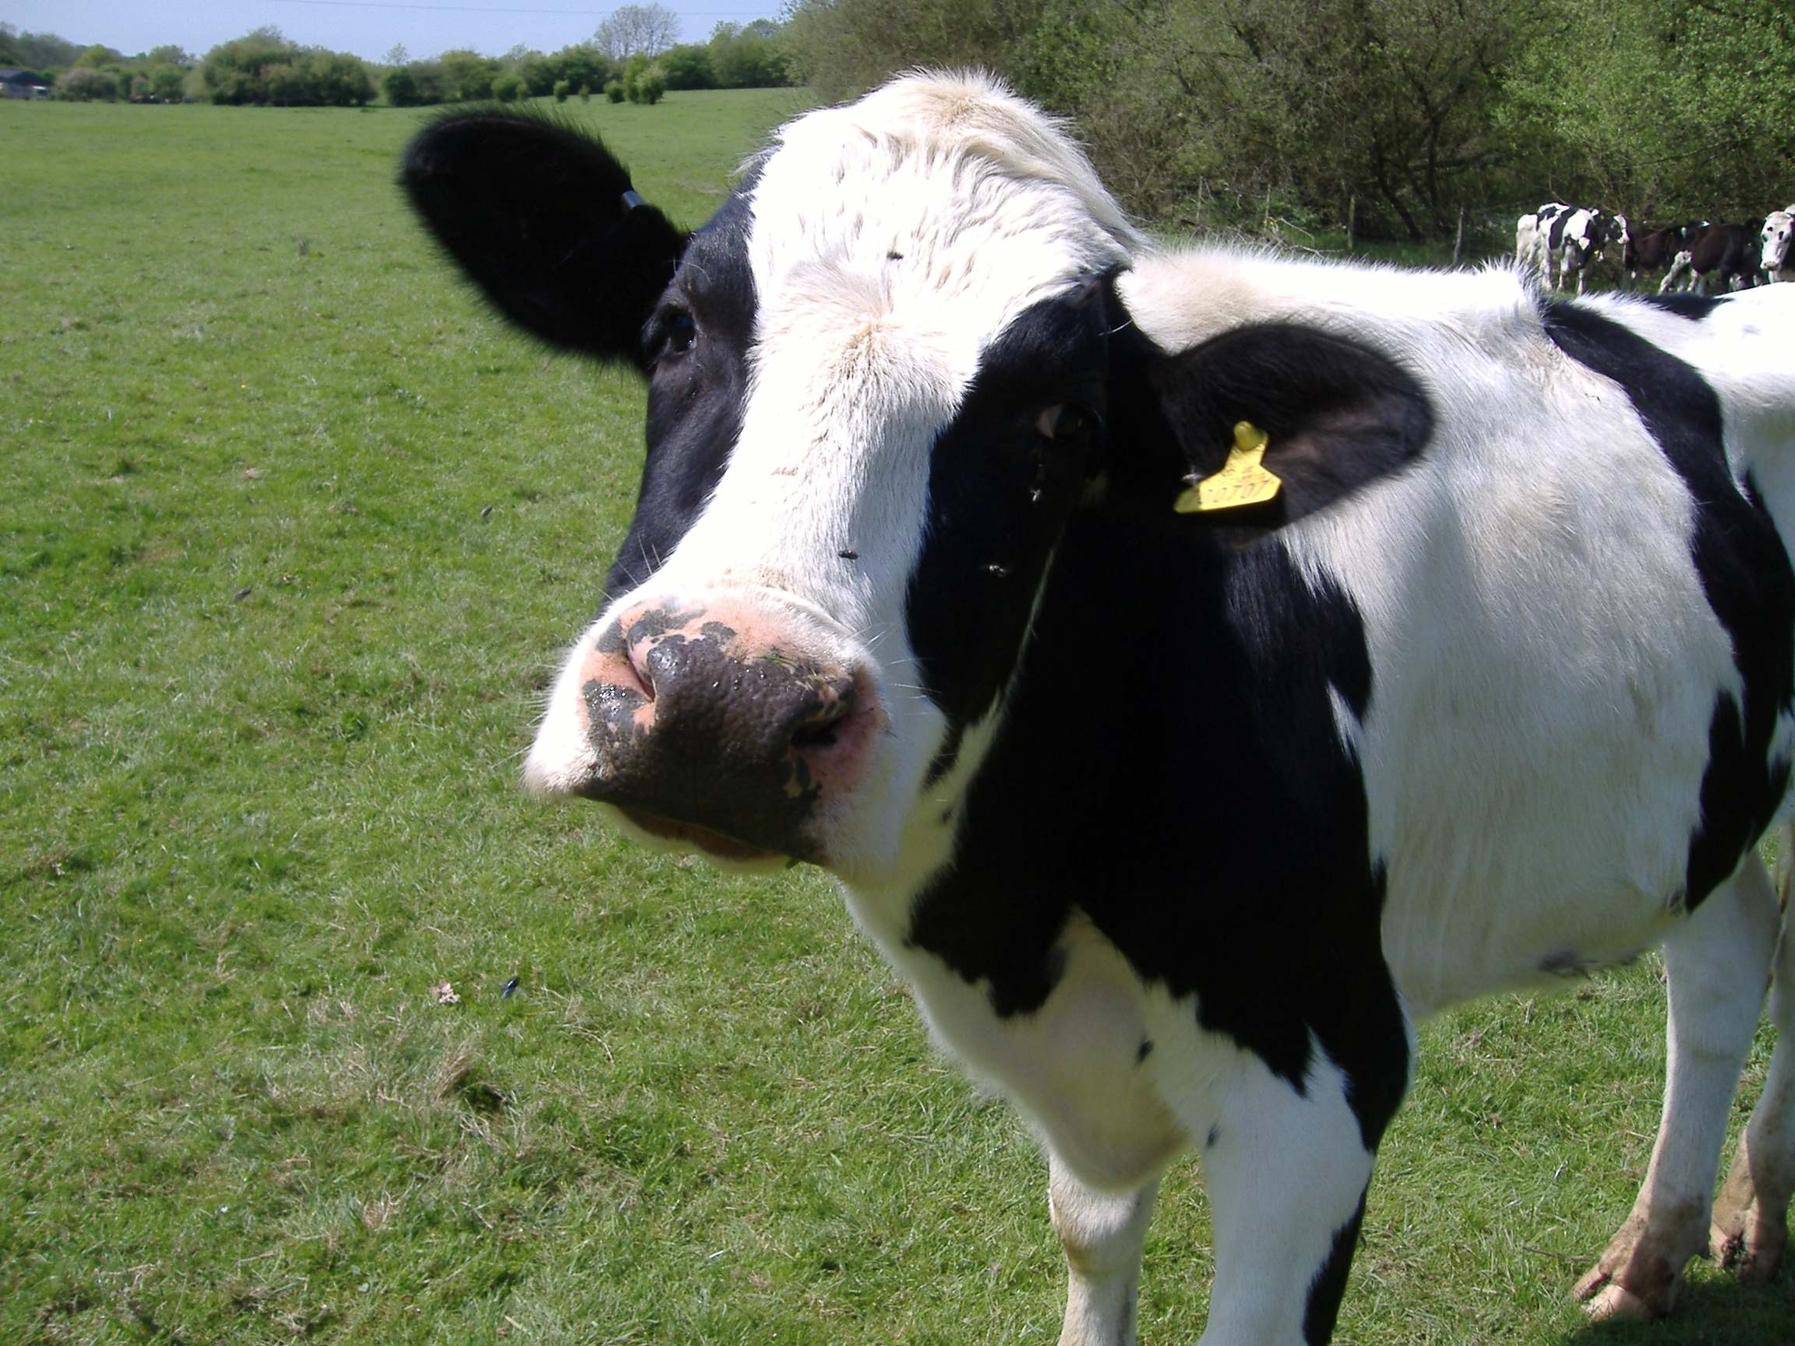
What is an Ag Water Quality Plan?
A plan is the list of BMPs to be implemented on the farm to protect water quality. It includes considerations for addressing:
  Livestock
  Crops
  Pesticides and Fertilizers
  Farmstead
  Forestry
  Streams and Other Waters
Plans should be updated and reflect current farm activities.
This Photo by Unknown Author is licensed under CC BY
Notes:
These plans are, most simply put, a list of the BMPs that should be implemented on a specific farm to help protect water quality.
Sections of the plan are devoted to protecting from pollution sources that relate to:
Livestock
Crops
Pesticide and Fertilizers
Farmsteads
Forestry
Streams and Other Waters
The Kentucky Agriculture Water Quality Authority developed the listings of BMPs, along with technical references and the existing regulatory requirements, to be used by agriculture and silviculture producers to build their own individualized plans that fit their unique operations.
In this way, it is hoped that producers have maximum flexibility to address nonpoint source problems on their own or by using available technical and financial assistance.

Slide 9
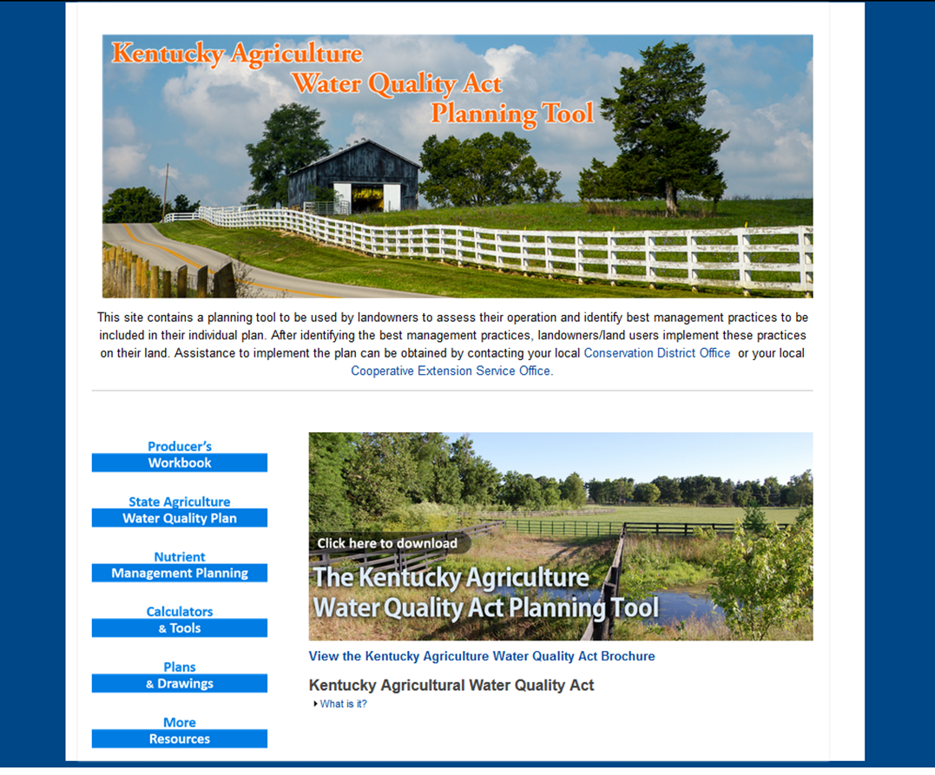

Kentucky Agriculture Water Quality Planning Tool (www.uky.edu/bae/awqp)
Notes:
The University of Kentucky created this web-based planning tool to be used by landowners to assess their operation and identify best management practices to be included in their individual plan.
The producer workbook can be used as a fillable PDF form and saved to a computer (use download button) or can be printed and used as hardcopy.
Landowners are led through a series of questions about their operations to help them determine what practices may be needed.
After identifying the appropriate best management practices, landowners/land users are responsible for implementing these practices on their land.
Assistance to develop and implement the plan can be obtained by contacting the local Soil Conservation District Office or Cooperative Extension Service Office. Frequently, these agencies will put farmers in contact with an area NRCS agent, who can provide further technical guidance on plan development, especially with BMP design and installation.
Each of these agencies can also provide assistance with identifying and applying for related cost-share assistance.

Slide 10
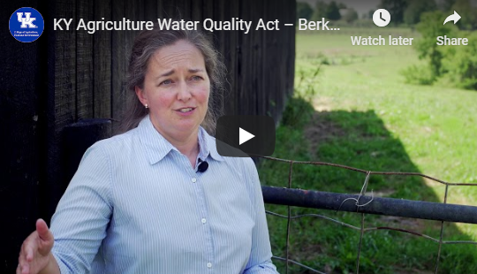
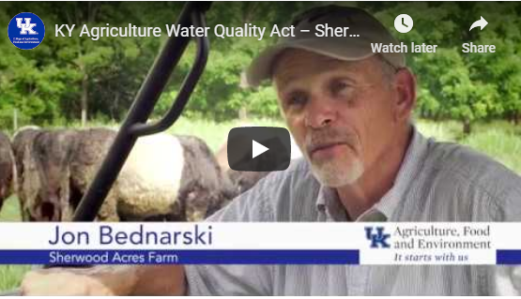
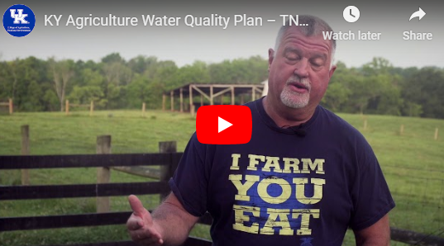
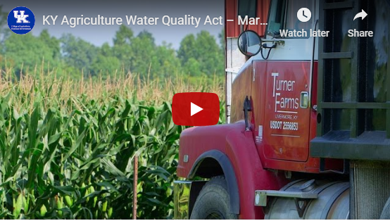
Farmer Stories/Testimonials (www.uky.edu/bae/awqp)
Notes:
There are several videos on the Ky Ag Water Quality Plan website that highlight farmer participation in planning and how has helped them achieve success. These real-world case studies offer great personal insights into why using best practices makes sense and how it can help run a more efficient, more profitable farming operation.
We don’t have time to watch the videos during this presentation, but you are encouraged to check them out later.

Slide 11
How are Agricultural BMPs implemented in Kentucky?
Producer obtains planning document or creates online form
Plan developed (with assistance from Soil Conservation District, Cooperative Extension or NRCS staff, if needed)
,
Producer may apply for cost-share assistance to install BMPs
  Applications to local Soil Conservation District Office
  Must have completed Ag Water Quality Plan
Management Practices installed, with/without $ assistance
If using cost-share, proper BMP installation is verified and cost-reimbursement approved
Ag practices for water quality are voluntary.
Notes:
This slide outlines the simplified, general progression of how BMPs are selected and implemented. The next module, Module 5 of Watershed Partners, will include much more detail on how to work with local and state partners, as well as the specifics of related Farm Bill technical and funding assistance programs.
If assistance is needed at any point, farmers should contact their county Soil Conservation District or their nearest NRCS office.
Once practices are selected, guidance is offered on proper installation and, if cost-share funding has been awarded, these agencies will assist with processing repayments for the installation costs.
Frequently, farmer labor is used as the matching contribution for funds, which typically range from 10 to 25% of the overall project cost.
(CLICK) It is important to remember that ag BMPs are voluntary, and there is not a mechanism for requiring their use unless citizen complaints bring violations to the attention of the Division of Water.

Slide 12
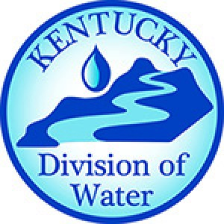
Kentucky Division of Water enforces Agriculture Water Quality Act on a complaints-driven basis.
Non-compliance occurs when:
KDOW staff document that a person engaged in agricultural activities is conducting or allowing conduct of operation that results in water pollution
Site Inspection
Talks to farmer
Requests plan or has farmer develop one
Directs farmer to technical assistance for needed practice(s)
Notes:
The Ag Water Quality Act is enforced when there are complaints to the Kentucky Division of Water.
If a site visit confirms that violations are occurring, a corrective measures process is followed to address the problem.

Slide 13
Ag Water Quality Plans…in summary
Must use practices outlined in the state planning guidance, unless special permission is given.
Plan does not have to be filed or approved, but…
you must produce a copy of the plan if a water quality problem is caused by your farm.
If you have a plan and problems are found,…
will need to work with the Ag Water Quality Authority to change the plan and implement corrective measures.
If problems are found and you do not have a plan,…
can be issued violations, fines, and other penalties.

Slide 14

9 Steps of Conservation Planning (NRCS)
1. Identify problems and opportunities
2. Determine objectives
3. Inventory resources
4. Analyze resource data
5. Formulate alternatives
6. Evaluate alternatives
7. Make decisions
8. Implement the plan
9. Evaluate the plan
Notes:
When an NRCS agent provides assistance, these are the general steps he or she will use in the planning and implementation process.
These should look very familiar, as they follow a similar progression to the steps of watershed planning and implementation!

Slide 15
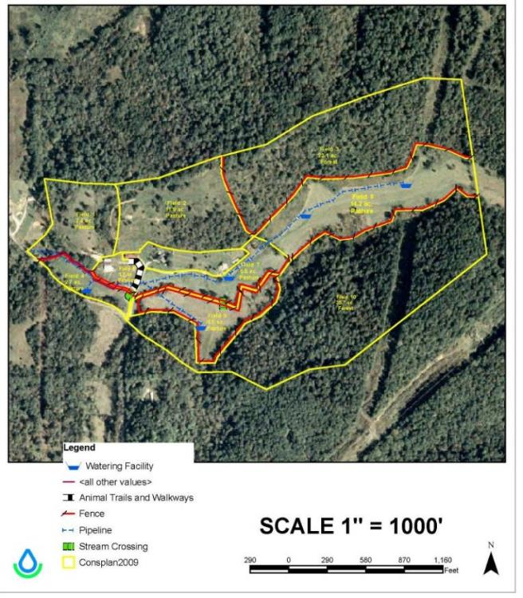
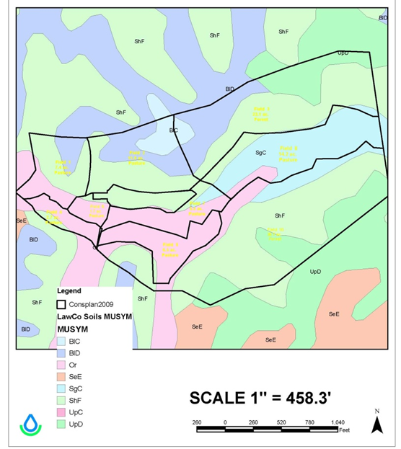
Conservation Plan Map
Soils Map
Source: NRCS
Notes:
As with watershed plans, site specific ag BMP plans and related maps are created for management of identified resource concerns.
In coordination with the NRCS, a conservation plan map can be created for the property with delineations of the recommended BMPs.
The plan is based on soil types, expected land use and production goals, known natural resource problems, topography, and other site-specific factors.
In this particular example, the yellow lines show property boundaries., the red lines show fence borders, and a water pipeline is show with a blue line.
Additional features are watering facilities (or tanks), animal trails and walkways, and stream crossings.
The 10 fields are divided into pasture and forested areas. You can see that there is some overlap between these uses and the underlying soil types.

Slide 16
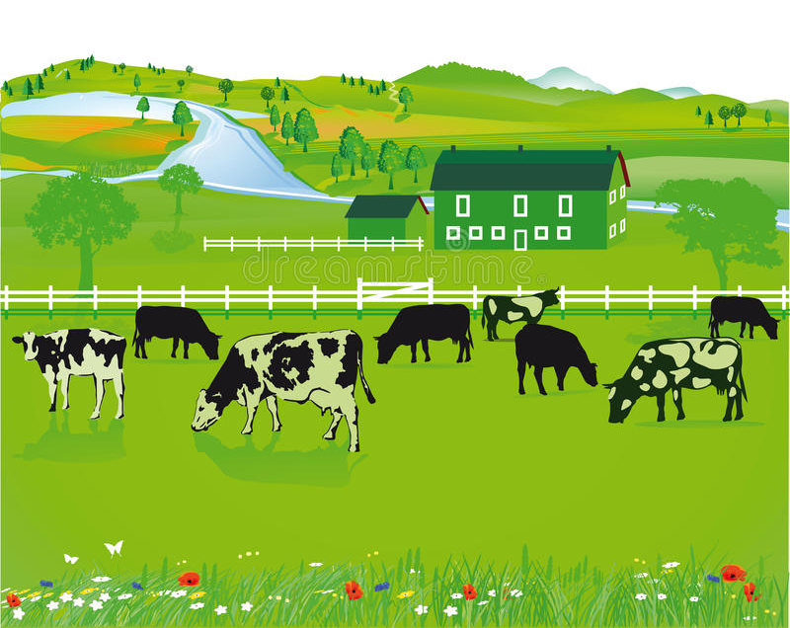
Livestock-Related BMPs
Notes:
We will now review some of the specific agricultural management practices, beginning with those that related to livestock farming.

Slide 17



Guide to BMP Information
Description
General description of the BMP with some design considerations
Pros and Cons
Examples
Pollutants Addressed: List of contaminants typically removed
Low | Medium | High
<$1,000 | $1,000 - $10,000 | $>10,000
Annual, or low cost | Monthly, or mid-cost | Weekly, or high cost
Low removal | Medium removal | High removal
Relative Cost Rating
Maintenance
Treatment Effectiveness
Notes:
This slide shows the format that will be used to describe each of the following stormwater BMPs.
The title will name the practice and label it as structural or non-structural.
A short description with pros and cons will be provided.
The pollutants addressed will list the contaminants typically removed by the practice.
And, three symbols are used for relative ratings of low, medium or high for Cost, Maintenance Needs and Treatment Effectiveness.

Slide 18
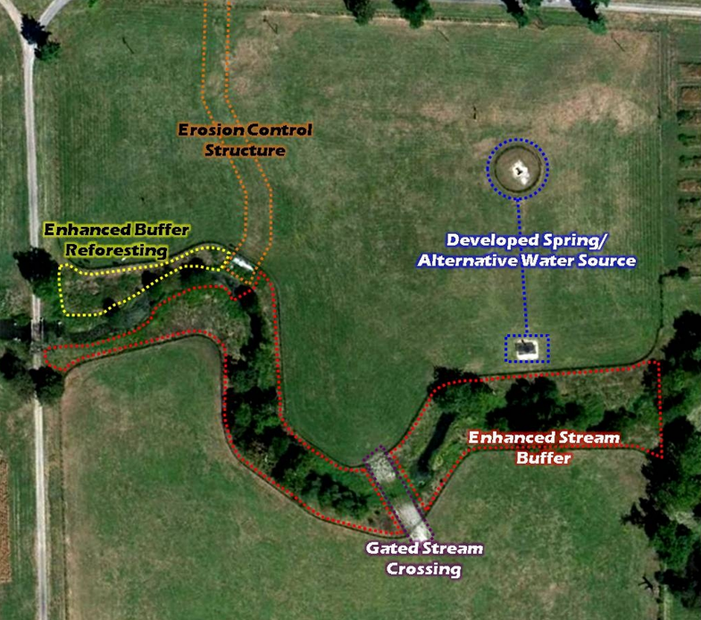
Herd Management System
More efficient
Healthier livestock
Protects soil/water
Potential Components:
Rotational Grazing
Stocking Density
Livestock Exclusion Fencing
Limited Stream Crossing
Offsite Water Source
Shade Structure
University of Kentucky College of Ag
Notes:
It is helpful to think through the following BMPs as components of a herd management system that:
makes day-to-day farming operations more efficient and easier
enables healthy livestock populations
protects soil and water resources.
A herd management system includes several options that can be installed to function together for optimal efficiency, including: a rotational grazing plan with multiple fenced pastures, livestock exclusion fencing, limited stream crossings, offsite water sources, and artificial shade structures.
This example from UK’s Coldstream Research Farm includes (CLICK) Livestock Exclusion Fencing, a (CLICK) Gated Stream Crossing, a spring that was developed as an (CLICK) Alternative Water Source, an (CLICK) Enhanced Buffer Area and (CLICK) Erosion Control Structure (grassed waterway?) to prevent a gully from forming in the pasture.

Slide 19
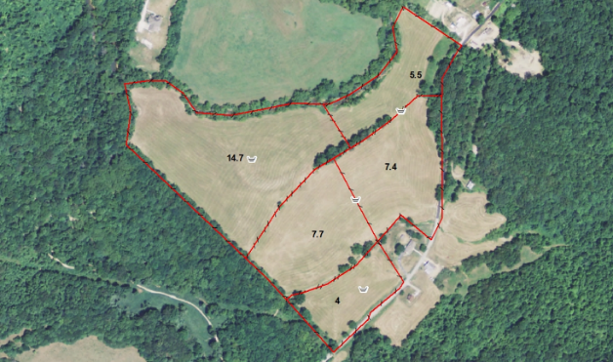
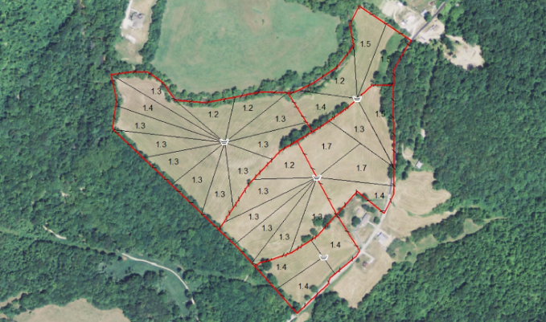

Non-Structural Practice – Rotational or Prescribed Grazing
Two or more pastures are alternately rested and grazed in a planned sequence to maintain minimum recommended grazing coverage, typically based on forage height.
Target Pollutants: Bacteria, Nutrients, Sediment
Medium
Medium
High
Notes:
Rotational grazing and prescribed grazing provide forage needs without overgrazing pastures.
Overgrazed pastures reduce forage productivity and can lead to erosion, compaction, and muddy winter conditions.
In a prescribed grazing approach, two or more pastures are alternately rested and grazed in a planned sequence to maintain minimum recommended grazing coverage, which is typically estimated by forage height.
Proper Grazing Use is another livestock BMP. It refers to stocking density, or the number of animals in a specific area (i.e. # of cows/acre of pasture), so that grazing occurs at an intensity that maintains quality and quantity of forage while simultaneously protecting soil resources.
Target Pollutants of this BMP: bacteria, nutrients, sediment (these pollutants are pretty consistent throughout for livestock farming BMPs)
Relative ratings of: Cost – medium, Feasibility – medium, Effectiveness – high
Photo 1: Land fenced into separate pastures for rotational grazing
Photo 2: Use of temporary fencing to divide pasture areas, further distributing and minimizing grazing impacts. Note shared watering sources at central points.

Slide 20
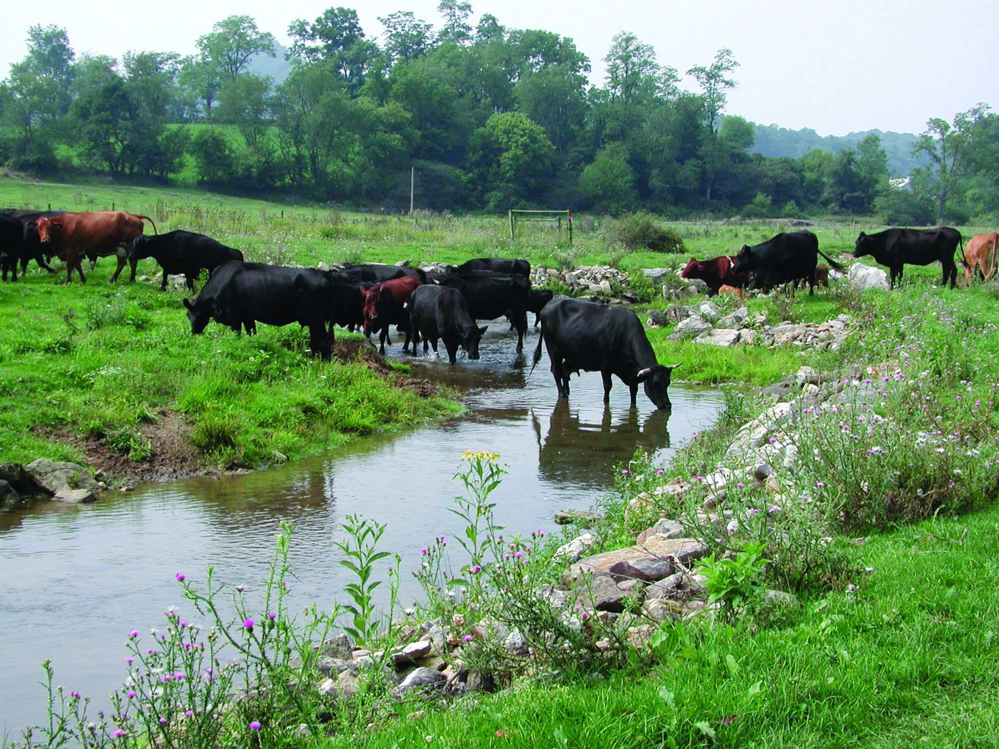
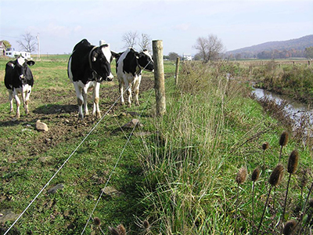

Structural Practice – Livestock Exclusion Fencing
The use of fencing to provide a barrier between livestock and a natural waterway.
Without Fencing
Target Pollutants: Bacteria, Nutrients, Sediment
Medium to High
Medium
High
With Fencing
Notes:
Allowing livestock to have free access to streams and other natural waterbodies can cause more problems than just the added nutrient and pathogenic contributions.
It also allows trampling of the banks and loss of vegetation, causing increased erosion and silt and sediment contributions to the adjacent waterway.
Livestock exclusion fencing provides a barrier between livestock and the stream, river, pond or lake.
When considering this BMP option, technical advisors can help determine the best type of fencing to use and the best alternative drinking water source for the animals, if needed.

Slide 21
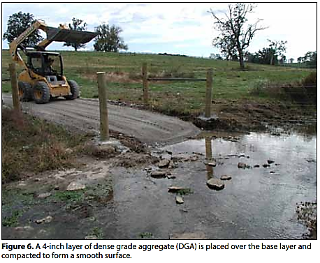
Structural Practice – Limited Stream Access
A limited stream crossing that enables livestock to have continued access to a natural water source and adjacent pastureland.
Target Pollutants: Bacteria, Nutrients, Sediment
Medium to High
Medium to High
High
University of Kentucky College of Ag
Notes:
One option for maintaining the stream as a water source, is a limited stream crossing. This also enables easy access from one pasture to another adjacent pasture.
For this practice, fencing is used to confine the area and geotextile fabric and rock are used to protect the exposed banks from erosion.
Hanging flood gates over the stream will restrict livestock but swing out during high flows.
It is also important to consider slopes and stream characteristics for optimal siting of stream crossings and access points.
Stream crossings should be located in straight sections where the stream bed is stable or where grade control can be provided to create stability. Avoid locations such as bends, abrupt changes in channel grade, areas of excessive seepage, confluences of tributaries, or areas that are immediately upstream or downstream of a bridge or culvert. Also, avoid stream banks that are greater than 5 feet in height.
Source: Stream Crossings for Cattle, University of Kentucky, Department of Agriculture, AEN-101

Slide 22
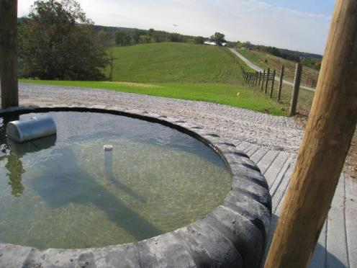
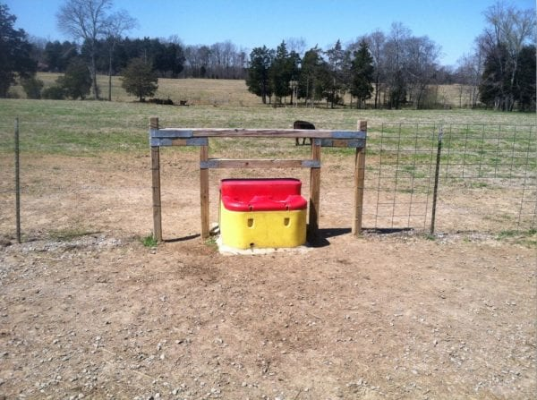

Structural Practice – Alternative Livestock Water Systems
Water supply other than a present system (generally a stream), which may include a spring development, pipeline and tank or temporary water system.
Tire Waterer at Eden Shale Farm, KY
Target Pollutants: Bacteria, Nutrients, Sediment
Medium to High
Low
Medium
Notes:
General guidance on livestock watering advises farmers to keep clean water within 800 ft. of animals and discourage loafing at the water point. Ideally, animals should take a drink and leave to minimize soil compaction and enable free access to others.
These measures also reduce erosion and sediment loading to waterways and improve livestock health.
The water tank in the lower picture is a more typical style seen in Kentucky pastures, but the upper photo shows a prototype of a tire waterer being used at the Eden Shale demonstration farm. The tire waterer (fabricated from a used equipment tire) has the following advantages and disadvantages.
Advantages
Size. A larger diameter means more livestock can drink at one time (e.g., 10-16 head versus one to two for automatic water fountains).
Cost. Used heavy duty tires may be free if picked-up. Expect additional costs for tires if delivery is required and if the sidewall is already removed.
Durability. Heavy duty tires are durable and can withstand forces exerted by large livestock.
​Disadvantages
Availability. Identifying a local source of heavy duty tires may be challenging.
Handling. Large tires can weigh over 1,000 lb. meaning a tractor with a front-end loader along with a set of chains is required to move and place the tire.
Sidewall removal. Cutting out the sidewall is difficult, especially if the tire is steel belted.
Freezing. As with an automatic water fountain, the water in tire-tank waterers can freeze. While the tire itself provides insulation, the surface of the water is exposed to air and wind.
Source: Alternative Water Source: Developing Springs for Livestock, University of Kentucky, College of Agriculture, AEN-98

Slide 23
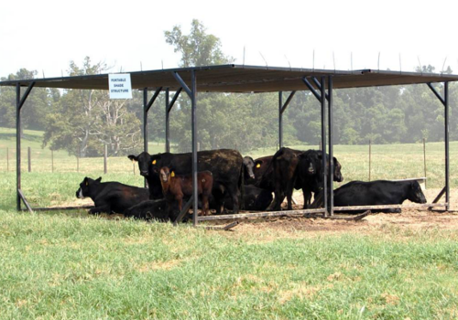
Structural Practice – Shade Structures
A structure that provides shade for livestock when access to natural riparian area trees is limited by stream exclusion fencing.
Reduces stress on livestock and can be located in areas that are less likely to contribute runoff pollution of waterways.
Can be permanent or portable for rotational grazing.
Portable shade structure, UK College of Ag
Medium
Low
Medium
Target Pollutants: Bacteria, Nutrients, Sediment
Notes:
Shade in pasture-based farming systems helps reduce heat-related stress to livestock, which can result in decreases in milk production, feed intake, weight gains, and fertility.
Natural shade from trees is preferred, but permanent and portable shade structures can also be used.
Permanent structures are most frequently used in lots, rather than in grazing systems.
Portable structures are less costly and can be moved on skidders, making them more appropriate for rotational grazing.
They are generally about 10 x 20 feet in size and can be built from pipe that is welded to make a frame with a skid-type bottom and covered with a shade cloth or corrugated metal. These portable structures should be moved around the pasture periodically to prevent overgrazed areas from developing.
Source: Shade Options for Grazing Cattle, University of Kentucky, College of Agriculture, AEN-99

Slide 24
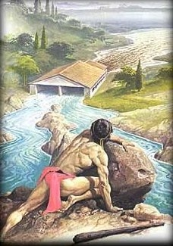
Managing Livestock Waste
When livestock waste washes into waterbodies, it can:
Raise nitrate concentrations to dangerous levels
(impacting the livestock’s own drinking water source)
Produce algal blooms by elevating nitrogen and phosphorus levels
Cause fish kills
Create noxious odors
Increase water turbidity
Add pathogenic contaminants
Notes:
Livestock waste can be a significant contributor of bacteria, pathogens, and nutrients to waterbodies.
Nitrates have the potential to make the livestock’s own water sources unhealthy, or even toxic.
Nitrogen and phosphorus from manure can also lead to heavy algal blooms that decay and consume dissolved oxygen, potentially killing off fish and other aquatic life.
And, the added sediment and odors make for an unpleasant stream situation!
According to Greek legend, Hercules cleaned out the Augean Stables in a single day by diverting the flow of two rivers through the stables and washing away all of the manure from thousands of animals that had accumulated over 30 years!
While impressive as a physical feat, this is not impressive to a water quality professional! We want to keep animal waste as far away from our streams and rivers as possible.

Slide 25
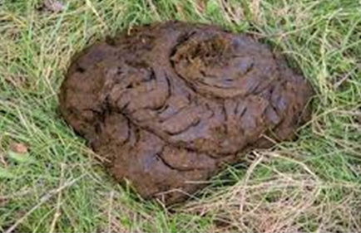
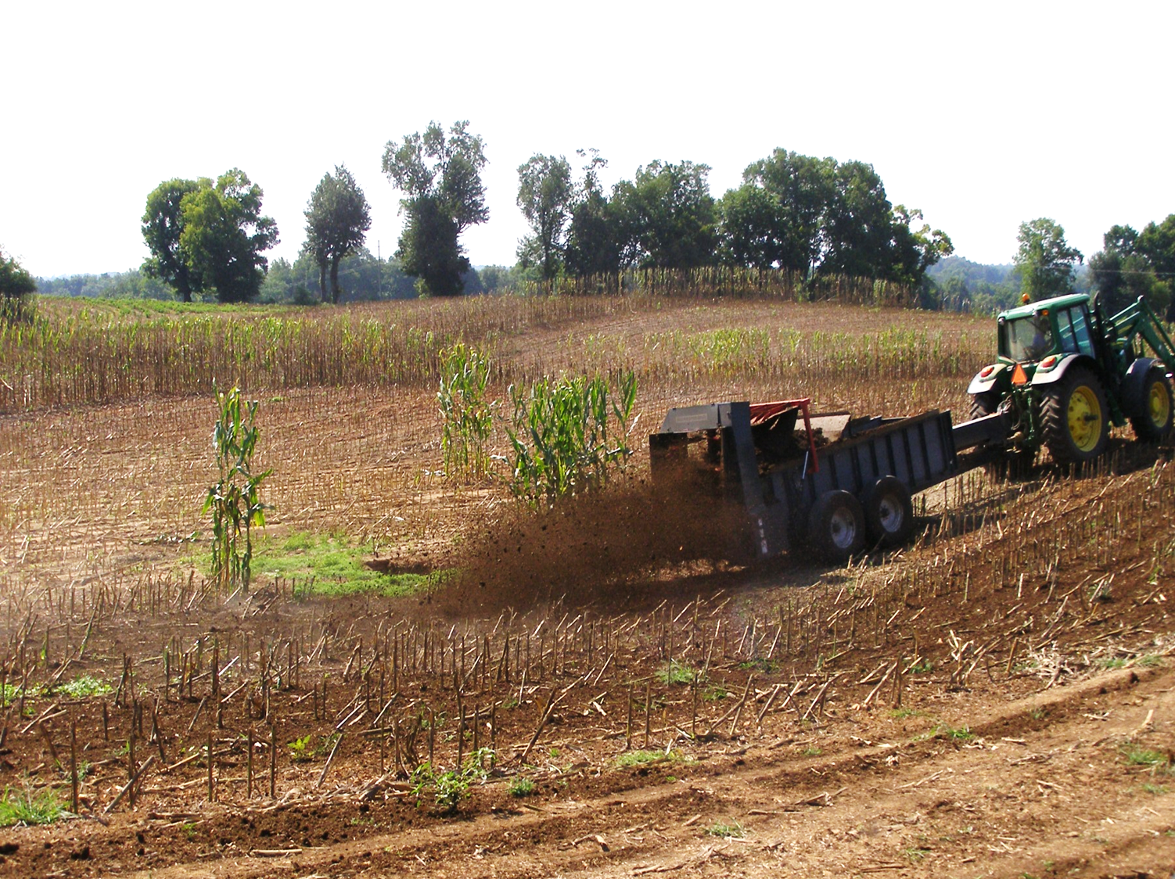
Non-Structural Practice – Manure Management System
A planned system for managing liquid and solid manure and associated runoff with components that do not degrade soil or water resources.
Target Pollutants: Bacteria, Nutrients, Sediment
Low to Medium
Low to Medium
High
University of Kentucky Dept of Ag
Notes:
One way to ensure this happens is by planning a system to manage liquid and solid manure in ways that protect soil and water resources.
Because of the high nutrient content in manure, a manure management plan is part of Kentucky’s Nutrient Management Planning guidance.
This aspect of the plan:
Guides management of all plant nutrients associated with animal manure (and crop applications)
Limits amount of nutrients lost to leaching, runoff and volatilization
Optimizes on-farm nutrient availability and use
Graphic: A farmer uses a manure spreader to apply it as a crop fertilizer. This practice requires that farmers first determine the nutrient content of the manure, the crop’s nutrient needs, and field application rates. The application equipment should then be calibrated to ensure accurate application rates.

Slide 26
Non-Structural Practice –
Nutrient Management Plan
All farms with 10 or more acres that land apply animal manures, commercial fertilizers, or other soil amendments as plant available nutrients are required to develop and implement a Nutrient Management Plan (NMP) as part of their Kentucky Agriculture Water Quality Plan (KAWQP).
4-R Concept:
Right source – fertilizer type
Right place – application method
Right amount/rate – based on soil fertility, crop needs, application timing
Right time – application timing
Notes:
The Kentucky Ag Water Quality Act states that landowners with 10 or more acres who land-apply plant-available nutrients or who export manure must develop and implement a Nutrient Management Plan as part of their Ag Water Quality Plan. UK has also developed guidance and technical resources for the development of this aspect of planning.
The ultimate goal of nutrient management planning is to develop a strategy for utilizing manure and inorganic fertilizer sources on the farm without polluting the environment.
All nutrient management plans can be simplified into the 4-R concept: right source (fertilizer type), right place (application method), right amount (for site-specific needs), and the right time for application.
The basic steps for developing a nutrient management plan:
1. Determine the total volume and amount of nutrients generated.
2. Determine soil fertility.
3. Determine application rates (right rate) based on existing soil fertility, crop requirements, application timing (right time), application method (right place), and fertilizer type (e.g. commercial fertilizer versus slow release fertilizer or additives to slow release) (right source).
4. Create a cropping plan for utilizing generated manure, based on storage capacity, on a field-by-field basis for a total of five years.
5. Implement the plan and keep records.

Slide 27
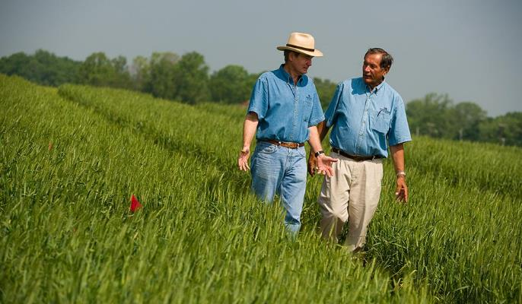
Farmer Interest in a Nutrient Management Plan:
University of Kentucky College of Ag
Reduced fertilizer costs
Potential to increase crop yields
Maximized nutrient uptake, minimized nutrient loss
Help qualify for EQIP and other cost-share opportunities
Documentation if faced with water quality complaint
Notes:
Farmers may see several benefits from developing and implementing a Nutrient Management Plan.
These may include:
Reduced fertilizer costs
Potentially better crop yields
Maximization of onsite nutrient use by plants, and minimzed nutrient losses from the property
Assistance with applications for EQIP and other cost-share opportunities for the operation
Due-diligence proof of effort if faced with a water-quality complaint that may be stemming from their property

Slide 28
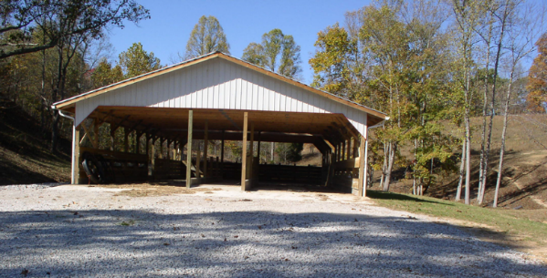
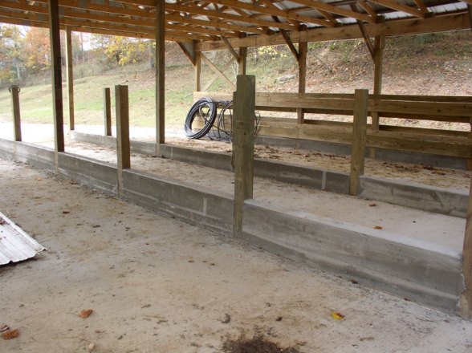

Structural Practice – Manure Storage Structure
A permanent facility used to temporarily store solid livestock manure or agricultural waste until it can be removed and properly applied to land using a nutrient management plan.
Target Pollutants: Bacteria, Nutrients
High
Medium to High
High
Notes:
Manure storage structures can take many forms, including ponds, tanks, lagoons, basins, stack pads. Some are covered and other are not, depending on the need for the end product to be dry.
These structures are best used with a comprehensive manure management system that helps outline practices for managing liquid and solid manure, including its runoff from concentrated areas.

Slide 29
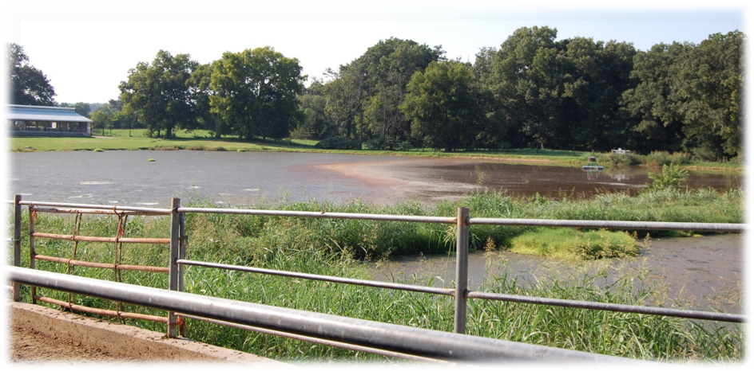
Structural Practice – Manure Storage Pond
A reservoir, pit or pond for the temporary storage of liquid and/or solid livestock manure, waste water and/or other polluted runoff prior to land application.
Target Pollutants:
Bacteria, Nutrients
High
High
High
University of Kentucky Dept. of Ag
Notes:
The construction of a storage pond is another option that allows manure to be stored and timed for land applications when it’s needed and weather and other conditions are most favorable.
Manure retention also reduces the likelihood that is will pollute streams and other waterbodies.
Ponds are sized to meet estimates of projected solid and liquid volumes, surface water runoff, and frequency of pumping. Their depth and shape are not critical, as long as the design capacity is achieved.
The embankment and surrounding areas of the pond should be vegetated.
A concrete ramps into the pond may be recommended for ease of pumping and hauling and to protect the integrity of the pond liner.
Manure storage ponds require a permit from the Kentucky Division of Water.

Slide 30
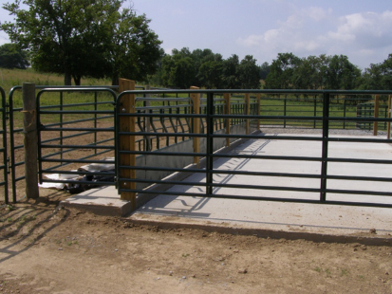
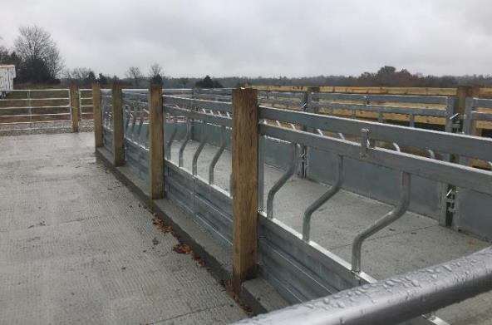

Structural Practice – Feeding & Heavy Use Areas
The use of vegetative cover, hard surfacing or structures to manage heavily used livestock areas for protection from soil erosion and water quality problems.
Target Pollutants: Bacteria, Nutrients, Sediment
Low to Medium
Low
Medium
Notes:
In addition to the construction techniques, the installation of feeding and heavy use areas should be conducted in a way that recognizes and avoids areas prone to water quality or soil erosion problems. For this reason, they should be located in upland areas away from streams or other waterways.
Design of the structure needs to factor surface and subsurface drainage and the disposal of runoff without erosion.
The feeding areas shown in the photos used fenced areas with hardened surfaces and contained feed access. These are also referred to as Winter Feeding Structures.
This allows for a more controlled, lower impact feeding area, as well as one that is more easily managed by the farmer.
It can be opened on various sides to enable staggered feeding of separate herds if necessary.
(This practice is described in Kentucky Ag Water Quality Plan Livestock BMP #14.)

Slide 31
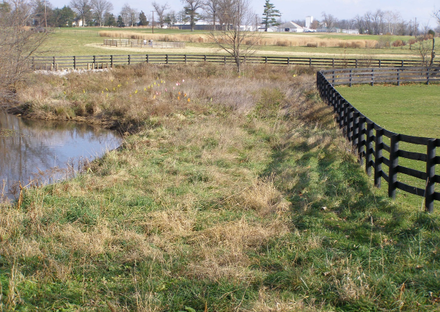

Non-Structural Practice – Riparian Area Protection
An area of trees, woody shrubs, grasses and other vegetation located adjacent to waterbodies and wetlands that is protected from livestock.
Typically, an “edge-of-field” practice
Also improves aquatic habitat and reduces streambank erosion
Source: UK Cooperative Extension
Medium to High
Low to Medium
High
Target Pollutants: Bacteria, Nutrients, Sediment, Organic Material
Notes:
This practice can be used in both livestock and crop situations to ensure protection of riparian areas.
Livestock exclusion fencing enables this practice when pastureland borders streams.
Riparian area protection from livestock is easiest when these are an “edge-of-field” practice, rather than one that is situated in the middle of a functioning pasture.
Another option is to use temporary fencing to allow occasional grazing, sometimes called “flash grazing,” that does not allow significant damage to the riparian vegetation.

Slide 32
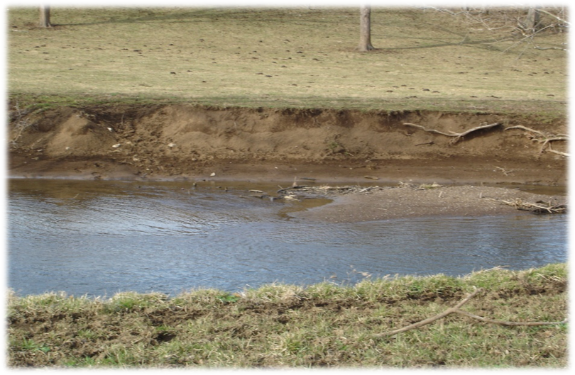
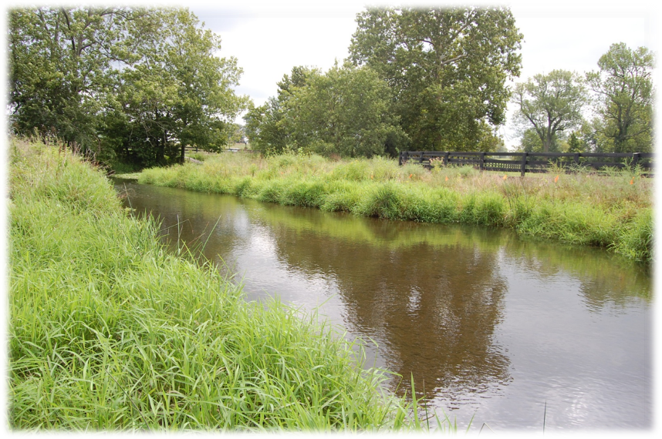
Unprotected vs Protected Riparian Areas
Notes:
The difference between the bank stability of protected vs unprotected riparian areas is stark.
Wherever possible, this practice should be adopted although it may require some creative marketing, since it can require the installation of significant lengths of fencing and long-term maintenance of the fencing and the loss of some land, shade and access to a water source.

Slide 33
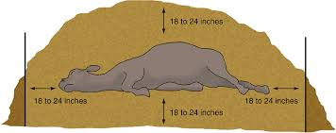
Non-Structural Practice - Dead Animal Disposal
Legally and environmentally acceptable methods of disposing of dead livestock, typically burial or incineration.
Some counties have programs that pick up dead livestock for free or minimal charge.
Carcasses should not be buried in areas subject to flooding or closer than 100 feet to a stream, well, spring, lake, or sinkhole.
Burial or Composting
Low
Low to Medium
Medium
Target Pollutants: Bacteria, Pathogens
Notes:
Another non-structural practice is the recommendation for dead animal disposal.
Acceptable methods for disposing of animal mortalities in Kentucky are incineration, burial, removal by a licensed rendering company, disposal in an approved landfill, and composting. (KRS.257.160)
Each of these methods must be accomplished within 48 hours of the animal’s death unless it is stored in a cooler.
Some counties have programs that assist with dead animal haulage. Producers should check with their county conservation districts for availability of this service.
In relation to water quality--If you are using composting or burial, there are restrictions for locating the animal at least 100 feet away from waterbodies and sinkholes.
And, animal composting facilities need to develop Groundwater Protection Plans.

Slide 34
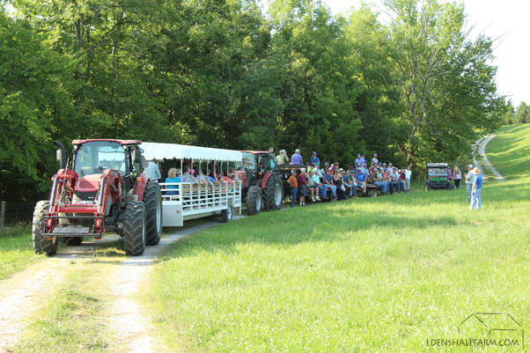
Non-Structural Practice –
Educational BMP Demonstration Field Days
Public events designed to showcase agricultural BMPs for farmers and the public during which relevant information is provided to enable broader acceptance and use.
Eden Shale Farm
Notes:
It is very helpful to offer opportunities for current and potential farmers, as well as the general public, to see the successful implementation of agricultural BMPs. Seeing is believing, and a lot of valuable information transfer can take place during these events.
Eden Shale Farm in Owen County is a research farm owned by the University of Kentucky and managed by the Kentucky Cattleman’s Association. It offers regular tours of the many BMPs that have been installed there. Additionally, the research that continues there provides a helpful basis for BMP effectiveness and feasibility. And, the farm’s managers can offer suggested modifications of BMPs to best suit individual farming operations.

Slide 35
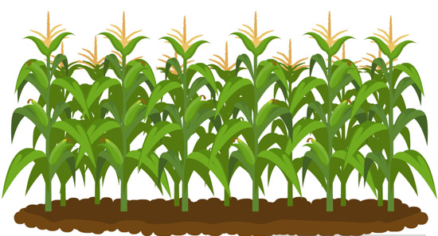
Crop-Related BMPs
Notes:
Now, we will switch focus to those BMPs that address water quality concerns related to crop farming.

Slide 36
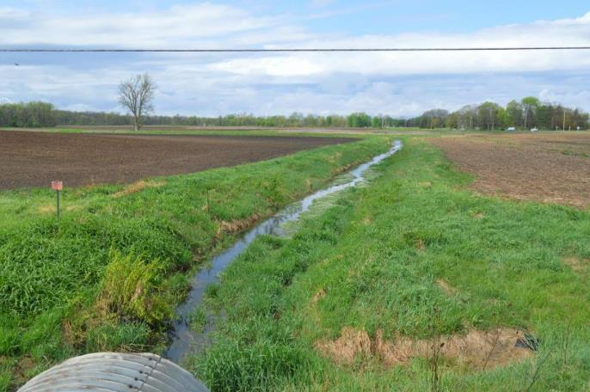
Structural Practice – Filter or Buffer Strips
Planting or maintenance of dense grass sod in strips that serve as a border between cropland and waterways or land used for other purposes.
Filter sediment, organic matter, nutrients and other pollutants from runoff
Increases infiltration of runoff
Can also serve as wildlife habitat
Source: Ohio State University
Low
Low
Medium
Target Pollutants: Sediment/Silt, Nutrients
Notes:
The filter strip should be placed on the lower edge of row crop fields, especially if they are adjacent to intermittent or perennial streams, sink holes, wells or lakes.
This practice works best on slopes of 5% or less.
Some fertilization of the filter strip vegetation may be necessary to maintain adequate vegetative growth and BMP effectiveness, and it will need to be mowed to eliminate woody plants.
These areas should not be used as a roadway and should be protected from herbicide drift from surrounding cropland application.
Filter strips are also recommended to intercept runoff from animals that are contained in confined areas.

Slide 37
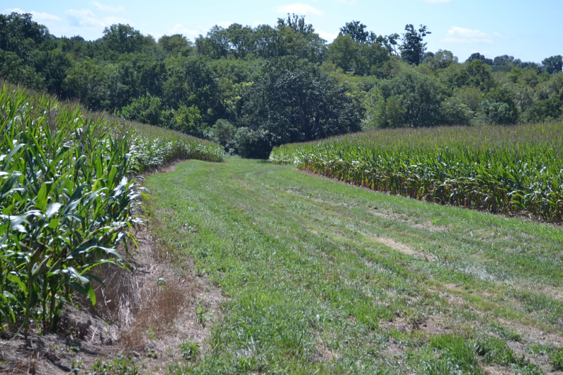
Structural Practice – Grassed Waterways
A natural or constructed channel, usually broad and shallow, covered with erosion-reducing grasses. Carries surface runoff from field, terrace or diversion to a suitable outlet.
Target Pollutants: Sediment/Silt, Nutrients
Low to Medium
Low
High
Source: University of Kentucky
Notes:
Grassed waterways are similar to filter strips, but are also used to slow and channel water from upslope fields to a stable outlet, in addition to filtering runoff.
They are usually constructed in natural water pathways where concentrated flows are likely to form erosive gulleys.
The decreased runoff volumes and velocity reduce erosion and sediment transport and may also decrease associated phosphorus runoff through removal of soil-adsorbed particles and infiltration.
It is important to maintain the BMP design width of adequate vegetation to ensure continued effectiveness of this practice.

Slide 38
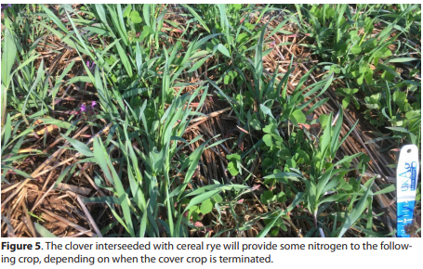
Non-Structural Practice – Cover Crop
A close‑growing crop (grass, legume, or small grain) grown primarily for the purpose of temporarily protecting from erosion and improving the soil.
Target Pollutants: Sediment/Silt, Nutrients
Medium
Medium
High
UK Cooperative Extension
Notes:
Cover crops help prevent soil erosion and loss.
They also help retain soil moisture and can trap nutrients to preserve soil fertility.
Some cover crops, such as crimson clover and hairy vetch, can help add nitrogen to the soil through biological fixation of nitrogen from the atmosphere.

Slide 39
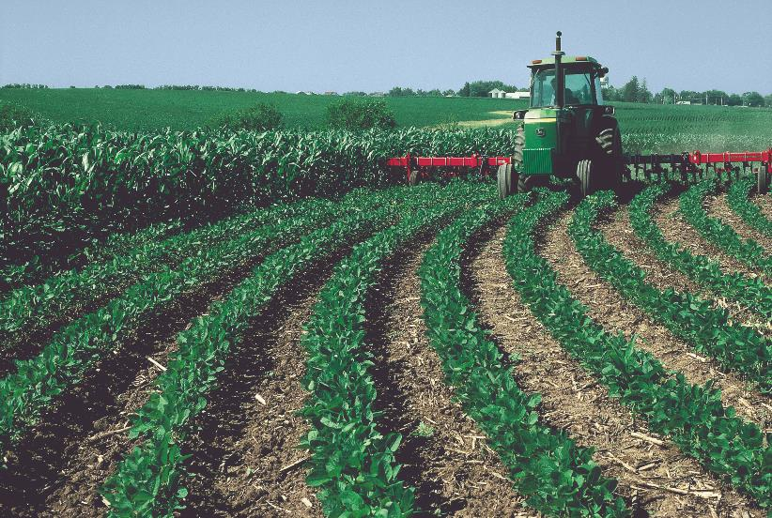
Non-Structural Practice – Conservation Tillage
A tillage and planting system that maintains plant residue on the soil surface to control erosion.
Target Pollutants: Sediment/Silt, Nutrients
Low
Low
Medium
Wikimedia Commons
Notes:
For this practice, at least any tillage or planting system can be used that maintained at least 30% coverage by crop residue after planting.
This practice may require farm machinery that can distribute crop residues evenly over the field.
Reduced tillage or no-tillage should be selected in cropping systems when practical.

Slide 40
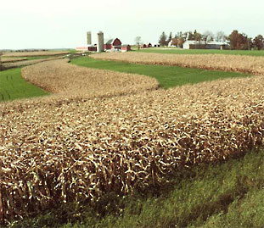
Non-Structural Practice – Contour Farming and Strip Cropping
Contour Farming – Tilling and planting across the slope and along the contours of the land
Strip Cropping – a system of growing two different crops in alternate strips on the contour
Target Pollutants: Sediment/Silt, Nutrients
Low to Medium
Medium
High
NRCS
Notes:
These two practices are often combined to minimize soil erosion and runoff pollution.
Contour farming refers to crop practices that enable all related operations (plowing, land preparation, planting, cultivating, and harvesting) to be conducted across the slope, rather than up and down the slope.
Existing natural waterways within the crop area should be left undisturbed.
Strip cropping typically involves breaking the field into alternating bands of row crops and close-growing crops, such as hay, small grains, or grass.
Strip width should be adjusted to fit equipment dimensions, and alternate crops should be selected to fit well into the overall farm operation and existing soil conditions.
These BMPs are not practical in karst areas or fields with short slopes that break in different directions.

Slide 41
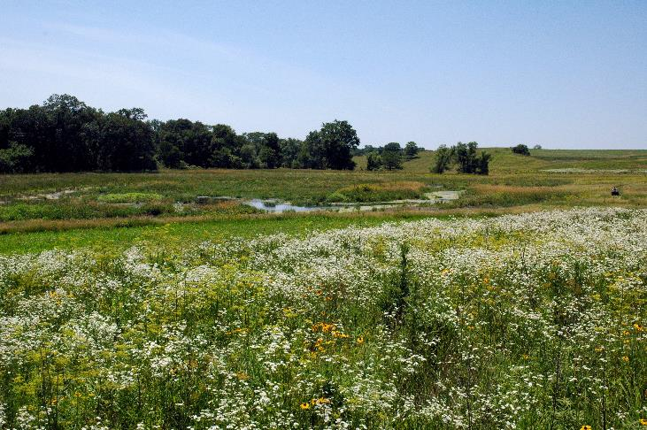
Non-Structural Practice – Conservation Coverage
Establishment and maintenance of perennial vegetative cover to protect soil and water resource on land that has been retired from agricultural production (i.e., grass, legume, tree, shrubs).
Target Pollutants: Sediment/Silt, Nutrients
Low to Medium
Medium
High
Iowa NRCS
Notes:
When agricultural lands are retired, farmers may choose to plant them with perennial vegetation that protects valuable water and soil resources. There may even be cost-share funding available to encourage this practice.
When planting grasses or legumes, it is necessary to mow periodically to control weeds, and herbicides can be used if needed to eradicate invasive or noxious vegetation, such as multi-flora rose, Johnson grass and thistles.
When trees and shrubs are also planted, mowing can occur as necessary to avoid competition with emerging seedlings.

Slide 42
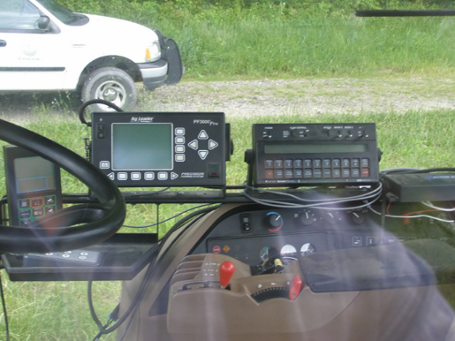
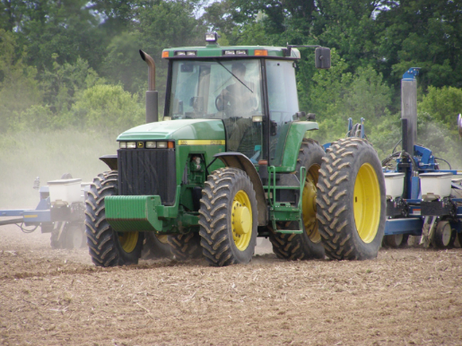
Non-Structural Practice - Precision Agriculture
The use of information technology to more accurately optimize farming practices to the capability of the land.
Considers productivity and environmental impacts.
Can assist with crop location and more efficient use of water, fertilizers and pesticides—reducing farming costs.
Target Pollutants: Sediment/Silt,
Nutrients
Medium
Medium
High
Notes:
Precision agriculture offers a lot of potential for optimum profitability, sustainability, and protection of the environment.
It results in a very site-specific farming plan that uses data that relates to the field’s soils, crop types, nutrients, pests, moisture, and crop yields.
Soil and water quality benefits can result from reduced or targeted application of inputs such as nutrients, pesticides, and irrigation water.
When used to precisely control where equipment travels in a field, precision agriculture can also reduce soil compaction and erosion.
Avoidance of environmentally sensitive areas can greatly reduce off-site delivery of runoff pollutants.
Variable rate irrigation can enable improvements in water use efficiency, providing both economic and environmental benefit.

Slide 43
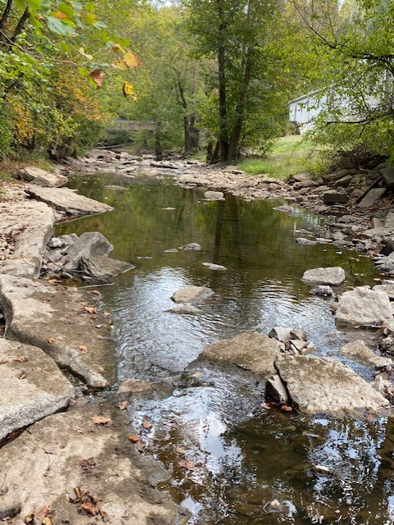
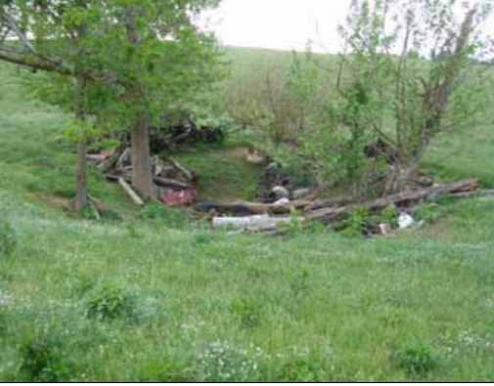



Non-Structural Practice – Storage of Liquid and Dry Pesticides (Small Quantities)
This BMP applies to storage, over any period of time, of dry pesticides (< 300 pounds) and liquid pesticides (< 300 gallons).
100 ft
Sinkholes
Perennial streams
400 ft
Open
sinkholes
200 ft
Domestic wells, springs, cisterns
Notes:
A section of the Agriculture Water Quality Plan is dedicated to BMPs related to pesticide and fertilizer storage and use.
Although many of the BMPs relate to bulk quantities of these chemicals, the document also contains a BMP specific to operations storing small quantities, which is frequently more relevant for individual farming operations.
This BMP includes requirements for storage distances from wells, sinkholes, springs, cisterns and streams.
Locate storage facilities:
100 feet minimum away from sinkholes
200 feet from private domestic wells
200 feet from springs & cisterns
400 feet from open sinkholes and perennial streams

Slide 44

Non-Structural Practice – Additional Pesticide & Fertilizer BMPs
Mixing, Loading, and Handling
  Avoid mixing and measuring within label-required distances of waterbodies or entry points (wells, springs, sinkholes)
Container Disposal
  Kentucky Rinse and Return Program
Applying Pesticides
  Restricted-use pesticide applications may require commercial operator training and a license
Notes:
Additional BMPs are available for other pesticide and fertilizer-related activities. These all relate to protecting water quality from contamination by these chemicals.
Mixing, Loading and Handling BMP:
Follow label requirements
Follow applicator regulations for restricted-use pesticides
Use backflow prevention
Container Disposal BMP:
Dispose of non-returnable containers according to label directions
Recycle or return containers if possible. The Kentucky Dept. of Agriculture sponsors a Rinse and Return program, which is often coordinated by County Cooperative Extension Service offices
DO NOT dump or burn containers
Triple or pressure rinse containers
Puncture containers for safer disposal
Applying Pesticides BMP:
Having a Private Applicator Card certifying the holder has participated in an educational program for the application of pesticides, which includes training by the Cooperative Extension Office

Slide 45
Simple Steps to Protect Water Quality
Develop and implement a Kentucky Agriculture Water Quality Plan
Implement a nutrient management plan
Get a soil test
Install stream buffers
Handle farm chemicals wisely
Dispose of dead animals properly
Notes:
We have covered several agricultural BMPs in some detail here, and there is a lot more information out there to learn more—especially on the NRCS website and the Kentucky Agriculture Water Quality Planning website.
If you are providing a more basic presentation to a generalized watershed group, you may want to use these basic recommendations for protecting water quality on the farm.

Slide 46

Kentucky EXCEL Farms
(EXCellence in Environmental Leadership)
Program that recognizes agricultural operations that incorporate good stewardship of the land and water.
Provides enhanced access to agency personnel, recognition and marketing opportunities
One-year, renewable membership
Apply and submit at least one voluntary environmental project each year, which can include developing an Ag Water Quality Plan!
Notes:
Agricultural operations that do incorporate these practices can be recognized by Kentucky’s EXCEL program as Kentucky EXCEL Farms.
The recognition is renewable on an annual basis as long as an application is submitted with documentation of at least one voluntary environmental project.
The project can even be the development of an Agriculture Water Quality Plan.
Membership benefits includes assistance with developing a plan, as well as many different networking and continuing education opportunities.
And, if necessary, EXCEL program staff can assist with any compliance arrangements.

Slide 47

Farm Solutions to Water Pollution, produced by Kentucky Education Television, 2008
https://ket.pbslearningmedia.org/resource/ket08.sci.ess.watcyc.farmsol/farm-solutions-to-water-pollution/#.XrqbAmhKiUl

