Slide 1
Watershed Academy
Watershed Coordinator Training Series
Effective Communications
9. Step 3 – Creating the Message

Slide 2
Developing a Watershed Outreach Campaign
STEP 1: Define the driving forces, goals, and objectives
STEP 2: Identify and analyze the target audience
STEP 3: Create the message
STEP 4: Package the message
STEP 5: Distribute the message
STEP 6: Evaluate the outreach campaign
Notes:
This presentation is focused on the 3rd step of our outreach campaign development: creating the message.

Slide 3
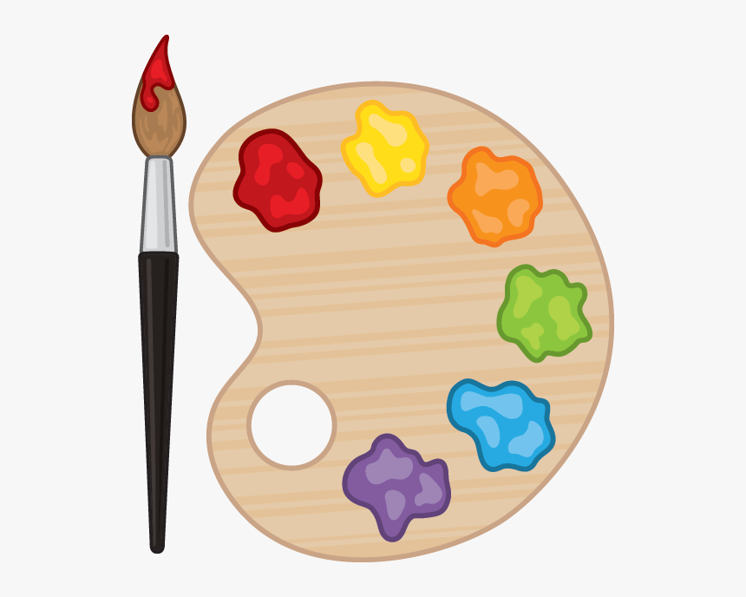
STEP 3: Create the Message(s)
STEP 3: Create the Message(s)
Your Message
Be clear and specific
Engage your audience
Consider Water Quality Objectives
Connect to audience values
Bring about awareness or change
Articulate needed actions
Notes:
As you’ll remember this is where you get to be creative and use the information you have gathered to create your message or, likely, messages!
It’s time to prompt the knowledge, attitudes and actions that will help you achieve your water quality objectives.
Begin by reflecting on your water quality objectives.
Then, when developing your related message:
Be clear and specific
Engage your audience
Make sure you do this by connecting with their values and appealing to them on their own terms.
In many cases, you will need to begin by building awareness of the issue before you can advocate for action.
And, prompt a response by providing clear, specific actions the audience members can take.

Slide 4
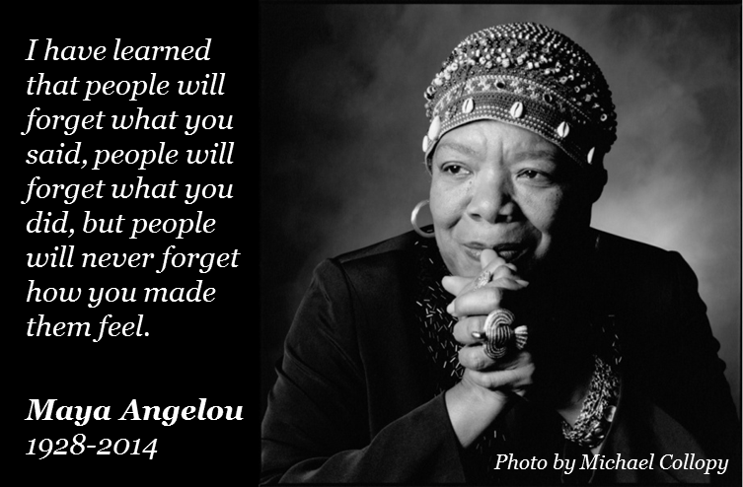
What Makes People Care?
Notes:
In thinking about crafting your message, it is important to think for a moment about what makes people care… about anything?
This quote from Maya Angelou is a powerful one. The things that stay with you are the one’s that make you feel in a deep way or someone connect with feelings you already have.
We react emotionally before we act logically. Think about it: as your body develops it must take the different stimuli from the environment and begin to prepare for action or reaction, and this begins before we even know how to speak. Our feelings have much more to do with how we behave than perhaps we would like to admit.

Slide 5
Five Principles for More Effective Communication
Join the Community
Communicate in Images
Invoking Emotions with Intention
Create Meaningful Calls to Action
Tell Better Stories
Christiano, A. and A. Neimand. 2018. The Science of What Makes People Care. Stanford Social Innovation Review. Fall 2018. P. 26-33
Notes:
Much of what we are going to discuss today has comes from a great paper from the Stanford Social Innovation Review by Christiano and Neimand. They list five principles for more effective communications. We will use these five principles as an outline for how to create better messages.

Slide 6
1. Join the Community
“Identify a group whose change in behavior could make a profound difference for your issue or inspire others to take action and figure out how to bring that group value.”
Christiano, A. and A. Neimand. 2018. The Science of What Makes People Care. Stanford Social Innovation Review. Fall 2018. P. 26-33
Notes:
The first principle is to “Join the Community.” Here is how they summarize this action.

Slide 7


1. Join the Conversation
Good conversation seeks to add value to
the individuals in existing conversation
vs
Reserve megaphones for when
ordinary public conversation breaks down
Notes:
Joining the community means joining the conversation. Think about how you might consider joining the conversation at a social outing. Likely you listen to what other people are talking about and try to add to the conversation in a meaningful way. (Click) You are seeking to provide a gift to others by sharing something meaningful or learning about what is meaningful to them.
It would be awkward to enter a social gathering and shout your demands to the group at large. This is not respecting the existing conversation. (Click) Megaphones are reserved for when conversation has broken down. There is a time for such messaging, but it is typically when other conversation avenues have been exhausted.
Whether you are entering into an individual conversation or putting up a billboard for public dialogue, remember that you are seeking to join the community and the conversation to provide a gift of how the world can be made better.

Slide 8
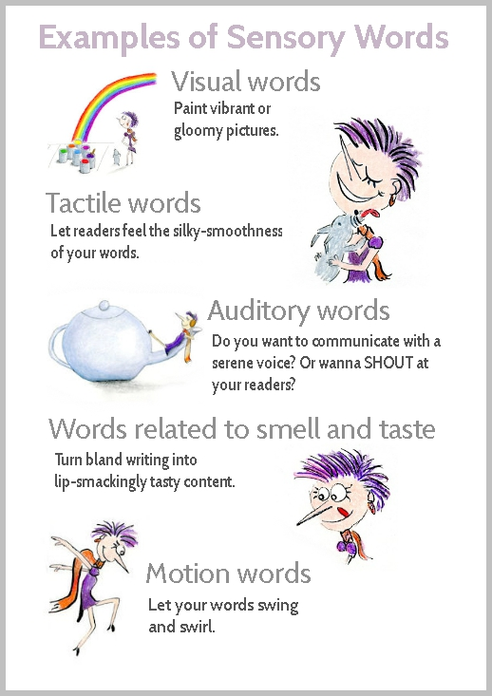
2. Communicate in
Images
“Use visual language instead of abstract concepts to help people connect with your work.”
Draw the images your presentation is putting in people’s brains.
www.enchantingmarketing.com/
Christiano, A. and A. Neimand. 2018. The Science of What Makes People Care. Stanford Social Innovation Review. Fall 2018. P. 26-33
Notes:
Second, communicate in images. If you have ever taken a memory improvement class, they probably taught you to use your other senses to help move items from short term memory to long term memory. This is because our brains store memory better when they involve these other areas of the brain. The human mind can only store 3-5 pieces of information in working memory at a time.
(Click)
The old proverb “a picture is worth 1000 words” is scientifically true at least in principle. Visually language helps to connect, but may not come naturally to those trained in to write technical science reports.
Using visual language to communicate helps your message to be remembered. So think about the images you are placing in people’s brains? (click) Perhaps draw a picture of the images that your metaphors are creating. What type of long term impression are you communicating?

Slide 9
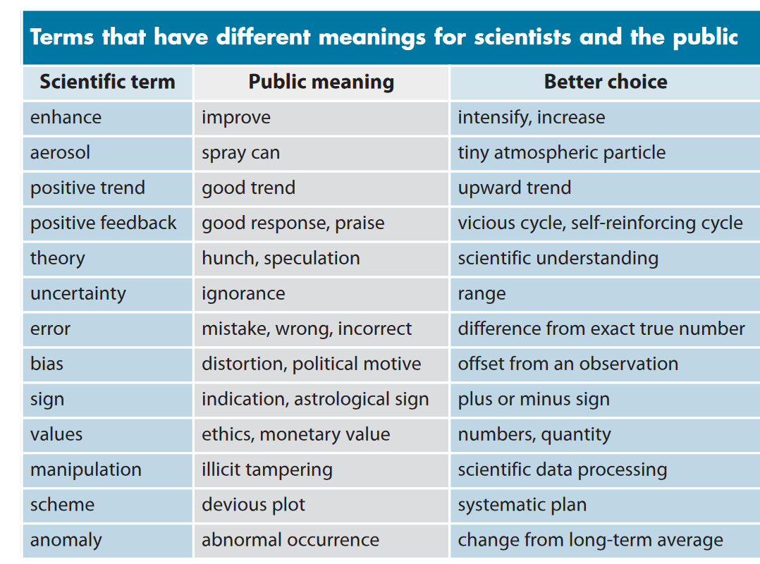
Beware of Jargon
https://climatecommunication.org/wp-content/uploads/2011/10/Somerville-Hassol-Physics-Today-2011.pdf
Notes:
Water professionals are notorious for using words, terms and acronyms that the general public is not familiar with and likely does not understand. In your communications, it is imperative to try to tone down this use of jargon and ensure that you are using vocabulary that successfully communicates your message.
Because your brain’s storage is limited, by using jargon or acronyms, even when you explain them, people may become lost and may not be able to follow you because they are trying to remember what the word means or they may have already forgotten. All of that takes up valuable short term memory.
Further, make sure you speak in language familiar to your audience. Scientific discipline specific language might as well be a foreign language to outside audiences. Here are some instances in which scientific words mean something very different to scientists vs the general public.

Slide 10
Water Words that Work waterwordsthatwork.com
Our mission is to ensure the American people enjoy clean and safe water, outdoors and at home. We do this by helping our clients and students succeed with their outreach and communication.
Professional Term Water Word
acute short-term
adjacent along
best management practices conservation activities
degraded worsened health
discharge release
greenspace natural areas
impaired of poor health/unhealthy
native naturally occurring
Notes:
The Water Words that Work organization was formed after a presentation by this name was given at a River Network River Rally in Virginia in 2004. Following the favorable response, the speaker started a blog, then a one-man business, then a small organization that provides individualized assistance to assist with water communications.
The basic premise of the initial presentation was that there are key words that will be better understood and more effective at communicating your message than others.
Here are a few examples of water specific jargon.

Slide 11

What’s your hook?
Make your message lively and personal so that it resonates with the audience and prompts them to respond.
Use humor, light-heartedness
Portray issue through stories
Use trusted sources
Don’t exaggerate situation/consequences
Find this and more ideas at US EPA NPS Outreach Toolbox.
Notes:
You can consider your audience in developing the hook that resonates best with their profession or world view.
A technical audience might respond to charts and graphs.
Developers, the business community and local officials may be best approached with cost and effectiveness measures.
And, you may reach a more general audience best with emotional connections.
Here is an example for cash washing in the EPA Toolbox
Beware of exaggerating as that might backfire , and only use trusted sources.

Slide 12
Lexington Stormwater Focus Group Study: Dog Waste
1
2
3
5
4
Opinion Works 2018
Notes:
As an example of communicating in images, the Lexington-Fayette Urban County Government (LFUCG) conducted a focus group study with different messages directed at picking up dog waste.
Survey question: Of these messages, choose which one you think is best?
The focus group rated each of these on a scale from 0 to 10 in terms of useful information, clear message, and motivation. The also voted which one they thought best and described the scores. The scores (from best to worst) were as follows:
#2 – Try Swimming in It = 8.44 (4 best votes)
#3 – Do Your Duty (Weiner dog) = 6.39
#1 – Pet Waste Thank You = 6.17 overall
#5 – Do Your Duty (Leash) = 6.06
#4 – Picking up after Your Dog = 4.06
For #2 one respondent said “Clear message. Dog looks sad I would pick it up. Pollution message. Gross image.”
This helps to demonstrate the power of communicating by images and even specifics such as the type of dog to use.

Slide 13
3. Invoking Emotions with Intention
“Think about what you’re trying to get people to do and how they would feel if they were doing it. Then think about stories that would make them feel that way.”
Christiano, A. and A. Neimand. 2018. The Science of What Makes People Care. Stanford Social Innovation Review. Fall 2018. P. 26-33
Notes:
The third principle of effective communication is intentionally invoking emotions.
This means thinking about they way in which your communications make people feel.

Slide 14
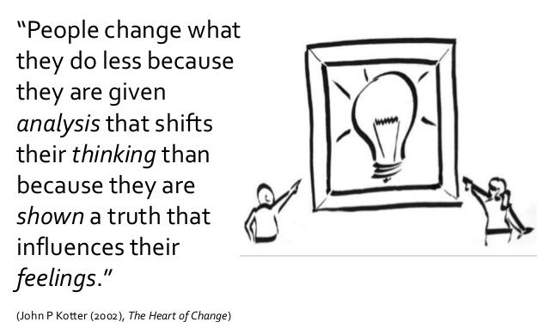
Framing Your Message
Story lines that make an issue relevant to a particular audience.
Puts a particular spin (or frame) on factual information.
Goal is to alter someone’s opinion on an issue.
Notes:
You want to frame your message in a way that relates to peoples’ values, context, anecdotes and stereotypes.
Try to find ways to make the concept fit into something that they already understand and that they want or like.

Slide 15
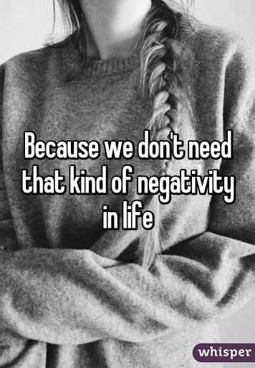
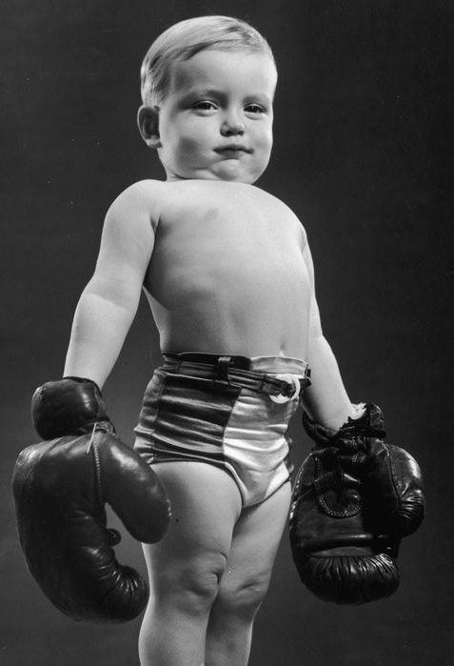

3. Invoking Emotions with Intention
Sadness / Feel Bad
Pride
Wonder / Connected
Notes:
Christiano and Neimand address three of the strongest emotions that are often used with messaging.
(Click) Sadness of Feeling Bad:
“Relying on sadness as a way to “pull on heartstrings” may actually result in your community tuning you out entirely. People tend to avoid or remain unmoved by stories and situations that attempt to make them feel bad.”
“Research tells us that people are really good at avoiding information for three reasons: It makes them feel bad; it obligates them to do something they do not want to do; or it threatens their identity, values, and worldview.”
(Click) Wonder or Connectedness
“Although people avoid information that makes them feel bad, they are attracted to things associated with pleasant emotions. For example, awe—the feeling of wonder that comes with seeing a brilliant landscape or sunset—opens us to connecting with others because we feel smaller and more connected to other humans.”
(Click) Pride
Another pleasant emotion, pride, can be exceptionally powerful. Researchers have found that people anticipating feeling pride in helping the environment were more likely to take positive action than those anticipating guilt for having failed to do so.”
How is your message connecting to these emotions.

Slide 16
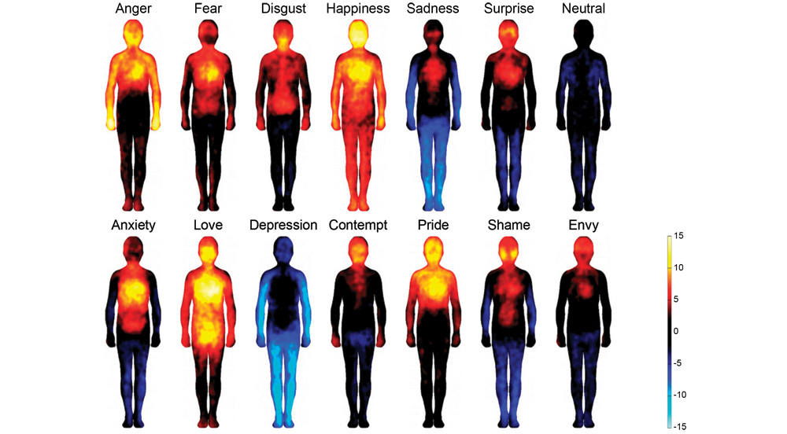
3. Invoking Emotions with Intention
Nummenmaa, L., E. Glerean, R. Hari, JK. Hietanen. Dec 2013. Bodily maps of emotions
Proceedings of the National Academy of Sciences. DOI: 10.1073/pnas.1321664111
Notes:
These maps produced by researchers in Finland had 700 participants describe increased or decreased sensations as a result of emotional words, stories, videos, or images.
What this shows is that messages physically affect the body. Think about how and where you feel these emotions. Your message is creating physical responses in your audience. What effects do you desire your message to create in others?

Slide 17






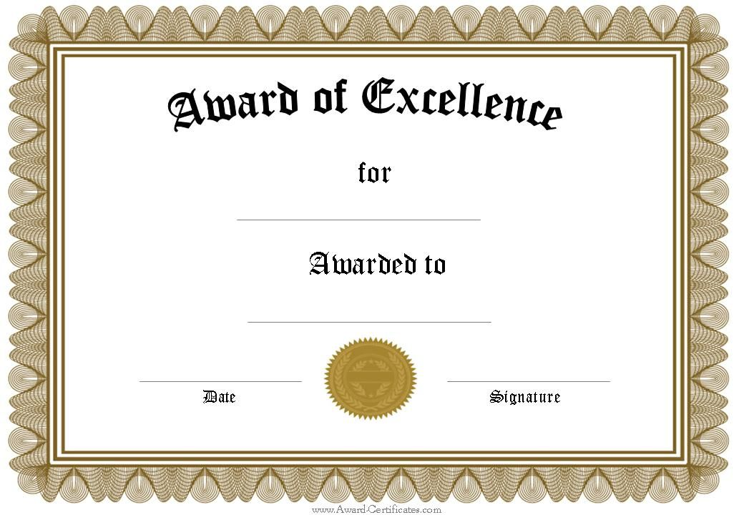
Appeal to motivations, values or benefits
Cost-Saving
No Cost!
Time Saving
Convenient!
Assists with Regulatory Compliance
Award/
Recognition
Improved Health
This Photo by Unknown Author is licensed under CC BY-SA
Notes:
When crafting your message, trying to appeal to motivations may increase the likelihood of people adopting the targeted action. Think about your specific audience and what they value and try to connect with that.

Slide 18
4. Create Meaningful Calls to Action
“Review your calls to action to make sure they ask communities to do:
something specific
that will connect them to the cause and
that they know how to do.”
Christiano, A. and A. Neimand. 2018. The Science of What Makes People Care. Stanford Social Innovation Review. Fall 2018. P. 26-33
Notes:
The fourth principle is creating meaningful calls to action. Here is the quote listing the three essential elements of a meaningful call.

Slide 19

4. Create Meaningful Calls to Action
1. Specific, Concrete Socially Beneficial Behavior Maximizes Happiness
Two groups given 24 hours to either:
“Support environmental sustainability” or
“Increase the amount of materials or resources that are recycled or reused.”
Study found #2 was statistically:
to be more concrete than abstract,
provide a lower gap between expectation and reality,
Gave more personal happiness to the giver
Although the types of acts did not differ
Rudd, M., J. Aaker, and MI. Norton. 2014. “Getting the Most Out of Giving: Concretely Framing a Prosocial Goal Maximizes Happiness,” Journal of Experimental Social Psychology, vol. 54, 2014, pp. 11-24. http://nrs.harvard.edu/urn-3:HUL.InstRepos:12534961
Notes:
Researchers in social psychology did a series of experiments which showed that (click) specific, concrete instructions for socially-beneficial behaviors actually maximized the amount of happiness that people had from engaging in the behaviors. Specific tasks that people know how to do are key.
How did they test this? Among other experiments, they used two groups. (click)
One group was asked to (click) “support environmental sustainability.” The other group was asked to (click) “increase the amount of materials or resources that are recycled or reused.” The 70 participants had 24 hours to complete their tasks. In a follow-up survey, the researchers assessed how happy the participants were with their action.
(click) Participants who had the concrete goal of increasing resources for recycling reported greater happiness.
This is in spite of the fact that both sets of people ended up doing about the same thing.
The improved happiness came because the expectations of the participants and the reality of what occurred were similar. They weren’t let down about what they ended up doing.
You can add happiness to people’s lives be giving them clear instructions about what they need to do. This takes the weight of figuring out what should be done off of the audience and on to the message creators. The better you do your job, the more satisfied they will feel because they helped make the world a better place!

Slide 20



4. Create Meaningful Calls to Action
2. Connect them to the cause
Christiano, A. and A. Neimand. 2018. The Science of What Makes People Care. Stanford Social Innovation Review. Fall 2018. P. 26-33
Notes:
Christiano and Neimand also address the need for obvious connectedness between the action and the cause of the problem in social psychological research:
“when people feel as though their actions will not make a difference, they are less likely to take action. The negative feelings outweigh any positive feelings they might have had from the action. The researchers refer to this as “pseudo-inefficacy.”
“If people believe they have no power to produce results, they will not attempt to make things happen.”
If you set your goals too high, you might lose the battle before you start it because people won’t try unless they think they can succeed.

Slide 21

4. Create Meaningful Calls to Action
3. They Need to Know How to Do It
Not just conceptually.
How can they easily incorporate it into their daily routines and habits?
Christiano, A. and A. Neimand. 2018. The Science of What Makes People Care. Stanford Social Innovation Review. Fall 2018. P. 26-33
Notes:
Thirdly, they need to know how to do it…. And not conceptually, but actually incorporating it into a daily routine.
A person can know everything about how treat invasive species along a riparian zone, but until they can figure out how to incorporate that into their schedule, they are not going to take action.
Mostly people operate within set boundaries and habits. Sometimes you need to show how the action can be taken without a lot of inconvenience.

Slide 22
5. Tell Better Stories
“Go beyond simply sharing messages to telling interesting stories with a beginning, middle, and end.”
“Stories have characters; a beginning, middle, and end; plot, conflict, and resolution. If you do not include these elements, you are not telling a story.”
Stories are remembered 22 times better than facts only.
Christiano, A. and A. Neimand. 2018. The Science of What Makes People Care. Stanford Social Innovation Review. Fall 2018. P. 26-33
Notes:
Our last principle is telling stories rather than providing messages. (click) Stories have a beginning, middle, and end. They have plot and conflict and resolution. All of these need to be in there. If you don’t have them, its not a story.
(click) People remember stories 22 times better than facts. People can connect with stories and relate those stories to others.

Slide 23
5. Tell Better Stories
Steps in Science Communication
Storytelling Training Process
“The detached and technical way in which scientists describe their research contributes to the perception of scientists as competent (i.e., worthy of respect due to their expertise) but also “cold”—and as a result, less likely to be trusted”
Green SJ, Grorud-Colvert K, and Mannix H. 2018. Uniting science and stories: Perspectives on the value of storytelling for communicating science. FACETS 3:164–173. doi:10.1139/facets-2016-0079
Notes:
In a previous presentation, we mentioned that trust is typically based on perceived competence and warmth. Because doctors are often less warm, nurses are more trusted.
(Click)
Scientists are often respected because of their expertise but are not trusted because they are not warm.
Story-telling is a way for scientists to communicate their message in a way that will increase their trust.
You may not be much of a storyteller but you can get better with practice. I’ve provided a like to a paper that describes a workshop that helped scientists move through a cycle of learning, implementing what you learn, practicing in front of peers, and then in front of the target audience, getting feedback on the storytelling, and then thinking about how you can improve.

Slide 24
5. Tell Better Stories
Green SJ, Grorud-Colvert K, and Mannix H. 2018. Uniting science and stories: Perspectives on the value of storytelling for communicating science. FACETS 3:164–173. doi:10.1139/facets-2016-0079
Notes:
One of the things you can do is try to plot the fortune of the characters in your story between prosperity and despair. Any story can be plotted in this way (from Cinderella to Harry Potter) to show that (1) the fortunes of the main character change as the result of a major problem they face and (2) the story nearly always ends with a resolution to the problem—typically resulting in good fortune for the main character (Figs. 2b–2d). If there is no change in fortune—no drama— then it is not a story (Fig. 2a).
Some stories have greater relevance than others for storytelling:
Discovery - The listener invests in our well-being as we take them on a journey through the successes and failures of our experiments, analyses, or field experiences. This process builds tension and expectation as we move closer to a discovery. The key to this type of story is that the result of these experiences (i.e., our discovery) is unexpected, increasing our overall understanding in ways we could not have imagined at the outset.
This is easy to do for watersheds. What did you learn? What about setbacks? How did stakeholders react? How did teamwork overcome?
Rescue - The key to this story’s progression is that the audience steps into the story at a high point in the character’s fortunes. They then experience a traumatic loss—followed by a recovery aided by science—as the story unfolds
This could be used for someone that buys a piece of land that is impacted by pollution, but then is restored to great habitat conditions. Think BMP success stories.
Mystery - Often phenomena occur that we cannot readily explain, and there is much at stake—often for society—by not understanding how, why, and what has transpired. Part of what drives science is the desire to solve mysteries and uncover a new understanding of the world, leaving us at a story high.
This is great when you are still researching the area. What do you know? What mystery stil remains? Can people help you solve the mystery?

Slide 25
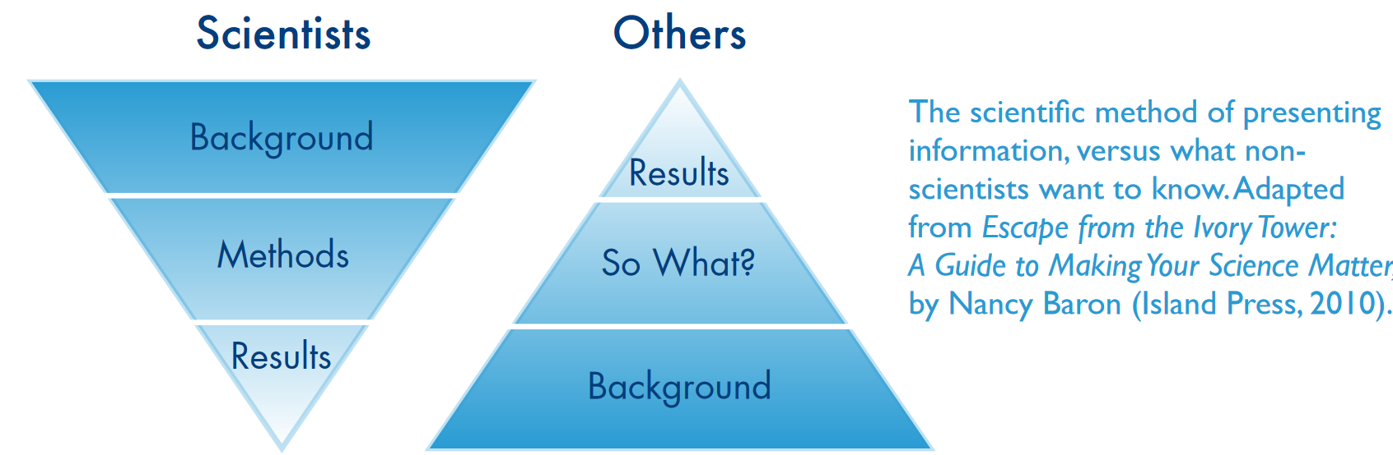
5. Tell Better Stories
Lessons and tips for a science story:
Difference between a news article and a science paper
Notes:
Another lesson that scientists need to understand about communication is that NO ONE outside of scientists bury the lead. Read a news article as opposed to a science journal. The newspaper will tell you everything you need to know in the first paragraph or two with some of the background buried deep in the article. They know people tune out easily.
Unless you are communicating to a scientific audience (or developing a mystery story), beware of following the background / methods / results format.

Slide 26
5. Tell Better Stories
Lessons and tips for a science story:
Identify your take-home message first. Think of the so-what and why the audience would care
Remember the shape of your story
Consider the sale and timing of your story
Use vivid language
Get feedback. Pause. Reflect. Try again.
Discomfort and transformation
Green SJ, Grorud-Colvert K, and Mannix H. 2018. Uniting science and stories: Perspectives on the value of storytelling for communicating science. FACETS 3:164–173. doi:10.1139/facets-2016-0079
Notes:
Here are some tips on story writing…

Slide 27
Five Principles for More Effective Communication
Join the Community
Communicate in Images
Invoking Emotions with Intention
Create Meaningful Calls to Action
Tell Better Stories
Christiano, A. and A. Neimand. 2018. The Science of What Makes People Care. Stanford Social Innovation Review. Fall 2018. P. 26-33
Notes:
So this completes our overview of the five principles for more effective communication. Hopefully I’ve left you with some images in your mind related to each of those principles.

Slide 28
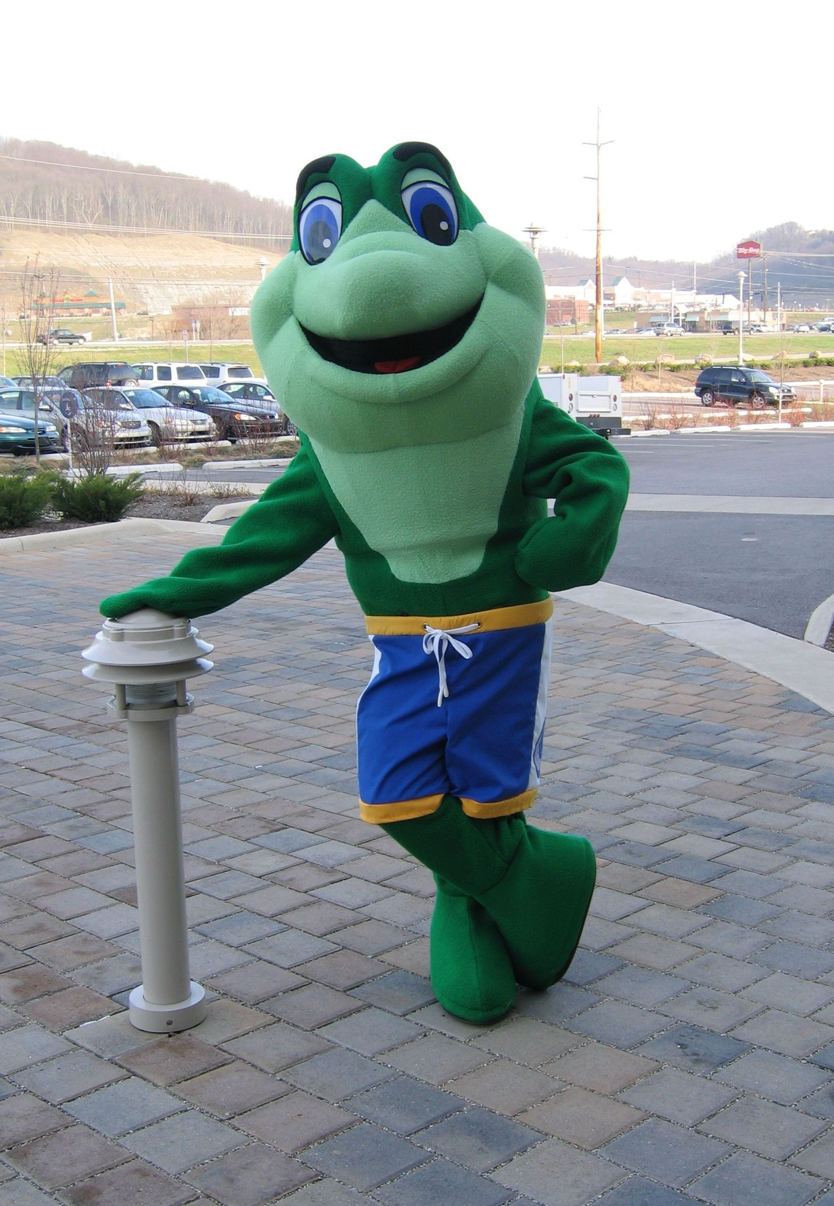


Branding Your Program
A brand is a trademark, name, phrase, logo or design used by an organization. Can also be a behavior your group is focused on addressing.
Maine DEP
Sanitation District 1’s “Splash McClean” mascot
Notes:
What do you want people to think or feel when they see or hear your brand?
Branding can affect level of trust and likelihood that message is accepted and spreads through social diffusion.

Slide 29
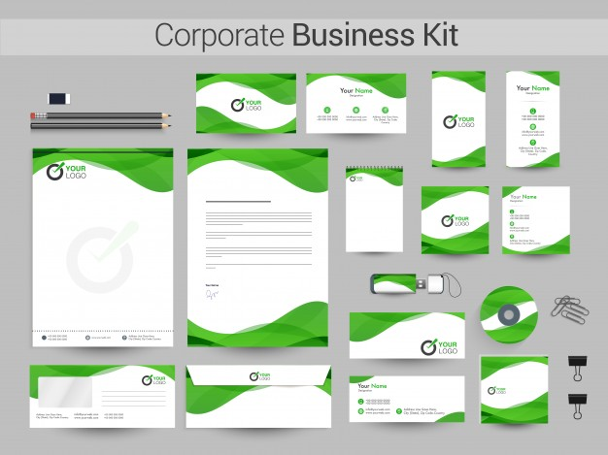
Brand Style Guide
A brand style guide lays out all the visual details of your brand. It maintains consistency across communications
Logos
Core Color Palette
Fonts (Styles and sizes)
Presentations / Reports
Image Guides
Tone or Voice
Notes:
When we think about brands, we tend to think of just a logo, but a brand should extend across all of your communications. Consistency is key.
It should include:
Logo as well as variations and when to use and not use.
Core color palette themes.
Not just the fonts, but the hierarchy as well… what is a heading… text.
All forms, reports, presentations, letterheads, business cards, etc. should have a consistent look.
In some cases you might need guidance what types of images to use (simple, clean look or fun cartoony, etc.)
Finally, you might need some statements about the tone or voice for communications. How are you looking to be viewed: professional / formal? Casual and humorous? Playful and fun? What is appropriate and what is not.

Slide 30

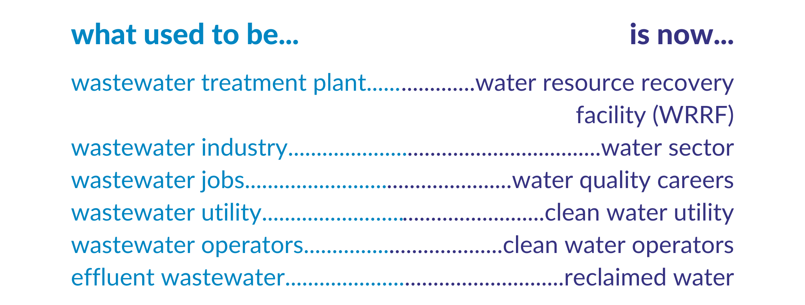
Rebranding: Clean Water Professionals
https://www.cleanwaterprofessionals.org/
Notes:
An example of an organization that has been going through a re-branding process is the “Clean Water Professionals of Kentucky and Tennessee.”
This organization was formally known as the Kentucky-Tennessee Water Environment Association.
They realized that “Water Environment” did not make sense (what is it?) and that referring to everything in terms of “wastewater” or stormwater or drinking water erased the interconnectedness between these resources. Further, the term “wastewater” gives a connotation that it is worthless or not being put to good use. Therefore “cleaning” water was emphasized in all their terminology.

Slide 31

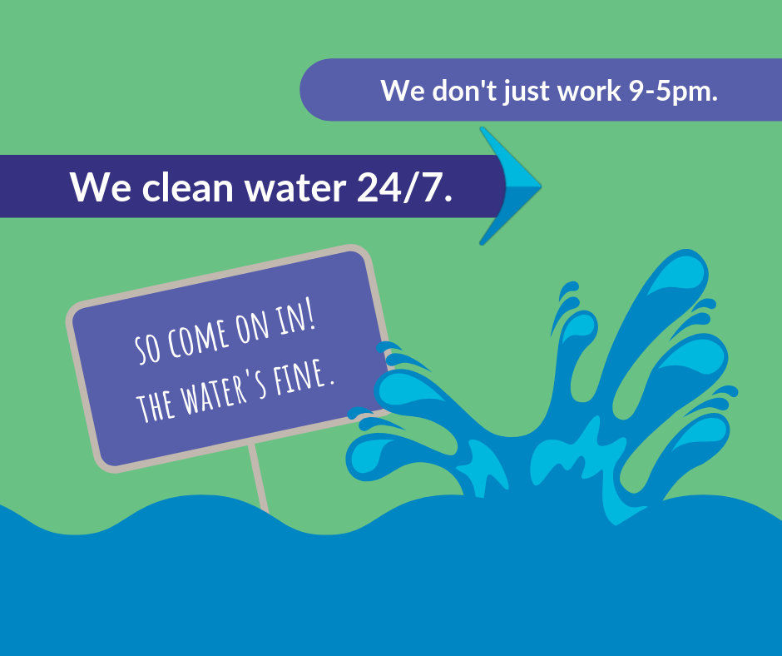
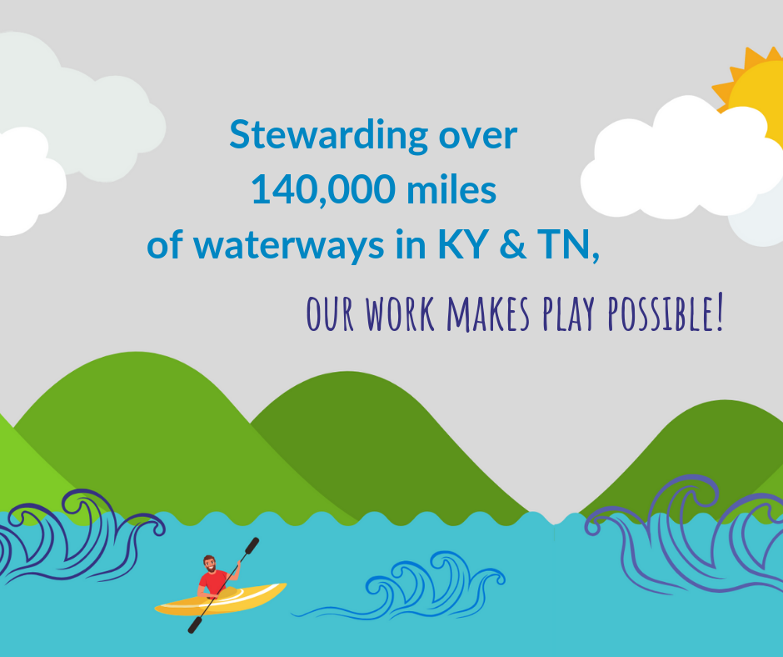
Rebranding: Clean Water Professionals
https://www.cleanwaterprofessionals.org/
Notes:
Here are some examples of the branding materials that are available on their website.

Slide 32
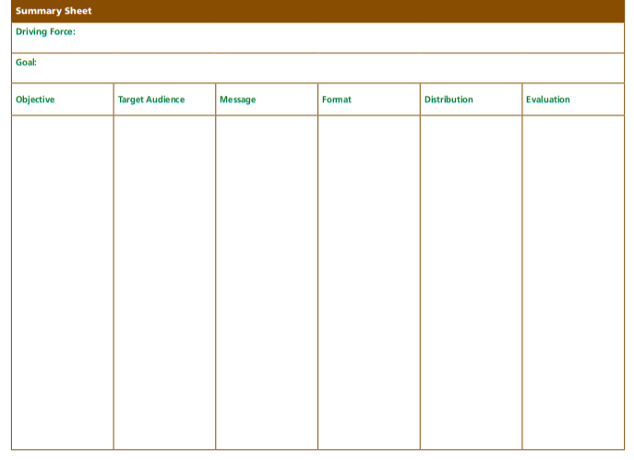
ACTIVITY: Building Blocks Worksheet
Make sure your message targets the audience.
Write simply and directly.
Use the active voice.
Write in simple declarative sentences.
Avoid use of technical terms, jargon and acronyms unless the audience is familiar with them.
Notes:
Now, you can start thinking through a scenario with this Building Blocks Worksheet Activity.
However, we first want to explore a tool to help you clarify your message.

Slide 33

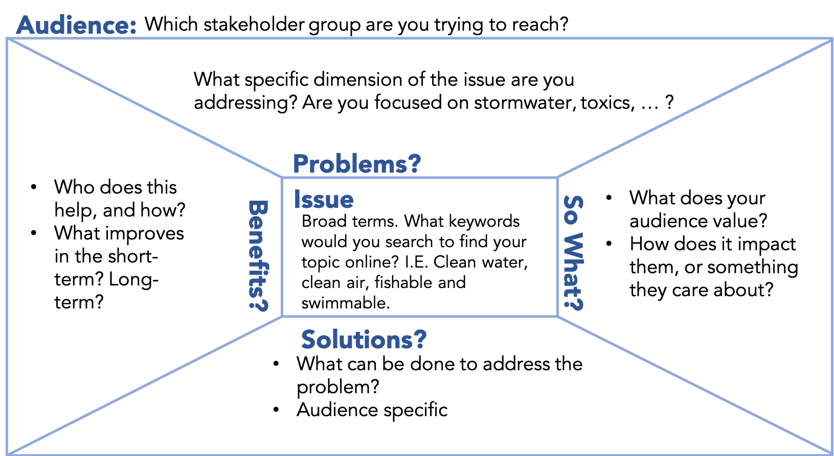
STEP 3: Create the Message(s)
Message Box
Notes:
And we will introduce you to the COMPASS Message Box as a tool to help you create your message and tell your story.
This tool was developed specifically to help scientists work to better communicate their findings and research, but it is a really helpful way of thinking through your message and how it communicates

Slide 34
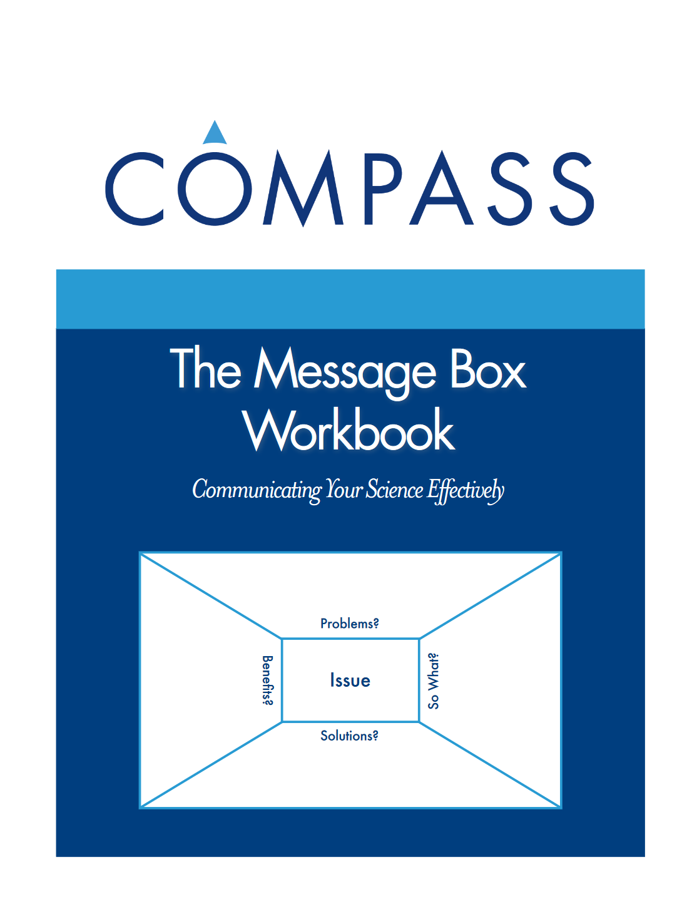
How to Use the Message Box
Workbook is available online
Written to help scientists communicate better.
https://www.compassscicomm.org/wp-content/uploads/2020/05/The-Message-Box-Workbook.pdf
Notes:
COMPASS Science Communications has graciously allowed us to utilize their material, but you can dig deeper using their workbook online as a reference. You can also reach out to them if you are looking for personal coaching through an outreach campaign, they are a nonprofit and they offer that as one of their services.
We have provided you with a version of the Message Box in our outreach campaign development spreadsheet workbook.

Slide 35
How to Use the Message Box
Why Use Message Box?
Telling Your Watershed Story
Talking to Leadership
Interviews
Press Releases
Websites
Funding Applications
Elevator Pitch
Notes:
So why should you use the Message Box?
If you are looking to develop a slogan type message, this might not be the best tool. However, it will help you to think through larger messages so that you can:
(Click through 7 uses)
The message box can be a quick way to organize your thoughts and information that you can be sure it is easily accessible, and you can pound home the main points without going on tangents.

Slide 36
How to Use the Message Box
You must identify the target audience first,
  You need one per audience, if you have multiple audiences
Notes:
The order in which you move through the elements of the message box do not really matter except that you must begin with the target audience at the top.
If you have more than one target audience, you will need more than one message box.
This is one of the ways in which you can decide if you have defined your target audience too narrowly – if your message is the same for several of your groups, then perhaps you should consider broadening your target audience. However, if you need to emphasize difference aspects, particularly in the “so what,” “solution,” or “solutions” areas then you might need separate message boxes.
At this point, we should also note that the audience and issue sections will likely be a short phrase or a few words. For the other sections, you want to seek to have no more than 5 points – because remember our short-term memory gets maxed out at 3-5 items.

Slide 37
How to Use the Message Box
Issue:
Short phrase
Broader context – big picture
Frames the problem
What is the national or state issue?
What are keywords that would bring up related information online?
  Consider starting with a word cloud and then reducing
Notes:
Likely, after the target audience, you may want to move to the “issue” section to start, or come back to this after you’ve worked on some of the other sections.
Here you want to have a (click) short phrase that sets (click) the big picture or broader context for your message. All of the other components of the message box should be able to relate to the “issue” This will help to (click) frame the problem you are seeking to address.
You might want to refer back to your project forces, goals, and objectives to determine the issue, but beware of being overly specific.
(click) you want to connect with a national or state level issue or perhaps keywords that others may do an internet search for in order to find information on your topic.
One way of find this might be using a word cloud or doing some internet searches yourself.
Some examples might be “Healthy Waters for Aquatic Wildlife” or “Nutrient Pollution” perhaps “Clean Water” or “Safe Swimming in Creek” or “Stream Monitoring”

Slide 38
How to Use the Message
Box
Problem:
Differs from the Issue in that it is more focused to your project or locality
  Troubling trend in the data?
  Impact to human or aquatic health?
Why should the audience see this as a problem?
Beware of having more than one problem
Notes:
The problem section is the area at the top of the page.
You may feel like the issue and the problem overlap, but (click) the problem is the specific slice of the issue that is specific and focused to your project or locality.
(click) Some examples might be:
Troubling trend in the data
Perhaps how few streams are able to be monitored by the Division of Water due to staff limitations when addressing Water monitoring
Perhaps the rise of harmful algal blooms or fish kills when addressing nutrients
Impact to human or aquatic health
Perhaps some children got sick when playing in the creek and the data showed it is not safe for swimming or wading
Perhaps the swimming holes have dried up due to changes in the impervious surface area
Perhaps the pollution sensitive aquatic organisms are disappearing from the stream (might have to work on selling that depending on audience).
(Click) Your goal is to help the audience understand why this is a problem.
(Click) Often you may have several points related to the same problem, but beware of having multiple problems listed together. If you have several, try to pick the priority problem… remember your behavior prioritization selection process.
Remember, you only have 5 or less points to make sure, so be sure they are vivid and communicate.

Slide 39
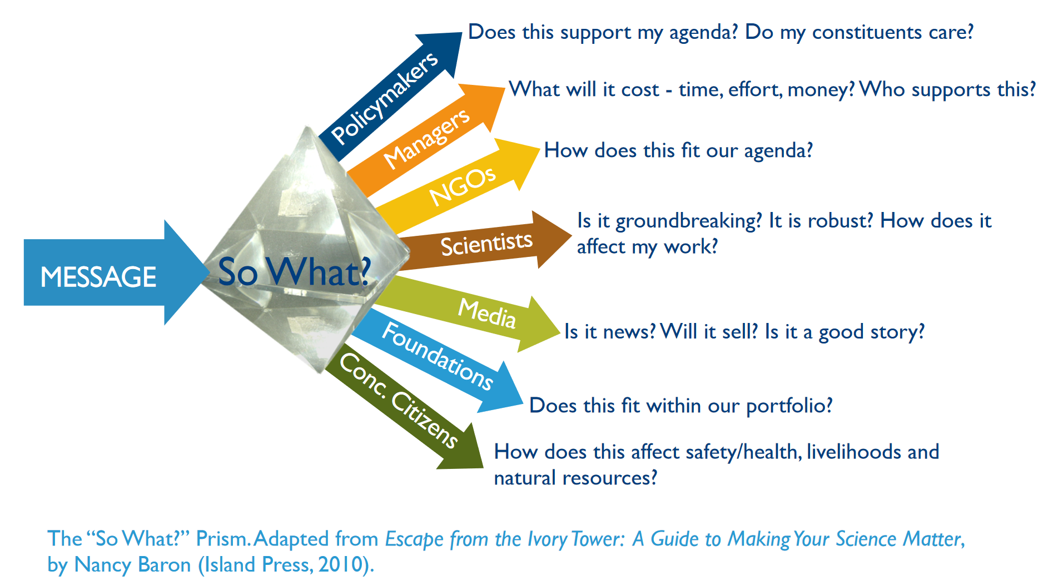
How to Use the Message Box
So What?:
Notes:
Next, we want to look at the “So what” of the message box.
For this element, the target audience is crucial because you need to think in terms of why that particular audience cares.
The illustration shows a prism through which the message is filtered and then individualized by the audience.
Look at the examples provided in the graphic and step through them.

Slide 40
How to Use the Message
Box
So What?:
How does your message connect to what is important to the audience?
How does it connect with their identity and values?
Only 3-5 total reasons to care
Notes:
So you see the “So what” box is to the right.
Here is where your target audience characterization comes into play.
Think about the 3-5 audience specific reasons that appeal to things that they care about. You are explaining why they should care by appealing to their motivations. How does it impact them. Your goal here is to CONNECT and resonate.
This will likely provoke thoughts about how they might be benefitted. Some of that may be appropriate here or their may be overlap. That is fine. The goal is to find and communicate the items that are most important.

Slide 41
How to Use the Message
Box
Solution:
What is the behavior that you want them to change?
How should the act?
Be careful about too many solutions (do the work and prioritize)
Must be related to problem at the same scale
Address anticipated barriers
Notes:
The Solution Section is located at the bottom of the form.
(Click) Here is where you put your proposed solution to the problem… i.e. the behavior to be changed.
(click) You might have a few solutions be careful about more than 3-5 points or solutions. Remember, you will increase the happiness of your audience if you make your solutions concrete and easy to carry out. Provide as much clarity as possible. There must be a clear connection between the problem and the solution, so you might need to adjust the problem statement if the solution is too narrow.
(click) Remember that people will not act if they do not believe the action matches the scale of the problem. Here is where you sell why this will work.
(click) you may want to speak to barriers and show why this approach will work,

Slide 42
How to Use the Message
Box
Benefit:
Good things that will happen if change is made
Be careful about overpromising (may need to clarify Problem, or qualify)
Notes:
In the benefits section (to the left)
(click) you want to list the good things achieved by the action. In your so-what, section, you might list negative consequences of inaction while here you list positive benefits or in the so what you may list specific issues related to the audience and here you list broader societal good.
(click) Here you do need to be careful of overpromising, as remember, you want perception to match reality. Are their statistics that show change? Are their case studies you can reference? You don’t want to over-qualify your statements of benefits but you want to be sure that people don’t blow you off because you’ve presented a panacea.

Slide 43
How to Use the Message Box
How to Improve Your Message Box:
Is there data that would strengthen a section? Stats should not be overly used, but they can be powerful if illustrative
Give specific examples
Use metaphors
You may not deliver the message in the same order you developed it, but you can use it to emphasize the key points
Notes:
As you move through the Message Box, it will likely take you several drafts to improve it. Its not ever “done” but you want to get comfortable with it.
(click) You might become aware of the need for some statistics in some sections. Depending on the audience, these can help strengthen the argument but beware of burying people in stats.
(click) Remember to give specific examples and communicate with vivid images, emotion, and metaphors. You may recognize the need for these, so not that – do your research on success stories perhaps and circle back to it.
(click) Finally, we want to emphasize that when delivering your message, you might not deliver the message in the same order in which you developed it. If you are doing a TV interview however, it can help you return again and again to the key messages. On a webpage, you can be sure to highlight these key items. In a social media campaign, you might just release specific items related to each point.

Slide 44
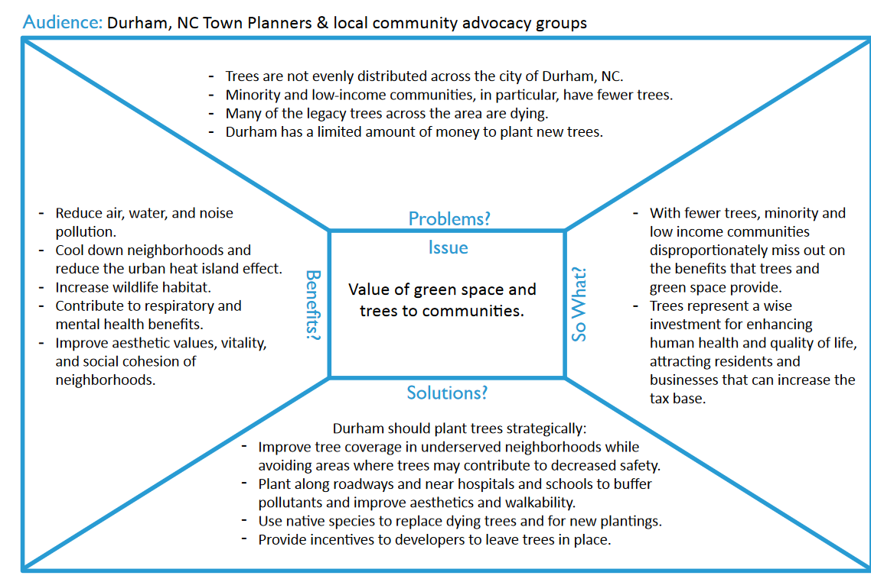
Examples
Notes:
Explore this message

Slide 45
Practice
Notes:
What I would like to do is to take a few moments to work through a message as groups.
First, you will want to decide on a topic for your group to work through… I’ll leave it to our facilitators to come up with examples, or if a member of the group has a topic of interest. Agree on the target audience and problem, and then, we want to take about five minutes to work through the message box individually. Then as a group, share your idea on each section and condense them into one overall .
Some examples could be:
Encouraging industries to support citizen water quality monitoring
Working with farmers to expand riparian zones
Reducing fertilizer use on home lawn and gardens to address nutrient pollution
Encouraging rural homeowners to replace their septic system
When developing your objectives, think through some of the questions highlighted in yellow. Later, we will be discussing ways to evaluate your outreach campaign, but it is good to start building in ways to assess each step of the process so that you can adjust and stay on track to meeting your goals.
You may also want to begin to prioritize your objectives by what is most important to achieving your goal and the sequencing of how they are carried out.

Slide 46
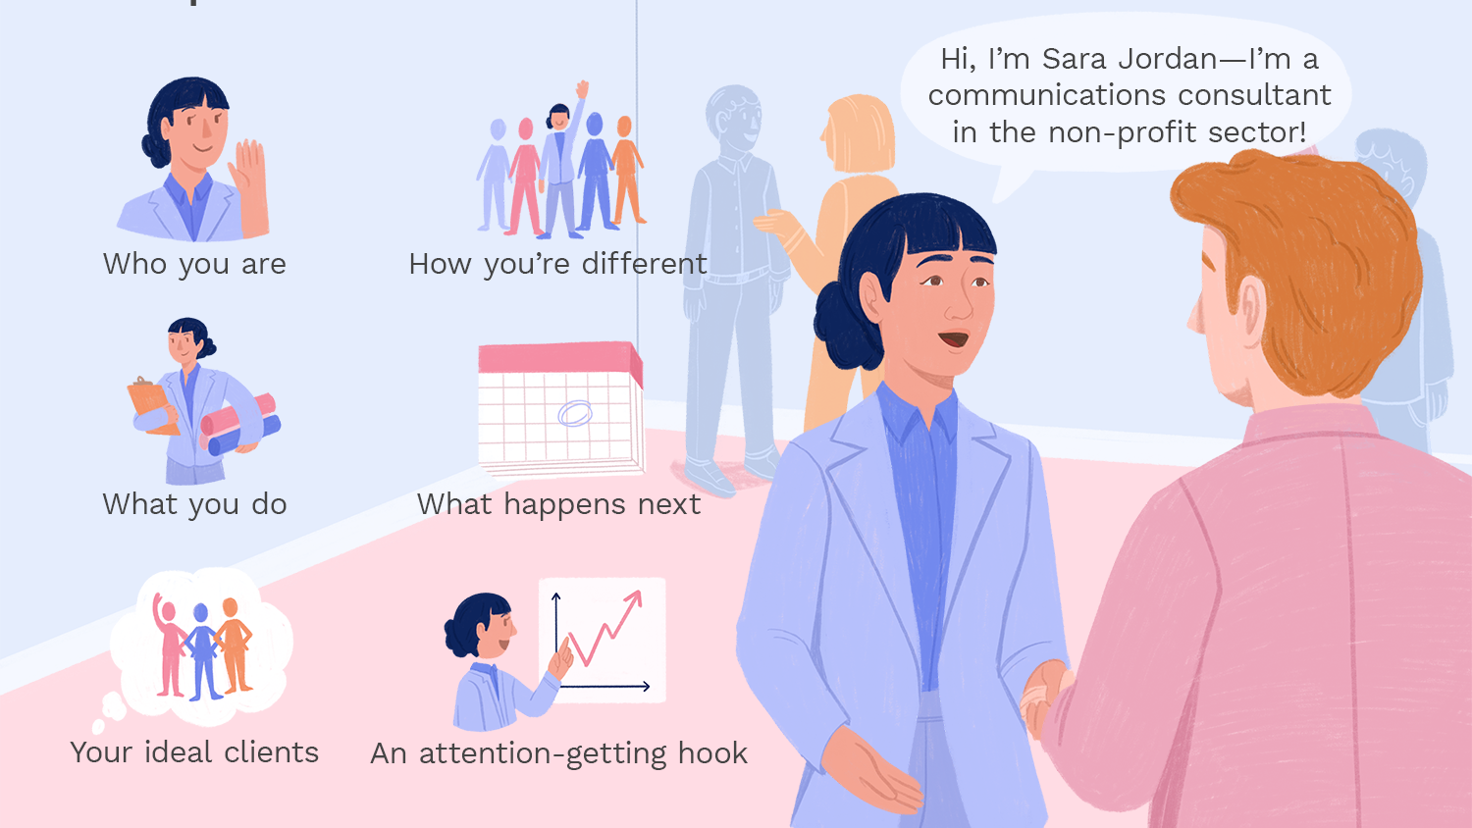
Practice Your Elevator Pitch
What do you do?
Why does it matter?
Why do you care?
~30 Seconds
Notes:
Now we want to divide into groups a practice our professional elevator pitches. This is a good exercise to engage in during regular meetings… everyone needs practice, so try your pitch – receive constructive feedback and then let another person try.

