Slide 1
Watershed Academy
Watershed Coordinator Training Series
Likely Partners
3. Agricultural Partner Organizations
Notes:
Greetings to everyone.
This presentation is part of our “Likely Partner” series focusing on an overview of agricultural partner organizations. The goal of the presentation is to provide some context for later presentations from the partners themselves.
[Personal Aside] Although my grandparents and uncles are farmers, I was not raised on a farm and have not worked extensively with the farming community. So I developed this presentation as an outsider who relied on others to help me understand how the agricultural community works. In particular, Cooperative Extension and the Division of Conservation helped answering many of my questions. My hope is to provide an introduction to new coordinators and to provide a refresher or a few new concepts for those who are farmers or work with them regularly.

Slide 2





Agricultural Partners Overview
Introduction to Kentucky Farmers
How Farmers Can Lead Watershed Management
Who’s Who of Kentucky Agriculture
Notes:
During this presentation, we will introduce you to Kentucky farmers via statewide statistics, speak to some national efforts to promote farmer leadership in watershed management, and then cover a who’s who of the major ag organizations in the state.

Slide 3


Introduction to Kentucky Farmers
Farm Size
Farm People
Farm Finances
Farm Products
https://www.nass.usda.gov/
Notes:
Ok. So we start with an introduction to Kentucky farmers (also known as producers) by consulting the 2017 census of agriculture from the USDA National Agricultural Statistics Service.
We will briefly look at the farm sizes, people, finances, and products to get an idea of what we mean when we talk about agriculture in Kentucky.

Slide 4
Farm Size, 2017
~50% of Kentucky is farmland
75,966 farms
Avg size 171 acres
Most acres are cropland
Notes:
When we think about the state of Kentucky, one statistic that stands out is that 50% of the state is categorized as farmland according to USDA. This may seem striking to you, but when you see what it encompasses that number may make more sense.
There were 76,000 farms in 2017 and that number has been slowly but steadily shrinking over the past 10 years or so.
The average farm is 171 acres or a little over a quarter of a square mile.
(click) in the top chart you can see the percentage of farms by size in acreage. So you can see that 40% are 50 acres or below. 37% are 50-180 acres. Only 6% are larger than 500 acres, but these tend to skew the average high.
(Click) Finally we can see the type of land in farms, with about half in cropland and near equal amounts for woodland and pastureland. Other includes lands on farms occupied by houses, ponds, roads, or wasteland.
So lots of Kentucky in lots of small farms

Slide 5
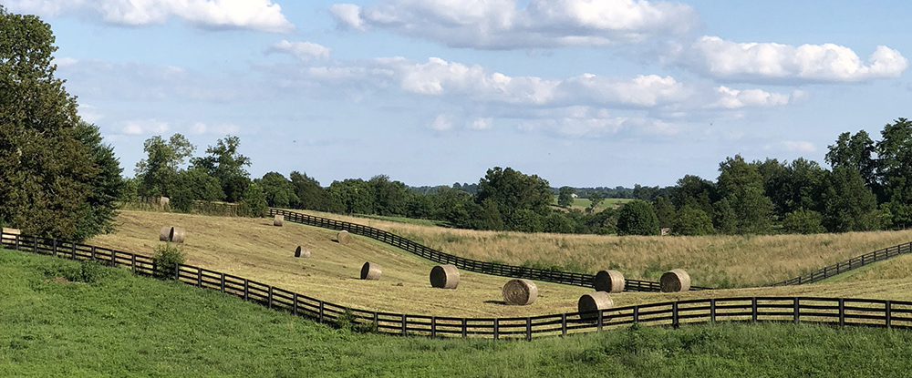
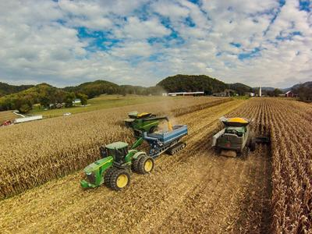
Farm People, 2017
97% Family Farms
22% Hire Labor
58 = Avg Operator Age
42 = Avg Operator Age with Farm as Primary Occupation
29% New and Beginning Farmers
Notes:
When we take a look at the people, we can see that almost all farms are family farms with under a quarter of them hiring labor. So you have a lot of farmers that are doing this as a family and only the family unit. The average operator is 58 years old, but for those who are farming full-time the age is much younger at 42 years old.
Of all the farmers of the state 29% are new and beginning farmers, which was a hirer number than I anticipated.
So quite a few younger farmers working full-time as well as a number of older farmers doing it part time.

Slide 6
Farm Finances, 2017
Farm Finances
Farming = $5.7 billion industry
2/3 farms $<10k in sales
Lots of small hay farms
Notes:
Farming itself is a $5.7 billion dollar industry in Kentucky. However, 2/3 of farms make less than $10K in sales per year.
(click) Here you can see the breakdown in the annual value of sales per year. So 40% of farms made less than $2500 in the year. As we shall see, there are a lot of small farms that produce hay.
So when you think about the farmers, many of them are funding things on their own dime and many are working part-time out of love for farming. That’s a lot of pressures and a lot to keep up with.

Slide 7
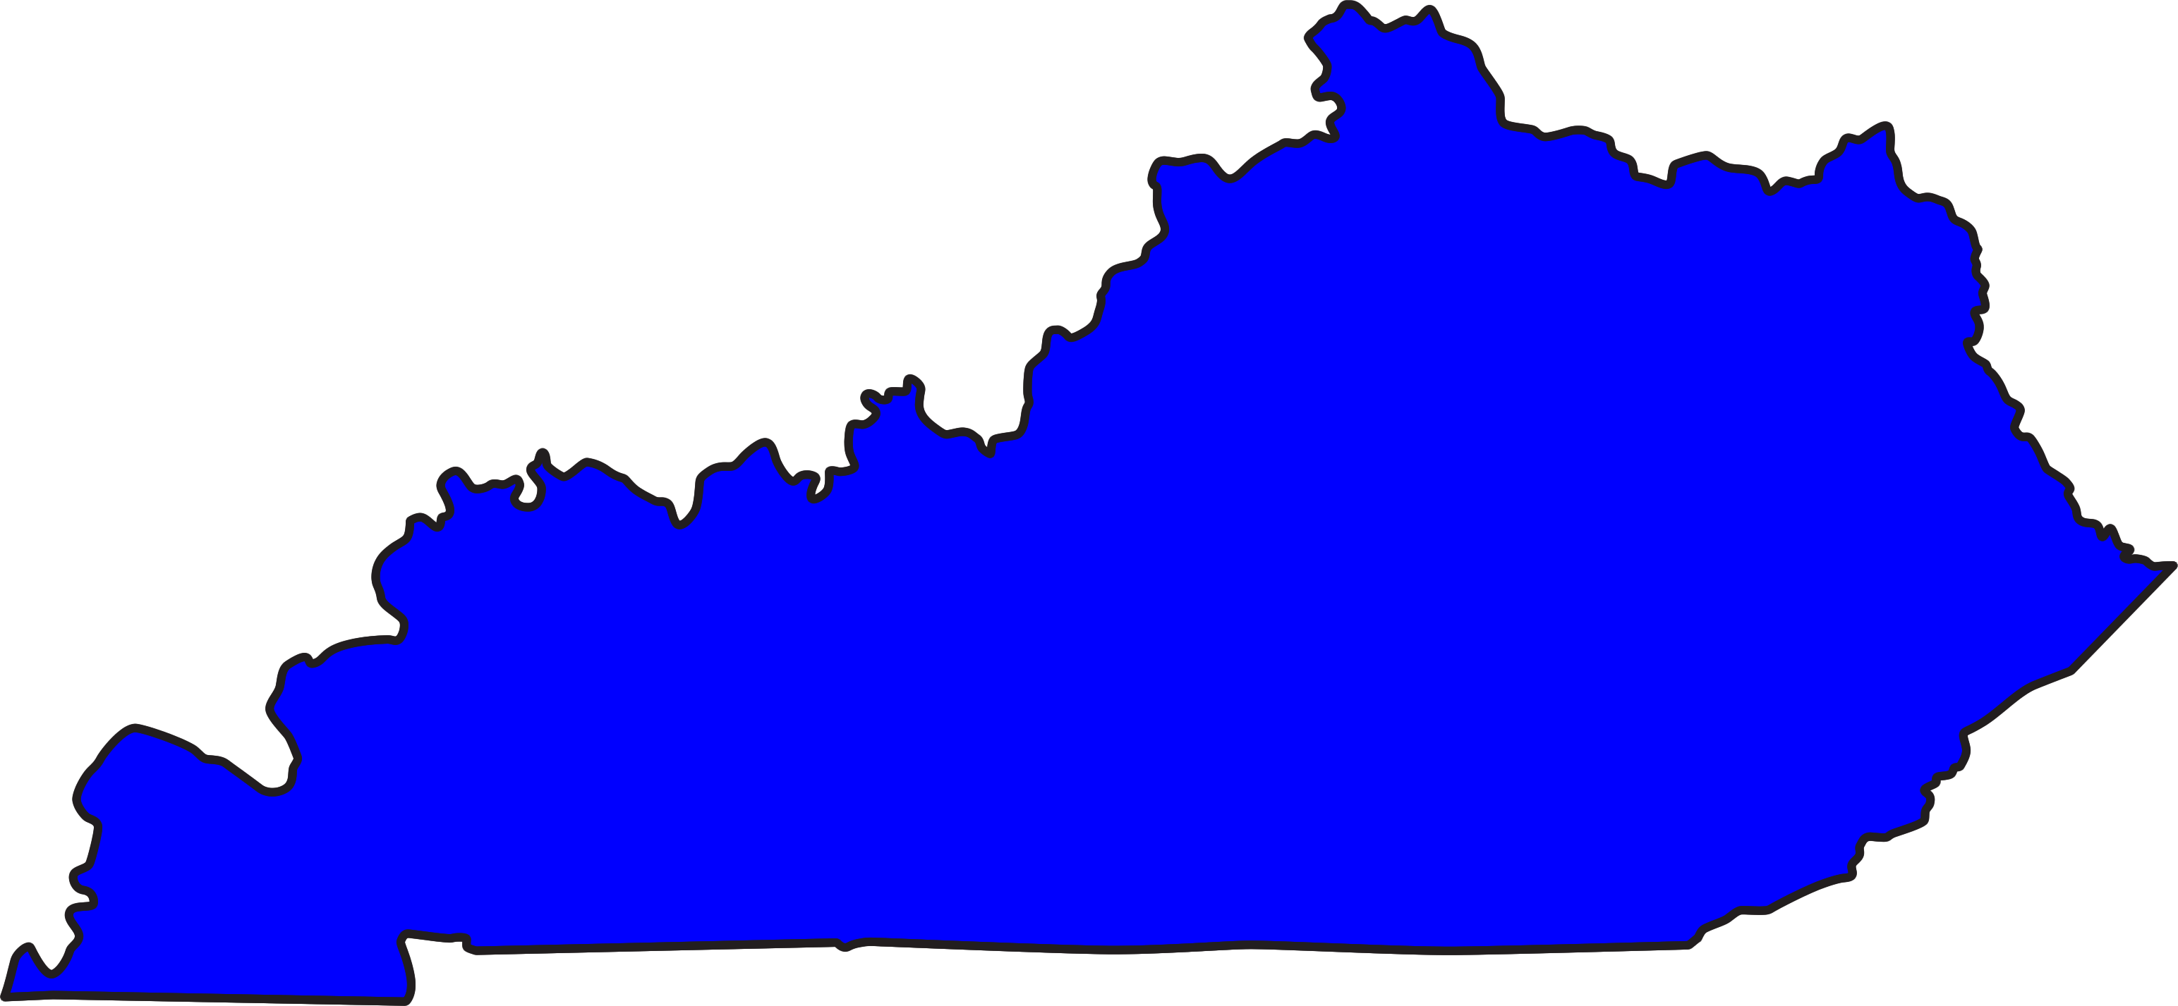

Farm Products, 2017
Notes:
As we turn to farm products, we tend to think of Kentucky as the horse capital of the world. But is that a right conception of the agricultural economy of the state? Try to guess what the top products are in terms of sales. I’ll give you a few minutes.

Slide 8
Farm Products, 2017
74%
Notes:
So first of all, we want to note that the breakdown of the $5.7 billion industry between animals and their products and crops is 56% to 44%. So almost even in terms of that divide.
For animal products, poultry and eggs represent 40% of the sales (in dollars) with cattle / calf operations second. Horses are third amongst animals.
For crops, grains and beans (which includes corn, soybeans, and wheat – in that order) are very dominant. Tobacco follows and then hay. It should be noted that hay accounts for almost a third of all cropland in the state.

Slide 9
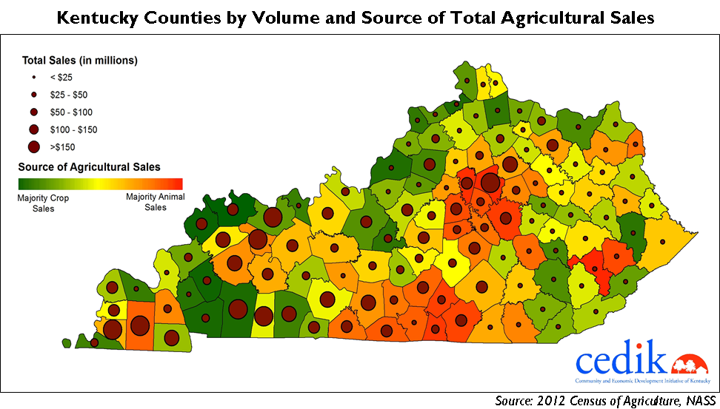
Volume and Source of Ag Sales, 2012
2
3
5
1
4
Notes:
So how does this break down by county?
University of Kentucky CEDIK produced this map from 2012 data but it displays a lot for data including both the amount of sales (size of dots) and the type of sales with green = crop sales and red = animal sales and yellow being a balance.
Top counties from 2017 include:
Graves (6% of ag sales - chickens and eggs) – the ag capital of the state.
Fayette (3.8%), Bourbon (3.7%) (both horses / cows),
Christian (3.6% grain, corn, soybeans – in that order), and
McLean (3.3% Poultry / Egg then grains and beans

Slide 10
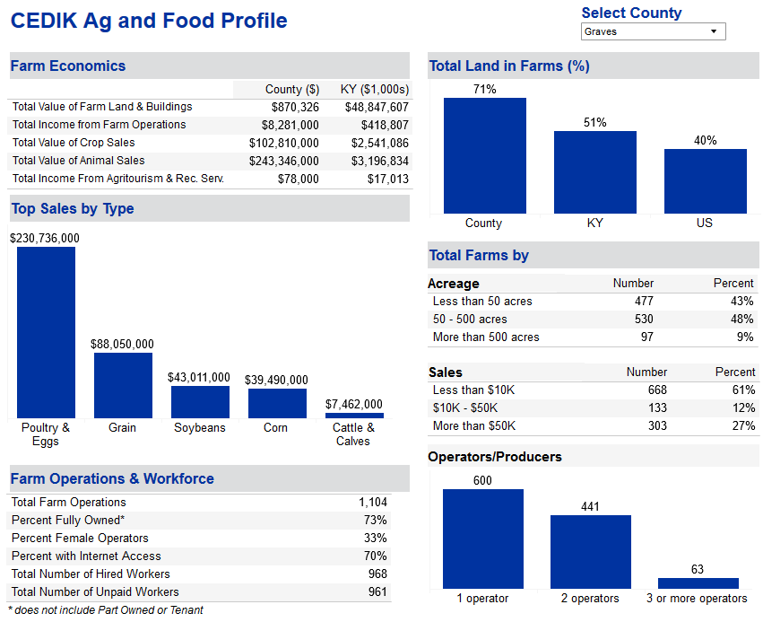
http://cedik.ca.uky.edu/data_profiles/ag_and_food
Notes:
Additionally, CEDIK has a webpage where you can see the breakdown of farming data from each county. Here is the information from Graves County, as an example. You can see top products, a breakdown on the farm operations, the total land in farms, farm sizes, farm sales, and number of operators.
You can use this information to get a better sense of your local farm community and some of the struggles and challenges they face.

Slide 11

How can I support my family?
Do I have supplies or equipment I need?
What can I improve my land and water resources?
Will my produce make it to the market?
How can I make a profit / keep farming?
Do I have time?
How can I be more efficient?
Who Understands These Challenges?
Other Farmers!
Notes:
So as we’ve looked at a profile of the agricultural community in Kentucky, it should give us some idea of questions farmers are wrestling with daily.
Farmers are facing questions like how to support their family and wondering how the markets will hold up (or the weather).
They are likely thinking about how to pay for equipment and supplies – how to farm more profitably and efficiency.
Among these questions is how to care about the land and water resources. However, there are also concerns that the environmental concerns may threaten the rest of their concerns. So there can be trust issues because (like any other community) they think that people outside the community do not understand the demands and challenges farmers face.
So if you are a farmer, who would you trust to speak to these issues?
Likely – above all - OTHER FARMERS!

Slide 12

Farmer-Led Watershed Management
Farmer Leadership
  Peer-to-Peer
  Consultation
  Watershed-Level
Supporting Farmer Leadership
  Initiating
  Facilitating
  Material
  Technical
  Educational
  Motivational
Fostering and Facilitating Farmer Leadership in Watershed Management Projects: A Needs Assessment (February 2019)
https://northcentralwater.org/files/2019/07/MARBreport-7-2019.pdf
Notes:
For this reason, the SERA-46 group (Southern Extension and Research Activities Committee Number 46), which is composed of USDA National Institute of Food and Agriculture (NIFA) and land-grant university funded committees, was created to operationalize a joint effort to address the Mississippi River / Gulf of Mexico Nutrient and Hypoxia issue.
This group, including Kentucky’s Dr. Amanda Gumbert, put out a report in 2019 on “Fostering and Facilitating Farmer Leadership in Watershed Management Projects: A Needs Assessment.” This report summarizes some of the ways in which farmers are taking the lead in watershed management and others can support them in this effort.
We will take a look at two of these areas – leadership and support.

Slide 13

Farmer Leadership
Peer-to-Peer
  Farmers recruit peers through “web of influence” via field days at demonstration projects and other interactions
Consultation
  Farmer advisory group to direct goals, BMPs, tactics and strategies by evaluating management scenarios
Watershed-Level
  Shared decision making with government agencies on directing implementation funds via elected peers
Notes:
Farmers are leading in watershed management in three ways, representing incremental involvement.
The first is recruiting. One farmer who is an early adopter of practices talks to other farmers in their web of influence and by showing practices on their farms. So if you have a few farmers who have bought into the goals of the watershed planning, you can empower them to reach out to their networks.
The second is consulting. In this approach, farmers take more leadership by forming an advisory group to direct the goals, BMPs, tactics, and strategies of the plan. Perhaps various scenarios for BMP implementation are demonstrated and the farmer choose the ones they believe would be most successful.
In the third – watershed-level leadership – farmers share decision making with government agencies on where to direct implementation funding through peers elected to represent them. So here, the farmers are involved not only in the planning but also the implementation funding efforts.
These provide some models to think about how you can empower the farming community to a greater degree in your watershed. So how can you support these supports?

Slide 14
Supporting Farmer Leadership
Initiate: Reach out, snowball invitation approach
Facilitate: Coordinate and facilitate meetings
Material: Website, meeting space, incentive payments
Technical: monitoring, field research trials, information/guidance
Educational: watershed science or leadership skills
Motivational: help avoid regulation, establish baselines, address crises, improve finances, etc.
Notes:
The SERA-46 report identifies 6 ways in which leadership can be supported.
Initiate – that means you reach out to a few farmers and build interest and relationship with them. Then you ask them to reach out to their networks in a snowball effect where more are reached as the word travels.
Facilitate – sometimes just coordinating meetings and acting to facilitate and prompt conversation can start and sustain the conversation, which may take time.
Material support – You can provide a website for them, provide them with access to your meeting rooms, or provide money to incentivize implementation.
Technical – This can include technical information about how to install BMPs as well as monitoring of the improvement of water quality or conducting field research trials.
Educational – education may be in two forms 1) on the science of watersheds or 2) on improving leadership skills such as facilitation, communication, and outreach.
Motivational – There are many different motivators for farmers. Helping them to see how engaging in watershed planning and implementation can address these concerns can encourage participation.

Slide 15
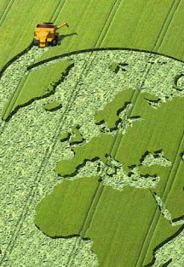
Who’s Who of Kentucky Agriculture Partners
Local
State
Federal
Non-profits and Commodity Groups
Notes:
Now having learned a bit about the farmers and how they can lead, let’s take a look at the organizations that compose the world of Kentucky agriculture and a little about what they do.
This may feel like a whirlwind tour but remember you will get subsequent presentation later from partners. The goal is to understand how they fit in the overall community.

Slide 16
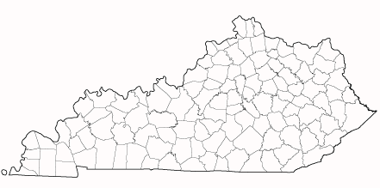
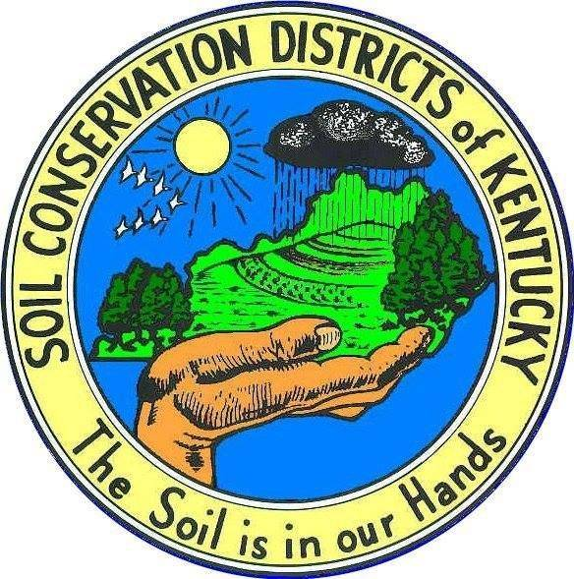

Local Hubs
First stop for farmers seeking cost share and technical assistance.
Notes:
First, we want to begin at the local level –the county - in which two organizations serve as the “first stop” for farmer assistance depending on how you talk to.
That is the Soil and water conservation districts and the Cooperative Extension Service.
We will begin with the Conservation districts

Slide 17
Soil and Water Conservation
Districts
121 Districts. All are independent with elected 7-member board of supervisors (847 statewide)
Funded by county fiscal court, property taxes, direct aid state contributions and grants, and business donations
Purpose: “Conserve and develop all renewable natural resources within the district.” Includes (KRS 262):
  Ag conservation practices
  Soil erosion
  Water runoff
  Flood control
  Floodplains
  Water supply
  Sedimentation and pollution
  Reforestation
  Parks and Rec
  Greenbelts
  Protect Fish and Wildlife
  Minimize impact of development on natural resources
Notes:
There are 121 Soil and Water Conservation Districts, or “Conservation Districts” in Kentucky – one per county with 2 in Logan County.
They are all special districts and you elect the 7-member board in your county election. Together there are 847 conservation district board members statewide. This is an unpaid board (except for meeting expenses and travel) but the districts have income from counties, property taxes, state contributions, grants, and donations.
All have at least 1 employee. If sufficient funding, they may hire technicians and additional staff.
The purpose is to conserve and develop all renewable resources as stated by the governing statute in KRS Chapter 262.
The statute has a really broad and inclusive list of what “all natural resources” means. We might tend to think just about farms, but it includes forestation efforts – parks /greenbelts, and protecting fish and wildlife. So you can see these are all key issues for watershed planning, so you should be working with the conservation district if you are not already.
We are doing to hear next week from Allan Bryant, with the Henry County Conservation District, to learn more about this essential partner in watershed planning.
I would note that if you want to do a deep dive on the Conservation Districts, the Conservation District Supervisor’s Handbook is available as a pocket guide on Division of Conservation Website under “Supervisor Training”

Slide 18
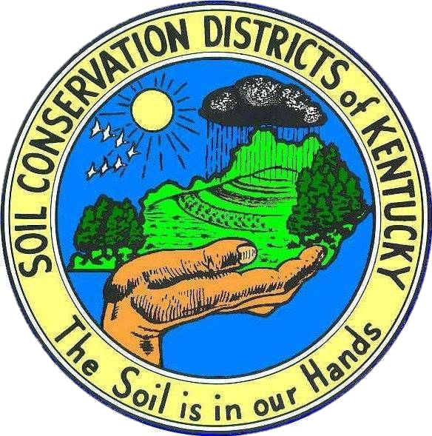
Local Hubs
Conservation District-Related Organizations
Support Associations and Training
  KACD / KACDE / NACD
  Kentucky Division of Conservation
Policy and Ranking Cost Share
  Soil and Water Conservation Commission
Independent Subdistricts:
  Agricultural Districts
  Watershed Conservancy Districts
Notes:
Because conservation districts are such a key partner, they have a whole universe of organizations that support their efforts. Which we will quickly overview.
This includes professional, peer organizations such as the Kentucky Association of Conservation Districts and the state organization the Kentucky Division of Conservation. These organizations help train and promote conservation districts in the state.
There is also a representative organization from among the conservation districts that helps shape their policy and rank out cost-share projects statewide.
Finally, there are several independent special districts that may be formed by conservation districts.

Slide 19

Kentucky Association of Conservation Districts (KACD)
Non-profit organization for independent districts
Mission:
  information relating to the administration and operation…;
  cooperation between districts and agencies and organizations…;
  promote welfare of conservation districts …; and
  maintain strong and active membership….
National Association of Conservation Districts (NACD)
Professional org to helps maintain health and message of conservation district needs.
Notes:
The Kentucky Association of Conservation Districts is the professional organization amongst these districts. It helps with information of administration, encouraging partner cooperation, and promoting the conservation district need and message. This is not an organization that watershed coordinators will typically interact with unless you have a statewide message. There is also a national association of conservation districts that provides similar support at the national level.

Slide 20
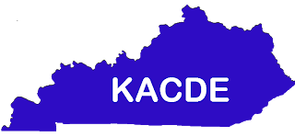
Kentucky Association of Conservation District Employees (KACDE)
Non-profit organization for independent districts
Mission:
  develop, promote, and strengthen conservation districts and their programs
  educate the district employees to be able to assist in determining policy and making decisions that affect each county.
Educational and training support on items such as media, field practices, youth education support, etc.
Notes:
Also supporting CDs is the Kentucky Association of Conservation District Employees. They do have some good training and outreach materials on their website, but this is not necessarily an organization that a watershed coordinator would interact with. They help educate the conservation district employees on items such as website development, providing technical guidance on field practices, and youth education.

Slide 21
Soil and Water Conservation
Commission (SWCC)
Formed from 9 Cons. District supervisors appointed by Governor
Administer organization of CDs and assist in carrying out function
Sets policy, rules, and regulations for CDs.
Rank state cost share applications
Representative leadership of CDs. Policy setting and cost share ranking.
Notes:
The Soil and Water Conservation Commission is the representative leadership group for conservation districts. It is formed from 9 of the 847 supervisors, and they help set policy, rules, and regulations for conservation districts and very importantly, they rank state cost share applications for funding.

Slide 22
Agricultural District
KRS 262.850
Purpose: Prevent best agricultural land from conversion to non-agricultural use. Cities cannot annex land in an agricultural district.
Creation: Landowner petitions the local conservation district board. Cannot be smaller than 250 acres unless special value. Must be renewed every 5 years
Benefits: Extra points for cost share. Taxed at agricultural rate
Notes:
An Agriculture Districts is a special district, governed by KRS 262.850 that is set up to encourage and develop agricultural lands by preventing them from being annexed by cities and providing some lower taxes and extra chances for cost share funding.
To form an agricultural district, a landowner of over 250 continuous acres petitions the CD. The district must be renewed every 5 years.

Slide 23
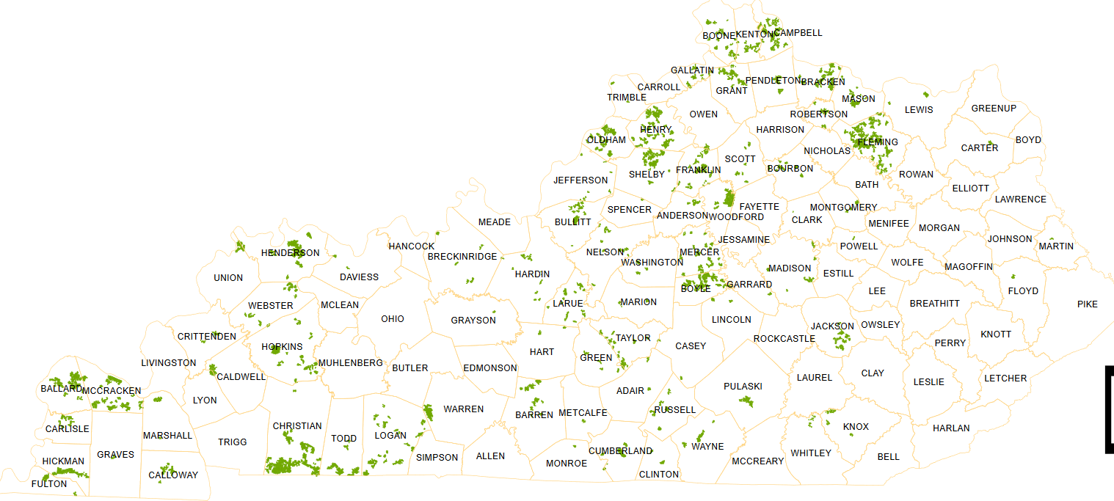
Agricultural Districts
Certified Agricultural Districts,
February 2020
Division of Conservation
Notes:
The green areas in this map, obtained from the Division of Conservation, show the current agricultural districts in the state with the orange lines showing the county borders. You can see that some counties are much more active in the use of these areas than others.

Slide 24
Watershed Conservancy Districts
KRS 262.700–.795 and 262.990
Purpose. Subdistricts of a soil conservation district formed for developing and executing plans and programs relating to any phase of water conservation, water usage, flood prevention, flood control, erosion, floodwater, and sediment damage.
Creation. By petition of 25+ landowners in a proposed watershed conservancy district to conservation district
Governance. 5-member board
Revenue: Millage (property) tax or flat rate with max budget
Notes:
Another sub-district of the CD is the Watershed Conservancy District. These can be set up when more than 25 landowner propose it to the CD to initiate a hearing and referendum. They have their own budget – funded by a flat rate or a millage (property tax) and typically a 5-member board to govern them (unless they cross county lines).
These are specially formed for developing a executing plans related to water conservation, flood control, erosion and sediment damage. Typically, these have dams that are being managed via this district.

Slide 25
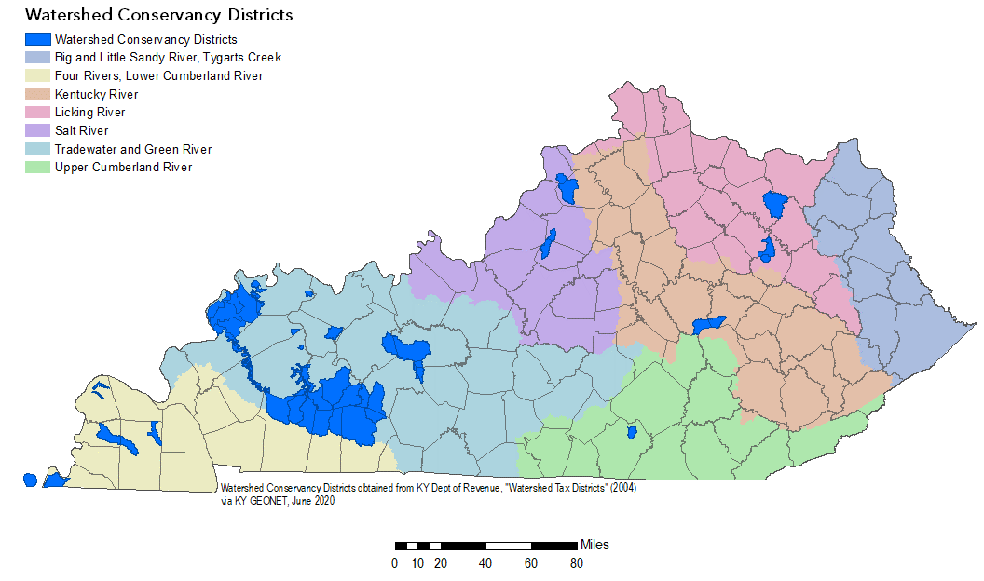
Watershed Conservancy Districts
Notes:
Here is a map of the Watershed Conservancy Districts (shown in blue) in the state overlaid with county and river basin boundaries. So especially in the Green / Tradewater basin these are used extensively.

Slide 26
Local Hubs
Notes:
So we’ve overview the conservation districts, so let’s turn to the other local hub: cooperative extension

Slide 27
Cooperative Extension
Service Districts
Morrill Act (1862), Smith-Lever Act (1914), and KRS 164.605–.675
Boundaries: Coextensive with the county, but independent.
Purpose: Promote agricultural practices, techniques, and research, as well as subjects related to home economics and rural and community life.
Revenue: Cooperative extension district education tax, fees for services, contributions from fiscal courts and boards of education, and private funding.
Research-based info for outreach and education for agricultural, community, and rural life.
Notes:
Amanda Gumbert is going to talk to us more about Cooperative Extension next week, but as a quick overview…
The Cooperative Extension service was formed as a result or the Morrill Act (which created land-grant institutions to focus on farming and mechanical skills) and the Smith-Lever Act which created the cooperative extension service at each land-grant university. The focus was on distributing information produced by agricultural research. In Kentucky, the local extension offices (which are co-extensive with the county) are governed by KRS 164.605-.675.
Cooperative extension service districts promote agricultural practices, techniques, and research, as well as subjects related to home economics and rural and community life throughout Kentucky in concert with the University of Kentucky and the US Department of Agriculture.
Funding is through a cooperative extension district education tax as well as fees, general funds from the county or education districts or accepted private funding.

Slide 28
Cooperative Extension
Service Districts
Two levels of local governance:
  Extension council: 15 to 40 citizen members whose major interest is agriculture and home economics (i.e. farm bureau or 4-H).
  Extension board: the county judge/executive and 6 appointed citizen members of the district selected by the extension council.
Land Grant Universities
  University of Kentucky and Kentucky State University
  Provide administrative support, program coordination, research, and technical specialists
Notes:
Cooperative extension service districts are controlled by two levels of governance at the local level: a larger council of 15-40 citizens whose major interest is agriculture and home economics, such as farm bureaus, homemaker councils, 4-H Club councils, and commodity groups. Then there is the local extension board, composed of the county judge/executive and six citizen members of the district (KRS 164.630). The county judge/executive makes the appointments, with the approval of the fiscal court, from nominations submitted by the extension council.
Then at the state level through the University of Kentucky and Kentucky State University you have a whole number of administrative support staff, program coordinators, researchers and technical specialists.

Slide 29
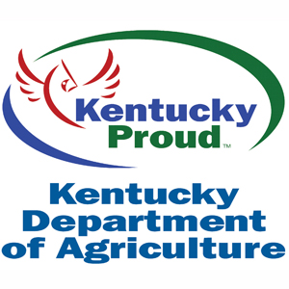
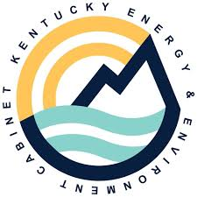

State
Local
State
Governor’s Office of Agricultural Policy
Notes:
Having looked at the local level – let’s look at some of the state partners.

Slide 30
Kentucky Division of Conservation (DOC)
Mission: “to conserve Kentucky’s natural resources through education and assistance to producers and local conservation districts”
Field Representatives advise CD Board and train supervisors
Administers
  Ag Water Quality Act
  Direct Aid to CDs
  Soil Erosion and Water Quality Cost Share Program
  Equipment Revolving Loan Program
  Agricultural District Program
Notes:
DOC serves to educate and assist farmers and conservation districts. We will be hearing from Paulette Akers, the director of the Division of Conservation next week.
DOC has a number of field representatives that advise the CD boards and train supervisors among other duties.
They also administer a number of programs including the AWQA, providing direct aid to CDs, cost share, equipment loans, and the ag district program.

Slide 31
Governor’s Office of Agriculture Policy
Kentucky Agricultural Development Board
  Tobacco Settlement Funds to increase farm income and stimulate markets
  County Agricultural Investment Program (CAIP) = “state cost share”
  On-Farm Water Management Program
  Multiple other programs
Kentucky Agricultural Finance Corporation Board
  Low interest rates for lending for farmers and agribusinesses
Notes:
Stefanie Osterman will be presenting next week on the Governor’s Office of Agricultural Development, which serves as a link between the Governor’s Office and Ag Industries. The GOAP administers two major funding programs, which each have independent boards:
The Kentucky Agricultural Development Board oversees the tobacco settlement funds to increase farm income and stimulate markets. Within that fund is the County Agricultural Investment Program or (CAIP) – frequently referred to as state cost share.
The Kentucky Agricultural Finance Corporation Board issues low interest rates for lending to farmers and agribusiness.

Slide 32
Kentucky Department of Agriculture
Office of Agricultural Marketing
  Includes:
  PACE Program (Ag Conservation Easement)
  Kentucky Proud
Office for Consumer and Environmental Protection
  Includes pesticide regulation
Office of State Veterinarian
  Includes animal composting regulation
Notes:
While for the most part, watershed coordinators will not interact with the Kentucky Department of Agriculture which focuses more on promoting agricultural products in the state, there are a few programs in which you might work with them.
Within the Office of Agricultural Marketing (which includes the Kentucky Proud program – sort of the flagbearer program for Ky dept of ag is the PACE program for Ag Easements, which I’ll discuss in a little more depth.
You might also interact with the pesticide regulation program within the office of consumer and environmental protection – particularly if you are going to do riparian cleanups or aquatic herbicide applications and will need certification.
Finally, the Office of the State Veterinarian includes regulation for animal composting.

Slide 33
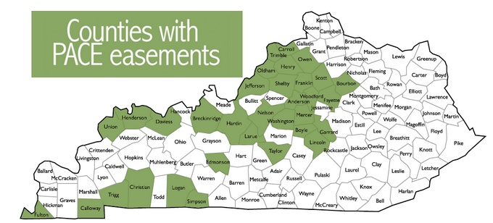
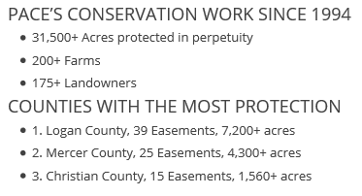
Kentucky Department of Agriculture
Farmland Preservation / PACE Program
Agricultural Conservation Easement to forever protect farmland from development. Provides financial incentives (tax deduction and reduction) while protecting farming, open space, or forests.
https://www.kyagr.com/marketing/PACE.html
Notes:
I mentioned the PACE program, and this program works with farmers to forever protect farmland for development through an agricultural easement. This can provide farmers with a tax deduction that can be claimed over multiple years as well as a property tax deduction that can provide some financial incentives for protecting farming, open space, or forests.
Since 1994, more than 31,500 acres have been enrolled. Note that no work has been done in eastern Kentucky – but it could be used to protect forest there even while allowing timber harvesting.

Slide 34



Federal
Local
State
Federal
Governor’s Office of Agricultural Policy
Notes:
Now let’s move to our federal partners who will be presenting subsequent to this presentation.

Slide 35
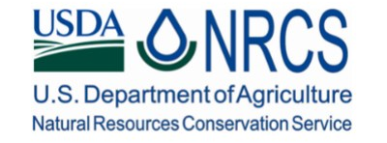
Natural Resource
Conservation Service
Provide farmers with financial and technical assistance to voluntarily put conservation on the ground
Non-Regulatory
Funding Programs
  Environmental Quality Incentives Program (EQIP)
  Conservation Stewardship Program (CSP)
  Agricultural Conservation Easement Program (ACEP)
Notes:
Sonya Keith will be presenting on the Natural Resources Conservation District programs related to water. They are a non-regulatory division of the USDA geared towards providing financial and technical assistance to farmers who voluntarily want to put conservation practices on the ground. They have several funding programs and planning mechanisms to achieve this.

Slide 36

Farm Service Agency
Implements agricultural policy, administers credit and loan programs, and manages conservation, commodity, disaster and farm marketing programs.
Funding Program
  Conservation Reserve Program (CRP)
Notes:
The CRP Program is described by the USDA as its single-largest, most effective environmental program. It is governed by the Farm Service Agency a separate division of USDA.
Kellie Samuels will be presenting on the FSA, which implements ag policy, administers credit and loan programs, as well as a number of other farm assistance programs of which conservation is one.
Producers enroll in CRP and plant long-term, resource-conserving covers to improve water quality, control soil erosion and enhance habitats for waterfowl and wildlife. In return, USDA provides producers with annual rental payments. CRP contract duration is from 10 to 15 years.

Slide 37
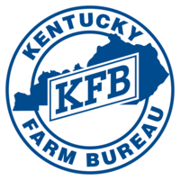


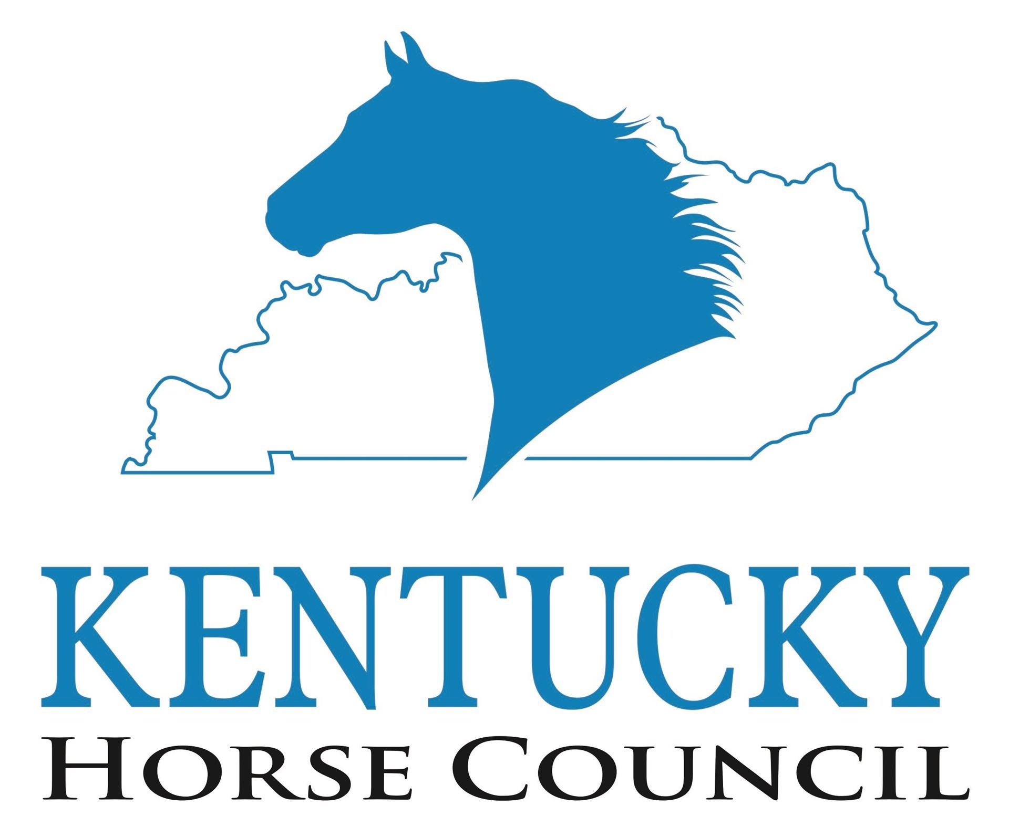
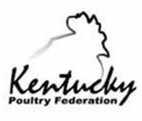
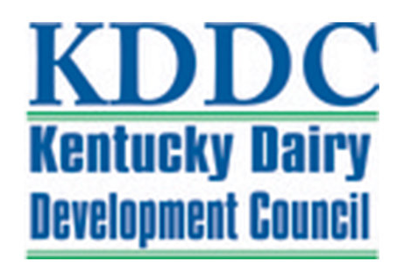




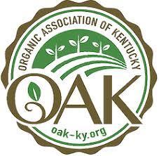


Non-profits and Commodity Groups
Notes:
So we’ve talked about the governmental partners, but there is a whole orbit of commodity groups and nonprofits that you may want to reach to talk to specific sub-communities in your watershed. I’ll only mention a few in depth but want to introduce you to the existence of these other orgs.

Slide 38
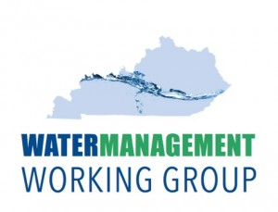
Kentucky Farm Bureau
www.kyfb.com/federation/
“Voice of Kentucky Agriculture”
Programs include:
  Public Affairs, Farm Bureau Insurance and Member Benefits, Women's Leadership, Commodity Market Information, and Youth Development
Water Management Working Group
  Task Force Assembled by Farm Bureau
  Research issue of inadequate water supplies available for agricultural production, examine potential actions to solve this deficiency and make recommendations for bringing new and reliable water sources to key areas of farm production in Kentucky.
Notes:
The Kentucky Farm Bureau has an insurance arm but also a federation arm which describes itself as “the Voice of Kentucky Agriculture” serving to advocate for farms, but also to develop leadership through youth development and woman’s leadership programs. They also provide market information on various commodities.
One of the ways in which Farm Bureau is involved in watershed is the “Water Management Working Group and Task Force” assembled by the Farm Bureau. This task force, comprised of various research, regulatory, and water-related organizations is tasked with researching inadequate water supplies available for ag uses and examine was to address the deficiency.

Slide 39
KCARD
Kentucky Center for Agriculture and Rural Development (KCARD)
  www.kcard.info/
  Facilitate agricultural and rural business development. Provide educational opportunities, technical assistance, and business support services.
  Can help farmers find funding and expand business
Notes:
Another organizations that provides a lot of assistance to farmers is KCARD – the Kentucky Center for Agriculture and Rural Development. This nonprofit seeks to help farmers find funding and expand their business by providing educational opportunities, technical assistance, and business support.

Slide 40
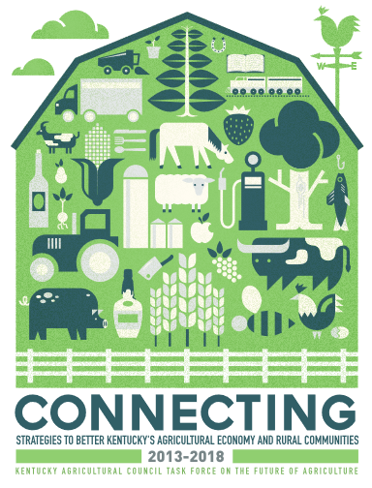
Kentucky Ag Council
www.kyagcouncil.org
Non-profit umbrella organization focused on communication toward common goals
Strategic planning to help increase net farm income and to improve the quality of life in rural Kentucky
Notes:
The Kentucky Ag Council is sort of an umbrella organization for ag – focused on communication within the ag community of common goals. They have a strategic plan available online to help increase farm income and improve the quality of life in Kentucky. I would recommend that you read at least the executive summary of this plan to understand some of the issues in the farm community.

Slide 41
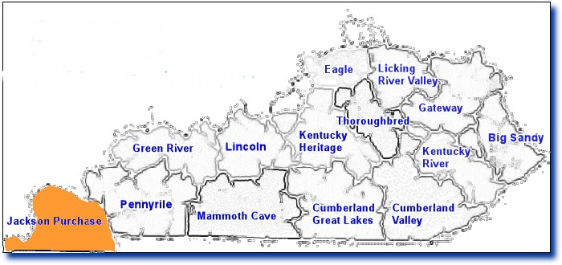

RC&D Councils
Resource Conservation
and Development (RC&D) Councils
Established in Agricultural Act of 1962 within NRCS and sustained by Farm Bill and grants
Independent nonprofits led by local RC&D Council of volunteers
Conserve natural resources and improve rural economies through community leadership and enhanced educational opportunities.
http://www.jpf.org/about.htm
Notes:
Finally, I want to mention Resource Conservation and Development Councils. To my knowledge the Jackson Purchase and the Pennyrile RC&Ds in western Kentucky are the most active RC&Ds in the state. These organizations are nonprofits set up originally in 1962 and later sustained by the Farm Bill and other grants to help communities interact with the federal government to conserve natural resources and improve rural economies.
The Jackson Purchase Foundation funds the Four Rivers Basin Coordinator.

Slide 42
Commodity and Other Ag Groups
Kentucky Cattlemen’s Association, kycattle.org/
Kentucky Dairy Development Council, www.kydairy.org/
Kentucky Horse Council, www.kentuckyhorse.org/
Kentucky Poultry Federation, www.kypoultry.org/
Kentucky Distillers Association, kybourbon.com/
Kentucky Soybean Association, kysoy.org/
Kentucky Corn Growers Association, www.kycorn.org/
Organic Association of Kentucky, www.oak-ky.org/
Kentucky Women in Ag, www.kywomeninag.com/
Black Soil, www.blacksoil.life/
And many others…
Notes:
There are a whole host of commodity groups and other ag organizations that have independent chapters or work with specific ag communities on issues related to that particular commodity or issue. It many cases, working through local farmers for an opportunity to speak at a commodity group meeting can be a helpful way to recruit participation in watershed management and implementation activities.
And with that, I hope you have a little better understanding of the agricultural community and are prepared for the presentations to come

