Slide 1
Watershed Academy Watershed Coordinator Training Series
Habitat Assessment Activity –
RATE THAT HABITAT!

Slide 2
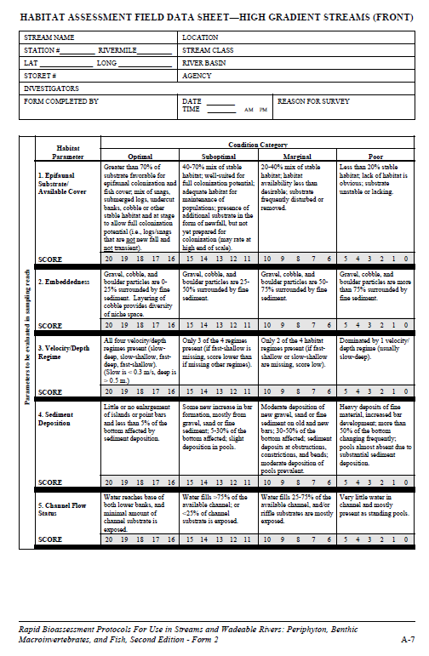
Habitat Parameters
Epifaunal Substrate/Available Cover
Embeddedness
Velocity/Depth Regime
Sediment Deposition
Channel Flow Status
Channel Alteration
Frequency of Riffles (or bends)
Bank Stability
Vegetative Protection
Riparian Vegetative Zone Width
Habitat
Parameters
Notes:
We are going to practice rating some streams based on the criteria that we just reviewed. We will consider each of the parameters based on a photo of a selected stream and see if we can come up with the appropriate condition category.
Helpful Terms:
Substrate - The material that forms the bed of a water body
Channel - The physical confines of a stream (river) consisting of a bed and stream banks
Riparian area – The land along and adjacent to a stream or river

Slide 3
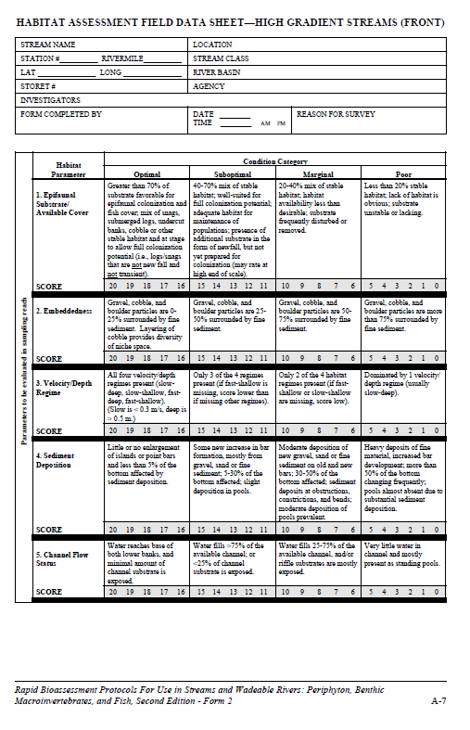
Condition Categories and Scores
Condition Category
Condition Categories:
Optimal (16-20)
Suboptimal (11-15)
Marginal (6-10)
Poor (0-5)
Score
Notes:
Each Habitat Parameter has four Condition Categories that must be carefully read to determine which one most closely matches the observed condition in your stream.
Although you would actually provide a score within each of the condition categories in an actual assessment, we are just going to try to come up with the appropriate condition rating—optimal, suboptimal, marginal or poor.
It is very difficult to come up with a score rating from a photograph alone! It would be much more helpful to be onsite where you can more fully observe and appreciate the stream segment.

Slide 4
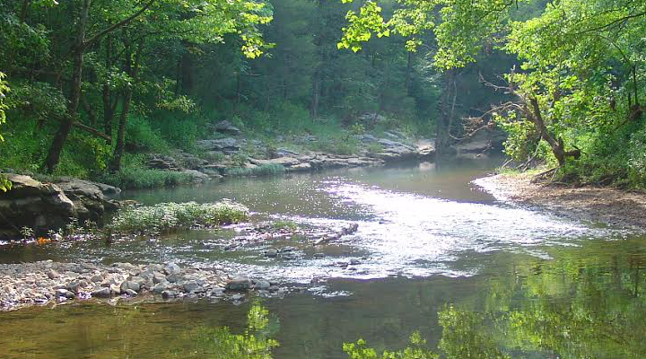
High or Low Gradient?
Pool
Run
Riffle
Notes:
First, we will have a go with determining whether a stream is high or low gradient based on the flow regime.
This stream is high gradient, based on the variety of flow types—riffle, run and pool.

Slide 5
High or Low Gradient?
Notes:
This stream is low gradient, based on the predominance of pools and flat water.

Slide 6
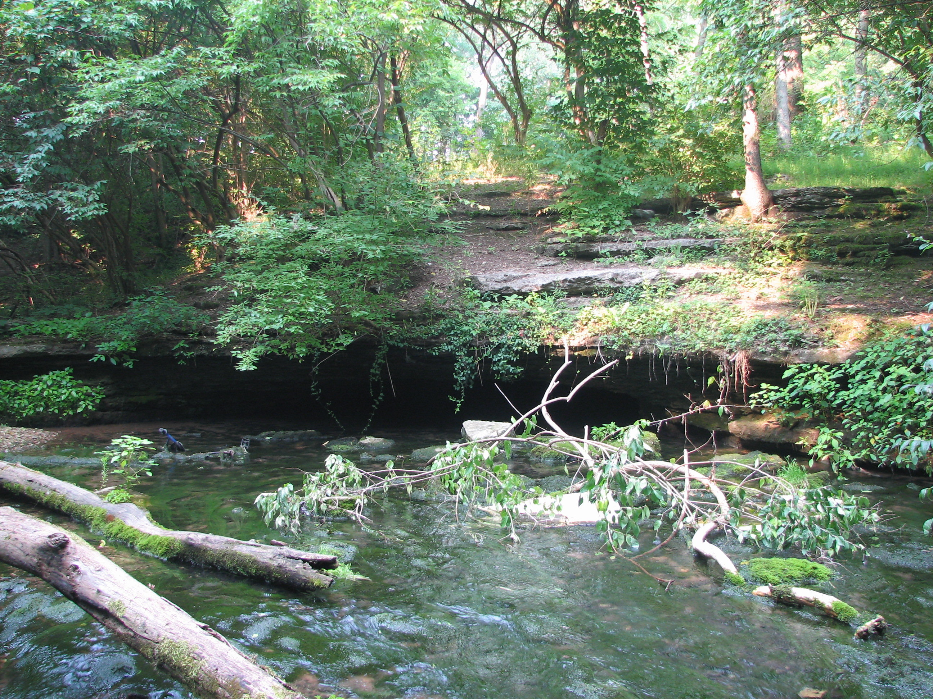
#1 - Epifaunal Substrate/Available Cover
What are the types and sizes of natural materials, such as the rocks and sticks, in the stream?
Rating:
Optimal (16-20)
Suboptimal (11-15)
Marginal (6-10)
Poor (0-5)
Notes:
High or Low Gradient? High, can see riffles downstream
Category Descriptions:
Optimal – Greater than 70% (50% for low gradient streams) of substrate favorable for epifaunal colonization and fish cover
Mix of snags, submerged logs, undercut banks, cobble or other stable habitat, and at stage for full colonization potential, i.e., not newly fallen and not likely to move away
Suboptimal – 40% to 70% mix of stable habitat, well-suited for colonization, may have some freshly fallen substrate material
Marginal – 20-40% mix of stable habitat, habitat availability less than desirable, substrate frequently disturbed or removed
Poor – Less than 20% (10% for low gradient streams) stable habitat, lack of habitat is obvious, substrate unstable or lacking
Category Rating? Suboptimal Epifaunal Substrate – some stable habitat, but not many snags or submerged logs, about 50% ideal

Slide 7
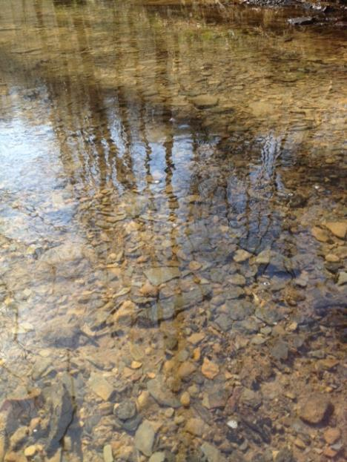
#2 – Embeddedness
How deeply are the rocks on the bottom of the stream covered with sediment?
Rating:
Optimal
Suboptimal
Marginal
Poor
Notes:
High of low gradient? High, shallow water
Category Descriptions:
Optimal – Gravel, cobble and boulder particles are 0 to 25% surrounded by fine sediment Layering of cobble provides diversity of niche space
Suboptimal – Gravel, cobble and boulder particles are 25 to 50% surrounded
Marginal – Particles are 50 to 75% surrounded
Poor – Particles are more than 75% surrounded
Category Rating? Optimal Embeddedness – rocks visible without siltation around them, can seem more than 75% of the rocks

Slide 8
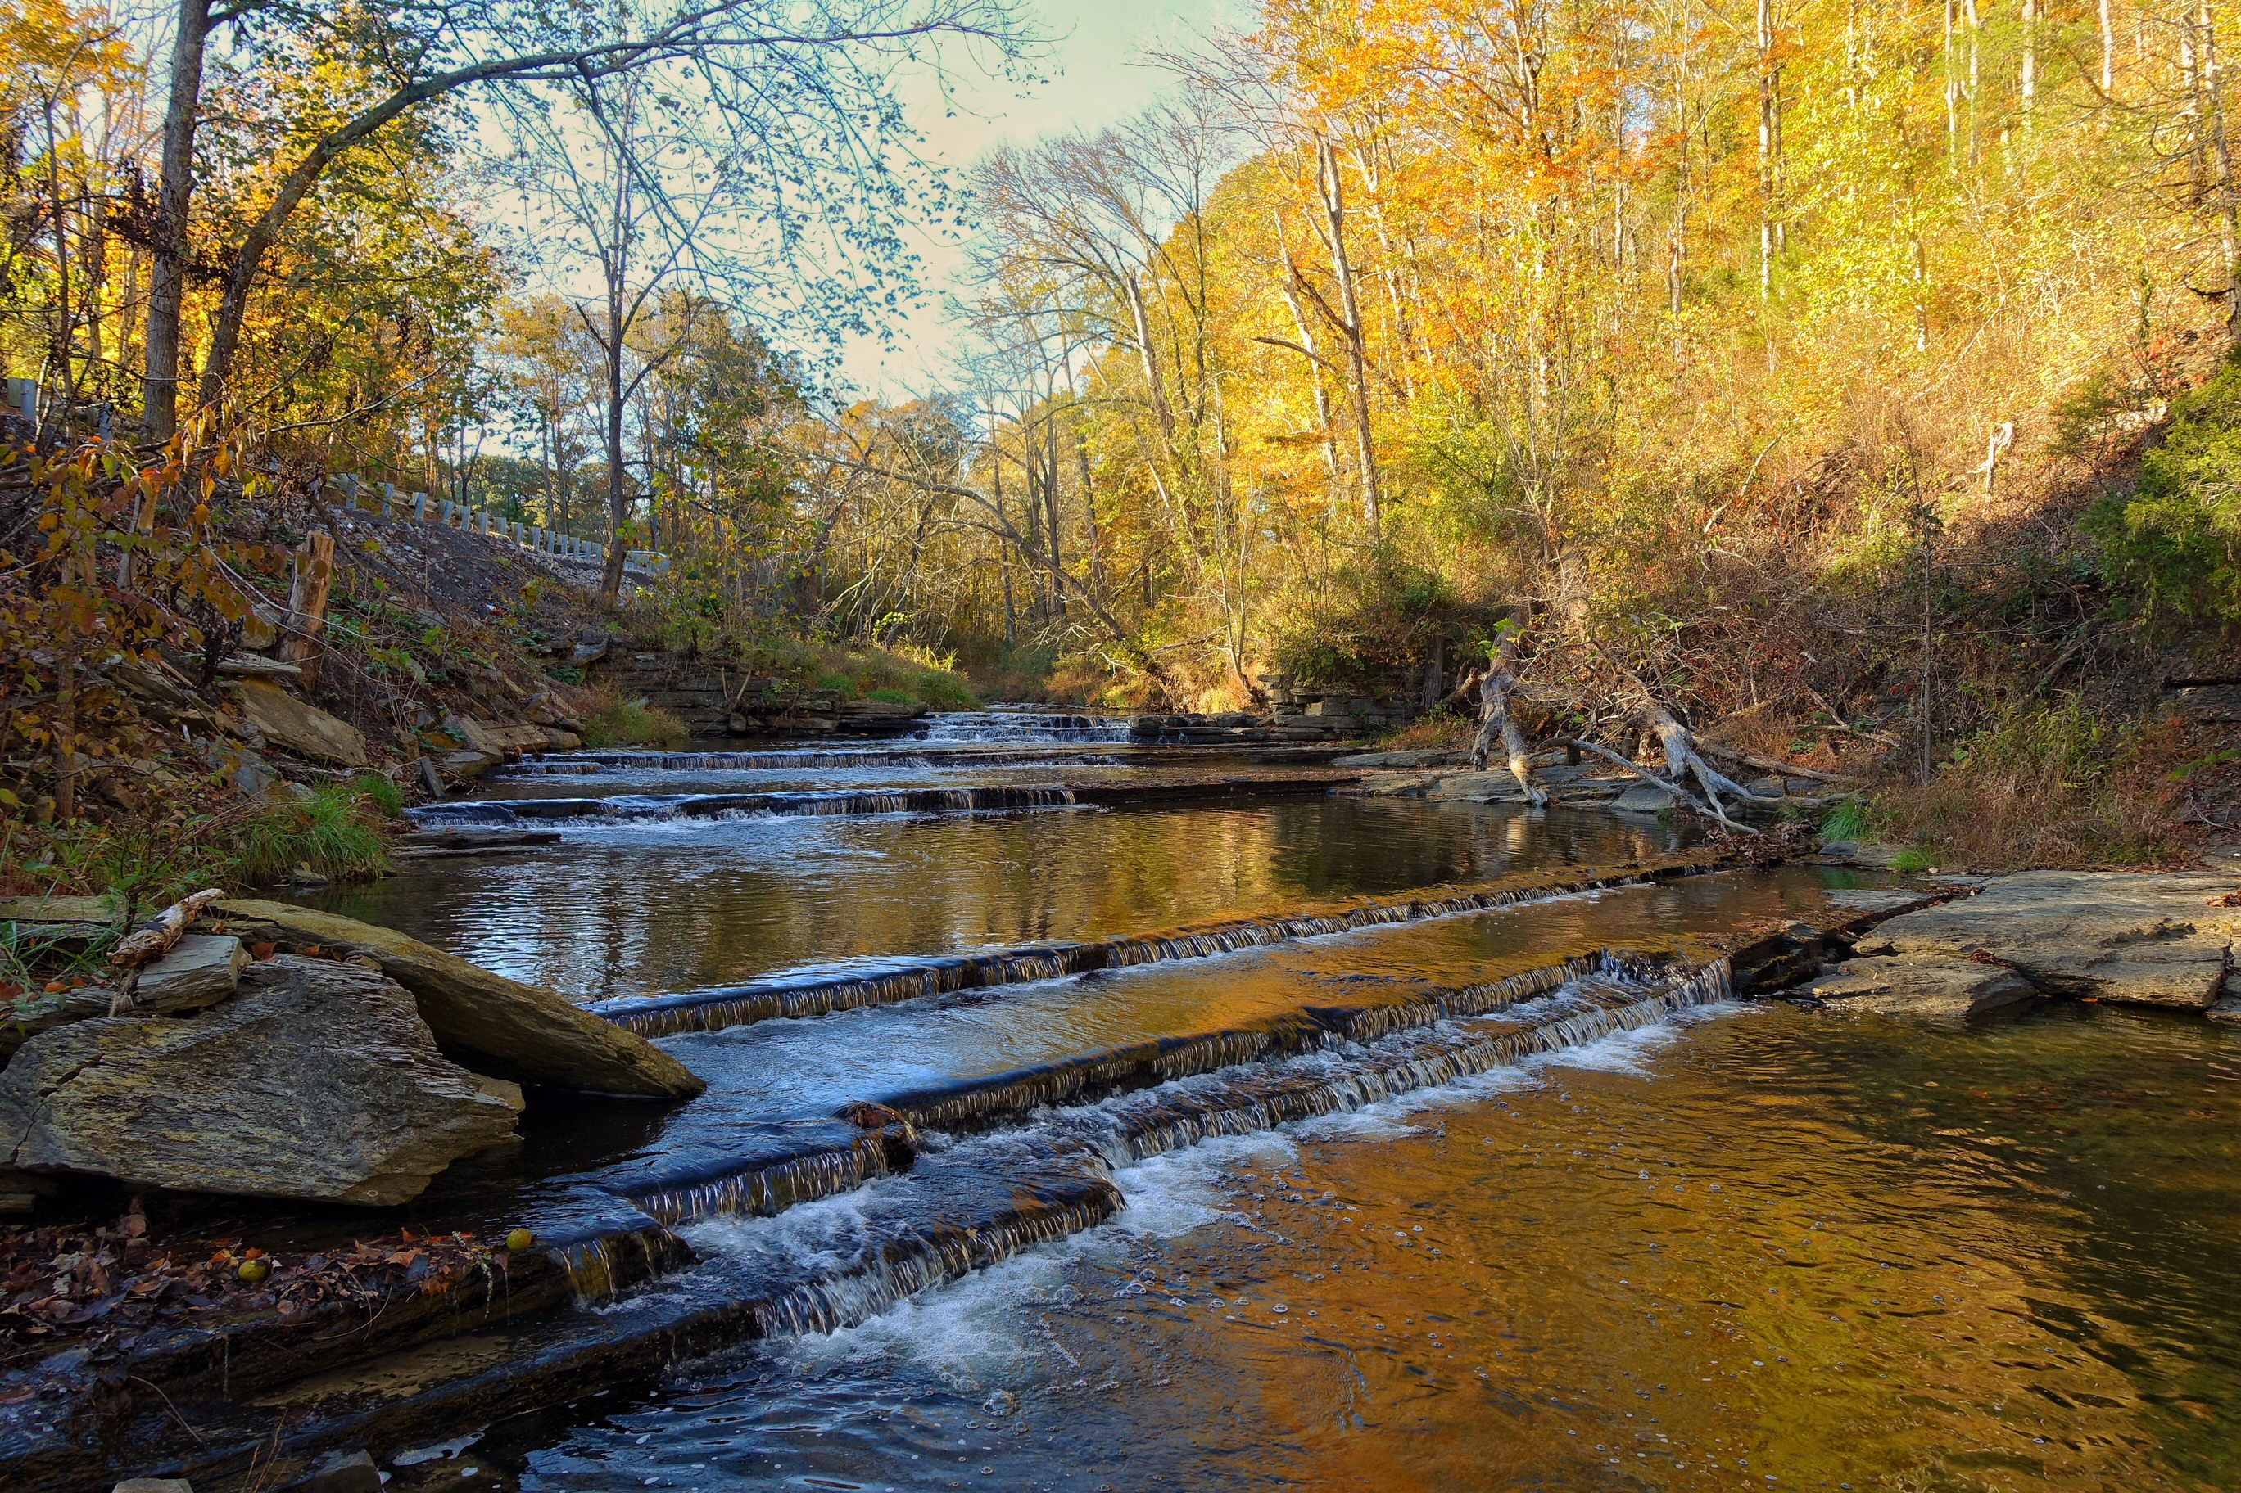
#3 - Velocity/Depth Regime
What depth and flow speed combinations are found in the stream?
Rating:
Optimal
Suboptimal
Marginal
Poor
Notes:
Category Descriptions:
Optimal – All four velocity/depth regimes present (slow-deep, slow-shallow, fast-deep and fast-shallow)
Suboptimal – Only 3 of 4 regimes are present (if fast-shallow is missing, score lower)
Marginal – Only 2 of 4 regimes (if fast-shallow or slow-shallow are missing, score lower)
Poor – Dominated by 1 velocity/depth regime (usually slow-deep)
Category Rating? Suboptimal Velocity/Depth Regime – appears to have fast/shallow, slow/shallow and slow/deep

Slide 9
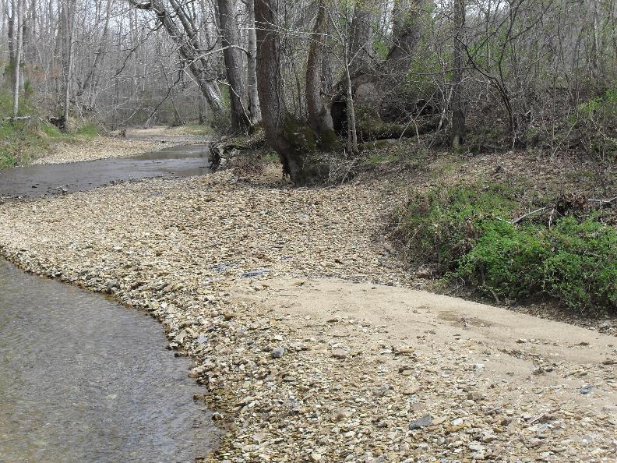
#4 - Sediment Deposition
What are the sizes and numbers of islands or point bars formed by sediment?
Rating:
Optimal
Suboptimal
Marginal
Poor
Notes:
High or low gradient? High, but could be low. Don’t see any true riffles.
Category Descriptions:
Optimal – Little or no enlargement of islands or point bars and less than 5% (<20% for low gradient) of the bottom affected by sediment deposition
Suboptimal – Some new increase in bar formation, mostly from gravel, sand or fine sediment, 5-30% (or 20-50% for low gradient) of the bottom affected
Marginal – Moderate deposition of new gravel, sand or fine sediment on old and new bars, 30-50% (50-80% for low gradient) of the bottom affected
Poor – Heavy deposits of fine material, increased bar development, more than 50% (80% for low gradient) of the bottom changing frequently, pools almost absent due to substantial sediment deposition
Category Rating? Poor Sediment Deposition – many new gravel bars forming, a lot of sediment movement occurring
This is a measurement of how much sediment is being moved by the stream. If there is a lot of dirt being washed into a stream or worn away from the streambanks and carried by the water, it will settle out at a place in the stream where the water is slowed down by a curve in the stream, a tree that has fallen into the stream, a large rock, a bridge, etc. As more sediment begins to collect, the water is slowed down even further, so more sediment settles there. This will cause an island or point bar to form and appear above the surface of the water. This is a natural process, but too much sediment in the stream will cause too many islands and point bars. These may even get larger and cover the entire width of the stream. They will change frequently and don’t provide good places for stream animals to live.

Slide 10
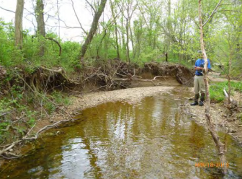
#5 - Channel Flow Status
How much of the stream bottom is covered by water?
Rating:
Optimal
Suboptimal
Marginal
Poor
Notes:
High or Low Gradient? Low
Category Descriptions:
Optimal – Water reaches base of both lower banks and minimal amount of channel substrate is exposed
Suboptimal – Water fills >75% of the available channel, or <25% of channel substrate is exposed
Marginal – Water fills 25-75% of the available channel, and/or riffle substrates are mostly exposed
Poor – Very little water in channel and mostly present in standing pools
Category Rating? Marginal Channel Flow, (about 50% of channel exposed)

Slide 11
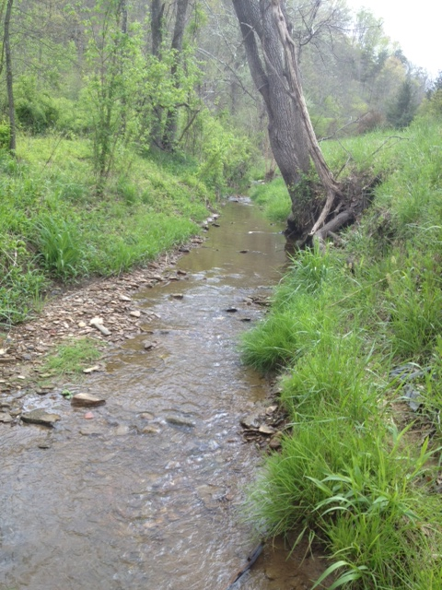
#6 - Channel Alteration
How much of the stream has been modified?
Rating:
Optimal
Suboptimal
Marginal
Poor
Notes:
High or Low Gradient? High
Category Descriptions:
Optimal – Channelization or dredging absent or minimal, stream with normal pattern
Suboptimal – Some channelization present, usually in areas of bridge abutments; evidence of past channelization, but no recent channelization activity
Marginal – Channelization may be extensive; embankments or shoring structures present on both banks
Poor – Banks shored with gabion or cement; over 80% of stream reach channelized and disrupted. Instream habitat greatly altered or removed entirely.
Category Rating? Suboptimal Channel Alteration – straight channel, but no embankments or shoring structures, almost marginal

Slide 12
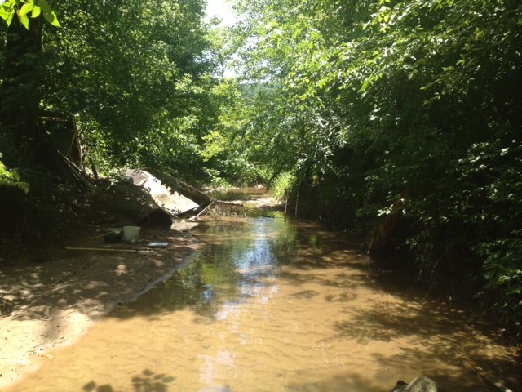
#7 - Frequency of Riffles
How often do riffles occur in the stream?
Rating:
Optimal
Suboptimal
Marginal
Poor
Notes:
High or low gradient? High
Category Descriptions:
Optimal – Occurrence of riffles relatively frequent; measured by distance between riffles divided by stream width; variety of habitat is key
Suboptimal – Occurrence of riffles is infrequent
Marginal – Occasional riffle or bend
Poor – Generally all flat water or shallow riffles; poor habitat
Category Rating? Poor Frequency of Riffles

Slide 13
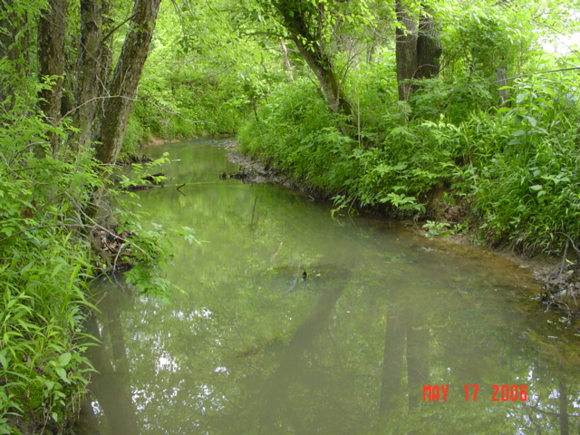
#8 - Bank Stability
How stable are the banks of the stream?
Rating:
Optimal
Suboptimal
Marginal
Poor
Right Bank
LB
Left Bank
RB
Notes:
High or Low Gradient? Low
Category Descriptions:
Optimal – Banks stable; evidence of erosion or bank failure absent or minimal; little potential for future problems; < 5% of banks affected
Suboptimal – Moderately stable; infrequent, small areas of erosion mostly healed over; 5-30% of bank in reach has area of erosion
Marginal – Moderately unstable; 30-60% of bank in reach has areas of erosion; high erosion potential during floods
Poor – Unstable; many eroded areas; “raw areas frequent along straight sections and bends; obvious bank sloughing; 60-100% of bank has erosional scars
Category Rating? Optimal (Left Bank) and SubOptimal (Right Bank) Bank Stability – TRICK QUESTION, conditions 8-10 on the field form are separately for both banks! These include bank stability, vegetative protection, and riparian vegetative zone width. Some erosion obvious on right bank.

Slide 14
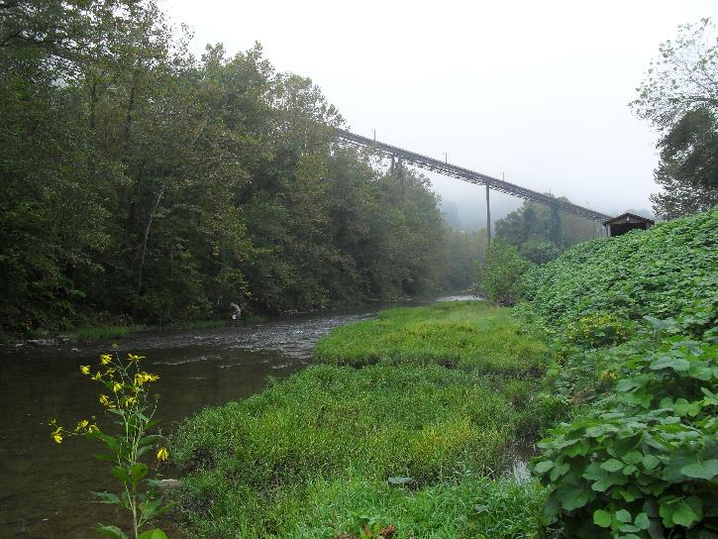
#9 – Vegetative Protection
How much of the stream bank is covered with native plants?
Rating:
Optimal
Suboptimal
Marginal
Poor
LB
RB
Notes:
High or low gradient? High
Category Descriptions:
Optimal – more than 90% of the streambank surfaces and immediate riparian zones covered by native vegetation, including trees, understory shrubs or nonwoody plants; vegetative disruption from grazing or mowing minimal or not evident, almost all plants allowed to grow naturally
Suboptimal – 70-90% of the streambank surfaces covered by vegetation, but one class of plants is not well-represented (trees, shrubs, non-woody); disruption evident, but not affecting full plant growth potential
Marginal – 50-70% of streambank surfaces covered by vegetation; disruption obvious; patches of bare soil or cropped vegetation common
Poor – Less than 50% of streambank surfaces covered by vegetation; disruption high; vegetation has been removed to 5 cm or less in average height
Category Rating? Left Bank Optimal, Right Bank low Suboptimal Vegetative Cover – not many trees or shrubs, invasive plants on right bank (Kudzu)

Slide 15
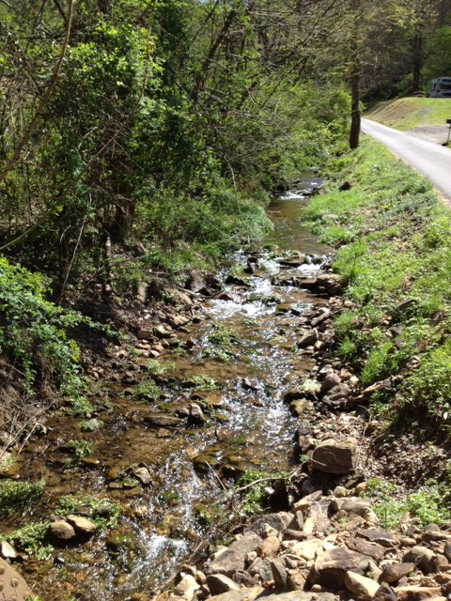
#10 - Riparian Zone Width
How wide is the riparian zone (on each bank)?
Rating:
Optimal
Suboptimal
Marginal
Poor
RB
LB
Notes:
High or low gradient? High
Category Descriptions:
Optimal – Width of riparian zone >18 meters; human activities (i.e., parking lots, roadbeds, clear-cuts, lawns, crops) have not impacted zone
Suboptimal – Width of riparian zone 12-18 meters; human activity impacts minimal
Marginal – Width of riparian zone 6-12 meters; human activities have impacted zone a great deal
Poor – Width of riparian zone < 6 meters; little or not riparian vegetation due to human activities
Category Rating? Poor Riparian Zone – Right bank optimal, left bank poor

