Slide 1
Watershed Academy
Watershed Coordinator Training Series
Water Quality Basics
6. Water Biology

Slide 2









Stream Functions Pyramid
Notes:
In this session, we are going to look at the top of the pyramid – biology.
Biology is located at the top of the Pyramid because these functions are dependent on all the underlying functions. Biological functions include “biodiversity”, or the variety of organisms, and “the life histories of aquatic and riparian organisms”. This includes the types of organisms that feed in an area, reproduce in an area, or spend some part of their life cycle in the water or in the habitat surrounding it.
Biological functions can affect lower-level functions, e.g., beaver activities; however, as with the other levels, the dominant cause-and-effect relationship is upward. A healthy aquatic ecosystem must have sufficient water contributed from the watershed, the right levels of hydraulic forces, proper bed form diversity and channel stability, suitable temperature and oxygen regimes, and so on. The value of the Pyramid at this level is that it helps regulators, scientists and engineers to identify the underlying functions that must be present in order to achieve improvements in biological quality.

Slide 3
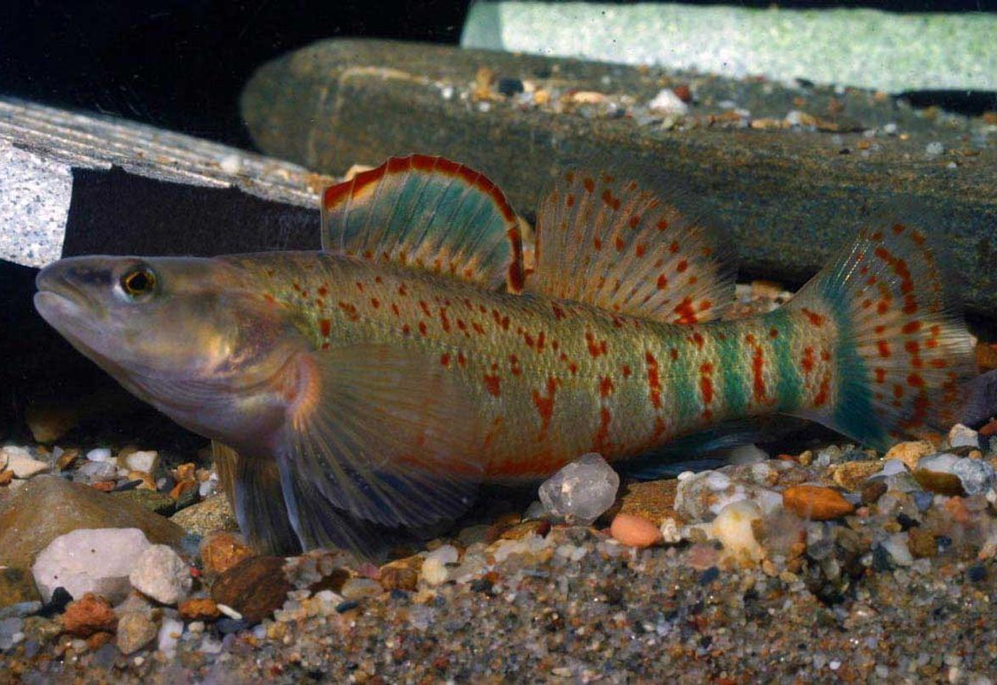
BIOLOGY
Aquatic and riparian organisms that rely on ambient conditions to sustain life
Biological functions dependent on previous levels
Aquatic and riparian organisms such as algae, fish, and benthic macroinvertebrates
Source: Kentucky Fish & Wildlife, 2015
Notes:
Biology is located at the top of the Pyramid because these functions are dependent on all the underlying functions. These functions include the biodiversity and the life histories of aquatic and riparian organisms.
(Ambient conditions – prevailing, current, existing conditions)
Biological functions can affect lower-level functions, e.g., beaver activities; however, as with the other levels, the dominant cause-and-effect relationship is upward.
A healthy aquatic ecosystem must have sufficient water contributed from the watershed, including:
the right levels of hydraulic forces,
proper bed form diversity and channel stability,
suitable temperature and oxygen regimes,
and so on.
The value of the Pyramid at this level is that it helps to identify the underlying conditions that must be present in order to achieve functional improvements in biology.
The microbiological community will also be considered at this level.

Slide 4
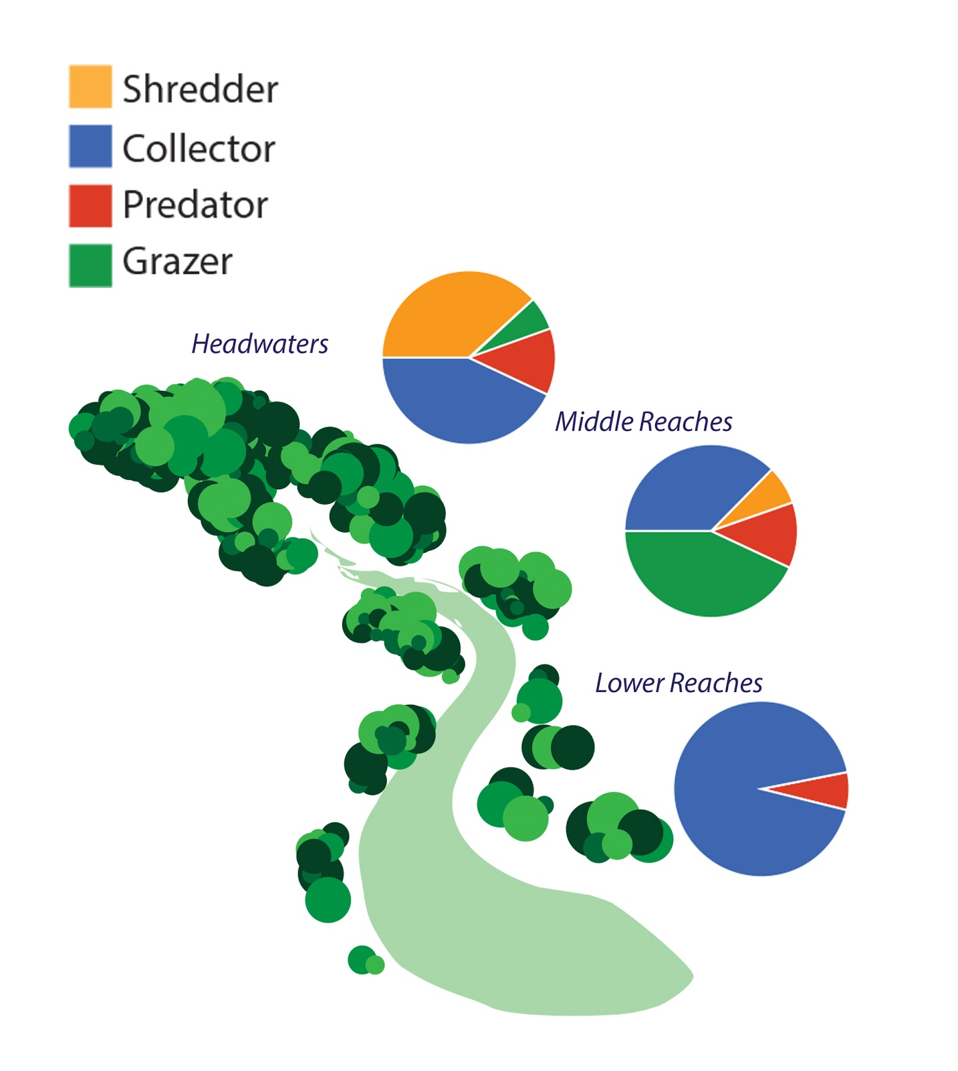
River Continuum Concept – size of stream influences biological community
1-3 Order Streams
Dependent on energy from outside the system like leaves and twigs
4-6 Order Streams
Greater algal production, fine particulates leads to higher biodiversity
7-12 Order Streams and Rivers
More dominated by zooplankton and fine particle collectors
Chart reproduced from, PBI and Trophic Structure, Engevold, Paul
Notes:
The River Continuum Concept generalizes the way in which biological communities function depending on the size of the stream or river.
Depending on the size of the stream, different communities or organisms are expected to live in different places.
The ecosystem functions differently based on the upstream drainage area—from the smaller drainage areas of 1st to 3rd order streams to the larger drainage areas of 7th to 12th order rivers.
The drainage area contributes to hydrological and geomorphological conditions, which affect the stream’s ability to provide habitat and support for different types of organisms.
Smaller headwater streams are dependent on a variety of microorganisms to convert energy from organic matter entering the stream. These include shredders, grazers, collectors and a few predators.
In larger streams, more algal production is occurring in the water itself, which changes the composition of organisms that it can support and allows for greater biodiversity.
In the even larger river systems, the increased diversity of aquatic life supports a range of zooplankton and other fine particle collectors that can support larger fish and other aquatic animals.

Slide 5
Aquatic Ecosystems Impacts
Biological Integrity
Flow Regime
Habitat
Energy Source (Food, Sunlight)
Water Chemistry
Biotic Factors (reproduction, disease, etc)
Notes:
A wide variety of factors contribute to the ability of a waterbody to support aquatic life.
Flow regime – velocity, groundwater contributions, floods and droughts
Water Chemistry – dissolved oxygen, nutrient levels, toxicity
Biotic factors – disease, reproduction
Energy sources – sunlight, seasonal cycles, lack of food
Habitat structure – bank stability, instream cover, sedimentation, erosion, lack of certain habitats
It is the biologists’ job to try to figure out what may be causing weaknesses in the make-up of the biological community.

Slide 6
Biological Assessment
What is a biologically healthy stream?
  If just measuring chemicals or visuals, what about when you aren’t there?
  “Pristine,” pre-European settlement conditions?
  Resilient and sustainable?
  Life present? Abundance of life?
  Types of organisms? Number of different species? How many? Which ones?
Notes:
The question of what makes a healthy stream is open to some debate and depends to some extent on the values of the society.
Some people think that all streams should be like they were believed to be prior to European settlement.
Some think that as long as something – anything - can live in it, the stream is fine.
Some people would be happy if all streams were concreted over as long as it kept their house from flooding.
Stream scientists cannot collect chemical samples all of the time because the cost for analyzing all of the potential pollutants would be too expensive. And, collection at a given time does not explain what happens when the scientist is not there.
So, how should we judge whether a stream is healthy? Should we compare to pre-European settlement conditions? Is it enough to show that the current organisms are resilient and sustainable?
How much life should be present? How many types of organisms? Does their life cycle or feeding style or rarity or sensitivity to pollution matter?

Slide 7
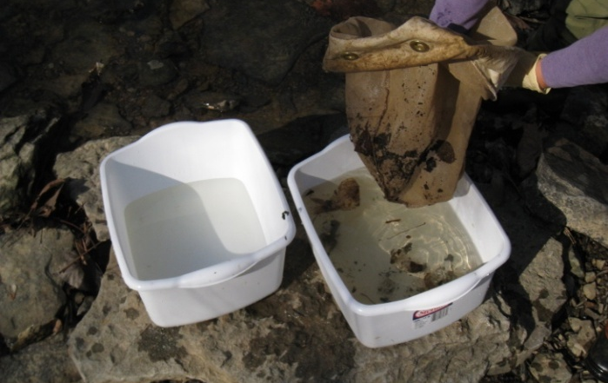
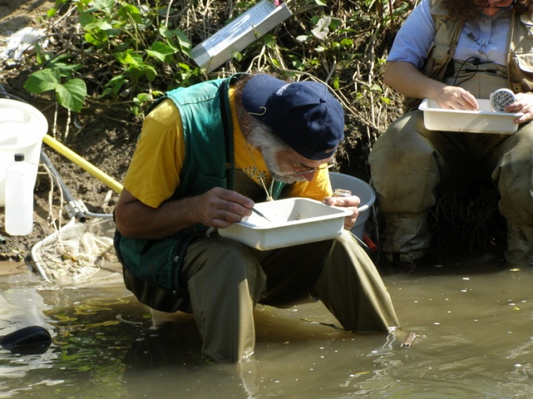
Biological Assessment
Biological Indicator Organisms
  Help us understand water quality
  Conduct biological survey and assess
  Organism types and quantity indicate level of water quality
Source: KY DOW, 2016
Notes:
In order to assess the environmental impact to a stream environment, biologists use indicator organisms.
These organisms provide information on what is impacting the stream during times when scientists are not there to observe or take samples.
We use similar evaluations all the time. It seems like every week we are ranking the health of cities or workplaces based on different indicators.

Slide 8
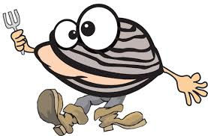
Bivalve Humor
“I’m coming down with something… I feel really clammy.”
“All my mussels hurt.”
“I’m about to become unhinged”
“I’ve got one foot in the ground already.”

Slide 9
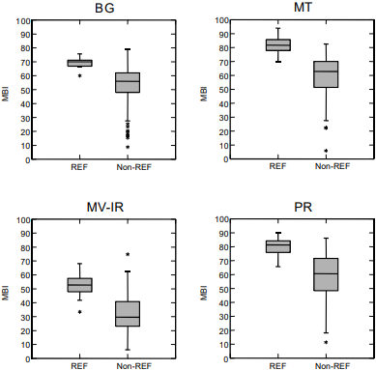
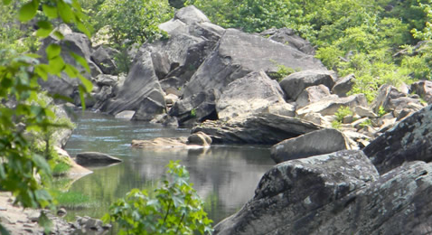

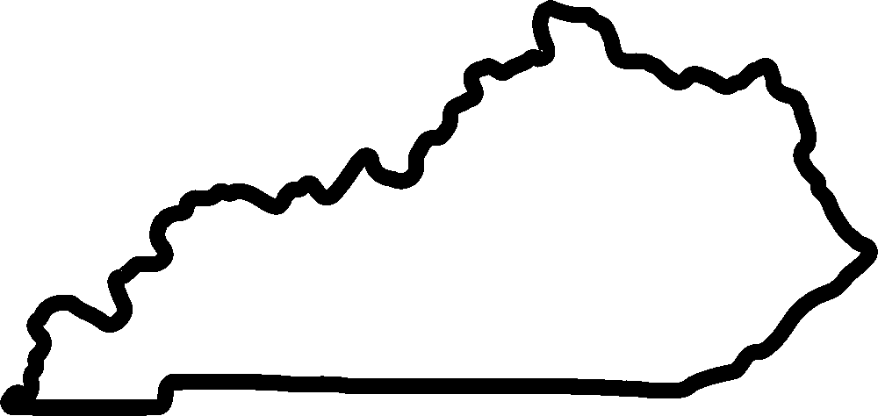
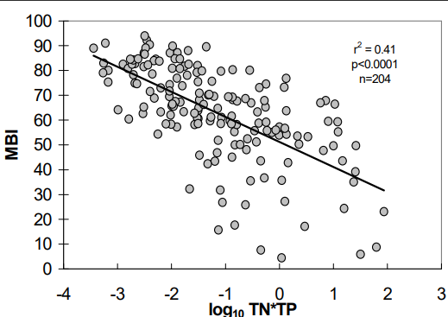
Biological Assessment
Biotic Index Development Method:
Fish
Benthic Macroinverte-brates
Algae / Diatoms
Habitat
Physico-Chemical
1.
Select “Healthy”
Reference Conditions vs Test Sites
2.
Collect Data on Indicators
3.
Statistical Analysis vs Impacts
4.
Regional Index for “Healthy” vs “Unhealthy”
Notes:
When developing a biotic index, there are four basic steps that help determine whether a stream is healthy or not. Understanding this process will help you understand how the biology acts as an indicator of health.
These steps are as follows:
Streams with minimal human impact or “reference reaches” are identified. Reference reaches include streams of different sizes and in different geographic regions of the state. These streams provide benchmark conditions that can be compared to water quality conditions in “test site” streams in the same region.
(CLICK to appear) A wide variety of parameters are collected at these reference sites, as well as at the streams of interest.
(CLICK to appear) Statistical analysis is used to assess different “metrics” or ways of looking at the biological data in order to find the best predictors of different types of pollution impacts. Some metrics are better in some areas of the state than others.
(CLICK to appear) These different metrics are calculated into an overall score that provides confidence that the results are statistically different from the least impacted areas. This allows for the development of metric values for rating comparison streams.

Slide 10
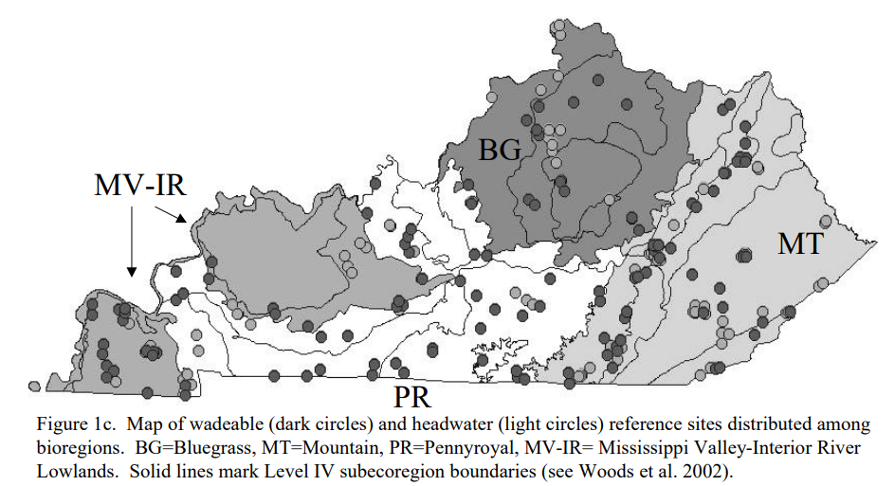
Biological Assessment
Reference Reaches:
Wadeable (~5-200 sq mi)
Headwater (<5 sq mi)
4 Bioregions
Source: Pond et al, 2003
Notes:
In Kentucky, the way that biological health is determined is dependent on the stream location’s specific bioregion and its size class – whether it is considered wadeable (with a watershed size between 5 and 200 square miles) or a headwater stream (with a watershed less than 5 square miles).
This graphic shows where each region was sampled in order to develop the metrics for macroinvertebrates.
Kentucky has four bioregions: (from west to east)
Mississippi Valley / Interior River (MV-IR)
Pennyroyal (PR)
Bluegrass (BG)
Mountains (MT)
It is important to compare the Biotic Index you calculated for your site to the correct bioregion scale on the Integrity Rating Chart. The chart is divided into 8 sections that include the 4 bioregions and the 2 different size classes (Wadeable and Headwater).
The scales on the Chart are adjusted for the variances in the actual biological communities found in the different Bioregions.
Example: If your biological sample is collected from your site in the Mountains and you calculate your Biotic Index, but you accidentally compare it to the scale on the Integrity Rating Chart for the Bluegrass, you could misinterpret the Integrity Rating for your stream as “Good” when in reality, based on the scale for the Mountains, it is only “Fair.”
Reference: The Kentucky Macroinvertebrate Bioassessment Index, Pond et. al., September 2003. (https://eec.ky.gov/Environmental-Protection/Water/QA/BioLabSOPs/KY%20Macroinvertebrate%20Bioassessment%20Index.pdf)

Slide 11
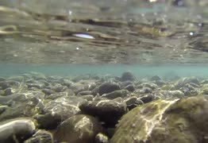

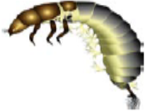
Biological Indicators
Benthic:
Bottom of a
water body
Macro:
Visible to the
naked eye
Invertebrate:
Lacking a
backbone
Notes:
Definition: (1) Benthic – live on the bottom, (2) Macro – large enough to be seen with the naked eye, and (3) Invertebrate – animal without a backbone
Benthic macroinvertebrates play an important role in a stream system. They provide a food source for larger animals, especially fish. Some of these macroinvertebrates eat algae and bacteria. Others shred and eat leaves and other decaying material that enters the stream. By feeding on and using the nutrients in these materials, the benthic macroinvertebrates make these nutrients available to the larger animals that eat them. Also, when they die and decay, the nutrients in their bodies become food for other benthic macroinvertebrates in the stream.
Literally thousands of different species of macroinvertebrates have been found in Kentucky's streams and rivers.

Slide 12
Macroinvertebrates:
Ideal for Biological Assessment
Live in the water
Exposed to all conditions in stream
Only survive in suitable areas (long-term)
Have varying tolerance to pollution levels
Easy to collect
Easy to identify
Notes:
In general, when seeking ideal indicators of watershed health, we look for the following characteristics:
• live in the water for all or most of their lives
• stay in areas suitable for their survival
• are easy to collect
• different species show different tolerances to pollution levels
• are easy to identify in the field or laboratory
• often live for more than one year
• don’t move very far in the stream
• are exposed to all conditions and pollution in the stream
Common Indicator Organism Categories
Abundance
Frequency
Pollution sensitivity
Feeding group
Life cycle type
Key habitat
In Kentucky, there are three different types of organisms that are used in biological assessments: fish, benthic macroinvertebrates, and algae / diatoms.
Of these, benthic macroinvertebrates are the easiest for most people to collect and identify.

Slide 13
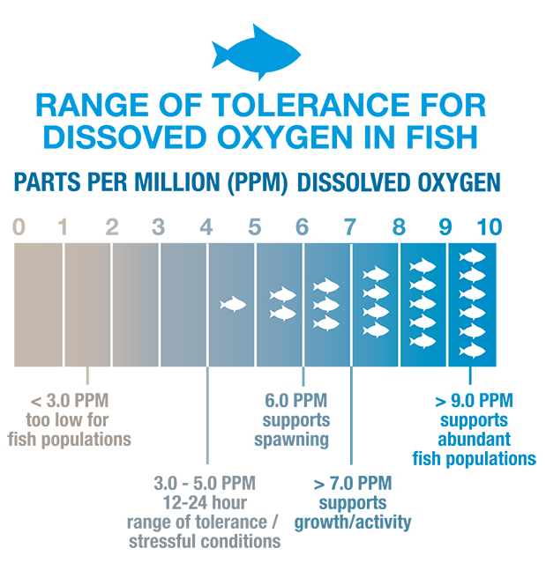
Water Quality Effects on Macros
Sediment
Suspended sediment causes difficulty with breathing through gills
Bed sediment smothers eggs and habitat niches between rocks and gravel
Dissolved Oxygen
Low levels make it difficult for macros to thrive and reproduce
www.water-research.net

Slide 14
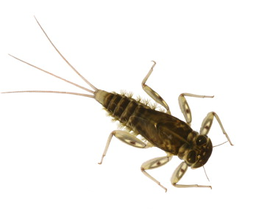
Water Quality Effects on Macros (continued)
Temperature
Warmer temps cause stress by reducing D.O. levels and increasing susceptibility to disease
Conductivity
Macros adapt to certain levels, are negatively impacted when levels change (especially increases)
Mayfly larvae are very sensitive to conductivity levels.

Slide 15
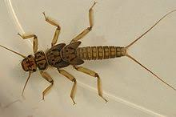
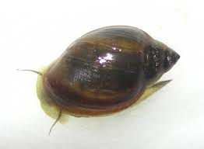
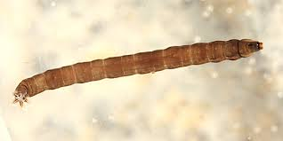
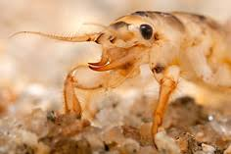
Macroinvertebrate Feeding Groups
Stonefly larvae
Snails
Cranefly larvae
Mayfly larvae
Shredders – Tear and eat coarse particulate organic matter
Grazers/Scrapers – “grazers” of biofilm and benthic algae
Notes:
The presence of macroinvertebrates that employ a range of feeding types indicate a healthy aquatic community that maximizes resources and completes the food web.
There are a wide variety of ways that macroinvertebrates collect and consume their food or energy sources.
Shredders – get energy from breaking down leaves and other vegetation.
Examples: Stonefly, Cranefly Caddisfly larvae and Sowbugs
Grazers or Scrapers – scrape algae and other food sources off of rocks and the stream substrate
Examples: Mayfly larvae and snails

Slide 16
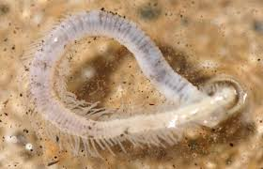
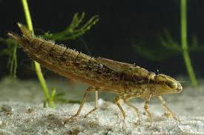
Macroinvertebrate Feeding Groups
Aquatic worms
Dragonfly larvae
Collectors – crawl around and pick up very small pieces of vegetation or debris
Predators – Eat other macroinvertebrates or small fish
Notes:
Collectors – crawl around and pick up very small pieces of vegetation or debris from the bottom of the stream
Example: Worms
Also, have filtering collectors that filter food out of the water. Examples are black fly larvae and net-building caddisflies.
Predators – eat other macroinvertebrates and small fish; mouth parts are specially adapted to feed on prey
Example: Dragonfly and damselfly larvae have scoop-like lower jaws

Slide 17
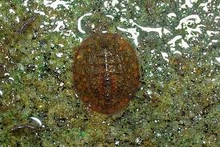
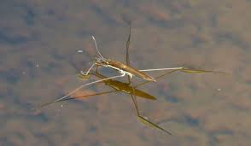
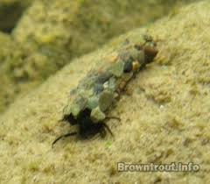
Macroinvertebrate Habitat Groups
Water penny larvae
Water strider
Caddisfly larvae
Clingers – attach to substrates, such as rocks
Skaters – move on surface of water
Notes:
Macroinvertebrates also display a wide range of mobility and use of the various habitats that exist in a stream environment.
These are some examples of places that you can find macroinvertebrates in the water column, on the stream bed and along the streambanks.

Slide 18
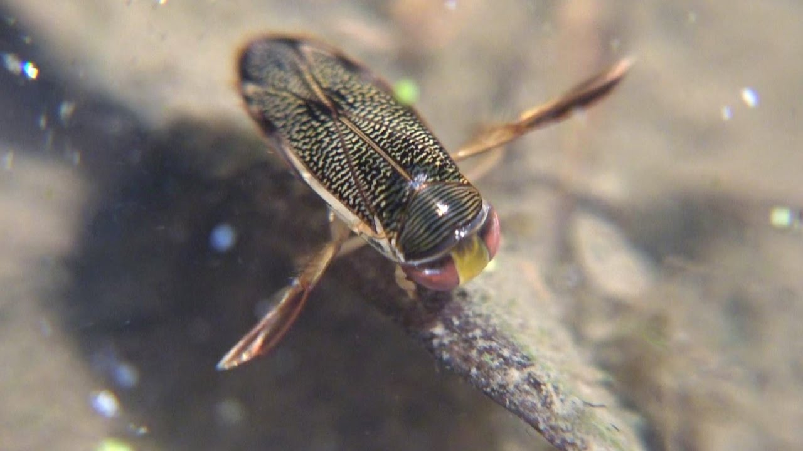
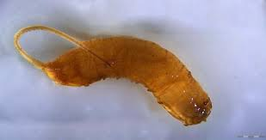
Macroinvertebrate Habitat Groups
Water Boatmen Beetles
Rat-Tailed maggot
Swimmer/Climber – move in fish-like short bursts, crawl on aquatic plants, roots or woody debris
Burrowers – dig into fine sediments
Notes:
Water Boatmen Fun Fact: They breathe from a bubble of air kept under their bodies.
Rat-Tailed Maggot Fun Fact: The tail-like structure is actually used to help the maggot breathe in low-oxygen environments. Because they can survive in extreme environments, they are useful as indicators of non-ideal water quality conditions.

Slide 19
Macroinvertebrate Indicators
Many factors are used to develop indicators of water quality for specific ecoregions:
Feeding group types
Habitat groups types
Pollution intolerance
Rarity of a given species
Number of species present
Abundance or percentage of certain groups
Notes:
Feeding and habitat groupings are combined with other factors to develop correlations with water quality within specific ecological regions.
These indicators help provide a general understanding of water quality conditions and alert stream scientists to potential problems in need of attention or higher quality waters in need of protection.

Slide 20
Sensitive Group – Healthy
EPT Index
Ephemeroptera
Plecoptera
Tricoptera
Mayflies
Stoneflies
Caddisflies
(casebuilder)
Water Penny
Alderflies
Mussels
Riffle Beetles
Snipeflies
Source: KY DOW & Cacapon Institute
Notes:
Watershed Planning Guidebook for Kentucky Communities
Benthic macroinvertebrates that are used as biological indicators for water quality can be grouped by their sensitivity to pollution.
The presence in a stream of many or all of the individuals in the Sensitive Group would indicate good water quality. However, a variety of macroinvertebrates from each group should be found in a healthy stream.
The EPT Index estimates water quality based on the relative abundance of the three major orders of stream insects that have low tolerance to many pollutants in the stream environment.
Ephemeroptera
Plecoptera
Tricoptera
It is calculated by dividing the total EPT taxa by the total taxa found and multiplying by 100% = % EPT Abudance
A high percentage of EPT taxa indicates good water quality.
The other (non EPT) examples on this slide have varying levels of sensitivity to pollution.

Slide 21
Moderately Tolerant Group - Fair
Damselflies
Dragonflies
Caddisflies
(netspinner)
Blackflies
Craneflies
Crayfish
Source: KY DOW & Cacapon Institute
Notes:
If only a few individuals, or none, of the Sensitive Group are present in a stream, and the macroinvertebrates are mostly from the Moderately Tolerant and Pollution Tolerant Groups, this would indicate fair water quality.

Slide 22
Pollution Tolerant Group - Poor
Midges
Worms
Leeches
Pouch Snails
(non-operculate)
Source: KY DOW & Cacapon Institute
Notes:
If most or all of the macroinvertebrates present are from the Pollution Tolerant Group, then poor water quality would be indicated.

Slide 23
Aquatic Life Use Support
Review All Available Data
Habitat
Macroinvertebrate
Fish
Algae / Diatom
Chemical Pollutants
Weight of evidence for sound decision?
Support
Impaired
Notes:
This is a simplified diagram of how the Kentucky Division of Water decides whether or not a waterway is impaired for warm-water or cold-water aquatic habitat use.
The idea is that all types of biological data are reviewed. Sometimes, all of this data tells the same story – the waterway is healthy or impaired.
Scores of excellent and good usually relate to support, scores of fair, poor or very poor usually relate to impaired.
If impaired, KDOW tries to associate probable causes to the impairment through analysis of chemical, physical, and habitat data.
However, if there is a conflict between the biological data – the macroinvertebrates, habitat, fish, algae – and the pollutant data, then a weight of evidence approach is used or re-sampling is done.
In order to improve the biology and restore these uses, the hydrology and geomorphology will often need to be addressed, as well as the pollutants.

Slide 24
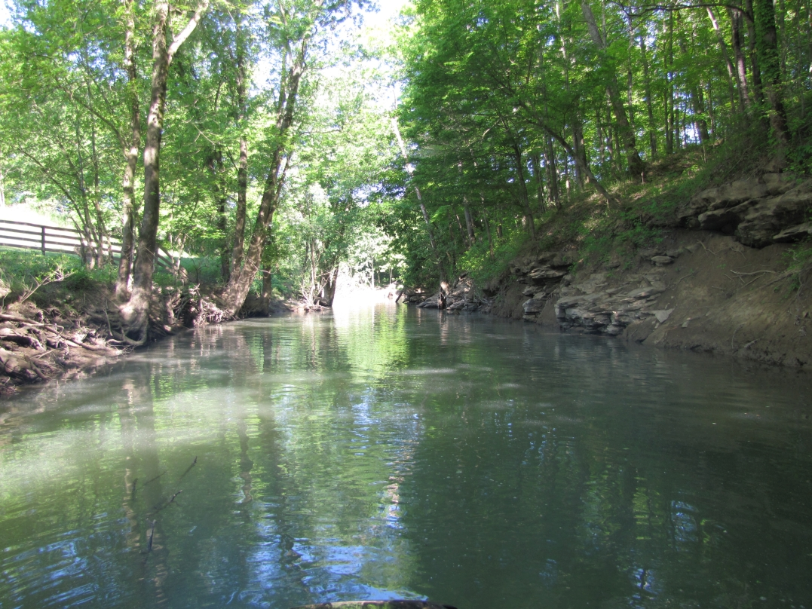
Questions?
Alexander Creek, KY

