Slide 1
Watershed Academy
Watershed Coordinator Training Series
Water Quality Basics
1. Overview of Water Quality Basics

Slide 2
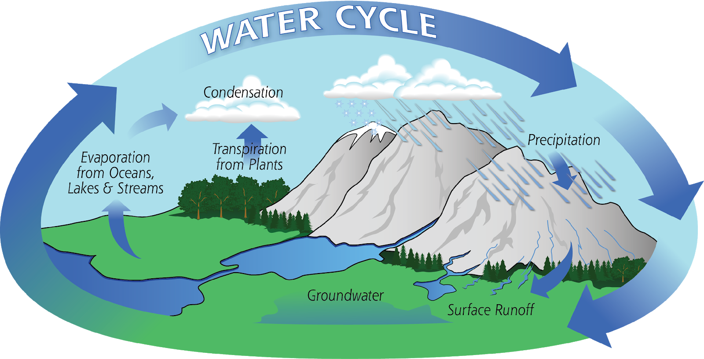
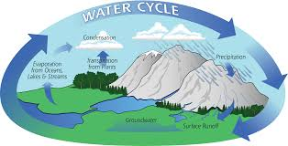
Water Cycle
Source: NASA.gov
Notes:
It is helpful to start with the basics…thus, we will refresh our memory of the Water Cycle!
The hydrologic cycle begins with PRECIPITATION falling to Earth in the form or rain or snow.
As this water falls, some EVAPORATES back into the Earth’s atmosphere.
Of the water that reaches the earth’s surface, some becomes SURFACE RUNOFF and some INFILTRATES into the soil, becoming groundwater or soil moisture.
The groundwater may PERCOLATE into natural underground reservoirs or aquifers, be released by TRANSPIRATION from vegetation, or seep back into a surface water.
The EVAPOTRANSPIRATION (combination of evaporation and transpiration) will cool and CONDENSE into clouds, which will then release the water as PRECIPITATION again.

Slide 3
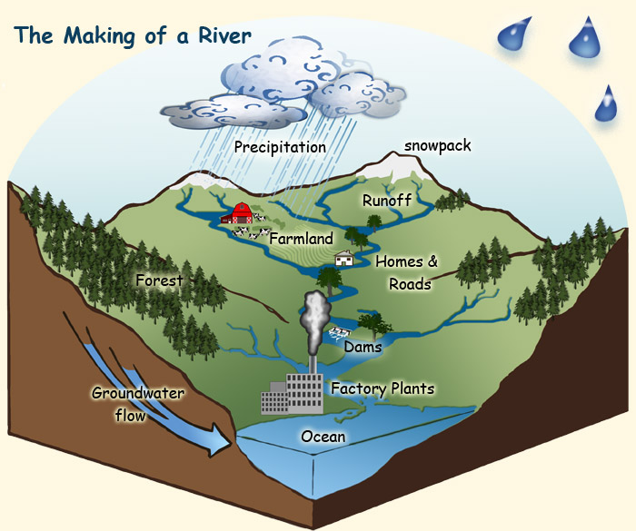
Watersheds
What are they?
  Area of land that collects and drains all precipitation -both surface runoff and groundwater -to a common outlet such as a stream, river or lake.
Image Credit. A. Vicente, U.S. Forest Service
Notes:
The concept of watersheds will be central to our discussion of water quality, so we will also review this concept.
Note how the water flows with gravity from high to low points in the landscape, where it collects to form streams, rivers, lakes and ultimately the oceans.

Slide 4
Watersheds
Why are they important?
  Capture precipitation across a large area
  Replenish water supply through:
    Groundwater infiltration
    Surface water runoff
  Collects and transports runoff pollution
    Eroded soil
    Fertilizers (nutrients)
    Livestock, pet and human wastes (bacteria/pathogens)
Notes:
Watersheds capture precipitation that falls across its geographical area.
This water initially seeps into the ground where it helps to recharge the groundwater table.
Once the soil becomes saturated, the remaining rainfall or snow begins to move across the land area as surface water runoff.
As it moves across the land, the water picks up contaminants and chemicals which form the basis for surface runoff pollution.
The land topography can dramatically impact the amount of runoff pollution. For example, steep elevation drops can accelerate the flow of water thereby causing more erosion and potentially more runoff pollution.

Slide 5
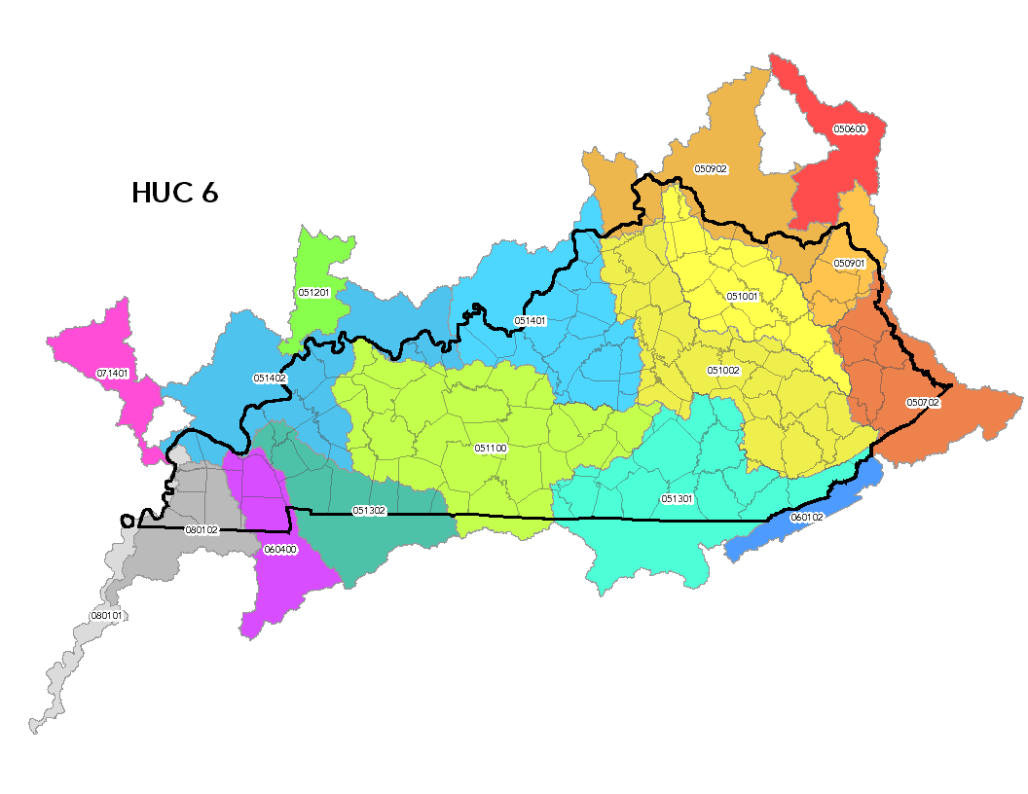
Hydrologic Unit Code (HUC)
HUC 10
Kentucky HUCs by Size
HUC Code | Count | Name | Avg. Area (sq mi)
Huc-4 | 10 | Subregion | 17,000
Huc-6 | 15 | Basin | 10,000
Huc-8 | 45 | Subbasin | 700
Huc-10 | 248 | Watershed | 200
Huc-12 | 1301 | Subwatershed | 40
Notes:
When we talk about watersheds, we may be talking about areas of all different sizes.
The United States Geological Survey created a hierarchical system of hydrologic units. Each unit was assigned a unique Hydrologic Unit Code (HUC).
The number of digits in the code indicates the relative size of the area with less digits being larger.
Additional digits indicate that a smaller watershed is nested within a larger drainage area.
There are 6 levels in the hierarchy, represented by hydrologic unit codes from 2 to 12 digits long, called regions, subregions, basins, subbasins, watersheds, and subwatersheds.
When we use the word “watershed” we are not typically using this technical definition of a HUC-10, but the area of land that drains to a common point or waterbody.

Slide 6
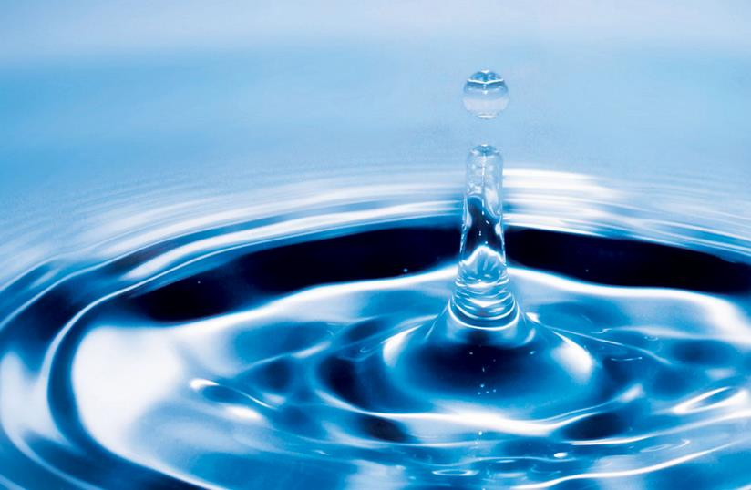
Water Quality
What is it?
  Water quality refers to the chemical, physical, and biological characteristics of water.
  It is a measure of the condition of water in relation to human health, ecological conditions, and the ways we use water.
Notes:
When we discuss water quality, we will be considering its chemical, physical and biological characteristics.
We compare these conditions to scientifically determined standards that protect human health, ecological conditions and other ways that we use water.

Slide 7
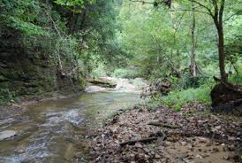
Watersheds and Water Quality
  Water
  Climate / Weather
  Hydrology / Hydraulics
  Environment
  Geomorphology
  Land Use
  Biology / Ecology
Notes:
Water quality is affected by 2 basic factors:
the water itself, which is affected by:
climate and weather
hydrology (properties, distribution, and circulation of water on and below the earth's surface and in the atmosphere)
hydraulics (how the water flows from one point to another).
The environment or physical setting which the water flows over and under and through and is being discharged into.
This is affected by the geomorphology of the area (physical features of the earth’s crust related to its geology), the land use of the area, as well as the vegetation and organisms that are in a watershed and water bodies.

Slide 8
Two views on Water Health
  Ecologist’s View Hydrologist’s View
Source: Gordon et al. 2004. “Stream Hydrology: An Introduction for Ecologists” Second Edition
Notes:
The study of water quality is multi-disciplinary and the different disciplines affect how we look at the streams, rivers, and lakes.
For example, an ecologist is looking at the waterbody and examining the biodiversity of the macroinvertebrates, the microhabitats where they might live, and whether or not the water quality is suitable for aquatic life.
A hydrologist looks at a stream and sees the water velocity, the cross-sectional area, the sheer stress, and the size of the substrate in the stream.
Each are simplifying in their own way in order to understand how the waters will respond under different conditions.
In this course, we want to give an overview of how to look at a stream or lake and become familiar with a broad range of relevant measurements and principles of water quality.

Slide 9







Stream Functions Pyramid
Adapted from: A Function-Based Framework for Stream Assessment & Restoration Projects, 2012
Notes:
In 2012, the US Fish and Wildlife and EPA released a document called “Function-Based Framework for Stream Assessments and Restoration Projects.”
This document provides a framework for understanding how various stream functions are related to one another in a pyramid like structure with higher functions being supported by lower more basic functions.
Note that Geology and Climate form the base of the pyramid with steps up the pyramid including:
Hydrology
Hydraulics
Geomorphology
Physicochemical
Biological
In our lessons, we will be climbing up this pyramid and examining how to think about various functions contributing to water quality.
First, we will briefly review the “functions” in order to provide orientation for the information to come.

Slide 10
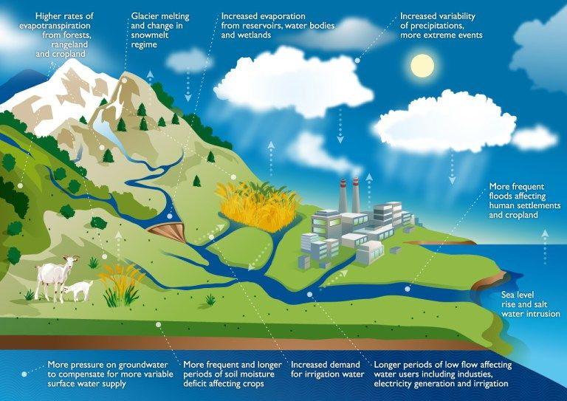
Climate
Source: UN Food and Agriculture Organization
Notes:
Climate change can increase our risks for both heavy rains and extreme droughts because water vapor concentrations, clouds, precipitation patterns and stream flow patterns are all affected by temperature.
Warmer temperatures increase evapotranspiration of water up into the atmosphere.
More intense storms will occur, instead of steady, lighter rainfall events.
Severe storms with heavy precipitation and rapid runoff do not recharge the groundwater as effectively as slow, steady rainfall, thus causing reduced soil moisture levels.
Heavy storms also increase runoff of sediment and other pollutants.
Warmer temperatures, increased evaporation and fewer soaking rains can lead to more severe droughts.
Groundwater supplies will also be depleted with fewer steady rain events and more frequent droughts.
Higher surface water temperatures also increase the development of algae, which can threaten the ecological balance of a waterbody.
Thus, climate affects how water flows through the hydrologic system and the resultant water quality.

Slide 11
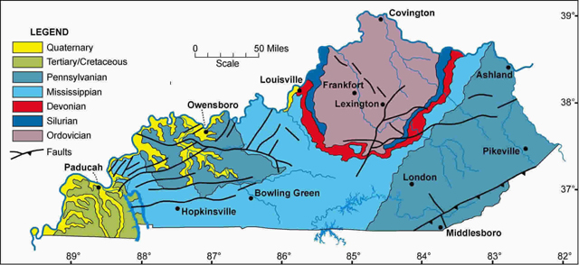
Geology
Bedrock layers include various mixtures of clay, sand, gravel, sandstone, limestone, shale, dolomite and coal.
Source: Kentucky Geological Survey, Geology of Kentucky
Notes:
The geology of Kentucky has a profound effect on the quality of our water and water’s movement over, under, and through the land surface.
The subsurface will affect the chemical characteristics of the water, the drainage patterns, and the groundwater-surface water interactions.
It will also affect the types of land uses in each area.
Healthy water quality conditions in one area of the state may not be the same as in another area of the state, due to differing geological contributors.
This map shows the layers that are exposed in different areas of the state.
Quaternary geology consists of clay, sand, and gravel
Tertiary: clay and sand and some clay
Pennsylvanian: shale, sandstone, and coal
Mississippian: shale, limestone, and sandstone
Devonian: shale and limestone
Silurian: dolomite and shale
Ordovician: limestone, dolomite, and shale

Slide 12
Summary
  Lessons Structure:
  Hydrology / Hydraulics
  Geomorphology
  Habitat Assessment
  Physical and Chemical Properties
  Aquatic Biology
Notes:
In summary:
The stream functions are inter-related and generally build on each other in a hierarchical system. Changes in a bottom layer of the pyramid will effect all the layers on top. In order to restore functions at the top, all the functions below need to be considered.
Scientists can perform different assessments and tests to measure how well the stream is performing in each of these functional areas.
With best management practices, watershed managers can also adjust functional conditions to better enable stream restoration to a more natural and balanced system.
We will now begin to take a more in-depth look at the base functions of Hydrology and Hydraulics and then work our way up to biological functions at the top of the pyramid.

