Slide 1
Watershed Academy Watershed Coordinator Training Series
Module 6: Effective Communications
4. Forces, Goals & Objectives
Notes:
Now, we’re going to begin our more in-depth look at developing the forces, goals and objectives for your campaign.

Slide 2
Source: bgky.org/stormwater
Notes:
Just about any view out of an airplane window can show you how complicated it is to manage all of the potential sources of water pollution in the landscape.
Runoff is coming off of so many different land uses, carrying a variety of potential pollutants along with it.
Much of the land’s surface is covered with paving or buildings, generating larger volumes of erosive runoff.
And, stream channels are altered and straightened to make way for the development, furthering bank erosion.
The situation can almost seem overwhelming as you consider the breadth of businesses and communities in a watershed.
But, as with all problems, you have to take a step back and break down the situation into smaller, more manageable parts.
By tackling watershed management in a more strategic, thoughtful way, we just may be able to help inform and motivate its residents to help us achieve cleaner, healthier water resources.

Slide 3
We really need a plan! Why?
Planning can:
Help with organization-building if it involves diverse members of the group
Develop a shared sense of purpose
Provide program/activity clarity
Excite and motivate a range of partners
Maximize organizational performance
Set the foundation for future efforts and help form an organization’s reputation
Notes:
As discussed in the overview, we really do need a plan for outreach. Here are some reasons why (Read).
This presentation is intended to help you establish the overarching framework for your plan.

Slide 4
Identify your driving forces
Develop your related goals
Assign objectives to achieve the goals
Notes:
In Step 1, we will cover 3 major items:
Identifying your driving forces
Developing the related goals, and
Assigning objectives to achieve those goals

Slide 5
Aesthetic Concerns
Water Quality Standard Violations
New Regulations
The Need for a Watershed Campaign!
Flooding
Drinking Water Problems
Erosion and
Loss of Land
Declining
Fisheries
Notes:
Most watershed outreach campaigns are driven by a problem, such as those on this slide.
By identifying the forces that are compelling the need for an outreach campaign and exploring their connections to water quality and quality of life issues, you will be able to better define the focus and related goals of the campaign.

Slide 6
Start with the DRIVING FORCE.
Why are we doing outreach?
How does it connect to watershed problems and associated water quality goals?
Driving
Forces
Goals &
Objectives
Outreach &
Engagement
Notes:
When considering an outreach campaign, you first need to articulate why you need one. These are your driving forces. They help to explain why you decided to start meeting, discussing and taking the initiative. What is your motivation?
Once you know your underlying driving forces, you can set the goals and objectives that are needed.
These will in turn guide your process of informing and engaging those are who potentially contributing to the water quality problem and hopefully motivating them to alter their behaviors in ways that can help.

Slide 7
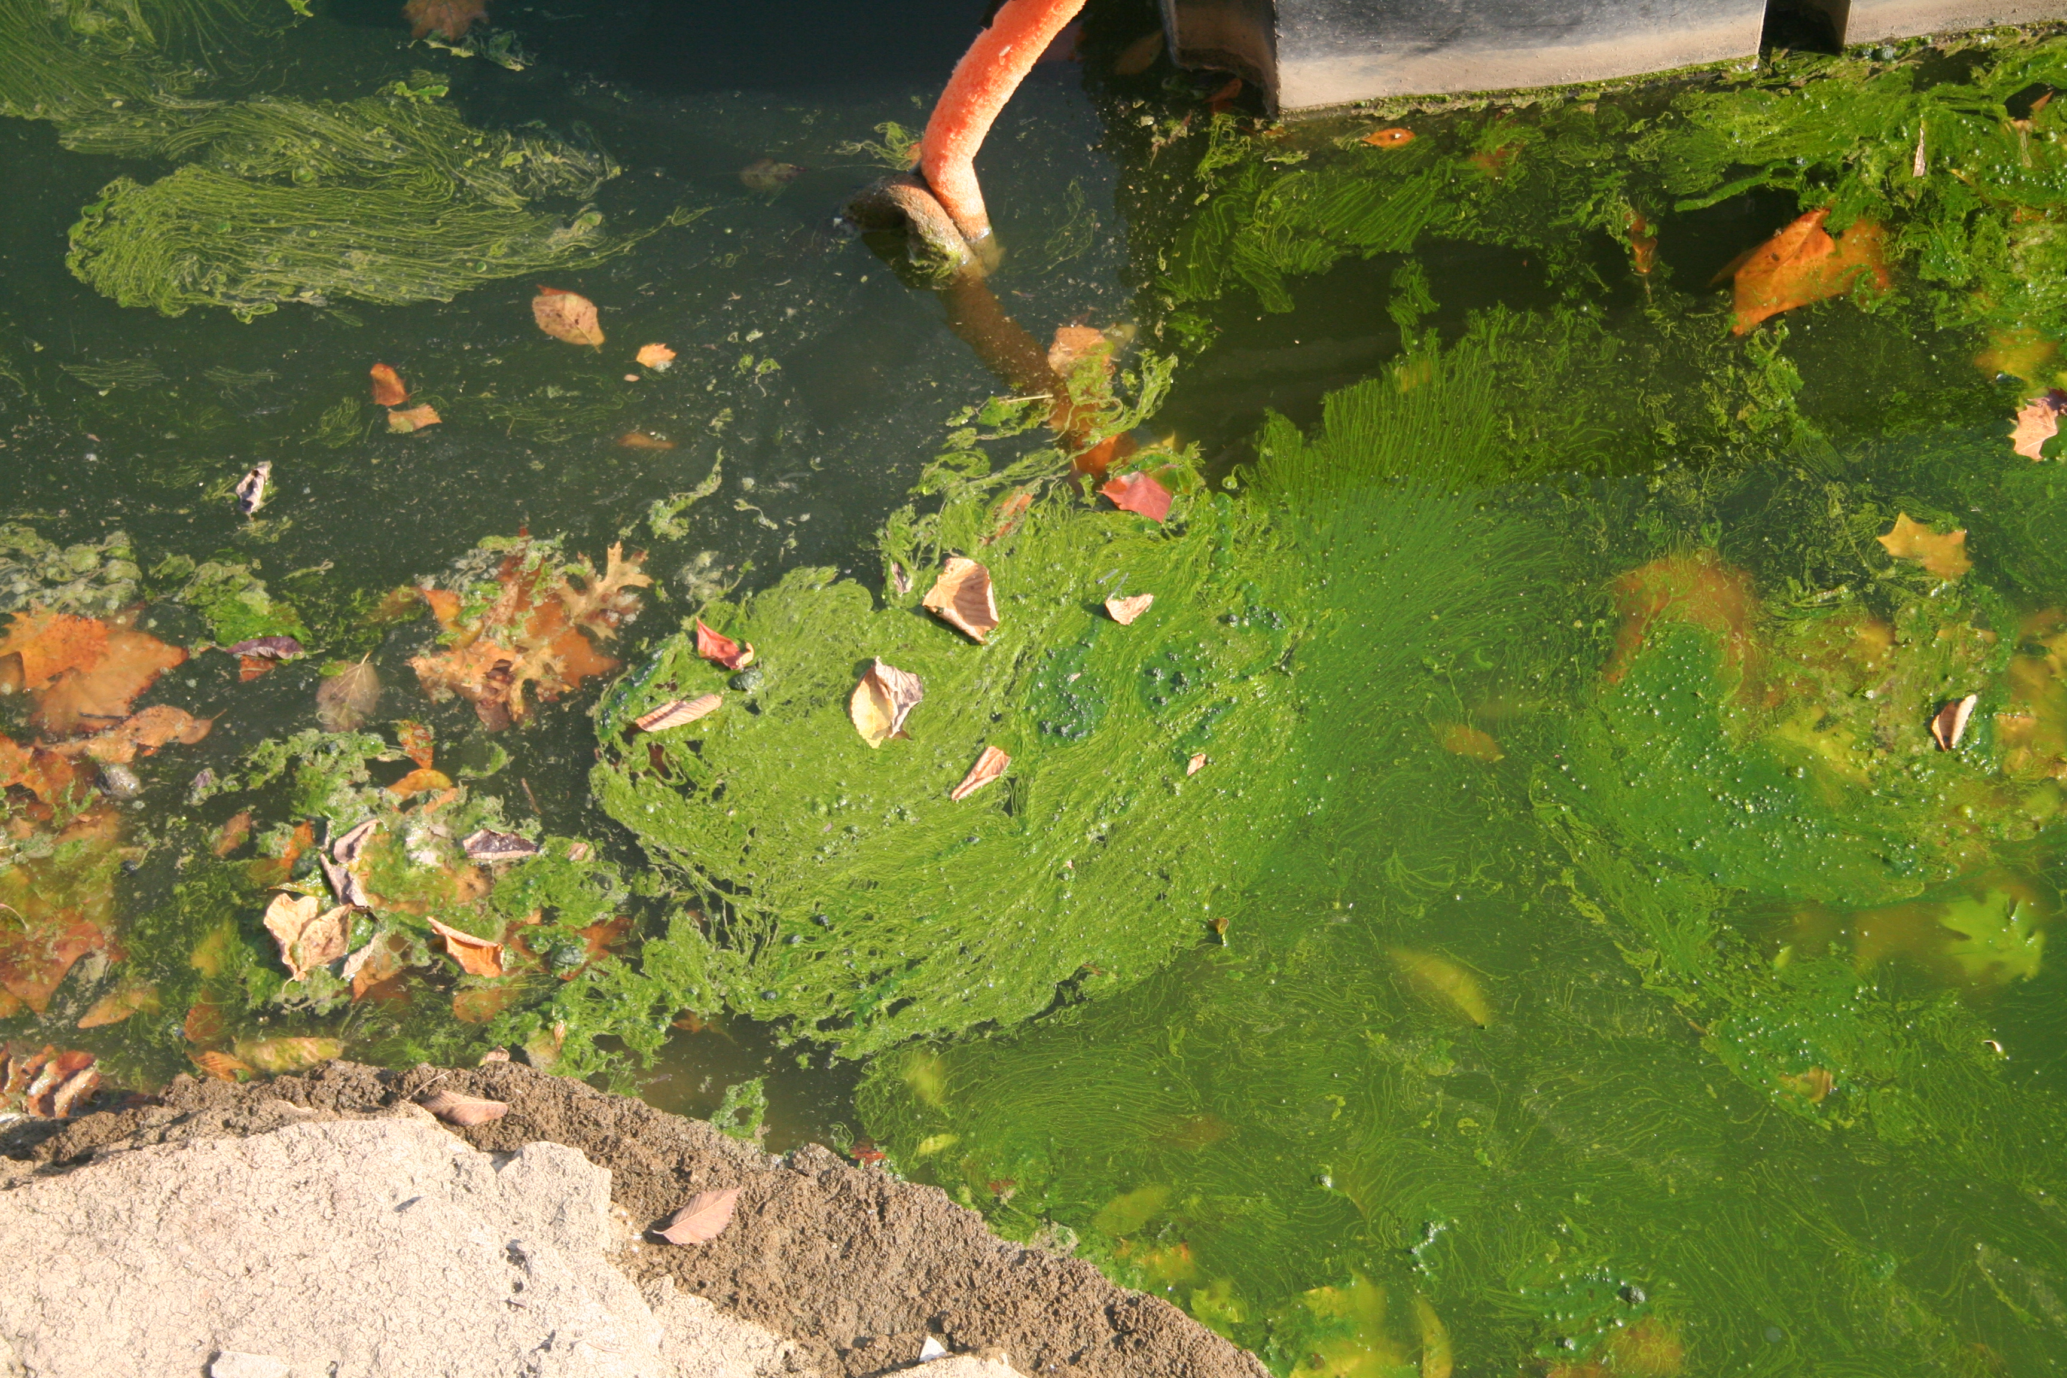
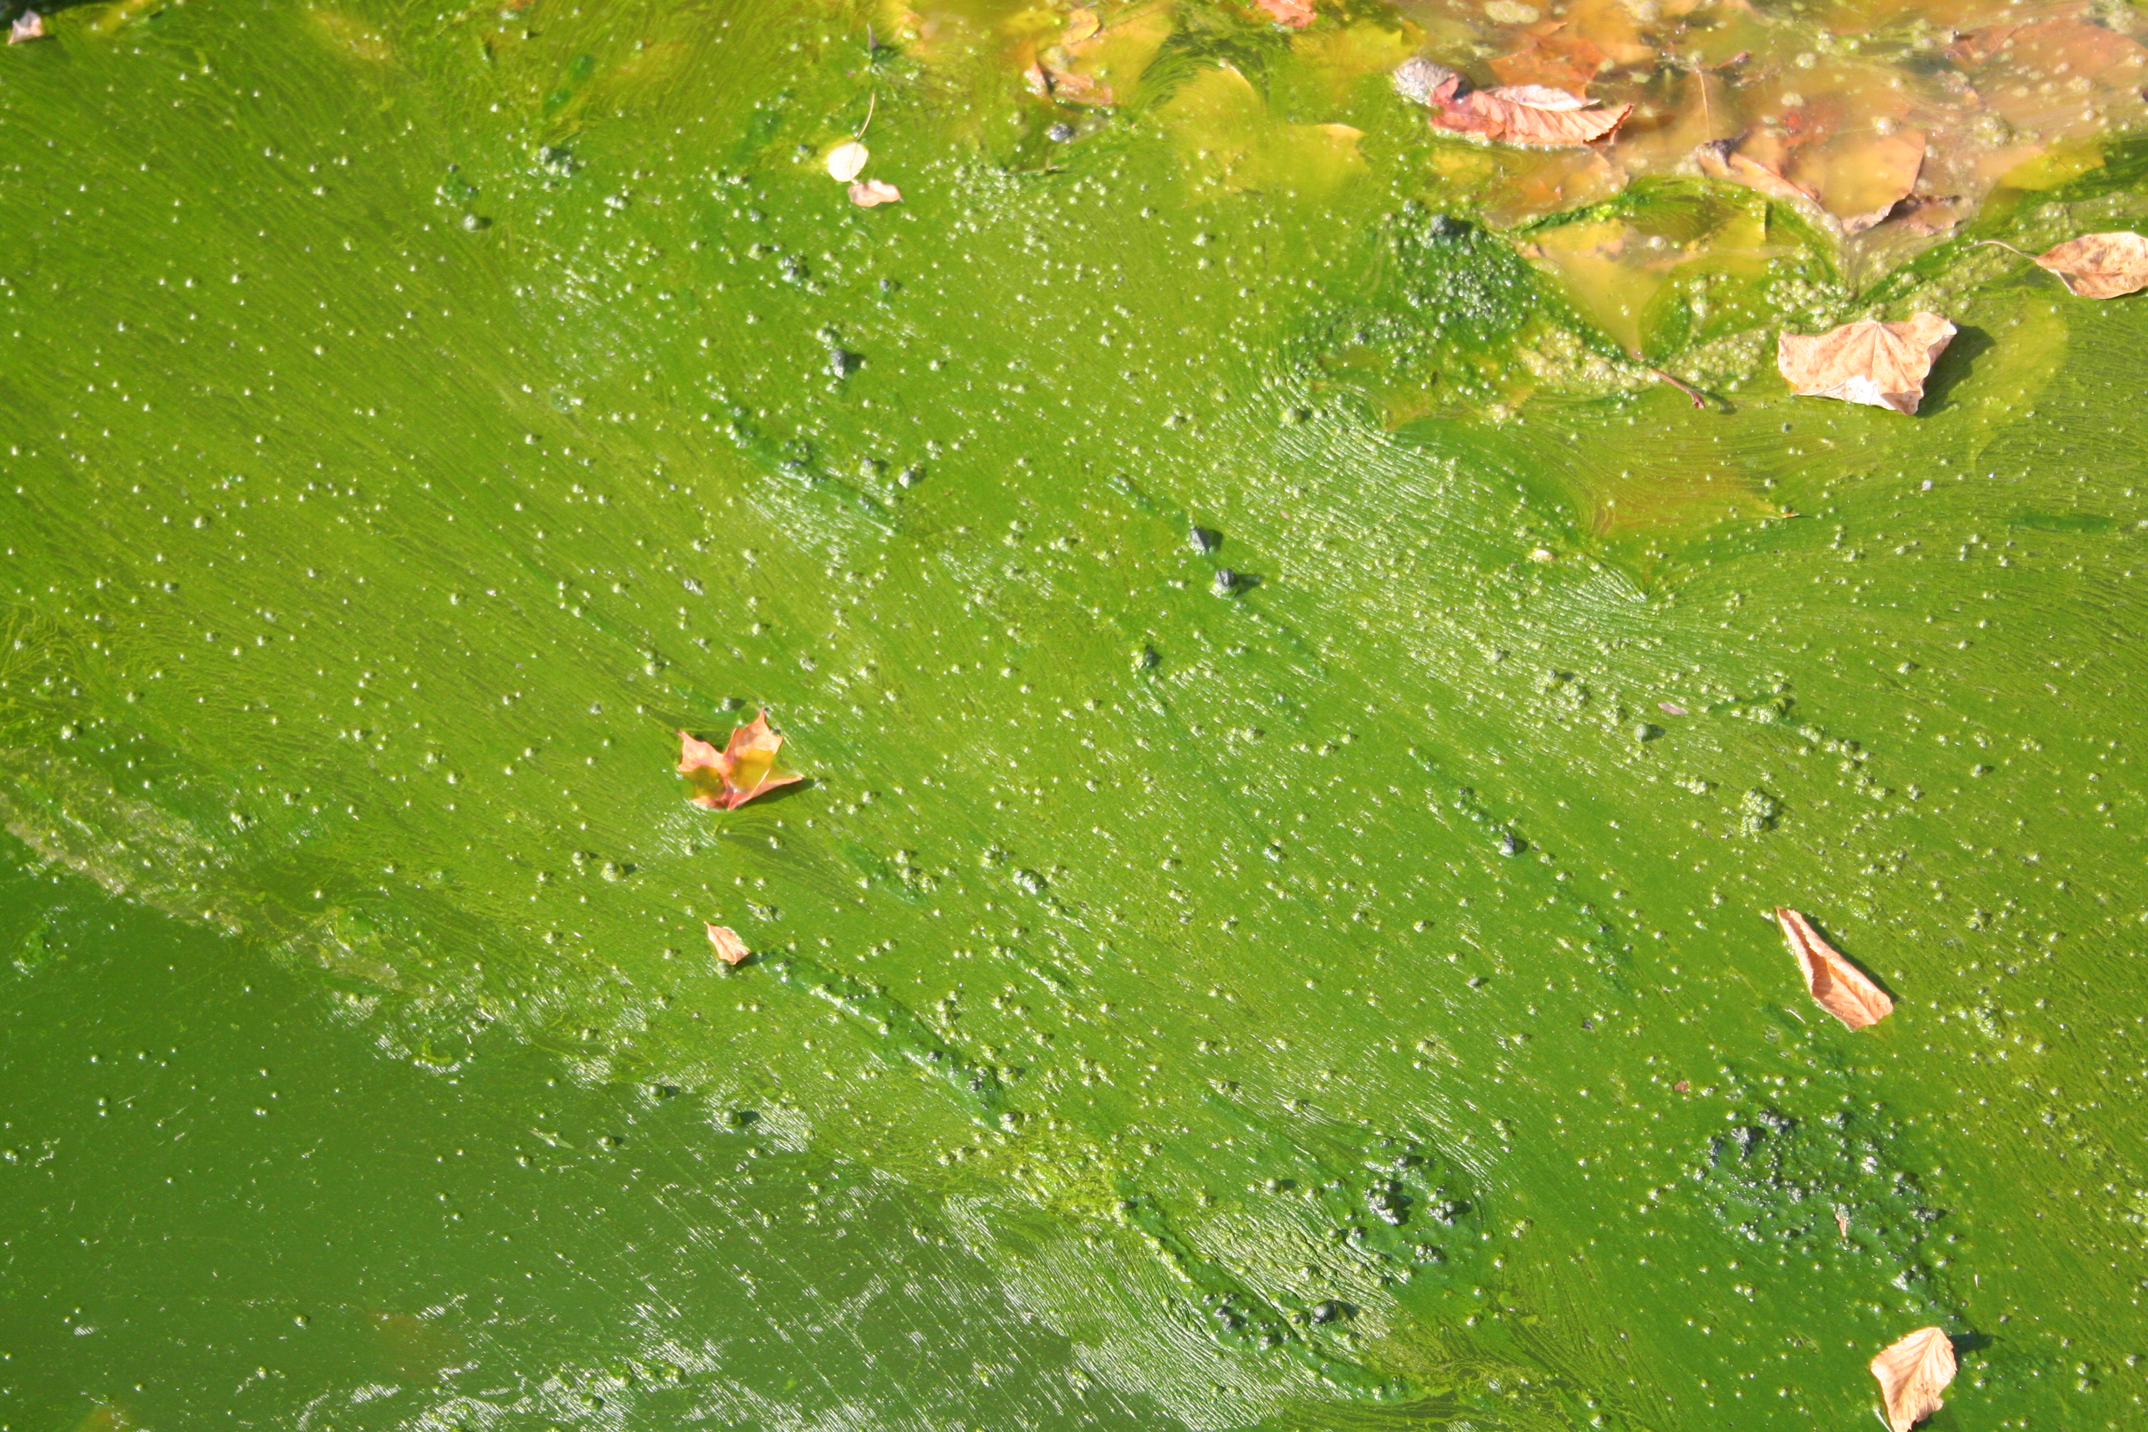
EXAMPLE – Driving Force
Force: Declining water quality in neighborhood creek & receiving lake, as evidenced by monitoring data and increased algal blooms.
Frequent seasonal algal blooms
Notes:
As an example, let’s consider a popular Kentucky reservoir that consistently shows very high levels of algae productivity in the late summer or early fall. Some of these are suspected of being of the blue-green variety that may produce toxins that are harmful to humans and other animals, and it is believed that high nutrient concentrations in one the lake’s major tributaries may be stimulating these algal blooms.
This lake is also used as a drinking water supply for most residents in the area, which is of added concern.
In addition to providing opportunities for boating, swimming and fishing, many people have purchased homes around the lake for its scenic qualities.
So, the increased algal blooms are the driving force in this example.
Along the way you may discover other interests and issues, but it is important to keep the main motivating issue in focus.

Slide 8
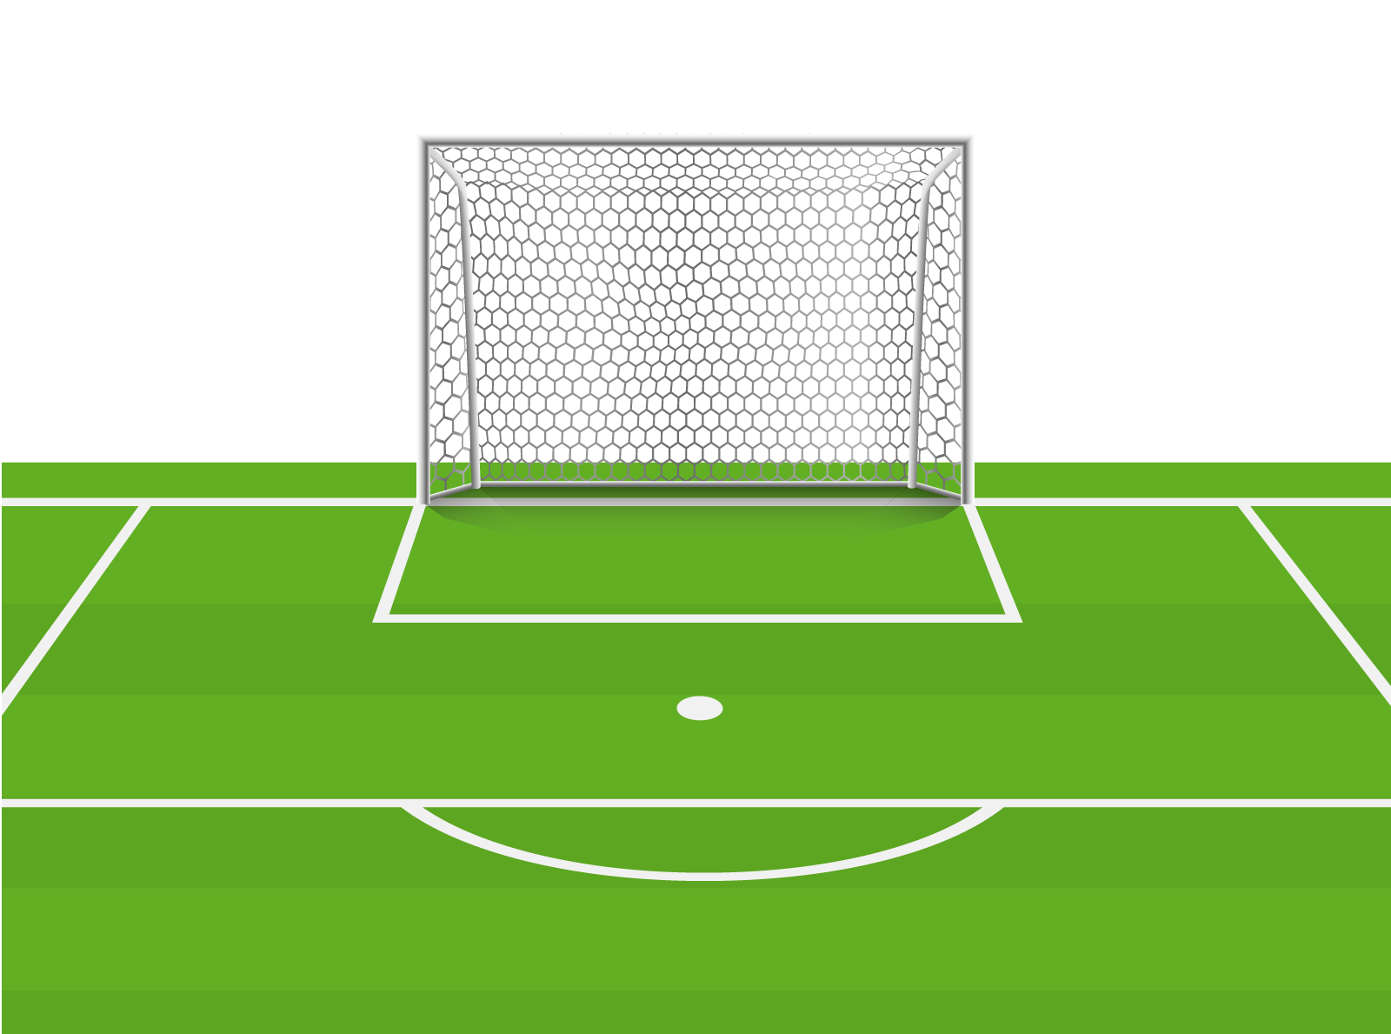
Move on to the GOALS.
These are general statements that express the broad focus of your efforts.
How are we going to address the driving force?
Notes:
Some examples of goals:
Characterizing and resolving an existing problem (e.g., flooding, water quality violations).
Protecting important recreational or habitat resources.
Developing a shared community vision of improvement
Evaluating implementation success
Your goals can be developed at any time in the planning process – whether you have a group or not. They may change along the way as you adapt to the growing movement and new information.
And, sometimes, you may have to take a step back and adjust if your stakeholder support changes or if partnerships change.

Slide 9
EXAMPLE - Goals
Goal 1: Form a group of stakeholders to address the algal blooms.
Goal 2: Identify potential nutrient sources to reservoir.
Goal 3: Develop an awareness campaign to help inform community about the problems, causes, and solutions to the algal blooms.
Goal 4: Encourage actions that can reduce the algae problem.
Notes:
Your goals will provide an overall vision of what you would like to achieve without specifying how to achieve it. They are not specific or measurable.
The goals listed here are primarily outreach-based, but if you have a watershed plan, the goals should correspond with that plan’s implementation goals.
Goals from Example - READ

Slide 10
Create OBJECTIVES to achieve your goals.
HELPFUL TIPS:
You’ll probably need several objectives for each goal you are trying to achieve.
Keep the desired outcome in mind when forming your objectives.
Keep objectives as specific as possible with a time element.
Be mindful of future need for evaluation/refinement.
Specific
Measurable
Achievable
Relevant
Time-focused
Notes:
To make goals achievable, you will need objectives.
Probably will need several for each goal
Keep desired outcome in mind
Make them as specific as possible
Be mindful of future need to evaluate and refine them
The acronym SMART helps to define what makes a good objective.
Specific – Objectives help you narrow down what you are seeking to accomplish. They should be simple and sensible.
Measurable – You need to be able to measure progress. Objectives should include “how much” and “how many.”
Achievable – The objective is not visionary, or overly ambitious (this can hinder progress), but can be realistically accomplished.
Relevant – Goals need to be worthwhile, timely, and well-matched to the needs. The action should match the context.
Time-Focused – The objective has due dates or specific milestones for accomplishing steps toward the goal.
Keep an eye on the deliverables as you develop these objectives. What specifically will be your outcomes?

Slide 11
As you progress through your outreach campaign, objectives and activities will change!
Once the target audience becomes more aware of issues,
you can focus more of your efforts toward action.
Ok, we understand the issues…now, what can we do about it???
Notes:
Goals will change, resulting in changes in objectives and activities.

Slide 12
EXAMPLE - Objectives
Goal 1: Form a group to address the algal blooms.
Objective 1 – In next 2 months, identify 3 key stakeholder groups affected by the algal blooms. (possibly marina owners, drinking water plant operators, lakeside homeowners, boating/fishing enthusiasts, etc.)
Objective 2 – Within 3 months, convene a stakeholder meeting to discuss the issue.
Objective 3 – Garner commitment from 2 stakeholder groups to assist with a campaign effort within the next 6 months.
Notes:
Continuing with our example, here are some objectives associated with Goal 1 to form a group.
Some other examples of objectives From EPA Stakeholder Engagement Guide:
• Identify, engage and involve relevant stakeholders.
• Characterize land uses and land management practices in the watershed.
• Assess land use/management practices on fish habitat.
• Identify activities and/or areas that significantly contribute to sediment loading.
• Identify land use/management practices that might exacerbate flooding.
• Assess cyclically flooded properties to determine impacts and possible options.
• Develop management strategies targeted at reducing flooding impacts, sediment and habitat degradation.
• Identify resources to implement the selected management strategies.
• Evaluate the success of implemented actions; adapt as necessary.

Slide 13
Objectives vs Behaviors?
Objectives:
SMART Specific, measurable, action-oriented, relevant, and time-focused) ways to achieve your goal(s)
Behaviors:
The behaviors, tasks, or actions that must be achieved or performed in order to accomplish the objective(s)
Notes:
There may be some overlap between objectives and the behaviors you are hoping to influence. When forming your objectives, try to distinguish them from the discrete behaviors needed.
Here are the differences between the objectives and behaviors (Read).
Later, we will be brainstorming possible behaviors to achieve the objectives.

Slide 14
EXAMPLE – Objectives and Behaviors
Objective:
Reduce nutrient runoff from residential areas by 10% over 5 years.
Related Behaviors:
Pick up pet waste
Reduce fertilizer application from twice/year to once/year
Plant streamside vegetation to filter out nutrients
Have septic systems inspected every 3 years and pumped as necessary
Leave grass clippings on the lawn
Plant native plants that require less fertilizer
Notes:
Here is our example with an objective and related behaviors.

Slide 15
ACTIVITY: Building Blocks Worksheet
Are the objectives consistent with your goals?
Are they specific, with time frames and measurable outcomes?
Will the objectives be understood and accepted by the people affected?
Will I be able to evaluate whether they were accomplished?
Do I have the resources needed to accomplish the objectives?
Notes:
Now, you can start using this Building Blocks Worksheet Activity to think through your driving force, goal and objectives.
When developing your objectives, it might be helpful to think through some of the questions highlighted in yellow.
You may also want to begin to prioritize your objectives and the sequencing of how they are carried out.
Later, we will be discussing ways to evaluate your outreach campaign. So, it’s a good idea to start building in ways to assess each step of the process, This will help you adjust and stay on track to meeting your goals.
Please take the next 5 minutes to fill in the first three sections of this worksheet, using either a real or imagined scenario.

Slide 16
Which behaviors should you focus on promoting?
What’s easiest to link to the problem?
What’s likely to be most acceptable?
What behavior is likely most sustainable?
What might have the most water quality benefits?
Notes:
Now that you’ve taken some time to think through your force, goals and objectives, here are some of the questions you might consider when refining your list of related behaviors to promote.
Greatest reduction?
Most affordable to promote?
Most affordable to adopt?
Most acceptable to community?
Easiest to link to the problem?
Most sustainable?
Additional water quality benefits?
Highest consumer response?
Fewest barriers?
Later, after we’ve selected our target audience, we’ll rank the proposed behaviors to help make final selections.

Slide 17
Community-Based Social Marketing
Social marketing is an approach to enabling sustainable behavior through direct understanding and contact with people at the community level.
Do I really understand my target audience and see things from their perspective?
Am I clear about what I would like my target audience to do?
For my target audience, do the benefits of doing what I would like them to do outweigh the costs or barriers to doing it?
Am I using a combination of activities in order to encourage people to achieve the desired action?
Source: National Social Marketing Centre
Notes:
Community-based social marketing is an approach to enabling sustainable behavior through direct contact with people at the community level. Doug McKenzie-Mohr has pioneered the use of CBSM to promote sustainable behavior change and has a book about it that is available online – Fostering Sustainable Behavior: An Introduction to Community-Based Social Marketing.
Social marketing helps ensure that your approach is based on an understanding of people’s daily lives so that it is more realistic and achievable.
CLICK - READ BULLETS
The goal of social marketing is always to change or maintain how people behave – not what they think or how aware they are about an issue. If your goal is only to increase awareness or knowledge, or change attitudes, you are not doing social marketing.
It also helps you target resources cost-effectively and select ways to advocate for changes that will have the greatest long-term impact.
Resources:
National Social Marketing Centre, https://www.thensmc.com/content/what-social-marketing-1
Source: Fostering Sustainable Behavior: An Introduction to Community-Based Social Marketing, Doug McKenzie-Mohr

Slide 18
The Social Marketing Approach
#1 Select Behavior to Change
#2 Identify Barriers and Benefits
#3 Develop Strategy
#4 Pilot the Strategy
#5 Implement the Strategy Broadly
Behavior should be indivisible and achieve the desired end-state
Use Research, Observation, Focus Groups, Surveys
Focus on Commitment, Social Norms, Social Diffusion, Prompts, Communication, Incentives, Convenience
Identify and resolve issues
Note prior participation levels for comparison. Communicate progress!
Notes:
The social marketing approach utilizes these steps to change behaviors. This approach is somewhat embedded in the watershed outreach campaign process that we are describing.
Step 1: Select a behavior to change.
Step 2: Identify barriers and benefits associated with the behavior. – perceived or actual by the target audience
Research – see if anyone has attempted to change this behavior before, how have they gone about it, what was successful
Observe – watch people engaging in the behavior or choosing not to
Focus groups – gather a small group of people from your target audience to discuss the behavior and issues you have selected, make sure to provide an incentive to participate (food or other reward). Separate people who do participate from those who don’t for the discussion. The goal is to learn why or why not participants practice the desired behavior.
Survey – conduct a survey of a random sample of your target audience to gather further insights (we will discuss this more later in this module)
Step 3: Develop a strategy.
You can focus your approach on different considerations:
Commitment – Beginning with a commitment to one particular action can lead to greater behavioral change. When the commitment is formalized, they are more likely to follow through. This is due to people’s desire to appear trustworthy. Commitments can be formalized through verbal, written, public or group pledges.
Social Norms – Individuals tend to adopt behaviors from other people. Signage can be used to convey desirable actions in positive way (as opposed to using it to discourage harmful actions). Example – picture of person picking up pet waste
Social Diffusion – increase the visibility of behavior adoption with stickers, signage, recognition listings or other notifications
Prompts – use noticeable, self-explanatory reminders to engage in the behavior, these should be as close as possible to the targeted behavior location
Communication – use messages that are “vivid, personal and concrete,” as well as easy to remember. Deliver from credible source. Frame message to focus on what you are losing by not acting, as opposed to what you are saving. “If you don’t compost, you’ll waste money by having to pay more for garbage collection.” vs “You should compost because you will save money on garbage collection fees.”
Incentives – can encourage people to conduct behavior that they might not otherwise do; should be presented when behavior should occur, be cautious about removing incentives since it may reduce motivation
Convenience – make sustainable action less time-consuming or burdensome
Step 4: Pilot your strategy to work out the issues before committing to its broader use.
Step 5: Implement your strategy with the entire targeted audience. Note participation levels prior to marketing efforts so you can make comparisons after. Communicate progress to help build trust and encourage continued adoption of targeted behavior.
Source: “Your Quick Guide to Community-Based Social Marketing, Pennsylvania State University, https://www.sustainability.upenn.edu/sites/default/files/Guide%20to%20Community-Based%20Social%20Marketing.pdf

Slide 19
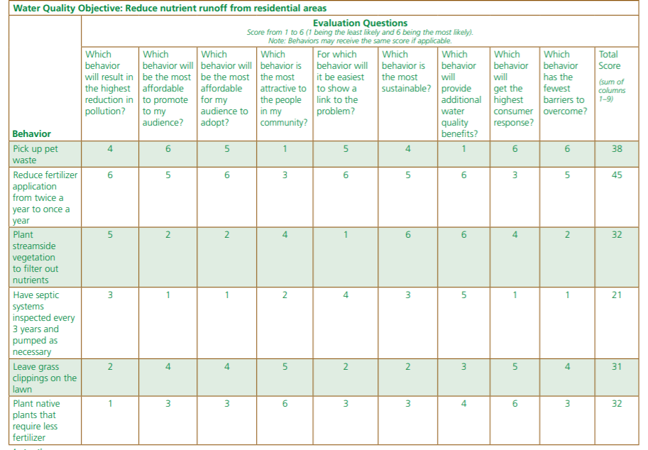
Notes:
Here is an example of a matrix that a group used to determine the most effective ways to help reduce nutrient runoff from residential areas.
The committee used its research to rate different behaviors based on various considerations, with 1 being least likely and 6 being most likely.
Considered behaviors included: picking up pet waste, reducing fertilizer applications form once to twice/year, planting streamside vegetation, septic system pumpouts, leaving grass clippings on lawn, planting native plants that require less fertilizer.
Questions addressed related to each behavior:
Reduction in pollution
Most affordable to promote
Most affordable to adopt
Most attractive in community
Easiest to show link to problem
Most sustainable
Additional water quality benefits
Highest consumer response
Fewest barriers to overcome
It was determined that reducing fertilizer applications to one a year would be the more likely and effective measure to encourage.
For now, we just want to identify some potential behaviors that address an objective. We will not be ready to score these behaviors until we have done the target audience assessment. But this will give you an idea of the complete process.

Slide 20
Message Result
Notes:
In the prioritization process, the group sought to reduce fertilizer applications to once a year and here is the message that the group settled on – simple and memorable.
Studies show that positive messages, like this one, tend to be more effective at changing people’s habits than negative ones.
“Do this,” instead of “don’t do this.”

Slide 21
Activity: Brainstorming Behaviors
1) Take 5 minutes and brainstorm a list of behaviors to accomplish one of your objectives.
2) Work in breakout groups (15 minutes) to help come up with some suggestions for each other’s ideas.
3) Share some questions and observations about the process.

