Slide 1
Watershed Academy
Watershed Coordinator Training Series
The Clean Water Act
2: Monitoring and Assessment

Slide 2

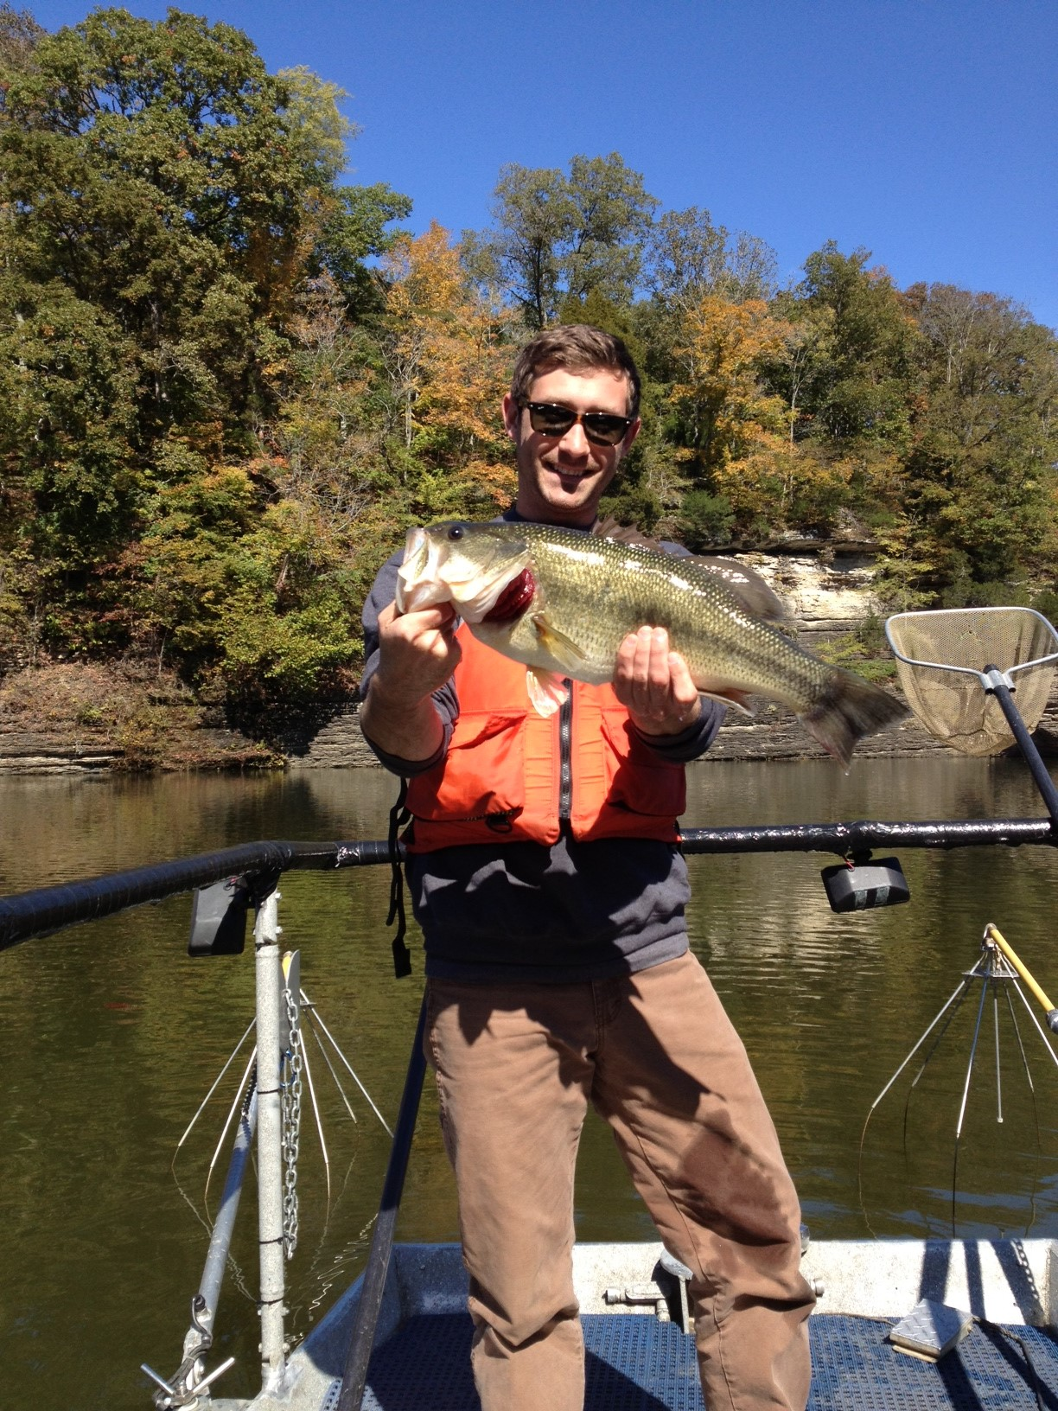
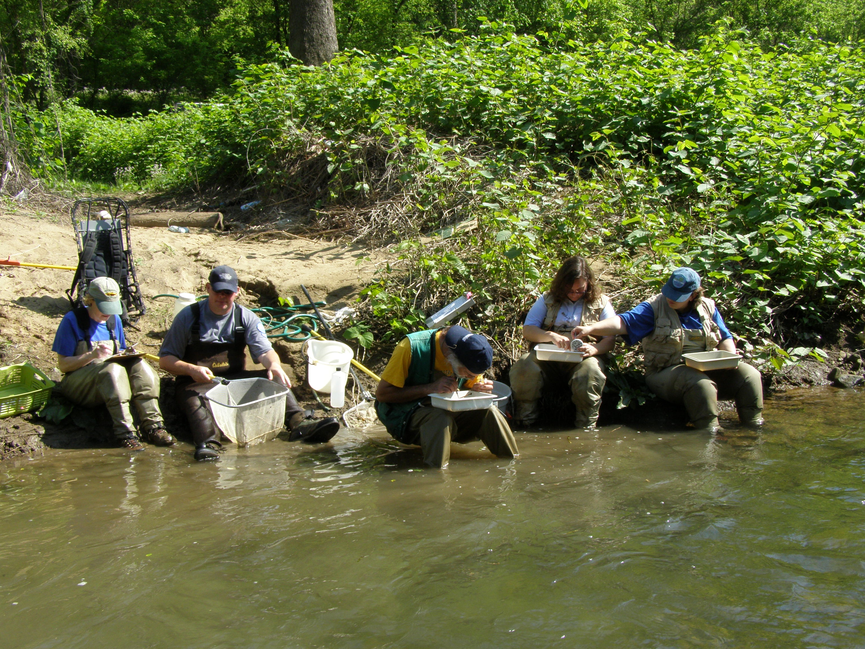
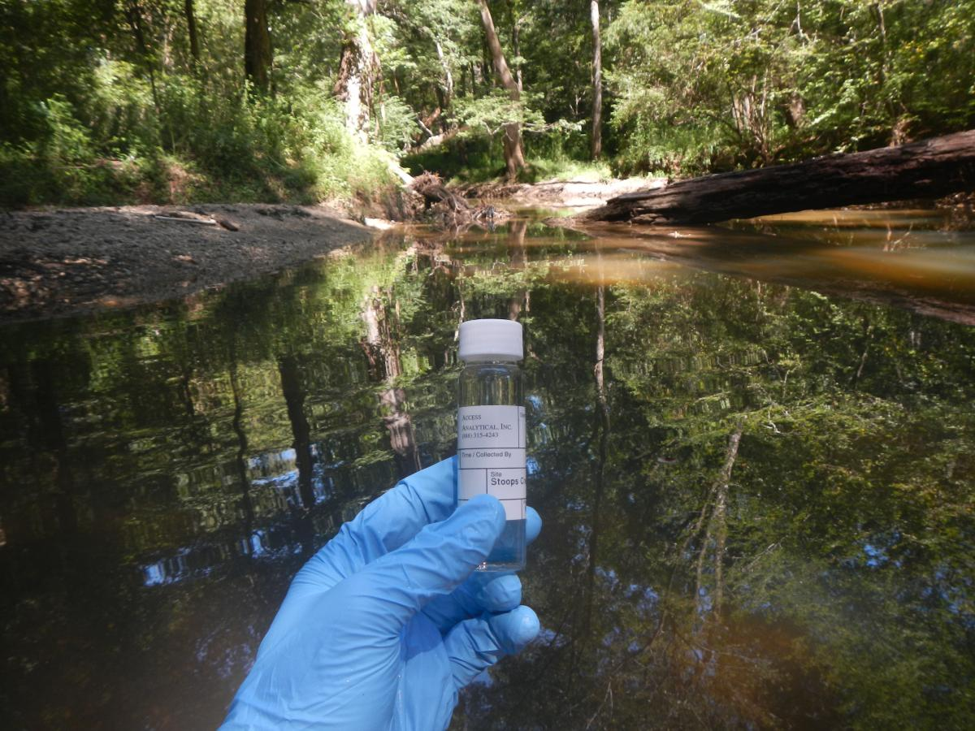
Notes:
When water quality monitoring in Kentucky first began, it consisted of a statewide network of only 45 sites throughout the entire state.
Since the Watershed Management Framework approach was adopted in 1998, the number of monitoring sites have increased and more intensive monitoring has been achieved.
The Division of Water’s Water Quality Branch is responsible for monitoring and assessing the quality of Kentucky’s stream, lakes and wetlands.
Using the data it collects, the Branch staff:
revises water quality standards and criteria,
classifies whether or not a waterbody satisfies its designated uses and
helps develop standards for KPDES permit decisions

Slide 3
Monitoring and Assessment
Overview
Monitoring:
  Ambient
  Probabilistic
  Monitoring for potential advisories for drinking water, recreation, or fish consumption
  TMDL monitoring
Assessment: National Water Quality Inventory
  Overall Assessment of State Waters (305b)
  Listing of Impaired Waters (303d)
  Total Maximum Daily Load (TMDL) Reports
Notes:
Some of the approaches used by the Division of Water to understand and classify Kentucky waterbodies are listed here.
We will be reviewing these different approaches to sampling and assessing water quality.
After describing these monitoring approaches, we will talk about the National Water Quality Inventory reporting.
This combined, or “integrated,” report satisfies CWA Sections 305b/303d requirements to report to Congress every two years.
We will also explain the ongoing Total Maximum Daily Load Reports (or TMDL reports) required from the Division of Water for streams that are found to be impaired.

Slide 4
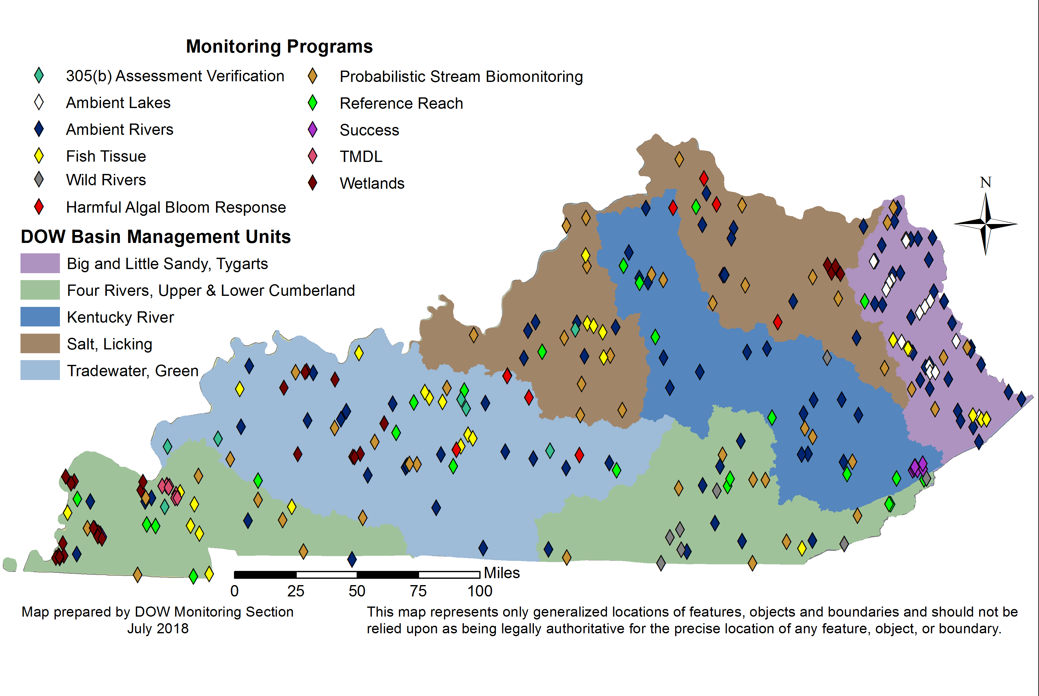
2017 Monitoring Locations
Notes:
This map shows an overview of all types of state monitoring sites throughout the state, with the major river basins shows in different colors.

Slide 5
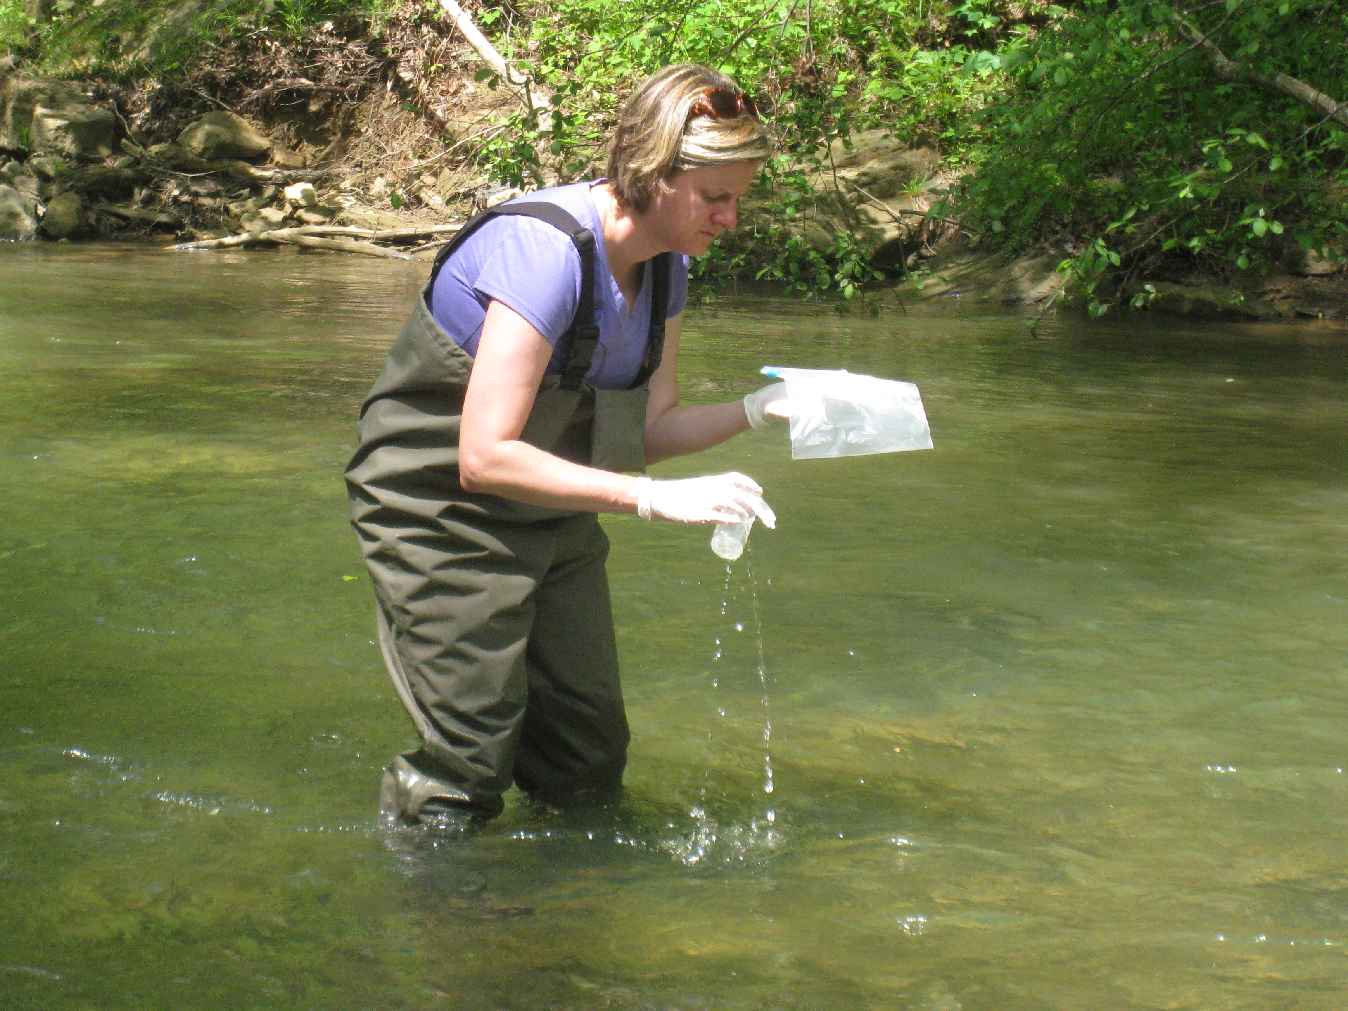
Kentucky DOW Monitoring Programs
Ambient Monitoring
  72 Fixed
  106 (20-25/year) Rotating Sites (as of 2016)
  Includes streams and rivers
  Ambient Lakes are a separate program
Probabilistic Monitoring
  About 50 random sites/year (as of 2018, not including wetlands)
  For Probabilistic Stream Biomonitoring, macroinvertebrates and fish are sampled across the state.
  Probabilistic Wetland Biomonitoring looks at vegetation, amphibians, soil, and other parameters.
Notes:
Kentucky uses two monitoring approaches:
Ambient Monitoring at sites that are consistently sampled to observe general water quality conditions and trends.
The ambient program includes streams/rivers and a separate program of lakes.
Probabilistic Monitoring in which sites are chosen at random to assess the overall health of streams. This is used for a number of reasons:
- It provides data that can be statistically applied to all waters in a basin of similar type for general assessment purposes.
- It is inherently unbiased and provides a representative assessment of the actual conditions of water quality in a basin.
- It provides comparable data trends of the biological health of each basin.
Historically, a basin management framework was utilized to focus sampling on a rotating basis for both ambient and probabilistic monitoring. Since 2016, the ambient river monitoring has maintained a rotating basin component, but there is no longer a basin rotation component to Probabilistic monitoring. Instead there is a statewide approach.
Probabilistic stream monitoring of macroinvertebrate populations at about 50 randomly selected sites statewide each year. This type of sampling takes place on boatable, wadeable, and headwater streams in order to more broadly characterize aquatic life support for that basin or watershed area. In other words, results are generalized to describe similar stream types within that watershed or basin.
There is also probabilistic monitoring of wetlands that assesses amphibians, soil, and other parameters.

Slide 6
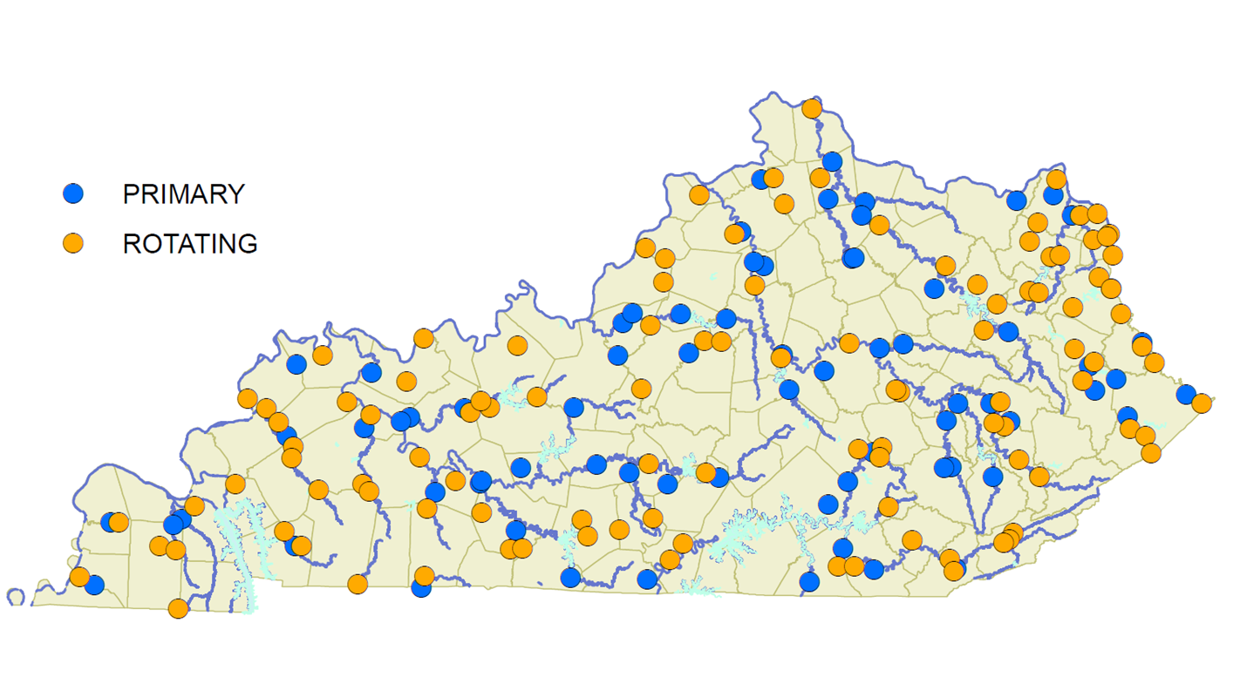
Ambient Rivers Monitoring
Notes:
Primary, fixed stations (in blue) are sampled every year, if possible.
Rotating stations (in yellow) are sampled during the year of focus for that particular “basin management unit.” Thus, they should be sampled every 5 years.

Slide 7
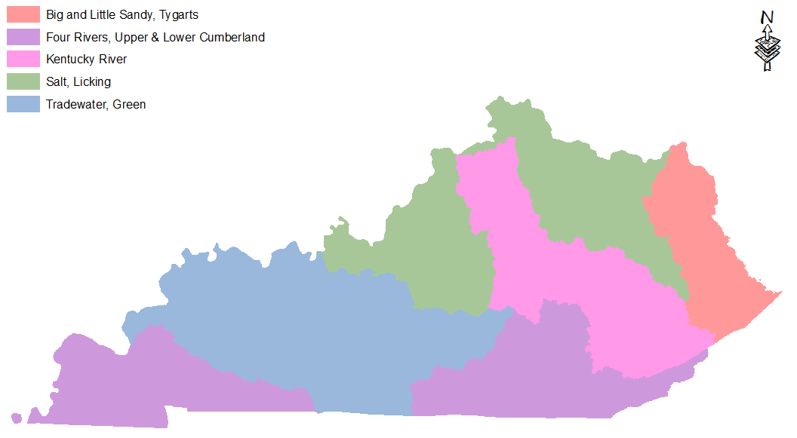
Ambient Rivers Monitoring
Framework 5-Year Rotation
2
2
5
1
4
3
3
Notes:
The rotating “Basin Management Unit” (BMU) cycle follows this sequential order.
1) Kentucky River Basin
2) Salt and Licking River Basins
3) Tennessee, Mississippi and Cumberland River Basins
4) Green and Tradewater River Basins
5) Big and Little Sandy and the Tygarts River Basins (eastern KY)

Slide 8
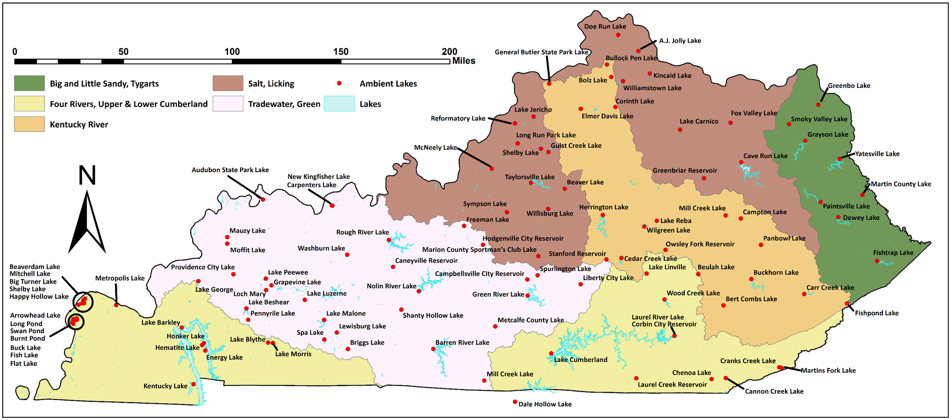
Ambient Lake Monitoring Locations
Notes:
This map shows the locations of all lakes that are sampled through Kentucky’s Ambient Lake Monitoring Program. The Division of Water’s Water Quality Branch is responsible for this effort.
In 1981, Kentucky created a lakes monitoring program that would satisfy CWA Section 314 goals to assess all publicly owned lakes in the state. Currently, a total of 108 lakes are sampled, also on the rotating BMU approach. The data is primarily used to determine use support for aquatic life.

Slide 9
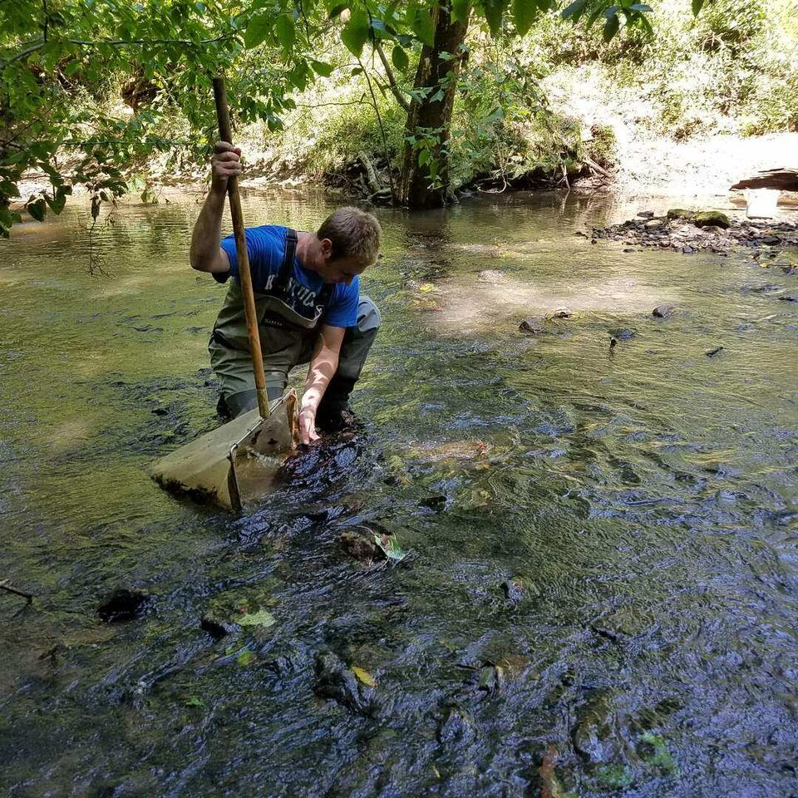
Additional Monitoring Approaches
Reference Reach
  Least disturbed streams
Fish Tissue Program
  Metals concentrations in fish
HAB (Harmful Algal Bloom) Response Program
  Health advisories for toxin concentrations
TMDL
  For developing Total Maximum
  Daily Load documents
Intensive Monitoring
  Area-concentrated monitoring
Notes:
Other types of water quality assessments are conducted by Division staff.
Reference Reach Program - In 1991, the Division also began collecting and summarizing data from least-disturbed streams in order to develop appropriate, regional bioassessment criteria.
The physical, chemical and biological analysis of these least-impacted streams in a bioregion provides benchmarks for the conditions that are naturally attainable in each bioregion.
TMDL sampling is necessary to help assess the pollutant concentrations and loading in a stream system, so that an accurate TMDL report can be developed. More about TMDLs to come, but it has to do with creating a “pollutant diet” for a stream so that its water quality meets minimum standards.
Intensive monitoring is sometimes needed to gain a more in-depth understanding of water quality in specific waterbody areas of interest or concern.

Slide 10
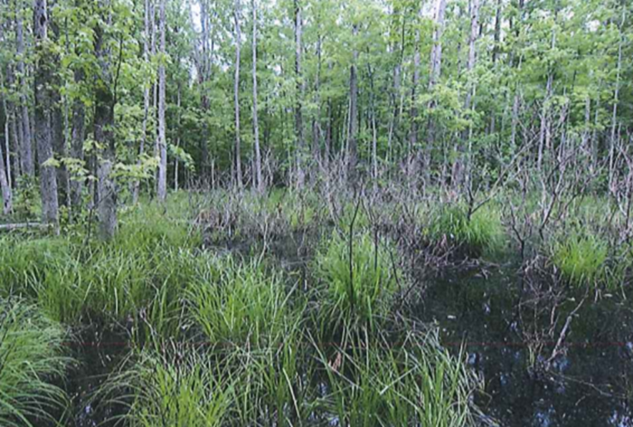
Additional Monitoring Approaches
Success Monitoring / Nonpoint Source
  Regular sampling in targeted locations
Wetlands
  Baseline characterization
Groundwater
  ambient and rotating groundwater quality sites
Notes:
Success monitoring is used to verify that best management practices are enabling water quality improvements.
Ideally, this type of targeted monitoring will demonstrate that management efforts have improved a waterbody’s condition to levels that meet attainment of its designated uses.
This will allow for 303d de-listings, which are noted as a success by the USEPA.
Nonpoint source monitoring techniques are similarly used to show whether of not NPS management approaches are decreasing runoff pollutant contributions.
Wetlands monitoring and assessment is also being conducted by DOW to establish a baseline in wetlands extent, condition and function, and to characterize trends over time.
Once these goals are better achieved, DOW plans to develop wetland-specific water quality standards and designated uses. Eastern Kentucky University is assisting with the development of vegetation and amphibian indices of biotic integrity for wetlands assessment.
Groundwater monitoring is conducted by the Division of Water and others, such as the Kentucky Geological Survey, to assess water quality parameters and note changes or issues. Frequently, monitoring well sites are used to collect samples and die-tracing is used to determe flow paths.

Slide 11
Using Monitoring Data to Make
Water Quality Assessments
Designated Use Attainment Decisions

Slide 12
Assessment (Chemical)
Evaluating Use Support
Pollutant Type | Measure | Fully Supporting | Partially Supporting | Non-Supporting
Nontoxic parameters (i.e. dissolved oxygen, pH, temp) | % samples exceed criteria | <10% | 10-25% | >25%
Toxic parameters (i.e. most metals) | Number of exceedances (quarterly) | <1 in 3 years | >1 in 3 years, <10% | >1 in 3 years, >10%
*These are general trends. Assessments are parameter dependent
Notes:
One set of criteria for water quality assessment is the basic physical and chemical conditions. This includes parameters with numeric criteria such as temperature, pH, and dissolved oxygen
An assessed water’s support categorization is based on frequency of samples meeting the criteria.
For example, if a stream’s dissolved oxygen readings are above the acceptable threshold of 5 mg/l in at least 90% of the samples taken, it is in “full support” of its associated aquatic life use.
Kentucky also has water quality standards for metals concentrations, such as iron, lead, and arsenic. These fall under the category of Toxic Pollutant Criteria
In order to fully satisfy designated uses, no violations are allowable with quarterly sampling and only one sample can exceed the metals standard with a monthly sampling frequency.

Slide 13
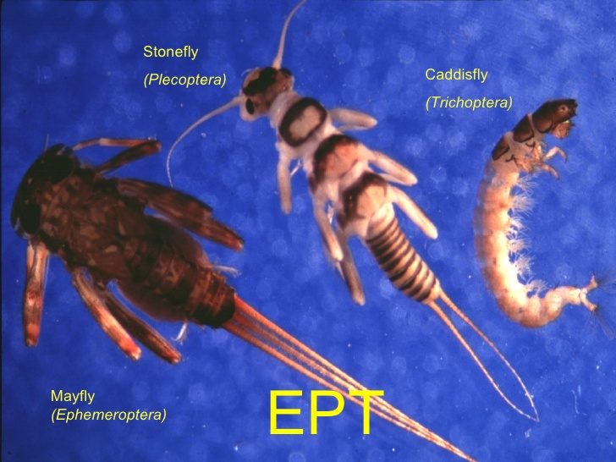
Assessment (Biological)
Evaluating Use Support
Pollutant Type | Fully Supporting | Partially Supporting | Non-Supporting
Macroinvertebrate Biotic Index (MBI) | Excellent or Good, EPT Good | Fair | Poor
Fish, Index of Biotic Integrity (IBI) | Excellent or Good | Fair | Poor, Very Poor or no fish
Notes:
Kentucky also uses biological assessments for water quality, including evaluations of algae, macroinvertebrates and fish.
These assessments incorporate many different observations and factors and results in an index rating of full, partial or non-support for aquatic life support.

Slide 14
Assessment (Recreational)
Evaluating Use Support
E. coli:
  Geomean Criteria: Cannot exceed a geomean of 130 CFU/100 mL (May 1 thru Oct 1) of at least 5 samples in a 30 day period
  Instantaneous Criteria: 240 CFU/100 mL (May 1- Oct 1)
Pollutant Type | Fully Supporting | Partially Supporting | Non-Supporting
E.coli | Not exceed 240 in >20% of samples | Not exceed 240 in 20 to 33% of samples | Not exceed 240 in >33% of samples
pH | Between 6 and 9 |  | <6 or >9
Notes:
In order to evaluate the safety of waterbodies for recreational uses, such as swimming, boating and fishing, the Division of Water samples both bacteria concentrations (E. coli or fecal coliform) and pH levels.
For bacteria assessment, samples are collected during the recreational season of May through October, and ideally 5 samples are collected within a 30-day period. The geometric mean (a type of average) helps moderate wide fluctuations often observed with bacteria counts.
CFU = colony forming units, used as a way to assess E. coli concentrations in the lab
In order to support the primary contact recreation use, water pH should be greater than 6 and less than 9. Otherwise, the waterbody is considered in non-support of this use.
Partially supporting if less 10% of samples exceed the normal range
Non supporting if more than 10% exceed normal range

Slide 15
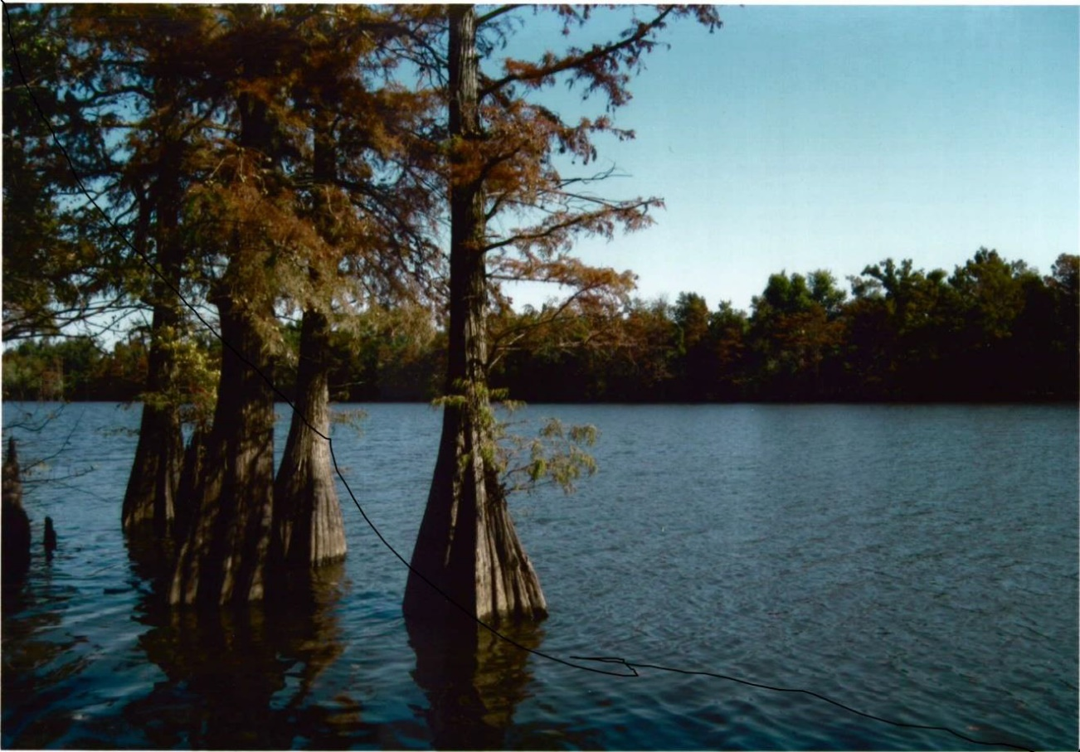
Assessment Report
Integrated Report to Congress
on the Condition of Water Resources
in Kentucky
VOL 1:
305(b)
Assessment
Results
VOL 2:
303(d)
List of
Impaired
Waters
Notes:
Water quality assessments are summarized in a report to congress, which is required every 2 years.
Kentucky now uses a combined (or integrated) report that includes satisfaction of 305b requirements to report water quality assessment findings and 303d requirements to submit a list of waterbodies that do not meet associated water quality criteria.

Slide 16
Category | Definition
1 | All designated uses for waterbody are Fully Supporting.
2 | Assessed designated use(s) is/are Fully Supporting, but not all designated uses assessed.
2B | Segment currently supporting use(s), but 303(d) listed & proposed to EPA for delisting.
2C | Segment with an EPA approved or established TMDL for the following use(s) now attaining Full Support.
3 | Designated use(s) has/have not been assessed (insufficient or no data).
4A | Segment with an EPA approved or established TMDL for the following listed use(s) not attaining Full Support.
4B | Nonsupport segment with an approved alternative pollution control plan (e.g., BMP) stringent enough to meet full support level of all uses within a specified time.
4C | Segment is not meeting Full Support of assessed use(s), but this is not attributable to a pollutant or combination of pollutants.
5 | Segment does not support designated use(s) and is impaired by a pollutant or a combination of pollutants. A TMDL is required.
5B | Segment does not support designated uses based on evaluated data, but based on Kentucky listing methodology, insufficient data are available to make a listing determination. No TMDL needed.
Supporting
Unassessed
Impaired
303(d)
Notes:
The 305b report includes a list of all waterbodies that have been assessed for one or more designated uses.
Waterbodies are put into different categories depending upon the assessment decision made for that waterbody.
This table shows the numeric ratings for a variety of assessment categories.
Categories 1 through 2C – considered supporting
Category 3 – waterbody has not been assessed
Categories 4 and 5 – non supporting or impaired
However, only waters in the 5 category are included in the 303d list, because waters in the 4A, 4B and 4C categories are being addressed through a TMDL or other means, or the non-support designation is due to something other than a manageable pollutant source.

Slide 17






Assessment Report
Assessment Categories
Source: 2016 Integrated Report, KDOW
Notes:
This table shows the number of assessed segments per category for each of the designated uses.
Note the large number of segments in Category 3, meaning that not enough information has been collected to perform these assessments.

Slide 18
KDOW: 2016 Integrated Report:
“In Kentucky, there are 90,961 stream miles…of which only 14% have been assessed. The agency considers all unassessed waterbodies to fully support each applicable designated use for regulatory purposes. This resource management practice results in 78,208 stream miles meeting uses for permitting and anti-degradation implementation.”
Notes:
Note that only 14% of the waterbodies in the state have been assessed. This means that the majority of the streams in the state have not yet been assessed. Unassessed waterbodies are assumed to be fully supporting, but the reality is the percentages are probably similar to what has already been assessed.

Slide 19
Assessment of Streams by Designated Use
Some designated uses are assessed more often than others.
  Aquatic life use 13% unassessed
  Drinking water supply use 95% unassessed
Some designated uses have more TMDLs.
  Primary Contact Recreation - 358 assessment units
  Aquatic life - 21 assessment units
  Fish consumption – 1 assessment unit
Source: 2016 Integrated Report, KDOW
Notes:
Of the 14% streams that have been assessed, not all designated uses have been assessed equally.
Some designated uses are assessed for most streams (such as aquatic life use and primate contact recreation), while others are only conducted for select streams (drinking water use).
For example, in the 2016 report, only 13% of the streams that had been assessed were NOT assessed for aquatic life, but 95% were not assessed as a drinking water supply.
Also TMDLs were developed much more frequently for primary contact recreation (358 segments) than aquatic life (21) or fish consumption (1).
So keep in mind that as more streams are assessed for more uses, we will likely find more impairments.

Slide 20







Assessment Report
Table 9. Number of stream or river segments assessed, fully supporting, partially supporting, or not supporting per designated use, with percentages for each attainment calculated.
Designated Use | Total Assessed | Fully Supporting | Partially Supporting | Not Supporting | Impaired | % Meeting | % Partially Supporting | % Not Supporting | % Impaired
Aquatic Life | 2264 | 955 | 695 | 614 | 1309 | 42 | 31 | 27 | 58
Fish Consumption | 132 | 53 | 68 | 11 | 79 | 40 | 52 | 8 | 60
Primary Contact Recreation | 1046 | 217 | 207 | 622 | 829 | 21 | 20 | 59 | 79
Secondary Contact Recreation | 255 | 139 | 24 | 92 | 116 | 55 | 9 | 36 | 45
Domestic Water Supply | 79 | 79 | 0 | 0 | 0 | 100 | 0 | 0 | 0
Outstanding State Resource Water | 369 | 310 | 33 | 26 | 59 | 84 | 9 | 7 | 16
2016 Integrated Report, Kentucky Division of Water
Notes:
This table summarizes the 2016 assessments by the number of stream miles or percentage of stream miles.
Note that the designated use with greatest number of assessed miles listed as impaired was for Aquatic Life.
But, the greatest percentage of assessments leading to a non-support categorization was for Primary Contact Recreation.
That's not surprising since NPS and TMDL tend to target these watersheds and, by the nature of their program, seek impaired waters.
While all waterbodies assessed for drinking water use (or domestic water supply), a small number, fully met the criteria for this use.

Slide 21
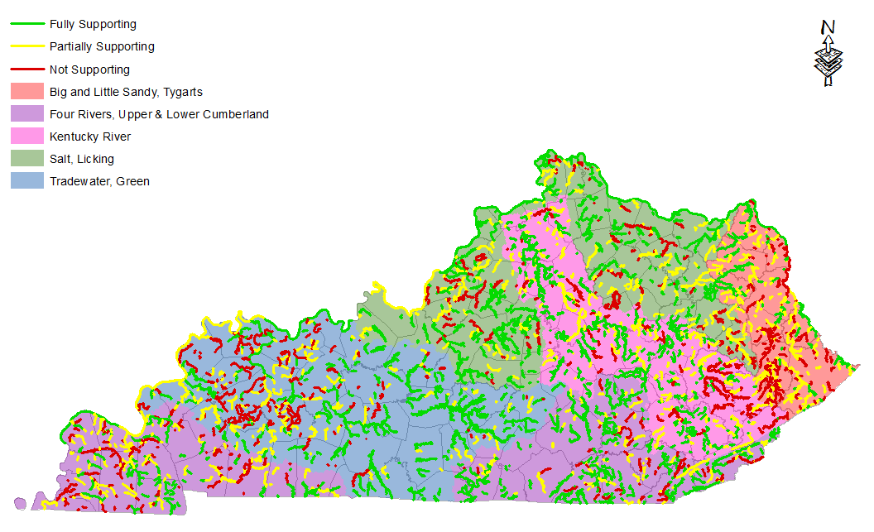

Assessment Report: Aquatic Life
Source: 2016 Integrated Report, KDOW
Notes:
This is a typical map used to display Kentucky’s water quality assessments. This map, in particular, shows which waterbodies fully support (in green), partially support (in yellow) or do not support aquatic life, based on the associated water quality criteria.

Slide 22
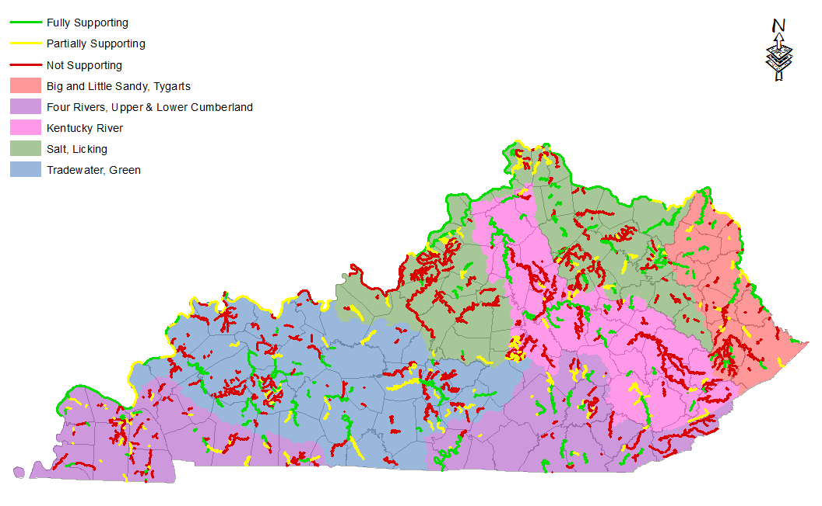

Assessment Report: Primary Contact
Source: 2016 Integrated Report, KDOW
Notes:
This is the same type of map, but for primary contact recreation.

Slide 23
Assessment Report
Impairments: All Uses
Table 10. Top 10 causes impairing streams and rivers statewide for all applicable designated uses.
Cause | Total # of Segments | Total Stream or River Miles
Bacteria | 755 | 4422
Sedimentation/Siltation | 722 | 3419
Nutrient/Eutrophication Biological Indicators | 350 | 1753
Specific Conductance | 221 | 1042
Cause Unknown | 208 | 821
Total Dissolved Solids | 153 | 747
Organic Enrichment (Sewage) Biological Indicators | 141 | 757
Iron | 67 | 475
pH | 57 | 226
Oxygen, Dissolved | 51 | 297
Source: 2016 Integrated Report, KDOW
Notes:
41 different causes are associated with the stream and river impairments in the 2016 report.
This table summarizes the 10 most common causes, with bacteria and sedimentation or siltation being the top two causes by a significant margin.

Slide 24
What is a TMDL?
Number
  T - Total
  M - Maximum
  D - Daily
  L - Load
Analysis to determine the TMDL.
Document that contains a description of the problem, data, and calculations used to determine the TMDL, existing loads, load allocations, load reductions, and Implementation Plans.
Process for restoring polluted waters by determining loads reductions for various point and non-point sources. If implemented, these steps should restore the stream to its designated use.
Notes:
So, when a waterbody is listed as non-supporting of one of its designated uses, a Total Daily Maximum Daily Load report is required.
The procedure for developing a TMDL includes:
Analysis of water quality data to determine the acceptable pollutant load to the waterbody.
The writing of a document that explains the water quality problem and provides the sampling data to verify it.
It also describes the modeling results that help calculate pollutant loading from point and nonpoint sources and the level of pollutant reductions needed.
Finally, it outlines a management process for achieving the necessary pollutant load reductions.

Slide 25
TMDL
“Pollution Diet”
Margin of Safety
subtracted from total to allow for unknown information or calculation errors
Wasteload Allocation (WLA)
maximum amount of pollution that can be released from regulated pipes or ditches (point source pollution)
Load Allocation
(LA)
maximum amount of pollution that can be released from runoff pollution (nonpoint source pollution)
NOTE: Illegal point sources are not allocated a pollution budget
Notes:
A TMDL is sometimes referred to as a “pollution diet” to help people understand the concept.
For this diet, restrictions are recommended from the Wasteload Allocation (WLA) of the pie, or the point source contributions.
WLA are permitted sources – such as wastewater treatment plants, municipal separate storm sewer systems (MS4s), combined sewer systems, or other permitted sources
Restrictions are also recommended for reducing Load Allocation contributions from nonpoint sources, or runoff.
These sources could be wildlife or agriculture or other sources.
An additional Margin of Safety acts as a buffer to ensure that designated use conditions are met.
Illegal point sources, such as sanitary sewer overflows or illicit discharges are not “budgeted” in the TMDL because they are illegal. This is not to ignore that these sources do not contribute to the loading in the stream. Nor does it mean that a community may not achieve healthy levels by focusing on these sources. It simply means there is not an allowance in the budget made for these sources.

Slide 26
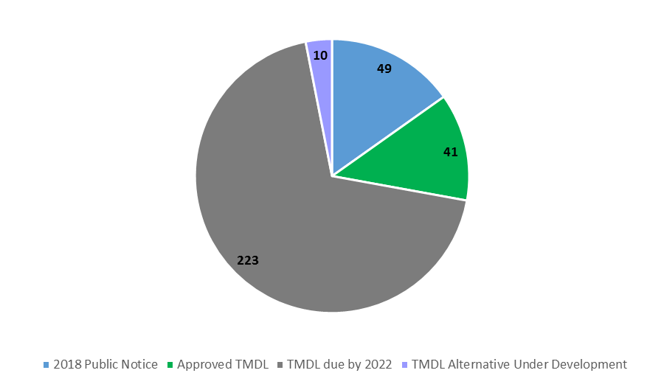
TMDL Status In Kentucky
TMDL Priorities:
49 public notices
41 approved
10 Alternatives
223 due by 2022
Source: 2016 Integrated Report, KDOW
Notes:
In 2011, the EPA and state TMDL program managers developed a new approach for handling TMDLs.
This Program Vision encourages a range of stakeholder support and agency involvement to help achieve water quality standards through a flexible watershed management approach.
In the fall of 2016, the DOW submitted TMDL program priorities, based on the 2014 303d listings.
The pie chart from the 2016 303d report shows how Kentucky stood with regard to these priorities:
223 TMDLs remained due by 2022
49 public notices for TMDL review were issued in 2018
41 TMDLs were approved
10 alternative to TMDLs were developed – this is possible when there are available resources that would be more effective at achieving the TMDL goal of achieving water quality support
The TMDL priorities are being updated with findings from the more recent 2016 report.

Slide 27
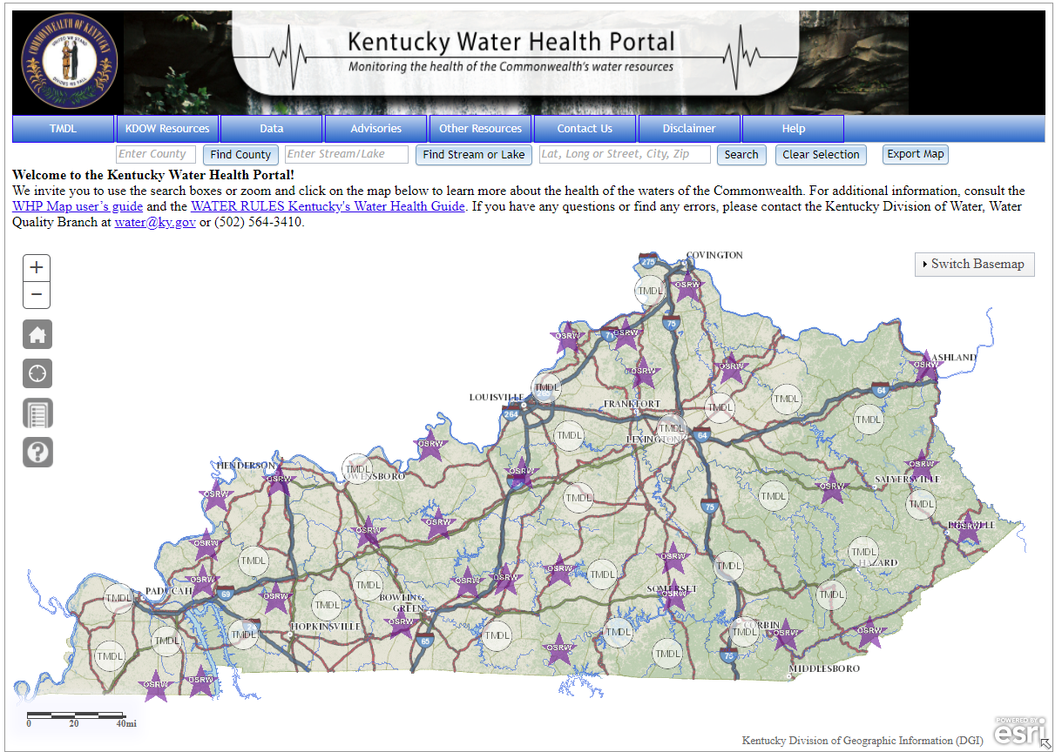
Assessment
http://watermaps.ky.gov/WaterHealthPortal/
Notes:
Kentucky’s Water Health Portal is a publicly available tool for finding water quality information contained in the 305b/303d report.
Thus, it only contains details for assessed waterbodies.
Through a mapping interface or search functions for county, waterbody name or location info, users can search for the health status of their waterbodies of interest.
Streams are color-coded according to the level of support for its designated uses.
When clicked on, a pop-up window shows further details, as well as links to additional information.

Slide 28
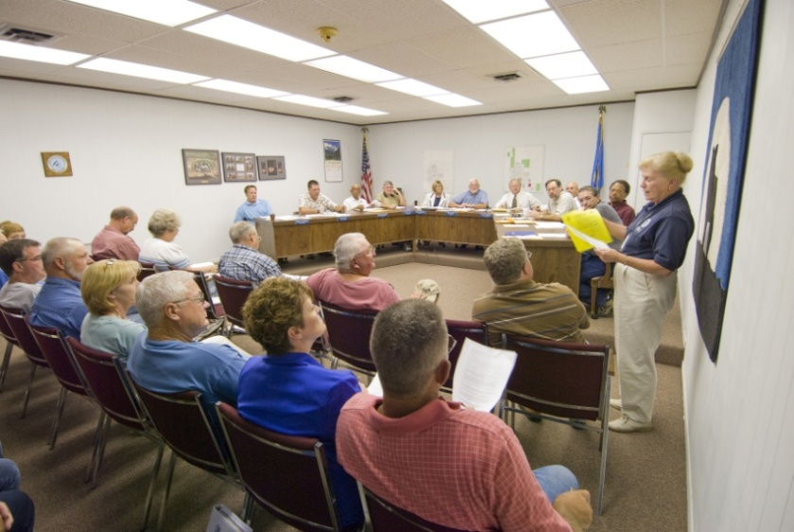
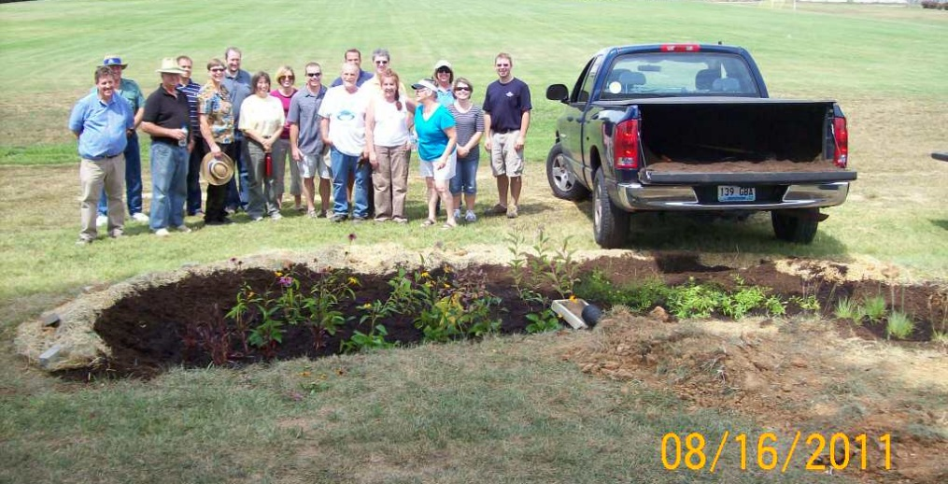
319(h) Nonpoint Source Management Program
  Provides Grants to States to support:
    Education & Outreach
    Demonstration Projects
    Planning
    Implementation

Slide 29
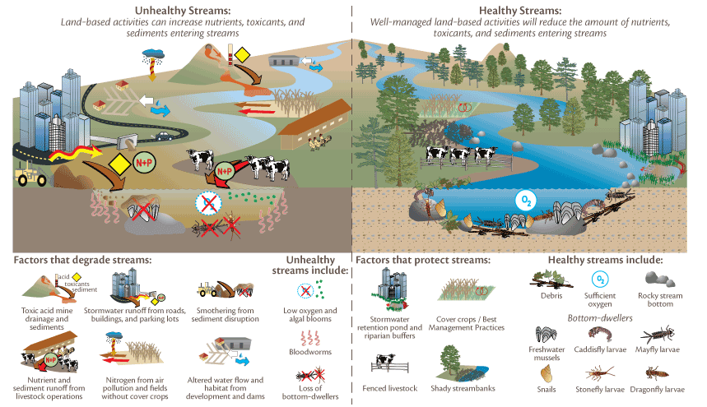
319(h) Nonpoint Source Management
From University of Maryland Center for Environmental Science, ian.umces.edu
Notes:
This graphic provides an overview of the differences between a healthy watershed and an unhealthy one and shows the contributions of various non-point sources.
A watershed based planning process seeks to address all of these sources and recommend ways to better manage land uses for reduced water pollution.

Slide 30
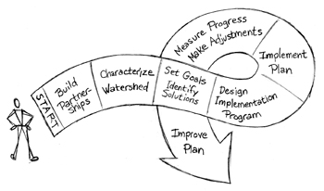
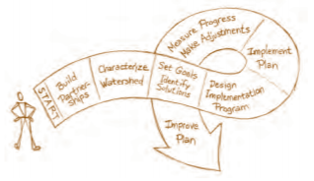
The Watershed Approach to
Planning & Management
Source: USEPA Getting in Step: A Guide for Conducting Watershed Outreach Campaigns
Notes:
This shows the general, cyclical process for developing, implementing and continuously updating and improving the plan.
Partnerships are key to getting started. They help build interest and enthusiasm, impart local knowledge during the plan’s development, and help with conducting the recommended implementation activities.

Slide 31
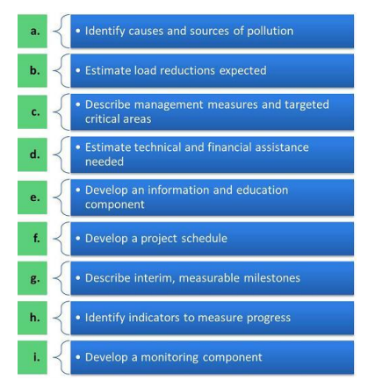
EPA’s
9 Key Elements of Successful Watershed Planning
Notes:
The USEPA requires 9 minimum elements for an acceptable watershed plan.
EPA-approved plans are currently required to receive 319 funding for watershed implementation, or management, activities.

Slide 32
The Watershed Approach to
Planning & Management
a
b, c
d - i
A-I Criteria are largely met in steps 2-4 of the watershed planning and implementation process
Source: USEPA Getting in Step: A Guide for Conducting Watershed Outreach Campaigns
Notes:
This shows the general, cyclical process for developing, implementing and continuously updating and improving the plan.
Partnerships are key to getting started. They help build interest and enthusiasm, impart local knowledge during the plan’s development, and help with conducting the recommended implementation activities.

Slide 33
Watershed Planning Guidebook for Kentucky Communities
  Chapter 1: Introduction
  Chapter 2: Watershed Characterization
  Chapter 3: Monitoring
  Chapter 4: Analysis
  Chapter 5: Best Management Practices
  Chapter 6: Strategy for Success
  Chapter 7: Making It Happen
Notes:
The EPA has its own guidance document for developing watershed plans, but it is lengthy and generalized for the entire country.
In 2010, Kentucky published its own Watershed Planning Guidebook, which condensed and simplified the instructions and made it more state-specific. It is available in printed or electronic copies. The electronic version includes many helpful hyperlinks to additional resources.

Slide 34
319(h) Nonpoint Source Management Program
A Watershed Plan:
  Is a flexible framework for managing water quality and quantity
  Identifies causes and sources of impairment
  Includes strategies to address the most important issues
  Provides an outline for implementation
    Including responsible entities, partners, schedule, resources needed, funding options
  Required for federal 319(h) implementation grant funding
Notes:
In summary….

Slide 35
Set Goals and Water Quality Standards (WQS)
Conduct Monitoring
305(b)
Receiving
Body Modeling
NO
YES
303(d)
Meeting WQS?
Anti-degredation
TMDL
Watershed
Modeling
KY DOW Watershed Branch
UK KCEWM
Point Source
Allocation
Sec 208 River Basin Plans
Non Point Source Allocation
319
Program
Watershed
Framework
Watershed
Planning
Sec 402
NPDES
Sec 201 Facilities Plans
Area Develop. Districts
9 Requirements
5 Stages
6 Steps
USDA/NRCS
e.g. EQIP, WHIP
KY Steering Committee
Watershed
Teams
Wastewater
KY Infrastructure
Authority
Discharge Monitoring Reports
Permit Compliance System
KY River Basin Coordinators
Watershed Plans
State Revolving Fund
Notice of Violation
Agreed Order
Basin Teams
CSOs
9 Minimum Controls
Wastewater
Facility
Industrial
KY Ag Water Quality Act
Watershed Watch of KY
Basin Watershed Watch
MS4
6 Minimum Controls
Construction
Ag WQ Plan
Citizen Action Plans
CAFOs
Mining
404 Permit
SMCRA
KY Nutrient Mgmt. Strategy
On-Site
Health Depts
Notes:
A flowchart to freak everyone out! You understand all of this now, right?

