Slide 1
Watershed Academy
Watershed Coordinator Training Series
Likely Partners
2. Local Government Function and Jurisdictions
Notes:
Hello and Welcome!
This presentation will be on Local Government Function and Jurisdictions as an introduction to some of the presentations in weeks to come on Likely Partners.

Slide 2
What Do These Maps Show Us?
Notes:
To begin, take a look at each of these maps. Here we see
Ecoregions
Farm Counts (in numbers) and average farm size (colors with yellow as smaller and purple larger)
Population
% of households serviceable by sewer by county (red = very low, blue =very high)
I want you to look at these four maps and in the comments, indicate some relationships you see between them. What implications do you see for watershed planning?

Slide 3

Watershed Planning Must Be Local!
Different Hydrology-Geomorphology
Different Populations
Different Land Uses
Different Ecology and Habitat
Different Zoning and Ordinances
Different Priorities
Notes:
Among the solutions that have been offered, I think the primary conclusion is that watershed planning must be local.
There are so many different factors that go into what makes up a physical watershed area and its unique challenges and issues that broad planning isn’t successful unless it narrows to a specific issue. To understand the issues specific to a drainage area, you have to consider it individually.

Slide 4

Communities are Different
Where are meeting places?
How do people get their information?
Who makes decisions or has influence?
What are the local concerns and politics?
What clubs and organizations are active?
Where are the opportunities?
Notes:
And as different as the land uses and behaviors are for a drainage area, so too are its communities.
You need to begin by considering how the community functions.
Where does community physically or virtually happen? For some it is at the corner store. For others it is through the local newspapers. For some it is via online groups.
How do people get their info? This gets at the questions of both media forms and trust. Commercials could work in areas where many people watch local TV, but what about the cord cutters? Newspapers may be used in some locations but what about those that speak different languages or don’t get the local paper. Do people more likely to trust information coming from the extension service, fish and wildlife, the USDA, or EPA? These are all relevant to think about as you consider your communities and subcommunities of interest.
Who makes the decisions or has influence? Our developing partnerships presentation focused on this, but it is unique by communities.
What are the contentious issues? Sometimes something that happened 20 years ago can still affect individual’s responses and trust. Is flooding a contentious issue? Are there keywords to avoid? What types of issues come before the local governments regularly?
What are the existing clubs and groups in a community. Sometimes piggy-backing on their events can provide the best outreach opportunities
Where are the obvious public areas for watershed work and willing partners. The low hanging fruit is often important to leverage for early wins to build capacity.

Slide 5
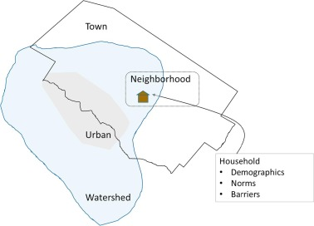
Consider Your Boundaries
Notes:
Watershed boundaries typically do not coincide with political or community boundaries.
Cities and counties may have differing views on how things should be handled.
Neighborhoods have different mechanisms for communication and engagement
Cultural norms within an area may effect whether or not practices are adopted
You will need representatives of these various organizations and jurisdictions to inform your process.
The more you know about these communities, the better you can engage them.

Slide 6

Local Government Functions and Jurisdictions
Government Jurisdictions
Federal and State Government
City Government
County Government
Special Districts
Regional and Multi-State Authorities
Notes:
In this presentation, we want to overview some of the layers that make communities unique.
For many of you, it has been a long time since your high school civics lessons and (at least in my case) I do not remember ever covering special districts and Kentucky specific local jurisdictions. I learned a lot during the research for this presentation and I hope this helps provide a better sense of how your local community operates.
We will start with some overviews on government jurisdictions and federal and state government and then focus on cities, counties, special districts, and then some regional and multi-state authorities.

Slide 7
Federal System
Determines how powers are divided between levels of government
POWER
State
Local
(Counties, Cities, Special Districts)
Federal
SPECIFICITY
Notes:
So, lets go back to our federal system.
In the United States, we have a federal system or federalism.
Federalism is a type of government in which the power is divided between the national government, states, and other government units. It contrasts with a unitary government, in which a central authority holds all the power, and a confederation, in which states, for example, are clearly dominant. We have enumerated powers for the federal government as well as reserved powers for the states. The balance of power is in constant flux on various situations, but we have this system. This means that both federal, state, and local powers are all constrained in various ways in how they respond to situations and projects.
This is important because it affects us at the state level as well as the local level.

Slide 8
Delegation of Local Power
Categories of Local Authority
  1) Structural, 2) Functional, 3) Fiscal, 4) Personnel
Dillion’s Rule: Local governments can only exercise:
  Powers explicitly given to them
  Powers implied or incident to those explicitly given
  Powers essential and indispensable to their purpose
Home Rule:
  Delegation of local autonomy in limited areas
Notes:
When it comes to local authority, the National League of Cities has helpfully identified four broad categories of authority:
1. Structural – power to choose the form or structure of government
2. Functional – power to exercise local self-government in a broad or limited manner
3. Fiscal – authority to determine revenue sources, taxes or other activities
4. Personnel – authority to set employment rules, rates, conditions, bargaining
Fiscal authority is typically the most limited of this list.
As we shall see, the American Civil War has had a lot of influence on local authority in the United States as well as Kentucky, both in the past and in the present.
Just a few years after the civil war, John Dillion made two supreme court rulings in 1868, which became known as Dillion’s Rule. This set of rules define the powers local governments vary narrowly as the three bullet points indicate. Local power must be explicit, implied, or essential to the purpose.
Because of this ruling, many states began to issue “Home Rule” to local municipalities in the early 1900 to provide broader authority to local governments. These rules differ from state to state with different allowances in the 4 different categories of authority. Functional powers are the most frequently used and expanded.
From https://www.nlc.org/resource/cities-101-delegation-of-power
In Kentucky, Kentucky’s counties, cities, and special districts had no powers except those things permitted by the state laws and constitution under 1891 Constitution (which is currently in force). Special or local legislation was originally prohibited under that state constitution (again – think – this was only a generation after the civil war and Kentucky was a border state). We shall talk more briefly
So local ordinances are a relatively recent occurrence in Kentucky, and there is not consistency from city to city on these ordinances.

Slide 9

Jurisdiction, Primacy and Authority
Whose problem?
  Who has power to enforce laws?
  Who has to responsibility to manage?
Primacy = Delegated Authority
May delegate authority to issue permit and enforce, but must be accountable delegator
May require demonstration of capacity and funding stability
Notes:
When we are speaking about local authority in terms of permitting, enforcement, and management, much confusion can result over who has jurisdiction or primacy.
Jurisdiction speaks of granted or delegated authority and is often thought about in terms of geography but that is not strictly true. It has to do with legal ability to act. Primacy refers to the act of coming first – of who is the lead in this action.
In terms of permitting, primacy (or primary enforcement authority) refers to those responsible for enforcement authority. Local governments are granted primacy, typically because they have been delegated authority from higher levels because of more specific laws or local governance, but sometimes because of unique local conditions. In some cases, primacy may not be given until certain criteria are met.
The function of primacy as it relates to public policy can be sensitive – often at the federal to state level but also at the local vs state level. States strive to maintain autonomy and can devote a lot of resources toward an issue and can therefore be sensitive when federal efforts preempt their efforts. Similarly, local governments can establish unique programs that can be preempted by state regulation… so there is a balance in jurisdiction and primacy

Slide 10


Stream Impacts
Construction Site, Erosion and Sediment Control
US Army Corp
Kentucky Division of Water
EPA: NPDES
Delegated
Authority
Kentucky: KPDES
Water of the U.S.?
Water of the Common-wealth?
KYG20
MS4 Permit
KYR10
Construction Permit
We want a say.
We want a say.
Is this in an MS4?
MS4:
Local ESC Ordinance
Development of 1 acre of land
Can I restore this stream using natural channel design?
Delegated ESC
Inspection and Enforcement
Notes:
Here are two examples of how jurisdiction and primacy work with regard to enforcement and permitting.
Stream impacts during restoration
During a stream restoration (a good thing), some impacts occur as the sediment is stirred up and the machinery is in the waters. So even in doing this good thing, you need to check jurisdiction. The USACE wants to know if this is a water of the United States or not (if so they want a say). The Division of Water wants to know if it is a water of the commonwealth. If it is neither of these things (perhaps it is a farm ditch on your property), then you can do what you please.
2) Development project
Let’s say you want to develop your land into a shopping center. Well in the process, you will generate a lot of sediment that may run off your property and into streams. Well the EPA has authority to regulate such pollutants, but in Kentucky they have delegated that authority to the state, so you have to apply for a KYR10 Construction permit if your project is above a certain size threshold. The state is responsible for inspection and enforcement of these sites.
But that’s not the end of the story. If the project is in an MS4 community, the Division of Water requires such communities, under a separate permit, to develop local ordinances to inspection and enforce construction erosion and sediment control. So the property owner still needs the state permit, but they also need to comply with the local ordinance that may be more stringent. Further, now the MS4 is responsible to inspect and enforce the pollution control.
Such is the balance of jurisdiction in regards to permitting.

Slide 11

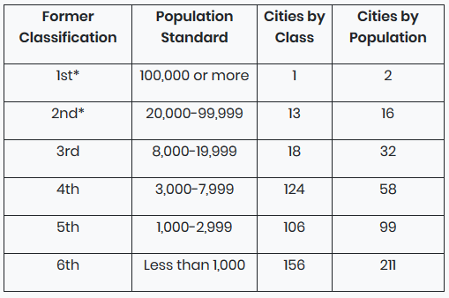
Kentucky Cities
418 Incorporated Cities
54% of population
Classification
  Since 2015: Two Classes
    First class = Louisville
    Home Rule = All others
  Prior to 2015:
    Six classes based on population
    1/3 of cities improperly classed in 2014
2014 Kentucky City Classification
Source: klc.org
Notes:
Kentucky has 418 incorporated cities containing about 54% of the state’s population. Just over half of Kentucky cities have fewer than 1,000 people. Louisville and Lexington contain about 24% of the state’s population.
Under the 1891 constitution, there were 6 classes of cities based on population and those laws applied. This was only repealed in 1994!
In 1980 (ratified constitutionally via amendment in 1994) that cities and counties were granted “home rule” (KRS 82.082) meaning they can manage their affairs as they see fit as long as it does not conflict with the constitution or state law.
(Kentucky Legislative Research Commission, Kentucky Municipal Statutory Law, Informational Bulletin No. 145, August 2019 as well as www.klc.org)
Prior to 2015, there was an arbitrary classification system based on population size. Although in 1994, the requirements for population criteria had been repealed, there was not a replacement system for the statutory requirements, so the old system held. Because changes in class could only come through approval of the General Assembly, 1/3 of cities were improperly classed according to population as of 2014. Because this information is storied in GIS databases, you will sometimes still see this information referenced.
In 2015, this system was changed into two classes – Louisville as a first-class city, and all other cities under home rule.

Slide 12
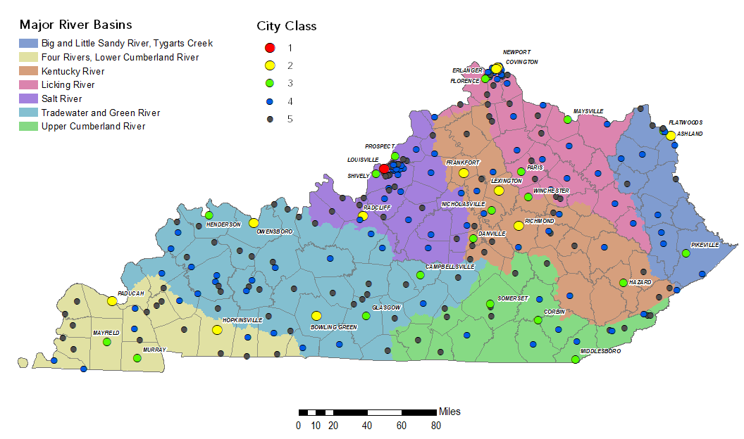
Kentucky Cities by Class, 2014
Notes:
Here is a graphic that shows the old classification system but, more importantly, the location of Kentucky cities.

Slide 13
Kentucky City Government Models
Source: klc.org
Notes:
Kentucky’s Cities are managed, except for Louisville and Lexington (which are merged Urban-County governments) in one of three ways – Mayor-Council (53%), Commission (42%), and City Manager (only 5% but mostly larger cities). Understanding how your city is structured will help you to know how to approach about issues.

Slide 14
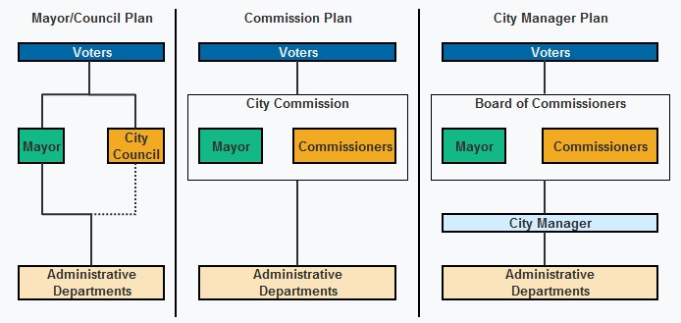
Kentucky City Government Models
Source: klc.org
Notes:
Mayor-Council Form: This is more than half. Mayor has broad executive authority and veto power while the council has legislative authority. Mayor presides over council meetings but only votes if tie. The size of the council may vary between 6 and 12 based upon the city’s class.
In a mayor-council plan, you may need to work with the mayor as well as the council members for your district to advocate for projects. This is in addition to the administrative department personnel who manages watershed issues daily (your first contact should be here).
Louisville and Lexington are governed under plans very similar to a mayor-council plan.
Lexington elects 15 council members, 12 represent districts and 3 are at-large. The mayor presides at council meetings and can vote to break ties.
Louisville has 26 districts each represented by a council member. The council president presides at Louisville Metro council meetings.
Commission Form: Second most common. All legislative, executive and administrative powers of the city are vested in the city commission, which includes the mayor and 4 elected city commissioners. The mayor presides over meetings of the commission and has full voting and participatory rights in commission deliberations. However, he or she has limited additional powers and responsibilities. So in this case the mayor is more the leader of the commission.
City departments are each placed under the supervision of one of the city commissioners, unless the commission has created the office of city administrative officer. The commission, as a whole, is free to override any action taken by an individual commissioner overseeing a department. If there is a city administrative officer (CAO), that person may be delegated the supervisory authority over the departments. Less than 5% of commission plan cities employ a chief administrative officer compared to 15% of mayor-council plan cities. (www.klc.org)
So in a commission plan city, you may need to understand who the commissioner is over your specific department of interest and direct questions towards them.
City Manager: The city manager plan is similar to the commission plan in that it provides for a mayor and 4 commissioners who make up the board of commissioners. The distinction is that significant administrative powers are vested in the city manager, which is a position the board of commissioners must establish. The manager is appointed to serve an indefinite term by a majority vote of the board and is responsible for the supervision of all departments of city government and the conduct of city employees. As in the commission plan, the mayor is a fully functioning member of the board of commissioners with only a limited role as mayor. This plan is used most often by larger cities. (www.klc.org)
In a City Manager plan, you may be best served by talking with the City Manager as well as the Admin departments about planning issues.

Slide 15
City Revenue and Expenditures
Source: klc.org
Notes:
Here are FY2011 figures on the breakdown of income (left) and expenditures (right) for Kentucky cities.
First, I want you to notice that understand that cities don’t necessarily have a lot of spare pots of money lying around to do everything communities would like them to do. They have to have a revenue source to fund this, which is why external grants to fund projects may be appealing. Alternatively, a water quality fee may be necessary to have money to address stormwater pollution.
Another item of note is that utilities (which often includes water and sewer) are a large source of income, but typically a larger percentage of expenditures. If projects can reduce the costs of utilities or increase the income, this would likely be of interest to a city.
Graphic Source: Kentucky League of Cities. 2012. “KLC Research Report: The Basics of Kentucky Cities.”

Slide 16

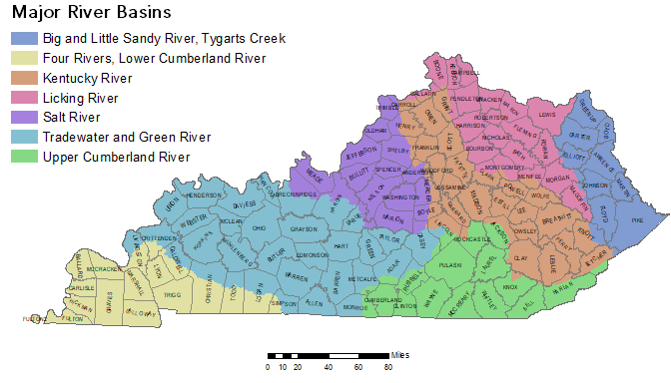
Kentucky County Government
Notes:
Now we want to turn from the cities to the county.
Kentucky is unique in that it was the third largest number of counties of any state. Only Texas and Georgia have more, and they are larger. The county is firmly entrenched in Kentucky identity, and it is also a strong level of Kentucky government.
Counties may enact ordinances, issue regulations, levy taxes, issue bonds, and appropriate funds for a variety of governmental functions specified in the statute. The result is that generally, county governments can function without seeking additional specific grants of authority from the general assembly, although there still are fiscal limitations. (NACO 2009)
Unless state law provides otherwise or a city sets more stringent standards, county ordinances prescribing penalties for their violation must be enforced throughout the entire area of the county, including cities. The fiscal court must send the mayor of each city in the county a copy of all ordinances with countywide application (KRS 67.083). Sometimes there are tensions between the city and county because of these ordinances.
Kentucky LRC, County Government in Kentucky

Slide 17
Kentucky County Government
Magistrate
Commission
Unified City-County
Source: NACO 2009
Notes:
The government of Kentucky counties fall into one of three systems: the magistrate, the commissioner, or the unified city-county government. As you can see here, most counties have magistrates.
Graphic source: Kathryn Murphy. March 2009. “County Government Structure: A State by State Report.” A Publication of the Research Division of National Association of Counties (NACO)’s County Services Department

Slide 18
County Fiscal Courts
Magistrate Fiscal Court
  County Judge/Executive and 3-8 “justices of the peace” (magistrates) elected from districts
  103 counties, ~55% of population
Commissioner Fiscal Court
  County Judge/Executive and 3 commissioners elected at-large
  15 counties, ~20% of population
Other Elected Officials in Both
  County attorney, sheriff, county clerk, coroner, jailer, PVA administrator, constable
Notes:
In both cases, a county judge/executive presides over the court. The magistrate fiscal court differs from the commissioner fiscal court in that the magistrates are elected from specific districts whereas the commissioners are at-large.
In 1975, the state constitution was amended such that “justices of the peace” and the county judge were relieved of their judicial duties and therefore the title was changed from judge to “Judge/Executive.” So the fiscal court serves the executive function of the county.
Other elected officials in the county are listed. Of interest is the Property Value Administrator which can help you to identify the owners of various parcels. Sometimes, this info is online (often for a fee) but many times it is not and therefore paper copies must be reviewed.

Slide 19
Key County
Fiscal
Court
Functions
Fiscal Court
Planning and Zoning
Recreation / Parks
Health Boards
Emergency Prep
Floodplain Manage-ment
County Roads
Water Supply Plans
Waste Disposal
Notes:
The fiscal court receives funding from a number of sources including:
Property Taxes and Licensing Fees or Taxes
Federal Block Grants
State Taxes and Fees
Project Grants
These revenues are them directed toward their many functions. Here we have identified some of the watershed-specific government functions that may be a reason to partner with them.
Planning and Zoning
Recreation and Parks
County Health Boards
Emergency Preparedness
Floodplain Management
County Roads
Water Supply Plans
Waste Disposal
Attending County Fiscal Court Sessions and requesting to present information about the watershed plan may help in furthering your planning goals.
Kentucky LRC, County Government in Kentucky

Slide 20
Special Districts
About 40 Special Districts in KY
Water and Sewer
  Metropolitan Sewer District and Sanitation Districts
  Water District
Flood and Rivers
  Flood Control District
  Riverport Authorities
Waste Management
  Solid Waste Management District
Agriculture
  Soil and Water Conservation District
  Cooperative Extension Service District
Notes:
There are about 40 types of special districts in KY. These are subdivisions of the state government separate from counties or cities, often with their own taxes and fees. Some of the more well-known districts are school districts or sanitation districts, but they cover a broad array of services. All special districts all have a limited number of services in a limited geographical area. We have highlighted a few of the relevant ones here.
Some of these districts are very important for watershed coordinators to understand, including those listed above. We will overview these here and will follow up in greater detail in later modules.
The fiscal court is involved in approving the creation of most special districts. The county judge/executive generally makes appointments to the boards of directors for most types of districts. The judge/executive may abolish or combine districts, with fiscal court approval (KRS 67.715). The county judge/executive also may require all special districts to make detailed annual financial reports to the fiscal court concerning their business and condition (KRS 67.710). So the fiscal court has some influence in some cases.
However, beyond these controls, the county government has little authority to regulate the day-to-day operation of most special districts. In fact, there are limits to the amount of control that county government could exercise without conflicting with the independent legal status of special districts.
Kentucky LRC, County Government in Kentucky

Slide 21
Wastewater Districts
Metropolitan Sewer District (1 system - Louisville MSD)
  City with population >20,000
  KRS 76.005–210
Joint Sewer Agency (5 systems)
  City with county or sanitation district 20,000 -100,000
  Alternative to MSD
  KRS 76.231-240
Sanitation District (50)
  May address sewer systems, onsite systems, storm drainage, or just pollution of streams
  KRS 220.010–613
Source: ASCE 2019 Kentucky Infrastructure Report Card
Other Wastewater Entities
  city systems (most common), water districts, county system, school districts or schools, state parks, federal entities, private-owned, non-profit
Notes:
Many different types of organizations have wastewater systems in Kentucky, but there are several special districts that have their own government that treat waste. As of 2019, there were 423 wastewater plants in Kentucky – 243 municipally owned and 180 privately owned (package plants). While many of the municipal systems are managed by cities (most common) or other entities, special districts are established for 56 of these systems and include metropolitan sewer districts (MSD-1), joint sewer agencies (JSA-5), and sanitation districts (SD-50).
A MSD is set up to deal with sanitation for first class cities – of which Kentucky has one - Louisville. The district is managed by a seven-member board appointed by the mayor and county judge/executive, but it operates separately. The MSD may establish a schedule of rates, rentals, and charges to be collected from all real property within the district area served by the facilities of the district.
A Joint Sewer Agency is like a MSD but for second to sixth class cities of sufficient size. It operates like an MSD but through a merger of city, county, or sanitation district sewer. The exact governance depends on the agreement between the local governments.
A Sanitation District is a little different in that it may address sanitary sewer, onsite management (i.e. septic systems), or even stormwater to prevent and / or correct stream pollution. It is governed by a 3-member board appointed by the judge executive(s). The secretary of the EEC acts as commissioner of sanitation districts and may establish sanitation districts in any county if a petition containing valid signatures of 60% of the people in the area is submitted. These boards can levy property taxes.
So these different districts have different degrees of control by the city or county governments through appointments but are separately managed entities

Slide 22
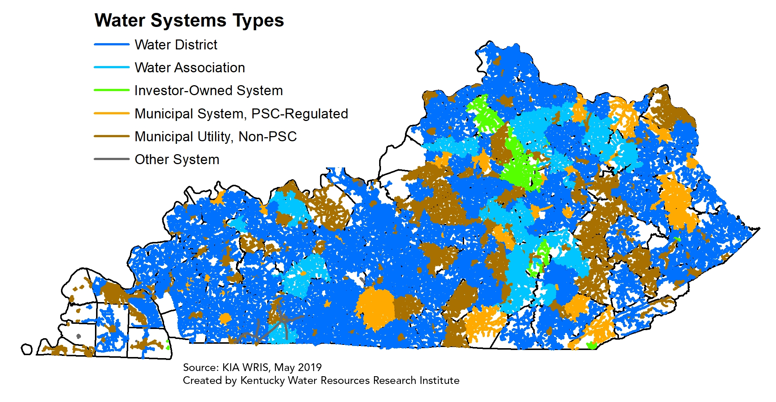

Water Districts
(KRS 74.010–.415)
Notes:
Water districts or associations are the most common form of supplying water to an area in Kentucky, as shown in the map. Privately-owned systems or municipally owned systems also occur throughout the state.
A water district is created by the fiscal court by citizen petition or a water association applies to the Public Service Commission to seek authority to petition the fiscal court. It is governed by a board of commissioners appointed by the judge/executive. The board is typically 3-5 members.
Because water districts are interested in source water protection efforts and planning, they can be great partners on watershed plans and implementation.

Slide 23
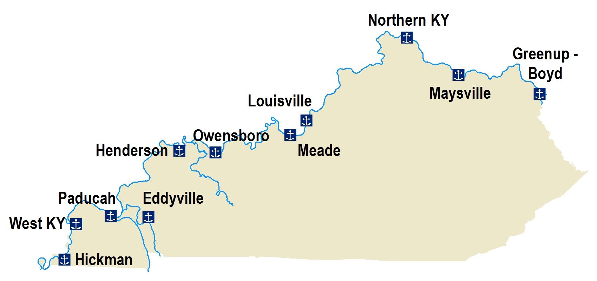
Flood Control and Riverports
Flood Control Districts (KRS 104.450–680)
Purpose: to maintain and operate any
existing or proposed flood control works in the state.
Creation: Secretary of EEC upon petition.
Governance: 5-member board
Riverport Authorities (KRS 65.510–650)
Purpose: to maintain and operate riverport, navigation, river transportation, and river-oriented industries.
Creation: Any government unit with approval of Transportation Cabinet
Governance: 6-member authority appointed by mayor, county judge/executive, or combination
Notes:
In some areas of the state there are also flood control districts and riverport authorities.
There is not a state GIS layer for flood control districts but there are several located throughout the state, such as in Spenser and Harris County. These may be created by the secretary of the EEC by petition to control or operate flood control works or levees
Riverport creations are approved by the transportation cabinet and are located, for the most part along the Ohio River
Source: Kentucky LRC, County Government in Kentucky

Slide 24
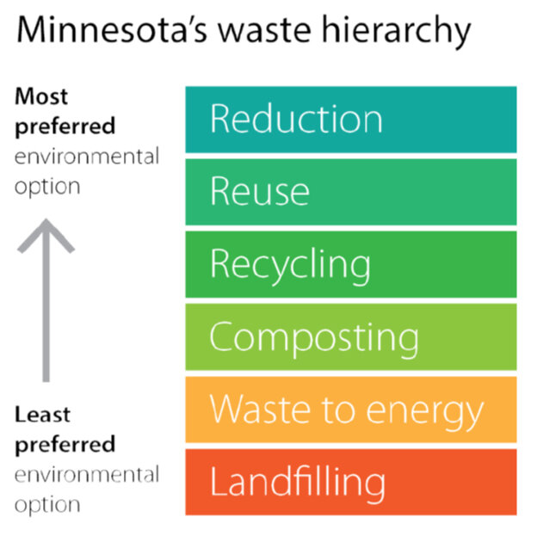
Solid Waste Management Districts
KRS 109.011–.310
Purpose: Provide solid waste management services for cities / counties.
Creation: County petition
Governance: Variable board of directors
Notes:
All counties are required to designate a solid waste management area or district and to have a solid waste plan. Their governance is variable but there is a solid waste coordinator in each county that helps with planning and develops resource materials to aid in the waste planning process.
In addition to assisting with planning, annual reports, solid waste permitting, and developing ordinances, one of the major responsibilities of solid waste coordinators is supporting environmental education and outreach efforts for communities. Therefore, working with these coordinators such be an essential for plans where litter is an issue.
Division of Waste Management website for Recycling and Local Assistance has a list of all solid waste coordinators in the state.
https://eec.ky.gov/Environmental-Protection/Waste/recycling-and-local-assistance/Pages/default.aspx

Slide 25


Ag-Related Special Districts
Cooperative Extension Service Districts
  Promote agricultural practices, techniques, and research, as well as home economics and rural and community life.
Soil and Water Conservation Districts
  Soil conservation districts conserve and develop natural resources.
Agricultural District
  Encourage and develop agricultural lands. Protect from annexation by cities.
Watershed Conservancy Districts
  Develop and execute plans and programs relating to water conservation, water usage, flood prevention, flood control, erosion, floodwater, and sediment damage.
Notes:
We are going to talk more about agricultural special districts in a later presentation focused on agriculture partners. But we want to note two major agriculture-related special districts.
The Cooperative Extension Service, through UK / Kentucky State, is actually a special district located in each county.
Soil and water conservation districts – sometimes just referred to as “soil” districts or “conservation districts” are elected offices in each county which statutorily are to focus on a broad range of natural resources.
Agricultural and water conservancy districts are sub-districts within soil water conservation districts that help protect agricultural land from annexation or focus on flood control, sedimentation, and water conservation.
In heavily agricultural areas, it is essential to work with these partners in watershed implementation and planning.

Slide 26
Regional and Multi-State Authorities
Regional
  Area Development Districts
  Kentucky River Authority
Multi-State
  ORSANCO
  Delta Regional Authority
  Appalachian Regional Commission
Notes:
Having discussed some of the local districts, we now want to zoom out a bit and look at some of the regional and multi-state authorities.

Slide 27
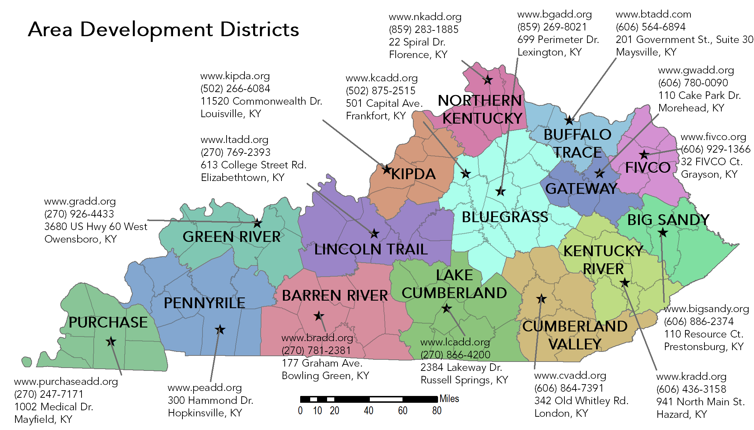
Area Development Districts
Notes:
There are 15 ADDs in Kentucky, established by statute in 1972 (KRS 147A.050-140).
“Area development districts (ADDs) are involved in many aspects of local governance. Among other duties, the ADDs serve as catalysts for networking local and state leaders to solve regional issues. Among the many services ADDs provide are grant writing and area planning services.”
Kentucky LRC, County Government in Kentucky

Slide 28
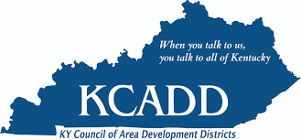
Area Development Districts
Typical Services:
Support local economic development and planning
Assist with preparing public funding applications
Help with administrative requirements of various federal and state programs
Support for creating local programs that partner with businesses, nonprofits and community organizations
Source: klc.org
Notes:
Some of the programs where they assist local governments include health and human
services, water and sewer planning, public management and administration, and technology support.
ADDs help rank out state revolving fund projects, help build the GIS systems of many water and sewer utilities, and do regular reviews on utility performance. Therefore they are very helpful allies for wastewater BMPs. They can also help with flood issues through their hazard mitigation grants.

Slide 29
Area Development Districts
Governance:
  Each governed by Board, typically of Mayors and County Judge/Executives
  May have salaried Executive Director
  Have a regional planning council composed of each planning unit in district
Funding:
  State general funds
  Charge for services
  Grant funding
Notes:
Each ADD is governed by a board of directors (109 KAR 5:010; KRS 147A.060).
Generally speaking, county judges/executive and mayors serve on the boards but may appoint alternates. They are often large.
Each board may appoint a salaried executive director.
Each ADD establishes a regional planning council composed of one representative from each planning unit in the district, selected by the planning commission therein (KRS 147A.125).
The board of directors of each ADD cannot levy taxes but may charge for services. The ADDs have historically received general fund budget money from the General Assembly. The Finance and Administration Cabinet can allocate money to the ADDs.
ADDs should be aware of watershed planning activities and may have numerous resources to help you in planning and implementation. They are very well connected and can give you great insight on issues in various areas.

Slide 30

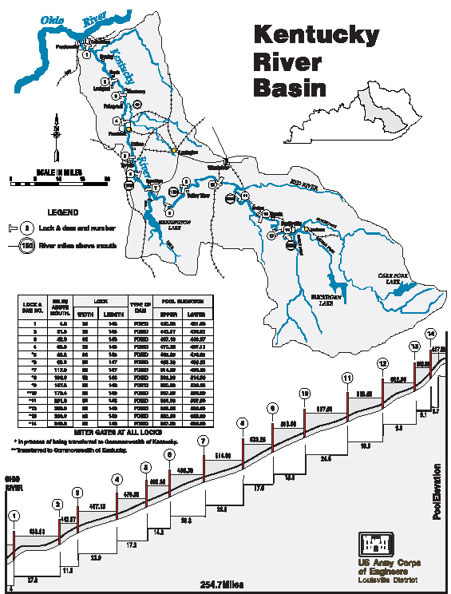
Kentucky River Authority
(KRA)
Established in 1986
Maintain 14 lock and dam structures
To protect and improve the waters of Kentucky River through environmental management
Support for water quality improvement projects
finance.ky.gov/offices/kra/
Notes:
Kentucky River Authority was established to maintain, protect, and improve the waters of the Kentucky River. They have an annual grant program to implement water quality improvement and support volunteer monitoring activities annually.

Slide 31

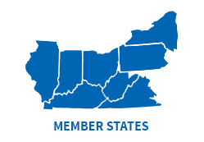
Ohio River Valley Sanitation Commission
(ORSANCO)
Established in 1948
Commission includes 8 states and federal government
Operate programs to improve water quality in the Ohio River and its tributaries including:
  setting wastewater discharge standards
  performing biological assessments
  monitoring the waterways
  conducting special surveys and studies
www.orsanco.org
Notes:
Here we move to some of the multi-state authorities that may be resources in certain areas of the state.

Slide 32

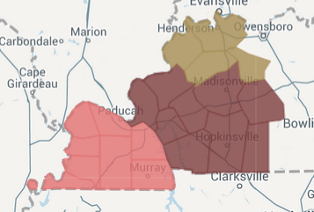
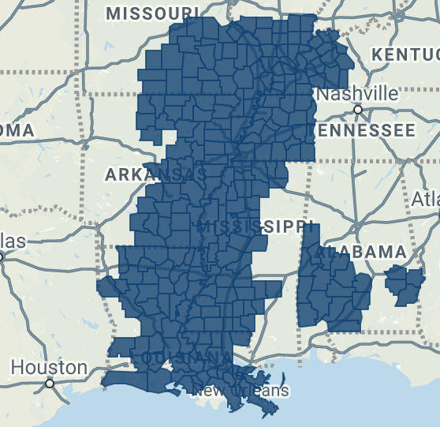

Delta Regional Authority (DRA)
Established in 2000
252 counties/parishes in 8 states
Seeks to improve regional economic opportunity
Fund water and wastewater infrastructure and flood control among other projects
dra.gov
KY
DRA
Notes:
For those in Western Kentucky (Four Rivers and small part of the Green River Basins), the Delta Regional Authority is a resource for water, wastewater, and flood control projects. They are focused on regional economic improvements by basic public infrastructure, transportation infrastructure, business development, and workforce development.

Slide 33

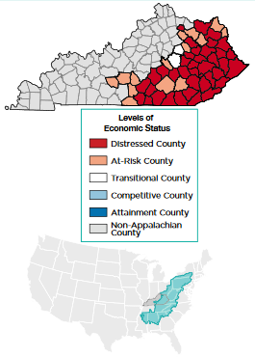
Appalachian Regional Commission (ARC)
Established in 1965
13 states and federal
Five Goals:
  Economic Opportunities
  Ready Workforce
  Critical Infrastructure
  Natural and Cultural Assets
  Leadership and Community Capacity
Fund water and wastewater infrastructure, septic replacement, among other projects
www.arc.gov
Notes:
Similarly in eastern Kentucky, the ARC is focused on economic issues with five goals.

Slide 34

Questions?

