Slide 1
Watershed Academy
Watershed Coordinator Training Series
Water Quality Basics
3. Geomorphology

Slide 2








Stream Functions Pyramid
Notes:
In this session, we are going to look at the third component of the functional pyramid – geomorphology and specifically fluvial geomorphology.

Slide 3
GEOMORPHOLOGY
Transport of wood and sediment to create diverse bed forms and dynamic equilibrium
Sediment / debris transport and deposition
Erosion
Channel evolution
Bank stability
Riparian zone
Bed material and form
Source: UK, College of Agriculture, 2014
Notes:
Geomorphology refers to the study of the landforms on the earth and the processes that change them over time.
Fluvial geomorphology refers to the structure and dynamics of stream and river corridors.
These concepts are especially important to understanding the formation and alteration of the stream or river channel, as well as the flood plain and associated upland transitional zone.
In terms of “stream function,” the functional pyramid restricts the idea to “the transport of wood and sediment to create diverse bed forms and dynamic equilibrium.”
The Hydrology and Hydraulic functions come together with the Geomorphology functions to create a channel form that is appropriate for the underlying geology and climate of the region.

Slide 4
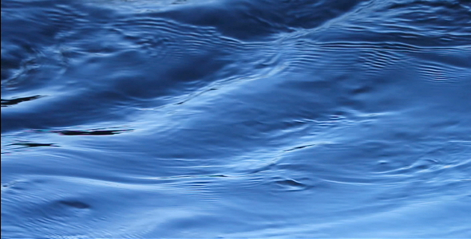
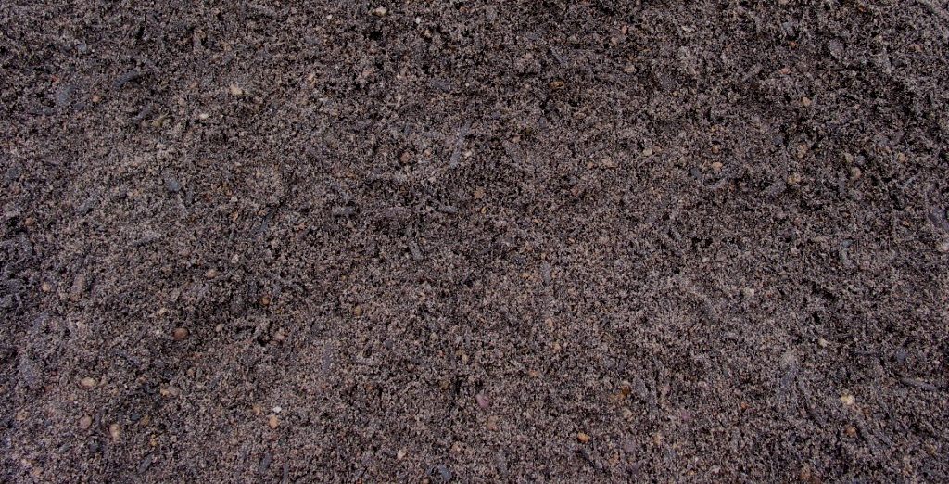
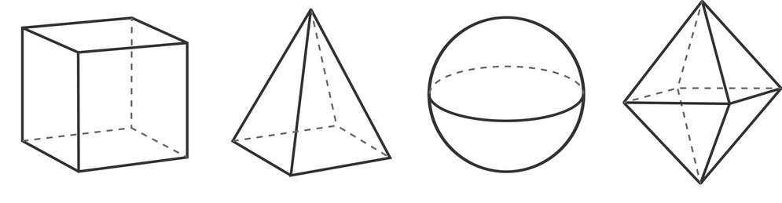
Fluvial Geomorphology
WATER
'Fluvial' refers to the processes associated with running waters,
‘Geo' refers to earth (sediment / rock)
‘Morphology' refers to study of channel shape.
Fluvial geomorphology is the study of the form and function of streams and the interaction between streams and the landscape around them.
EARTH
SHAPE
STUDY
Notes:
Fluvial geomorphology is the study of how running water shapes and modifies the earth’s surface through erosion and depositional processes.
It seeks to explain why streams and rivers look the way that they do and how they change over time.

Slide 5
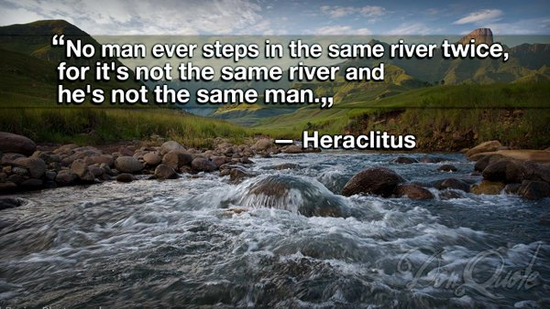
Fluvial Geomorphology
Notes:
We want to begin this session by noting that streams are never the same. Every time you enter a stream, there is new water flowing in it. The sediment and rocks there are different. There is different vegetation which has either grown or left. The root system is different. The organisms in the stream are different. It is a living ecosystem and even though it looks like the same stream, it is not.

Slide 6

Dynamic Equilibrium
STREAM CHANNEL SHAPE CHANGE
EARTH
WATER
Notes:
Dynamic Equilibrium is a key concept for understanding fluvial geomorphology.
The idea is best illustrated by a balance. If something happens to one side, the other side will adjust to try to find a new balance.
In Fluvial Geomorphology, the balance has “water” (fluvial) on one side and “earth” or sediment / rocks (geo) on the other. The shape of the stream will change to adjust to changes on the other side.
Streams are always changing – both the water in the stream and the sediment and rocks over which the water flows. There is a natural equilibrium. But rapid changes in the environment can alter the balance and cause streams to change more quickly and with potentially damaging repercussions to human property and stream ecosystems.

Slide 7
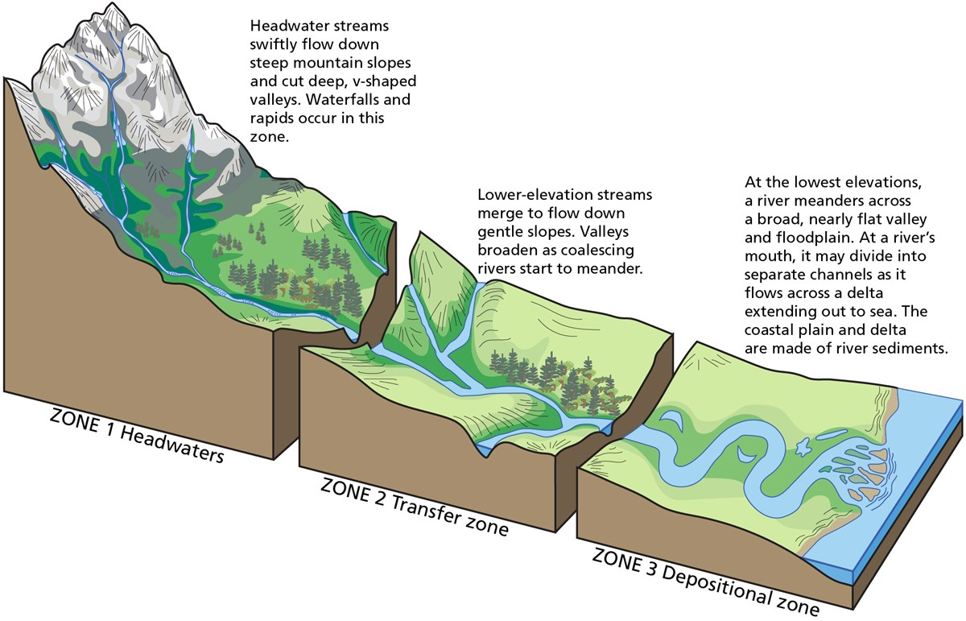
Fluvial Geomorphology
Source: Trista L. Thornberry-Ehrlich, Colorado State University
Notes:
This slide graphic depicts the transitional zones from headwaters (narrow, straighter channels with faster flowing streams) to transfer zone streams (gentler slopes, some meanders or curvier streams) to the depositional zone (broad meanders, flatter topography, wider stream channels) where sediments carried by the stream network begin to settle out.

Slide 8
Fluvial Geomorphology
What is a “balanced” or stable stream?
  “Stream bed is not aggrading or degrading over time, and lateral adjustments do not change the cross-sectional area, even though its position in the landscape may change.” - EPA 843-K-12-006
  “Sediment particles that erode and are transported downstream from one area are replaced by particles of the same size and shape that have originated upstream.” - EPA 841-B-07-002

Slide 9
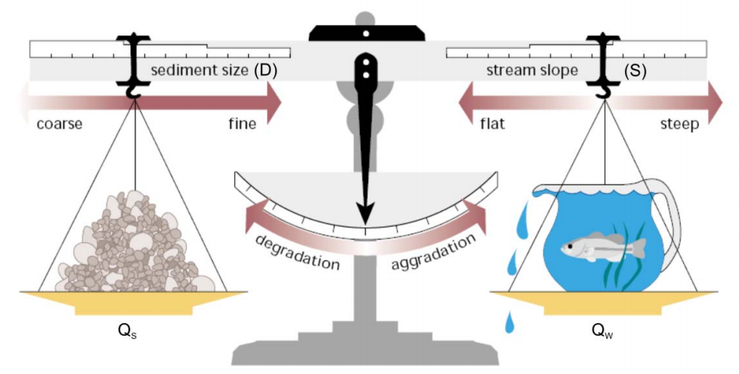
Dynamic Equilibrium
Sediment LOAD (Q_{s})
x
Sediment SIZE (D)
Stream SLOPE (S)
x
StreamFLOW (Q_{w})
∝
Proportional to
Source: FISRWG, 1998
Notes:
Lane’s Alluvial Channel Equilibrium, also known as “Lane’s balance” is a basic, fundamental concept for fluvial geomorphology. It involves the interplay of four basic factors:
1) Sediment discharge (Q_{s}) multiplied by 2) Sediment particle size (D₅₀)
Is proportional to:
3) Streamflow or discharge (Q_{w}) multiplied by 4) Stream slope (S)
When all four factors are in balance, the stream is in dynamic equilibrium. Think about a mild rocking back and forth.
However, when one of the factors changes, the stream will begin to degrade or aggrade to seek a new equilibrium.
For example:
If stream discharge increases, the scales will tip toward degradation, or erosion of the streambed.

Slide 10
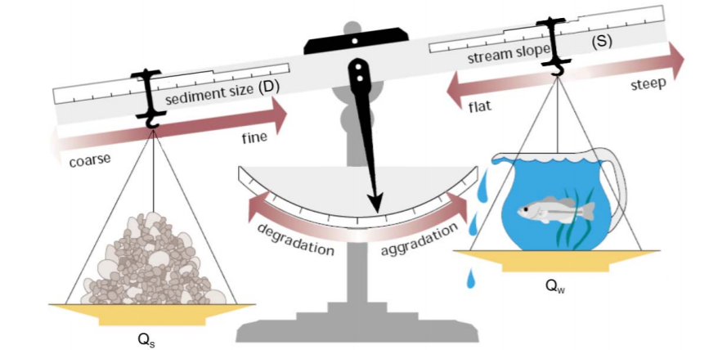
Aggradation due to increased sediment load (Q_{s})
Source: USEPA
Notes:
If an erosive activity is occurring in a stream headwaters, delivering more sediment to the stream, the scales will tip toward aggradation of the streambed.
The streamflow can no longer carry the bedload down the stream, so it is deposited in the streambed.
How would the stream correct for this imbalance?
It could cut through stream meanders and straighten the stream channel, which would generate greater flow rates that could more easily move the sediment load. (Cut-off stream or river meanders are called oxbow lakes.)

Slide 11
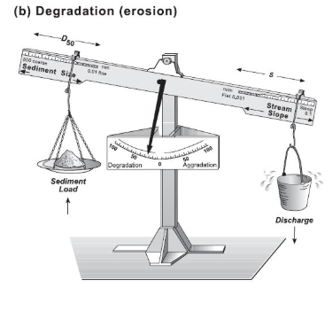
Degradation (erosion) due to increased streamflow (Q_{w})
Notes:
Now, imagine that you have an overgrazed watershed, causing a lot more stormwater runoff and increased streamflows.
What will happen in this situation?
The scales will tip to the right and degradation, or erosion, of the stream channel will occur.
How could the stream naturally correct for this situation?
It would increase stream bends or meanders to dissipate or slow the energy of the increased stream flows. This would also reduce the slope of the stream channel.
Graphic source: http://www.science.earthjay.com/instruction/HSU/2016_fall/GEOL_332/labs/lab_04/GEOL_332_lab_04.pdf

Slide 12
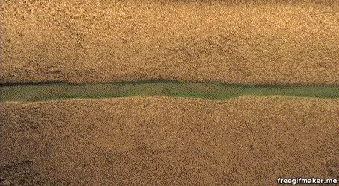
How Streams Work:
Straightened Stream Channel
Source:emriver.com
Notes:
This is a simulation on sandy soil of water pulses moving through a straightened channel.
As you can see the channel shape begins to meander to seek a shape that better conforms to the sediment size and shape over time. The stream is adjusting to reach equilibrium by changing shape.

Slide 13
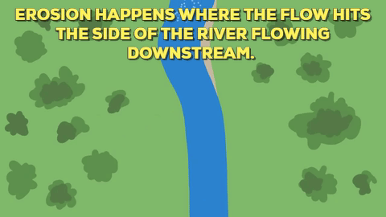
How Streams Work: Erosion
Source: https://uag-earthsci.blogspot.com/
Notes:
This is a demonstration of the process of erosion. The stream is changing shape through erosion and sediment transport to adjust to the discharges of water.

Slide 14
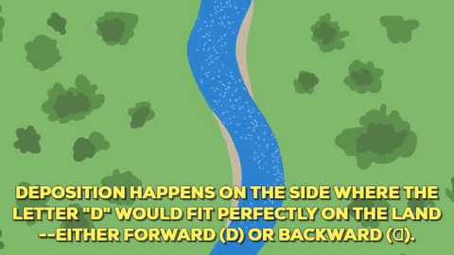
How Streams Work: Deposition
Source: https://uag-earthsci.blogspot.com/
Notes:
Here is a demonstration of deposition.
Note the helicoidal (spiraling while moving forward) flow in the channel. The fastest waters cause erosion on the outside of the stream bends while the slower waters on the inside of the stream bends deposit sediments.
Note that similar forces work over larger scales, but bigger rivers will have less frequent bends.

Slide 15
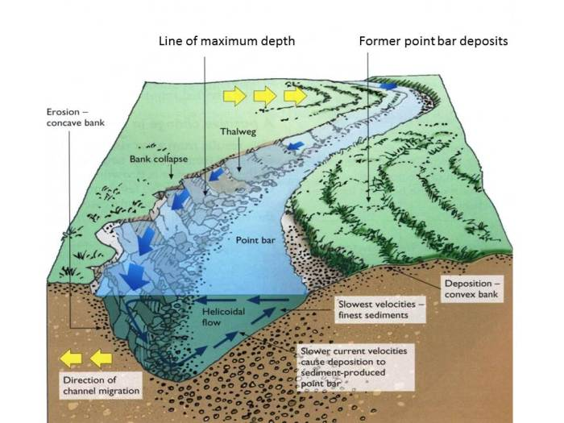
How Streams Work: Meanders
https://geographyiseasy.wordpress.com/
Notes:
Here we see an unanimated diagram of the cross-sectional view of a bend that shows how the channel meanders.
As was shown in the previous clip, the water in the stream moves in helicoidal flow. That is, the water moves top to outside to bottom to inside across the meander as it moves downstream.
This transports sediment eroded from the concave bank downstream to the next convex bank.
On the inside of the channel, the point bar expands as sediments settle out due to the slower flows.
On the outside, the fastest currents cause erosion and can undermine the bank.
The greater erosion of the concave bank occurs just downstream of the axis of the meander bend. This causes meander to migrate down the valley. The lateral erosion of the meanders and their migration widen the flood plain. Thus the asymmetrical pattern reinforces itself.

Slide 16
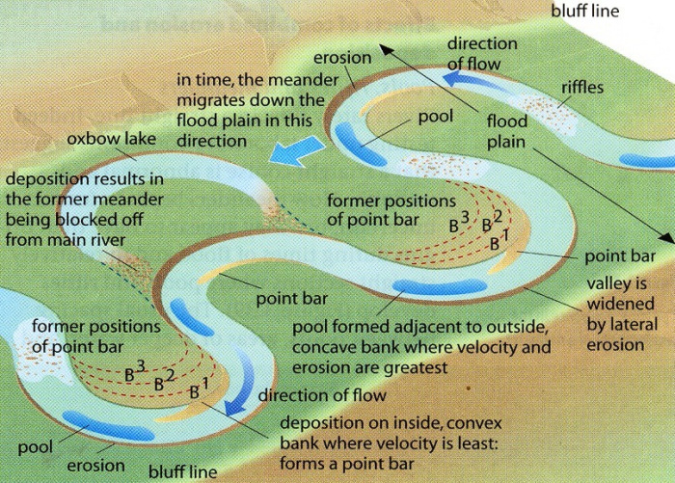
How Streams Work: Meanders
https://geographyiseasy.wordpress.com/
Notes:
Here is the same example from another view.
The width of the channel remains relatively constant, while the whole channel migrates laterally and becomes more sinuous. Sinuosity is described as the actual channel length divided by the straight-line distance.
If sinuosity becomes too great, the river in flood may be able to break through the meander neck, thereby straightening its channel. The abandoned channel, a cut-off, may be used during flood, but frequently the ends nearest the new course become blocked with alluvium and the channel becomes a small lake or oxbow lake.

Slide 17
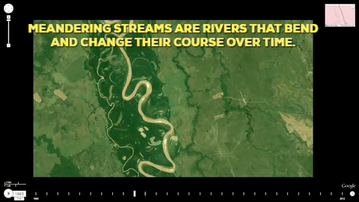
How Streams Work: Meanders
Source: https://uag-earthsci.blogspot.com/
Notes:
Now, we can see again this time lapse video and better understand how this is occurring.

Slide 18
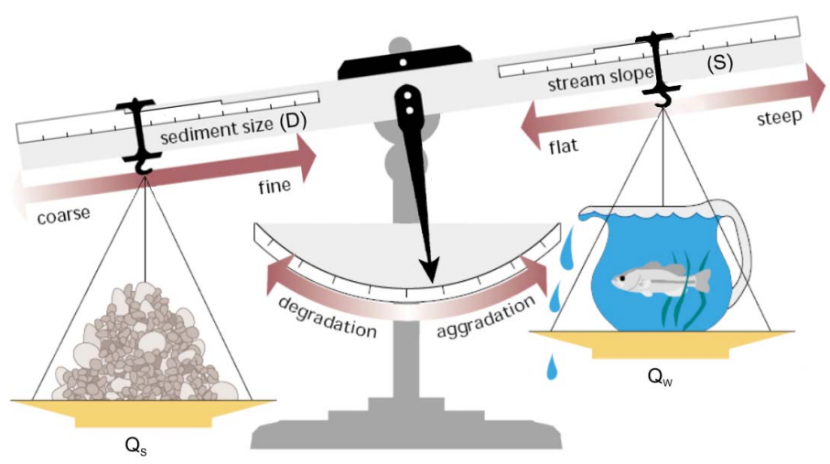
Disturbance and Imbalance
Sediment LOAD x
Sediment SIZE
Stream SLOPE x
Stream DISCHARGE
∝
Proportional to
Source: FISRWG, 1998
Notes:
Disturbances in the landscape can cause the regular balance to be thrown off resulting in rapid, catastrophic changes as well as long-term unstable conditions as the stream seeks to slow regain a dynamic equilibrium through its slower processes.

Slide 19
Channel Response to Disturbance
Widening
  Stream width increases through bank material removal from erosion, failure, and toe scouring.
Aggradation
  Stream’s elevation increases due to deposition of bed sediment
Stream Disturbance
Aggradation
Narrowing (Bank Advancement)
Degradation
Widening
(Bank Retreat)
Degradation
  Stream’s elevation decreases due to erosion of bed sediment and incision
Narrowing
  Stream width decreases due to bank building by slumping, toe benches, or berms.
Notes:
In response to disturbance, the stream channel will move
1) up (aggradation) or
2) down (degradation) or
3) in (narrowing) or
4) out (widening).
Some signs of deposition (aggradation) can include:
Point Bar
Mid-Channel
Side Bar
Islands
Deltas
Some signs of incision (degradation) can include, headcuts or channelization, disconnection with the floodplain, increased entrenchment. Erosional Features

Slide 20
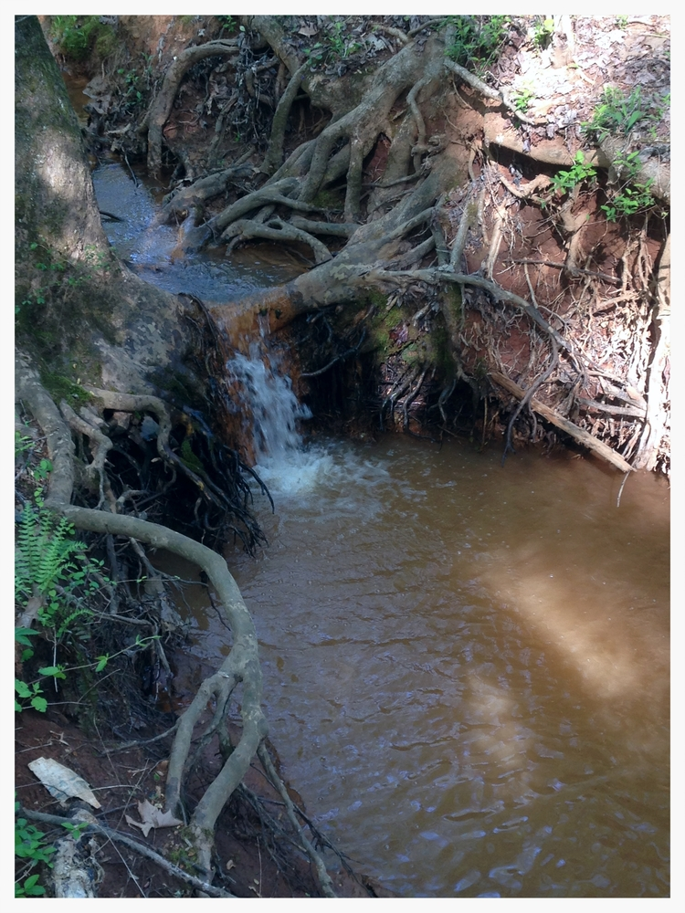
What is a headcut?
Stream surface is lower than the surrounding valley floor with the stream confined between steep banks
Created by a sudden down-cutting of the stream bottom.
Looking like a miniature waterfall, a headcut slowly migrates upstream and becomes deeper as it progresses.
Notes:
When multiple headcuts are observed migrating upstream, it can be a sign of past channelization and increased stream slope, causing the stream bed to degrade.
As the bed elevation decreases, the stream channel becomes more deeply incised, with steeper banks.

Slide 21
Common Channel Disturbances
  Dams / water withdrawals
  Straightening (channelization)
  Land use change
  Irrigation
  Soil compaction
  Dredging
  Gravel mining
  Channel crossing (vehicle or animal)
  Forest harvesting
  Urbanization

Slide 22
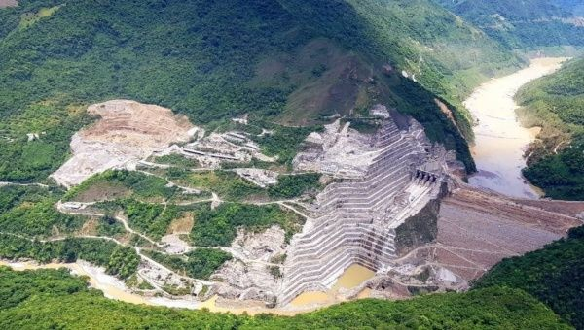
Disturbance: Decreased flow
Notes:
Let’s say the volume of water entering into a stream changes due to a dam or reservoir construction or a withdrawal upstream, or it could be drought conditions or climate change.
The stream no longer has the force to move the same sized sediments and debris that it once did, therefore the sediments will begin to settle out or “aggrade.” Only a portion of the channel previously used will be utilized.

Slide 23
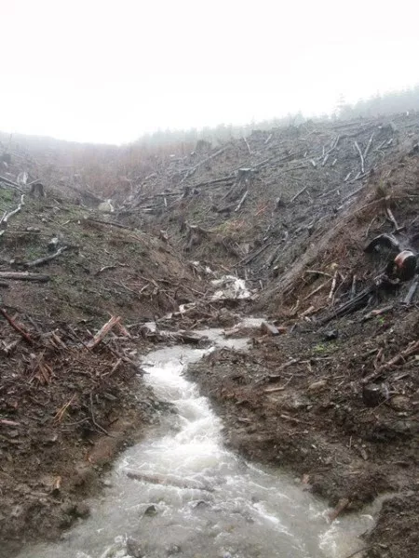
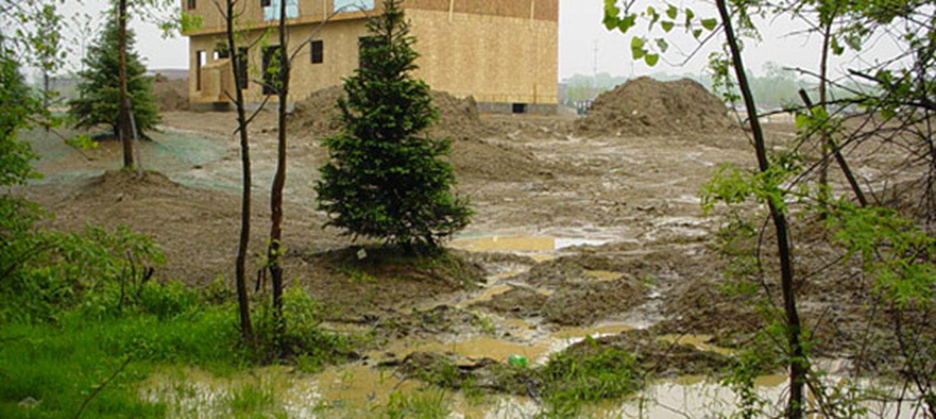
Disturbance: More Sediment
Notes:
Let’s say a poorly managed logging operation or home construction site contributes a lot of sediment and dirt runoff, but the stream does not have the slope or discharge to pick up the particles and transport them.
The sediment will deposit and will not be transported, raising the level of the stream. The stream will slowly form a new channel.

Slide 24
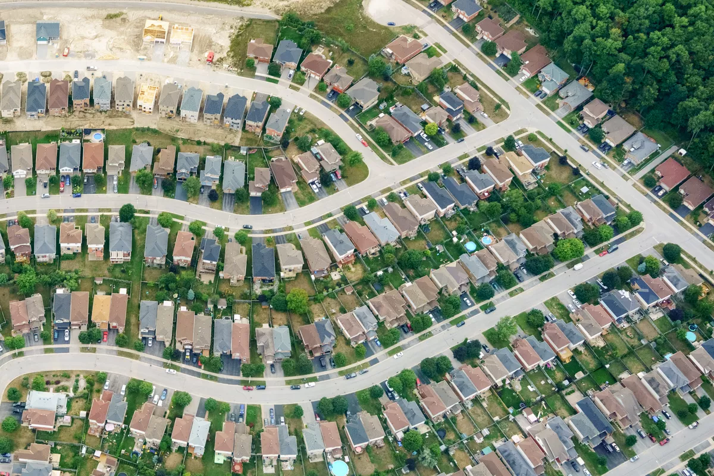
Disturbance: Increased Runoff
Notes:
Let’s say a lot of development occurs in an area causing more runoff to enter the stream. In that case, the additional water discharge will start eroding (degrading) the stream because it now has the force to move those particles.

Slide 25
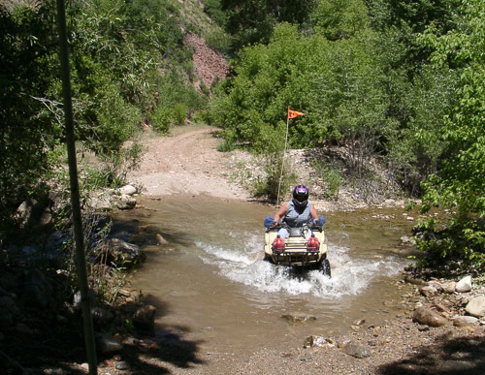
Disturbance: Increased Sediment Transport
Notes:
Let’s say regular ATV use in the stream dislodges sediment from the stream banks and bottom and is transported into the water column. This sediment is not normally eroded by the stream and therefore deposits downstream changing the shape of the stream. The stream will be unstable as it seeks to establish a new channel shape.

Slide 26
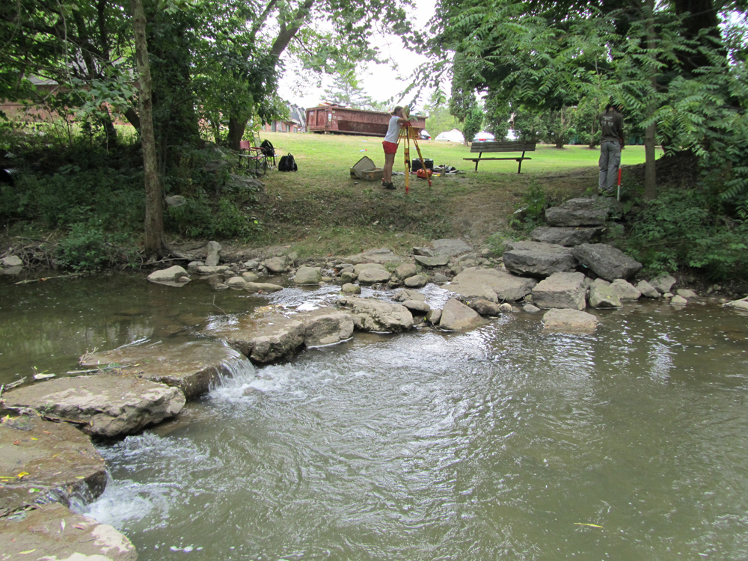
Restoration: Decreased Flow Rate
Source: Fondriest.com
Notes:
Or, let’s say that some large boulders (big enough that the stream cannot move them) are added to a stream that is unstable due to increased flow rates. The boulders can help stabilize the stream (such as at a riffle or even at a bank) because these cannot be moved by the water.
This is an example of a stream restoration technique called a cross-vanes, which slow water velocity and create eddies where the water can cleanse itself.

Slide 27
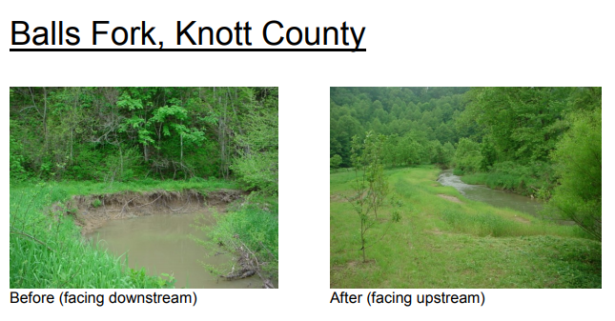
Restoration: Access to Floodplain
Source: http://fw.ky.gov
Notes:
Example of one of Kentucky’s Stream Mitigation Projects in Knott County.
Note the sharp bend in the stream with severe bank erosion, which would be contributing significant sediment loading to the stream.
Following restoration, banks have more gradual slope, allowing flows to spread and slow over the floodplain area and reducing erosional pressures on bends in the stream.

Slide 28
Fluvial Geomorphology
Measurements of Form and Functions:
  Sediment and Debris Transport – Ability of a stream to transport sediment and debris of a given size
  Bed Material – Composition of the stream bed substrate based on transport, deposit, and erosion
  Bank Erosion / Stability – Stability of banks and susceptibility to erosion and deposition
  Channel Evolution – Series of steps in modifications of the channel shape to move toward equilibrium
  Riparian Vegetation – Evaluation of the riparian vegetation functions
Notes:
This is a list of the various functions produced by a stream’s unique fluvial geomorphology.
Hydrologists have developed ways to measure how well each of these functions is performing.
An example would be a pebble county analysis, which measures pebble size and numbers to account for bed material, as well as sediment transport.

Slide 29
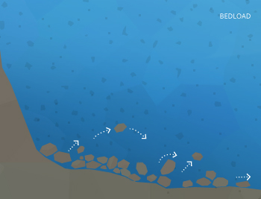
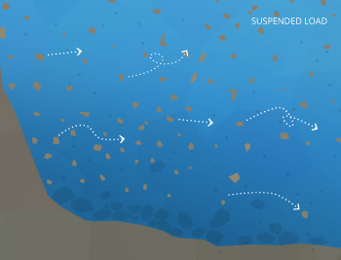

1. Stream Flow and Sediment Transport
Bed Load
Suspended
Load
Wash
Load
Bed load – sediment that rolls, slides, or bounces on the bottom
Suspended load – amount of sediment carried downstream by water flow (moving water)
Wash load – portion of suspended load that will not settle to the bottom during low flow.
https://www.fondriest.com
Notes:
Because sedimentation is a major pollutant, it is helpful to think through how sediment is transported in a stream. There are three different ways in which sediment is transported in the stream
Bed load
Suspended Load
Wash load (which is a portion of the suspended load)
When you measure the total suspended solids, you are only capturing the suspended and wash portions. Larger boulders and cobbles will move, but typically not very far.

Slide 30
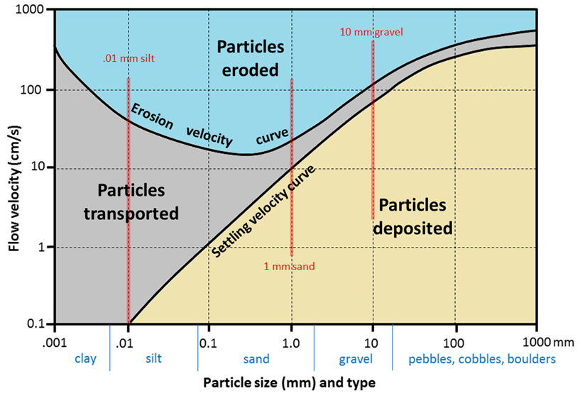
1. Stream Flow and Sediment Transport
Hjulström-Sundborg Diagram
Notes:
Erosion, transportation, or deposition is determined by the size of the particle and the velocity of the water. This diagram helps indicate the velocity at which different particles will settle and erode and be transported.
So notice this chart is looking at the SPEED of the water, not the AMOUNT of water.
So take the same amount of water and put it in a very small area (concentrate it) is that going to increase the speed or decrease it? Increase
This is what happens when a stream cannot extend out into its floodplain – the speed and power increases. When it spreads over a floodplain it slows down.
Similarly meanders in a river help to slow down the water as it hits the banks.
So let’s take some examples – let’s say a stream reaches a velocity of 100 cm/s.
What will it erode from the banks? Silt, sand, and gravel
What will it transport? Clay, silt, sand, and gravel
What will it deposit or leave in place? Pebbles, cobbles, or boulders.
What about if the water is flowing slower, at only 1 cm/s?
What will it erode from the banks? Nothing
What will it transport? Clay, silt
What will it deposit or leave in place? Sand, gravel, pebbles, cobbles, or boulders.
So what is the streambed going to look like at the top of the hill where there is a lot of velocity and slope? More pebbles, cobbles, and boulders
What will the streambed going to look like at the top of the hill where there is a lot of velocity and slope? More sand, silt, and gravel that settles out from upstream.

Slide 31
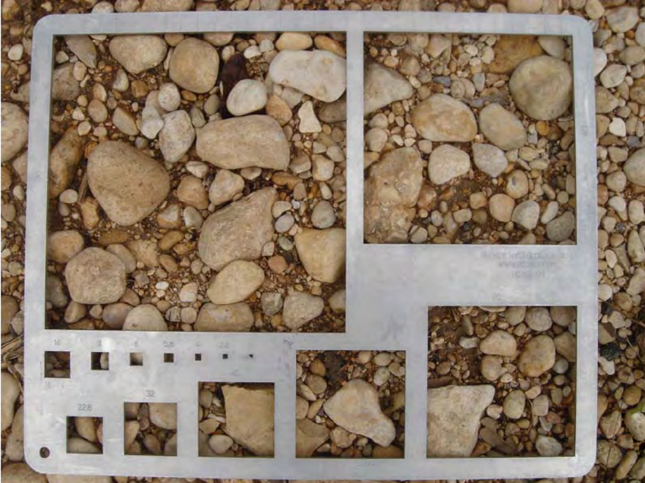
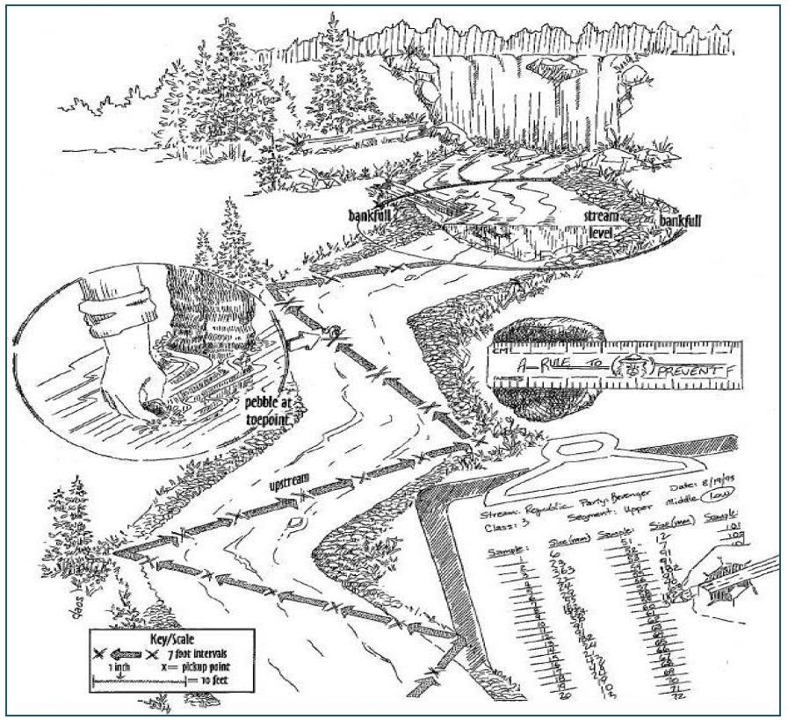
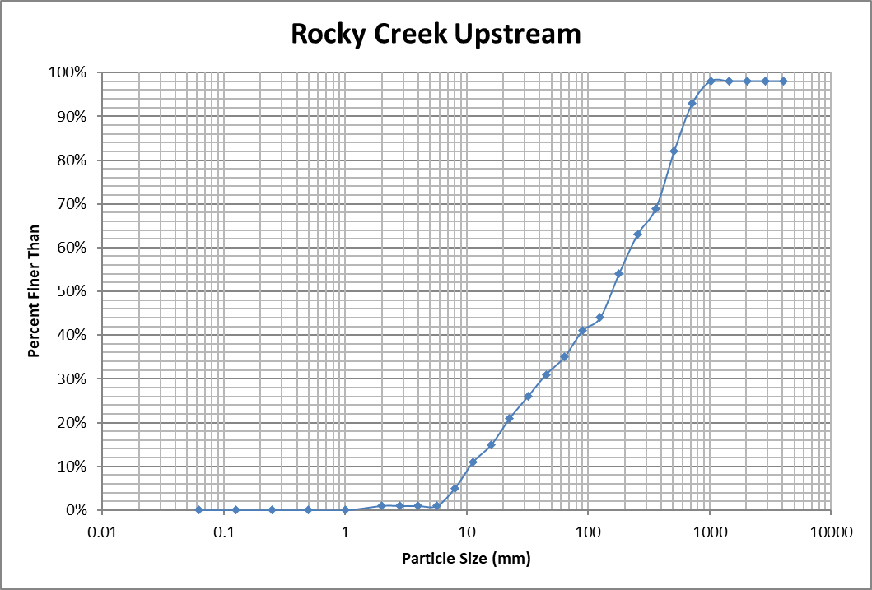
2. Bed Material
Source: KDOW
Notes:
In order to determine the size of the particles in the stream, a Wolman pebble count may be conducted in which a person walks back and forth across the stream and measures the first pebble they touch without looking, repeating this 100 times.
A gravelometer can be used to determine the sizes. These can then be plotted and the median particle size and other information can be determined.
Alternatively, individuals can estimate the amount of each particle size type (clay, silt, sand, gravel, cobble, boulder, bedrock) within riffles, runs, and pools and what percentage of the stream these represent.
This information helps determine what size of sediment will be transported under various flows within a stream.

Slide 32
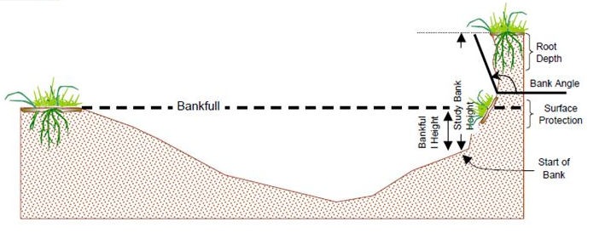
3. Bank Erosion / Stability
Visual Identification of Severe Erosion Areas
Bank Erosion Height Index (BEHI) / Near Bank Sheer Stress (NBS)
BEHI Variables (Source: EPA / Rosgen, 1996)
Notes:
Every watershed plan will need to have some sort of quantification of erosion in the watershed. A range of approaches can be used to quantify erosion.
At the simplest level, the locations and lengths of stream with severe erosion can be identified visually using the Maryland Stream Corridor Assessment Survey method for Erosion Sites http://dnr.maryland.gov/streams/Publications/SCAProtocols.pdf
This method requires documentation of the length of stream and average height as well as some basic information about the severity of the erosion, the correctability, and the accessibility of the site.
If looking to calculate the rate of erosion on an annual basis, the Bank Erosion Height Index (BEHI) / Near Bank Sheer Stress (NBS) can use different visually observed stream variables such as the bank height, bank angle, root depth, and surface protection. Using erosion curves for different regions, these values can be translated into estimates of tons of sediment / year for a given area.

Slide 33
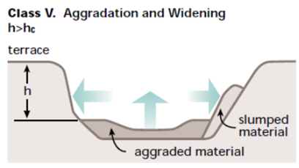
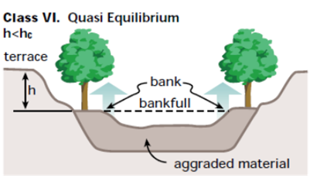
4. Channel Evolution Model
Source: FISRWG, 1998,
Simon and Hupp, 1986
Notes:
There are different conceptual models about the process by which streams change. You do not need to know the specifics of each of these steps but having an idea of how stream change is important to provide some understanding of the relationship between land use changes or stream modifications and erosion and sedimentation.
Simon and Hupp proposed a 6 stage model in which channels modification occurs.
Class 1 - Premodified – the stream is stable with mild aggradation – basal erosion on outside bends and deposition on the inside bends.
Class 2 - Channelized – This stream has been channelized by “straightening” by construction. It is trapezoidal with vegetation removed.
Class 3 – Degradation – Banks are heightening and steepening – flowline lower relative to the top of bank. Some pop-out failures on the slope may occur.
Class 4 – Threshold – Degradation and Widening – erosion down and out with large failures on upper banks, flow line very low in relation to top bank. Slab rotation and pop-out failures. Riparian vegetation high and might lean in
Class 5 – Aggradation – Sediment begins to accumulate in the bottom of the channel while widening still continues. Vegetation tilted or falling in
Class 6 – Quasi-equilibrium – The old floodplain becomes a terrace and the vegetation begins to grow in the new floodplain. A new smaller bankfull cross-sectional area is achieved with new stability.
So conceptually, a stream will move through a series of stages until the stream reaches a new equilibrium. Knowing where a stream is in this process will help determine BMPs.

Slide 34
4. Channel Evolution Model
Source: FISRWG, 1998,
Simon and Hupp, 1986
Notes:
Associated with that model is the idea that the bank shape can help determine the channel’s evolutionary stage.
For example, the gradual slope of the Class I example suggests an unmodified, or premodified, channel.
The steeper, longer slope in Class 3 suggests that degradation has been occurring.
And, the added deposition at the base of the bank in Class 5 tells us that degradation has occurred, but aggradation is now rebuilding some of the bank.

Slide 35
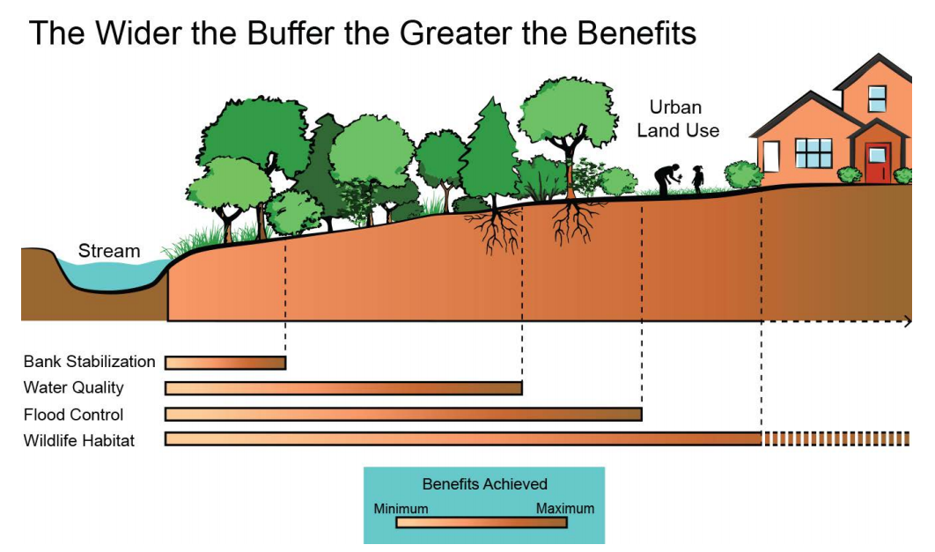
5. Riparian Zone
Tennessee Urban Riparian Buffer Handbook (2015)
Notes:
The riparian zone has a lot of impact upon the stream shape and sediment transport. Even a small riparian zone can provide root structures to stabilize the banks or help hold slumping banks together. Wider riparian zones provide additional benefits including water quality (due to filtration), flood control (by slowing down the waters entering the stream and providing storage area for floods), and habitat for wildlife.

Slide 36
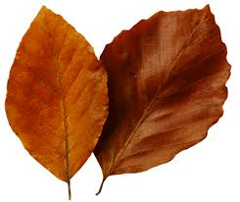


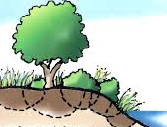
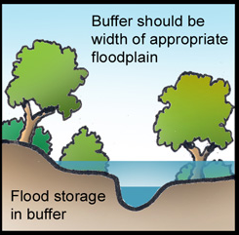




5. Riparian Buffer Widths
 | Function | Description | Width from Bank (Feet)
 | Detrital Input | Leaves, twigs, and branches provide source of nutrients and habitat. | 10 – 30
 | Water Quality Protection | Barrier and filter for runoff through herbaceous vegetation. Steeper slopes need wider widths. | 16 – 100
 | Stream Stabilization | Root stabilization of banks and moderation of soil moisture. | 30 – 60
 | Flood Attenuation | Floodplain storage and interception of overland flow slowing time to peak. | 65 – 500
 | Riparian Habitat | Shrubs and trees in particular provide food and shelter for terrestrial and aquatic life. | 100 – 1600
Source: Modified from Fischer and Fischenich 2000
Notes:
Based on a literature review, the following widths are recommended to support various riparian zone benefits.

Slide 37
Habitats Associated with Channel Structures
Flow Types
Habitat Types
Source: Cluer and Thorne, 2013
Notes:
Now the point that we need to circle back to is that the fluvial geomorphology of the stream has a lot to do with the habitat that is present for aquatic organisms to live.
The extent to which the ecosystem benefits are provided by a stream depends on the presence and pattern of different stream structures.
If a stream is unstable, some of the unique habitats may be buried or disrupted, negatively affecting the aquatic life.
This will be addressed in more detail in the next section on habitat assessment.

Slide 38
Geomorphology Summary
Transport of wood and sediment to create diverse bed forms and dynamic equilibrium
  Sediment and Debris Transport
  Bed Material
  Bank Erosion / Stability
  Channel Evolution
  Riparian Vegetation
Notes:
Fluvial geomorphology

