Slide 1
Watershed Academy Watershed Coordinator Training Series
Dealing with Data
7. Pollutant Load Calculation and Allocation

Slide 2
Pollutant Load Calculation and Allocations
Definitions and Terms
Calculation Methods
Source Allocation and BMP Determination
Helpful Visualizations
Notes:
Understanding the concept of pollutant loads is critical to understanding how your watershed is functioning and how best to address any water quality problems.
Loads help us understand the contributions to the problem and where and how to focus our efforts.
This section will review:
What a Pollutant Load is and how to calculate it.
How to use the pollutant loading information to identify likely sources and develop appropriate best management practices to address them.

Slide 3
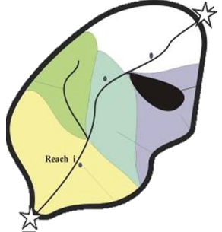
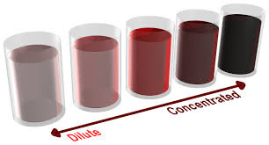
Pollutant Load
Different concentration but same load
Notes:
A pollutant load is the amount of a specific pollutant moving through a stream.
It is based on both the concentration and the flow rate and is generally expressed as a weight of the pollutant over a period of time.
Example: pounds/day of nitrogen
In the diagram above, the concentration of the “pollutant” in the jars transitions from more dilute on the left to more concentrated on the right.
Pollutant loads are important in watershed planning because they allow a more balanced comparison of subwatersheds and their associated pollutant contributions.
Within the example watershed, the concentration becomes more diluted as it moves toward larger stream reaches with higher flows or discharges.
However, the actual load of the pollutant may be greater from subwatersheds with lower concentrations IF THEY HAVE GREATER FLOWS, as opposed to a subwatershed that has a higher pollutant concentration, but only a trickle of flow.
Large pollutant loads can have significant impacts on the larger watershed as a whole.

Slide 4
Calculation of Pollutant Load
= Concentration X Flow
= mass X volume = mass
volume time time
(i.e. pounds / year)
Multiply by a conversion factor to get right units:
NOTE:
Conversions if flow is in
cubic feet per second (CFS)
Notes:
The load formula demonstrates the impact of including flow, by multiplying a known concentration by this value.
The greater the VOLUME/time, the greater the resulting load in MASS/time.
The chart shows conversion factors that can be used to translate from cubic feet per second to daily, monthly and annual loads,

Slide 5
Load and Yield
Load = mass / time (e.g. lbs/year)
Amount at a point
Yield = mass / time / area (e.g. lbs/year/sq mi)
Amount by an area
Notes:
To account for geographic size differences between watersheds or subwatersheds, annual loads must be normalized.
This will enable the comparison and prioritization of subwatershed areas during the watershed planning process.
To do this, a pollutant yield is calculated by dividing the total load by a unit of area, such as square miles.
Yields are especially important to consider for nonpoint sources, since they account for land runoff sources.
In this diagram of a watershed, the total load would account for all of the pollutant reaching the most downstream point, and the yield would be calculated by dividing this load by the entire area of the delineated watershed (black line) + the area flowing into the upstream station.
So, loads refer to pollutant measurements at a point and yields to pollutant amounts contributed by a land area.

Slide 6
Total and Incremental Load
Total Load - all load delivered to sampling point (Red Site)
Incremental Load - local load (Yellow Area) not including source upstream of other sites (Red Site minus Green Sites)
Total Load
Incremental Load
Notes:
We can further define the load as either incremental or total.
The total load is everything that is delivered to a given sampling point.
For watershed planning, however, you need to know how specific areas contribute to that load.
To figure out the loading from a localized area, you will need to substract out the upstream loading contributions.
Let’s say the total load at the red site is 10. If each of the green dots contribute 4, what is the incremental load contributed by sources in the yellow area? (10-4-4 = 2)
Incremental loads refer to the portion of the load from a subwatershed area, as opposed to the total load from the entire watershed.

Slide 7
Total and Incremental Yield
Total Yield – total load divided by total upstream drainage area (Red Site / Black Outline + Upstream Area)
Incremental Yield – incremental load divided by local area (Yellow Area)
Total Yield
Incremental
Yield
Notes:
Just as you can have total and incremental load, you can have total and incremental yields:
For the total load, you divide the total load by the area of land draining to the point. For the red side, this is everything in the black outlined area plus the drainage area upstream.
For the incremental load, you divide the incremental yield by the local drainage area (subtracting out the upstream drainage).

Slide 8
Load Calculation Goal
How much do we need to reduce to be healthy?
Where to focus?
Healthy Stream
Notes:
After calculating the existing pollutant load, you will want to compare it to a water quality standard or benchmark.
If it is greater than this standard, you will see how much the level needs to be reduced to achieve the criteria of a healthy stream.

Slide 9
Pollutant Load Calculation
= Concentration X Flow
Concentration = Easier. Based on some summary of monitoring result data
Flow = More difficult. How do you represent wide ranging conditions? Avoid bias of sampling site arrival time.
Notes:
This process all seems very straightforward at this point. However, we need to talk about the second part of the equation—FLOW.
Determining the concentration to use in a load calculation will be based on some summary (average, geometric mean, etc) from the monitoring results.
However, determining which flow rate to use can be more challenging since flow rates vary greatly and you don’t want to bias your loading rate based on a single flow observation.

Slide 10
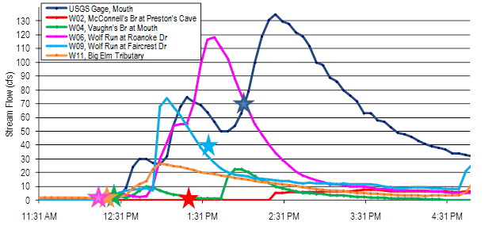
Pollutant Load Calculation
Notes:
This graph from the Wolf Run Watershed shows how much load calculations could vary depending on which flow rate is chosen over a 4-hour time period.
All of these sampling events captured rising water at the site (with the exception of the light blue site). Using an average of the flow measured in the field would only provide a representation of the time in which the sampler arrived at the site.
It is therefore important that the flow conditions in the watershed are normalized across the watershed in some way.

Slide 11
Questions for Selecting Load Model
Weather conditions represented (wet vs dry)?
(KDOW requires minimum of 2 wet and 2 dry events)
Flows represented by monitoring (high / medium / low flow)?
Representative flows for subwatershed sites (scaled gage data)?
Sufficient data to group pollutant data by weather or flow?
During what portion of the year do represented events occur?
Notes:
One way that you can calculate estimates of pollutant loads over varying flow conditions is to use a watershed model.
There are lots of different models ranging from simple spreadsheet models to complex computer programs or statistical relationships. Models use cause-and-effect relationships to estimate loads under varying conditions.
They are based on a set of equations that can be used to describe the natural or man-made processes in the system, such as runoff or stream transport.
There is not a one-size fits all method for calculating the pollutant load for a watershed. Rather, you need to investigate what type of data do you have.
What type of representation do you have of wet and dry weather conditions. The KDOW planning effort requires at least 2 wet and 2 dry events (with antecedent dry periods). You need to consider whether you have enough data to divide the loading according to event type.
What sort of flows are represented by the monitoring? Did you capture very high? Very low? Any sites dry on a regular basis? How are dry periods accounted for? If not, perhaps you can only make some general statements.
Do you have a way to generate representative flows for the subwatershed sites? Often this can be done by establishing a relationship with a nearby continuous gage based on the field measurements.
Some pre-screening of the data by weather and flow will be helpful in deciding whether to group data by flow or weather condition.
If the data can be grouped by flow or weather type, then the load can be represented by the portion of the year in which those conditions occur (i.e. wet weather events occur during 40% of the year so the wet weather load is proportioned likewise.)
All of these questions will factor into selecting a watershed modeling approach.

Slide 12
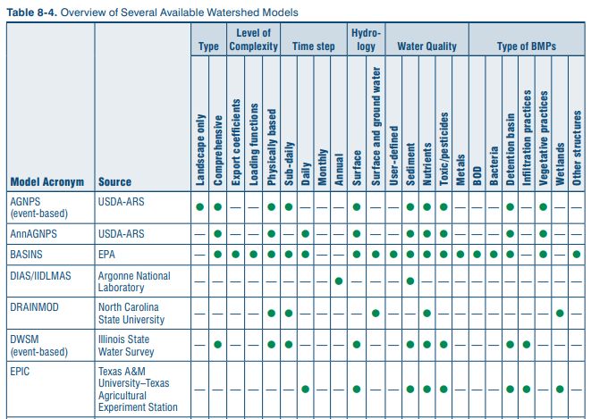
Load Modeling Methods
Not one size fits all:
Type
Complexity
Sampling Frequency
Hydrology
Water Quality Parameters
Types of BMPs
EPA. 2008. “Handbook for Developing Watershed Plans to Restore and Protect Our Waters”
Lists 37 different models (… and more since)
Notes:
In the EPA’s 2008 “Handbook for Developing Watershed Plans to Restore and Protect Our Waters” there is a table in chapter 8 that lists out different types of models that might be used depending on the type of data, complexity, sampling frequency, hydrology, water quality parameters, and types of BMPs to be implemented.
There are 37 different models in this table and more have been developed since that time.
The point is that you should be making decisions about the modeling during the QAPP development period and tailoring your data collection to meet the needs for the watershed.

Slide 13
Target Load vs Existing Load
Whatever method utilized to generate existing load, substitute benchmark concentrations for measured concentrations to generate a target load.
Notes:
The same method must be used to generate your target load as your existing load.

Slide 14
Total Maximum Daily Load
Source: Wisconsin Department of Natural Resources
Notes:
A Total Maximum Daily Load (TMDL) is a regulatory term in the U.S. Clean Water Act, describing a plan for restoring impaired waters.
It identifies the maximum amount of a pollutant that a body of water can receive while still meeting water quality standards.
The pollutant under consideration can come from any source – background loading that occurs naturally, waste loading from point sources, or as runoff from the landscape (referred to as load allocation above).

Slide 15
Total Maximum Daily Load (TMDL)
TMDL = Waste Load Allocation (WLA)
(Permitted point sources)
+ Load Allocation (LA)
(Nonpoint sources + background)
+ Margin of Safety (MOS)
(Allow for error – generally 10%)
+ Future Growth Capacity
(Illegal sources not allocated)
Notes:
In addition to the Waste Load Allocation from point sources and the Load Allocation from runoff and background sources, TMDLs factor in a Margin of Safety as a safety buffer for error, as well as a Future Growth Capacity to allow for added loading from future development.
Illegal pollutant sources, such as combined sewer overflows or sewage straight pipes, are not factors into the TMDL calculation. This is because TMDLs are regulatory – addressing capacity for permitted or unpermitted loads, while watershed plan load calculations are non-regulatory. Thus, although much of the pollutant load for bacteria in an urban area may be due to aged sanitary sewer infrastructure, this source is illegal. Therefore no allocation is made in the TMDL for this source.
Also, TMDLs are developed for a DAY as opposed to loading in watershed plans which typically consider a year. While the process of development may be somewhat similar, TMDLs are typical developed for a critical flow period (often the period in which the load most greatly exceeds the criteria). However, because that flow does not occur every day, it can be hard to track success against a TMDL.
For this reason, a TMDL may not always be helpful in achieving implementation.

Slide 16
Total Maximum Daily Load (TMDL)
Reduce through Best Management Practices
WQ Criteria
MOS
Future
WLA
LA
Is there sufficient capacity for permitting?
Notes:
As with the process used in load comparison to benchmark loads in watershed planning, a TMDL is also compared to related water quality criteria.
This TMDL calculation helps regulators determine whether or not there is sufficient capacity in a waterbody for added inputs from permitted point source discharges.
For example, if a stream is already exceeding its water quality criteria for nitrogen, a discharge permit application that would result in added nitrogen inputs from a proposed sewage treatment plant upgrade would not be acceptable.
One interesting note is that permitted dischargers must be allocated all of the capacity in the permit, even if they are discharging significantly less. This means that the instream concentrations achieved by implementation of a TMDL may often be far less that the WQ standard.

Slide 17
Annual Load Reduction Goal
WQ Criteria
Notes:
In contrast, a watershed plan is not concerned with how much a discharger is allowed to pollute, but how much they actually are. The goal is to come up with the most cost effective plan to reduce pollutant loading from existing levels to target levels.
In this example of an annual load reduction goal for achieving acceptable phosphorus loading, you can see how the phosphorus sources may need to be reallocated to achieve the goal.
Sources from developed, forested and agricultural lands, as well as the stream bank itself, will need to be reduced.

Slide 18
Annual Load Reduction Goal
Bank Stabilization (ft)
Stormwater BMP (acres treated)
Logging BMPs (acres)
Ag Nutrient Management BMPs (acres)
Notes:
And, in the next step of planning, we can begin to suggest ways to achieve these goals by recommending corresponding BMPs. The number of BMPs necessary to achieve load reductions can be calculated and will need to be stated in the plan.
Streambank stabilization can reduce phosphorus loading from eroded soils. Using literature values some approximations of how many eroding feet of eroding stream will need to be addressed can be calculated.
Stormwater BMPs (such as raingardens or pervious pavement or streetscaping, etc.) on developed land can enhance absorption before runoff reaches the stream. In this case, the number of acres that would need to be captured can be calculated.
Logging BMPs can also reduce soil-related phosphorus loading by minimizing erosion potential from these operations.
And, agricultural nutrient management can help keep needed phosphorus on cropland and reduce the application of unneeded additional phosphorus fertilization.
For all of these practices literature can be consulted to estimate the type of gains for a given BMP.

Slide 19
Subwatershed Prioritization & Planning
Priority #2
Total Nitrogen and E. coli loads greatest
Priority #3 Lowest Total Nitrogen and E. coli loads
Compare pollutant loads and yields among the subwatersheds to assist with prioritization.
Priority #1
Total Nitrogen and E. coli loads and yields greatest
Notes:
Another step in the watershed planning process is to compare the pollutant loads and yields among the subwatersheds to assist with their prioritization.
Kentucky’s watershed planning guidance requires that, at a minimum, the loads of total nitrogen, total phosphorus, total suspended solids and E. coli are considered.
By assessing load and yields, we can begin to determine what areas are in most need of improvement.

Slide 20
Compare Actual vs Target Loads for Pollutant Reduction Needs
#1
#3
Total N 65%
E. coli 75%
Total N 20%
E. coli 15%
#2
Total N 45%
E. coli 50%
Notes:
And, by comparing the actual loads to the target loads, we can see how much pollutant reduction is needed to meet water quality standards.

Slide 21
Other Prioritization Considerations
Priority #1
High Pollutant Yields
Motivated stakeholders
Mainly agricultural
Priority #3
Lower Pollutant Yields Most of area already protected
Land Use/Cover
Geology
Soils
Stakeholder Support
Local concerns
Available funding
Priority #2
Highest Pollutant Yields Greater Imperviousness
Notes:
Final prioritization should also consider other contributing factors in each subwatershed, such as:
Land use and land cover characterization - What types of BMPs will be needed to address the prevailing land uses? Are these likely to be effective? Is much of the watershed area already protected as public or forested lands?
Geological characteristics – Is the geology favorable for karst formations that would allow for underground pollutant flows into or out of the watershed area?
Soil characteristics – Is the soil type easily erodible and likely to contribute to loading? Does it allow for slow or fast infiltration rates? Are the soils already high in certain nutrients?
Stakeholder support – Is there local interest in protecting or restoring water quality? What are the local goals or special water interests? Do these align with the watershed planning goals?
Local concerns that may strengthen support – Is there a strong local concern, such as pending development permit or a threatened water supply, that may bolster related watershed management initiatives?
Available funds that may make some subwatershed efforts easier – Are there related funding sources that can help pay for proposed BMPs, such as Farm Bill cost-share programs that help pay for agricultural practices? Could a proposed development project incorporate BMPs, such as stormwater retention basins? Could you work with a recreational trail planning effort to add some water education signage?

Slide 22
Selection of Best Management Practices
Identification of Priority Subwatershed Areas
Subwatershed Characterization
Likely Sources
Selection of Appropriate Best Management Practices
Notes:
Once you have evaluated the monitoring data and the relevant watershed characteristics, then prioritized your focus areas and identified likely sources, you can begin developing appropriate best management practice recommendations.
This is the stage at which we will approach the next Watershed Academy Modules, which will discuss land use impacts to water quality and related best management practices.

Slide 23
Helpful Pollutant Load Visualizations
Notes:
Before moving into this module’s final section, which will delve into some spreadsheet tools for managing and manipulating data, we will go through a few exercises in interpreting flow and loading graphs.
This overview should help you better understand some of the technical subtleties of these graphs and fine-tune your management recommendations.

Slide 24
Flow Duration Curve
Highest flow
Low Flow
No flow
High
Flow
Logarithmic Scale
Mid-Range Flow
Shows range of flow for a waterbody and
% of time a flow rate is met or exceeded.
Notes:
Let’s first familiarize ourselves with a Flow Duration Curve.
This type of graph plots flows vs the percentage of time that a specific flow rate is equaled or exceeded. A flow duration curve characterizes the ability of the basin to provide flows of various magnitudes.
The highest flows are plotted on the left side of the graph, and the lowest flows (possibly down to zero) are on the right side of the graph.
Mid-range flows are plotted in the middle of the curve.
A logarithmic scale is typically for used for flow values on the y-axis.
Further info: The shape of a flow-duration curve in its upper and lower regions is particularly significant in evaluating the stream and basin characteristics. The shape of the curve in the high-flow region indicates the type of flood regime the basin is likely to have, whereas, the shape of the low-flow region characterizes the ability of the basin to sustain low flows during dry seasons. A very steep curve (high flows for short periods) would be expected for rain-caused floods on small watersheds. Snowmelt floods, which last for several days, or regulation of floods with reservoir storage, will generally result in a much flatter curve near the upper limit. In the low-flow region, an intermittent stream would exhibit periods of no flow, whereas, a very flat curve indicates that moderate flows are sustained throughout the year due to natural or artificial streamflow regulation, or due to a large groundwater capacity which sustains the base flow to the stream. (Source: Oregon State University, https://streamflow.engr.oregonstate.edu/analysis/flow/index.htm)

Slide 25
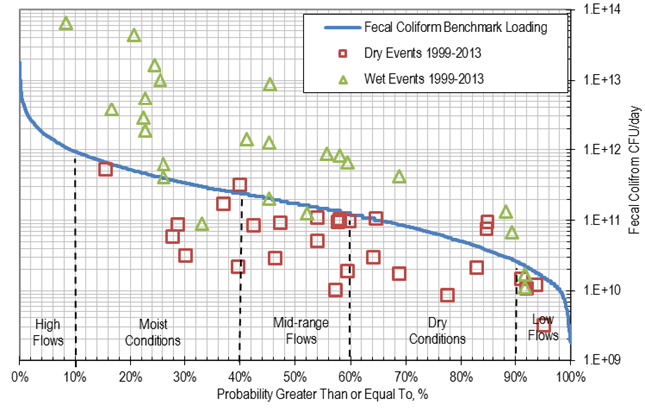
Load Duration Curve
Load = Benchmark Flow Conversion Factor
Compare results against whole flow range.
Notes:
A load duration curve plots the pollutant’s benchmark value multiplied by flow and then a conversion factor for the time frame being used.
In this example, we are looking at fecal coliform loading per day, with the benchmark value indicated by the blue line.
Specific monitoring results are plotted with their respective fecal coliform concentrations and flow rates.
Sampling results characterized as occurring wet events” by the level of preceding rainfall are plotted as green triangles.
“Dry event” results are plotted as red squares.

Slide 26
Load Duration Curve
Sample result with flow conditions
Above Criteria
WQ Criteria across flow
Below Criteria
The weather condition (wet vs dry) is shown here for each sample. Indicates problem primarily with wet weather samples.
Notes:
PRESENTER: Check comprehension of flow duration curve by reviewing the parts of the graph.
You can see on this graph that most of the results above the benchmark line, or above the water quality criteria, were collected during wet events.
This implies that the fecal coliform is most likely being contributed by rainfall-related runoff.
What are some possible sources that could be causing this?
Sanitary sewer or combined sewer overflows
Livestock waste from pasture land
Inundated septic system drainage fields
Pet or wildlife wastes

Slide 27
Load Duration Curve
Sample result with flow conditions
Above Criteria
WQ Criteria across flow
Below Criteria
The weather condition (wet vs dry) is shown here for each sample. Indicates problem primarily with wet weather samples.
Notes:
Isn’t this the same as the previous slide?

Slide 28
Load Duration Curve Benefits
Allows for identification of when load contributions occur.
Can better predict sources (point vs non-point).
Condenses lots of data into an easy format.
Can identify sampling gaps.
Notes:
These are some benefits of considering load duration curves before drawing conclusions about pollutant sources and causes.

Slide 29
Pollutant Load Summary
Goal is to target best management practices in a general area and source type.
Loads and yields can help determine how many best management practices need to be put on the ground to address a pollutant.
Target load is developed using the same method as the existing load.
Flow duration curves and load duration curves can effectively demonstrate when problems are occurring and how to address them.

