Slide 1
Watershed Academy Watershed Coordinator Training Series
Land Use Impacts &
Related Best Management Practices
5. Urban BMPs

Slide 2
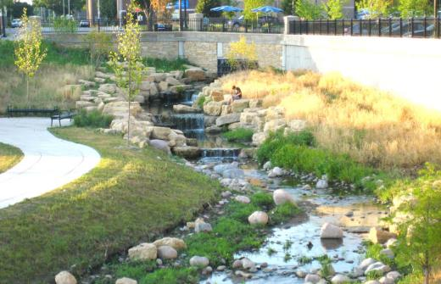
Urban Water Quality BMPs
Can reduce water pollutants:
Soil/sediment
Nutrients (nitrogen, phosphorus)
Organic materials
Oil/Grease/Hydrocarbons
Chemical pesticides and herbicides
Bacteria/pathogens
Metals
Help regulate stream flows by slowing runoff/reduces flooding
Improve riparian habitat
Improve aesthetics (combat erosion, add vegetation, create shade)
Notes:
Urban stormwater BMPs are intended to reduce the listed pollutants, as well as:
Helping to slow runoff and regulate streamflows, which subsequently improves stream quality as well as reduces flooding and its associated human impacts
Improving riparian habitat
Improving the aesthetics of stream corridors

Slide 3
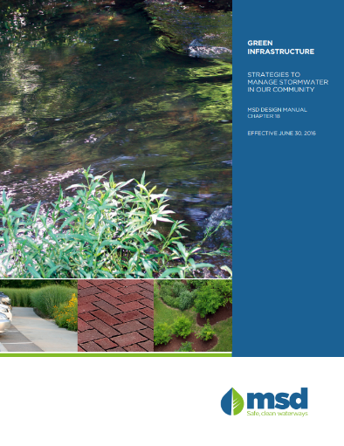
LOTS of resources available on this topic!
Bowling Green Louisville Lexington
Notes:
There are endless resources available on the topic of urban stormwater best practices.
For example, Bowling Green, Louisville and Lexington have very in-depth manuals and websites that offer a lot of helpful guidance for practice selection and implementation.
The information presented in this module will only touch the surface of this topic, but hopefully, it will give you some foundational information to work from.

Slide 4
Urban Stormwater Runoff – Contaminants & Sources
Contaminant | Contaminant Source
Sediment and Floatables | Streets, lawns, driveways, construction sites, atmospheric deposition, drainage channels
Pesticides and Herbicides | Residential lawns and gardens, roadsides, utility rights-of-way, commercial and industrial areas
Organic Materials | Residential lawns and gardens, commercial landscaping, animal wastes
Metals | Automobiles, bridges, atmospheric deposition, industrial areas, soil erosion, corroding metal surfaces, combustion processes
Oil and Grease/Hydrocarbons | Roads, driveways, parking lots, vehicle maintenance areas, gas stations, illicit dumping to storm drains
Bacteria and Viruses | Lawns, roads, leaky sanitary sewer lines or connections, animal waste, septic systems
Nitrogen and Phosphorus | Lawn fertilizers, soil erosion, animal waste, detergents (phosphorus), atmospheric deposition (nitrogen)
Notes:
As there are a myriad of land uses in urban areas, there are also a wide variety of pollutants that need to be captured and treated in the runoff water.
This table shows an overview of the common contaminants (or pollutants) previously mentioned, as well as some of their potential sources.
Floatables include litter, with parking lots being a major source.
Organic materials include grass clippings and leaves gathered from lawns.
Nitrogen and phosphorus can be contributed by human sewage, cleaning products can contribute nitrogen, and detergents are contributors of phosphorus.

Slide 5
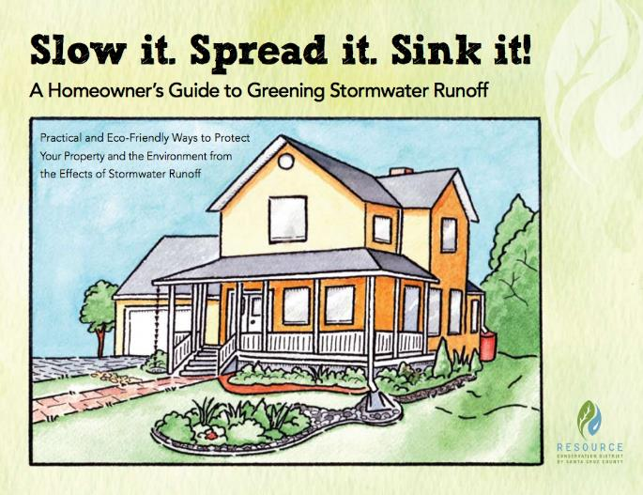
Urban Stormwater Management
And, Settle out!
Notes:
“Slow it, spread it, sink it” is the mantra of urban stormwater management.
You could also add “Settle Out” for a 4th “S” word, since these measures often allow pollutants to settle out before the water moves away.
Many urban stormwater BMPs will use these concepts to manage large stormwater volumes in order to minimize flooding and pollution impacts.
This graphic shows how homeowners can also apply these concepts at a smaller scale on their own properties by:
Slowing the runoff from roofs, sidewalks and driveways. (CLICK)
Spreading it out in planters, gardens, or over other pervious surfaces, rather than confining runoff to pipes. (CLICK)
And, creating landscaped areas that help the water sink back into the ground.
Source: http://montereysea.org/wp-content/uploads/2017/05/HomeDrainageGuide.v25.pdf, Resource Conservation District of Santa Cruz County, CA

Slide 6
Gray to Green Infrastructure Movement
Benefits of Going Green:
Economic
Less damage from localized flooding
Reduced construction costs
Higher property values
Environmental
Filters pollutants, better water quality
Increases groundwater recharge
Reduces greenhouse gases
Community/Public Health
Improves water quality
Creates open spaces
Reduces urban heat island effect
Source: https://gitoolkit.njfuture.org/
Notes:
The Gray to Green Movement refers to the effort to transition from traditional urban stormwater solutions to plant and soil-based solutions.
Traditional gray infrastructure is designed to move stormwater away from the built environment and includes the curbs, gutters, drains, piping and collection systems that we have become familiar with. Generally, these systems collect and convey stormwater from impervious surfaces, such as parking lots, roads and rooftops, into a piped system that ultimately discharges directly into a local water body.
Green infrastructure is designed to mimic nature and capture rainwater where it falls. It reduces runoff and treats stormwater at its source while providing many other economic, environmental and community benefits.
The graphic above shows how the landscape can be used as a filter rather than using it as a funnel directing untreated stormwater through piped systems to a receiving waterbody.
Sources: USEPA and New Jersey Green Infrastructure Municipal Toolkit

Slide 7
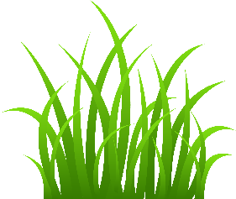
Fundamentals of Green Infrastructure
Provides means of capturing and temporarily storing stormwater while it infiltrates, is taken up by plants, or evaporates
Takes advantage of natural abilities of soil to absorb water and support microbial breakdown of pollutants
Prioritizes native plants – high evapotranspiration rates, deep root systems, relatively low maintenance requirements
Effectively designed for targeted pollutants of concern
Creates attractive landscape design
Notes:
Green Infrastructure is a critical concept for current urban stormwater BMPs.
This listing provides some of the fundamental concepts and advantages of greener approaches.
In reality, a combination of some traditional gray infrastructure and retrofits or new additions of green infrastructure will best address flooding and water quality impacts.

Slide 8
Combined effect of reducing runoff volume and pollutant concentration
Notes:
It’s also worth reiterating importance of the combined effect of some stormwater BMPs—in this case, a rain garden—removing BOTH pollutant amounts and runoff water volume.
Using this practice, the pollutant concentration is reduced by half (100 mg/L to 50 mg/L) AND the runoff water volume is reduced by half as the water percolates into the ground below the rain garden.
The result is an overall 75% reduction of the total load of the pollutant running off the land (from 100 kg to 25 kg in this example).
By providing these dual services, stormwater BMPs can create “collaborative benefits” (or “co-benefits”) when implemented.

Slide 9
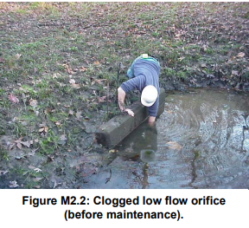
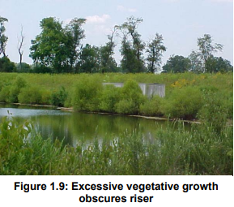
Drawbacks of Going Green
Maintenance
Require regular maintenance and upkeep to maintain function
Cost
Some GI practices are more expensive than traditional (i.e., permeable pavement)
Aesthetics
If not maintained, planted areas can appear weedy or unkempt, grow algae or become mosquito breeding grounds
Space
Larger land areas are needed for some GI practices, such as detention or retention basins and wetlands
USEPA
Notes:
There are also some drawbacks to transitioning away from gray and toward green infrastructure.
Maintenance is critical to ensure the longevity and continued effectiveness of green infrastructure practices. Routine maintenance on vegetated practices is similar to general landscape maintenance: removing trash, leaf litter, and debris; keeping plants healthy; and cleaning out accumulated sediment and pollutants. Regular inspections will indicate if the practices are not functioning properly.
The initial up-front cost of some green practices may be more than those of traditional infrastructure. But, the costs can also offset the added costs of further stormwater controls that would be needed. For example, the use of permeable pavement may eliminate the need for a stormwater detention basin adjacent to a parking area.
While aesthetics can be considered an advantage of well-maintained green infrastructures features, the installations can also be judged as unkempt or weedy when not adequately managed and maintained. Some people see damp, weedy areas as mosquito breeding grounds and they may be opposed for that reason.
While gray infrastructure can largely be buried underground, green practices require more land surface and it may be more difficult to find adequate space to install them.
Stormwater Wet Pond and Wetland Management Guidebook, USEPA, February 2009
https://www3.epa.gov/npdes/pubs/pondmgmtguide.pdf

Slide 10
Stormwater Video: https://vimeo.com/91338501

Slide 11
Structural vs Non-Structural BMPs
Structural BMPs
Built facilities that typically capture runoff, treat it through chemical, physical or biological means, and discharge the treated effluent to receiving waters, groundwater or conveyance systems.
Non-Structural BMPs
Changes in activities or behavior that help minimize runoff pollution. May also refer to preservation of open space or other low-impact land management strategies.
Notes:
BMPs can be categorized many ways, one of which is whether they are structural or non-structural measures. Other comparisons are source controls vs treatment controls and point vs nonpoint source controls.
We will consider these stormwater BMPs according to whether they are structural or non-structural.
The majority of the BMPs we will discuss in this module are structural practices, or built facilities that capture runoff, treat it and discharge it. These practices require construction, installation, and maintenance.
Most non-structural BMPs relate to policy or educational initiatives to encourage human behaviors that minimize impacts. These can include erosion and sediment control planning and related ordinances, public information about fertilizer management, pet waste pick up, and septic system care.
Other non-structural measures are aimed at reducing imperviousness or connections to impervious areas and increasing open space and natural systems (such as wetland areas or riparian buffers).
Sources: StormwaterPennsylvania (stormwaterpa.org)
USEPA Handbook for Developing Watershed Plans to Restore and Protect Our Waters

Slide 12
Guide to BMP Information
Description
General description of the BMP with some design considerations
Pros and Cons
Examples
Pollutants Addressed: List of contaminants typically removed
Low | Medium | High
<$10,000 | $10,000 - $100,000 | $>100,000
Annual, or low cost | Monthly, or mid-cost | Weekly, or high cost
Low removal | Medium removal | High removal
Relative Cost Rating
Maintenance
Treatment Effectiveness
Notes:
This slide shows the format that will be used to describe each of the following stormwater BMPs.
The title will name the practice and label it as structural or non-structural.
A short description with pros and cons will be provided.
The pollutants addressed will list the contaminants typically removed by the practice.
And, three symbols are used for relative ratings of low, medium or high for Cost, Maintenance Needs and Treatment Effectiveness.

Slide 13
Urban Structural BMPs
Notes:
We will begin with a review of several of the structural BMPs used to manage and treat stormwater runoff.

Slide 14
Structural Practice – Bioretention Cells
Areas that use soil and plants to remove pollutants from stormwater runoff through a variety of chemical, physical and biological processes.
Medium
Medium
Medium
Pollutants Addressed: Sediment, Suspended Solids, Metals, Nutrients, Pathogens
Notes:
Bioretention cells are similar in concept to rain gardens, which many people have heard about. They may also be called tree pits or curb extensions, and may be placed in parking lots, along roads, medians, or even off-line from grassy swales.
The name gives away how these practices function. Bio- indicating that it is the biological micro-organisms in the filter media that are working to achieve water quality improvements and – retention indicating that they hold water for a period of time. The filtration media of bioretention cells help remove pollutants, especially sediments and nitrogen, before the water percolates out of the retention cell. This process of using soil, plants and associated microorganisms to remove pollutants is called “bioremediation.”
The runoff flows into these areas through a pretreatment area – often a forebay (a small depression) – or graded entryway. The water then flows onto
soil media -a mixture of sand or gravel, soil, and mulch is planted with water-tolerant woody and herbaceous plants. This area maximizes infiltration and pollutant removal. The runoff is temporarily stored in these areas where it infiltrates into the soil. If the soil infiltration rate is too slow, an underdrain may be installed underneath and connected to the stormwater system. An overflow pipe and or emergency spillway is installed to allow for a bypass when capacity is exceeded.
When these cells are created during construction, they are inexpensive and easy to install. They can be sized to suit many areas from suburban, commercial and industrial settings and can minimize costs of associated curb and gutter or other stormwater drainage systems.
Relative Cost Rating: Medium
Maintenance: Medium
Effectiveness: Medium
Source: https://capecodgreenguide.wordpress.com/bio-retention/

Slide 15
Bioretention Cells
Pros:
Generally high-volume reduction (groundwater recharge +/- 90%)
Generally high pollutant removal for suspended solids, heavy metals nutrients, pathogens
Flexible small or urban areas
Natural integration into landscaping
Performance improved without underdrains or when using BMPs in series
Cons:
Surface soil layer may clog over time
Frequent trash removal may be required
Must be protected during nearby construction activity
Single unit only serves small drainage area
Requires frequent maintenance of plant material and mulch layer
Source: USEPA
Notes:
Bioretention cells both reduce stormwater volumes and extend the duration of stormwater discharge. By controlling these two hydrologic processes, peak flows of stormwater events are reduced and the energy of the discharges is decreased.
This slides shows several of the pros and cons of bioretention cells.
EXAMPLE of Bioretention maintenance issues that may be found:
Erosion at inflows
Soil media may be clogged by algae, may not be dewatering as designed
Too many weeds, choking out desirable vegetation
Slope too steep, need to prevent erosion
Too little or too much mulch (2 – 3“)

Slide 16
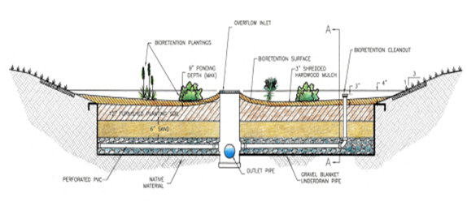
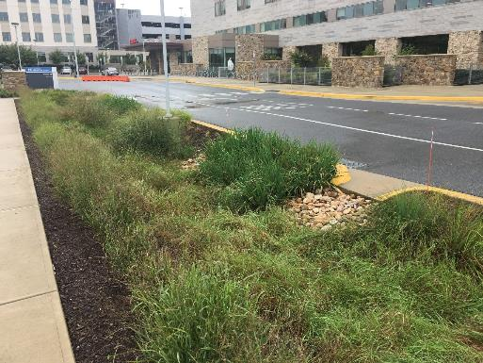
Examples of Bioretention Cells
Source: Ecological Landscape Alliance
Notes:
Both photos show bioretention cells in medians with curb inlets to allow stormwater inflow.
Photo on left: Parking lot retention cell
Photo on right: bioretention cell at a hospital in Maryland (photo courtesy of Ecological Landscape Alliance)
Graphic shows mulch, soil, sand and gravel layers with perforated pipe and overflow outlet.

Slide 17
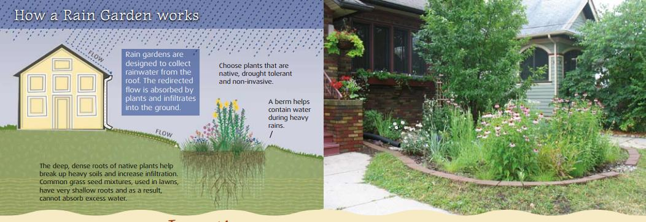
Structural Practice – Rain Gardens A smaller, residential bioretention cell
Shallow, vegetated basins that collect and absorb runoff from rooftops, sidewalks, driveways
Source: Louisville and Jefferson County Metropolitan Sewer District
Notes:
Rain gardens are simply smaller bioretention cells, which are vegetated depressions that store and treat runoff from nearby roofs, pavement or other hard structures.
They are designed to accommodate the amount of stormwater you expect to capture and drain within 48 hours.
The center of the raingarden should be planted with vegetation that can tolerate periodic ponded water or wet conditions. Sedges and rushes are usually ideal for these areas.
As you move outward from the center, you can use plants that can tolerate both wet and drier conditions.
It is suggested that rain gardens should be planted at least 10 feet from the house and 40 feet from septic systems or steep slopes.
Weeding and watering are critical in the first few months of installation to help plants become established.
Annual pruning and mulching are recommended, and some irrigation may be needed during drought periods.
The use of native vegetation reduces maintenance needs, including the use of fertilizers and pesticides.
Resources:
A How-To Guide for Building Your Own Rain Garden, Louisville MSD, http://www.msdlouky.org/aboutmsd/pdfs/RainGardenRev.pdf
Residential Rain Gardens: Design, Construction and Maintenance, UK Cooperative Extension Service, http://www2.ca.uky.edu/agcomm/pubs/HENV/HENV205/HENV205.pdf
Rain Garden Manual for Schools: A How-To Manual for Fayette County Public Schools, https://register.greenschoolsconference.org/uploads/GSCE2017/HANDOUTS/KEY_14036551/RainGardenManualForSchools.compressed.pdf

Slide 18
Rain Gardens
Pros:
Stormwater infiltration reduces volume of runoff
Diminish peak discharges to waterways
Remove substantial percentages of pollutants (bacteria, organics, suspended solids, nutrients)
Flexible to suit space
Cons:
Require proper design & some maintenance (weeding, replacement of dead plants)
Require buy-in of homeowners and willingness to install in private lawns
Limited impact unless have widespread use by multiple homeowners/businesses in the watershed
Source: USEPA

Slide 19
Structural Practice – Stormwater Wetland Stormwater wetlands are constructed systems that mimic the functions of natural wetlands and use physical, chemical and biological processes to treat stormwater pollution.
Notes:
Stormwater wetlands are constructed systems that mimic the functions of natural wetlands and use physical, chemical and biological processes to treat stormwater pollution. In these wetlands, the microorganisms can eat the E.coli and other bacteria, the nitrogen is broken down by the anoxic conditions, and the phosphorus is taken up by the plant life.
In this stormwater wetland example, the flow enters at the left and flows into a forebay (a slow water pool area) where some of the sediments can settle out. It then flows through water levels of various heights to allow for different plants to grow – some submerged – some emergent - providing a variety of habitats and filtration through the dense rooted vegetation. There is as a shallow micropool to provide some retention prior to flowing out. There are also features such as safety bench – to maintain water within the feature, and a primary outlet and an emergency spillway to allow for bypass when capacity is reached.
Other items such as trash rakes or a series of pools and wetlands can be added to increase habitat and variation.
Resource: Stormwater Wetlands publication ID-215, UK College of Agriculture, Food and Environment
https://www.uky.edu/bae/sites/www.uky.edu.bae/files/ID-215_0.pdf

Slide 20
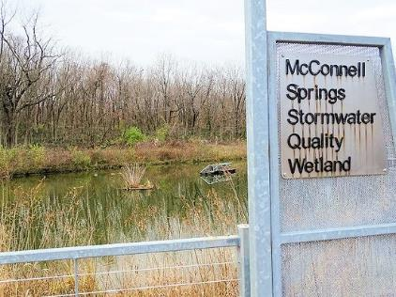
Structural Practice – Stormwater Wetlands
McConnell Springs stormwater wetland in Lexington helps improve stormwater quality, while providing community education.
Pollutants Addressed: Sediment, Suspended Solids, Metals, Nutrients, Pathogens, Temperature
Medium
Medium
Medium

Slide 21
Stormwater Wetlands
Pros:
Removes multiple pollutants
Best BMP design for max TSS, nitrogen and phosphorus removal, while also reducing volume
Aesthetically pleasing when maintained
Can provide excellent wildlife and waterfowl habitat
Cons:
Occupies more land than detention basins and other BMPs
Needs to have critical water balance to function properly
Can be colonized by invasive species that outcompete native wetland plants
Nutrient and sediment loading can create algae and aesthetic problems
Source: USEPA
Notes:
Resource: Stormwater Wet Pond and Wetland Management Guidebook, USEPA, February 2009
https://www3.epa.gov/npdes/pubs/pondmgmtguide.pdf

Slide 22
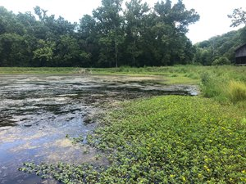
Structural Practice – Floodplain or Bankfull / Benchfull Wetlands
Route overbank stream flows through large off-line wetland areas. Provide stormwater storage, pollutant removal and habitat.
Medium
Low to Medium
Medium to High
Sustainable Streams, LLC
Pollutants Addressed:
Total suspended solids, nutrients, bacteria
Notes:
Floodplain, streamside, bankfull or benchfull wetlands are different names for the same feature. They refer to wetlands located in the floodplains are adjacent to streams. When water flows over the banks of the stream, it is stored in these wetlands for a prolonged period. This practice has a high potential to treat large volumes of polluted water by routing overbank stream flows through large off-line wetland areas.
Ideal candidates for the creation of bankfull wetlands include large, low-lying swaths of land adjacent to the channel and publicly-owned lands improve feasibility.
Reference: Gunpowder Creek Watershed-Based Plan
Gunpowder Creek Example: YMCA BANKFULL WETLAND
BOONE COUNTY CONSERVATION DISTRICT - BURLINGTON, KY
~7-acre-ft floodplain wetland provides hydrologic restoration to Gunpowder Creek while also improving habitat conditions, water quality benefits, and serving as an educational feature for YMCA programming.

Slide 23
Structural Practice – Vegetated Swales / Bioswales
Broad, shallow, natural or constructed channels with a dense stand of vegetation covering side slopes and bottom of channel. Can include an engineered soil matrix and underdrain system.
Low
Low
Low to Medium
University of Kentucky Bioswale, Ridgewater, LLC
Photo by Carol Lea Spence
Pollutants Addressed: Sediment, Suspended Solids, Nutrients
Notes:
Bioswales can be thought of as a linear bioretention area.

Slide 24
Vegetated Swales / Bioswales
Pros:
Can reduce use of costly development infrastructure (i.e., curb and gutter)
Can be aesthetically pleasing
Low-slope swales can create wetland areas
Reduces runoff velocity by creating longer flow paths, channel roughness (vegetation)
Cons:
Could cause problems with standing water and mosquitoes
May become channelized due to concentrated flows
Low pollutant removal rates and minimal volume control.
Frequently must be used with other stormwater BMPs.
Source: USEPA

Slide 25
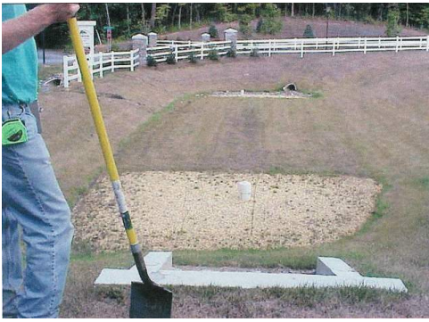
Structural Practice: Filtration Devices / Sand Filters
Temporarily stores and treats runoff through filter media (sand, soil, gravel, peat, compost)
Then, routes water through underdrain system to stormwater pipes
Effective for treating runoff from small, highly impervious sites
Medium
Medium
Medium
Pollutants Addressed:
Primarily Nutrients
Source: Virginia Dept. of Conservation & Recreation
Notes:
These filtration devices are not effective at reducing runoff volumes. Also, they are not applicable in karst areas, due to the potential for underground mis-routing to nearby waterways or aquifers.
Resource: http://chesapeakestormwater.net/wp-content/uploads/downloads/2012/02/DCR-BMP-Spec-No-12_FILTERING-PRACTICES_Final-Draft_v1-8_03012011.pdf

Slide 26
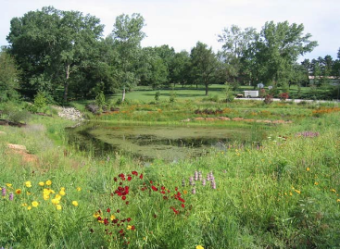
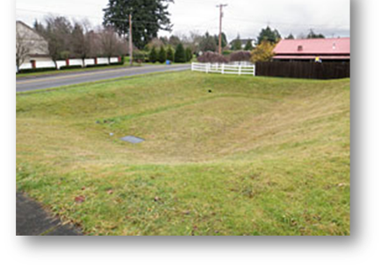
Structural Practice – Wet (Retention) vs Dry (Detention) Basins
Wet (Retention) Basin
Dry (Detention) Basin
Designed to maintain permanent pool, plus extra storage for stormwater capture
Pollutant reduction primarily through settling, with some biological uptake, mainly of nutrients
Designed to detain stormwater for 2-3 days to reduce peak flow and settle pollutants
Do not maintain pool between storm events
May develop wetland vegetation and shallow pools in the bottom of basin
Notes:
Retention or Wet Detention Basins (also called stormwater ponds) create a permanent pool for water quality treatment and some additional capacity for temporary runoff storage.
Detention or Dry Detention Basins are depressions or basins created by excavation or berm construction that temporarily store runoff and release it slowly via surface flow or groundwater infiltration following storms.

Slide 27
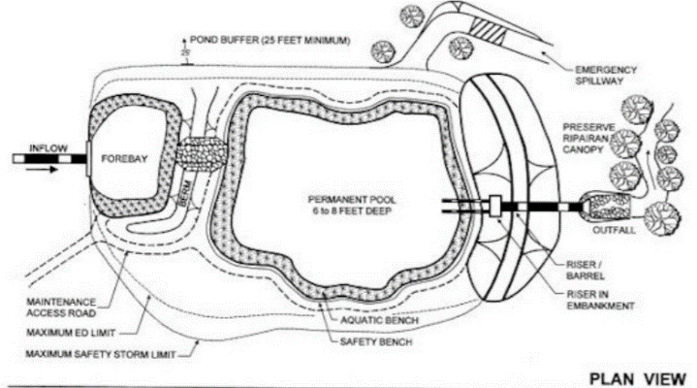
Structural Practice – Wet (Retention) Basin
Earthen basins that allow a substantial permanent pool for water quality treatment and additional capacity for temporary runoff storage.
Target Pollutants: Sediment, Suspended Solids, Nutrients, Organics
Low
Low
Low to Medium
Pennsylvania Stormwater Manual
Notes:
Retention basins are better at improving water quality (especially total suspended solids) than reducing runoff volumes.
They should include a forebay area that traps coarse sediment and eases maintenance procedures. The perimeter should be covered by dense emergent wetland vegetation.
They require an adequate source of inflow to maintain the permanent pool and are sometimes called “stormwater ponds.”
Source: Pennsylvania Stormwater Best Management Practices Manual

Slide 28
Wet (Retention) Basins
Pros:
Permanent pool can effectively provide significant water quality improvements
When used broadly across an area, can capture storm volumes and limit impacts
Can provide substantial recreational and wildlife benefits
Can be designed to control peak flows
Cons:
Ponded water can be viewed as a safety concern
Maintenance and sediment removal can be more difficult than with dry basins
Other maintenance concerns are floating litter, algae and scum, nuisance odors, aquatic plants
Requires permanent pool, which may be difficult to maintain without a sufficient drainage area
Can attract geese, which add to nutrient and fecal loading

Slide 29
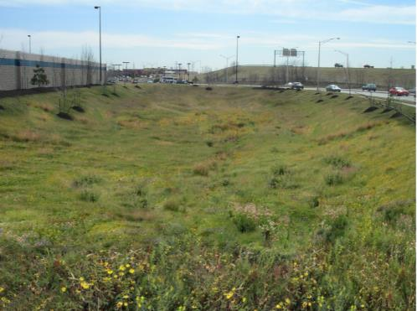
Structural Practice – Dry (Detention) Basin
Earthen basins that capture a stormwater runoff volume, hold it, and slowly release it into the soil over a period of days.
Target Pollutants: Sediment, Suspended Solids, Nutrients, Organics
Low
Low
Low to Medium
Louisville MSD
Notes:
Dry detention basins are surface depressions that provide temporary storage of stormwater runoff. They release the flow slowly over a period of a few days and are normally dry between events. They represent one of the most common stormwater BMPs since the 1970s and have helped control runoff peaks, as well as some level of suspended solids.
Although they are effective at providing flood protection by volume control, they provide very limited water quality controls. When water quality control is needed, they should be utilized in a treatment train approach with other helpful BMPs. The vegetation that grows in the bottom of these basins may enhance pollutant removal through biological uptake, followed by maintenance removal of the vegetation.
A dry detention basin is a typical stormwater BMP used in residential and commercial areas. They are usually less costly than retention basins since they require less excavation.
Source: Bowling Green Stormwater BMP Manual, October 2011
https://www.bgky.org/files/t2CToz3Z.pdf

Slide 30
Dry Detention Basins
Pros:
Simplicity of design makes them relatively easy and inexpensive to construct
Can substantially capture sediment and pollutants attached to particles
Reduce volume of runoff—which reduces downstream flooding and protects stream channels
Can be designed to provide other benefits – recreation, open space
Cons:
Require large flat area of land
Moderate pollutant removal when compared to some other structural practices
Relatively ineffective at removing soluble pollutants
Have potential for clogging
Can detract from nearby home values because of large expanse of dry, bare area with inlet/outlet structures

Slide 31
Why Retrofit Detention Basins?
Originally designed for flood prevention – collected runoff from impervious sites and channeled it to a nearby stream fairly quickly. Created erosion and water quality problems downstream.
Source: Pennsylvania Environmental Council
Notes:
There has been a push to retrofit old detention basins that were designed mainly for flood prevention. These retrofits can improve their overall effectiveness of treating both volume and pollutant levels.
The speed of stormwater movement through the basin channel carried trash, sediment and pollutants quickly through the channel.
Turf grass did little to slow water movement and was not effective at soaking up or filtering the stormwater.
Additional water entered the basin at its edges.
And, the outlets were designed to move water out of the basin quickly and into receiving streams—causing erosion and water quality problems.

Slide 32
After retrofitting…
Retrofits enable natural processes, such as infiltration and evapotranspiration, to return stormwater to the atmosphere or soak it into the ground.
Source: Pennsylvania Environmental Council
Notes:
A retrofit of a dry basin can better enable natural processes to help stormwater soak into the ground or reenter the atmosphere.
These retrofits may include:
A forebay that slows stormwater after it enters through the inlet, allowing some sediment to settle out.
A berm or energy dissipater that forces water to disperse to either side of it, slowing and spreading the flow.
Added meanders to the flow path, further slowing and spreading the flow.
Additional plantings that help absorb some of the water and encourage it to soak into the ground.
Possibly, a rain garden pocket, that provides a concentrated area of stormwater treatment.
And, and outlet and outflow that better control the amount and timing of water releases.
Video at http://bit.ly/SWPARethinkingBasins

Slide 33
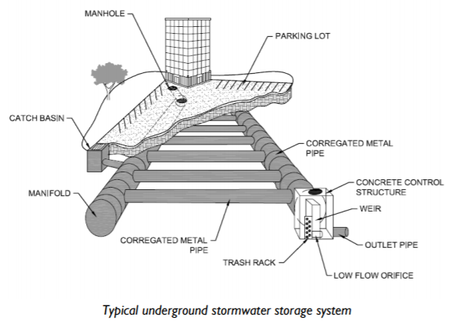
Structural Practice – Underground Detention
The practice of collecting and detaining stormwater runoff underground in pipes, vaults, chambers, or modular structures. The collected runoff is then released back to surface systems at a reduced rate.
Target Pollutants: Sediment, Floatables
High
Low to Medium
High
Louisville MSD
Notes:
Some underground storage systems also allow the stormwater to infiltrate into the soil, provided they have the necessary permeability.
These systems are typically constructed of concrete, steel or plastic.
When water quality improvements are needed, they should be used in conjunction with other practices or pretreatment devices.

Slide 34
Underground Detention
Pros:
Reduces runoff flow volumes and impacts of bankfull events
Does not consume land surface area
Adaptable to property shape
Cons:
Requires pretreatment of stormwater to reduce maintenance or enable soil infiltration
Shouldn’t be used in areas with a high groundwater table
Should be located in areas that can be excavated in the future
Notes:
Underground detention structures are typically used in a variety of ultra-urban areas from high-density residential to commercial and industrial. They are helpful when land is not available or is too expensive.
These structures need to be constructed so that gravity helps water flow into and out of the system, with a slope of no more than 2%.
They should be located in areas that can be excavated if needed for maintenance or repairs.
Source: Louisville MSD Green Infrastructure Manual
https://louisvillemsd.org/sites/default/files/inline-files/Chapter18_GreenInfrastructureDesignManual_Rev062016_0.pdf

Slide 35
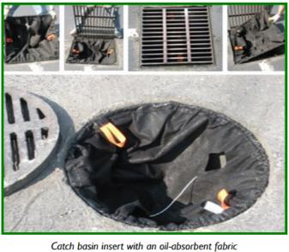
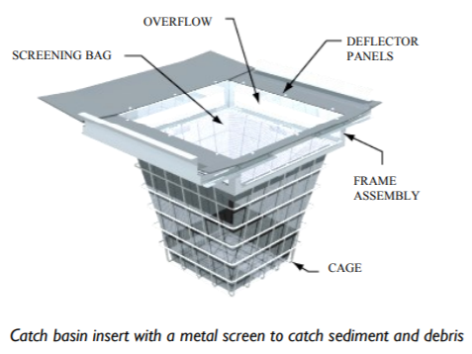
Structural Practice – Catch Basin Inserts
Space-saving inserts that are installed under the grate of an inlet to remove sediment, debris, oil or metals from stormwater inflow.
Target Pollutants: Sediment, Floatables, Metals, Oil and Grease
Low
High
High
Source: Louisville MSD

Slide 36
Catch Basin Inserts
Pros:
Easy to install in new construction and as system retrofits
Work well in treatment train approaches
Appropriate for sites with space limitations and limited infiltration opportunities
No added storage required beyond storm sewer system
Cons:
Not effective for water quality treatment on its own
Doesn’t address dissolved pollutants or fine particles
May clog easily, so not ideal for areas with heavy sediment loads
High inflow may necessitate more frequent maintenance
Notes:
These work well in treatment trains because they trap sediments and prevent clogs in subsequent structures.

Slide 37
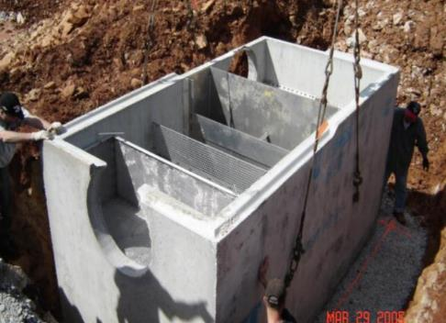
Structural Practice – Manufactured Water Quality Units
Underground treatment systems installed at inlet structures. Vary based on manufacturing design, but typically use a swirling vortex or multiple chambers to separate sediments, floatables (oil/grease) from inflow.
Target Pollutants: Sediment, Floatables, Oil and Grease, Organic Materials
Medium to High
Medium
Medium
Source: Bowling Green BMPs
Notes:
These units provide water quality improvement at stormwater inlets and are generally underground structures.
They often enable a swirling motion which helps sediments and particulates to settle out. A chamber captures floatables, such as oil and grease.

Slide 38
Water Quality Units
Pros:
Easy to install
Ideal for retrofit applications
Optimal for sites with space limitations or limited infiltration
Can be designed to handle hazardous substance runoff
Cons:
Not effective for volume reduction or infiltration
Variable maintenance frequency
Not effective for removal of dissolved pollutants or fine particulates
Can be source of pollutants if not maintained adequately
Notes:
Maintenance frequency dependent on size of structure and quantity of flow and pollutants
Sources: Bowling Green Stormwater BMP Manual and Louisville Green Infrastructure Design Manual

Slide 39
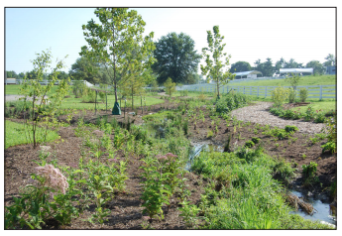
Structural Practice – Restored Riparian Buffers
Vegetated zones along stream and river banks, ideally with a mixture of herbaceous plants, shrubs and trees and with a minimum width of 50 feet from each bank
Target Pollutants: Sediment, Metals, Floatables, Nutrients, Bacteria
Low to Medium
Low
Medium to High
Newly planted riparian buffer at Kentucky Horse Park, UK College of Agriculture
Notes:
The wider the buffer, the more benefits it provides. But some buffer is better than no buffer!

Slide 40
Riparian Buffers
Pros:
Provides water quality treatment, reduced runoff flow/velocities, erosion control, water temperature benefits
Helps prevent streambank erosion
Offers aesthetic and passive recreational benefits
Enhances wildlife habitat
Cons:
Can be viewed as unkempt areas
Can be perceived as obstructing views of streams, especially with shrubby vegetation
Can be abused as places for trash dumping

Slide 41
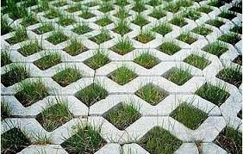
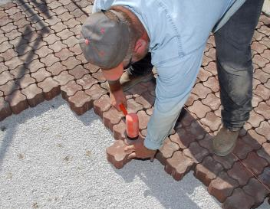
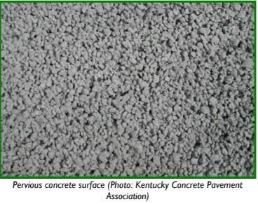
Structural Practice – Permeable Pavement
Pavement that allows stormwater to infiltrate into the ground through a permeable surface.
Target Pollutants: Fine Sediment, Suspended Solids, Metals
Permeable Pavers
Medium to High
Low to Medium
Medium
Louisville MSD
Pervious Concrete
Notes:
Porous pavement is an alternative to conventional paving materials (concrete and asphalt) that allows stormwater to infiltrate through void spaces. Common uses are for parking lots, sidewalks and multi-use paths.
Stormwater can then infiltrate the soil or be detained underground and released.
Options include permeable pavers, porous asphalt, pervious concrete, or reinforced turf.
Permeable pavers create hard surfaces that allow infiltration of stormwater through gaps between the paving components. They can be used in block or grid-systems and are aesthetically pleasing. They are also compliant with Americans with Disabilities (ADA) regulations.
Pervious concrete is a permeable pavement that allows water to infiltrate into the subsoil through the pavement surface and base layers. It is designed without any fine material, resulting in a mixture that has high void space. Pervious concrete should be used over soils that allow sufficient infiltration rates. Louisville’s Stormwater BMP manual recommends subsoils with a permeability of at least 0.5 in/hr.
Porous asphalt also allows water to infiltrate into the subsoil through the pavement surface and a stone reservoir. It is developed with a single aggregate size that allows for a “gap-graded mixture and high void space.” In addition to the subsoil requirements for pervious concrete, it is important to ensure that the high water table is at least 3 feet below the subsoil’s surface.
Source: Louisville MSD Green Infrastructure Design Manual
https://louisvillemsd.org/sites/default/files/inline-files/Chapter18_GreenInfrastructureDesignManual_Rev062016_0.pdf
`

Slide 42
Permeable Pavement
Pros:
Allows stormwater to infiltrate or be detained
Eliminates standing water
Reduces pollutant loading, runoff rate and volume
Reduces land consumption by using treatment area for parking/driving
Can be an attractive pavement option
Cons:
Can become clogged with sediment without proper maintenance, reducing effectiveness
Not applicable for all site conditions
Pavement costs higher than conventional options, but may be offset with reduced need for other stormwater BMPs.
Notes:
Not applicable for all site conditions, such as in roadways or under tree canopy, which may cause excessive clogging from fallen leaves.
Specialized knowledge is required for proper site evaluation, design and installation.
EXAMPLE of Permeable Pavement issues that may be found:
Pavers may require debris removal, vacuuming and stone reinstallation
Permeable concrete or pavement only needs to be periodically vacuumed

Slide 43
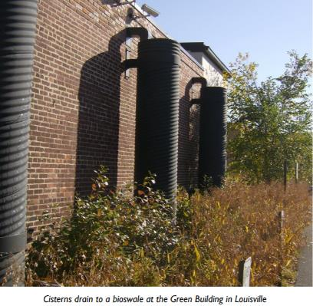
Structural Practice – Rain Barrels and Cisterns
A rainwater tank used to collect and store rain runoff, usually from rooftops via rain gutters.
A 1” rain on a 1,000 square foot roof can yield 620 gallons of water.
Target Pollutants: None
Low
Low to Medium
Low
Notes:
Rainwater harvesting through the use of rain barrels or larger rain cisterns slows water down by temporarily storing rooftop runoff that is channeled through gutters to the downspout and into the device.
Widespread use in an urban area could help reduce runoff volumes and subsequent pollutant loading from the runoff itself. These practices do not capture and treat pollutants; they are only meant to capture and prevent stormwater from running offsite.
If the water is not used for beneficial purposes (watering plants, washing cars, etc) or gradually released, it will not provide the stormwater capture benefits.
Captured rainwater can be used for watering plants (irrigation) or other non-potable uses.
Advantages of rain barrels are that they take up little space, are inexpensive and are easy to install.
Mesh screens can prevent debris from clogging the barrel’s faucet and mosquito breeding. You can also use natural mosquito dunks to prevent mosquito larvae from hatching.
Empty your rain barrel no more than a week after a rain event to prevent the water from becoming stagnant.
Resource: Bluegrass Greensource, https://bggreensource.org/what-you-can-do/water-quality-conservation/rain-barrels/

Slide 44
Rain Barrels and Cisterns
Pros:
May reduce water bill
Reduces channel or streambank erosion by reducing flow volumes
Allows beneficial reuse of stormwater
Cons:
Need to drain or use captured roof runoff between events
Overflow needs to be routed to a stable, pervious location
Not ideal for use with tar and gravel or asbestos shingled roofs
May need to use mosquito deterrents
Notes:
If used properly, rain barrels or cisterns can enable sustainable use of stormwater, reducing water bills. And, if used widely or on a larger scale, such as through the use of multiple cisterns at a commercial or industrial facility, they can significantly reduce runoff volumes and impacts.
In order to maintain their effectiveness, the captured water in barrels or cisterns need to be used or emptied between rain events. So, they should be located as close to the irrigation area as possible and at a height that allows the water to drain through gravity.
Also, system overflows should be routed to a pervious location that will not be easily eroded from concentrated flows.
A grated inlet to the container can prevent leaves and other debris from entering, and a fine mesh screen can prevent mosquito access.

Slide 45
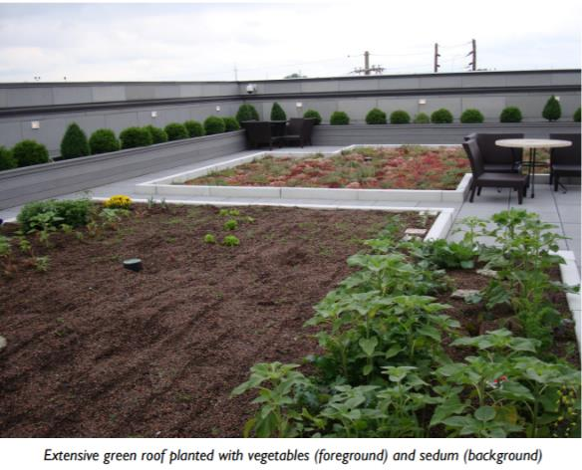
Structural Practice: Green / Vegetated Roof
Rooftop plantings that help mitigate the effects of urbanization on water quality by filtering, absorbing and detaining rainfall.
Target Pollutants: None
Medium to High
Medium to High
Medium
Louisville MSD
Notes:
A major benefit of green rooftops is their ability to absorb stormwater and release it over a prolonged time period. They have been shown to retain 60 – 100% of stormwater received.
The roofing system is made up of multiple layers, including a waterproof layer (protecting the roof), a drainage system, engineered soils and vegetation.
Extensive green roofs have a soil layer of six inches or less that supports dense, low growing, drought-tolerant plants. Intensive green roofs have deeper soils greater than 6 inches in depth that can support larger plants, shrubs and trees.
The selection of the soil material will effect the quality of effluent from a vegetated roof. Typically, non-organic, high-mineral content soils are recommended.
Resource: Water Environment Research Foundation, Liveable Communities, Sustainable Stormwater BMPs

Slide 46
Green / Vegetated Roofs
Pros:
Significantly reduces roof runoff volume
Reduction of roof runoff pollutant loads from conventional roof materials
Decreased roof temperature and energy costs in warm weather
Can extend life of roof
Adds landscaping value to rooftop
Cons:
Can contribute nutrient and bacteria to runoff
Requires adequate roof structural support and minimal roof slope
Extreme sun and wind may make plant survival difficult
Potential for roof leaks
Irrigation often required for plant establishment
Notes:
Vegetated roofs can prolong the roof structure’s lifespan by protecting the roof from ultraviolet radiation and extreme temperature fluctuations.
Green roofs can increase nutrient runoff due to nutrients present in the soil. For this reason, typically, non-organic, high mineral content soils are recommended. Also, if birds and other wildlife are attracted to the roof, they can be a source of bacteria runoff.

Slide 47
Urban Non-Structural BMPs
Notes:
Now, we will focus on non-structural BMPs that focus on educational or policy approaches to changes behaviors that can help limit urban runoff pollution.

Slide 48
Education is always an ongoing need.
Notes:
Due to the broad community audience and the huge range of stormwater runoff sources, public education is critical and should be ongoing!
Raising awareness about stormwater pollution and the different contributors and solutions is critical to achieving success.
In this example, a simple education campaign is being used to illustrate how homeowners should responsibly get rid of leaves in the fall.
City pick up or composting are good options, since leaving them on the street can cause storm drain blockage and flooding and disposing of them in the creek can harm wildlife.

Slide 49
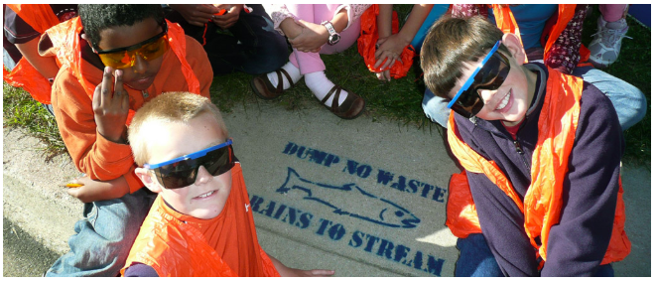
Public Education!
Source: Bluegrass Greensource
Notes:
Also, most people do not know that stormwater captured in storm sewer infrastructure is directed straight to a natural waterbody without being pre-treated.
Thus, storm drain stenciling campaigns are one important way to help educate people of this fact and help them understand that dumping something down on a storm drain is effectively dumping it in a stream.
This photo was taken from Bluegrass Greensouce’s website. This central Kentucky organization helps organize and provide the materials for local storm drain stenciling efforts.

Slide 50
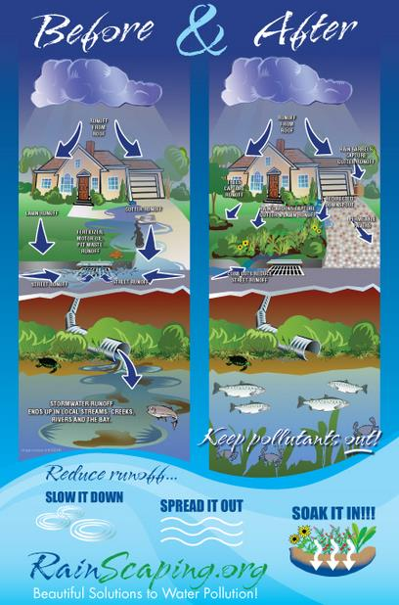
The Chesapeake Ecology Center has created some excellent graphics to illustrate the concept of green infrastructure and how it reduces runoff pollution.
http://www.livewellandgreen.org/signage/
Notes:
There are many education and outreach resources available from a wide variety of organizations and government agencies.
The effort to protect the Chesapeake Bay has produced some of the best examples of outreach materials, such as this poster about “Rainscaping” to reduce runoff pollution.

Slide 51
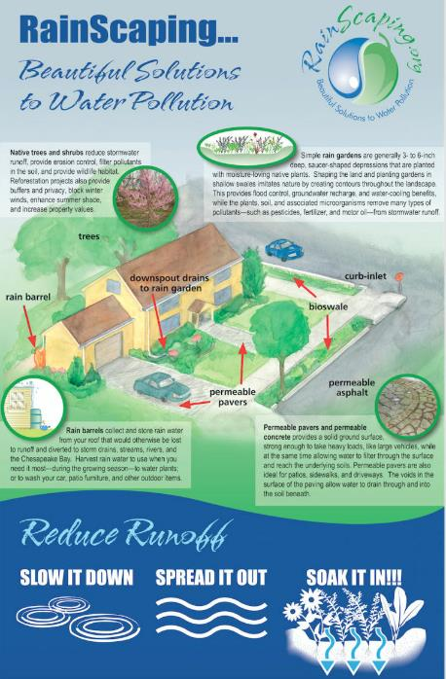
RainScaping BMPs:
reduce stormwater runoff
promote infiltration, and
filter runoff by controlling it at its source
Practices range from simple measures:
redirecting downspouts to planting beds
installing rain gardens and rain barrels
planting native trees and shrubs
replacing hard surfaces with permeable surfaces
To more sophisticated measures:
larger bioretention areas
green roof installations
Chesapeake Ecology Center
Notes:
Rainscaping suggests simple measures for the homeowner such as:
Redirecting roof downspouts to planting beds to help with infiltration
Installing rain gardens to manage onsite runoff and rain barrels to capture roof runoff for irrigation or other needs
Planting native trees and shrubs that require less chemicals and watering
And minimizing paved surfaces in favor of permeable options, such as permeable pavers or concrete driveways
This campaign also promotes more complex and larger scale measures, such as bioretention areas or green roofs.

Slide 52
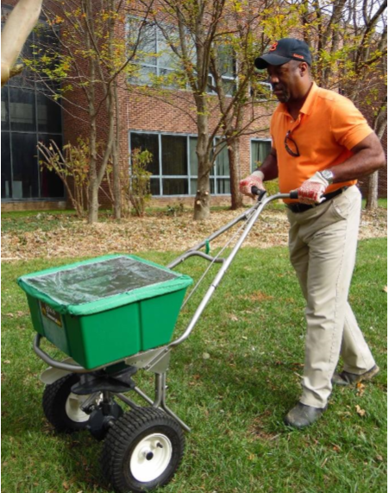
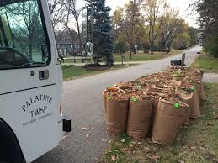
Urban Behavioral Management Practices
Lawn fertilizer application
Yard trimming management
Composting
Pet litter
Car washing
Conservative watering
Downspout redirection
Notes:
Urban behavioral management focuses on promoting practices among local residents that benefit water quality. Widespread adoption of these practices can have a large impact on water quality because of the collective impact.
However, it can be difficult to convince people to alter their habits and behaviors through messaging alone. Finding effective incentives or alerting people to associated costs savings can help motivate people to adopt these practices.
Lawn fertilizer – When people overapply fertilizer or apply it at the wrong times, the nutrients in the fertilizers can wash off into streams and cause water quality problems. So, it is important to provide education about appropriate amounts, timing and frequency for lawn fertilization. Encouraging use of free soil sampling at county extension offices is another helpful suggestion, since it allows residents to fine tune their fertilizer needs. In Kentucky, additional phosphorus is rarely needed, due to high levels already present in the soils.
Yard trimmings – When yard trimmings are left in places that are vulnerable to storm runoff, rains can wash them into storm drains and into local streams. They become a source of excess nutrients, leading to water quality problems.
Composting – Instead of sending it to a landfill or allowing it to be washed away, composted yard waste can provide a valuable organic fertilizer for gardens and lawns.
Pet litter – By picking up pet waste and disposing of it in a trash can, people can reduce the amount that washes down storm drains and into nearby waterways. Pet litter contains high amounts of nutrients, bacteria and organic matter, all of which contribute to water quality problems. Public awareness campaigns can help residents understand the importance of picking up after their pets, and convenient bag/trash stations make it more convenient.
Car washing – Car detergents can contain high levels of phosphates and other nutrients, and soap suds can harm aquatic life. Rather than washing cars in driveways, where these substances can flow to the nearest waterbody, it is recommended that people wash their cars at commercial car washes which capture the runoff for treatment. If a commercial car wash is not available, washing on the grass is better than on a driveway or road.
Conservative watering – Overwatering lawns can result in unnecessary runoff, possibly carrying fertilizer or excess nutrients with it. Water efficient landscaping using native plants and grasses can also help cut water use.
Downspout redirection – This refers to the disconnection of the gutter downspout to a pipe or paved area and its redirection to a rain barrel or to a lawn or garden where water can soak into the ground.
Redirecting downspouts to a landscaped area is a great way to help reduce runoff from a property.

Slide 53
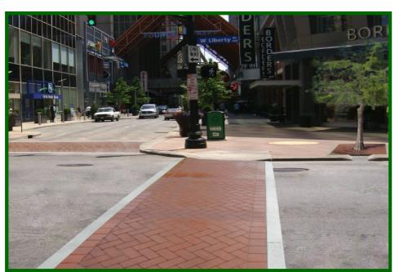
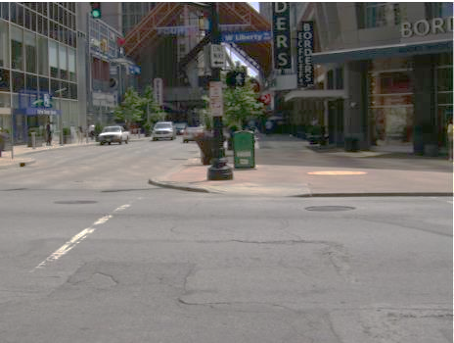
Non-Structural Practice: Reduced Curb and Gutter
Reduced or eliminated use of curb and gutter systems to encourage infiltration of stormwater, rather than routing it to the storm sewer system.
Traditional Curb & Gutter
Green Design: Use of Curb Cuts with Tree Boxes to treat stormwater and Permeable Pavers in crosswalks
Louisville MSD
Notes:
In comparison to a traditional curb and gutter system, the photo on the right includes curb cuts allowing water to flow into planters with trees. This photo also shows a crosswalk using permeable pavers to allow additional stormwater infiltration.

Slide 54
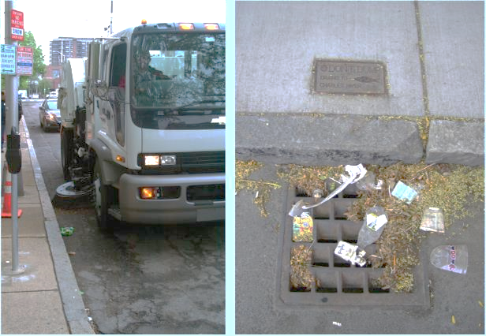
Non-Structural Practice: Street Sweeping
The use of sweeping and vacuum equipment to regularly remove larger debris and smaller particulate pollutants from roadways and prevent them from entering storm sewers or waterbodies.
Source: USGS
Notes:
With proper equipment and program design and scheduling, street sweeping can significantly reduced total suspended solid and nutrient contributions (especially phosphorus) in stormwater runoff.
Parking prohibitions and other program factors help with this BMP’s performance.
Source: Pennsylvania BMP Manual
Photo Source: Potential Reductions of Street Solids and Phosphorus in Urban Watersheds from Street Cleaning, Cambridge, Massachusetts, 2009-11

Slide 55
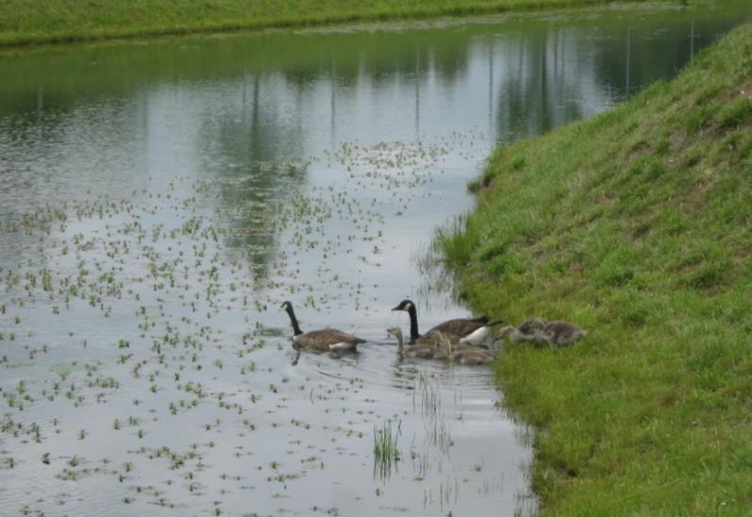
Non-Structural Practice: Waterfowl Controls
Practices that reduce the presence of year-round populations of waterfowl from stormwater ponds, which can impact protective vegetation and contribute to nutrients and bacteria in the water.
Maintain tall shoreline vegetation and no-mow zones
Addling eggs to make them non-viable
Introduce predators, such as snapping turtles!
Stop feeding them!
Source: sustainablestormwater.org
Notes:
Waterfowl, such as geese and ducks, are often attracted to stormwater ponds and can overgraze vegetative protections or cause high fecal coliform levels.
Approaches to addressing an overabundance of waterfowl include:
Maintaining tall shoreline vegetation, likely requiring no-mow zones
Addling eggs to make them non-viable. The Humane Society even has guidance on this practice and involves either coating the eggs in corn oil or simply removing fresh eggs from nests.
Introducing predators, such as snapping turtles, which may not be so acceptable if the pond is used for recreation.
And, of course, discouraging people from feeding the birds, which may be easier said than done!
The humane way to limit flock growth and stabilize goose populations is to keep eggs from hatching, in a process known as “addling.” It can be done by treating eggs with corn oil or by removing the eggs from the nest, which is humane if done at the earliest stages of development. It limits the number of geese in places people don’t want more. And it frees adult geese from tending flightless goslings, so they can be encouraged to move elsewhere before summer conflicts are greatest. In order to addle, there have to be nests. Some properties have goose issues but no nests. – The Humane Society of the United States (https://www.humanesociety.org/resources/limit-goose-flock-growth-addling-eggs)

Slide 56
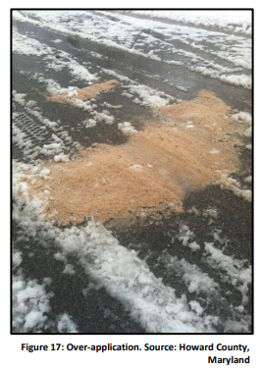
Non-Structural Practice: Deicing Salt Management
Practices that reduce the amount of road salt and other deicing chemicals in stormwater runoff.
Calibrate application equipment and monitor amount applied
Provide yearly training on application guidance
Use proper storage of deicers
Apply brine solution (salt and water) or abrasives as anti-icing measure
Use snow fences to block blowing snow
Notes:
The use of road salt to ensure safe winter driving conditions can raise the levels of chlorides and salinity in surface and groundwater, potentially harming aquatic life.
Cities and towns should develop and implement maintenance practices for handling road salt and other deicing agents, such as calibrating application equipment to apply only the amount needed and properly storing salt stockpiles to prevent runoff.
There are also other ways to manage icy roads, such as using a brine solution and snow fences to block blowing snow in areas where it tends to be a problem.
Road salt management and other municipal stormwater management needs are addressed in Stormwater Permits, or MS4 permits (Municipal Separate Storm Sewer System). These are required for many communities by the Kentucky Division of Water.
Source: Quick Resource Guide for Winter Maintenance BMPs, Pennsylvania DEP and Southwestern Pennsylvania Commission Water Resource Center
https://spcwater.org/pdf/WinterMaintenanceBMPs.pdf

Slide 57
MS4 Permit Minimum Control Measures
Six Minimum Control Measures (MCMs):
#1 – Public Education and Outreach
#2 – Public Involvement and Participation
#3 – Illicit Discharge Detection and Elimination
#4 – Construction Site Stormwater Runoff Control
#5 – Post-Construction in New Development and Redevelopment
#6 – Pollution Prevention/Good Housekeeping for Municipal Operations
Notes:
MS4 permits include 6 minimum control measures for all Phase I and Phase II permitted communities.
Each of these MCMs is worthy of a separate discussion. For this presentation, we will just make sure that you are aware of these requirements.
(CLICK) MCMs 1 and 2 - The first two relate to much of the work that watershed and basin coordinators help with on a regular basis to make sure that people are aware of stormwater runoff impacts and many of the BMPs that have been described today. Municipalities with permits are required to do this as well.
(CLICK) MCM 3 - Illicit discharge detection and elimination addresses the need to find and remove dry weather discharges to storm sewer systems. These can include illegal wastewater connections from homes or businesses and improper disposal of wastes into storm drains.
(CLICK) MCM 4 - construction site stormwater runoff control mainly addresses soil and sediment pollution. We will spend a little more time on this measure in the upcoming slides.
(CLICK) MCM 5 - Post-Construction in New Development and Redevelopment – this applies to projects that disturb an acre or greater, or smaller lot sizes that are part of a larger development project.
(CLICK) MCM 6 - Pollution Prevention and Good Housekeeping for Municipal Operations – this requires permittees to implement an Operations & Maintenance Program to prevent or reduce polluted runoff from municipal operations. It includes employee training on pollution prevention measures and techniques, such as street sweeping or detention basin cleaning and the previously mentioned ways to handle road salt deicers.

Slide 58
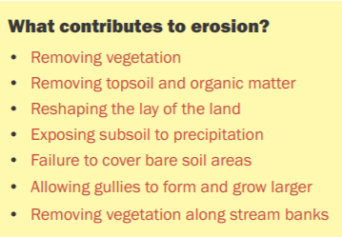
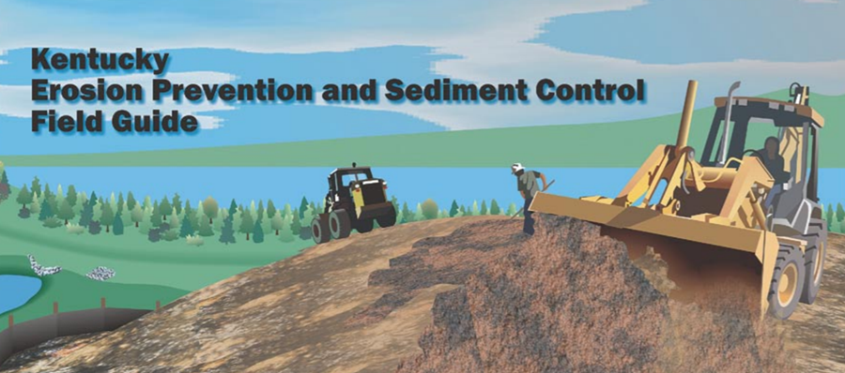
Non-Structural Practice: Erosion and Sediment Control
Practices that reduce the amount of soil and sediment runoff from construction sites of that disturb one or more acres.
Required for MS4 communities in Minimum Control Measure #4, Construction Site Stormwater Runoff Control.
Notes:
Minimum Control Measure #4 requires erosion and prevention control measures to be used on construction sites.
A 2001 USEPA 319h grant was used to create the Kentucky Erosion Prevention and Sediment Control Field Guide. This guide outlines the pre-project planning and operational activities, and describes the related erosion prevention and sediment control measures that should be utilized in communities with Stormwater (MS4) Permits.
By paying attention to the construction-related activities that enable greater erosion (in yellow box), it is easier to understand what is needed to help with erosion prevention. You need to try to avoid or do the opposite of what is listed!
Kentucky Erosion Prevention and Sediment Control Field Guide, USEPA 319h-funded publication,
https://www.epa.gov/sites/production/files/2015-11/documents/esc_guide_0.pdf
LFUCG/Tetra Tech Presentation: Construction Site Erosion, Sediment and Stormwater Management
https://www.lexingtonky.gov/sites/default/files/2018-07/Slide%20Presentation%20Conducting%20Erosion%20and%20Sediment%20Control%20Inspections.pdf

Slide 59
Basic concepts that are addressed by the BMP recommendations described in the manual.
Practices follow a “top down” approach from higher elevation levels above the construction site and proceed down the slope all the way to the nearest waterway.
Notes:
This graphic shows the basic concepts covered in the manual.
Instead of removing vegetation – try to preserve as much of it as you can, especially near waterbodies (CLICK) and seed and mulch bare soil as quickly as possible (CLICK).
When bare soil must be left exposed – divert upland runoff around it. (CLICK)
Example - Bermed soil
Use sediment barriers to prevent soil from running off of the construction site. (CLICK)
Example - Silt fencing
Protect slopes from gully formation. (CLICK)
Example – Erosion control mats
And, use sediment traps and settling basins to catch soil that does escape. (CLICK)
The publication begins with these introductory concepts, then provides detailed guidance on ways to address silt and sediment sources from upland to streambank.

Slide 60
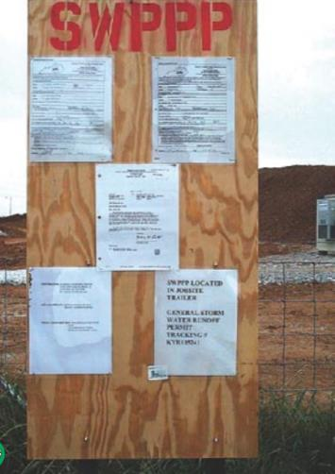
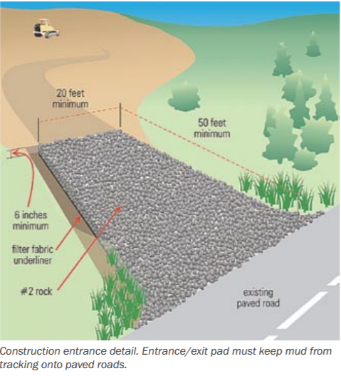
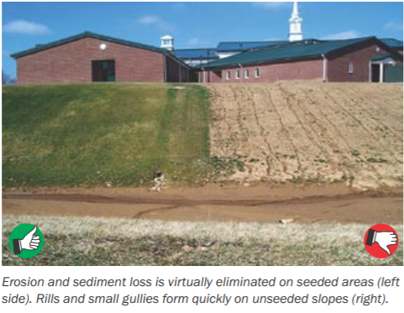
Pre-Construction Planning through Final Site Stabilization
Planning Phase
Construction Phase
Stormwater Pollution Prevention Plan
(SWPPP)
https://www.epa.gov/sites/production/files/2015-11/documents/esc_guide_0.pdf
Notes:
A course on the topic of erosion and sediment control is worthy of a full day in and of itself, but it is helpful to at least be familiar with the basic concepts and stages of planning through final site stabilization.
This includes the need for a stormwater pollution prevention plan.
You are encouraged to look more closely at the publication, which is available online.
Kentucky Erosion Prevention and Sediment Control Field Guide, USEPA 319h-funded publication
https://www.epa.gov/sites/production/files/2015-11/documents/esc_guide_0.pdf

Slide 61
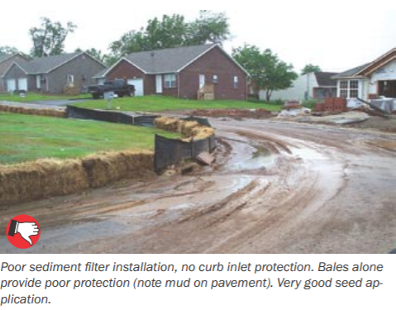
Silt Fencing and Other Silt Barrier Installation Practices
Notes:
A lot of guidance and examples are provided for the installation and maintenance of silt fence and other silt barrier methods.
Instruction with helpful graphics are combined with photographs of good and poor examples.
In this poor example, the developer has not done an effective job of keeping soil on the construction site. The straw bales and silt fencing have not been installed properly, allowing soil to escape to the adjacent roadway. The stormwater inlet along the curb is not protected from soil entering. It is noted that this site does have good seed application with a protective cover of grass already in place.

Slide 62
Final Site Stabilization
Final grading complete
Site seeded and stabilized
Temporary sediment controls removed
Drainage system is stable
Notes:
Once the construction phase is complete, temporary controls, such as sediment fences, can be removed. But, permanent erosion and sediment controls need to be inspected and maintained for future effectiveness.
If the site is one acre or larger and covered under a KPDES or MS4 permit, contractors are required to submit a Notice of Termination to the Kentucky Division of Water when the project is complete.
Permit violations or other legal liabilities may result if temporary sediment traps or basins are not filled, graded and seeded or silt fences, check dams or other controls are not removed. The KPDES permit will provide the complete list of post-construction closeout requirements.

Slide 63
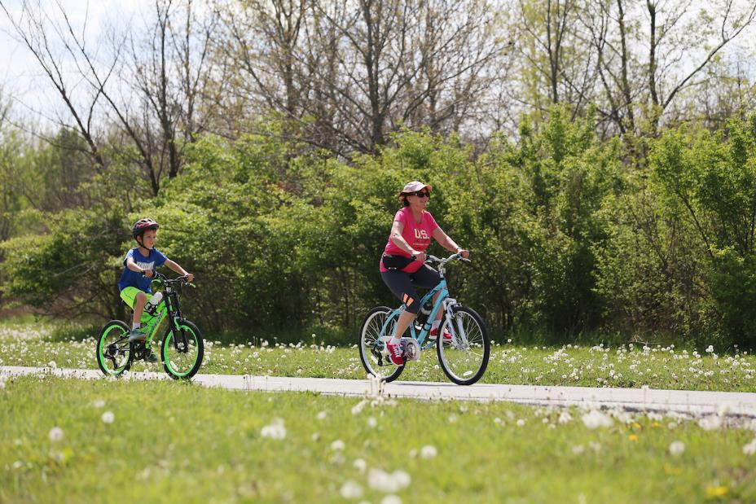
Non-Structural Practice: Land Protections
Measures to limit impacts of land development on areas with important stormwater functional values, such as:
Floodplains
Wetlands
Riparian Areas
Drainage Ways
Steep slopes with highly erodible soils
Lexingtonky.gov
Notes:
Additionally, land protections approaches can be used to identify, map and prioritize these key features—floodplains, wetlands, riparian areas, drainage ways and steep slopes with highly erodible soils.
Community planners and leaders can help protect these features from future development, possibly with local ordinances or by purchasing the land and attaching conservation easements.
This preventative measure can greatly enhance both water quantity and quality management.
As an example of this practice, Lexington has a Greenways Program that is created and managed by the city. These serve as corridors for wildlife and people and often include trails. Some are designated as Conservation Greenways with the primary purpose of providing water quality and wildlife habitat. Private landowners with property bordering these greenways are instructed not to mow or alter them and not to install personal property within them without an encroachment agreement with the city.

Slide 64
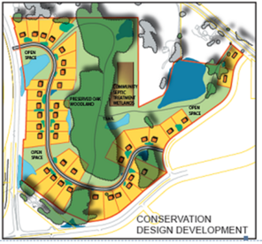
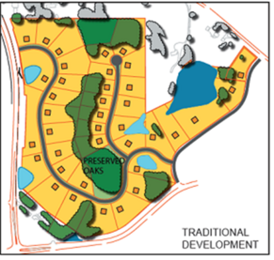
Non-Structural Practice: Conservation Design Development
Residential Streets & Parking Lots
Lot Development
Conservation of Natural Areas
3 Habitats of Suburban Landscape
Center for Watershed Protection Better Site Design Handbook
Source: MPCA
Notes:
Sustainable development approaches are promoted to encourage economic growth while also protecting the natural environment.
The Center’s Better Site Design handbook includes 22 model development principles for ways to reduce impervious cover, conserve natural areas, reduce stormwater pollution from new development, and lower the overall cost of development. These practices can also work to enhance quality of life for local neighborhoods, such as more open space for recreation, safer streets and a sense of community.
The principles apply to what the Center refers to as the three “habitats of the suburban landscape.”
Residential Streets and Parking Lots, or the habitat for automobiles
EXAMPLE: ways to minimize street widths
Lots (Yards and Homes), or the habitat for where people live and work – principles focus on the regulations that determine lot size and shape, housing density and overall design of neighborhoods
EXAMPLE: Prince George’s County, Maryland conservation subdivision with condensed housing and large open space areas (see graphic with smaller lot size, reduced roads and larger green space)
Natural Areas (Open Spaces), or the habitat for wildlife
Unfortunately, many local codes and ordinances actually work against or even prohibit these approaches—such as requiring unnecessarily wide residential streets, expansive parking lots, curb and gutter roadsides, or the clearing and grading of large areas of land.
The Center for Watershed Protection has developed detailed guidance that helps communities work through these development requirements and better tailor them in ways that allow and may even encourage smarter, more protective development practices.
The handbook, available for download on the Center’s website, provide a Codes and Ordinances Worksheet to help local groups evaluate development regulations based on these model development principles. This process can help local workgroups identify and pursue strategic code changes that can help them achieve better, more sustainable development that helps protect water quality.
Graphic: https://stormwater.pca.state.mn.us/index.php/Better_site_design

Slide 65
http://watershedplanning.tamu.edu/media/5558/urban%20nps%20measures.pdf https://www.werf.org/liveablecommunities/tool_sbmps.htm http://stormwaterpa.org/ https://stormwater.pca.state.mn.us/index.php?title=Main_Page https://stormwater.pca.state.mn.us/index.php?title=Main_Page https://www.bgky.org/stormwater/bmp https://louisvillemsd.org/sites/default/files/inline-files/Chapter18_GreenInfrastructureDesignManual_Rev062016_0.pdf Contractor’s Handbook for Erosion, Sediment and Stormwater Management on Capital Project Construction Sites, Lexington Division of Water Quality, November 2018
References and Resources:
Bluegrass Greensource Stormwater Feature Video
https://vimeo.com/91338501

