Slide 1
Watershed Academy
Watershed Coordinator Training Series
Water Quality Basics
4. Water Habitat

Slide 2






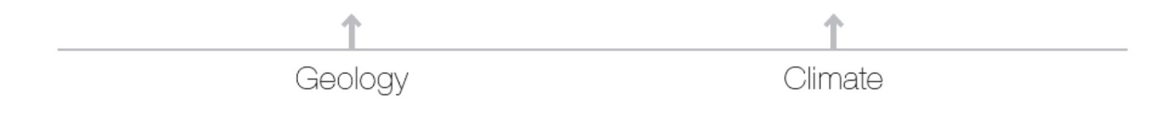
Stream Functions Pyramid
How well do these provide potential to support biology?
HABITAT
Notes:
The first 3 levels of the stream function pyramid create the habitat conditions available for aquatic life.

Slide 3
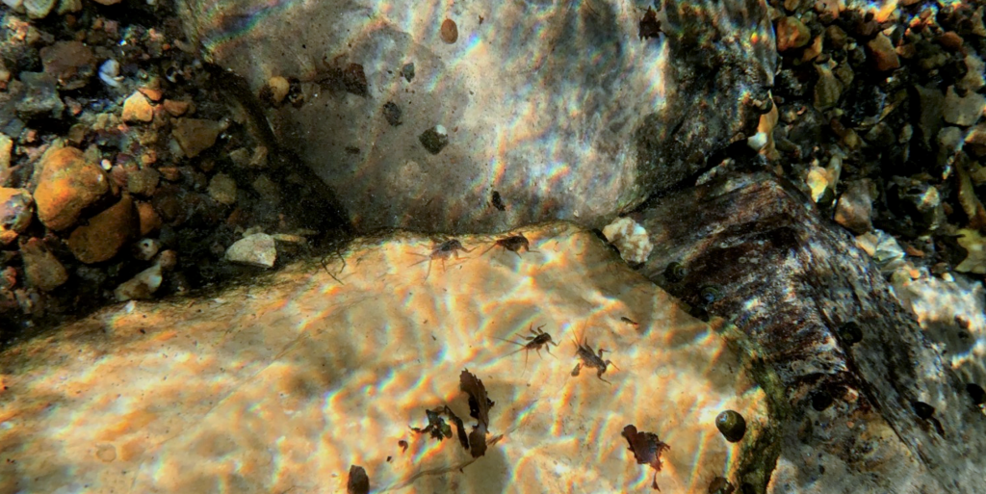
Overview
Water Habitat
  Encompasses all
  stream areas where aquatic organisms live
  Includes water column, rocks, plants, leaf litter, logs, undercut banks, plant roots, depositional areas, etc.
  Effected by hydrology, hydraulics, and geomorphology
Pennsylvania DEP
Notes:
A general habitat assessment is crucial in evaluating the ecological integrity of a site. The assessment is done using a visually-based approach to characterizing the physical habitat structure of the stream site.
Habitat assessment refers to the evaluation of the structure of the surrounding habitat that influences the quality of the water resource and the condition of the aquatic community.
Habitat assessment also evaluates the human-induced degradation of the habitat.

Slide 4
Overview
Habitat Assessment Method
  Based on EPA’s Rapid Bioassessment Protocols
  Evaluates the quality and quantity of the physical habitat structures in the stream as an assessment of the aquatic community potential
  Establishes parameters for habitat quality ratings based on high- and low-gradient streams
Notes:
We are going to walk through a habitat assessment method that is based on the U.S. Environmental Protection Agency‘s Rapid Bioassessment Protocol.

Slide 5
Timing of Habitat Assessment
Headwater Streams (drainage area < 5 sq² mi)
Sampled March 1 – May 31
Wadeable Streams (drainage area > 5 sq² mi)
June 1 – September 30
* Should not conduct assessment during excessively high or low flows or within 2 weeks of a known scouring (heavy storm) event
Notes:
For accurate assessments, it is important to conduct observations during the designated sampling periods for headwater or wadeable stream sizes.
Assessments also should not be conducted during very high or very low flow conditions or within 2 weeks of a known scouring (of streambed) event caused by high flows.

Slide 6
Stream Gradient
Characteristic | High-Gradient | Low-Gradient
Velocity of Water (Fast or Slow) | Typically > 0.5 ft/sec | Typically < 0.5 ft/sec
Slope Profile | Steep with rapid changes in elevation and lower water surface | Gentle with higher water surface
Riffles | High frequency of riffle habitat | Naturally lack true riffles
Bioregion Location | Mountain, Bluegrass, or Pennyroyal | Mississippi Valley and Interior River or some in western Pennyroyal
Notes:
When assessing aquatic habitat in Kentucky, we approach it differently depending on the stream’s gradient or slope.
In most areas of the state, streams have a higher gradient, or steeper slope.
But in a few areas of the state, mainly in western Kentucky, we see streams with a much lower gradient or gentler slope due to the flatter topography.

Slide 7
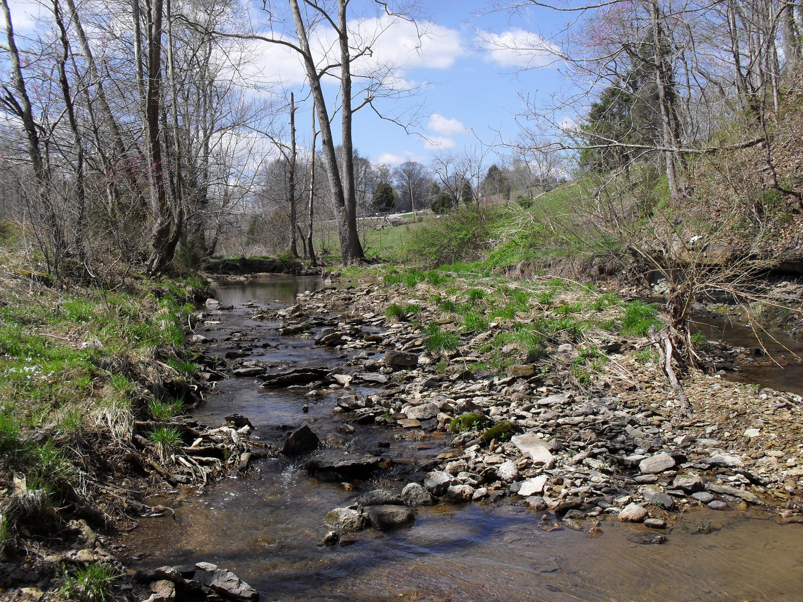
High Gradient Streams
What are they?
Streambeds have steeper slopes (gradients)
Creates more rapid streamflow (> 0.5 ft/sec)
Riffle habitat dominates (exposed rocks at or near surface)
Commonly found in KY’s Mountain, Bluegrass and Pennyroyal Bioregions
Notes:
Most of Kentucky’s topography produces high gradient streams

Slide 8
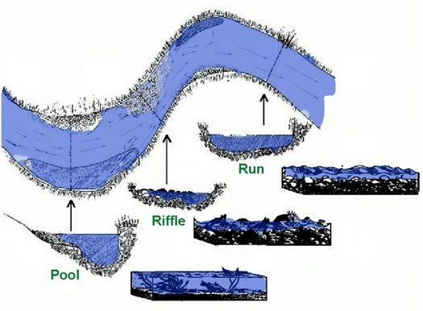
High Gradient
Pools
- Deep areas with slow flow
Riffles
- Stream elevation drop where bed rocks break the surface
- Produces turbulence with rough and bubbly water
Runs
- Fast flowing stream segments between riffles and/or pools
Notes:
High gradient streams produce a greater range of flow depths and speeds, including pools, riffles and runs.
This provides a variety of niche habitats

Slide 9
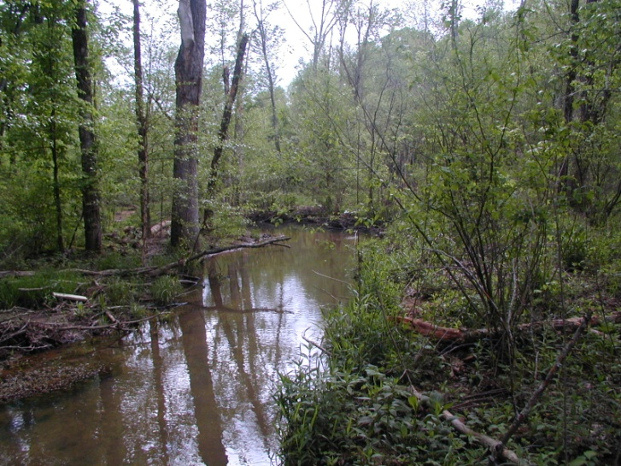
Low Gradient
What are they?
Found in flatter terrain
Causes slower streamflow (< 0.5 ft/sec)
Lack riffle habitat
Commonly found in Western KY’s Mississippi Valley Bioregion
Notes:
In Kentucky, mainly only seen in western region.

Slide 10
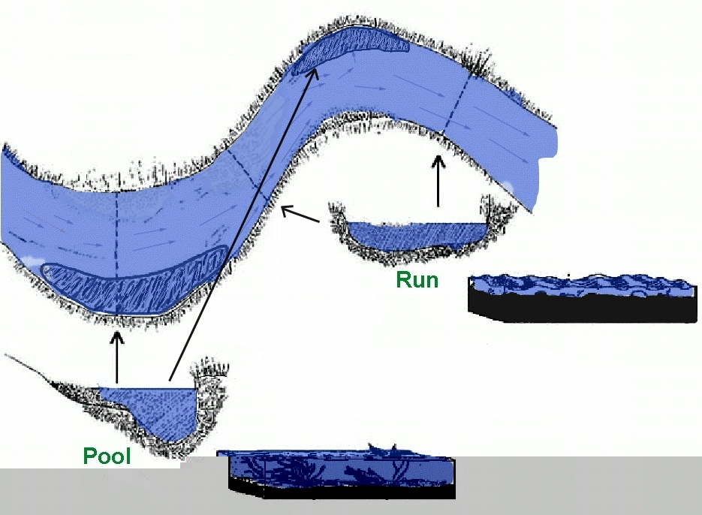
Low Gradient
Pools
- Deep areas with slow flow
Runs
- Fast flowing stream segments between pools
Notes:
Flow depths and speeds are more limited to pools and runs (no true riffles) in Low Gradient Streams.

Slide 11
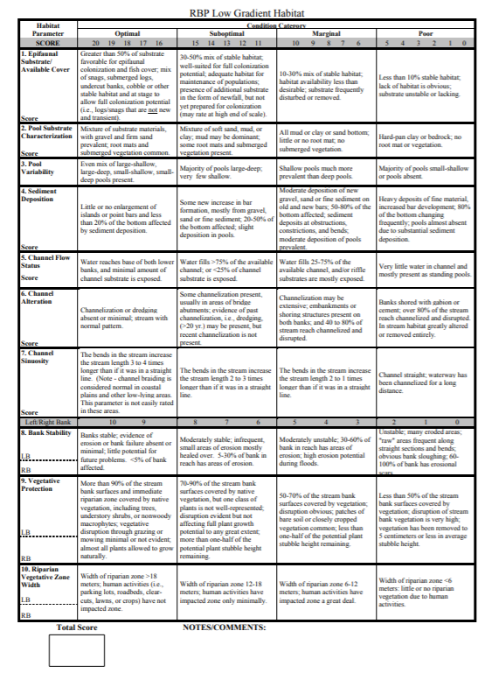
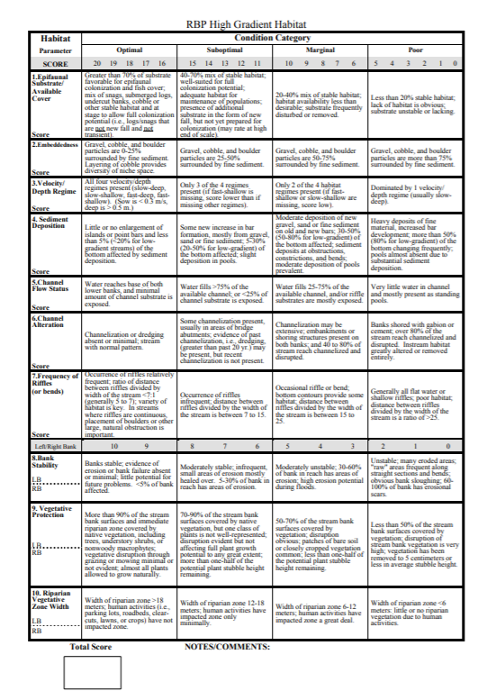
Habitat Field Data Sheets
LOW GRADIENT
HIGH GRADIENT
Notes:
There are two different Habitat Assessment Forms for high and low gradient, so it’s important to make sure that you are using the correct form for the stream you are assessing.

Slide 12
Habitat Parameters
Epifaunal Substrate/Available Cover
Embeddedness / Pool Substrate (Low gradient)
Velocity Depth Regime / Pool Variability
Sediment Deposition
Channel Flow Status
Channel Alteration
Riffle Frequency / Channel Sinuosity
Bank Stability
Vegetative Protection
Riparian Vegetative Zone Width
Each rated on a scale of 1-20
Notes:
These are the ten conditions or parameters of streams that are typically assessed for habitat quality. Referring back to our functional pyramid – the habitat assessment is providing a way to evaluate how the hydrology, hydraulics, and geomorphology provide support for the biology.
Some parameters (1, 4) assess the same general characteristics for high vs low gradient streams, but the rating criteria are slightly different. Example: Naturally, expect to see less sediment deposition in high gradient streams than would see in low gradient streams.
Some parameters specify different considerations for high vs low. Example: For high gradient streams, we look at the velocity depth regime of the flow types, but since low gradient streams mainly only display pools, we assess the variability of pool types.
Each parameter is assessed and rated on a scale from 0-20. All of the ratings are totaled to derive a habitat ranking for the site.
The habitat ranking is compared against the reference condition (ideal condition) to make an assessment relative to the region.

Slide 13
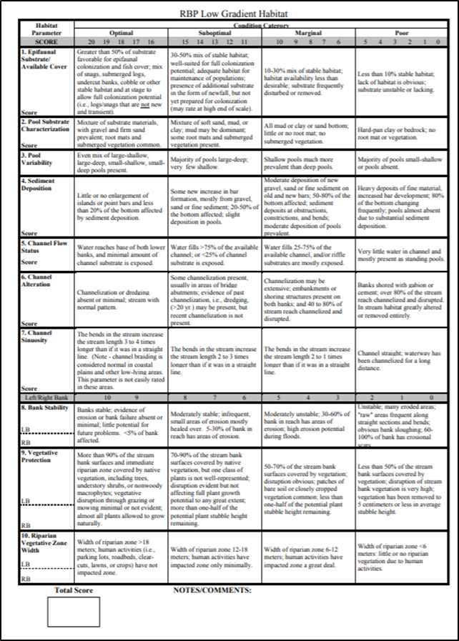
Habitat Assessment Field Data Sheet
10 Habitat Parameters
Assess parameters within a defined stream segment length
Habitat
Parameters
Notes:
To conduct a habitat assessment, we consider features within a defined stream segment length.
We look at individual features and determine how well they are functioning individually. It may be helpful to imagine the stream from a macroinvertebrate’s perspective!
These are then combined into one overall measurement of how livable the stream is for stream animals
Performing the habitat and biological assessments annually will enable us to see changes over time that can affect stream health. This is why it is important to be as consistent as possible each time these assessments are performed.

Slide 14
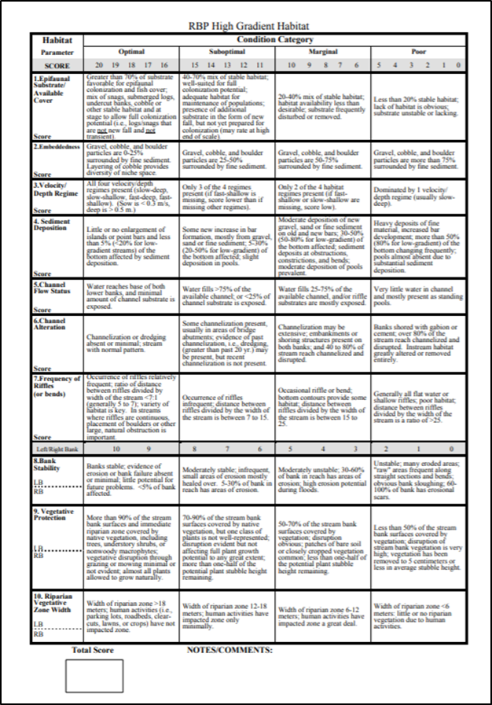
Habitat Assessment Field Data Sheet
4 Condition Categories
  Optimal: 16-20
  Suboptimal: 11-15
  Marginal: 6-10
  Poor: 0-5
Left/Right Bank Scoring
  Bank stability, vegetative protection, riparian zone width
Scores
  Higher is better
  Total at bottom
Condition Category
Score
Notes:
Each Habitat Parameter has 4 Condition Categories that must be carefully read to determine which one most closely matches the observed condition in your stream.
Within each Condition Category, users assign one of 5 numerical scores (poor has 6 numbers including 0) to represent how closely the condition of the stream matches that particular Condition Category’s description.
For some parameters (bank stability, vegetative protection, riparian zone width), each streambank is assessed separately.

Slide 15

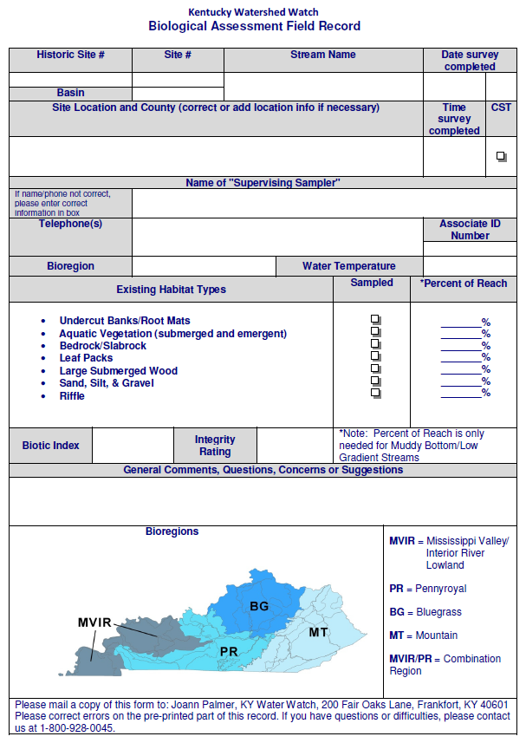
Field Data Sheet Compilation
High Gradient
Low Gradient
Kentucky Bioregions
Notes:
We already talked about the bioregions and the occurrence of high or low gradient streams. As you can see, low gradient streams are found in the the MVIR bioregion and the other three have high gradient streams.
When evaluating field score totals, we also consider the stream’s bioregion location and whether we are assessing a headwater or wadeable stream.
A headwater stream has a smaller drainage area of less than five square miles, and for this reason tends to be a smaller-sized stream.
A wadeable stream has a larger drainage area of greater than five square miles. (How should we explain that people will know this information?)
The 4 bioregions in Kentucky are:
Mississippi Valley/Interior River Lowland
Pennyroyal
Bluegrass
Mountain

Slide 16
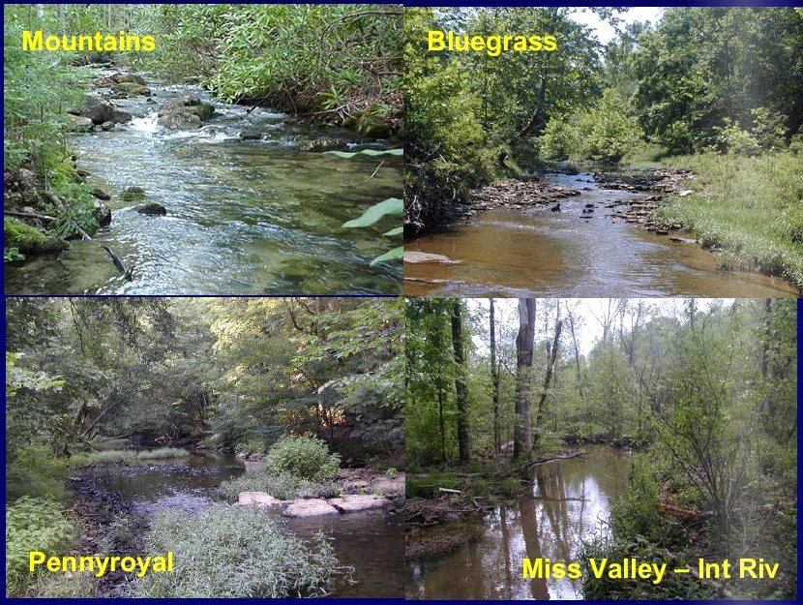
Kentucky Bioregions
Notes:
These are representative photos of the 4 bioregions in Kentucky.
Note the variations in flow from the Mountains to Bluegrass to Pennyroyal to Mississippi Valley/Interior River region.

Slide 17
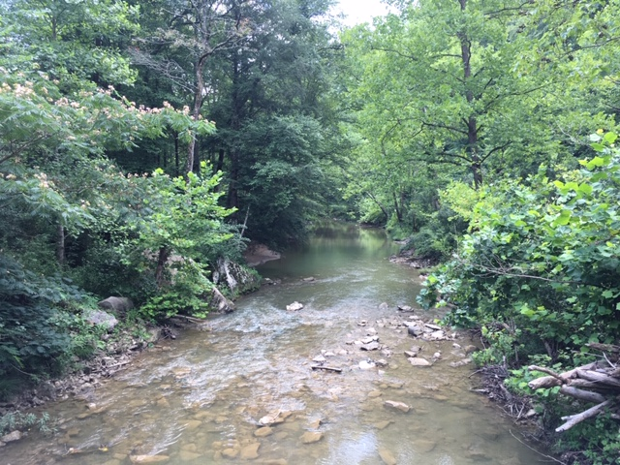
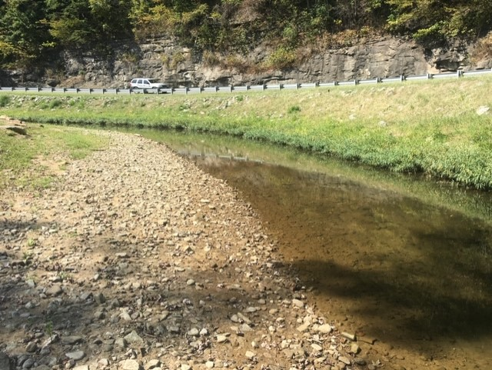
Epifaunal Substrate/Available Cover
P1
What are the types and sizes of stable natural materials, such as the logs and large rocks, in the stream?
Optimal
Poor
Notes:
We will start with the 1st parameter (P1), which is generally the same for both high and low gradient streams, epifaunal substrate and available cover.
Epi – on top of, Fauna – animals, Substrate – material on the bottom
The epifaunal substrate characteristics of the stream refer to the available cover available for animals that live on the bottom of the stream.
This can include submerged logs, undercut banks, and larger rocks or “cobble” that appears to have been in place for a while and unlikely to move.
Ideally, we will see a good mix of stable habitat types in this region of the stream that are favorable for colonization and fish cover.
However, we expect to see a greater percentage of favorable substrate in a high gradient stream vs a low gradient stream, and this criterion is ranked slightly differently between the two categories.

Slide 18
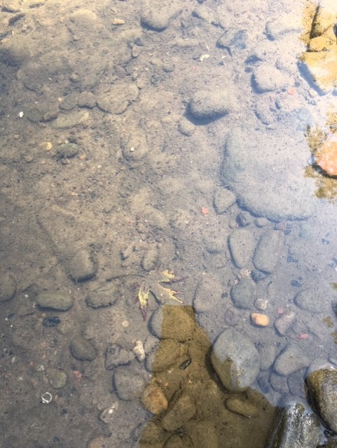
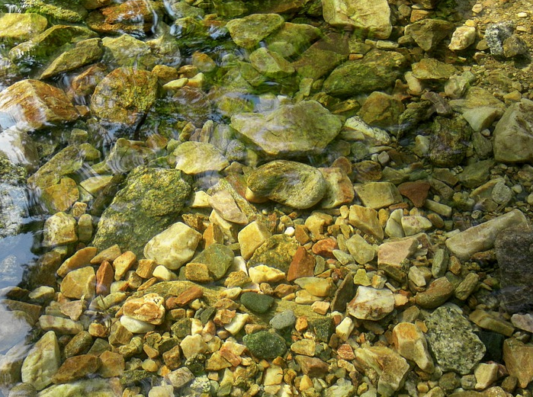
Embeddedness (High Gradient)
P2
How much of the rocks or tree snags on the bottom of the stream are covered with silt or sediment?
Optimal
Poor
Notes:
Observations of embeddedness are unique to high gradient stream assessments. This parameter refers to the amount of sediment covering the stream bottom.
We like to see a mix of gravel, cobble and boulder particle that are minimally surrounded by fine sediments.
This creates more surface area for macroinvertebrate and fish shelter, spawning and feeding.
When rocks are covered with sediment, habitat availability it more limited.
The layering of cobble-sized rocks (bigger than your fist) also creates a diversity of niche spaces for aquatic organisms to live and reproduce.
Conditions are ideal when less than 25% of these variously-sized rocks and snags are surrounded by fine sediments.
Conditions are considered poor when rocks and snags are more than 75% surrounded by fine sediments.

Slide 19
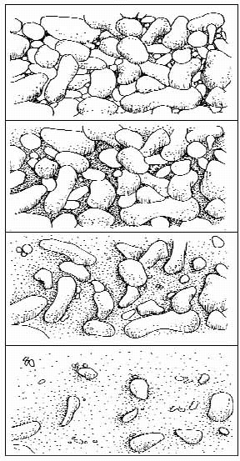
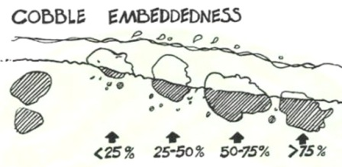
Embeddedness (High Gradient)
P2
Optimal Suboptimal Marginal Poor
Notes:
Here is a graphic depiction of what we are considering for this parameter.
You can see how the rocks become more covered by sediment as you move from optimal toward poor conditions.

Slide 20
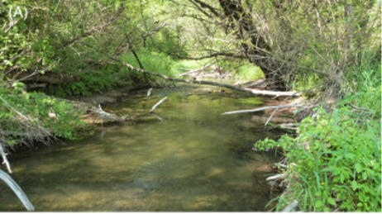
Pool Substrate Characterization
(Low Gradient)
P2
What types of materials are covering the bottoms of the pools and is there a variety of types?
Optimal
Poor
Notes:
Remember that with lower gradient streams, we have slower flows and, therefore, less stream velocity to move larger rocks along the stream bed.
This results in more pooled water and allows more aquatic vegetation to grow. SO, instead of embeddedness, we rate pool substrate.
We still want to see a variety of habitat niche types at the bottom of the pools, which will include a mixture of gravel and sand substrate materials and abundant aquatic plants and associated root mats.
POOL SUBSTRATE measures the amount of fine or coarse sediments on pool bottom, as well as root mats and submerged vegetation
When the stream substrate is all mud and clay or even all bedrock, with very little to no vegetation and root mats, scoring for this category is poor.

Slide 21
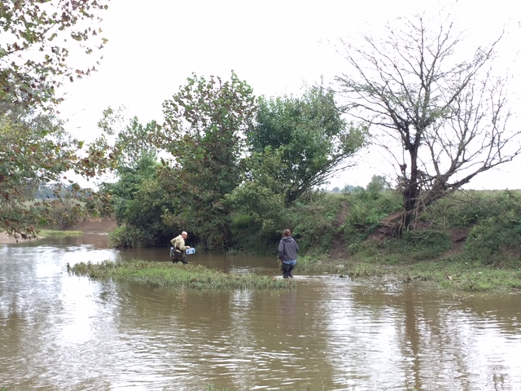
Velocity/Depth Regime
(High gradient)
P3
What are the depth and flow speed combinations found in the stream?
Pool
Run
Riffle
Pool
Optimal
Poor
Notes:
This parameter is also unique to high gradient stream assessments.
As previously mentioned, unaltered high gradient streams should display a sequence of stream velocities and depths that creates a variety of habitat types.
These will include 4 velocity depth regimes:
Slow-Deep (Pool)
Slow-Shallow (Glide)
Fast-Deep (Run)
Fast-Shallow (Riffle)
The fewer of these profiles observed, the less ideal the habitat.

Slide 22
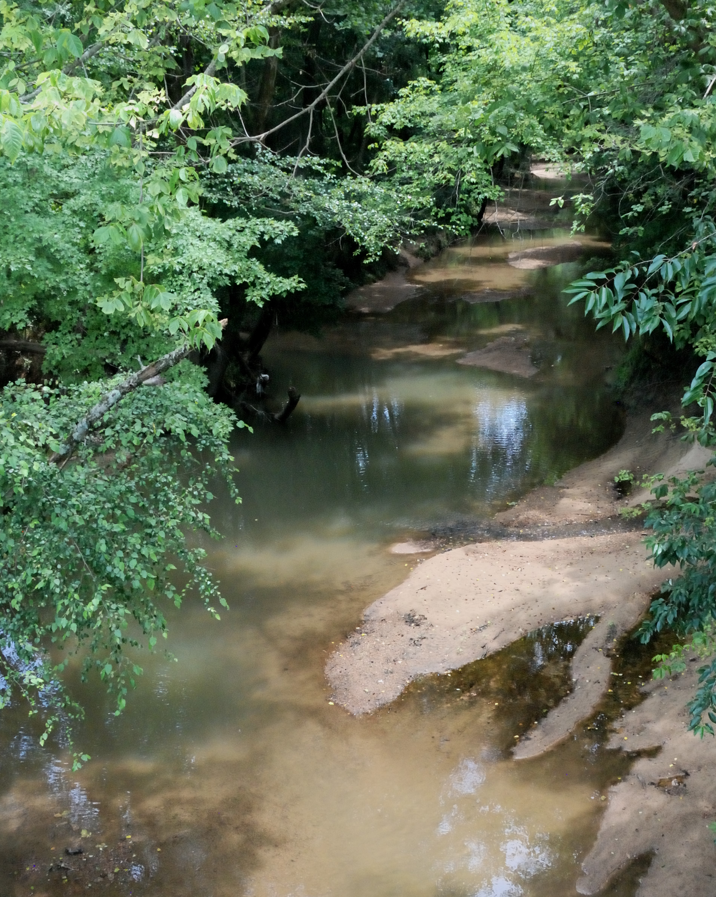
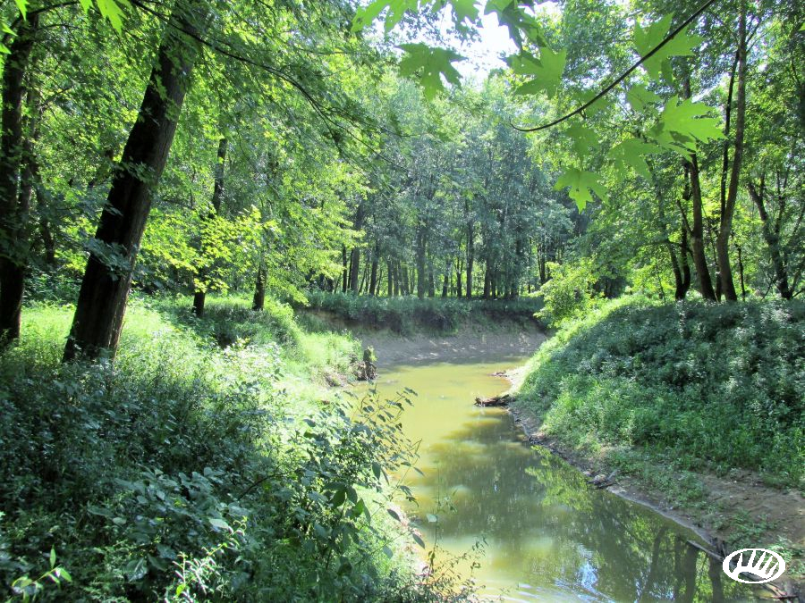
Pool Variability
(Low gradient)
P3
What are the sizes and depths of the pools?
Optimal
Poor
Notes:
For low gradient streams, we will be looking for an even mix of different types of pools for a good diversity of aquatic habitat.
These will include different size and depth of pools that are:
large-shallow
large-deep
small-shallow and
small-deep
When the majority of pools are small-shallow or absent, this habitat indicator is rated as poor.

Slide 23
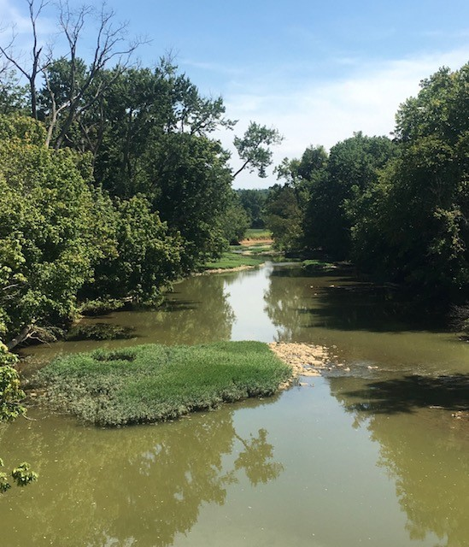
Sediment Deposition
P4
How much sediment has accumulated in pools and on the stream bottom?
Lesser evidence of point bar formation – sign of
better habitat conditions.
More evidence of point bars – sign of poorer habitat conditions.
Point Bar
Poor
Notes:
The next few parameters are the same for high and low gradient stream assessments.
Sediment deposition is another measurement of how much sedimentation is affecting the availability of a variety of habitat niches (with embeddedness being the other one we have covered).
This metric estimates the amount of sediment that has accumulated in pools and changes that have occurred to the stream bottom as a result of deposition.
If there is a lot of dirt being washed into a stream or worn away from the streambanks and carried by the water, it will settle in the stream where the water is slowed down by a curve in the stream, a tree that has fallen into the stream, a large rock, a bridge, etc.
As more sediment begins to collect, the water is slowed down even further, so more sediment settles there. This will cause an island or point bar to form and appear above the surface of the water, or it can cause the filling in of runs or pools.
Point Bar – a ridge of sediment deposited by a stream on the inside of a bend, can be located below the surface of the water or extend above it
This is a natural process, but too much sediment in the stream will cause too many islands and point bars. These may even get larger and cover the entire width of the stream. They also will move and change frequently and don’t provide good long-term places for aquatic organisms to live.

Slide 24
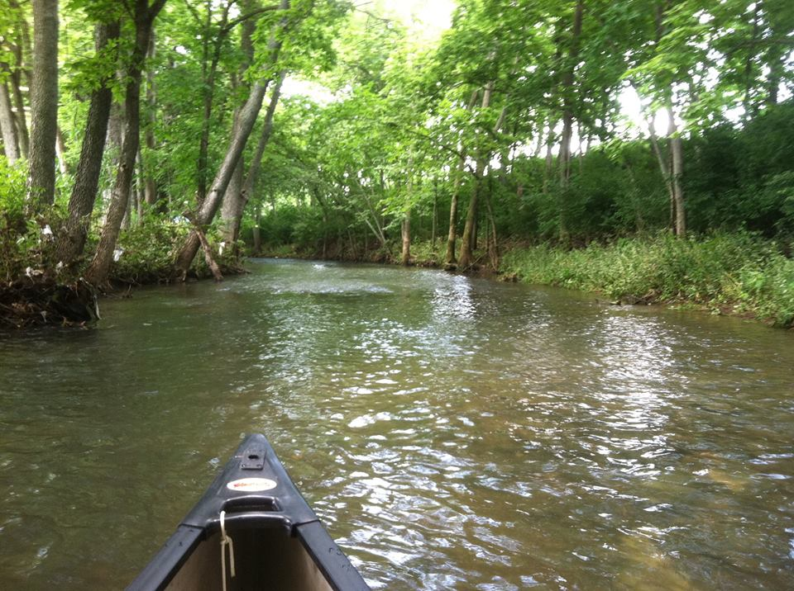
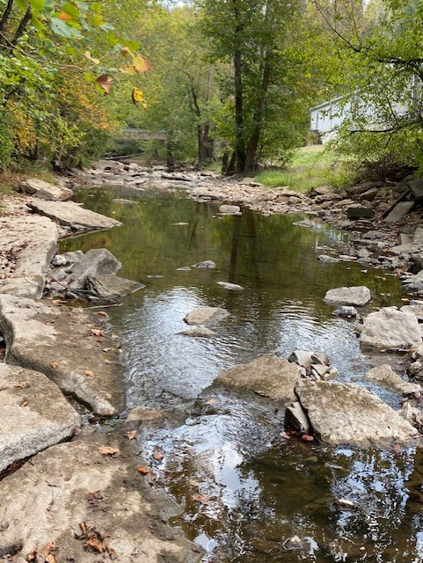
Channel Flow Status
P5
How much of the stream bottom is covered by water?
  When streambed exposed, not dependable habitat for animals
Optimal
Poor
Notes:
Observed for evaluation of both high and low gradient streams.
Assesses how much of the channel is carrying the flow of the stream, or the percentage of the channel that is wet using the low water mark.
Is the water extending to both lower banks with a minimal amount of the substrate exposed?
Or, is the channel carrying very little water, with much of the substrate exposed and water present mainly in standing pools?
Ideally, the flow will extend to both banks and all substrate habitats will be covered with healthy flow levels. This ensures a broader range of stable aquatic habitat.

Slide 25
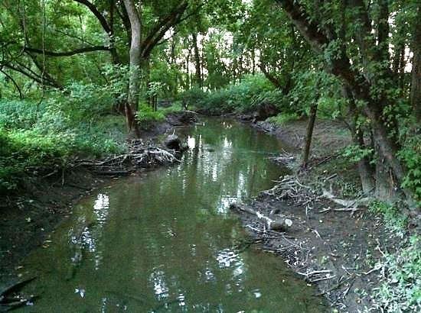
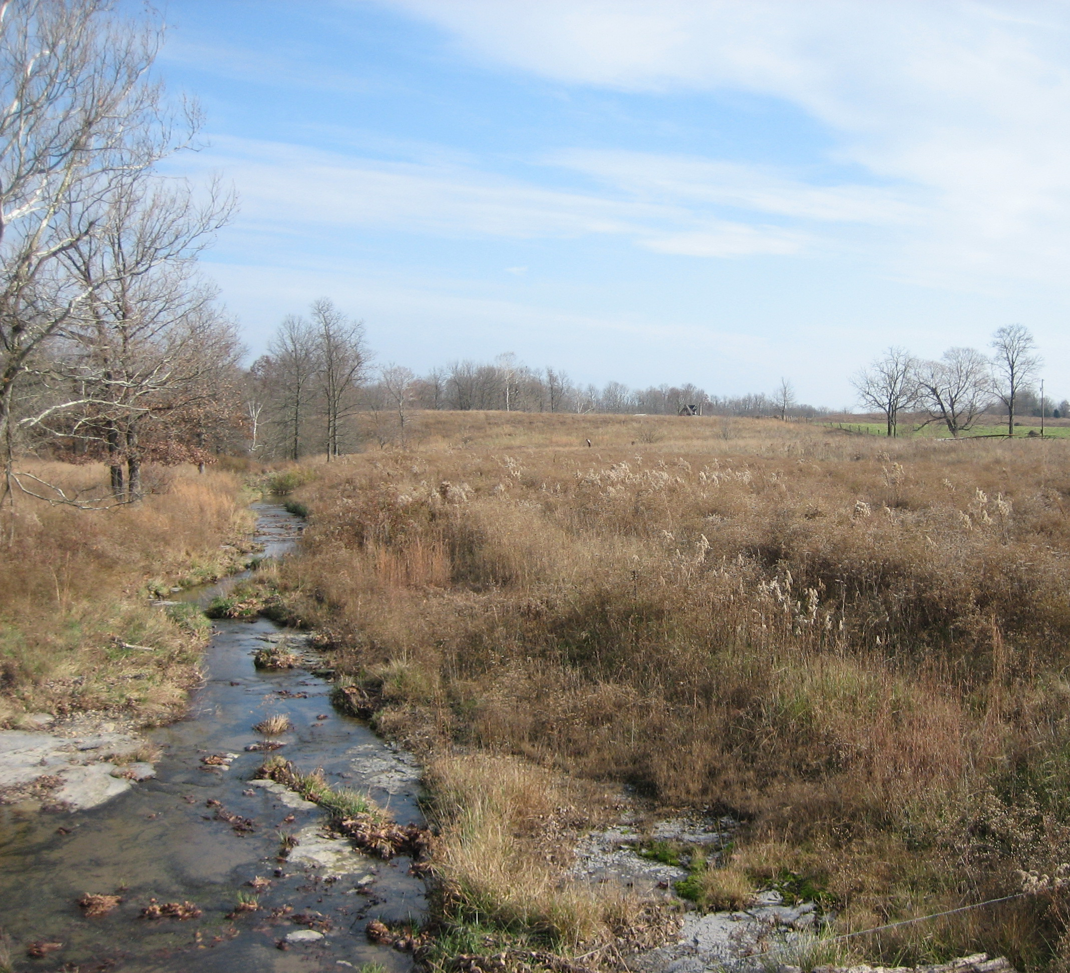
Channel Alteration
P6
How much of the stream has been channelized or been changed in shape?
  Man-made channelization often involves straightening
Straightened Channel
Optimal
Poor
Notes:
Beginning with Parameter 6 through Parameter 10, a habitat evaluation includes an additional 100 meter upstream stretch from the originally assessed 100 meter segment.
When rating the effects of channel alteration, look for evidence of human activities that have straightened, or channelized, the stream.
Channel alteration evidence can include:
Artificial embankments, rip-rap, and other forms of bank stabilization structures
Significant stretches of straightened stream
Dams and bridges that are obstructing flow
Dredging or other substrate mining (gravel, sand, silt)
Helpful Terms:
Dredging – physical removal of material from stream bed, usually done with heavy equipment
Embankment – a stream bank that has been raised to hold back water, carry a roadway, etc.
Bridge Abutment - a structure that supports a bridge and is built in or near the stream
Gabion - a metal cage containing natural materials (usually rock) that are stacked to support stream banks

Slide 26
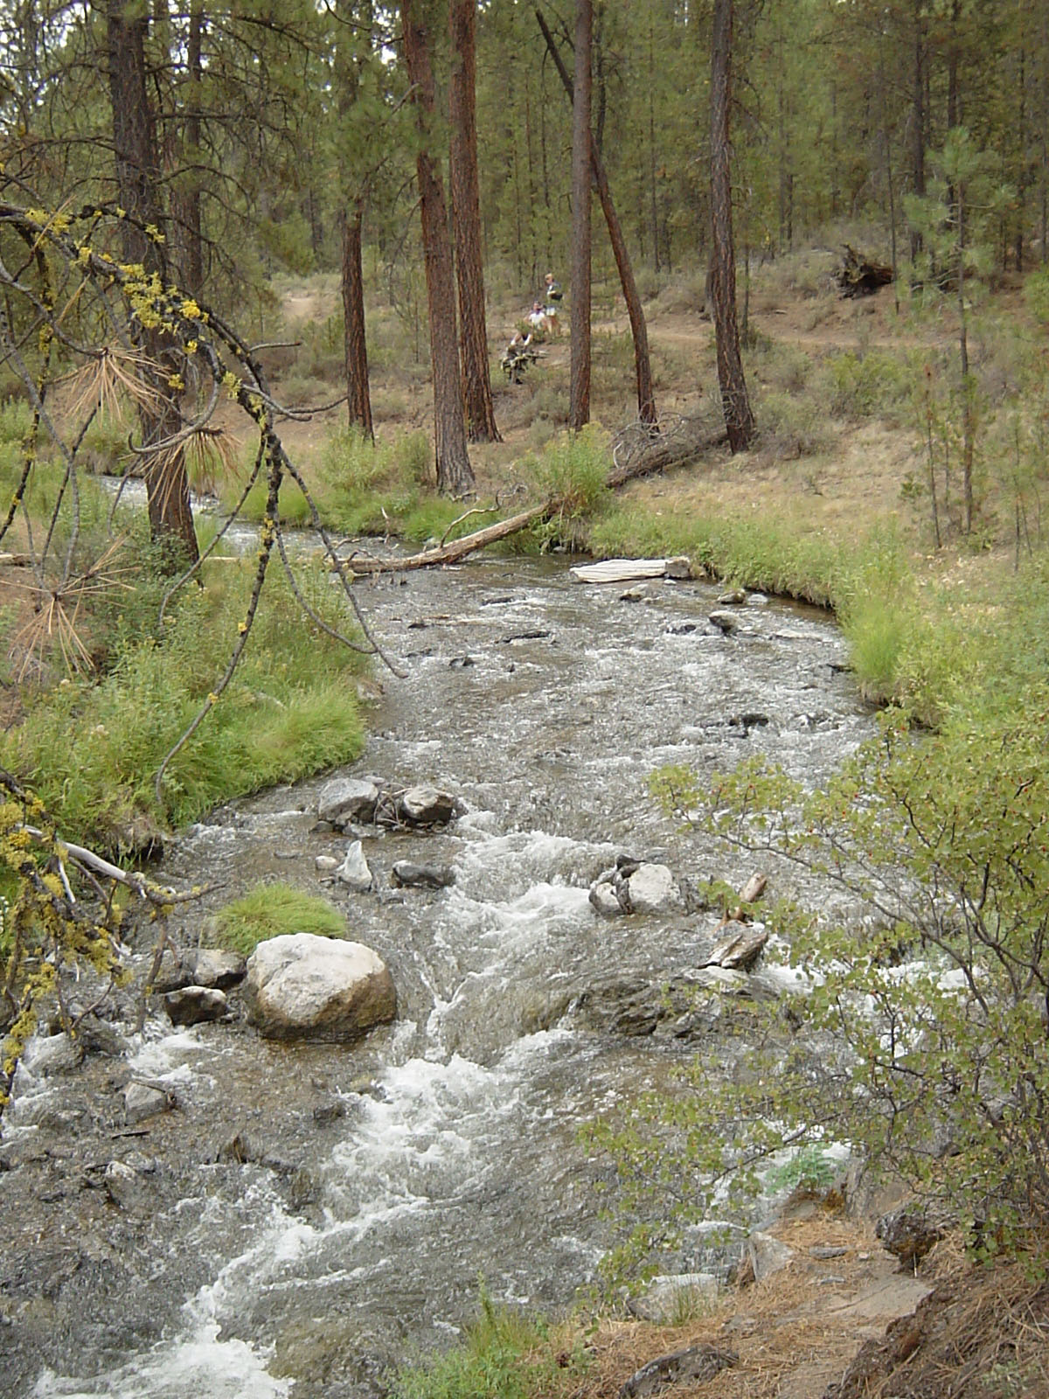
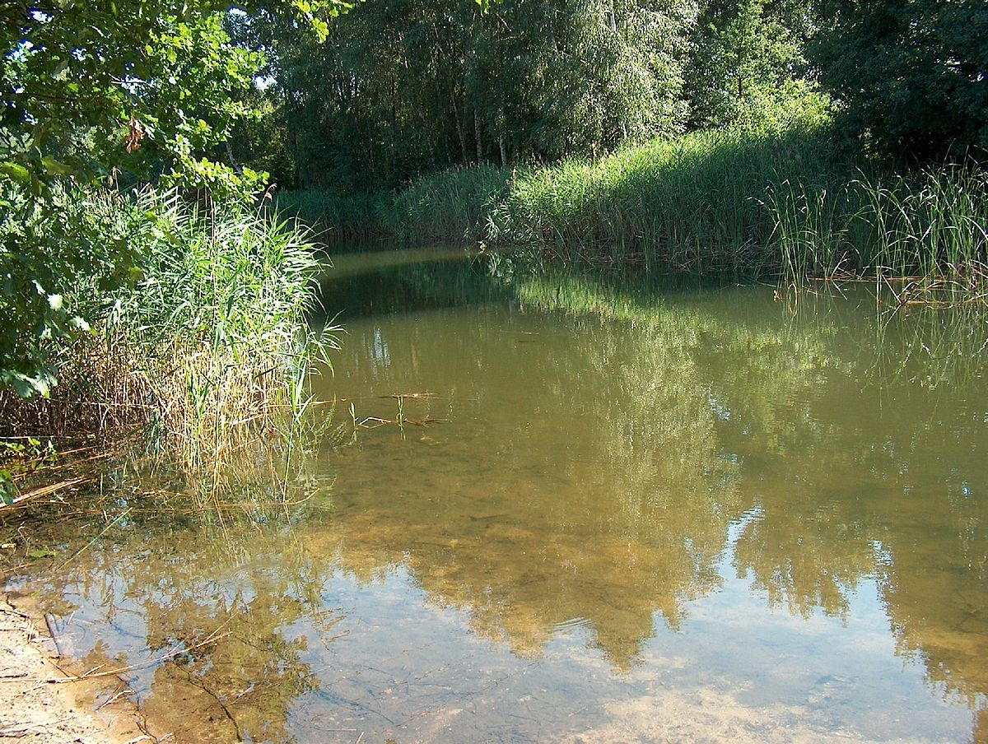
Riffle Frequency (High gradient)
P7
How many riffles are in the stream?
  A measure of the heterogeneity of the stream and its habitat
Riffles
Optimal
Poor
Notes:
For high gradient streams only, we assess riffle frequency.
Mountainous or hilly terrain creates streams with more frequent riffles.
You will calculate the distance between riffles divided by the stream width to help determine a ratio for this rating.
In addition to the variety of habitat indicated by riffle frequency, the presence of riffles often signals the availability of well-oxygenated water that is ideal for aquatic life.

Slide 27
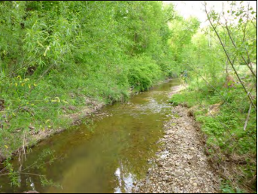
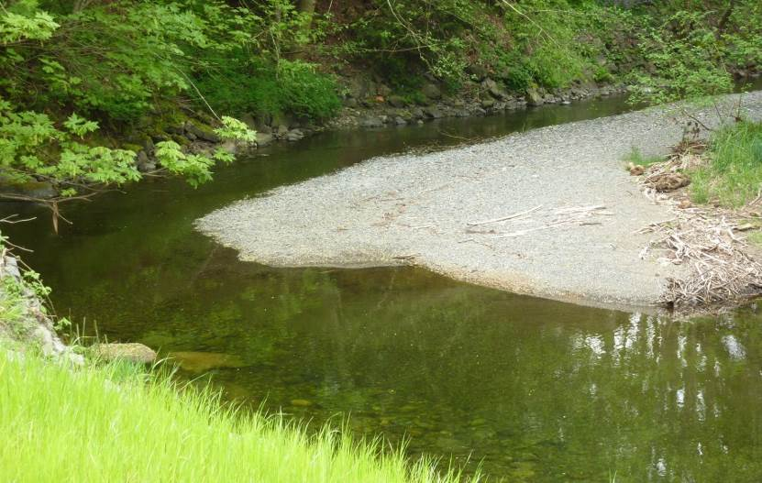
Channel Sinuosity (Low gradient)
P7
How much do the stream curves increases its length?
  Length , Velocity , Erosion , Animal Habitat
Optimal
Poor
Notes:
For low gradient streams, you will consider Channel Sinuosity instead of Riffle Frequency.
This parameter characterizes the meandering of sinuosity of the stream.
Curves or bends in the stream increase stream length, which reduces the force or energy of flows, also reducing erosion and improving stream habitat. Thus, a high degree of sinuosity provides for better habitat and fauna, and the stream is better able to handle storm surges.
Straightened channels do the opposite, increasing flow velocities and erosion and damaging stream habitat.

Slide 28
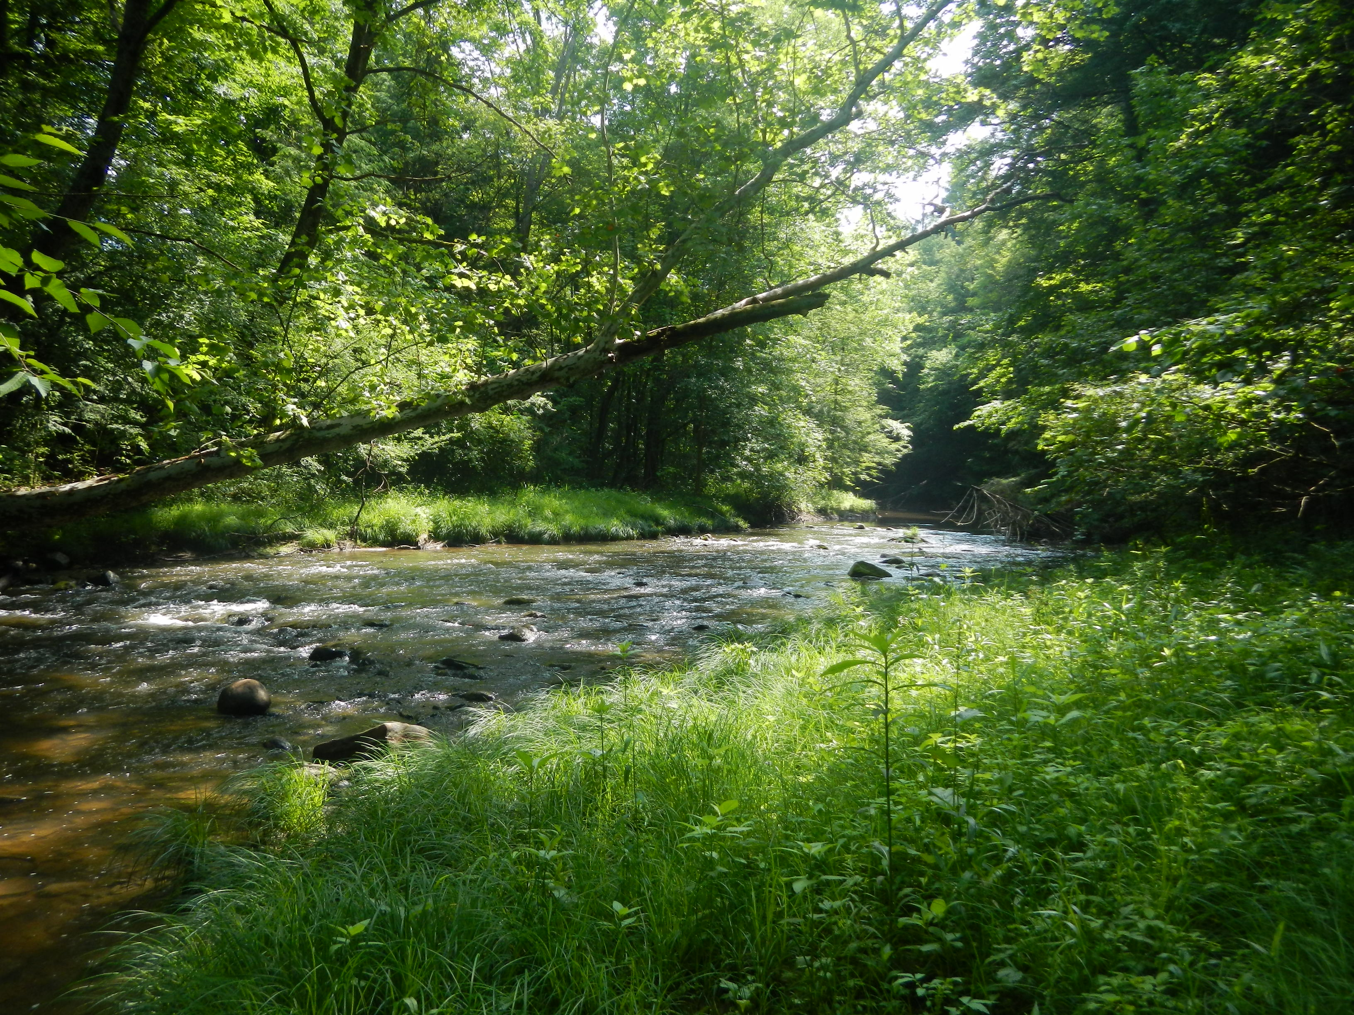
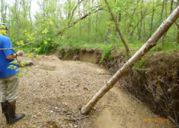
Bank Stability
P8
How much have the banks eroded and how much more erosion is likely?
  Look for areas of bare dirt, slumping of banks into stream
Optimal
Poor
Notes:
When large areas of bare dirt, exposed tree roots, undercut areas, and trees falling into the stream are seen along the streambanks, it is a sign that the banks aren’t stable.
When facing downstream, will evaluate left bank and right bank separately.
Ideally, you will see very minimal evidence of erosion of the streambanks, with less than 5% being optimal and 60 to 100% being poor.
Eroding sediment covers up and fills in the places where stream animals live.
Also, the high levels of mud and sediment in the water make it difficult for fish and other stream animals to absorb the dissolved oxygen they need and make it difficult to find food.
Terms from field data sheet:
Erosion – loss of soil or rock material from the stream bank due to the flow of water
Bank Failure or Sloughing – events that cause large scale displacement of soil or rock material due to support being undercut or weakened by erosion
Raw areas – stream bank locations with recently exposed soil
Additional background information:
Stable streams in wide valleys have the freedom to migrate across the landscape slowly over geologic time, while maintaining their overall form and function.
Naturally stable streams are able to transport the sediment load supplied by their watershed.
Instability occurs when scouring causes the channel bed to erode (degrade), or excessive deposition causes the channel bed to rise (aggrade). The photo on the right is a clear example of a degrading stream that is far below its original streambank.
Often, bank instability results from changes in the watershed.
For example, stream degradation can result from urbanization influences. Increased impervious surfaces from urbanization in a watershed produce greater runoff amounts, and stream flooding frequency and intensity also increase, which leads to excessive stream bed scour and degradation.
Stream aggradation can result from poor land-use practices that lead to excess sediment in runoff reaching the stream, increasing the sediment load of a stream above that which it can adequately transport.
Source: A Function-Based Framework for Stream Assessment & Restoration Projects, USEPA. (pg. 23)
https://www.epa.gov/cwa-404/function-based-framework-stream-assessment-restoration-projects

Slide 29
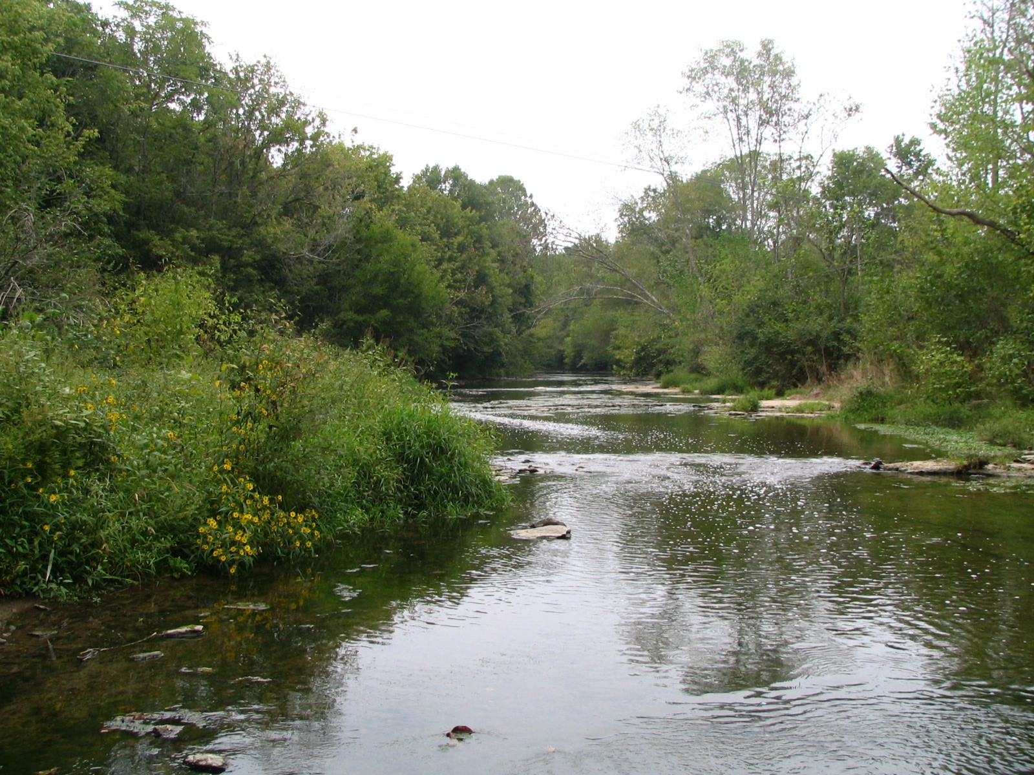
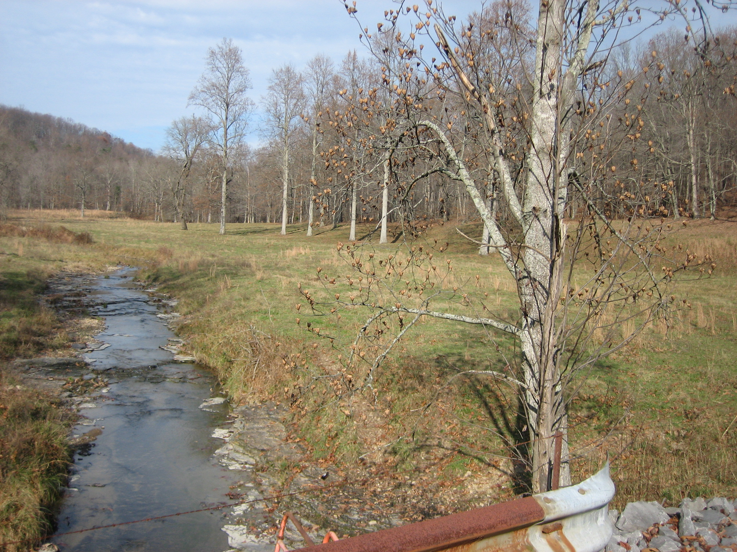
Vegetative Protection
P9
What is the availability and variety of vegetation to the stream and near-stream portion of the riparian zone?
  better erosion control and wider variety of food material
Plentiful variety of vegetation
Light Vegetation, Mainly Grasses
Poor
Optimal
Notes:
Vegetative protection also estimated separately for left and right banks.
Ideally, more than 90% of the streambank surfaces and immediate riparian zones are:
covered by native vegetation, including trees, understory shrubs or nonwoody plants
vegetative disruption from grazing or mowing is minimal or not evident, AND
almost all plants are allowed to grow naturally (not mowed)
Terms from field data sheet:
Native Vegetation – the plants that have developed over time to exist in a particular geographic area
Understory Shrub – a woody plant of low height having several stems arising from the base; grows beneath the tree canopy
Non-Woody Macrophytes – soft-stemmed plants that are visible to the naked eye
Supplemental Information:
Source: A Function-Based Framework for Stream Assessment & Restoration Projects (pg. 145-46)
“The lateral migration parameters discussed above primarily focus on maintaining streambank stability and do not evaluate the overall condition of the riparian buffer. The BEHI/NBS method for predicting streambank erosion, for example, does include assessments of streambank vegetation, but is only for the purpose of providing bank stability. Riparian buffers or zones are the vegetated region adjacent to streams and wetlands that are critical to providing channel stability, cover/shade, wood recruitment to the channel, and a source of carbon (Sweeney, 1993; Hession et al., 2000; Sweeney et al., 2004; Hoffman, 2006; Sweeney and Blaine, 2007). Therefore, the restoration of riparian vegetation as part of a Level–3 assessment and design approach provides the vegetative structure to support many of the Level 3, 4 and 5 functions.
Research has shown that a well-managed restored buffer can trap and/or convert up to 75% of nitrogen and 70% of phosphorus from nonpoint source runoff, if the source is from land uses that are adjacent to the stream corridor (Orzetti et al., 2010; Claussen et al., 2000; Lee et al., 2003; Schoonover and Williard, 2005). Additional research has shown 50% to 80% reductions in sediment loads from adjacent nonpoint source pollution (Orzetti et al., 2010; Cooper et al., 1987; Daniels and Gilliam, 1996; Lowrance and Sheridan, 2005; Schoonover and Williard, 2005; Tomer et al., 2007). Orzetti et al. (2010) went on to show that habitat, water quality and benthic macroinvertebrate parameters improved with the age of the restored buffer.”

Slide 30
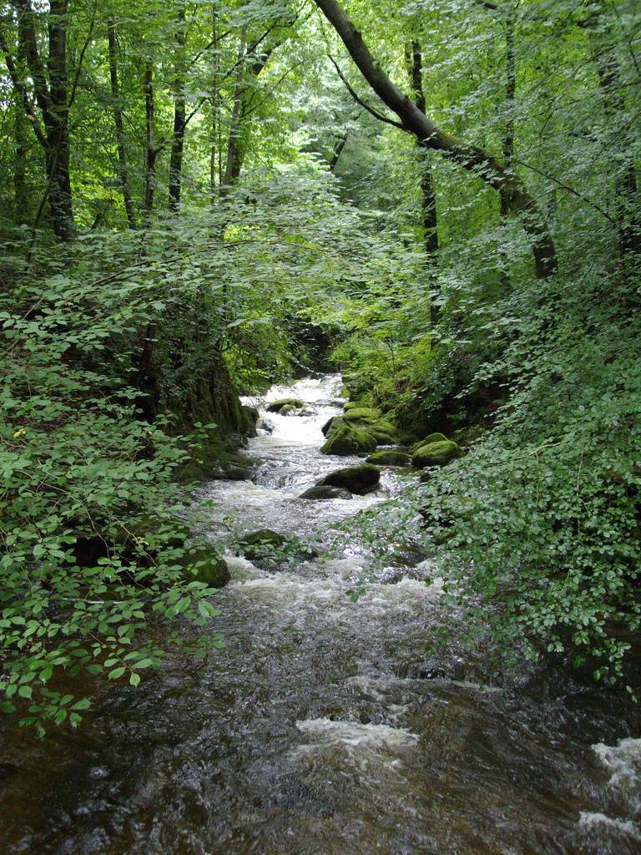
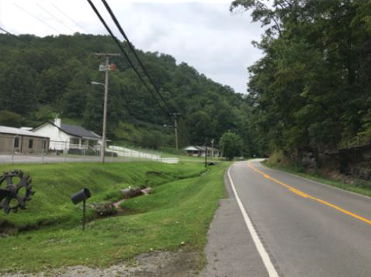
Riparian Vegetative Zone Width
P10
How wide is the riparian area?
Considers human impacts in this zone, such as walkways, parking lots, lawns, crops, etc.
Optimal
Poor
Notes:
Again, each bank is scored separately.
Riparian Zone – the land along and adjacent to a stream or river
We are interested in the amount of the riparian zone that is filled in by plants or vegetation.
The width and vegetative cover of the riparian zone are determinants of its effectiveness in providing ideal aquatic habitat, as well as absorbing and removing excess stormwater runoff and associated pollutants.
Ideally, the buffer width will be greater than 50 feet on each side of the stream and provide a variety of vegetation types, including grasses, shrubs and trees, with little to now mowing or other human impacts.
This area can be constricted by adjacent roadways, lawns, parking lots, trails or other manmade structures.

Slide 31
Summary
Streams categorized by gradient
  High-gradient: Steeper slope / faster, shallower water / more riffles
  Low-gradient: Flatter terrain / slower, deeper streams / more pools
Streams are assessed via a Habitat Assessment Field Data Sheet
  10 parameters (categories)
  4 condition categories (optimal, suboptimal, marginal or poor rating)

Slide 32
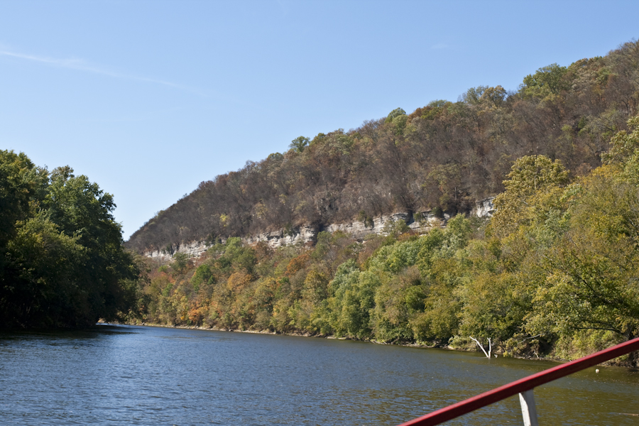
Questions?
Kentucky River
Source: Hensley, 2008

Slide 33
References
Methods for Assessing Habitat in Wadeable Waters, Commonwealth of Kentucky Energy and Environment Cabinet, Department for Environmental Protection, Division of Water, March 1, 2011.
High Gradient Photos
  P1-P7, P10: U.S. EPA, “Rapid Bioassessment Protocols For Use in Streams and Wadeable Rivers”, 2nd ed., 1999
  P8 (left photo): USDA, Natural Resources Conservation Service, October 2011
  P8 (right photo): University of Kentucky, College of Agriculture, Carmen Agouridis, “Streambank Erosion”, July 2014
  P9 (left photo): Thomas Richter, Wilde Sau stream, Germany, 2005
  P9 (right photo): University of Tennessee, Institute of Agriculture, https://ag.tennessee.edu/watersheds/Pages/Riparian-Buffer.aspx
Low Gradient Photos
  P2, P3, P7: U.S. EPA, “Rapid Bioassessment Protocols For Use in Streams and Wadeable Rivers”, 2nd ed., 1999

