Slide 1
Watershed Academy
Watershed Coordinator Training Series
Module 6: Effective Communications
7. Social Survey Research Tools
Notes:
Welcome all to the seventh presentation of Module 6: Effective Communication. This presentation will focus on providing an overview of social survey research tools. Our hope is to empower you to begin or expand your use of social research to inform your outreach campaigns.
The length of time that we have precludes going into much depth on social research, but we hope to give you an introduction to the approach and tools.

Slide 2
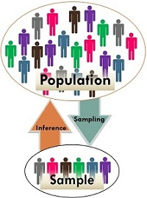
Social Research Methods
Social research is intended to discover differences, patterns, and trends in populations by doing studies.
A representative sample can be used to generalize for the population.
Notes:
Social sciences collect data from individuals to better understand differences, patterns, and trends among populations. Populations are simply groups of people of interest to the researcher.
Sometimes you can gather data from an entire population of interest, but typically you must collect data from only a sample of that population, hopefully a representative subset. The data received from this smaller sample of people is then inferred onto the larger population.
How well your sampling represents the population determines the confidence with which you can make generalizations and inferences from the sample to the whole.

Slide 3
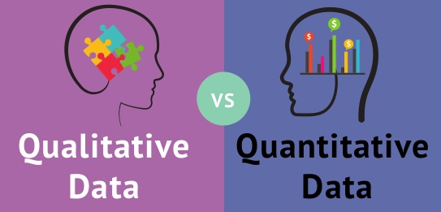
Social Survey Research Types
Quantitative Surveys (Quantity = Numbers)
  Survey Questionnaire
Qualitative Interviews (Quality = Descriptive)
  Interview
  Focus Group
  Community Forum
  Direct Observation
  Social Mapping
Notes:
If you decide you need to collect some additional data, there are two main types of social research:
Quantitative research – focused on generating statistics and numbers based on the sample group. This survey approach, which involves some sort of questionnaire, poll, or survey, can answer questions about percentages of the population with a given view or comparisons between populations. These surveys get at the “what” questions
Qualitative research - here the focus is on understanding “why.” These methods involves some form of interview or open-ended question to provide case studies and meanings to responses. Qualitative research can be a one-on-one interview, a focus group, or a community forum. Some other forms of qualitative research include direct measurement (describing what you saw). And utilizing drawn pictures or visualizations to better understand study participant perspectives.
These methods are complementary and not in competition with each other. Both are needed to provide a full picture of the situation.
We should note that prior to beginning either of these, one should do some literature review to see what has already been done. A literature review may be all the research that is necessary in some cases, but in other cases it can provide some general context for more specific follow up studies.
POLL QUESTION: Which of these have you utilized before in your outreach survey?

Slide 4
Social Research Steps
1. Develop the research questions, goals, and population
2. Determine the study type
3. Develop sampling plan
4. Develop questionnaire
5. Train interviewers
6. Pretest the survey instrument
7. Conduct the survey
8. Process data and analyze the results
Notes:
Whether quantitative or qualitative, social research has some basic steps.
First, you must decide what general questions you are trying to answer and the population of interest.
Second, you will need to decide how to collect the data.
Third, you must develop a plan to collect the data from a representative sample of the population.
Fourth, develop the specific questionnaire or interview questions.
Fifth, make sure everyone collecting the data (interviewers) has been trained in the collection process so that it can be done consistently
Sixth, try it out on a smaller group to work out kinks and misunderstandings
Seventh, perform the research
Finally, process the results and draw conclusions.

Slide 5

Ethics of Human Subject Research
Voluntary
Informed consent
Protection from harm
Protection of Privacy
Notes:
Because sociology studies are human subject research, it is important to recognize that there are ethical and legal requirements to ensure that study participants are not harmed, know their risks, and responses are confidential. Because of several infamous cases of unethical research, national and international laws such as the Nuremberg Code, Declaration of Helsinki, and the Belmont Report cover key ethical and legal requirements of studies to prevent abuses of human studies.
If you intend to publish your results in some form and your study participants are providing private (non-public) and or personally identifiable information, then you need to be sure that you follow ethical guidelines. Universities and researchers are required to have independent, third-party boards review their study plan for ethical concerns. Whole courses are available on human subject research ethics, but for this presentation, we will cover just a few principles.
Voluntary – Studies cannot coerce participation, especially if captive audience. Further, participants must have:
Informed consent – Participants must know about procedures, risk, and use of the data before completing the survey.
Protection from harm – Must minimize risk of harm, physical or psychological. This can include unintended consequences that could occur because the responses enabled others to discover their identity or participation.
Protection of Privacy– Assure identifying information will not be made available to anyone not directly involved in study. Study participants must give permission for sharing or research beyond the specific study.
The goal is that you respect the participants as autonomous agents who know what they are getting into by participating.

Slide 6
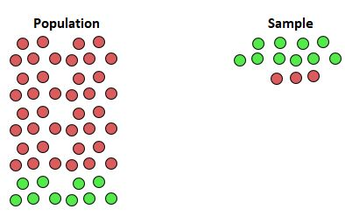

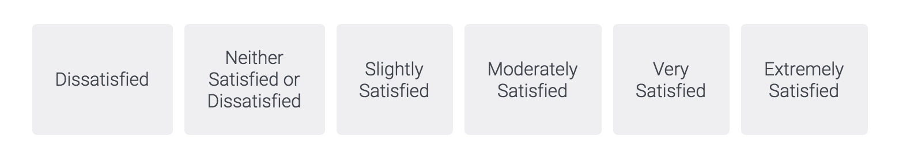
Social Research Biases
Nonrepresentative Sample
  Are you a resident of X county?
  Surveys at the Country Club Grocery might be different than at the Thrift Store
Response Bias
  Would you rather have dead parking lots or living habitats?
  Do you litter when no one is looking?
Misinterpreting Questions
  How much benefit do you think streams provide for recreation and health?
Sample Bias
Response Bias
Imbalanced Scale
Notes:
You need to be on the lookout for ways that you can introduce bias into your research through sampling and your questions. Here are some examples:
Nonrepresentative Sample (when your sample is not representative of population)
Consider screening questions to sift out non-target audiences (such as the county they inhabit)
Beware of population bias due to format (time, location, medium). It matters where you collect surveys as well as the medium – not everyone has access online or traffics your website. Your results may be different at the Country Club vs the Thrift Store
Response Bias (Leading questions or expected responses)
Balance positively and negatively worded questions to avoid expected responses. People want to answer “right” and will look for the expected response. (The adjective dead parking lots vs living habitats biases respondents).
Beware of question / response order bias
Respondents may deny their undesirable traits to look more sociably favorable (People may not be truthful about littering when it is framed as taboo… perhaps frame this a frequency in which they toss out trash)
Avoid leading questions or extra information
Misinterpreting Questions
Beware of double barrel questions (two things asked together) – people may see the benefits to recreation and health differently.
Be sure rating labels are clear (the example is biased toward positive responses – 1 neg, 1 middle, and 4 positive)

Slide 7
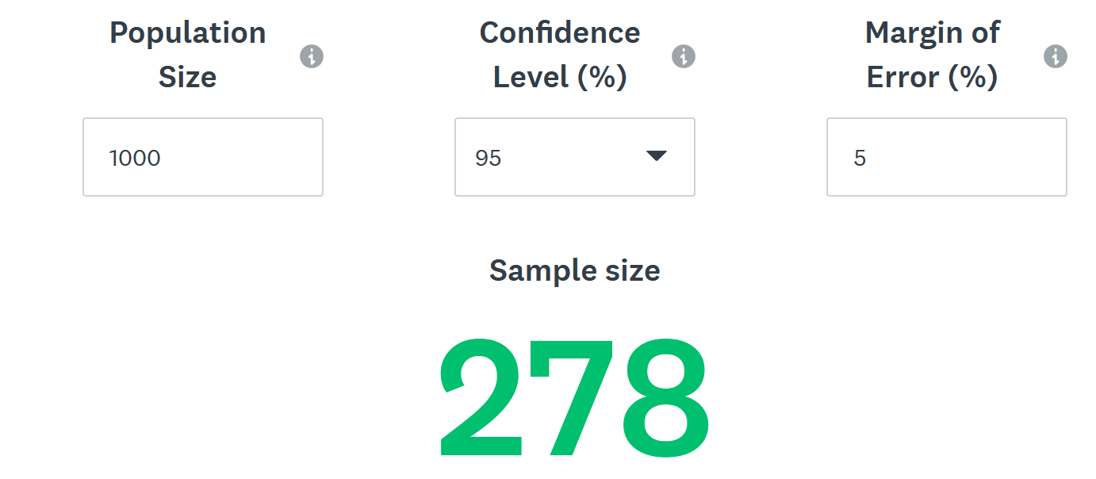
Sample Size for Statistical Significance
https://www.surveymonkey.com/mp/sample-size-calculator/
Chance results happen by coincidence in random sampling of target population
Do you need to worry about this? Depends on use:
  General feedback - No. Market characterization - Yes.
Notes:
You might be wondering how many responses you need to receive to get a valid survey. Survey Monkey has a quick “survey size calculator” that can help you to determine that.
You may not need statistical significance if you are trying to get general feedback, but if you are seeking to characterize a target audience, you will.
Not having statistical significance does not mean that you are not still receiving valuable information.

Slide 8
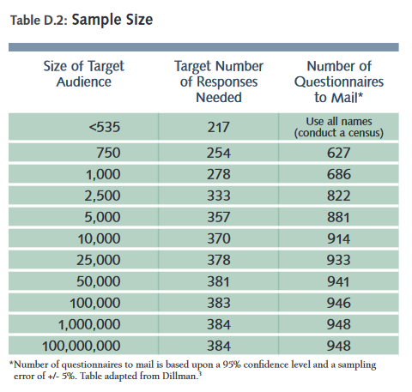
Sample Size for Statistical Significance
https://iwr.msu.edu/sidma/Info/pdfs/SI_Handbook_v4_02012012.pdf
Notes:
Here is an example of the number of target responses needed based on the audience size. This table is taken from “The Social Indicator Planning and Evaluation System (SIPES) for Nonpoint Source Management: A Handbook for Watershed Projects.”
One thing that you might notice is that you need about that same number of responses for an audience size of 10,000 as 100,000,000.
Particularly if your audience is small, you need to think through your needs. Notice that you need to send mail surveys to over 80% of the audience at a sample size of 750 to get the number of target responses needed for statistically representative survey.

Slide 9
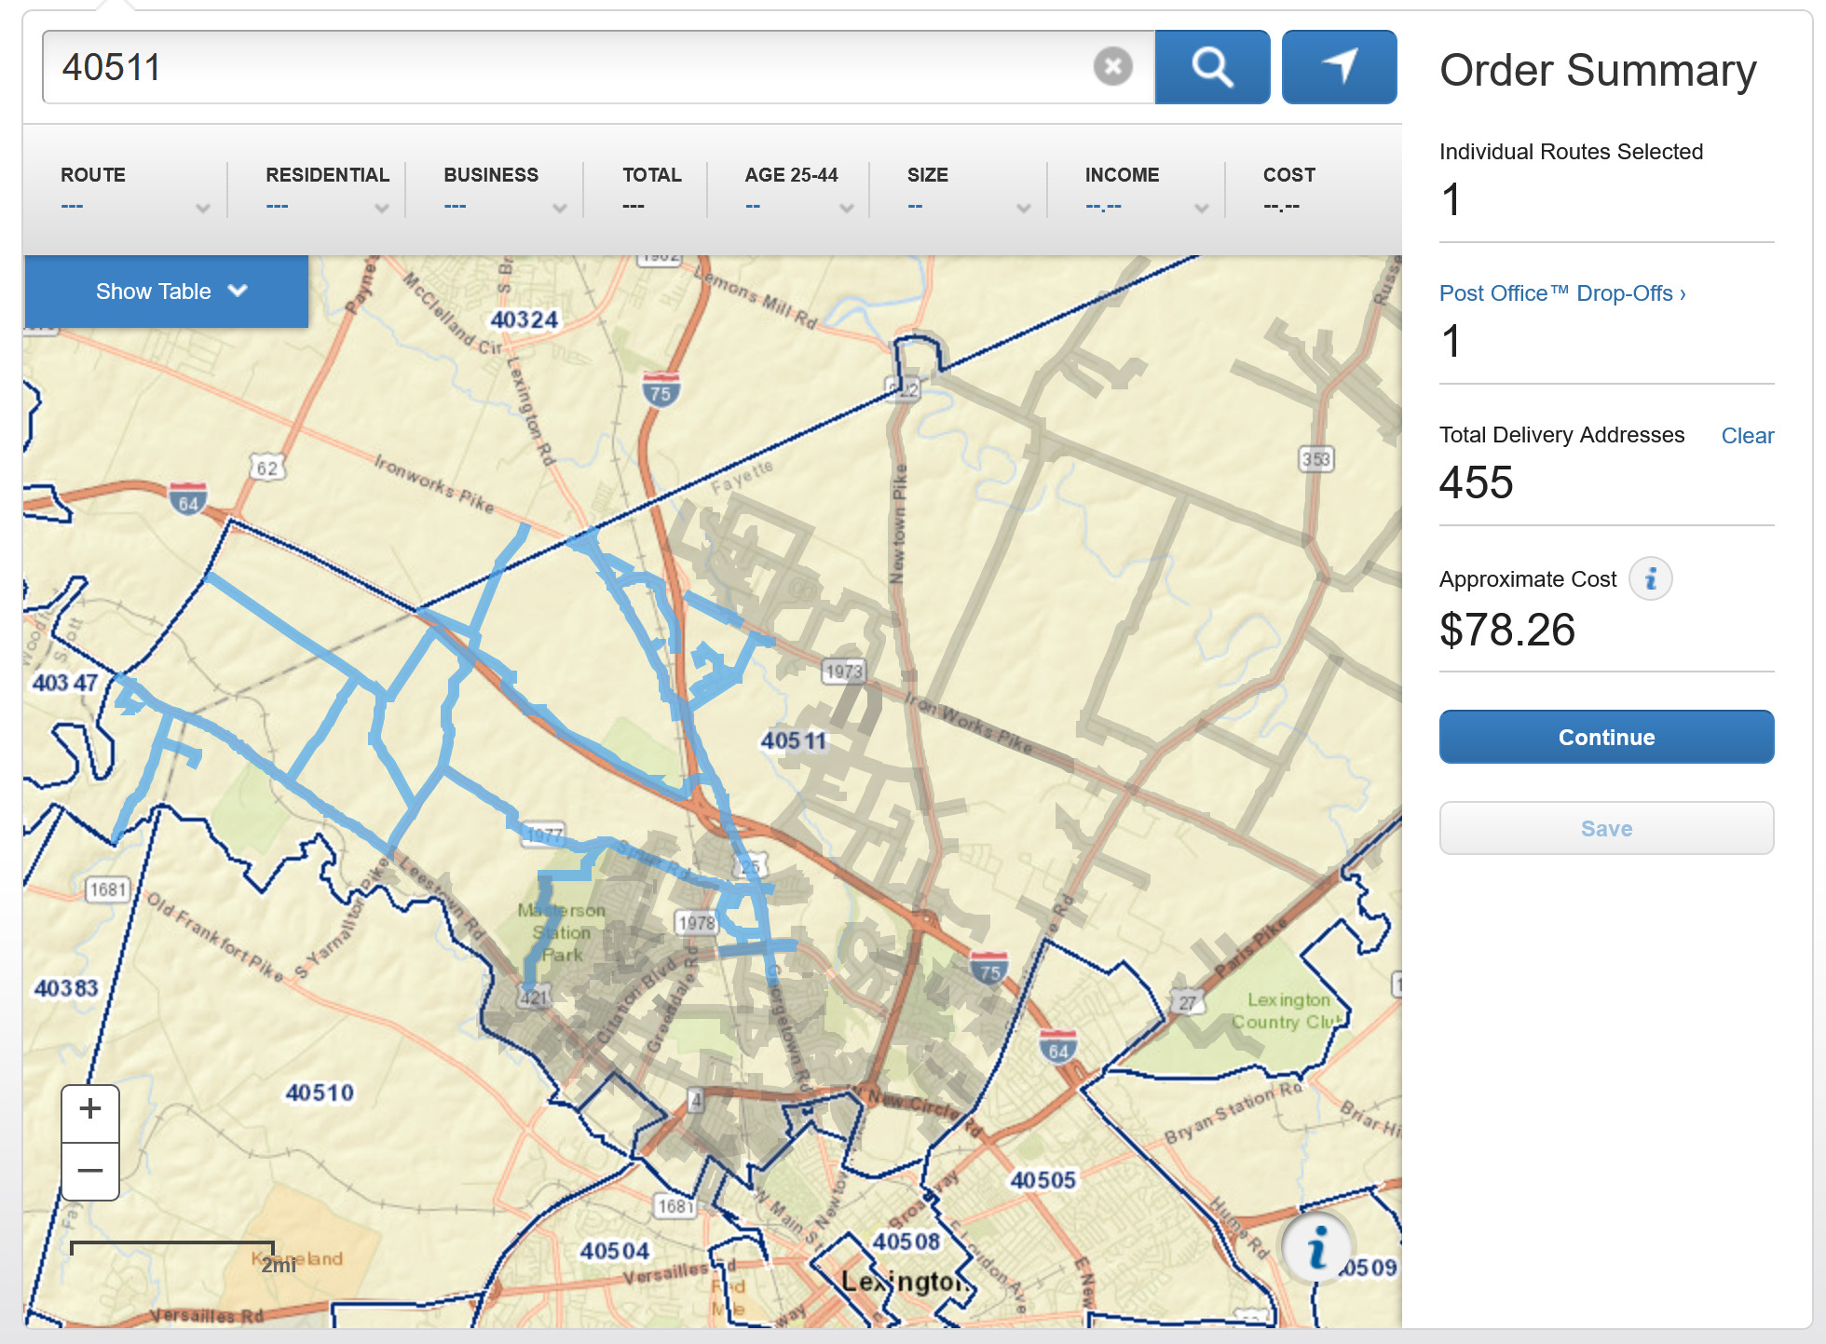

Mail Surveys
Specific Addresses or Direct Mail (https://www.usps.com/business/every-door-direct-mail.htm)
Pros
  Can reach large audience
  Can reach those without internet
Cons
  Printing and mailing costs
  Need to hand-enter results
  Low response rate
  Typically biased toward more interested people
Notes:
For mail surveys, you will either need the specific addresses for your target audience or you might utilize a mailing route that reaches your audience. The US Postal Service has the “Every Door Direct Mail” service that can be used to deliver to an entire mail route. Through this service, you will be given the mailing cost in advance and some demographics of the area. (The small map in the top right shows how you can select the routes).
Make sure to include a self-addressed stamped envelope and consider a giveaway or reward to incentivize responses.
(click) Read Pros and Cons

Slide 10

Intercept Surveys
“Intercept” people as they walk around a high traffic area and ask people to take part in a survey.
Most effective when:
  Visuals (such as map) establish credibility of surveyors
  Conducted in a high-traffic areas
Pros
  Very quickly conducted by different interviewers at different locations
  Low-cost
  Analyzing results is relatively easy
Cons.
  Often not representative due to small sample size
Notes:
Intercept surveys are so called because they “intercept” people as they go about their other business and ask people to take part in a survey.
They are most effective when:
Respondents can see topic-related visuals such as a map or informational display to show credibility
Conducted in high-traffic areas
Surveyors must:
Ask permission if administered in front of a business
Survey each person separately and away from others
Not discuss the response options (so as to introduce bias), but just read them or have them fill out on tablet
(Click) Read pros and cons

Slide 11

Online Surveys
Can use multiple platforms to distribute including email, social media, and even postcards with QR codes or link.
Free / low-cost options are available through Google Forms, SurveyMonkey or other outlets.
Biased to audience with internet access
Pros
  Anonymous
  Flexible, allowing bypass questions
  Easy and low-cost
  Data already electronic
Cons
  Absence of interviewer (miss non-verbal responses)
  Need screening (whole world can access)
  Hard to reach some populations (not online, reception poor, etc.)
Notes:
Read
(Click) for pros and cons

Slide 12
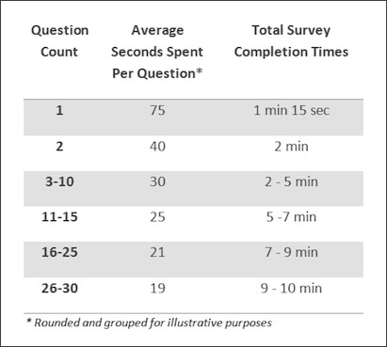
Survey Tips: How Long?
More questions you ask, the less time people spend responding.
If takes longer than 7-8 minutes, completion rates drop.
Recommend no longer than 15 minutes for online or intercept.
Source: surveymonkey.com
Notes:
There are studies that have evaluated how long surveys should be. What they have found is that the more questions you have, the less time people spend in answering them.
(Click) Also, you might get drops in completion rates if the survey takes too long to complete (although some feel like once they commit to start they have to finish).
(Click) If you are doing an intercept or online survey, it is recommended that it takes no longer than 15 minutes to complete.

Slide 13



Examples
Chesapeake Bay Citizen Stewardship Indicators, 2016-2017
Headwaters and KWRRI in Whitesburg, KY, 2019
https://www.chesapeakeprogress.com/?/engaged-communities/citizen-stewardship

Slide 14
Chesapeake Bay Citizen
Stewardship Indicators
https://www.chesapeakeprogress.com/?/engaged-communities/citizen-stewardship
Notes:
The Chesapeake Bay study was very large, using a final total of 5,200 randomly selected residents across 6 states and Washington D.C. via phone interviews. This made the results statistically significant at the state level.
Here we will present the result distribution from earlier in the study (N=2000) for the purpose of showing the survey methodology. You can interact with the full dataset at: https://www.chesapeakeprogress.com/?/engaged-communities/citizen-stewardship

Slide 15
Chesapeake Bay Citizen
Stewardship Indicators
Questionnaire Structure (77 questions)
Introduction and Screening (8)
Stewardship Behavior (19)
Future Likelihood (19)
Volunteerism (5)
Keys to Individual Engagement (8)
Civic Engagement (6)
Classification (12)
Notes:
The survey was rather large based on the time that it took the phone interviewers (about 13 minutes) with 77 questions.
Here you can see the categories of questions they asked.

Slide 16
Chesapeake Bay Citizen
Stewardship Indicators
Measured Behaviors
(19 questions)
Pet waste
Leaves/Lawn clippings (2)
Litter (2)
Fats, grease, contaminants down the drain (2)
Fertilizer use (2)
Pesticide/Herbicide use (2)
Conservation landscaping
Rain garden installation
Septic system
Tree planting
Downspout redirect
Rain barrel (2)
Water conservation
Notes:
The study looked at 13 different stewardship indicators, asking 19 questions. Here are the behaviors.

Slide 17
Chesapeake Bay Citizen
Stewardship Indicators
Response Scales
Yes/No:
In the last several years, have you…?
  Reduced an area of grass lawn by planting native plants?
Frequency (5-point scale):
For each of the following things, please tell me if you never, seldom, sometimes, usually, or always do it:
  Pick up your dog’s waste and dispose of it in the trash.
Agreement (5-point scale):
For each of the statements that follow please tell me if you strongly disagree, somewhat disagree, are neutral, somewhat agree, or strongly agree.
  Polluted water affects me personally.
Likelihood (3-point scale):
Looking forward over the next year or so, how likely are you to do each of these things using the scale not likely, somewhat likely, or very likely.
  Have your septic system inspected or pumped out.
Notes:
Here are the types of questions that they asked with the scales that were used. These scales can be assigned point values and weighted.

Slide 18
Chesapeake Bay Citizen Stewardship Indicators
Notes:
Here you can see the answers to yes / no questions.
In this case, most people have recently had the septic system pumped out but are not utilizing rain barrels

Slide 19
Chesapeake Bay Citizen Stewardship Indicators
Notes:
Here you can see an example of the behaviors.
Most people are not littering or flushing medicine

Slide 20
Chesapeake Bay Citizen Stewardship Indicators
Notes:
… however many fertilize their lawns and are not careful to keep it off of their driveways. Also a much lower percentage pick up litter routinely

Slide 21
Chesapeake Bay Citizen Stewardship Indicators
Notes:
These scores were then converted from a 5-point scale to a 100-pt scale for comparisons and thresholds for citizen engagement levels

Slide 22
Chesapeake Bay Citizen Stewardship Indicators
Notes:
They also were able to see the behaviors where they were most likely to get behavior change.
In this case, getting people to stop littering had the greatest opportunity whereas getting people to stop using pesticides or herbicides is a tougher sale.

Slide 23
Chesapeake Bay Citizen Stewardship Indicators
Notes:
Here you can see that although many people volunteer or give to charities, the percentage giving to water organizations or charities is much lower. Further, only 40% of the audience can name a water organization.

Slide 24
Chesapeake Bay Citizen Stewardship Indicators
Notes:
You can see that most people want to do more to make waters healthier…

Slide 25
Chesapeake Bay Citizen Stewardship Indicators
Notes:
But fewer know how to do that locally

Slide 26
Chesapeake Bay Citizen Stewardship Indicators
Notes:
And almost know one thinks they are actually contributing to the problem.

Slide 27
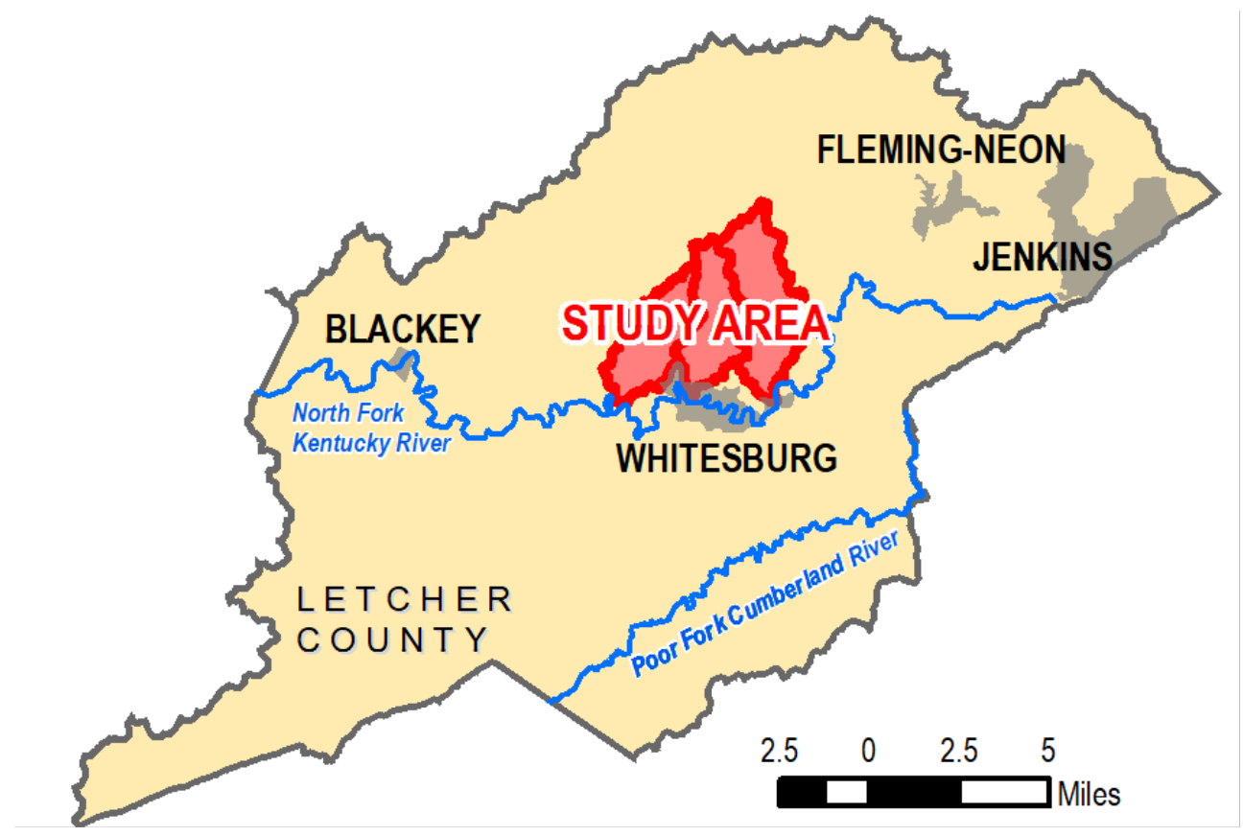
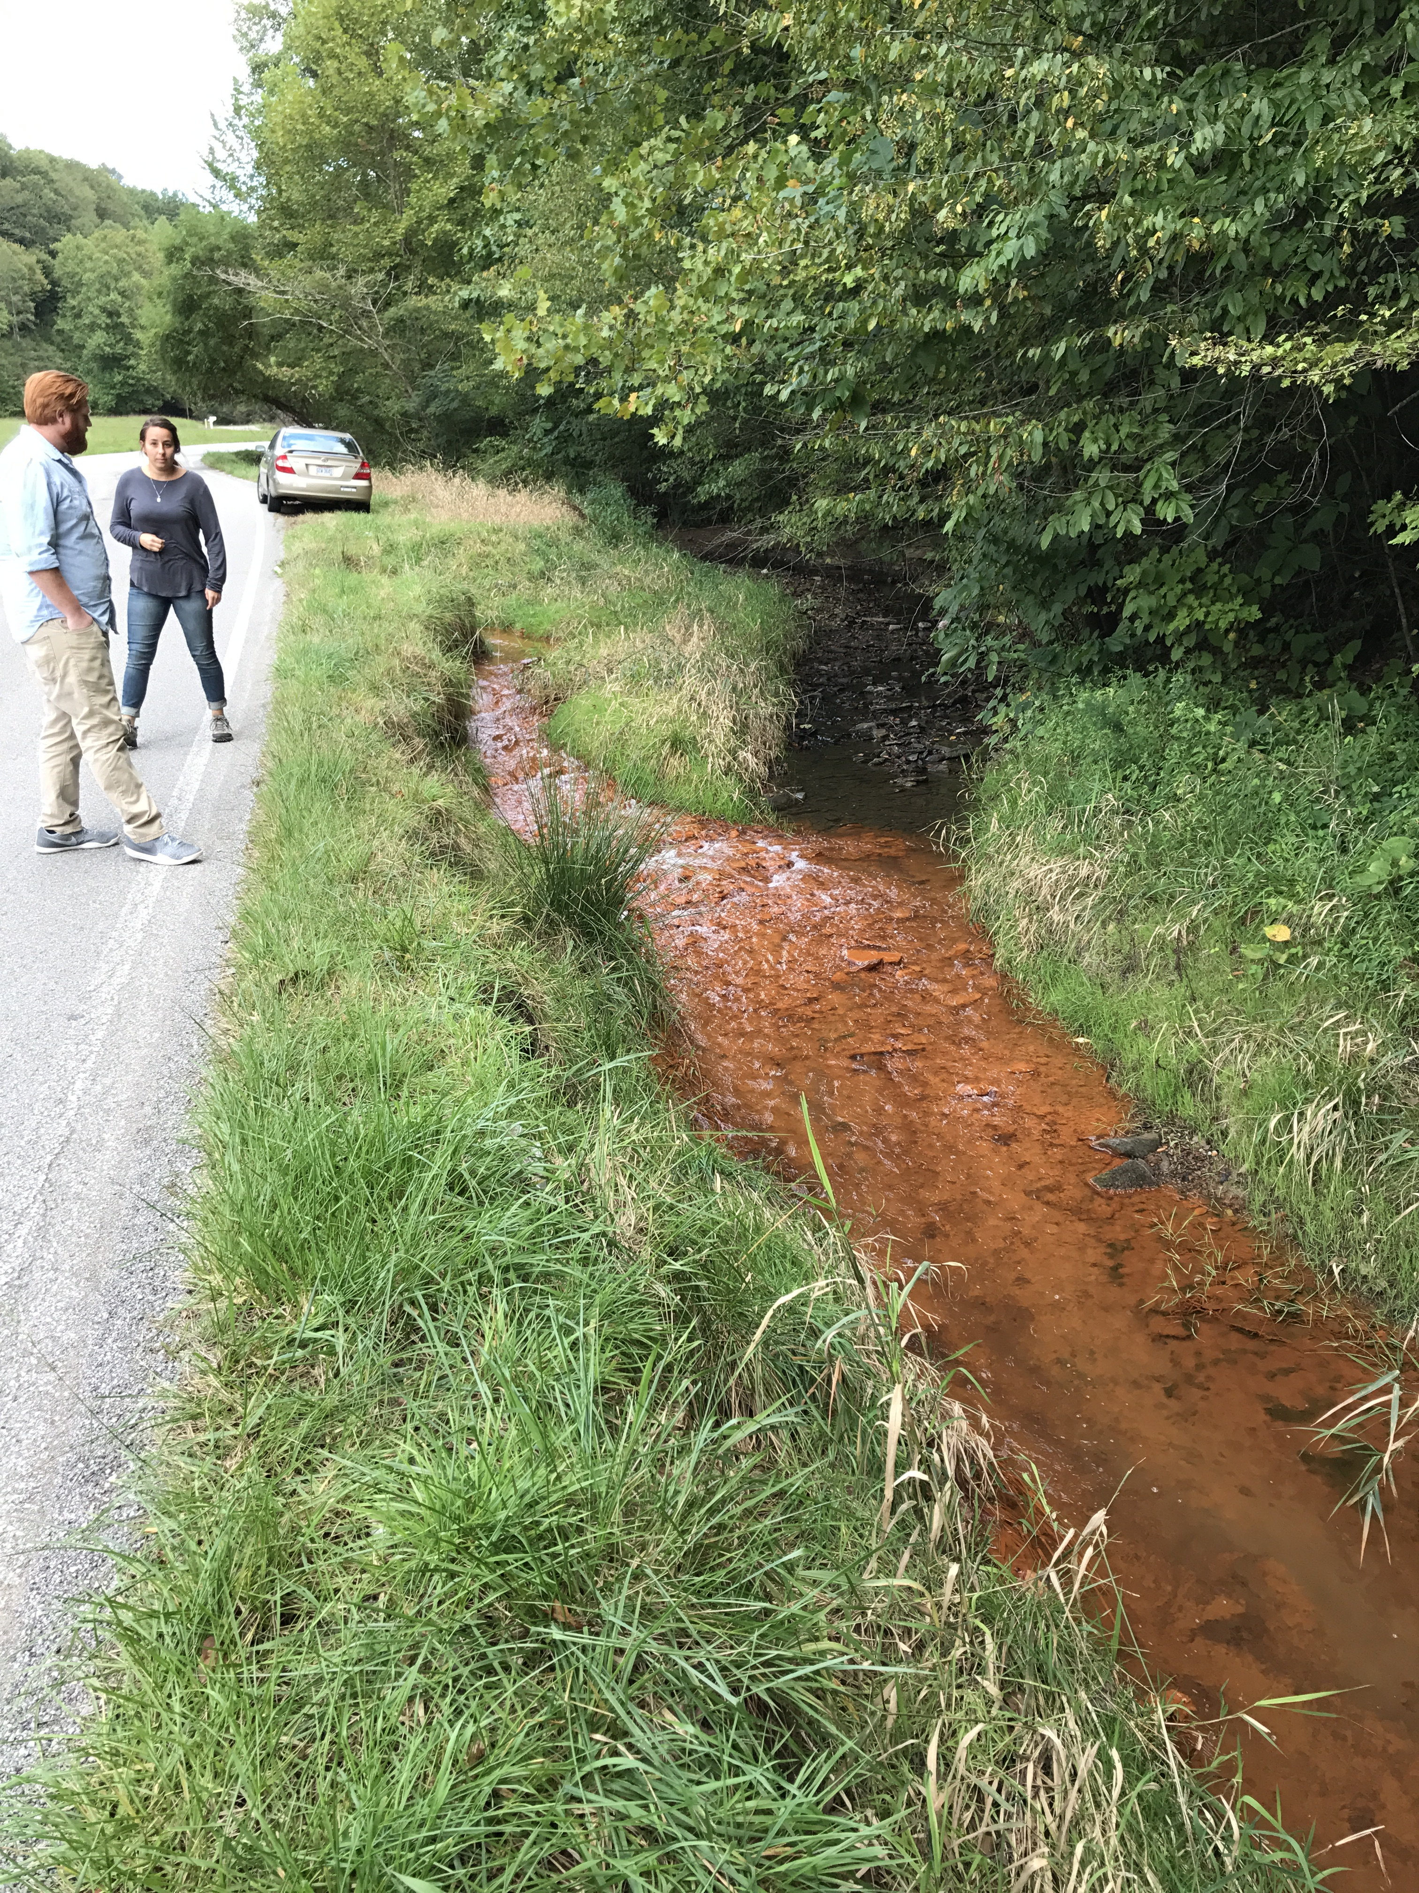
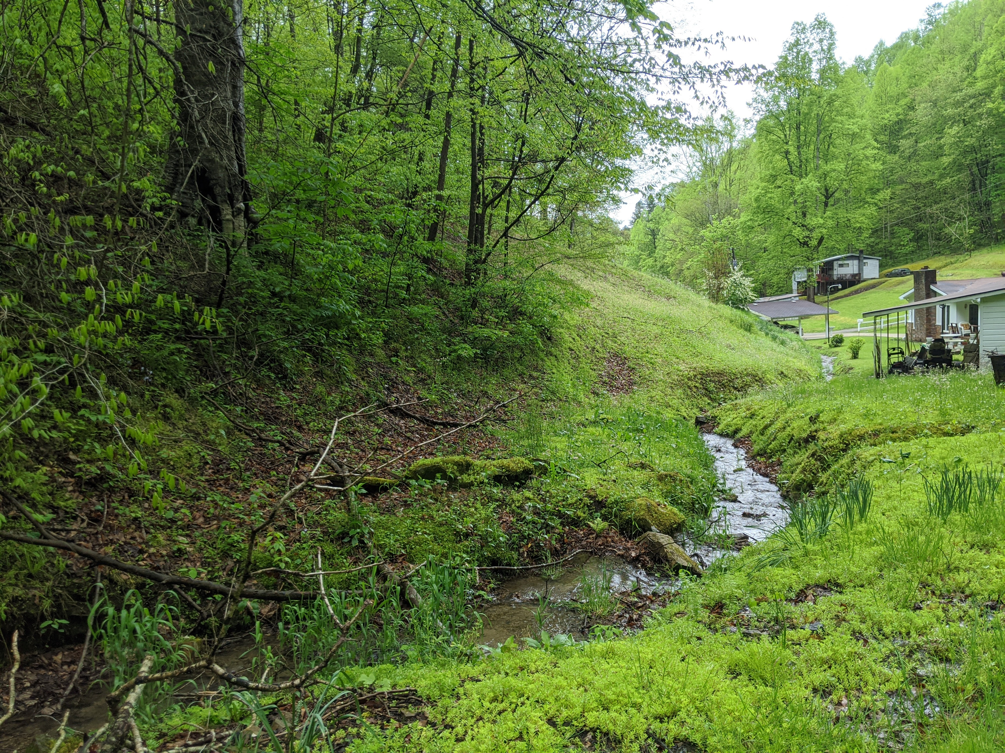
Whitesburg Project Area
Notes:
Unless there is major funding for a statewide study, you probably will not be able to conduct something as elaborate as what was done for the Chesapeake Bay. Therefore, we thought we might give you a Kentucky specific example of how to adapt some of the questions and process in a local study.
KWRRI worked with Headwaters in Letcher County KY to evaluate stakeholder views in the area. The surveys were collected in an intercept format – by tabling at events.

Slide 28
Whitesburg, KY – Headwaters and KWRRI
Notes:
Here is an example of the form that was developed, using some lessons learned from the Chesapeake Bay study. The form was just two pages and had a paper version and an online version which were the same.
You can see there are some general information questions (including screening questions) and some questions about the impact of different water quality concerns where they live.

Slide 29
Whitesburg, KY – Headwaters and KWRRI
Notes:
There was also a section on water quality views - both positive and negative statements are recorded.

Slide 30
Whitesburg, KY – Headwaters and KWRRI
Notes:
And finally there was a section evaluating their home stewardship including questions on wastewater systems, stream maintenance, as well as (not shown here) animal waste, lawn and garden care, and issues affecting / limiting their property management.

Slide 31
Whitesburg, KY – Headwaters and KWRRI
Notes:
Here you can see that failing septic systems and straight pipes were rightly seen as the greatest concern whereas people were not concerned about pet waste.
One issue that was surprising was how much the community viewed trash as a concern – speaking to the need for community litter pick up events as a gateway for improved stewardship engagement.
These results are not statistically representative due to the small sampling number, but it demonstrates that you can use simple surveys to get very power data about your community relatively simply with some planning and forethought.
Hopefully these results provide you with some ideas of how you can utilize surveys in your watershed.

Slide 32

Interviews
“A Conversation with a Knowledge-Seeking Purpose”
Semi-structured, more in-depth
Can Tell You How
Cannot Tell You How Many
Can Provide A Perspective
Cannot Provide THE Perspective
Can Explain
Cannot Predict
Notes:
Now we want to transition from quantitative surveys to qualitative research, beginning with interviews.
Interviews are semi-structured conversations seeking expanded knowledge. For instance, I might want to why trash was viewed as such a large impact or understand why people thought oil and gas drilling was a concern (despite data from the watershed showing otherwise).
Interviews can tell you how, but not how many.
They can provide subjective perspectives but not an objective view.
They can explain why people respond in certain ways but cannot predict.

Slide 33
Interview Goals
Gather process-related information that is not easily observed
Understand a participant’s unique perspective and/or interpretations of activities, events, motivations
Verify information gathered from other sources
Determine validity of research-derived conclusions
Notes:
Here are some goals of interviews

Slide 34
Interview Types
Informant
  Interviewee is considered an expert
  Interviewer may already have relationship
  Provides insider information and perspectives
Respondent
  Single contact between the interviewer and interviewee
  Interview protocol is fairly standard
  Probes are included in the protocol to help draw out attitudes, opinions, experiences, etc.
Ethnographic
  Interviewer is embedded in the situation (as an observer, participant-observer, or observer-participant)
  Opportunistic/situational
  Often focuses on something that just happened or happening in the scene
Notes:
There are three different types of one-on-one interviews
Informant interviews are “expert” interviews. You might want to interview your key stakeholders for example.
Respondent interviews are one time, often random, interviews where a standard protocol is used to draw out responses.
An ethnographic interview might occur by getting perspectives on riparian zones while planting trees, interviewing someone walking their dog about pet waste, or understanding water quality views of kayakers during a boating recreational event.

Slide 35
Interview Pros and Cons
Pros
  Respond and record the interviewee’s body language and tone.
  Can adapt for probe for more in-depth answers
Cons
  Remove the anonymity that might provide more honest answers.
  Time consuming
  Requires travel and scheduling
  Effected by skill of the interviewer

Slide 36
Community Engagement in Urban Minneapolis Water Restoration
Interviews with 25 Community Stakeholders
Water resource professionals, government officials and community actors, then chain referral
Questionnaire Sections
You and Community (5)
Community Needs and Assets (4)
Community Planning and Water Resources (10)
Recommendations for Representatives Moving Forward (2)
Pradhananga, A. M. Davenport, and E. Green. 2019. Cultural Narratives on Constraints to Community Engagement in Urban Water Restoration. Universities Council on Water Resources. Journal of Contemporary Water Research & Education. Issue 166, Pages 79-94.
Notes:
As an example for how interviews might be utilized in the watershed engagement and management process, the 2019 Paper of the Year Award of the University Council on Water Resources went to researchers in urban Minneapolis looking at stakeholder perspectives on community and water resources.
They conducted 25 interviews with stakeholder consisting on water professionals, government officials, and community actors – especially of underrepresented minority populations. Some of these interviews were identified by community recommendations.
The survey had 5 parts with a total of 21 questions focused on the role of the individual in the community, the communities’ needs and assets, planning and water resources, and a feedback mechanism to identify additional community representatives and key stakeholders.

Slide 37
Community Engagement in Urban Minneapolis Water Restoration
1. You and Community
How would you define community?
How would you describe your connection to this community?
What has been your role as [position] in this community?
What would you say are the best things about the work you do in this community?
What have been some of the most challenging things about the work you do in this community?
Pradhananga, A. M. Davenport, and E. Green. 2019. Cultural Narratives on Constraints to Community Engagement in Urban Water Restoration. Universities Council on Water Resources. Journal of Contemporary Water Research & Education. Issue 166, Pages 79-94.
Notes:
Here are the questions on “you and the community.”
Notice the open-ended questions and the freedom provided to describe the community as a whole and the individual’s responsibilities.

Slide 38
Community Engagement in Urban Minneapolis Water Restoration
2. General Community Needs
What would you say are the biggest assets of the community? What makes these assets important?
What do you believe are the most pressing needs in the community? What makes these needs important?
In the past 5 years, what would you say have been the most significant problems the community has faced?
How effective has the community been at responding to or managing these problems? What made it effective/ineffective? Can you provide examples?
Pradhananga, A. M. Davenport, and E. Green. 2019. Cultural Narratives on Constraints to Community Engagement in Urban Water Restoration. Universities Council on Water Resources. Journal of Contemporary Water Research & Education. Issue 166, Pages 79-94.
Notes:
The second section looks at the community needs and assets as a whole. Notice that water nowhere enters into the picture at this point. The questions are geared towards just understanding the community first – understanding how it functions. This is a wide-angle lens.

Slide 39
Community Engagement in Urban Water Restoration
3. Community and Water Resources
How important are water resources such as local streams and lakes to quality of life for residents in this community?
Is the community actively engaged in land use planning in this watershed?
Is the community actively engaged in water resource protection and restoration in this watershed? What success has the community had related to water resource protection?
What challenges or setbacks has the community had related to water resource protection?
Pradhananga, A. M. Davenport, and E. Green. 2019. Cultural Narratives on Constraints to Community Engagement in Urban Water Restoration. Universities Council on Water Resources. Journal of Contemporary Water Research & Education. Issue 166, Pages 79-94.
Notes:
The third section then narrowed in on water resources. These are just a few of those questions. Notice again the open-ended nature of the questions and the lack of bias.

Slide 40
Results:
Narratives Constraining Community Engagement
Water is an invisible and inaccessible community resource.
Water discourse lacks community relevance.
Culture shapes water uses, values, and civic engagement.
Water management is complex and uncoordinated.
Community members of color are disempowered in decision-making.
Pradhananga, A. M. Davenport, and E. Green. 2019. Cultural Narratives on Constraints to Community Engagement in Urban Water Restoration. Universities Council on Water Resources. Journal of Contemporary Water Research & Education. Issue 166, Pages 79-94.
Notes:
Based on the results of the interviews, five different narratives were found amongst the community. Because the study began with considering the larger community issues and concerns, they were able to see that some groups felt disempowered from water-related decision making even though culture shaped interactions with water. Further they found that often the connection is not made between relevant issues in the community and water resources and the water is invisible and off-limits.
This was the case in an urban community. What about in your local watershed communities? Perhaps taking the time to understand the community issues and then tie water issues to them in a more simple, straightforward manner would increase interest and involvement.

Slide 41

Focus Groups
Small, representative group
(6-12) from target audience
Trained facilitator / moderator often needed to avoid extremes, arguments, and group think
1.5-2 hour session of group dialogue.
Ask series of questions with answers recorded by audio or video.
Guidance: coast.noaa.gov/data/digitalcoast/pdf/focus-groups.pdf
Notes:
Similar to one-on-one interviews in their qualitative approach, focus groups utilize group interactions and discussions to provide feedback on community issues. Often focus groups are selected from survey participants to get more a in-depth understanding of the responses. However, focus groups can also be used prior to surveys to help in their design.
(Click) One approach to focus groups is to divide into separate groups based on whether they practice a given behavior (or not) to understand what is driving the behaviors. Another approach may be to develop “groups” based on similar responses to a survey and better understand the views of the respective groups.
(Click) Often a trained facilitator is helpful to keep the discussion on track and avoid extremes or arguments caused by powerful emotions of dominant personalities. They can also help minimize the role of group think by allowing participants to first capture their own thoughts before sharing with the group.
(Click) The process is that a series of questions are asked in a session on about 1.5 to 2 hours. Sometimes some quantitative surveys can be mixed in with the open questions.
(Click) These sessions are often recorded to get the non-verbal responses as well as the verbal ones.
(Click) If you would like additional guidance on focus groups, we recommend consultation with an excellent guidance document developed by NOAA.

Slide 42
Focus Group Checklist
Identify target audience. (4 months prior)
Define goal of focus group. (2 months)
Determine payment amount and method. (2 months)
Compile mailing list for invitees. (6 weeks)
Identify moderator. (5 weeks)
Develop questions. (4 weeks)
Arrange and reserve session site. (4 weeks)
Write and send invitations. (4 weeks)
Follow up invitations with phone calls. (2 weeks)
Determine room arrangements (seating, audio/visual aids). (2 weeks)
Place reminder call to participants. (2 days)
Make arrangements for food or beverages. (2 days)
Conduct the focus group.
Distribute payments. (At the conclusion)
Send thank-you letter to participants. (2 days after)
Review tapes or notes from focus group and summarize. (2 days)
Analyze focus group summary and write report. (1 week)
Notes:
Here is an example of a checklist of items to perform in hosting a focus group. We include this as a resource for later reference if you are planning one. Beginning some 4 months in advance is often necessary to properly conduct the study.

Slide 43
Focus Groups: Floyd’s Fork
Nutrient Study
Listening Tour to understand groups
Nutrient Management Strategies Preferred by 7 Different Groups
  Developers, Preservation, Environmental, Agricultural, Recreational, Government, Residents
Discussed life goals and values, trusted info channels, and reviewed 20 BMPs
Used real-time clicker responses and then discussed
Notes:
As an example, in 2012-13 a study was conducted by KWRRI (funded by KDOW) to understand stakeholder views about nutrient management in the Floyd’s Fork watershed in the Salt River Basin.
(click) This began with a series of listening sessions to understand the perspectives the composition and perspectives of different groups and then
(click) focus studies with the groups to determine their preferences of various nutrient BMPs as well as life goals, values, and trusted information sources.
Seven different stakeholder groups emerged from the listening sessions including:
(click) Developers, Preservation, Environmental, Agricultural, Recreational, Government, and Residents.
(click) During the focus sessions, real-time feedback was provided on various issues and then the group discussed their answers.

Slide 44
Focus Groups: Floyd’s Fork Nutrient Study
Notes:
Here you can see how various groups responded differently to 4 of the 20 practices examined.
The blue bars are the average, green is the median, and red is the standard deviation in the responses, based on a 9-point Likert scale.
You can see that:
1) Top Left: eliminating failing septic systems was supported across the board
Some of the comments included:
Obviously anybody would want failing septic systems corrected for the area.
Potential problems with the strategy will always be the cost and then compliance, basically getting people to do this.
2) Top Right: Crop / Fertilizer Management was supported by all groups except for developers and recreational groups.
Well I think the strategy represents a good idea and something to be considered as a way of managing some of the influence of nutrients getting into the streams as far as just in general. As compared to things like housing development and other infrastructure I think, but you would know better than I, that fertilizers in agriculture uses have much more of a tremendous impact on streams nearby.
I don’t think DOW has any control over what the farmers do.
One of the disadvantages of the strategy also noted is political. The control of the agriculture interest you know. It is pretty important to have food growing in the United States I guess locally or regionally and it would be a pretty tall mountain I would think to climb to get many changes legislatively.
3) Bottom Left: Most groups were in favor of reducing urban runoff, but developers scored the practice much lower.
We simply don’t have that much impermeable surfaces at this point in time so there are other methods with greater effect.
I’m not against it, it’s just you know some of that permeable pavement the ones with the grass that grows between it. They did that whole thing down on the waterfront where they had the mat down there that supposed to grow up so they drive on it. If you don’t manage it right the grass dies.
I mean people like the nice clean driveway. They don’t want to see weeds in their driveway.
4) Bottom Right: Finally, pollution trading was rejected by most groups
It could allow some nutrient sources not to make any or little effort to resolve their infrastructure and plant capacity inadequacy.
They’re saying, “I can pay somebody else to implement.”
I just really don’t think that sounds ethical to me. Something’s not right about it.
There’s not been a successful cap and trading program since acid rain. Once the grant money ran out for carbon trading programs the organizers cashed out and it dissolved.

Slide 45

Community Forums or Listening Sessions
Hear directly from target audience, typically who are already interested stakeholders or participants
Good first step to understanding community needs and resources
Can identify active stakeholders
Like focus groups but more open-ended and less focused.
Feedback on:
  Issues and concerns
  Barriers
  Resources for change
  Alternatives and solutions
https://ctb.ku.edu/en/table-of-contents/assessment/assessing-community-needs-and-resources/conduct-public-forums/main
Notes:
A listening session is a bit different from a focus group in that it is more open-ended and less focused.
Basically you hold a session where the audience is prompted to speak. You want to hear their views. This can be a good starting place for working in a community.
(click) The goal is to get feedback on issues and concerns, barriers, resources, and different solutions. However, these types of events typically attract the most interested and active stakeholders.

Slide 46
Direct Observation
Record what triggered the behavior, how much effort the person exerted for the behavior, and what behaviors accompanied the target behavior.
Always carry out in public place
Example: observing dog waste pickup in public park.
Pros
  Provides a clearer picture of how people actually behave as opposed to what they say.
Cons
  Can be viewed as an invasion of privacy.
  Anecdotal
  Can be time consuming
Notes:
Direct observations include the researcher observing people engaging or not engaging in a behavior. They may record what caused the behavior, how much effort was exerted, or what other behaviors were associated with it.
Obviously, respecting people’s privacy is important, so this should be done in a public place lest it be viewed as invading privacy
(Click) Hopefully, it can provide some insight into what people are actually doing as opposed to what they say they are doing.
(Click) However the results are often anecdotal and can be time consuming.

Slide 47
Social Mapping
Tools to collect, organize and analyze social data about a community.
Can help illustrate:
Issues/problems
Causes and effects
Relationships
Perceptions
4 Types:
Asset maps - resources
Cognitive maps – surroundings, community elements
Concept maps – causes and effects, linkages
Social Network maps - communications
Notes:
Social mapping can be used to create drawings that illustrate social dynamics, such as possible issues and problems, causes and effects and relationships between organizations and individuals. They can be developed through your in person gatherings, surveys or data analysis.
There are four main types of social maps—asset, cognitive, concept and social.
Helpful Resource: https://www.epa.gov/sites/production/files/2015-09/documents/community_culture.pdf

Slide 48
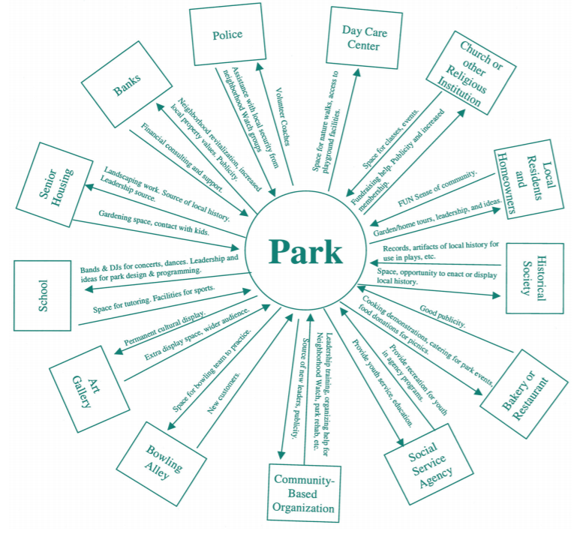
Social Mapping
Asset Map
Show the assets or resources that various individuals or groups in the community could contribute to solving a water quality problem.
Notes:
An Asset Map can show the assets or resources that various individuals or groups in the community could contribute to solving a water quality problem. This example shows how community groups and entities can contribute to the success of a park and what they can receive from it.

Slide 49
Social Mapping
Cognitive Map
created by community members to visualize how they view and perceive their surroundings (i.e. most important elements and where they spend most of their time).
Notes:
A Cognitive Map is a drawing created by community members that can help visualize how they view and perceive their surroundings. You can learn what different people see as the most important elements of the community and where they spend most of their time—which may be helpful in determining where to distribute your message.

Slide 50
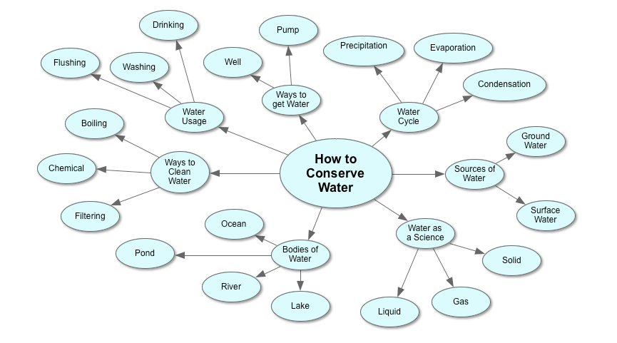
Social Mapping
Concept Map
Perceived relationships between causes and effects of environmental problems (i.e. stereotypes). Helps identify barriers for change.
Notes:
Concept maps help identify perceived relationships between causes and effects of environmental problems, such as a linkage between a land use and a water quality problem. By asking community members to draw a map of some areas where the nonpoint source contributions may be occurring, you can see where stereotypes may be, what perceptions might serve as barriers to change, and where you may need to focus your campaign’s efforts.

Slide 51
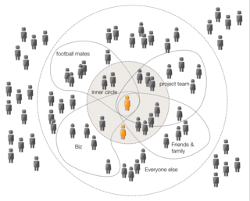
Social Mapping
Social Network Map
How information is delivered throughout your target audience by sketching out their own personal networks of communication and comparing to others.
Notes:
Finally, a social network map will help you learn how information is delivered throughout your target audience. Participants sketch out their own personal networks of communication and compare them with others. You can then tailor your information distribution methods based on this exercise.
Question - What do you think is the largest obstacle to conducting these mapping activities?
Answer - The need for group participation with enough diverse participants to provide a broad range of perspectives.
Helpful Resource: https://www.epa.gov/sites/production/files/2015-09/documents/community_culture.pdf

Slide 52
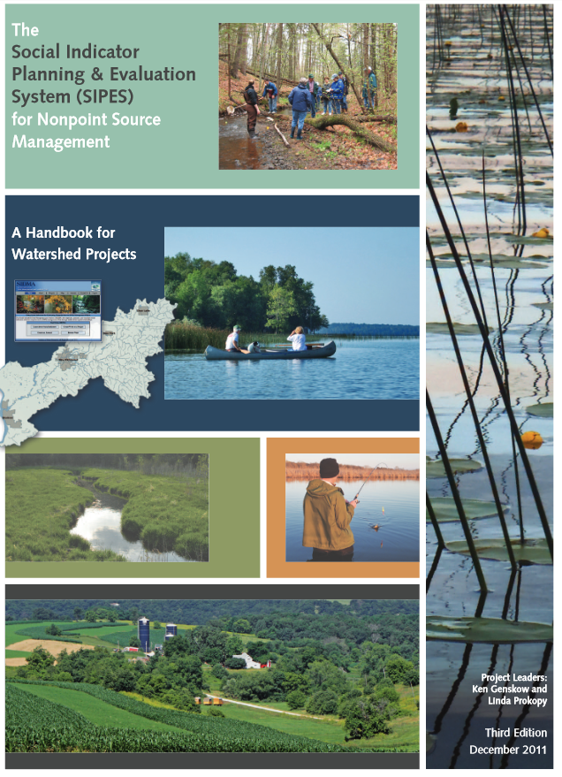
Social Indicators Data Management and Analysis Tool (SIDMA)
USEPA Region 5: Great Lakes Regional Social Indicators Team
Watershed management focused social survey how-to guidebook and with online survey development and administration tools
Survey Building Tool: https://iwr.msu.edu/sidma/Home.aspx
Handbook: https://iwr.msu.edu/sidma/Info/pdfs/SI_Handbook_v4_02012012.pdf
Notes:
The USEPA Region 5: Great Lakes Regional Social Indicators Team developed the “The Social Indicator Planning and Evaluation System (SIPES) for Nonpoint Source Management: A Handbook for Watershed Projects.”
This is a guide to help work through watershed specific survey related items. It also has a tool to help you build surveys and ask the right questions.
This guide covers much more than we are able to address during this presentation, so we recommend you reference it for next steps.

Slide 53
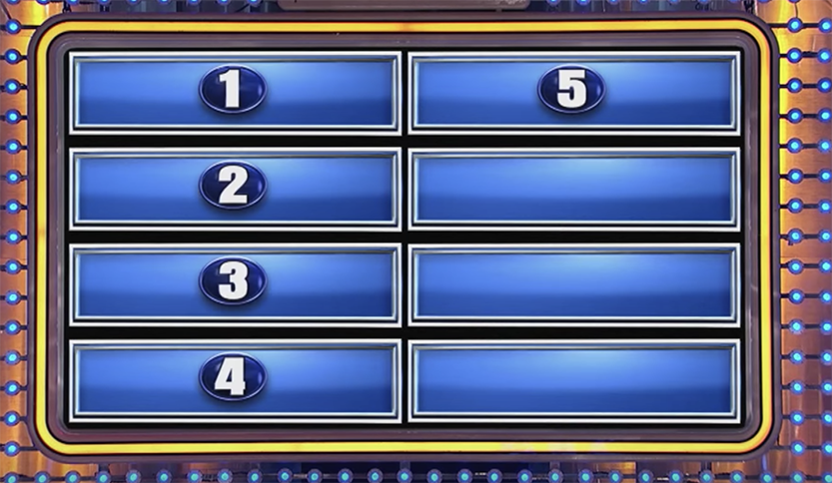
And the Survey Says….
Notes:
And at this point, we will take feedback and questions as to how you received this presentation.
Surveying 100 people, what are the top 5 responses that watershed coordinators will have to this presentation?

