Slide 1
Watershed Academy
Watershed Coordinator Training Series
Land Use Impacts &
Related Best Management Practices
4. Wastewater BMPs

Slide 2

Wastewater BMPs
Brief History of Wastewater BMPs
Science Behind Treatment Technology
Modern Treatment Options
  Sanitary Sewer
  Package Treatment Systems
  Septic Systems and Alternatives
  Alternative Methods
Notes:
In this presentation, we wanted to start with a sort of history of wastewater BMPs. To quote the famous Taro Gomi, “Everyone poops.” Therefore we believe it will be educational to see how people have dealt with their waste over time.
Then we want to briefly look at the science behind this treatment. And then what sort of technology is available today.

Slide 3
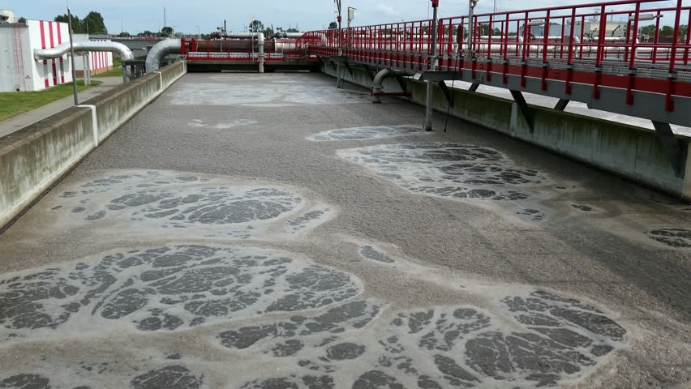
Wastewater BMPs
Can reduce water pollutants:
Bacteria/pathogens
Total Suspended Solids
Nutrients (nitrogen, phosphorus)
Biochemical oxygen demand
Petroleum/oils
Notes:
Wastewater BMPs have been included in every watershed plan that I am aware of in the state. The BMPs can help address a number of pollutants. The exact rate of removal of these pollutants will vary depending on the type of waste upstream (i.e. industrial vs residential) as well as the degree of treatment being provided by the current system. Literature values can be used to predict rates of pollution for each of these contaminants. This helps to determine how many houses would need to be addressed.
The US EPA has some excellent guidance manuals, including the Onsite Wastewater Treatment and Disposal Systems Manual (2002), which provides influent rates that can be used to predict what the untreated sewage from a household contributes on a daily basis. https://www.epa.gov/septic/technical-information-about-septic-systems

Slide 4
History of Wastewater BMPs
Babylon (3500-2500BC) – Some latrines to cesspits, mostly through on roads then covered with clay – stairs down to houses
Indus Valley (2500BC) – Home sump to catch solids, then drainage channels to street
Egypt (2100 BC) – Limestone toilets (for wealthy) – basin to catch or drain outside to sand
Greece (300 BC-500 AD) – Public latrines with combined storm and waste sewer to collection basin then via brick lined conduits to ag field
Romans (800 BC-476 AD) – Aqueducts, latrines and public baths, sewage collection system but no treatment, Cloaca Maxima in Rome
Sanitary Dark Age (476-1800 AD) – Chamber pot to the street, some cesspits and cesspools (but often near drinking water wells). Water thought to be bad.
G. Lofrano, J. Brown. (2010) “Wastewater management through the ages: A history of mankind.” Science of the Total Environment. doi:10.1016/j.scitotenv.2010.07.062
Notes:
Wastewater management has had a surprising amount of impact on the history of civilization. Indeed, the spread of diseases due to unsanitary conditions has been responsible for much premature death throughout history and was a major impediment to city life. All is well if people are spread out over the earth in rural life, but when people congregate together in large communities, there begin to be problems.
It is probably safe to say that for much of civilization, cities would have smelled like the inside of a porta-potty. However, contrary to common perception, many ancient peoples had some relatively modern ways of dealing with waste as traced by a very helpful review by Lofrano and Brown. Even as early as 3500 BC, the Babylonian civilization utilized latrines and cesspits with a drainage system to carry away wastes in Ur and Babylon however many still threw their waste in the streets which were then tiled over such that stairs had to be built down to the houses.
The Indus Valley civilizations had remarkable advanced systems to remove solids and then discharge the liquids into the streets. The wealthy among the Egyptians had limestone toilets which sometimes had drains outside to the sand while the less wealthy used stools over bowls
The Greeks had some modern type sanitation systems. In the Palace of Minos, there has actually a closed sanitary system with toilets. It is still functional now after 4000 years. For the most part they used public latrines connected by pipes to stormwater which was carried out of the city and into agricultural fields for irrigation and fertilization.
The city of Rome had a large sewage collection system, and indeed the Romans were experts in constructing them. They would actually recycle wastewater from their spas and use it for flushing. Obviously, their aqueducts are of world renown but so should be their sewers
However, with the fall of the Roman empire, much of the Western world forgot about this technology and resorted back to the chamber pot, cess pits and cess pools (often placed near drinking water wells. Because of a misunderstanding of sanitation, they thought water was bad for the soul and body. They covered the dirt with makeup, perfumes, and wigs.

Slide 5
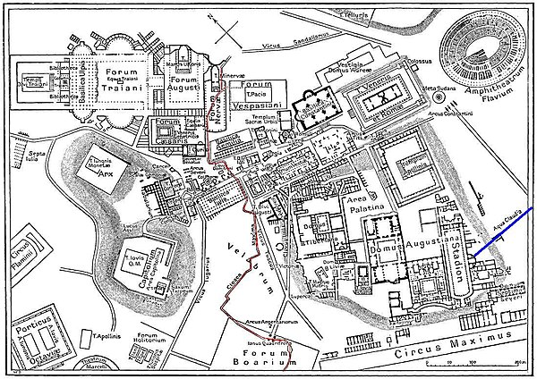
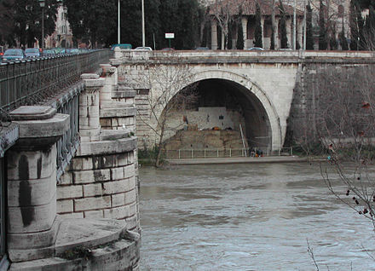
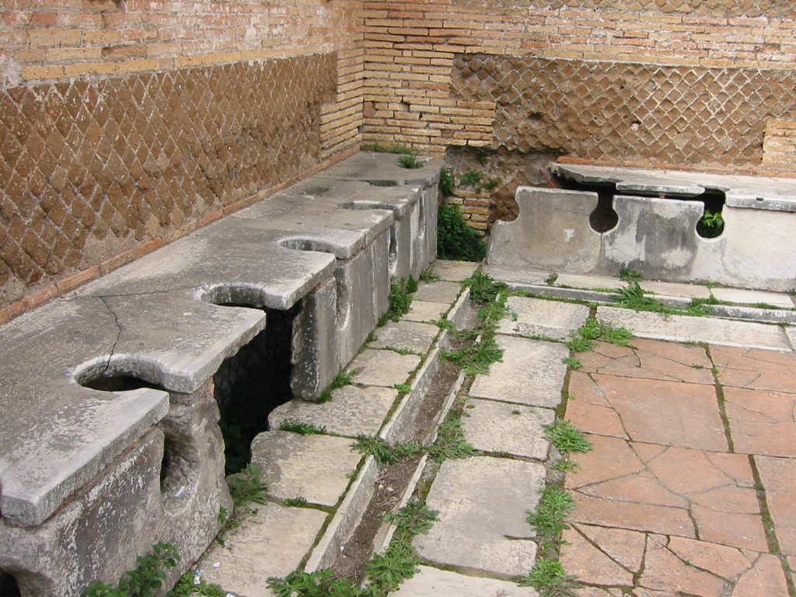

Roman Sewage
Path of sewer through ancient city (red line)
Cloaca Maxima
“Greatest Sewer”
Public latrine in Ostia, Italy
Source: wikipedia
Notes:
On the top left is a current picture of the Cloaca Maxima or “greatest sewer” still present in Rome, Italy.
On the right you can see the red line marking the path of the Cloaca Maxima through Rome running from the forum out past the Circus Maximus
In the center is a picture of a public latrine in Ostia, Italy.

Slide 6
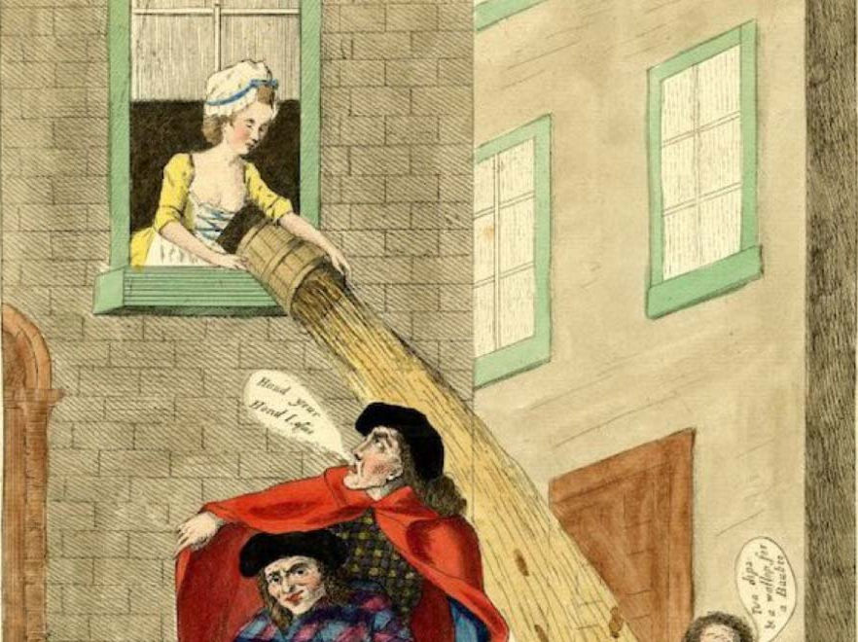
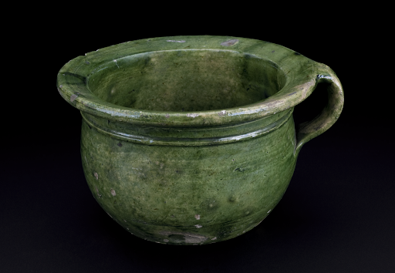
Chamber pots
Gardi loo
  Believed to come from french: garde à l'eau! “Watch out for the water”
Source: www.ancient-origins.net
Notes:
Contrast this to the situation during the “Middle Ages.” Here’ people would use chamber pots and then toss them out of the windows while yelling “Gardi loo” from the French “watch out for the water.”
The smell of the Palace of Versailles in France was legendary with over 5000 visitors per day and public restrooms in the bottom of the stairwells in the hopes that they would provide ventilation (it did not work) and which frequently spilled over. This caused some to go in the galleries and of course the use of perfume was heavy throughout.

Slide 7
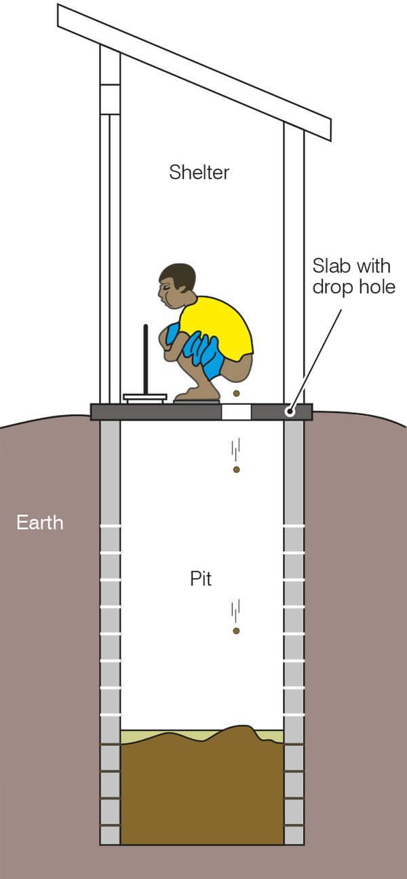
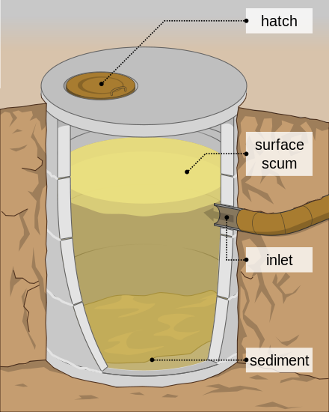
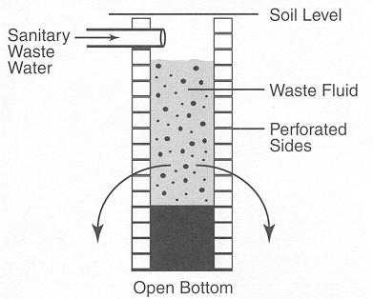
Cesspit and cesspool
Cesspit (sealed) Cesspool (dry well)
Source: wikipedia
Source: EPA
Pit Latrine with Privy (outhouse)
Source: wikipedia
Notes:
One of the base technologies through history is the cesspit and the cesspool.
The cesspit is an underground holding tank that is sealed at the bottom as a temporary holder of sewage. This must be cleaned out frequently.
The cesspool is similar but has an open bottom and perforated sides where the waste can leach out.
Often these are joined with a “privy” or a privacy building. It may have a hole in the floor or a toilet seat.
In Kentucky, we would call this an outhouse. These are still widely in use in some areas or the world.

Slide 8

History of Wastewater BMPs
1854 – Dr. John Snow traced cholera outbreak in Soho, England (which killed 616 people) to mother washing child’s diaper near town well.
1858 – “The Great Stink” – hot weather on river Thames exposed untreated sewage along banks. Joseph Bazalgette installs sewers to move sewage away from London.
Source: wikipedia
Notes:
So how did we get to where we are today?
Well, cholera had a lot to do with it.
In 1854, Dr. John Snow was able to trace the cholera outbreak to a mother washing a child’s diaper near a well. This showed the strong link between sanitation and disease. Building on that discovery, in 1858, the river Thames receded due to a drought which exposed huge amounts of untreated sewage along its banks. The smell was so bad they had to cancel parliament. You can see a cartoon from a magazine from the time which depicts the River Thames introducing his offspring of diphtheria, scrofula, (which were mistakenly thought to be waterbourne diseases at the time) and cholera to the City of London.
As so frequently happens, the health crisis loosened the purse strings for funding and the engineer, Joseph Bazalgette installed a sewer system to move the sewage outside of London. It should be noted that none of this sewer system included treatment. It just moved it out of the city to be the problem of those unfortunately downstream.

Slide 9
Science Behind the Technology
Treatment | Definition | History
Primary | Removal of heavier solids via gravity | Early – trenches and pits 1860 – Fosse Mouras (proto-type septic system) 1895 – Septic tank
Secondary | Biological micro-organisms to convert wastewater to CO₂ and water | 1893 – Trickling filter 1930 – Rotating biological contactors 1913 – Activated sludge via aeration 1972 – Clean Water Act mandates secondary treatment
Tertiary / Advanced: | Nutrient and other chemical removal | 1962 – Anoxic zone to denitrify 1973 – Nutrient removal via sludge system
Disinfection | Pathogenic organisms killed or inactivated | 1893 – Chlorine first used 1961 – Commercial chlorine residual controlled disinfection ~2000 – UV light more commonly used
G. Lofrano, J. Brown. (2010)
Notes:
When we take a look of the technology being used to treat wastewater, much of what we see is primary treatment – the removal of the solid waste. This is still the technology behind the septic tank. The proto-type of the septic tank was first devised in France just prior the American civil war. It had two compartments with a gas outlet. We are celebrating the 125th anniversary of the septic system – a relative short time ago.
Secondary treatment include using microorganisms to breakdown the liquid wastewater to carbon dioxide and water. Some of the first mechanisms to provide treatment arose near the beginning of World War I. Activated sludge using aeration is still the most common method of secondary treatment. It is only in 1972 with the Clean Water Act that secondary treatment was mandated – less than 50 years ago.
In the 1960s and 1970’s teritary systems to remove nutrients and other chemicals were first developed, but these are still not widely used in Kentucky.
Finally, one important component of wastewater treatment is disinfection of the waste to kill pathogens. Although chlorine was first used in 1893, it was not really used commercially until 1961. Chlorine is still commonly used, and it is only in the 2000’s that UV light began to be commonly used.
What was stunning to me – and hopefully for you – is how relatively recent these treatments are. This is in the lifetimes of parents, grandparents, or great grandparents for most of us.

Slide 10
Septic Systems
Notes:
So what are the treatment methods available today?
Let’s start with septic systems.

Slide 11
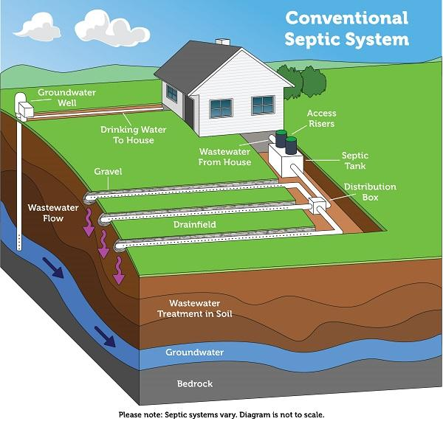
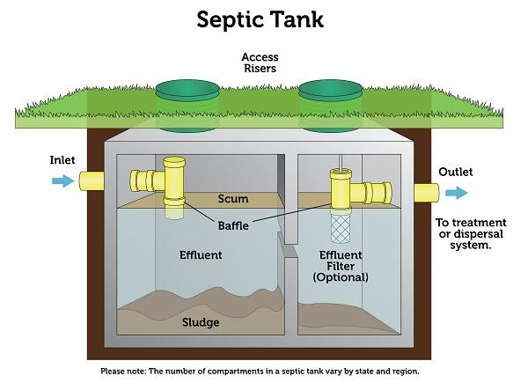
Septic System
Source: www.epa.gov/septic/
Notes:
A septic system consists of three main parts: the septic tank, the drainfield, and the soil beneath the drainfield.
The septic tank is a watertight container about 9 feet long and 5 feet tall. It is buried in the ground just outside the home. The tank is usually precast from reinforced concrete, although tanks made from plastic or fiberglass may be seen on occasion.
While a tank is typically designed with a 1,000-gallon liquid capacity, its size is legally determined by the number of bedrooms in the home. The tank temporarily holds household wastes and allows a small amount of pretreatment to take place.
All of the wastewaters from the home should flow into the septic tank. As wastewater flows into the tank, the heavier solid materials settle to the bottom (forming a sludge layer), and the lighter greases and fats float to the top (forming a scum layer). The tank’s primary purpose is to retain the solids. THIS IS PRIMARY TREATMENT.
After a retention time of about two days, the liquid portion (the sewage effluent) flows out of the tank through the outlet pipe. The retention time is necessary for separation of the solids from the liquid and for anaerobic digestion of the solids to begin in the septic tank.
The purpose of the drainfield is to deliver the liquid sewage effluent to the soil. The treatment of the liquid wastewater occurs in the soil beneath the drainfield. Sewage effluent flows out of the tank as a cloudy liquid that still contains many disease-causing germs and environmental pollutants. Effluent flows into the perforated pipe in the trenches, passes through the holes in the pipe, and then trickles down through the gravel to the soil.
As sewage effluent enters and flows through the ground, soil particles filter out many of the bacteria that can cause diseases. THIS IS SECONDARY TREATMENT. The soil adsorbs some of the smaller germs, such as viruses, until they are destroyed. The soil can also retain certain chemicals, including phosphorus and some forms of nitrogen.
A special zone, called a biomat, forms in the upper 1 to 6 inches of the soil at the soil/trench interface just below the trench bottom. This biomat zone is useful. It helps remove many of the germs and chemical pollutants. If the solids accumulating in the septic tank are never pumped out, however, they can flow into the trenches and accumulate into an intensive biomat that becomes too thick. When that happens, the biomat completely clogs the soil and does not allow the sewage effluent to flow out of the trench. An improperly maintained system will fail and cause untreated sewage to completely fill the trenches and come out on top of the ground or back up into the home in its plumbing system.
Source: https://content.ces.ncsu.edu/septic-systems-and-their-maintenance
NOTE: The graphics utilized in this and the subsequent slides are from the EPA Septic SMART program. Their website has lots of materials for education and outreach.

Slide 12
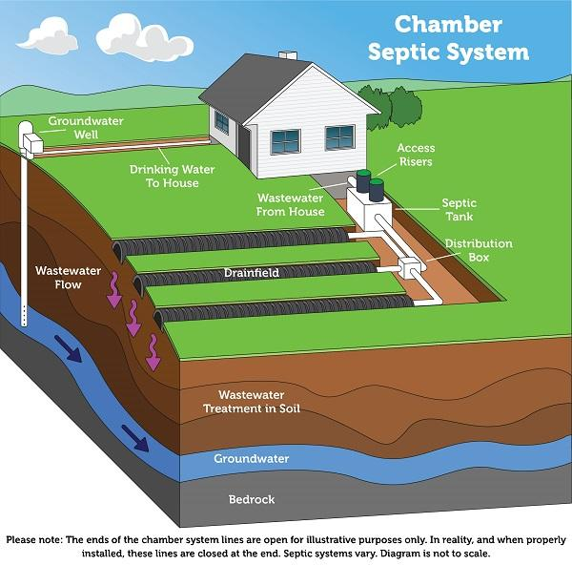
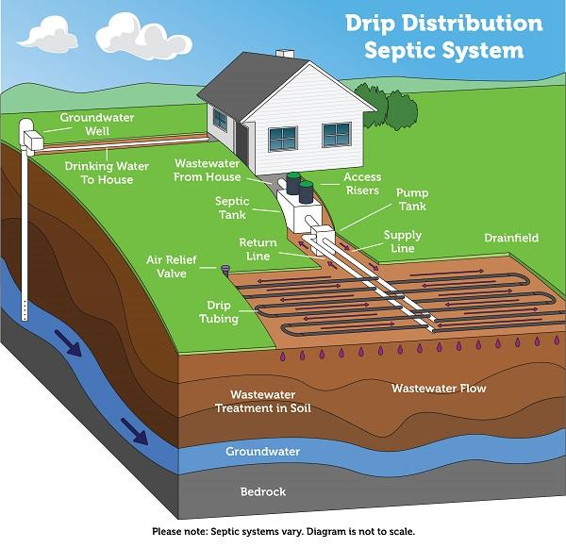
Septic System
Source: www.epa.gov/septic/
Notes:
There are some alternatives to the typical gravel septic drainfield.
Chamber System
Gravel-less drainfields can take many forms. An example of a gravel-less system is the chamber system. The primary advantage of the chamber system is increased ease of delivery and construction. This type of system consists of a series of connected chambers. The area around and above the chambers is filled with soil. Pipes carry wastewater from the septic tank to the chambers. In the chambers, the wastewater comes into contact with the soil. Microbes on or near the soil treat the effluent.
Drip Distribution System
The drip distribution system is a type of effluent dispersal that can be used in many types of drainfields. The main advantage of the drip distribution system is that no large mound of soil is needed as the drip laterals are inserted into the top 6 to 12 inches of soil. The disadvantage of the drip distribution system is that it requires a large dose tank after the septic tank to accommodate the timed dose delivery of wastewater to the drip absorption area. Additional components, such as electrical power, are necessary for this system, requiring an added expense and increased maintenance. This system requires a much smaller area for installation.
From EPA

Slide 13
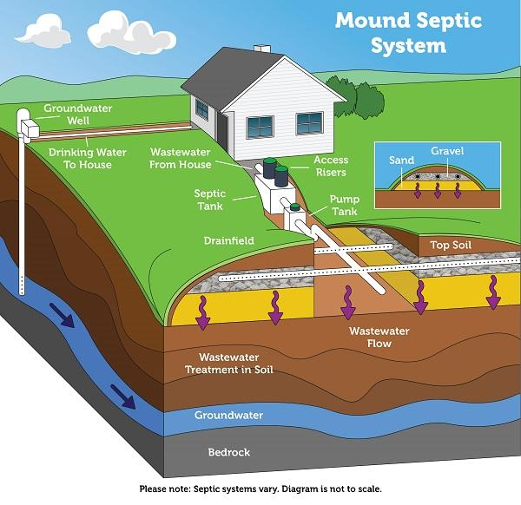
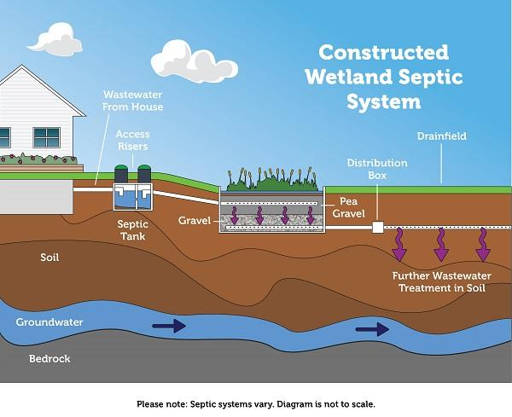
Septic System
Source: www.epa.gov/septic/
Notes:
Mound System
Mound systems are an option in areas of shallow soil depth, high groundwater, or shallow bedrock. The constructed sand mound contains a drainfield trench. Effluent from the septic tank flows to a pump chamber where it is pumped to the mound in prescribed doses. Treatment of the effluent occurs as it discharges to the trench and filters through the sand, and then disperses into the native soil. While mound systems can be a good solution for certain soil conditions, they require a substantial amount of space and periodic maintenance.
Constructed Wetland System
A constructed wetland mimics the treatment processes that occur in natural wetlands. Wastewater flows from the septic tank and enters the wetland cell. The wastewater then passes through the media and is treated by microbes, plants, and other media that remove pathogens and nutrients. The wetland cell typically consists of an impermeable liner, and gravel and sand fill, along with the appropriate wetland plants, which must be able to survive in a perpetually saturated environment. A wetland system can work via either gravity flow or pressure distribution. As wastewater flows through the wetland, it may exit the wetland and flow into a drainfield for further wastewater treatment into the soil. These systems require a smaller footprint and some maintenance of the plants and media. They are often recommended by the Health Dept around lakes.

Slide 14
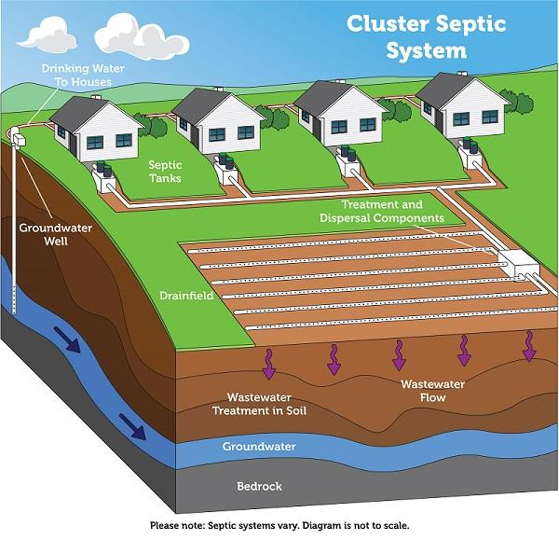
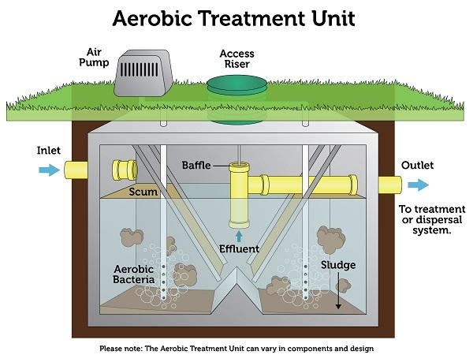
Septic System
Source: www.epa.gov/septic/
Notes:
Cluster System
A decentralized wastewater treatment system under some form of common ownership that collects wastewater from two or more dwellings or buildings and conveys it to a treatment and dispersal system located on a suitable site near the dwellings or buildings. It is common to find cluster systems in places like rural subdivisions.
Aerobic Treatment Units (ATUs) use many of the same processes as a municipal sewage plant, but on a smaller scale. An aerobic system injects oxygen into the treatment tank. The additional oxygen increases natural bacterial activity within the system that then provides additional treatment for nutrients in the effluent. Some aerobic systems may also have a pretreatment tank and a final treatment tank including disinfection to further reduce pathogen levels.
The benefits of this system are that it can be used in homes with smaller lots, inadequate soil conditions, in areas where the water table is too high, or for homes close to a surface water body sensitive to contamination by nutrients contained in wastewater effluent. Regular life-time maintenance should be expected for ATUs.

Slide 15
Septic System BMPs
Septic System Education and Outreach
Septic System Failure Detection
Septic Pumpout Program
Septic System Replacement and Repair or Installation

Slide 16

Septic System Maintenance Education
Public outreach to provide information about the how septic systems function and the maintenance required for these onsite wastewater systems to be effective.
Educational pamphlets, flyers, mailings
Workshops, presentations
Newspaper articles
Health Department outreach
Source: Bluegrass Greensource
Key Elements of Septic System Care:
  Inspect and pump frequently
  Use water efficiently
  Properly dispose of waste
  Maintain your drainfield
Notes:
1) Up to 60% of the solids in the tank decompose, but the remainder accumulate in the tank. Over time, the solids build up and consume space for the liquid layer. This decreases wastewater retention time and increases the likelihood of solids reaching and clogging the drainage field. This can lead to system failure as the sewage backs up into the house due to clogged lateral lines.
It is recommended that the tank be pumped every 3-5 years, depending on the number of people living in the household and the size of the tank.
2) Efficient water uses prevents overloading the system with too much wastewater. Appliances such as high-efficiency toilets, showerheads and washing machines help reduce water use. It is also helpful to spread washing machine use throughout the week, rather than doing all laundry in one day.
3) What goes down the drain affects your septic system—including what is flushed down the toilet, ground in the garbage disposal, or poured down the sink. Only human waste and toilet paper should be flushed. And, toxins should not be poured down the drain, since they can kill the living organisms that help treat household wastewater.
4) The drainfield is a critical component of the system that removes contaminants from the liquid that leaves the tank. To protect it, do not drive over it or park on it, do not plant trees over it to prevent root invasion, and keep water drainage away from the field as much as possible.

Slide 17
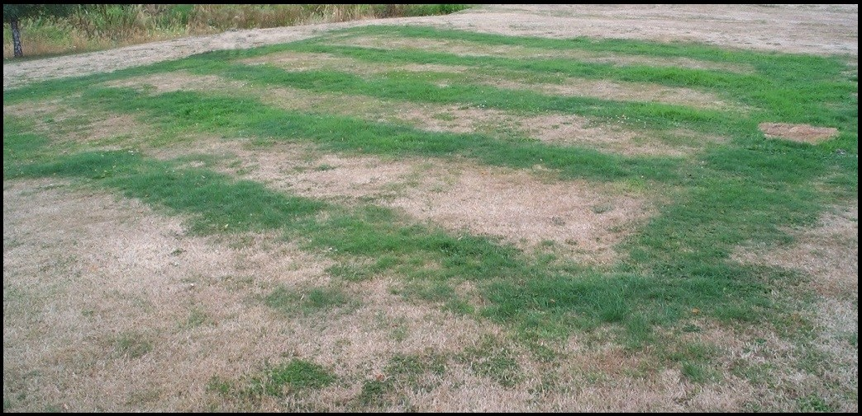
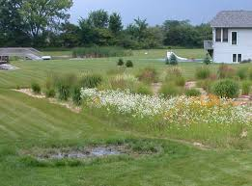
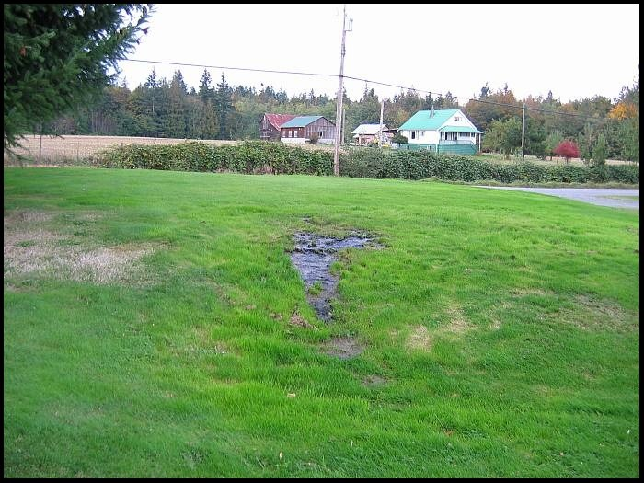
Septic System Failure Detection
Signs of Septic System Failure:
Surfacing of the sewage
Ground is wet or soggy
Grass grows greener
Sewage odors in the house
Plumbing backs up into house
Slowly draining sinks or toilets
Gurgling sounds in plumbing
Bacteria or nitrates in well water
Source: Lee 2012
Notes:
Here are eight different signs of septic system failure. Failure will often show up by surfacing or backing up, but sometimes this is not the case.

Slide 18
Septic System Failure Detection
EPA, 2002 Onsite Wastewater Treatment Systems Manual
Notes:
Remember the wastewater in the leach fields flows downward through the soil where bacteria treatment occurs. However, if there is a perched water table or fragipan soil, then the wastewater may flow along this layer toward lakes and streams.

Slide 19
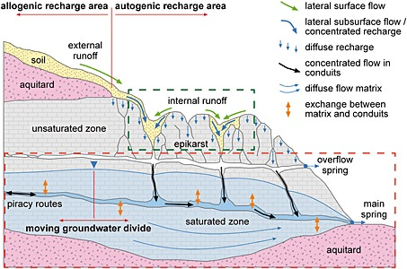
Septic System Failure Detection in Karst Environments
Source: Hartmann et al, 2014
Notes:
There are a lot of technical terms on this graphic, but the point that we want to emphasize is that in karst or epikarst environments, even when not near a sinkhole, septic failures may not surface. They groundwater flow can quickly transport contaminants to springs and streams. In these cases, the secondary treatment may be limited or largely bypassed.

Slide 20
Nitrogen and Septic System
Near waterbodies Chesapeake Bay report recommended:
Setback distance from waterbody of 100 feet at minimum for septic system (no discharges) .
100-1,000 feet have advanced treatment with denitrification
  To upgrade to ATU unit plus anoxic environment costs $10,000-15,000.
Traditional Septic systems will contribute 9lbs N/year even if functioning properly.
Chesapeake Bay (EPA 2013)
Notes:
It should also be noted that even when working properly, elevated nitrogen levels will be transported to waterbodies if:
They are located too close to waterbodies. Setback distances of up to 1,000 feet were recommended in the Chesapeake Bay area.
They do not have an upgraded ATU unit with an anoxic environment to provide improved secondary and tertiary treatment. These units can cost an additional $10-15 thousand dollars.

Slide 21
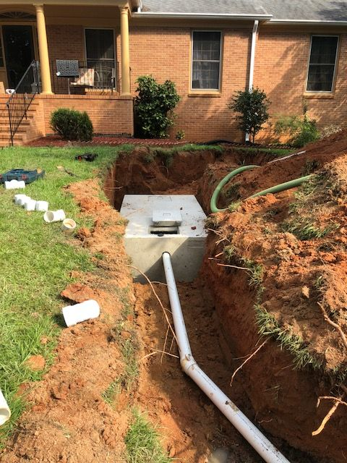
Repair or Replacement of Failing Septic Systems
Assess and correct any issues with tanks, connection pipes and drainage field that limit system effectiveness.
Usually requires assistance from county health department staff
Private businesses provide system pump-outs and repairs
Eligible for 319 funding assistance as a nonpoint source
Typically a prioritization process for assistance
Notes:
Finally, a program to repair or replace failing systems to frequently necessary. This program typically is done in cooperation with health departments with a prioritization process. Private businesses provide the pump-outs and repairs.
Note that a third party is often a better choice to manage this program as some people are afraid of notifying the health department for fear of enforcement actions against them.

Slide 22
Package Plants

Slide 23
Package Plants
180 Small privately owned and operated systems (2017).
All considered temporary.
“Available” to connect regional sewer if within one mile. Required to connect if available.
About half were available in 2017.
Source: KDOW
Notes:
Sometimes, there are conversations about installing package plants to address waste in an area.
Small wastewater treatment plants (WWTPs) or “package plants” are used to treat wastewater in small communities or on individual properties. The most common types of package plants are extended aeration plants, sequencing batch reactors, oxidation ditches, contact stabilization plants, rotating biological contactors, and physical/chemical processes. (Metcalf and Eddy, 1991)
Package plants are often out of compliance because as these private systems age the owners don’t want to maintenance or pay for a new system. Often there are no maintenance fees or ability to support it long-term. Therefore they are abandoned and become an environmental hazard not easily remedied.
Because of the poor compliance, in 2016 a house joint resolution was issued to investigate these facilities. Laws currently exist that state that when a sewer extends within a mile of these facilities they are “available” to that system and must be connected. However, there are problems with the financing and other logistics of this occurring.
Because of the stigma associated with past management of these systems, they should not be viewed as a viable solution without establishing some sort of sanitation district to maintain and support.

Slide 24
Composting Toilet

Slide 25
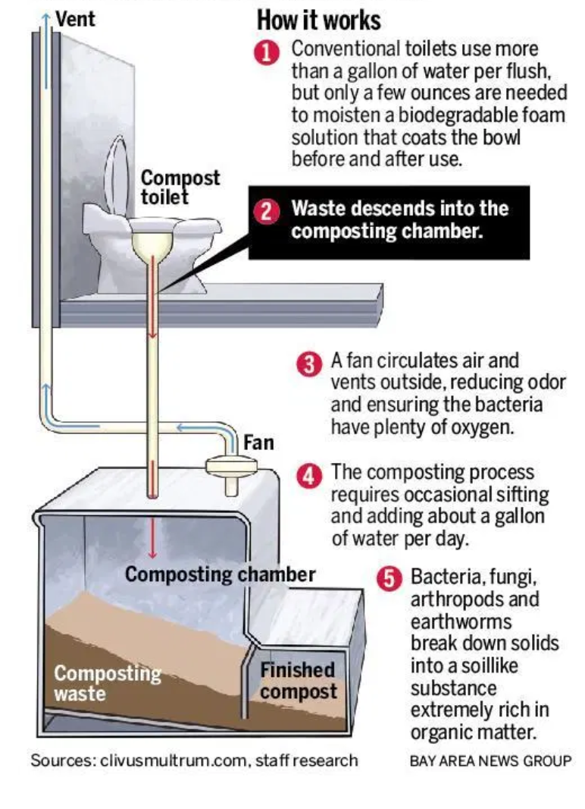
Composting Toilet
Various set-ups
Not connected to sewage system
Utilizes wood shavings to help covert waste to fertilizer and keep dry
Vent pipe for odors
Requires daily maintenance
Have capacity limitations
May have restrictions on compost use
Source: www.mercurynews.com

Slide 26
Sewer Systems

Slide 27
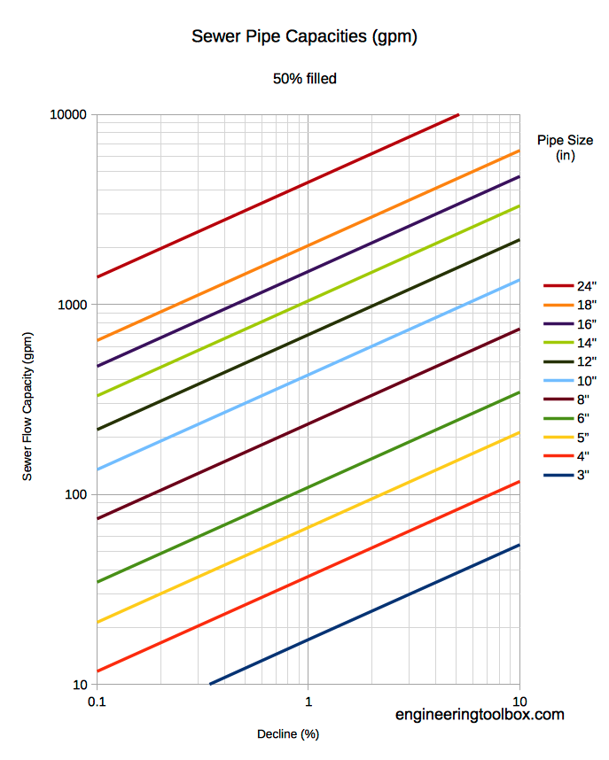
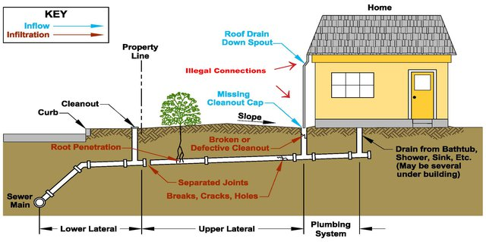
Collection System
Private Lateral Line vs Public Sanitary Sewer
Pipe Sizes Have Limited Capacity and Must Sustain Flow
Source: Sonoma Water
Notes:
First, we want to consider how the sewage gets to the treatment plant.
The sewage collections system is a series of pipes that connects the home or business to the wastewater treatment plant. It is important to recognize that part of this system – the private lateral line – is to be owned and maintained by the homeowner. It typically runs to the property line. These private laterals “tap-on” the building to the public system, which is maintained by the wastewater utility. This is important to note because in some areas the majority of the inflow and infiltration into the sanitary sewer system comes from the private lateral lines, but the wastewater utilities apply solutions on the public side.
We also want to note that sanitary sewer pipes are engineered to be the proper size. Too small and the pipe will overflow. Oversized or not enough slope and the solids will not transport. Therefore, expansion of sanitary sewer into an area is not always as simple as tapping onto a nearby pipe. There must be capacity to handle the additional discharge. Expansions may require widening mains in addition to expanding new pipe into an area.

Slide 28
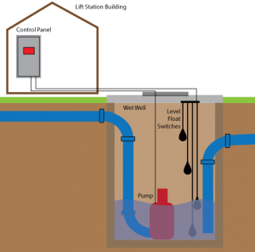
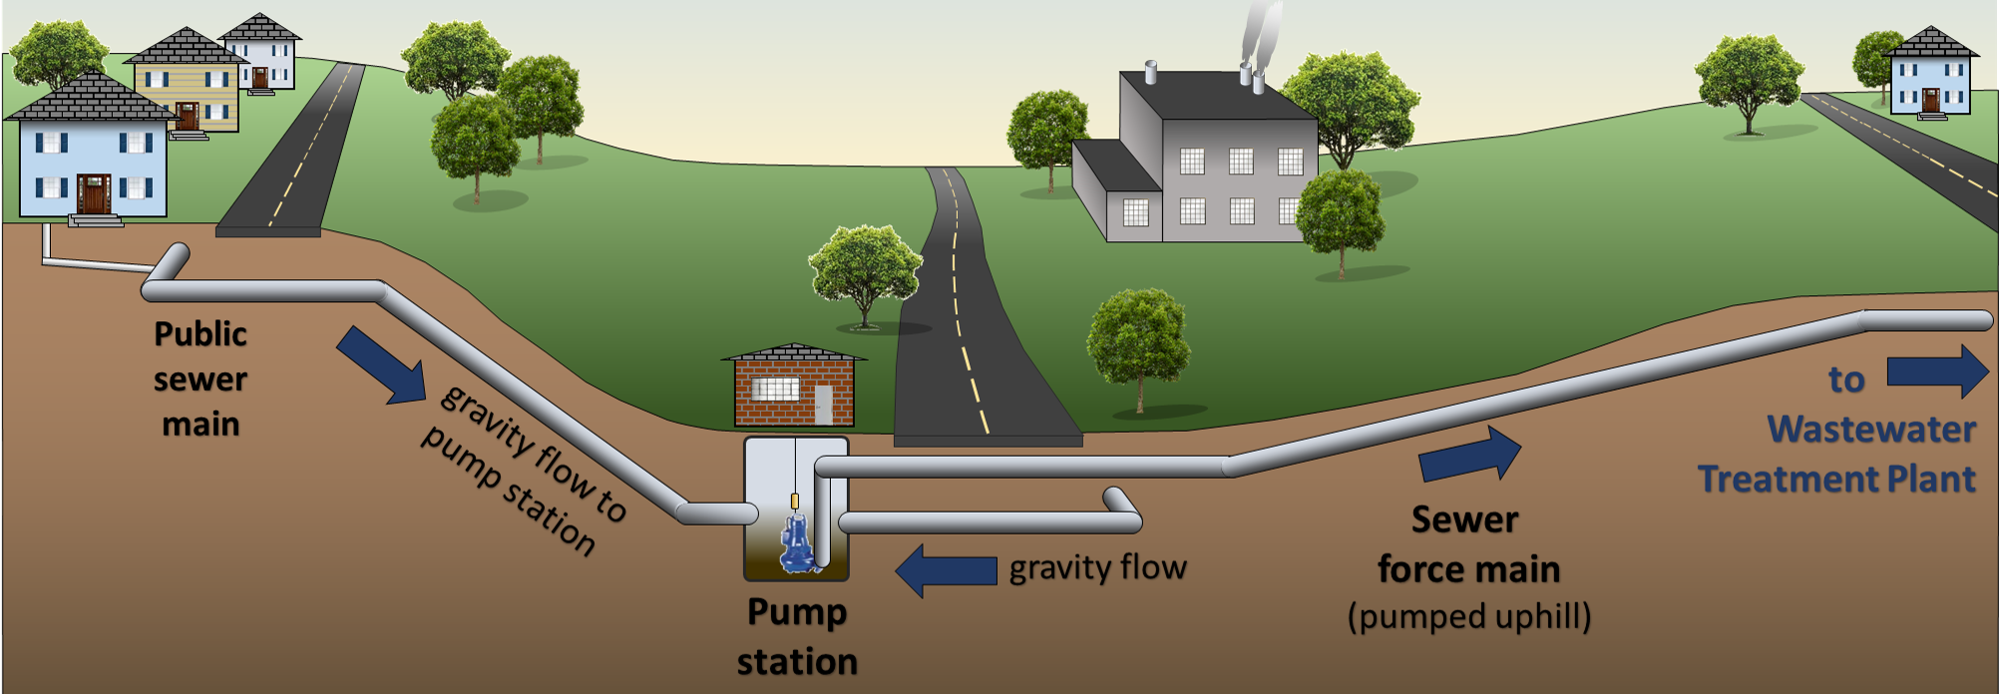
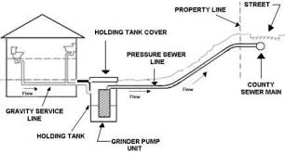
Lift Station
Source: data-command.com
Pump or lift station needed to go over higher elevation or lift uphill (requires energy and maintenance). Forced mains pump under pressure to treatment plant.
Source: dmmwra.org
Notes:
Pump or lift station needed to go over higher elevation or lift uphill. Pump or lift stations always have multiple pumps and a generator (if they go down it is bypassed directly into the stream. This is of course expensive and requires maintenance, particularly when “flushable wipes” which do not break down are used upsewer. Pump stations have a series of floating switches that trigger how much to pump.
Forced mains pump under pressure to treatment plant. Pump stations may simply lift the sewage to a higher elevations so that gravity can be used again or they may created the pressure for the forced mains.
Grinder pumps (lower right corner) work on a similar principle as lift stations but are installed at the residence level.

Slide 29
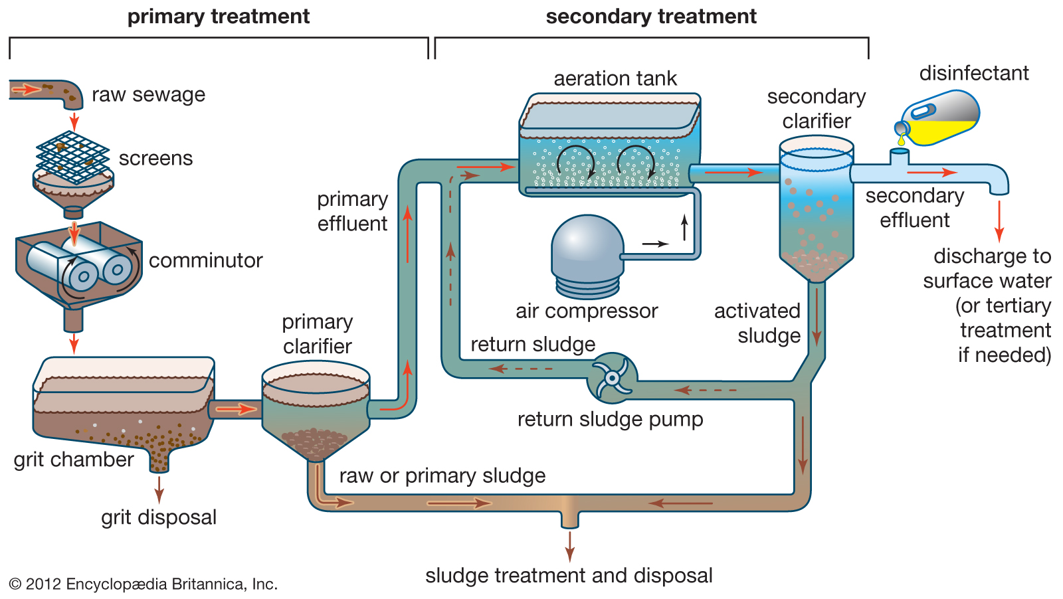
Primary and Secondary Wastewater Treatment
4
5
6
1
2
3
Notes:
Wastewater treatment refers to the process of treating sewage to remove solids and use biological and chemical processes to purify water before returning it to a natural waterbody. This includes the removal of bacteria, pathogens, biochemical oxygen demand, and total suspended solids. Nutrients can also be removed with advanced treatment.
Primary treatment removes solids and oils via physical methods. Secondary treatment utilizes biological to reduce organics and remove solids.
In the above graphic:
1st – as the wastewater enters the plant, screens are used to remove large floating objects that might clog the pipes or damage equipment (sticks, flushable wipes, cloth, feminine products, condoms, litter). Then sometimes comminutors are used to reduce the particle size.
2nd – The sewage then enters a grit chamber, where cinders, sand and small stones settle to the bottom. This is particularly important when sanitary and storm sewers are combined. Grit removal is not included in most small plants. All of these materials from 1 and 2 are landfilled.
3rd – Additional suspended solids are removed from sewage in a sedimentation tank (or primary clarifier above) where the water is retained for 2-3 hours. Materials that float (scum) are removed by skimming. As the flow speed is reduced, the suspended solids are able to sink to the bottom where they form raw primary biosolids, or “sludge.” About 25 to 50% of the biochemical oxygen demand (BOD5), 50 to 70% of the total suspended solids (TSS), and 65% of the oil and grease are removed during primary treatment. Sludge is usually pumped out of the tanks and may be further treated for fertilizer, disposed of in a landfill, or incinerated.
4th – Then, secondary treatment is used to remove nutrients and other contaminants. Much of the organic matter is removed by making use of the bacteria already present in the sewage. Because some chemicals can kill off these micro-organisms, wastewater utilities have pre-treatment programs to deal with industrial discharges that might effect this treatment. The most common method is activated sludge but trickling filters and rotating biological contactors are also used in some locations. In activated sludge, the primary effluent is pumped into an aeration tank where it is mixed with air and sludge that contains plenty of bacteria. These blowers must run constantly and are one of the main expenses of WWTPs. The effluent is allowed to remain in the tank for 3-8 hours, during which the bacteria break down the organic matter in to harmless by-products. These steps can remove 85% of BOD and TSS.
5th – Effluent from the aeration tank then flows into another sedimentation tank (or secondary clarifier) for removal of excess bacteria. And, the activated sludge from the aeration tank, which now contains additional bacteria, can be used again.
6th – To complete the secondary treatment process, the effluent is usually disinfected with chlorine before being discharged into a receiving waterbody. The chlorine helps kill pathogenic bacteria and reduce odors. In order to prevent harmful effects to fish or other aquatic life, operators may remove excess chlorine through dichlorination or use disinfection alternatives of ozone or ultraviolet light are used to kill additional bacteria. UV light is increasingly used today.
If done properly, this process should kill 99% of the harmful bacteria in sewage.
It should be noted that this process does little to remove nitrogen or phosphorus or other contaminants like heavy metals from the wastewater. That requires tertiary treatment which is expensive. Tertiary treatment can include nitrification/denitrification, chemical precipitation, chemical coagulation and filtration, carbon absorption, reverse osmosis or other methods. Many WWTPs are waiting to install tertiary treatment for nutrients until nutrient limits are set because of the higher level of costs associated with lower target concentrations.
References: How Wastewater Treatment Works…The Basics, USEPA, May 1998
Wastewater treatment and use in agriculture - FAO irrigation and drainage paper 47, http://www.fao.org/3/t0551e/t0551e05.htm

Slide 30
Sanitary Sewer BMPs
Formation of a Sanitation District
Inspection and Preventative Maintenance Program
Fats, Oils, and Grease program (FOG)
Reduce inflow / Infiltration
Private Lateral Line Replacement or Repair Program
Sanitary Sewer Overflow Elimination
Extend Sanitary Sewer Lines into New Areas

Slide 31
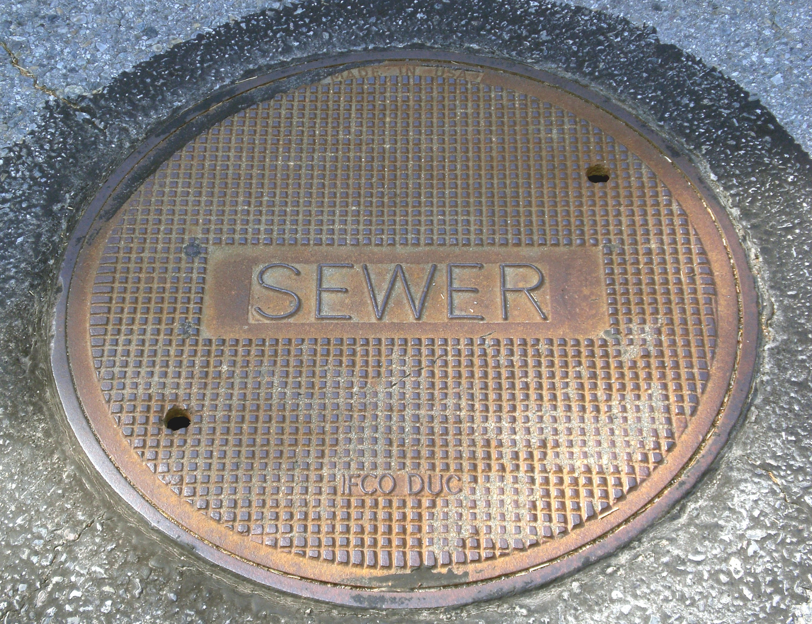
Formation of a Sanitation District
Typically formed by County Fiscal Court Ordinance
Establishes:
  Governing Board
  Fiscal Policy
  Management Authority
  Policies, Rates, Regulations
Typically a large project associated with the formation of a district
Notes:
Forming a sanitation district is often the first step towards addressing sewage in a region. This is a major undertaking requiring the input of many partners. The establishment of the sanitation district allows for initial projects, such as building a wastewater treatment plant or running a line to a large number of new users, to be accomplished.

Slide 32
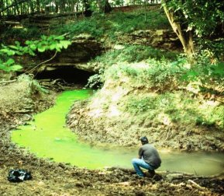
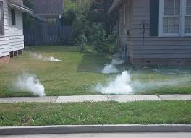
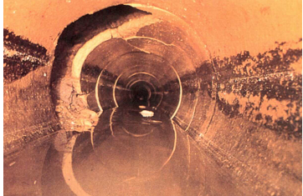
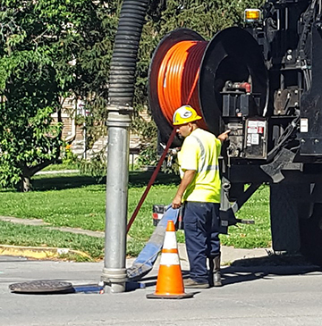
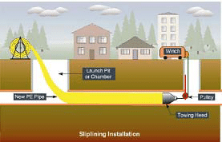
Inspection and Maintenance
Inspection:
Dye Testing
Smoke Testing
Closed Caption Television (CCTV)
Maintenance:
High pressure water stream cleaning
Cured-in-place-pipe lining (Slip lining)
Dye Testing
CCTV Image
(Source: KDEP)
High Pressure Cleaning (Source: LFUCG)
Cured-in-place-pipe
Notes:
Dye Testing:
Dye testing is an excellent indicator of illicit connections and is conducted by introducing non-toxic dye into toilets, sinks, plumbing fixtures, or manholes. The discovery of dye in the storm drain, rather than the sanitary sewer, conclusively determines that the illicit connection exists.
Dye water flooding involves pumping a large amount of water into a ditch or plugged storm sewer to imitate a rain storm in the area of a defective sanitary sewer line. A non-toxic, bright green dye is added to the water to make it highly visible. As the dyed water infiltrates the sanitary sewer system, cracks and defects can be located. Both the visual confirmation and fluorescence method can be used to evaluate the
sources. Dye testing may also be conducted in conjunction with CCTV inspections to observe where the dyed water is entering the storm sewer pipes.
Smoke Testing:
Some testing is a relatively quick an inexpensive tool for locating illicit discharges. Smoke testing can find improper connections, or damage to the storm drain system. This technique works best when the discharge is confined to the upper reaches of the storm drain network, where pipe diameters are too small for video testing and gaining access to multiple properties renders dye testing infeasible.
Smoke testing is performed by isolating a section of sewer with sand bags, placing a blower over a manhole, and forcing non-toxic vapor into the sewer. The pressure of the blower will force the smoke through a defect to the surface of the ground where field crews can mark and survey the location of the defect.
CCTV:
Video inspections by closed circuit television (CCTV) are typically used as a source tracing methodology when looking for an illicit connection (typically a sanitary sewer) between two manhole structures or along an isolated segment of the storm drainage system. Video inspections are performed using a sewer inspection camera to record activity and condition of the storm drainage system segment. Video inspections provide documentation of actively flowing illicit connections, grease buildup, and other deposits or conditions caused by illicit discharges. They are particularly helpful when an illicit connection from the sanitary sewer system is suspected in a smaller reach of the storm drainage system or when used to inspect potential cross connections from a single business. Video inspections can be used in smaller sections of a piped storm drainage system to identify the source of an illicit discharge or illicit connection after indicator sampling has triggered a follow-up investigation. CCTV will not detect discharges when the illicit connection is not flowing at the time of the video survey.
High pressure water stream sewer cleaning
Cleaning sewers is performed with a high pressure water stream through a hose using various nozzles appropriate for the type of sewer pipe cleaning (roots, grease, etc.). The debris washed from the pipe is collected at another manhole through a suction hose, or other means. The equipment used is called a Vactor (vac) truck and you may have seen them before or within your community.
During the cleaning process, sewer lines can develop air pressure or a partial vacuum from the cleaning process. Usually any excess air pressure or vacuum will dissipate through the plumbing vents. But occasionally in some cases air pressure could escape through the toilet, floor, sink, tub or shower drains, causing water to splash out or, a vacuum could draw the water out of the fixture traps causing and unpleasant odor. This is called a “blow-back.” (Lexington.gov)
Cured-in-place-pipe lining:
A cured-in-place pipe (CIPP) is a trenchless rehabilitation method used to repair existing pipelines. It is a jointless, seamless pipe lining within an existing pipe. It is one of the most widely used rehabilitation methods. The process of CIPP involves inserting and running a felt lining into a preexisting pipe that is the subject of repair. Resin within the liner is then exposed to a curing element to make it attach to the inner walls of the pipe. Once fully cured, the lining now acts as a new pipeline. (Wikipedia)

Slide 33
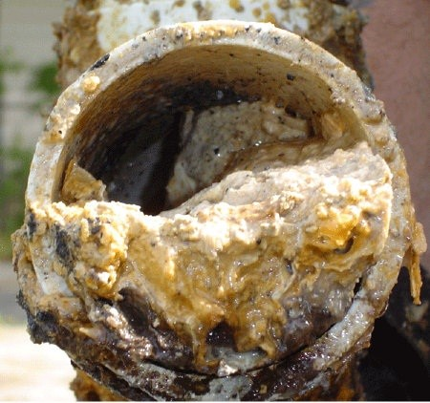
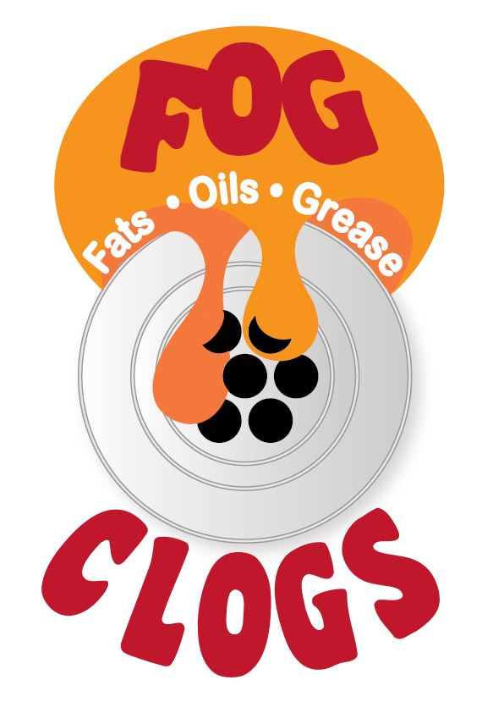
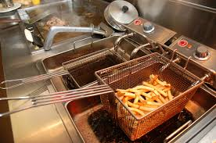
Fats, Oils, and Grease Program
FOG Program
Required as part of the Pretreatment program of the sanitary sewer utility.
FOG hardens in the pipes (like in your arteries) causing clogs.
Without regular cleanout of grease traps and interceptors than can overflow into sewer.
Notes:
The National Pretreatment Program implements Clean Water Act requirements to control pollutants that are introduced into POTWs. As part of this program, EPA requires state and local pretreatment programs to control pollutants which pass through or interfere with POTW treatment processes or may contaminate POTW sewage sludge. Meeting these requirements may require elimination of interference caused by the discharge to POTWs of Fats, Oils, and Grease (FOG) from food service establishments (FSE).
The annual production of collected grease trap waste and uncollected grease entering sewage treatment plants can be significant and ranges from 800 to 17,000 pounds/year per restaurant.
The Sewer Service is required to inspect these facilities and has authority to enforce limits. Education programs as well as inspection and maintenance of pipe to remove clogs are required to maintain line capacity.

Slide 34
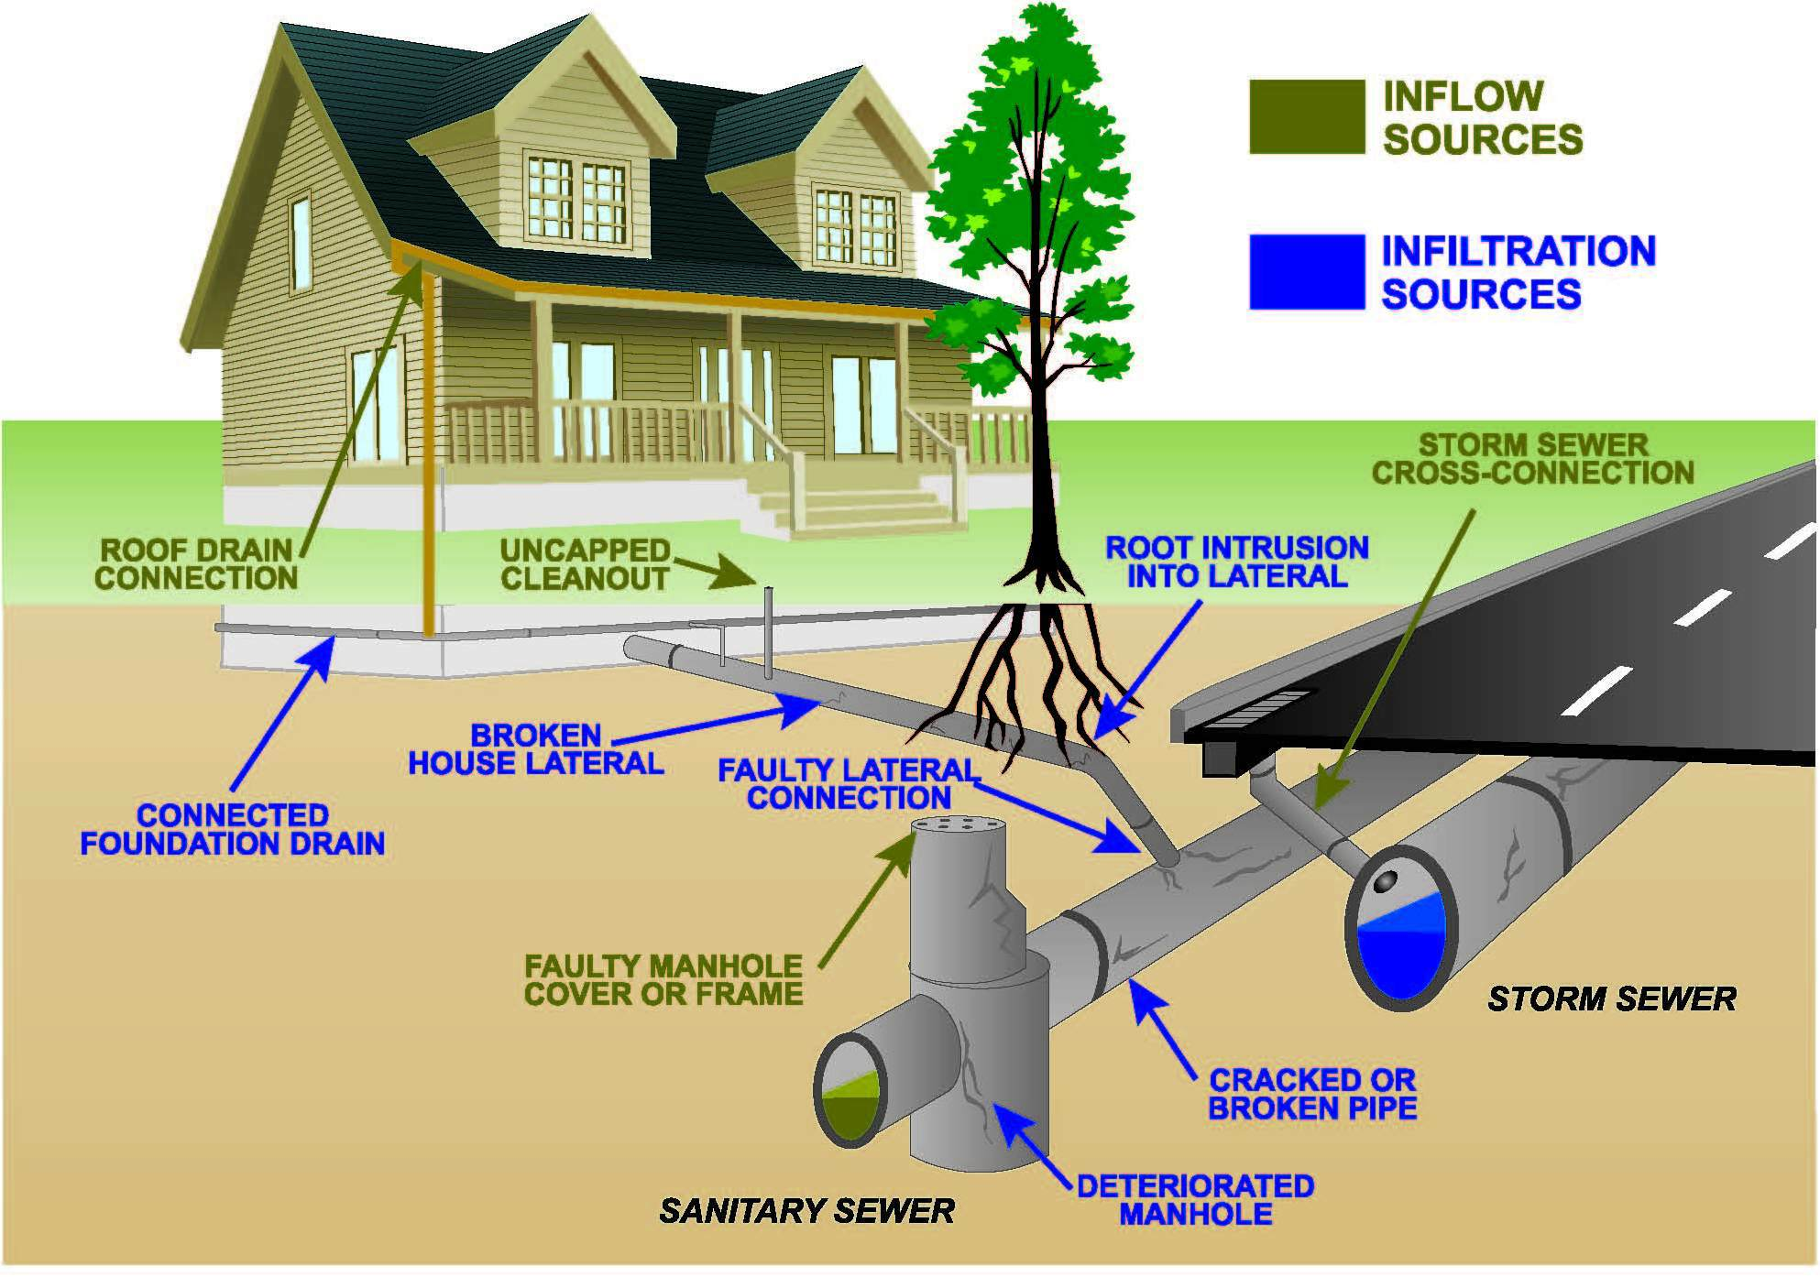
Reduce inflow and infiltration (I&I)
Measures taken to reduce the ability of stormwater and groundwater to enter the wastewater collection and treatment system.
Source: Oregon, Ohio
Notes:
Inflow is stormwater that enters into sanitary sewer systems at points of direct connection to the systems. These are improper or illegal connections to the sanitary sewer system and should either be allowed to soak into the ground or directed to the stormwater collection system. These direct sources are usually easier to correct than infiltration sources.
Examples: Faulty manhole cover, storm sewer connection, roof drain connection, sump pump to sanitary sewer
Infiltration is groundwater that enters the sanitary sewer through cracks or leaks in the collection pipes. This can occur when the pipes are located beneath the water table or the soil surrounding the pipes becomes saturated. This can also occur when pipes are installed across streams, enabling streamflow to directly enter the sewage pipes. These sources are more difficult to fix since they are located underground.
During wet weather, inflow and infiltration (I&I) can contribute significant volumes of water to sanitary sewer systems and overwhelm the system. If volumes become to high, they can cause sewage backups in homes, sanitary sewer overflows, or bypass of overloaded treatment plants, resulting in direct sewage discharges to receiving waterbodies.
During wet weather, the rain and groundwater flows into the sanitary but as the groundwater table lowers during dry weather, these same leaks can lead flow out of the sewer (exflow and exfiltration, or E&E) and into the groundwater or streams.

Slide 35
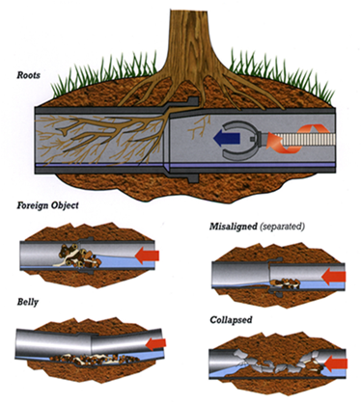
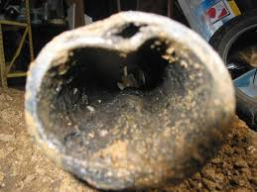
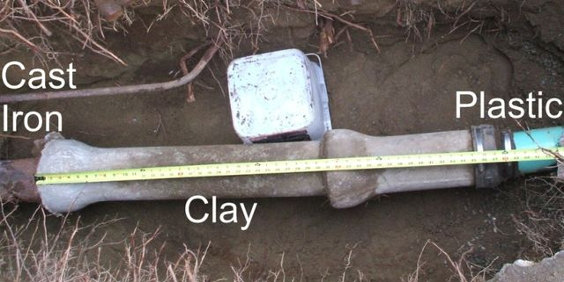
Private Lateral Line Replacement / Repair Program
Prior to 1970s, no PVC so unless replaced lines are likely orangeburg, cast iron, or clay tile.
Responsibility for repair or replacement is with homeowner, but some cities have cost share to help address this source.
Orangeburg Pipe
Notes:
One of the leading contributors to I&I / E&E are private lateral lines.
EPA estimates high lateral leakage rates with older pipes, less durable pipe materials, and poor pipe installation (bedding, cover). Prior to 1970s, no PVC so unless replaced lines are likely orangeburg, cast iron, or clay tile. Homeowners may replace these if they have backups into their system, but if going into groundwater they may be unaware. So age of neighborhood may be an indicator of potential for private lateral failure.
Most responsibility for repairing laterals rests with property owner. Replacing leaking laterals can range from $5,000 to 10,000. However, there may be little incentive for homeowners to address if no perceived problems. Because of this some cities may use cost share program to assist in repair or replacement of leaking laterals when the leak is verified (i.e., via dye, smoke testing, closed-circuit TV). Widespread replacements are an option where whole neighborhood sewer lines are being rehabilitated or replaced.
Some systems have sought to address the private laterals while others have sought to work on the public side and build large storage tanks for sewage and enlarge the sewer lines to increase capacity.

Slide 36
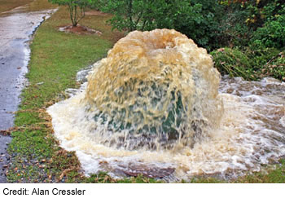
Eliminate Sanitary Sewer Overflows (SSOs)
Sanitary sewers can release raw sewage due to:
blockages
line breaks
sewer defects that allow stormwater and groundwater to overload the system
sump pump discharges to sanitary
power failures at pump station or treatment plant
improper sewer design
vandalism
Notes:
SSOs that reach waters of the U.S. are point source discharges. Like other point source discharges from municipal sanitary sewer systems, SSOs are prohibited unless authorized by a NPDES permit. Moreover, SSOs, including those that do not reach waters of the U.S., may be indicative of improper operation and maintenance of the sewer systems, and may violate NPDES permit conditions. (USEPA)

Slide 37
Eliminate Sanitary Sewer Overflows
Many avoidable SSOs are caused by inadequate or improper operation or maintenance, inadequate system capacity, and improper system design and construction.
SSOs can be reduced by:
Sewer system cleaning and maintenance
Reducing infiltration and inflow through system rehabilitation and repairing broken or leaking service lines
Enlarging or upgrading sewer, pump station, or sewage treatment plant capacity and/or reliability
Controls limiting fats, oils and grease (FOG) into the sewer systems
Construction of wet weather storage facilities
Educating the public on how FOG and certain household products can clog sewers
Communities also should address SSOs during sewer system master planning and facilities planning, or while extending the sewer system into previously unsewered areas.
Notes:
Sewer rehabilitation to reduce or eliminate SSOs can be expensive, but the cost must be weighed against the value of the collection system asset and the added costs if this asset is allowed to further deteriorate. Ongoing maintenance and rehabilitation adds value to the original investment by maintaining the system's capacity and extending its life.
The costs of rehabilitation and other measures to correct SSOs can vary widely by community size and sewer system type. Those being equal, however, costs will be highest and ratepayers will pay more in communities that have not put together regular preventive maintenance or asset protection programs in place.
Assistance is available through the Clean Water Act State Revolving Fund (CWSRF) for capital projects to control SSOs. State Revolving Funds in each state co can help arrange low-interest loans.
Source: USEPA

Slide 38
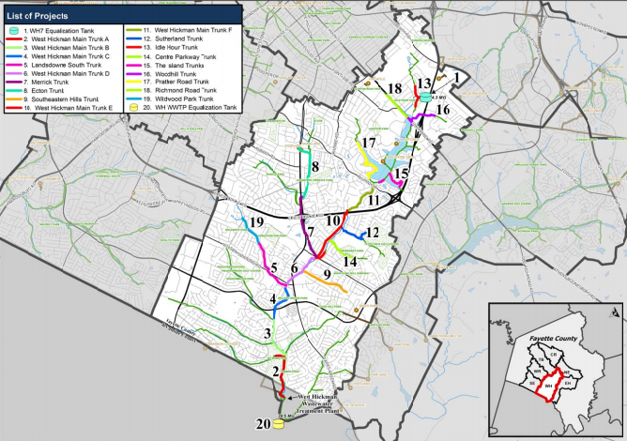
Repair or Replacement of Sanitary Sewer Pipes
Sewer connection pipes that are damaged from invading tree roots, deterioration, clogs, or collapse need to be identified and repaired.
Breakages can be detected through surfacing sewage, cameras or water quality sampling.

Slide 39
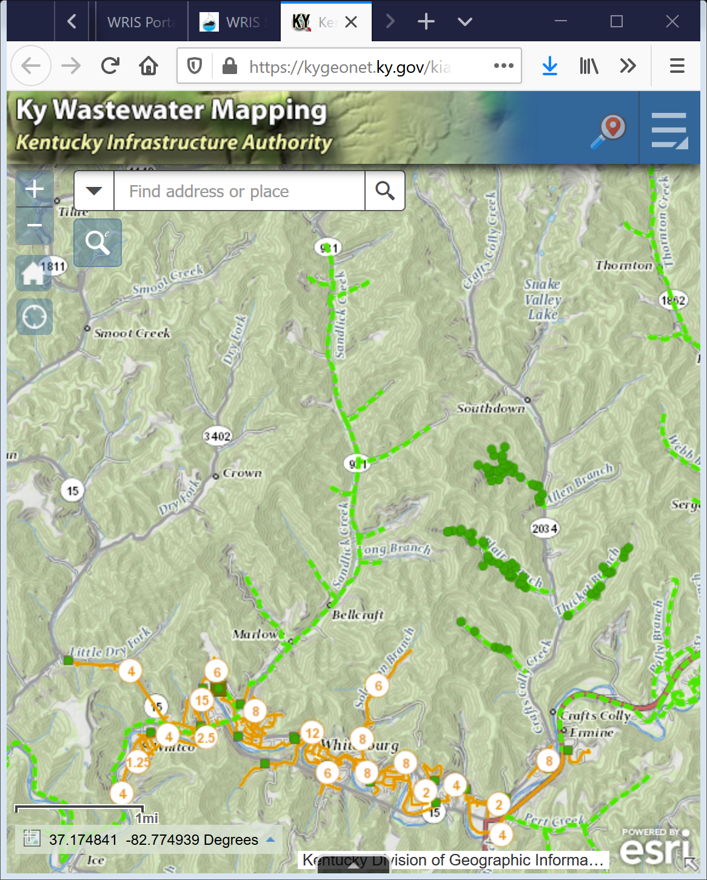
Expand Sanitary Sewer Coverage
The extension of existing sanitary sewer infrastructure to capture wastewater from additional residences.
Can increase scope of sewer collection, remove failing septic systems, increase customer base, and reduce impacts to natural waterbodies.

Slide 40
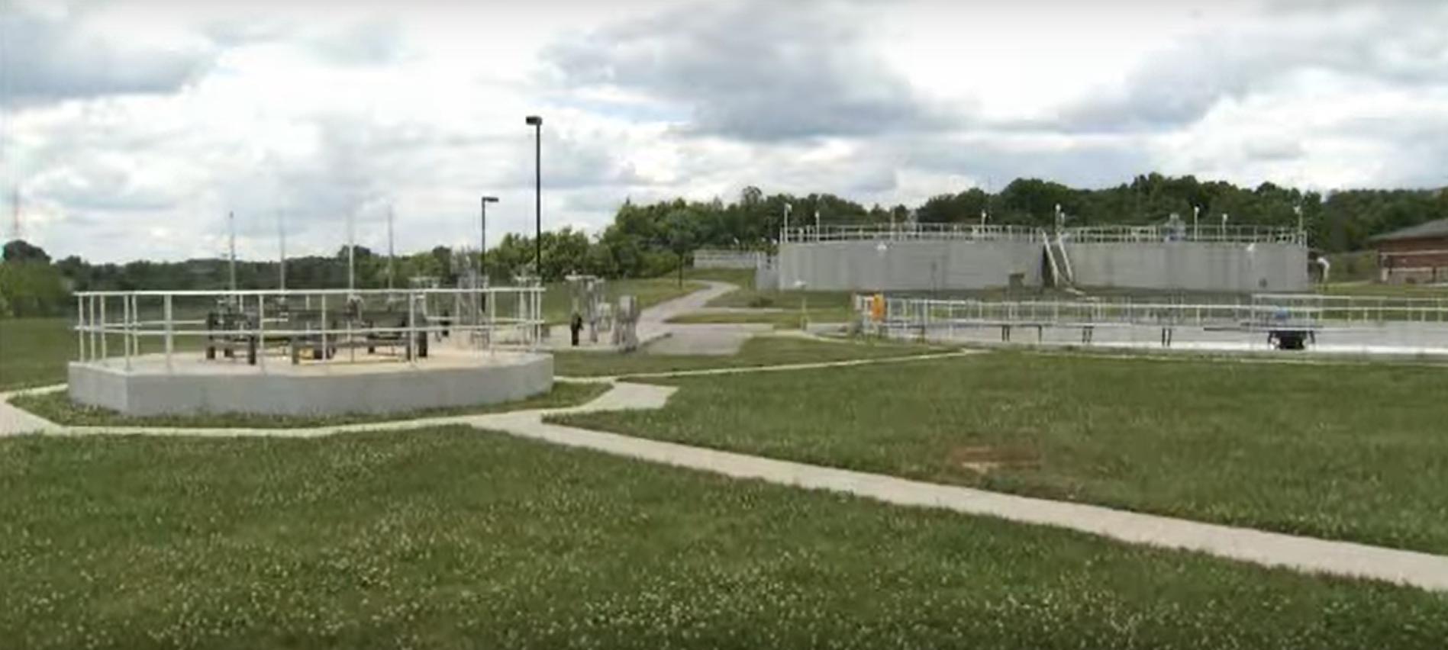
Wastewater Regionalization
Restructuring or combining smaller wastewater systems to save money, improve operational and maintenance efficiency, and meet regulatory requirements.
Northern Kentucky’s SD1 operates 3 major and several smaller WWTPs in Northern Kentucky
Notes:
Small systems struggle to support the infrastructure costs needed to maintain them. The low number of customers does not provide sufficient revenue to fund projects, and these systems must rely on grants or low-interest loans to operate successfully. Small systems also struggle to maintain trained operators that can keep up with ongoing system oversight.
In Kentucky, a push toward regionalization accompanied a desire to reduce the number of poorly functioning “package plants,” or small, pre-fabricated wastewater treatment systems typically used in remote and/or unincorporated areas. These systems are frequently operated by people without the necessary training to ensure proper function, and the life-span of the systems is usually only about 20 years. They may also encourage growth in areas where they are located, which can quickly overwhelm the system’s treatment capacity.
Regionalization can provide several advantages over smaller, separate facilities:
Economies of scale in construction and purchasing costs
Ability to attract and afford more experienced plant operators
Better treatment performance
Reduced environmental and administrative burdens due to fewer treatment sites and discharge points
Potential disadvantages of regionalization include:
Longer design and construction periods
Induced development
Need for new organizational structures and agreements
Difficulties with political cooperation across municipal jurisdictions
Resource: Regionalization of Wastewater Treatment Facilities in Kentucky: Progress, Problems and Recommendations, June 1994
https://eec.ky.gov/Environmental-Protection/Water/Reports/Reports/1994-Regionalization.pdf

Slide 41
Types of Wastewater Regionalization:
Elimination of treatment facility (e.g. package plant) and diversion of wastewater to a POTW
Connection of one or more existing facilities to a new or existing regional treatment facility
Prevention of new discharges by requiring connection to an existing facility
Creation of Sanitation Districts, Regional Wastewater Authorities, or other cooperative ownership arrangements

Slide 42
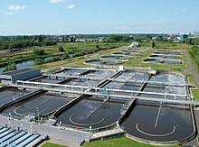
Optimization of Wastewater Treatment Technology
Added treatment capacity
Higher quality treated effluent
Reduced operating and maintenance costs
Follows an iterative process that enables continuous improvement through:
Establishing treatment objectives
Evaluating plant’s baseline conditions, opportunities for optimization, and performance or capacity limiting factors
Identifies and implements process changes to address limiting factors
Conducts follow-up monitoring to document benefits
Notes:
WWTPs have typically been designed with conservative design guidelines and are often operated based on historic practices.
Often, these facilities have significant additional capacity to treat wastewater that can be realized through an optimization approach.
The USEPA’s Composite Correction Program provides guidance for performance evaluation and technical assistance to maximize treatment efficiency and effectiveness.
Through an iterative process, wastewater treatment facilities can achieve added treatment capacity, higher quality effluent (better treatment), and reduced operating and maintenance costs.
References: Wastewater Treatment Plant Optimization, National Guide to Sustainable Infrastructure, Federation of Canadian Municipalities and National Research Council, November 2003
https://fcm.ca/sites/default/files/documents/resources/guide/infraguide-wastewater-treatment-plant-optimization-mamp.pdf
USEPA Handbook: Optimizing Water Treatment Plant Performance Using the Composite Correction Program, 1998 Edition
https://nepis.epa.gov/Exe/ZyNET.exe/30004D17.txt?ZyActionD=ZyDocument&Client=EPA&Index=1991%20Thru%201994&Docs=&Query=%28Figure%204-8%29%20OR%20FNAME%3D%2230004D17.txt%22%20AND%20FNAME%3D%2230004D17.txt%22&Time=&EndTime=&SearchMethod=1&TocRestrict=n&Toc=&TocEntry=&QField=&QFieldYear=&QFieldMonth=&QFieldDay=&UseQField=&IntQFieldOp=0&ExtQFieldOp=0&XmlQuery=&File=D%3A%5CZYFILES%5CINDEX%20DATA%5C91THRU94%5CTXT%5C00000002%5C30004D17.txt&User=ANONYMOUS&Password=anonymous&SortMethod=h%7C-&MaximumDocuments=1&FuzzyDegree=0&ImageQuality=r85g16/r85g16/x150y150g16/i500&Display=hpfr&DefSeekPage=x&SearchBack=ZyActionL&Back=ZyActionS&BackDesc=Results%20page&MaximumPages=1&ZyEntry=4#

Slide 43
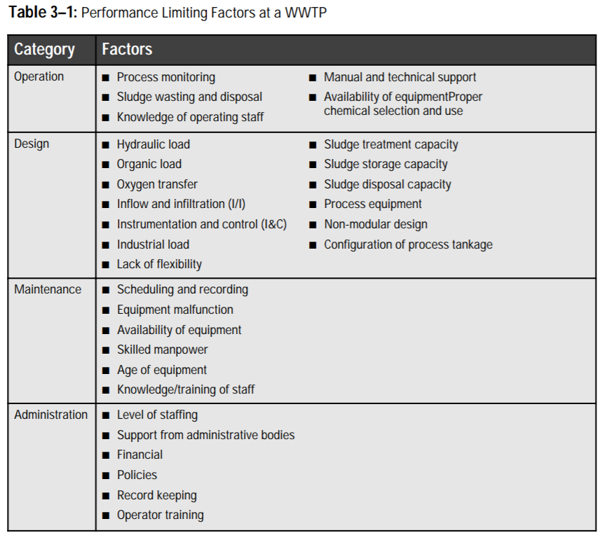
Limiting factor categories:
Operational
System design
Maintenance
Administrative
Source: Federation of Canadian Municipalities
Notes:
This table lists the categories and factors that can limit optimal performance of wastewater treatment plants.
References: Wastewater Treatment Plant Optimization, National Guide to Sustainable Infrastructure, Federation of Canadian Municipalities and National Research Council, November 2003
https://fcm.ca/sites/default/files/documents/resources/guide/infraguide-wastewater-treatment-plant-optimization-mamp.pdf

Slide 44
Wastewater BMPs
“No one shall with malice pollute the waters where they issue publicly. Should anyone pollute them, his fine shall be ten thousand sesterti.” (approx. $600)
Source: Sextus Julian Frontinus, Water Commissioner of the City of Rome, 97 CE
For more history go to www.sewerhistory.org
Questions?

